Slide 1
AtwoM Framework
A2m-Back

Slide 2




Tổng quan
Redirect to sso service
User request
User mng
access_token
Call API
User mng
Sys mng

Slide 3
a2m-back
Tạo api lấy thông tin user
Tạo api CRUD
Phân quyền api
- Sử dụng spring security
- Sử dụng Interceptor

Slide 4
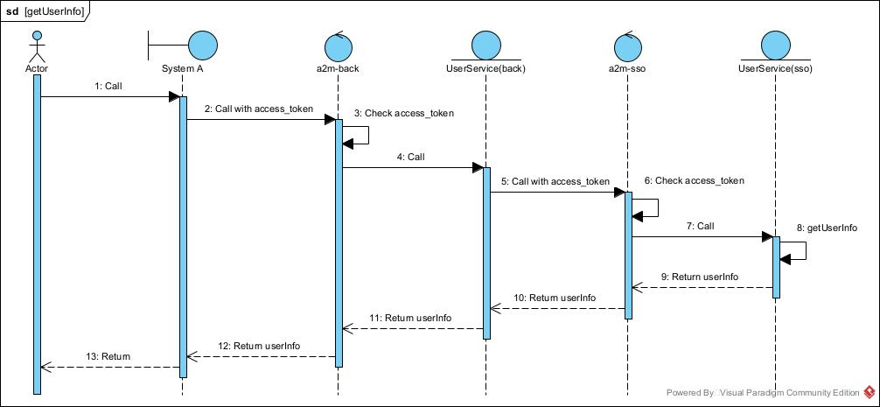
API getUserInfo

Slide 5
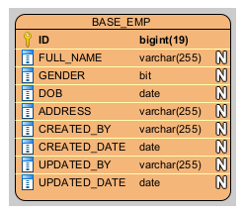
API CRUD

Slide 6
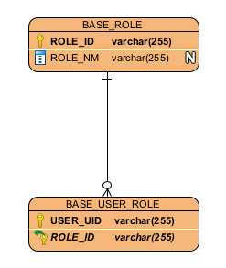
Authorization

Slide 7
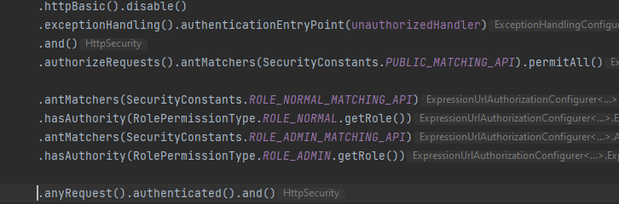
Authorization
Spring security

Slide 8
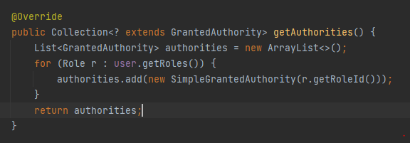
Authorization
Spring security

Slide 9
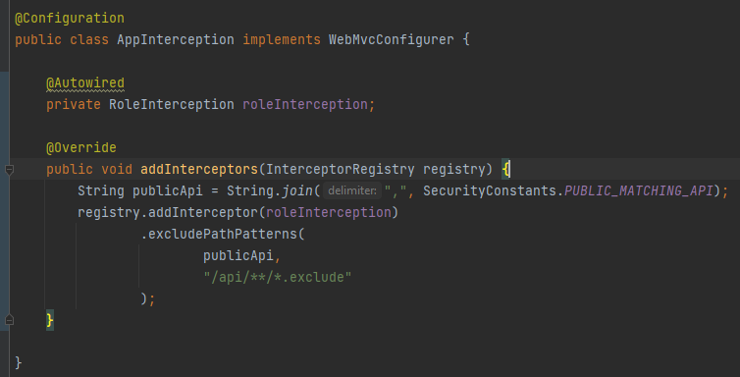
Authorization
Interception

Slide 10
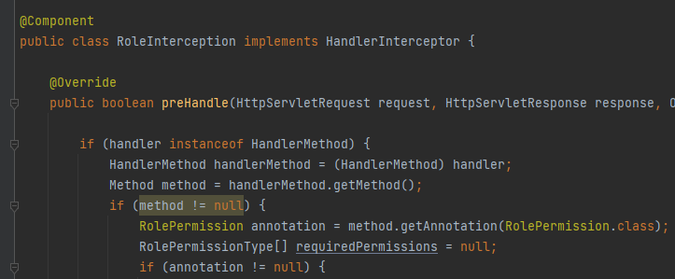
Authorization
Interception

