Slide 1
Introduction to Data Science
Final Project
Group 3
Instructors:
Kiều Vũ Minh Đức - Lê Nhựt Nam
Data Science

Slide 2
Members
ID Student | Full Name
20127458 | Đặng Tiến Đạt
20127627 | Nguyễn Quốc Thắng
20127680 | Phạm Thị Ánh Phát

Slide 3
CONTENT
01
02
03
04
About Project
Questions
Model & Evaluation
Reflection

Slide 4
01
About project
Final Project
Group 3

Slide 5
About project
Data is crawled for analysis, statistics and sales to help Tiki’s sellers supply and demand adjustment.
Predict the number of products sold in Tiki.

Slide 6
About Data
p_id | Id of the product
p_name | Name of the product
p_id_shop | Shop id that sells the product
p_shop_name | Shop name that sells the product
p_brand | Brand of the product
p_categories | Category of product
p_day_create | Number of days the product was created since data collection
p_sold_quanlity | Number of the product sold
p_original_price | Original price of the product
p_current_price | Current price of the product
p_discount_rate | Discount rate of the product

Slide 7
02
Questions
Final Project
Group 3
We will create questions and derive insight the data.

Slide 8
Meaningful Questions
Question 1:
Which store sells best and what items in that store sell best? Why is it the best seller?
Question 2:
Group 3
Sales of each category in “Tiki trading”. The best-selling category accounts for what percentage of that sales?

Slide 9
Meaningful Questions
Question 3:
Compared with the discount and no discount, which shop's items sell the best?
Question 4:
Group 3
Calculate the average daily sales of the brand. Bring out the brand with the highest and lowest revenue.

Slide 10
Meaningful Questions
Question 5:
What products do brands have? Compare sales of the same product but in different brands.
Group 3

Slide 11
03
Model & Evaluation
Final Project
Group 3
Use model to predict the number of products sold in Tiki.

Slide 12
Models
Linear Regression
Mercury is the closest planet to the Sun
Polynomial Regression
Venus has a beautiful name and is a hot place
SGD Regression
Despite being red, Mars is actually a cold place

Slide 13
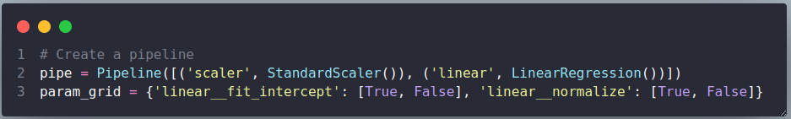

Linear Regression
Features
Parameters
Result with hyperparameters
Use all features in data
Fit_intercept: False
Normalize: True

Slide 14

Linear Regression
Features
Parameters
Result with hyperparameters
Drop original price and discount rate
Fit_intercept: False
Normalize: True
Comments:
RMSE and MSE in Linear Regression is really high because the features in data are not linear with each other.(as figure in code)

Slide 15
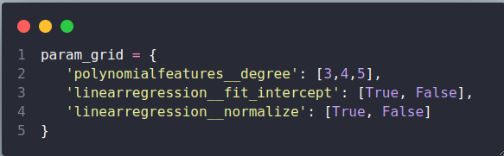

Polynomial Regression
Features
Parameters
Result with hyperparameters
Use all features in data
Degree: 3
Fit_intercept: False
Normalize: True

Slide 16

Polynomial Regression
Features
Parameters
Result with hyperparameters
Drop original price and discount rate
Degree: 3
Fit_intercept: False
Normalize: True
Comments:
RMSE and MSE in Polynomial Regression is still high but better than Linear Regression.

Slide 17

SGD Regression
Features
Parameters
Result with hyperparameters
Use all features in data
Loss: Squared_loss
Penalty: l2
Comments:
RMSE and MSE in SGD Regression is Incredibly big, so the SGD regression model cannot predict the number of units sold for each product

Slide 18
04
Reflection
Final Project
Group 3
For each member re-evaluate the work

Slide 19
If we have more time...
Create more questions and derive important, useful insights from the data.
Such as Bayes search…
Use more techniques to find hyperparameters
We will
May be using Logistic Regression
Predict top trending or not
Compare with more model to find the optimal result
Such as Bayesian Linear Regression,…

Slide 20
For each member…
ID Student: 20127458 - Đặng Tiến Đạt
What difficulties have you encountered?
Github: merge code with notebook files (conflict,...)
For each step:
Data engineer: Data exchange protocols, choose the right API for you and the params, headers, ... required to be able to request the API. Data cleaning is not good, leading to errors when the model
Data analyst: Choose how to visualize to be reasonable for the question you posed, statistical methods to find that question.
Machine learning: Choose the right algorithm models to make accurate predictions, scale the data as well as create a pipeline to process each different thread, how to evaluate the model, which model will be selected when completed.
What have you learned?
Understand the workflow of a data science as well as be more careful in each step so that the next steps do not affect much
Proficient in using project libraries (numpy, pandas, matplotlib, ...)

Slide 21
For each member…
ID Student: 20127627
What difficulties have you encountered?
About data collection, I had difficulty in crawling data by getting API.Finding data and how to crawl using the API is also the first time, so it is quite difficult.
About clear and preprocess data: It is quite difficult to clear data from crawl data, data is missing, data type is wrong a lot, making it quite difficult for me to keep or delete that row. And about the examination as well as asking questions and answering, as this is the first time, it is a challenge to ask meaningful questions
About the model, because I have not studied machine learning, it is quite difficult to choose a model and use it as input, and the model's prediction is wrong, the difference is too much, it is also unpredictable.
What have you learned?
Crawl data using API
Learn how to ask questions based on data and visualize questions correctly
Steps to clean data and explore data
Learn how to model data, based on the given data to try to predict a feature

Slide 22
For each member…
ID Student: 20127680 - Phạm Thị Ánh Phát
What difficulties have you encountered?
Because Tiki does not provide API so we have manually crawl data for each page.
Because i had not learned model before, so i have difficult in using model to predict. But now, i can :D
What have you learned?
Learn the process of Data Analysis. From raw data to visualize data for customers.
Learn how to analysis information of products in order to bring benefits in business.
Learn how to use pipeline in preprocessing.
Learn how to use techniques to evaluate predicted models.

Slide 23
Thanks!
Final Project
Group 3
Do you have any questions?

Slide 24
References
https://machinelearningcoban.com/2016/12/28/linearregression/
https://scikit-learn.org/stable/modules/generated/sklearn.pipeline.Pipeline.html
Two files demo assignment in class.
https://slidesgo.com/theme/pestel-analysis-thesis-defense?fbclid=IwAR1Ju4MeCCwSeQ-v7PPUJEE0do0IPxpMTB4FVhLm3zmzq0AEx8GWqd1ptks#position-132&results-11706
https://www.kaggle.com/datasets/hellbuoy/car-price-prediction

Slide 25
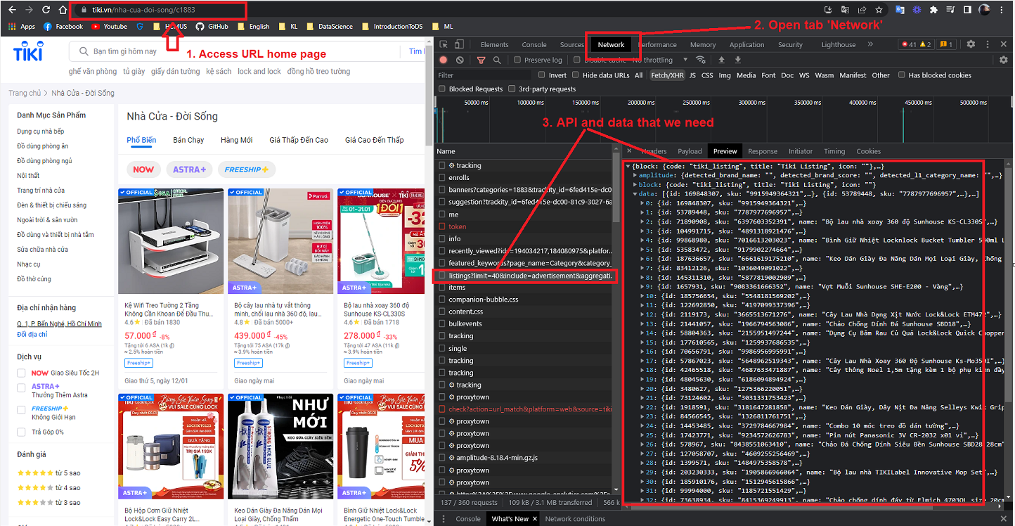
2.1. What is API of Tiki ?
Collection

Slide 26
2.2. How to request this API?
Method & URL
Param
Example: Method (get, post,...), URL (link we need request)
Example: page, platform, category, …
Header
Cookie
Example: token access, User-agent, ..
Cookie of website (Note: removed)

