Slide 1


MAZE-SOLVING PROBLEM WITH BASIC REINFORCEMENT LEARNING
NGUYEN TIEN MINH -22010759
FACULTY OF ELECTRICAL AND ELECTRONIC ENGINEERING

Slide 2

PRESENTATION OUTLINE
Introduction
Theoretical Background
Methodology
Experimental Setup
Results

Slide 3
INTRODUCTION
Reinforcement Learning (RL) is a branch of machine learning where an agent learns how to interact with an environment by taking actions and observing the results. In this project, I focus on solving a classic RL problem: the maze-solving problem. The agent is placed in a maze and must find its way out by moving through square cells step by step. The agent's goal is to find the shortest path from the start position to the goal.
The primary objective of this project is to implement and compare various traditional RL algorithms, such as Q-Learning, SARSA, Policy Iteration, Value Iteration, and Monte Carlo, to solve the maze-solving problem. I will evaluate these algorithms based on their performance in solving the problem, speed, and the quality of the optimal path.

Slide 4
THEORETICAL BACKGROUND
Reinforcement Learning (RL) is built on the interaction between an agent and an environment. The agent takes actions based on its current state, aiming to maximize the cumulative reward it receives from the environment over time. The policy defines the agent’s behavior, mapping states to actions. RL operates under the framework of a Markov Decision Process (MDP), which assumes that the future state depends only on the current state and action, not on previous states or actions.

Slide 5
METHODOLOGY
Q LEARNING
SARSA
OFF-POLICY
ON-POLICY
MONTE CARLO
POLICY ITERATION
VALUE ITERATION
FREE-MODEL
MODEL-BASED
MODEL-BASED

Slide 6
METHODOLOGY
q LEARNING
SARSA
PI AND VI
MONTE CARLO
simple and efficient model-free, off-policy method suitable for environments like mazes, where the optimal policy may differ from the agent's current exploration policy
being on-policy, is useful for environments where we want the agent to follow a consistent strategy during learning
These model-based algorithms are chosen for their ability to explicitly compute and refine policies and value functions in structured environments
Useful for estimating values based on complete episodes, they are effective when the environment is deterministic, as is the case with the maze problem

Slide 7
EXPERIMENTAL SETUP
GENERATE MAZE
CREATE ENVIRONMENT
SET UP ENVIRONMENT
IMPLEMENTAION
HYPERPARAMETER TUNING

Slide 8
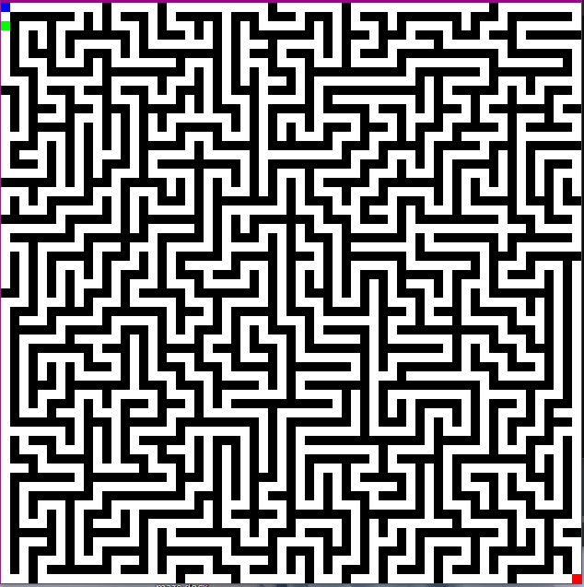
EXPERIMENTAL SETUP

Slide 9

EXPERIMENTAL SETUP
Element | Description
States | Each state represents a specific location (node) in the maze, based on the maze's adjacency matrix. The start state is the maze's startNode, and the goal state is the sinkerNode.
Actions | Actions correspond to moving between connected nodes. A valid action occurs when there is a connection between nodes in the adjacency matrix (value > 0).
Rewards | - Valid move: -0.1 per move (to encourage efficiency). - Invalid action: -1 penalty for attempting an invalid move. - Goal reached: +10 reward for reaching the sinkerNode.

Slide 10
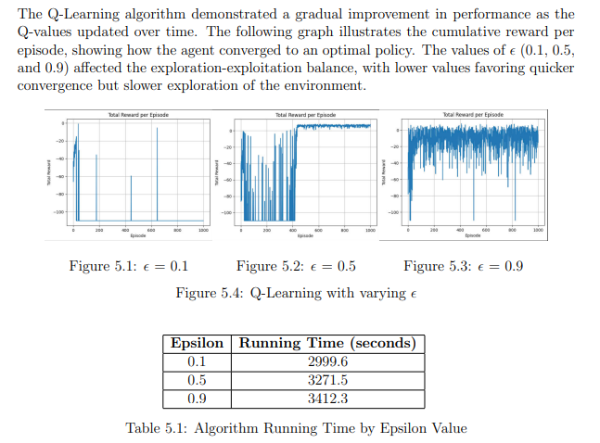
RESULTS

Slide 11
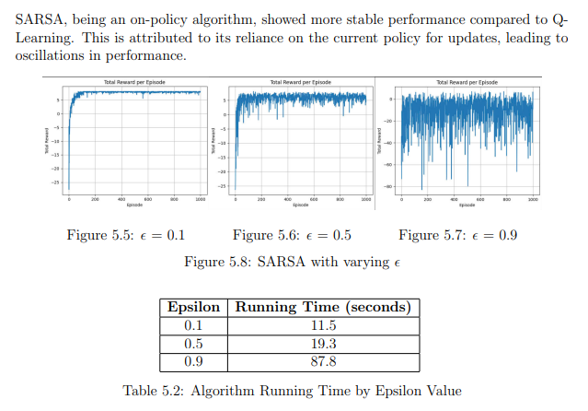
RESULTS

Slide 12
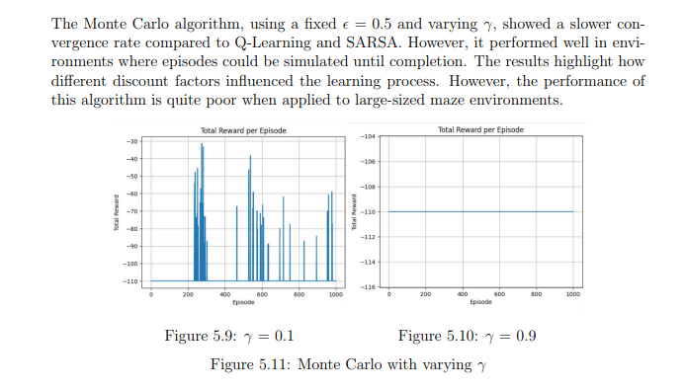
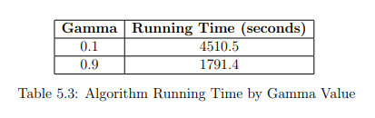
RESULTS

Slide 13
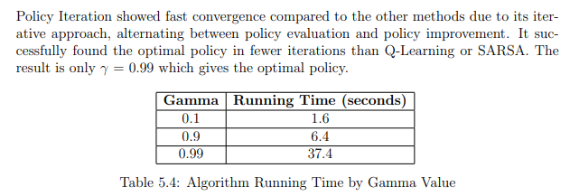
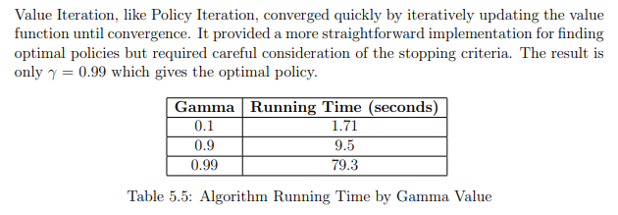
RESULTS

Slide 14
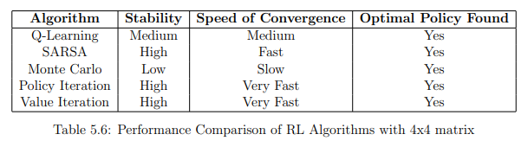
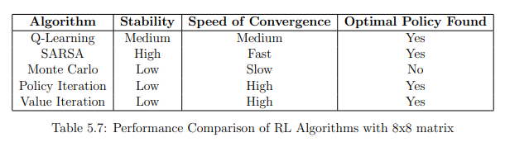
RESULTS

Slide 15
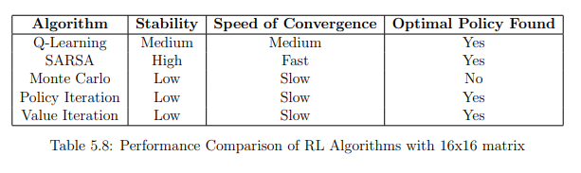
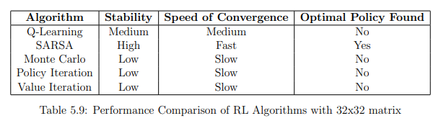
RESULTS

Slide 16
CONCLUSION
This project implemented and compared several traditional Reinforcement Learning (RL) algorithms, including Q-Learning, SARSA, Monte Carlo, Policy Iteration, and Value Iteration, in the context of solving maze navigation problems
SARSA demonstrated the fastest convergence and execution time, attributed to its on-policy nature. Q-Learning showed slower convergence. Monte Carlo had the slowest performance both in terms of computation time and convergence rate. Policy Iteration and Value Iteration performed very efficiently in small maze environments but encountered significant slowdowns in larger mazes

Slide 17
THANK’S FOR WATCHING

