Slide 1
IA-32 Architecture
Computer Organization
&
Assembly Language Programming
Dr Adnan Gutub
aagutub ‘at’ uqu.edu.sa
[Adapted from slides of Dr. Kip Irvine: Assembly Language for Intel-Based Computers]
Most Slides contents have been arranged by Dr Muhamed Mudawar & Dr Aiman El-Maleh from Computer Engineering Dept. at KFUPM

Slide 2
Outline
Intel Microprocessors
IA-32 Registers
Instruction Execution Cycle
IA-32 Memory Management

Slide 3
Intel Microprocessors
Intel introduced the 8086 microprocessor in 1979
8086, 8087, 8088, and 80186 processors
  16-bit processors with 16-bit registers
  16-bit data bus and 20-bit address bus
    Physical address space = 2²⁰ bytes = 1 MB
  8087 Floating-Point co-processor
  Uses segmentation and real-address mode to address memory
    Each segment can address 2¹⁶ bytes = 64 KB
  8088 is a less expensive version of 8086
    Uses an 8-bit data bus
  80186 is a faster version of 8086

Slide 4
Intel 80286 and 80386 Processors
80286 was introduced in 1982
  24-bit address bus ⇒ 2²⁴ bytes = 16 MB address space
  Introduced protected mode
    Segmentation in protected mode is different from the real mode
80386 was introduced in 1985
  First 32-bit processor with 32-bit general-purpose registers
  First processor to define the IA-32 architecture
  32-bit data bus and 32-bit address bus
  2³² bytes ⇒ 4 GB address space
  Introduced paging, virtual memory, and the flat memory model
    Segmentation can be turned off

Slide 5
Intel 80486 and Pentium Processors
80486 was introduced 1989
  Improved version of Intel 80386
  On-chip Floating-Point unit (DX versions)
  On-chip unified Instruction/Data Cache (8 KB)
  Uses Pipelining: can execute up to 1 instruction per clock cycle
Pentium (80586) was introduced in 1993
  Wider 64-bit data bus, but address bus is still 32 bits
  Two execution pipelines: U-pipe and V-pipe
    Superscalar performance: can execute 2 instructions per clock cycle
  Separate 8 KB instruction and 8 KB data caches
  MMX instructions (later models) for multimedia applications

Slide 6
Intel P6 Processor Family
P6 Processor Family: Pentium Pro, Pentium II and III
Pentium Pro was introduced in 1995
  Three-way superscalar: can execute 3 instructions per clock cycle
  36-bit address bus ⇒ up to 64 GB of physical address space
  Introduced dynamic execution
    Out-of-order and speculative execution
  Integrates a 256 KB second level L2 cache on-chip
Pentium II was introduced in 1997
  Added MMX instructions (already introduced on Pentium MMX)
Pentium III was introduced in 1999
  Added SSE instructions and eight new 128-bit XMM registers

Slide 7
Pentium 4 and Xeon Family
Pentium 4 is a seventh-generation x86 architecture
  Introduced in 2000
  New micro-architecture design called Intel Netburst
  Very deep instruction pipeline, scaling to very high frequencies
  Introduced the SSE2 instruction set (extension to SSE)
    Tuned for multimedia and operating on the 128-bit XMM registers
In 2002, Intel introduced Hyper-Threading technology
  Allowed 2 programs to run simultaneously, sharing resources
Xeon is Intel's name for its server-class microprocessors
  Xeon chips generally have more cache
  Support larger multiprocessor configurations

Slide 8
Pentium-M and EM64T
Pentium M (Mobile) was introduced in 2003
  Designed for low-power laptop computers
  Modified version of Pentium III, optimized for power efficiency
  Large second-level cache (2 MB on later models)
  Runs at lower clock than Pentium 4, but with better performance
Extended Memory 64-bit Technology (EM64T)
  Introduced in 2004
  64-bit superset of the IA-32 processor architecture
  64-bit general-purpose registers and integer support
  Number of general-purpose registers increased from 8 to 16
  64-bit pointers and flat virtual address space
  Large physical address space: up to 2⁴⁰ = 1 Terabytes

Slide 9
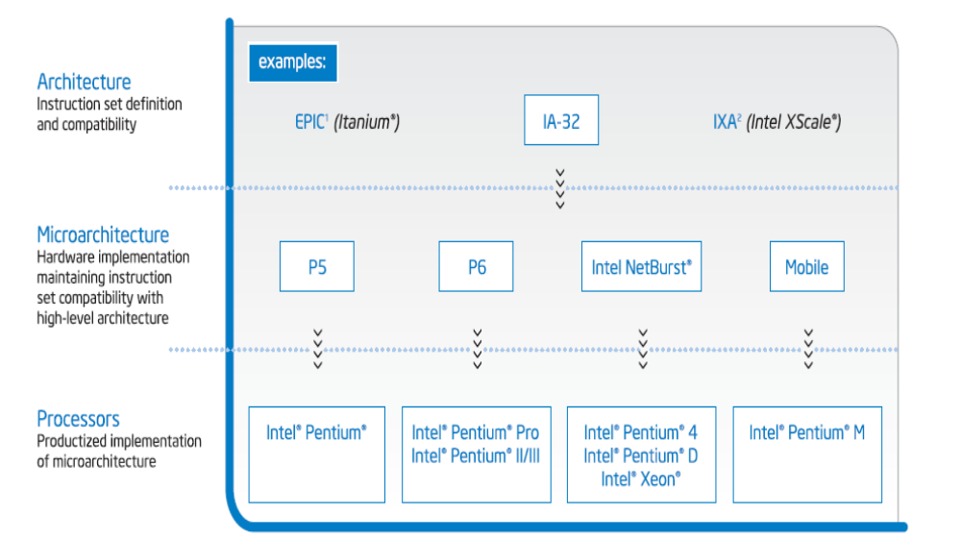
Intel MicroArchitecture History

Slide 10
Intel Core MicroArchitecture
64-bit cores
Wide dynamic execution (execute four instructions simultaneously)
Intelligent power capability (power gating)
Advanced smart cache (shares L2 cache between cores)
Smart memory access (memory disambiguation)
Advanced digital media boost
See the demo at http://www.intel.com/technology/architecture/coremicro/demo/demo.htm?iid=tech_core+demo

Slide 11
CISC and RISC
CISC – Complex Instruction Set Computer
  Large and complex instruction set
  Variable width instructions
  Requires microcode interpreter
    Each instruction is decoded into a sequence of micro-operations
  Example: Intel x86 family
RISC – Reduced Instruction Set Computer
  Small and simple instruction set
  All instructions have the same width
  Simpler instruction formats and addressing modes
  Decoded and executed directly by hardware
  Examples: ARM, MIPS, PowerPC, SPARC, etc.

Slide 12
Next ...
Intel Microprocessors
IA-32 Registers
Instruction Execution Cycle
IA-32 Memory Management

Slide 13
Basic Program Execution Registers
Registers are high speed memory inside the CPU
  Eight 32-bit general-purpose registers
  Six 16-bit segment registers
  Processor Status Flags (EFLAGS) and Instruction Pointer (EIP)
32-bit General-Purpose Registers
EAX
EBP
EBX
ESP
ECX
ESI
EDX
EDI
16-bit Segment Registers
EFLAGS
CS
ES
SS
FS
EIP
DS
GS

Slide 14
General-Purpose Registers
Used primarily for arithmetic and data movement
  mov eax, 10 move constant 10 into register eax
Specialized uses of Registers
  EAX – Accumulator register
    Automatically used by multiplication and division instructions
  ECX – Counter register
    Automatically used by LOOP instructions
  ESP – Stack Pointer register
    Used by PUSH and POP instructions, points to top of stack
  ESI and EDI – Source Index and Destination Index register
    Used by string instructions
  EBP – Base Pointer register
    Used to reference parameters and local variables on the stack

Slide 15



Accessing Parts of Registers
EAX, EBX, ECX, and EDX are 32-bit Extended registers
  Programmers can access their 16-bit and 8-bit parts
  Lower 16-bit of EAX is named AX
  AX is further divided into
    AL = lower 8 bits
    AH = upper 8 bits
ESI, EDI, EBP, ESP have only
16-bit names for lower half

Slide 16
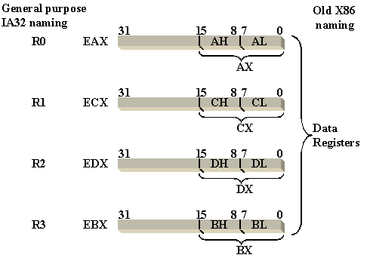
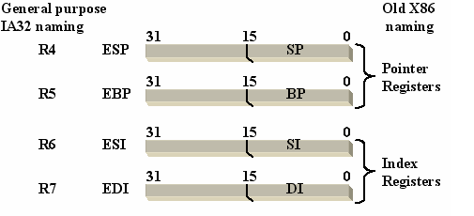
Accessing Parts of Registers

Slide 17
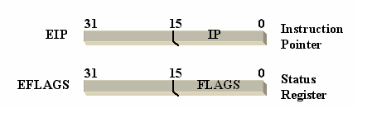
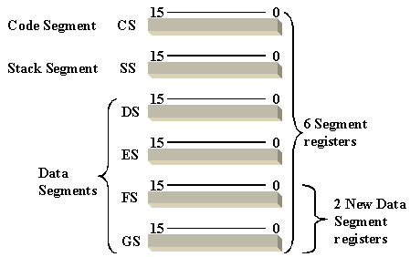
Special-Purpose & Segment Registers
EIP = Extended Instruction Pointer
  Contains address of next instruction to be executed
EFLAGS = Extended Flags Register
  Contains status and control flags
  Each flag is a single binary bit
Six 16-bit Segment Registers
  Support segmented memory
  Six segments accessible at a time
  Segments contain distinct contents
    Code
    Data
    Stack

Slide 18
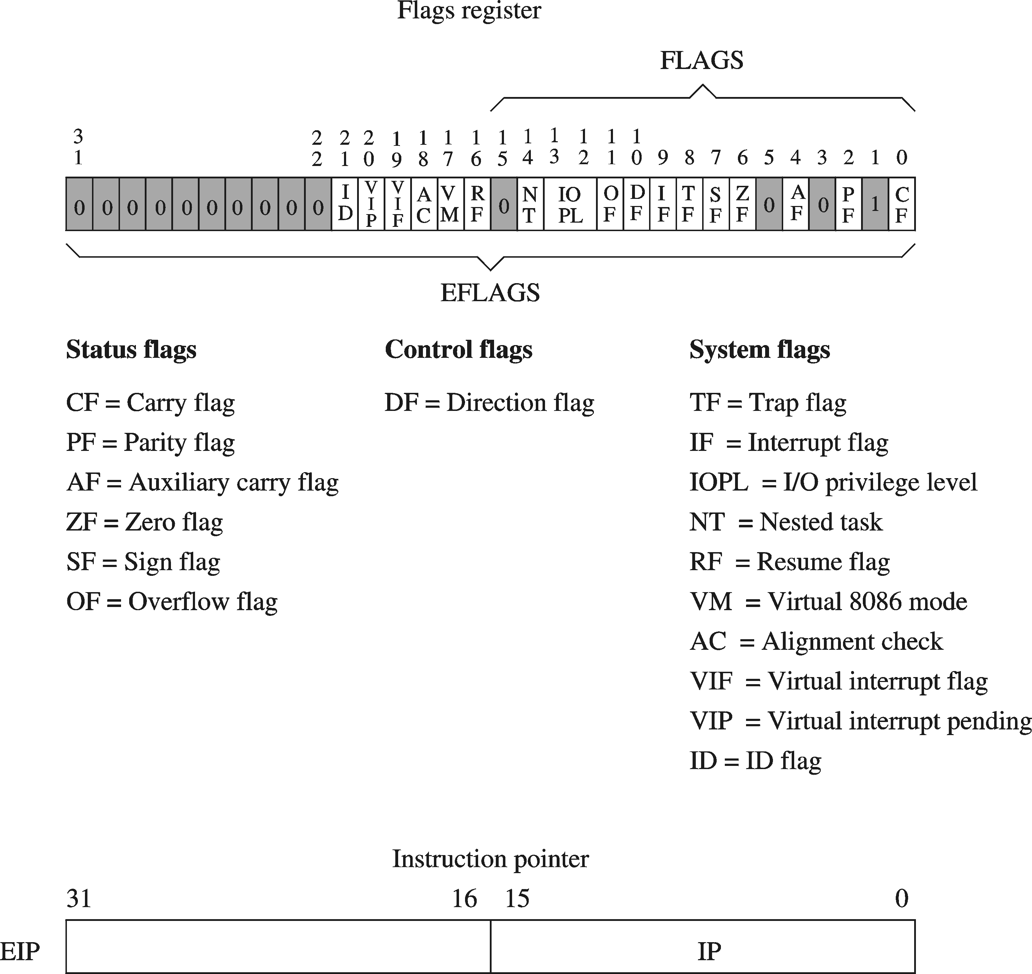
EFLAGS Register
Status Flags
  Status of arithmetic and logical operations
Control and System flags
  Control the CPU operation
Programs can set and clear individual bits in the EFLAGS register

Slide 19
Status Flags
Carry Flag
  Set when unsigned arithmetic result is out of range
Overflow Flag
  Set when signed arithmetic result is out of range
Sign Flag
  Copy of sign bit, set when result is negative
Zero Flag
  Set when result is zero
Auxiliary Carry Flag
  Set when there is a carry from bit 3 to bit 4
Parity Flag
  Set when parity is even
  Least-significant byte in result contains even number of 1s

Slide 20

Floating-Point, MMX, XMM Registers
Floating-point unit performs high speed FP operations
Eight 80-bit floating-point data registers
  ST(0), ST(1), . . . , ST(7)
  Arranged as a stack
  Used for floating-point arithmetic
Eight 64-bit MMX registers
  Used with MMX instructions
Eight 128-bit XMM registers
  Used with SSE instructions

Slide 21
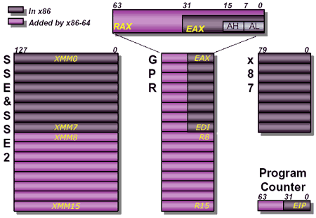
Registers in Intel Core Microarchitecture

Slide 22
Next ...
Intel Microprocessors
IA-32 Registers
Instruction Execution Cycle
IA-32 Memory Management

Slide 23

Fetch-Execute Cycle
Each machine language instruction is first fetched from the memory and stored in an Instruction Register (IR).
The address of the instruction to be fetched is stored in a register called Program Counter or simply PC. In some computers this register is called the Instruction Pointer or IP.
After the instruction is fetched, the PC (or IP) is incremented to point to the address of the next instruction.
The fetched instruction is decoded (to determine what needs to be done) and executed by the CPU.

Slide 24
Instruction Execute Cycle
Instruction
Fetch
Obtain instruction from program storage
Instruction
Decode
Determine required actions and instruction size
Operand
Fetch
Infinite Cycle
Locate and obtain operand data
Execute
Compute result value and status
Writeback
Result
Deposit results in storage for later use

Slide 25
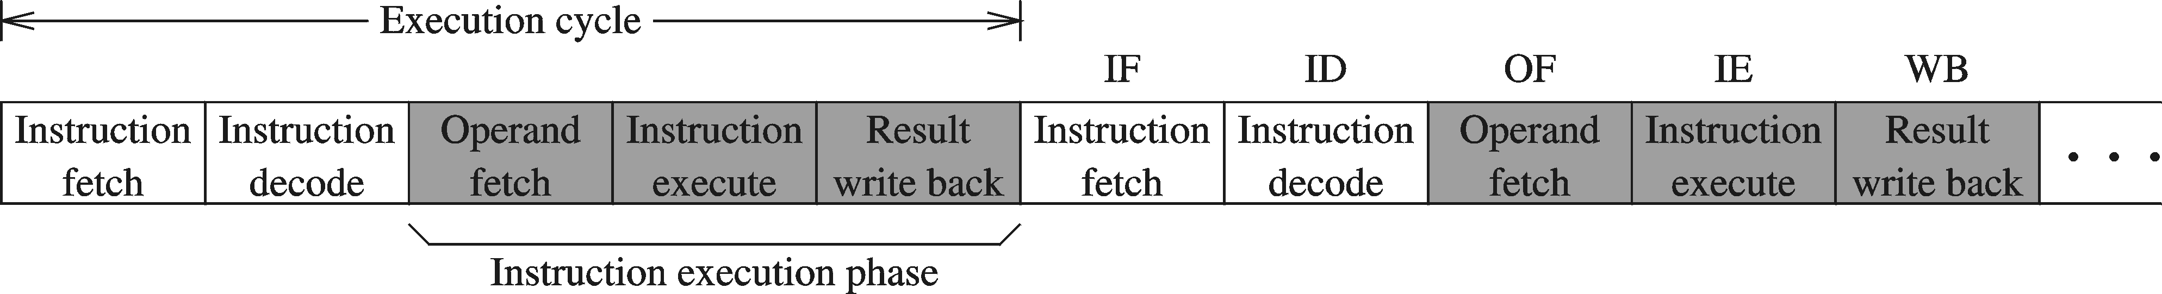
Instruction Execution Cycle – cont'd
Instruction Fetch
Instruction Decode
Operand Fetch
Execute
Result Writeback
PC
program
I1
I2
I3
I4
. . .
memory
fetch
op1
read
op2
registers
registers
I1
instruction
register
decode
write
write
flags
ALU
execute
(output)

Slide 26
Pipelined Execution
Instruction execution can be divided into stages
Pipelining makes it possible to start an instruction before completing the execution of previous one
Stages
For k stages and n instructions, the number of required cycles is: k + n – 1
S1
S2
S3
S4
S5
S6
1
I-1
2
I-1
3
I-1
4
I-1
5
I-1
Cycles
6
Non-pipelined execution
Wasted clock cycles
I-1
7
I-2
8
I-2
9
I-2
Pipelined
Execution
10
I-2
11
I-2
12
I-2

Slide 27
Wasted Cycles (pipelined)
When one of the stages requires two or more clock cycles to complete, clock cycles are again wasted
  Assume that stage S4 is the execute stage
  Assume also that S4 requires 2 clock cycles to complete
  As more instructions enter the pipeline, wasted cycles occur
  For k stages, where one stage requires 2 cycles, n instructions require k + 2n – 1 cycles
Stages
exe
S1
S2
S3
S4
S5
S6
1
I-1
2
I-2
I-1
3
I-3
I-2
I-1
4
I-3
I-2
I-1
Cycles
5
I-3
I-1
6
I-2
I-1
7
I-2
I-1
8
I-3
I-2
9
I-3
I-2
10
I-3
11
I-3

Slide 28
Superscalar Architecture
A superscalar processor has multiple execution pipelines
The Pentium processor has two execution pipelines
  Called U and V pipes
In the following, stage
S4 has 2 pipelines
  Each pipeline still
  requires 2 cycles
  Second pipeline
  eliminates wasted cycles
  For k stages and n
  instructions, number of
  cycles = k + n

Slide 29
Next ...
Intel Microprocessors
IA-32 Registers
Instruction Execution Cycle
IA-32 Memory Management

Slide 30
Modes of Operation
Real-Address mode (original mode provided by 8086)
  Only 1 MB of memory can be addressed, from 0 to FFFFF (hex)
  Programs can access any part of main memory
  MS-DOS runs in real-address mode
Protected mode
  Each program can address a maximum of 4 GB of memory
  The operating system assigns memory to each running program
  Programs are prevented from accessing each other’s memory
  Native mode used by Windows NT, 2000, XP, and Linux
Virtual 8086 mode
  Processor runs in protected mode, and creates a virtual 8086 machine with 1 MB of address space for each running program

Slide 31
Memory Segmentation
Memory segmentation is necessary since the 20-bits memory addresses cannot fit in the 16-bits CPU registers
Since x86 registers are 16-bits wide, a memory segment is made of 2¹⁶ consecutive words (i.e. 64K words)
Each segment has a number identifier that is also a 16-bit number (i.e. we have segments numbered from 0 to 64K)
A memory location within a memory segment is referenced by specifying its offset from the start of the segment. Hence the first word in a segment has an offset of 0 while the last one has an offset of FFFFh
To reference a memory location its logical address has to be specified. The logical address is written as:
  Segment number:offset
For example, A43F:3487h means offset 3487h within segment A43Fh.

Slide 32
Program Segments
Machine language programs usually have 3 different parts stored in different memory segments:
  Instructions: This is the code part and is stored in the code segment
  Data: This is the data part which is manipulated by the code and is stored in the data segment
  Stack: The stack is a special memory buffer organized as Last-In-First-Out (LIFO) structure used by the CPU to implement procedure calls and as a temporary holding area for addresses and data. This data structure is stored in the stack segment
The segment numbers for the code segment, the data segment, and the stack segment are stored in the segment registers CS, DS, and SS, respectively.
Program segments do not need to occupy the whole 64K locations in a segment

Slide 33
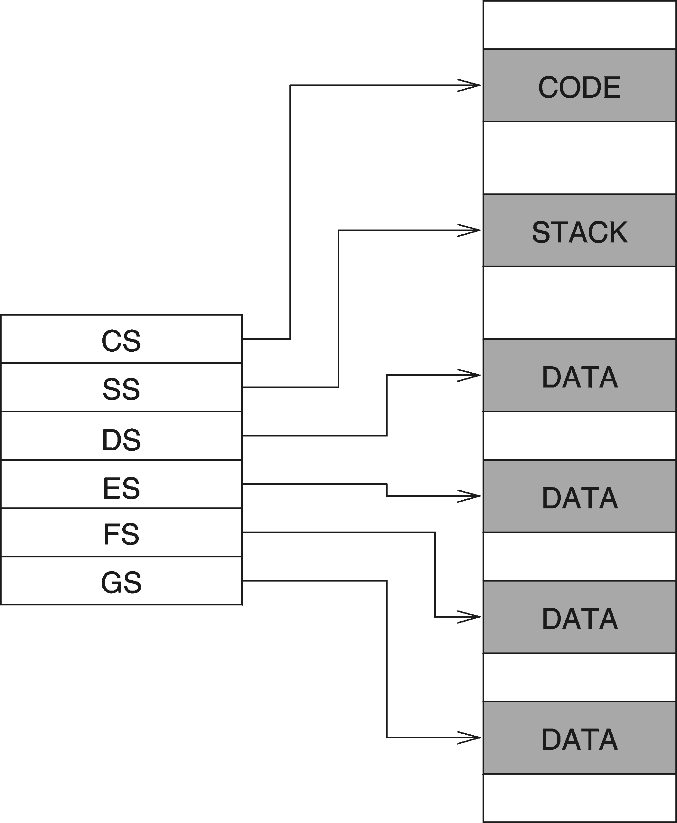
Real Address Mode
A program can access up to six segments at any time
  Code segment
  Stack segment
  Data segment
  Extra segments (up to 3)
Each segment is 64 KB
Logical address
  Segment = 16 bits
  Offset = 16 bits
Linear (physical) address = 20 bits

Slide 34
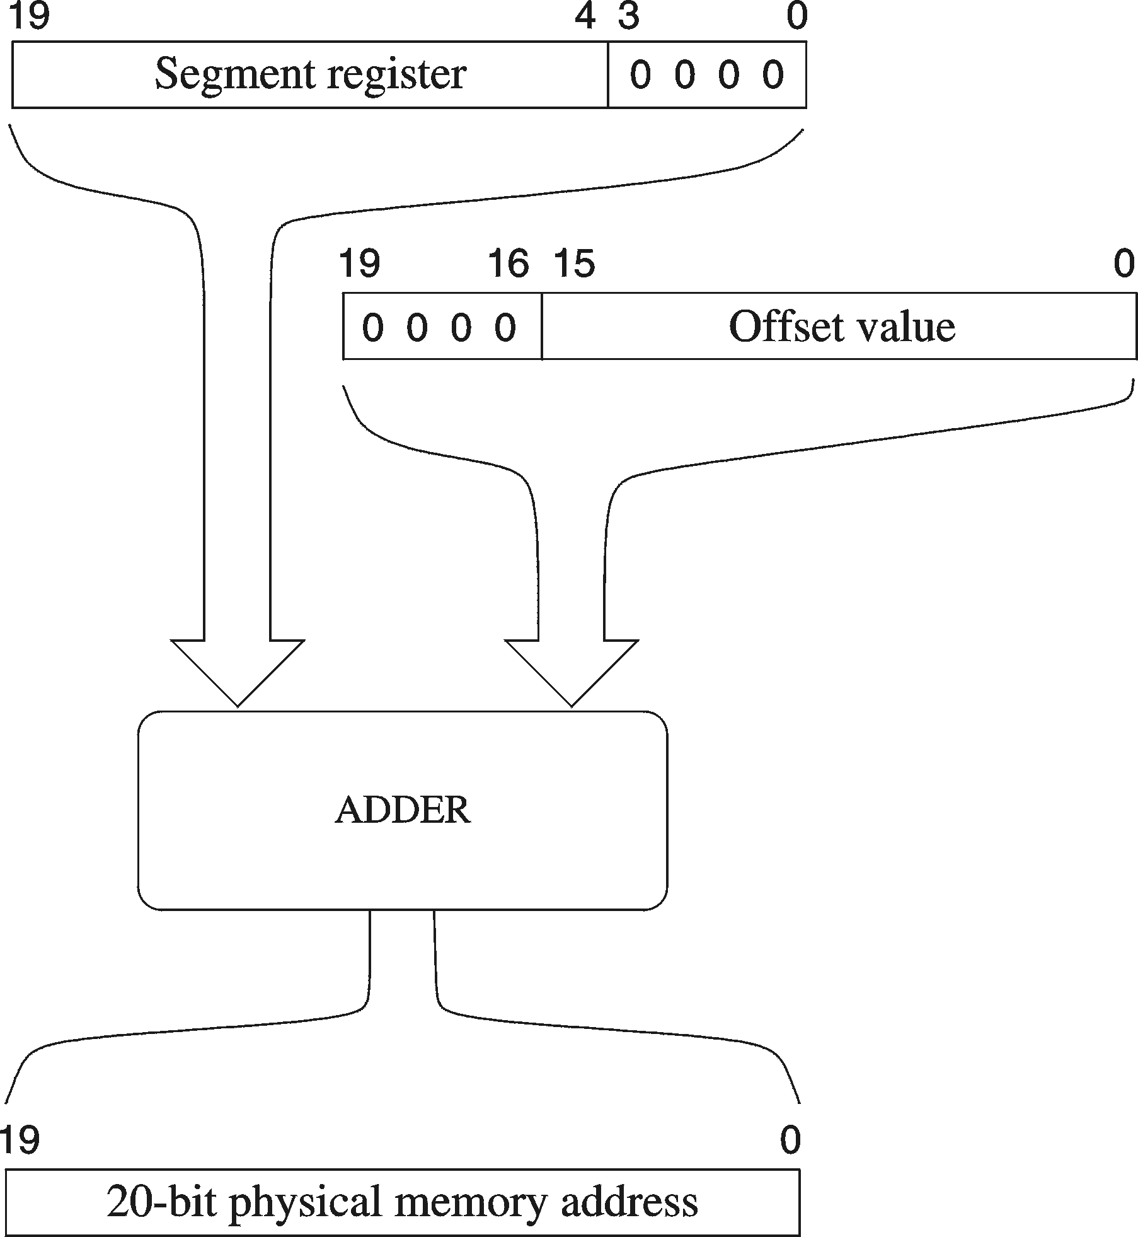
Logical to Linear Address Translation
Linear address = Segment × 10 (hex) + Offset
Example:
segment = A1F0 (hex)
offset = 04C0 (hex)
logical address = A1F0:04C0 (hex)
what is the linear address?
Solution:
A1F00 (add 0 to segment in hex)
+ 04C0 (offset in hex)
A23C0 (20-bit linear address in hex)

Slide 35
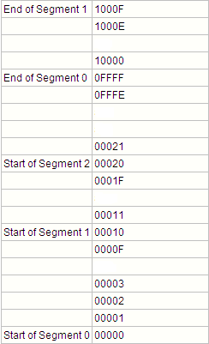
Segment Overlap
There is a lot of overlapping between segments in the main memory.
A new segment starts every 10h locations (i.e. every 16 locations).
Starting address of a segment always has a 0h LSD.
Due to segments overlapping logical addresses are not unique .

Slide 36
Your turn . . .
What linear address corresponds to logical address 028F:0030?
Solution: 028F0 + 0030 = 02920 (hex)
Always use hexadecimal notation for addresses
What logical address corresponds to the linear address 28F30h?
Many different segment:offset (logical) addresses can produce the same linear address 28F30h. Examples:
28F3:0000, 28F2:0010, 28F0:0030, 28B0:0430, . . .

Slide 37
Flat Memory Model
Modern operating systems turn segmentation off
Each program uses one 32-bit linear address space
  Up to 2³² = 4 GB of memory can be addressed
  Segment registers are defined by the operating system
  All segments are mapped to the same linear address space
In assembly language, we use .MODEL flat directive
  To indicate the Flat memory model
A linear address is also called a virtual address
  Operating system maps virtual address onto physical addresses
  Using a technique called paging

Slide 38
Programmer View of Flat Memory
Same base address for all segments
  All segments are mapped to the same linear address space
EIP Register
  Points at next instruction
ESI and EDI Registers
  Contain data addresses
  Used also to index arrays
ESP and EBP Registers
  ESP points at top of stack
  EBP is used to address parameters and variables on the stack
Linear address space of a program (up to 4 GB)
32-bit address
ESI
DATA
EDI
32-bit address
CODE
EIP
32-bit address
STACK
EBP
ESP
Unused
CS
DS
SS
ES
base address = 0 for all segments

Slide 39
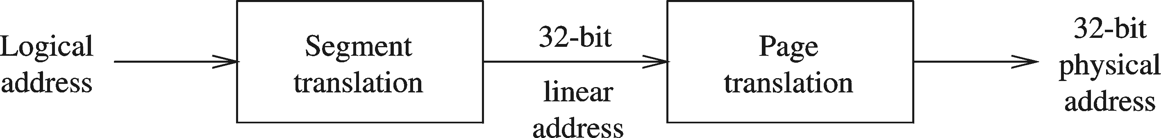
Protected Mode Architecture
Logical address consists of
  16-bit segment selector (CS, SS, DS, ES, FS, GS)
  32-bit offset (EIP, ESP, EBP, ESI ,EDI, EAX, EBX, ECX, EDX)
Segment unit translates logical address to linear address
  Using a segment descriptor table
  Linear address is 32 bits (called also a virtual address)
Paging unit translates linear address to physical address
  Using a page directory and a page table

Slide 40
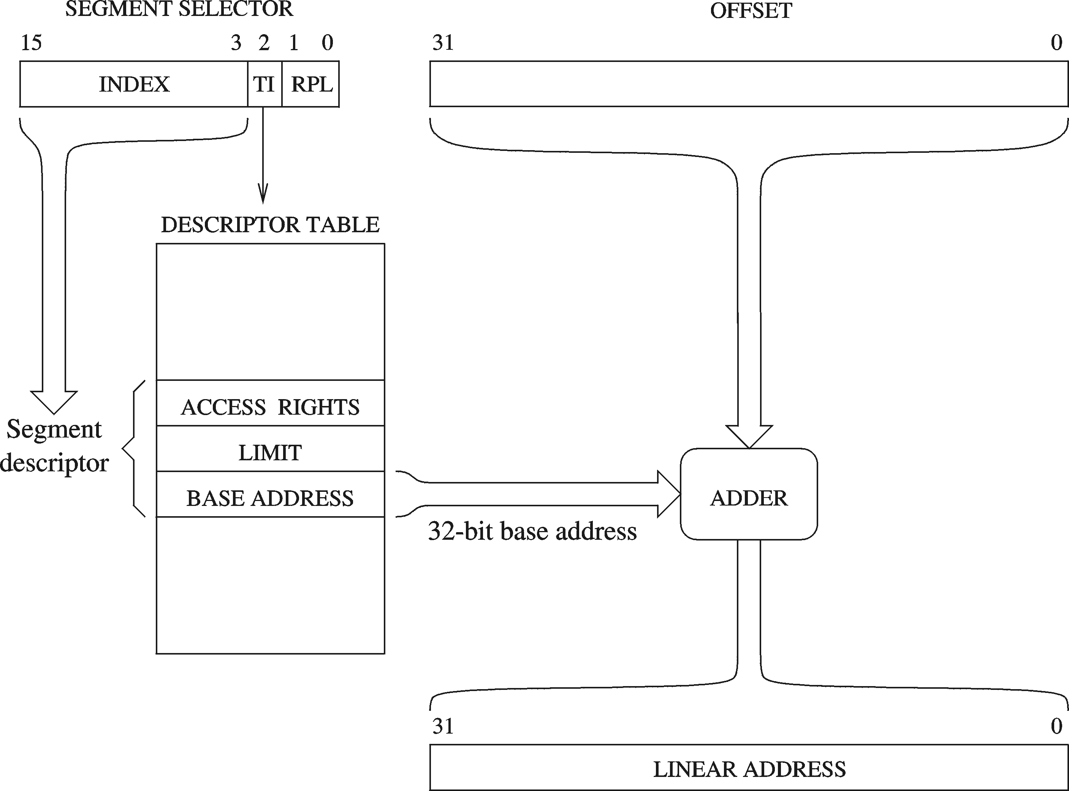
Logical to Linear Address Translation
Upper 13 bits of segment selector are used to index the descriptor table
GDTR, LDTR
TI = Table Indicator
Select the descriptor table
0 = Global Descriptor Table
1 = Local Descriptor Table

Slide 41
Segment Descriptor Tables
Global descriptor table (GDT)
  Only one GDT table is provided by the operating system
  GDT table contains segment descriptors for all programs
  Also used by the operating system itself
  Table is initialized during boot up
  GDT table address is stored in the GDTR register
  Modern operating systems (Windows-XP) use one GDT table
Local descriptor table (LDT)
  Another choice is to have a unique LDT table for each program
  LDT table contains segment descriptors for only one program
  LDT table address is stored in the LDTR register

Slide 42
Segment Descriptor Details
Base Address
  32-bit number that defines the starting location of the segment
  32-bit Base Address + 32-bit Offset = 32-bit Linear Address
Segment Limit
  20-bit number that specifies the size of the segment
  The size is specified either in bytes or multiple of 4 KB pages
  Using 4 KB pages, segment size can range from 4 KB to 4 GB
Access Rights
  Whether the segment contains code or data
  Whether the data can be read-only or read & written
  Privilege level of the segment to protect its access

Slide 43
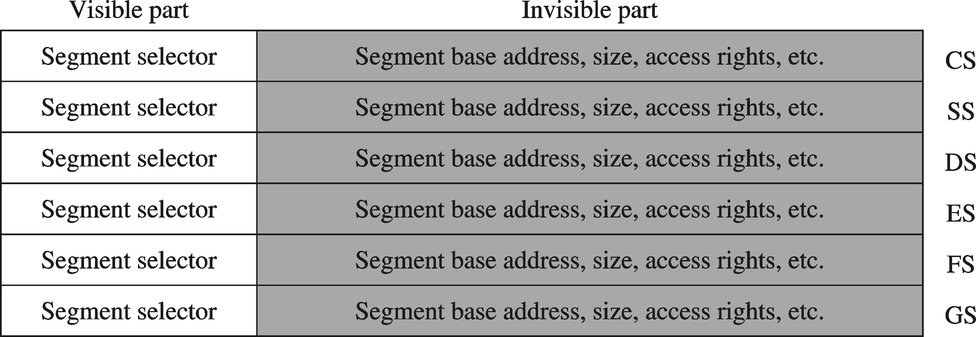
Segment Visible and Invisible Parts
Visible part = 16-bit Segment Register
  CS, SS, DS, ES, FS, and GS are visible to the programmer
Invisible Part = Segment Descriptor (64 bits)
  Automatically loaded from the descriptor table

Slide 44
Paging
Paging divides the linear address space into …
  Fixed-sized blocks called pages, Intel IA-32 uses 4 KB pages
Operating system allocates main memory for pages
  Pages can be spread all over main memory
  Pages in main memory can belong to different programs
  If main memory is full then pages are stored on the hard disk
OS has a Virtual Memory Manager (VMM)
  Uses page tables to map the pages of each running program
  Manages the loading and unloading of pages
As a program is running, CPU does address translation
Page fault: issued by CPU when page is not in memory

Slide 45
Paging – cont’d
Main Memory
The operating system uses page tables to map the pages in the linear virtual address space onto main memory
Page m
. . .
Page n
. . .
. . .
linear virtual address space of Program 1
linear virtual address space of Program 2
Page 2
Page 2
Page 1
Page 1
Page 0
Page 0
Hard Disk
The operating system swaps pages between memory and the hard disk
Each running program has its own page table
Pages that cannot fit in main memory are stored on the hard disk
As a program is running, the processor translates the linear virtual addresses onto real memory (called also physical) addresses

