Slide 1


HCMC UNIVERSITY OF TECHNOLOGY AND EDUCATION
FALCUTY FOR HIGH-QUALITY TRAINING
DATABASE MANAGEMENT REPORT
TOPIC : RESTAURANT MANAGEMENT APPLICATION
Lecturer: LÊ THỊ MINH CHÂU
Students:
Nguyễn Hoàng Trường Minh - 17110050
Nguyễn Mạnh Tiến - 17145370
HCMC December 18, 2019

Slide 2
Content
01
LOGIN SYSTEM
02
FEATURE OF ADMIN
03
ORDER SYSTEM
1

Slide 3
LOGIN SYSTEM
The administrator can perform any features in this application
ADMIN
Staff may only use some features authorized by the administrator
LOGIN
STAFF
2

Slide 4
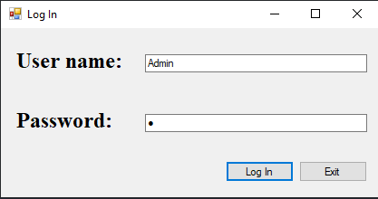
LOGIN SYSTEM
3

Slide 5
Feature of admin
01
List
All information that was added will be listed in table
04
Delete information of any table
01
02
Add
03
Edit
02
Add new information into table in database
05
Find immediately information of food table
04
Delete
05
Search
03
Change the information of any table
4

Slide 6
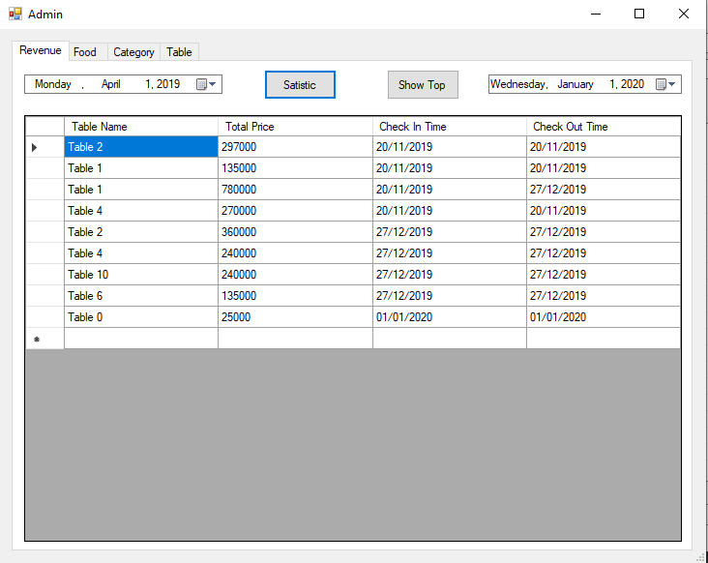
Features of admin
5

Slide 7
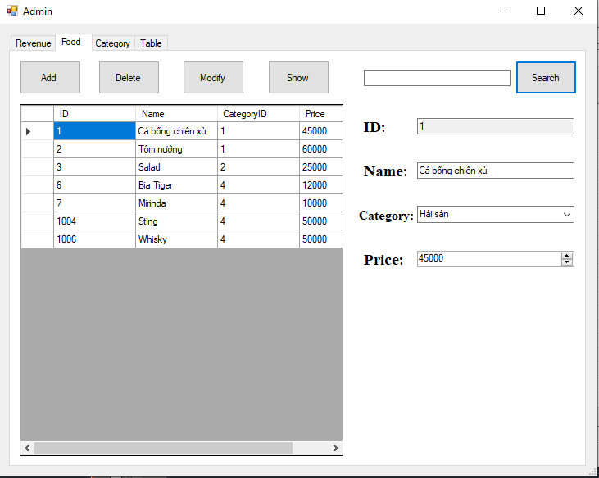
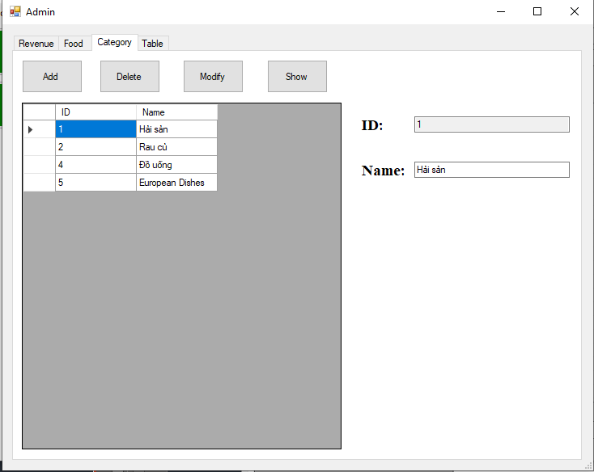
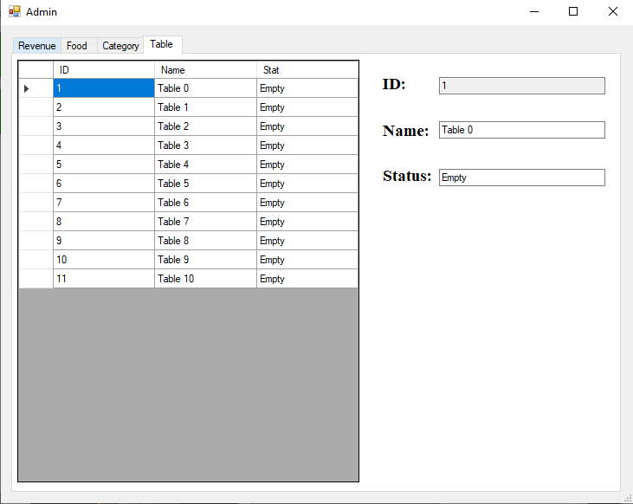
Features of admin
6

Slide 8
Order system
03
05
01
02
04
Order
Delete
Select
Edit
Check out
Select table that is empty or customer want to book
Order food
Change information of the bill of each table
Delete information of bill
Check out the bill
7

Slide 9
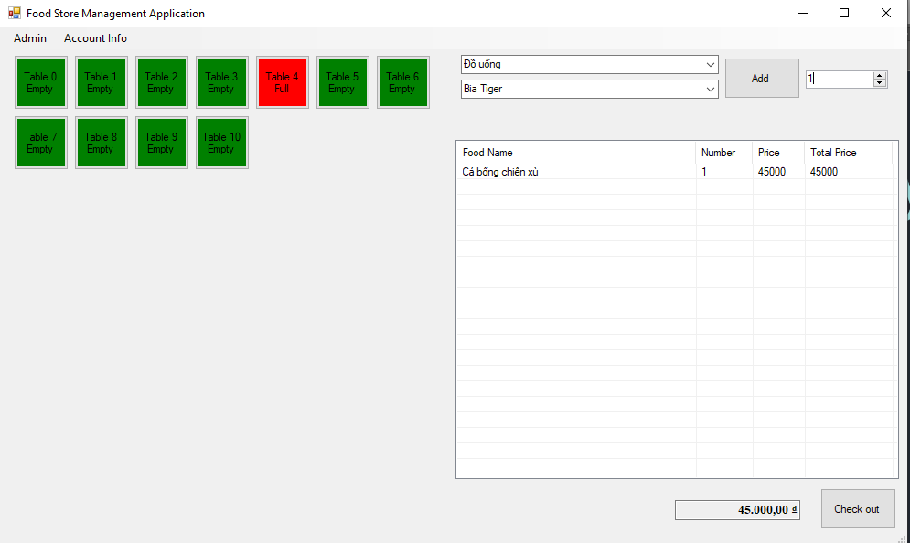
Order System
8

