Slide 1

Web Project : Online Shop Management System
Team Member:
Le Tuan Dat
Nguyen Manh Tien
Nguyen Hoang Truong Minh

Slide 2
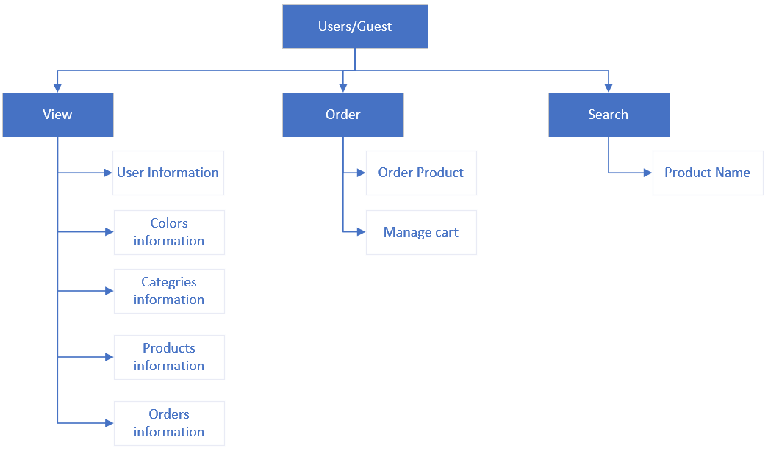



Detail of function for user/guest
STT | Funtion | Describtion
1 | View | User can view colors, products,categories,order and users table.
2 | Order | User can order products on website and click order the product user want.
3 | Cart | allow users to edit their orders, update the number or order new product

Slide 3
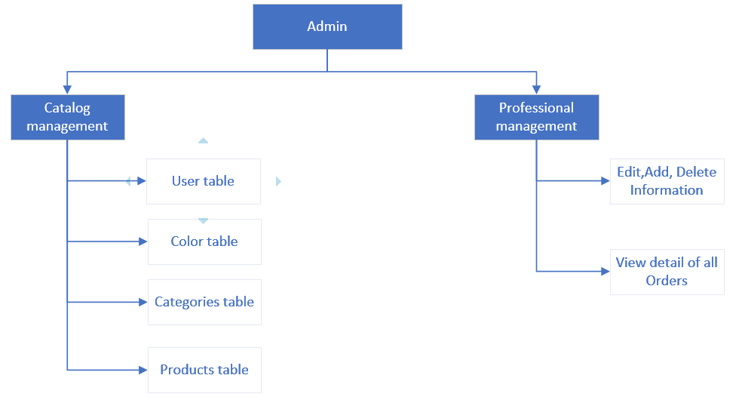
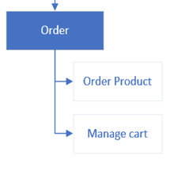
Function Diagram for admin
Stt | Funtion | Describtion
1 | Product Management | Information management of product images, administrators can upload product images, enter feature description information product, price, quantity
2 | Categories management | Information management of category each product
3 | Customer management | Add, edit, delete user information
4 | Order Detail | Display order details including information About customers, information about the products in the order, order fulfillment staff, order status, administrator notes

Slide 4
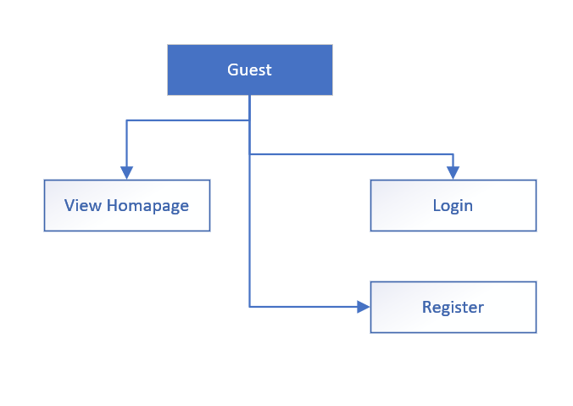
2.1.7 Funtion Diagram for Guest

Slide 5
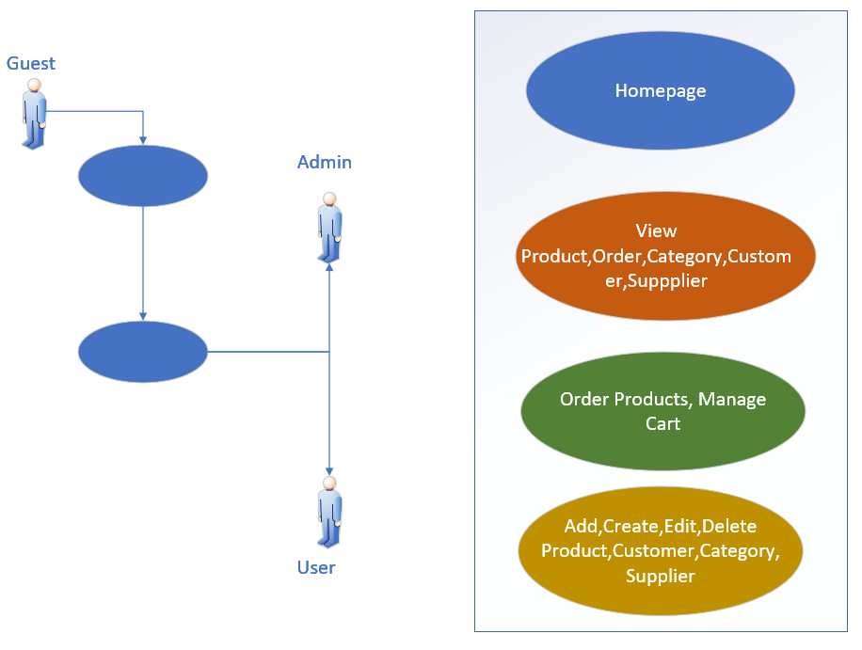
Usecase Diagram For WebSite

Slide 6
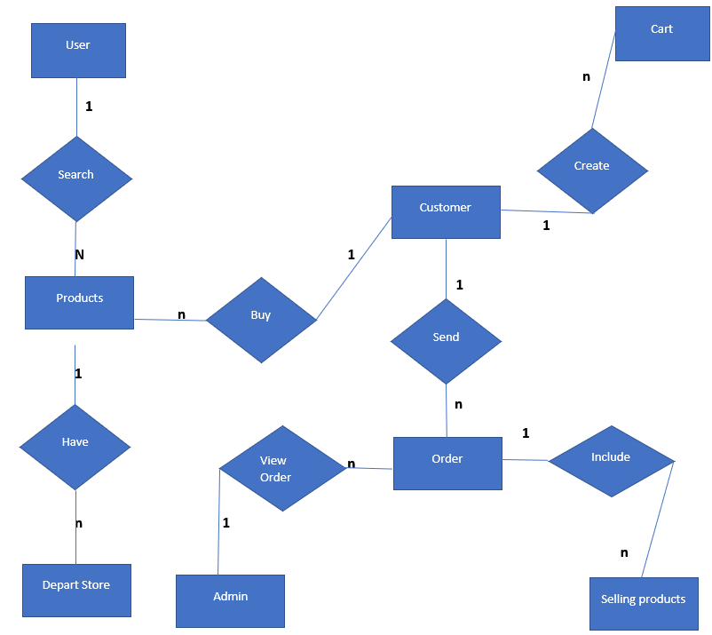
Entity Relationship model

Slide 7
Design database
STT | TABLE NAME | SUBSTANCE
1 | Customer | Customer table info
2 | Supplier | Detail Supplier
3 | Order Detail | Detail orders table of each customer
4 | Order | Order Table of each customer
5 | Category | Category of product
6 | Products | Detail content of each product
7 | ProductCategory | Connect 2 table Product and category

Slide 8
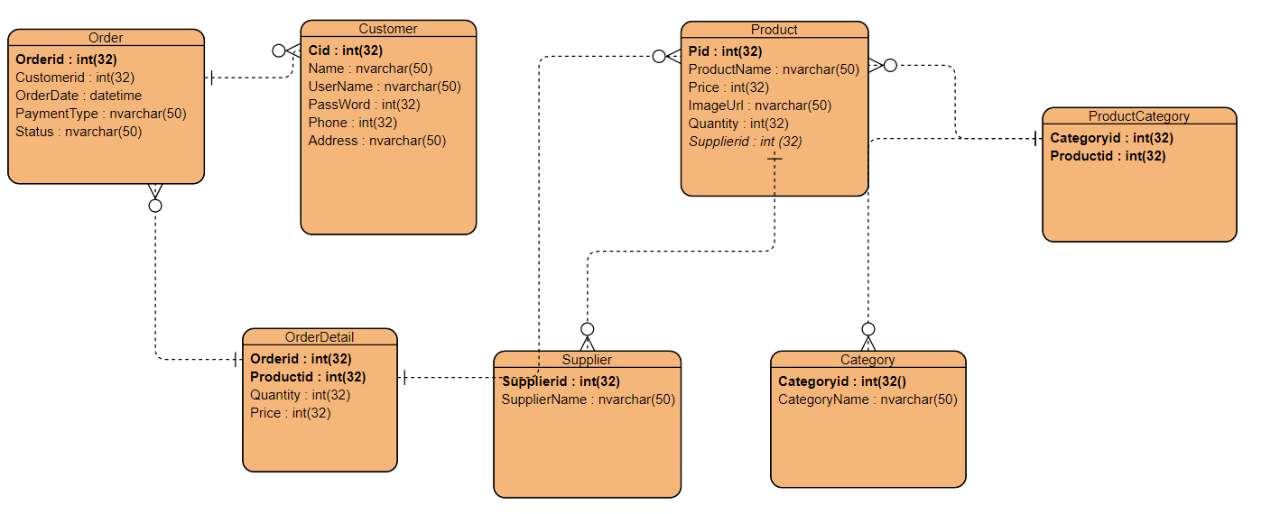
ERD

Slide 9
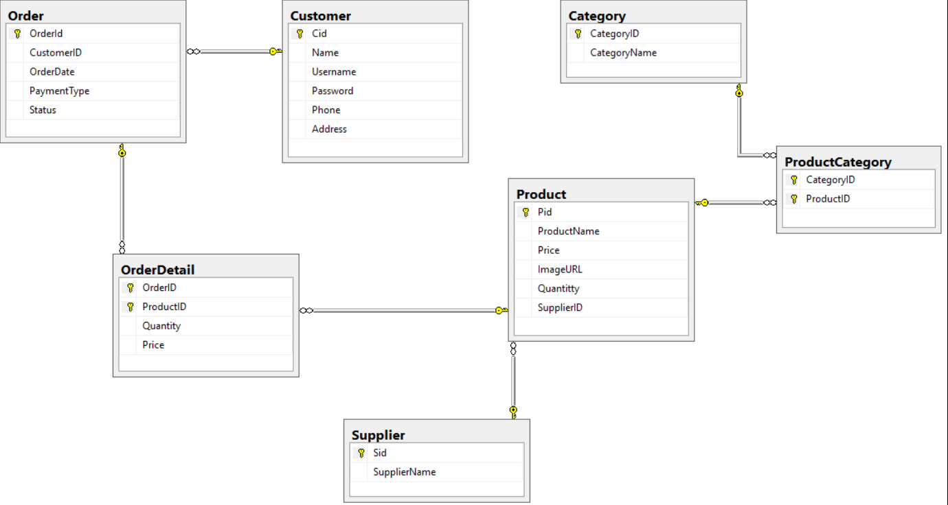
Task Assignment

Slide 10
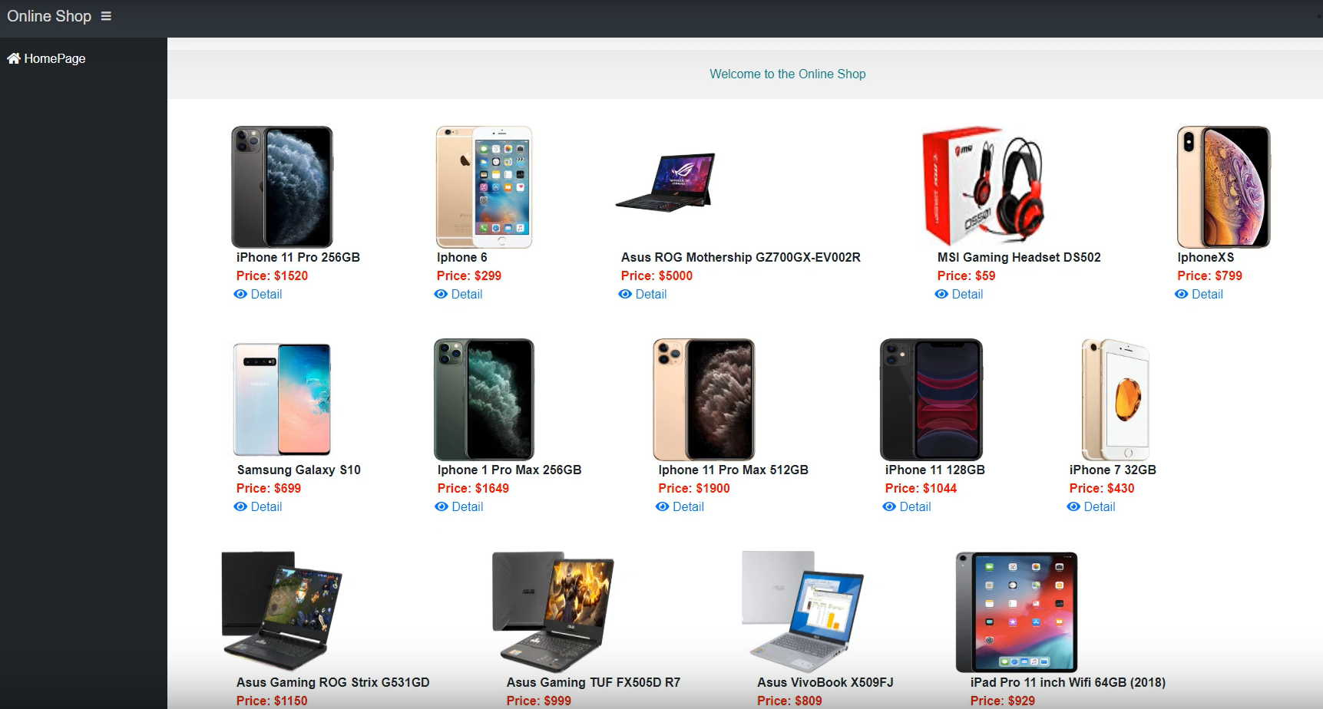

Slide 11
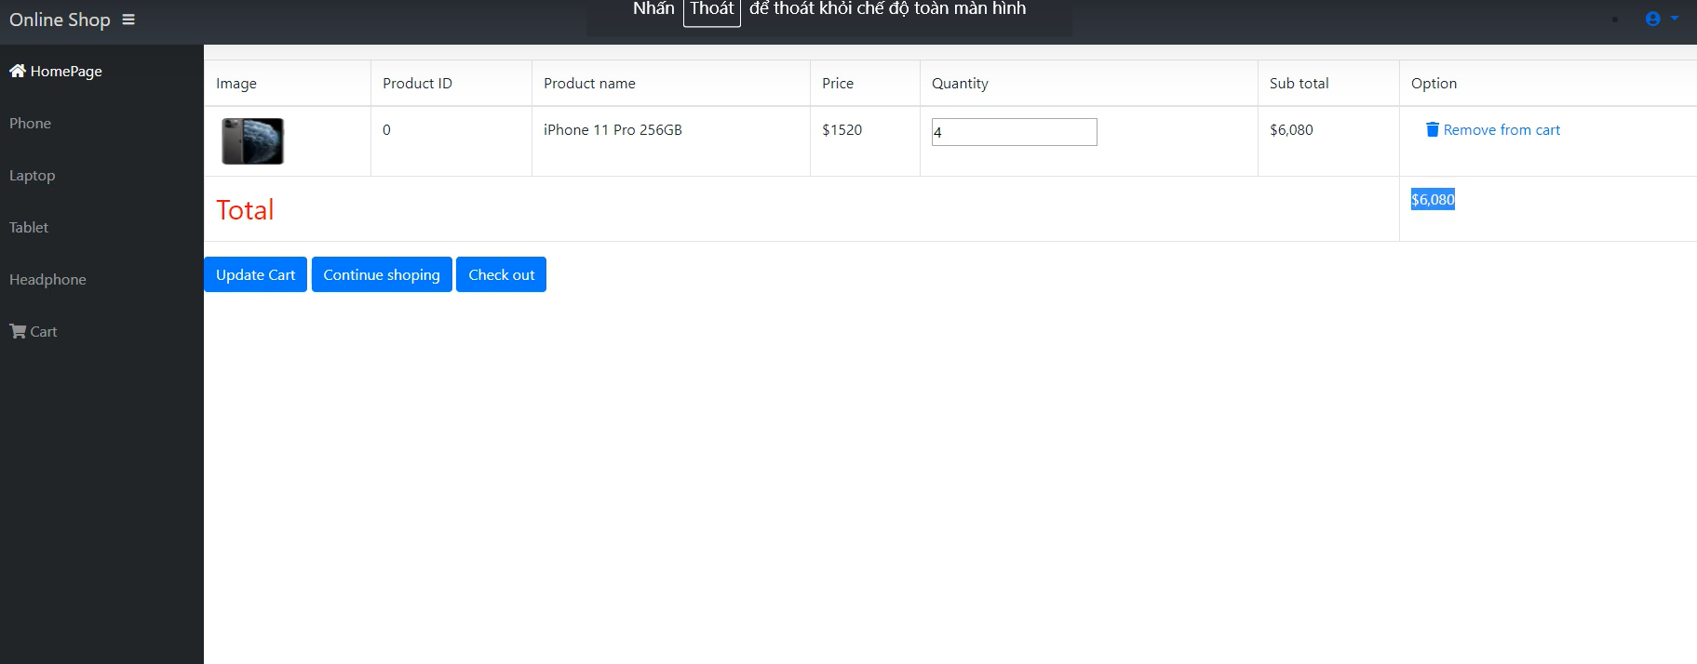

Slide 12
