Slide 1
RMIT CAPSTONE PROJECT 2026 · TEAM QUOTA · NASHTECH
NTG Agent
A platform for building AI assistants that know your documents, use your tools, and stay under your control.
Presented by [Your name] · Team QUOTA: Vu Gia An · Nguyen Tien · Tran Nguyen Quy Khang · Nguyen Dinh Minh Chau
Academic supervisor Tran Nhat Quang · Industry partner NashTech
[Course code] · [Date] · Progress & Accomplishments Presentation
Notes:
OPEN (0:00-0:30)
"Good [morning]. I'm [name], presenting for team QUOTA. Our capstone is NTG Agent, built with our
industry partner NashTech.
The one-line version: lots of organisations want an AI assistant that actually knows their own
documents and can use their own systems. Building one safely is still hard. NTG Agent is a platform
that makes it something you set up, rather than something you build from scratch.
I'll cover the problem, what already exists, how our solution works, and then show it running."
Leave this slide at 0:30. Don't read the team list out.

Slide 2
AGENDA
What I'll cover in 13 minutes
 | Section | Time
1 | What the project is, and the problem it solves | 1.5 min
2 | Market research and key concepts | 2.5 min
3 | How our solution works | 3.5 min
4 | Live demonstration of the working system | 4 min
5 | Progress so far, and what's next | 1.5 min
No prior AI background needed. Slide 7 explains every term I use before I use it.
Notes:
AGENDA (0:30-0:55)
Don't read the table. Just:
"Four parts and a demo — the problem, what's already out there, how ours works, then I'll show you
the real system, and finish with where we are."
Point at the callout: "I'll define the jargon as I go."
25 seconds. Move.

Slide 3
1
What the project is
The problem it solves, and who it is for
Notes:
DIVIDER — 3 seconds. Don't narrate dividers.

Slide 4
THE PROBLEM
Every team wants an AI assistant. Few can safely have one.
A chatbot is easy to start and hard to trust. These are the four reasons it usually stops there.
It doesn't know you
It forgets you
It can't do anything
Nobody is in control
A general AI model has never read your company's documents, policies or product manuals, so it answers from the internet — or invents something.
Close the window and everything is gone. It cannot build up any understanding of a person or a project over time.
It can talk about your systems but not use them. Connecting it to real tools means custom work for every tool and every AI provider.
No record of who may use it, what it was asked, or what it costs — which is exactly what stops it being approved for real use.
Our starting point. NashTech had already built a first version — a working chat application with a single fixed assistant. It had none of the four properties above. Turning it into something an organisation could actually deploy is our capstone.
Notes:
THE PROBLEM (0:58-1:50)
"Getting a chatbot onto a web page is a solved problem. That's not where teams get stuck.
They get stuck on these four. The model has never read your documents, so it answers confidently
about things it doesn't know. It forgets the user the moment they close the tab. It can talk about
your systems but can't actually use them — and wiring it up is custom work for every combination of
tool and AI provider. And there's no record of who used it, or what it cost, which is usually the
thing that stops it getting approved.
NashTech had already built a first version — a working chat app with one fixed assistant, and none of
these four properties. Closing that gap is our project."
~50s. Talk over the tiles, don't read them.

Slide 5
THE PROJECT
What NTG Agent does
A platform where you set up an AI assistant in a browser — no programming, no redeployment.
Build assistants without code
Give it your documents
Connect it to real tools
Name it, pick the AI model, write its instructions, publish it. All from an admin screen.
Upload files to an assistant. It answers from them and shows which document it used.
Live weather, web search, and any other tool added through one standard connector.
Let assistants work together
Answer with a screen, not a paragraph
Keep it under control
A general assistant can hand specialist questions to a specialist one, automatically.
For some tasks it replies with a working form or card the user can fill in and submit.
Decide who may use each assistant, and see exactly what everyone is using and costing.
Notes:
WHAT IT DOES (1:50-2:40)
"So what is it. Six things, and they're the whole product.
You build an assistant without writing code — you name it, pick the model, write its instructions,
publish it. You give it your documents, and it answers from them and tells you which document it
used. You connect it to real tools. You let assistants hand work to each other. It can reply with a
working form rather than a paragraph. And you keep control of who uses it and what it costs.
Everything after this slide is one of these six, in more detail."
~50s. Read the six headings only — the body text is for the examiner, not the room.

Slide 6
THE PROJECT
Who uses it, and why it matters
Two audiences, two screens — and one reason NashTech wanted it built.
The administrator
The end user
Sets up assistants — model, instructions, documents
Chooses the tools each one is allowed to use
Decides who can use it and watches the cost
Just chats — picks an assistant and asks a question
Gets answers with sources they can check
Never sees any of the setup
Why NashTech wanted this built
Almost every serious tool in this space is built in Python. NashTech is a Microsoft .NET consultancy, and so are most of its clients. So the goal was never a single chatbot — it is an open-source example NashTech can reuse and show to customers as proof of what their teams can build.
Notes:
WHO AND WHY (2:40-3:20)
"Two audiences. Administrators set assistants up. End users just chat — they never see any of the
setup, they pick an assistant and ask a question.
And the bottom box is the part I'd emphasise for NashTech. Almost everything serious in this field is
built in Python. NashTech is a Microsoft .NET consultancy and so are most of its clients. So this was
never meant to be one chatbot — it's an open-source reference they can reuse on client work and point
at as proof of what their teams can build."
~40s.

Slide 7
2
Market research and key concepts
What already exists, the terms you need, and the gaps we chose to fill
Notes:
DIVIDER — 3 seconds.

Slide 8
KEY CONCEPTS
Four terms, in plain English
These come up for the rest of the talk, so here they are once, up front.
Term | What it means | Why it matters here
RAG (retrieval) | Before answering, the system searches your uploaded documents and gives the AI the most relevant pages to read. | This is how the assistant answers from your documents instead of guessing.
MCP (tool standard) | An agreed way for any AI model to use any tool — like USB, but for connecting AI to software. | Without a standard, every AI model needs custom wiring to every tool. With one, they plug together.
Agent | An AI assistant with a job, a set of documents, and permission to use certain tools. | The thing an administrator creates. The product is a factory for these.
Skill | A prepared pack that teaches an assistant a task, and can include a ready-made screen for it. | How we make an assistant reply with a working form instead of a wall of text.
Notes:
KEY CONCEPTS (3:23-4:05)
Do NOT read the table. Say:
"Four terms carry the rest of the talk.
RAG just means: before answering, search your documents and hand the AI the relevant pages. That's
how it answers from your material instead of guessing.
MCP is a standard for connecting AI to tools. Think USB — before USB, every device needed its own
connector. Same idea here.
An agent is an assistant with a job, some documents and permission to use certain tools. That's the
thing administrators create.
And a skill is a prepared pack that teaches an assistant a task, and can bring a ready-made screen
with it. I'll show you one."
~42s. The USB comparison is the one people remember — use it.

Slide 9
MARKET RESEARCH
What already exists, and where it stops
The four best-known platforms, plus the version NashTech started from.
 | LangChain / LangGraph | AutoGen | CrewAI | Semantic Kernel | NTG Agent v1 (our start)
Built in | Python | Python | Python | .NET / Python | .NET
Assistants work together | Yes | Yes | Yes | Partly | No
Remembers users | Partly | No | No | Partly | Partly
Answers from your documents | Strong | Minimal | Minimal | Strong | Limited
Standard tool connections | Own system | Limited | Limited | Yes | Yes, 2 tools
Access control & permissions | Minimal | Minimal | Minimal | Minimal | Minimal
Cost and usage tracking | Add-on | Minimal | Minimal | Partly | None
Ready for enterprise use | Low | Low | Low | Medium | Medium
Look at the last three rows. Permissions, cost tracking and enterprise readiness are weak or missing everywhere. That is the gap we build into.
Notes:
MARKET RESEARCH (4:05-4:55)
"We compared the four best-known platforms against what NashTech actually needs.
Read it by column. LangChain and LangGraph are the most capable — and Python. AutoGen, Python.
CrewAI, Python. Semantic Kernel is the only one with a real .NET story, and it does less.
But the rows that matter are the last three. Access control: minimal, minimal, minimal, minimal.
Cost tracking: barely there. Enterprise readiness: low, low, low.
Every one of these treats permissions and cost as somebody else's problem. That's fine for a
research tool. It's not fine inside a company — and that's the gap we build into."
~50s. Trace the bottom three rows with the cursor. That's the whole argument.

Slide 10
FROM RESEARCH TO DESIGN
What the research told us to build
Five gaps we found in the literature and the market, and the feature each one became.
What the research said was missing | What we built because of it
When several assistants share one pool of documents, answers become inconsistent and information leaks between them | Every assistant gets its own separate knowledge base. One cannot see another's documents.
Most platforms are tied to one AI provider, and switching means rewriting | Five AI providers supported. Switching an assistant between them is a dropdown, not a rewrite.
Assistants usually forget everything between sessions | Long-term memory across conversations, which the user can switch on or off.
Connecting AI to tools is different for every product | One standard connector (MCP) for every tool, including other assistants.
Almost nothing tracks what an assistant is doing or costing | Usage and cost recorded for every request, per user, visible in an admin dashboard.
Notes:
RESEARCH TO DESIGN (4:55-5:35)
"We didn't want a literature review that sits in a document and never touches the product, so every
gap we found became a feature. Left column, the gap. Right column, what we built.
The one I'd highlight is the first. In the research, document search is almost always studied with
one assistant and one set of documents. The moment several assistants share a pool, they start
retrieving each other's material — answers get inconsistent, and information crosses boundaries it
shouldn't. Our answer is that every assistant gets its own separate knowledge base. I'll show you
that working."
~40s. Read the first row aloud, summarise the rest.

Slide 11
3
How our solution works
The parts of the system, and the four features that matter most
Notes:
DIVIDER — 3 seconds.

Slide 12
SOLUTION DESIGN
How the system fits together
Three things people use, one service that does the work, and what it connects to.
Chat app
where people ask questions
Admin console
where assistants are set up
Interactive client
where forms and cards appear
The platform
decides which assistant answers · searches the documents · calls the tools · records who asked and what it cost
Tools
weather, web search, more
Knowledge bases
one per assistant
Database
conversations, settings, usage
AI providers
OpenAI, Azure, Gemini, more
Notes:
ARCHITECTURE (5:38-6:20)
"At the top, the three things people actually open. The chat app, where end users ask questions.
The admin console, where assistants get set up. And a third client that can display interactive
forms and cards — I'll come back to that one.
Everything goes through one service in the middle. That's where the decision happens: which
assistant answers, which documents to search, which tools to call, and recording who asked and what
it cost.
Underneath, what it connects to. Tools. The knowledge bases — and note, one per assistant, not one
shared pool. The database. And whichever AI provider that assistant is set to use."
~42s. Keep it at this level. Don't go deeper even if asked — offer to take it in Q&A.

Slide 13
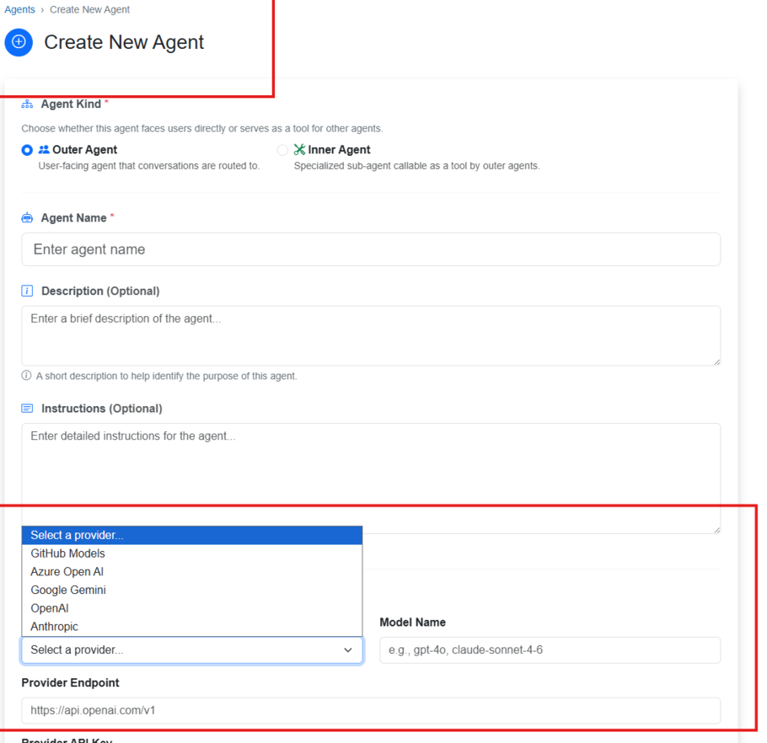
FEATURE
Setting up an assistant takes four steps
All of it in a browser. No programming, and nothing is redeployed when it changes.
1
2
3
4
Describe it
Feed it
Equip it
Release it
Give it a name, write what it should do, pick the AI
model.
Upload the documents
it should answer from.
Tick the tools it may
use, and any specialist
assistants it can ask.
Choose who is allowed
to use it, and publish.
Why this matters. On most platforms, changing which AI model an assistant uses, or giving it a new tool, is a developer task and a release. Here it is a dropdown and a Save button — which is what makes it usable by the people who own the content, not just the people who write the code.
Step 1 on screen — including the list of AI providers.
Notes:
BUILDING AN ASSISTANT (6:23-7:05)
"Setting one up is four steps, and all four are in a browser.
Describe it — name, instructions, and which AI model. That's the screen on the right, and you can see
the provider list open: GitHub, Azure, Google, OpenAI, Anthropic.
Feed it — upload the documents it should answer from.
Equip it — tick which tools it may use, and which specialist assistants it's allowed to ask for help.
Release it — choose who's allowed to use it, and publish.
And the point at the bottom: on most platforms, swapping the AI model or adding a tool is a developer
task and a software release. Here it's a dropdown and Save. That's what makes it usable by the people
who own the content rather than only the people who write the code."
~42s.

Slide 14
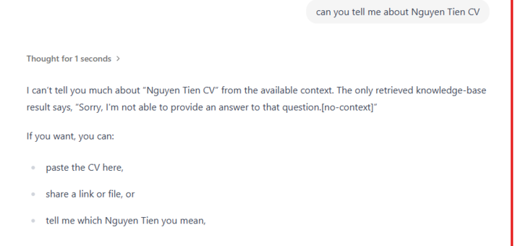
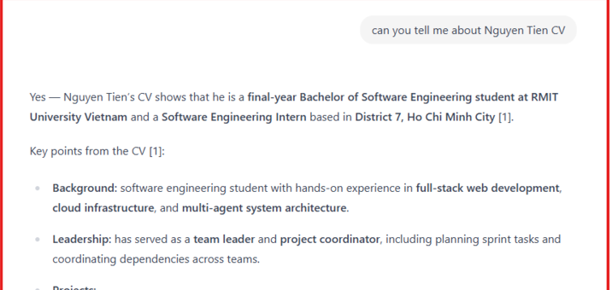
FEATURE
Answers from your documents — with the source shown
The same question, asked of two assistants. Only one has the document.
ASSISTANT WITHOUT THE DOCUMENT
SAME QUESTION, ASSISTANT WITH THE DOCUMENT
It says it doesn't know, instead of inventing an answer.
It answers — and the [1] marks which document it came from.
Two features in one picture. Answers are grounded in your documents and carry a source the reader can check — and each assistant is limited to its own documents, so one cannot reach into another's.
Notes:
DOCUMENTS AND SOURCES (7:05-7:40)
"This is the feature I'd most want you to remember, and it's easiest to just show.
Same question on both sides — asked about a specific document. On the left, an assistant that doesn't
have it. It says so. It doesn't guess, which is the behaviour you want and the thing AI is least
reliable at.
On the right, the identical question to an assistant that does have the document. It answers, and
you can see the bracket-one — that's the source, so the reader can check where it came from.
Nothing changed but which assistant was asked. That's the separation working."
~35s. Let the images do the work. Don't read them out.

Slide 15
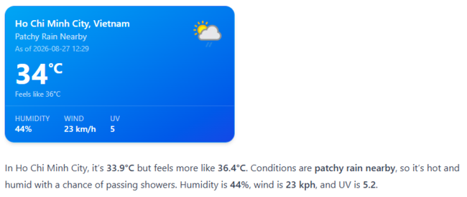
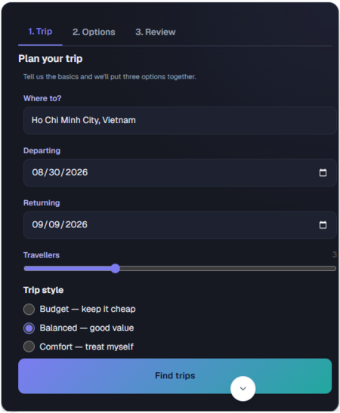
FEATURE
Using real tools — and replying with a screen
An assistant can fetch live information, and for some tasks it answers with something you can use.
USING A TOOL
REPLYING WITH A SCREEN
A working form. Tabs, dates, a slider — the user fills it in and submits, and the conversation continues.
No custom code. The assistant describes the screen; the app draws it. New tasks need no new development.
Taught by a skill. The trip-planning pack is uploaded once and switched on per assistant.
Any tool, one connector. Weather and web search today; anything else plugs in the same way.
Specialists on call. An assistant can also hand a question to another assistant, automatically.
Asked for the weather, it calls a live service and shows the result as a card.
Asked to plan a trip, it
replies with a form.
Notes:
TOOLS AND SCREENS (7:40-8:30)
"Two features, side by side.
On the left, tools. Asked for the weather, the assistant doesn't guess — it calls a live service and
shows the result. The important part isn't weather, it's that any tool plugs in the same standard
way. And an assistant can also hand a question to a specialist assistant.
On the right is the one people react to. Asked to plan a trip, it doesn't write three paragraphs — it
replies with a form. Tabs, dates, a slider. You fill it in, submit, and the conversation carries on.
And nobody wrote a screen for that. The assistant describes what it wants and the app draws it, so a
new task doesn't need new development. That one was taught by a skill pack, uploaded once and
switched on for this assistant."
~48s. Pause on the trip planner. This is the memorable slide.

Slide 16
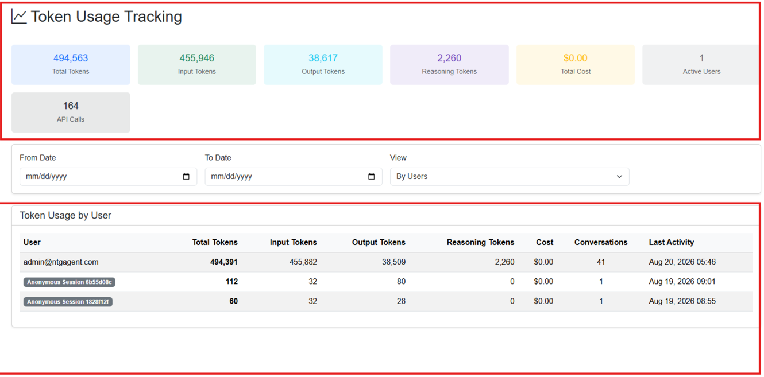
FEATURE
Staying in control
The features that decide whether something like this is allowed near real company data.
Who may use what. Each assistant is granted to specific groups of people. Someone without permission cannot open it — and cannot reach it indirectly through another assistant either.
What everything costs. Every request records its usage against a user, including visitors who are not signed in. Administrators see the totals.
Limits for the public. If an assistant is opened to the internet, unregistered visitors get a capped number of messages.
Safe by default. Uploaded skill packs are checked before they are accepted, and can only be uploaded by an administrator.
Usage and cost per user, including anonymous visitors.
Notes:
CONTROL (8:30-9:05)
"Last design slide, and it's the unglamorous one that decides whether a company will actually allow
this near real data.
Who may use what — each assistant is granted to specific groups, and someone without permission can't
reach it, including indirectly by asking another assistant to fetch it for them.
What it costs — every request is recorded against a user. That's the dashboard on the right, and it
includes visitors who never signed in.
Limits for the public, if an assistant is opened to the internet.
And uploaded skill packs get checked before they're accepted, and only administrators can upload them.
Remember the comparison table — this whole column was missing from every product we looked at."
~35s.

Slide 17
4
Live demonstration
The working system, running online
Notes:
DIVIDER — 3 seconds. Switch inputs NOW while this is up.

Slide 18
DEMONSTRATION
What you are about to see
Six steps, about four minutes, on the deployed system. Each one is a feature from the last few slides.
 | On screen | The feature it shows
1 | Signing in to the live, hosted application | It is deployed and running, not a laptop build
2 | Creating an assistant — name, model, instructions | Setting one up without code (slide 13)
3 | Its tools, its permissions, and its specialists | Capability and delegation are settings, not code
4 | The same question to two assistants — one has the document | Answers from your documents, with the source (slide 14)
5 | A help desk with no documents, asked a question spanning two departments | It routes to two specialists and combines their answers
6 | Asking it to plan a trip | Replying with a working form instead of text (slide 15)
Notes:
DEMO HANDOFF (9:08-9:25) then LIVE 9:25-13:00
"Rather than talk about it any longer, let me show you. It's deployed and online, so this is the real
thing. Six steps, about four minutes, and each one is a feature I've just described."
───── PRE-FLIGHT, BEFORE YOU RECORD ─────
□ Open and sign in to every tab in advance — chat app, admin console, interactive client.
Never sign in on camera.
□ Check the trip-planning skill is SWITCHED ON for the demo assistant (Tools → Skills → Save).
□ Check HR Lookup and Expense Lookup are bound as inner agents of the help desk —
the Agent Dashboard should show Inner Agents = 2.
□ Check the document shows Uploaded, not Processing.
□ Start a fresh conversation so the sidebar isn't full of old trip plans.
□ Have slide 24 open in a background tab as a fallback.
───── IF SOMETHING STALLS ─────
Steps 4, 5 and 6 need a live AI response. If any of them hangs for more than about eight seconds,
say "I have this captured" and go to the slide that shows it — 14 for documents, 15 for the trip
form. Do not debug on camera.
Step 5 is the one most likely to misbehave: the help desk has to decide to call BOTH specialists
and sometimes calls only one. Rehearse it at least three times. If it asks only one on the day,
say so and ask the follow-up out loud — recovering gracefully reads better than pretending.
Behind schedule? Shorten step 2. Never drop step 5 or 6.
THE SILENT FAILURE: a skill or tool that is uploaded but not switched on for this assistant
produces no error at all — the assistant just replies in plain text as if the feature didn't exist.

Slide 19
5
Progress and next steps
What is working today, what changed along the way, and what remains
Notes:
DIVIDER — 3 seconds. Breathe before you speak.

Slide 20
PROGRESS
What is working today
Every item below is in the deployed system — not planned, not partial.
Assistants built in a browser — model, instructions, documents, tools, permissions
Five AI providers — switchable per assistant from a dropdown
Answers from uploaded documents with the source shown
A separate knowledge base per assistant
Live tools — weather and web search, over one standard connector
Assistants that call other assistants for specialist work
Replies as working forms and cards
Memory across conversations, switchable by the user
Access control by user group
Usage and cost tracking per person
Conversation sharing, file upload, themes
Limits for unregistered visitors
500
288
9
5
automated tests
reviewed changes merged
services running together
AI providers supported
Notes:
DELIVERED (13:00-13:25)
"Coming back from the demo — this is everything that works today. Not planned, not partial. In the
deployed system.
I won't read the list. The short version is that all six things I promised on slide 5 are working,
plus the control features.
And underneath: five hundred automated tests, two hundred and eighty-eight reviewed changes merged,
nine services running together, five AI providers."
~25s. Do NOT read the lists — gesture at them and give the four numbers.

Slide 21
PROGRESS
What we promised, and what we actually did
The five things our project proposal committed to, scored honestly.
What we promised | Status | What happened
Better document search, including relationship-aware search | Done, differently | We adopted an existing open-source search engine instead of building our own. Less code, and it is what let us give every assistant its own separate knowledge base.
A four-layer memory system | Half done | Memory across conversations works, and so does keeping recent messages in focus. Two of the four planned layers were not built.
Assistants that work as a team, with a planner handing out tasks | Done, differently | We let an assistant call another assistant directly, as a tool. Simpler, and it removed a whole layer we would have had to maintain.
A recorded, auditable trail of assistants talking to each other | Not done | Assistants do hand work to each other, but it is not written to a permanent audit log. This is the clearest thing we did not finish.
Replies that show the assistant's thinking and can include components | Done, and more | Thinking is shown live. We went further than planned and built full interactive forms, plus uploadable skill packs — neither was in the original scope.
Also built, and never promised: access control, cost tracking, uploadable skill packs, provider management, and limits for public visitors.
Notes:
PROMISED VS DELIVERED (13:25-14:00) — the slide that earns credibility
"I want to be straight about our proposal, because three of our five promises didn't land the way we
wrote them.
Better document search — done, but by adopting an existing open-source engine rather than building
our own. Less code, and it's what made a separate knowledge base per assistant practical.
Four-layer memory — half. Memory across conversations works. Two of the four layers don't exist, and
I'm not going to claim they do.
Team-working assistants — done, differently. Instead of a planner handing out tasks, we let one
assistant call another directly. Simpler, and one less thing to maintain.
The audit trail — not done. They do hand work to each other, but it isn't permanently recorded.
That's the clearest thing we didn't finish.
And the last one we overshot — we went past showing thinking to full interactive forms and uploadable
skill packs, neither of which was in scope.
Plus, at the bottom, several things we built that were never promised at all."
~35s. If asked why you changed: we followed what we learned, and we wrote it down.

Slide 22
PROGRESS
What comes next
In priority order, if the project continued.
Measure the answer quality. We set a target for how often answers stay faithful to the source documents, and have not yet run a formal test against it. This is the first thing we would do.
Record the audit trail. Make assistant-to-assistant handovers permanently logged, as promised.
Finish the memory layers. Summaries of past conversations, and knowledge shared across users.
Version the skill packs. Re-uploading one currently replaces it with no history and no warning.
Tidy the developer setup. A new contributor cannot yet start the whole system with one command.
Harden the public edges. Uploaded packs are checked, but instructions hidden inside them remain an accepted risk we document rather than claim to have solved.
Notes:
NEXT (14:00-14:15) — compress to 10s if needed
"Briefly, what's next, in order.
The first one is the one I'd flag to an examiner. We set a target in our proposal for how often
answers stay faithful to the source documents, and we have not yet run a formal test against it.
Measuring that is the next thing we do.
Then the audit trail we didn't finish, the two missing memory layers, versioning for skill packs, and
tidying up the developer setup.
We would rather be asked about these than found out on them."
~15s. Don't linger.

Slide 23
Thank you — questions
Three things worth taking away
You set an assistant up, you don't build one. Model, documents, tools and permissions are all settings in a browser.
It answers from your documents, and shows you where from. And each assistant is limited to its own.
It can reply with something you can use. A working form, not a paragraph describing one.
Open source · github.com/nashtech-garage/ntg-agent Team QUOTA · NashTech · RMIT Capstone 2026
Notes:
CLOSE (14:15-14:30) — aim to be here by 12:40 so Q&A starts on time
"I'll stop there. Three things worth taking away: you set an assistant up rather than build one; it
answers from your documents and shows you where the answer came from; and it can reply with something
you can actually use.
It's open source, the link is on screen. Happy to take questions."
─── LIKELY QUESTIONS ───
Q: How is this different from ChatGPT?
A: ChatGPT is one assistant owned by someone else. This is a platform where your organisation creates
its own assistants, on its own documents, with its own permissions, on whichever AI provider it
chooses — and can see what each one costs.
Q: Why not just use LangChain or AutoGen?
A: Slide 9. They're Python, and NashTech and its clients are .NET. And none of them gave us
permissions or cost tracking, which is most of what a company actually needs to approve it.
Q: How do you stop it making things up?
A: Slide 14 — it answers from the uploaded documents and shows the source, and when it has nothing it
says so rather than guessing. We haven't yet measured how often that holds, and that's the top of
our next-steps list.
Q: Can one assistant see another's documents?
A: No. Each has its own separate knowledge base — that's the left-hand side of slide 14.
Q: What was the hardest part?
A: Deciding what NOT to build. Three of our five proposal promises changed once we understood the
problem better, and slide 21 is us being honest about that.

Slide 24
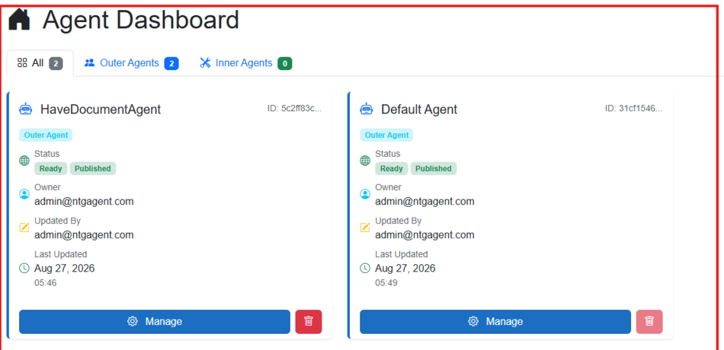
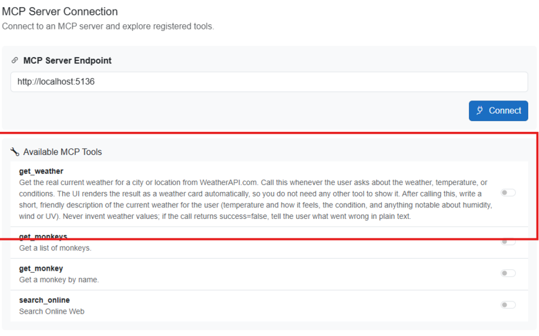
APPENDIX
Demo fallback — the admin console
If a setup screen will not load during the demo, use these.
The list of assistants — each with its status, owner and last change.
Tools — each one is a switch, per assistant. Off means that assistant simply does not have it.
Notes:
APPENDIX — not presented.
Use if step 2 or 3 of the demo won't load. The right-hand picture is also the answer to
"how does an assistant get a tool?" — it's a switch, per assistant.

Slide 25
APPENDIX
References (1 of 2)
IEEE style, as submitted in our capstone project proposal.
[1] P. Lewis et al., “Retrieval-Augmented Generation for Knowledge-Intensive NLP Tasks,” in Proc. NeurIPS, vol. 33, pp. 9459–9471, 2020.
[2] K. Shuster et al., “Retrieval Augmentation Reduces Hallucination in Conversation,” arXiv:2104.07567, 2021.
[3] Y. Gao et al., “Retrieval-Augmented Generation for Large Language Models: A Survey,” arXiv:2312.10997, 2024.
[4] Microsoft, “Single agent vs. multiple agents,” Microsoft Learn.
[5] Microsoft, “Agent handoff,” Microsoft Learn, Agent Framework workflows.
[6] “Manager–worker communication patterns,” Level Up – GitConnected.
[7] Anthropic, “Introduction,” Model Context Protocol documentation.
[8] Z. Zhang et al., “A Survey on the Memory Mechanism of Large Language Model-based Agents,” arXiv:2404.13501, 2024.
[9] H. Liu et al., “From Human Memory to AI Memory: A Survey on Memory Mechanisms in the Era of LLMs,” arXiv, 2024.
[10] C. Packer et al., “MemGPT: Towards LLMs as Operating Systems,” arXiv:2310.08560, 2023.
[11] J. S. Park et al., “Generative Agents: Interactive Simulacra of Human Behavior,” in Proc. ACM UIST, 2023, pp. 1–22.
[12] Y. Wu et al., “Memory for Autonomous LLM Agents: Mechanisms, Evaluation, and Emerging Frontiers,” arXiv:2603.07670, 2025.
Notes:
APPENDIX — not presented. Jump here only if a reference is challenged in Q&A.

Slide 26
APPENDIX
References (2 of 2)
[13] R. Wang et al., “Rethinking Memory in LLM-based Agents: Representations, Operations, and Emerging Topics,” arXiv, 2024.
[14] NashTech Garage, “NTG.Agent.Orchestrator,” GitHub, 2026.
[15] T. Schick et al., “Toolformer: Language Models Can Teach Themselves to Use Tools,” in Proc. NeurIPS, vol. 36, 2023.
[16] Anthropic, “Introducing the Model Context Protocol,” Anthropic Blog, Nov. 2024.
[17] Anthropic, “Model Context Protocol Specification,” 2025.
[18] NashTech Garage, “NTG-Agent source code and DeepWiki documentation,” 2026.
[19] “MCPTox: A Benchmark for Tool Poisoning Attack on Real-World MCP Servers,” arXiv, 2025.
[20] “MCPSecBench: A Systematic Security Benchmark and Playground for Testing Model Context Protocols,” arXiv, 2025.
[21] OWASP, “OWASP Top 10 for Large Language Model Applications,” 2023.
[22] Q. Wu et al., “AutoGen: Enabling Next-Gen LLM Applications via Multi-Agent Conversation,” arXiv:2308.08155, 2023.
[23] L. Wang et al., “A Survey on Large Language Model based Autonomous Agents,” Front. Comput. Sci., vol. 18, no. 6, 2024.
Notes:
APPENDIX — not presented. Jump here only if a reference is challenged in Q&A.

