Slide 1
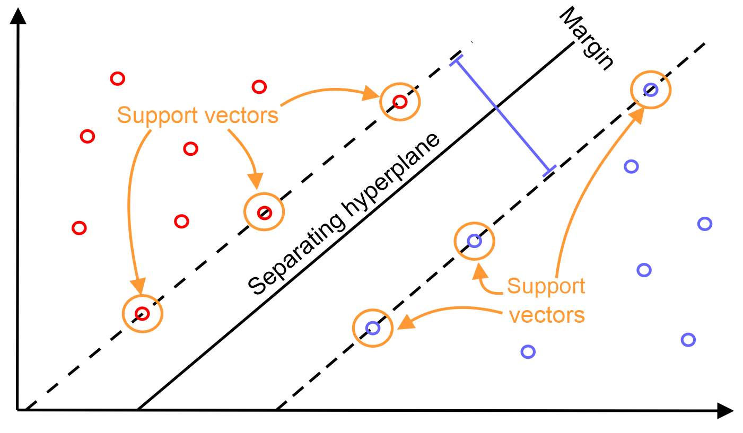
Support Vector Machines - SVMs
Group 1:
Nguyễn Lê Anh Quân
Nguyễn Khả Tiến
Nguyễn Trung Tuấn
Trịnh Nhật Tân

Slide 2
Content
Data source.
Test with imbalanced data.
Test with balanced data.
Visualize differences between 2 methods.
PCA
Visualize differences between 3 methods.
Conclusion.

Slide 3
Data source
https://www.kaggle.com/lowecoryr/universalbank
Predict customers that are able to accept a loan.

Slide 4
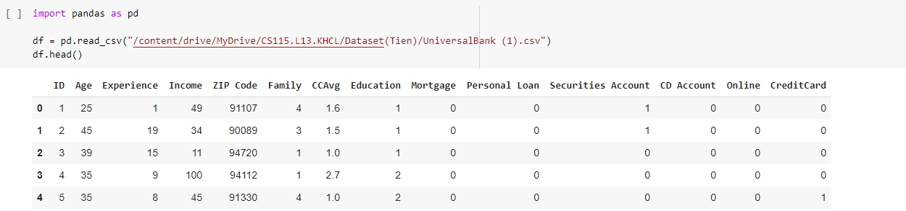
Data source
Analyze:

Slide 5
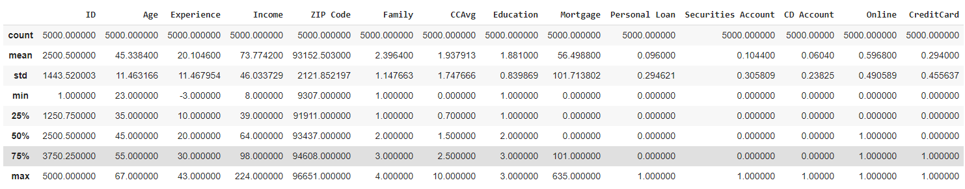
Data source
Analyze:

Slide 6
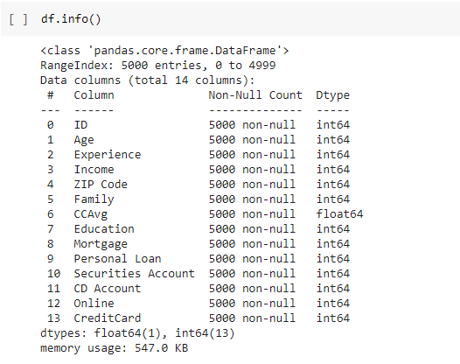
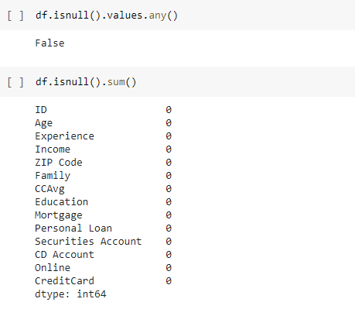
Data source
Analyze:

Slide 7
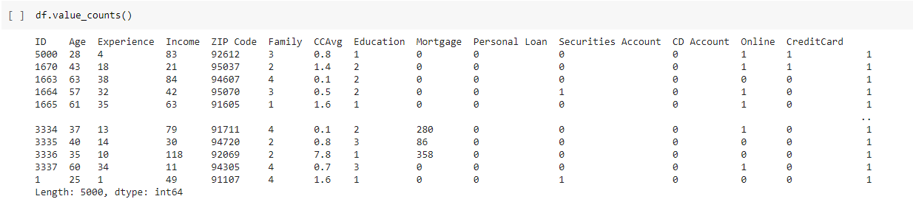
Data source
Analyze:

Slide 8
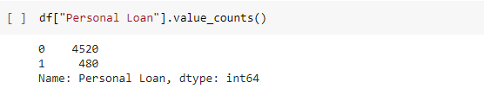
Data source
Analyze:

Slide 9
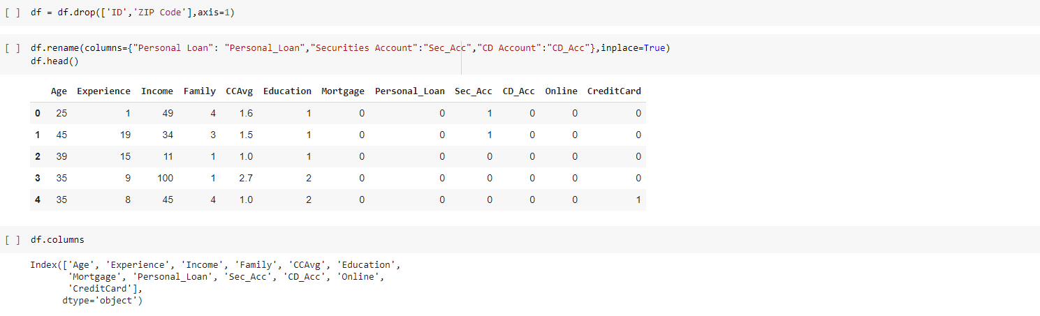
Data source
Analyze:

Slide 10
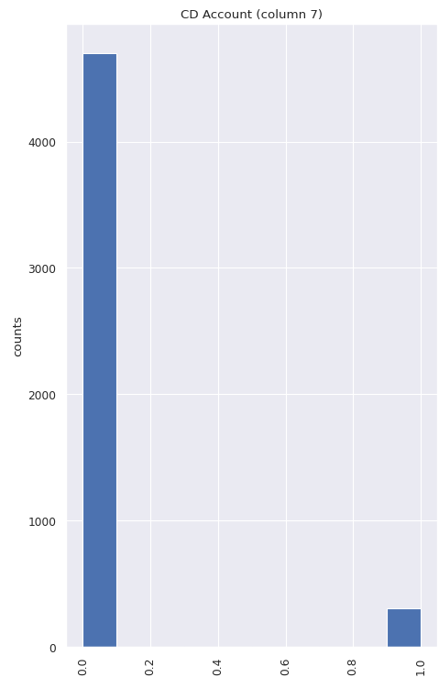
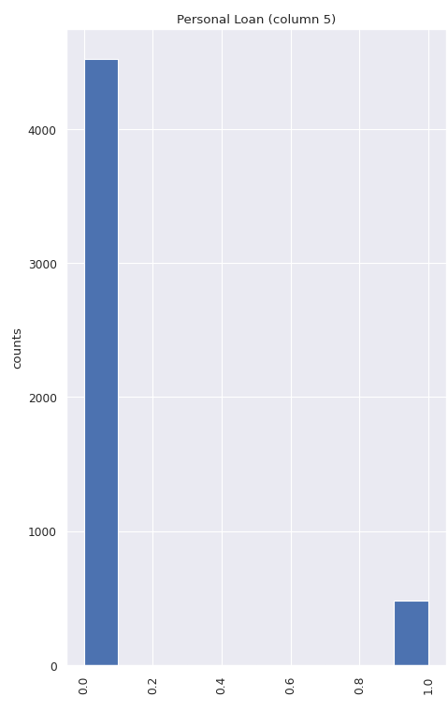
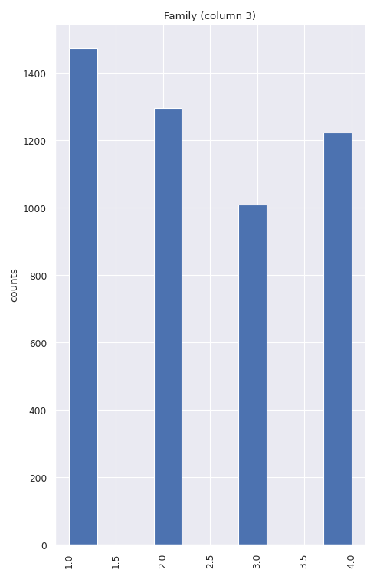
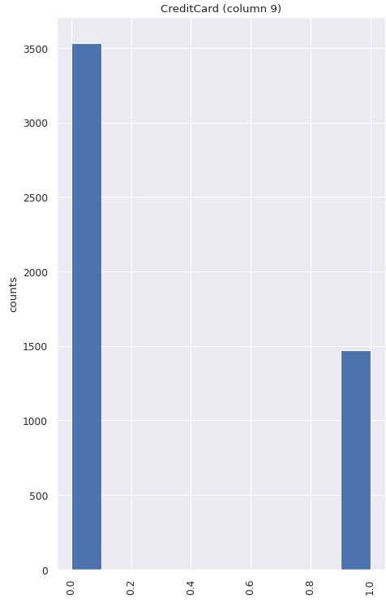
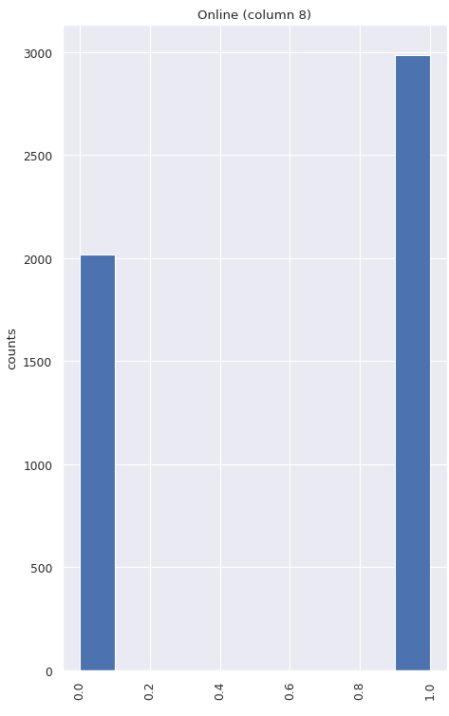
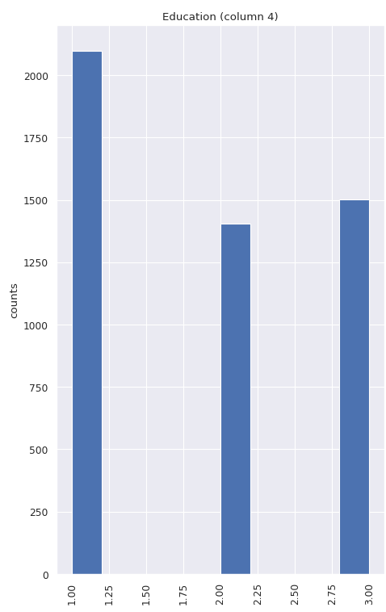
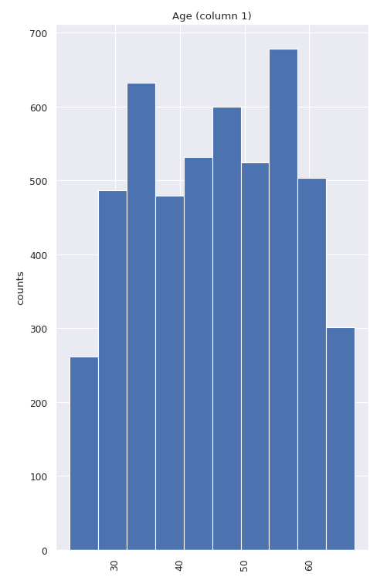
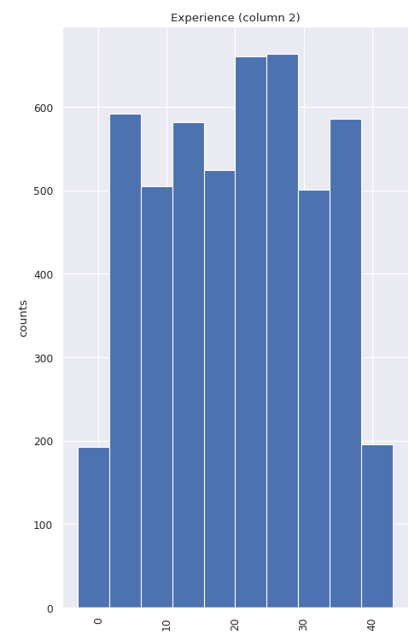
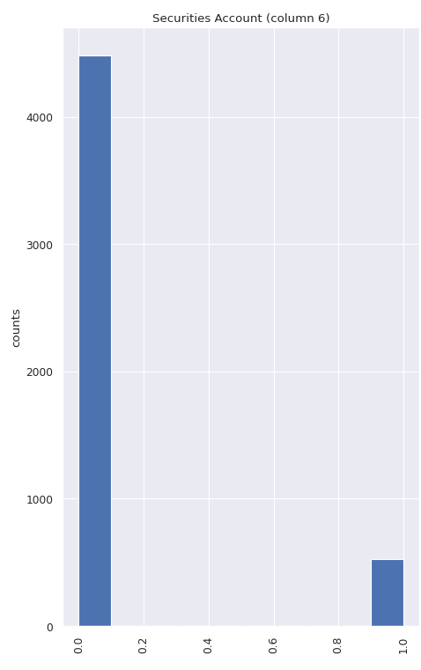
Data source
Visualize:

Slide 12
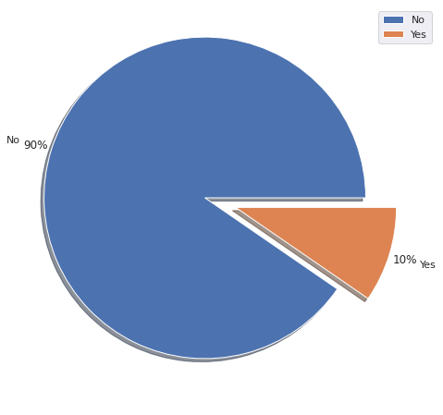
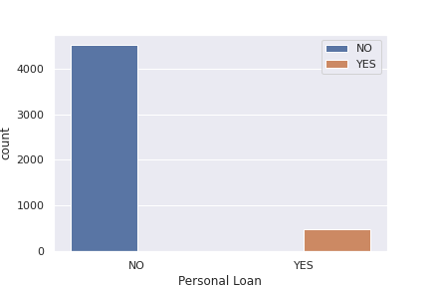
Notes:
Imbalanced data

Slide 13
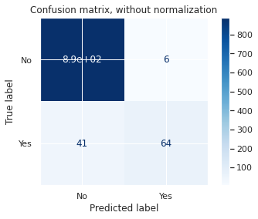
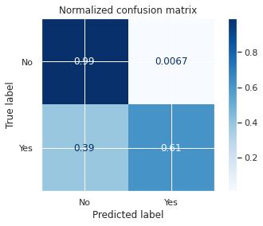
Test with imbalanced data
SVM Linear

Slide 14
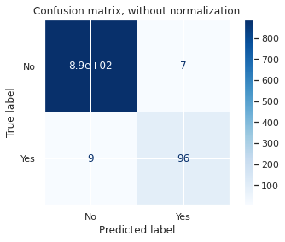
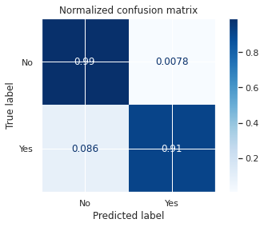
Test with imbalanced data
SVM Non-linear

Slide 15
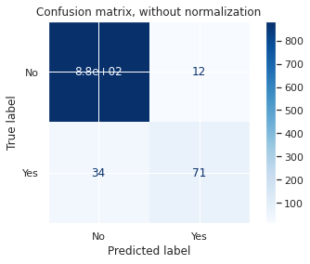
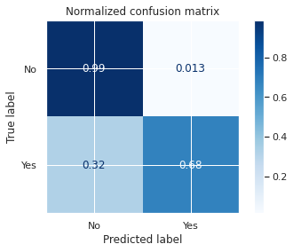
Test with imbalanced data
Logistic Regression

Slide 16
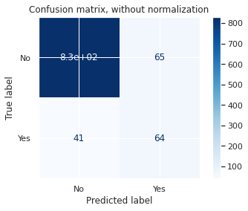
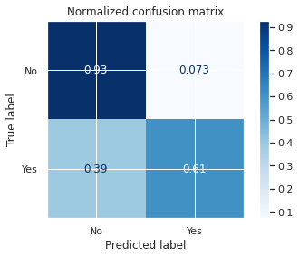
Test with imbalanced data
Naïve Bayes

Slide 17


Test with imbalanced data
Decision Tree

Slide 18
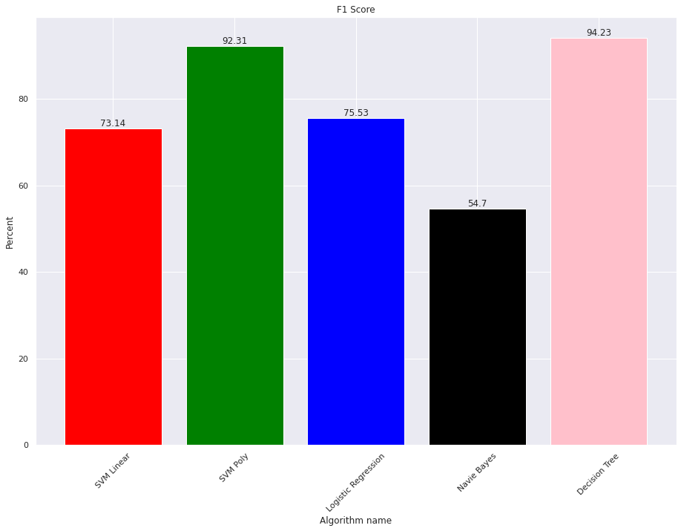
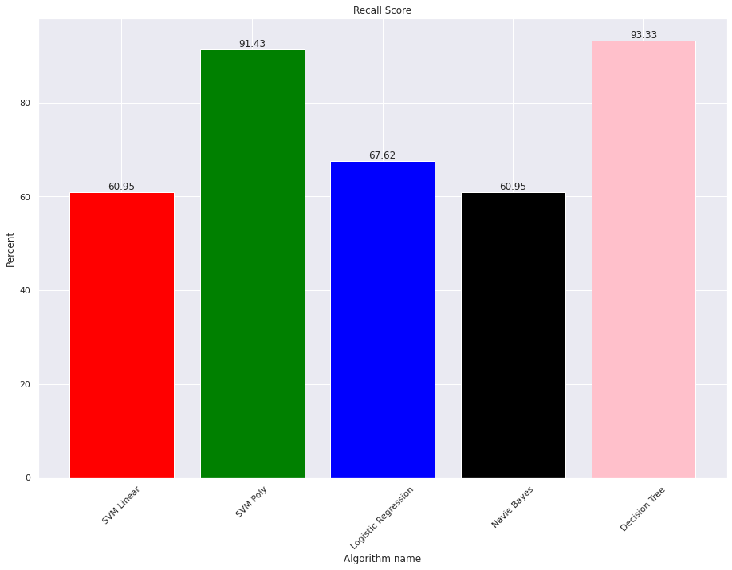
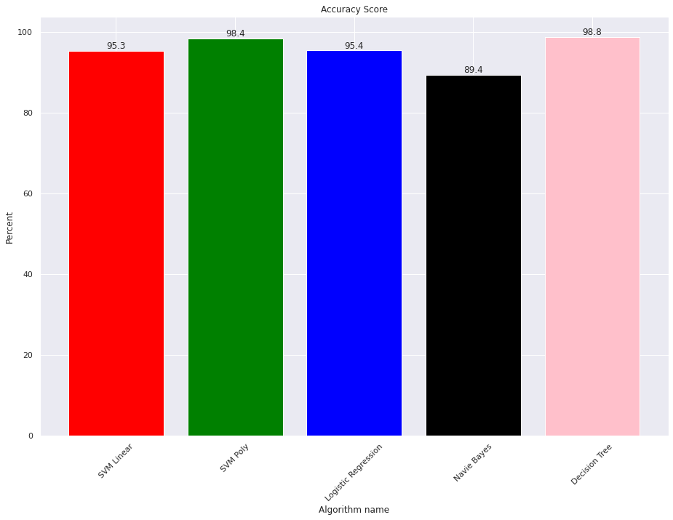
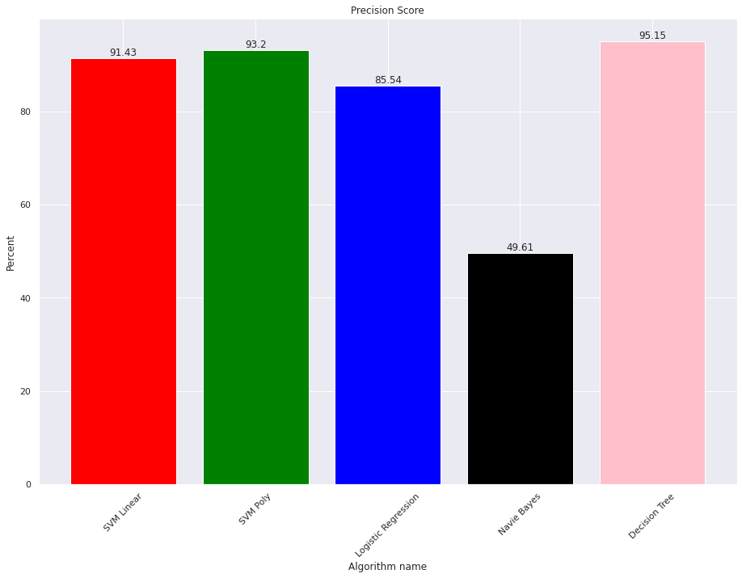
Test with imbalanced data
Result of imbalanced data:
Accuracy
Precision
Recall
F1 score

Slide 19
Test with imbalanced data
 | SVM Linear | SVM Non-linear | Logistic Regression | Naïve Bayes | Decision Tree
Accuracy | 95.3 | 98.4 | 95.4 | 89.4 | 98.8
Precision | 91.43 | 93.2 | 85.54 | 49.61 | 95.15
Recall | 60.95 | 91.43 | 67.62 | 60.95 | 93.33
F1 score | 73.14 | 92.31 | 75.53 | 54.7 | 94.23
Overall result with imbalanced data

Slide 20
Test with balanced data
 | SVM Linear | SVM Non-linear | Logistic Regression | Naïve Bayes | Decision Tree
Accuracy | 91.86 | 94.83 | 92.28 | 92.16 | 96.43
Precision | 87.89 | 93.16 | 88.91 | 89.44 | 95.23
Recall | 97.28 | 96.93 | 96.81 | 95.74 | 97.87
F1 score | 92.33 | 94.98 | 92.67 | 92.48 | 96.51
Overall result with balanced data

Slide 21
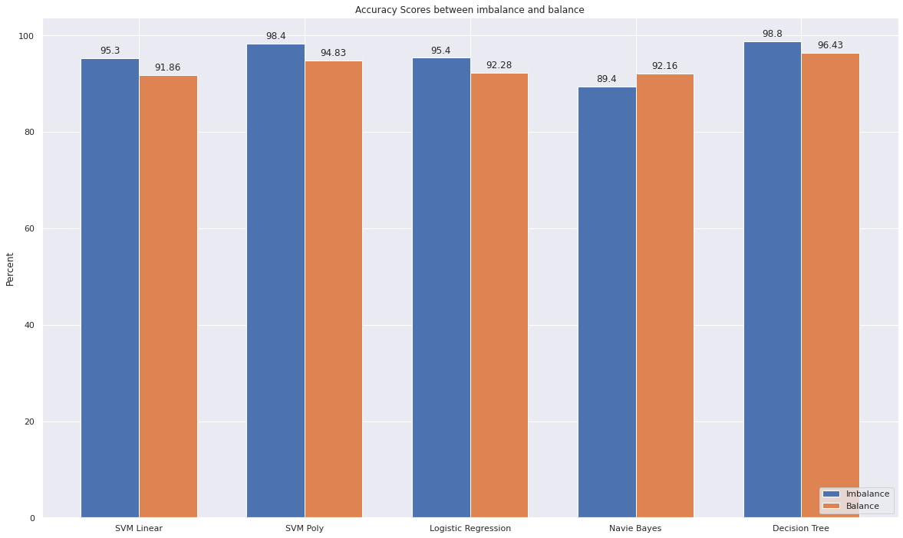
Visualize differences between 2 methods
Accuracy:

Slide 22
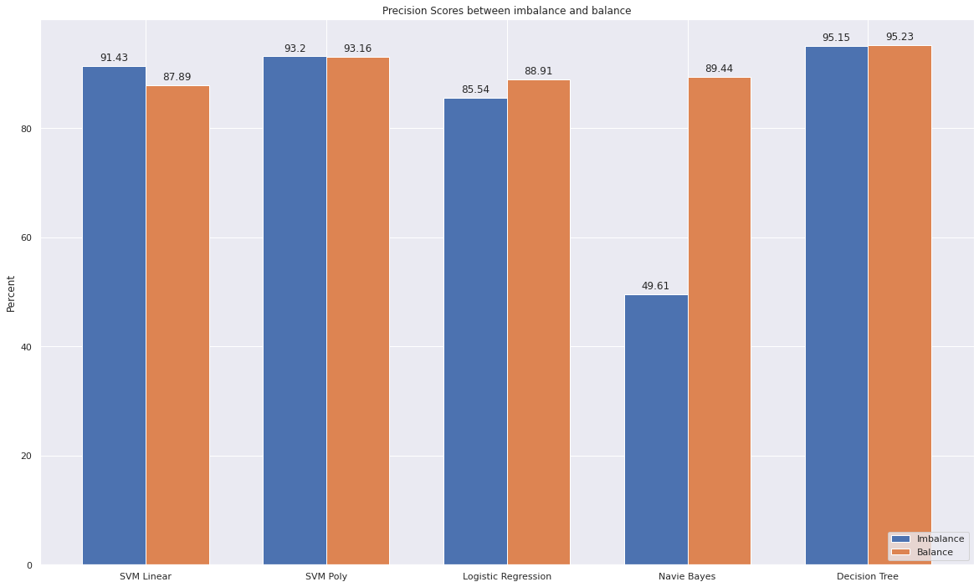
Visualize differences between 2 methods
Precision:

Slide 23
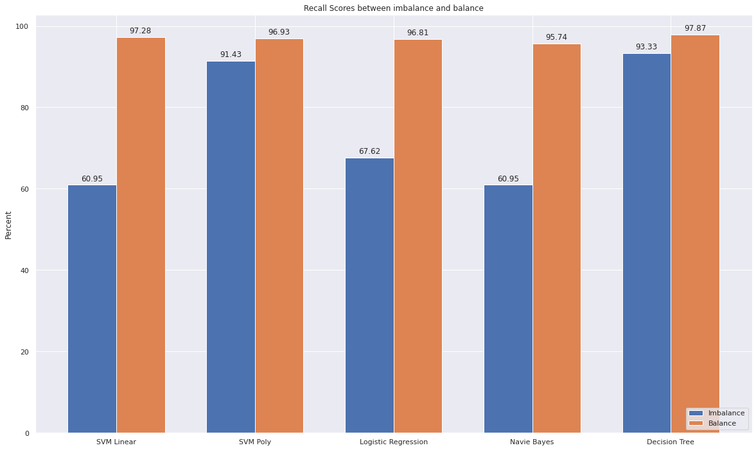
Visualize differences between 2 methods
Recall:

Slide 24
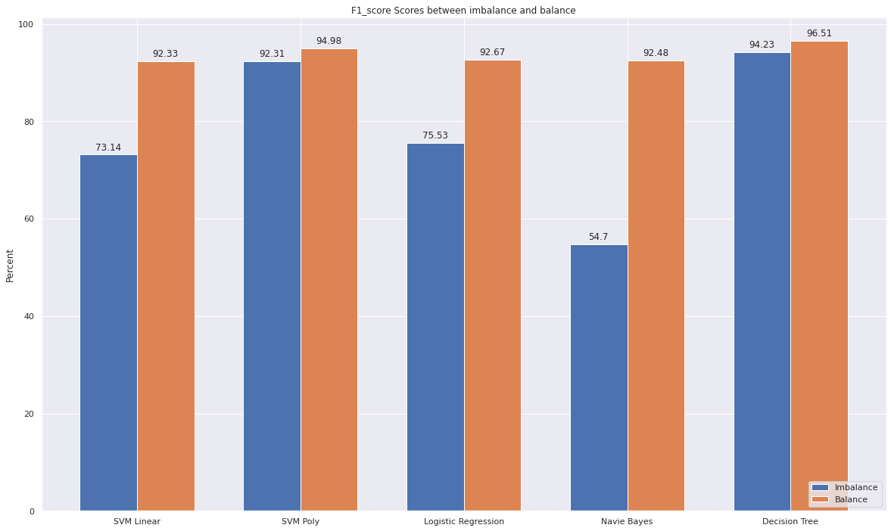
Visualize differences between 2 methods
F1 score:

Slide 25
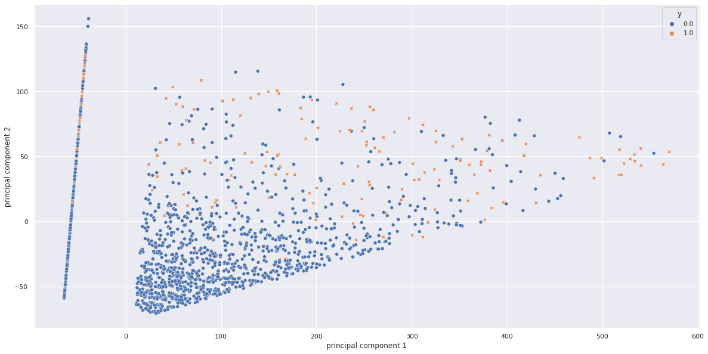
PCA
2D:

Slide 26
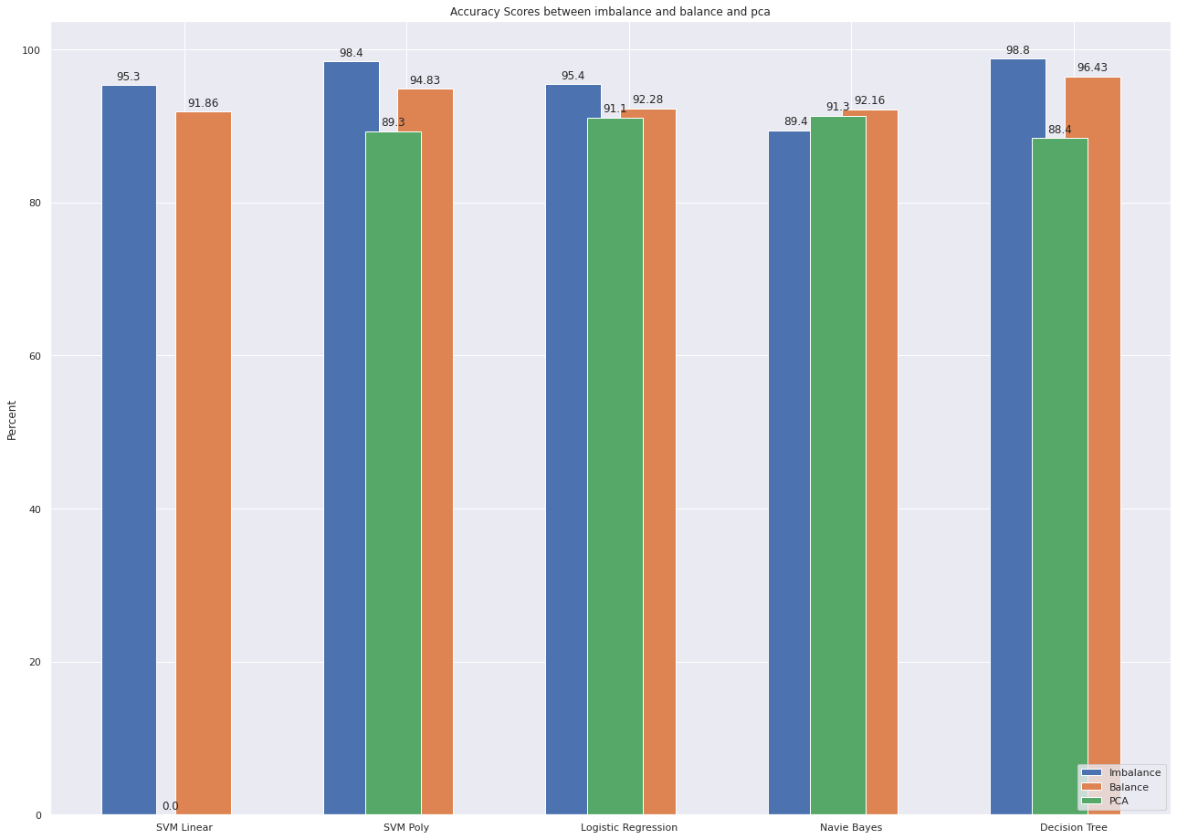
Visualize differences between 3 methods
Accuracy:

Slide 27
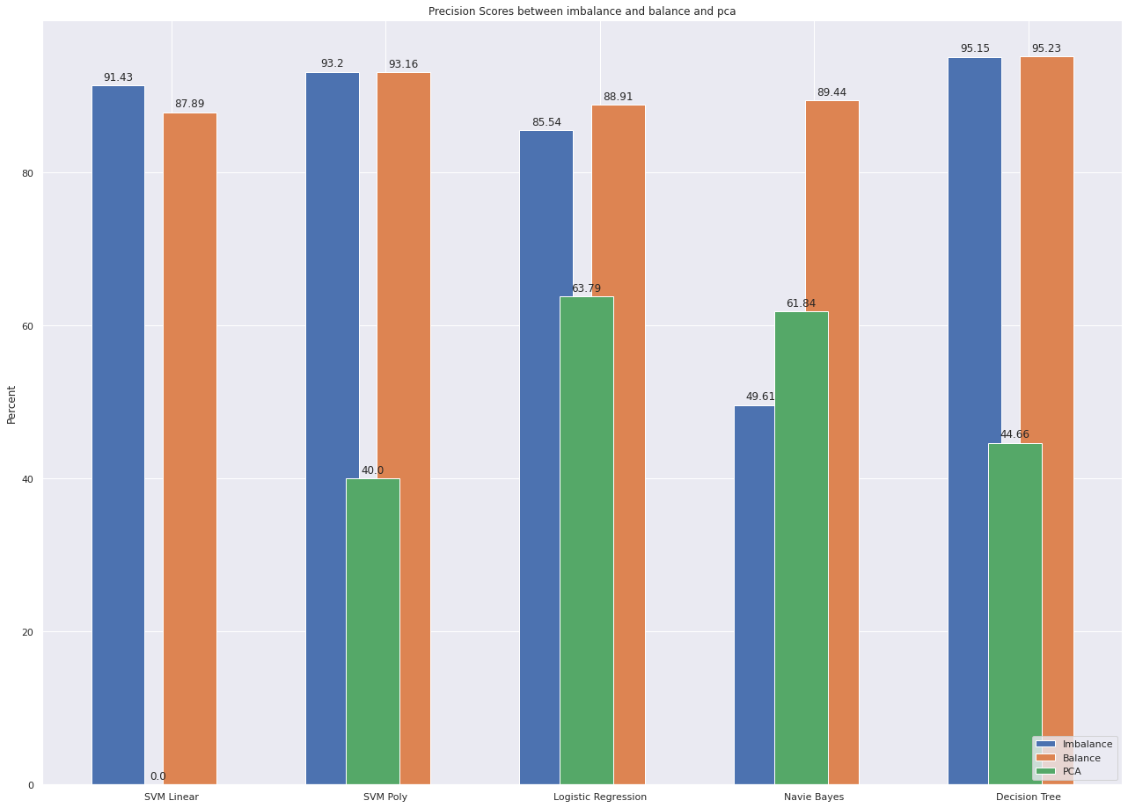
Visualize differences between 2 methods
Precision:

Slide 28
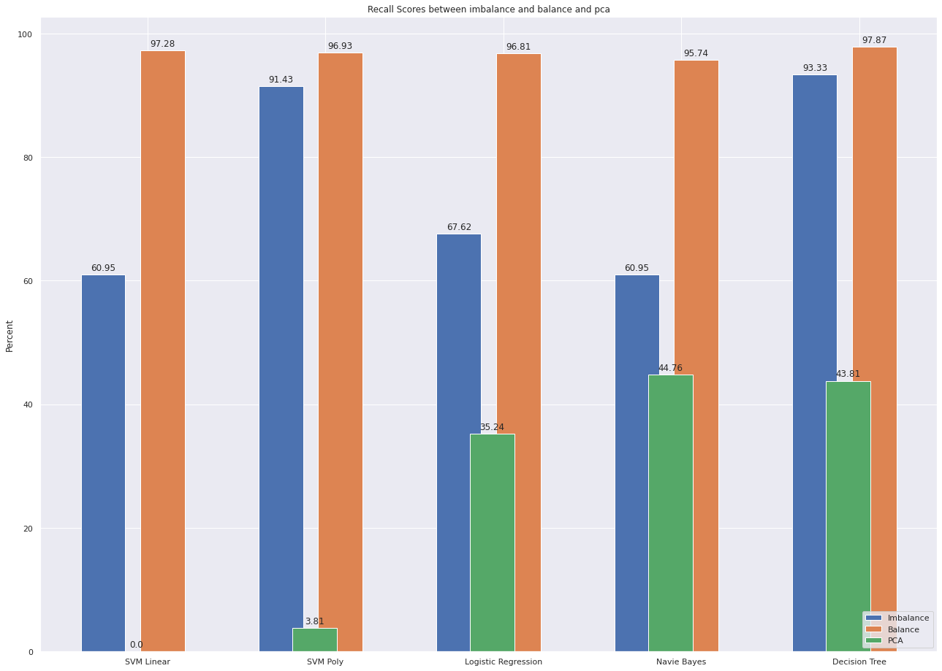
Visualize differences between 2 methods
Recall:

Slide 29
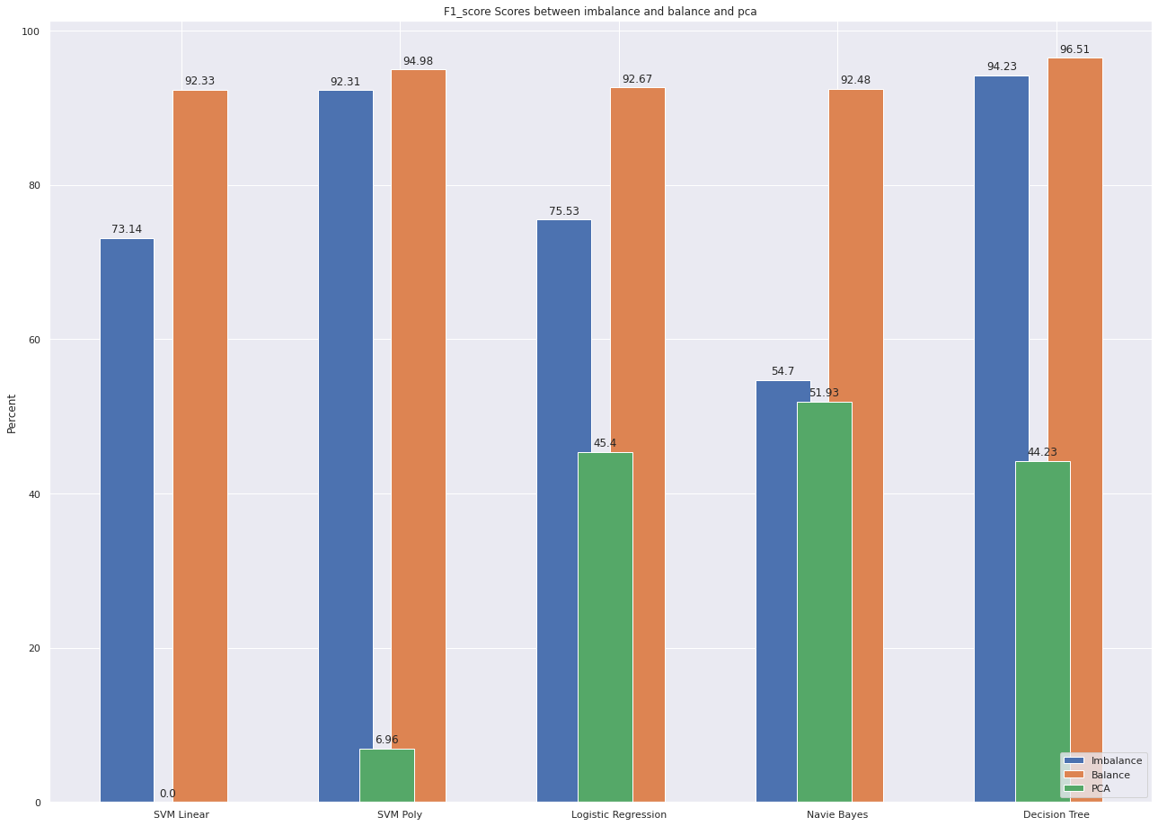
Visualize differences between 2 methods
F1 score:

Slide 30
Conclusion

