Slide 1
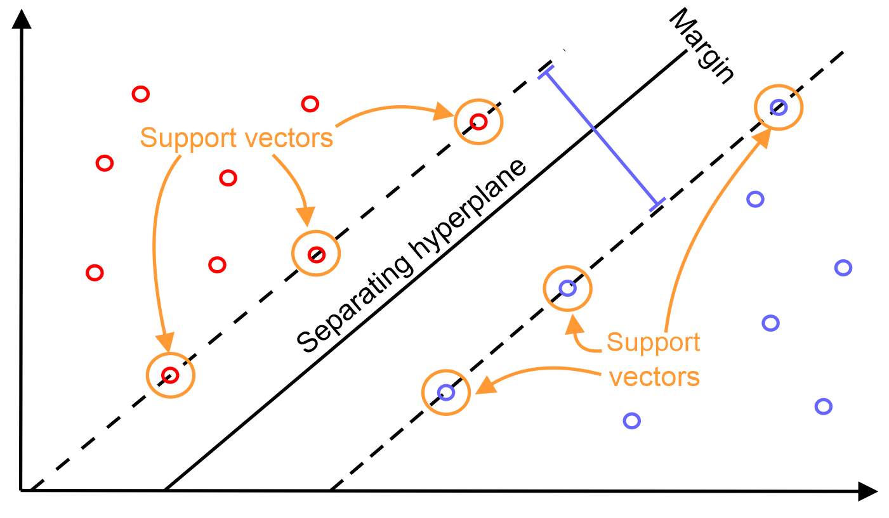
Support Vector Machines - SVMs
Group:

Slide 2
Content
Data source.
Test with imbalanced data.
Test with balanced data.
Visualize differences between 2 methods.
PCA
Visualize differences between 3 methods.
Conclusion.

Slide 3
Data source
https://www.kaggle.com/lowecoryr/universalbank
Predict customers that are able to accept a loan.

Slide 4
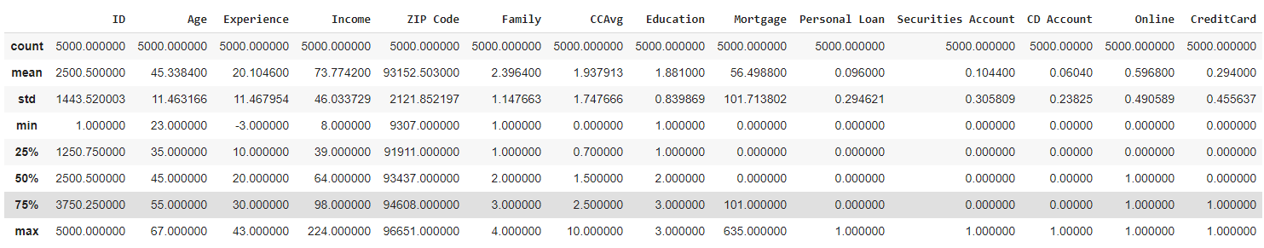
Data source
Analyze:

Slide 5
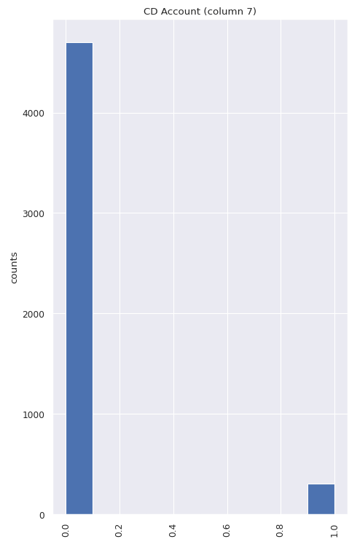
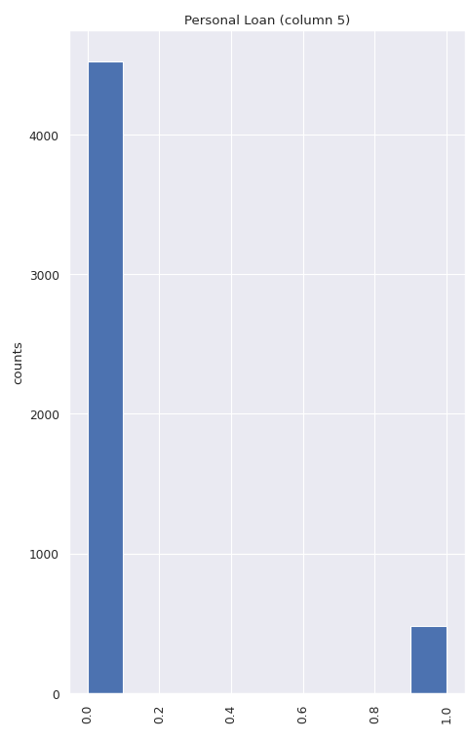
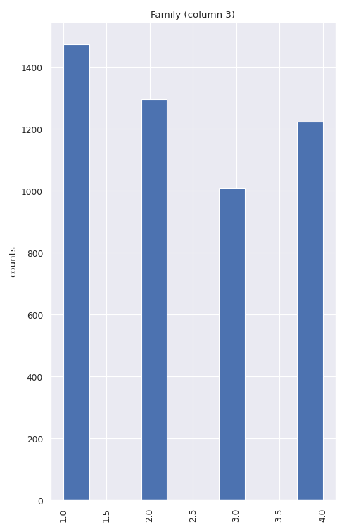
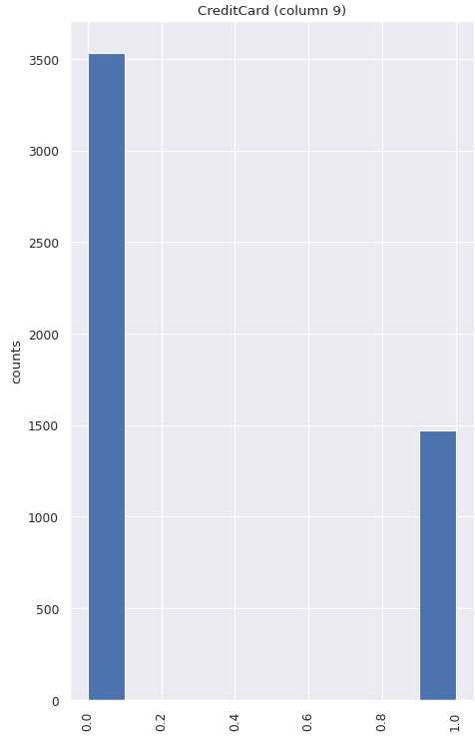
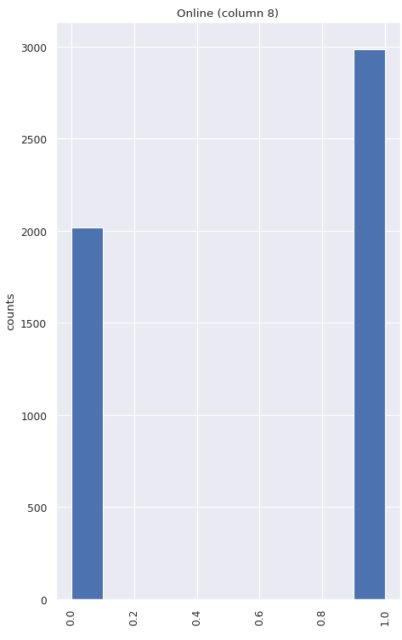
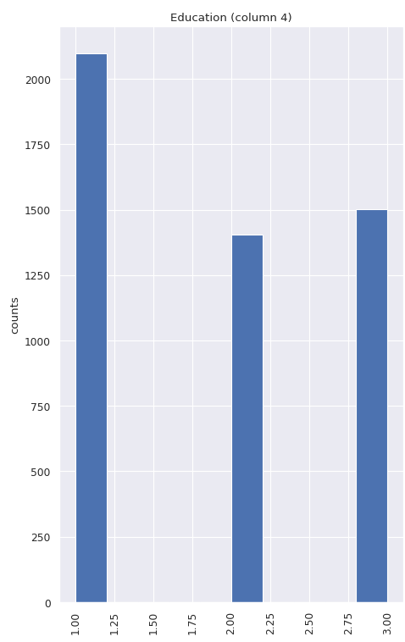
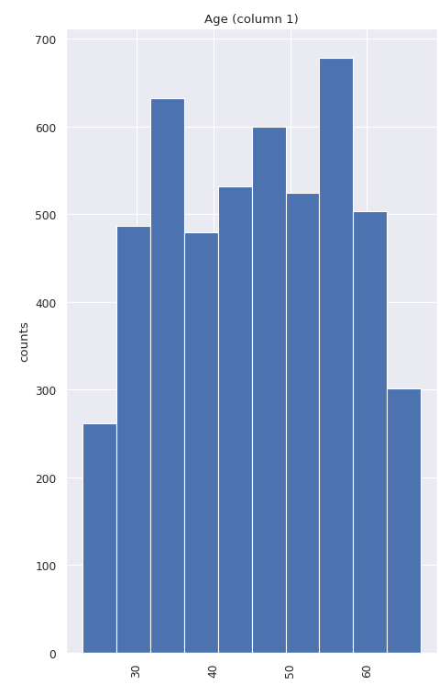
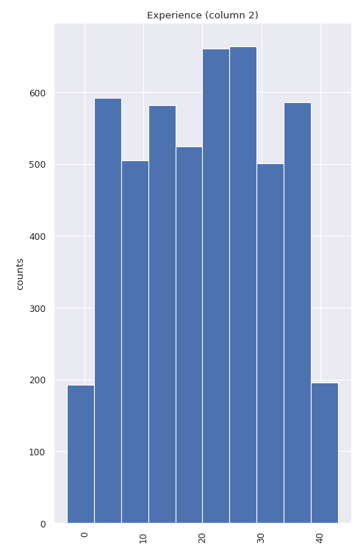
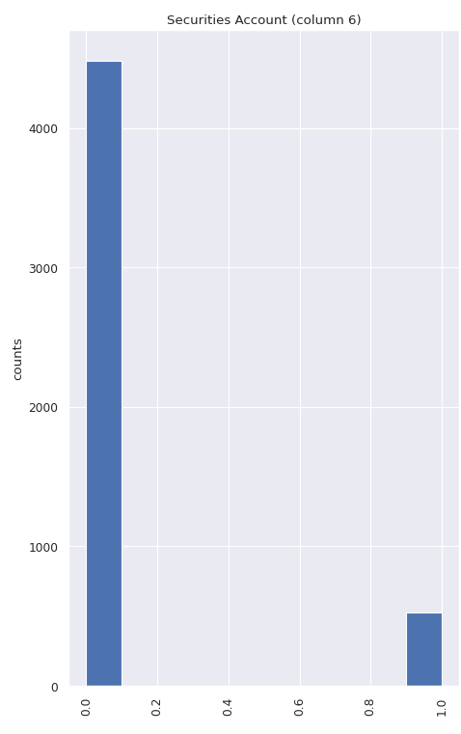
Data source
Visualize:

Slide 7
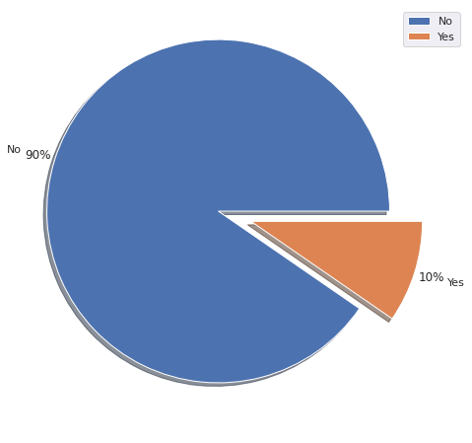
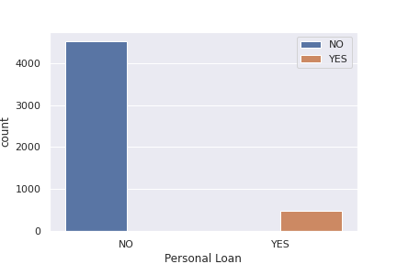
Notes:
Imbalanced data

Slide 8
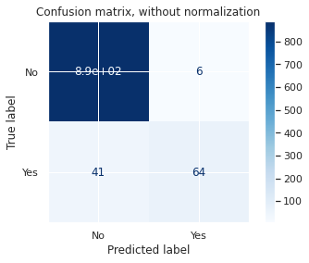
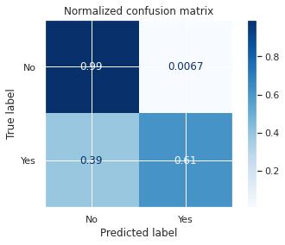
Test with imbalanced data
SVM Linear

Slide 9
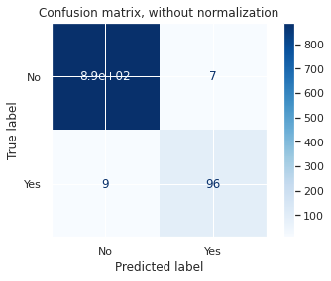
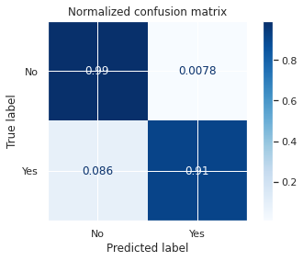
Test with imbalanced data
SVM Non-linear

Slide 10
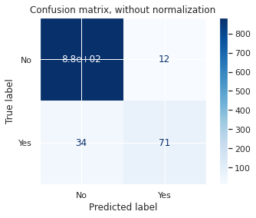
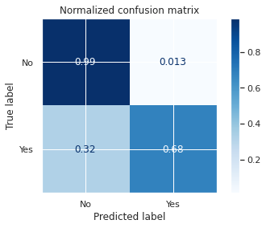
Test with imbalanced data
Logistic Regression

Slide 11
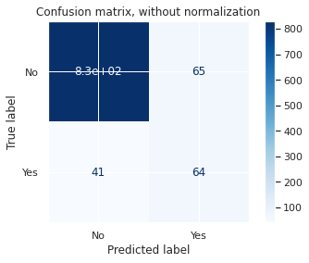
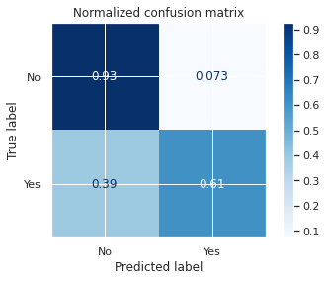
Test with imbalanced data
Naïve Bayes

Slide 12


Test with imbalanced data
Decision Tree

Slide 13
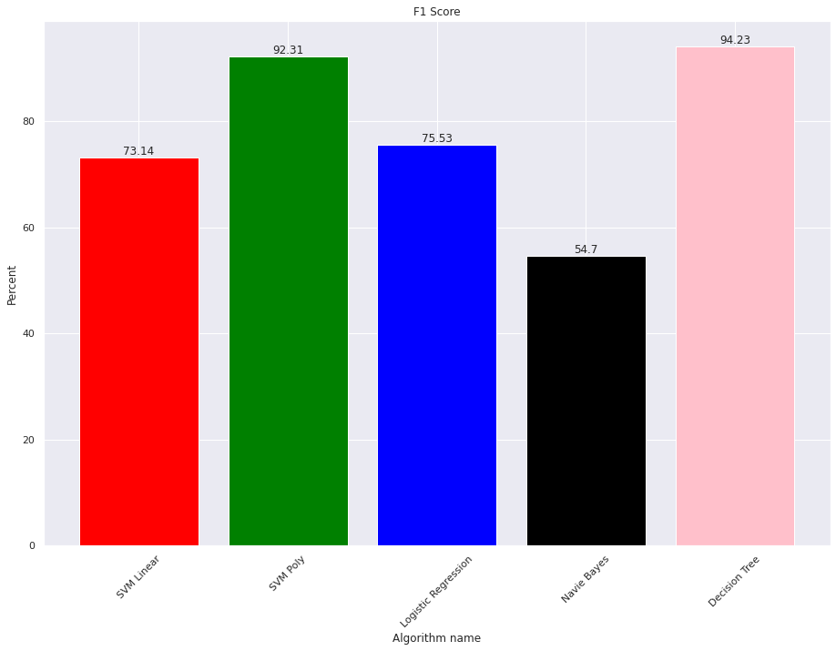
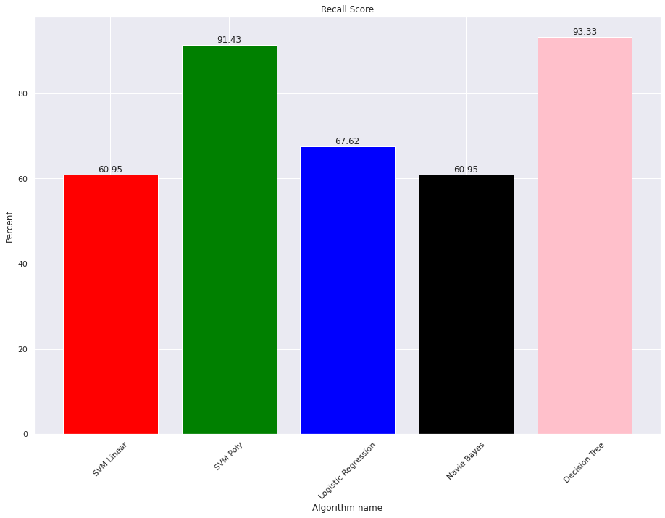
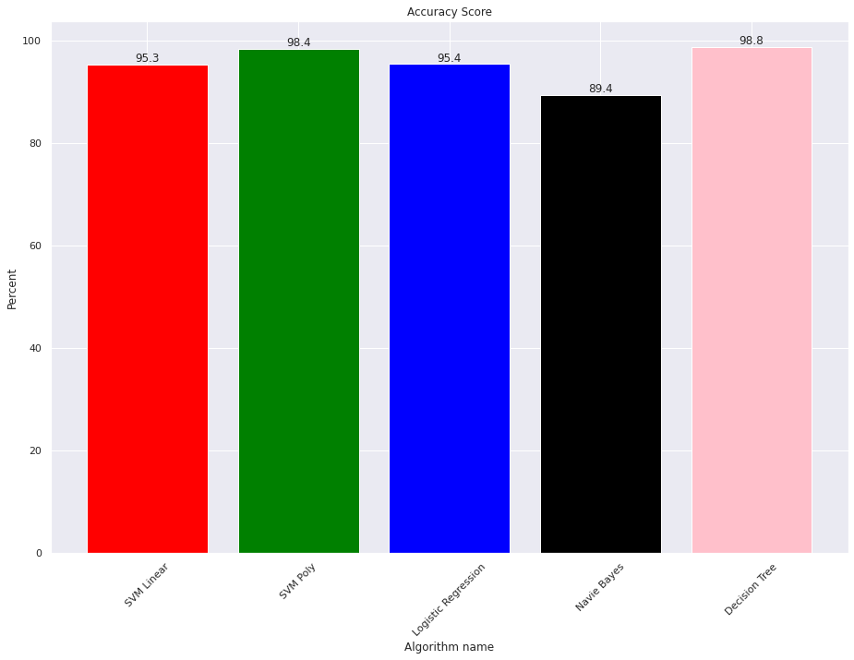
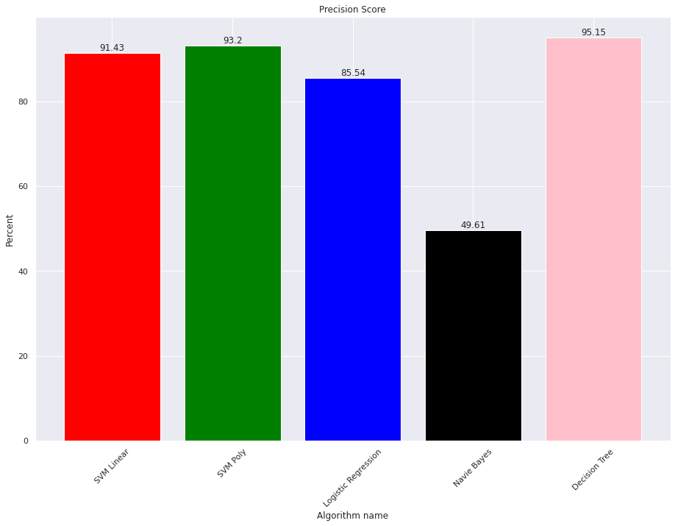
Test with imbalanced data

Slide 14
Test with imbalanced data
 | SVM Linear | SVM Non-linear | Logistic Regression | Naïve Bayes | Decision Tree
Accuracy | 95.3 | 98.4 | 95.4 | 89.4 | 98.8
Precision | 91.43 | 93.2 | 85.54 | 49.61 | 95.15
Recall | 60.95 | 91.43 | 67.62 | 60.95 | 93.33
F1 score | 73.14 | 92.31 | 75.53 | 54.7 | 94.23

Slide 15
Test with balanced data
 | SVM Linear | SVM Non-linear | Logistic Regression | Naïve Bayes | Decision Tree
Accuracy | 91.86 | 94.83 | 92.28 | 92.16 | 96.43
Precision | 87.89 | 93.16 | 88.91 | 89.44 | 95.23
Recall | 97.28 | 96.93 | 96.81 | 95.74 | 97.87
F1 score | 92.33 | 94.98 | 92.67 | 92.48 | 96.51

Slide 16
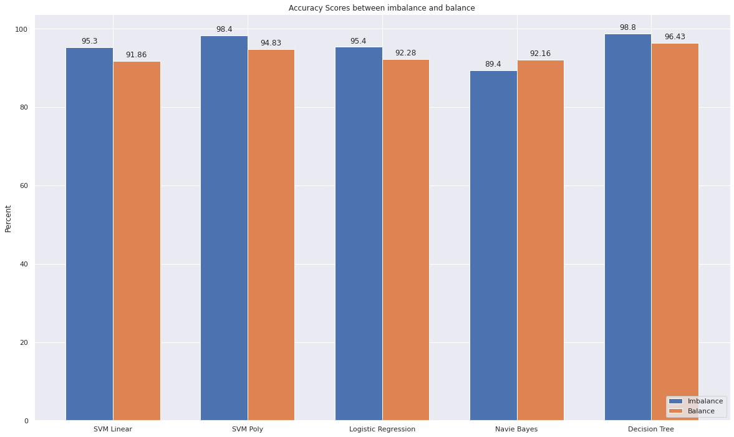
Visualize differences between 2 methods
Accuracy:

Slide 17
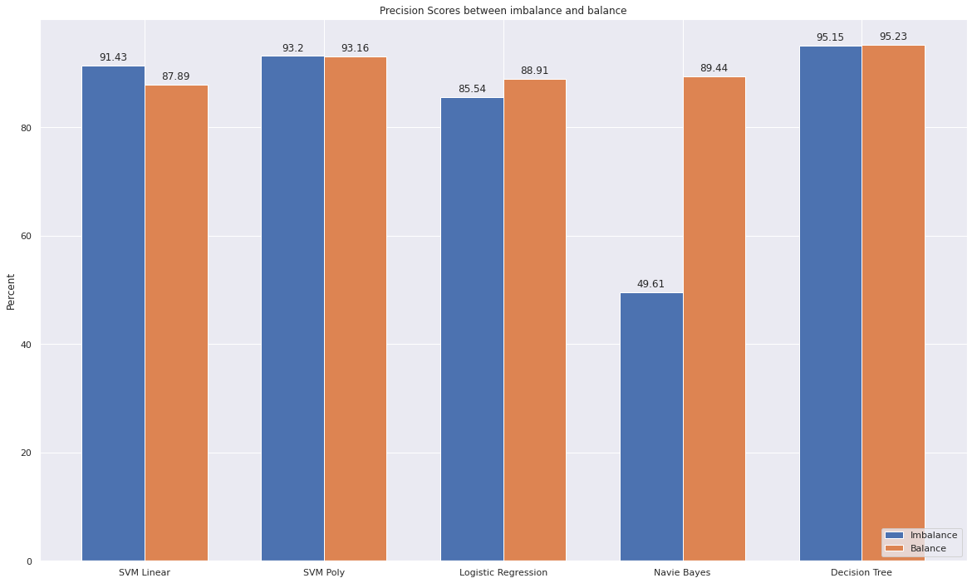
Visualize differences between 2 methods
Precision:

Slide 18
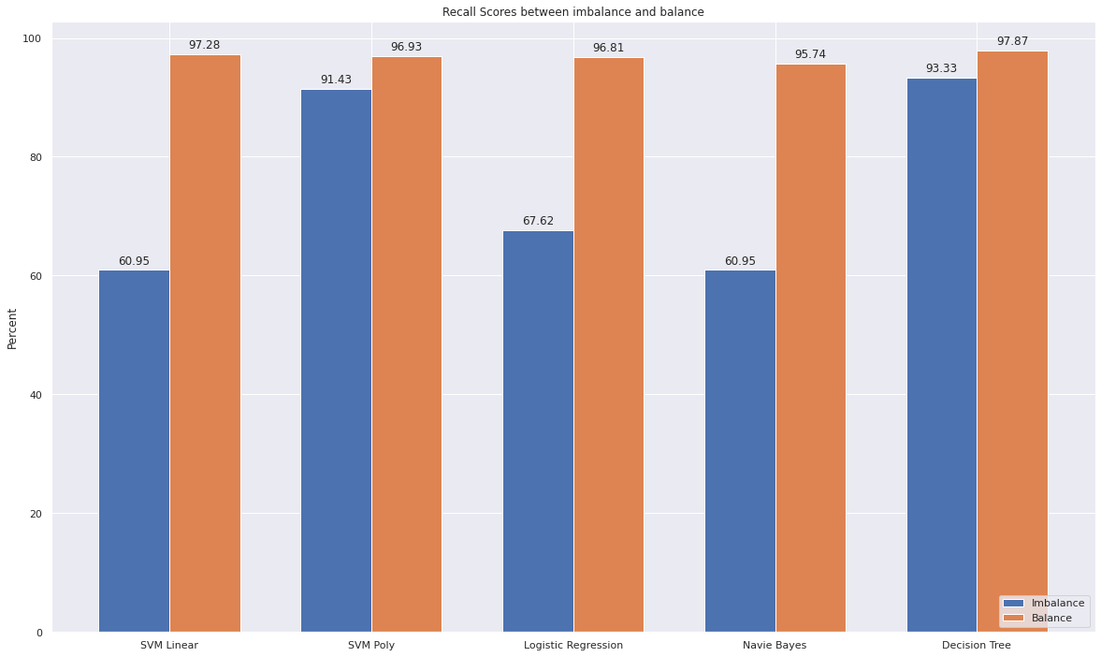
Visualize differences between 2 methods
Recall:

Slide 19
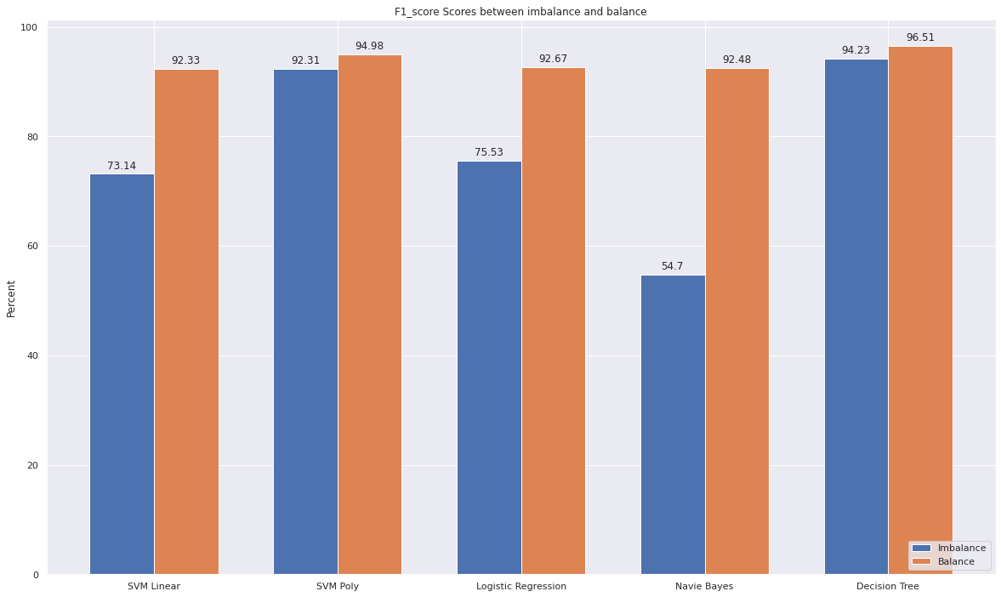
Visualize differences between 2 methods
F1 score:

Slide 20
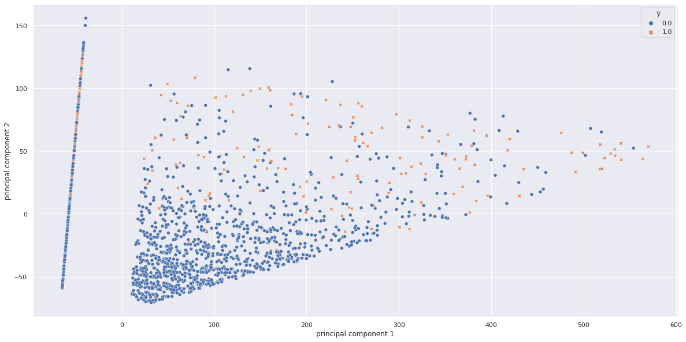
PCA
2D:

Slide 21
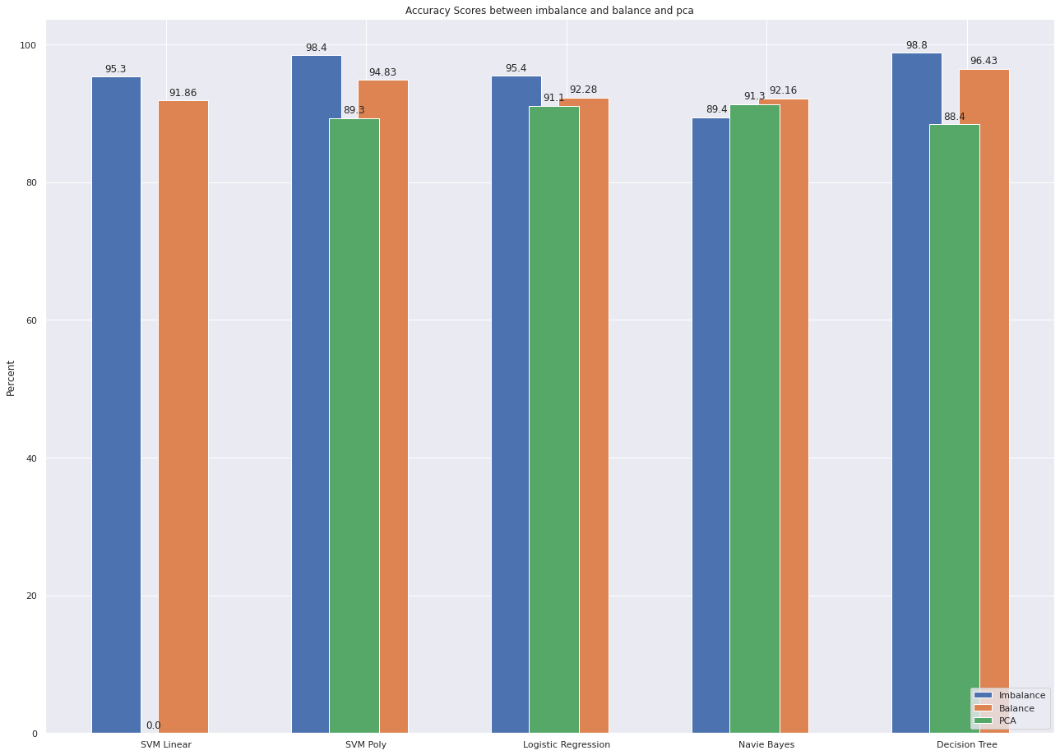
Visualize differences between 3 methods
Accuracy:

Slide 22
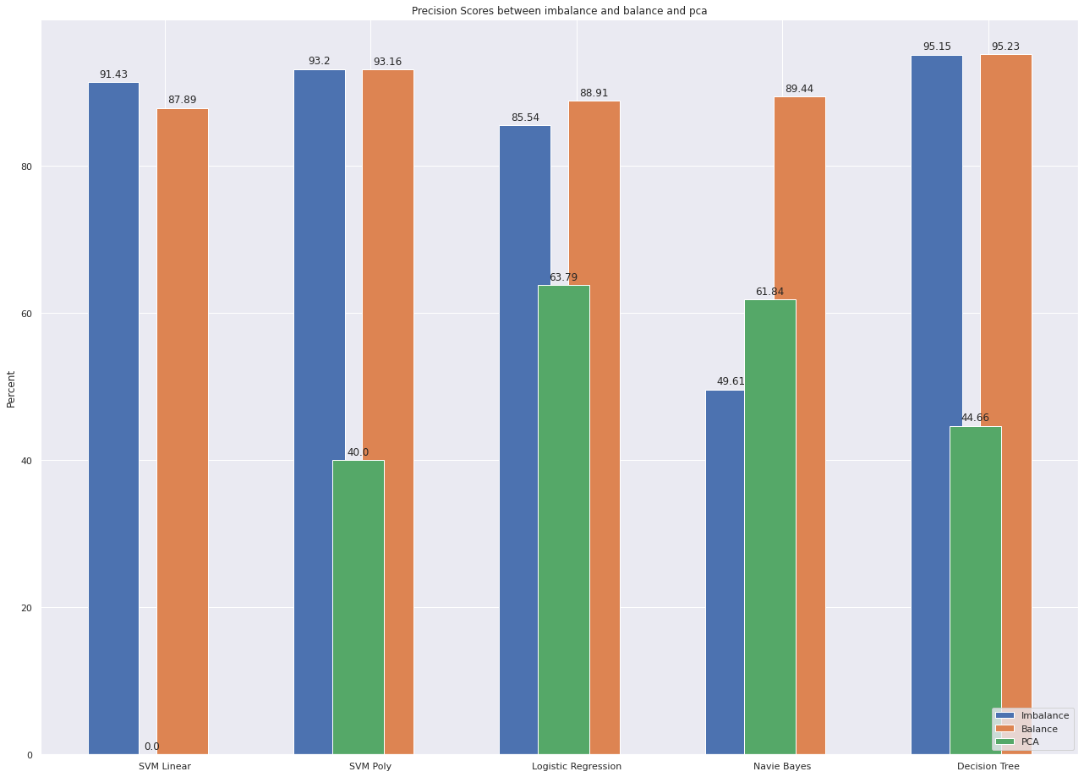
Visualize differences between 2 methods
Precision:

Slide 23
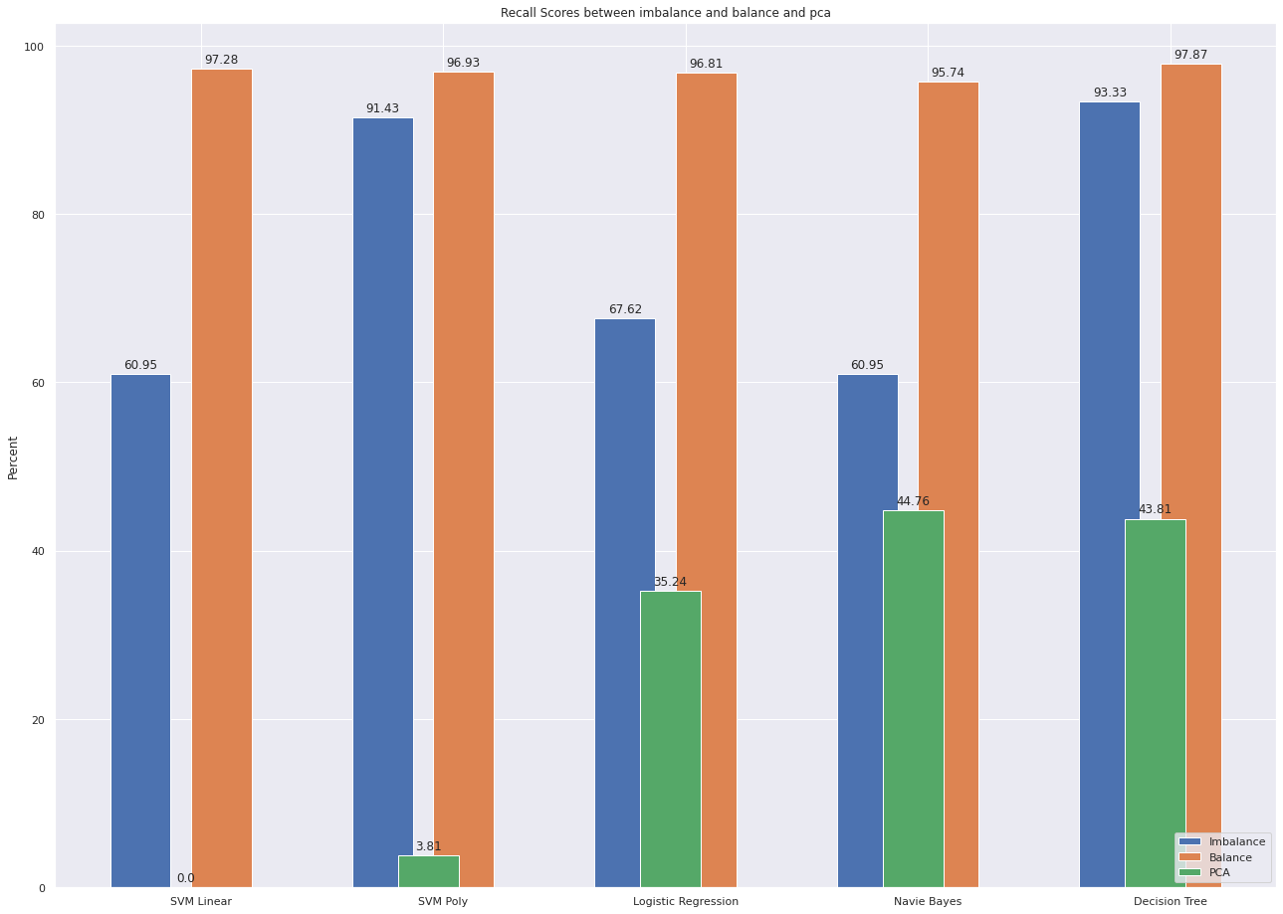
Visualize differences between 2 methods
Recall:

Slide 24
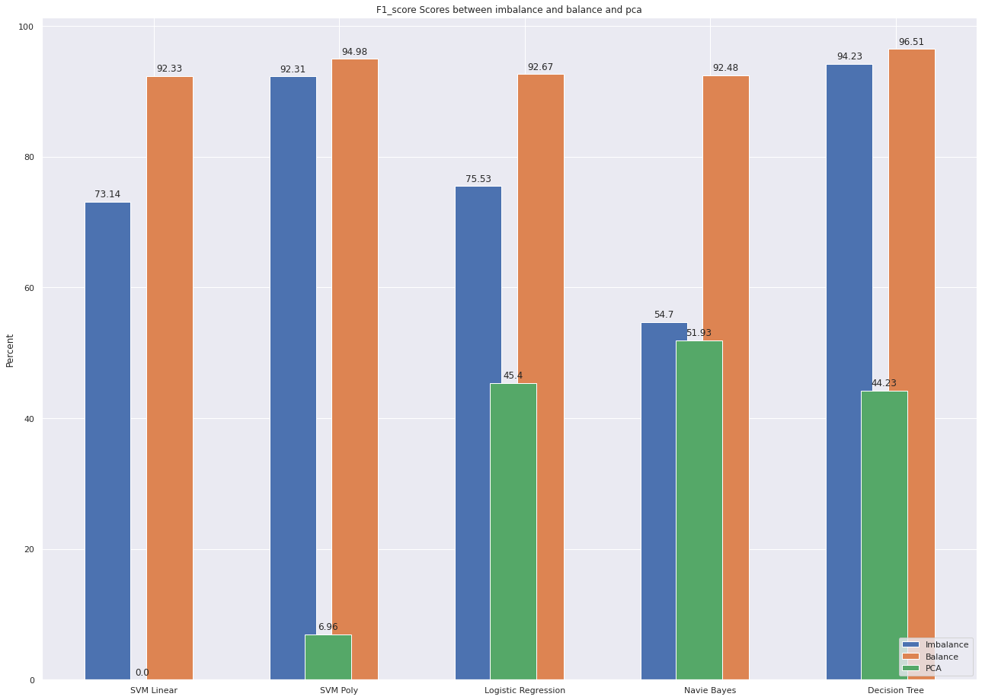
Visualize differences between 2 methods
F1 score:

