Slide 1
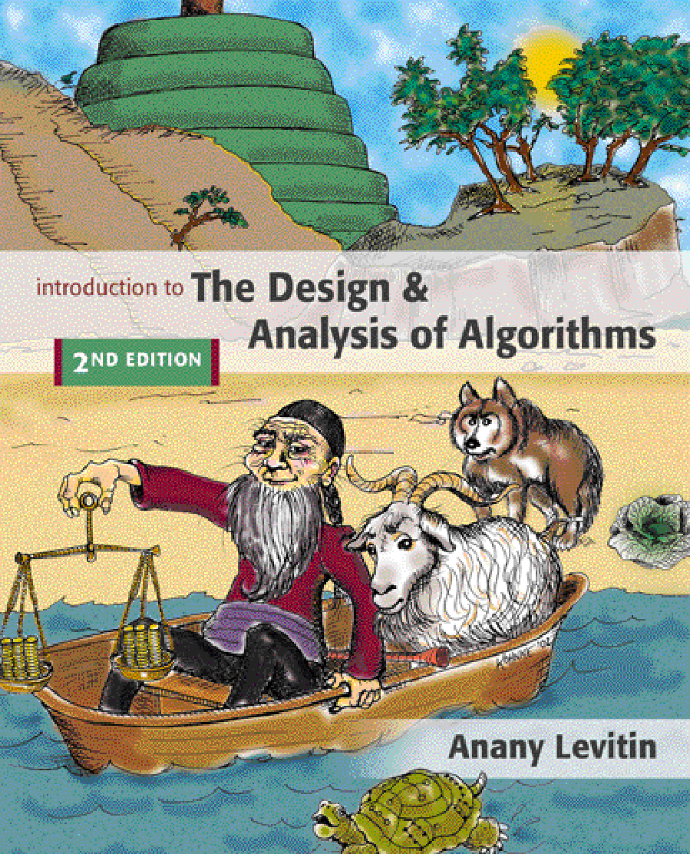

Chapter 2
Fundamentals of the Analysis of Algorithm Efficiency
Copyright © 2007 Pearson Addison-Wesley. All rights reserved.

Slide 2
Analysis of algorithms
Issues:
correctness
time efficiency
space efficiency
optimality
Approaches:
theoretical analysis
empirical analysis

Slide 3
Theoretical analysis of time efficiency
Time efficiency is analyzed by determining the number of repetitions of the basic operation as a function of input size
Basic operation: the operation that contributes the most towards the running time of the algorithm
T(n) ≈ c_{op}C(n)
input size
running time
execution time
for basic operation
or cost
Number of times basic operation is executed
Note: Different basic operations may cost differently!

Slide 4
Input size and basic operation examples
Problem
Input size measure
Basic operation
Searching for key in a list of n items
Number of list’s items, i.e. n
Key comparison
Multiplication of two matrices
Matrix dimensions or total number of elements
Multiplication of two numbers
Checking primality of a given integer n
n’size = number of digits (in binary representation)
Division
Typical graph problem
#vertices and/or edges
Visiting a vertex or traversing an edge

Slide 5
Empirical analysis of time efficiency
Select a specific (typical) sample of inputs
Use physical unit of time (e.g., milliseconds)
or
Count actual number of basic operation’s executions
Analyze the empirical data

Slide 6
Best-case, average-case, worst-case
For some algorithms, efficiency depends on form of input:
Worst case: C_{worst}(n) – maximum over inputs of size n
Best case: C_{best}(n) – minimum over inputs of size n
Average case: C_{avg}(n) – “average” over inputs of size n
Number of times the basic operation will be executed on typical input
NOT the average of worst and best case
Expected number of basic operations considered as a random variable under some assumption about the probability distribution of all possible inputs. So, avg = expected under uniform distribution.

Slide 7
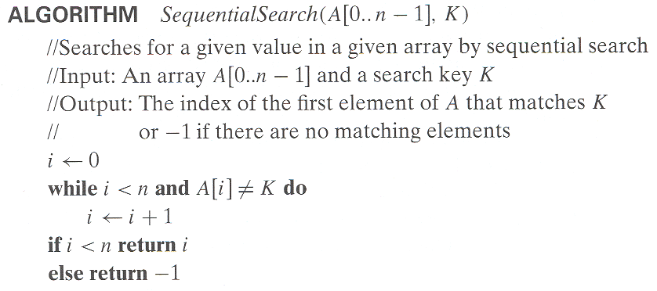
Example: Sequential search
Worst case
Best case
Average case
n key comparisons
1 comparisons
(n+1)/2, assuming K is in A

Slide 8
Types of formulas for basic operation’s count
Exact formula
e.g., C(n) = n(n-1)/2
Formula indicating order of growth with specific multiplicative constant
e.g., C(n) ≈ 0.5 n²
Formula indicating order of growth with unknown multiplicative constant
e.g., C(n) ≈ cn²

Slide 9
Order of growth
Most important: Order of growth within a constant multiple as n→∞
Example:
How much faster will algorithm run on computer that is twice as fast?
How much longer does it take to solve problem of double input size?
Notes:
Example: cn²
how much faster on twice as fast computer? (2)
how much longer for 2n? (4)

Slide 10
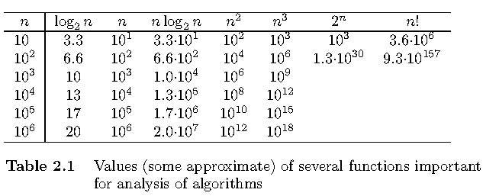
Values of some important functions as n → ∞

Slide 11
Asymptotic order of growth
A way of comparing functions that ignores constant factors and small input sizes (because?)
O(g(n)): class of functions f(n) that grow no faster than g(n)
Θ(g(n)): class of functions f(n) that grow at same rate as g(n)
Ω(g(n)): class of functions f(n) that grow at least as fast as g(n)

Slide 12
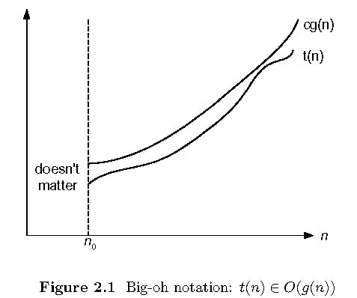
Big-oh

Slide 13
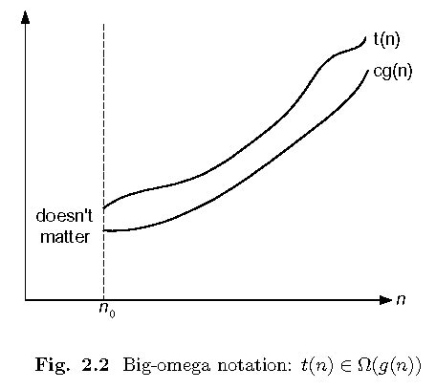
Big-omega

Slide 14
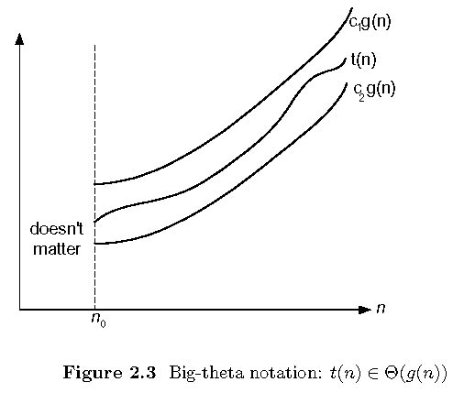
Big-theta

Slide 15
Establishing order of growth using the definition
Definition: f(n) is in O(g(n)), denoted f(n) ∈ O(g(n)), if order of growth of f(n) ≤ order of growth of g(n) (within constant multiple), i.e., there exist positive constant c and non-negative integer n₀ such that
f(n) ≤ c g(n) for every n ≥ n₀
Examples:
10n is in O(n²)
5n+20 is in O(n)
Notes:
Examples:
10n is O(n²)
since 10n ≤ 10n² for n ≥ 1 or 10n ≤ n² for n ≥ 10
c n₀
5n+20 is O(10n)
since 5n+20 ≤ 10 n for n ≥ 4
c n₀

Slide 16
Ω-notation
Formal definition
A function t(n) is said to be in Ω(g(n)), denoted t(n) ∈ Ω(g(n)), if t(n) is bounded below by some constant multiple of g(n) for all large n, i.e., if there exist some positive constant c and some nonnegative integer n₀ such that
t(n) ≥ cg(n) for all n ≥ n₀
Exercises: prove the following using the above definition
10n² ∈ Ω(n²)
0.3n² - 2n ∈ Ω(n²)
0.1n³ ∈ Ω(n²)

Slide 17
Θ-notation
Formal definition
A function t(n) is said to be in Θ(g(n)), denoted t(n) ∈ Θ(g(n)), if t(n) is bounded both above and below by some positive constant multiples of g(n) for all large n, i.e., if there exist some positive constant c₁ and c₂ and some nonnegative integer n₀ such that
c₂ g(n) ≤ t(n) ≤ c₁ g(n) for all n ≥ n₀
Exercises: prove the following using the above definition
10n² ∈ Θ(n²)
0.3n² - 2n ∈ Θ(n²)
(1/2)n(n+1) ∈ Θ(n²)

Slide 18
>=
Ω(g(n)), functions that grow at least as fast as g(n)
=
Θ(g(n)), functions that grow at the same rate as g(n)
g(n)
<=
O(g(n)), functions that grow no faster than g(n)

Slide 19
Theorem
If t₁(n) ∈ O(g₁(n)) and t₂(n) ∈ O(g₂(n)), then
t₁(n) + t₂(n) ∈ O(max{g₁(n), g₂(n)}).
The analogous assertions are true for the Ω-notation and Θ-notation.
Implication: The algorithm’s overall efficiency will be determined by the part with a larger order of growth, i.e., its least efficient part.
For example, 5n² + 3nlogn ∈ O(n²)
Proof. There exist constants c1, c2, n1, n2 such that
t1(n) ≤ c1*g1(n), for all n ≥ n1
t2(n) ≤ c2*g2(n), for all n ≥ n2
Define c3 = c1 + c2 and n3 = max{n1,n2}. Then
t1(n) + t2(n) ≤ c3*max{g1(n), g2(n)}, for all n ≥ n3

Slide 20
Some properties of asymptotic order of growth
f(n) ∈ O(f(n))
f(n) ∈ O(g(n)) iff g(n) ∈Ω(f(n))
If f (n) ∈ O(g (n)) and g(n) ∈ O(h(n)) , then f(n) ∈ O(h(n)) Note similarity with a ≤ b
If f₁(n) ∈ O(g₁(n)) and f₂(n) ∈ O(g₂(n)) , then
f₁(n) + f₂(n) ∈ O(max{g₁(n), g₂(n)})
Also, Σ_{1≤i≤n} Θ(f(i)) = Θ (Σ_{1≤i≤n} f(i))
Exercise: Can you prove these properties?

Slide 21
Establishing order of growth using limits
0 order of growth of T(n) < order of growth of g(n)
lim T(n)/g(n) =
c > 0 order of growth of T(n) = order of growth of g(n)
n→∞
∞ order of growth of T(n) > order of growth of g(n)
Examples:
10n vs. n²
n(n+1)/2 vs. n²

Slide 22
L’Hôpital’s rule and Stirling’s formula
L’Hôpital’s rule: If lim_{n→∞} f(n) = lim_{n→∞} g(n) = ∞ and
the derivatives f´, g´ exist, then
Stirling’s formula: n! ≈ (2πn)^{1/2} (n/e)^{n}
f(n)
g(n)
f ´(n)
g ´(n)
lim
n→∞
=
lim
n→∞
Example: log n vs. n
Example: 2^{n} vs. n!

Slide 23
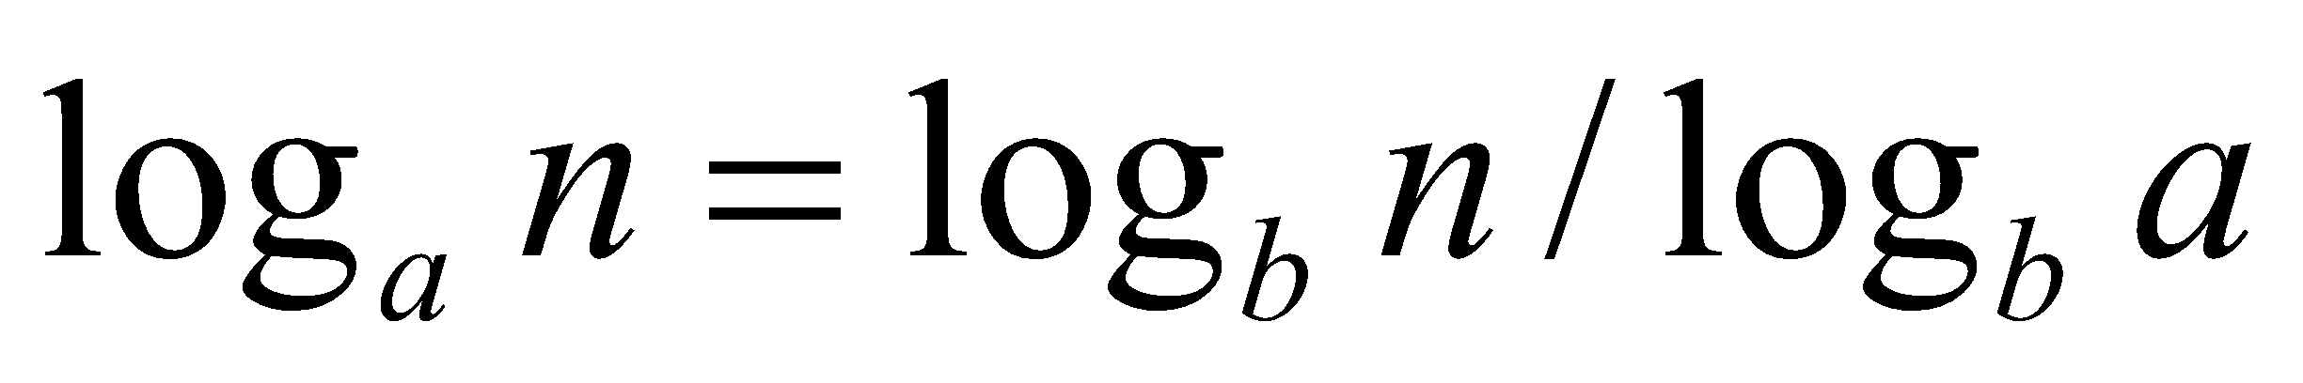
Orders of growth of some important functions
All logarithmic functions log_{a} n belong to the same class Θ(log n) no matter what the logarithm’s base a > 1 is because
All polynomials of the same degree k belong to the same class:
a_{k}n^{k} + a_{k-1}n^{k-1} + … + a₀ ∈ Θ(n^{k})
Exponential functions a^{n} have different orders of growth for different a’s
order log n < order n^{α} (α>0) < order a^{n} < order n! < order n^{n}

Slide 24
Basic asymptotic efficiency classes
1 | constant
log n | logarithmic
n | linear
n log n | n-log-n
n² | quadratic
n³ | cubic
2^{n} | exponential
n! | factorial

Slide 25
Time efficiency of nonrecursive algorithms
General Plan for Analysis
Decide on parameter n indicating input size
Identify algorithm’s basic operation
Determine worst, average, and best cases for input of size n
Set up a sum for the number of times the basic operation is executed
Simplify the sum using standard formulas and rules (see Appendix A)

Slide 26
Useful summation formulas and rules
Σ_{l≤i≤n}1 = 1+1+…+1 = n - l + 1
In particular, Σ_{l≤i≤n}1 = n - 1 + 1 = n ∈ Θ(n)
Σ_{1≤i≤n} i = 1+2+…+n = n(n+1)/2 ≈ n²/2 ∈ Θ(n²)
Σ_{1≤i≤n} i² = 1²+2²+…+n² = n(n+1)(2n+1)/6 ≈ n³/3 ∈ Θ(n³)
Σ_{0≤i≤n} a^{i} = 1 + a +…+ a^{n} = (a^{n+1} - 1)/(a - 1) for any a ≠ 1
In particular, Σ_{0≤i≤n} 2^{i} = 2⁰ + 2¹ +…+ 2^{n} = 2^{n+1} - 1 ∈ Θ(2^{n} )
Σ(a_{i} ± b_{i} ) = Σa_{i} ± Σb_{i} Σca_{i} = cΣa_{i} Σ_{l≤i≤u}a_{i} = Σ_{l≤i≤m}a_{i} + Σ_{m+1≤i≤u}a_{i}

Slide 27
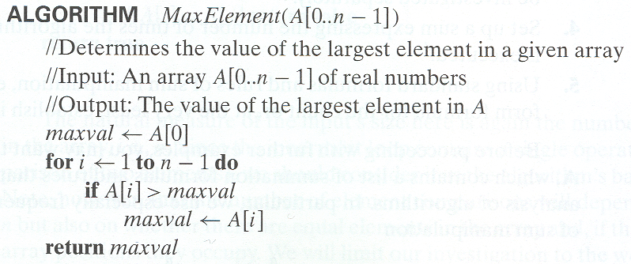
Example 1: Maximum element
T(n) = Σ1≤i≤n-1 1 = n-1 = Θ(n) comparisons

Slide 28
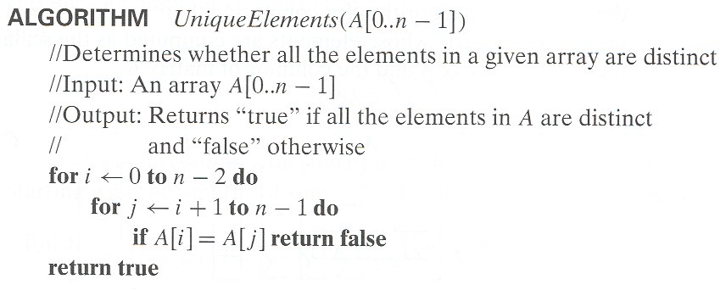
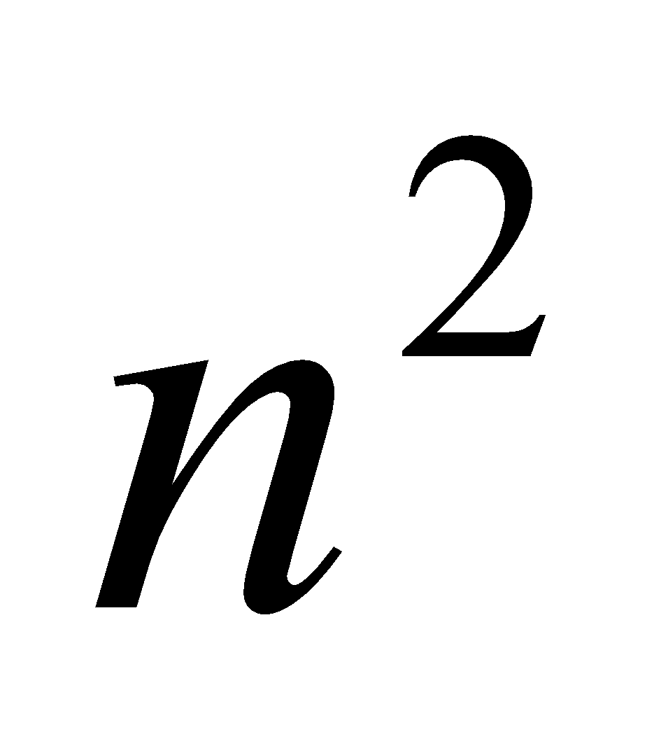
Example 2: Element uniqueness problem
T(n) = Σ0≤i≤n-2 (Σi+1≤j≤n-1 1)
= Σ0≤i≤n-2 n-i-1 = (n-1+1)(n-1)/2
= Θ( ) comparisons

Slide 29
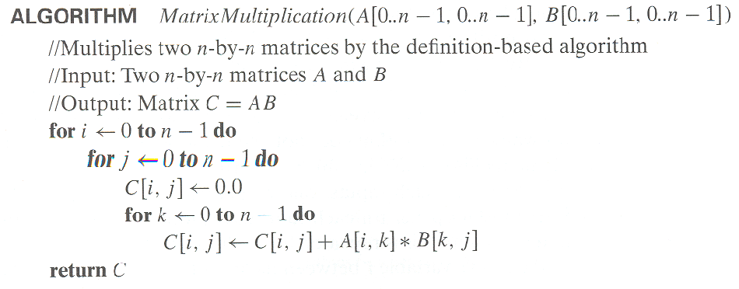
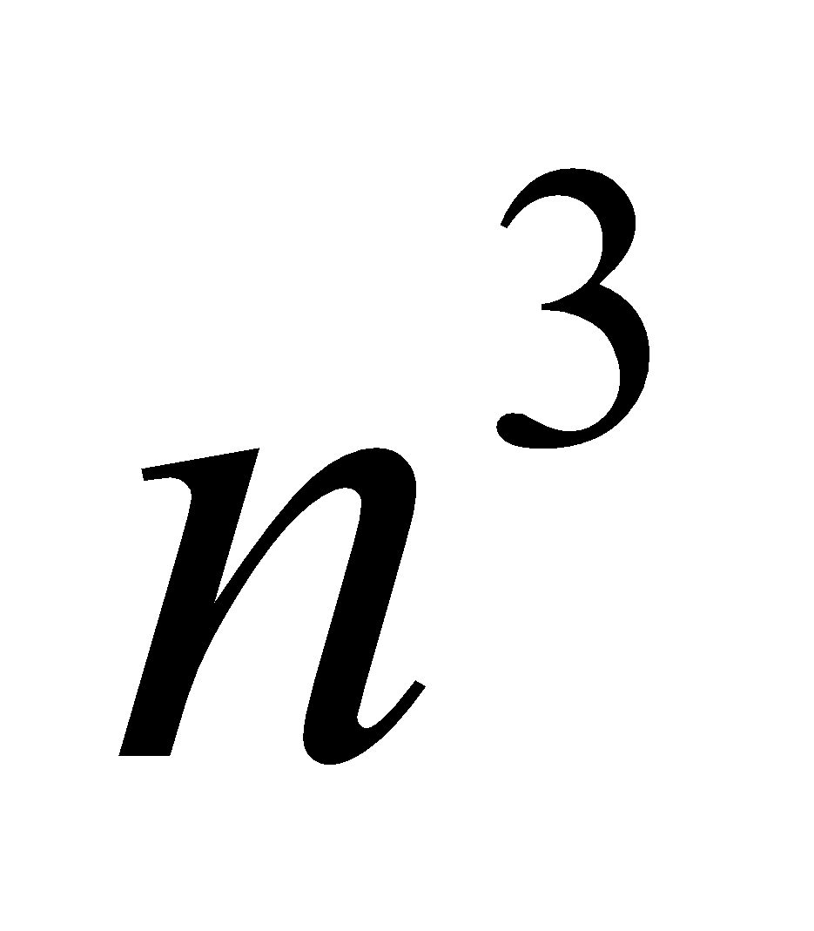
Example 3: Matrix multiplication
T(n) = Σ0≤i≤n-1 Σ0≤i≤n-1 n
= Σ0≤i≤n-1 Θ( )
= Θ( ) multiplications

Slide 30
Example 4: Gaussian elimination
Algorithm GaussianElimination(A[0..n-1,0..n])
//Implements Gaussian elimination on an n-by-(n+1) matrix A
for i ← 0 to n - 2 do for j ← i + 1 to n - 1 do for k ← i to n do
A[j,k] ← A[j,k] - A[i,k] * A[j,i] / A[i,i]
Find the efficiency class and a constant factor improvement.
for i ← 0 to n - 2 do for j ← i + 1 to n - 1 do B ← A[j,i] / A[i,i]
for k ← i to n do
A[j,k] ← A[j,k] – A[i,k] * B

Slide 31
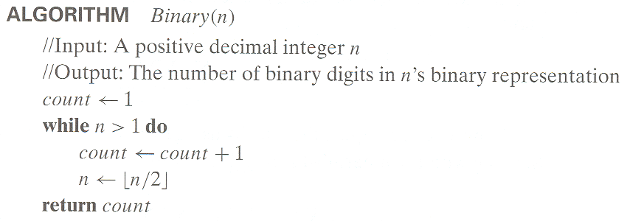
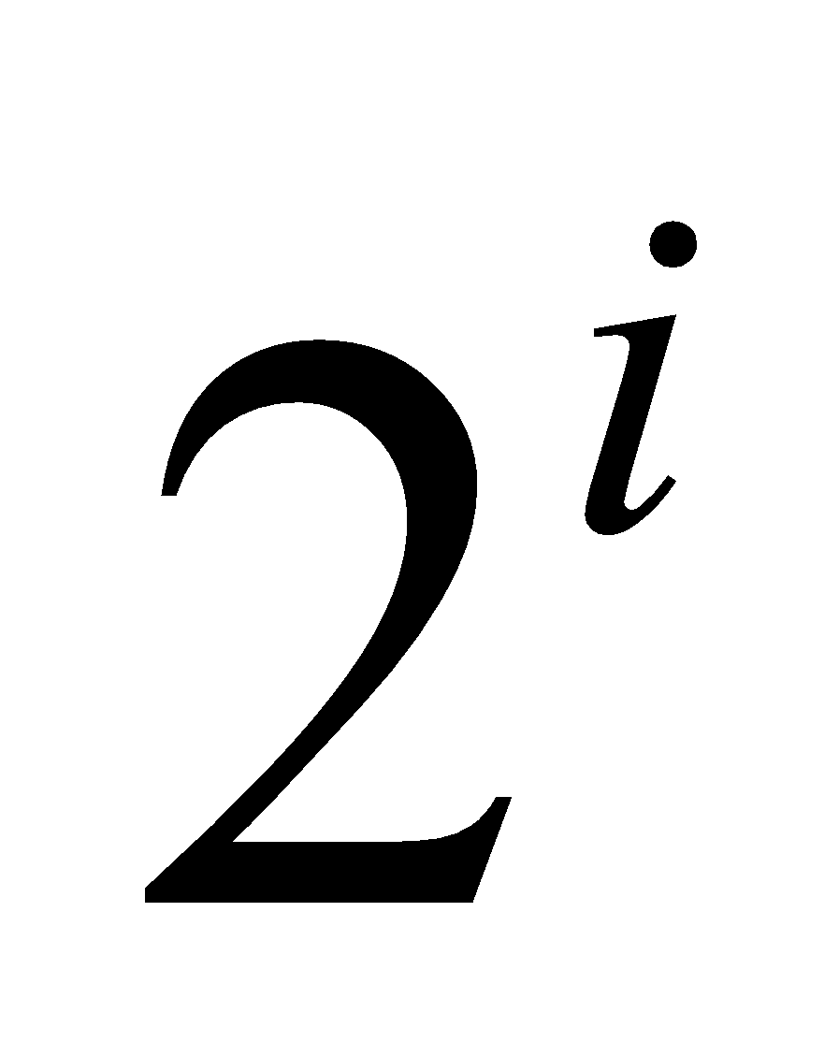
Example 5: Counting binary digits
It cannot be investigated the way the previous examples are.
The halving game: Find integer i such that n/ ≤ 1.
Answer: i ≤ log n. So, T(n) = Θ(log n) divisions.
Another solution: Using recurrence relations.

Slide 32
Plan for Analysis of Recursive Algorithms
Decide on a parameter indicating an input’s size.
Identify the algorithm’s basic operation.
Check whether the number of times the basic op. is executed may vary on different inputs of the same size. (If it may, the worst, average, and best cases must be investigated separately.)
Set up a recurrence relation with an appropriate initial condition expressing the number of times the basic op. is executed.
Solve the recurrence (or, at the very least, establish its solution’s order of growth) by backward substitutions or another method.

Slide 33
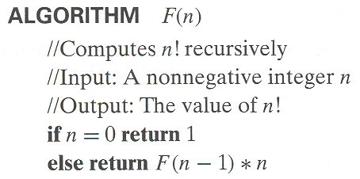
Example 1: Recursive evaluation of n!
Definition: n ! = 1 * 2 * … *(n-1) * n for n ≥ 1 and 0! = 1
Recursive definition of n!: F(n) = F(n-1) * n for n ≥ 1 and
F(0) = 1
Size:
Basic operation:
Recurrence relation:
n
multiplication
M(n) = M(n-1) + 1
M(0) = 0
Notes:
Note the difference between the two recurrences. Students often confuse these!
F(n) = F(n-1) n
F(0) = 1
for the values of n!
------------
M(n) =M(n-1) + 1
M(0) = 0
for the number of multiplications made by this algorithm

Slide 34
Solving the recurrence for M(n)
M(n) = M(n-1) + 1, M(0) = 0
M(n) = M(n-1) + 1
= (M(n-2) + 1) + 1 = M(n-2) + 2
= (M(n-3) + 1) + 2 = M(n-3) + 3
…
= M(n-i) + i
= M(0) + n
= n
The method is called backward substitution.

Slide 35
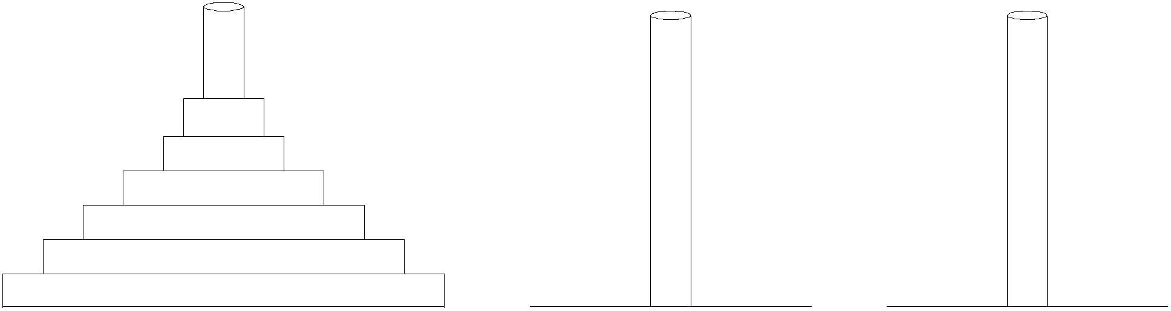
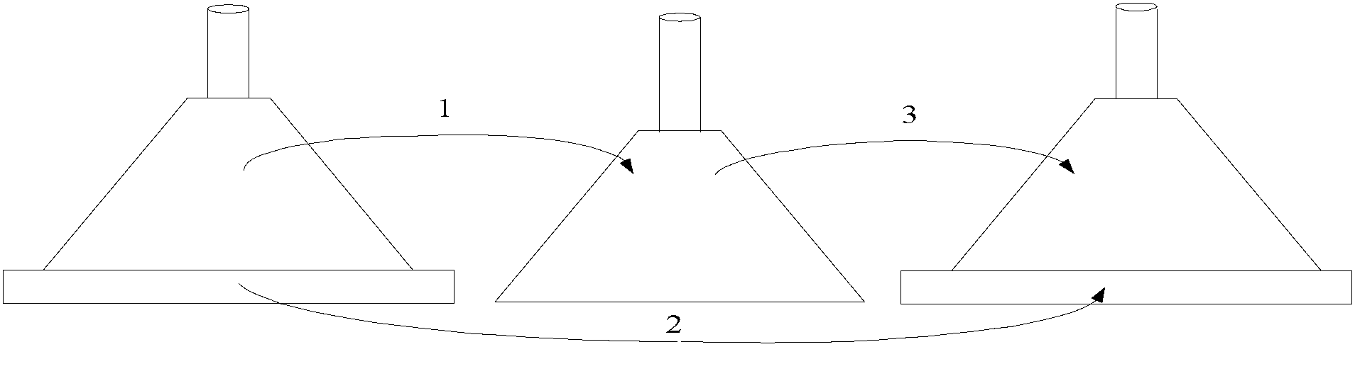
Example 2: The Tower of Hanoi Puzzle
Recurrence for number of moves:
M(n) = 2M(n-1) + 1

Slide 36
Solving recurrence for number of moves
M(n) = 2M(n-1) + 1, M(1) = 1
M(n) = 2M(n-1) + 1
= 2(2M(n-2) + 1) + 1 = 2^2*M(n-2) + 2^1 + 2^0
= 2^2*(2M(n-3) + 1) + 2^1 + 2^0
= 2^3*M(n-3) + 2^2 + 2^1 + 2^0
= …
= 2^(n-1)*M(1) + 2^(n-2) + … + 2^1 + 2^0
= 2^(n-1) + 2^(n-2) + … + 2^1 + 2^0
= 2^n - 1

Slide 37
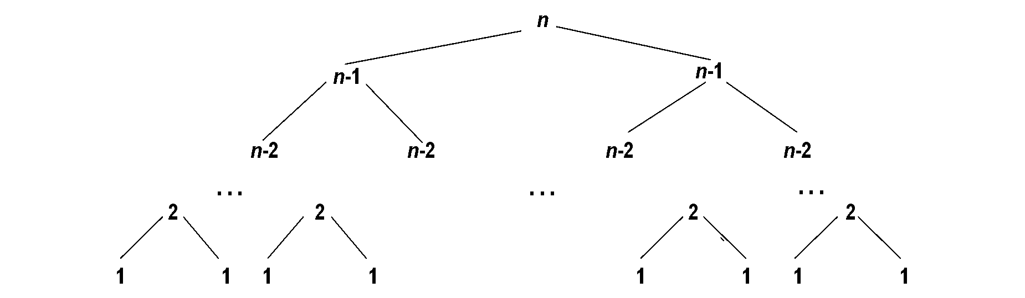
Tree of calls for the Tower of Hanoi Puzzle

Slide 38
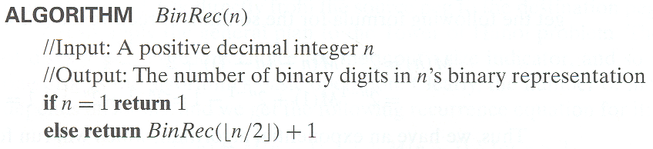
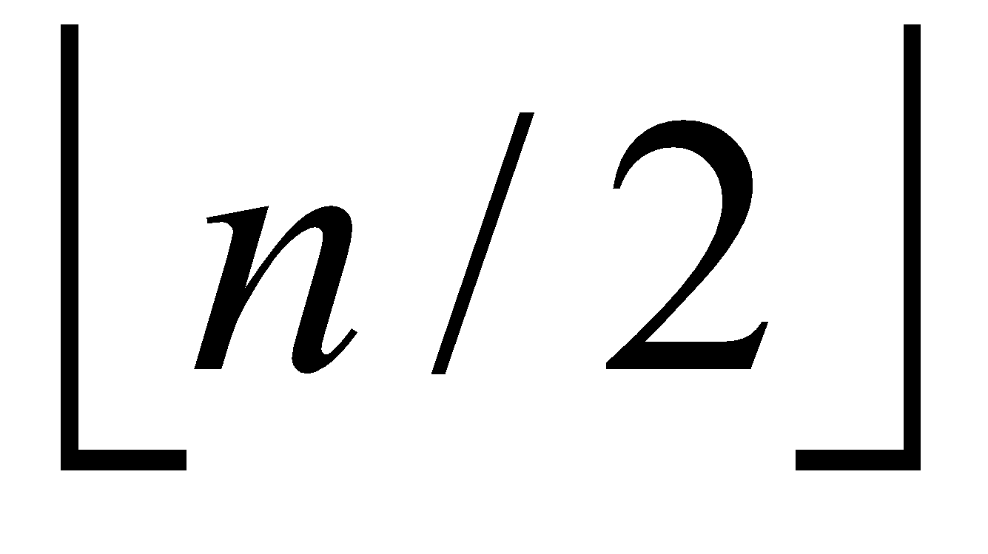
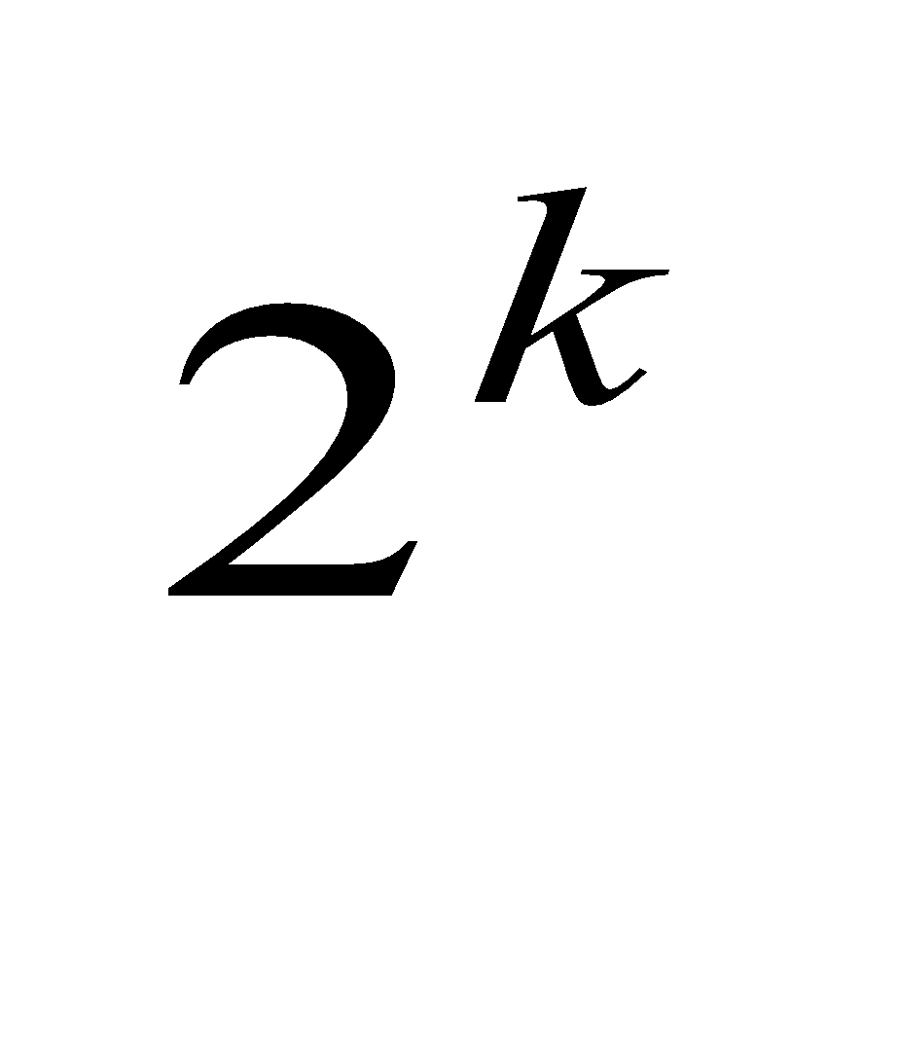
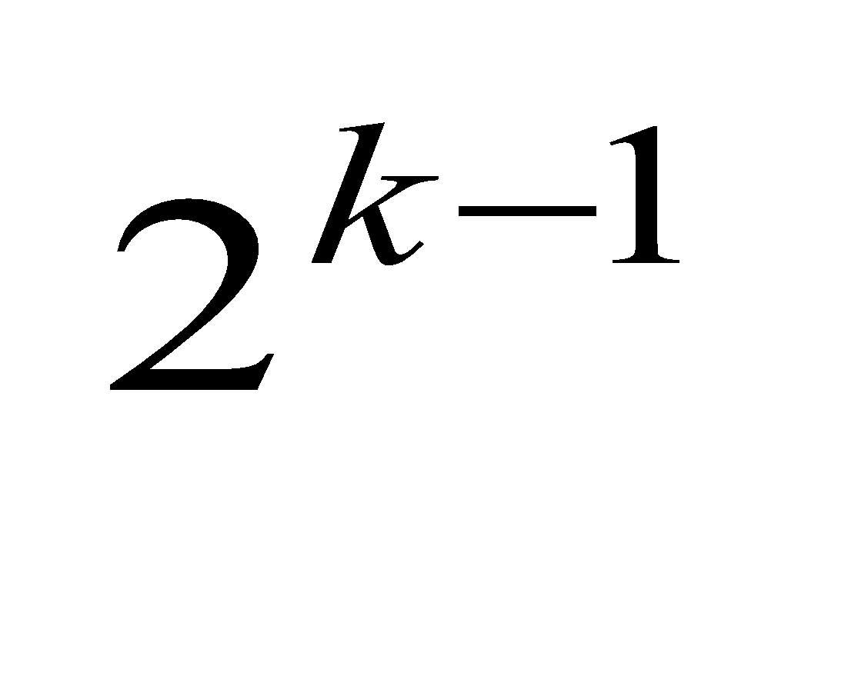
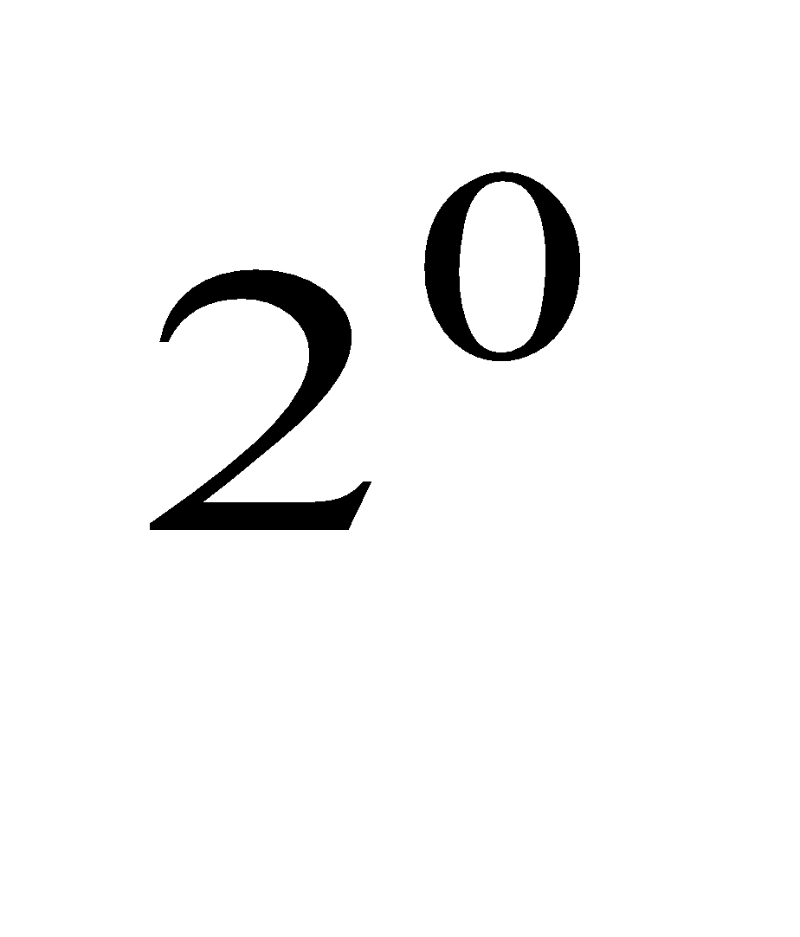
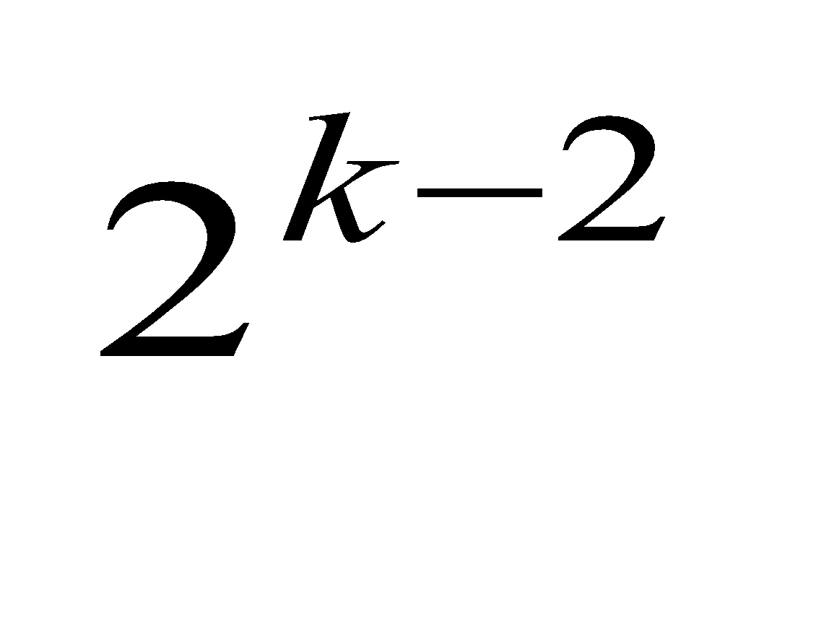
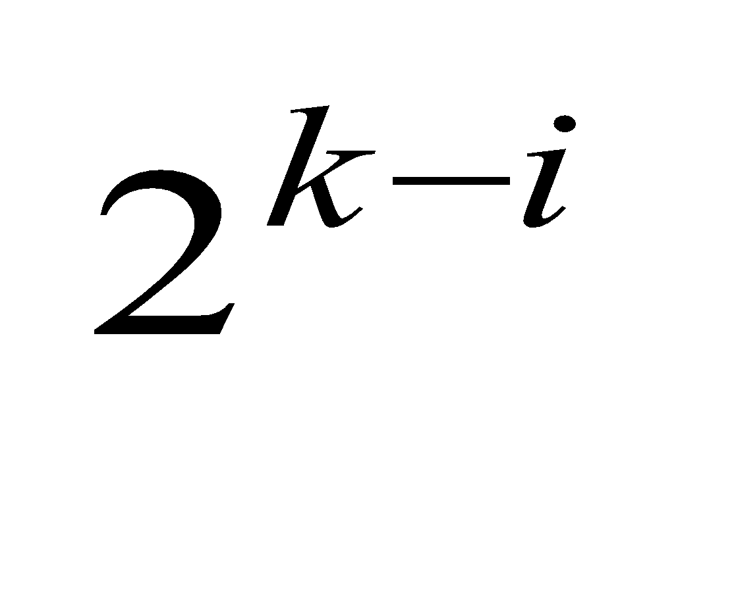
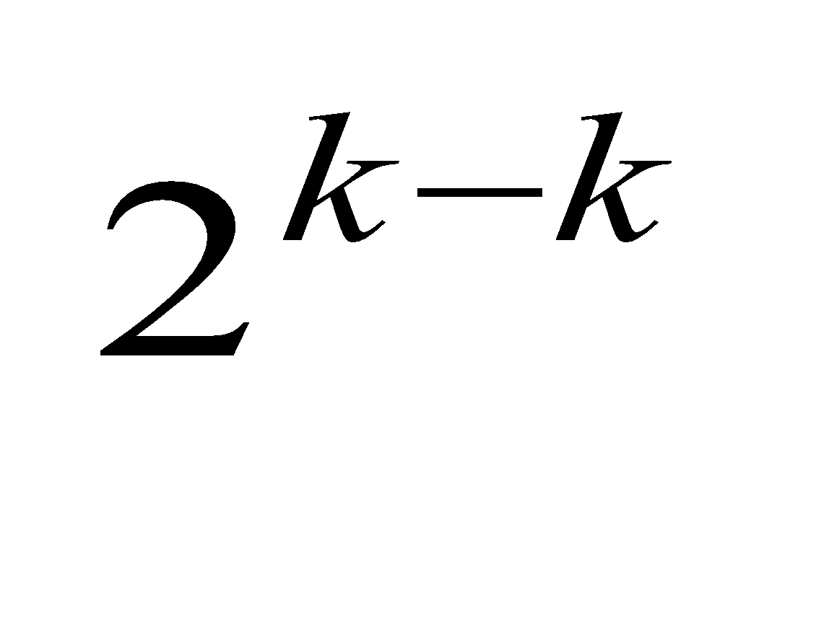
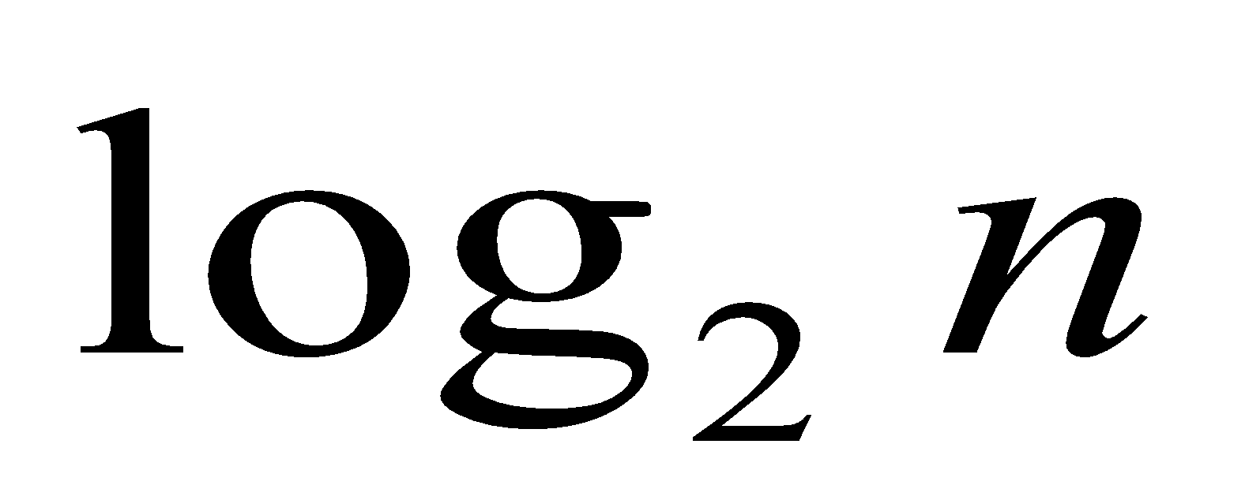
Example 3: Counting #bits
A(n) = A( ) + 1, A(1) = 0
A( ) = A( ) + 1, A( ) = 1 (using the Smoothness Rule)
= (A( ) + 1) + 1 = A( ) + 2
= A( ) + i
= A( ) + k = k + 0
=

Slide 39
Smoothness Rule
Let f(n) be a nonnegative function defined on the set of natural numbers. f(n) is call smooth if it is eventually nondecreasing and
f(2n) ∈ Θ (f(n))
Functions that do not grow too fast, including logn, n, nlogn, and n^{α} where α>=0 are smooth.
Smoothness rule
Let T(n) be an eventually nondecreasing function and f(n) be a smooth function. If
T(n) ∈ Θ (f(n)) for values of n that are powers of b,
where b>=2, then
T(n) ∈ Θ (f(n)) for any n.

Slide 40
Fibonacci numbers
The Fibonacci numbers:
0, 1, 1, 2, 3, 5, 8, 13, 21, …
The Fibonacci recurrence:
F(n) = F(n-1) + F(n-2)
F(0) = 0
F(1) = 1
General 2nd order linear homogeneous recurrence with
constant coefficients:
aX(n) + bX(n-1) + cX(n-2) = 0

Slide 41
Solving aX(n) + bX(n-1) + cX(n-2) = 0
Set up the characteristic equation (quadratic)
ar² + br + c = 0
Solve to obtain roots r₁ and r₂
General solution to the recurrence
if r₁ and r₂ are two distinct real roots: X(n) = αr₁^{n} + βr₂^{n}
if r₁ = r₂ = r are two equal real roots: X(n) = αr^{n} + βnr ^{n}
Particular solution can be found by using initial conditions

Slide 42
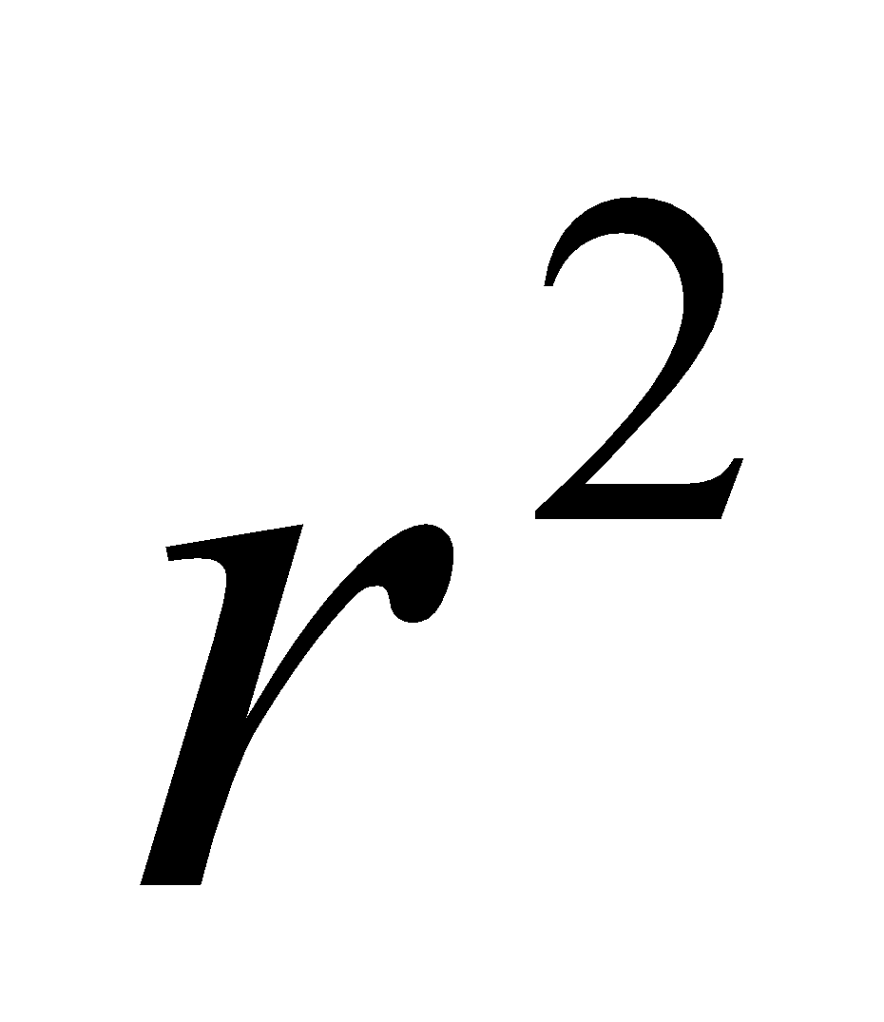
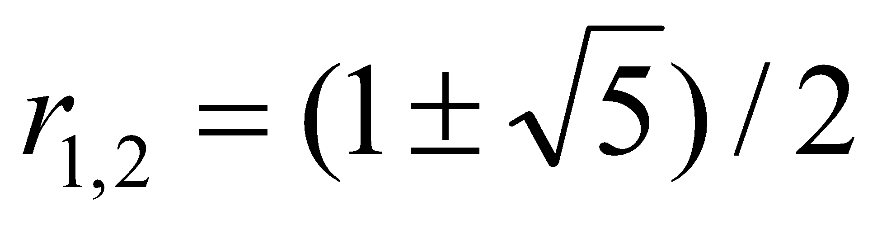
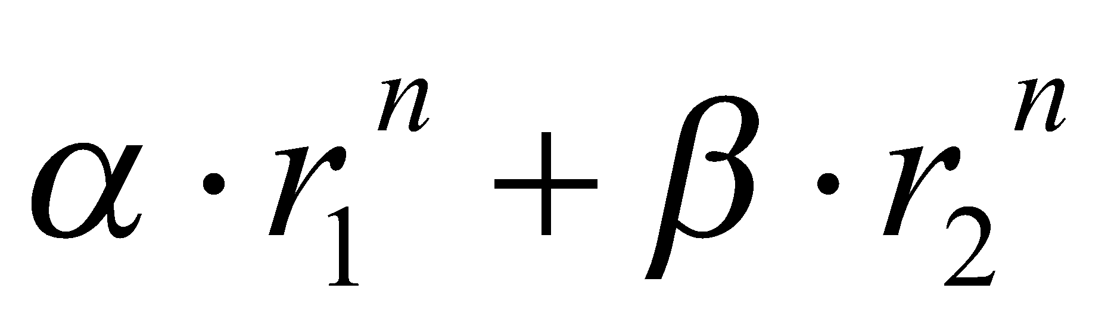
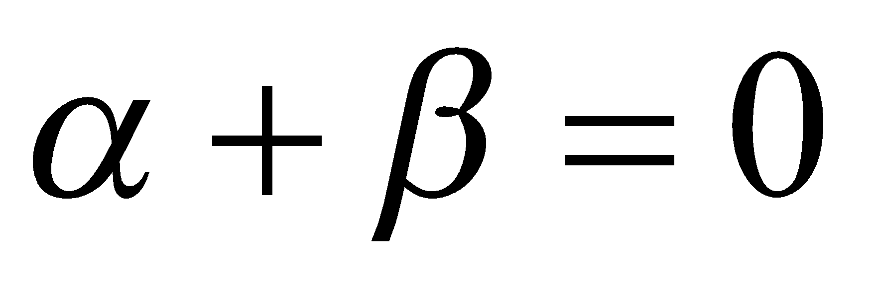
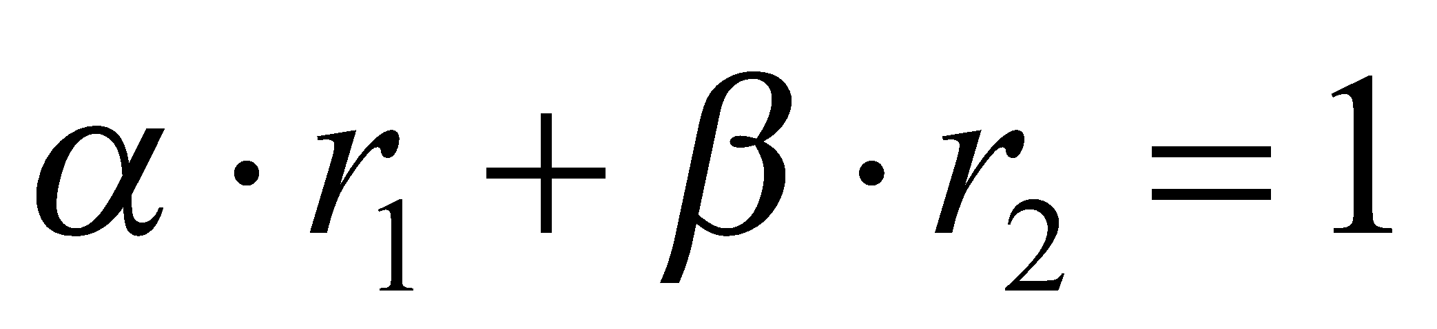
Application to the Fibonacci numbers
F(n) = F(n-1) + F(n-2) or F(n) - F(n-1) - F(n-2) = 0
Characteristic equation:
Roots of the characteristic equation:
General solution to the recurrence:
Particular solution for F(0) =0, F(1)=1:
- r -1 = 0

Slide 43
Computing Fibonacci numbers
Definition-based recursive algorithm
Nonrecursive definition-based algorithm
Explicit formula algorithm
Logarithmic algorithm based on formula:
n
F(n-1) F(n)
0 1
=
F(n) F(n+1)
1 1
for n≥1, assuming an efficient way of computing matrix powers.

Slide 44
Important Recurrence Types
Decrease-by-one recurrences
A decrease-by-one algorithm solves a problem by exploiting a relationship between a given instance of size n and a smaller size n – 1.
Example: n!
The recurrence equation for investigating the time efficiency of such algorithms typically has the form
T(n) = T(n-1) + f(n)
Decrease-by-a-constant-factor recurrences
A decrease-by-a-constant-factor algorithm solves a problem by dividing its given instance of size n into several smaller instances of size n/b, solving each of them recursively, and then, if necessary, combining the solutions to the smaller instances into a solution to the given instance.
Example: binary search.
The recurrence equation for investigating the time efficiency of such algorithms typically has the form
T(n) = aT(n/b) + f (n)

Slide 45
Decrease-by-one Recurrences
One (constant) operation reduces problem size by one.
T(n) = T(n-1) + c T(1) = d
Solution:
A pass through input reduces problem size by one.
T(n) = T(n-1) + c n T(1) = d
Solution:
T(n) = (n-1)c + d linear
T(n) = [n(n+1)/2 – 1] c + d quadratic

Slide 46
Decrease-by-a-constant-factor recurrences – The Master Theorem
T(n) = aT(n/b) + f (n), where f (n) ∈ Θ(n^{k}) , k>=0
a < b^{k} T(n) ∈ Θ(n^{k})
a = b^{k} T(n) ∈ Θ(n^{k} log n )
a > b^{k} T(n) ∈ Θ(n^{log a})
Examples:
T(n) = T(n/2) + 1
T(n) = 2T(n/2) + n
T(n) = 3T(n/2) + n
T(n) = T(n/2) + n
b
Θ(log n)
Θ(nlog n)
Θ(n^{log}₂³)
Θ(n)

Slide 47
Exercise 1
1. Use the informal definitions of O, Θ, and Ω to determine whether the following assertions are true or false.
a. n(n + 1)/2 ∈ O(n^3)
b. n(n + 1)/2 ∈ O(n^2)
c. n(n + 1)/2 ∈ Θ(n^3)
d. n(n + 1)/2 ∈ Ω(n)

Slide 48
Exercise 2
1. Var int: d = 0
2. For i from 1 to n do
1. d = d + 1
2. a[i] = a[i] × a[i] + d × d
3. Endfor

Slide 49
Exercise 3
1. Var int: i = 1
2. While i ≤ n do
1. Write "Bonjour"
2. i = i + 1
3. EndWhile

Slide 50
Exercise 4
1. Var int: i = 1
2. While i ≤ n do
1. Write "Bonjour"
2. i = i × 2
3. EndWhile

Slide 51
Exercise 5
1. Var int: i = 1
2. While i ≤ n do
1. Var int: j = 1
2. While j ≤ n do
1. Write "Bonjour"
2. j = j × 3
3. EndWhile
4. i = i + 1
3. EndWhile

Slide 52
Exercise 6
Function XYZ(array: a[])
1. Var int: i
2. For i from 1 to n do
1. Var int: t = a[i]
2. Var int: j
3. For j from i - 1 to 0 do
1. a[j + 1] = a[j]
4. EndFor
5. a[j + 1] = t
3. EndFor

Slide 53
Exercise 8
Determine complexity
a. T(n)=4T(n/2)+n
b. T(n)=4T(n/2)+n^2
c. T(n)=4T(n/2)+n^3
d. T(n)=2T(n/2)+nlog⁡n

Slide 54
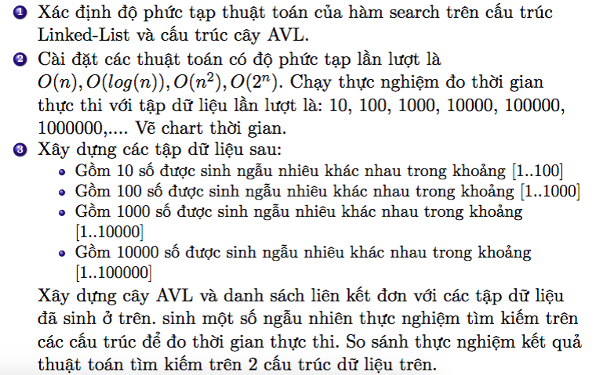
Elearning

