Slide 1
YUAN ZE UNIVERSITY · AI CENTER (ICAIA)
YZU AI Center Assistant
An MCP client–server RAG system — grounded answers that cite their sources
Anh Cao
47
373
6
0
source pages
indexed chunks
MCP tools
API keys required
Notes:
Three things to remember: retrieval sits behind a real MCP server; every answer cites its source; the system refuses instead of guessing when evidence is weak.

Slide 2
What this project is
A chatbot that answers questions about the Yuan Ze University AI Center using only that centre's own website.
1
Grounded answers
2
Refusal, not guessing
Every factual sentence carries a [n] citation
linked to the page it came from.
Below a calibrated confidence threshold the
system declines and says why.
3
Retrieval behind MCP
4
Runs without an API key
A stateless MCP server any host can connect to —
client and server are separate processes.
Degrades to cited extractive answers, and the
UI states which mode it is in.
SCOPE
TAICA credit programs · courses · labs and equipment · faculty · news and announcements
Notes:
Two classic failure modes this design targets: an LLM given a corpus will still fabricate, and the reader cannot verify where an answer came from.

Slide 3
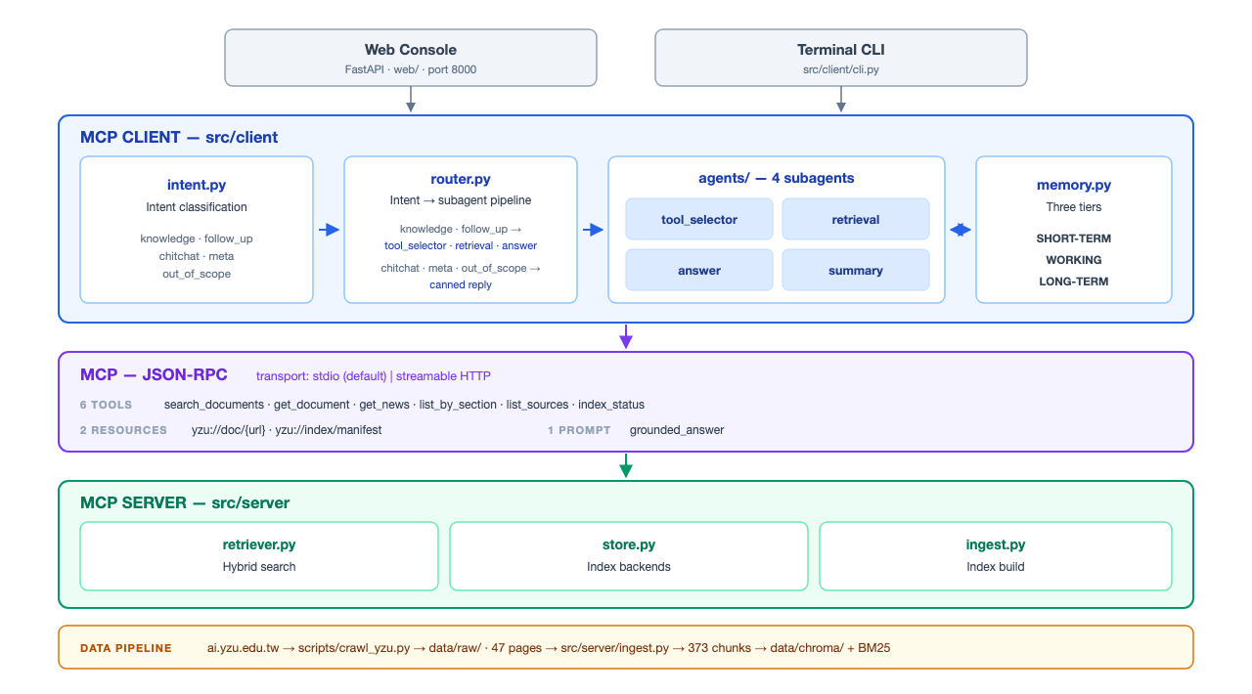
Architecture
Notes:
Read it top down. The key property is at the server layer: it holds no conversation state, so any MCP host can drive it unchanged.

Slide 4
Workflow of one turn
Stages and timings taken from the trace panel.
1
Intent
2
Router
3
Tool selection
Regex rules first; the LLM is called
only on ambiguity. ~0 ms, 0 tokens.
Static table maps intent to an
ordered subagent pipeline.
Chooses among the tools the server
advertised; the name is validated.
4
Retrieval
5
Confidence gate
6
Answer
Query rewritten from memory into
2–3 variants, issued in parallel.
Top score below MIN_SCORE → refuse,
in control flow, before generation.
Generated with [n] citations, then
memory is updated and persisted.
27 ms
both MCP retrieval calls, combined
99.6%
of the 7.4 s turn is three LLM calls — latency lives in generation, not retrieval
Notes:
The two numbers at the bottom decide where optimisation effort should go: a smaller model, streaming, fewer calls.

Slide 5
Technology stack
Chosen so the whole system runs from a plain git clone, with no service to start and no API key.
Language
Protocol
Python 3.12 · asyncio
MCP over JSON-RPC · stdio or streamable HTTP
Embeddings
Vector store
sentence-transformers · multilingual-e5-small
ChromaDB — persistent, cosine + metadata filter
Lexical search
Generation
rank_bm25 (BM25Okapi) · jieba · CJK bigrams
any OpenAI-compatible endpoint — GPT, Gemini, Ollama
Serving
Crawl & eval
FastAPI · pydantic-settings · vanilla JS console
requests + BeautifulSoup · pytest · custom eval set
Notes:
Every optional install upgrades one layer; without them the system still answers, extractively and with citations.

Slide 6
Why MCP
Client and server are separate processes that discover each other through a standard schema.
A
The server is stateless
B
The client picks the tool
No memory, no LLM, no conversation state.
That is what lets any host — ours, or a
third-party one — drive it unchanged.
Keyword search cannot answer "what's new" —
that needs date ordering. The client chooses
from the schemas MCP sends at discovery.
All three MCP primitives — most implementations expose only Tools
6 TOOLS
2 RESOURCES
1 PROMPT
search_documents · get_document
get_news · list_by_section
list_sources · index_status
yzu://doc/{url}
yzu://index/manifest
grounded_answer
a citation-first template
Transport is a deployment decision: MCP_TRANSPORT=stdio | http — one environment variable, no code change.
Notes:
If memory or an LLM moved into the server, it would become an HTTP API wearing the MCP label.

Slide 7
Retrieval — hybrid search
Dense alone misses exact identifiers; BM25 alone misses paraphrase.
Query
Dense
+ BM25
RRF
Confidence
Top 5
Chinese or English
top 12 each
rank fusion
scored separately
passages
RRF orders — it does not score
jieba + CJK character bigrams
Its top hit always scores 1/(k+1), however bad.
Confidence is computed separately as
max(cosine, query-term coverage).
jieba segments query and document differently.
Bigrams give a segmentation-independent
backstop — standard practice in Chinese IR.
Why ChromaDB
Chosen for its metadata query surface — that is what get_news and list_by_section filter on — plus persistence with no service to run. At 373 chunks a flat matmul would match its speed.
Notes:
Cosine and BM25 live on different scales; fusing by rank avoids normalising them.

Slide 8
Indexing — chunks that carry their own context
Heading-aware first, then length-bounded: 500 characters, 80 overlap, cut at sentence ends.
A bare chunk
With title + heading prefix
本聯盟各學分學程總修習學分為 15 學分
TAICA聯盟學分學程介紹 > 人工智慧視覺技術學分學程
本聯盟各學分學程總修習學分為 15 學分
A fragment with no subject — the reader cannot tell which programme it describes.
The chunk keeps its own context once it is separated from its neighbours.
What fixing the crawler removed from the index
923 → 373
207 → 4
61% → 46%
0 → 168
chunks — 60% was noise
duplicated lines
largest page's share
table rows preserved
Notes:
The extraction bugs were not cosmetic: the site name sat as a prefix on all 47 titles, so every chunk opened with the same 12 characters.

Slide 9
Client — intent, routing, subagents
Everything conversational lives on the client, so the server can stay stateless.
1
Intent — rules before the model
2
Router — a table, not if-else
Five labels. A regex fast path settles greetings
and obvious off-topic queries in ~0 ms, which is
also what keeps the system working with no LLM.
Adding a capability means adding a row, and the
routing decision stays inspectable — it appears
as a named stage in the trace panel.
Four subagents
tool_selector
retrieval
answer
summary
picks a tool from the
server's own schemas
query rewriting and
multi-query fan-out
grounded generation,
plus the refusal gate
long-term memory
compaction
Query rewriting is what makes a follow-up work: “那個學程呢？” retrieves nothing standalone, but resolved against memory it retrieves correctly.
Notes:
Splitting the subagents keeps each stage separately traceable and gives the refusal gate one definite place to live.

Slide 10
Memory — three tiers, three lifetimes
One blob either forgets too fast or floods the context window.
SHORT-TERM
WORKING
LONG-TERM
Recent turns
Topic & entities
Rolling summary
last 6 exchanges, verbatim
last topic + up to 12 entities
recomputed every 8 exchanges
Goes into every prompt, so the model sees the thread without replaying the whole history.
What makes an elliptical follow-up answerable — the retrieval agent splices it into the query.
Persisted per session to data/memory/, so a conversation survives a restart.
The answered turn is written to disk before summarisation runs — compaction is best-effort and must never discard the turn that triggered it.
Notes:
Three tiers because they have different lifetimes and different token costs.

Slide 11
The refusal gate is calibrated, not guessed
MIN_SCORE
Refusal happens in control flow, not in the prompt
0.854
A model handed weak context still writes a confident paragraph. The only reliable place to stop that is before generation.
lowest in-scope 0.863
highest out-of-scope 0.844
Found by calibration, not by tests
The threshold sat at 0.35 while every query scored above 0.83 — the gate was live code that could never fire.
The margin is 0.019 — clean, but thin
multilingual-e5-small has a high similarity floor: unrelated text pairs already sit around 0.75–0.85, so the usable band is narrow and one badly worded out-of-scope question could still cross it.
The honest fix — score the top hit against the corpus's own background similarity instead of raw cosine — is identified but not yet done.
Notes:
Calibration scores questions the corpus should answer against ones it should not, then reports where the distributions separate.

Slide 12
Built to degrade
Each missing layer costs one capability — and the UI states which mode it is in.
No LLM, or no network
Answers become cited extractive excerpts
verified with LLM_MODE=offline and HF_HUB_OFFLINE=1
No embedding model
Falls back to BM25 alone
the status badge reads “lexical”
Split deployment needed
stdio switches to streamable HTTP
one environment variable, no code change
A different MCP host
Runs the same server unchanged
no conversation state to carry over
The system never pretends to be more capable than it is — both degradations are visible in the status bar and in index_status.
Notes:
With an empty .env the system still runs: lexical retrieval plus extractive answers.

Slide 13
Measured results
Full crawl, hybrid mode, 15-question evaluation set.
0.933
0.813
0.667
70 ms
doc hit @5
doc MRR
answer span @5
retrieval p50
Why answer_span is the number that matters
It checks the retrieved text actually contains the expected fact. A system can score a perfect hit@5 while returning a page's
navigation menu — which is why it is reported separately, and why it is the lowest number here rather than the flattering one.
Three of the five misses are a Unicode bug, not retrieval
The site uses compatibility ideographs — 領 U+F9B4 — identical in appearance to what users type, 領 U+9818. The facts are in
the index; keyword matching cannot see them. Fix: normalise at ingest and query time.
Notes:
17 unit tests, lint clean, plus the evaluation and calibration scripts.

Slide 14
Known limits, and what comes next
KNOWN LIMITS
NEXT
Refusal margin is 0.019 — the e5 similarity floor.
Score the top hit against the corpus's own background similarity.
Three evaluation misses from look-alike Unicode characters.
Normalise compatibility ideographs at ingest and query time.
One page is 46% of the corpus.
Cap or down-weight each document's share of the index.
The index is a point-in-time snapshot.
Incremental update with change detection.
Faithfulness of generated answers is judged by hand.
Add a RAGAS evaluation pass.
Notes:
Knowing the limits of your own system is part of the work, not an apology.

Slide 15
Questions?
Thank you.
RUN IT
READ MORE
make install
make ingest
make run # http://127.0.0.1:8000
docs/functional-spec.md — full specification
README.md — design notes and demo script
Anh Cao · Yuan Ze University AI Center

