Slide 1
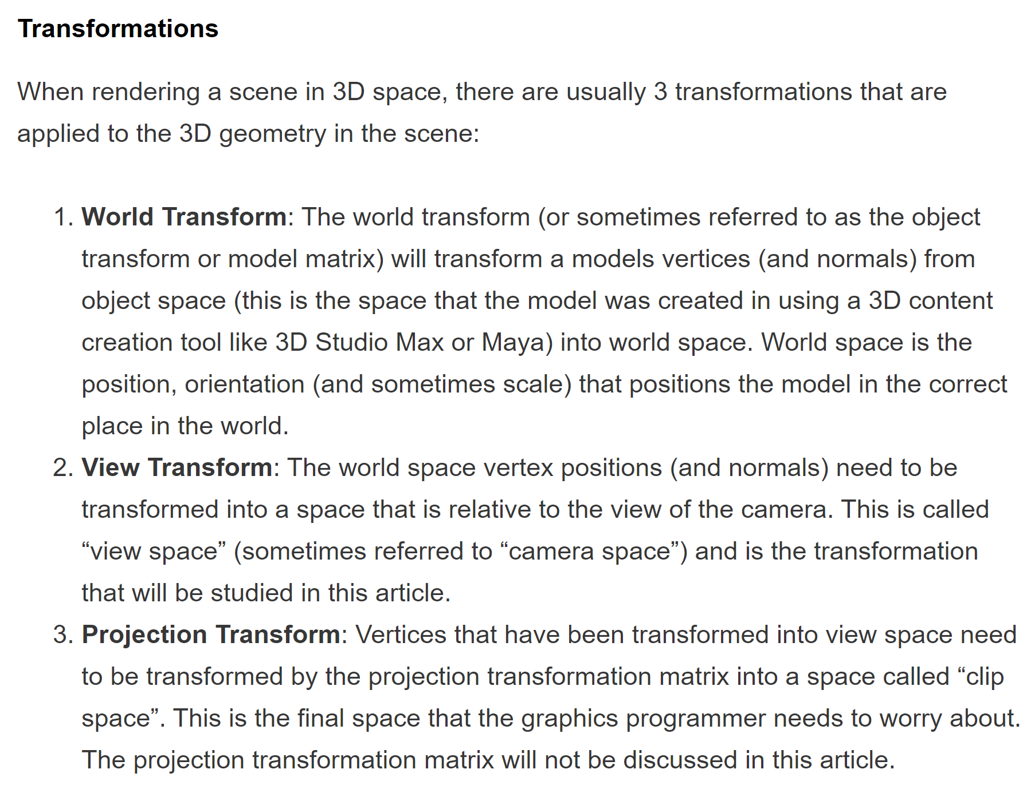
Spaces and Transformations
Local Space
World Space
View Space
NDC/Clip Space
Screen Space
Model
View
Projection
??? Scale

Slide 2
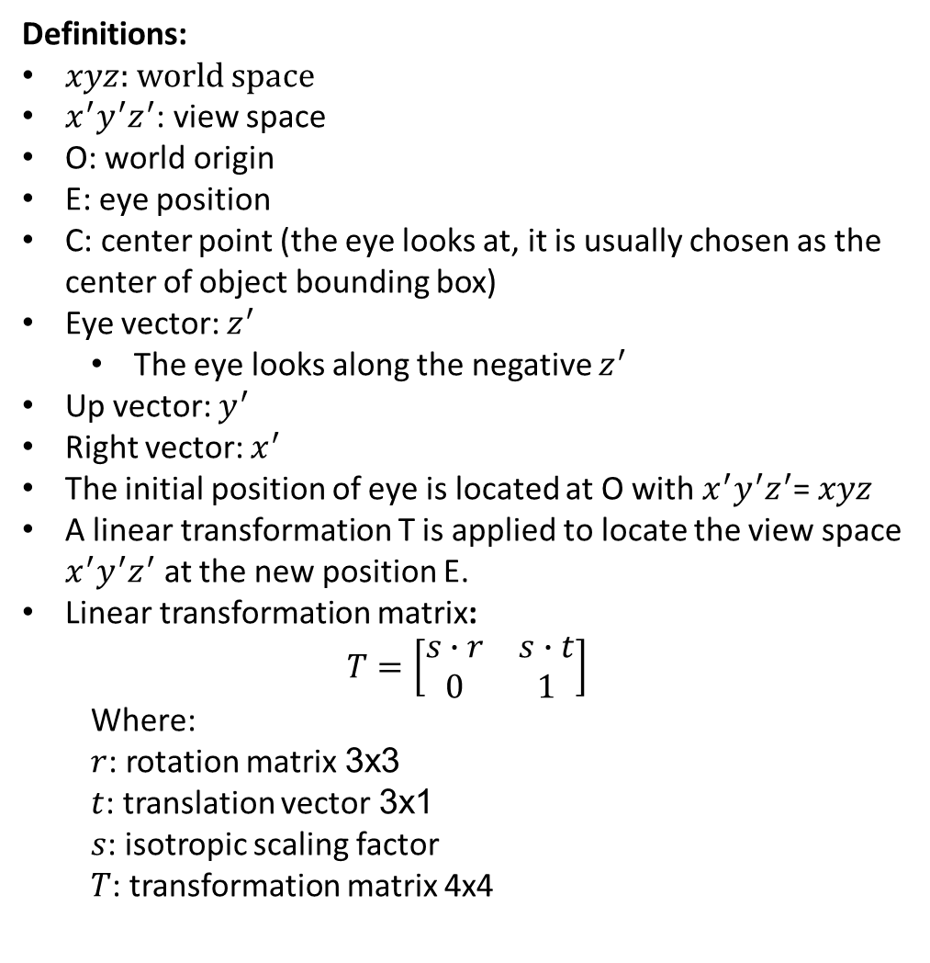






View Space
Definitions:
$xyz$: world space
${x^{′}y}^{′}z^{′}$: view space
O: world origin
E: eye position
C: center point (the eye looks at, it is usually chosen as the center of object bounding box)
Eye vector: $z^{′}$
The eye looks along the negative $z^{′}$
Up vector: $y^{′}$
Right vector: $x^{′}$
The initial position of eye is located at O with ${x^{′}y}^{′}z^{′}$= $xyz$
A linear transformation T is applied to locate the view space ${x^{′}y}^{′}z^{′}$ at the new position E.
Linear transformation matrix:
$$T=\left[\begin{matrix}s∙r & s∙t \\ 0 & 1\end{matrix}\right]$$
Where:
$r$: rotation matrix 3x3
$t$: translation vector 3x1
$s$: isotropic scaling factor
$T$: transformation matrix 4x4
$$y$$
C
$$y^{′}$$
O
$$x$$
$$x^{′}$$
E
$$z$$
$$z^{′}$$

Slide 3
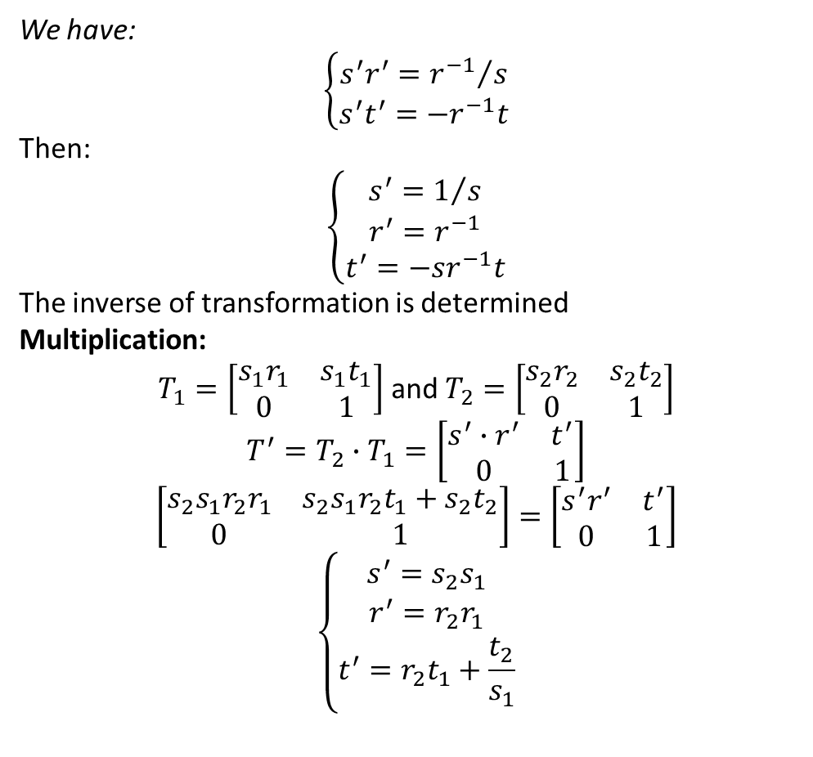
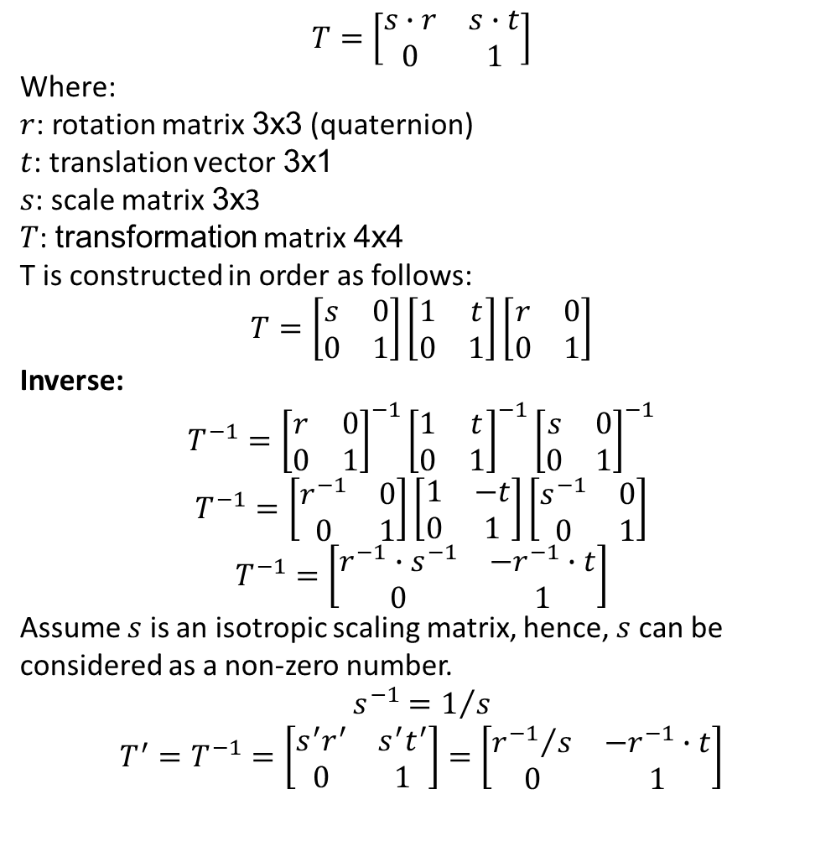
View Matrix
We have:
$$\left\{\begin{matrix}s^{′}r^{′}={r^{−1}}/s \\ s^{′}t^{′}=−r^{−1}t\end{matrix}\right.$$
Then:
$$\left\{\begin{matrix}s^{′}=1/s \\ r^{′}=r^{−1} \\ t^{′}=−sr^{−1}t\end{matrix}\right.$$
The inverse of transformation is determined
Multiplication:
$T_{1}=\left[\begin{matrix}s_{1}r_{1} & {s_{1}t}_{1} \\ 0 & 1\end{matrix}\right]$ and $T_{2}=\left[\begin{matrix}s_{2}r_{2} & {s_{2}t}_{2} \\ 0 & 1\end{matrix}\right]$
$$T^{′}=T_{2}∙T_{1}=\left[\begin{matrix}s^{′}∙r^{′} & t^{′} \\ 0 & 1\end{matrix}\right]$$
$$\left[\begin{matrix}s_{2}s_{1}r_{2}r_{1} & s_{2}s_{1}r_{2}t_{1}+{s_{2}t}_{2} \\ 0 & 1\end{matrix}\right]=\left[\begin{matrix}s^{′}r^{′} & t^{′} \\ 0 & 1\end{matrix}\right]$$
$$\left\{\begin{matrix}s^{′}=s_{2}s_{1} \\ r^{′}=r_{2}r_{1} \\ t^{′}=r_{2}t_{1}+\frac{t_{2}}{s_{1}}\end{matrix}\right.$$
$$T=\left[\begin{matrix}s∙r & s∙t \\ 0 & 1\end{matrix}\right]$$
Where:
$r$: rotation matrix 3x3 (quaternion)
$t$: translation vector 3x1
$s$: scale matrix 3x3
$T$: transformation matrix 4x4
T is constructed in order as follows:
$$T=\left[\begin{matrix}s & 0 \\ 0 & 1\end{matrix}\right]\left[\begin{matrix}1 & t \\ 0 & 1\end{matrix}\right]\left[\begin{matrix}r & 0 \\ 0 & 1\end{matrix}\right]$$
Inverse:
$$T^{−1}={\left[\begin{matrix}r & 0 \\ 0 & 1\end{matrix}\right]}^{−1}{\left[\begin{matrix}1 & t \\ 0 & 1\end{matrix}\right]}^{−1}{\left[\begin{matrix}s & 0 \\ 0 & 1\end{matrix}\right]}^{−1}$$
$$T^{−1}=\left[\begin{matrix}r^{−1} & 0 \\ 0 & 1\end{matrix}\right]\left[\begin{matrix}1 & −t \\ 0 & 1\end{matrix}\right]\left[\begin{matrix}s^{−1} & 0 \\ 0 & 1\end{matrix}\right]$$
$$T^{−1}=\left[\begin{matrix}r^{−1}∙s^{−1} & −r^{−1}∙t \\ 0 & 1\end{matrix}\right]$$
Assume $s$ is an isotropic scaling matrix, hence, $s$ can be considered as a non-zero number.
$$s^{−1}=1/s$$
$$T^{′}=T^{−1}=\left[\begin{matrix}s^{′}r^{′} & s^{′}t^{′} \\ 0 & 1\end{matrix}\right]=\left[\begin{matrix}{r^{−1}}/s & −r^{−1}∙t \\ 0 & 1\end{matrix}\right]$$

Slide 4
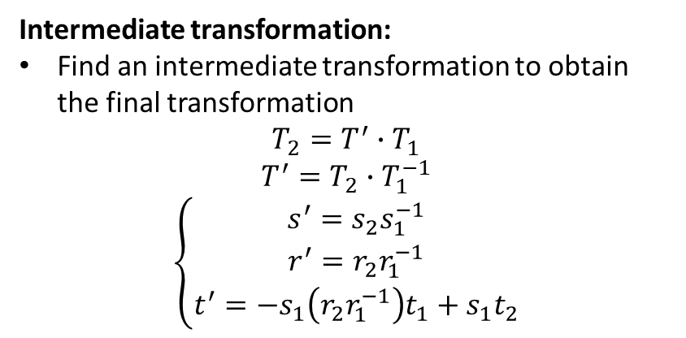
View Matrix
Intermediate transformation:
Find an intermediate transformation to obtain the final transformation
$$T_{2}=T^{′}∙T_{1}$$
$$T^{′}=T_{2}∙T_{1}^{−1}$$
$$\left\{\begin{matrix}s^{′}=s_{2}s_{1}^{−1} \\ r^{′}=r_{2}r_{1}^{−1} \\ t^{′}=−s_{1}\left(r_{2}r_{1}^{−1}\right)t_{1}+s_{1}t_{2}\end{matrix}\right.$$

Slide 5
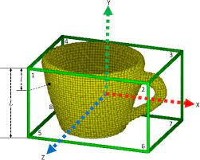
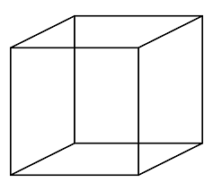
Bounding Box of Objects
$$y$$
A, B: two bounding points
C: center point
AB: diagonal distance
r=AB/2: radius of bounding box
R=OC+r: hud radius
A
C
O
$$x$$
B
$$z$$
Source: https://www.researchgate.net

Slide 6
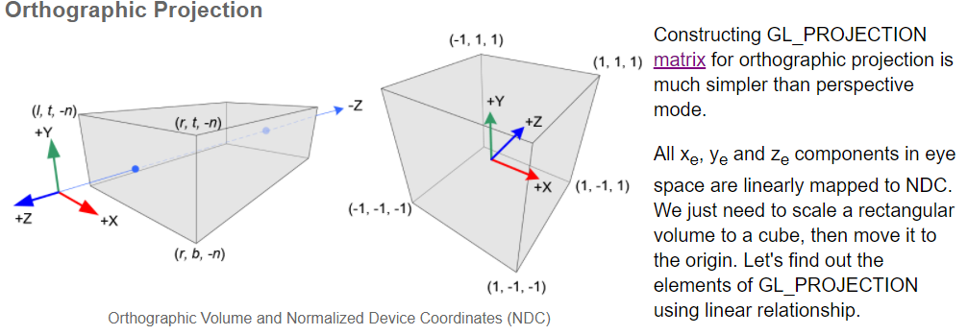
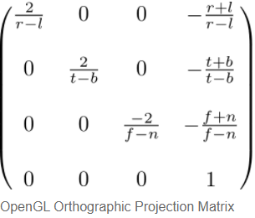
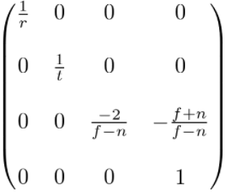
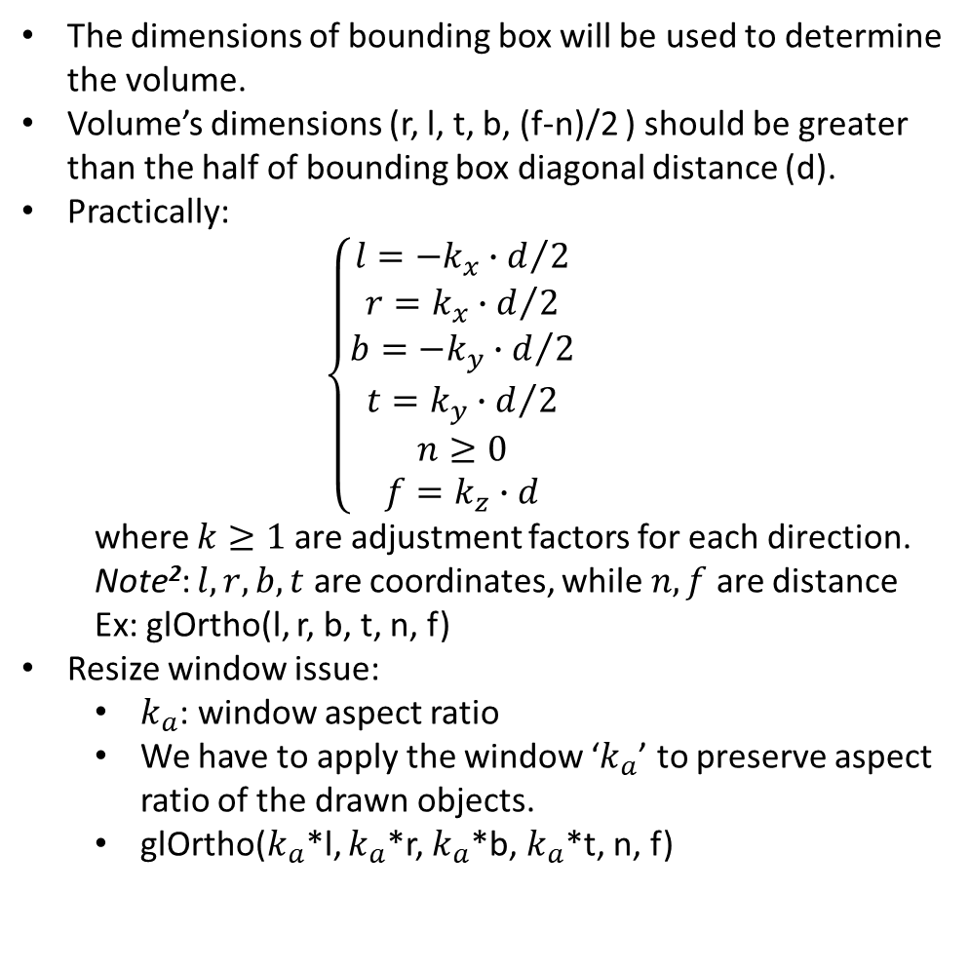
Orthographic projection
The dimensions of bounding box will be used to determine the volume.
Volume’s dimensions (r, l, t, b, (f-n)/2 ) should be greater than the half of bounding box diagonal distance (d).
Practically:
$$\left\{\begin{matrix}l=−k_{x}∙d/2 \\ r=k_{x}∙d/2 \\ \begin{matrix}b=−k_{y}∙d/2 \\ t=k_{y}∙d/2 \\ \begin{matrix}n≥0 \\ f=k_{z}∙d\end{matrix}\end{matrix}\end{matrix}\right.$$
where $k≥1$ are adjustment factors for each direction. Note²: $l,r,b,t$ are coordinates, while $n, f$ are distance
Ex: glOrtho(l, r, b, t, n, f)
Resize window issue:
$k_{a}$: window aspect ratio
We have to apply the window ‘$k_{a}$’ to preserve aspect ratio of the drawn objects.
glOrtho($k_{a}$*l, $k_{a}$*r, $k_{a}$*b, $k_{a}$*t, n, f)
Vertices located inside the volume will be visible.
The volume is defined by near plane and far plane located in the negative z-direction
Generic¹:
Symmetric:
Source 1: http://www.songho.ca/opengl/gl_projectionmatrix.html
Source 2: https://www.khronos.org/registry/OpenGL-Refpages/gl2.1/xhtml/glOrtho.xml

Slide 7
Window coordinate system
+W
+H

Slide 8
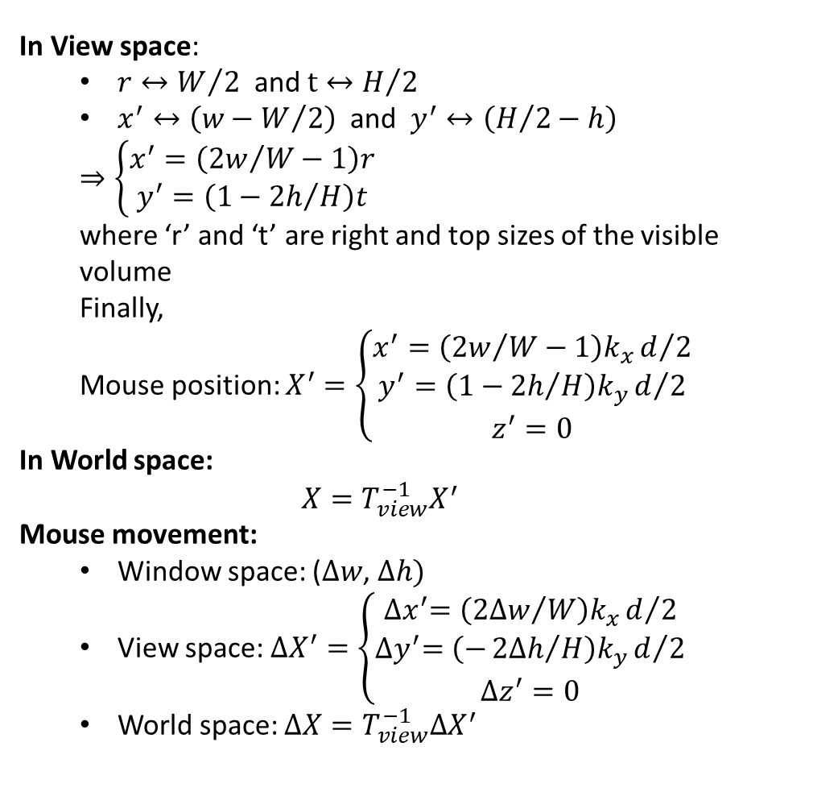
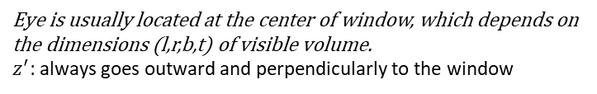

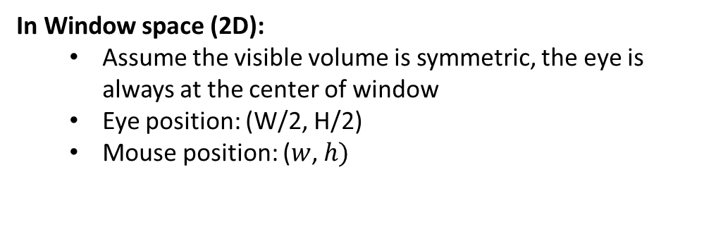



Mouse position
In View space:
$r↔W/2$ and $t↔H/2$
$x^{′}↔\left(w−W/2\right)$ and $y^{′}↔\left(H/2−h\right)$
$$⇒\left\{\begin{matrix}x^{′}=\left({2w}/W−1\right)r \\ y^{′}=\left(1−{2h}/H\right)t\end{matrix}\right.$$
where ‘r’ and ‘t’ are right and top sizes of the visible volume
Finally,
Mouse position: $X^{′}=\left\{\begin{matrix}x^{′}=\left({2w}/W−1\right)k_{x}d/2 \\ y^{′}=\left(1−{2h}/H\right)k_{y}d/2 \\ z^{′}=0\end{matrix}\right.$
In World space:
$$X=T_{view}^{−1}X^{′}$$
Mouse movement:
Window space: ($∆w$, $∆h)$
View space: $∆X^{′}=\left\{\begin{matrix}{∆x}^{′}=\left({2∆w}/W\right)k_{x}d/2 \\ {∆y}^{′}=\left(−{2∆h}/H\right)k_{y}d/2 \\ ∆z^{′}=0\end{matrix}\right.$
World space: $∆X=T_{view}^{−1}∆X^{′}$
$$y^{′}$$
Window origin
+W
$$h$$
$$w$$
mouse
eye
$$x^{′}$$
Eye is usually located at the center of window, which depends on the dimensions (l,r,b,t) of visible volume.
$z^{′}$: always goes outward and perpendicularly to the window
+H
In Window space (2D):
Assume the visible volume is symmetric, the eye is always at the center of window
Eye position: (W/2, H/2)
Mouse position: ($w$, $h)$

Slide 9






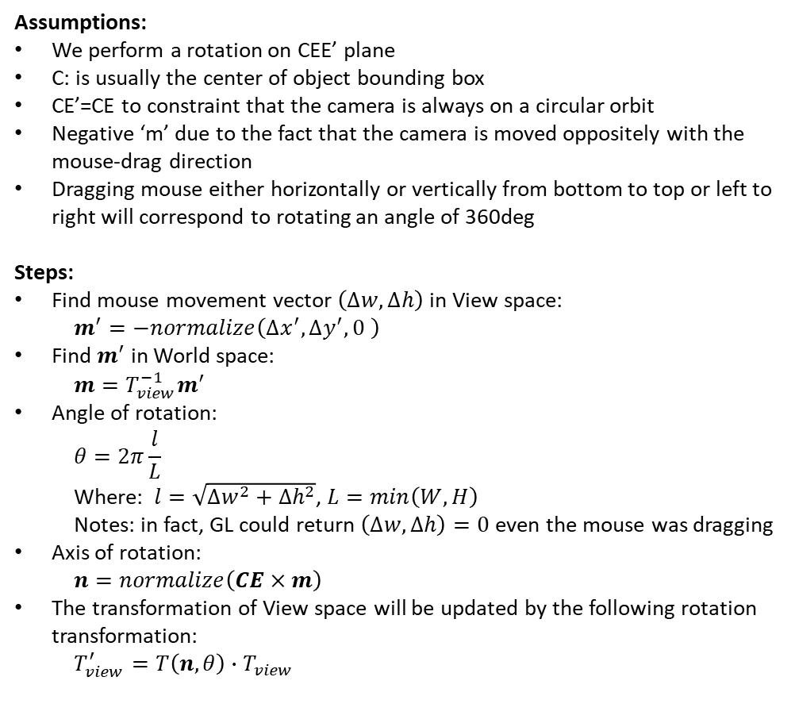


Mouse Movement – Rotate Camera
Assumptions:
We perform a rotation on CEE’ plane
C: is usually the center of object bounding box
CE’=CE to constraint that the camera is always on a circular orbit
Negative ‘m’ due to the fact that the camera is moved oppositely with the mouse-drag direction
Dragging mouse either horizontally or vertically from bottom to top or left to right will correspond to rotating an angle of 360deg
Steps:
Find mouse movement vector $\left(∆w,∆h\right)$ in View space:
$$m^{′}=−normalize\left({∆x}^{′},{∆y}^{′},0 \right)$$
Find $m^{′}$ in World space:
$$m=T_{view}^{−1}m^{′}$$
Angle of rotation:
$$θ=2π\frac{l}{L}$$
Where: $l=\sqrt{{∆w}^{2}+{∆h}^{2}}$, $L=min\left(W, H\right)$
Notes: in fact, GL could return $\left(∆w,∆h\right)=0$even the mouse was dragging
Axis of rotation:
$$n=normalize\left(CE×m\right)$$
The transformation of View space will be updated by the following rotation transformation:
$$T_{view}^{′}=T\left(n,θ\right)∙T_{view}$$
$$y$$
$$n$$
$$y^{′′}$$
$$x^{′′}$$
C
$$y^{′}$$
$$θ$$
E’
$$z^{′′}$$
O
$$x$$
$$m$$
$$x^{′}$$
E
$$z$$
$$z^{′}$$

Slide 10
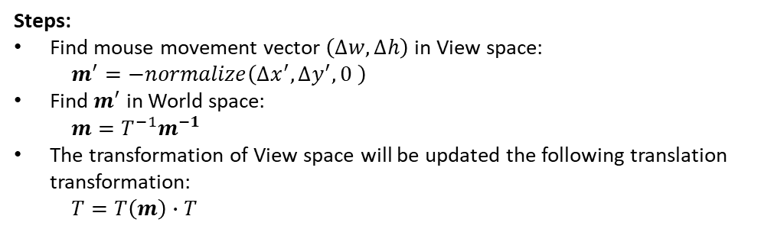




Mouse Movement – Translate Camera
$$y$$
$$y^{′′}$$
Steps:
Find mouse movement vector $\left(∆w,∆h\right)$ in View space:
$$m^{′}=−normalize\left({∆x}^{′},{∆y}^{′},0 \right)$$
Find $m^{′}$ in World space:
$$m=T^{−1}m^{−1}$$
The transformation of View space will be updated the following translation transformation:
$$T=T\left(m\right)∙T$$
$$x^{′′}$$
$$y^{′}$$
E’
O
$$x$$
$$m$$
$$x^{′}$$
$$z^{′′}$$
E
$$z$$
$$z^{′}$$

Slide 11
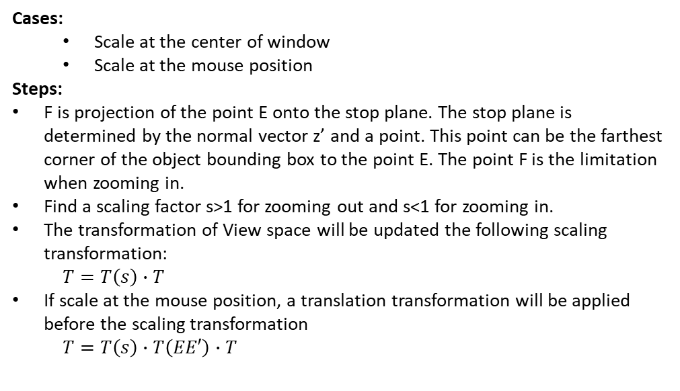


Mouse Movement – Scale Camera
$$y$$
Stop plane
Cases:
Scale at the center of window
Scale at the mouse position
Steps:
F is projection of the point E onto the stop plane. The stop plane is determined by the normal vector z’ and a point. This point can be the farthest corner of the object bounding box to the point E. The point F is the limitation when zooming in.
Find a scaling factor s>1 for zooming out and s<1 for zooming in.
The transformation of View space will be updated the following scaling transformation:
$$T=T\left(s\right)∙T$$
If scale at the mouse position, a translation transformation will be applied before the scaling transformation
$$T=T\left(s\right)∙T\left(EE′\right)∙T$$
$$F′$$
$$F$$
$$y^{′}$$
O
$$x$$
E’
$$x^{′}$$
E
$$z$$
$$z^{′}$$

Slide 12
Draw Internal Objects
Color bar
Draw it directly on the near plan of NDC space (x, y, z=-1)
Use QPainter to perform 2D draw on the top layer of GL window
Global directional triad
Determine the position of triad in the NDC space
Draw directly on the NDC space
Create the triad at the origin of NDC space. Also, the determine the correct length of arrows (Lx=L/r, Ly=L/t, Lz=L*2/(f-n)) so that the arrows will have the same length ‘L’ (length in world space) when displayed
Only apply the rotation part of the view matrix on the triad
Translate the triad to the determined position
Draw on the World space
Convert the position of triad from the NDC space to the world space
Create the triad at the origin of World space
Only apply the rotation part of the view matrix on the triad
Translate the triad to the determined position in World space

Slide 14
Rendering Pipeline
CPU/RAM
GPU
Accesses data
Runs shading process
Binds data
Frame Buffer
Processors
Vertex data (vertices, colors, normal, indices, etc.)
Instruction
Inserts instructions
Instructions can be customized to control the shading process via GLSL (OpenGL Shading Language)
https://www.khronos.org/registry/OpenGL/specs/gl/GLSLangSpec.4.40.pdf

Slide 16
Camera Matrix Vs View Matrix
Camera matrix is a transformation matrix which positions the camera in the world space
Whereas the view matrix is a transformation matrix which transforms vertices from world space into the view space
cam_mat * view_mat = unit_matrix
-> cam_mat = inv(view_mat) and vice versa

Slide 17
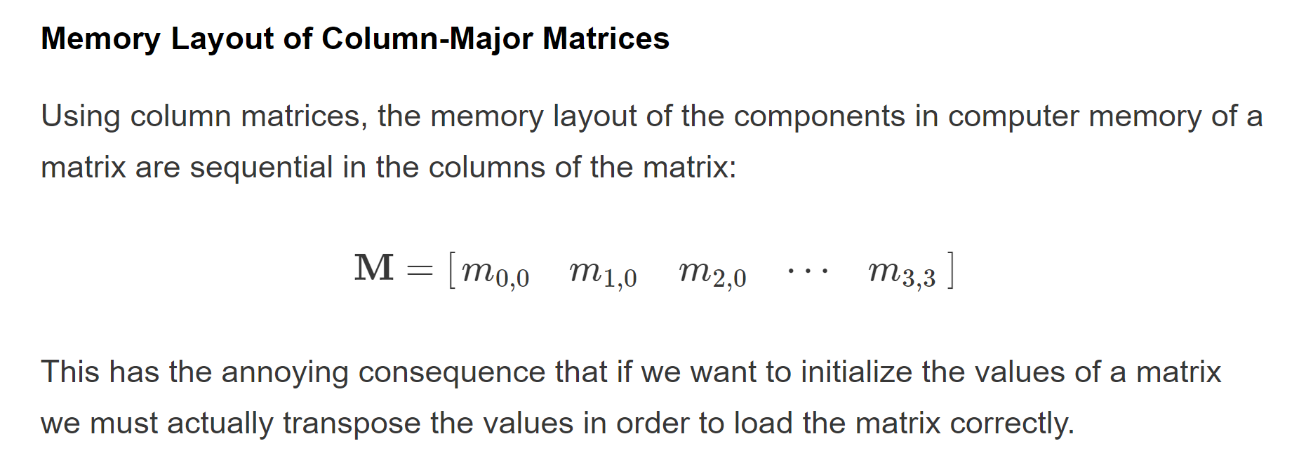
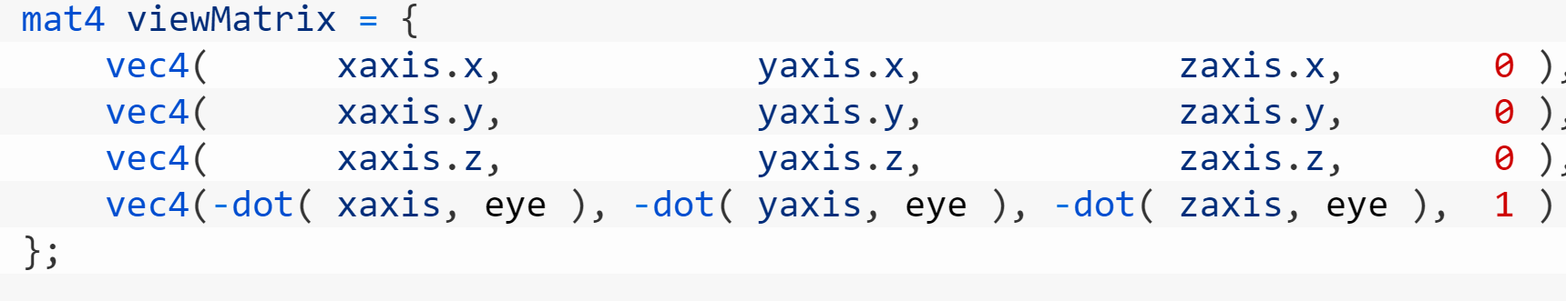
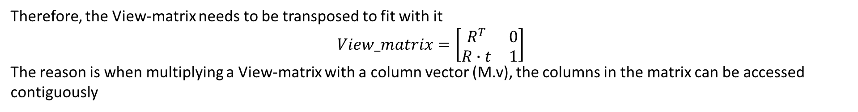
Note: Even we access entries of matrix by firstly ith-row and then jth-column, but the memory layout is sequential in column
Therefore, the View-matrix needs to be transposed to fit with it
$$View_matrix=\left[\begin{matrix}R^{T} & 0 \\ R∙t & 1\end{matrix}\right]$$
The reason is when multiplying a View-matrix with a column vector (M.v), the columns in the matrix can be accessed contiguously
Reference: https://www.3dgep.com/understanding-the-view-matrix/#Look_At_Camera
Column 1

Slide 18
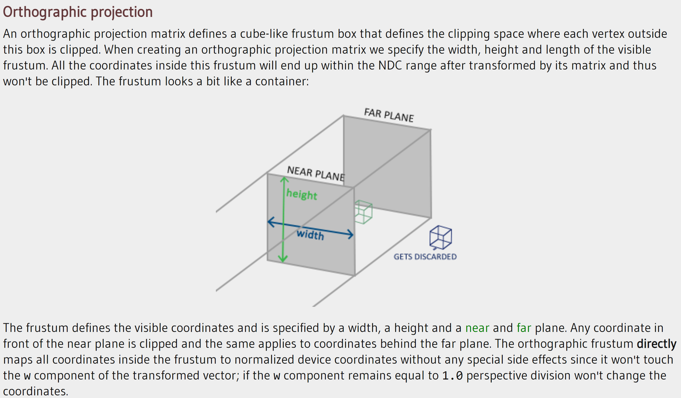
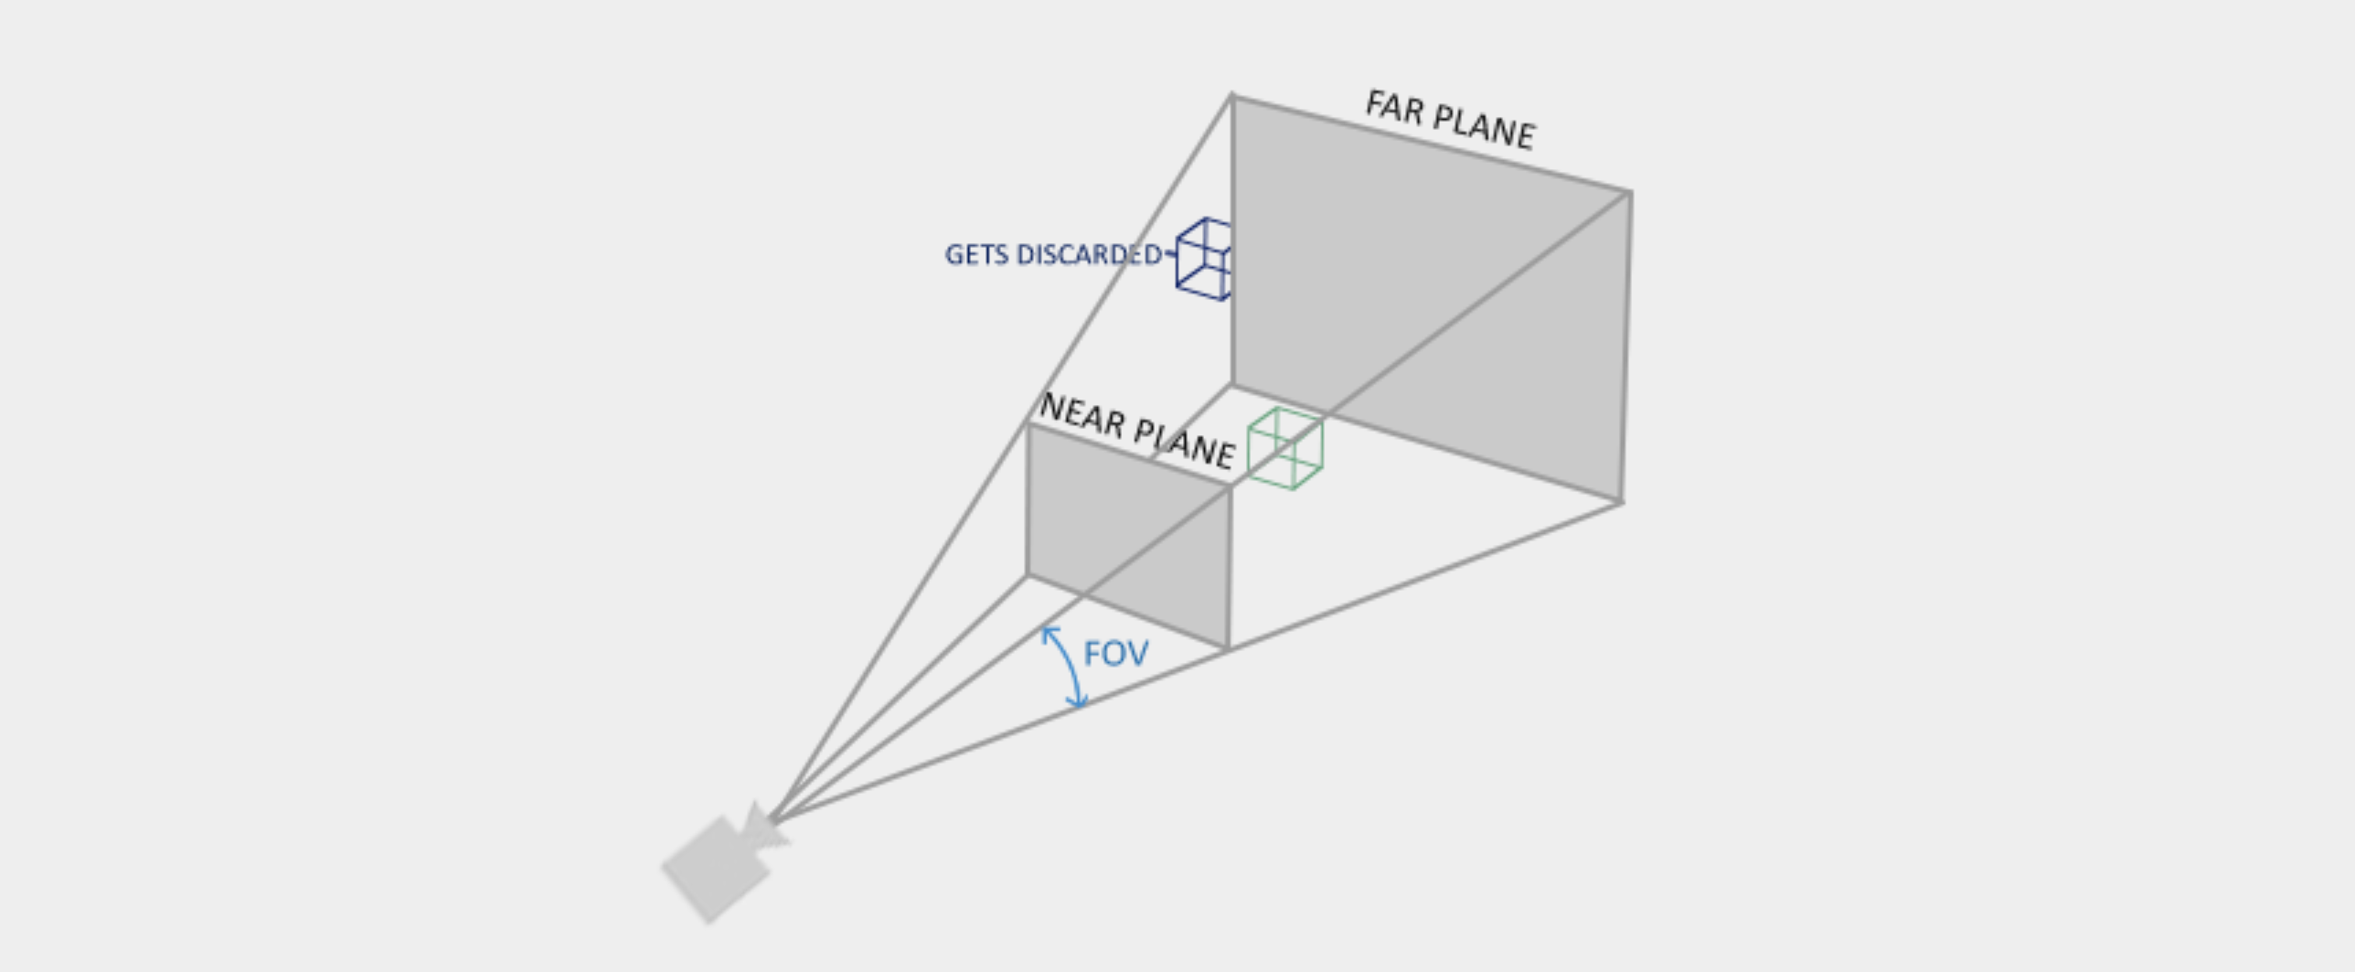
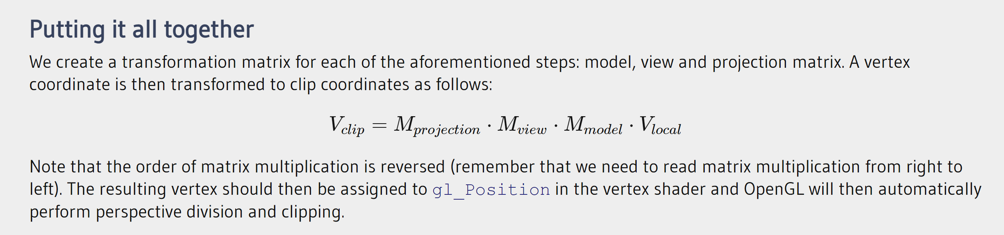
Clip space
https://learnopengl.com/Getting-started/Coordinate-Systems

Slide 19
https://nrotella.github.io/journal/first-steps-python-qt-opengl.html

