Slide 1
Security Analysis Presentation

Slide 2
Initial Premise
CyberSecurity Threats Are On The Rise
Reported Data Breaches in 2015
781
Estimated Global Cost of Cyber Attacks Annually
$400 Billion
Projected Global Cost of Cyber Attacks in 2019
$2.1 Trillion
Average Annual Amount of CyberSecurity Incidents
80-90 million

Slide 3
Initial Premise
What can we do to mitigate this situation?
Analysis of existing cyber attack data
Attempt to find patterns and/or other identifiable nuances that could possibly help us prevent attacks to valued resources
Updating our systems to the latest technologies
Keeping systems updated prevents us from being exposed to vulnerabilities that are already patched and/or mitigated. Allows us to minimize the amount of risk that our systems are vulnerable to.
Leveraging Machine Learning
Using machine learning algorithms we could possibly automate the process of Data Analysis using specific algorithms designed for identifying clusters in data. This data would serve to help us identify certain recurring themes within isolated and group attacks, possibly allowing us to shore up our defenses when and where necessary.

Slide 4
Data
Real Production Environment
Real Attacks Received From External Forces
Location: Marist College
System Attacked: Marist Mainframes located in Donnelly
Logging System: BlackRidge 1Gb Authentication Gateway
GeoLocation-ISP: geo_cheese v. 1.0 Python Module
Data Collected
SRC_IP: What IP address did the attack originated from
SRC_Port: What port was the attack sent out of
DEST_IP: What IP address was targeted
DEST_Port: Which port was targeted
City: The city of the Attacking IP Address
Host: Host address of the attacking IP’s ISP
Subdivision: The principality of the attacking IP Address
Name: The name of the Attacking IP’s ISP
Host_IP: The Attacking IP’s ISP IP
Lat/Long: The latitude and longitude associated with the Attacking IP
Country: The country of the Attacking IP
Postal: Postal Code (if applicable) of the Attacking IP
ASN: Autonomous System Number of ISP

Slide 5
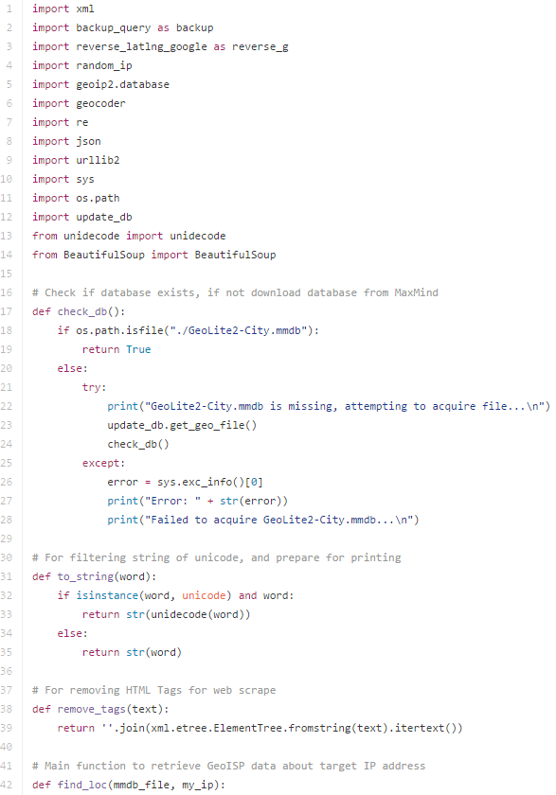
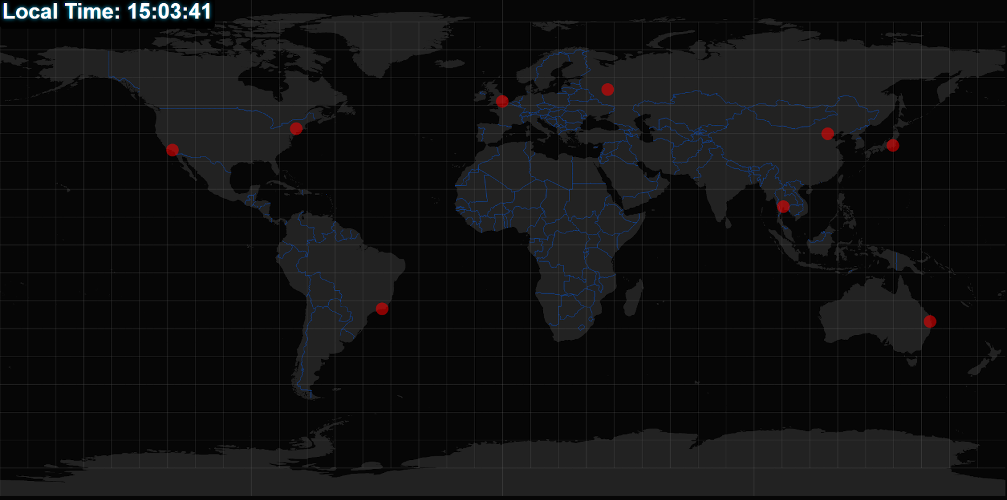
GeoLocation-ISP

Slide 6
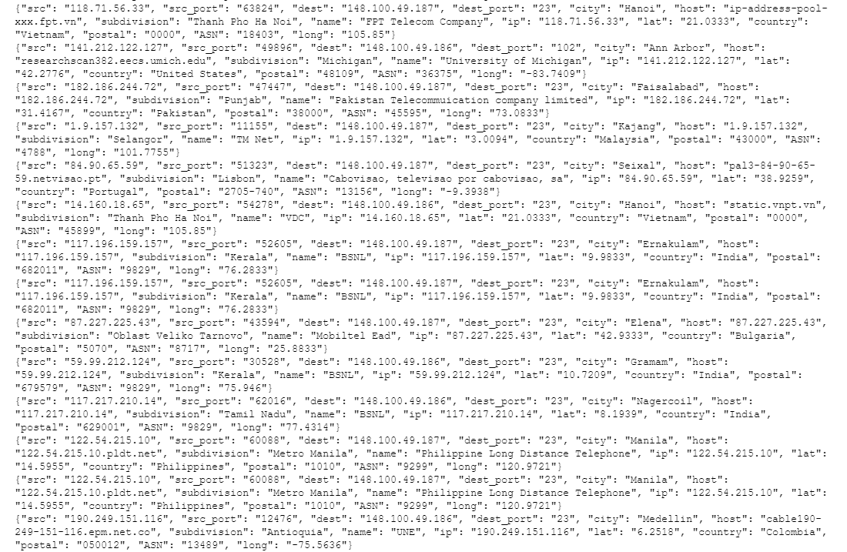
Data

Slide 7
K-Means.py
k-means clustering is a method of vector quantization, originally from signal processing, that is popular for cluster analysis in data mining. k-means clustering aims to partition n observations into k clusters in which each observation belongs to the cluster with the nearest mean, serving as a prototype of the cluster. This results in a partitioning of the data space into Voronoi cells.
The problem is computationally difficult (NP-hard); however, there are efficient heuristic algorithms that are commonly employed and converge quickly to a local optimum. These are usually similar to the expectation-maximization algorithm for mixtures of Gaussian distributions via an iterative refinement approach employed by both algorithms. Additionally, they both use cluster centers to model the data; however, k-means clustering tends to find clusters of comparable spatial extent, while the expectation-maximization mechanism allows clusters to have different shapes.
The algorithm has a loose relationship to the k-nearest neighbor classifier, a popular machine learning technique for classification that is often confused with k-means because of the k in the name. One can apply the 1-nearest neighbor classifier on the cluster centers obtained by k-means to classify new data into the existing clusters. This is known as nearest centroid classifier or Rocchio algorithm

Slide 8

K-Means.py
Given a set of observations (x₁, x₂, …, x_{n}), where each observation is a d-dimensional real vector, k-means clustering aims to partition the n observations into k (≤ n) sets S = {S₁, S₂, …, S_{k}} so as to minimize the within-cluster sum of squares (WCSS) (sum of distance functions of each point in the cluster to the K center). In other words, its objective is to find:
where μ_{i} is the mean of points in S_{i}.

Slide 9
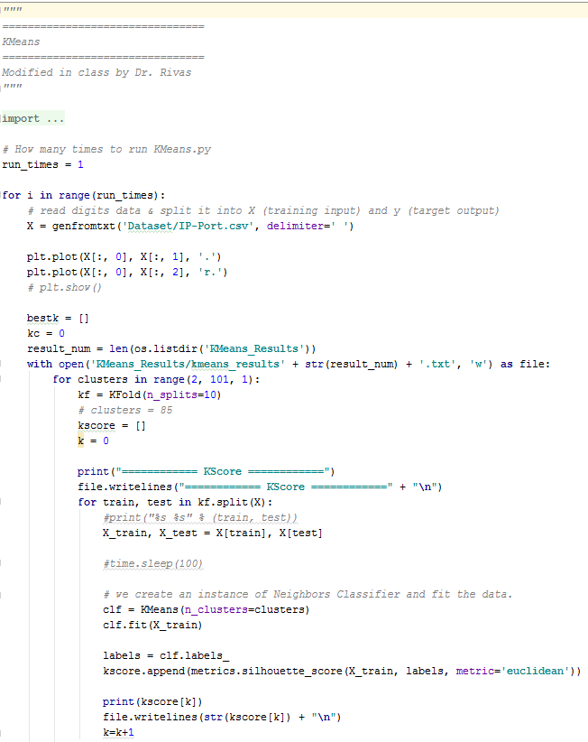
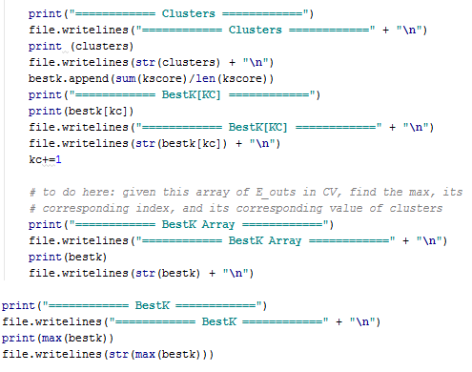
K-Means.py

Slide 10
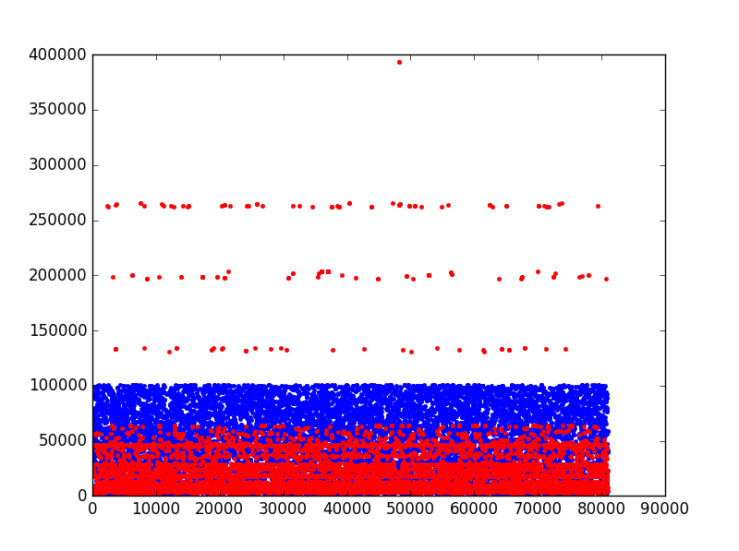
Graph of Data

Slide 11
K-Means Results
============ BestK Array ============
[0.32275529884040943, 0.3476449452820386, 0.33865681258417046, 0.34637379668274176, 0.32932986508833562, 0.32832920977268981, 0.31320283348200539, 0.31886748405655435, 0.31820892144513224, 0.31845371261665029, 0.32046593104135479, 0.32286548256595637, 0.32056327021535508, 0.31722276199635341, 0.31584830049232065, 0.31188241179739828, 0.31112891627456252, 0.30947299719065718, 0.30760707749542526, 0.3084086056466363, 0.30368203309162312, 0.30508395648202868, 0.30252013717324239, 0.30046506435532061, 0.30177186741724688, 0.30171240375402286, 0.29830348375265492, 0.30183261163338165, 0.30283258149465986, 0.30404816961996295, 0.30261316683214728, 0.30453145554052014, 0.30538318604391407, 0.30391821459526691, 0.30582448451648764, 0.30637133408877071, 0.3032977782033654, 0.30487187395570231, 0.30435387759016252, 0.3042724634594095, 0.30350387339127938, 0.30495206161168464, 0.30436961450241745, 0.30350062274920558, 0.30461153064788088, 0.30434630177151117, 0.30506188045178184, 0.30494880108241496, 0.30258117377571586, 0.30418233062111366, 0.30122629571454979, 0.30251978749831865, 0.30319461501828565, 0.30495433069524458, 0.3035787223820311, 0.30414482543574606, 0.30381740183736239, 0.3028383016343934, 0.30340374154819499, 0.30305707503319124, 0.30295986512645334, 0.30081422083849496, 0.30234574575792245, 0.30096957882411346, 0.30328101374168165, 0.30522020348313961, 0.30102153923611474, 0.30261311089488058, 0.30266999369057207, 0.30379765727671815, 0.30333409181821602, 0.30413308936767064, 0.30316524204455975, 0.30449222953493049, 0.30368704555489495, 0.30334009880590401, 0.30234806390945862, 0.30460630148040513, 0.30226308569850124, 0.30463881099772944, 0.30613710647376197, 0.30527782926172753, 0.303974427245221, 0.30417299145636029, 0.30542883076145538, 0.30501248019413707, 0.3035779083918414, 0.30521295645669044, 0.30405001953743016, 0.30694141289619126, 0.30362681004183528, 0.30405982631441669, 0.30455052007273747, 0.30521351727692236, 0.30548936544538952, 0.30550292450903982, 0.30481011218268017, 0.30583745561796144, 0.30620261289739414]
============ BestK ============
0.347644945282

Slide 12
Moving Forward
Apply more datasets to be analyzed by K-Means.py
Spectral Analysis
In multivariate statistics and the clustering of data, spectral clustering techniques make use of the spectrum (eigenvalues) of the similarity matrix of the data to perform dimensionality reduction before clustering in fewer dimensions. The similarity matrix is provided as an input and consists of a quantitative assessment of the relative similarity of each pair of points in the dataset.
In application to image segmentation, spectral clustering is known as segmentation-based object categorization.
More Perspective
More Real World Application

Slide 13
Spectral Clustering
Traceback (most recent call last):
File "C:/Users/Tien/Documents/GitHub/CMPT404-ARTIFICAL-INTELLIGENCE/Liengtiraphan-Project/Project Resources/Spectral_Clustering.py", line 50, in <module>
clf.fit(X_train)
File "C:\Users\Tien\Anaconda3\lib\site-packages\sklearn\cluster\spectral.py", line 463, in fit
assign_labels=self.assign_labels)
File "C:\Users\Tien\Anaconda3\lib\site-packages\sklearn\cluster\spectral.py", line 258, in spectral_clustering
eigen_tol=eigen_tol, drop_first=False)
File "C:\Users\Tien\Anaconda3\lib\site-packages\sklearn\manifold\spectral_embedding_.py", line 312, in spectral_embedding
largest=False, maxiter=2000)
File "C:\Users\Tien\Anaconda3\lib\site-packages\scipy\sparse\linalg\eigen\lobpcg\lobpcg.py", line 455, in lobpcg
activeBlockVectorBP, retInvR=True)
File "C:\Users\Tien\Anaconda3\lib\site-packages\scipy\sparse\linalg\eigen\lobpcg\lobpcg.py", line 101, in _b_orthonormalize
gramVBV = cholesky(gramVBV)
File "C:\Users\Tien\Anaconda3\lib\site-packages\scipy\linalg\decomp_cholesky.py", line 81, in cholesky
check_finite=check_finite)
File "C:\Users\Tien\Anaconda3\lib\site-packages\scipy\linalg\decomp_cholesky.py", line 30, in _cholesky
raise LinAlgError("%d-th leading minor not positive definite" % info)
numpy.linalg.linalg.LinAlgError: 6-th leading minor not positive definite

