Slide 1








Data Management 2
Prof. Dr. Ajinkya Prabhune​
Academic Researcher: Ashish Chouhan
By: Nguyen Ngoc Quyen

Slide 2





Business Case
Covid 19
Global Hunger due to Insecure food supply …
World Food Project to support citizens (Food data analyst for decision making)
Russia vs Ukraine
Global warming

Slide 3
Smart Strategy Board
Purpose Panel
Purpose: fighting hunger globally
Vision: a world where everyone always has access to the food needed for an active and healthy life.
Customer Panel
Finance Panel
Competition and Risk Panel
Target Market: all countries, especially developing countries
Finance Objectives: is funded entirely by voluntary grants with USD 13.5 Billion in 2021, planned to distribute it to the Global Food Program
Value Proposition: Sustainable Development, call to action and prioritizes ending hunger and food insecurity
Competition factors and Risk: What is threatening our success?
Wars
Points of view from political/ billionaire
Global warming
Operations Panel
Partners: WHO, UN Volunteers, United Nations Multi-Partner Trust Fund, UN Office for South-South Cooperation, and United Nations Capital Development Fund
Core Competences: Providing assistance in emergencies and crises and saving lives and livelihoods
Resources Panel
IT Systems and Data: Data Innovation Lab; a Data Visualization platform and dashboard; the World Forum on Sustainable Development Data; and the UN System Data Catalog
Infrastructure: Direct provision of food, cash or vouchers, economic and social development, logistic services
People & Talent: full time employees and mostly volunteers (no pay) online and offline from worldwide
Culture, Value, Leadership: International workplace, open to feedback, relax working environment with support. However, there is internal politics, favoritism

Slide 4





ETL Pipeline
Store
Extract
Transform
Load
Historical data downloaded from https://data.humdata.org/dataset/wfp-food-prices
Store original dataset in Google Shared Drive
Data cleaning, Profiling, Star Schema
Store Star Schema dataset in GSD
Data visualization & Forecasting

Slide 5

Dataset
Columns: 24 (including 5 primary keys)
Original dataset: Global Food Prices data from the World Food Program covering foods price such as maize, rice, beans, fish, and sugar for 76 countries and some 1,500 markets. For our business story, India and Vietnam are filtered for analysis
Data Shape: 137370 x 24
Data type: integer, float, string, and date
Food dataset
wfpvam_foodprices.csv
https://data.humdata.org

Slide 6
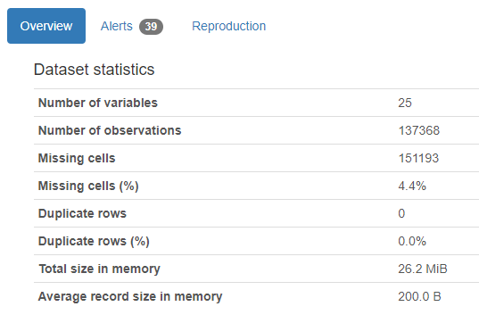
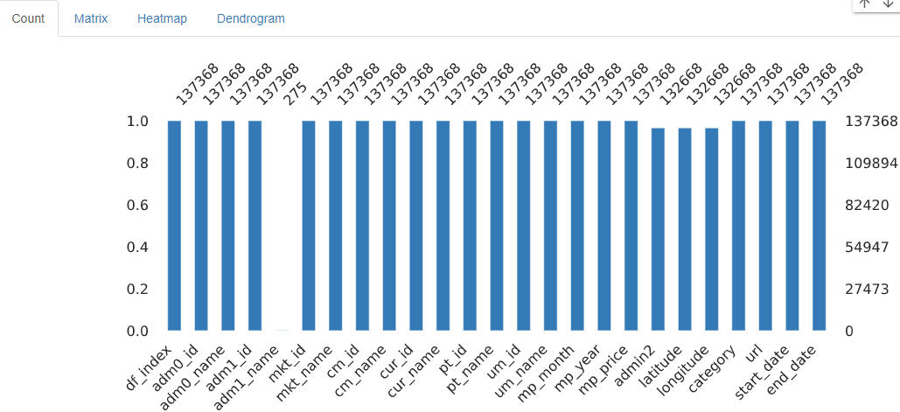
Data Profiling
The data profiling: Python- library ProfileReport with respect to the different data quality dimensions.​​
After profiling, found that mostly data is clean except unnecessary row, incorrect data type and blank values.

Slide 7

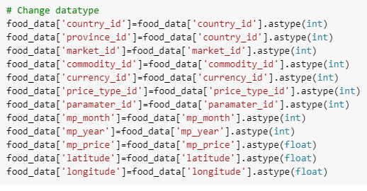
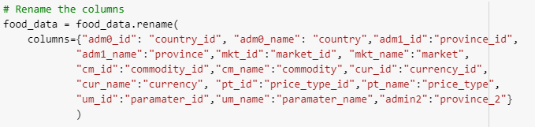
Data Cleaning
Tool: Python/Google Colab
Task:
Remove the second row in dataset
Rename the columns
Update data type

Slide 8
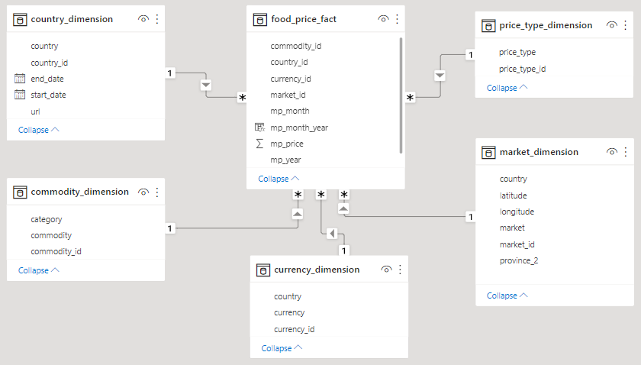
Star Schema
Before: original dataset (24 columns with 5 primary keys)
After: split columns
Country Dimension table
Commodity Dimension table
Currency Dimension table
Market Dimension table
Price Type Dimension table
Food Price Fact table

Slide 9
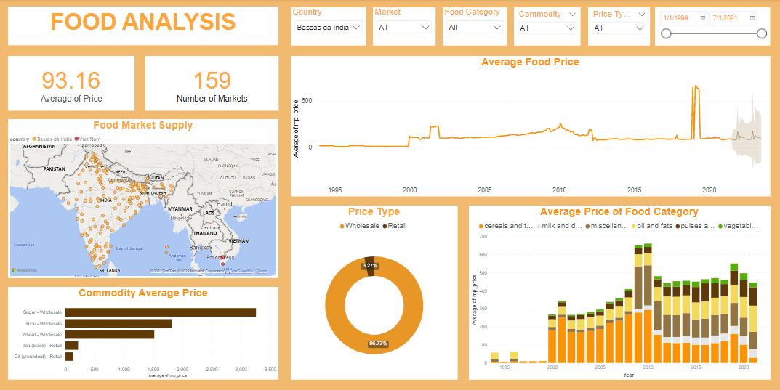
Load for user story

Slide 10
Demo & Thank You

Slide 11
Reference
https://data.humdata.org/dataset/wfp-food-prices
https://rom-io.diplo.de/fao-en/un-rome-based-agencies/world-food-programme-wfp/-/1345766?openAccordionId=item-2303034-0-panel#content_1
https://unsceb.org/topics/data-and-statistics
https://www.indeed.com/cmp/United-Nations/reviews?ftopic=culture

