Slide 1




Data Engineering 2 Nov-Dec 2021
Prepared by: Nguyen Ngoc Quyen

Slide 2



Movie Analysis
Advertiser: EDA for online adv campaign

Slide 3


Advertiser
Product: Movie (language English)
Year: 2021 (real time)
Target: run online advertising/marketing campaign for Dec 2021 holiday coming
Objectives
1. Look for the data from Movie website
2. API Python connection to extract data
3. Python data pre-processing/cleaning
4. Python upload data to GCP (Cloud storage)
5. Power BI connects with Google Big Query
6. Power BI data visualization
Process

Slide 4
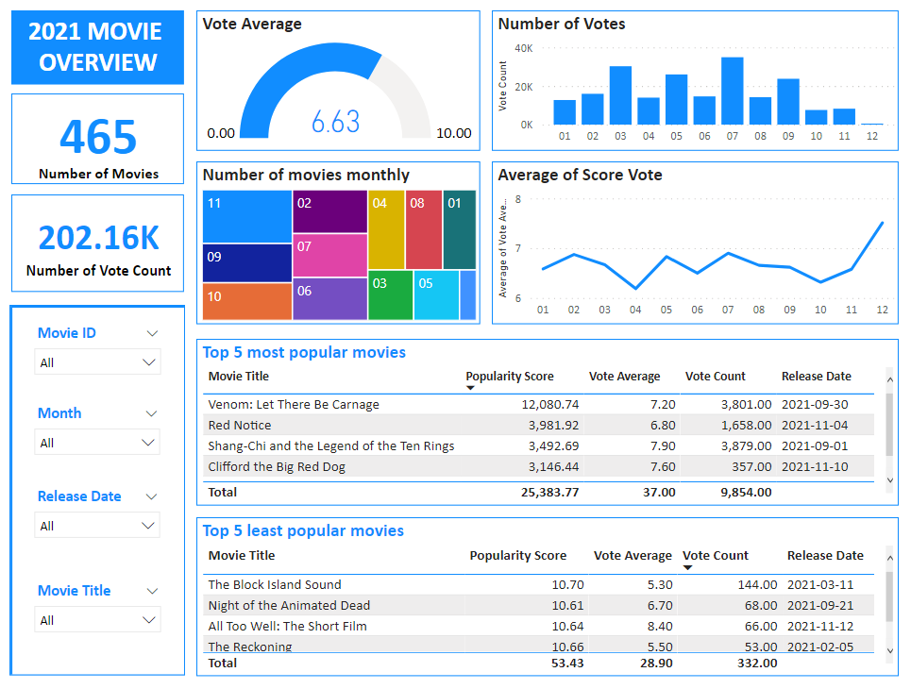
Advertiser

