Slide 1
Preventing Customer Churn, Identifying Hidden Segments and Improving Satisfaction of Pharmaceutical Drug Users
By: Yuan Tieming

Slide 2
Problem Statement
Pharmaceutical companies are facing the challenge of customer churn. Unhappy customers are switching to other companies and giving bad reviews that might negatively impact their brand value. Therefore, there is a need to efficiently identify unhappy customers and quickly conduct customer recovery. Companies will also need to make improvements to their drugs after gathering more information from unsatisfied customers. Besides that, pharmaceutical companies will need to know their customer segments in order to provide tailored services to enhance customer experience and also to develop marketing strategies to boost sales. Lastly, companies will need to efficiently recommend medicines to customers based on their condition or switch drugs when customer is not satisfied with their existing drug.
Therefore, our problem statement can be summed up to: preventing customer churn, identify hidden segments and improving satisfaction.
Pharmaceutical companies, clinics and hospitals will benefit from this project. It will help them to reduce customer churn, improve their service offering and making their business more profitable. Patients will also benefit from better service and more effective medicines.

Slide 3
Contents
Methodology
Exploratory Data Analysis
Sentiment Classification
Clustering
Recommender System
Conclusion and recommendation

Slide 4
Methodology
Data Inspection
Exploratory Data Analysis
Data Pre-processing
Classification Modelling
Clustering
Recommender

Slide 5
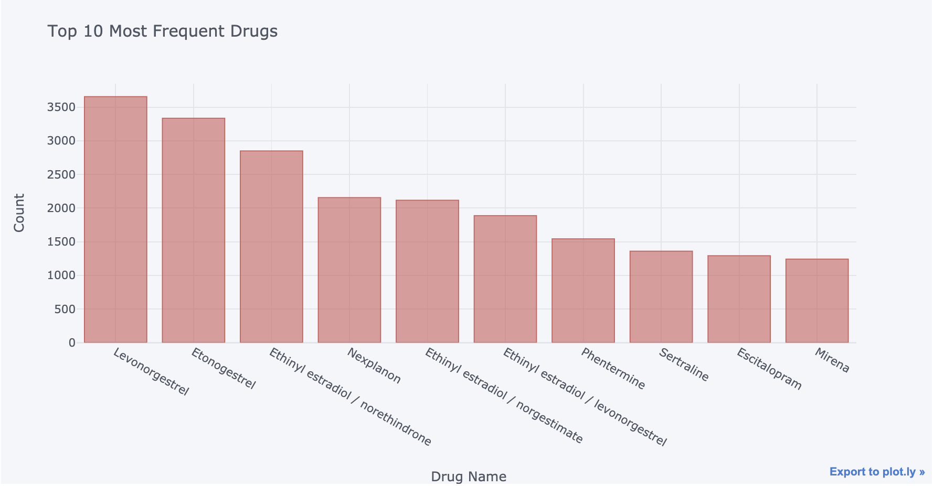
Exploratory Data Analysis

Slide 6
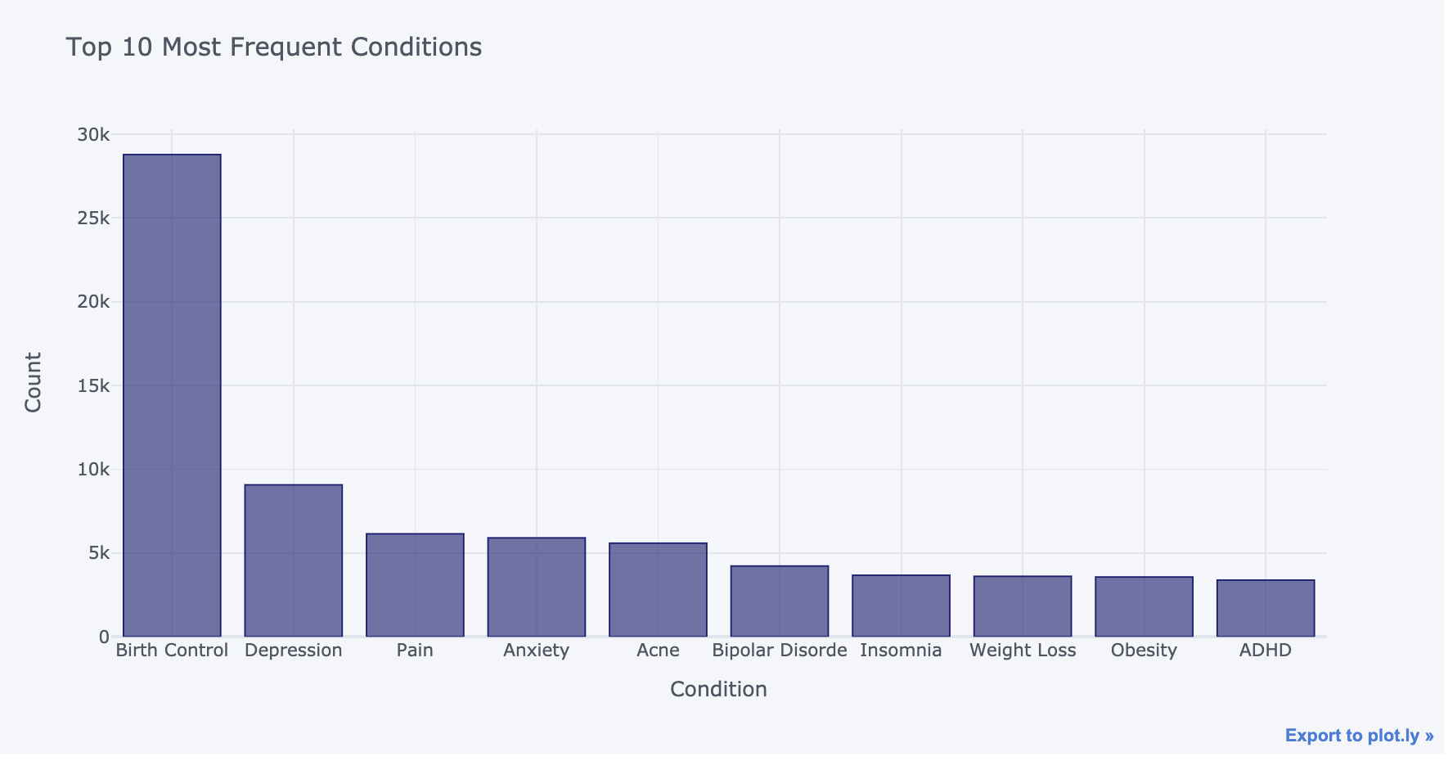
Exploratory Data Analysis

Slide 7
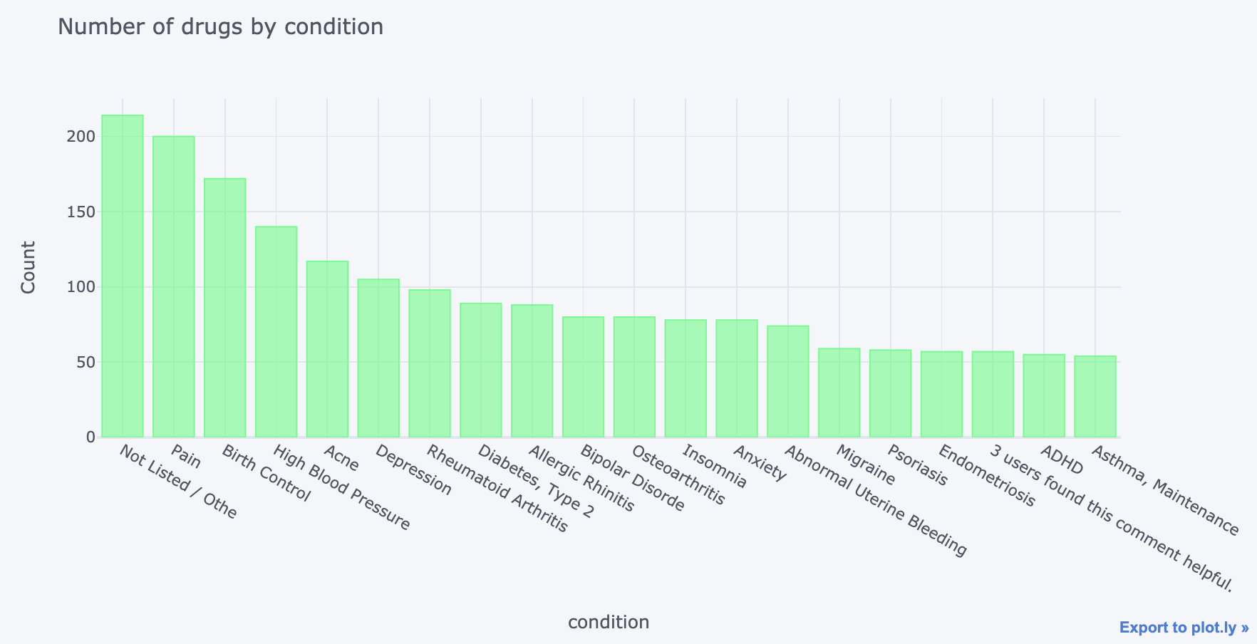
Exploratory Data Analysis

Slide 8
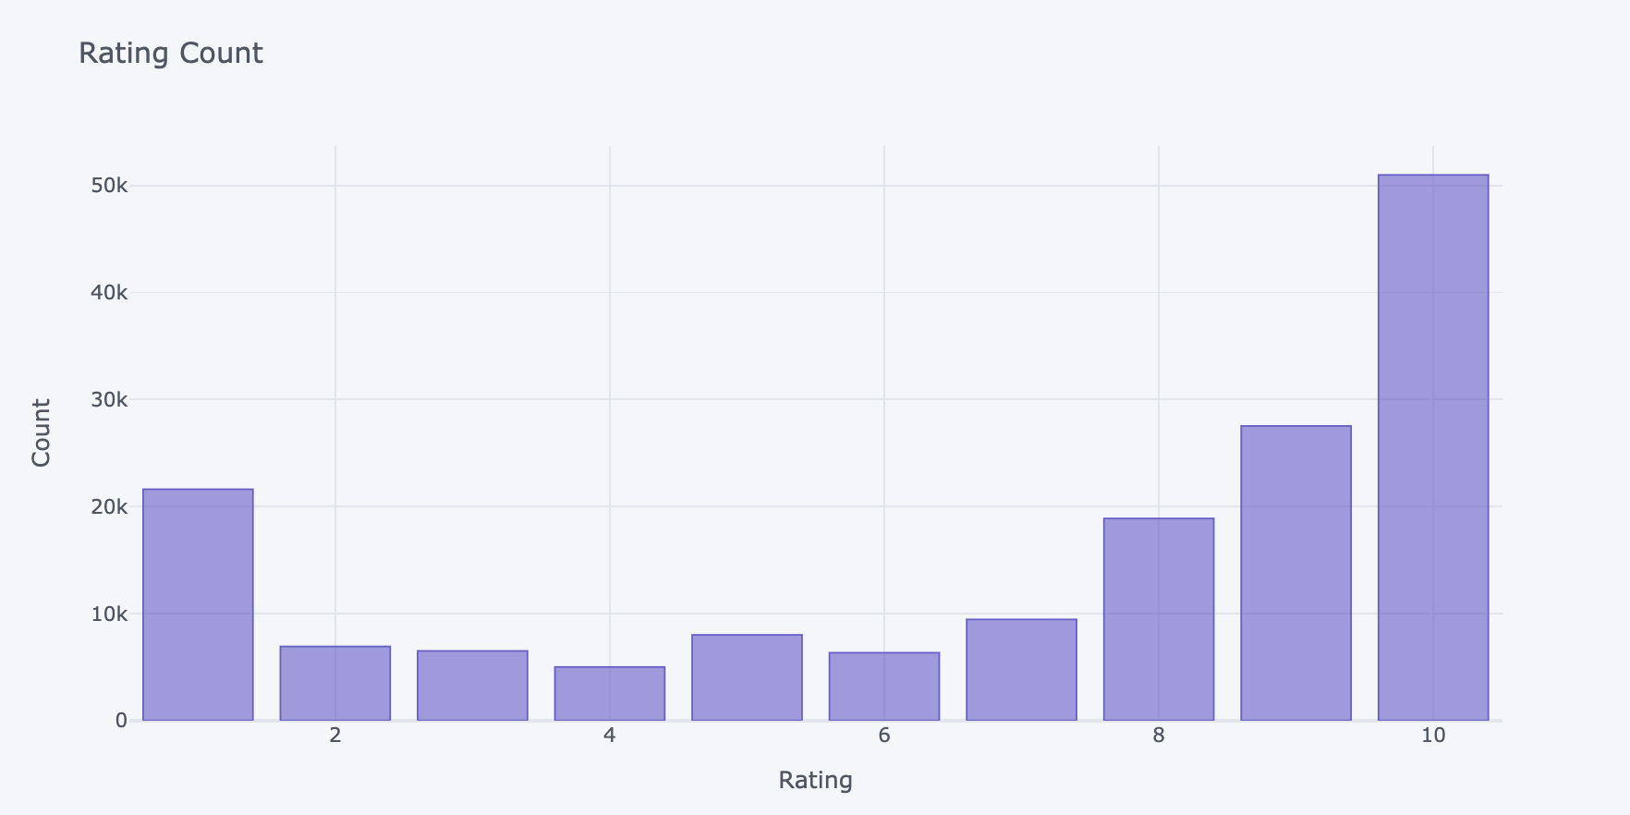
Exploratory Data Analysis

Slide 9
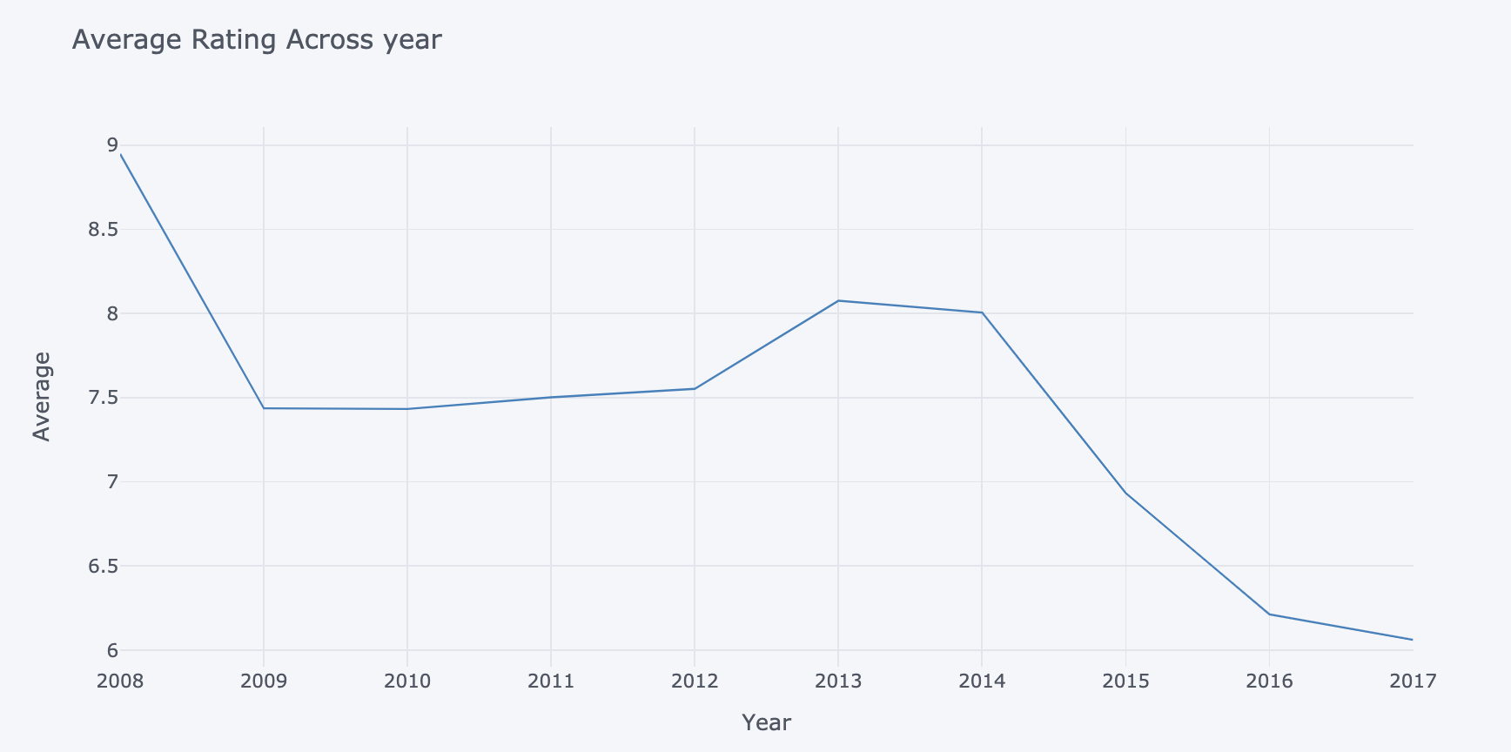
Exploratory Data Analysis

Slide 10
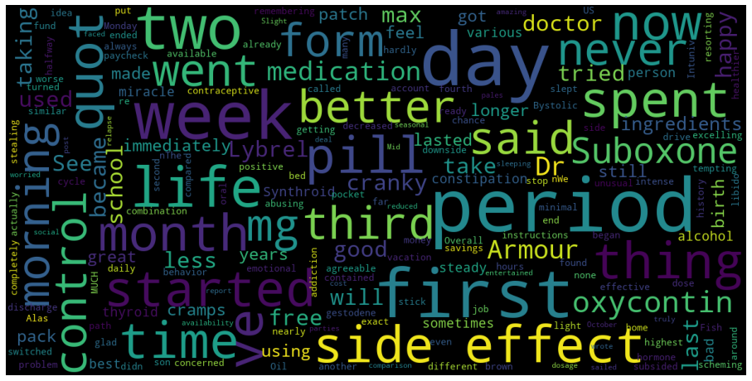
Exploratory Data Analysis

Slide 11
Classification Models
Training Models | Accuracy | Precision | Recall
Base Line | 0.5 | - | -
Logistic Regression | 0.82 | 0.83 | 0.81
Naïve Bayes | 0.78 | 0.77 | 0.78
Random Forest | 0.93 | 0.94 | 0.92
XGBoost | 0.74 | 0.76 | 0.70
Neural Network | 0.91 | 0.93 | 0.88
Testing Models | Accuracy | Precision | Recall
Logistic Regression | 0.84 | 0.86 | 0.92
Random Forest | 0.91 | 0.91 | 0.98

Slide 12
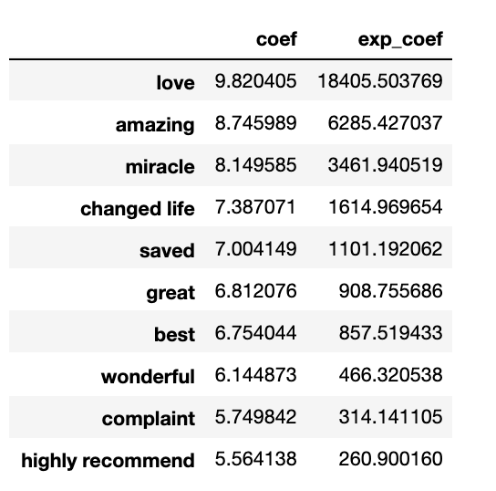
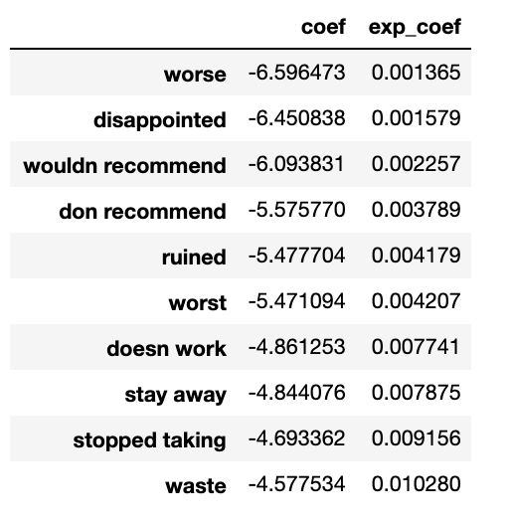
Logistic Coefficients

Slide 13

Clustering
Cluster 1: The Image Conscious
Uses Birth Control, Weight loss and anti-acne drugs
Concern about the drug’s side effect on their physical appearance
Young to middle age female users
Short to mid term drug user
"Fantastic! No bloating or weight gain!! Yippee!!! Hot flashes are gone, helped the first week, would have a few here and their but they were mild and by the second month- they are totally gone and sleeping so much better- the feeling of anxiety is gone- life grand again! \r\r\nImmmmmm soooo happy!"

Slide 14
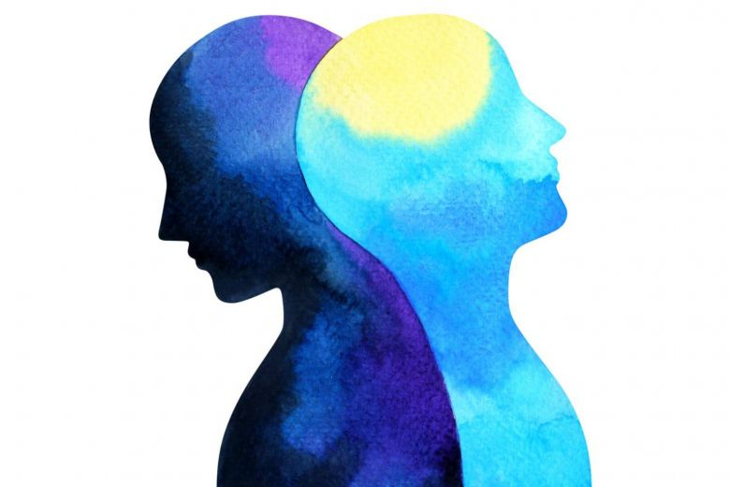
Clustering
Cluster 2: The Mental Well-Being
Uses anti-depression, anxiety and ADHD drugs
Concern about their mood, energy level and thoughts
All age range and gender
Long term drug user
"This is my miracle. I was put on it in Germany and had to go off it until I had insurance again. I suffer from depression and anxiety. Often I would find myself stuck in a daydream world because of all the things going on in my life, including my partner of years (15-25). I would have no energy and just feel so low. Finally I had insurance and was put on 1800mg a day. I feel so much better. I feel like I can handle life and set goals for myself. I don&#039;t feel anxiety. I don&#039;t sit here and think of the negative and focus on a positive life. I am more fun and interactive with my son. \r\n\r\nIt literately saved my life. I don&#039;t know why."

Slide 15
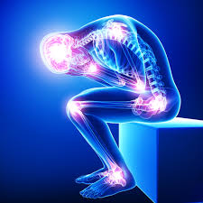
Clustering
Cluster 3: The Pain Killers
Uses pain easing drugs
Concern about mobility and level of pain
All age range and gender
Both short and long term users
"I have severe psoriatic arthritis and I&#039;ve had it since I was 18. I&#039;ve been on remicade for almost 10 years and I have almost no pain. My joints get a little stiff close to my infusion but that&#039;s it. It is my miracle drug and I owe my life to it. I would be crippled without it."

Slide 16
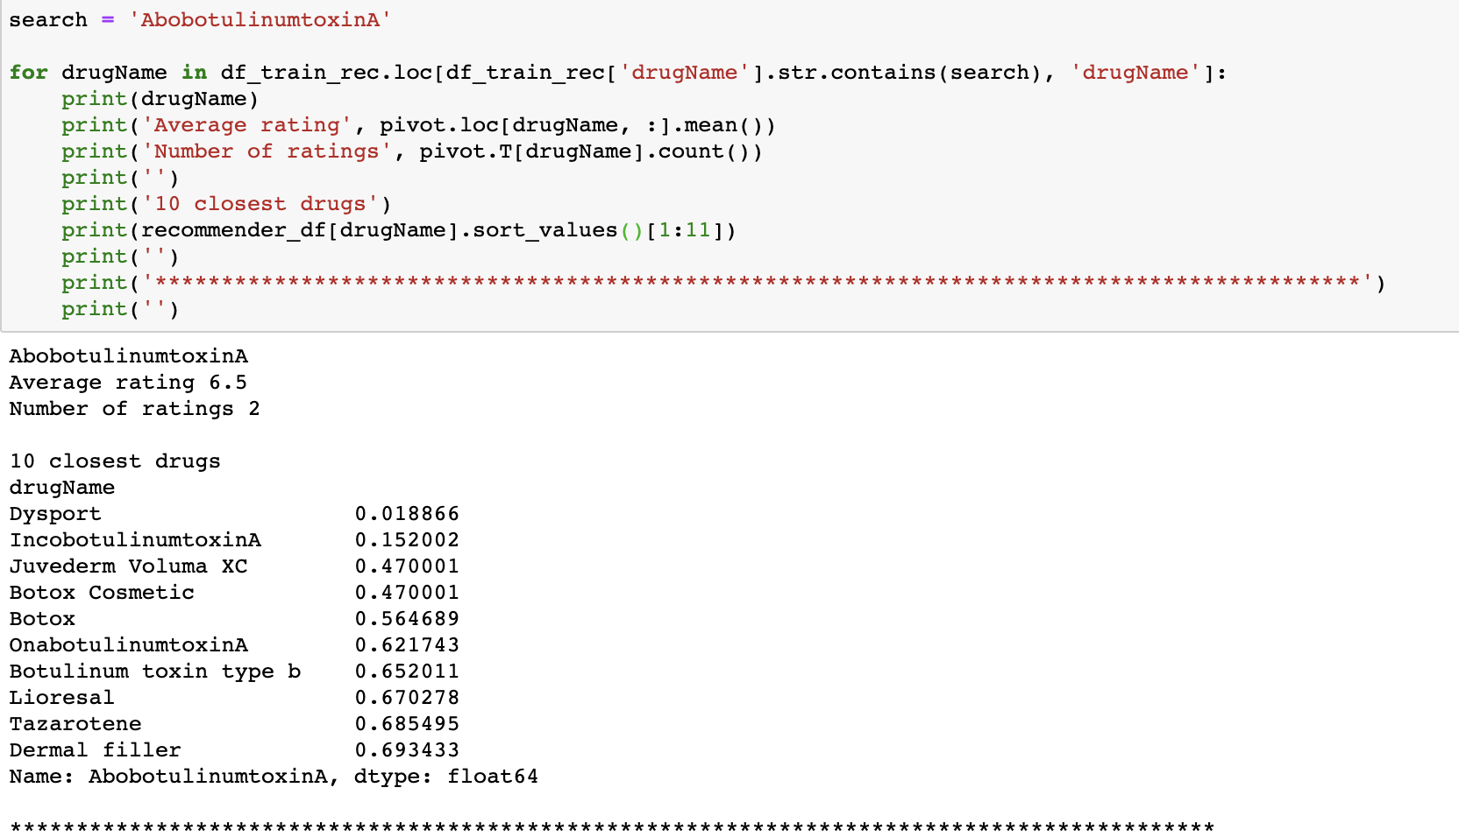
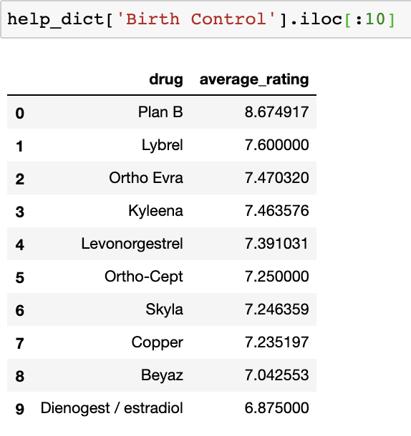
Recommender

Slide 17
Conclusion and Recommendation
Marketing message should contain words such as love, amazing, miracle and life changing
Differentiated Marketing Strategies
Marketing message for Image conscious segment could be better appearance, no weight gain or better skin
Marketing message for Mental well-being could be better mood, positivity and good energy
Marketing message for Pain killer could be disappearing pain
Companies should quickly conduct customer recovery service when a negative sentiment was detected
Use the random forest model to classify positive and negative review
Conduct more R&D on drugs that generally have bad reviews
Recommend new drugs based on the recommender system built
New customers can recommend based on condition
Companies should focus on developing drugs for birth control, weight loss, depression, anxiety and pain
Biggest customer base as shown in exploratory data analysis
Cluster analysis and topic modelling revealed three clusters

Slide 18
Questions?

