Slide 1
Physically Consistent
Vision Generation
10 November, 2026
Alan Yuille · Probabilistic Models of the Visual Cortex

Slide 2
What this lecture covers
1
Image-to-3D generation
2
DiffusionGS
3D Gaussians, two-stage methods
A diffusion model that outputs 3D Gaussians
3
Results of DiffusionGS
4
Physics in text-to-video
Objects, scenes, ablation, code
Distorted bodies, costly fine-tuning
5
PhyGDPO
6
Results of PhyGDPO
Physics data, groupwise preferences
Sports prompts and an ablation
Generative Models · A. Yuille
2

Slide 3
Image-to-3D generation
1
Generate a 3D representation from one image and render it from new views;
two-stage methods generate views first and lift them to 3D afterwards.
Generative Models · A. Yuille
3

Slide 4
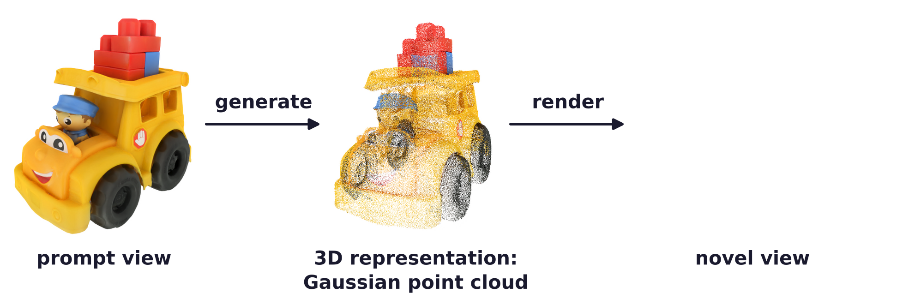

Image-to-3D generation
Image-to-3D generation turns one view into a 3D model
Input: a single prompt view of an object or a scene; output: a 3D representation of it.
The 3D representation, here a cloud of 3D Gaussians, is rendered to novel views.
Applications: augmented and virtual reality (AR/VR), film making, robotics, animation, gaming.
Generative Models · A. Yuille
4

Slide 5
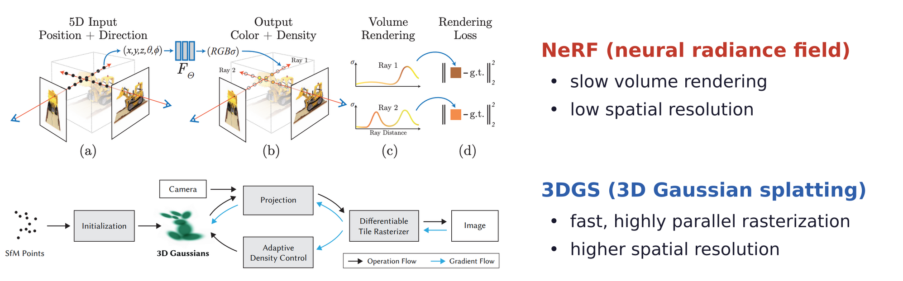
Image-to-3D generation
3D Gaussian splatting renders faster than NeRF
NeRF is hard to scale up to larger scenes beyond object-centric cases.
A 3D Gaussian has a center μ, a covariance Σ, an opacity α and a color c.
B. Mildenhall, P. P. Srinivasan, M. Tancik, J. T. Barron, R. Ramamoorthi and R. Ng, “NeRF: representing scenes as neural radiance fields
for view synthesis,” ECCV, 405–421, 2020.
B. Kerbl, G. Kopanas, T. Leimkühler and G. Drettakis, “3D Gaussian splatting for real-time radiance field rendering,” ACM Transactions on
Graphics, 42(4):1–14, 2023.
Generative Models · A. Yuille
5

Slide 6
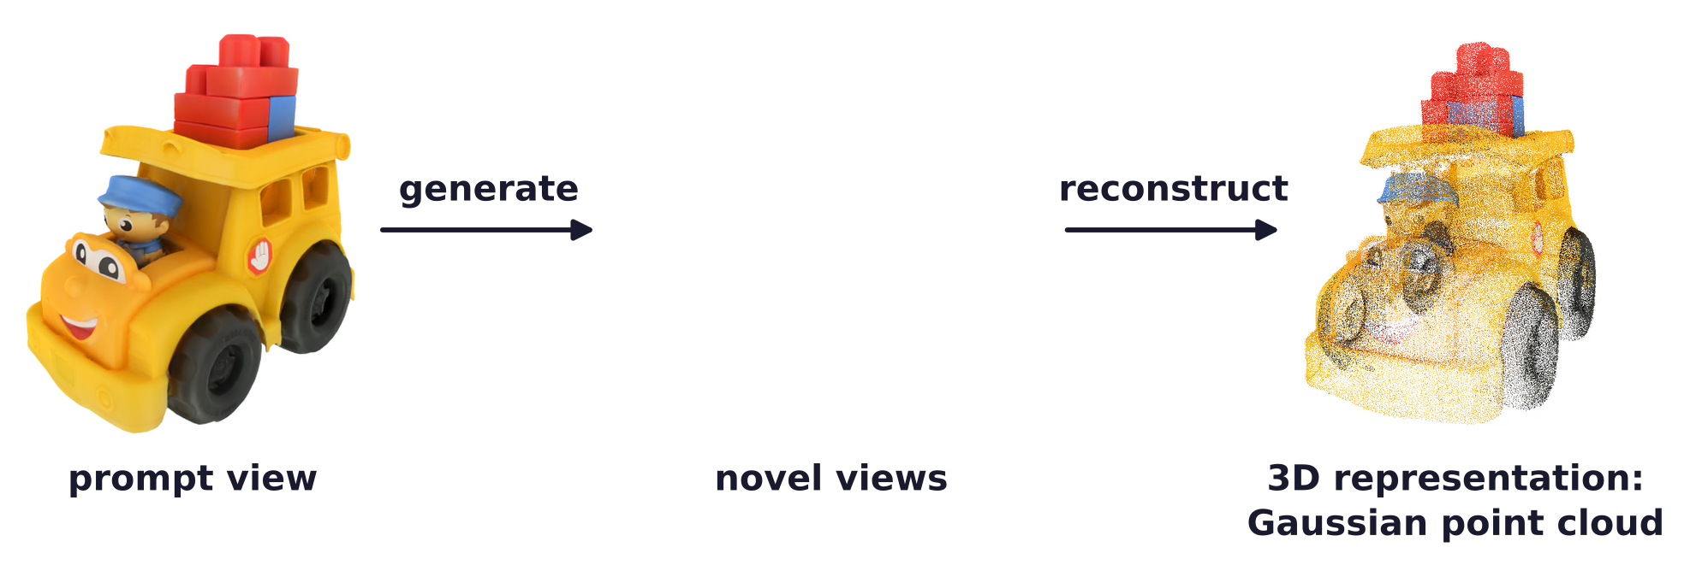
Image-to-3D generation
Existing methods generate views first, then reconstruct 3D
Examples: CAT3D (NeurIPS 2024) and LGM (ECCV 2024).
Is this still 3D generation? The 3D model is reconstructed from generated 2D views.
R. Gao, A. Hołyński, P. Henzler et al., “CAT3D: create anything in 3D with multi-view diffusion models,” NeurIPS, 75468–75494, 2024.
J. Tang, Z. Chen, X. Chen, T. Wang, G. Zeng and Z. Liu, “LGM: large multi-view Gaussian model for high-resolution 3D content creation,”
ECCV, 1–18, 2024.
Generative Models · A. Yuille
6

Slide 7
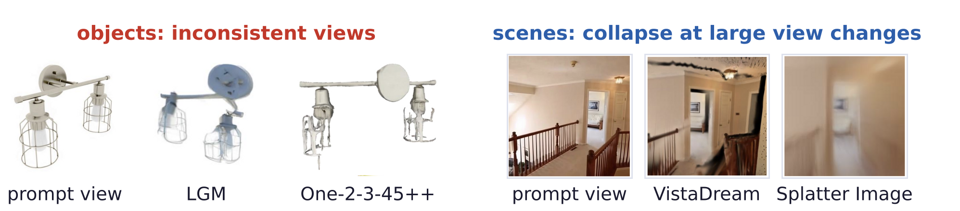
Image-to-3D generation
Objects come out view-inconsistent; scenes often collapse
Objects: two-stage methods generate a grid of views, then lift it to 3D; the views disagree.
Scenes: single-view methods usually rely on a depth estimator and collapse at large view changes.
DiffusionGS: a one-stage diffusion model based on 3D Gaussian splatting.
M. Liu, R. Shi, L. Chen et al., “One-2-3-45++: fast single image to 3D objects with consistent multi-view generation and 3D diffusion,”
CVPR, 10072–10083, 2024.
H. Wang, Y. Liu, Z. Liu, W. Wang, Z. Dong and B. Yang, “VistaDream: sampling multiview consistent images for single-view scene
reconstruction,” ICCV, 26772–26782, 2025.
S. Szymanowicz, C. Rupprecht and A. Vedaldi, “Splatter Image: ultra-fast single-view 3D reconstruction,” CVPR, 10208–10217, 2024.
Generative Models · A. Yuille
7

Slide 8
DiffusionGS
2
A one-stage diffusion model: at every timestep the denoiser predicts 3D
Gaussians, and their 2D renderings are supervised.
Generative Models · A. Yuille
8

Slide 9
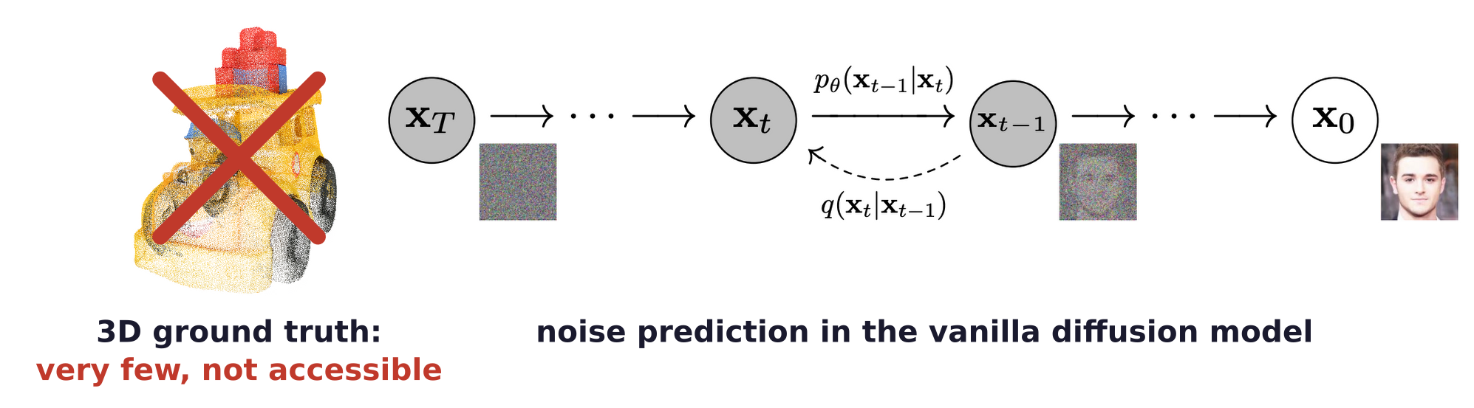
DiffusionGS
Previous methods lack 3D ground truth and predict noise
Why do previous methods generate multi-view images instead of the 3D representation?
Lack of ground truth for the 3D representation: very few and not accessible.
Diffusion models usually predict the noise ε, which makes no sense for clean 3D point clouds.
J. Ho, A. Jain and P. Abbeel, “Denoising diffusion probabilistic models,” NeurIPS, 6840–6851, 2020.
Generative Models · A. Yuille
9

Slide 10
DiffusionGS
Review: the vanilla diffusion model adds noise step by step
A principled 3D diffusion framework needs no 3D ground truth and predicts the clean data.
Real data x₀ is diffused by adding noise until it becomes the Gaussian N(0, I) at step T.
ᾱ_{t} falls from 1 to near 0 as t grows: the share of the variance of x_{t} that comes from x₀.
In the denoising process p_{θ} of the vanilla model, the network learns to predict the noise ε_{t}.
J. Ho, A. Jain and P. Abbeel, “Denoising diffusion probabilistic models,” NeurIPS, 6840–6851, 2020.
Generative Models · A. Yuille
10

Slide 11
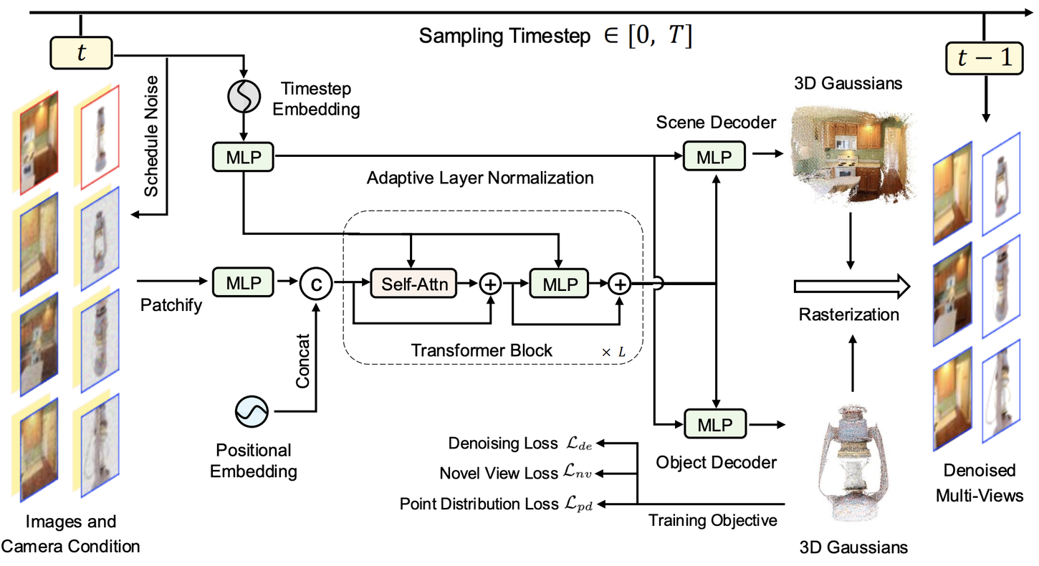
DiffusionGS
The denoiser predicts pixel-aligned 3D Gaussians
DiffusionGS recovers clean 3D Gaussian point clouds instead of predicting the noise.
The Gaussians are rasterized; their renderings are supervised by the clean multi-view images.
Y. Cai, H. Zhang, K. Zhang et al., “Baking Gaussian splatting into diffusion denoiser for fast and scalable single-stage image-to-3D
generation and reconstruction,” ICCV, 25062–25072, 2025.
Generative Models · A. Yuille
11

Slide 12
DiffusionGS
At every timestep the denoiser outputs 3D Gaussians
Input: one clean condition view x_{con} and N noisy views; v_{con} and V: their viewpoints.
G_{t}^{(k)}: the k-th 3D Gaussian, with center μ, covariance Σ, opacity α and color c.
Each view gives a per-pixel map of Gaussians; merging the maps of all views gives the point cloud.
Why per-pixel? The Gaussians are aligned with the pixels and regular.
Y. Cai, H. Zhang, K. Zhang et al., “Baking Gaussian splatting into diffusion denoiser for fast and scalable single-stage image-to-3D
generation and reconstruction,” ICCV, 25062–25072, 2025.
Generative Models · A. Yuille
12

Slide 13
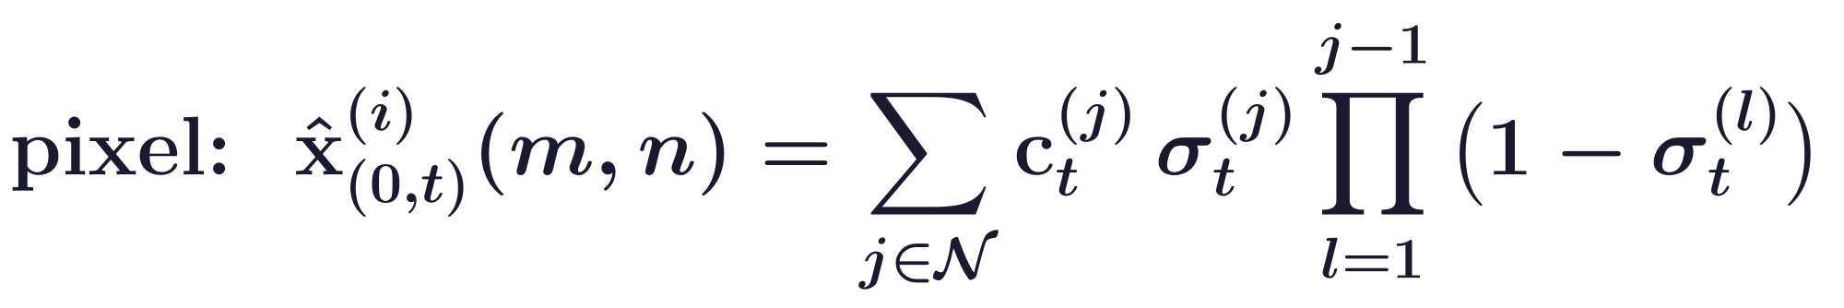
DiffusionGS
Rendering the Gaussians gives the denoised views
F_{r}: highly parallel rasterization with the extrinsic and intrinsic camera matrices of view i.
Pixel (m, n): colors c of the Gaussians on its ray, in depth order; σ: opacity times Gaussian value.
L_{de}: an L₂ loss plus λ times a VGG-19 perceptual loss, between renderings and clean views.
Testing: 30 DDIM (denoising diffusion implicit model) steps from one image and relative poses.
J. Song, C. Meng and S. Ermon, “Denoising diffusion implicit models,” ICLR, 2021.
Generative Models · A. Yuille
13

Slide 14
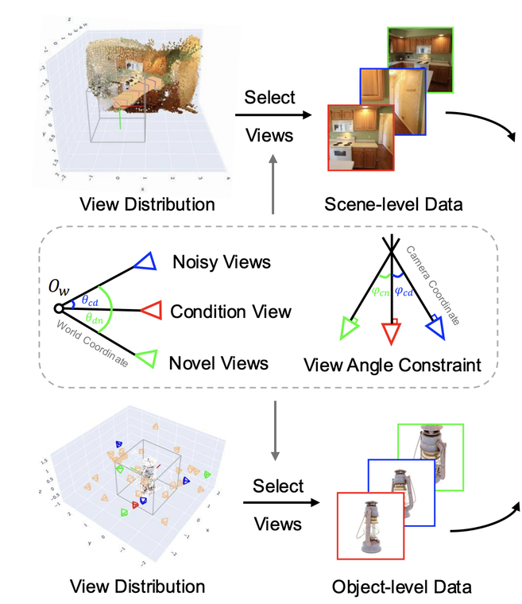
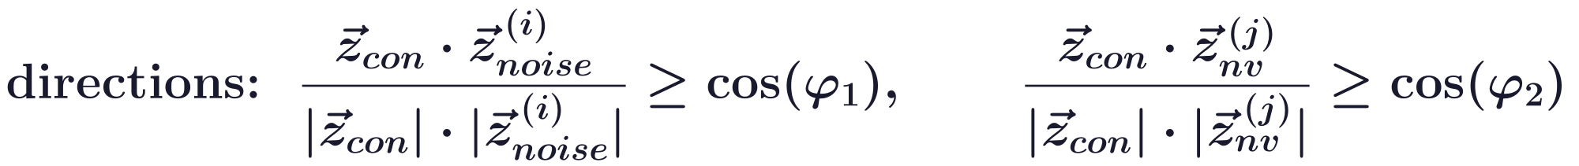
DiffusionGS
Scene-object mixed training constrains the viewpoints
3D data are scarce: scene datasets have only about 90K samples, with small viewpoint changes.
Objects and scenes trained together: (1) viewpoint constraints, (2) a dual Gaussian decoder.
θ_{cd}, θ_{dn}: angles between camera positions; z: view directions; θ₁, θ₂, φ₁, φ₂: thresholds.
Generative Models · A. Yuille
14

Slide 15
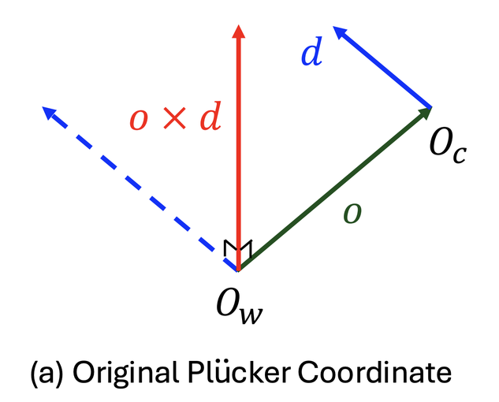
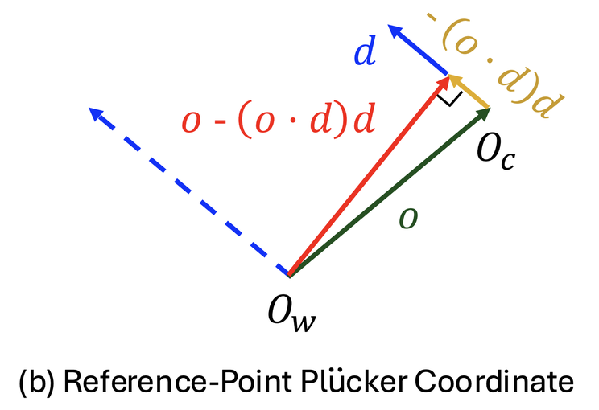
DiffusionGS
RPPC encodes the ray position and the relative depth
o: the camera center O_{c} from the world origin O_{w}; d: the ray direction; o × d mainly gives rotation.
RPPC (reference-point Plücker coordinate) uses the point of the ray closest to the world origin.
By skip connections it reaches every transformer block and the Gaussian decoder.
V. Sitzmann, S. Rezchikov, W. T. Freeman, J. B. Tenenbaum and F. Durand, “Light field networks: neural scene representations with
single-evaluation rendering,” NeurIPS, 19313–19325, 2021.
Generative Models · A. Yuille
15

Slide 16
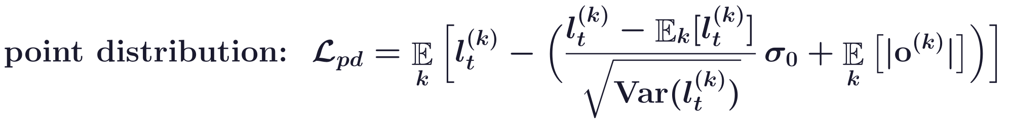
DiffusionGS
A point distribution loss warms up object generation
Each Gaussian lies on the ray of its pixel: u is its distance along d, l its distance from o.
During mixed training this loss is a warm-up for objects, where the point clouds are centralized.
σ₀ = 0.5: a target standard deviation; L_{nv}: the rendering loss on novel views.
iter₀: the last warm-up iteration; 1_{object}: the loss is used on object data only.
Y. Cai, H. Zhang, K. Zhang et al., “Baking Gaussian splatting into diffusion denoiser for fast and scalable single-stage image-to-3D
generation and reconstruction,” ICCV, 25062–25072, 2025.
Generative Models · A. Yuille
16

Slide 17
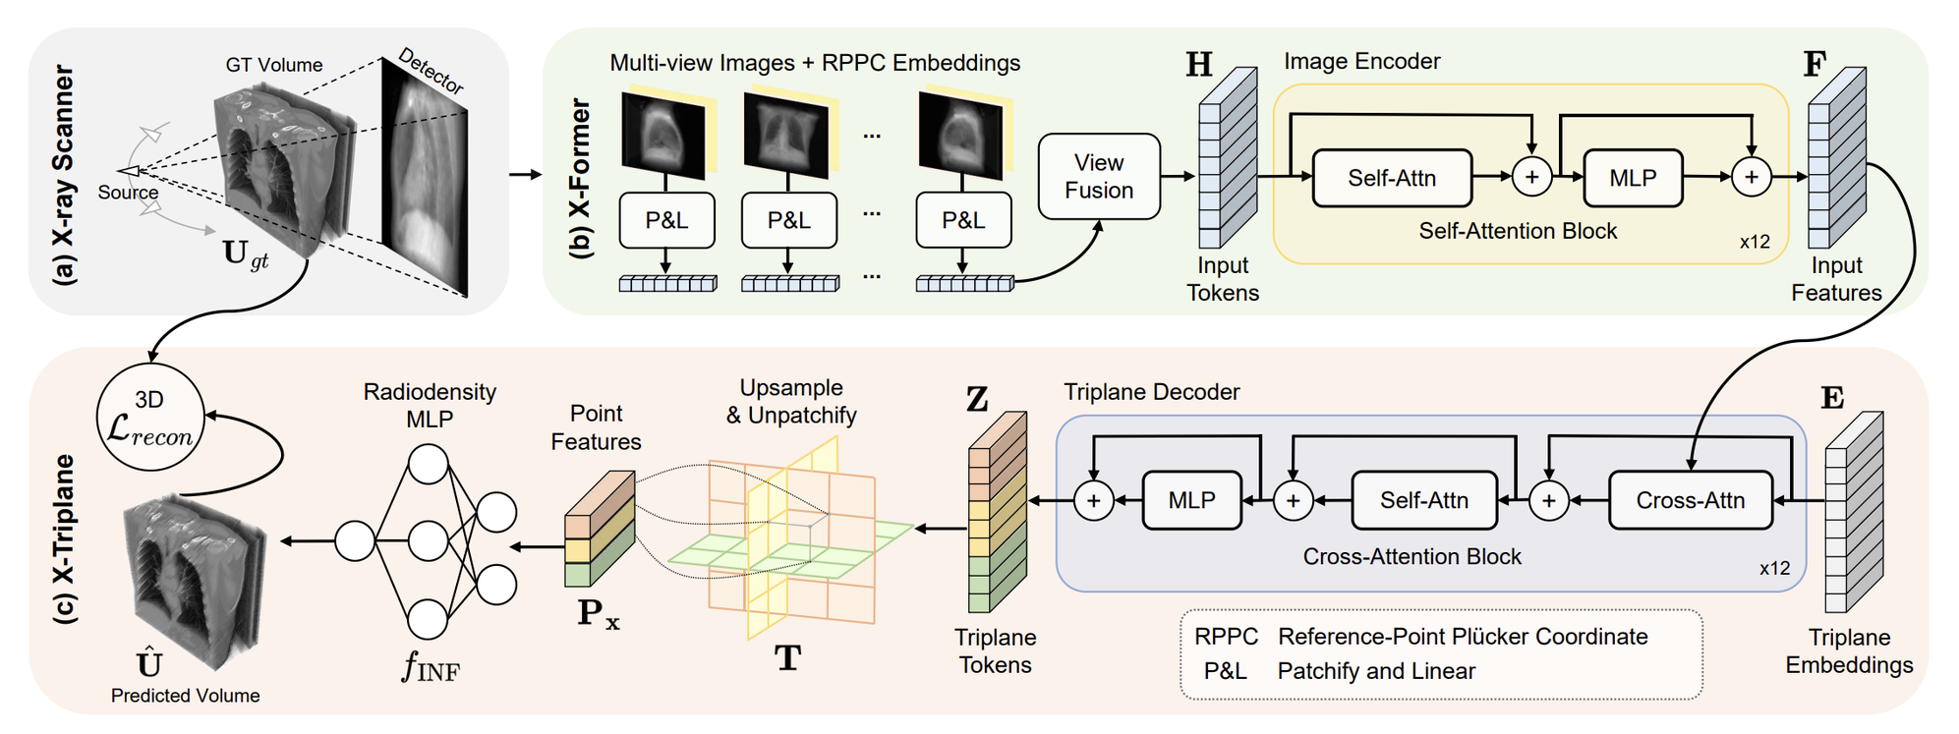
DiffusionGS
RPPC also improves feed-forward CT reconstruction
RPPC is a general camera conditioning, more effective than the normal Plücker ray embedding.
X-LRM (X-ray large reconstruction model): CT (computed tomography) from a few X-rays.
G. Zhang, R. Zha, H. He, Y. Liang, A. Yuille, H. Li and Y. Cai, “X-LRM: X-ray large reconstruction model for extremely sparse-view
computed tomography recovery in one second,” arXiv:2503.06382, 2025.
Generative Models · A. Yuille
17

Slide 18
Results of DiffusionGS
3
DiffusionGS generates objects and scenes from one view in seconds, with
better scores than earlier methods; every component adds to them.
Generative Models · A. Yuille
18

Slide 19






Results of DiffusionGS
DiffusionGS generates objects and scenes from a single view
Generative Models · A. Yuille
19

Slide 20

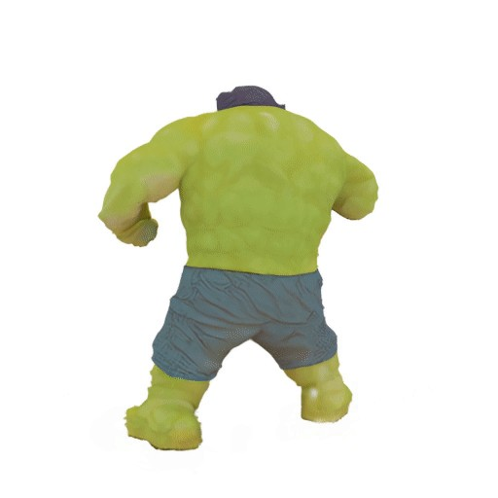




Results of DiffusionGS
More objects and scenes generated from a single view
Generative Models · A. Yuille
20

Slide 21
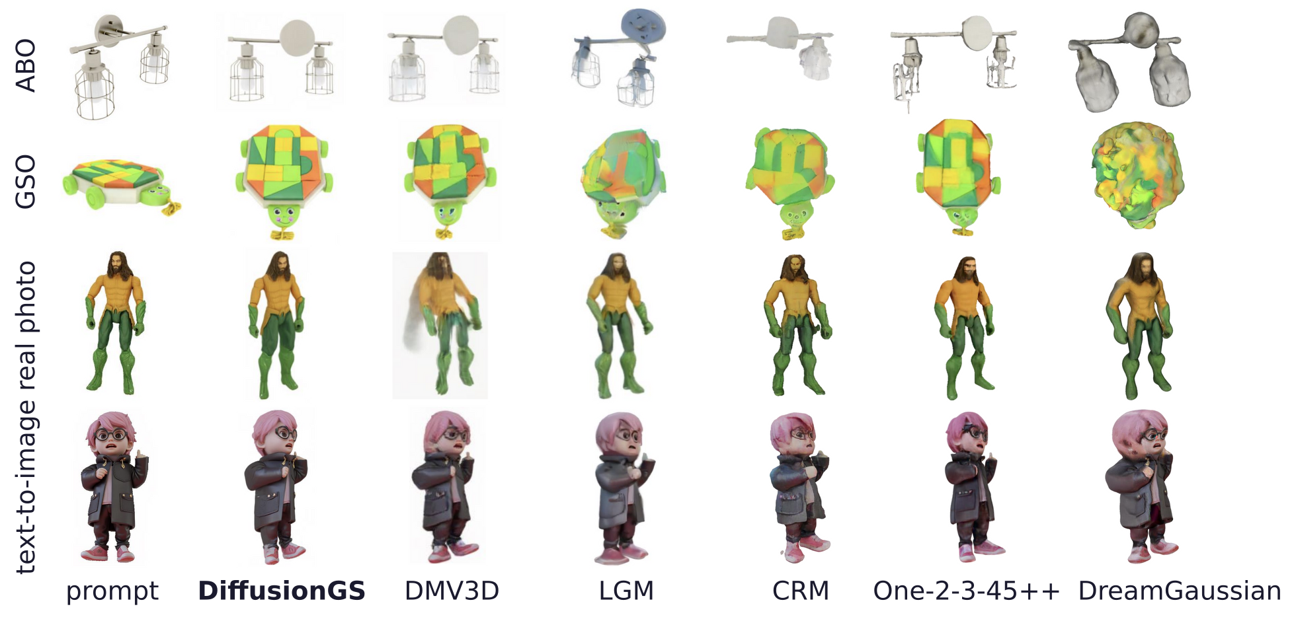
Results of DiffusionGS
DiffusionGS gives clearer novel views of objects
Rows: ABO (Amazon Berkeley Objects) and GSO (Google Scanned Objects), a real photo, a text-to-image.
Generative Models · A. Yuille
21

Slide 22
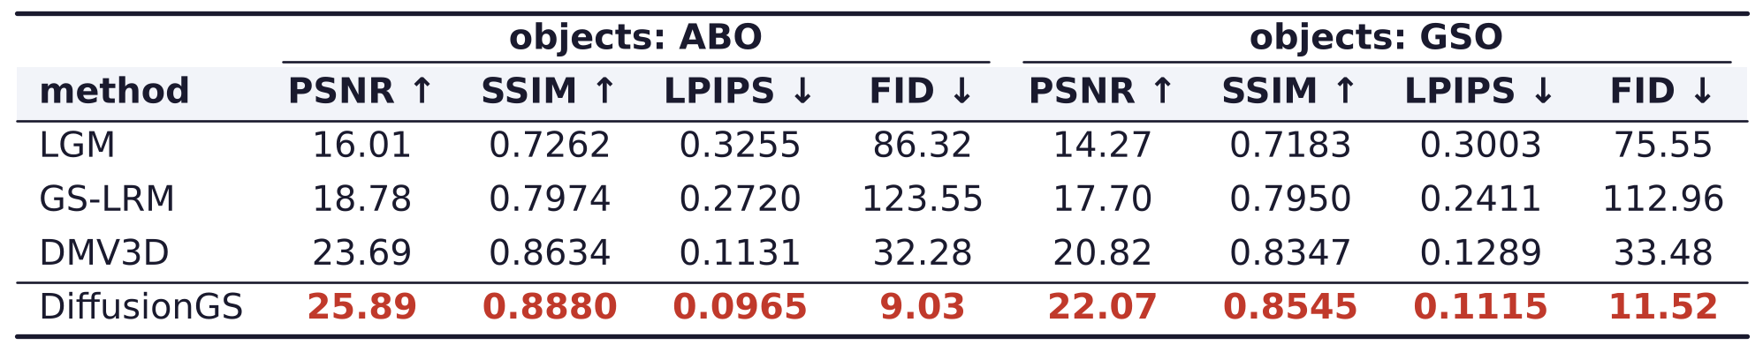
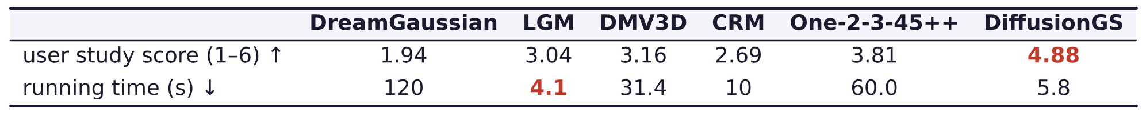
Results of DiffusionGS
DiffusionGS leads on ABO, GSO and in a user study
LGM, GS-LRM, DMV3D, CRM, DreamGaussian, One-2-3-45++: earlier image-to-3D methods.
PSNR: peak signal-to-noise ratio; SSIM: structural similarity (higher is better).
LPIPS: learned perceptual image patch similarity; FID: Fréchet inception distance (lower is better).
DiffusionGS is more than five times faster than DMV3D; only LGM is faster.
Generative Models · A. Yuille
22

Slide 23
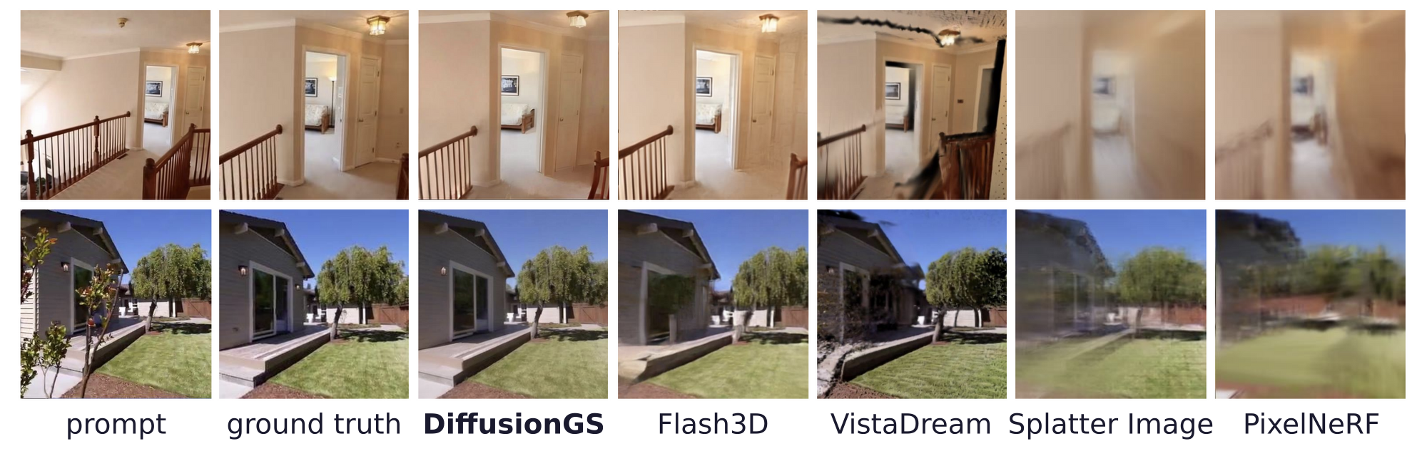
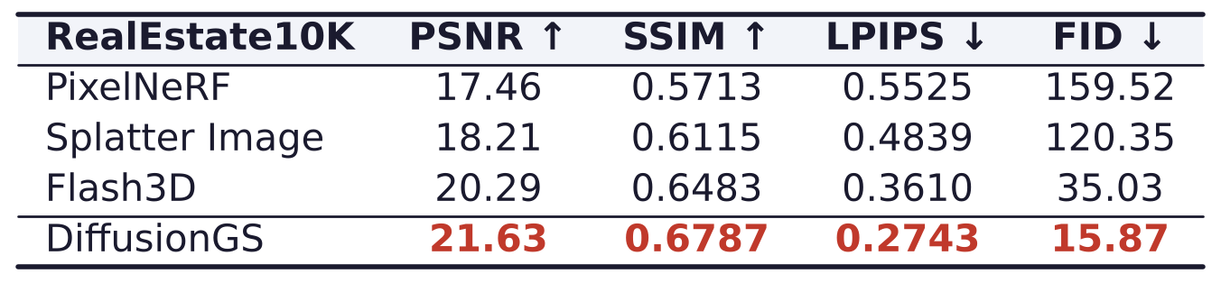
Results of DiffusionGS
DiffusionGS gives the best scene views on RealEstate10K
RealEstate10K: house video clips; Flash3D, VistaDream, Splatter Image, PixelNeRF: single-view methods.
Generative Models · A. Yuille
23

Slide 24
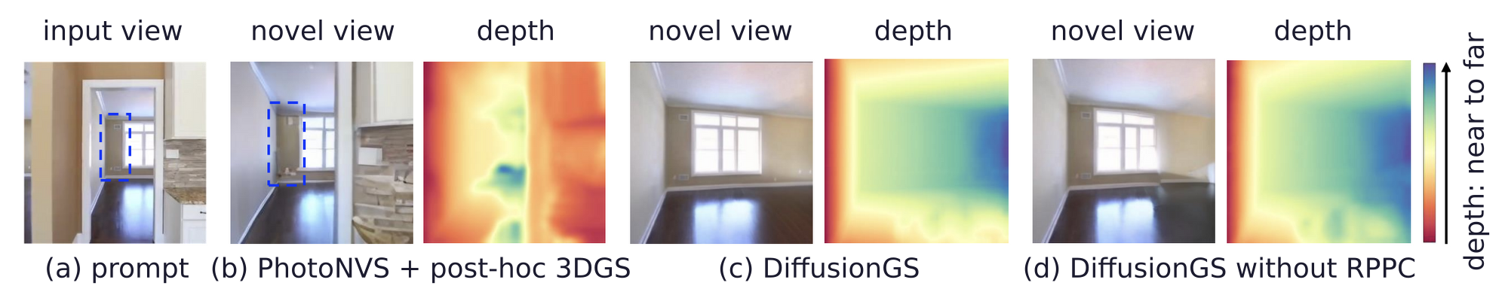
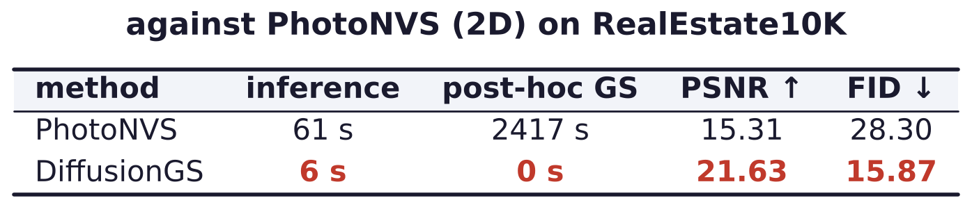
Results of DiffusionGS
DiffusionGS scores above PhotoNVS and needs no 3DGS fitting
PhotoNVS (a 2D method) synthesizes views; its depth comes from 3DGS fitted to them afterwards.
Panel (d) is DiffusionGS trained without RPPC: the effect of the reference-point coordinate.
J. J. Yu, F. Forghani, K. G. Derpanis and M. A. Brubaker, “Long-term photometric consistent novel view synthesis with diffusion models,”
ICCV, 7094–7104, 2023.
Generative Models · A. Yuille
24

Slide 25
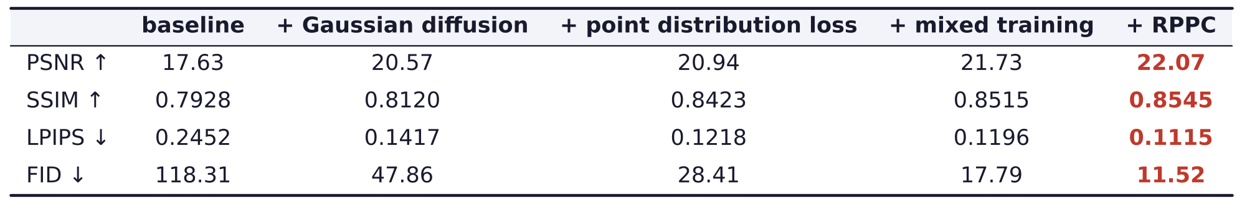
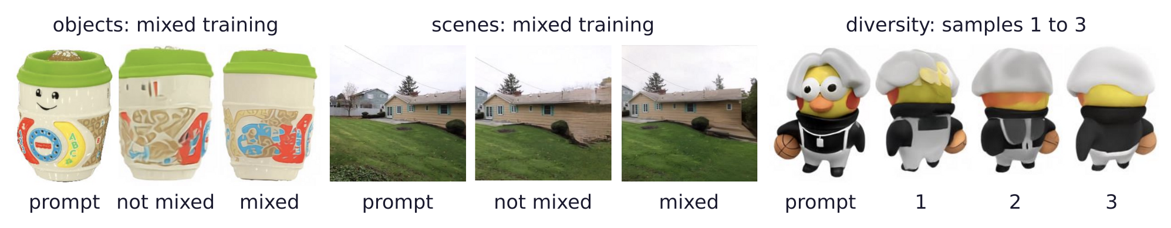
Results of DiffusionGS
Every component of DiffusionGS improves the results
Ablation on GSO: from left to right, each column adds one component to the previous one.
Mixed training off and on; three samples of one prompt differ in the unseen back.
Generative Models · A. Yuille
25

Slide 26


Results of DiffusionGS
The project page, the code and the models are public
project page
code and models
Project page: caiyuanhao1998.github.io/project/DiffusionGS
Code and models (re-implemented): github.com/caiyuanhao1998/Open-DiffusionGS
For object-centric image-to-3D generation, one script runs the model: python run.py
Generative Models · A. Yuille
26

Slide 27
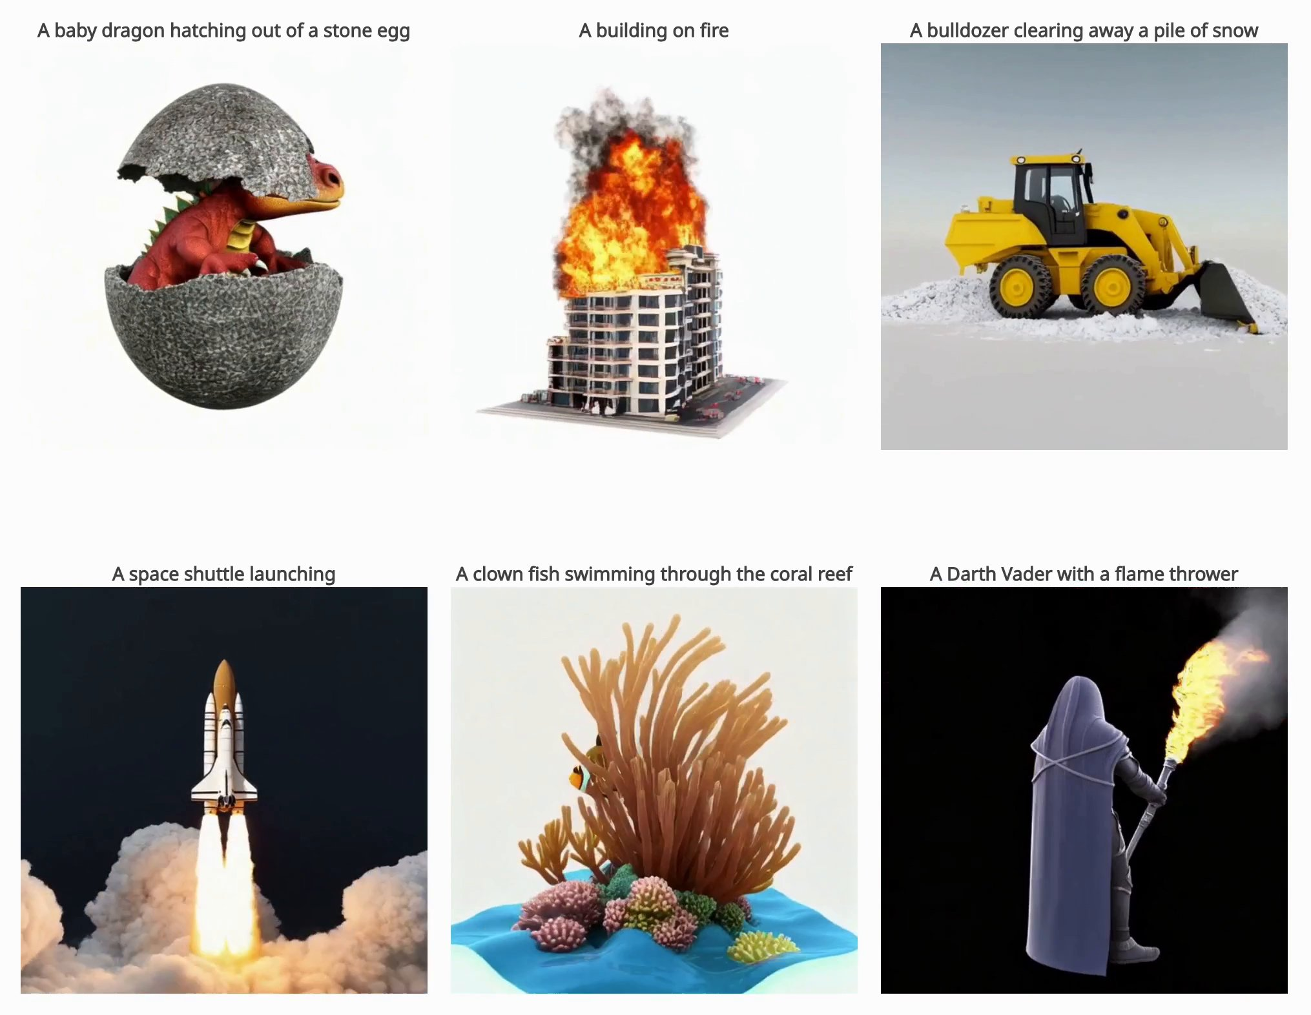
Results of DiffusionGS
A video model generates 3D/4D with no 3D representation
Do we really need a 3D representation in 3D/4D generation?
OmniVCus adapts a video model to 3D/4D generation without any 3D representation.
Y. Cai, H. Zhang, X. Chen et al., “OmniVCus: feedforward subject-driven video customization with multimodal control conditions,”
NeurIPS, 115404–115423, 2025.
Generative Models · A. Yuille
27

Slide 28
Physics in text-to-video
4
Even the best text-to-video models break physics; fine-tuning needs costly
data, and direct preference optimization has three problems.
Generative Models · A. Yuille
28

Slide 29


Physics in text-to-video
Text-to-video generation turns a prompt into a video
“A woman is talking to a man on a street.”
“A child is happy doing her homework.”
Text-to-video (T2V) generation: given a prompt, generate a video accordingly.
Generative Models · A. Yuille
29

Slide 30
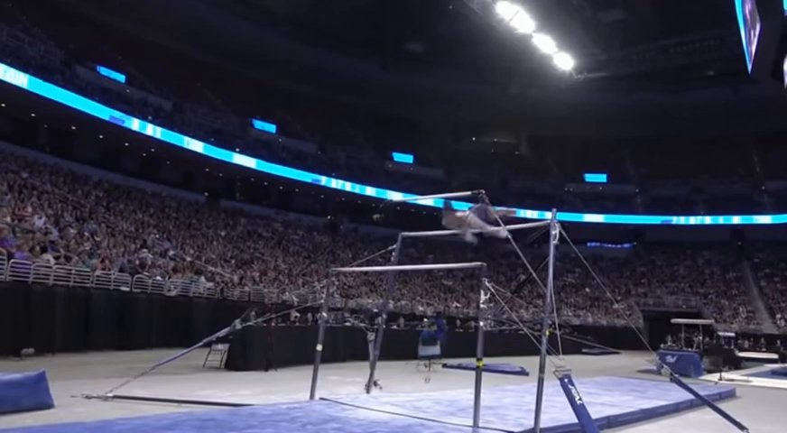
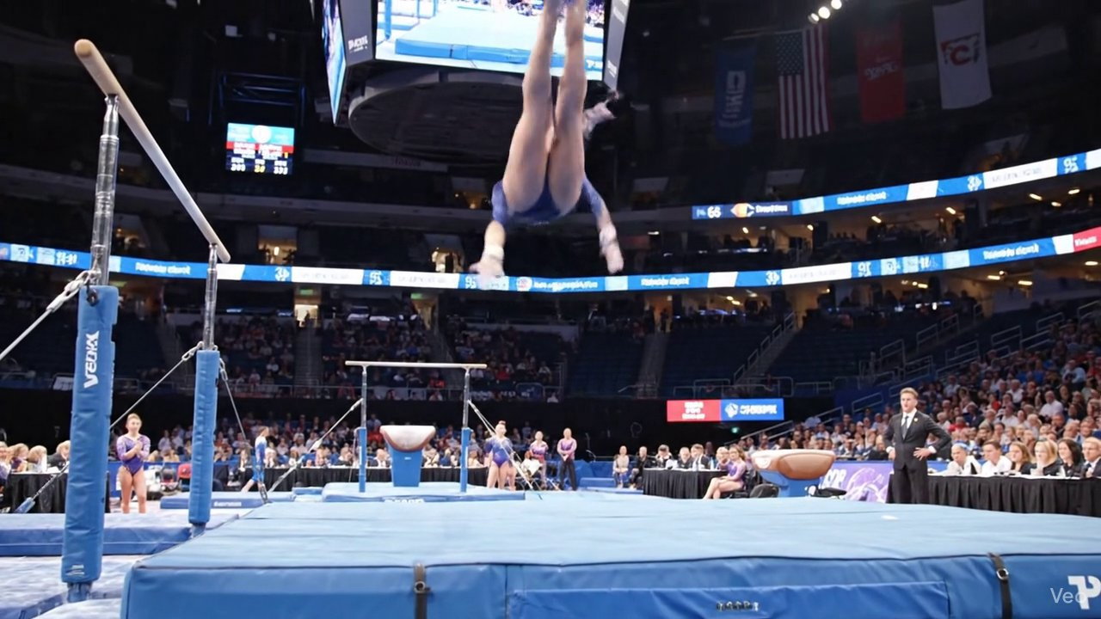
Physics in text-to-video
Even the best text-to-video models distort human bodies
OpenAI Sora2
Google DeepMind Veo3.1
Prompt: “A gymnast drops from the parallel bars and lands safely on the mat below.”
The physics is bad: even the recent best models generate a distorted human body.
Generative Models · A. Yuille
30

Slide 31
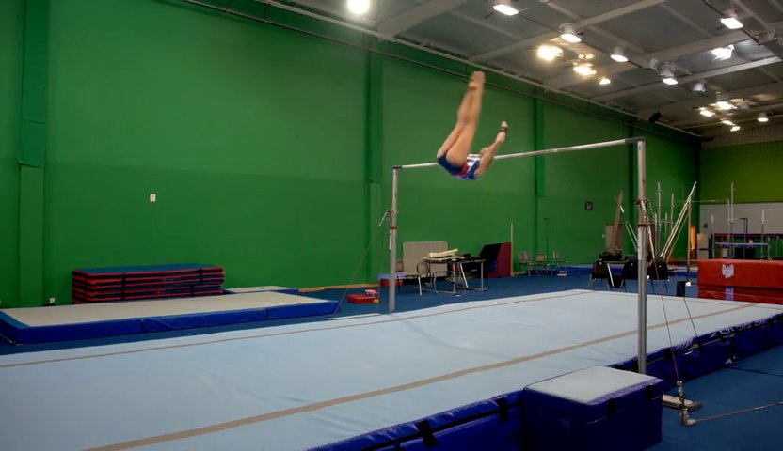
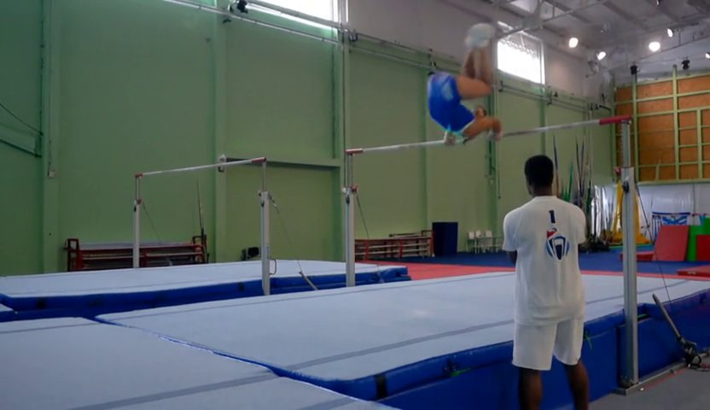
Physics in text-to-video
The goal: more physics, approaching a real-world simulator
Wan2.1: physically inconsistent
Wan2.1 + PhyGDPO: physically consistent
The same prompt: “A gymnast drops from the parallel bars and lands safely on the mat below.”
PhyGDPO: physics-aware groupwise direct preference optimization, applied to Wan2.1.
Physically consistent videos can be used for human action analysis.
Team Wan, A. Wang, B. Ai et al., “Wan: open and advanced large-scale video generative models,” arXiv:2503.20314, 2025.
Generative Models · A. Yuille
31

Slide 32
Physics in text-to-video
Fine-tuning is costly, and plain DPO may face three problems
Most text-to-video models learn implicit physics from massive high-quality text–video pairs.
Collecting and annotating such data is extremely costly and labor-intensive.
Supervised fine-tuning (SFT) still gives limited physics reasoning, as in Sora2 and Veo3.1.
Direct preference optimization (DPO) may address this; used directly, it has three problems:
(1) lack of training pairs rich in physical activities, interactions and phenomena;
(2) the Bradley–Terry model behind DPO only compares pairs of samples;
(3) vanilla DPO duplicates the trained model as a fixed reference: much more GPU memory.
R. Rafailov, A. Sharma, E. Mitchell, S. Ermon, C. D. Manning and C. Finn, “Direct preference optimization: your language model is
secretly a reward model,” NeurIPS, 53728–53741, 2023.
Generative Models · A. Yuille
32

Slide 33
PhyGDPO
5
Physics-aware groupwise DPO: physics-rich training data, a groupwise
Plackett–Luce model with vision-language rewards, and a shared reference.
Generative Models · A. Yuille
33

Slide 34
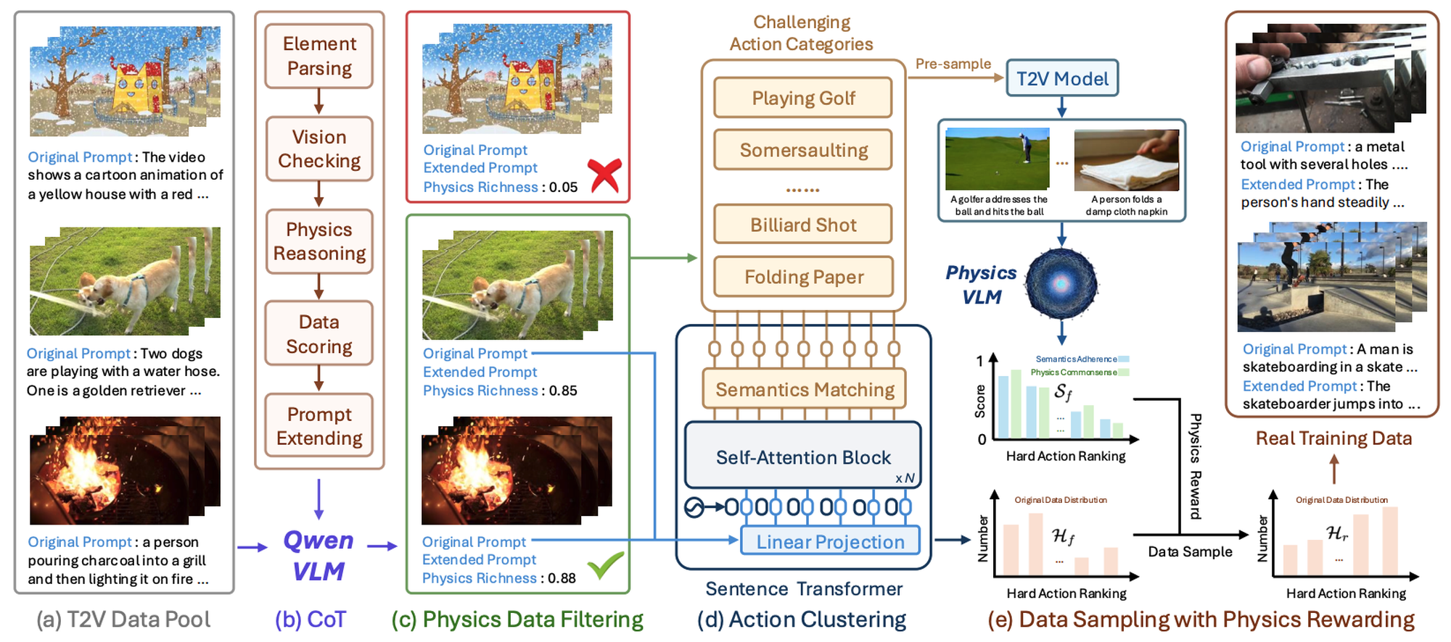
PhyGDPO
PhyAugPipe builds physics-rich training data
PhyAugPipe (physics-augmented data pipeline): about 1M text–video pairs, 135K kept, 17K for training.
A vision-language model (VLM, here Qwen) reasons step by step (CoT: chain of thought) about physics.
Generative Models · A. Yuille
34

Slide 35
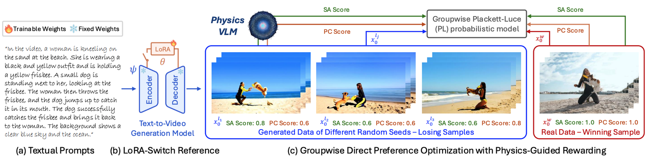
PhyGDPO
A real video wins against a group of generated videos
Winning sample: a real video; losing samples: videos generated from different random seeds.
A physics-aware VLM scores each video: SA (semantics adherence) and PC (physics commonsense).
The scores weight a groupwise Plackett–Luce (PL) loss: physics-guided rewarding.
LoRA-SR (LoRA-switch reference; LoRA: low-rank adaptation): one model is trained and reference.
Y. Cai, K. Li, M. Jia et al., “PhyGDPO: physics-aware groupwise direct preference optimization for physically consistent text-to-video
generation,” arXiv:2512.24551, 2025.
Generative Models · A. Yuille
35

Slide 36
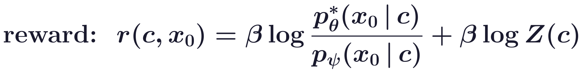
PhyGDPO
Plackett–Luce generalizes the Bradley–Terry model of DPO
c: the text prompt; G^{l}(c): the group of m losing videos for c; r: the reward of a video.
DPO: the Bradley–Terry model compares one preferred video (w) with one rejected video (l).
PhyGDPO: Plackett–Luce compares the real video with m generated ones; m = 1 is Bradley–Terry.
r: through the optimal trained model p* and the frozen reference p_{ψ}; β: a strength; Z(c) cancels.
R. A. Bradley and M. E. Terry, “Rank analysis of incomplete block designs: I. The method of paired comparisons,” Biometrika,
39(3/4):324–345, 1952.
R. L. Plackett, “The analysis of permutations,” Applied Statistics, 24(2):193–202, 1975.
Generative Models · A. Yuille
36

Slide 37
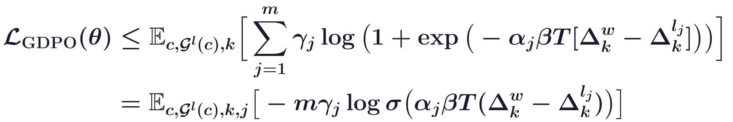
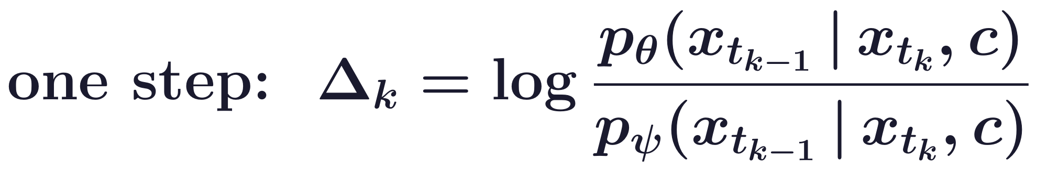
PhyGDPO
An upper bound turns the group loss into weighted pairs
L_{GDPO}: the expected −log p_{PL}; σ: the sigmoid; Δ_{k}: the log-ratio at denoising step k of T.
v_{j}: physics difficulty from the SA and PC scores in [0, 1]; worse videos get larger γ_{j}, α_{j}.
w: the winner; l_{j}: loser j; α_{min} (a lower bound of α_{j}), λ, κ, b: hyperparameters.
Generative Models · A. Yuille
37

Slide 38
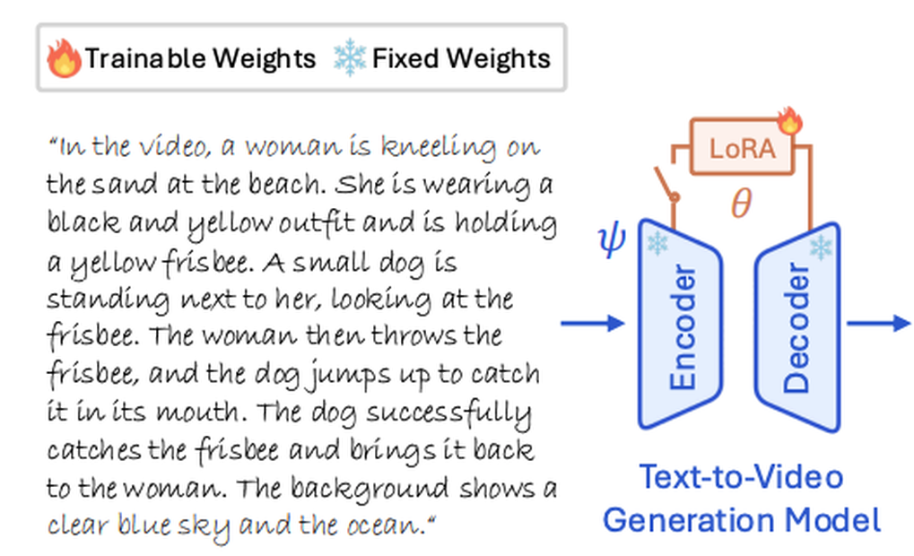
PhyGDPO
LoRA-Switch Reference shares one backbone for both models
The backbone is frozen as the reference model ψ; trainable LoRA modules attached to it give θ.
Switching the light LoRA parameters on and off evaluates both terms without an extra full model.
This saves GPU memory and keeps the model from drifting too far from the reference.
E. J. Hu, Y. Shen, P. Wallis et al., “LoRA: low-rank adaptation of large language models,” ICLR, 2022.
Y. Cai, K. Li, M. Jia et al., “PhyGDPO: physics-aware groupwise direct preference optimization for physically consistent text-to-video
generation,” arXiv:2512.24551, 2025.
Generative Models · A. Yuille
38

Slide 39
Results of PhyGDPO
6
Generated videos for sports prompts, against Sora2, Veo3.1, Wan2.1, PhyT2V
and VideoDPO, and an ablation of the three components.
Generative Models · A. Yuille
39

Slide 40
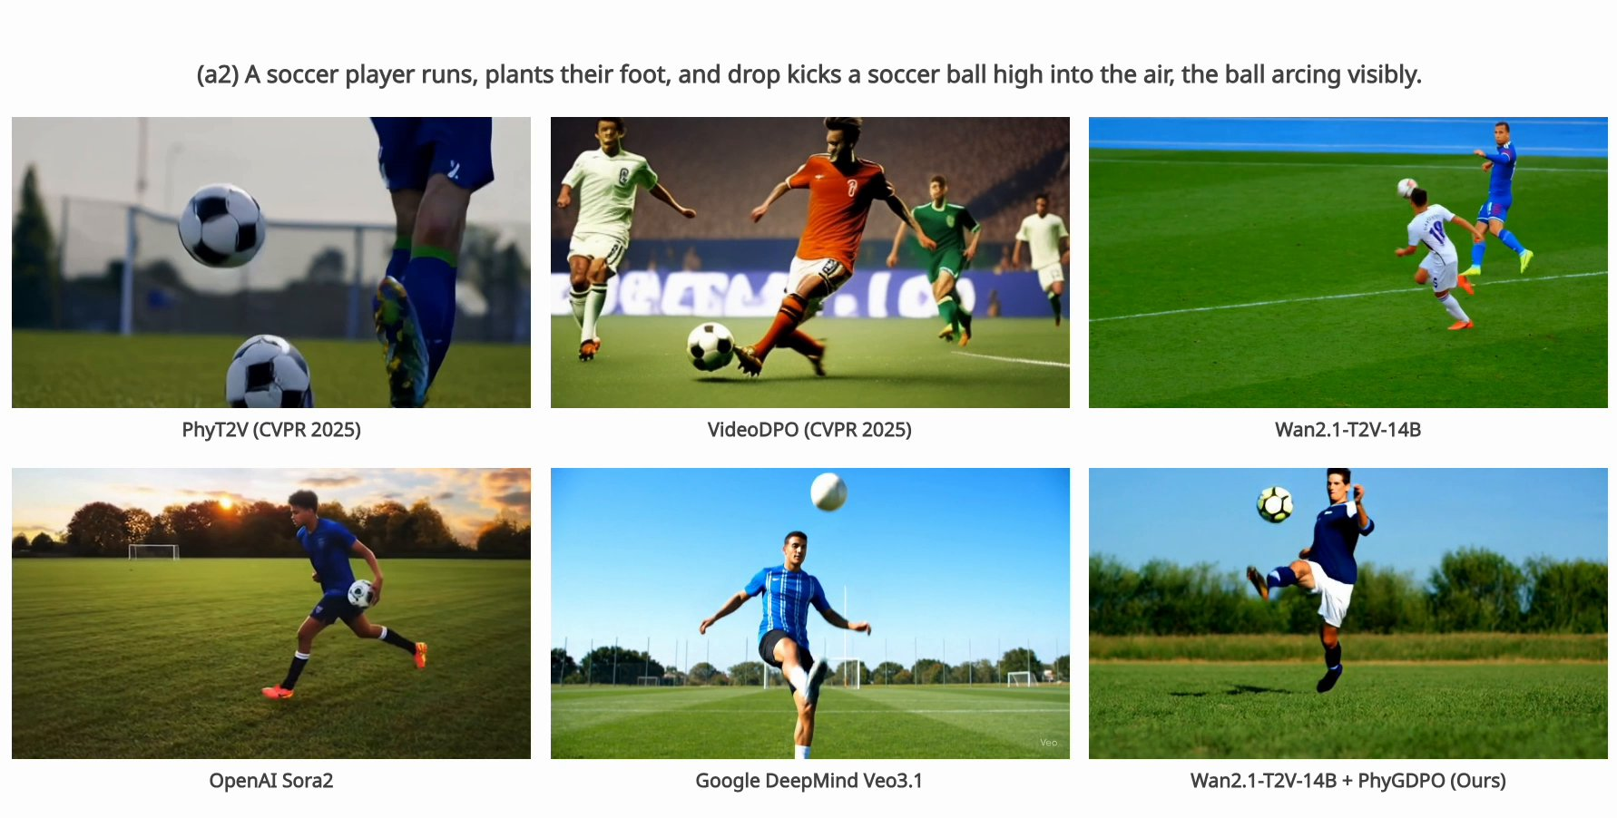
Results of PhyGDPO
Soccer: PhyGDPO against five text-to-video models
PhyT2V: prompts refined by a language model; VideoDPO: DPO for video; Wan2.1: PhyGDPO's base.
Generative Models · A. Yuille
40

Slide 41
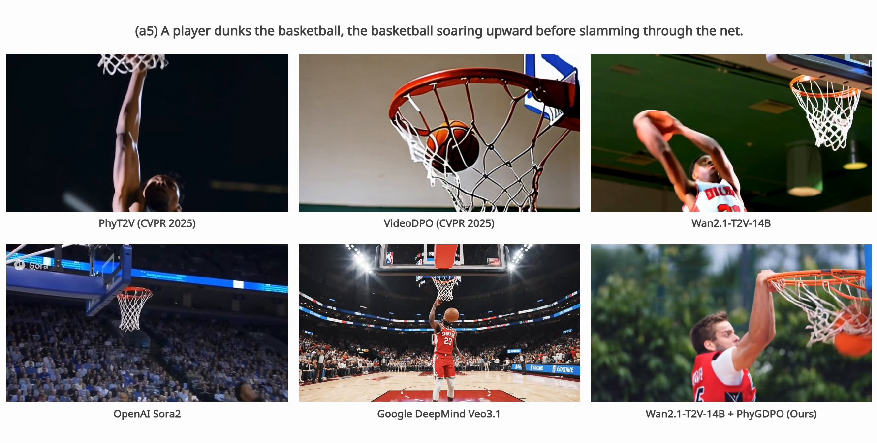
Results of PhyGDPO
Basketball: PhyGDPO against five text-to-video models
Generative Models · A. Yuille
41

Slide 42
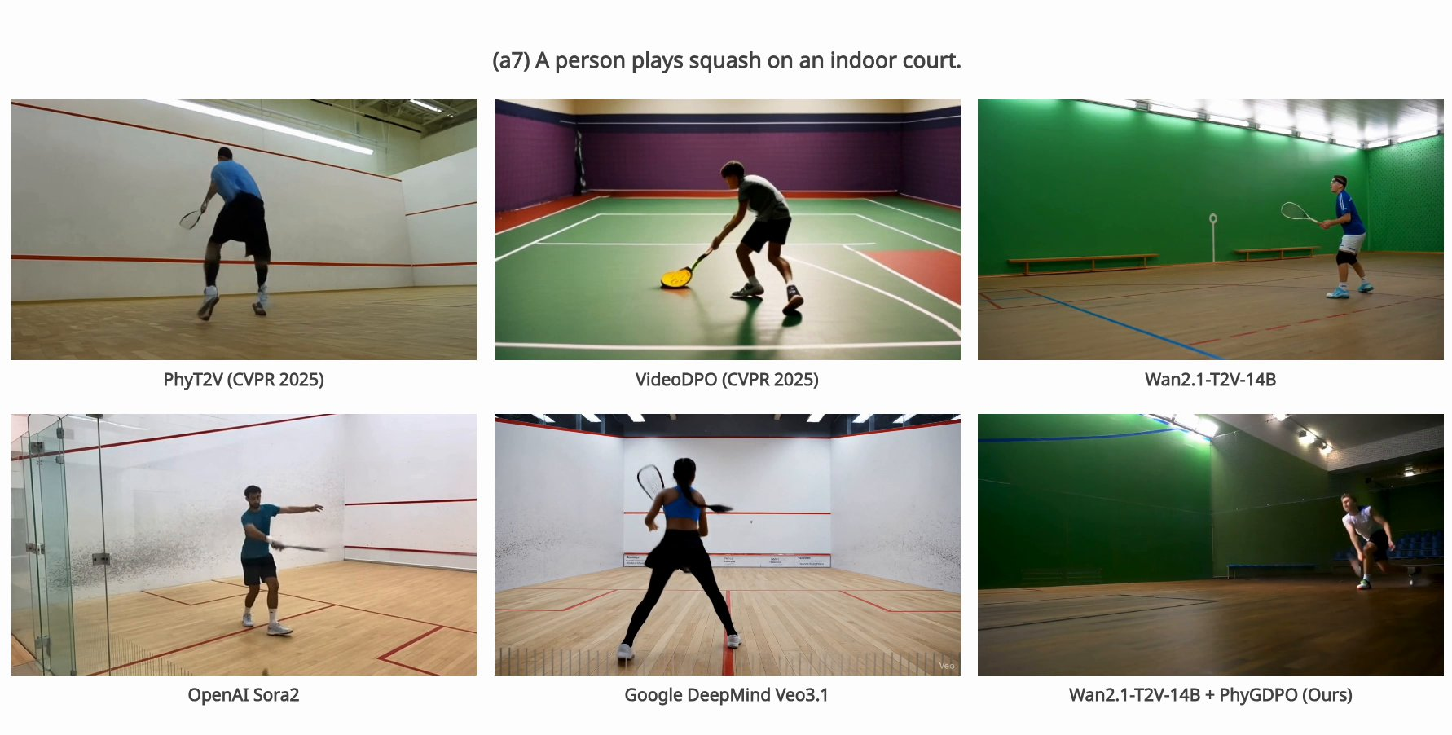
Results of PhyGDPO
Squash: PhyGDPO against five text-to-video models
Generative Models · A. Yuille
42

Slide 43
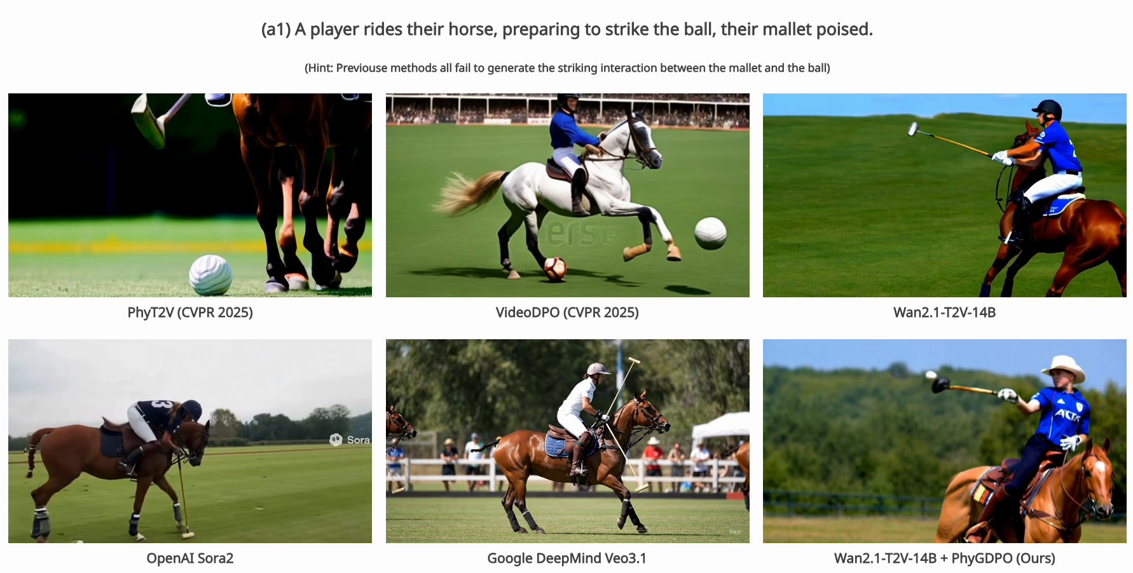
Results of PhyGDPO
Polo: the mallet striking the ball is the hard interaction
The video's hint: previous methods all fail to generate the strike of the mallet on the ball.
Generative Models · A. Yuille
43

Slide 44
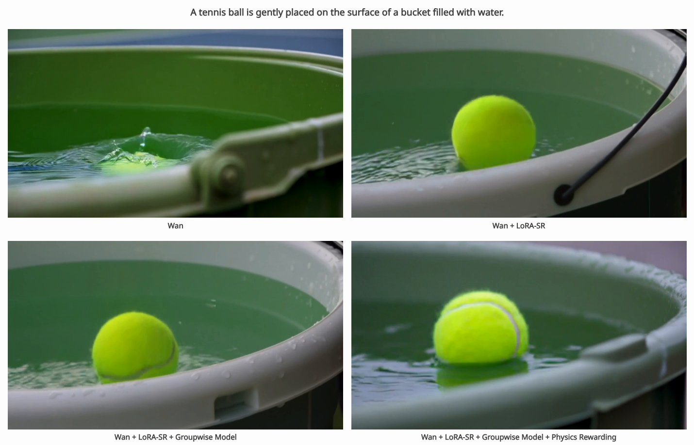
Results of PhyGDPO
Each ablation step adds one component of PhyGDPO
Panels, row by row: Wan; + LoRA-SR; + groupwise Plackett–Luce model; + physics rewarding.
Generative Models · A. Yuille
44

Slide 45
Results of PhyGDPO
Summary
Image-to-3D generation: one view in, a 3D representation out, rendered from new views.
Two-stage methods generate views first and reconstruct 3D afterwards; the views disagree.
DiffusionGS: a one-stage diffusion model whose denoiser predicts 3D Gaussians at every step.
Supervised by 2D renderings it needs no 3D ground truth; mixed training and RPPC help.
It generates objects and scenes from one view in seconds, with better scores than earlier methods.
Text-to-video models still break physics; plain DPO compares only pairs and copies the whole model.
PhyGDPO: physics-rich data, a groupwise Plackett–Luce loss with VLM rewards, and LoRA-SR.
Sports prompts compare PhyGDPO with Sora2, Veo3.1, Wan2.1, PhyT2V and VideoDPO.
Generative Models · A. Yuille
45

