Slide 1
Geometry and Motion:
Stereo, Structure from Motion
27 October, 2026
Alan Yuille · Probabilistic Models of the Visual Cortex

Slide 2
What this lecture covers
1
Projection and vanishing points
2
Calibration and stereo
Pinhole camera, perspective, affine
Epipolar lines, essential, fundamental
3
Structure from motion
4
Geometric priors
Rank three, factorization, non-rigid
Ames room, Manhattan World
Geometry and Vision · A. Yuille
2

Slide 3
Projection and
vanishing points
1
A pinhole camera divides by depth: lines stay straight, parallel lines
meet at a vanishing point. Far away, projection is nearly linear.
Geometry and Vision · A. Yuille
3

Slide 4
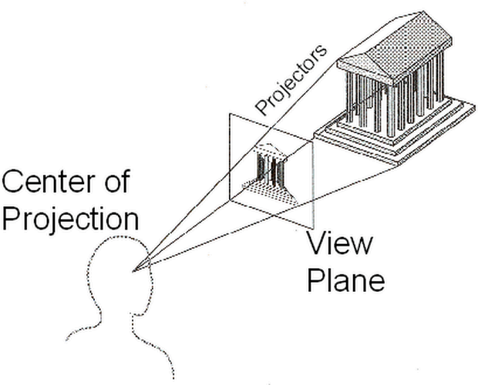
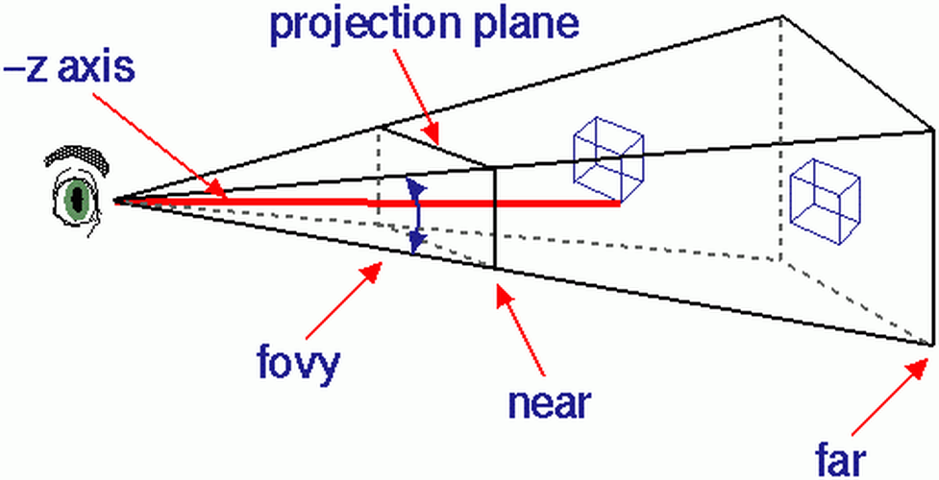
Projection and vanishing points
Most analysis of projection uses the pinhole camera model
A pinhole camera has a lens of size zero: every ray from the scene passes through one point.
Perspective projection, and the approximations to it, are based on the pinhole camera model.
Real cameras have lenses of finite size; Szeliski’s book gives corrections, often needed near the borders.
Graphics draws the image plane in front of the eye, which looks along −z: the image is upright.
fovy is the vertical field of view; the near and far planes bound the depth that is drawn.
R. Szeliski, Computer Vision: Algorithms and Applications, 2nd ed., Springer, 2022.
Geometry and Vision · A. Yuille
4

Slide 5

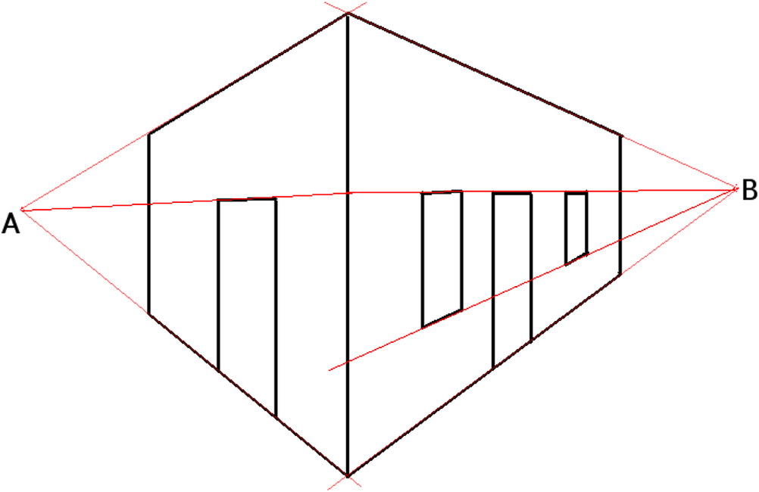
Projection and vanishing points
Perspective: straight lines stay straight, parallels converge
Straight lines project to straight lines.
Parallel lines in space project to lines that converge to a vanishing point (which may be at infinity).
Perugino’s fresco: the lines of the pavement converge at the central door of the temple.
The drawing: the horizontal edges of a building converge to A and B; its vertical edges stay parallel.
Picture: Pietro Perugino, Delivery of the Keys to Saint Peter, fresco, Sistine Chapel, 1481–1482.
Geometry and Vision · A. Yuille
5

Slide 6
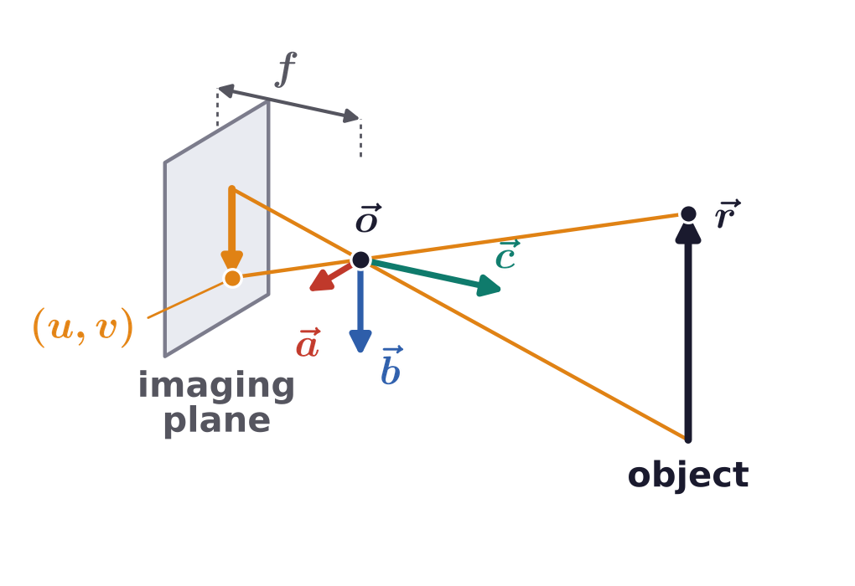
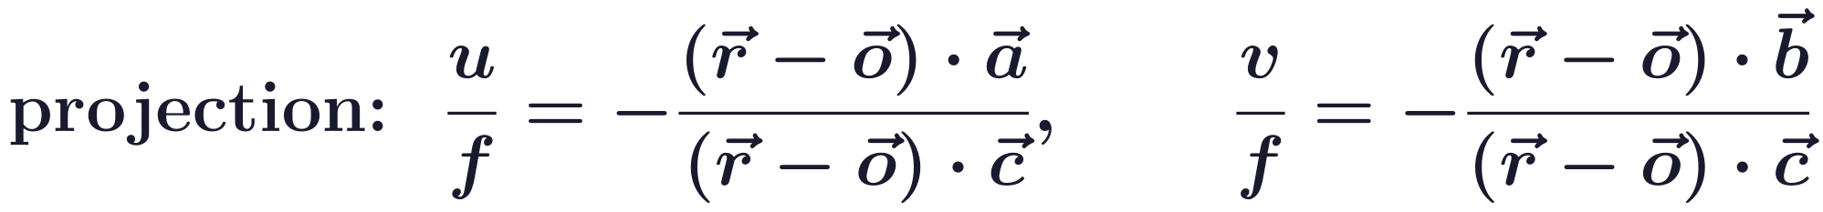
Projection and vanishing points
A camera is an origin, three axes and a focal length
o: the origin, at the pinhole; a, b, c: right-handed coordinate axes of the camera.
c is the direction of gaze; a and b are axes of the imaging plane; f is the focal length.
A point r projects to (u, v), its coordinates along a and b in the imaging plane.
The imaging plane lies behind the pinhole, so the image is inverted: hence the minus signs.
Geometry and Vision · A. Yuille
6

Slide 7
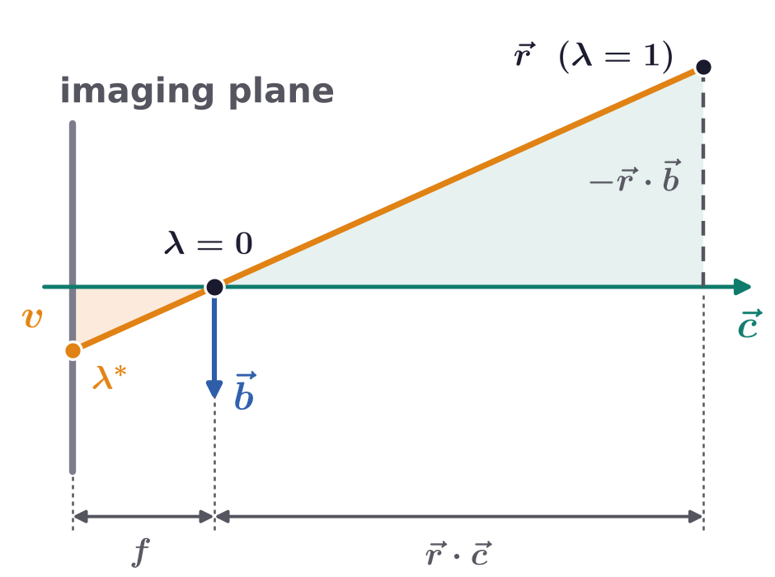
Projection and vanishing points
The projection is where the ray meets the imaging plane
Set o = 0: the pinhole is the origin, and (r − o) becomes r.
The straight line λr passes through the pinhole (λ = 0) and the point r (λ = 1).
It meets the imaging plane at λ*; dot products with a and b give u and v.
Dividing by the depth r · c is what makes perspective projection nonlinear.
Geometry and Vision · A. Yuille
7

Slide 8
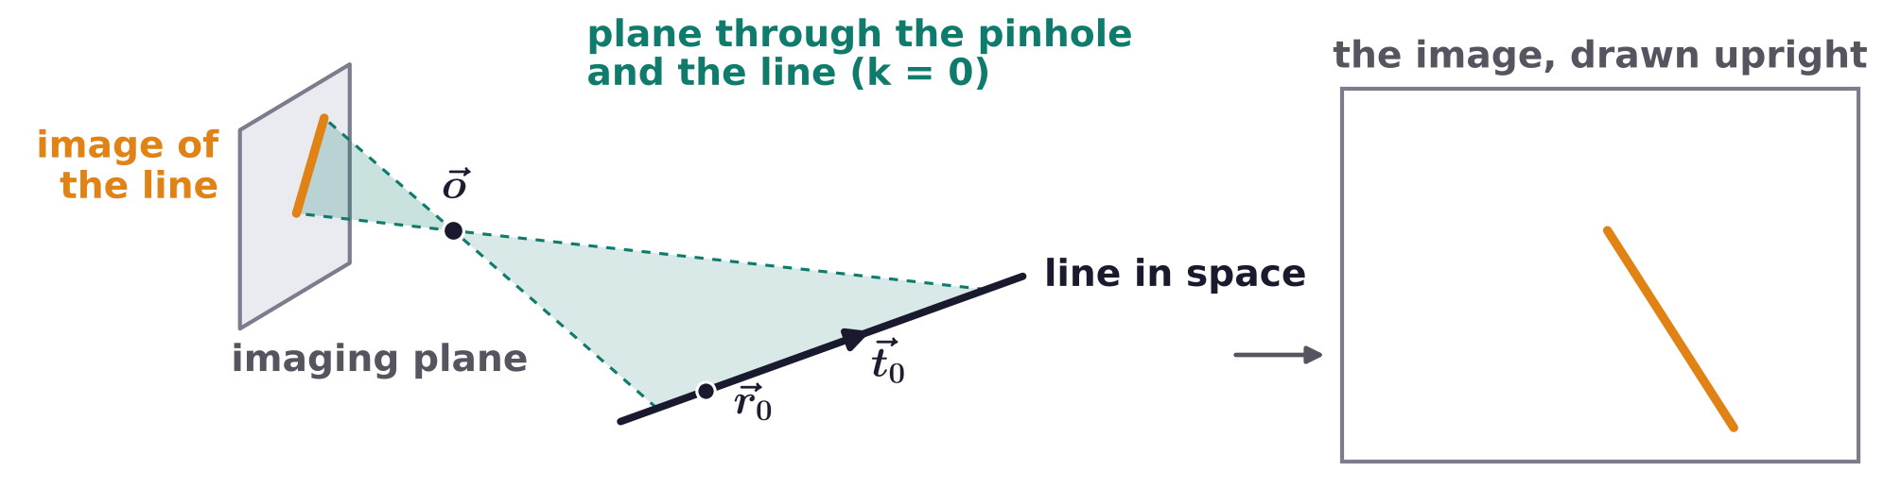
Projection and vanishing points
Straight lines in space project to straight lines
A line: r_0 is any point on it, t_0 its direction and λ the position along it.
A plane: n is its unit normal and k the shortest distance from the plane to the origin.
The pinhole and a line span a plane through the origin, with k = 0.
That plane meets the imaging plane in a straight line: the image of the line.
Geometry and Vision · A. Yuille
8

Slide 9
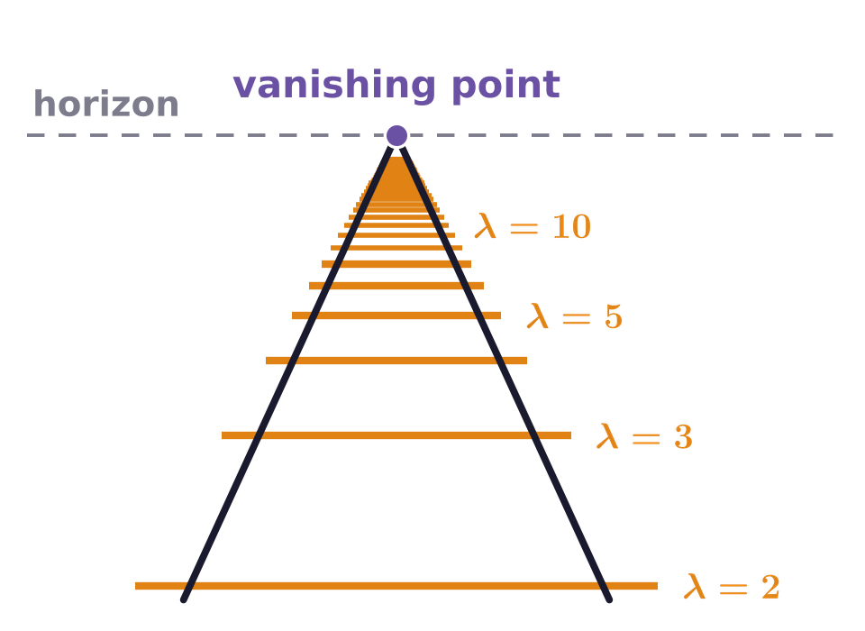
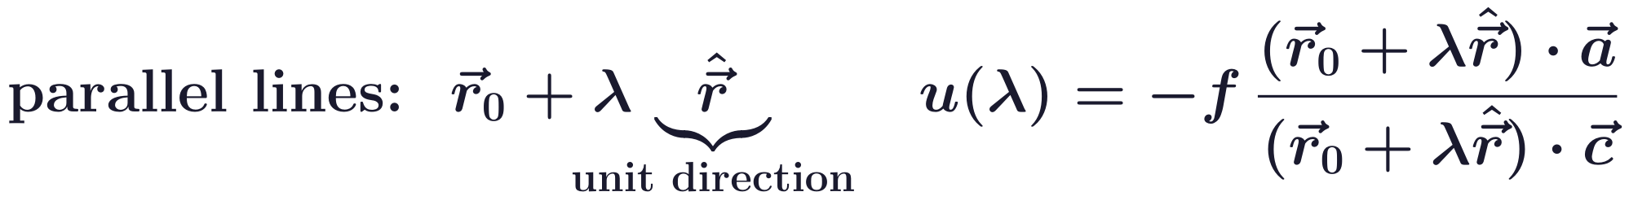
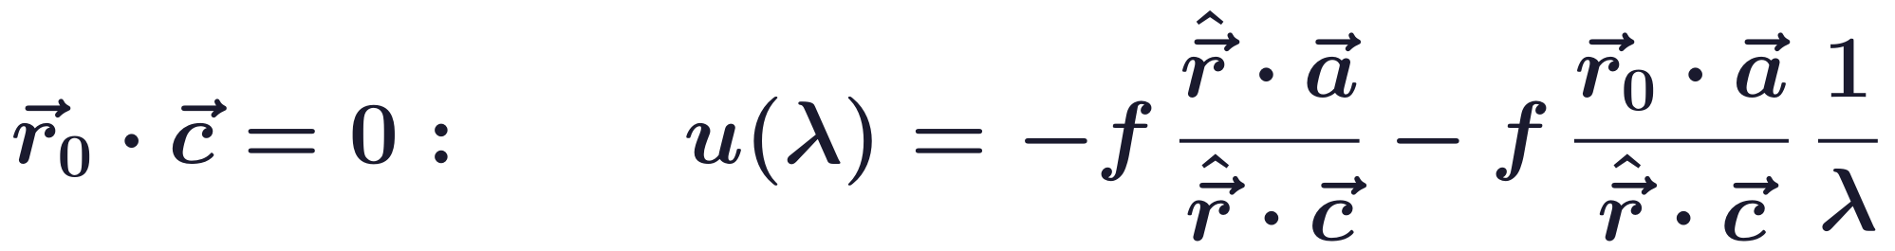
Projection and vanishing points
The image of a line depends on 1/λ, the inverse distance
Parallel lines share one unit direction; each base point r_0 gives a different line.
Slide r_0 along its line until r_0 · c = 0 (possible unless the line is perpendicular to the gaze c).
Then u is a constant plus a term in 1/λ, the inverse distance along the line; v is the same with b.
Equally spaced points along a line, such as railway sleepers, crowd together in the image.
Geometry and Vision · A. Yuille
9

Slide 10
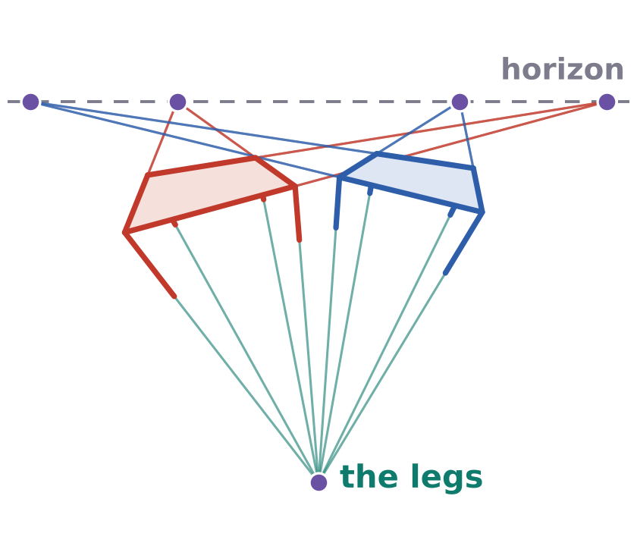
Projection and vanishing points
All lines with one direction meet at one vanishing point
The limit does not depend on r_0: all lines in one direction converge to the same vanishing point.
Lines perpendicular to the gaze c have their vanishing point at infinity.
How many vanishing points an image has depends on its families of parallel lines; some have none.
Square tables on a flat floor, none aligned to another: two vanishing points per table, one for all legs.
Geometry and Vision · A. Yuille
10

Slide 11
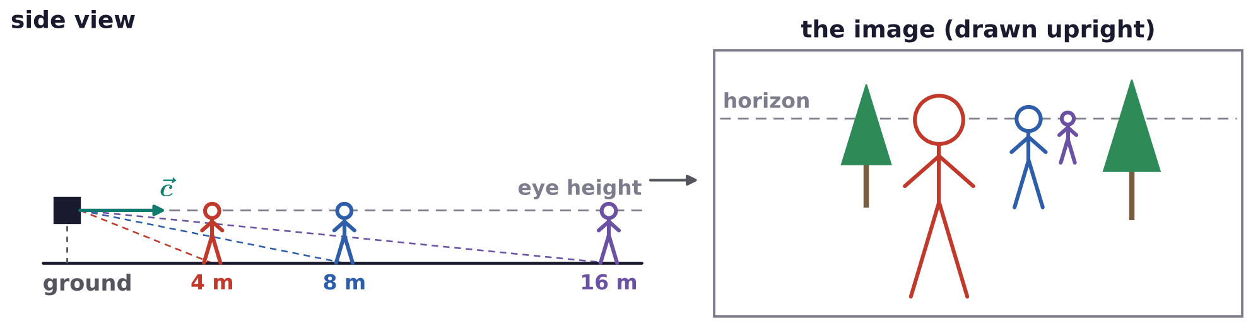
Projection and vanishing points
On a ground plane, vertical lines stay parallel in the image
Often the ground is a flat plane and the direction of gaze c is parallel to it.
Lines perpendicular to the ground, like trees, are then perpendicular to c: their images stay parallel.
Ultimately this is physics: humans and animals stand vertically to resist gravity.
Animals and vision systems use the ground plane to estimate depth: farther feet are nearer the horizon.
Filmmakers use it to make actors look bigger (The Green Mile; Gandalf in The Lord of the Rings).
Geometry and Vision · A. Yuille
11

Slide 12
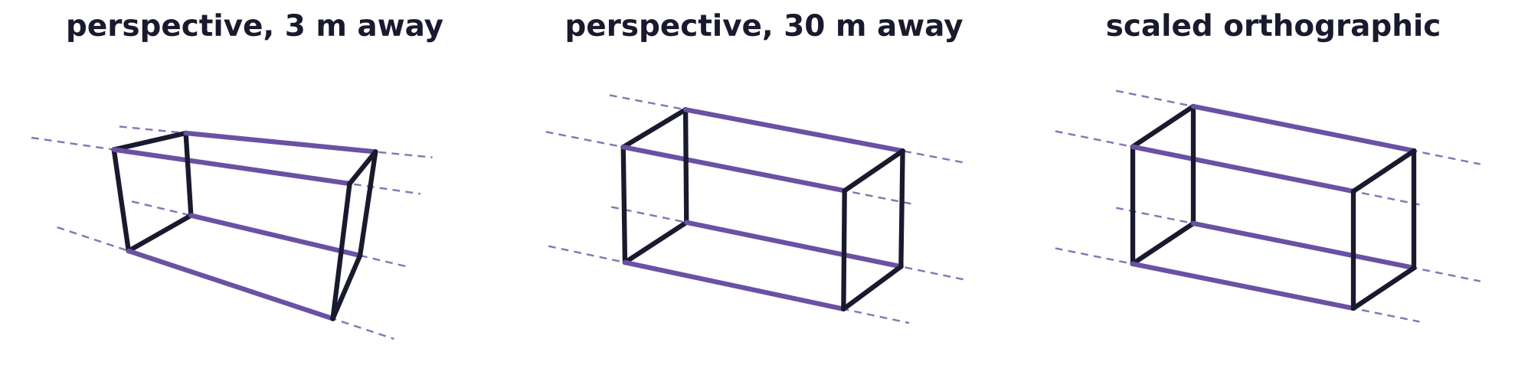
Projection and vanishing points
Scaled orthographic projection approximates perspective
Valid when the depth r · c is large and varies little over the scene: replace r · c by a constant.
f is now the scale. The projection is linear, which simplifies the mathematics.
It also throws away information: parallel lines stay parallel, so the vanishing points are lost.
If parallel lines in the scene look parallel in an image, a linear approximation is probably valid.
Geometry and Vision · A. Yuille
12

Slide 13
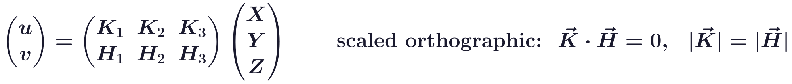
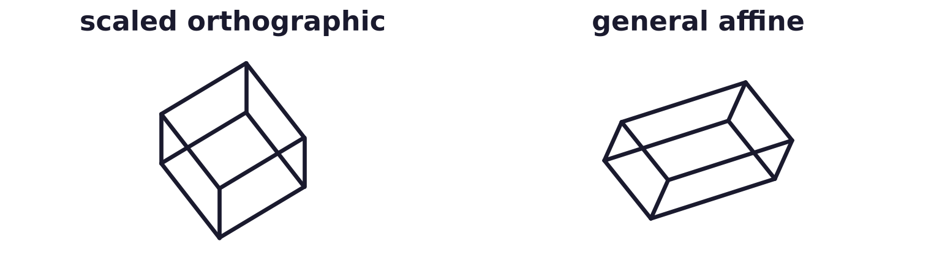
Projection and vanishing points
Affine cameras are the most general linear projection
(X, Y, Z): the point in space; the row K = (K_1, K_2, K_3) gives u and the row H = (H_1, H_2, H_3) gives v.
Scaled orthographic: K and H orthogonal and of equal length, two rows of a scaled rotation.
A general affine camera can also stretch and shear the image.
People write papers, and entire book chapters, about special cases with restrictions on K and H.
Geometry and Vision · A. Yuille
13

Slide 14
Calibration and stereo
2
Stereo triangulates depth from corresponding points on epipolar lines;
each match gives one equation for the rotation and translation.
Geometry and Vision · A. Yuille
14

Slide 15
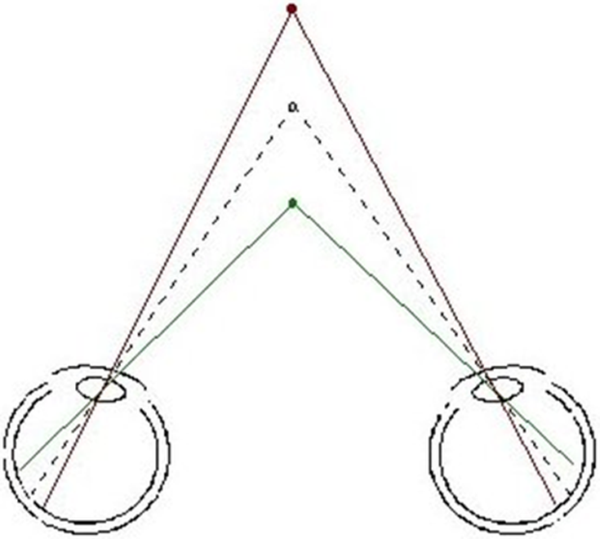
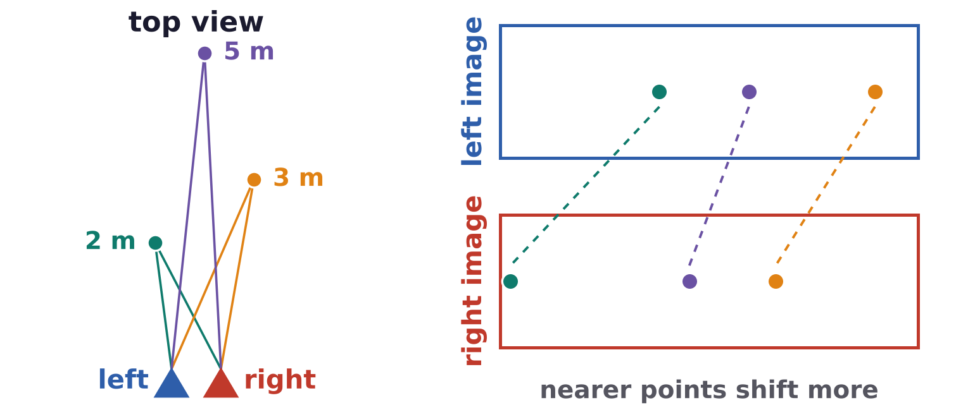
Calibration and stereo
Binocular stereo estimates depth by triangulation
Two eyes or cameras see a point along two rays; its depth is where the rays meet.
This requires solving the correspondence problem between points in the two images.
The correspondence problem is helped by the epipolar line constraint.
Triangulation needs camera calibration: the relative position and orientation of the cameras.
Geometry and Vision · A. Yuille
15

Slide 16
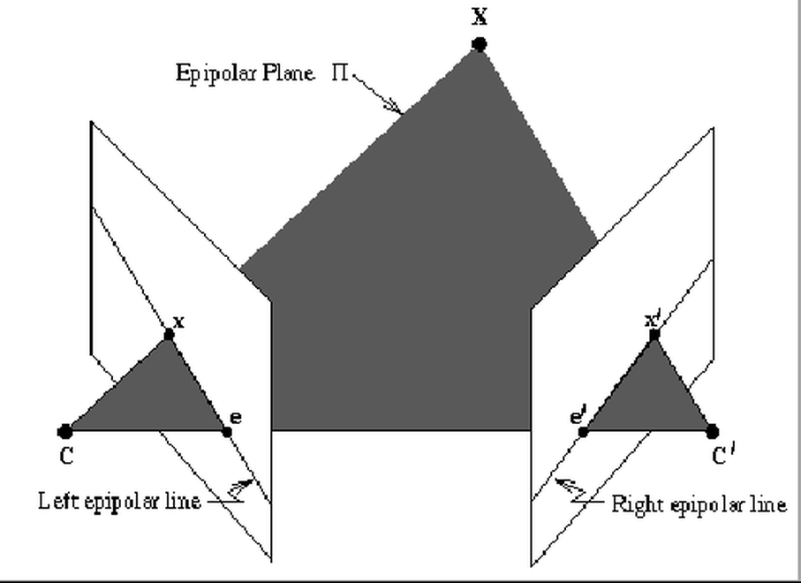
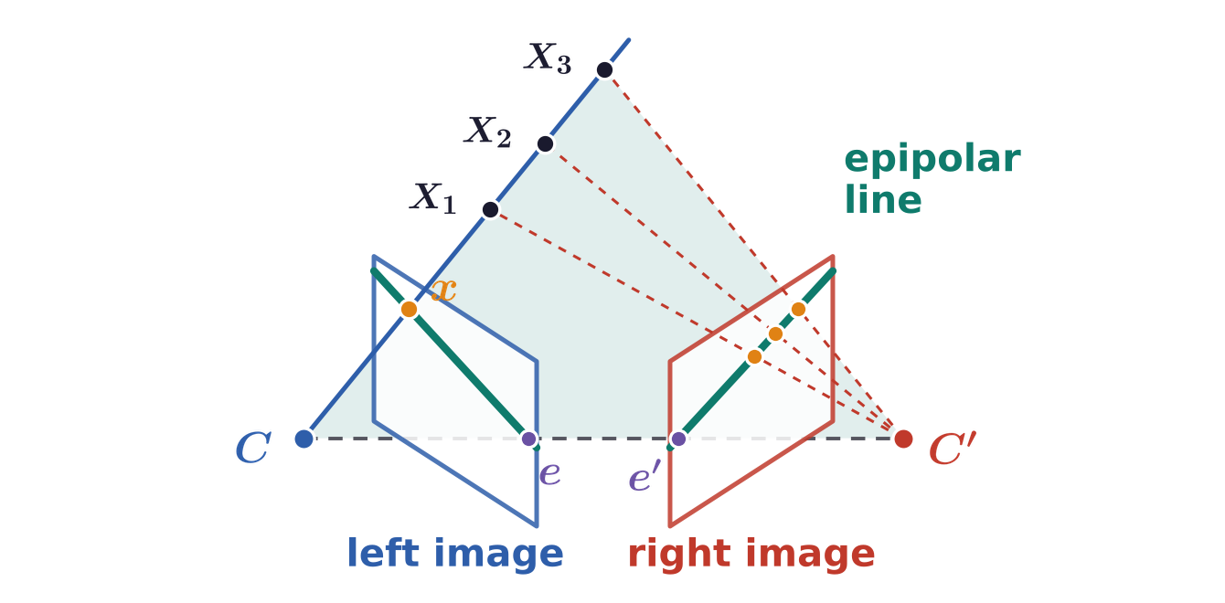
Calibration and stereo
Corresponding points lie on corresponding epipolar lines
Epipolar plane: the plane through the scene point X and the two camera centers C and C'.
It cuts each image in an epipolar line; the epipoles e and e' are where the line CC' meets the images.
Points on one epipolar line can only be matched to points on the corresponding epipolar line.
X1, X2, X3 on the ray through x all project onto the epipolar line: the search for a match is 1D.
Geometry and Vision · A. Yuille
16

Slide 17
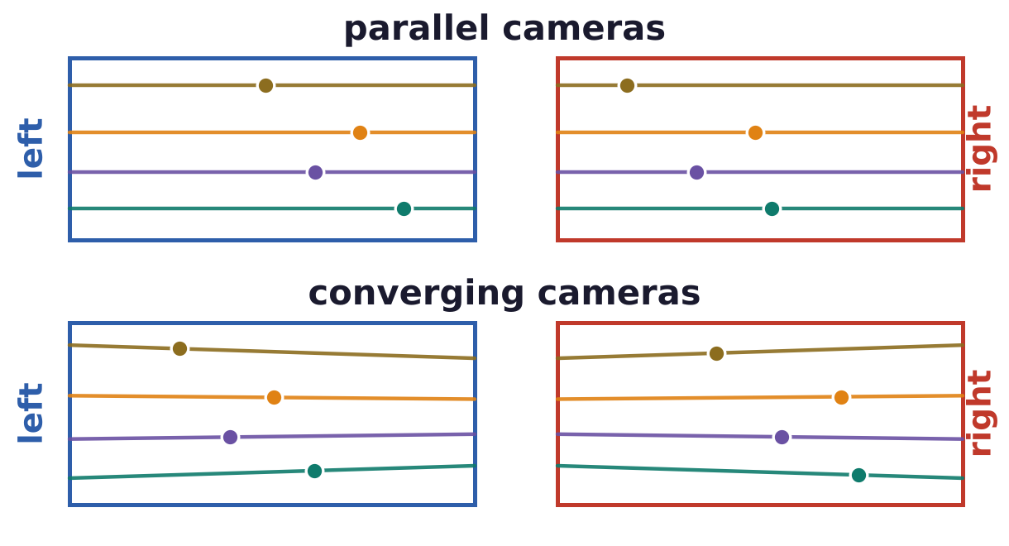
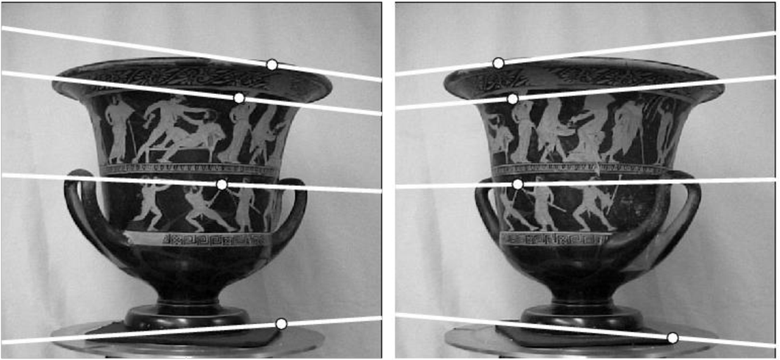
Calibration and stereo
Epipolar lines depend on the camera parameters
Epipolar lines depend on the camera parameters: their positions, orientations and focal lengths.
If both cameras are parallel, then epipolar lines are horizontal: a match lies on the same row.
Converging cameras give slanted epipolar lines, which all pass through the epipole.
The vase: two views with corresponding epipolar lines (white) through matched points.
Geometry and Vision · A. Yuille
17

Slide 18
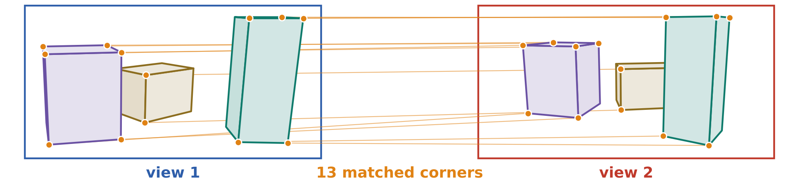
Calibration and stereo
Camera calibration finds the relative positions of cameras
Calibration finds the relative positions and viewpoints of cameras; human vision must calibrate itself.
It is a prerequisite for binocular stereo, structure from motion and depth from multiple cameras.
It is also needed for 3D (three-dimensional) reconstruction, e.g. by Gaussian splatting.
It assumes corresponding points, found with interest points and corner detectors.
Theorems informally called “M views of N points” find the minimum number of points needed.
R. Hartley and A. Zisserman, Multiple View Geometry in Computer Vision, 2nd ed., Cambridge University Press, 2003.
Y. Ma, S. Soatto, J. Košecká and S. S. Sastry, An Invitation to 3-D Vision: From Images to Geometric Models, Springer, 2004.
Geometry and Vision · A. Yuille
18

Slide 19
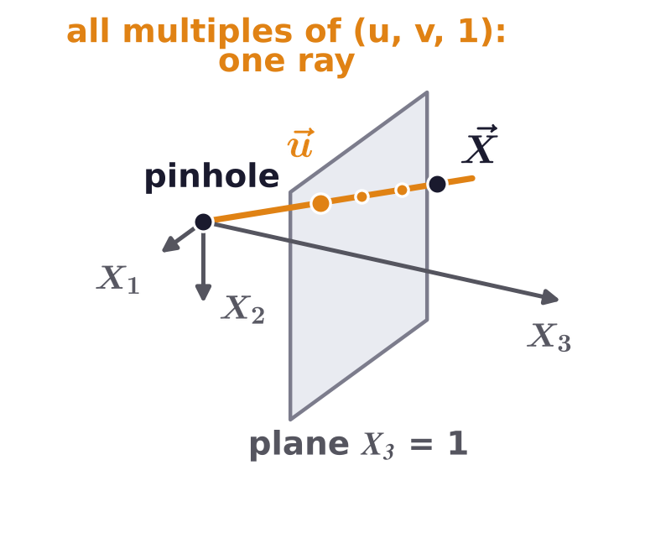
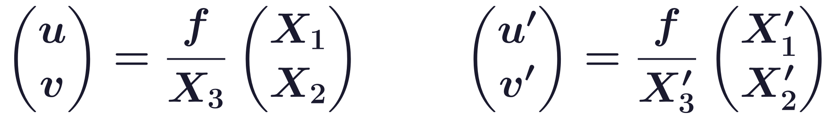
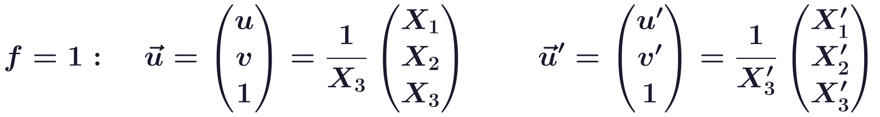
Calibration and stereo
Homogeneous coordinates: an image point is a ray
X = (X_1, X_2, X_3) in the first camera’s coordinates, X' in the second’s. The image plane is now in front.
With u and v in units of the focal length (f = 1), the vector u is the point X divided by its depth X_3.
Homogeneous: u is defined up to scale; all multiples of (u, v, 1) are one ray through the pinhole.
R and t relate the cameras: t is the second camera’s center, R its rotation.
Geometry and Vision · A. Yuille
19

Slide 20
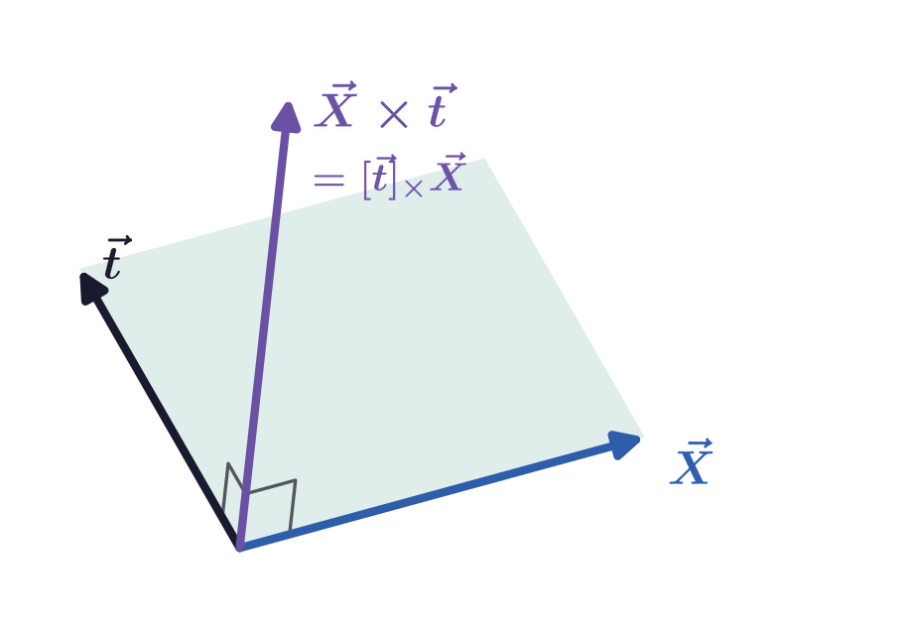
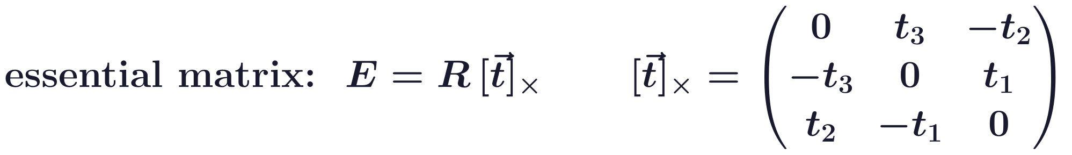
Calibration and stereo
The essential matrix combines the rotation and translation
ε_ijk: the anti-symmetric tensor; 0 if two indices are equal, 1 or −1 for even or odd permutations of 123.
So [t]_× X = X × t: multiplying by [t]_× takes the cross product with t.
The cross product X × t is perpendicular to both X and t.
E contains the six camera parameters, R and t, that calibration must find.
Hartley and Zisserman write X' = RX + t' and E = [t']_× R with [t']_× X = t' × X: the same matrix E.
Geometry and Vision · A. Yuille
20

Slide 21
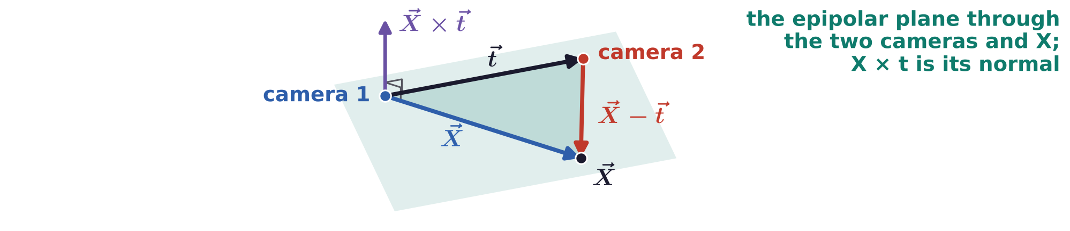
Calibration and stereo
Corresponding points satisfy the epipolar constraint
u and u' are proportional to X and X' = R(X − t); the rotation cancels because R^T R = I.
X, t and X − t lie in one plane, the epipolar plane; X × t is its normal, so the product is zero.
Each pair of corresponding points gives one equation for the camera parameters R and t.
For a fixed u, the points u' that satisfy it form a line: the epipolar line in the second image.
Geometry and Vision · A. Yuille
21

Slide 22
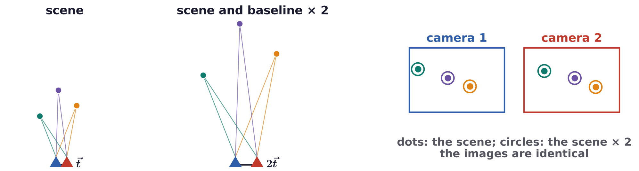
Calibration and stereo
Point matches determine R and the direction of t
R has three parameters and t three, but scaling t leaves the epipolar constraint unchanged.
Only the direction of t can be found: five unknowns. The size of the scene is lost.
Each correspondence gives one equation; five in general position give up to ten solutions (Nistér).
Longuet-Higgins’s linear algorithm uses eight: E has nine entries, defined up to scale.
H. C. Longuet-Higgins, “A computer algorithm for reconstructing a scene from two projections,” Nature, 293:133–135, 1981.
D. Nistér, “An efficient solution to the five-point relative pose problem,” IEEE TPAMI, 26(6):756–770, 2004.
Geometry and Vision · A. Yuille
22

Slide 23
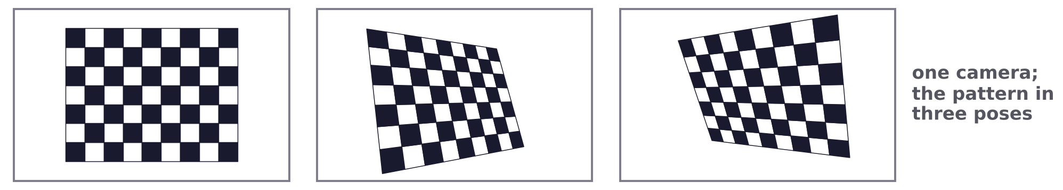
Calibration and stereo
The fundamental matrix handles uncalibrated cameras
The essential matrix needs normalized coordinates u: the focal length and image center must be known.
K, K': the 3 × 3 calibration matrices (focal length in pixels, image center); p: the coordinates in pixels.
Substituting u = K^-1 p and u' = K'^-1 p' gives F, which can be found from point matches alone.
Zhang (2000) finds K from several views of a planar pattern, such as a checkerboard.
O. D. Faugeras, “What can be seen in three dimensions with an uncalibrated stereo rig?” ECCV, LNCS 588, 563–578, 1992.
R. I. Hartley, “Estimation of relative camera positions for uncalibrated cameras,” ECCV, LNCS 588, 579–587, 1992.
Z. Zhang, “A flexible new technique for camera calibration,” IEEE TPAMI, 22(11):1330–1334, 2000.
Geometry and Vision · A. Yuille
23

Slide 24
Structure from motion
3
Under linear projection the image points of a rigid object have rank three;
the singular value decomposition (SVD) gives its shape and viewpoints.
Geometry and Vision · A. Yuille
24

Slide 25
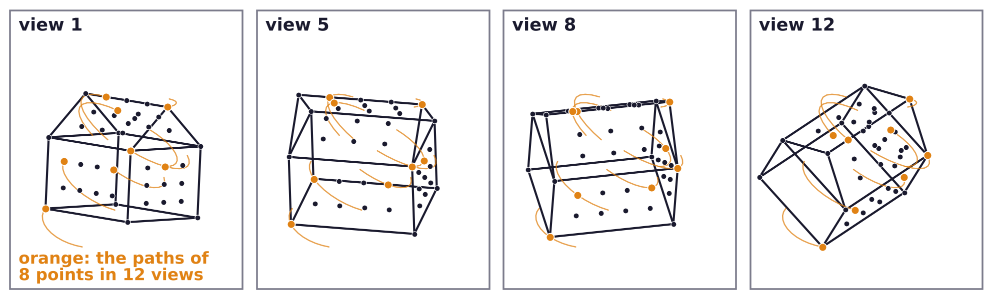
Structure from motion
Structure from motion estimates shape and viewpoints
We have a set of images, or views, of a rigid scene or a rigid object.
Simplest form: detect interest points in each image and correspond them between images.
Then calibrate the cameras, i.e. estimate the viewpoints, and estimate the shape of the object.
With linear projection, 3D structure can be estimated by linear algebra (the SVD).
Geometry and Vision · A. Yuille
25

Slide 26
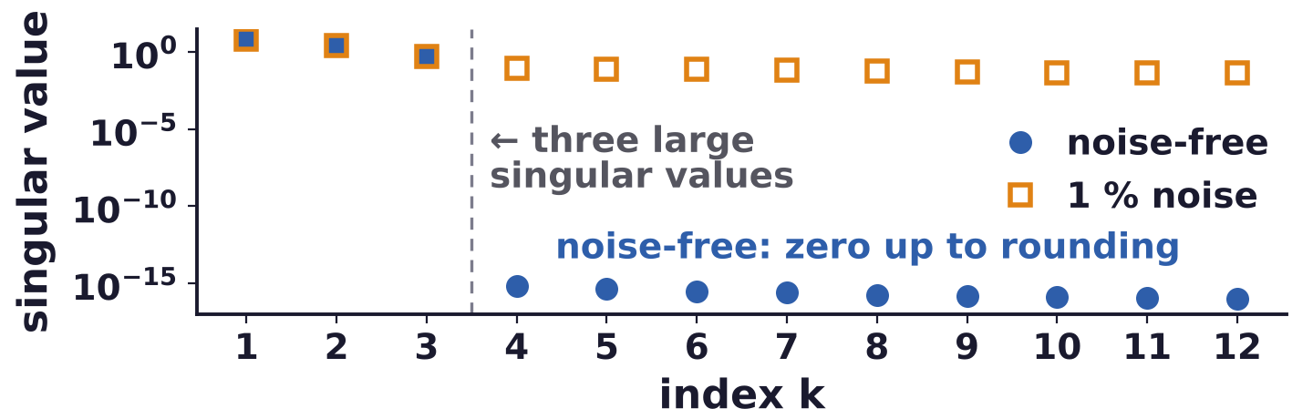
Structure from motion
Under linear projection the measurements have rank three
N points X^n, detected and matched in M views; K^m and H^m are the projection rows of view m.
Image coordinates are measured from the centroid of the points in each view: no translation.
The M × N matrix U of all the u coordinates is K (M × 3) times the shape X (3 × N): rank three.
Noise-free, the fourth and later singular values of U are zero; with noise they are small.
Geometry and Vision · A. Yuille
26

Slide 27
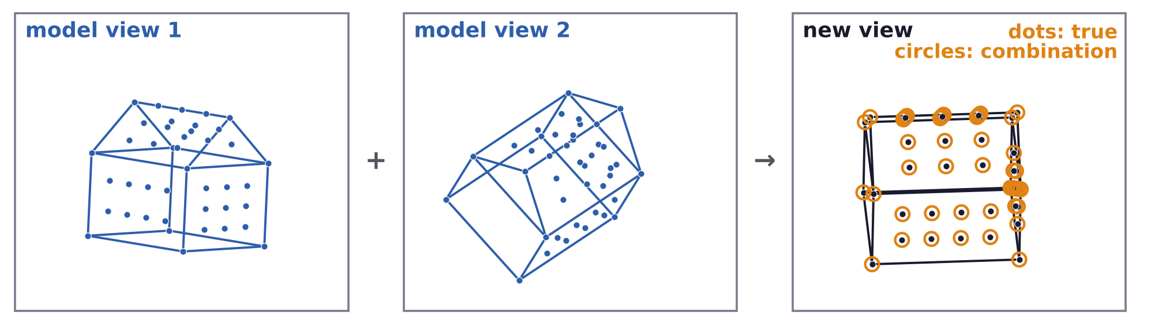
Structure from motion
A new view is a linear combination of known views
The u and v of every view lie in the 3D space spanned by the three rows of X (Ullman and Basri).
Two views give four rows (their u and v), which span this space.
So the coordinates of any new view are linear combinations of those in two model views.
Recognition: an object is recognized if a linear combination of its model views fits the image.
S. Ullman and R. Basri, “Recognition by linear combinations of models,” IEEE TPAMI, 13(10):992–1006, 1991.
Geometry and Vision · A. Yuille
27

Slide 28
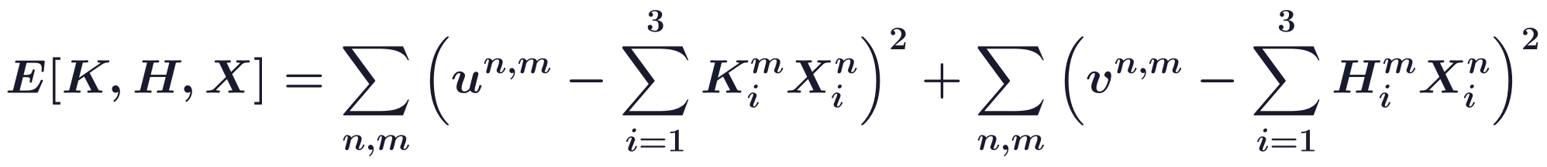
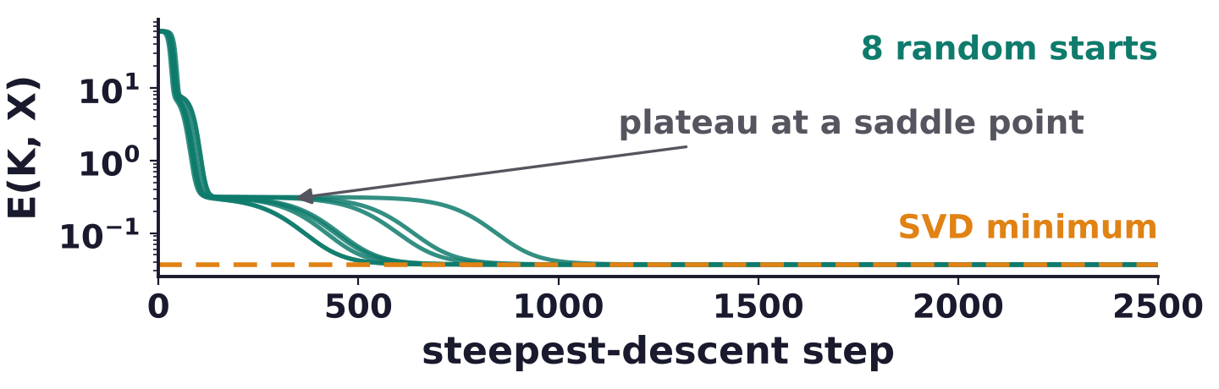
Structure from motion
Structure from motion as least squares: a bilinear problem
The observations are corrupted by additive zero-mean Gaussian noise: minimize E over K, H and X.
Rotating the object and the coordinate system together does not change E: an ambiguity.
Simpler case E(K, X), the u terms only: if K is known the solution for X is linear, and vice versa.
E(K, X) is non-convex but has no local minima, only saddle points: steepest descent finds the minimum.
Geometry and Vision · A. Yuille
28

Slide 29
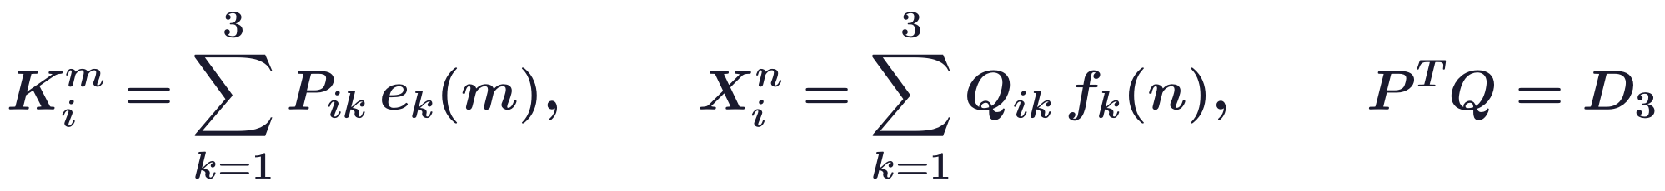
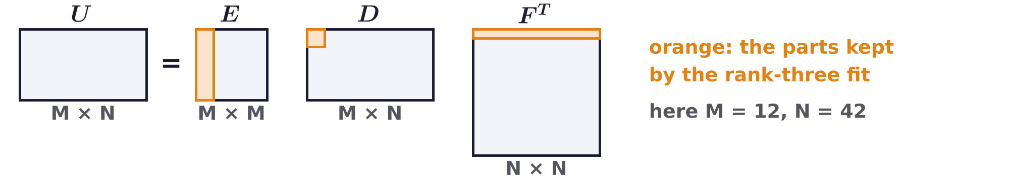
Structure from motion
The singular value decomposition gives the global minimum
Letters reused: U = E D F^T is the SVD of U; E, F orthogonal; D diagonal, δ_ij = 1 if i = j, else 0.
Columns of E and F: eigenvectors of UU^T and U^T U; d_1 ≥ d_2 ≥ d_3 ≥ ... ≥ 0: the singular values.
e_k(m), f_k(n): the first three columns of E and F; D_3: the top 3 × 3 block of D; P, Q: 3 × 3 matrices.
Keeping the three largest singular values gives the best rank-three fit: the global minimum of E(K, X).
Geometry and Vision · A. Yuille
29

Slide 30
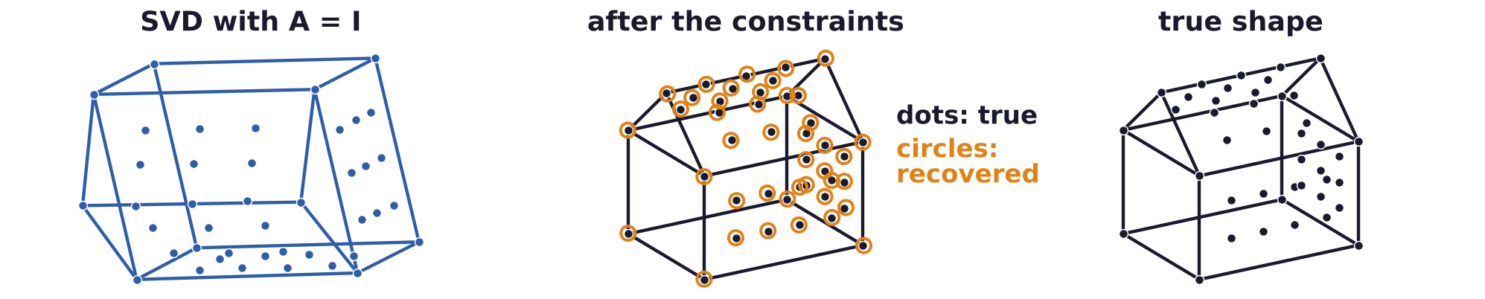
Structure from motion
Orthogonality constraints leave an orthogonal ambiguity
K: the M × 3 matrix of rows K^m; X: the 3 × N matrix of points X^n. Any invertible A also fits.
Part of this ambiguity is the rotation of the object and the coordinate system.
Stack the u and v rows into one 2M × N matrix: a single SVD gives K, H and the same shape X.
Then impose, for every view m, that K^m and H^m are orthogonal and of equal length.
Then A is orthogonal up to a scale: a rotation, possibly with a mirror reflection in depth.
Geometry and Vision · A. Yuille
30

Slide 31
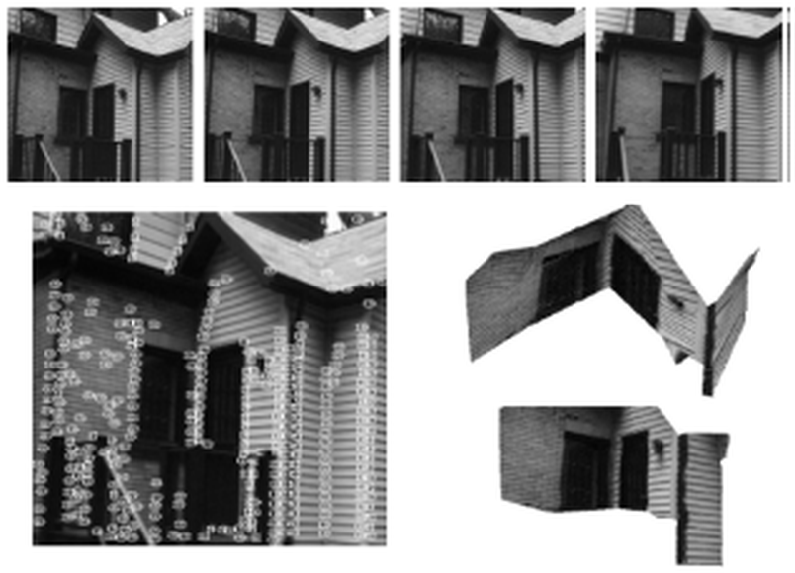
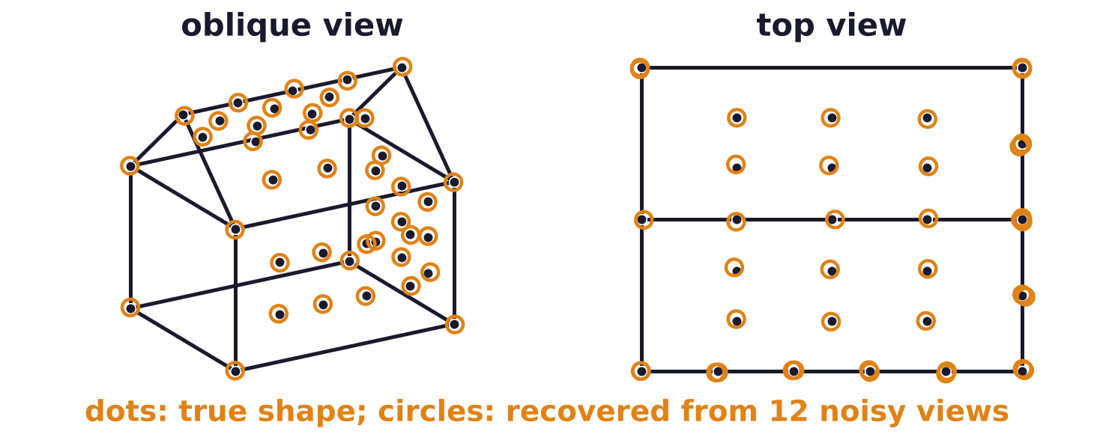
Structure from motion
Factorization recovers shape from real and synthetic views
Tomasi and Kanade: four frames of a house sequence, the tracked features and the recovered shape.
The algorithm was first found by Kontsevich et al. (1987) and reinvented by Tomasi and Kanade.
It can be extended to perspective projection, but this requires a more complex algorithm.
Synthetic house: from twelve noisy views, the shape is recovered up to rotation, scale and reflection.
C. Tomasi and T. Kanade, “Shape and motion from image streams under orthography: a factorization method,” IJCV, 9(2):137–154, 1992.
L. L. Kontsevich, M. L. Kontsevich and A. Kh. Shen, “Two algorithms of shape reconstruction,” Avtometriya, no. 5, 72–77, 1987.
Geometry and Vision · A. Yuille
31

Slide 32
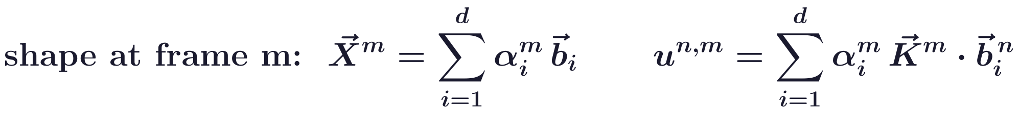
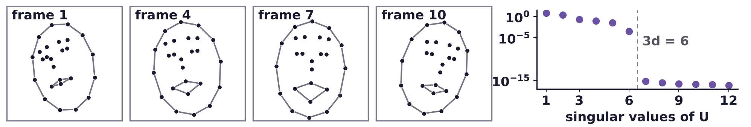
Structure from motion
Non-rigid shapes as linear sums of basis shapes
A special class of non-rigid motion: the object is a linear sum of d basis shapes b_i (point n: b_i^n).
The coefficients α_i^m of the basis shapes vary with time, the frame m.
Each frame contributes d rigid-like terms, so the measurements have rank at most 3d.
This approach was developed by Bregler, Hertzmann and Biermann (2000).
C. Bregler, A. Hertzmann and H. Biermann, “Recovering non-rigid 3D shape from image streams,” CVPR, 690–696, 2000.
Geometry and Vision · A. Yuille
32

Slide 33
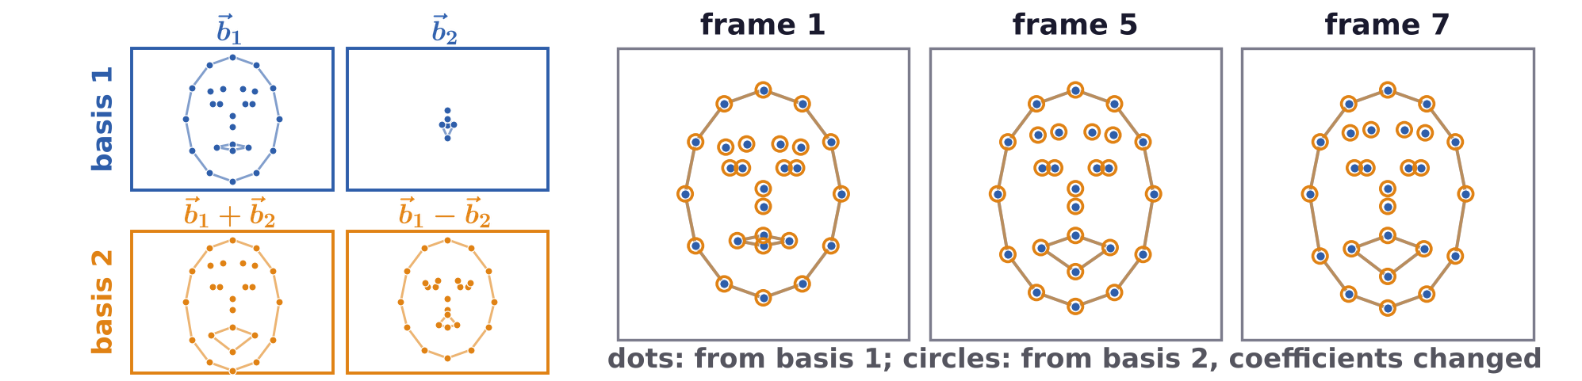
Structure from motion
The non-rigid ambiguities are only coordinate changes
Researchers first made unnecessary assumptions, thinking there were ambiguities in b, α, K and H.
It was realized that these were only coordinate changes.
This led to theoretically very attractive algorithms (Dai, Li and He, 2012), but they are complex.
They are not guaranteed to reach the global minimum, and apply to limited types of motion.
For example, they cannot deal with articulated objects like humans and animals.
Y. Dai, H. Li and M. He, “A simple prior-free method for non-rigid structure-from-motion factorization,” CVPR, 2018–2025, 2012.
Geometry and Vision · A. Yuille
33

Slide 34
Geometric priors
4
The ground plane and the three axes of Manhattan World let one image
reveal geometry; when they fail, as in the Ames room, perception errs.
Geometry and Vision · A. Yuille
34

Slide 35
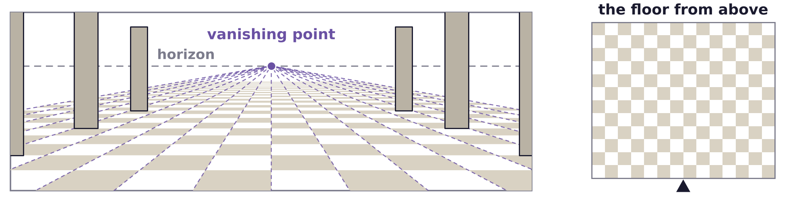
Geometric priors
Painters exploited vanishing points to give depth
European painters used vanishing points to give their pictures the impression of 3D depth.
This started from crude attempts by Giotto.
Computer vision used this to find the 3D structure of objects with enough vanishing points.
Gravity makes one axis of trees, cars and people vertical; vanishing points help to detect the ground.
A tiled floor: the lines going into depth (orthogonals) meet at one point; tiles shrink toward the horizon.
Geometry and Vision · A. Yuille
35

Slide 36
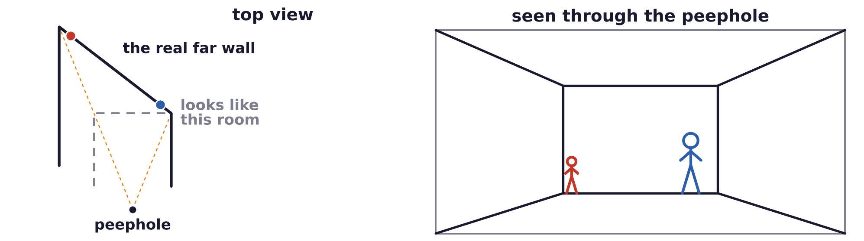
Geometric priors
The Ames room breaks the assumptions of perspective
Humans obtain depth from perspective, but these cues make strong assumptions about the scene.
If the assumptions are invalid, human perception makes mistakes.
The Ames room looks like a real room from its viewpoint, but its far wall recedes on one side.
This fools humans: people seem to change in size when they move across the room.
W. H. Ittelson, The Ames Demonstrations in Perception, Princeton University Press, 1952.
Geometry and Vision · A. Yuille
36

Slide 37
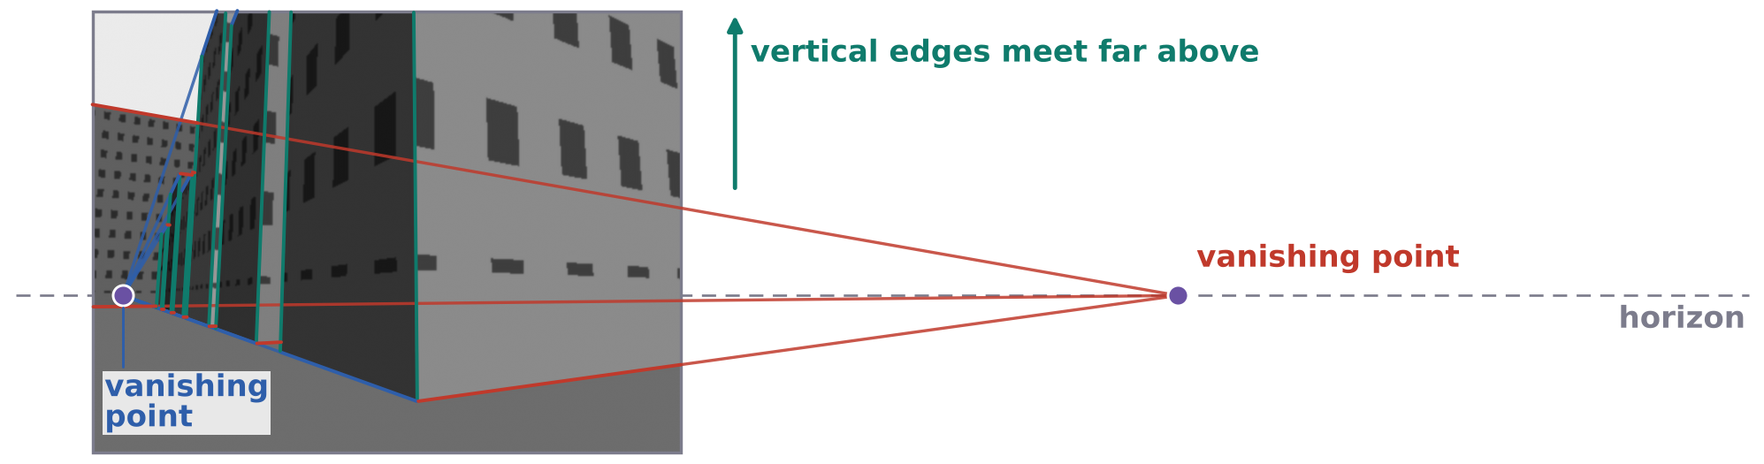
Geometric priors
Manhattan World: man-made scenes have three main axes
Man-made scenes often have three dominant axes, perpendicular to each other: Manhattan World.
It gives the orientation of the camera with respect to this natural coordinate system of the scene.
Either by finding the vanishing points (up to three), or from the statistics of the edge orientations.
The statistics assume that most edges come from the three dominant axes.
J. M. Coughlan and A. L. Yuille, “Manhattan World: orientation and outlier detection by Bayesian inference,”
Neural Computation, 15(5):1063–1088, 2003.
Geometry and Vision · A. Yuille
37

Slide 38
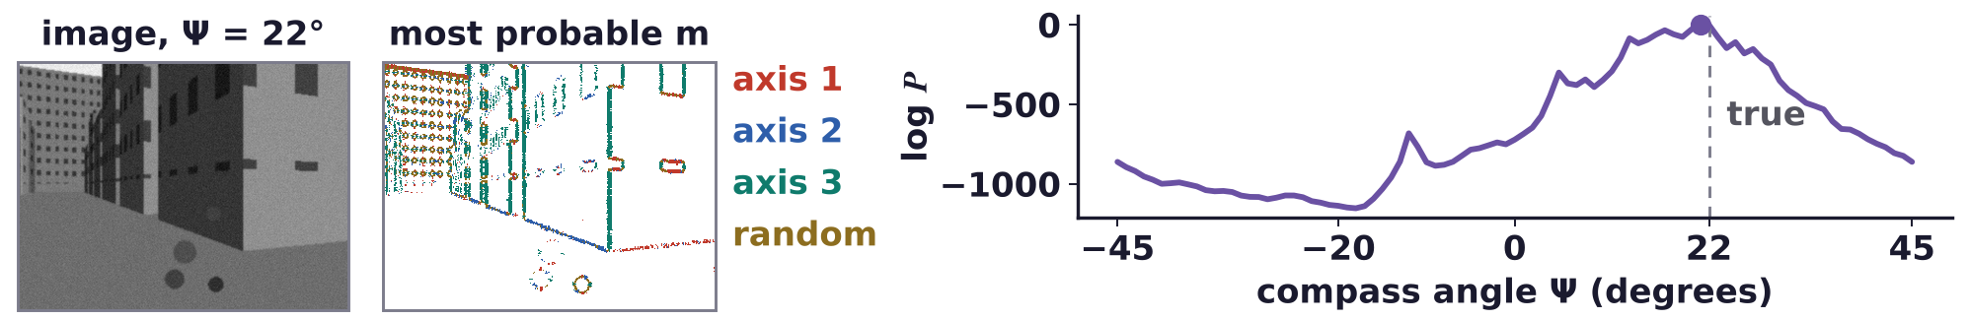
Geometric priors
Bayesian inference finds the compass angle from edges
Every pixel, at position u, gives its edge strength E_u and gradient direction φ_u: the vector E_u.
Hidden m_u: edge of axis 1, 2, 3 (vertical), random edge or no edge (prior 0.02, 0.02, 0.02, 0.04, 0.9).
An axis edge points to its axis’s vanishing point, which moves with the compass angle Ψ.
Sum over m_u, multiply over the pixels, search over Ψ: within 5° on 23 of 25 indoor images.
J. M. Coughlan and A. L. Yuille, “Manhattan World: compass direction from a single image by Bayesian inference,” ICCV, 941–947, 1999.
Geometry and Vision · A. Yuille
38

Slide 39
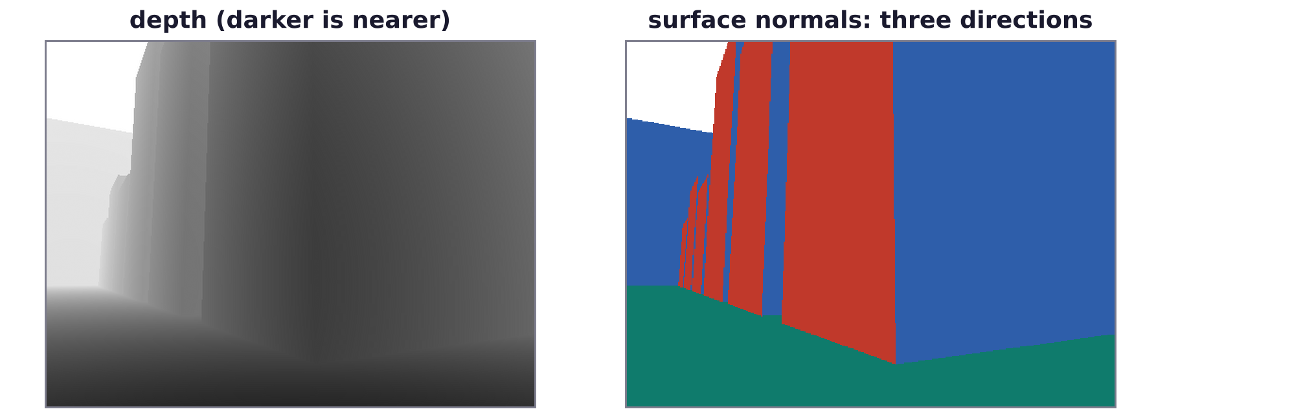
Geometric priors
Planes aligned to the three axes are a prior for stereo
Manhattan World extended: the world often consists of planar surfaces aligned to the three axes.
This has been used as a prior for stereo, e.g. with many views (Furukawa et al.).
Every surface normal is one of three directions, so depth is piecewise planar.
Y. Furukawa, B. Curless, S. M. Seitz and R. Szeliski, “Manhattan-world stereo,” CVPR, 1422–1429, 2009.
Geometry and Vision · A. Yuille
39

Slide 40
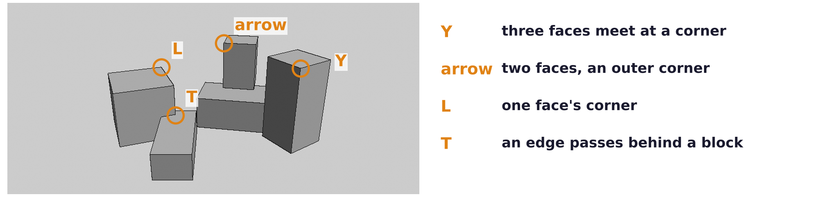
Geometric priors
Structured scenes reveal their 3D geometry in a single image
The classic blocks world is constructed by placing a set of blocks on the ground.
Analyzing the boundaries of the blocks determined their three-dimensional structure.
Each junction (L, arrow, Y, T) allows only a few 3D readings; junctions that share an edge must agree.
It was extended to cities: inverting a regular enough grammar of the scene can give its 3D structure.
L. G. Roberts, “Machine perception of three-dimensional solids,” PhD thesis, MIT, 1963.
D. A. Huffman, “Impossible objects as nonsense sentences,” in Machine Intelligence 6, Edinburgh University Press, 295–323, 1971.
M. B. Clowes, “On seeing things,” Artificial Intelligence, 2:79–116, 1971.
Geometry and Vision · A. Yuille
40

Slide 41
Geometric priors
Summary
Pinhole camera: u = −f (r · a)/(r · c). Dividing by depth keeps lines straight, makes parallels converge.
All lines with one direction share a vanishing point, unless they are perpendicular to the gaze.
Scaled orthographic and affine cameras approximate projection linearly, and lose the vanishing points.
Stereo needs calibration; corresponding points lie on corresponding epipolar lines.
Essential matrix: u'^T E u = 0 gives R and the direction of t; the fundamental matrix F works in pixels.
Rigid structure from motion: the measurements have rank three; the SVD gives shape and viewpoints.
Non-rigid motion as sums of d basis shapes has rank at most 3d; its ambiguities are coordinate changes.
Geometric priors (ground plane, Manhattan World) give geometry from one image, if they hold.
Geometry and Vision · A. Yuille
41

