Slide 1
Lambertian Models of
Reflectance and Rendering
29 October, 2026
Alan Yuille · Probabilistic Models of the Visual Cortex

Slide 2
What this lecture covers
1
Light and the Lambertian model
2
Photometric stereo, bas-relief
Mirrors, diffuse surfaces, the cosine law
Factorization, integrability, bas-relief
3
Shape from shading
4
Harmonic analysis of lighting
Eikonal equation, fast marching, priors
Illumination cone, spherical harmonics
5
Rendering
Meshes, rasterization, ray tracing, Phong
Geometry and Vision · A. Yuille
2

Slide 3
Light and the
Lambertian model
1
A Lambertian surface reflects light equally in all directions: the image is the
albedo times normal dot light, linear in the light apart from shadows.
Geometry and Vision · A. Yuille
3

Slide 4
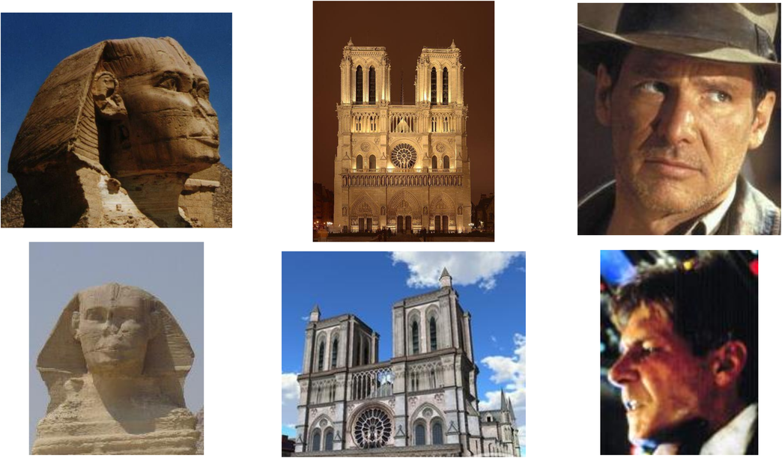
Light and the Lambertian model
Lighting and pose change the appearance of objects
Each column shows one object in two images: the Sphinx, Notre-Dame and an actor’s face.
Lighting changes the shading, the shadows and the highlights; pose changes which parts are seen.
For faces, two images of one person under different lighting can differ more than two people.
Understanding the effect of lighting is challenging, but can lead to better interpretation of images.
Y. Adini, Y. Moses and S. Ullman, “Face recognition: the problem of compensating for changes in illumination direction,” IEEE TPAMI, 19(7):721–732,
1997.
Geometry and Vision · A. Yuille
4

Slide 5
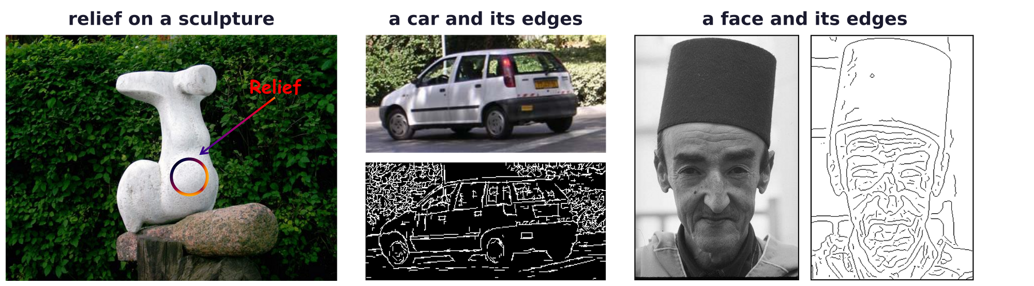
Light and the Lambertian model
Shading reveals the shape of smooth surfaces
Edges capture the outlines and the markings of objects such as the car.
On smooth surfaces, such as a face, the edges miss most of the shape.
The relief on the sculpture (circled) has no edges: only its shading shows it.
Shading depends on the shape of the surface, how it reflects light, and the lighting.
Sculpture by Dumitru Verdianu.
Geometry and Vision · A. Yuille
5

Slide 6
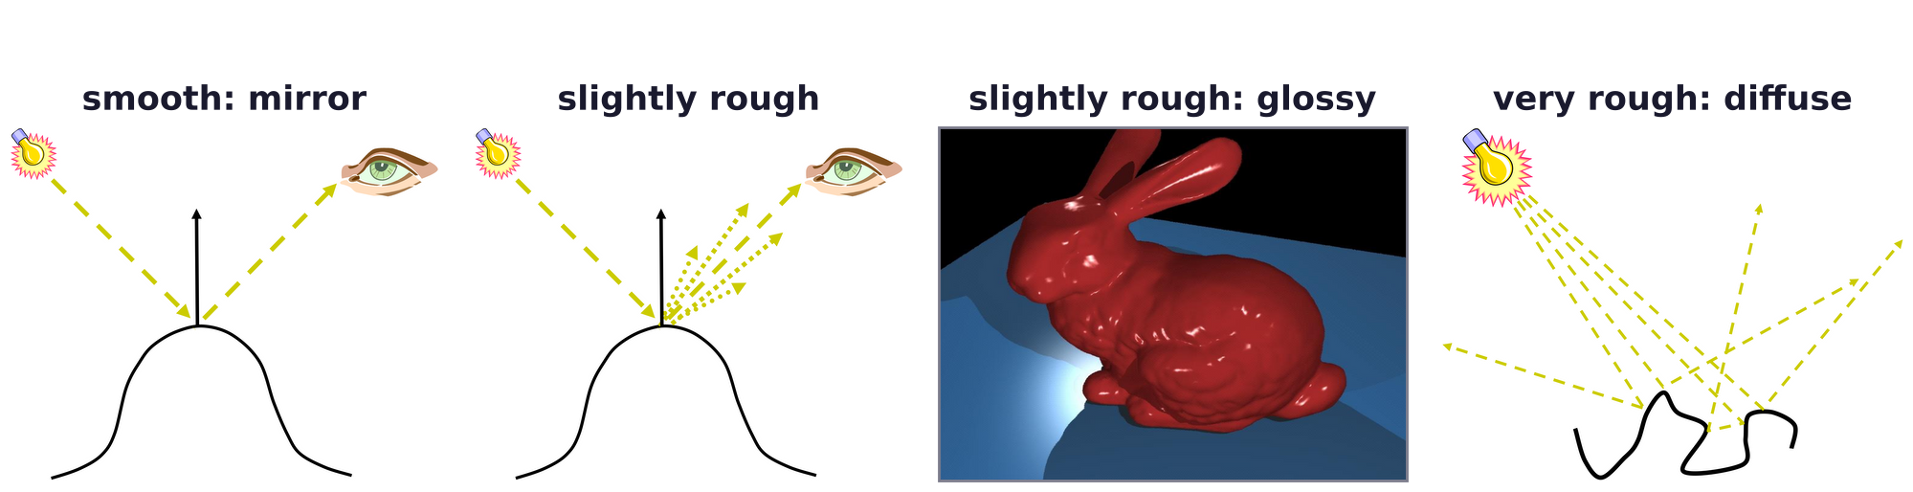
Light and the Lambertian model
Smooth surfaces reflect like mirrors, rough ones diffusely
Rays travel from sources to objects, where they are absorbed or reflected, losing energy at each bounce.
The camera captures the rays through its focal center; we assume that its response is linear.
A smooth surface reflects light in the mirror direction: at equal angles on both sides of the normal.
On a slightly rough surface the reflected light falls off around the specular direction.
A very rough surface may reflect light equally in all directions.
Geometry and Vision · A. Yuille
6

Slide 7
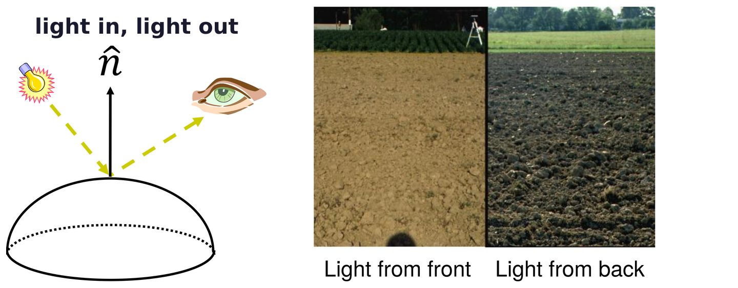
Light and the Lambertian model
The BRDF gives the light reflected toward each direction
Bidirectional Reflectance Distribution Function (BRDF): it specifies how a surface reflects light.
For a unit of incoming light in a direction (θ_in, φ_in), f is the light reflected in direction (θ_out, φ_out).
A ploughed field looks bright with light from the front (behind the viewer), dark with light from the back.
Expanded in a series, the BRDF starts with the Lambertian: the only term independent of the viewpoint.
Geometry and Vision · A. Yuille
7

Slide 8
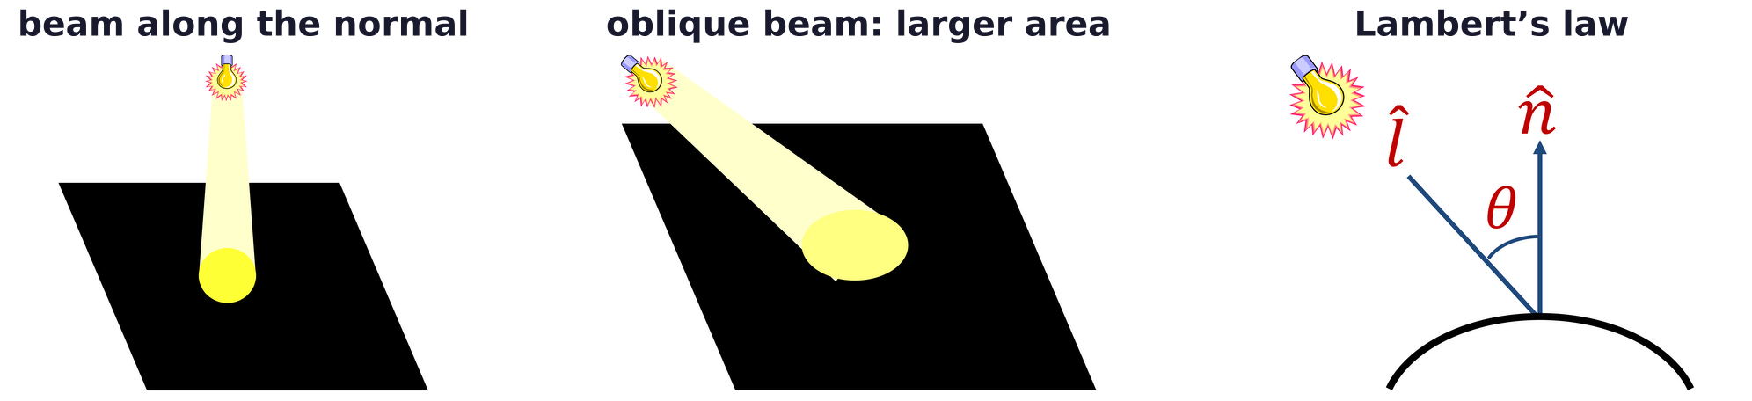
Light and the Lambertian model
Lambertian surfaces follow the cosine law
A Lambertian surface reflects equally in all directions: it looks equally bright from every viewpoint.
A beam at angle θ to the normal covers 1/cos θ times the area: each point gets cos θ as much light.
E is the strength of the light, ρ the albedo (the fraction of light reflected), θ the angle to the normal.
In vector form the light is l = E l̂ and the scaled normal is n = ρ n̂.
J. H. Lambert, Photometria, sive de mensura et gradibus luminis, colorum et umbrae, Eberhard Klett, Augsburg, 1760.
Geometry and Vision · A. Yuille
8

Slide 9
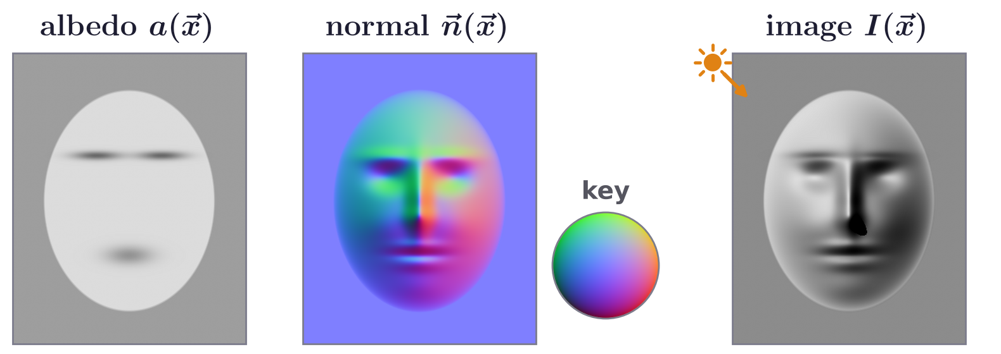
Light and the Lambertian model
The Lambertian model is the simplest model of imaging
I(x): image; a(x): albedo; n(x): unit surface normal; |s|: strength and s/|s|: direction of the light.
It is called the cosine rule: the image depends on the cosine between the normal and the light direction.
It is Lambert’s law with a = ρ and s = l. It ignores specularity and inter-reflection.
It is a good approximation much of the time and easy to analyze; BRDF models are much harder.
Geometry and Vision · A. Yuille
9

Slide 10
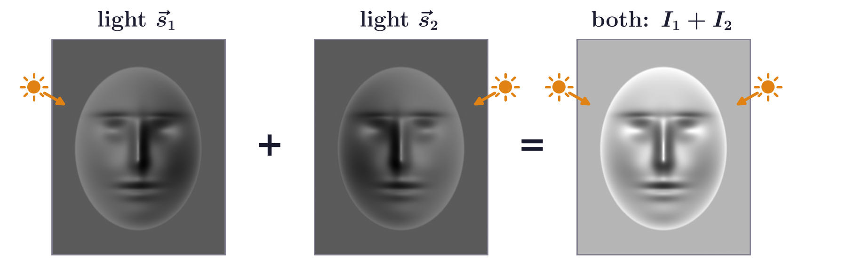
Light and the Lambertian model
Without shadows, the image is linear in the light source
Two lights add: the image under both is the sum of the two images.
The two lights come from the upper left and the upper right; no point of the face turns away from either.
Most importantly, the image does not depend directly on the viewpoint.
A mirror is different: its image depends on the viewpoint, the light direction and its orientation.
Geometry and Vision · A. Yuille
10

Slide 11
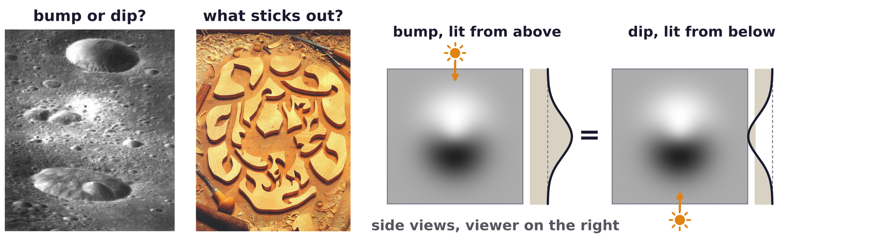
Light and the Lambertian model
Convex lit from above looks like concave lit from below
It is impossible to distinguish a convex object lit from above from a concave object lit from below.
Humans resolve this ambiguity by tending to perceive objects to be convex.
Surprisingly, an inverted face mask appears to be a real face, even with stereo or motion cues present.
In the computed pair, a bump z lit from above and the dip −z lit from below give identical images.
R. L. Gregory, “Knowledge in perception and illusion,” Phil. Trans. R. Soc. Lond. B, 352(1358):1121–1127, 1997.
Geometry and Vision · A. Yuille
11

Slide 12

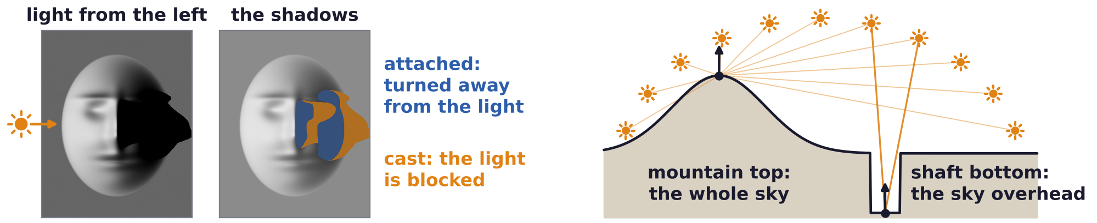
Light and the Lambertian model
Attached and cast shadows break the linear model
Attached shadow: the surface faces away from the light (a n · s < 0); cast shadow: the light is occluded.
With attached shadows the image is no longer linear in the light sources: harder to analyze, still possible.
A mountain top and a mineshaft bottom: same normal and albedo, same Lambertian intensity.
Yet the bottom of the shaft is much darker: it is occluded from most of the light sources.
Geometry and Vision · A. Yuille
12

Slide 13
Photometric stereo, bas-relief
2
Images under several lights have rank three: factorizing them gives shape and
lights up to a 3 × 3 matrix; integrability leaves only the bas-relief ambiguity.
Geometry and Vision · A. Yuille
13

Slide 14
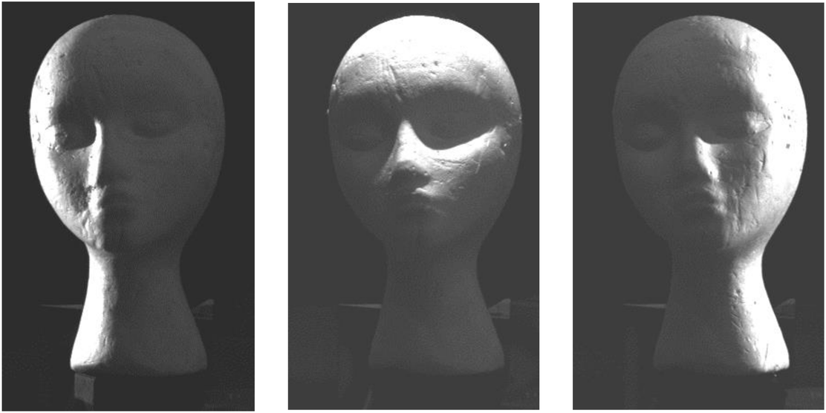
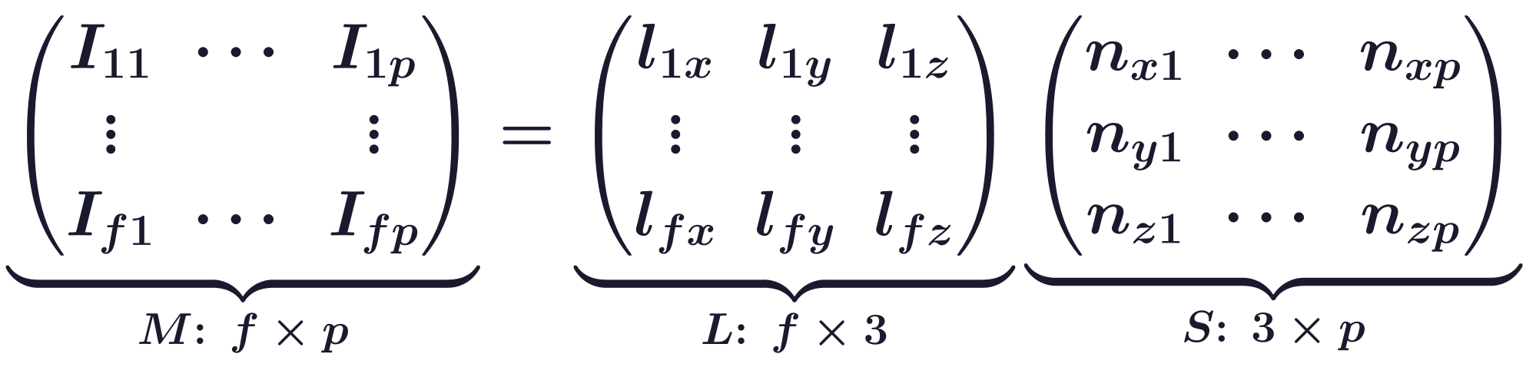
Photometric stereo, bas-relief
With known lights, photometric stereo finds the normals
Given several images of a Lambertian object under varying lighting, a single directional source each.
M: f images (rows) of p pixels; rows of L: the f lights l; columns of S: scaled normals n = ρ n̂.
We can solve for S if L is known, by least squares at every pixel (Woodham); then ρ = |n| and n̂ = n/ρ.
This algorithm extends to more complex reflectance models (if known) through a lookup table.
R. J. Woodham, “Photometric method for determining surface orientation from multiple images,” Optical Engineering, 19(1):139–144, 1980.
Geometry and Vision · A. Yuille
14

Slide 15
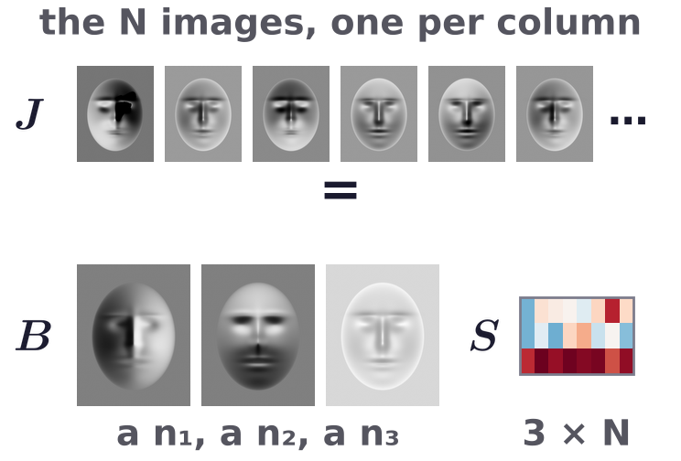
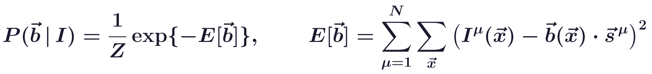
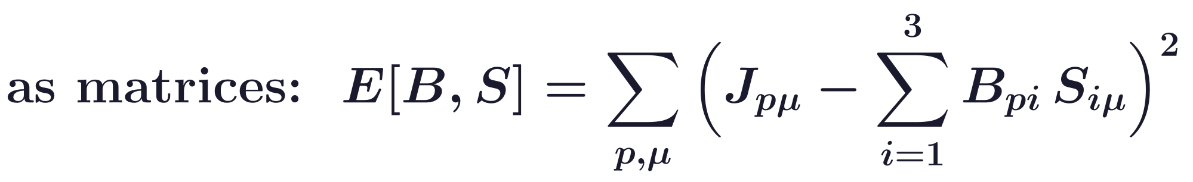
Photometric stereo, bas-relief
With unknown lights, shape and lighting are fitted together
Write b(x) = a(x) n(x): the albedo is a(x) = |b(x)| and the surface normal is n(x) = b(x)/a(x).
J holds the N images as columns (pixels p, images μ), B the vectors b (p × 3), S the N lights (3 × N).
In the letters of photometric stereo, J = M^T, B = S^T and S = L^T: here S holds the lights.
E[b] is an energy and Z normalizes P; minimizing E is solved, up to an ambiguity, by linear algebra.
A. L. Yuille, D. Snow, R. Epstein and P. N. Belhumeur, “Determining generative models of objects under varying illumination:
shape and albedo from multiple images using SVD and integrability,” IJCV, 35(3):203–222, 1999.
Geometry and Vision · A. Yuille
15

Slide 16
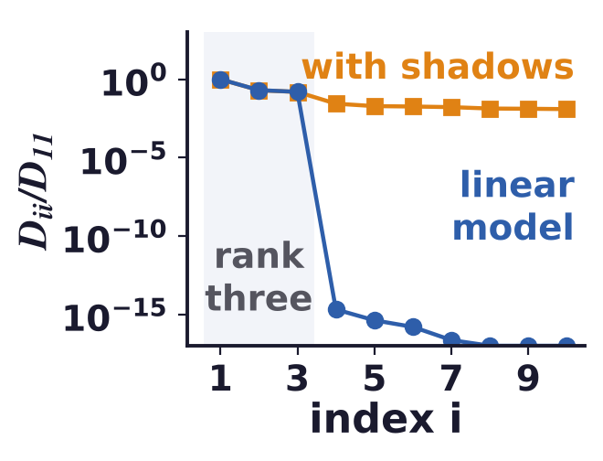
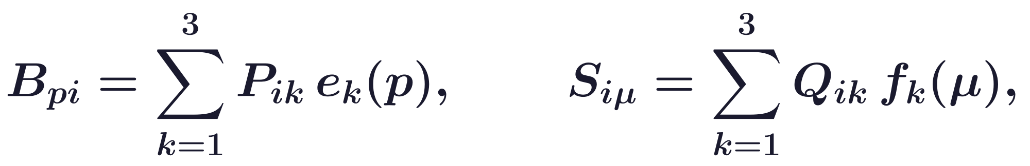
Photometric stereo, bas-relief
The singular value decomposition (SVD) gives the rank-3 fit
Without shadows the images lie in a three-dimensional space: J has rank three (Shashua).
U, V: eigenvectors of J J^T and J^T J, eigenvalues D_ii² (I: identity); e_k, f_k: their first three columns.
The leftover energy, the sum of D_ii² for i ≥ 4, is zero exactly when J = BS: it tests the model.
Hayakawa factorizes M = LS in the same way, with the SVD of M.
A. Shashua, “On photometric issues in 3D visual recognition from a single 2D image,” IJCV, 21(1–2):99–122, 1997.
H. Hayakawa, “Photometric stereo under a light source with arbitrary motion,” JOSA A, 11(11):3079–3089, 1994.
Geometry and Vision · A. Yuille
16

Slide 17
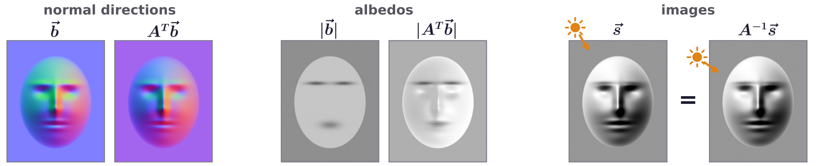
Photometric stereo, bas-relief
Shape and lights are found only up to an invertible matrix
P and Q are fixed only up to an invertible 3 × 3 matrix A: P ↦ A^T P, Q ↦ A^-1 Q keep P^T Q.
It is inherent in the Lambertian model: b · s_μ is unchanged, so attached shadows keep it too.
It is similar to the ambiguity of structure from rigid motion solved by the SVD.
The transformed b has other normals and albedos; with the lights A^-1 s it gives the same images.
Geometry and Vision · A. Yuille
17

Slide 18
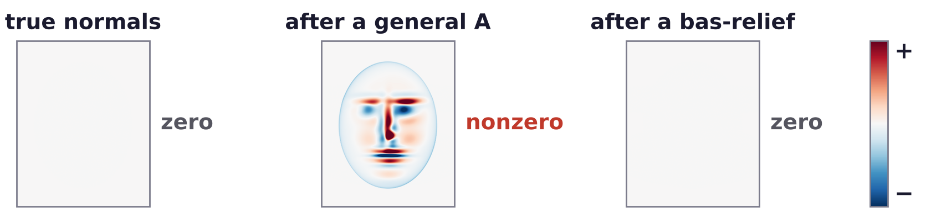
Photometric stereo, bas-relief
Integrability: a surface returns to its height around a loop
The tangents (1, 0, z_x), (0, 1, z_y) give n_1/n_3 = −z_x, n_2/n_3 = −z_y; z_xy = z_yx gives the condition.
Given the normals, depth follows by least squares; p = z_x and q = z_y are the slopes.
∂_x(n_2/n_3) − ∂_y(n_1/n_3) is zero for true and bas-relief normals, nonzero after a general A.
Geometry and Vision · A. Yuille
18

Slide 19
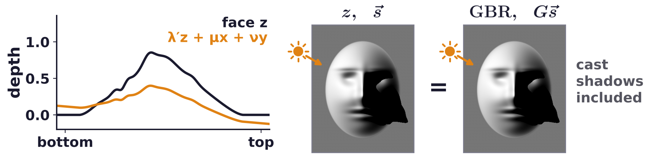
Photometric stereo, bas-relief
Integrability leaves the generalized bas-relief ambiguity
Integrability is consistent only with a subgroup of the invertible linear transformations (top line).
On the surface, λ′z is a bas-relief transformation, and μx + νy adds a plane (μ, ν are constants here).
Generalized bas-relief (GBR): with the lights moved to G s, a flattened, tilted face gives the same images.
P. N. Belhumeur, D. J. Kriegman and A. L. Yuille, “The bas-relief ambiguity,” IJCV, 35(1):33–44, 1999.
Geometry and Vision · A. Yuille
19

Slide 20
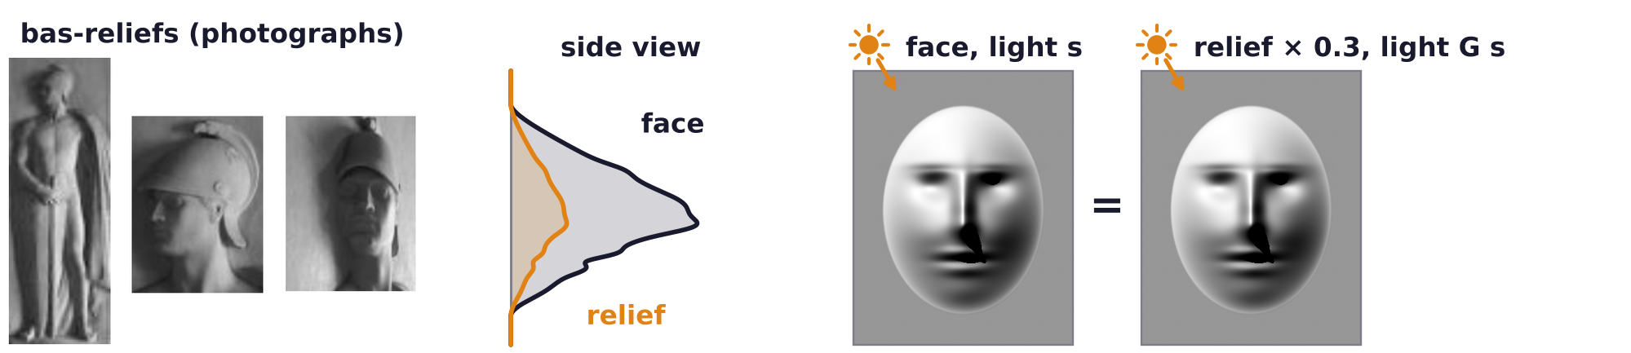
Photometric stereo, bas-relief
Sculptors and human vision show the bas-relief ambiguity
Sculptors save material by making reliefs with small changes in depth, which look like full figures.
Make-up can alter the albedo of a face and make its shape appear different, e.g. enhancing cheek bones.
Studies (Bülthoff, Koenderink, others) find biases in perceived shape, Koenderink’s like the bas-relief.
KGBR adds viewpoint to the GBR: an affine change of shape and albedo, with matching views and lights.
Their images agree up to an affine warp of the image; the GBR is the case of one viewpoint, other lights.
J. J. Koenderink, A. J. van Doorn, A. M. L. Kappers and J. T. Todd, “Ambiguity and the ‘mental eye’ in pictorial relief,” Perception, 30(4):431–448, 2001.
A. L. Yuille, J. M. Coughlan and S. Konishi, “The KGBR viewpoint–lighting ambiguity,” JOSA A, 20(1):24–31, 2003.
Geometry and Vision · A. Yuille
20

Slide 21
Shape from shading
3
From one image, with a known light and constant albedo, depth solves an
eikonal equation; priors make real images, such as faces, possible.
Geometry and Vision · A. Yuille
21

Slide 22
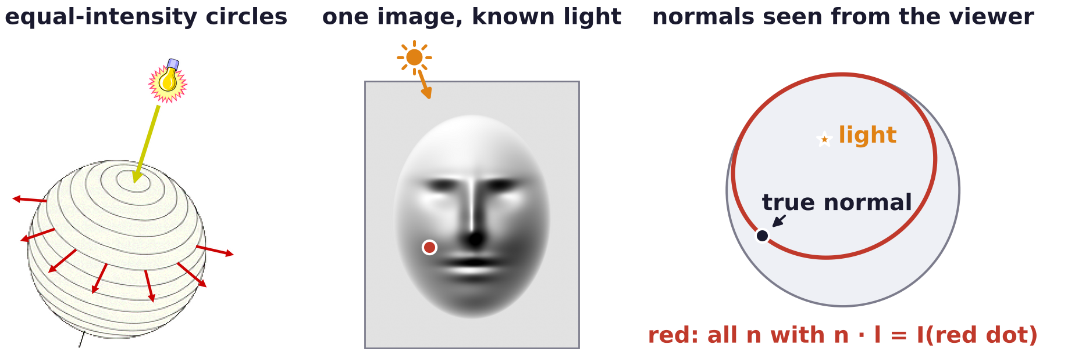

Shape from shading
Shape from shading estimates shape from a single image
Humans can estimate shape from shading, but from one image it is a severely ill-posed problem.
With known lighting and uniform albedo, every intensity determines a circle of possible normals.
There is only one unknown (z) for each pixel, since uniform albedo is assumed.
Classic methods (Horn) assume known light directions and a locally smooth surface.
B. K. P. Horn, “Obtaining shape from shading information,” in P. H. Winston (ed.), The Psychology of Computer Vision, McGraw-Hill, New York,
115–155, 1975.
Geometry and Vision · A. Yuille
22

Slide 23
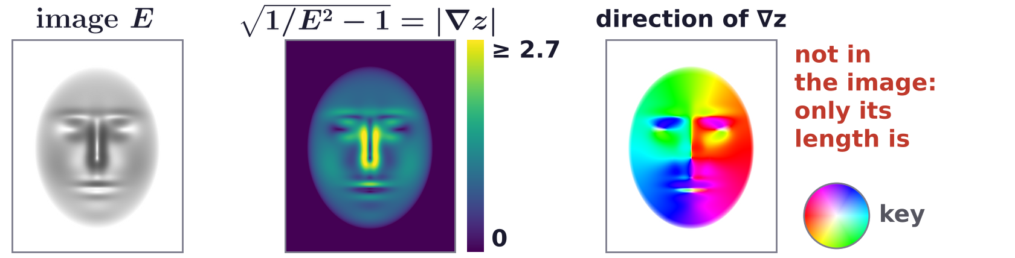
Shape from shading
Shape from shading is a first-order nonlinear PDE
Here n is the normal before normalizing, E the image intensity, l the known light and I the identity.
A first-order, nonlinear partial differential equation (PDE) for z (Horn); eikonal for l = (0, 0, 1).
For l = (0, 0, 1) the image gives the slope |∇z| at each pixel; the direction of steepest ascent is free.
Geometry and Vision · A. Yuille
23

Slide 24
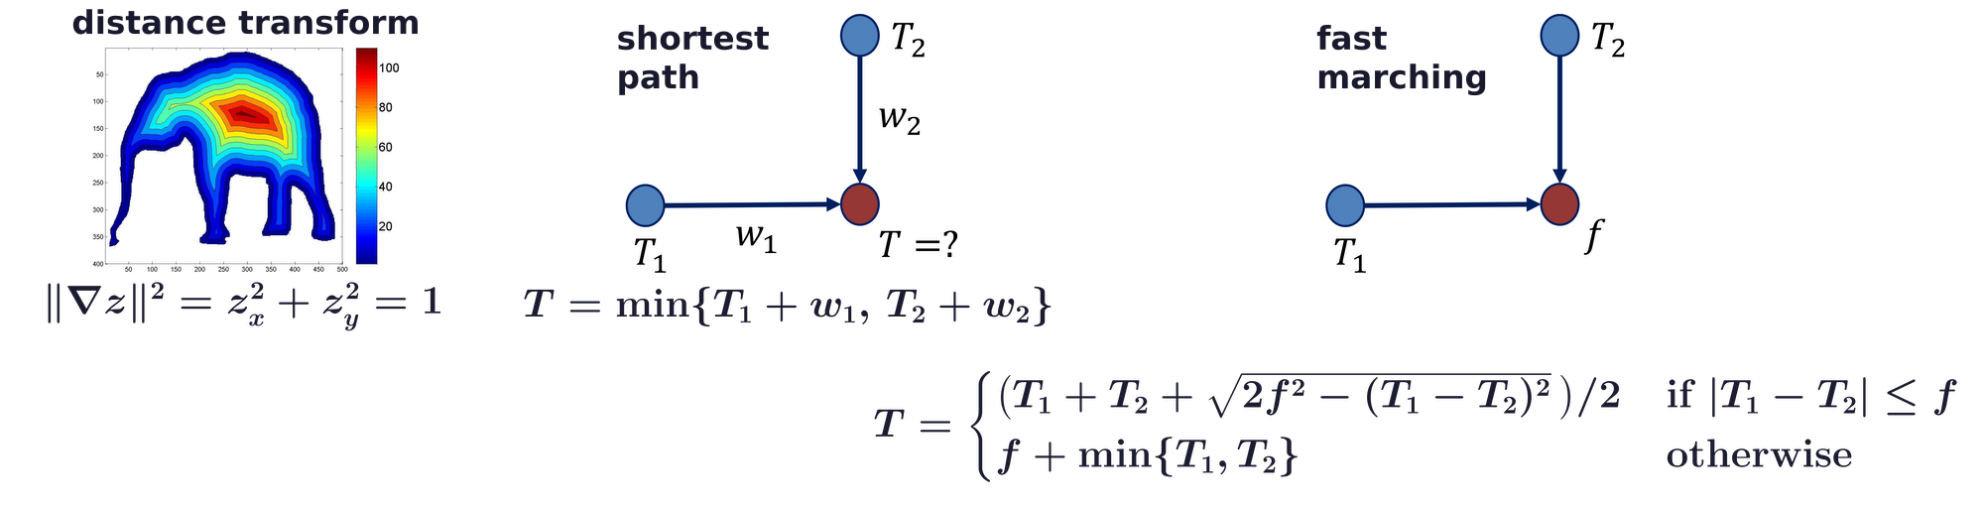
Shape from shading
Fast marching solves the eikonal equation by shortest paths
The distance transform: the distance of each point to the boundary, posed as an eikonal equation.
On a graph, a node’s distance T is the minimum over its neighbors of their T plus the edge weight w.
Fast marching (Tsitsiklis, Sethian) updates T from two grid neighbors and the local cost f.
Nodes are fixed in increasing order of T, as in a shortest-path algorithm.
J. N. Tsitsiklis, “Efficient algorithms for globally optimal trajectories,” IEEE Trans. Automatic Control, 40(9):1528–1538, 1995.
J. A. Sethian, “A fast marching level set method for monotonically advancing fronts,” PNAS, 93(4):1591–1595, 1996.
Geometry and Vision · A. Yuille
24

Slide 25
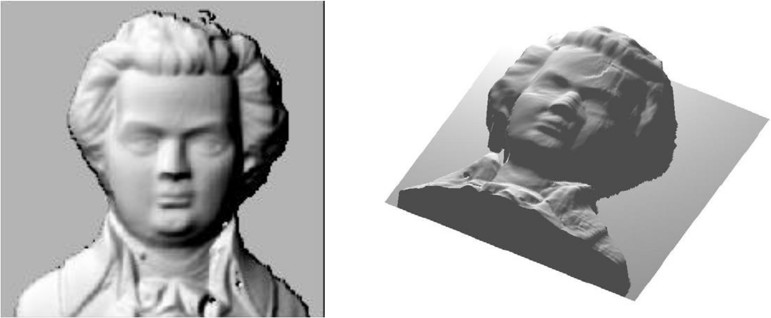
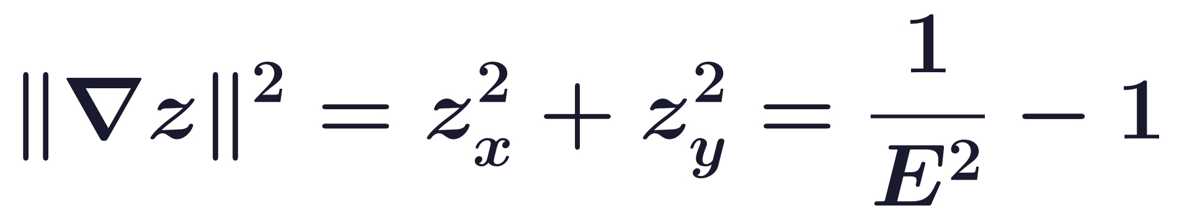
Shape from shading
Fast marching solves Lambertian shape from shading
Lambertian shape from shading gives an eikonal equation whose right-hand side is the local cost f.
Boundary conditions: depth values at local maxima of intensity, and possibly at shape boundaries.
The case l ≠ (0, 0, 1) is handled by a change of variables.
Example: an image of a bust of Mozart and the surface recovered from it.
R. Kimmel and J. A. Sethian, “Optimal algorithm for shape from shading and path planning,” J. Mathematical Imaging and Vision, 14(3):237–244,
2001.
R. Zhang, P.-S. Tsai, J. E. Cryer and M. Shah, “Shape from shading: a survey,” IEEE TPAMI, 21(8):690–706, 1999.
Geometry and Vision · A. Yuille
25

Slide 26
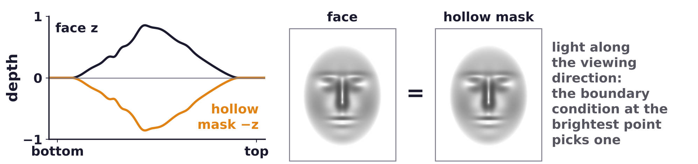
Shape from shading
Assumptions or priors resolve the ambiguities of one image
With constant albedo and a known light source, the solution is often unique (Oliensis).
A shape prior: Atick et al. use principal components of three-dimensional (3D) face depth maps.
Statistical shape from shading learns intensity and depth together from range data (Potetz and Lee).
Their results suggest that Lambertian models rarely apply in natural images; nearer objects look brighter.
J. Oliensis, “Uniqueness in shape from shading,” IJCV, 6(2):75–104, 1991.
J. J. Atick, P. A. Griffin and A. N. Redlich, “Statistical approach to shape from shading: reconstruction of three-dimensional face surfaces
from single two-dimensional images,” Neural Computation, 8(6):1321–1340, 1996.
B. Potetz and T. S. Lee, “Statistical correlations between two-dimensional images and three-dimensional structures in natural scenes,”
JOSA A, 20(7):1292–1303, 2003.
Geometry and Vision · A. Yuille
26

Slide 27
Harmonic analysis of lighting
4
Lambertian reflectance smooths the lighting: nine spherical harmonic images
approximate the images of a convex object closely.
Geometry and Vision · A. Yuille
27

Slide 28
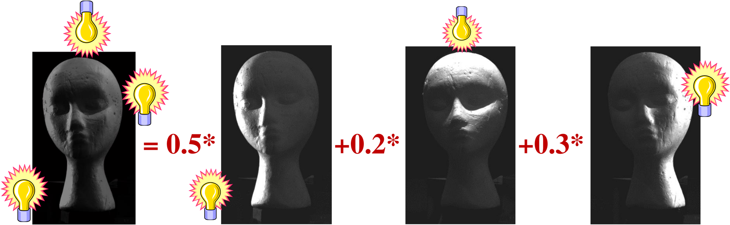
Harmonic analysis of lighting
The images under all lightings form a convex cone
Images are additive and non-negative, for any number of light sources.
The set of images is therefore a convex cone in R^p, p pixels (Belhumeur and Kriegman).
The cone characterization is generic: it also holds with specularities, shadows and inter-reflections.
Representing the cone is complicated (infinite degrees of freedom); for Lambertian objects it is thin.
P. N. Belhumeur and D. J. Kriegman, “What is the set of images of an object under all possible illumination conditions?” IJCV, 28(3):245–260, 1998.
Geometry and Vision · A. Yuille
28

Slide 29
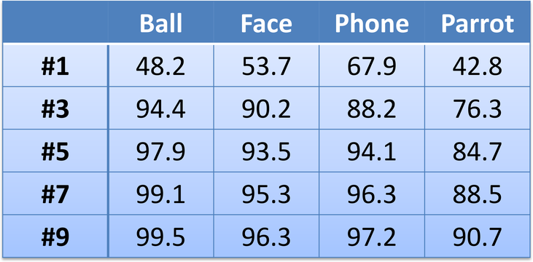
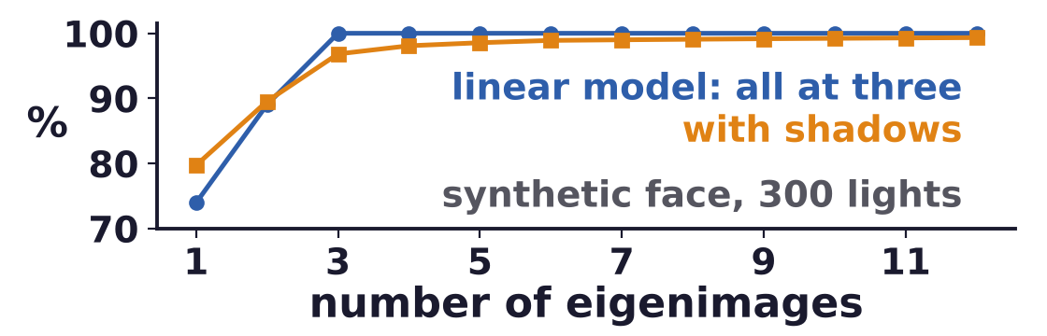
Harmonic analysis of lighting
A few principal components capture the images of an object
Photograph an object under N lightings; the eigenvectors e of the correlation K are eigenimages.
Table: % of the energy (the sum of all the eigenvalues λ) in the first k eigenimages; five hold 85–98 %.
Theory: nine for convex objects; in a single view about five or six suffice (Ramamoorthi).
A. L. Yuille, D. Snow, R. Epstein and P. N. Belhumeur, “Determining generative models of objects under varying illumination:
shape and albedo from multiple images using SVD and integrability,” IJCV, 35(3):203–222, 1999.
R. Ramamoorthi, “Analytic PCA construction for theoretical analysis of lighting variability in images of a Lambertian object,” IEEE TPAMI,
24(10):1322–1333, 2002.
Geometry and Vision · A. Yuille
29

Slide 30
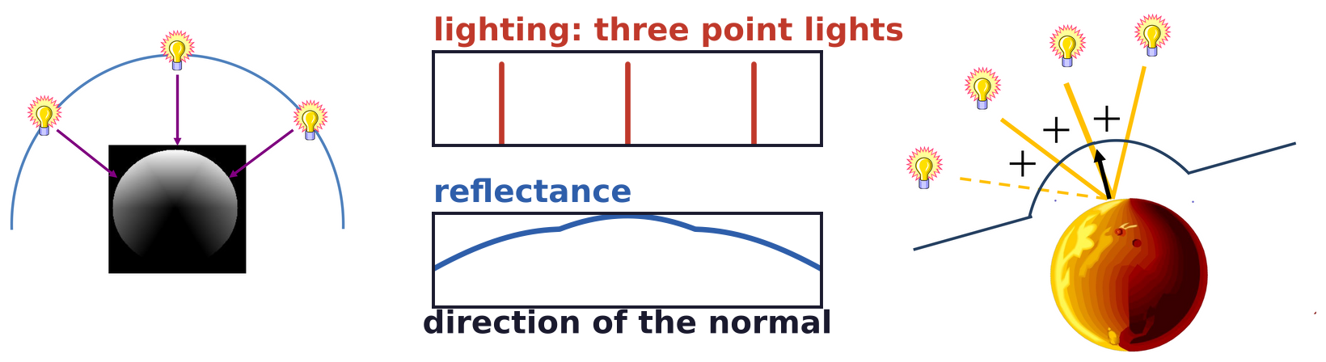
Harmonic analysis of lighting
Reflectance is the lighting convolved with a smooth kernel
It deals with attached shadows for convex objects (Basri and Jacobs; Ramamoorthi and Hanrahan).
l(u) is the light from direction u; k(u, v) the light reflected at a normal v per unit input; R(v) the total.
Three point lights (spikes) give a smooth reflectance: each adds its cosine, cut at zero behind the surface.
R. Basri and D. W. Jacobs, “Lambertian reflectance and linear subspaces,” IEEE TPAMI, 25(2):218–233, 2003.
R. Ramamoorthi and P. Hanrahan, “On the relationship between radiance and irradiance: determining the illumination from images
of a convex Lambertian object,” JOSA A, 18(10):2448–2459, 2001.
Geometry and Vision · A. Yuille
30

Slide 31
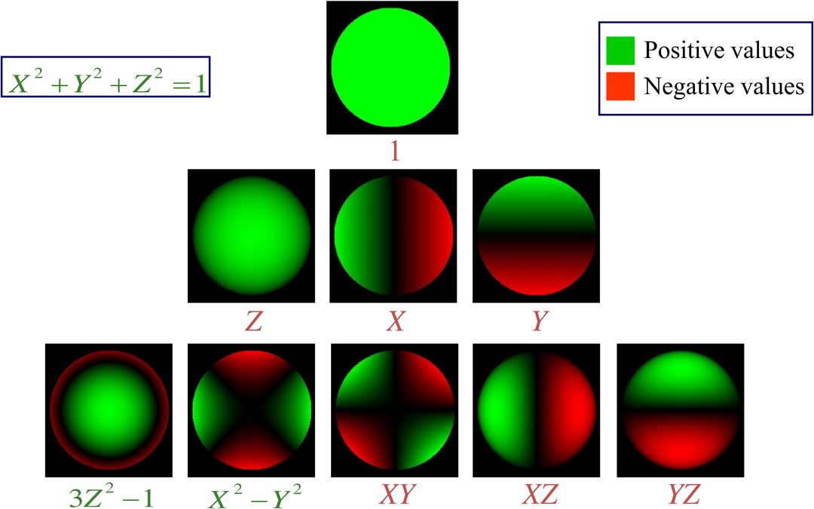
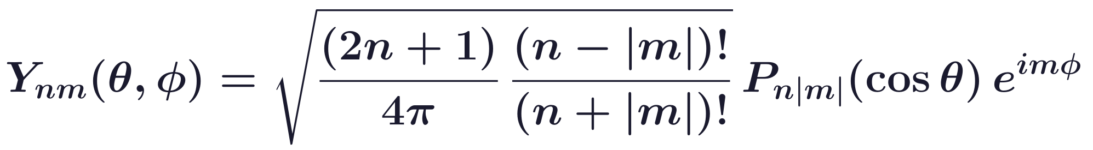
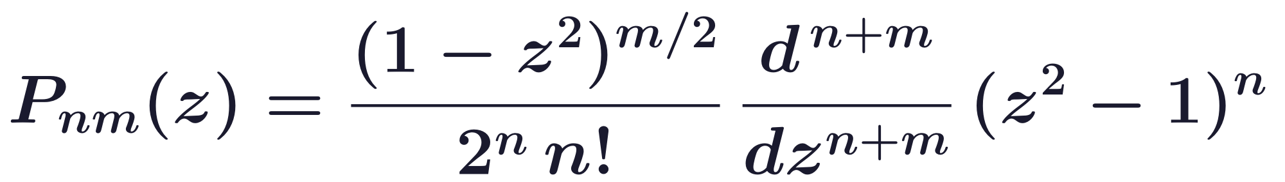
Harmonic analysis of lighting
Spherical harmonics are an orthonormal basis on the sphere
Similar to sinusoids on the plane; there is an equivalent convolution theorem (Funk-Hecke).
Order n has 2n + 1 harmonics; a rotation mixes only harmonics of the same order n.
In space coordinates these are polynomials of degree n: 1; Z, X, Y; 3Z² − 1, X² − Y², XY, XZ, YZ.
Each sphere shows one harmonic on X² + Y² + Z² = 1 (X to the left): green positive, red negative.
Geometry and Vision · A. Yuille
31

Slide 32
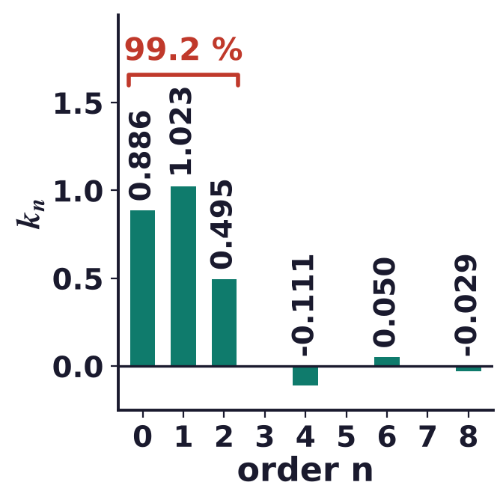
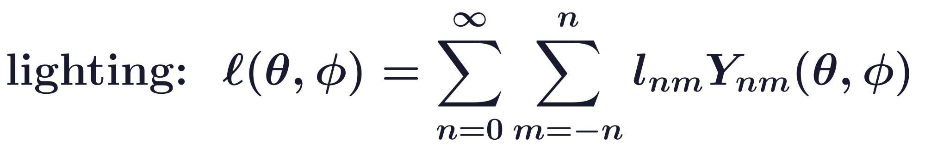
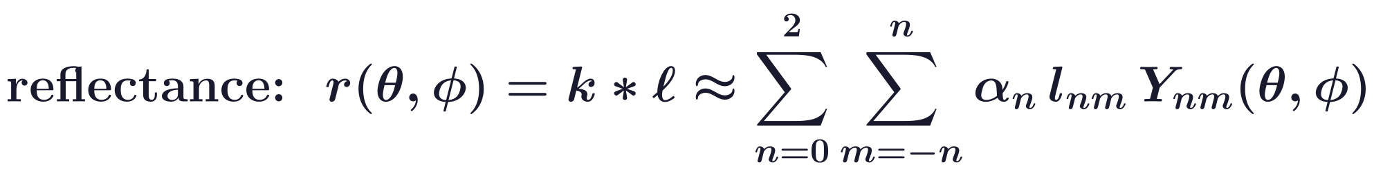
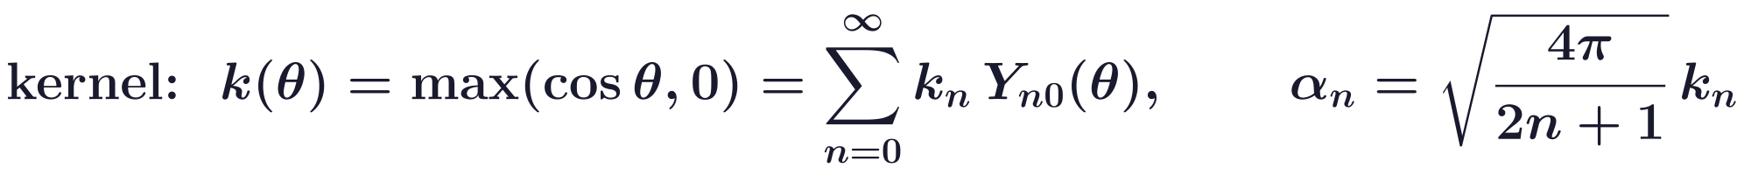
Harmonic analysis of lighting
Nine harmonics capture 99.2 % of the Lambertian kernel
The kernel’s coefficients k_n fall quickly: the terms with n = 0, 1, 2 carry 99.2 % of its energy.
Nine basis images: 99.2 % for a point light, at least 97.96 % for any lighting; four: 87.5 % and 75 %.
In practice, due to self-occlusions, about 98 % can be achieved with just six basis images (Ramamoorthi).
R. Basri and D. W. Jacobs, “Lambertian reflectance and linear subspaces,” IEEE TPAMI, 25(2):218–233, 2003.
R. Ramamoorthi, “Analytic PCA construction for theoretical analysis of lighting variability in images of a Lambertian object,” IEEE TPAMI,
24(10):1322–1333, 2002.
Geometry and Vision · A. Yuille
32

Slide 33
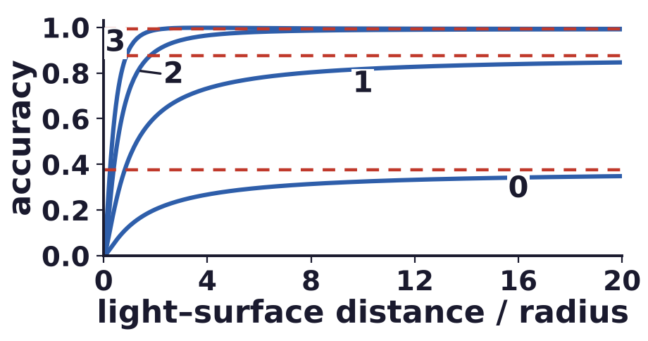
Harmonic analysis of lighting
Harmonic models suit convex Lambertian objects
They handle convex Lambertian objects with multiple light sources, including attached shadows.
They do not model cast shadows and inter-reflections; specular objects may require a very large basis.
Accuracy is maintained for fairly close light sources: the plot shows orders 0 to 3 (dashed: distant light).
Non-negative light can be enforced by projecting the illumination cone onto the harmonic space.
Closed-form constraints exist at first order; higher orders use sampling or a Toeplitz matrix.
D. Frolova, D. Simakov and R. Basri, “Accuracy of spherical harmonic approximations for images of Lambertian objects under far and
near lighting,” ECCV, LNCS 3021, 574–587, 2004.
S. Shirdhonkar and D. W. Jacobs, “Non-negative lighting and specular object recognition,” ICCV, 1323–1330, 2005.
Geometry and Vision · A. Yuille
33

Slide 34
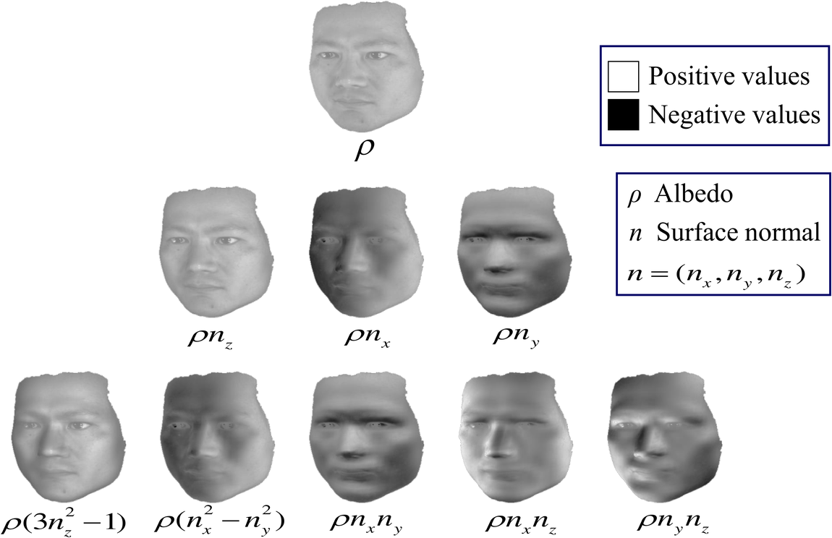
Harmonic analysis of lighting
Nine harmonic images approximate a face in any lighting
Each basis image is the albedo ρ times a polynomial of the normal (n_x, n_y, n_z), up to a constant.
We can use them to predict novel appearances under new lighting.
Applications: face recognition, photometric stereo, 3D reconstruction with a prior, motion analysis.
R. Basri and D. W. Jacobs, “Lambertian reflectance and linear subspaces,” IEEE TPAMI, 25(2):218–233, 2003.
Geometry and Vision · A. Yuille
34

Slide 35

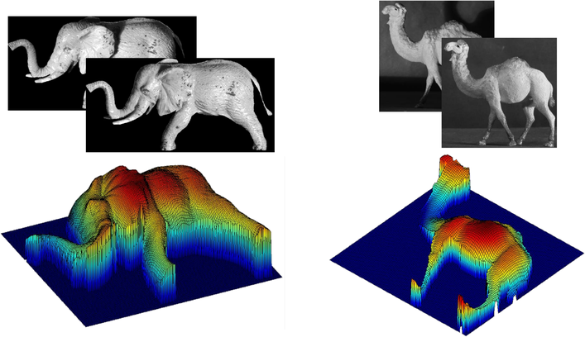
Harmonic analysis of lighting
Photometric stereo with harmonic images has rank nine
Photometric stereo as before, M = LS, with nine (or four) basis vectors S for shape and albedo.
SVD recovers L and S up to an r × r ambiguity (r = 9 or 4); the lights may be general and unknown.
Images of an elephant and a camel figurine, and the recovered depth (color is height).
R. Basri, D. Jacobs and I. Kemelmacher, “Photometric stereo with general, unknown lighting,” IJCV, 72(3):239–257, 2007.
Geometry and Vision · A. Yuille
35

Slide 36
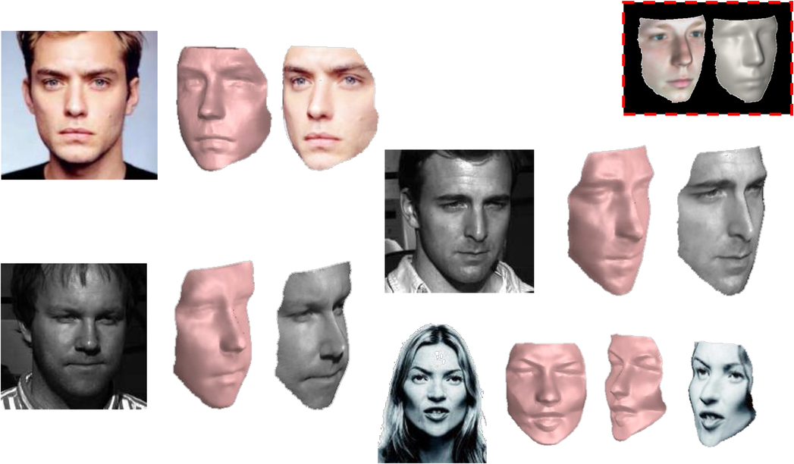
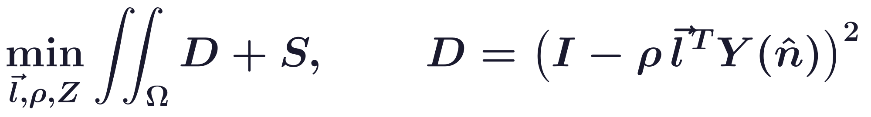
Harmonic analysis of lighting
A reference face allows reconstruction from one image
Given just one image, shape from shading is impractical; reconstruction is possible with a prior.
D: the image against the nine harmonic images Y(n̂); S: depth Z and albedo ρ close to a reference face.
Ω: the image; Δ: the Laplacian; λ1, λ2: weights. Minimized over l, ρ and Z, it is solved as a linear PDE.
Each photograph is followed by its shape, then the shape with its albedo; red box: the reference face.
I. Kemelmacher-Shlizerman and R. Basri, “3D face reconstruction from a single image using a single reference face shape,” IEEE TPAMI, 33(2):394–405,
2011.
Geometry and Vision · A. Yuille
36

Slide 37
Rendering
5
Graphics computes the image from a 3D model, its lights and a camera;
differentiable rendering lets vision invert it by following gradients.
Geometry and Vision · A. Yuille
37

Slide 38
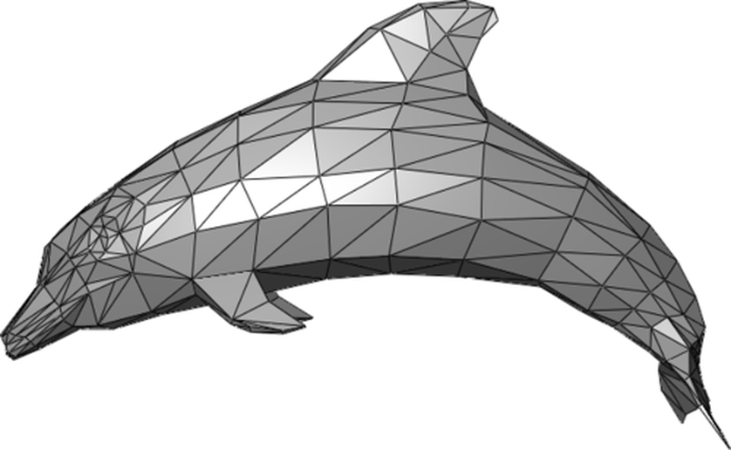
Rendering
Graphics renders images from 3D models; vision inverts it
Rendering, or image synthesis, generates an image from a 3D model by a computer program.
Classic surface models: light is reflected off surfaces; Lambert’s law dates back to the 18th century.
CAD (computer-aided design) models represent an object by a polygon mesh: vertices, edges and faces.
Graphics knows the objects and the light sources; vision addresses the harder inverse problem.
Radiosity (light bouncing between surfaces) is more realistic but hard to invert; Lambertian is easier.
C. M. Goral, K. E. Torrance, D. P. Greenberg and B. Battaile, “Modeling the interaction of light between diffuse surfaces,” SIGGRAPH,
Computer Graphics, 18(3):213–222, 1984.
Geometry and Vision · A. Yuille
38

Slide 39
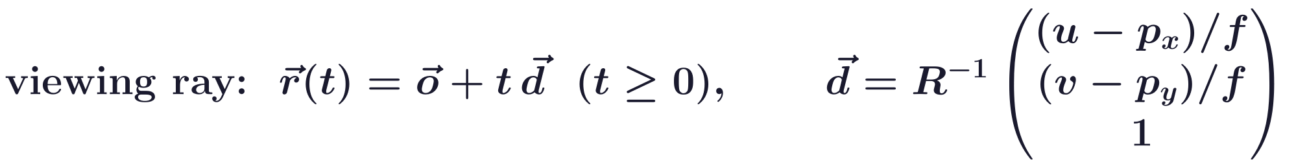
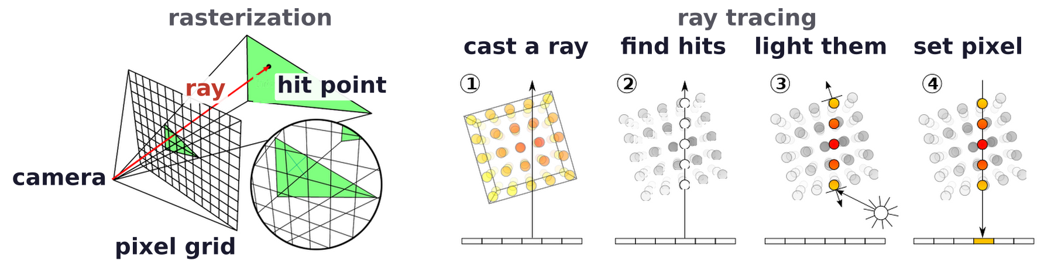
Rendering
Rasterization projects triangles; ray tracing casts rays
Rasterization determines the visible triangle at each image pixel; vertex properties are interpolated.
Ray tracing casts a viewing ray through each pixel and traces the primitives that the ray meets.
o: camera location; R: its rotation; (p_x, p_y): principal point; (u, v): a pixel; f: focal length.
Picture: www.scratchapixel.com.
Geometry and Vision · A. Yuille
39

Slide 40
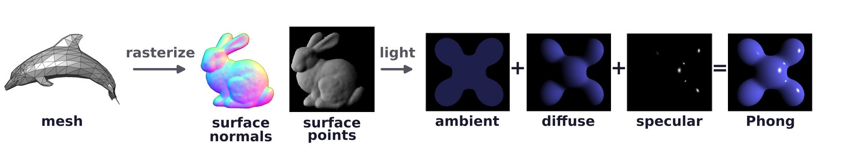
Rendering
Phong shading adds ambient, diffuse and specular terms
I_p: intensity at p; L̂_m: to light m; N̂: normal; R̂_m: reflected ray; V̂: to the viewer; α: shininess.
k_a, k_d, k_s: ambient, diffuse and specular reflection constants; i_a, i_m,d, i_m,s: the light intensities.
Rasterize the mesh, find the normal at each surface point, then light it: ambient + diffuse + specular.
B. T. Phong, “Illumination for computer generated pictures,” Communications of the ACM, 18(6):311–317, 1975.
Geometry and Vision · A. Yuille
40

Slide 41
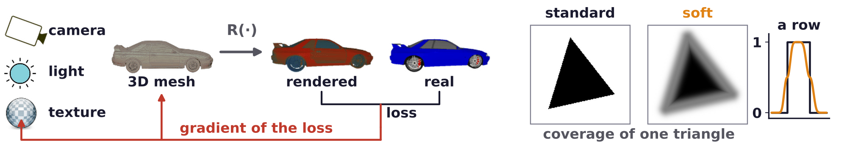
Rendering
Differentiable rendering relates pixels back to 3D properties
R(·) is a differentiable function: render, compare with the real image, follow the gradient of the loss.
Hard coverage has no useful gradient: the soft rasterizer softens edges and blends triangles by depth.
Classic models (Lambertian, Phong, BRDF) suit single objects; their parameters are set by hand.
For scenes, complex lighting is probably best dealt with by learning methods.
N. Ravi, J. Reizenstein, D. Novotny, T. Gordon, W.-Y. Lo, J. Johnson and G. Gkioxari, “Accelerating 3D deep learning with PyTorch3D,”
arXiv:2007.08501, 2020.
S. Liu, T. Li, W. Chen and H. Li, “Soft rasterizer: a differentiable renderer for image-based 3D reasoning,” ICCV, 7708–7717, 2019.
Geometry and Vision · A. Yuille
41

Slide 42
Rendering
Summary
Smooth surfaces reflect specularly and rough ones diffusely; the BRDF describes both.
Lambertian model: I(x) = a(x) n(x) · s, linear in the light and independent of the viewpoint.
Attached and cast shadows break the linearity; a convex shape and a concave one can look alike.
Photometric stereo: images under several lights have rank three; the SVD finds shape and lights.
Shape and lights are found up to a 3 × 3 matrix; integrability leaves the generalized bas-relief ambiguity.
Shape from shading (known light, constant albedo) solves an eikonal equation by fast marching.
Lambertian reflectance smooths the lighting; nine harmonics capture at least 97.96 % of the reflectance.
Rendering rasterizes or ray traces a mesh and shades it; differentiable rendering fits it by gradients.
Geometry and Vision · A. Yuille
42

