Slide 1
Detecting and Parsing Humans
5 November, 2026
Alan Yuille · Probabilistic Models of the Visual Cortex

Slide 2
What this lecture covers
1
Image dependent relations
2
Parsing occluded people
Pose: a tree of joints and a deep network
Flexible compositions of the parts
Geometry and Vision · A. Yuille
2

Slide 3
Image dependent relations
1
The pose is the location of every joint: a tree-structured graphical model
whose terms one deep network computes from local image patches.
Geometry and Vision · A. Yuille
3

Slide 4
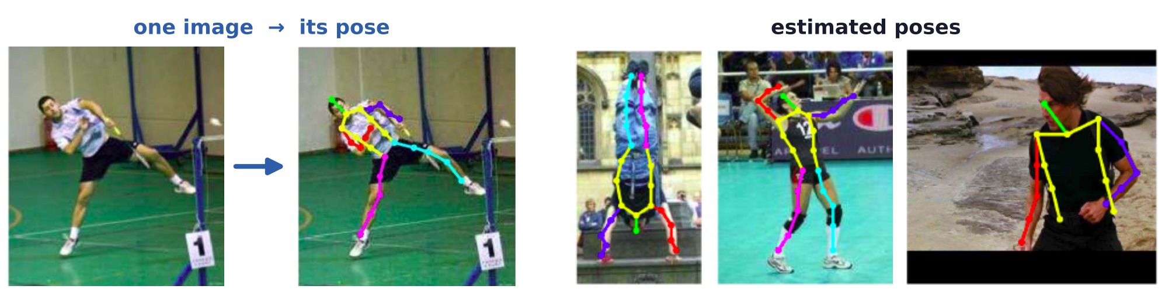
Image dependent relations
Pose estimation locates every joint in a single image
The parts are joints (elbows, wrists, shoulders, ...); the pose is the image location of every joint.
DCNNs (deep convolutional neural networks) detect parts but have no explicit relations between them.
Graphical models represent the spatial relationships between the parts.
X. Chen and A. L. Yuille, “Articulated pose estimation by a graphical model with image dependent pairwise relations,” NIPS, 1736–1744, 2014.
Geometry and Vision · A. Yuille
4

Slide 5
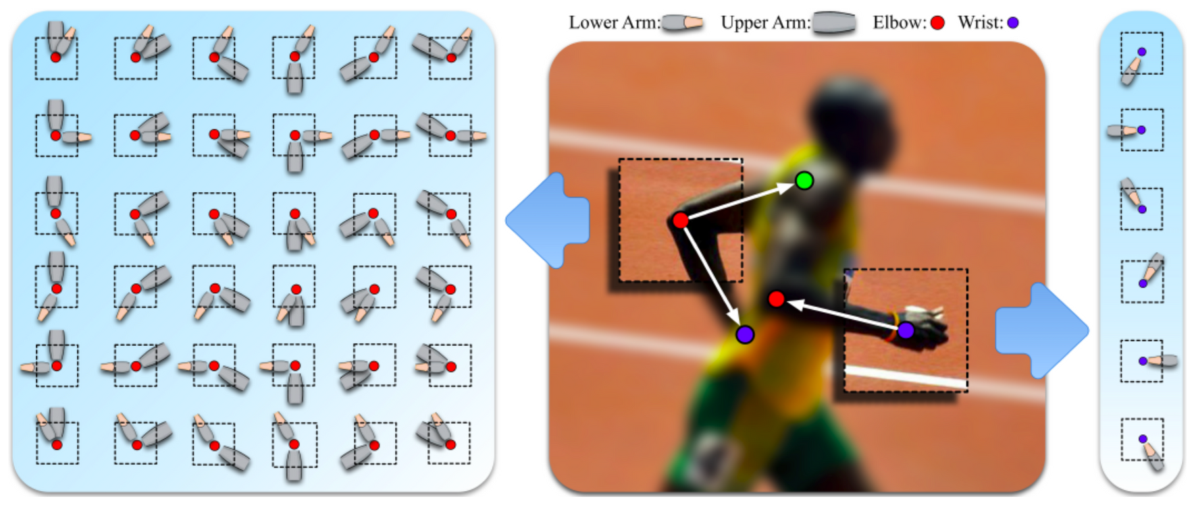
Image dependent relations
A local patch predicts where the part's neighbors are
The local patch around a part reliably predicts the relative positions of its neighbors.
Center: the patch at the elbow (red) predicts the shoulder (green) and the wrist (purple), and back.
Sides: the types of spatial relation the elbow (left) and the wrist (right) have with their neighbors.
X. Chen and A. L. Yuille, “Articulated pose estimation by a graphical model with image dependent pairwise relations,” NIPS, 1736–1744, 2014.
Geometry and Vision · A. Yuille
5

Slide 6
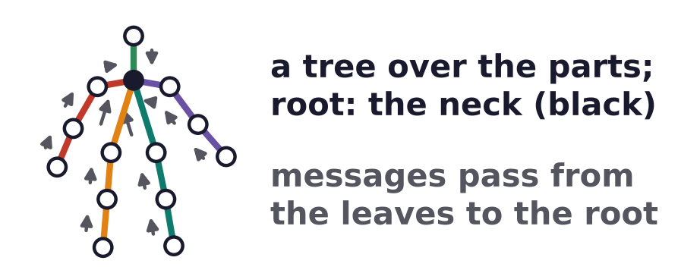
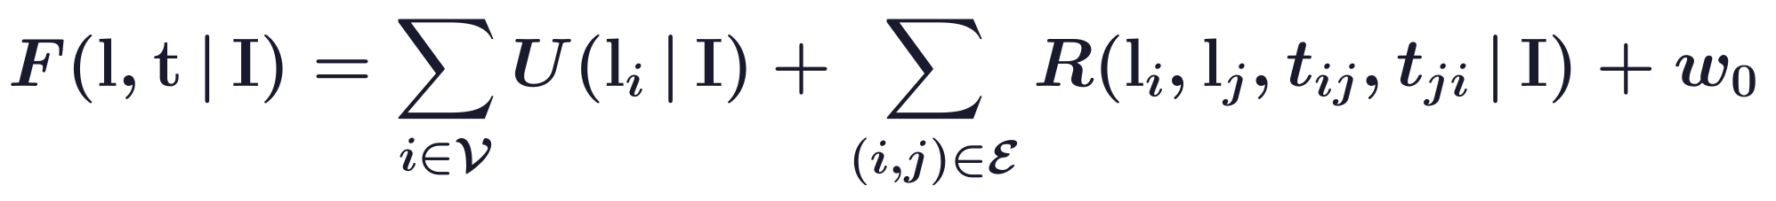
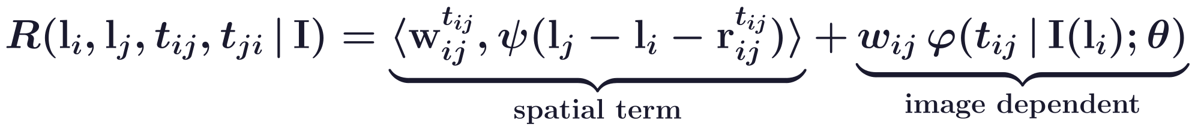
Image dependent relations
A tree model scores joint locations and relation types
Tree G = (V, E) of K parts; l_i = (x, y): location of part i; t_ij ∈ {1, ..., T_ij}: type of the relation i → j.
r_ij: the mean relative position of each type; ψ: quadratic deformation features; F: the full score.
I(l_i): the patch at l_i; the φ terms: DCNN log-probabilities with parameters θ; w: learned weights.
X. Chen and A. L. Yuille, “Articulated pose estimation by a graphical model with image dependent pairwise relations,” NIPS, 1736–1744, 2014.
Geometry and Vision · A. Yuille
6

Slide 7
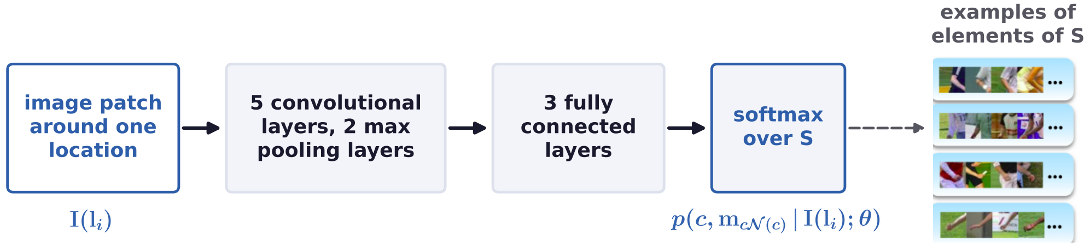
Image dependent relations
One DCNN computes all the image dependent terms
S: each element is a part c with the types m of its relations to its neighbors N(c), or the background.
Marginalization gives the unary term and the IDPR (image dependent pairwise relation) term.
Fully connected layers act as 1 × 1 convolutions, so one DCNN shares its computations over all locations.
X. Chen and A. L. Yuille, “Articulated pose estimation by a graphical model with image dependent pairwise relations,” NIPS, 1736–1744, 2014.
Geometry and Vision · A. Yuille
7

Slide 8
Image dependent relations
Dynamic programming finds the best pose exactly
L: number of locations; K: number of parts (26 on LSP: joints and midway points); T: number of types.
On a tree, dynamic programming is exact; distance transforms make each message linear in L.
Supervised learning: pairwise type labels are derived from the annotated joint locations by clustering.
Learned: the relative positions r by k-means (T_ij clusters); θ by the DCNN; w by a structured SVM.
T_ij = 1 recovers pictorial structures; earlier models used HOG (histogram of gradients) filters.
Yang and Ramanan's mixtures of parts: each part predicts only the relative position of its parent.
X. Chen and A. L. Yuille, “Articulated pose estimation by a graphical model with image dependent pairwise relations,” NIPS, 1736–1744, 2014.
M. A. Fischler and R. A. Elschlager, “The representation and matching of pictorial structures,” IEEE Trans. Computers, C-22(1):67–92, 1973.
P. F. Felzenszwalb and D. P. Huttenlocher, “Pictorial structures for object recognition,” IJCV, 61(1):55–79, 2005.
Geometry and Vision · A. Yuille
8

Slide 9
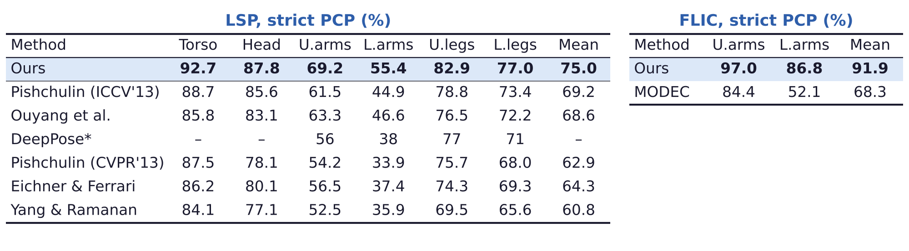
Image dependent relations
The model outperforms the state of the art on LSP and FLIC
Strict PCP (percentage of correct parts): both ends of a part within half its length of the truth.
LSP (Leeds Sports Poses): 1000 train, 1000 test, full body; FLIC (Frames Labeled In Cinema): 3987, 1016.
DeepPose* uses person-centric annotations and 10,000 extra training images. U., L.: upper, lower.
S. Johnson and M. Everingham, “Clustered pose and nonlinear appearance models for human pose estimation,” BMVC, 2010.
B. Sapp and B. Taskar, “MODEC: multimodal decomposable models for human pose estimation,” CVPR, 3674–3681, 2013.
Geometry and Vision · A. Yuille
9

Slide 10
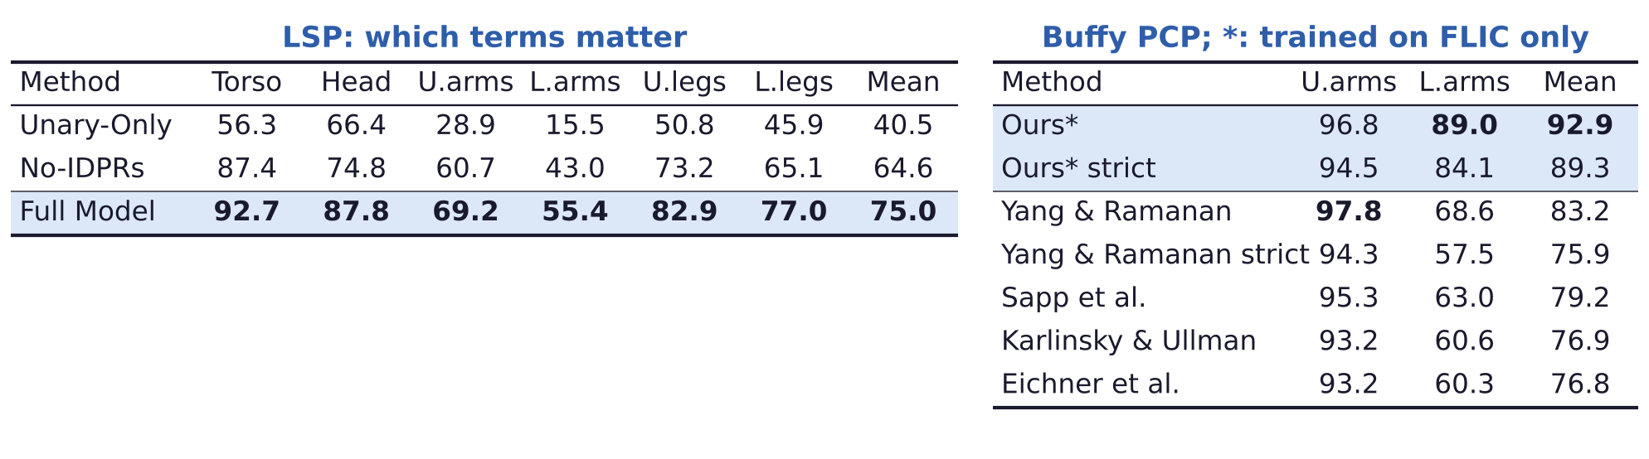
Image dependent relations
Image dependent pairwise terms improve on fixed ones
The unary term alone is not powerful enough, even though it is trained by a DCNN classifier.
The No-IDPRs model, with image-independent pairwise terms, is comparable with the state of the art.
Buffy Stickmen: 276 test images; Ours* is trained on FLIC only. Buffy PCP is looser than strict PCP.
V. Ferrari, M. Marín-Jiménez and A. Zisserman, “Progressive search space reduction for human pose estimation,” CVPR, 2008.
X. Chen and A. L. Yuille, “Articulated pose estimation by a graphical model with image dependent pairwise relations,” NIPS, 1736–1744, 2014.
Geometry and Vision · A. Yuille
10

Slide 11
Parsing occluded people
2
Occluded parts break the tree into connected subtrees; decoupling terms
and part sharing find the visible parts at twice the cost.
Geometry and Vision · A. Yuille
11

Slide 12
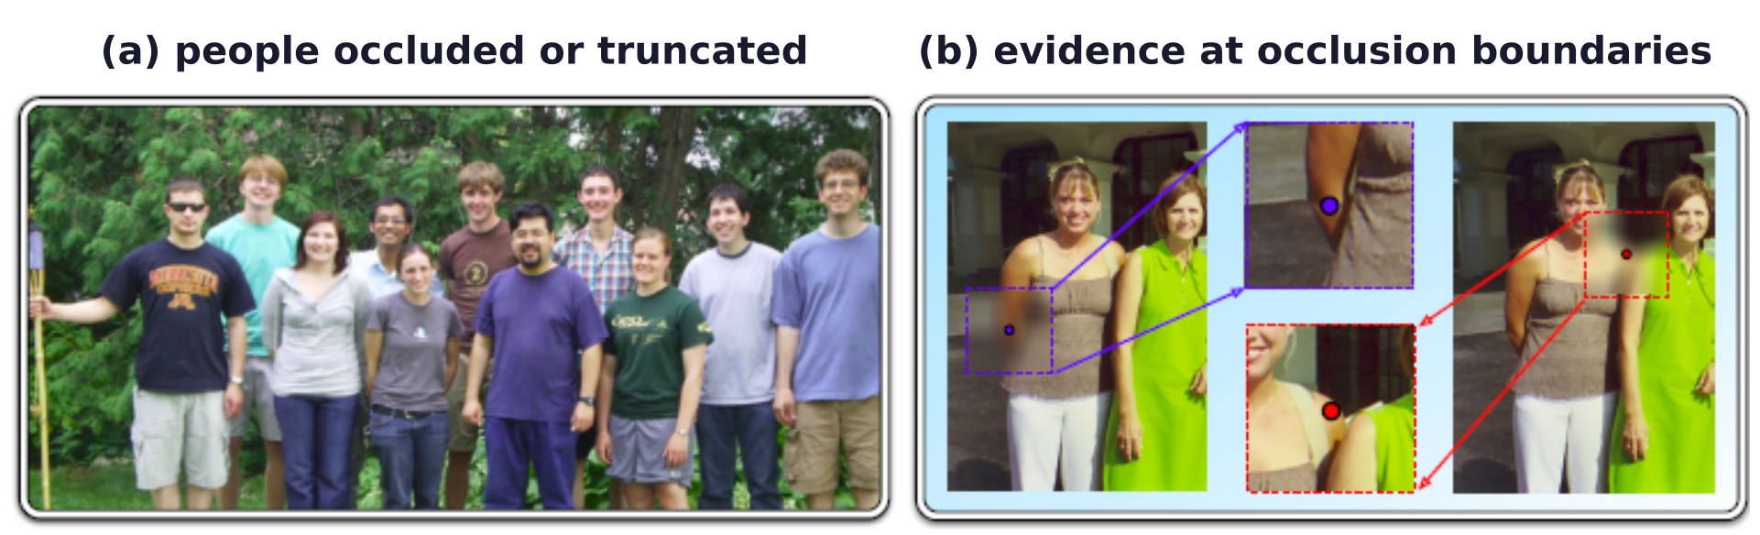
Parsing occluded people
In realistic images many object parts are occluded
Previous graphical models are robust to only a few occlusions.
Prior: the observed nodes of the graphical model are often connected.
Absent evidence helps predict occlusion: no wrist appears near the right elbow of the lady in brown.
Absence of evidence is not evidence of absence; the image at an occlusion boundary gives evidence.
X. Chen and A. L. Yuille, “Parsing occluded people by flexible compositions,” CVPR, 3945–3954, 2015.
Geometry and Vision · A. Yuille
12

Slide 13
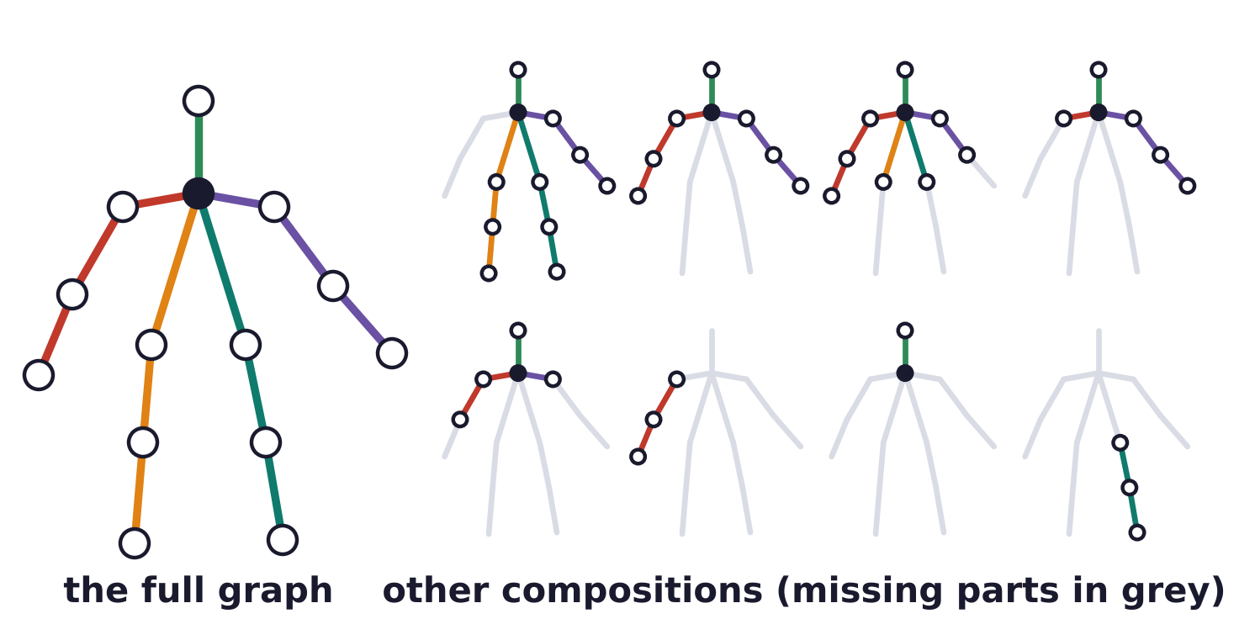
Parsing occluded people
Every connected subtree is a flexible composition
Each connected subtree of the full graph, including the full graph itself, is a flexible composition.
The compositions that lack some parts suit the people whose parts are occluded.
X. Chen and A. L. Yuille, “Parsing occluded people by flexible compositions,” CVPR, 3945–3954, 2015.
Geometry and Vision · A. Yuille
13

Slide 14
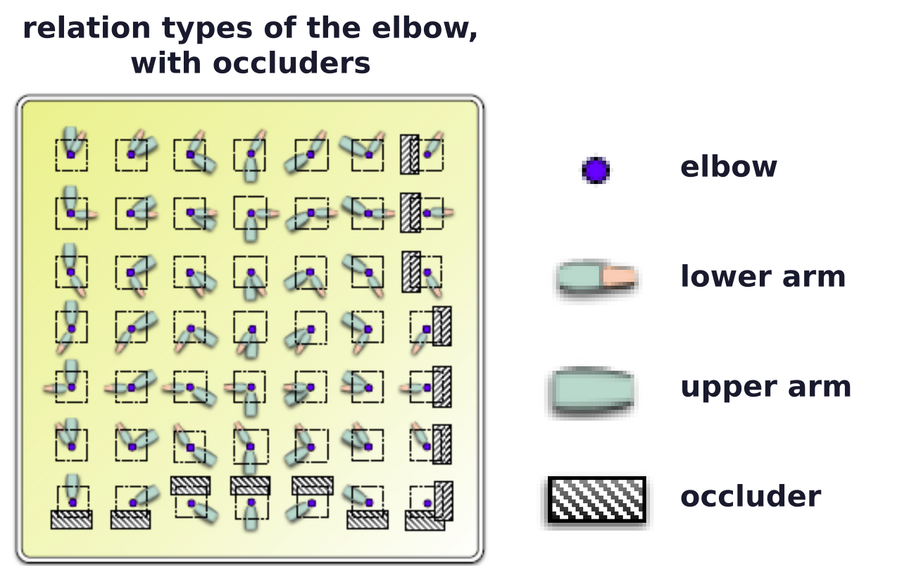
Parsing occluded people
The local patch also gives evidence of occluded neighbors
When the neighbors are visible, the patch at the elbow predicts their relative positions (NIPS 2014).
When a neighbor is occluded (hatched boxes), the patch provides evidence for the occlusion.
X. Chen and A. L. Yuille, “Parsing occluded people by flexible compositions,” CVPR, 3945–3954, 2015.
Geometry and Vision · A. Yuille
14

Slide 15
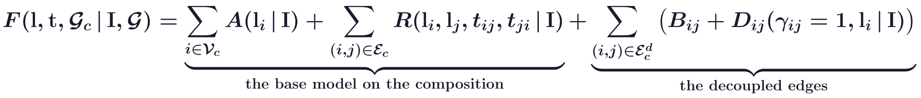
Parsing occluded people
Decoupling terms and missing-part penalties score a pose
Base model: the NIPS 2014 model (A is its U); G_c = (V_c, E_c): a composition; E_c^d: the edges cut.
γ_ij = 1 cuts off the subtree rooted at j; D_ij (IDOD): the image evidence at i that j is occluded.
B_ij penalizes the missing parts k of that subtree: b_k is a bias for each part.
Inference also maximizes over compositions; they share parts, so it costs twice the base model.
X. Chen and A. L. Yuille, “Parsing occluded people by flexible compositions,” CVPR, 3945–3954, 2015.
Geometry and Vision · A. Yuille
15

Slide 16
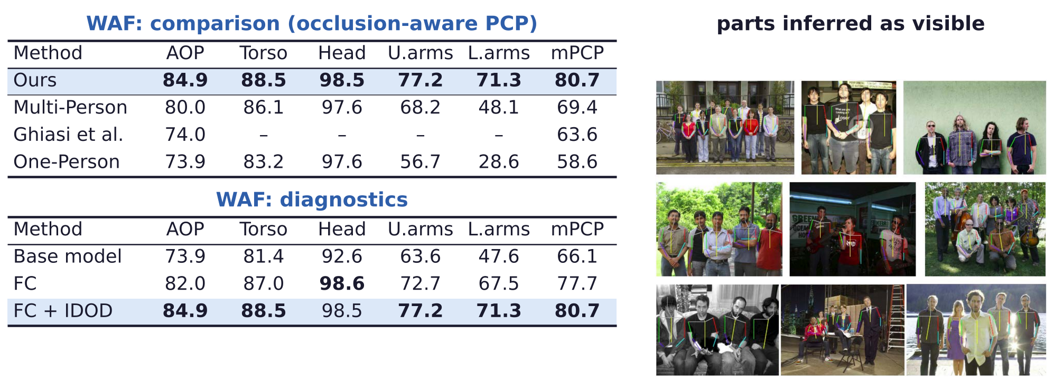
Parsing occluded people
Flexible compositions improve occlusion prediction and PCP
WAF (“We Are Family”): 525 group photos, about six people each; Multi-, One-Person: Eichner & Ferrari.
AOP: accuracy of occlusion prediction; mPCP: mean PCP; FC: flexible compositions; IDOD: the D_ij terms.
M. Eichner and V. Ferrari, “We are family: joint pose estimation of multiple persons,” ECCV, LNCS 6311, 228–242, 2010.
X. Chen and A. L. Yuille, “Parsing occluded people by flexible compositions,” CVPR, 3945–3954, 2015.
Geometry and Vision · A. Yuille
16

Slide 17
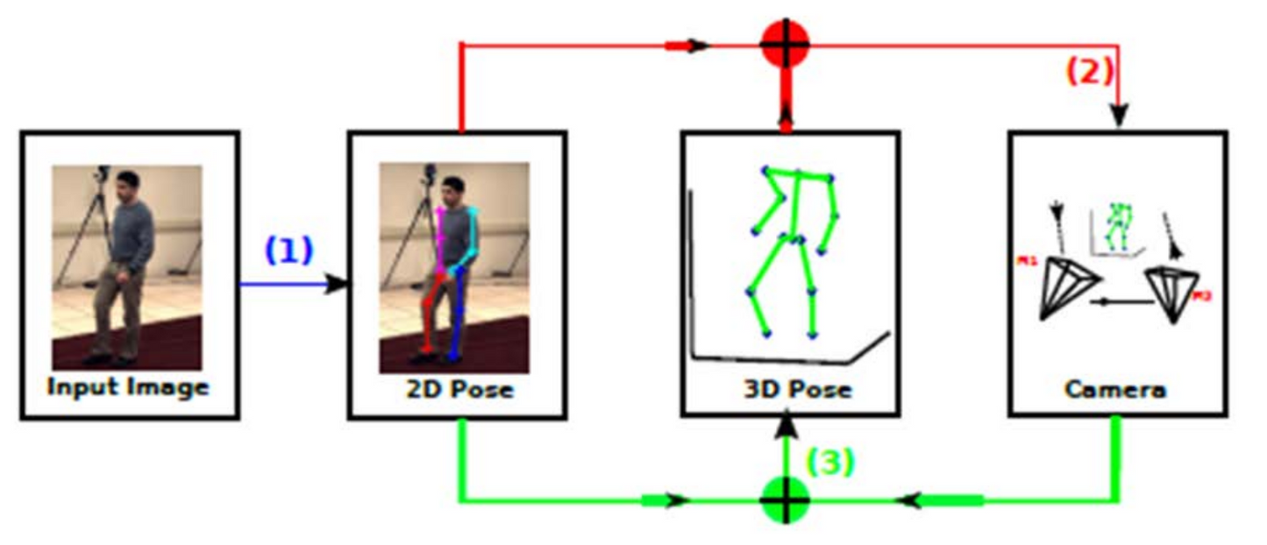
Parsing occluded people
Detected joints are used to estimate 3D pose and actions
Detection of pose is important for many applications: estimating the 3D structure, action recognition.
(1) the 2D pose; (2) the camera from 2D and 3D pose; (3) the 3D pose from the 2D pose and the camera.
Steps (2) and (3) alternate.
C. Wang, Y. Wang, Z. Lin, A. L. Yuille and W. Gao, “Robust estimation of 3D human poses from a single image,” CVPR, 2361–2368, 2014.
C. Wang, Y. Wang and A. L. Yuille, “An approach to pose-based action recognition,” CVPR, 915–922, 2013.
Geometry and Vision · A. Yuille
17

Slide 18
Parsing occluded people
Summary
Parsing humans: detect the joints, with DCNNs for the parts and graphical models for their relations.
A tree of parts with pairwise relation types; a local patch predicts where the neighbors are.
One DCNN gives the appearance and IDPR terms; dynamic programming gives the best pose, O(T²LK).
On LSP the image dependent pairwise terms improve on fixed ones; the model transfers to Buffy.
Flexible compositions handle occlusion: connected subtrees, decoupling terms, missing-part penalties.
Part sharing keeps inference at twice the cost; the detected joints lead to 3D pose and actions.
Limitation: objects are represented by joints only, which is problematic for some human configurations.
Geometry and Vision · A. Yuille
18

