Slide 1
Neural Network
Generative Models:
from GANs to Diffusion with Text
10 November, 2026
Alan Yuille · Probabilistic Models of the Visual Cortex

Slide 2
What this lecture covers
1
Deep generative models
2
Generative adversarial networks
Learned from big data, hard to interpret
A generator and a discriminator
3
StyleGAN
4
GAN inversion
Latents at every level, a disentangled W
Find the latent code of a real image
5
Autoencoders
6
Diffusion with text
Bottleneck, reconstruction, a latent density
Noise encoder, latent space, cross-attention
Generative Models · A. Yuille
2

Slide 3
Deep generative models
1
Deep networks learn to generate images from big data: generative adversarial
networks (GANs) came first; text-prompted diffusion models followed.
Generative Models · A. Yuille
3

Slide 4
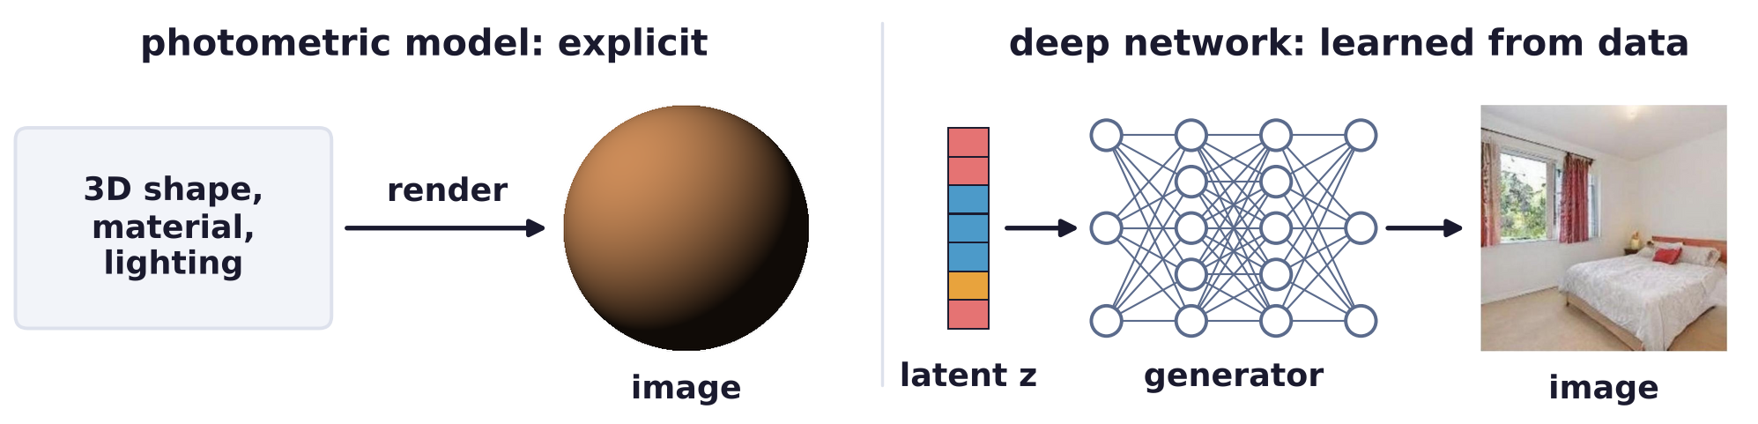
Deep generative models
Deep networks learn to generate images from big data
Deep network approaches to generating images are learning based and use big data.
They have many nice properties but are difficult to interpret.
Photometric models render images from 3D shape, material and lighting.
They are explicit, so they can generalize to novel viewing conditions.
A deep generator maps a latent z, a vector of random numbers, to an image.
Generative Models · A. Yuille
4

Slide 5
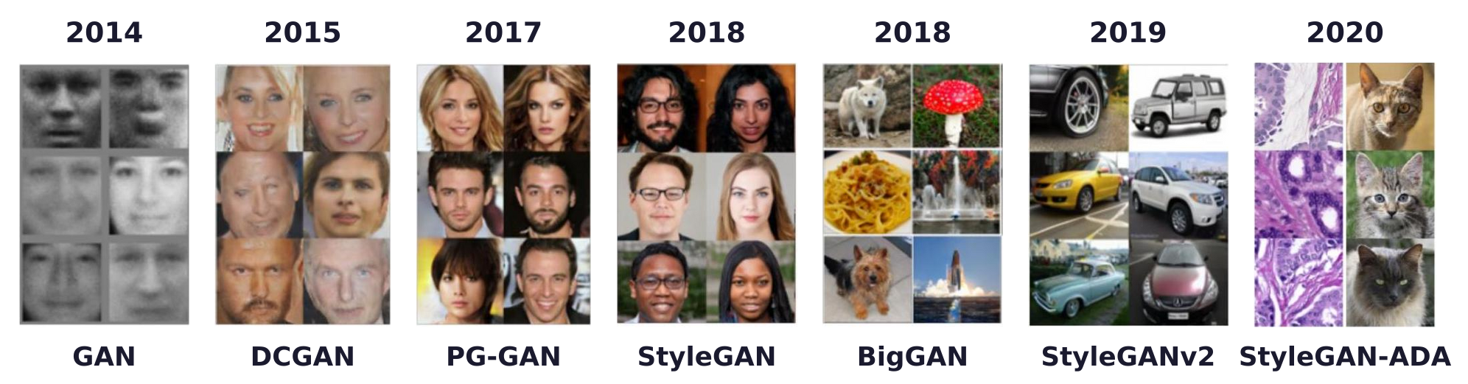
Deep generative models
GANs improved the generated images year by year
The quality and complexity of the images of generative adversarial networks (GANs) improved over time.
DCGAN: deep convolutional GAN; PG-GAN: progressive growing of GANs; BigGAN: large-scale GAN.
StyleGAN: style-based GAN; StyleGANv2: its second version.
StyleGAN-ADA: StyleGAN2 trained with adaptive discriminator augmentation.
Generative Models · A. Yuille
5

Slide 6
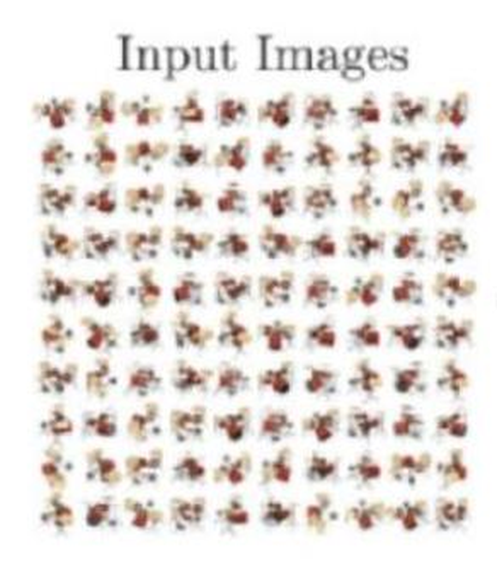
Deep generative models
NeRF generates highly realistic new views (2020)
NeRF (neural radiance fields) learns a scene from many input images (shown here) to render new views.
NeRF enables researchers to generate highly realistic images, much better than shown here.
B. Mildenhall, P. P. Srinivasan, M. Tancik, J. T. Barron, R. Ramamoorthi and R. Ng, “NeRF: representing scenes as neural radiance fields
for view synthesis,” ECCV, 405–421, 2020.
Generative Models · A. Yuille
6

Slide 7
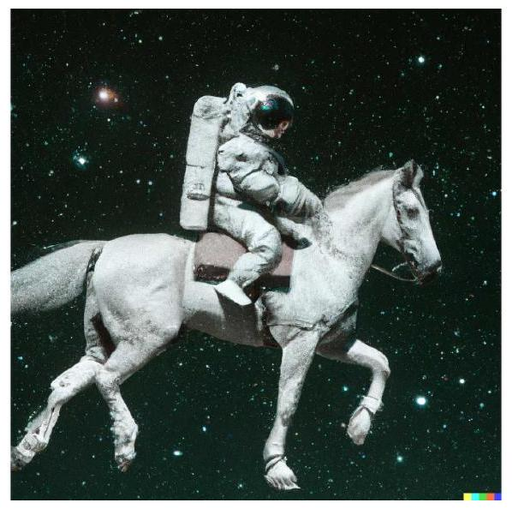
Deep generative models
Diffusion models generate realistic images prompted by text
Diffusion models (a special case of autoencoders, which reconstruct their input) make realistic images.
They generate images prompted by text, like an astronaut riding a horse: a breakthrough.
A few generative systems: OpenAI DALL-E 2, Google Imagen, Meta Make-A-Video, GPT-4.
OpenAI, “DALL-E 2,” https://openai.com/dall-e-2/, 2022 (the astronaut and its prompt).
Generative Models · A. Yuille
7

Slide 8
Generative
adversarial networks
2
A generator turns a latent z into an image and a discriminator tells real
from generated; the two are trained as a minimax game.
Generative Models · A. Yuille
8

Slide 9
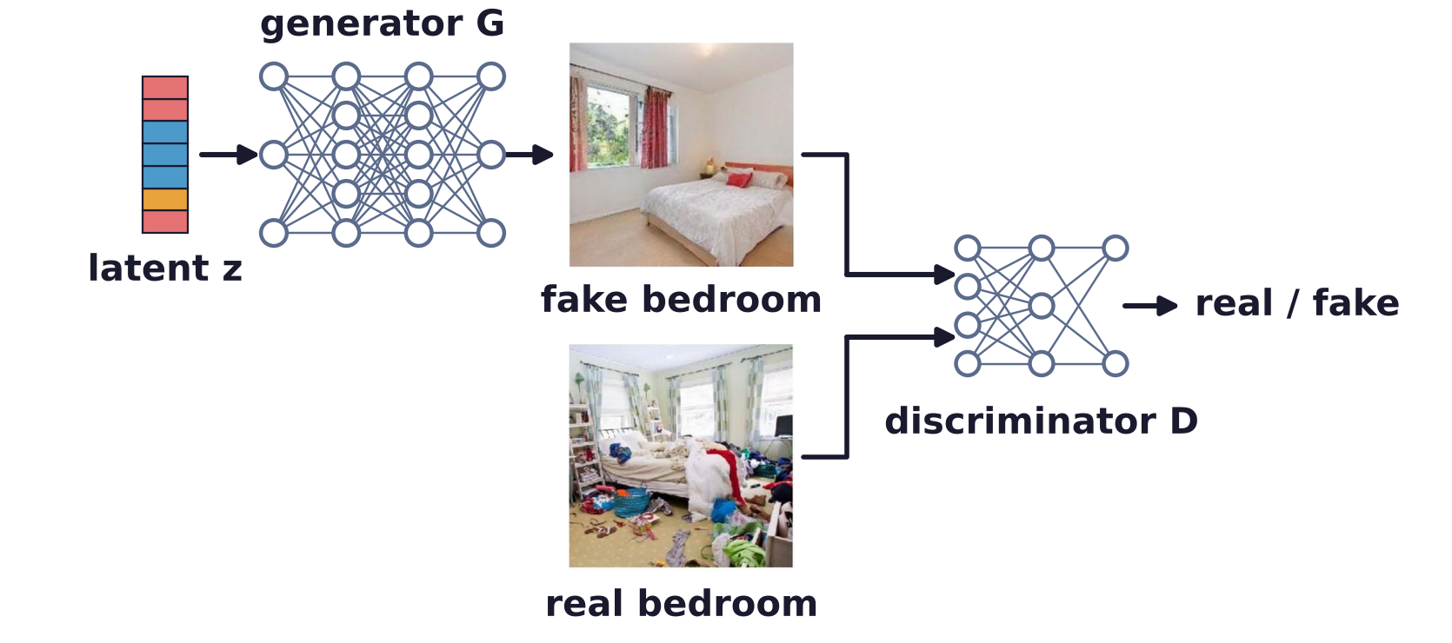
Generative adversarial networks
A GAN is a game between a generator and a discriminator
The Generator is trained to generate images similar to the training data.
The Discriminator is trained to predict if images are real or generated.
I. Goodfellow, J. Pouget-Abadie, M. Mirza, B. Xu, D. Warde-Farley, S. Ozair, A. Courville and Y. Bengio, “Generative adversarial nets,”
NeurIPS, 2672–2680, 2014.
Generative Models · A. Yuille
9

Slide 10
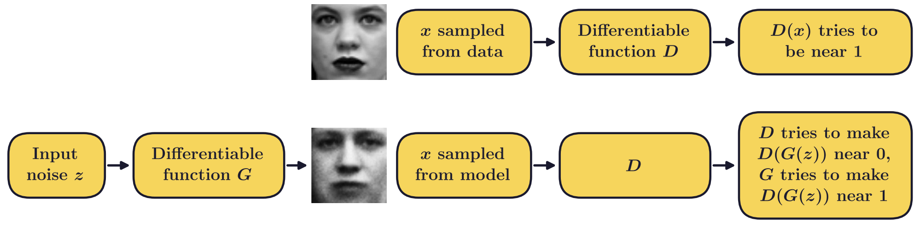
Generative adversarial networks
The generator is a counterfeiter, the discriminator the police
Generator: a structured probabilistic model with latent variables z as input, an image x as output.
Discriminator: a conventional deep network; input an image x, output a binary decision real/fake.
D(x): the probability that x is real. G, the counterfeiter, tries to fool D, the police; z is the latent.
I. Goodfellow, “NIPS 2016 tutorial: generative adversarial networks,” arXiv:1701.00160, 2016.
Generative Models · A. Yuille
10

Slide 11
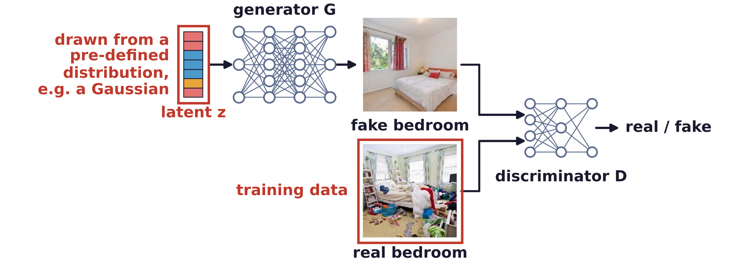
Generative adversarial networks
Training uses real images and latents from a Gaussian
Real bedrooms are the training data; fake bedrooms are made by the generator.
The latent z is typically drawn from a pre-defined distribution, e.g. a Gaussian.
Generative Models · A. Yuille
11

Slide 12
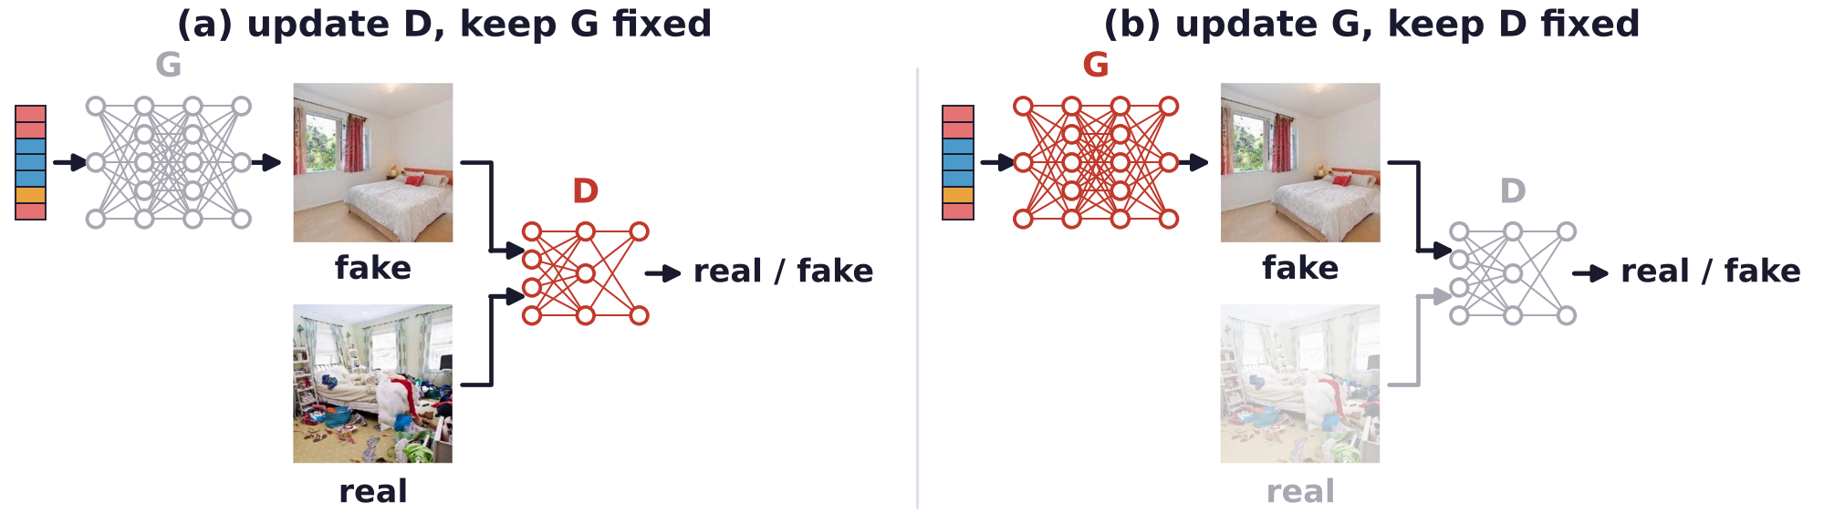
Generative adversarial networks
Training alternates discriminator and generator updates
Discriminator update: G is fixed; D learns to call training images real and generated ones fake.
Generator update: D is fixed; G learns to make D call its images real.
Red: the network being updated; grey: held fixed. Update (b) uses generated images only.
I. Goodfellow, J. Pouget-Abadie, M. Mirza, B. Xu, D. Warde-Farley, S. Ozair, A. Courville and Y. Bengio, “Generative adversarial nets,”
NeurIPS, 2672–2680, 2014.
Generative Models · A. Yuille
12

Slide 13
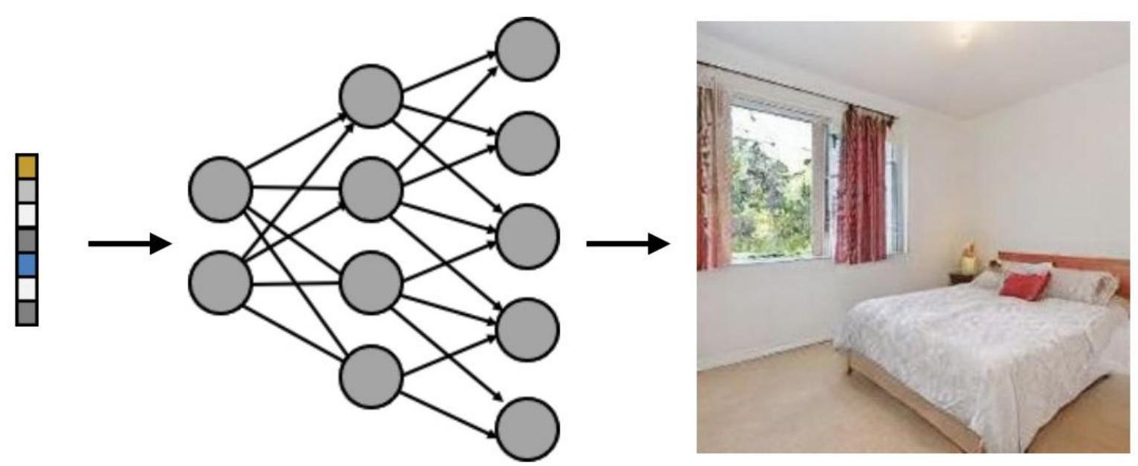
Generative adversarial networks
At convergence the generator alone makes realistic images
Ideally the generated images then follow the same distribution as the training images.
The trained generator turns a new random latent z into a new image.
Generative Models · A. Yuille
13

Slide 14
Generative adversarial networks
GAN training is a minimax game
D maximizes V: log D(x) is large on real images, log(1 − D(G(z))) on generated ones.
G minimizes V: it wants D(G(z)) near 1, so that its images are taken for real ones.
In practice G maximizes log D(G(z)) instead, which gives stronger gradients early in training.
Training alternates: k steps of gradient ascent on D, then one step on G.
p_{data}: the distribution of the training images; p_{z}: the distribution of z; 𝔼: expectation.
I. Goodfellow, J. Pouget-Abadie, M. Mirza, B. Xu, D. Warde-Farley, S. Ozair, A. Courville and Y. Bengio, “Generative adversarial nets,”
NeurIPS, 2672–2680, 2014.
Generative Models · A. Yuille
14

Slide 15
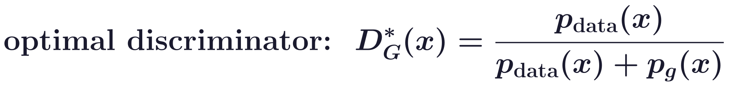
Generative adversarial networks
The optimal discriminator compares the two densities
For a fixed G, the best D is the ratio of the data density to the sum of both; p_{g}: the density of G(z).
With this D, minimizing C(G) means minimizing the Jensen–Shannon divergence (JSD) of p_{data} and p_{g}.
JSD ≥ 0, and 0 only when p_{g} = p_{data}: the global minimum, where D(x) = 1/2 everywhere.
The minimax game is hard to optimize: training can oscillate or collapse to a few images.
I. Goodfellow, J. Pouget-Abadie, M. Mirza, B. Xu, D. Warde-Farley, S. Ozair, A. Courville and Y. Bengio, “Generative adversarial nets,”
NeurIPS, 2672–2680, 2014.
Generative Models · A. Yuille
15

Slide 16
StyleGAN
3
StyleGAN maps z to an intermediate latent w that sets the style at every
level of the generator; W is more disentangled than Z.
Generative Models · A. Yuille
16

Slide 17
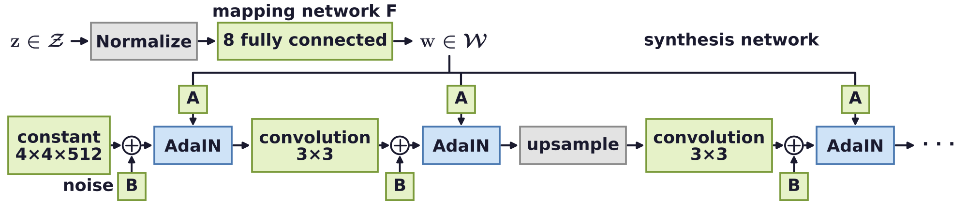
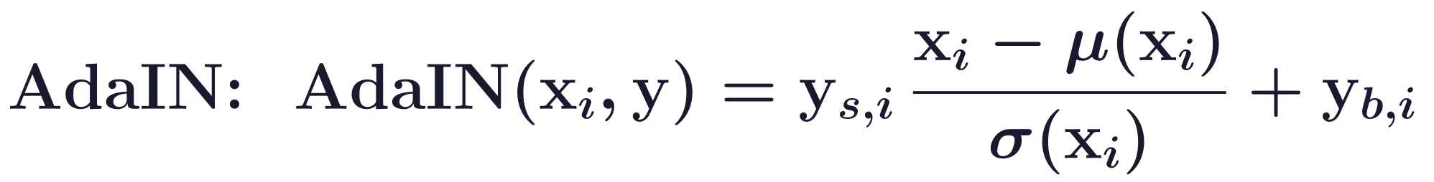
StyleGAN
StyleGAN has latent variables at every level of the network
GANs take input from a single latent variable z; StyleGAN has latents at different levels.
AdaIN (adaptive instance normalization): normalize x_{i} (mean μ, deviation σ), scale by y_{s}, shift by y_{b}.
A: learned affine maps from w to the style y; B: scaled noise, added before each AdaIN.
T. Karras, S. Laine and T. Aila, “A style-based generator architecture for generative adversarial networks,” CVPR, 4401–4410, 2019.
Generative Models · A. Yuille
17

Slide 18
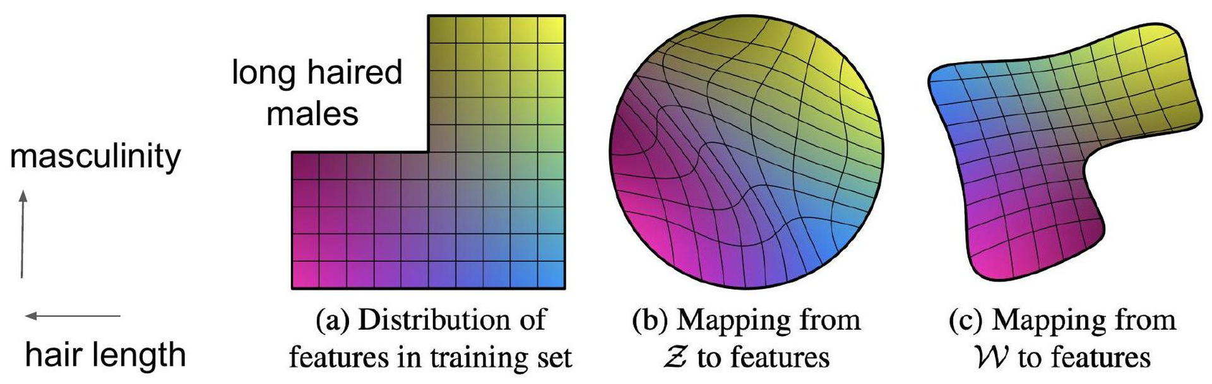
StyleGAN
A mapping network F turns z into an intermediate latent w
StyleGAN embeds z into an intermediate latent w = F(z). Now it is w, not z, that controls the style.
F can unwarp z to w so that the factors of variation become more linear.
Style: the factors of variation of the domain of interest, here masculinity and hair length.
No long-haired males in training: Gaussian Z must warp around the gap; W can follow it.
T. Karras, S. Laine and T. Aila, “A style-based generator architecture for generative adversarial networks,” CVPR, 4401–4410, 2019.
Generative Models · A. Yuille
18

Slide 19
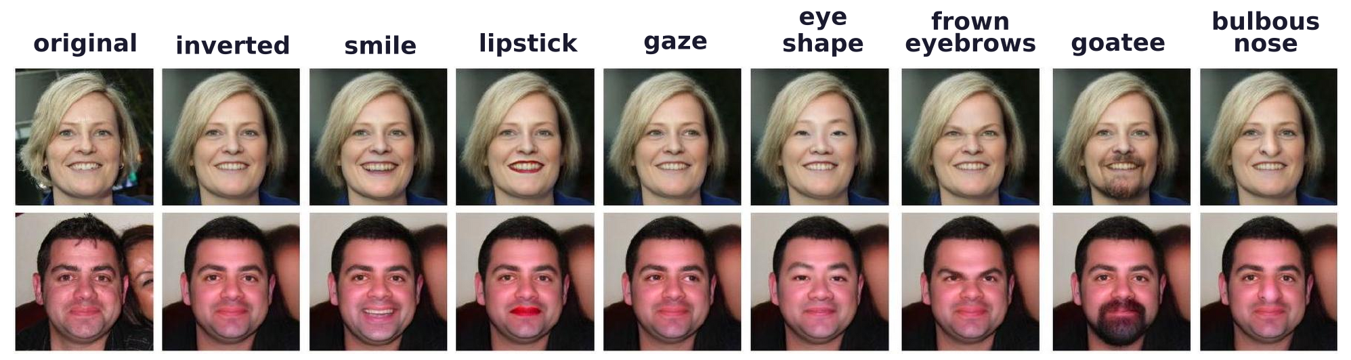
StyleGAN
A disentangled latent space has one direction per factor
There are various definitions for disentanglement.
A common goal: linear subspaces of the latent space, each controlling one factor of variation.
Inverted: the generator's reconstruction of the photo; each other column changes one style channel.
Z. Wu, D. Lischinski and E. Shechtman, “StyleSpace analysis: disentangled controls for StyleGAN image generation,”
CVPR, 12863–12872, 2021.
Generative Models · A. Yuille
19

Slide 20
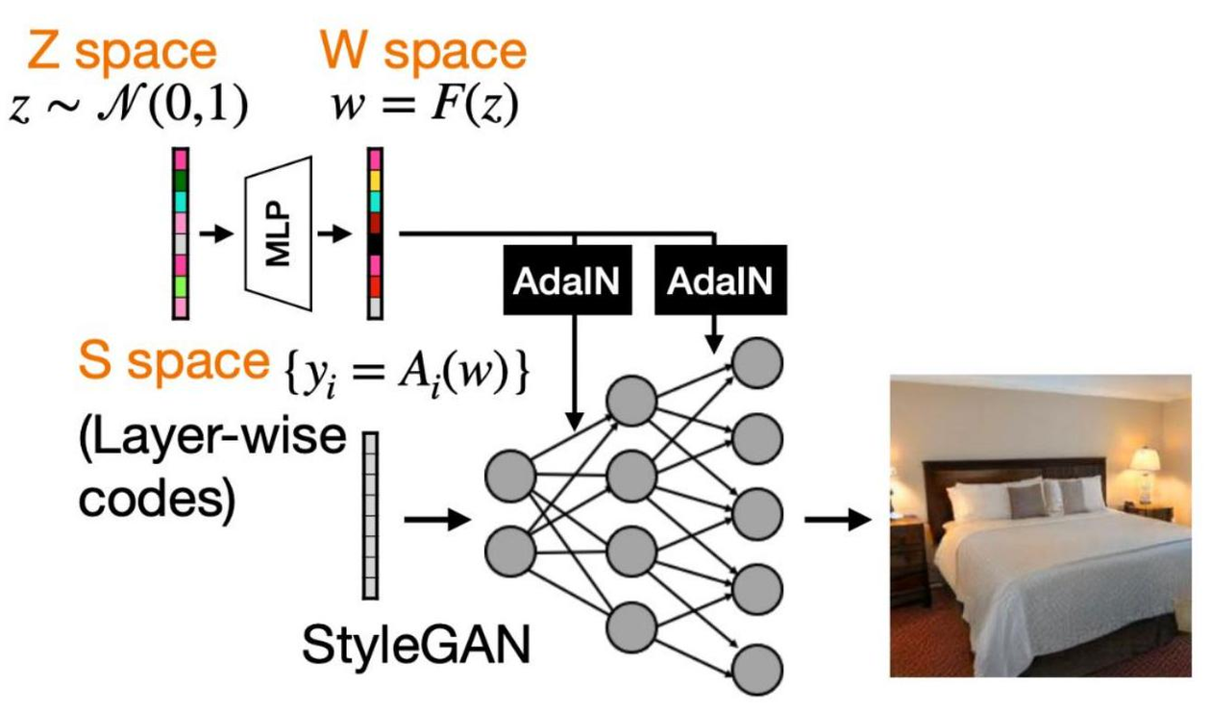
StyleGAN
The latent spaces Z, W and S are increasingly disentangled
Z: z from N(0, I); W: w = F(z), F a multilayer perceptron (MLP); S: style codes y_{i} = A_{i}(w).
W is more disentangled than Z (Karras et al.); the style space S more than W (Wu et al.).
T. Karras, S. Laine and T. Aila, “A style-based generator architecture for generative adversarial networks,” CVPR, 4401–4410, 2019.
Z. Wu, D. Lischinski and E. Shechtman, “StyleSpace analysis: disentangled controls for StyleGAN image generation,”
CVPR, 12863–12872, 2021.
Generative Models · A. Yuille
20

Slide 21
GAN inversion
4
Inversion finds the latent code whose generated image matches a target:
reconstruction, colorization, super-resolution, denoising, inpainting.
Generative Models · A. Yuille
21

Slide 22
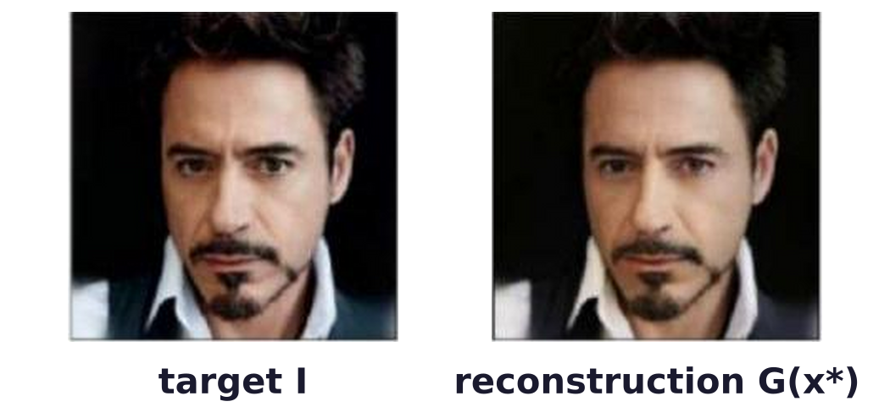
GAN inversion
GAN inversion finds the latent code of a target image
Applying the pretrained GAN model to image processing tasks.
Here x is the latent code, G the generator and I the target image.
x* is found by gradient descent on x, with G fixed.
J. Gu, Y. Shen and B. Zhou, “Image processing using multi-code GAN prior,” CVPR, 3012–3021, 2020.
Generative Models · A. Yuille
22

Slide 23
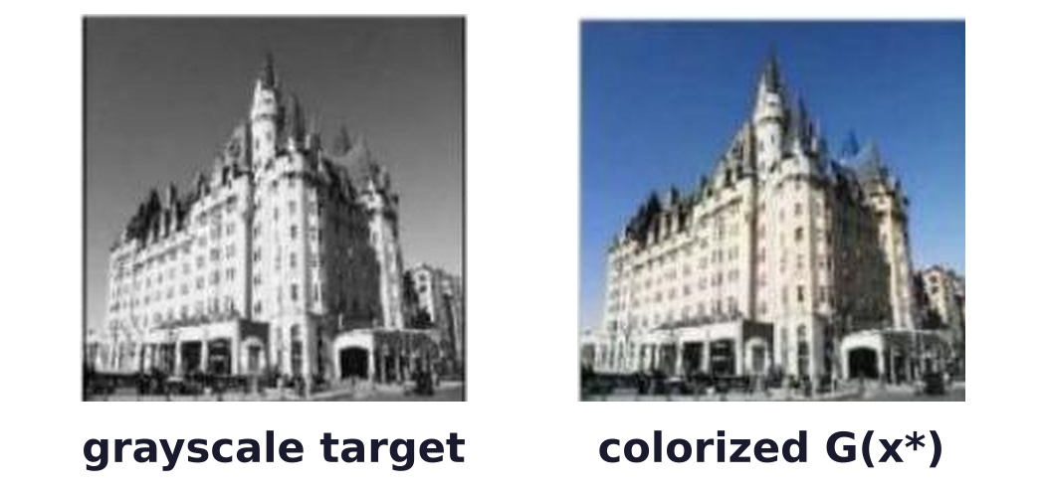
GAN inversion
Inversion colorizes and super-resolves images
Colorization: find x* whose generated image, made gray, matches the grayscale target.
Super-resolution: find x* whose downsampled generated image matches the low-resolution target.
J. Gu, Y. Shen and B. Zhou, “Image processing using multi-code GAN prior,” CVPR, 3012–3021, 2020.
Generative Models · A. Yuille
23

Slide 24
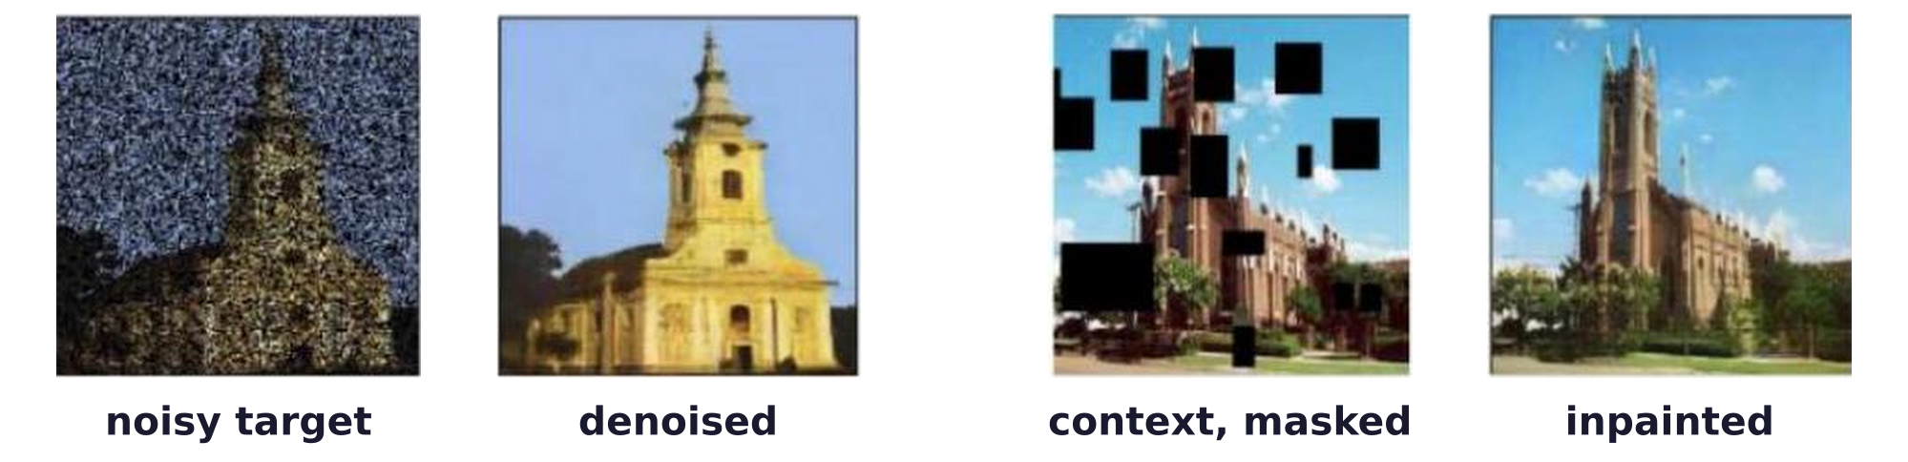
GAN inversion
Inversion denoises and inpaints images
Denoising: the same optimization as reconstruction, with the noisy image as target.
Inpainting: the mask m (1 on known pixels, 0 elsewhere; product pixel by pixel) keeps the known pixels.
J. Gu, Y. Shen and B. Zhou, “Image processing using multi-code GAN prior,” CVPR, 3012–3021, 2020.
Generative Models · A. Yuille
24

Slide 25
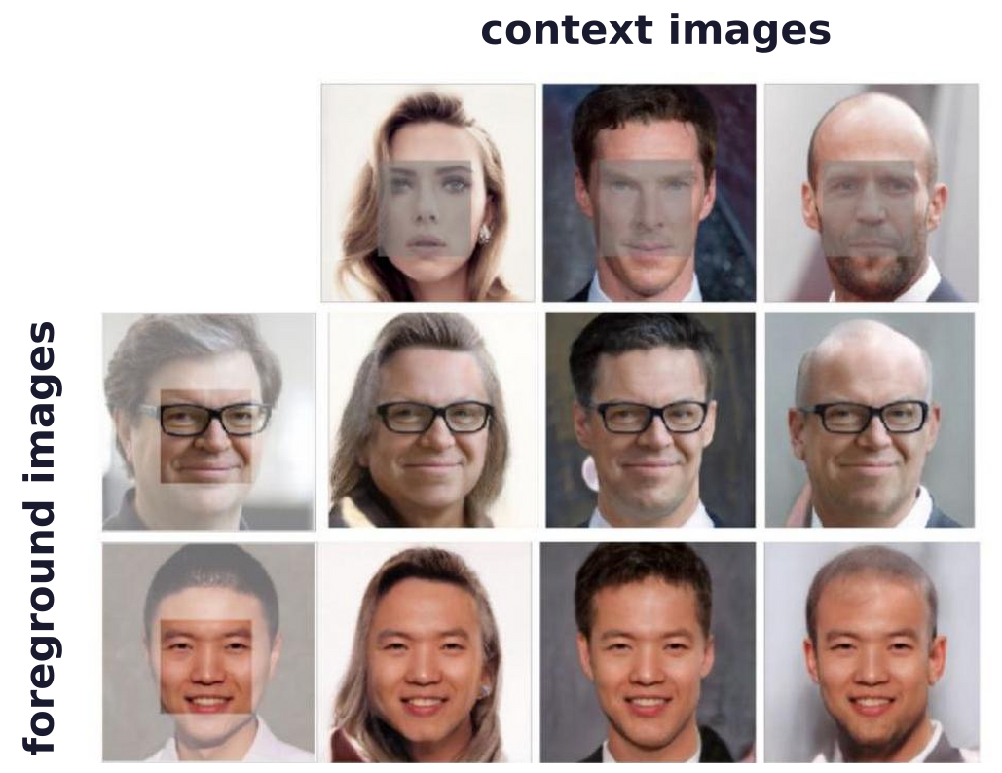
GAN inversion
In-domain inversion keeps the code semantically meaningful
In-domain inversion keeps the code among the generator's own codes, so it can be edited semantically.
Semantic diffusion: the central face of the foreground (grey box) is blended into each context face.
J. Zhu, Y. Shen, D. Zhao and B. Zhou, “In-domain GAN inversion for real image editing,” ECCV, 592–608, 2020.
Generative Models · A. Yuille
25

Slide 26
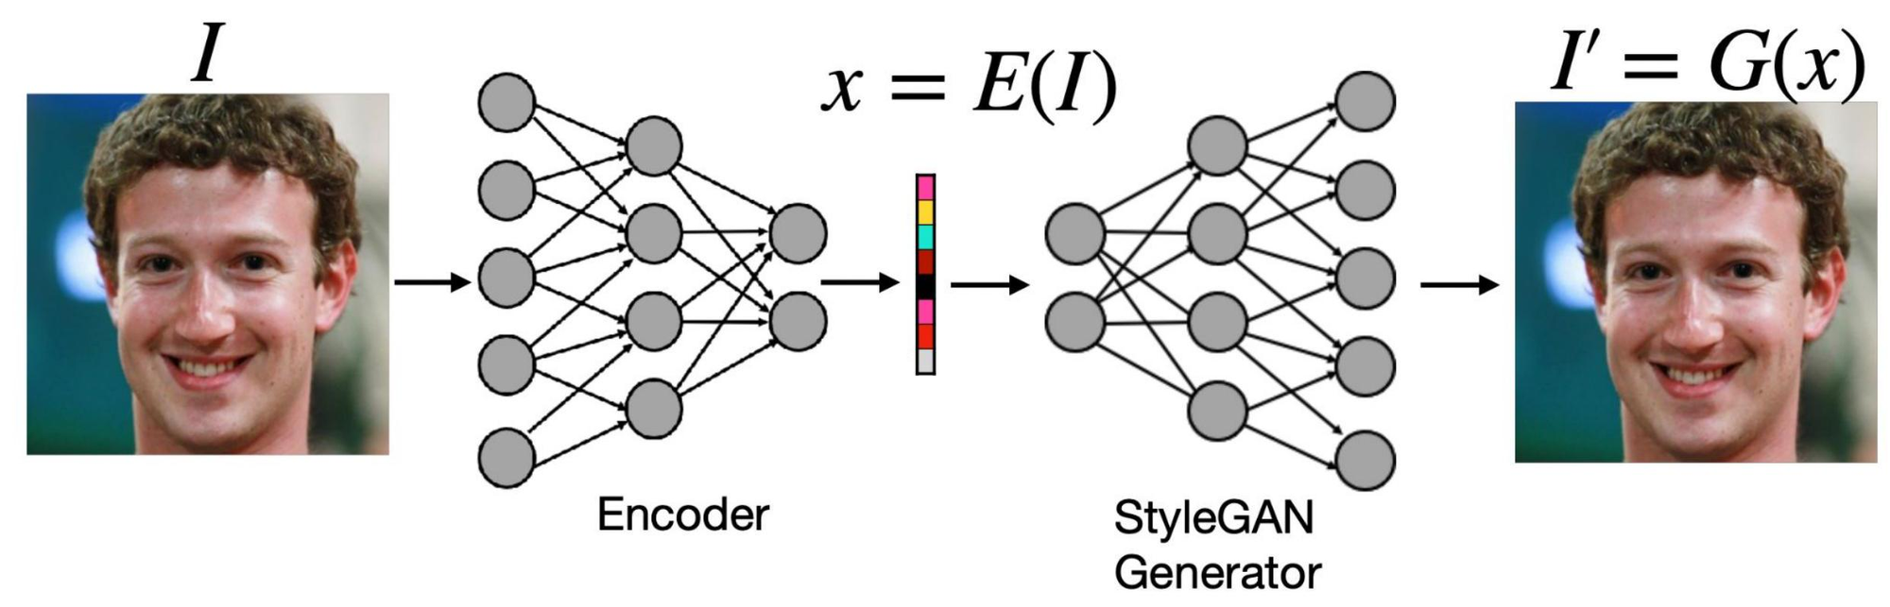
GAN inversion
An encoder maps a real image into StyleGAN space
The encoder E gives the latent code x = E(I) of the image I in one forward pass.
The StyleGAN generator turns it back into an image, I′ = G(x): together they form an autoencoder.
Generative Models · A. Yuille
26

Slide 27
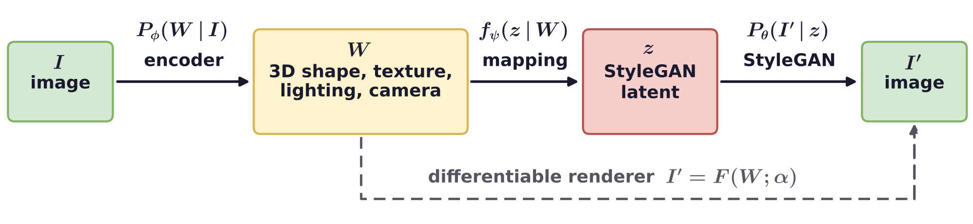
GAN inversion
Fidler's 3D neural rendering autoencoder uses StyleGAN
I → W: an encoder P_{φ}(W | I); the decoder is a differentiable renderer F with parameters α.
W → z: a mapping f_{ψ}(z | W), learned with an autoencoder reconstruction loss.
z → I′: a learned StyleGAN generative model P_{θ}(I′ | z).
Feasible because the latent variables of StyleGAN are fairly interpretable.
Y. Zhang, W. Chen, H. Ling, J. Gao, Y. Zhang, A. Torralba and S. Fidler, “Image GANs meet differentiable rendering for inverse
graphics and interpretable 3D neural rendering,” ICLR, 2021.
Generative Models · A. Yuille
27

Slide 28
Autoencoders
5
An autoencoder squeezes the input through a low-dimensional bottleneck;
a variational autoencoder makes the latent a distribution.
Generative Models · A. Yuille
28

Slide 29
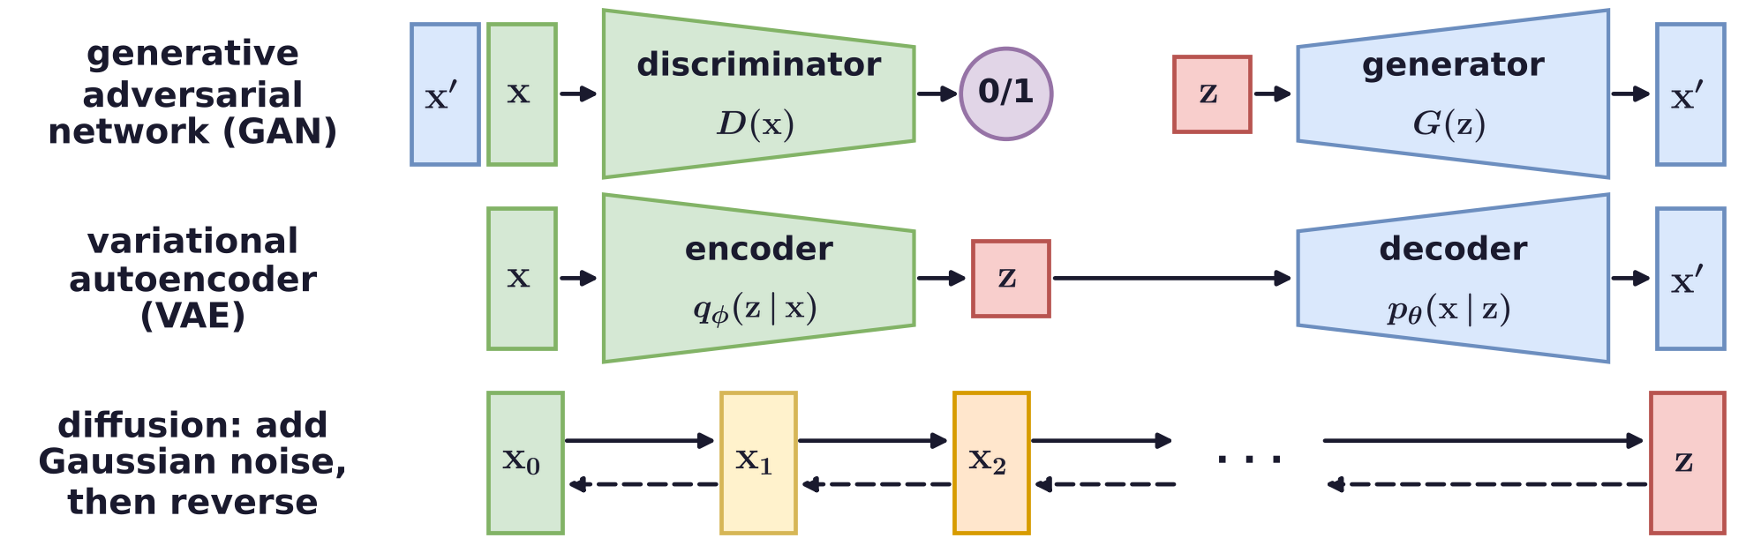
Autoencoders
GANs were hard to train; autoencoders are old and general
GANs generate highly realistic images, but their minimax formulation makes them hard to train.
The autoencoder is an old idea (1980s): a neural network alternative to principal component analysis.
The autoencoder concept is extremely powerful and general; diffusion models are a special case.
P. Baldi and K. Hornik, “Neural networks and principal component analysis: learning from examples without local minima,”
Neural Networks, 2(1):53–58, 1989.
L. Weng, “What are diffusion models?,” lilianweng.github.io, 2021.
Generative Models · A. Yuille
29

Slide 30
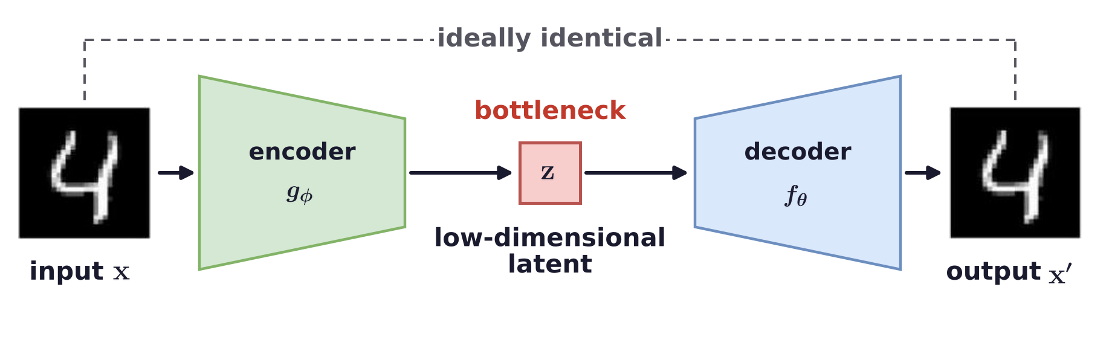
Autoencoders
An autoencoder squeezes the input through a bottleneck
Encoder g_{φ}: transforms the high-dimensional input (e.g. images) into a low-dimensional latent.
Decoder f_{θ}: recovers the high-dimensional data from the latent; ideally x′ = x.
L. Weng, “From autoencoder to beta-VAE,” lilianweng.github.io, 2018.
Generative Models · A. Yuille
30

Slide 31
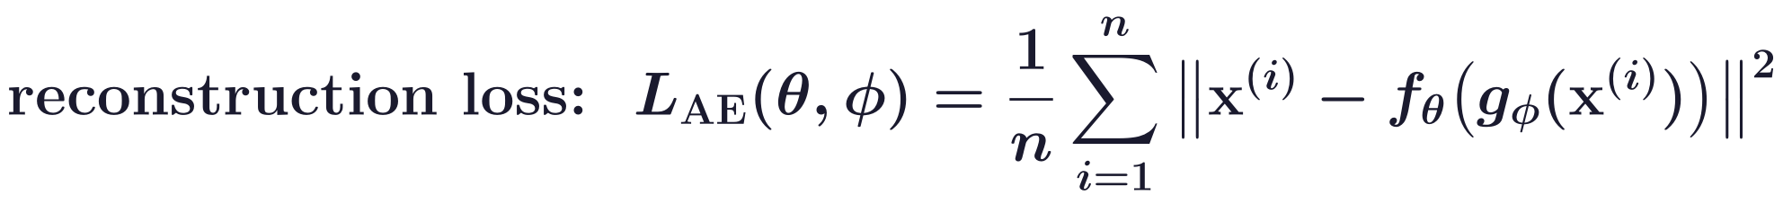
Autoencoders
An autoencoder minimizes the reconstruction loss
The n training images x^{(i)} are encoded and decoded; the loss is the squared error.
Hopefully lossless: the low-dimensional latent preserves the information of the input.
Dimensionality reduction: links to principal component analysis (PCA).
Linear encoder and decoder: the optimum projects onto the top principal components.
P. Baldi and K. Hornik, “Neural networks and principal component analysis: learning from examples without local minima,”
Neural Networks, 2(1):53–58, 1989.
Generative Models · A. Yuille
31

Slide 32
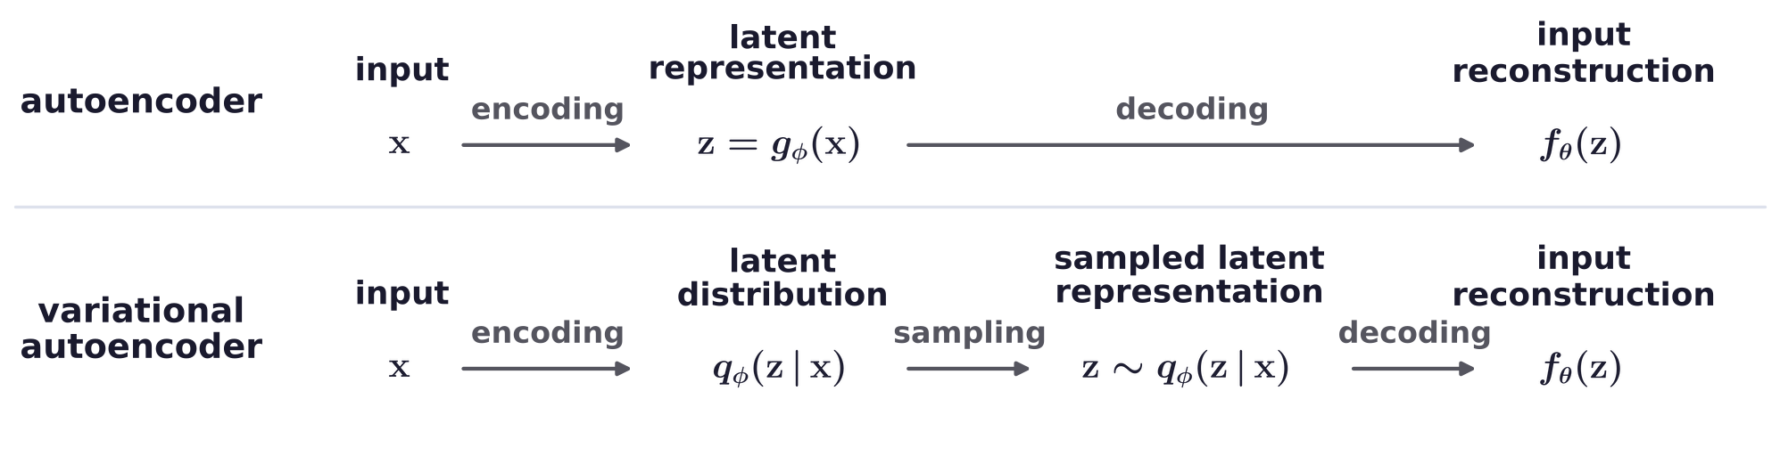
Autoencoders
A variational autoencoder makes the latent a distribution
The autoencoder's latent space is not necessarily organized to be sampled to generate images.
VAEs regularize the latent space to follow a structured distribution, e.g. a standard Gaussian.
The latent representation is now a distribution q_{φ}(z | x) rather than a single point.
In the figure, g_{φ} is the encoder and f_{θ} the decoder, as for the autoencoder.
D. P. Kingma and M. Welling, “Auto-encoding variational Bayes,” ICLR, 2014.
Generative Models · A. Yuille
32

Slide 33
Autoencoders
The VAE loss is a variational bound, as in mean field theory
The Kullback–Leibler (KL) term is at least 0, so L_{VAE} is an upper bound on −log p_{θ}(x).
Second line: a reconstruction term, plus a KL term that pulls q_{φ}(z | x) toward the prior p_{θ}(z).
As in mean field theory: approximate a distribution by a simpler, factorized one.
μ_{φ}(x), σ_{φ}(x): the mean and standard deviation from the encoder; ⊙: elementwise product.
Sampling z this way lets the gradient pass through the sampling step.
D. P. Kingma and M. Welling, “Auto-encoding variational Bayes,” ICLR, 2014.
Generative Models · A. Yuille
33

Slide 34
Diffusion with text
6
A diffusion model is an autoencoder whose encoder adds noise; Stable
Diffusion denoises in a latent space, conditioned on text by cross-attention.
Generative Models · A. Yuille
34

Slide 35
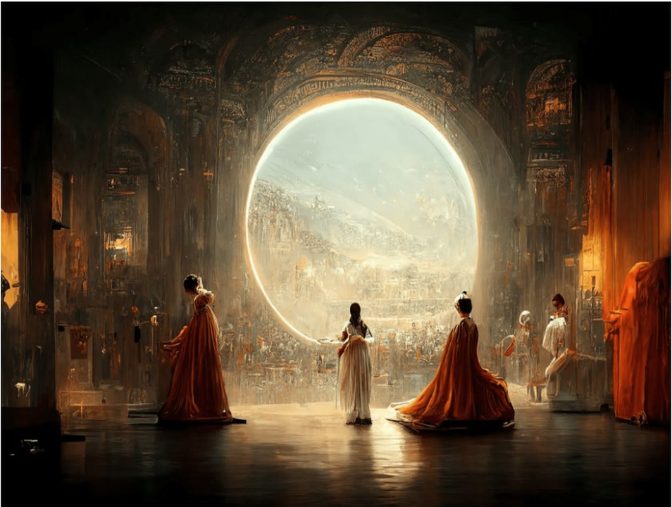
Diffusion with text
Diffusion models conditioned on text create realistic images
Diffusion models conditioned on text are able to create complex and realistic images.
They use the huge advances of large language models (auto-regressive: predicting one word at a time).
This prize-winning image was created almost entirely by diffusion models.
“Théâtre D’opéra Spatial”, J. M. Allen with Midjourney, first prize in digital arts, Colorado State Fair 2022.
Generative Models · A. Yuille
35

Slide 36
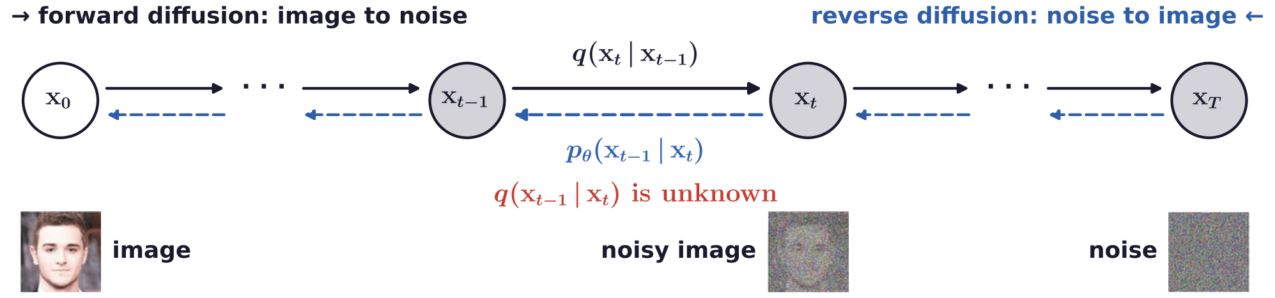
Diffusion with text
A diffusion model is an autoencoder with a noise encoder
Forward diffusion process: input image x₀, output latent variables x₁, …, x_{T} (grey); x_{T} is pure noise.
Reverse diffusion process: input latent variables, output image; the steps p_{θ} are learned.
The latents have the size of the image; the encoder is fixed, only the decoder is learned.
The true reverse step q(x_{t−1} | x_{t}) is unknown; training uses a variational bound, as for the VAE.
J. Sohl-Dickstein, E. Weiss, N. Maheswaranathan and S. Ganguli, “Deep unsupervised learning using nonequilibrium thermodynamics,”
ICML, 2256–2265, 2015.
J. Ho, A. Jain and P. Abbeel, “Denoising diffusion probabilistic models,” NeurIPS, 6840–6851, 2020.
Generative Models · A. Yuille
36

Slide 37
Diffusion with text
Each forward step adds a little Gaussian noise
β_{t}: a small noise variance, set by a schedule (Ho et al.: linear from 0.0001 to 0.02, T = 1000).
N(x; μ, Σ): a Gaussian density in x with mean μ and covariance Σ; I: the identity matrix.
Any x_{t} can be drawn from x₀ in one step; the weight of x₀ falls from 1 toward 0 as t grows.
At t = T almost nothing of x₀ is left: x_{T} is close to pure Gaussian noise.
J. Ho, A. Jain and P. Abbeel, “Denoising diffusion probabilistic models,” NeurIPS, 6840–6851, 2020.
Generative Models · A. Yuille
37

Slide 38
Diffusion with text
The network learns to predict the added noise
Training uses a simplified, reweighted form of the bound: predict the noise ε added to x₀.
ε_{θ}: a network of the noisy image x_{t} and the timestep t, with t drawn uniformly from 1 to T.
Predicting the noise gives the mean μ_{θ} of the reverse step; its variance is fixed (σ_{t}² = β_{t}).
J. Ho, A. Jain and P. Abbeel, “Denoising diffusion probabilistic models,” NeurIPS, 6840–6851, 2020.
Generative Models · A. Yuille
38

Slide 39
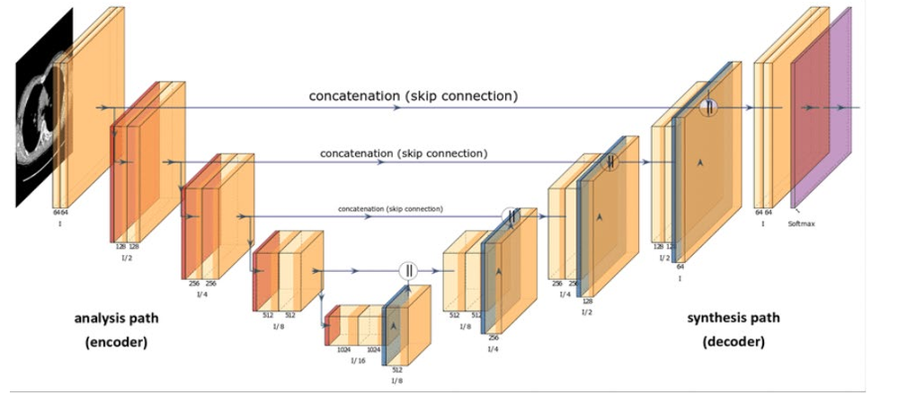
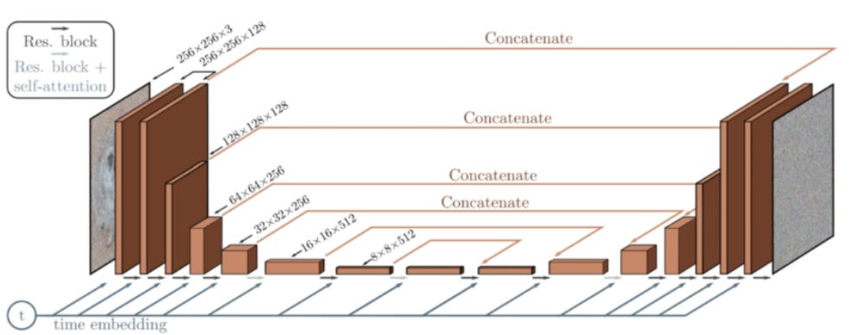
Diffusion with text
The denoising network is a U-Net
These are variants of the U-Net architecture: an encoder path, a decoder path, skip connections.
Skip connections copy encoder features to the decoder; the timestep t enters as a time embedding.
The details are out of the scope of the course.
O. Ronneberger, P. Fischer and T. Brox, “U-Net: convolutional networks for biomedical image segmentation,” MICCAI, 234–241, 2015.
J. Ho, A. Jain and P. Abbeel, “Denoising diffusion probabilistic models,” NeurIPS, 6840–6851, 2020.
Generative Models · A. Yuille
39

Slide 40
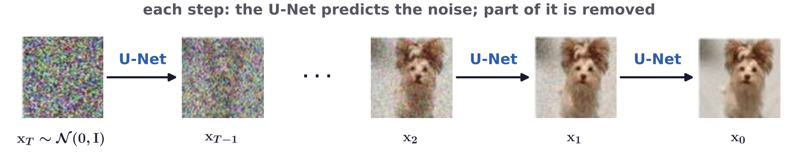
Diffusion with text
Sampling denoises Gaussian noise step by step
Sample the latent variables: random Gaussian noise x_{T}, here T = 1000.
Each step subtracts part of the noise predicted by the U-Net and adds fresh noise σ_{t}n (none at t = 1).
J. Ho, A. Jain and P. Abbeel, “Denoising diffusion probabilistic models,” NeurIPS, 6840–6851, 2020.
Generative Models · A. Yuille
40

Slide 41
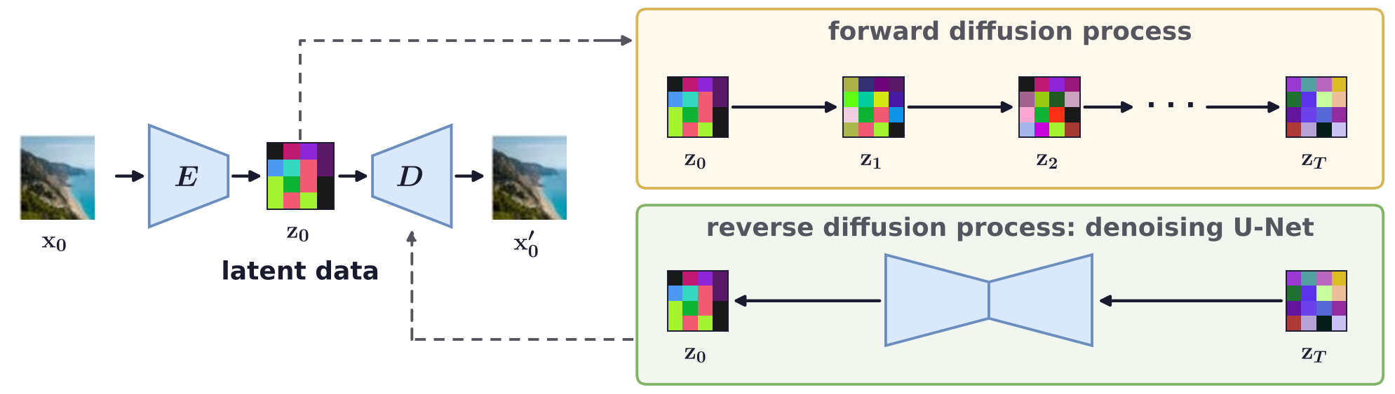
Diffusion with text
Stable Diffusion performs diffusion in a latent space
An autoencoder (encoder E, decoder D, not the discriminator) compresses the image x₀ into a latent z₀.
Forward and reverse diffusion run on the latents; the decoder turns the result into an image.
Diffusion in the small latent space is much cheaper than in pixel space.
R. Rombach, A. Blattmann, D. Lorenz, P. Esser and B. Ommer, “High-resolution image synthesis with latent diffusion models,”
CVPR, 10684–10695, 2022.
Generative Models · A. Yuille
41

Slide 42
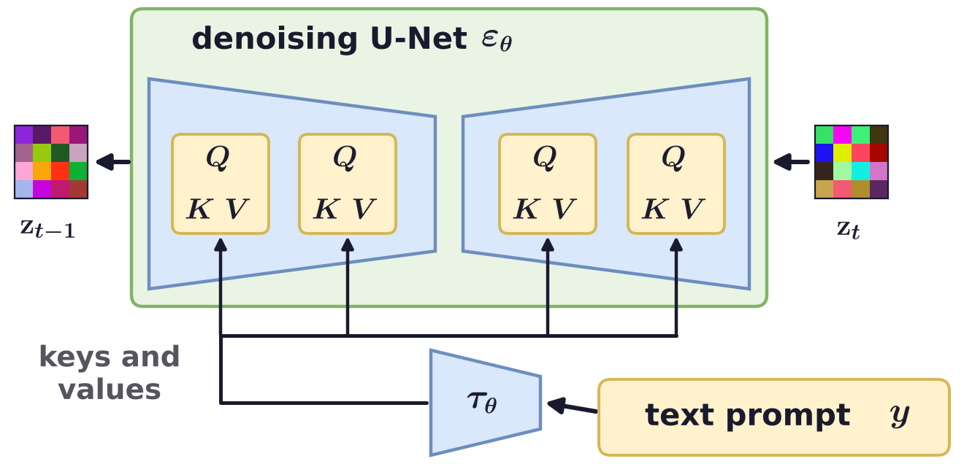
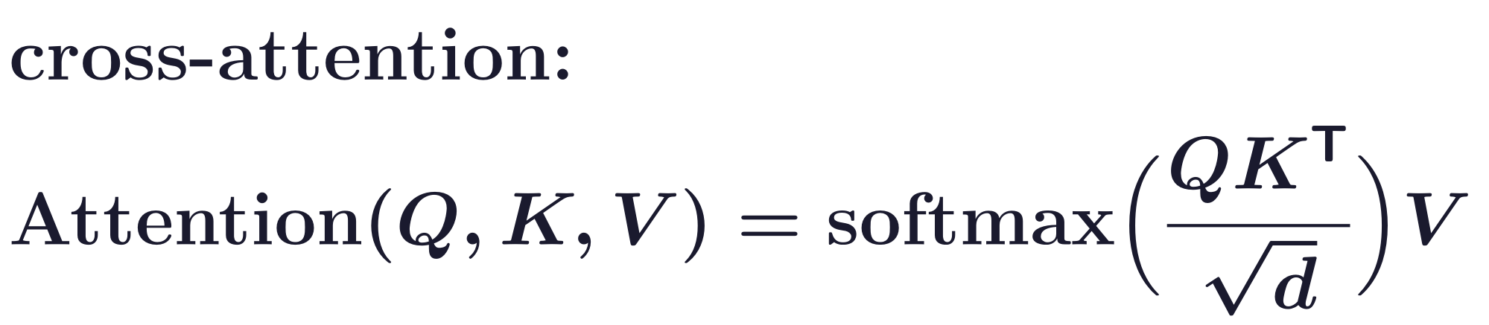
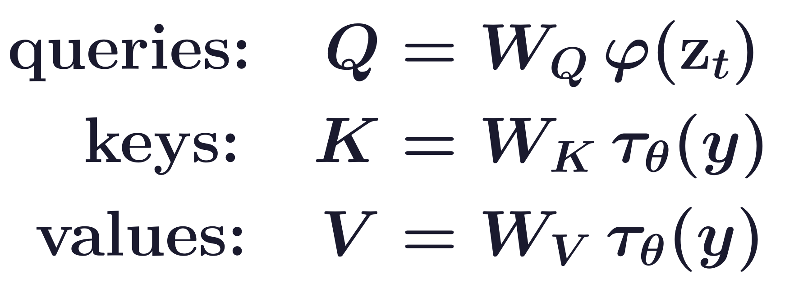
Diffusion with text
Cross-attention conditions Stable Diffusion on text
Text conditioning uses a cross-attentional mechanism (from Transformers): it enables prompting on text.
A text encoder τ_{θ} turns the prompt y into token embeddings; they give the keys K and the values V.
U-Net features φ(z_{t}) give the queries Q; W_{Q}, W_{K}, W_{V}: learned matrices; d: the key length.
R. Rombach, A. Blattmann, D. Lorenz, P. Esser and B. Ommer, “High-resolution image synthesis with latent diffusion models,”
CVPR, 10684–10695, 2022.
A. Vaswani, N. Shazeer, N. Parmar et al., “Attention is all you need,” NeurIPS, 5998–6008, 2017.
Generative Models · A. Yuille
42

Slide 43
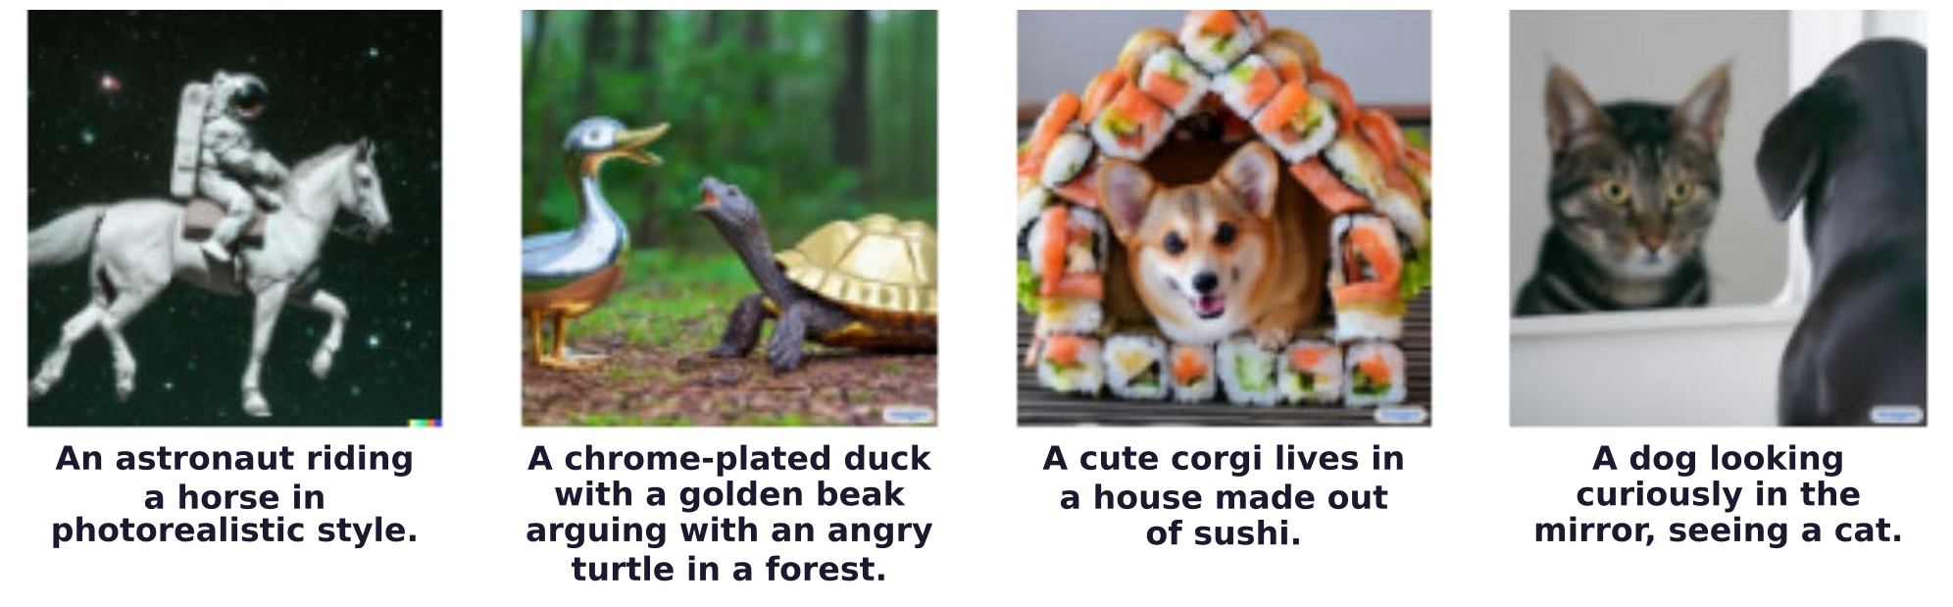
Diffusion with text
Text prompts control the generated images
A few examples: each image was generated from the prompt below it.
They come from other diffusion models: the astronaut from DALL-E 2, the duck and corgi from Imagen.
OpenAI, “DALL-E 2,” https://openai.com/dall-e-2/, 2022 (the astronaut and its prompt).
C. Saharia, W. Chan, S. Saxena et al., “Photorealistic text-to-image diffusion models with deep language understanding,”
NeurIPS, 36479–36494, 2022.
Generative Models · A. Yuille
43

Slide 44
Diffusion with text
Diffusion models lack conditioning on the 3D world state
Diffusion models (DMs) can generate a very rich variety of realistic images controlled by text prompts.
They can be extended to generate videos. This is a research industry.
From the computer vision perspective, they are lacking as generative models.
Bayesian analysis by synthesis wants generative models conditioned on the 3D world state.
DMs have implicit 3D representations, partially understood, that can help estimate 3D properties.
Can implicit representations emerge within DMs?
Some people are betting a lot of money that they will. But I am not convinced.
Generative Models · A. Yuille
44

Slide 45
Diffusion with text
Summary
Deep generative models learn from big data; they are realistic but hard to interpret.
A GAN trains a generator against a discriminator in a minimax game: hard to train.
StyleGAN maps z to a latent w that sets the style at every level; W is more disentangled than Z.
GAN inversion finds the latent code of a real image: editing, colorization, denoising, inpainting.
An autoencoder reconstructs its input through a bottleneck; a VAE makes the latent a distribution.
A diffusion model is an autoencoder whose encoder adds noise; a U-Net learns to remove it.
Stable Diffusion denoises in a latent space and is conditioned on text by cross-attention.
Diffusion models lack conditioning on the 3D world state that analysis by synthesis needs.
Generative Models · A. Yuille
45

