Slide 1
2D Compositional
Networks: Approximate
Analysis by Synthesis
8 October, 2026
Alan Yuille · Probabilistic Models of the Visual Cortex

Slide 2
What this lecture covers
1
Generalization under occlusion
2
Generative model of features
Occluders are exponentially variable
vMF kernels, mixtures, inference
3
Robustness to occlusion
4
Detection under occlusion
Outlier model and occluder localization
Context-aware CompNets, box voting
5
Three additional projects
Patch attacks, amodal shapes, many objects
Neural Networks · A. Yuille
2

Slide 3
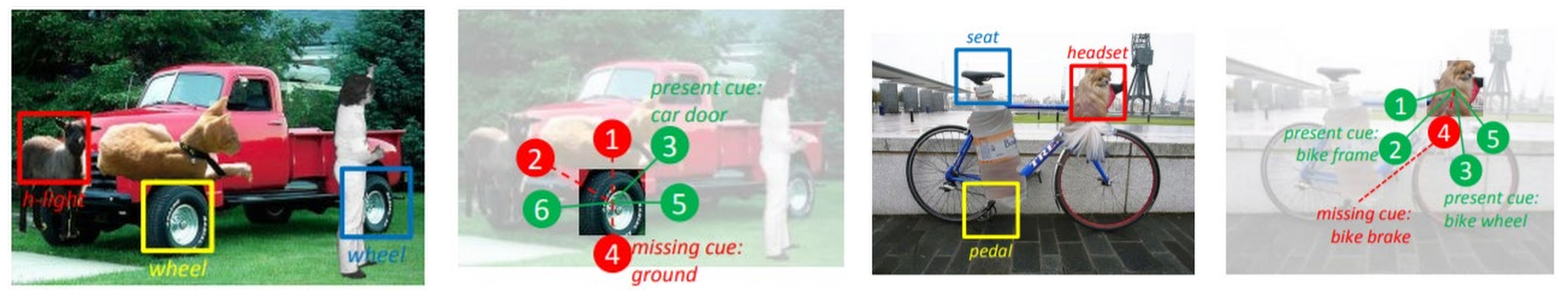
Explicit parts can be switched off when they are occluded
Lecture 11: visual concepts, clusters of deep-network feature vectors, are subparts of objects.
Compositional voting: present cues (green) vote for a semantic part; missing cues (red) give no vote.
Can we extend this to classify objects? 2D compositional networks (CompNets).
A CompNet is a generative model of the features: it can explain which parts are occluded.
Neural Networks · A. Yuille
3

Slide 4
Generalization
under occlusion
1
Objects are partly hidden by highly variable occluders;
deep networks trained without occlusion generalize poorly.
Neural Networks · A. Yuille
4

Slide 5
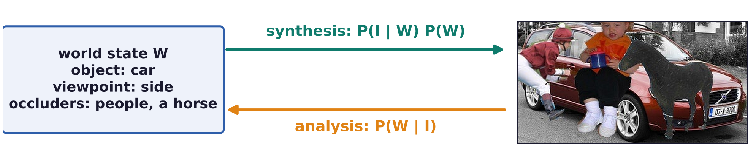
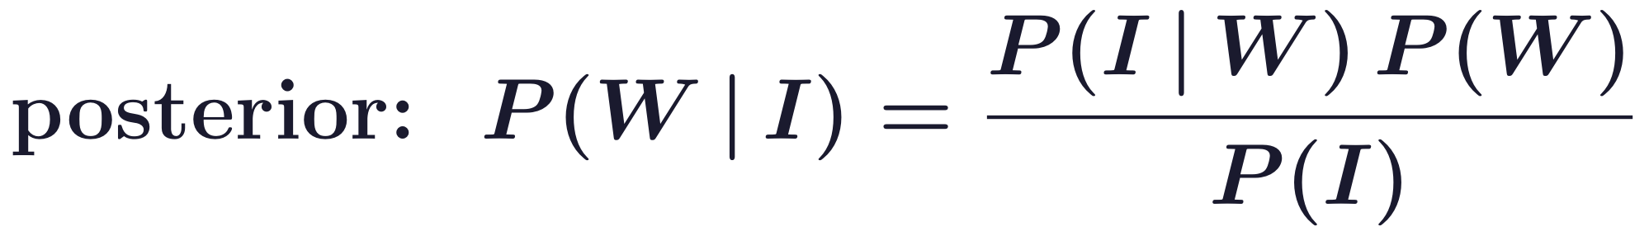
Generalization under occlusion
Analysis by synthesis inverts a generative model of images
Generative model P(I | W): a model for generating an image I from a state of the world W; prior P(W).
Synthesis means that we have models P(I | W) P(W) for generating images.
Analysis means that we can determine the world state W from the posterior P(W | I).
A. Yuille and D. Kersten, “Vision as Bayesian inference: analysis by synthesis?,” Trends in Cognitive Sciences, 10(7):301–308, 2006.
Neural Networks · A. Yuille
5

Slide 6
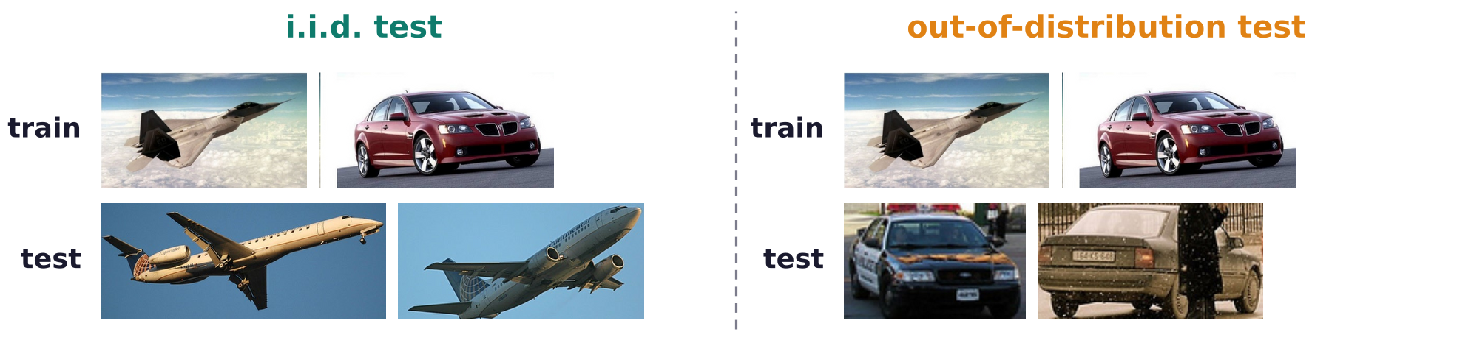
Generalization under occlusion
Out-of-distribution tests are tougher than i.i.d. splits
Usually vision models are tested by assuming i.i.d. (independent, identically distributed) samples.
We train on half the data and test on the other half; this yields standard performance measures.
Claim: these are problematic for many reasons; e.g. the average case hides the weak points.
Tougher tests: out-of-distribution, domain transfer. Here: occluders that never appear in training.
Neural Networks · A. Yuille
6

Slide 7
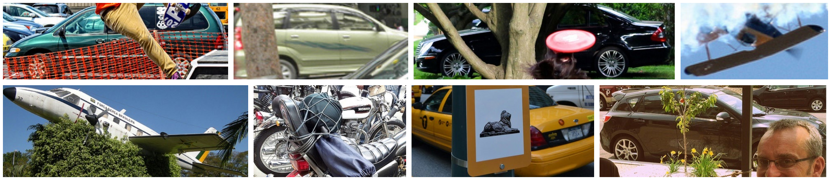
Generalization under occlusion
Generalization under occlusion is important
In natural images objects are surrounded and partially occluded by other objects.
Occluders are highly variable in terms of shape and texture: exponential complexity.
Vision systems must generalize in exponentially complex domains.
Neural Networks · A. Yuille
7

Slide 8
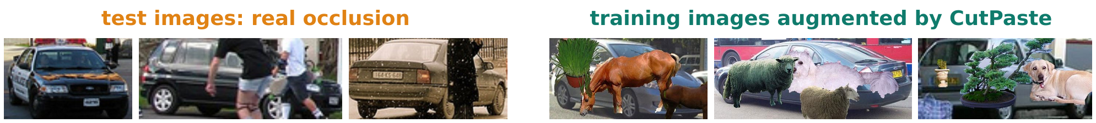
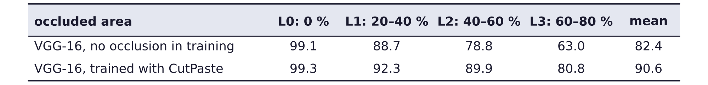
Generalization under occlusion
Occlusion degrades DCNNs trained on unoccluded data
DCNN: deep convolutional neural network; VGG-16 (Visual Geometry Group, 16 layers) is one.
Training: unoccluded MS-COCO (Microsoft Common Objects in Context) vehicles; test: occluded ones.
L1 to L3: occlusion levels, the fraction of the object that is occluded.
What if we train with lots of augmented data? CutPaste pastes occluders into the training images.
A. Kortylewski, J. He, Q. Liu and A. L. Yuille, “Compositional convolutional neural networks: a deep architecture with innate robustness
to partial occlusion,” CVPR, 8940–8949, 2020.
Neural Networks · A. Yuille
8

Slide 9
Generative model of features
2
A class is a mixture over viewpoints of spatial mixtures of
von Mises-Fisher (vMF) kernels; inference is a feed-forward network.
Neural Networks · A. Yuille
9

Slide 10
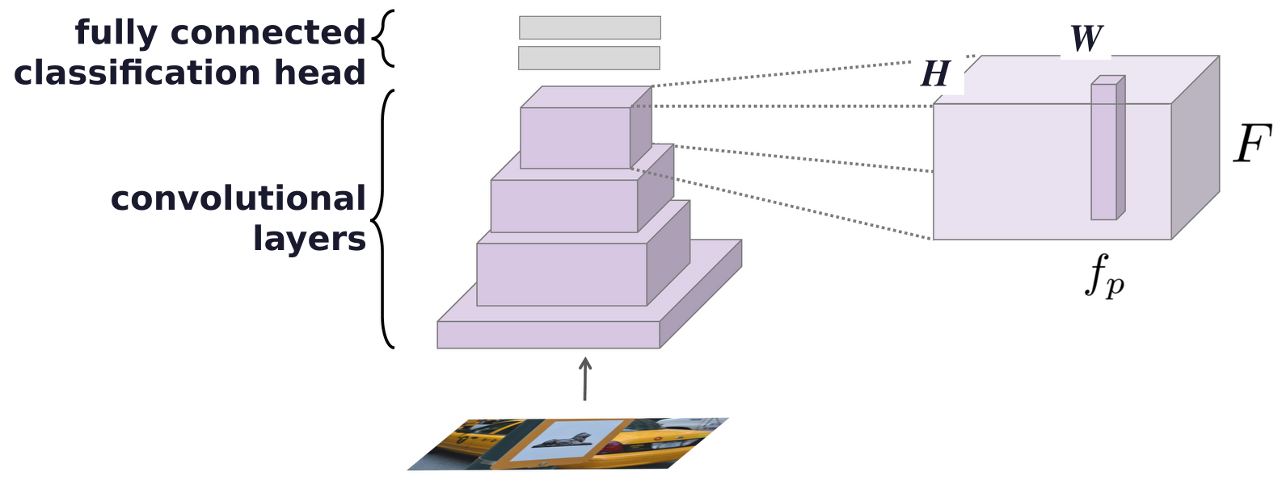
Generative model of features
A generative model of neural feature activations
The model generates F, the feature map of the last convolutional layer of a DCNN.
F has H × W positions p, each with a feature vector; this W is the width, unrelated to the world state.
CompNets replace the fully connected classification head of the DCNN.
Approximate analysis by synthesis: the features are invariant to low-level details of the image.
A. Kortylewski, J. He, Q. Liu and A. L. Yuille, “Compositional convolutional neural networks: a deep architecture with innate robustness
to partial occlusion,” CVPR, 8940–8949, 2020.
Neural Networks · A. Yuille
10

Slide 11
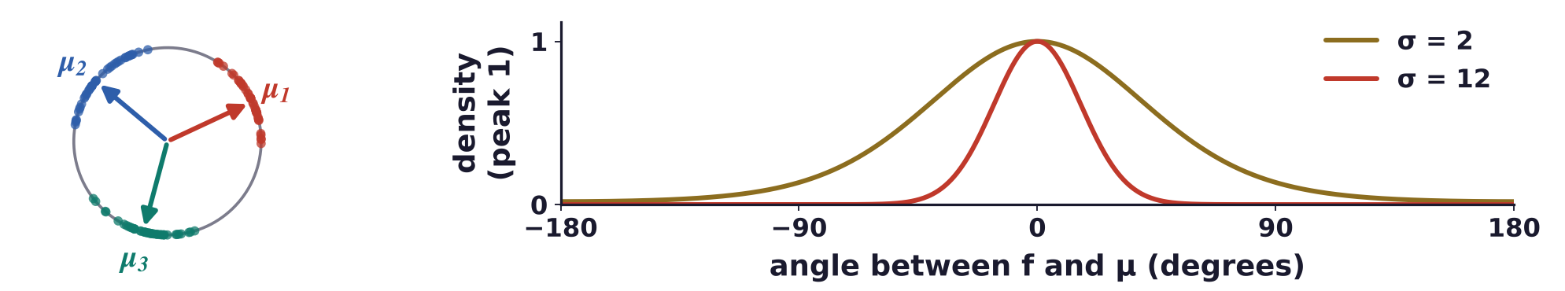
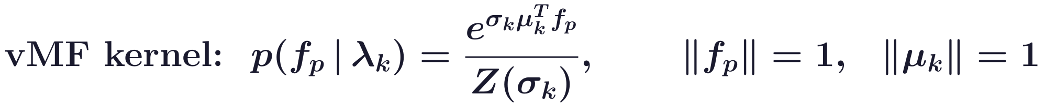
Generative model of features
vMF kernels cluster the normalised feature vectors
Every feature vector is normalised to unit length: it is a point on a sphere (dots: samples).
A von Mises-Fisher (vMF) distribution with mean direction μ is a Gaussian on the sphere (Lecture 8).
λ = {μ, σ}: μ is learnt; σ sets how tightly the vectors cluster around μ; Z(σ) normalises.
A. Banerjee, I. S. Dhillon, J. Ghosh and S. Sra, “Clustering on the unit hypersphere using von Mises-Fisher distributions,”
Journal of Machine Learning Research, 6:1345–1382, 2005.
Neural Networks · A. Yuille
11

Slide 12
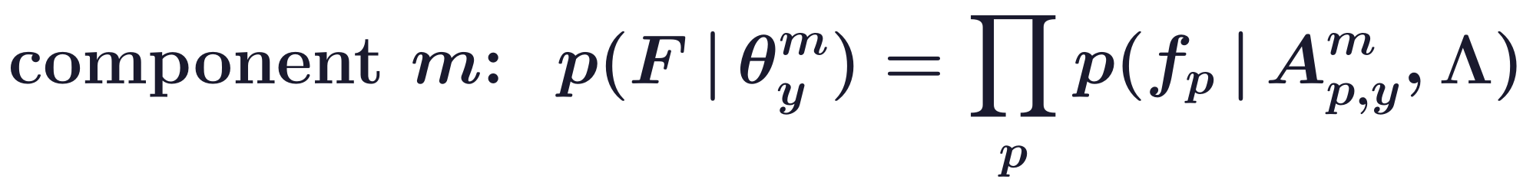
Generative model of features
The object model mixes viewpoints and, per position, parts
y labels the object class; m labels the mixture component (viewpoint); p labels the position in F.
ν selects one of the M components; Θ holds all components of a class, θ one of them.
A holds the α's at a position: which of the K vMF kernels (parts) are expected there; Λ: all kernels.
The α's and μ's are learnt (σ is fixed), without viewpoint labels; given m, positions are independent.
A. Kortylewski, J. He, Q. Liu and A. L. Yuille, “Compositional convolutional neural networks: a deep architecture with innate robustness
to partial occlusion,” CVPR, 8940–8949, 2020.
Neural Networks · A. Yuille
12

Slide 13
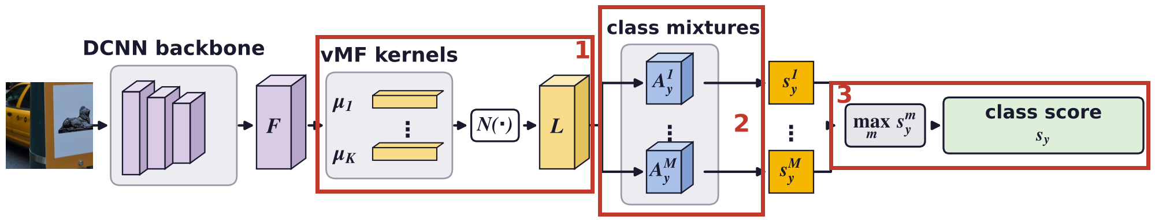
Generative model of features
Inference as a feed-forward neural network
Step 1 is a 1 × 1 convolution of F with the kernels μ; N(·) applies the exponential and 1/Z(σ), giving L.
A. Kortylewski, J. He, Q. Liu and A. L. Yuille, “Compositional convolutional neural networks: a deep architecture with innate robustness
to partial occlusion,” CVPR, 8940–8949, 2020.
Neural Networks · A. Yuille
13

Slide 14
Generative model of features
Learning the model parameters with backpropagation
Class loss: cross-entropy of the prediction y′ against the true class y; the γ's weigh the losses.
Weight loss: weight decay of the backbone's weights, written W here; A: the α's of class y.
vMF loss: pulls feature vectors and their closest kernels μ together, as k-means on the sphere.
Mixture loss: the best component of the true class must explain the feature map.
A. Kortylewski, J. He, Q. Liu and A. L. Yuille, “Compositional convolutional neural networks: a deep architecture with innate robustness
to partial occlusion,” CVPR, 8940–8949, 2020.
Neural Networks · A. Yuille
14

Slide 15
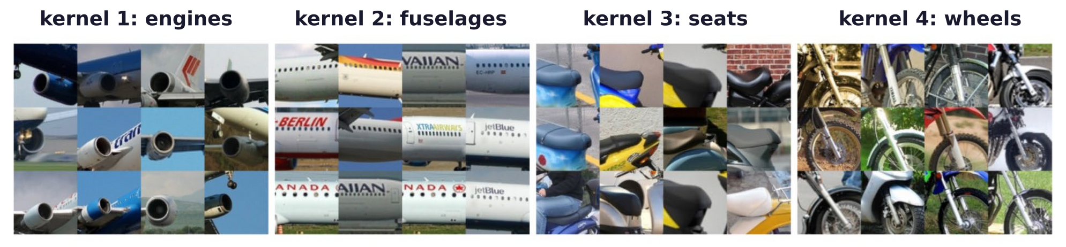
Generative model of features
vMF kernels resemble part detectors
Image patterns with the highest likelihood for four vMF kernels: each responds to one kind of part.
The kernels are shared by all classes and viewpoints; the α's place them in each object.
Explainability: a detection can be explained by the parts which are present.
A. Kortylewski, Q. Liu, A. Wang, Y. Sun and A. Yuille, “Compositional convolutional neural networks: a robust and interpretable model for
object recognition under occlusion,” International Journal of Computer Vision, 129(3):736–760, 2021.
Neural Networks · A. Yuille
15

Slide 16
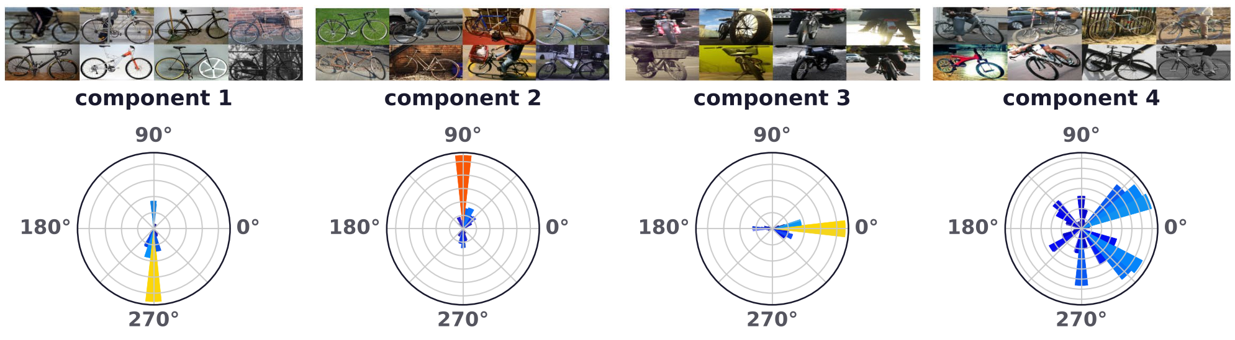
Generative model of features
Mixture components model object pose
Bicycles: training images with the highest likelihood for each of the four mixture components.
Below: their 3D viewpoints (azimuth), never used in training; bar length and colour count images.
Images with different 3D viewpoint are approximately separated into different components.
A. Kortylewski, Q. Liu, A. Wang, Y. Sun and A. Yuille, “Compositional convolutional neural networks: a robust and interpretable model for
object recognition under occlusion,” International Journal of Computer Vision, 129(3):736–760, 2021.
Neural Networks · A. Yuille
16

Slide 17
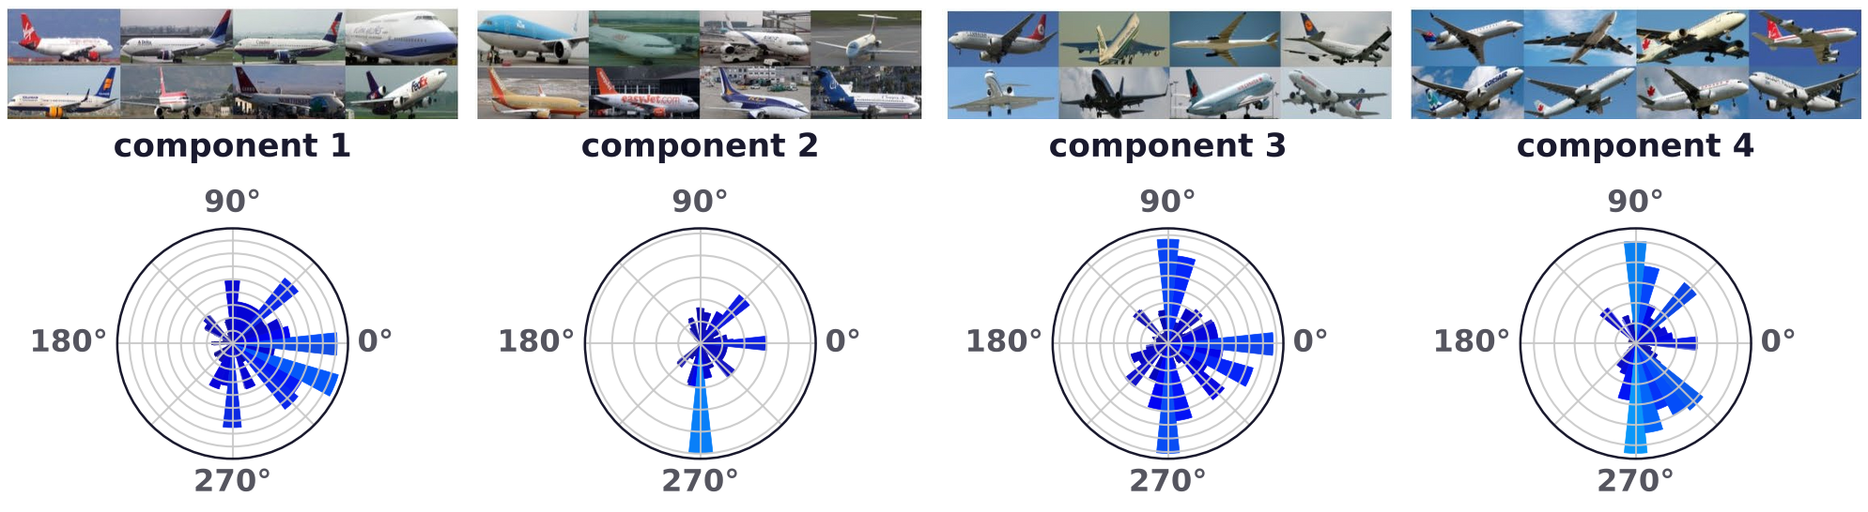
Generative model of features
Aeroplane components also follow the background
Components 1 and 2 hold aeroplanes on the ground; components 3 and 4 hold aeroplanes in the sky.
The split follows the background more than the viewpoint: the components also capture the context.
A. Kortylewski, Q. Liu, A. Wang, Y. Sun and A. Yuille, “Compositional convolutional neural networks: a robust and interpretable model for
object recognition under occlusion,” International Journal of Computer Vision, 129(3):736–760, 2021.
Neural Networks · A. Yuille
17

Slide 18
Robustness to occlusion
3
An outlier model competes with the object model at every position;
the occlusion map shows where the occluders are.
Neural Networks · A. Yuille
18

Slide 19
Robustness to occlusion
An outlier model explains the occluded positions
z = 1 at a position if its feature vector is generated by the occluder; z = 0 if by the object.
The occluder model p(f | β, Λ) uses the same vMF kernels with weights β that ignore the position.
p(z = 1), the prior probability that a position is occluded, is fixed in advance.
A simple model of what the object does not look like; z picks the larger of the two terms.
A. Kortylewski, J. He, Q. Liu and A. L. Yuille, “Compositional convolutional neural networks: a deep architecture with innate robustness
to partial occlusion,” CVPR, 8940–8949, 2020.
Neural Networks · A. Yuille
19

Slide 20
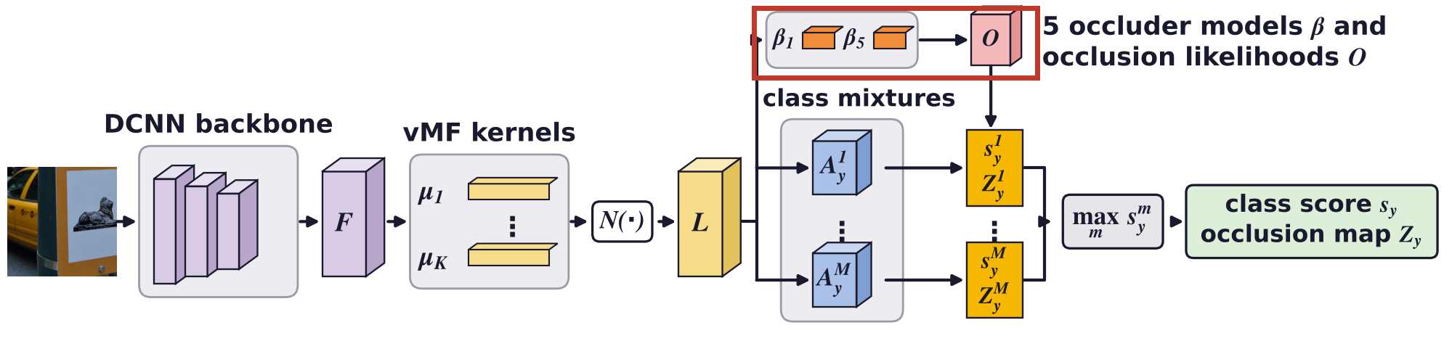
Robustness to occlusion
The outlier model is learnt from images without the objects
Occluder models: weights β on the vMF kernels, from clustered features of images without the objects.
Each component gives a class score and an occlusion map Z, the set of z's: where the outlier model wins.
A. Kortylewski, J. He, Q. Liu and A. L. Yuille, “Compositional convolutional neural networks: a deep architecture with innate robustness
to partial occlusion,” CVPR, 8940–8949, 2020.
Neural Networks · A. Yuille
20

Slide 21
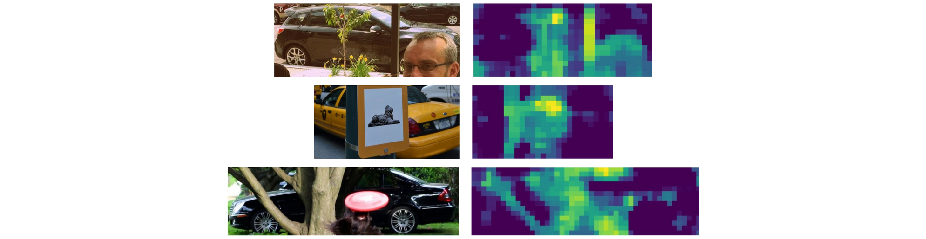
Robustness to occlusion
The object and outlier models compete at every position
At each position the larger likelihood wins; the maps show the occlusion score (bright: occluder).
This is the Bayesian test of Lecture 4, applied to feature vectors instead of filter responses.
A. Kortylewski, J. He, Q. Liu and A. L. Yuille, “Compositional convolutional neural networks: a deep architecture with innate robustness
to partial occlusion,” CVPR, 8940–8949, 2020.
Neural Networks · A. Yuille
21

Slide 22
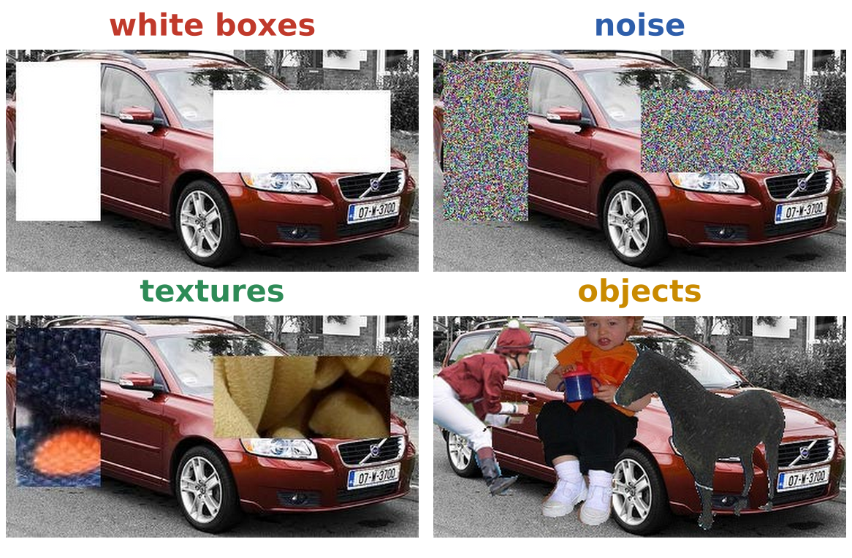
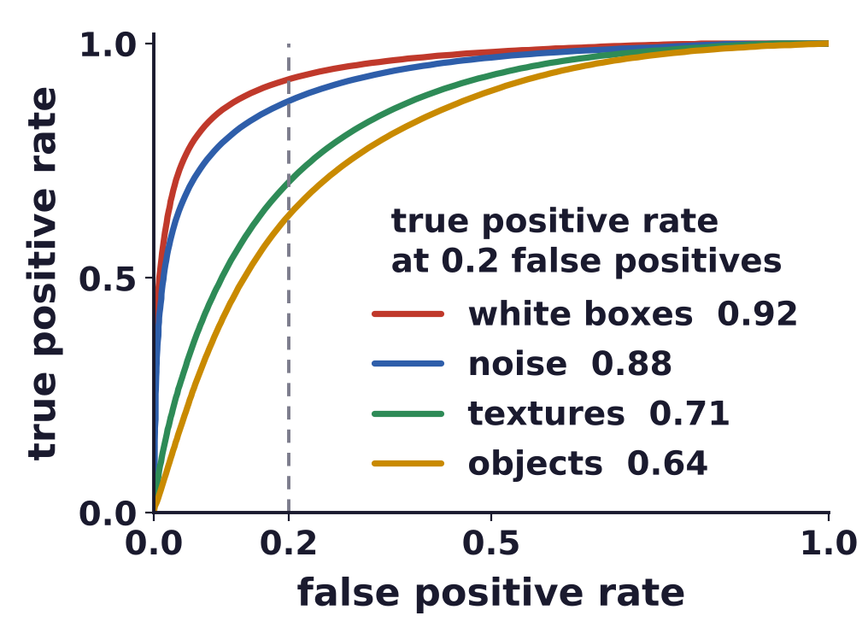
Robustness to occlusion
Occluders are localized well, natural objects least well
Occluded-Vehicles: PASCAL3D+ (3D-annotated) vehicles with four kinds of artificial occluders.
ROC (receiver operating characteristic): positive = occluded position, as the threshold moves.
A. Kortylewski, J. He, Q. Liu and A. L. Yuille, “Compositional convolutional neural networks: a deep architecture with innate robustness
to partial occlusion,” CVPR, 8940–8949, 2020.
J. Wang, Z. Zhang, C. Xie, J. Zhu, L. Xie and A. Yuille, “Detecting semantic parts on partially occluded objects,” BMVC, 2017.
Neural Networks · A. Yuille
22

Slide 23
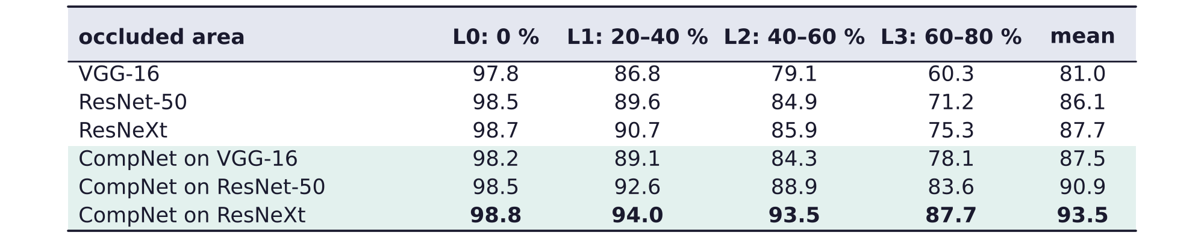
Robustness to occlusion
CompNets can classify partially occluded vehicles robustly
Trained on PASCAL3D+ vehicles without occlusion; tested on MS-COCO vehicles with real occlusion.
Backbones: VGG-16, ResNet-50 (residual network, 50 layers), ResNeXt (a ResNet with grouped layers).
Built on the same backbones, CompNets gain most where most of the object is occluded.
A. Kortylewski, Q. Liu, A. Wang, Y. Sun and A. Yuille, “Compositional convolutional neural networks: a robust and interpretable model for
object recognition under occlusion,” International Journal of Computer Vision, 129(3):736–760, 2021.
Y. Xiang, R. Mottaghi and S. Savarese, “Beyond PASCAL: a benchmark for 3D object detection in the wild,” WACV, 75–82, 2014.
Neural Networks · A. Yuille
23

Slide 24
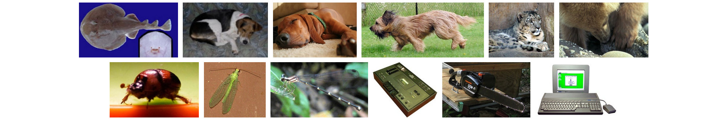
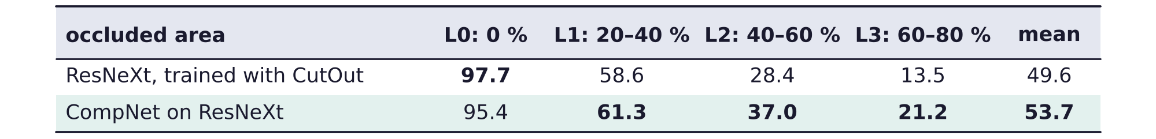
Robustness to occlusion
CompNets also gain on 50 occluded ImageNet classes
50 ImageNet classes (examples above), tested with artificial occluders, L1 to L3 as for vehicles.
CutOut erases random squares of the training images.
Best suited to object classes whose appearance a few mixture components can represent.
A. Kortylewski, Q. Liu, A. Wang, Y. Sun and A. Yuille, “Compositional convolutional neural networks: a robust and interpretable model for
object recognition under occlusion,” International Journal of Computer Vision, 129(3):736–760, 2021.
Neural Networks · A. Yuille
24

Slide 25
Detection under occlusion
4
Separate the context from the object,
and let the visible parts vote for the bounding box.
Neural Networks · A. Yuille
25

Slide 26
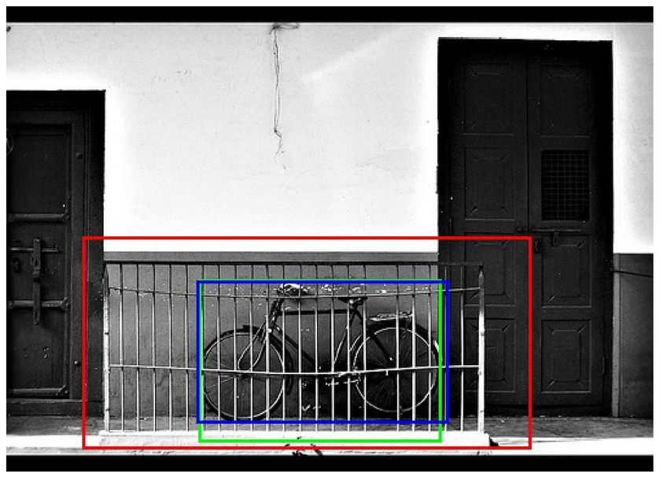
Detection under occlusion
DCNNs for object detection also generalize poorly
A bicycle behind a fence. Blue: ground truth; red: Faster R-CNN, a DCNN detector.
Green: a context-aware CompNet, which models the context separately from the object.
Faster R-CNN's box is far too large; the box of the context-aware CompNet is close to the truth.
A. Wang, Y. Sun, A. Kortylewski and A. L. Yuille, “Robust object detection under occlusion with context-aware CompositionalNets,”
CVPR, 12645–12654, 2020.
S. Ren, K. He, R. Girshick and J. Sun, “Faster R-CNN: towards real-time object detection with region proposal networks,” NIPS, 91–99, 2015.
Neural Networks · A. Yuille
26

Slide 27

Detection under occlusion
Context has too much influence when object is occluded
Blue: ground truth; orange: the original CompNet; green: the context-aware CompNet.
Training aeroplanes (right) are surrounded by sky: the CompNet learns the sky as part of the aeroplane.
The occluded aeroplane gets a box that covers the sky above it.
A. Wang, Y. Sun, A. Kortylewski and A. L. Yuille, “Robust object detection under occlusion with context-aware CompositionalNets,”
CVPR, 12645–12654, 2020.
Neural Networks · A. Yuille
27

Slide 28
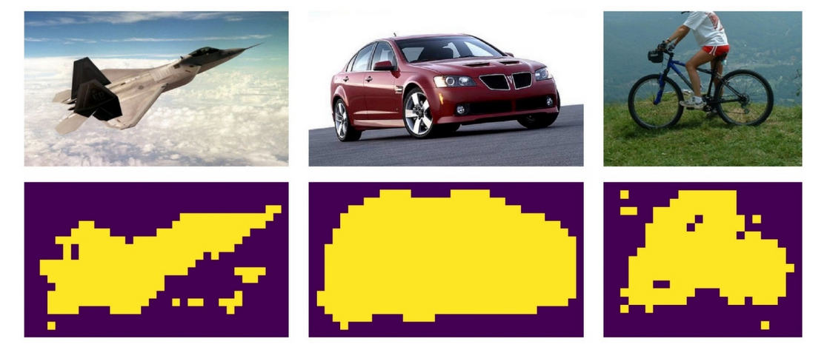
Detection under occlusion
Context-aware CompNets separate context and object
χ: a mixture model of the context; ω weighs it. ω = 0.5 gives the original CompNet; ω = 0 drops context.
Segment the training images: features close to clusters of background features are context.
Masks: yellow positions are the object, purple positions the context.
A. Wang, Y. Sun, A. Kortylewski and A. L. Yuille, “Robust object detection under occlusion with context-aware CompositionalNets,”
CVPR, 12645–12654, 2020.
Neural Networks · A. Yuille
28

Slide 29
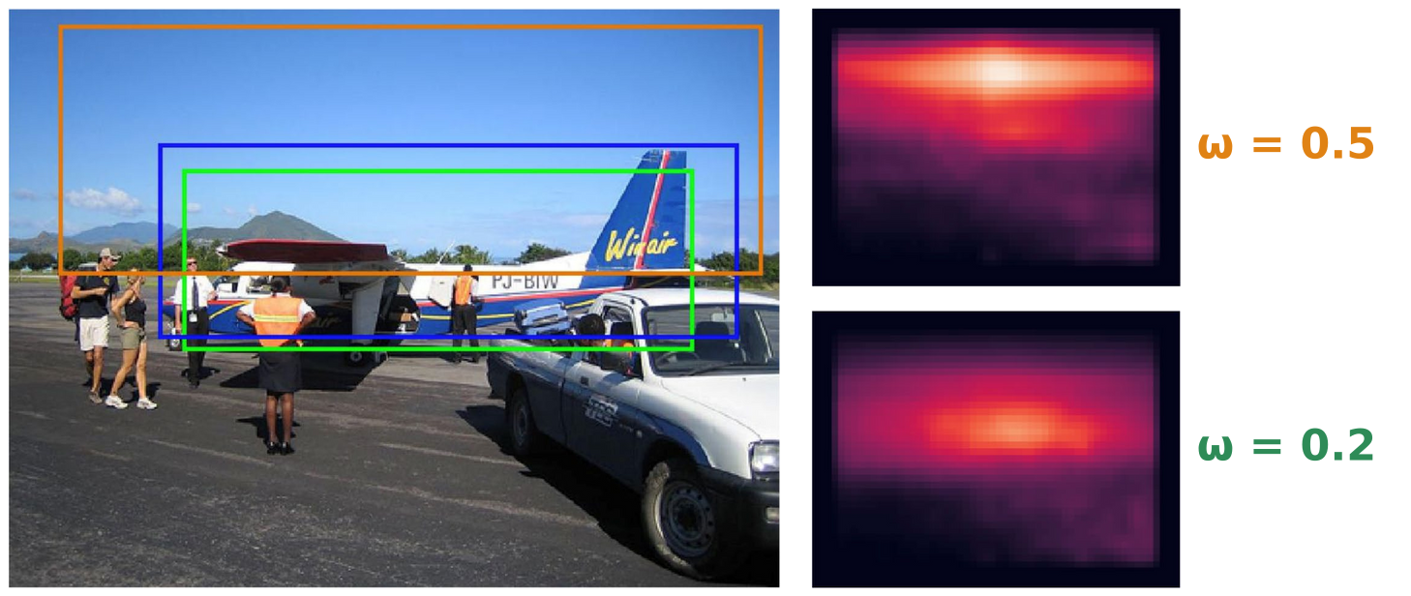
Detection under occlusion
Context-awareness improves localization
The two maps are the probability of the object centre at each position, for ω = 0.5 and ω = 0.2.
With ω = 0.5 the centre is pulled up into the sky; with ω = 0.2 it lies on the aeroplane.
Bounding box voting (BBV): the visible parts vote for the centre and two opposite corners of the box.
A. Wang, Y. Sun, A. Kortylewski and A. L. Yuille, “Robust object detection under occlusion with context-aware CompositionalNets,”
CVPR, 12645–12654, 2020.
Neural Networks · A. Yuille
29

Slide 30
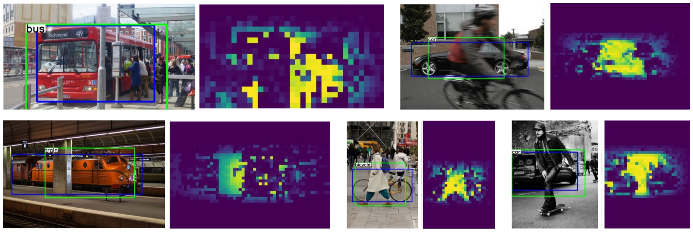
Detection under occlusion
The outlier model also localizes occluders in detection
Occlusion maps of the context-aware CompNet on MS-COCO; yellow: explained by the outlier model.
People in front of the bus, a cyclist in front of the car and a pillar in front of the train are found.
Boxes: blue ground truth, green CompNet, with the class label.
A. Wang, Y. Sun, A. Kortylewski and A. L. Yuille, “Robust object detection under occlusion with context-aware CompositionalNets,”
CVPR, 12645–12654, 2020.
A. Kortylewski, Q. Liu, A. Wang, Y. Sun and A. Yuille, “Compositional convolutional neural networks: a robust and interpretable model for
object recognition under occlusion,” International Journal of Computer Vision, 129(3):736–760, 2021.
Neural Networks · A. Yuille
30

Slide 31
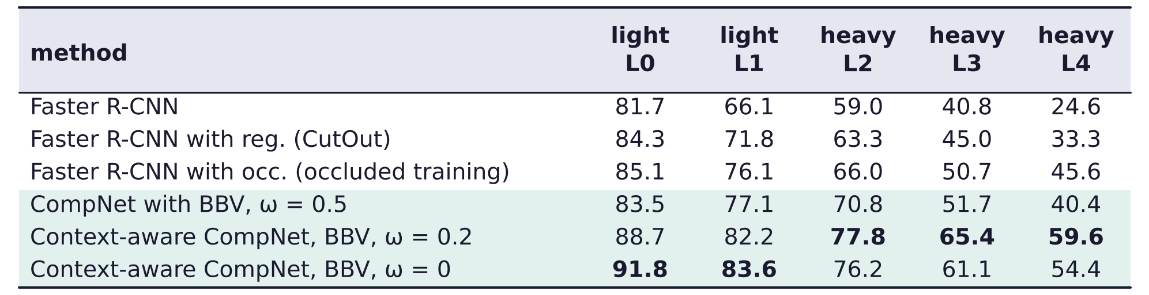
Detection under occlusion
Context-aware CompNets detect occluded vehicles best
AP (average precision, %) on MS-COCO vehicles, by occlusion level from L0 (lightest) to L4 (heaviest).
Boxes: blue ground truth, red Faster R-CNN, yellow CompNet on proposed regions, green context-aware.
A. Wang, Y. Sun, A. Kortylewski and A. L. Yuille, “Robust object detection under occlusion with context-aware CompositionalNets,”
CVPR, 12645–12654, 2020.
Neural Networks · A. Yuille
31

Slide 32
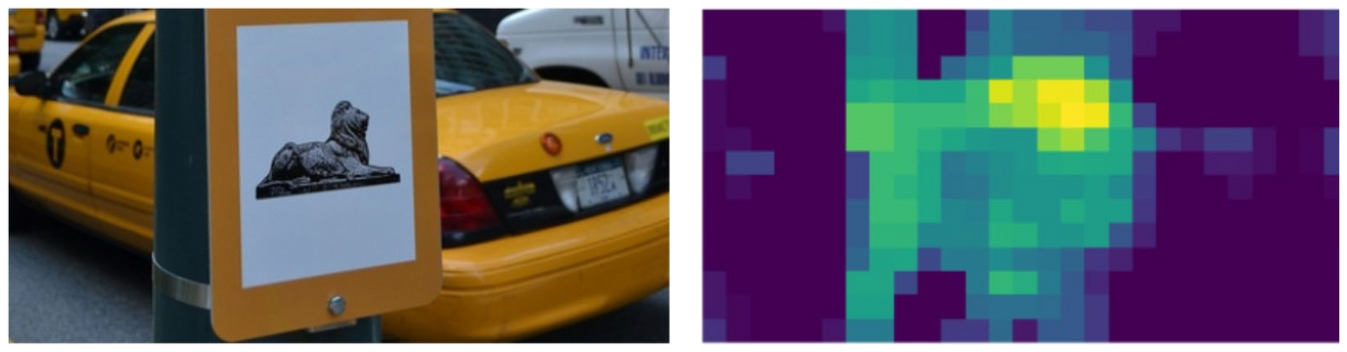
Detection under occlusion
Prior knowledge in the network narrows the complexity gap
Partial occlusion introduces exponential complexity in the data: a gap that no dataset covers.
The gap can be overcome by prior knowledge about compositionality, occlusion and context.
Generalization beyond the training data in terms of partial occlusion and context.
High discriminative performance is retained thanks to end-to-end training.
Future work: articulated objects, 3D geometry, top-down reasoning, scale.
Neural Networks · A. Yuille
32

Slide 33
Three additional projects
5
CompNets resist patch attacks, segment amodal shapes without masks,
and reason about which object occludes which.
Neural Networks · A. Yuille
33

Slide 34
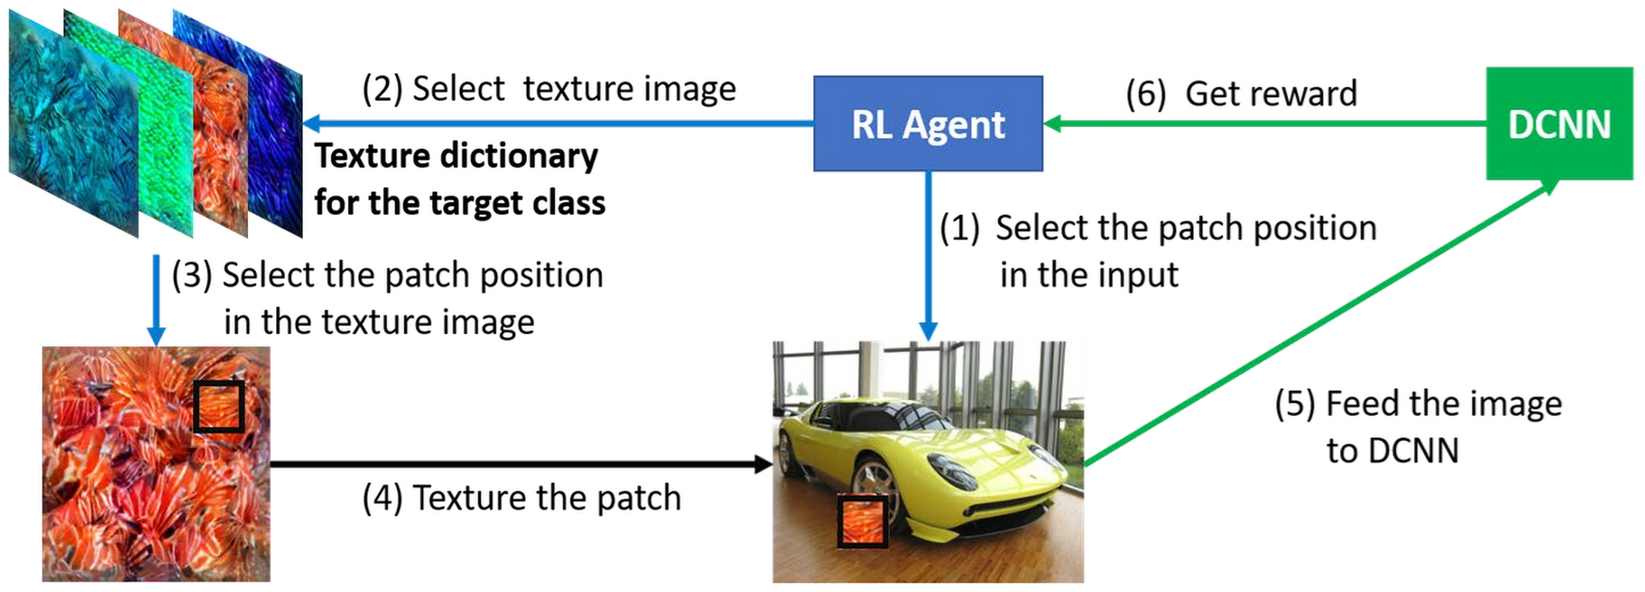
Three additional projects
Patch attacks fool deep nets with a few textured patches
Evaluate algorithms by modifying the input adaptively to make them fail: an adversarial examiner.
PatchAttack (Lecture 11): a black-box policy learnt by reinforcement; over 90 % targeted success.
This suggests that deep nets lack knowledge of the spatial structure of objects.
C. Yang, A. Kortylewski, C. Xie, Y. Cao and A. Yuille, “PatchAttack: a black-box texture-based attack with reinforcement learning,”
ECCV, LNCS 12371, 681–698, 2020.
Neural Networks · A. Yuille
34

Slide 35
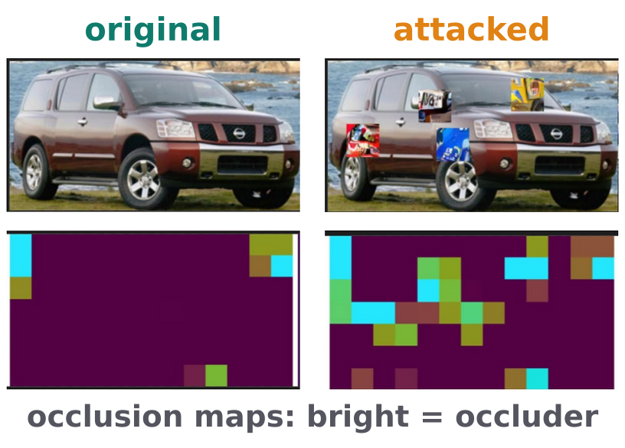
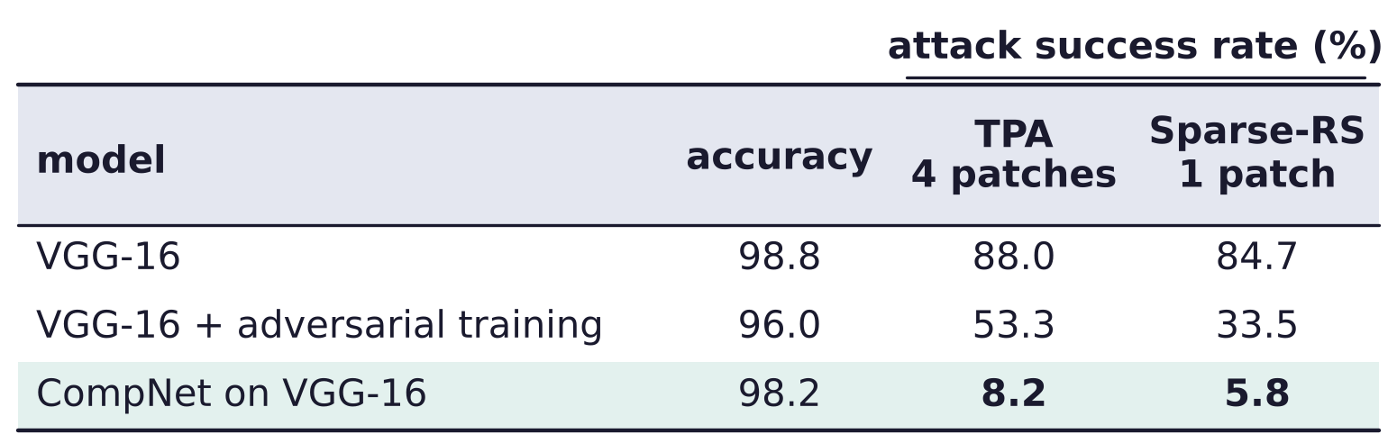
Three additional projects
CompNets are robust to patch attacks out of the box
CompNets know the spatial structure of objects; their outlier model can reject the attacking patches.
Targeted attacks on at most 10 % of the image: texture patches (TPA) or random search (Sparse-RS).
Both succeed an order of magnitude less often on CompNets than on VGG-16; the maps localize them.
C. Cosgrove, A. Kortylewski, C. Yang and A. Yuille, “Robustness out of the box: compositional representations naturally defend against
black-box patch attacks,” arXiv:2012.00558, 2020.
F. Croce, M. Andriushchenko, N. D. Singh, N. Flammarion and M. Hein, “Sparse-RS: a versatile framework for query-efficient sparse black-box
adversarial attacks,” AAAI, 36(6):6437–6445, 2022.
Neural Networks · A. Yuille
35

Slide 36
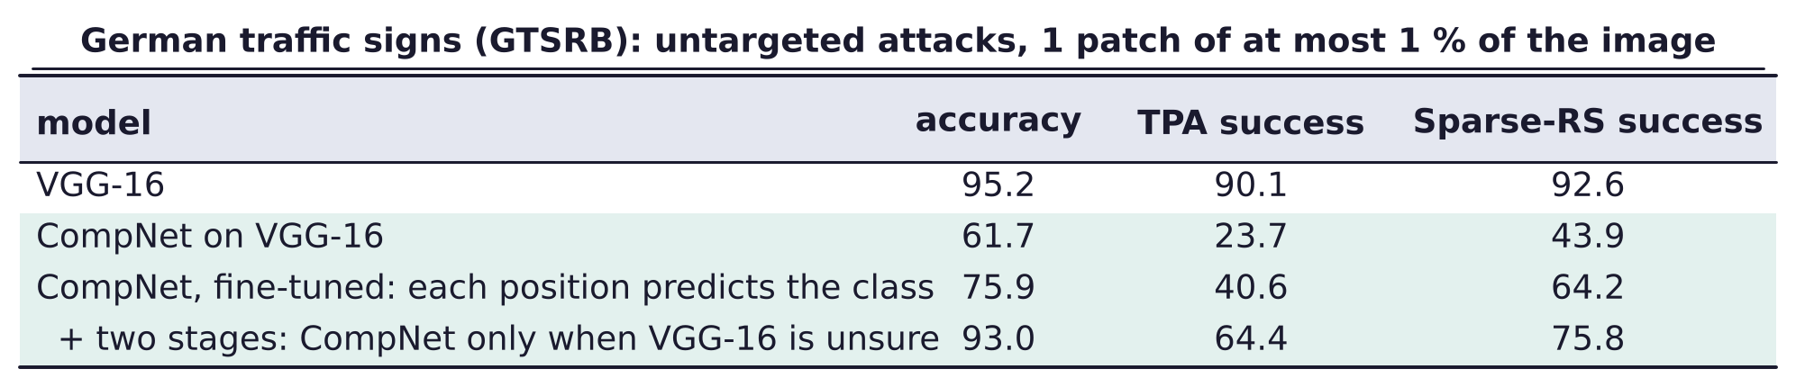
Three additional projects
CompNets need finer detail for similar traffic signs
CompNets were less effective for fine-scale discrimination, e.g. speed limit 60 versus 80.
They are generative on high-level features, invariant to low-level details: coarse geometry only.
Supplement coarse CompNets with fine-scale CompNets at lower levels, with more detailed geometry.
Bottom-up processing seeks invariant features; top-down is needed for higher resolution.
C. Cosgrove, A. Kortylewski, C. Yang and A. Yuille, “Robustness out of the box: compositional representations naturally defend against
black-box patch attacks,” arXiv:2012.00558, 2020.
J. Stallkamp, M. Schlipsing, J. Salmen and C. Igel, “Man vs. computer: benchmarking machine learning algorithms for traffic sign recognition,”
Neural Networks, 32:323–332, 2012.
T. S. Lee and D. Mumford, “Hierarchical Bayesian inference in the visual cortex,” JOSA A, 20(7):1434–1448, 2003.
Neural Networks · A. Yuille
36

Slide 37
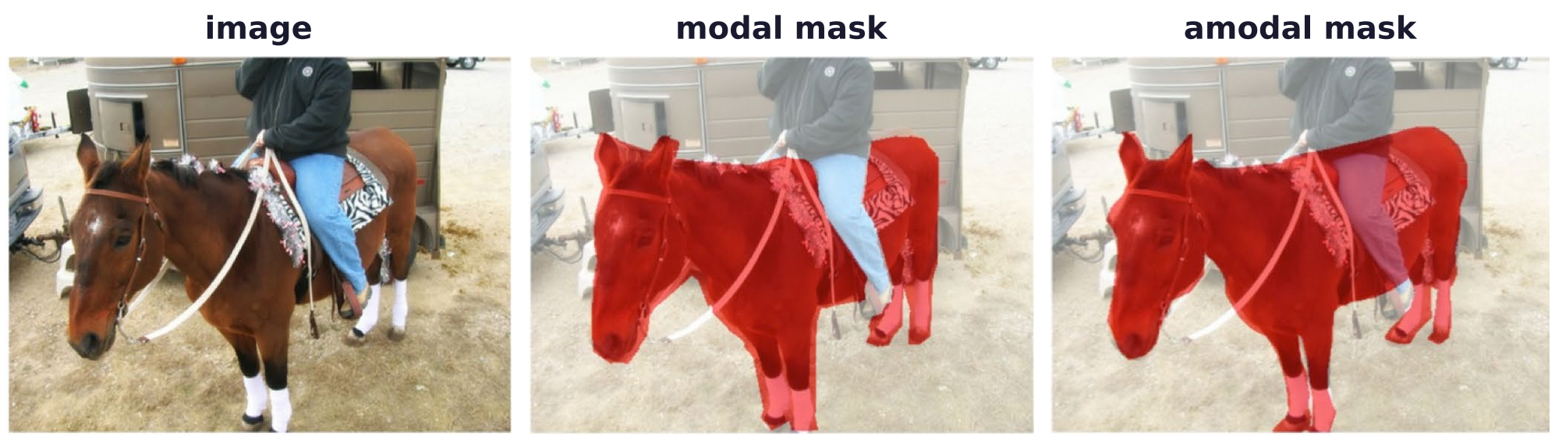
Three additional projects
CompNets find modal and amodal boundaries without masks
Modal boundaries are the ones you can see; amodal boundaries include the occluded parts (example).
Trained on bounding boxes only, CompNets estimate the foreground by log-likelihood ratio tests.
Most amodal methods assume annotated visible segmentations in training; CompNets do not.
Y. Sun, A. Kortylewski and A. Yuille, “Weakly-supervised amodal instance segmentation with compositional priors,” arXiv:2010.13175, 2020.
Neural Networks · A. Yuille
37

Slide 38
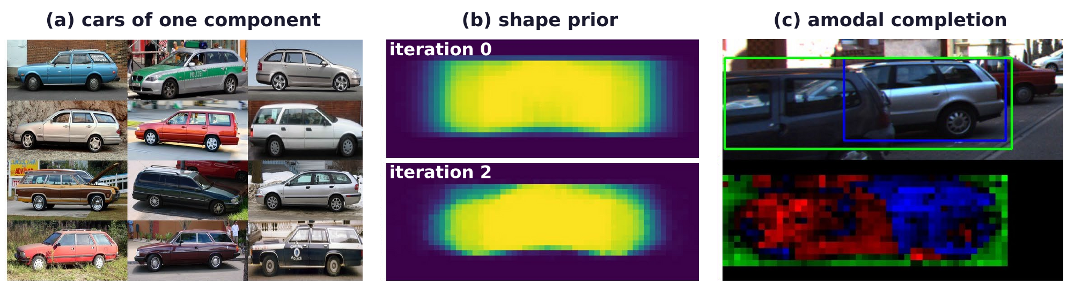
Three additional projects
A shape prior for each viewpoint completes occluded objects
Learn a prior for the boundary of the object, conditioned on the mixture component (viewpoint).
EM (Lecture 8): initialize the modal and amodal boundaries from the foreground / background estimate.
(c) Boxes: visible (blue), amodal (green); pixels: blue object, red occluder, green context.
Y. Sun, A. Kortylewski and A. Yuille, “Weakly-supervised amodal instance segmentation with compositional priors,” arXiv:2010.13175, 2020.
Neural Networks · A. Yuille
38

Slide 39
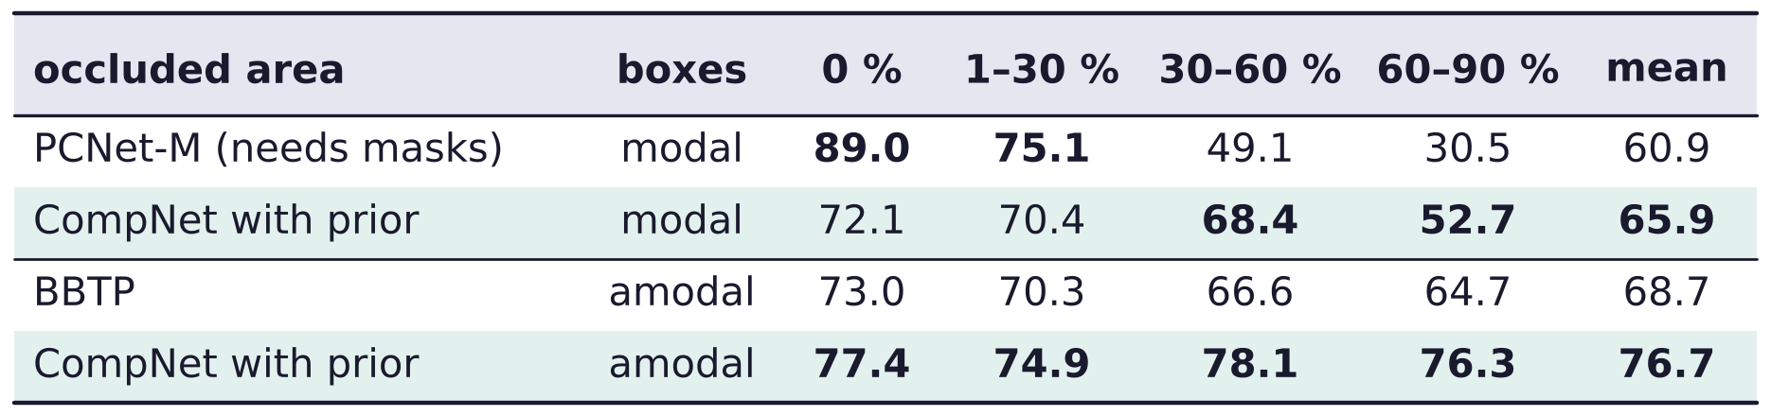
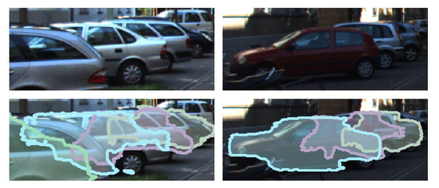
Three additional projects
CompNets segment heavily occluded vehicles best
KINS: vehicles in KITTI street scenes (Karlsruhe and Toyota institutes), with amodal masks.
Mean IoU (intersection over union, %) of the amodal masks, by the occluded area of the vehicle.
Boxes: modal or amodal training boxes. PCNet-M (partial completion network) also needs masks.
Multi-task consistency: one model classifies the object and estimates its modal and amodal shape.
Y. Sun, A. Kortylewski and A. Yuille, “Weakly-supervised amodal instance segmentation with compositional priors,” arXiv:2010.13175, 2020.
L. Qi, L. Jiang, S. Liu, X. Shen and J. Jia, “Amodal instance segmentation with KINS dataset,” CVPR, 3014–3023, 2019.
X. Zhan, X. Pan, B. Dai, Z. Liu, D. Lin and C. C. Loy, “Self-supervised scene de-occlusion,” CVPR, 3784–3792, 2020.
C.-C. Hsu, K.-J. Hsu, C.-C. Tsai, Y.-Y. Lin and Y.-Y. Chuang, “Weakly supervised instance segmentation using the bounding box tightness
prior,” NeurIPS, 6586–6597, 2019.
Neural Networks · A. Yuille
39

Slide 40
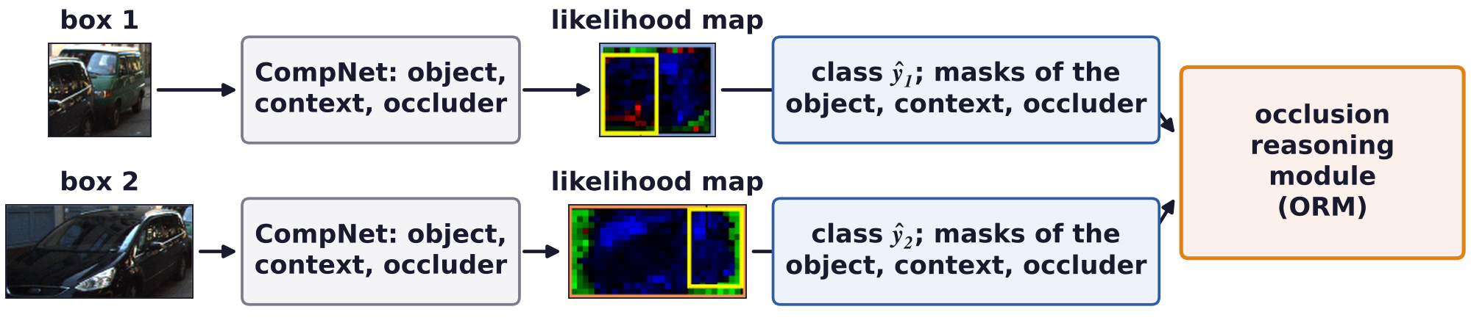
Three additional projects
Multi-object occlusion is hard to resolve purely bottom-up
CompNets assumed a single object, which could be occluded; often one object partly occludes another.
Bottom-up: a CompNet per box gives likelihood maps: blue object, red occluder, green context.
Top-down: the occlusion reasoning module (ORM) finds the most consistent interpretation.
This relates to reading CAPTCHAs (distorted, overlapping letters); only boxes are annotated.
X. Yuan, A. Kortylewski, Y. Sun and A. Yuille, “Robust instance segmentation through reasoning about multi-object occlusion,”
CVPR, 11141–11150, 2021.
D. George, W. Lehrach, K. Kansky, M. Lázaro-Gredilla et al., “A generative vision model that trains with high data efficiency and breaks
text-based CAPTCHAs,” Science, 358(6368):eaag2612, 2017.
Neural Networks · A. Yuille
40

Slide 41
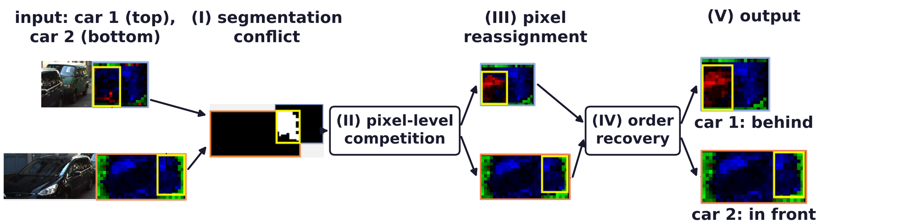
Three additional projects
The ORM resolves conflicts and recovers the occlusion order
(I) Conflict (white): pixels that both car models claim as foreground, in the overlap of the boxes (yellow).
(II–III) Each conflict pixel goes to the more likely car model, or to the occluder model.
(IV) Order: the car that wins more of the conflict pixels is in front, the other is behind it.
X. Yuan, A. Kortylewski, Y. Sun and A. Yuille, “Robust instance segmentation through reasoning about multi-object occlusion,”
CVPR, 11141–11150, 2021.
A. Geiger, P. Lenz and R. Urtasun, “Are we ready for autonomous driving? The KITTI vision benchmark suite,” CVPR, 3354–3361, 2012.
Neural Networks · A. Yuille
41

Slide 42
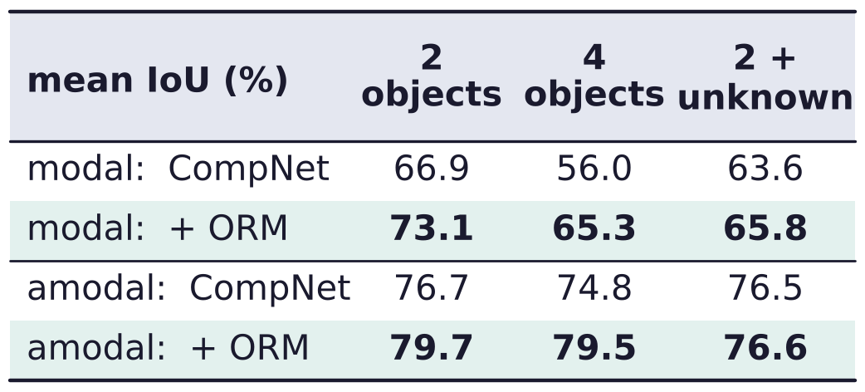
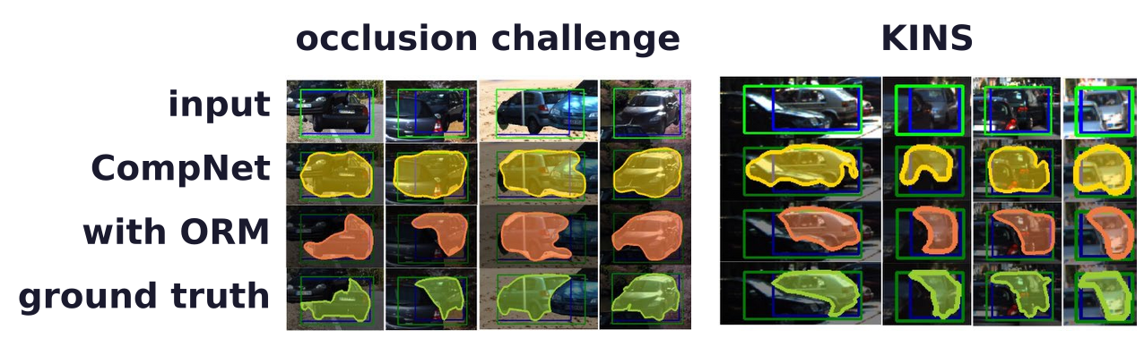
Three additional projects
Reasoning about occlusion improves the instance masks
Occlusion challenge: KITTI cars on random backgrounds: 2 cars, 4 cars, or 2 cars + unknown occluders.
Mean IoU over all occlusion levels; ORM: occlusion reasoning module.
On KINS, Mask R-CNN (a region-based DCNN trained with masks) is better on modal masks.
This is simpler than the methods used for CAPTCHAs; it needs extending to harder conditions.
X. Yuan, A. Kortylewski, Y. Sun and A. Yuille, “Robust instance segmentation through reasoning about multi-object occlusion,”
CVPR, 11141–11150, 2021.
K. He, G. Gkioxari, P. Dollár and R. Girshick, “Mask R-CNN,” ICCV, 2961–2969, 2017.
Neural Networks · A. Yuille
42

Slide 43
Three additional projects
Summary
Analysis by synthesis, approximately: CompNets are generative models of deep-network features.
Deep nets trained without occlusion fail under occlusion; augmentation closes only part of the gap.
A CompNet mixes viewpoints of spatial mixtures of vMF kernels; the kernels resemble part detectors.
Inference is a feed-forward network; kernels and mixtures are trained end to end by backpropagation.
An outlier model competes with the object model at every position and so localizes the occluders.
Separating context from object, and voting for the box, makes detection robust to occlusion.
CompNets resist patch attacks out of the box, but need finer detail for fine-grained classes.
Shape priors give amodal boundaries; occlusion reasoning orders several overlapping objects.
Neural Networks · A. Yuille
43

