Slide 1
Compositional (Semantic)
Models and Unsupervised
Graph Structure Learning
8 October, 2026
Alan Yuille · Probabilistic Models of the Visual Cortex

Slide 2
What this lecture covers
1
Compositional models
2
AND/OR graphs
Objects, parts, subparts as a graph
ANDs compose parts, ORs switch them
3
Learning from interest points
4
Learning a hierarchy
PGMMs grow a grammar of triplets
Unsupervised, level by level
5
Part sharing for many objects
120 object and viewpoint models
Neural Networks · A. Yuille
2

Slide 3
Compositional models
1
Objects are built from semantic parts and subparts;
a probability model on a hierarchical graph.
Neural Networks · A. Yuille
3

Slide 4
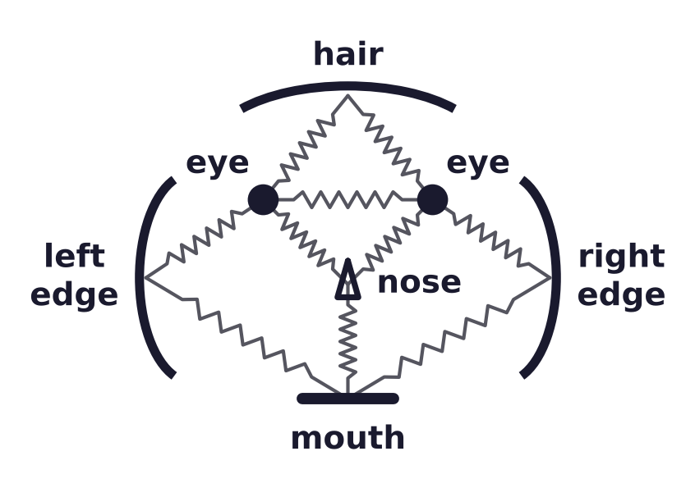
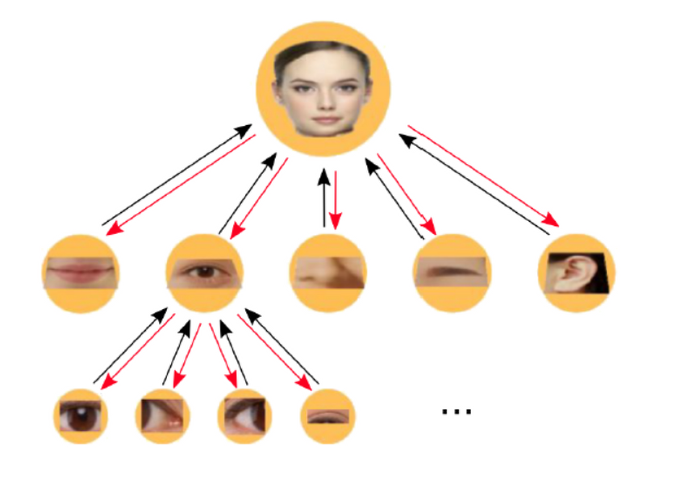
Compositional models
Objects and semantic parts
Objects can be represented by parts and their spatial relations (pictorial structures: left).
Hierarchical semantic compositional models: objects, parts, subparts (right).
Springs hold the parts in place; black arrows run bottom-up, red arrows top-down.
Semantic: the parts are interpretable (an eye or a nose, not an arbitrary patch of the object).
M. A. Fischler and R. A. Elschlager, “The representation and matching of pictorial structures,” IEEE Transactions on Computers,
C-22(1):67–92, 1973.
Neural Networks · A. Yuille
4

Slide 5
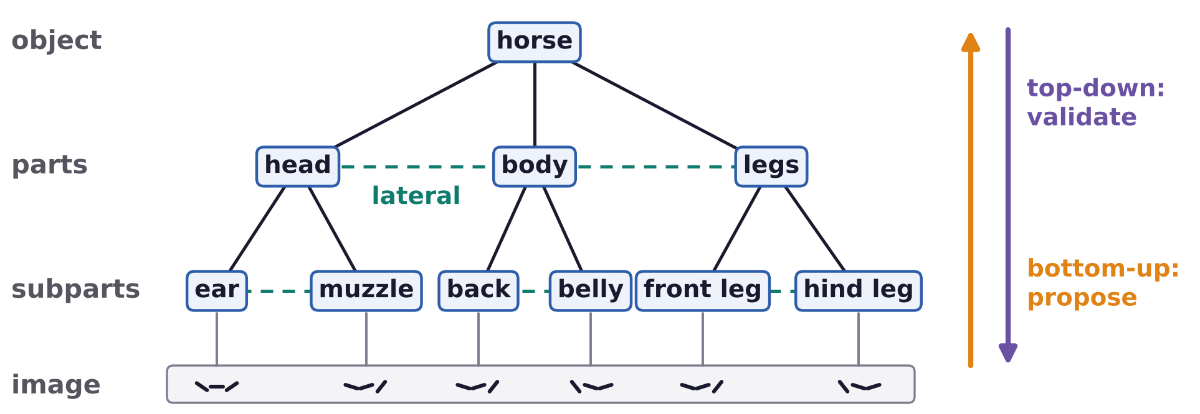
Compositional models
A hierarchical compositional model is a graph of parts
Explainable: if an object is detected, you can explain which parts and subparts are present.
Multiple tasks: detect and localize objects, parts, subparts and the object boundaries.
Inference is bottom-up and top-down, and requires sideways (lateral) reasoning.
The parts, subparts and the relationships between them need to be learnt.
Neural Networks · A. Yuille
5

Slide 6
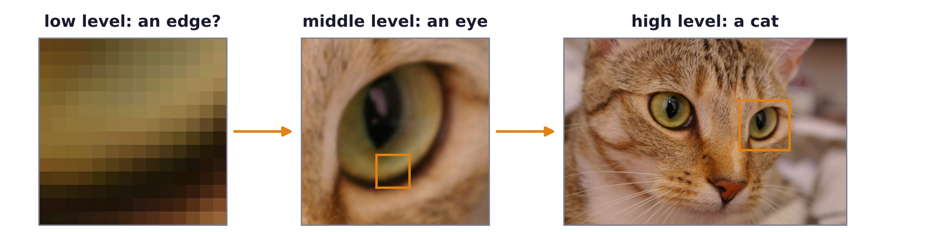
Compositional models
Hierarchies follow low-, middle- and high-level vision
Low-level vision is ambiguous; high-level vision exploits context and is unambiguous.
Hierarchies mimic the structure of the human / primate ventral visual system.
An optimal design for representing, learning and retrieving image patterns?
Photograph: “chelsea”, scikit-image sample data (CC0).
Neural Networks · A. Yuille
6

Slide 7
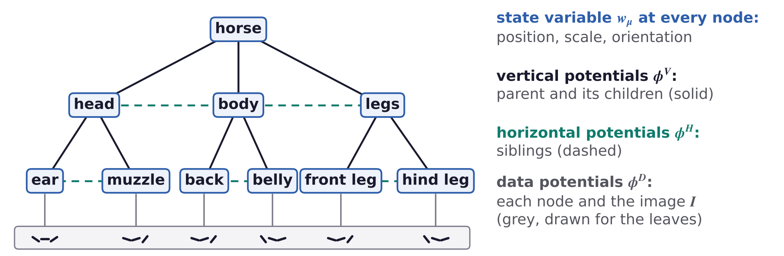
Compositional models
A probabilistic model is defined by four elements
(i) Graph structure: nodes and edges. (ii) State variables W at the nodes: the representation.
(iii) Potentials φ and (iv) parameters (weights) λ, on the edges: the probability.
The potentials and parameters also relate the model to the image I.
L. Zhu, Y. Chen and A. Yuille, “Recursive compositional models for vision: description and review of recent work,”
Journal of Mathematical Imaging and Vision, 41(1–2):122–146, 2011.
Neural Networks · A. Yuille
7

Slide 8
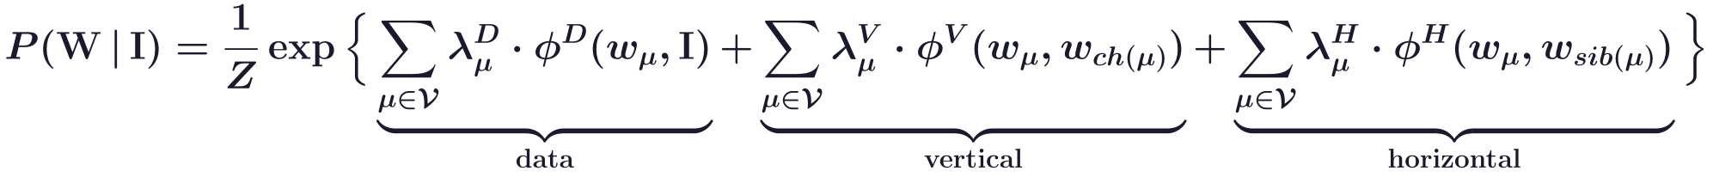
Compositional models
The mathematics: an exponential model on the graph
Each node μ has a state w; ch(μ) are its children and sib(μ) its siblings, with their states.
Vertical potentials relate a part to its subparts, horizontal ones a part to its siblings.
Data potentials relate the nodes to the image I; the weights λ say how much each term counts.
Z = Z[λ, I] normalises over all states W: a Gibbs distribution with energy E = −Σ λ · φ.
L. Zhu, Y. Chen and A. Yuille, “Recursive compositional models for vision: description and review of recent work,”
Journal of Mathematical Imaging and Vision, 41(1–2):122–146, 2011.
Neural Networks · A. Yuille
8

Slide 9
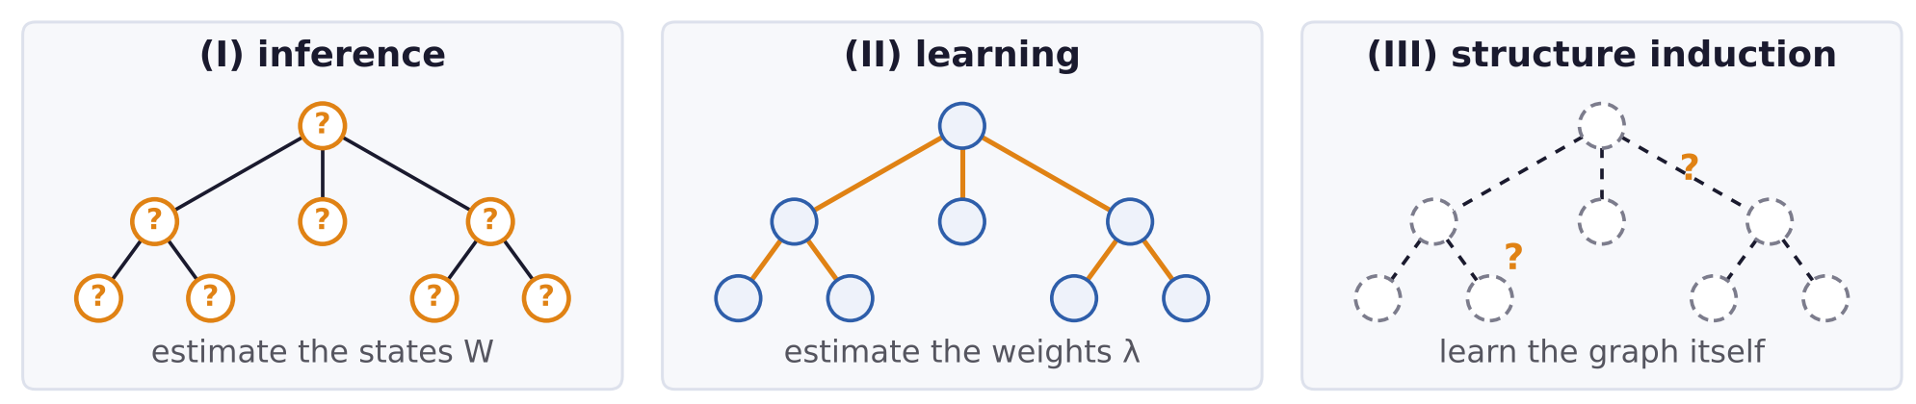
Compositional models
Three tasks: inference, learning and structure induction
(I) Inference: estimate W from I, with the graph, potentials and parameters known.
Propagate hypotheses up and validate them top-down (dynamic programming as a special case).
(II) Learning the parameters and potentials, with the graph known: easy if inference can be done.
(III) Structure induction: learn the graph structure.
Neural Networks · A. Yuille
9

Slide 10
AND/OR graphs
2
AND nodes compose parts, OR nodes switch between alternatives;
one graph covers many poses and viewpoints.
Neural Networks · A. Yuille
10

Slide 11
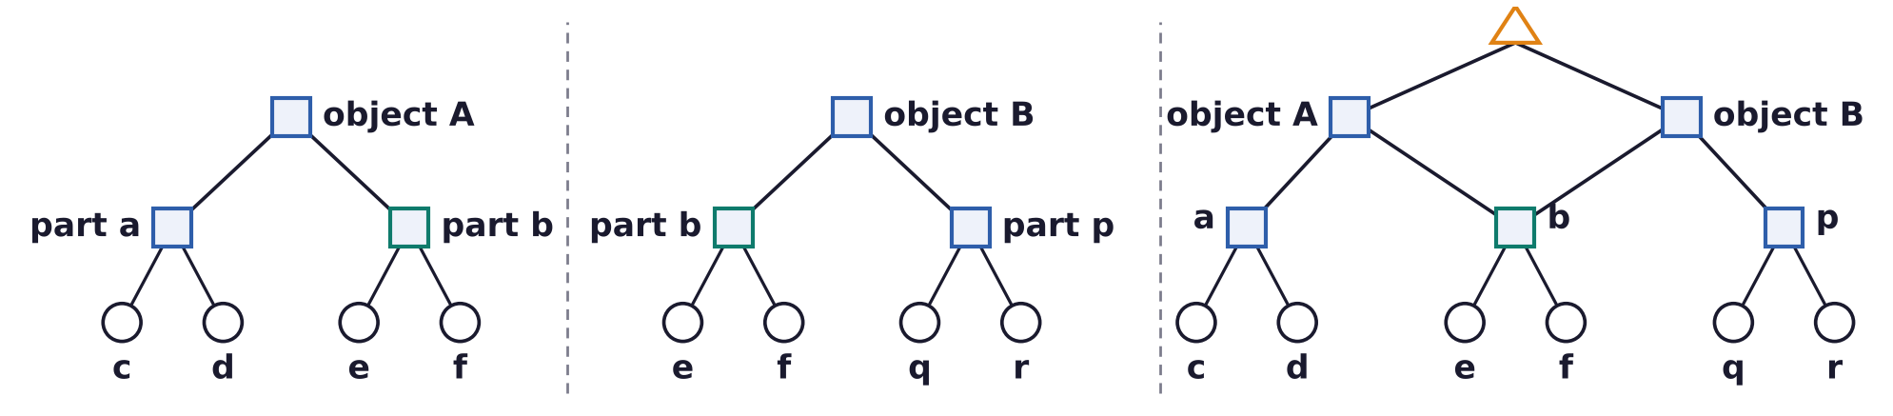
AND/OR graphs
Compositionality: objects are built from shared parts
Objects and images are constructed by compositions of parts: ANDs (squares) and ORs (triangle).
The probability models are built by combining elementary models (circles) by composition.
Sharing parts (b, teal) makes inference and learning efficient.
This relates to the stochastic grammars used in natural language processing.
L. Zhu, Y. Chen, A. Torralba, W. Freeman and A. Yuille, “Part and appearance sharing: recursive compositional models for multi-view
multi-object detection,” CVPR, 1919–1926, 2010.
S.-C. Zhu and D. Mumford, “A stochastic grammar of images,” Foundations and Trends in Computer Graphics and Vision, 2(4):259–362, 2007.
Neural Networks · A. Yuille
11

Slide 12
AND/OR graphs
Compositionality lets a system transfer, reason and scale up
“An embodiment of faith that the world is knowable, that one can tease things apart,
comprehend them, and mentally recompose them at will.”
(1) Transfer between contexts, and generalize or extrapolate (e.g. from cow to yak).
(2) Reason about the system, intervene, do diagnostics.
(3) Answer many different questions based on the same underlying knowledge structure.
(4) Scale up to multiple objects by part sharing.
“The world is compositional or God exists.” (Stuart Geman)
A. L. Yuille and C. Liu, “Deep nets: what have they ever done for vision?,” International Journal of Computer Vision, 129(3):781–802, 2021.
Neural Networks · A. Yuille
12

Slide 13
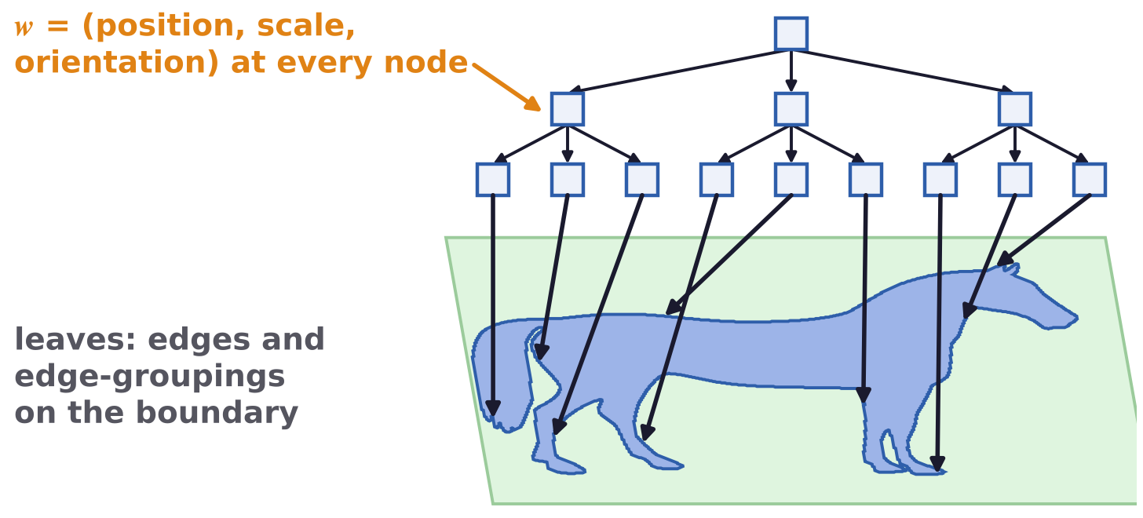
AND/OR graphs
A horse model with AND nodes only
Nodes of the graph represent parts of the object; lower-level parts are edges and edge-groupings.
Parts can move and deform: each node has a state w = (position, scale, orientation).
A single topology: one model for one pose and viewpoint.
L. Zhu, Y. Chen and A. Yuille, “Learning a hierarchical deformable template for rapid deformable object parsing,”
IEEE Transactions on Pattern Analysis and Machine Intelligence, 32(6):1029–1043, 2010.
Horse silhouette: “horse”, scikit-image sample data (CC0).
Neural Networks · A. Yuille
13

Slide 14
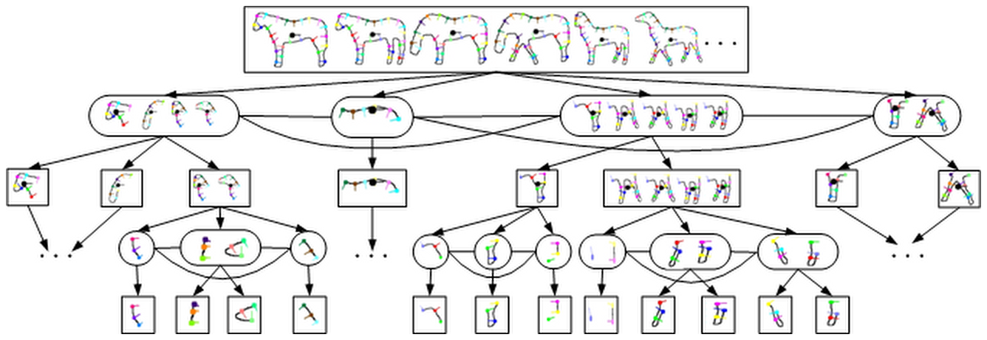
AND/OR graphs
AND/OR graphs switch between parts for different poses
Introduce OR nodes (ellipses) and switch variables: each OR node selects one of its children.
The switch variables alter the graph topology: different parts for different viewpoints and poses.
Mixtures of models, with shared parts; rectangles are AND nodes.
L. Zhu, Y. Chen, C. Lin and A. Yuille, “Max margin learning of hierarchical configural deformable templates (HCDTs) for efficient object
parsing and pose estimation,” International Journal of Computer Vision, 93(1):1–21, 2011.
Neural Networks · A. Yuille
14

Slide 15
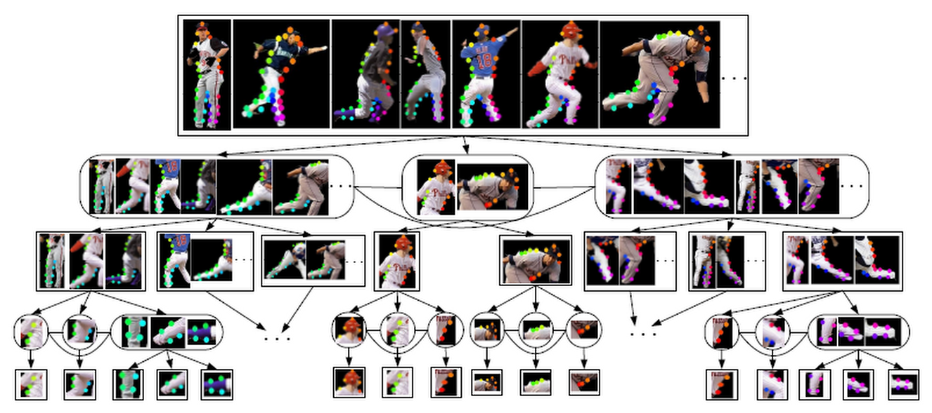
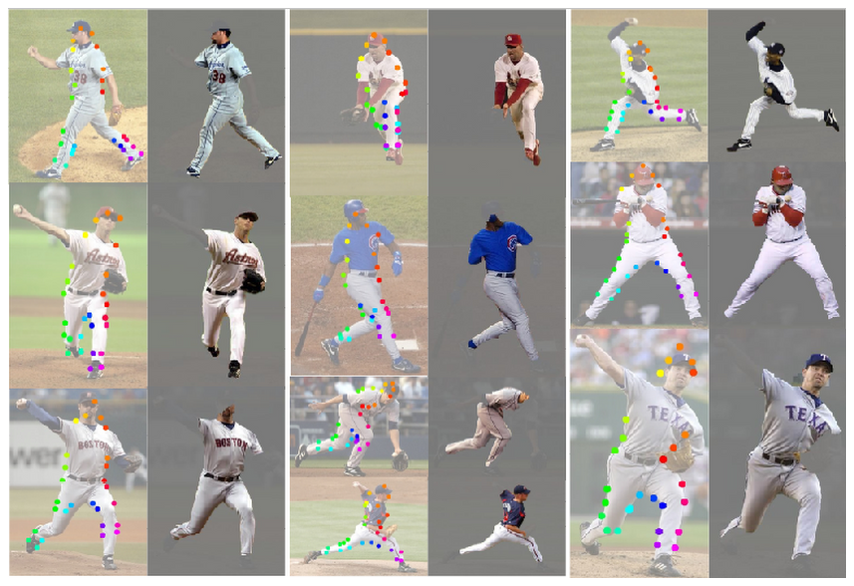
AND/OR graphs
AND/OR graphs parse baseball players in 98 poses
AND/OR graphs enable recursive compositional models (RCMs) to deal with many poses and viewpoints.
Ellipses: OR nodes; rectangles: AND nodes. Inference and learning are bottom-up and top-down.
Performed well on benchmarked datasets (2008, 2010). Coloured dots: positions of body parts.
L. Zhu, Y. Chen, Y. Lu, C. Lin and A. Yuille, “Max margin AND/OR graph learning for parsing the human body,” CVPR, 1–8, 2008.
L. Zhu, Y. Chen, C. Lin and A. Yuille, “Max margin learning of hierarchical configural deformable templates (HCDTs) for efficient object
parsing and pose estimation,” International Journal of Computer Vision, 93(1):1–21, 2011.
Neural Networks · A. Yuille
15

Slide 16
AND/OR graphs
HCMs are hard to learn but worth pursuing
HCMs (hierarchical compositional models) need more complex inference and learning than deep nets.
Structure learning is particularly difficult.
Their advantages (interpretability, multi-tasking) are so strong that they should be pursued.
Potential: the ability to deal with domain transfer and with sophisticated attacks.
CompNets combine compositional models with deep network features.
Neural Networks · A. Yuille
16

Slide 17
Learning from interest points
3
Learn the graph itself, without labels:
grow it triplet by triplet while the data are fitted better.
Neural Networks · A. Yuille
17

Slide 18
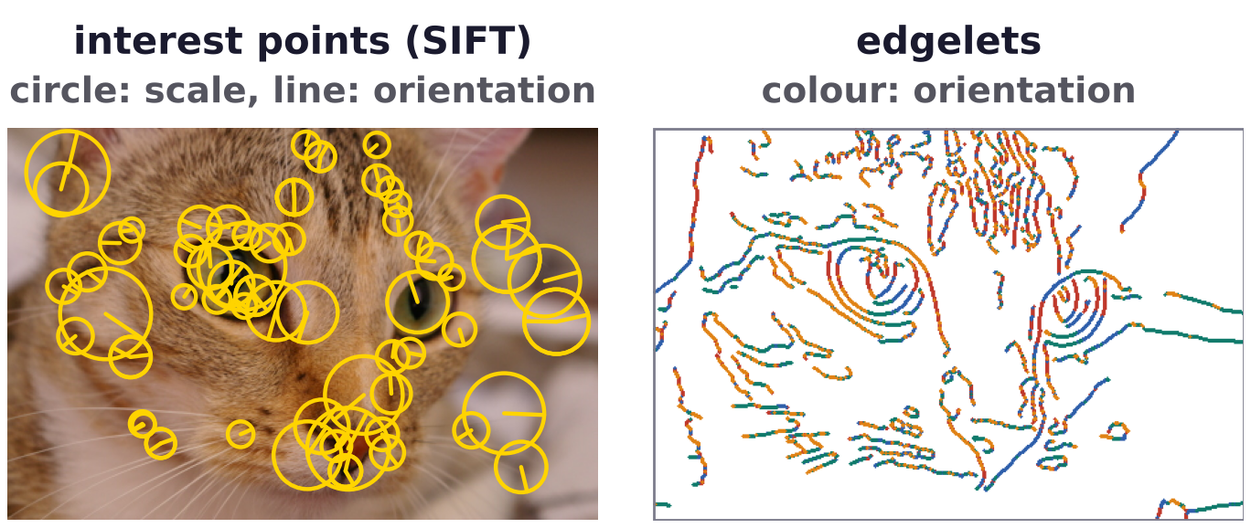
Learning from interest points
Learn models of simple features: interest points, edgelets
Learning generative models of entire images was too hard (2008); structure induction is very hard.
To simplify, learn models of objects (not images) on simple features: interest points (IPs) and edgelets.
IPs are sparse and capture the important parts; SIFT (scale-invariant feature transform) describes them.
Intuition for structure learning: clustering.
T. Kadir and M. Brady, “Saliency, scale and image description,” International Journal of Computer Vision, 45(2):83–105, 2001.
D. G. Lowe, “Distinctive image features from scale-invariant keypoints,” International Journal of Computer Vision, 60(2):91–110, 2004.
Photograph: “chelsea”, scikit-image sample data (CC0).
Neural Networks · A. Yuille
18

Slide 19
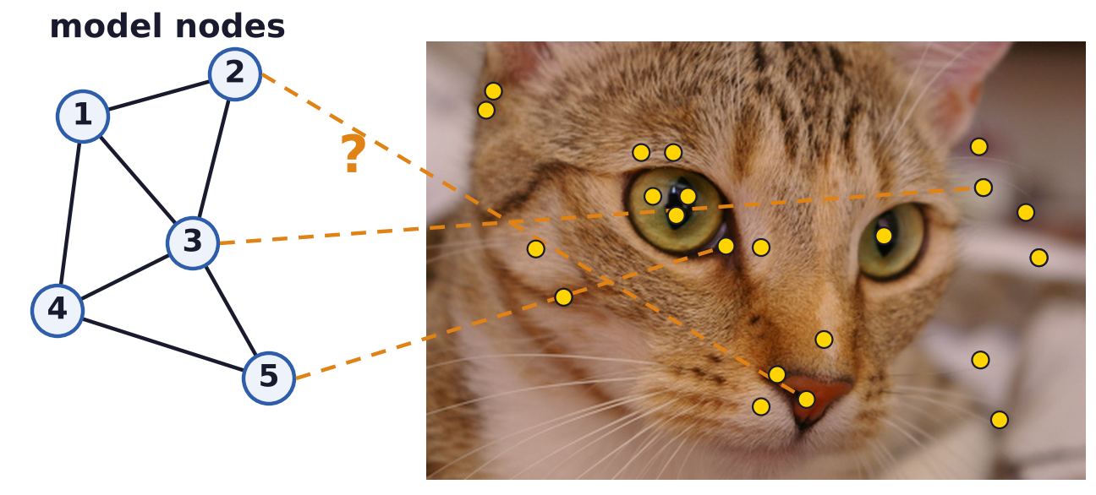
Learning from interest points
Unsupervised structure induction: everything is unknown
Unknown: the graph structure, whether an object is present, and how many types of objects there are.
Which IPs are object and which background is unknown: one voice among many at a cocktail party.
Correspondence problem: which IP belongs to which part of the object?
L. Zhu, Y. Chen and A. Yuille, “Unsupervised learning of probabilistic grammar-Markov models for object categories,”
IEEE Transactions on Pattern Analysis and Machine Intelligence, 31(1):114–128, 2009.
Photograph: “chelsea”, scikit-image sample data (CC0).
Neural Networks · A. Yuille
19

Slide 20
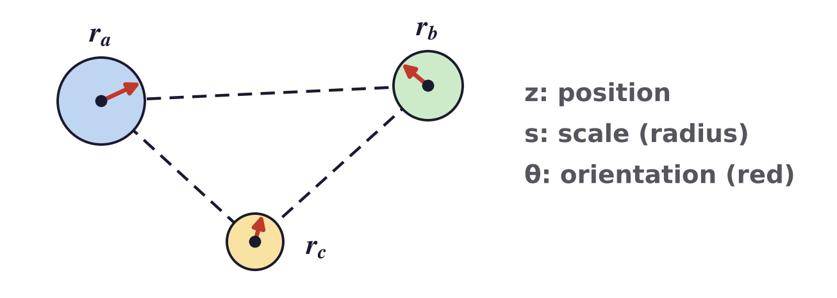
Learning from interest points
The basic elements are triplets of interest points
PGMM (probabilistic grammar-Markov model): a graph grammar builds it from triplets of IPs.
Each point has a position z, a scale s and an orientation θ; three related points form a triplet T.
AND: a new triplet on two nodes of an old one. OR: a new triplet starts an aspect (a viewpoint).
The triplet's shape (side ratios and angles) is invariant to scale and rotation.
L. Zhu, Y. Chen and A. Yuille, “Unsupervised learning of probabilistic grammar-Markov models for object categories,”
IEEE Transactions on Pattern Analysis and Machine Intelligence, 31(1):114–128, 2009.
Neural Networks · A. Yuille
20

Slide 21
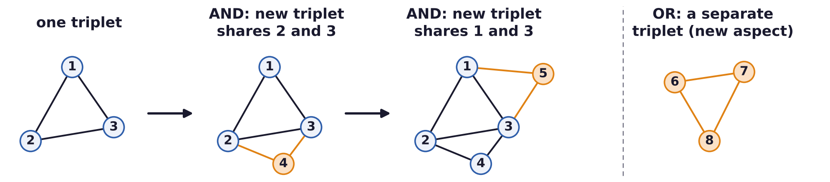
Learning from interest points
PGMMs search greedily over model structures
Initially all the data are generated by a background model, without spatial relations.
Expand the structure with the AND/OR graph grammar; score every extension and accept the best.
Repeat until the score almost doesn't change.
L. Zhu, Y. Chen and A. Yuille, “Unsupervised learning of probabilistic grammar-Markov models for object categories,”
IEEE Transactions on Pattern Analysis and Machine Intelligence, 31(1):114–128, 2009.
Neural Networks · A. Yuille
21

Slide 22
Learning from interest points
Model selection scores how well a model generates the data
Model selection is performed by evaluating the probability that the model generates the data.
D: the interest points of all training images; H: their correspondence to the model nodes.
θ: all the parameters of the model (unrelated to the orientations of the points).
The integral over θ is replaced by its value at the best θ* (Laplace would add a volume factor).
G: the graph structure; the structure with the highest score is kept.
L. Zhu, Y. Chen and A. Yuille, “Unsupervised learning of probabilistic grammar-Markov models for object categories,”
IEEE Transactions on Pattern Analysis and Machine Intelligence, 31(1):114–128, 2009.
Neural Networks · A. Yuille
22

Slide 23
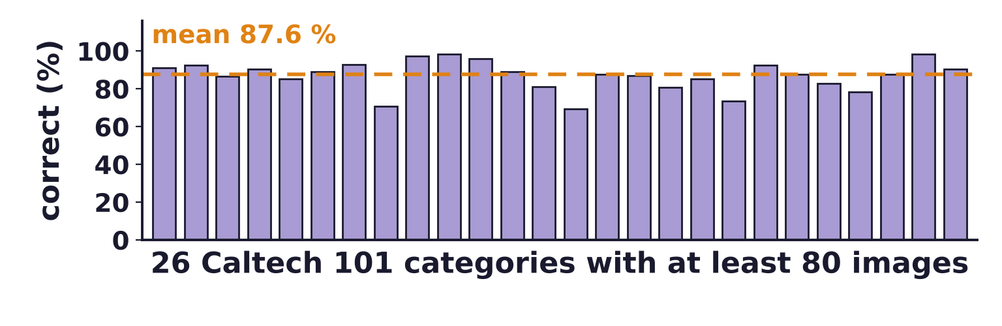
Learning from interest points
PGMMs learn Caltech 101 categories without part labels
Bars: % correct for 26 classes with at least 80 images; one PGMM per class, without part labels.
Could learn one, two, three or more aspects (OR nodes) if the dataset required it (e.g. plane, face, bike).
Could learn object models when the training images were a random mix with and without the object.
As good as supervised methods (2006) with enough data; unsupervised learning on Caltech is unusual.
L. Zhu, Y. Chen and A. Yuille, “Unsupervised learning of probabilistic grammar-Markov models for object categories,”
IEEE Transactions on Pattern Analysis and Machine Intelligence, 31(1):114–128, 2009.
L. Fei-Fei, R. Fergus and P. Perona, “Learning generative visual models from few training examples: an incremental Bayesian approach
tested on 101 object categories,” CVPR Workshop on Generative-Model Based Vision, 2004.
Neural Networks · A. Yuille
23

Slide 24
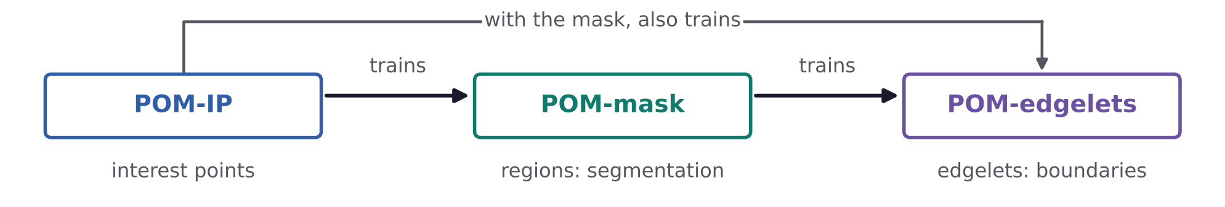
Learning from interest points
Interest-point models can teach models with more cues
Limitation of PGMMs: they only use image features defined at interest points.
Use the PGMM to learn a skeleton structure of the object; then use it to train a model with more cues.
Probabilistic object models (POMs): POM-IP, the PGMM, trains a mask; both train edgelet models.
Eureka moment? The simple IP model is powerful enough to train a model with more cues.
Y. Chen, L. Zhu, A. Yuille and H. Zhang, “Unsupervised learning of probabilistic object models (POMs) for object classification, segmentation,
and recognition using knowledge propagation,” IEEE Transactions on Pattern Analysis and Machine Intelligence, 31(10):1747–1761, 2009.
Neural Networks · A. Yuille
24

Slide 25
Learning a hierarchy
4
Compose, cluster, keep suspicious coincidences, exclude competitors;
then refine the hierarchy top-down.
Neural Networks · A. Yuille
25

Slide 26
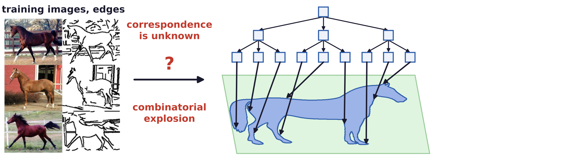
Learning a hierarchy
A hierarchy is learnt from a few unlabelled images
Task: given a few training images (12 horses), no labelling, no alignment, highly ambiguous features.
Estimate the graph structure (nodes and edges) and the parameters.
The correspondence is unknown: trying all matches is a combinatorial explosion.
L. Zhu, C. Lin, H. Huang, Y. Chen and A. Yuille, “Unsupervised structure learning: hierarchical recursive composition, suspicious coincidence
and competitive exclusion,” ECCV, LNCS 5303, 759–773, 2008.
Horse silhouette: “horse”, scikit-image sample data (CC0); photographs: Weizmann horse database (Borenstein and Ullman, ECCV 2002).
Neural Networks · A. Yuille
26

Slide 27
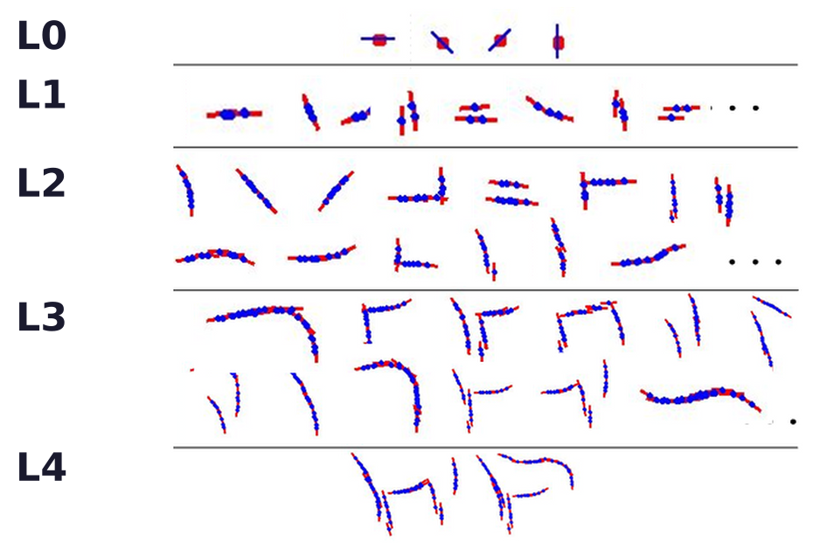
Learning a hierarchy
The dictionary: from generic parts to object structures
A unified representation (RCMs) and learning, level by level.
Bridges the gap between generic features (L0, L1) and specific object structures (L4).
Concept: a dictionary entry, a cluster of compositions of three concepts of the level below.
L. Zhu, C. Lin, H. Huang, Y. Chen and A. Yuille, “Unsupervised structure learning: hierarchical recursive composition, suspicious coincidence
and competitive exclusion,” ECCV, LNCS 5303, 759–773, 2008.
Neural Networks · A. Yuille
27

Slide 28
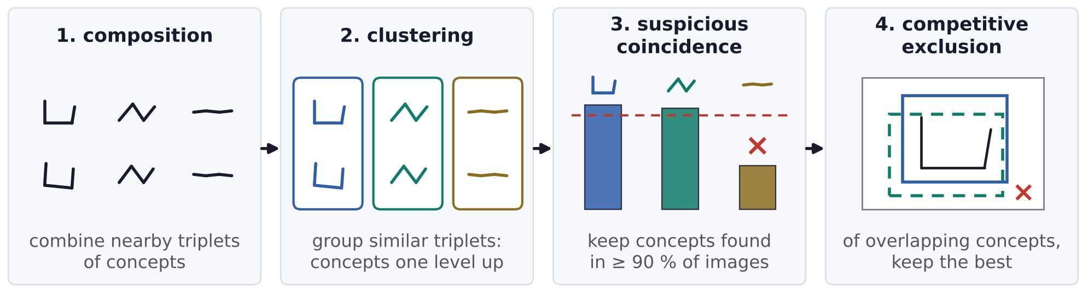
Learning a hierarchy
Bottom-up learning composes, clusters, prunes and excludes
Composition proposes candidate triplets; clustering turns them into concepts at the next level.
Suspicious coincidence: a concept is kept only if it occurs in at least 90 % of the training images.
Competitive exclusion: concepts that explain overlapping parts of the image compete; the best is kept.
L. Zhu, C. Lin, H. Huang, Y. Chen and A. Yuille, “Unsupervised structure learning: hierarchical recursive composition, suspicious coincidence
and competitive exclusion,” ECCV, LNCS 5303, 759–773, 2008.
Neural Networks · A. Yuille
28

Slide 29
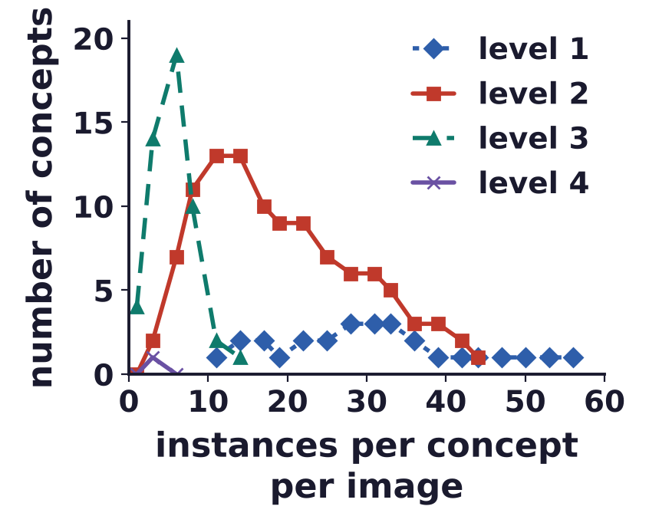
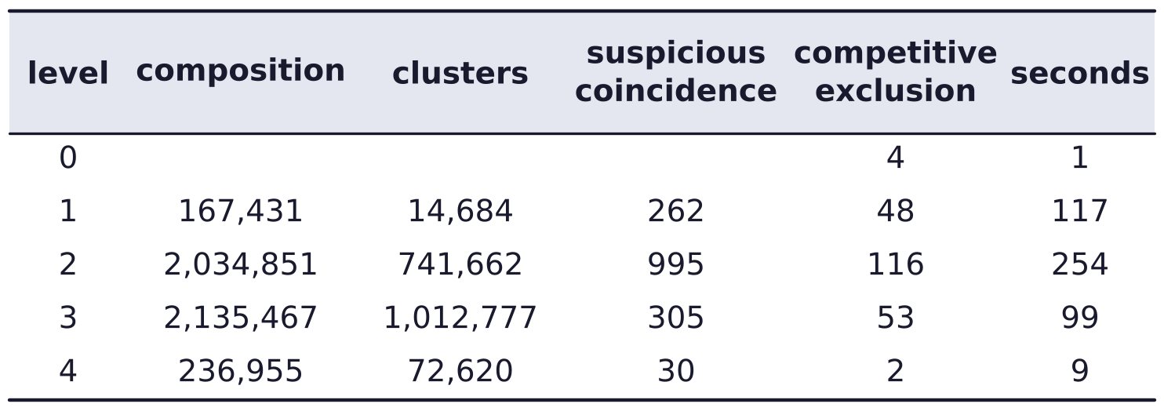
Learning a hierarchy
Dictionary size, part sharing and computational complexity
Each step cuts the number of proposals: up to two million compositions become 2 to 116 concepts.
The chart: how many instances of each concept appear per image; low-level concepts are shared more.
Times in seconds for the 12 training images; the levels above 2 get cheaper.
L. Zhu, C. Lin, H. Huang, Y. Chen and A. Yuille, “Unsupervised structure learning: hierarchical recursive composition, suspicious coincidence
and competitive exclusion,” ECCV, LNCS 5303, 759–773, 2008.
Neural Networks · A. Yuille
29

Slide 30
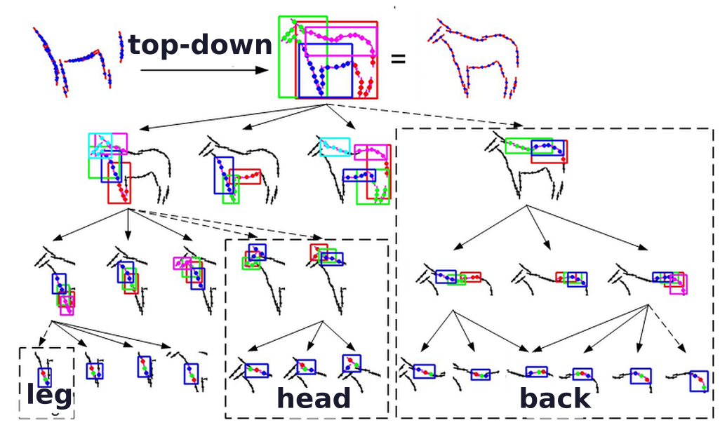
Learning a hierarchy
Top-down refinement fills in missing parts
Fill in missing parts: examine every node from top to bottom.
Dashed boxes: parts learnt top-down, where clustering finds no small regularities (legs, head, back).
Coloured rectangles mark the same structures across levels; top left: the bottom-up result.
The top-down process also adds a dense representation at the lowest level, for segmentation.
L. Zhu, C. Lin, H. Huang, Y. Chen and A. Yuille, “Unsupervised structure learning: hierarchical recursive composition, suspicious coincidence
and competitive exclusion,” ECCV, LNCS 5303, 759–773, 2008.
Neural Networks · A. Yuille
30

Slide 31
Part sharing for many objects
5
Objects and viewpoints share parts:
low-level parts are generic, high-level parts are specific.
Neural Networks · A. Yuille
31

Slide 32
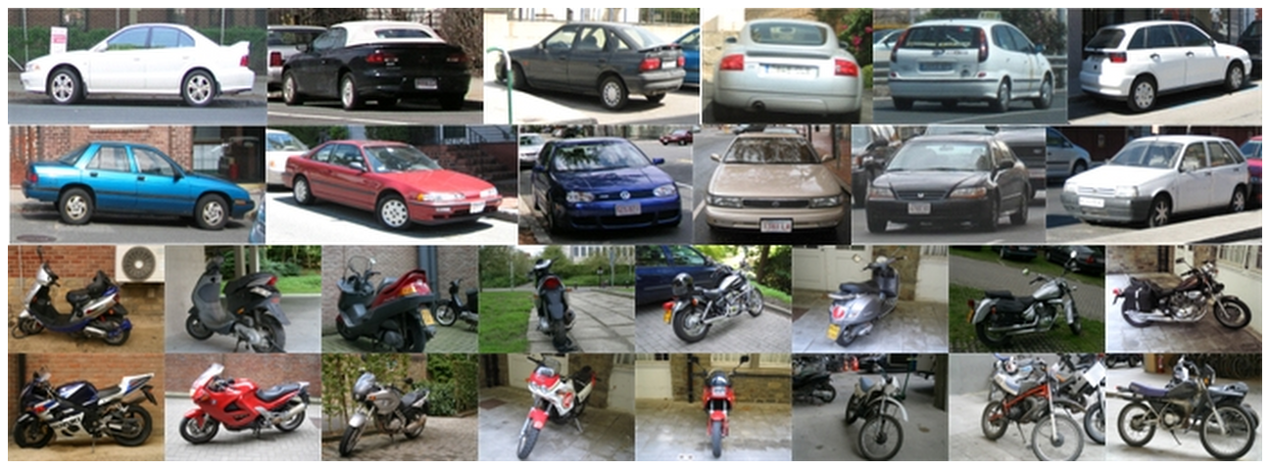
Part sharing for many objects
Different objects and viewpoints can share parts
Strategy: share parts between different objects and viewpoints.
Shared parts are learnt from object boundaries, without object labels.
Structure induction learns the graph structures and the parameters; masks are learnt with supervision.
L. Zhu, Y. Chen, A. Torralba, W. Freeman and A. Yuille, “Part and appearance sharing: recursive compositional models for multi-view
multi-object detection,” CVPR, 1919–1926, 2010.
Neural Networks · A. Yuille
32

Slide 33
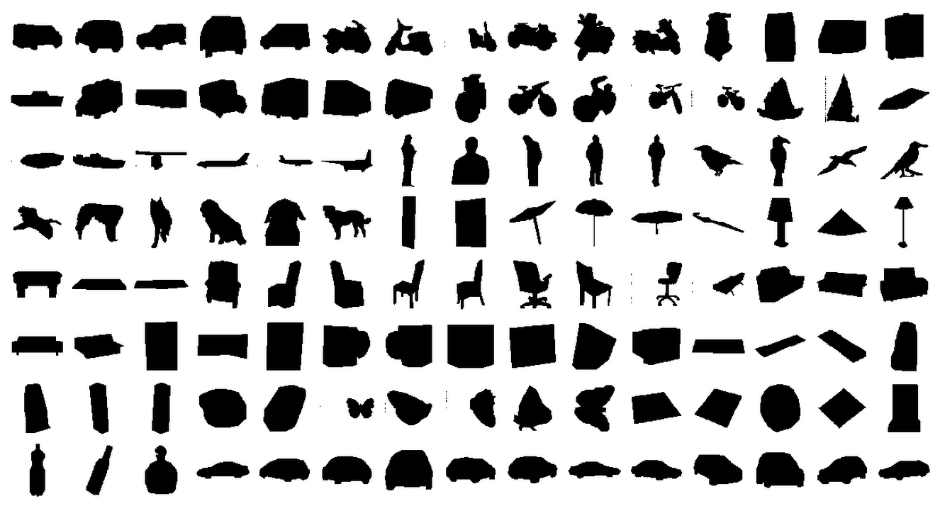
Part sharing for many objects
120 templates cover 26 classes in several viewpoints
26 object classes from LabelMe, each from several viewpoints: 120 object / viewpoint templates.
The number of viewpoints varies from class to class.
L. Zhu, Y. Chen, A. Torralba, W. Freeman and A. Yuille, “Part and appearance sharing: recursive compositional models for multi-view
multi-object detection,” CVPR, 1919–1926, 2010.
B. C. Russell, A. Torralba, K. P. Murphy and W. T. Freeman, “LabelMe: a database and web-based tool for image annotation,”
International Journal of Computer Vision, 77(1–3):157–173, 2008.
Neural Networks · A. Yuille
33

Slide 34
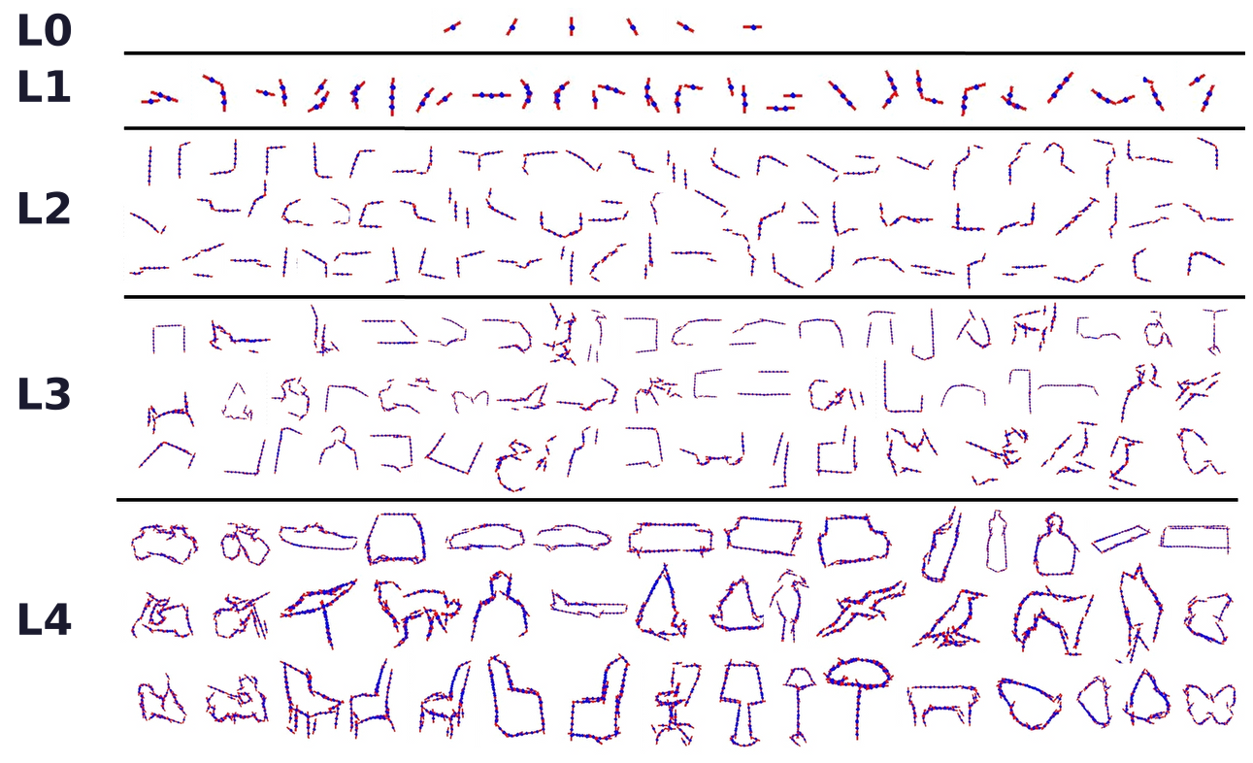
Part sharing for many objects
Learn a hierarchical dictionary by suspicious coincidences
Low-level to mid-level to high-level parts, learnt by suspicious coincidences.
A 5-level dictionary (L0 to L4) for the 120 templates: the mean shapes of the parts at each level.
L. Zhu, Y. Chen, A. Torralba, W. Freeman and A. Yuille, “Part and appearance sharing: recursive compositional models for multi-view
multi-object detection,” CVPR, 1919–1926, 2010.
Neural Networks · A. Yuille
34

Slide 35
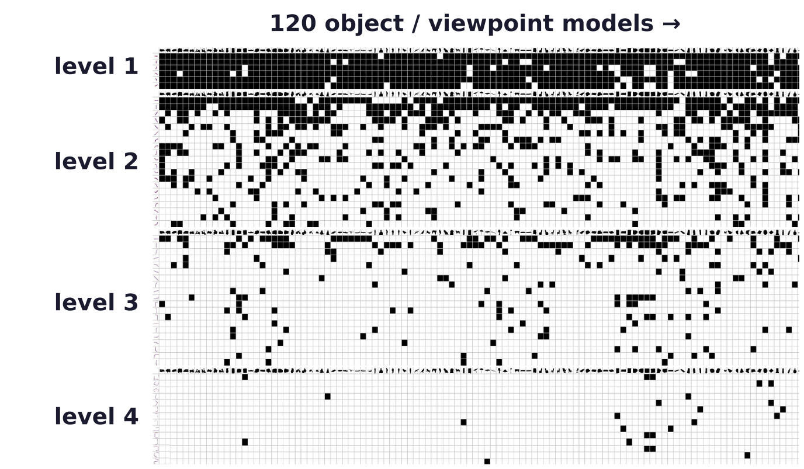
Part sharing for many objects
Part sharing decreases with levels
Columns: the 120 object / viewpoint models. Rows: parts of the dictionary, level 1 at the top.
Black: the part is used by the model. Low-level parts are used by almost all objects.
L. Zhu, Y. Chen, A. Torralba, W. Freeman and A. Yuille, “Part and appearance sharing: recursive compositional models for multi-view
multi-object detection,” CVPR, 1919–1926, 2010.
Neural Networks · A. Yuille
35

Slide 36
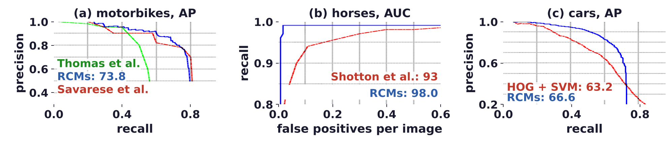
Part sharing for many objects
RCMs are comparable to the state of the art on single classes
RCMs (blue) against the best methods of the time, on three single-class datasets.
Precision: fraction of detections that are correct; recall: fraction of objects found; AP: average precision.
AUC: area under the curve (b). HOG + SVM: gradient histograms and a support vector machine.
L. Zhu, Y. Chen, A. Torralba, W. Freeman and A. Yuille, “Part and appearance sharing: recursive compositional models for multi-view
multi-object detection,” CVPR, 1919–1926, 2010.
A. Thomas, V. Ferrari, B. Leibe, T. Tuytelaars, B. Schiele and L. Van Gool, “Towards multi-view object class detection,” CVPR, 1589–1596, 2006.
S. Savarese and L. Fei-Fei, “3D generic object categorization, localization and pose estimation,” ICCV, 1–8, 2007.
J. Shotton, A. Blake and R. Cipolla, “Efficiently combining contour and texture cues for object recognition,” BMVC, 2008.
N. Dalal and B. Triggs, “Histograms of oriented gradients for human detection,” CVPR, 886–893, 2005.
Neural Networks · A. Yuille
36

Slide 37
Part sharing for many objects
Unsupervised structure learning is possible but very hard
Question: can limited extra information, e.g. one annotated example of the object, make it much easier?
How do humans learn object structure? In a life-long manner since infancy.
Infants learn by interacting with the world, touching and playing with objects, not just by seeing images.
Neural Networks · A. Yuille
37

Slide 38
Part sharing for many objects
Summary
Objects are compositions of semantic parts and subparts: a hierarchical graph.
A probability model on it: graph, state variables, potentials and weights; an exponential (Gibbs) model.
Three tasks: inference (bottom-up and top-down), learning the weights, and structure induction.
AND/OR graphs: AND nodes compose parts, OR nodes switch them for different poses and viewpoints.
Unsupervised structure learning: PGMMs grow the graph triplet by triplet while the score improves.
Bottom-up: compose, cluster, keep suspicious coincidences, exclude competitors; then refine top-down.
Sharing parts across objects and viewpoints makes many models efficient; sharing decreases with level.
Compositional models are challenging, but multi-task, interpretable and promising for domain transfer.
Neural Networks · A. Yuille
38

