Slide 1
Probabilities on Graphs
Directed Models
15 September, 2026
Alan Yuille · Probabilistic Models of the Visual Cortex

Slide 2
What this lecture covers
1
Graphs and weak coupling
2
Priors and double counting
Nodes, edges, and the inverse-variance rule
A shared prior must be applied only once
3
Strong coupling
4
Explaining away
Dependent cues need the joint model
One cause explains the evidence away
5
Model selection
6
A network for diagnosis
Choose the model, then estimate
Eight variables, eight small tables
Probabilities on Graphs · A. Yuille
2

Slide 3
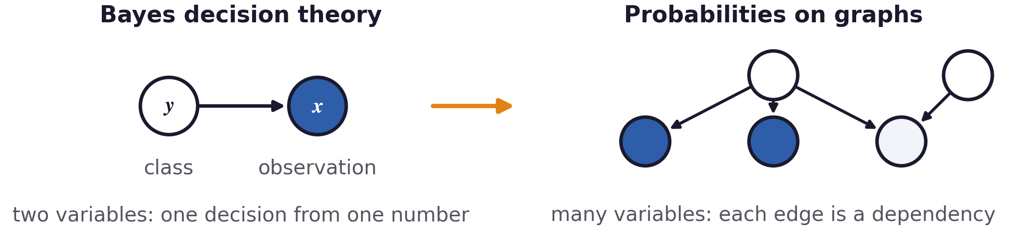
From Bayes decision theory to probabilities on graphs
The new question is: how do several variables that influence each other combine into one distribution?
The nodes specify the variables and the edges indicate which influence which.
Probabilities on Graphs · A. Yuille
3

Slide 4
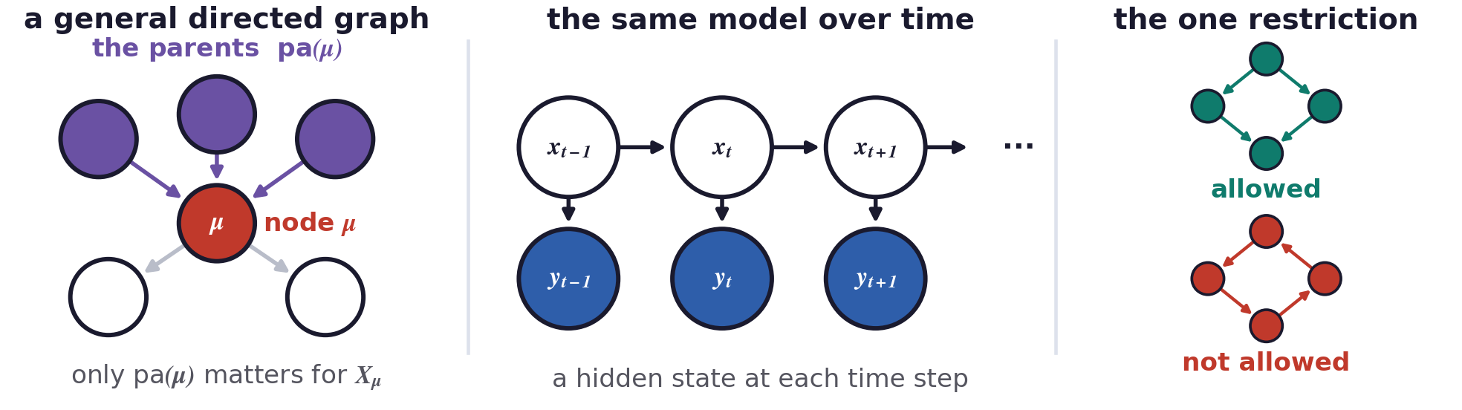
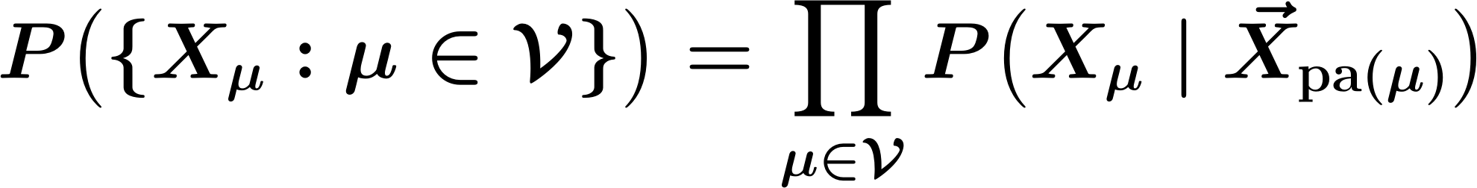
Graphs and weak coupling
Two general directed model - edges are directed
Each variable depends on the rest of the graph only through its parents.
A chain of states in time gives the Bayes-Kalman filter and the hidden Markov model.
Probabilities on Graphs · A. Yuille
4
Notes:
e08_factor:
P\big(\{X_\mu:\mu\in\mathcal{V}\}\big)=\prod_{\mu\in\mathcal{V}}P\big(X_\mu\mid \vec X_{\mathrm{pa}(\mu)}\big)
e08_markov:
P\big(X_\mu\mid \vec X_{/\mu}\big)=P\big(X_\mu\mid \vec X_{\mathrm{pa}(\mu)}\big)

Slide 5
1
Graphs and weak coupling
Nodes are the variables, and edges say which variable directly influences which.
Probabilities on Graphs · A. Yuille
5

Slide 6
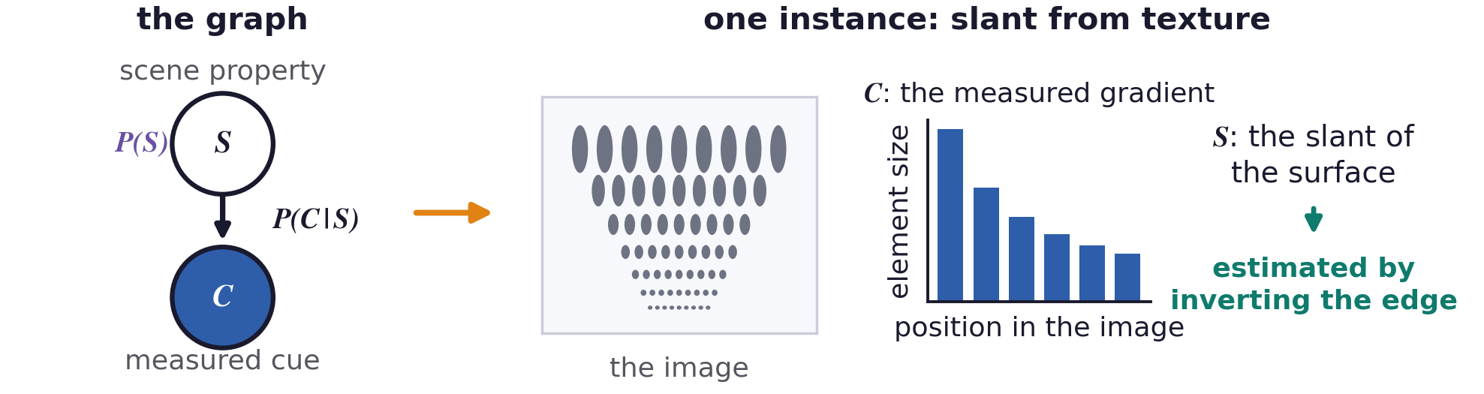
Graphs and weak coupling
One cue: a two-node graph
Estimating S from C inverts the edge, and the prior P(S) enters through Bayes’ rule.
Slant from texture is one instance: S is the slant, C is the measured element-size gradient.
Probabilities on Graphs · A. Yuille
6
Notes:
e06_bayes:
P(S\mid C)=\frac{P(C\mid S)\,P(S)}{P(C)}\,,\qquad S^{*}=\arg\max_{S}\;P(C\mid S)\,P(S)

Slide 7
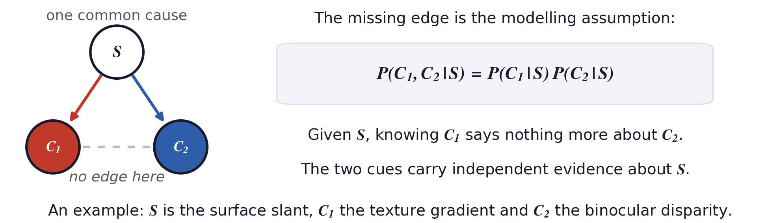
Graphs and weak coupling
Two cues: conditional independence
Weak coupling: the two cues are conditionally independent given S, and the prior on S is uniform.
The graph makes the assumption visible as a missing edge between the two cues.
Each cue then contributes its own likelihood evidence, and the two likelihoods multiply.
Probabilities on Graphs · A. Yuille
7

Slide 8
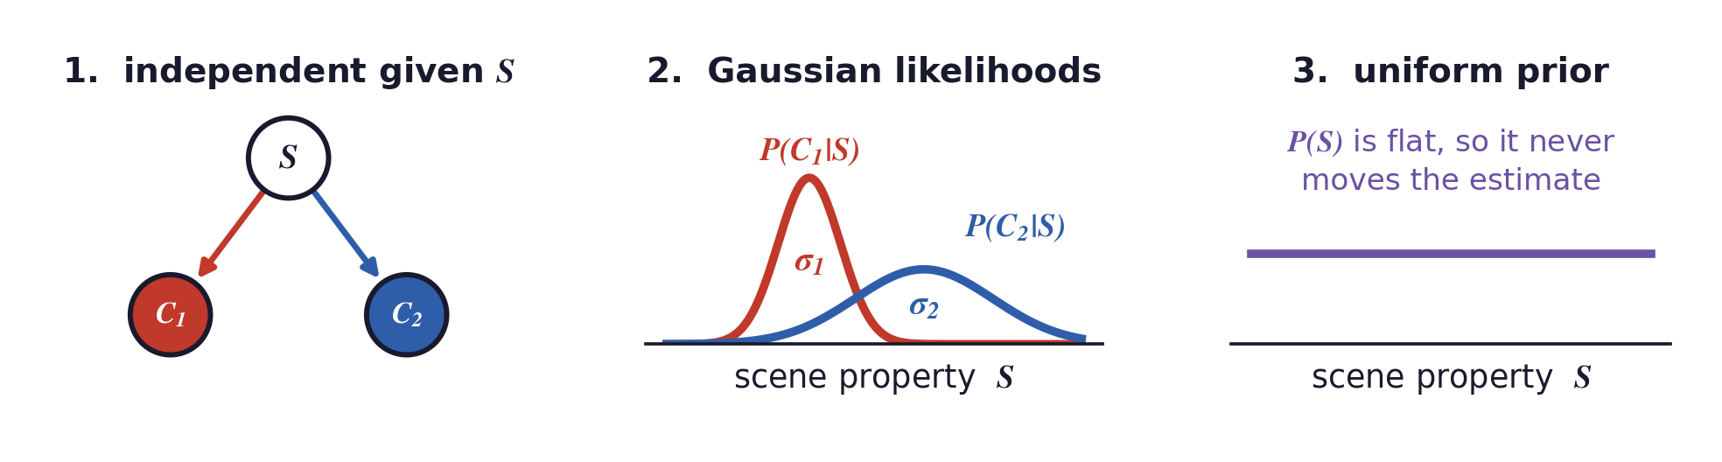
Graphs and weak coupling
Conditions for the linear rule
The linear rule takes the estimate to be a weighted sum of the two single-cue estimates.
These three conditions are the special case in which that rule is the optimal one.
Probabilities on Graphs · A. Yuille
8
Notes:
e10_gauss:
P(C_1\mid S)=\frac{1}{Z_1}\exp\Big\{-\frac{|C_1-S|^{2}}{2\sigma_1^{2}}\Big\}\,,\qquad P(C_2\mid S)=\frac{1}{Z_2}\exp\Big\{-\frac{|C_2-S|^{2}}{2\sigma_2^{2}}\Big\}

Slide 9
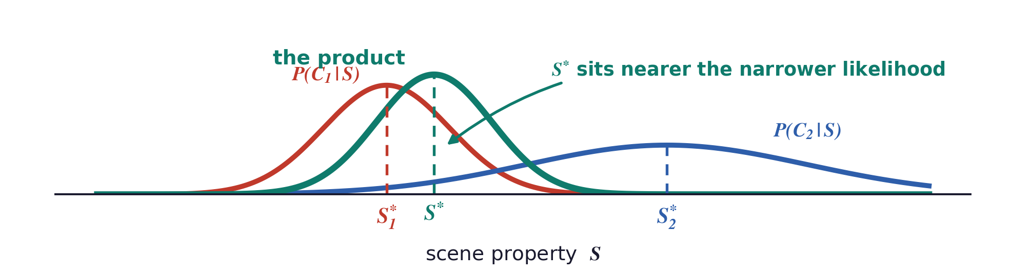
Graphs and weak coupling
The optimal estimate from both cues
Each cue alone points at its own measurement, and the product of the two Gaussians lands between them.
Probabilities on Graphs · A. Yuille
9
Notes:
e11_joint:
S^{*}=\arg\max_{S}P(C_1\mid S)P(C_2\mid S)=\frac{\sigma_2^{2}}{\sigma_1^{2}+\sigma_2^{2}}\,C_1+\frac{\sigma_1^{2}}{\sigma_1^{2}+\sigma_2^{2}}\,C_2
e11_ml:
S_1^{*}=\arg\max_{S}P(C_1\mid S)=C_1\,,\qquad S_2^{*}=\arg\max_{S}P(C_2\mid S)=C_2

Slide 10
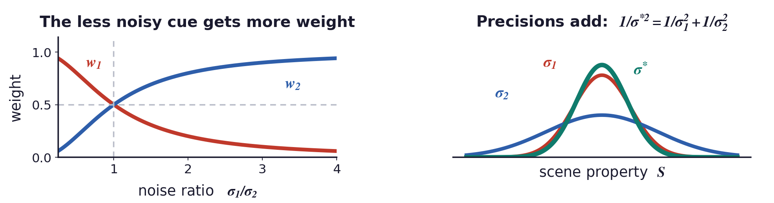
Graphs and weak coupling
The weights are the inverse variances
The cue with the smaller variance gets the larger weight.
The two cues together are more precise than either one, because the precisions add.
Probabilities on Graphs · A. Yuille
10
Notes:
e12_w:
w_1=\frac{\sigma_2^{2}}{\sigma_1^{2}+\sigma_2^{2}}\,,\qquad w_2=\frac{\sigma_1^{2}}{\sigma_1^{2}+\sigma_2^{2}}\,,\qquad S^{*}=w_1S_1^{*}+w_2S_2^{*}

Slide 11
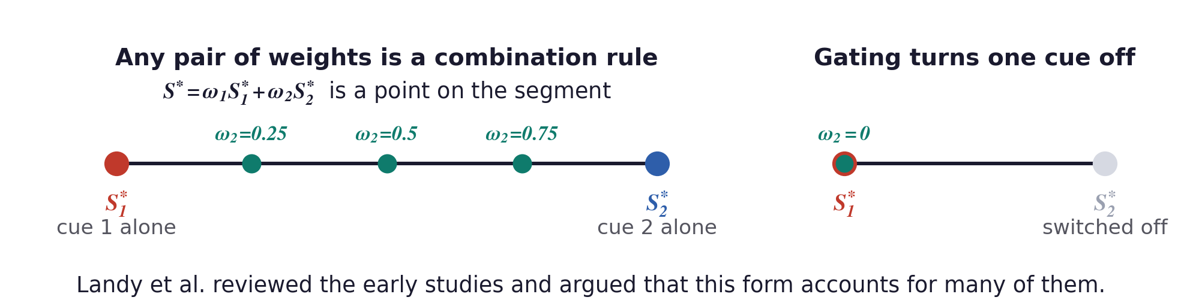
Graphs and weak coupling
Landy et al.: the general weighted rule - an empirical finding
Any positive weights that sum to one define a combination rule.
Landy et al. also described gating, and Clard and Yuille described from the Bayesian perspective.
M. S. Landy, L. T. Maloney, E. B. Johnston and M. Young, “Measurement and modeling of depth cue combination: in defense of weak fusion,” Vision Research, 35(3):389–412, 1995. · J. J. Clark and A. L. Yuille, Data Fusion for Sensory Information Processing Systems. Kluwer Academic Publishers, 1990.
Probabilities on Graphs · A. Yuille
11
Notes:
e14_landy:
S^{*}=\omega_1 S_1^{*}+\omega_2 S_2^{*}\,,\qquad \omega_1+\omega_2=1\,,\qquad \omega_1,\omega_2>0

Slide 12
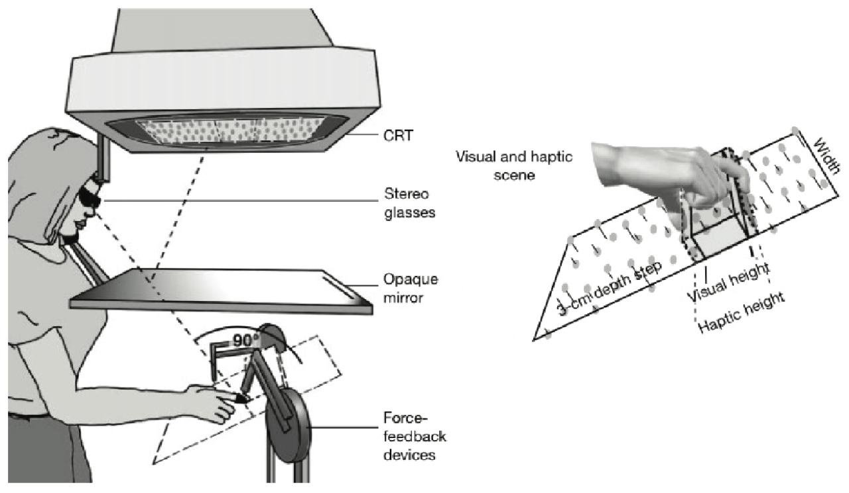
Graphs and weak coupling
Ernst and Banks: vision and touch
Subjects judged the height of a ridge seen in a stereo display and felt through force feedback.
Noise added to the display raises the visual variance, and the visual weight falls with it.
The measured weights follow the inverse-variance prediction.
M. O. Ernst and M. S. Banks, “Humans integrate visual and haptic information in a statistically optimal fashion,” Nature, 415:429–433, 2002.
Probabilities on Graphs · A. Yuille
12

Slide 13
2
Priors and double counting
Two cues that use the same prior must not apply it twice.
Probabilities on Graphs · A. Yuille
13

Slide 14
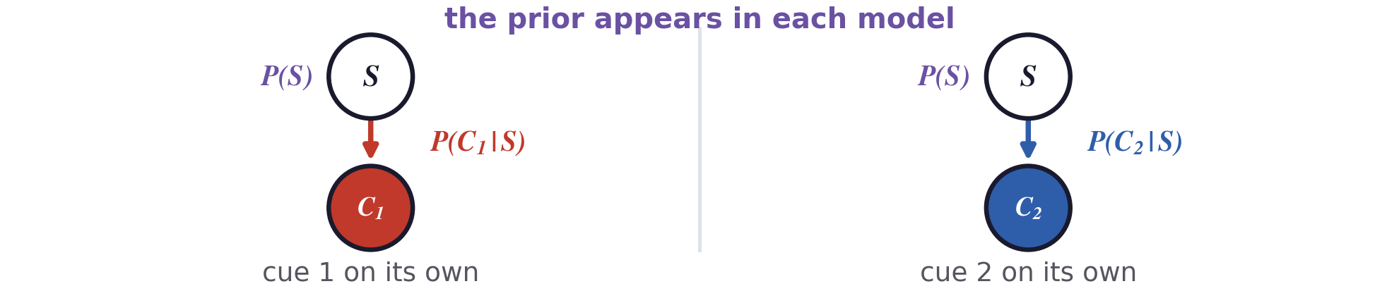
Priors and double counting
The posterior for one cue
Each cue is modelled by its own likelihood, and both models use the same prior on S.
Taking the two estimates and averaging them would use that prior twice.
Probabilities on Graphs · A. Yuille
14
Notes:
e15_post:
P(S\mid C_1)=\frac{P(C_1\mid S)\,P(S)}{P(C_1)}\,,\qquad P(S\mid C_2)=\frac{P(C_2\mid S)\,P(S)}{P(C_2)}
e15_est:
S_1^{*}=\arg\max_{S}P(S\mid C_1)\,,\qquad S_2^{*}=\arg\max_{S}P(S\mid C_2)

Slide 15
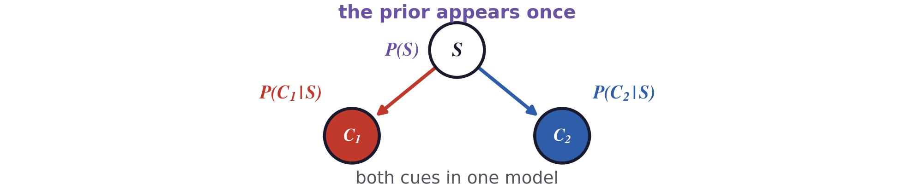
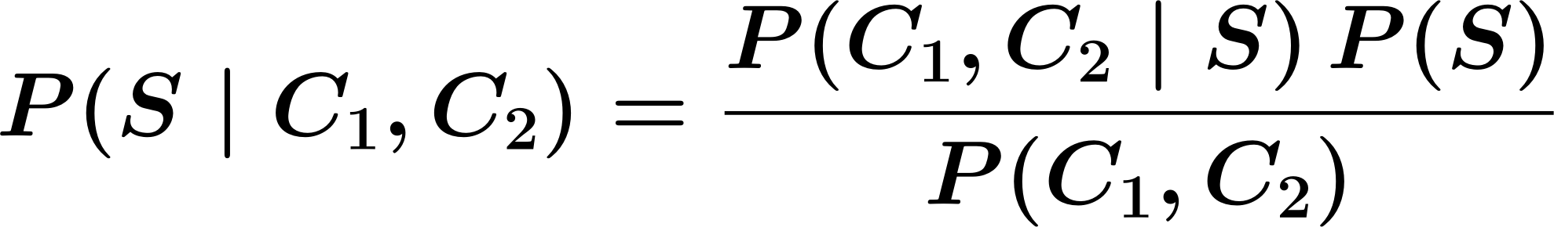
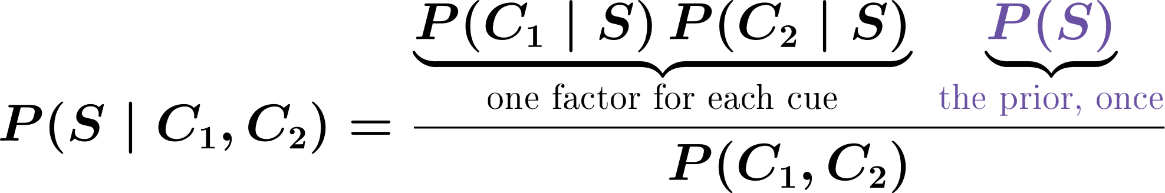
Priors and double counting
The posterior for both cues
Conditional independence turns the joint likelihood into one factor for each cue.
The prior multiplies in once, however many cues there are.
Probabilities on Graphs · A. Yuille
15
Notes:
e16_joint:
P(S\mid C_1,C_2)=\frac{P(C_1,C_2\mid S)\,P(S)}{P(C_1,C_2)}
e16_ci:
P(S\mid C_1,C_2)=\frac{\underbrace{P(C_1\mid S)\,P(C_2\mid S)}_{\textrm{\fontsize{12}{14}\selectfont one factor for each cue}}\;\underbrace{{\color{prior}P(S)}}_{{\color{prior}\textrm{\fontsize{12}{14}\selectfont the prior, once}}}}{P(C_1,C_2)}

Slide 16
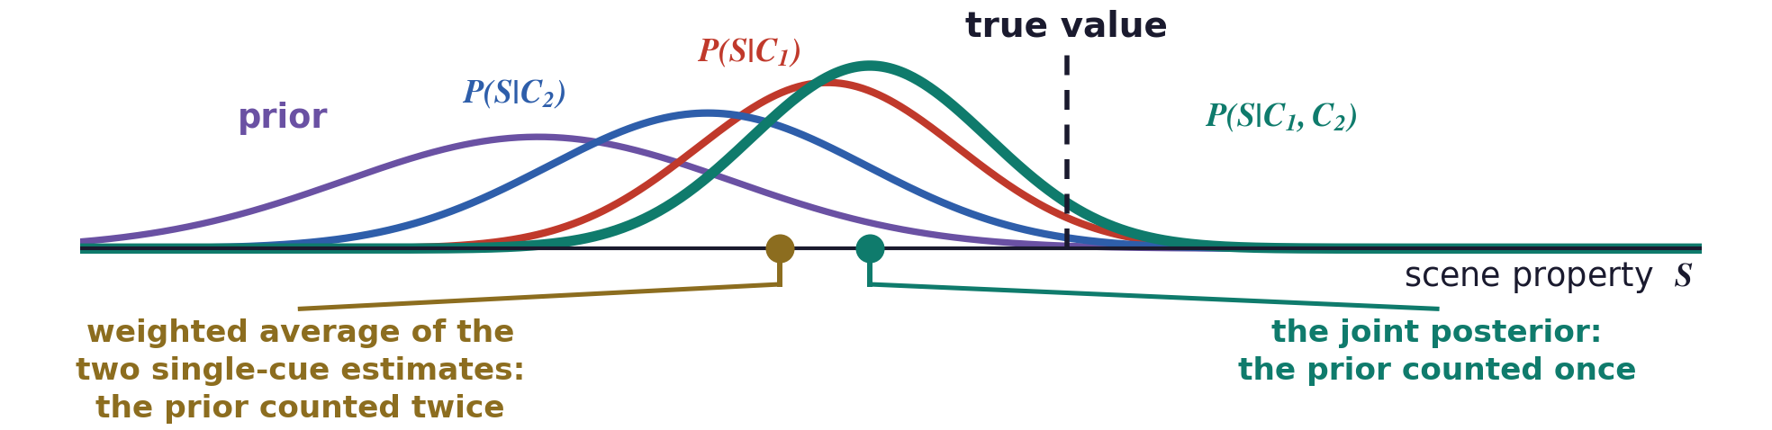
Priors and double counting
A Gaussian prior enters only once
Subscript p marks the prior, whose mean is the flat surface, and each t is one over a variance.
Probabilities on Graphs · A. Yuille
16
Notes:
The prior is Gaussian, centred on the flat surface S_p with variance sigma_p squared. A larger t means a more reliable source. The prior term appears once in the joint estimate and once in each single-cue estimate, which is why averaging the two counts it twice.
e19_gauss:
P(S)=\frac{1}{Z_p}\exp\Big\{-\frac{|S-S_p|^{2}}{2\sigma_p^{2}}\Big\}\,,\qquad t_1=\frac{1}{\sigma_1^{2}}\,,\quad t_2=\frac{1}{\sigma_2^{2}}\,,\quad t_p=\frac{1}{\sigma_p^{2}}
e19_prior:
S^{*}=\frac{t_1C_1+t_2C_2+t_pS_p}{t_1+t_2+t_p}\,,\qquad S_1^{*}=\frac{t_1C_1+t_pS_p}{t_1+t_p}\,,\qquad S_2^{*}=\frac{t_2C_2+t_pS_p}{t_2+t_p}

Slide 17
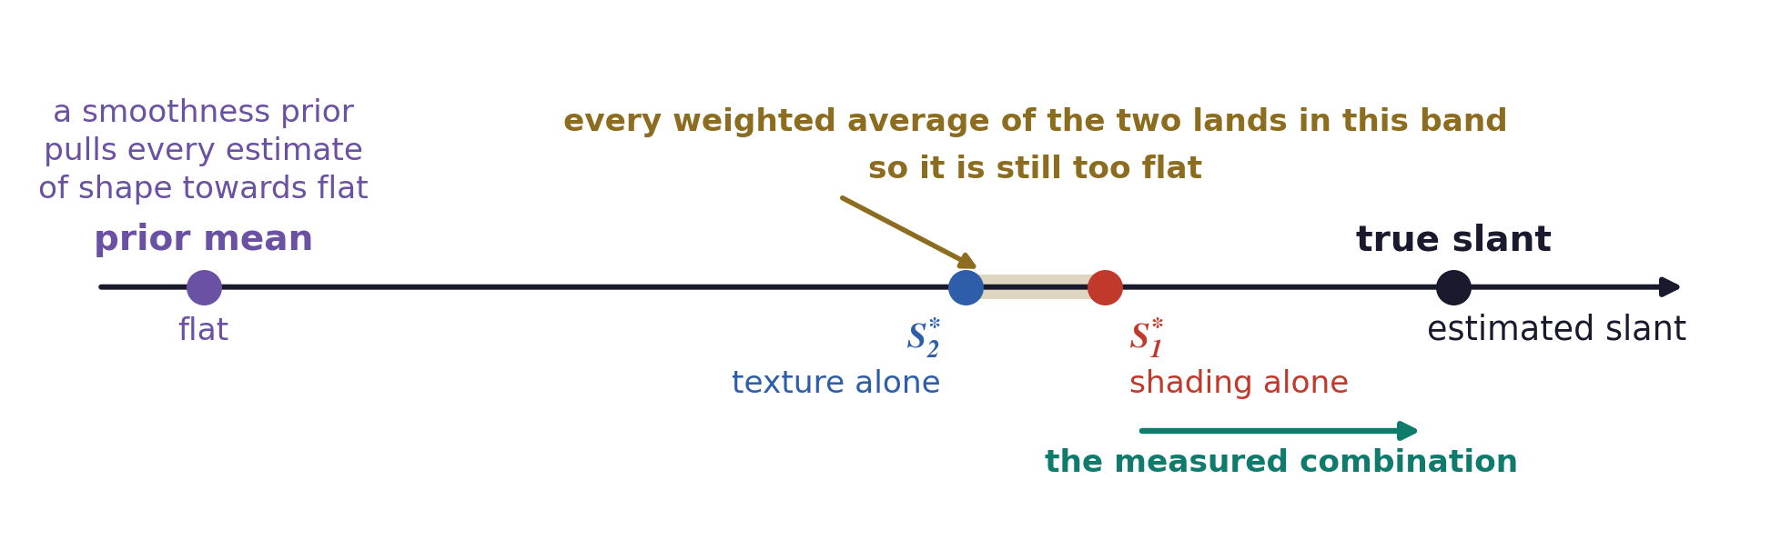
Priors and double counting
The prior biases each single-cue estimate
Shape from shading and shape from texture both assume the surface is smooth.
A smoothness prior pulls each single-cue estimate towards a flatter surface.
Any weighted average of two flattened estimates is still flat.
Probabilities on Graphs · A. Yuille
17

Slide 18
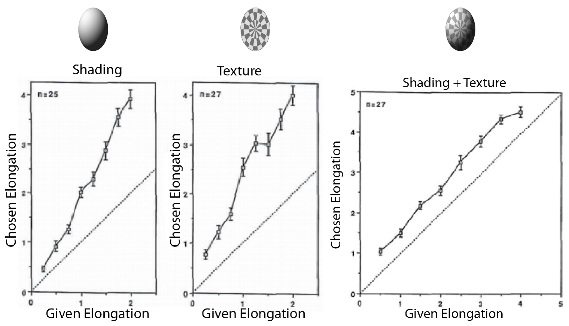
Priors and double counting
Shading and texture: the experiment
Subjects judged the elongation of an ellipsoid from shading only, texture only, or both.
Each cue alone was seen as too flat, and the two together were close to correct.
H. H. Bülthoff and H. A. Mallot, “Integration of depth modules: stereo and shading,” Journal of the Optical Society of America A, 5(10):1749–1758, 1988.
Probabilities on Graphs · A. Yuille
18

Slide 19
3
Strong coupling
When the cues depend on each other, the estimate comes from the joint model.
Probabilities on Graphs · A. Yuille
19

Slide 20
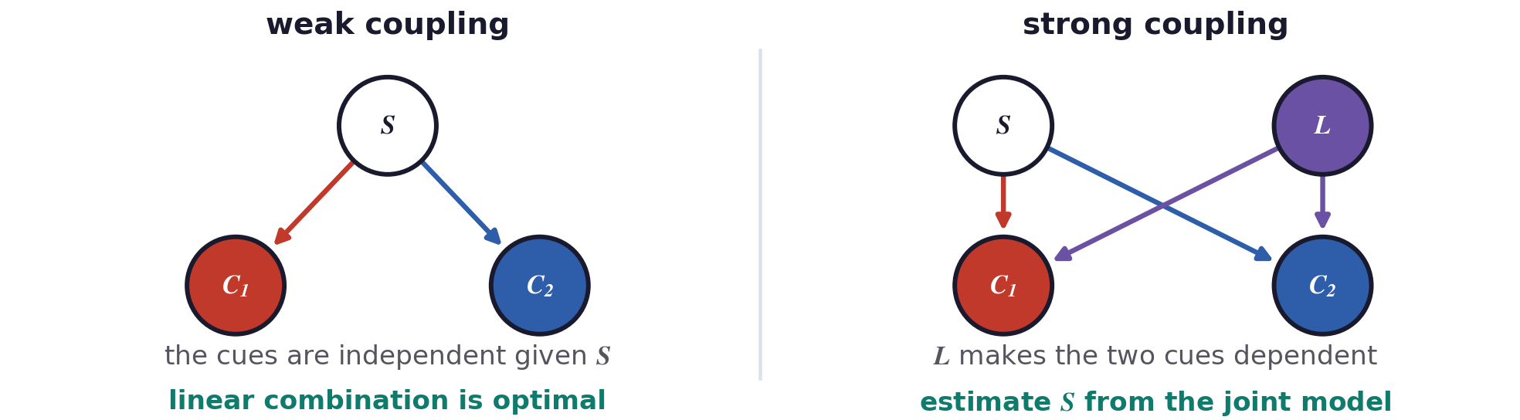
Strong coupling
Weak and strong coupling
Weak coupling means conditionally independent cues, Gaussian likelihoods and a uniform prior.
Strong coupling covers shared priors, dependent cues, and a choice between models.
Under strong coupling the estimate has to come from the joint model.
J. J. Clark and A. L. Yuille, Data Fusion for Sensory Information Processing Systems. Kluwer Academic Publishers, Boston, 1990.
Probabilities on Graphs · A. Yuille
20

Slide 21
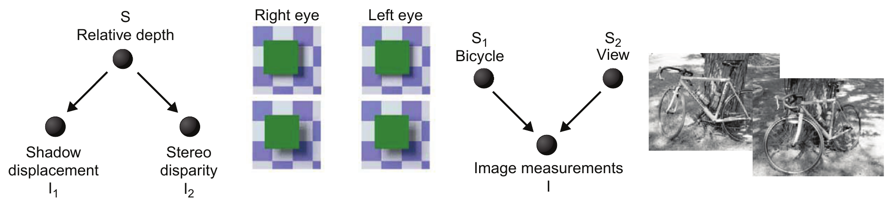
Strong coupling
A taxonomy of cue interactions
Common cause: one scene event produces two cues, and the evidence from them combines.
Common effect: several scene variables produce one image, and they have to be separated.
The pattern in the graph decides how the cues must be treated.
Probabilities on Graphs · A. Yuille
21

Slide 22
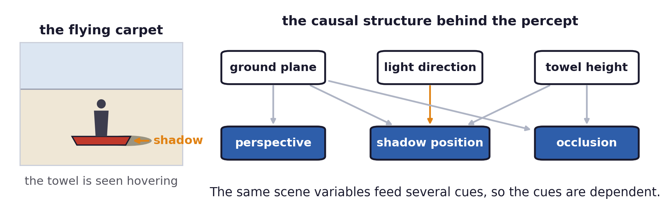
Strong coupling
Visual cues depend on one another
The flying carpet needs the ground plane, the segmentation, the shadow and the lighting at once.
These cues are computed from the same image regions, so they constrain one another.
Splitting a natural image into a texture part and a shading part is itself an open problem.
Probabilities on Graphs · A. Yuille
22

Slide 23
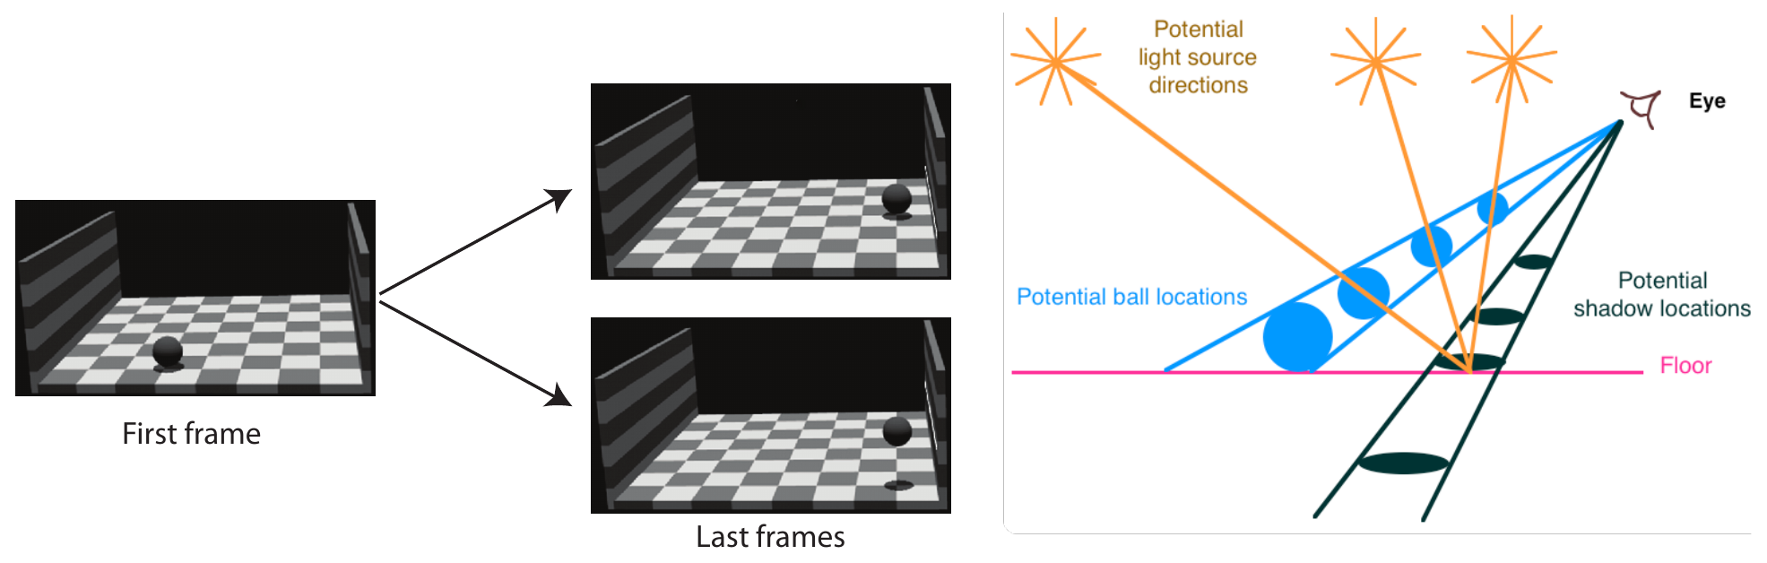
Strong coupling
A cast shadow decides the perceived motion
The image trajectory of the ball is identical in the two movies, and only the shadow differs.
The visual system finds the floor, the ball and the light, then attaches the shadow to the ball.
https://www.youtube.com/watch?v=XZO8-Df3mxA
D. Kersten, P. Mamassian and D. C. Knill, “Moving cast shadows induce apparent motion in depth,” Perception, 26(2):171–192, 1997.
Probabilities on Graphs · A. Yuille
23

Slide 24
4
Explaining away
Evidence for one cause of an event lowers the probability of the other cause.
Probabilities on Graphs · A. Yuille
24

Slide 25
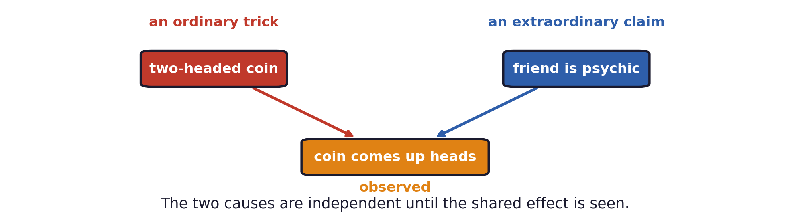
Explaining away
Two causes and one effect
Your friend says he is psychic and predicts that a coin toss will come up heads, and it does.
Either he is psychic or the coin is two-headed, and a two-headed coin is far more common.
The two causes are independent a priori, and observing the shared effect makes them dependent.
Probabilities on Graphs · A. Yuille
25
Notes:
With P(two-headed coin) = 0.20, P(psychic) = 0.001 and a fair coin otherwise, observing heads
gives P(two-headed coin | heads) = 0.33 and P(psychic | heads) = 0.002.

Slide 26
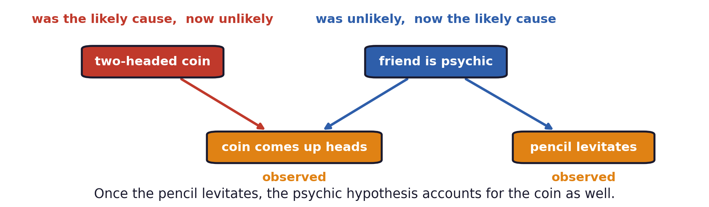
Explaining away
A second effect explains the first away
He is challenged to levitate a pencil, which is easy for a psychic and hard otherwise.
If the pencil levitates, the psychic hypothesis becomes probable and takes over the coin result.
Explaining away: evidence for one cause of an event lowers the probability of the other cause.
Probabilities on Graphs · A. Yuille
26
Notes:
Same model, with P(pencil | psychic) = 0.99 and P(pencil | not psychic) = 0.0001.
P(two-headed coin) falls from 0.33 to 0.21; P(psychic) rises from 0.002 to 0.94.

Slide 27
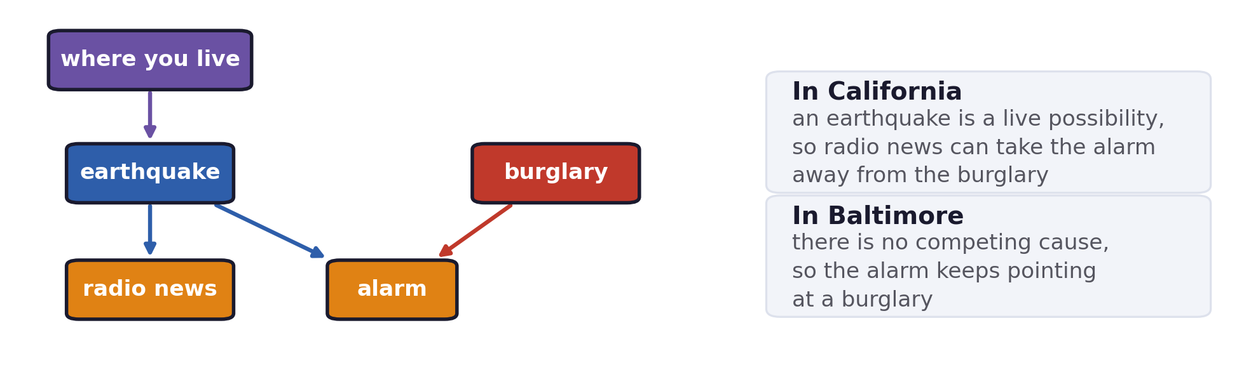
Explaining away
Burglary, earthquake and where you live
An alarm can be set off by a burglary or by an earthquake, and burglaries are much more common.
Radio news of an earthquake explains the alarm away, and the location sets how often that happens.
J. Pearl, Probabilistic Reasoning in Intelligent Systems: Networks of Plausible Inference. Morgan Kaufmann, San Mateo, 1988.
Probabilities on Graphs · A. Yuille
27
Notes:
Pearl's alarm table with P(burglary) = 0.001. In California, P(earthquake) = 0.01:
P(burglary | alarm) = 0.19, falling to 0.004 once the radio reports an earthquake.
In Baltimore, P(earthquake) = 0.00005: P(burglary | alarm) = 0.48.

Slide 28
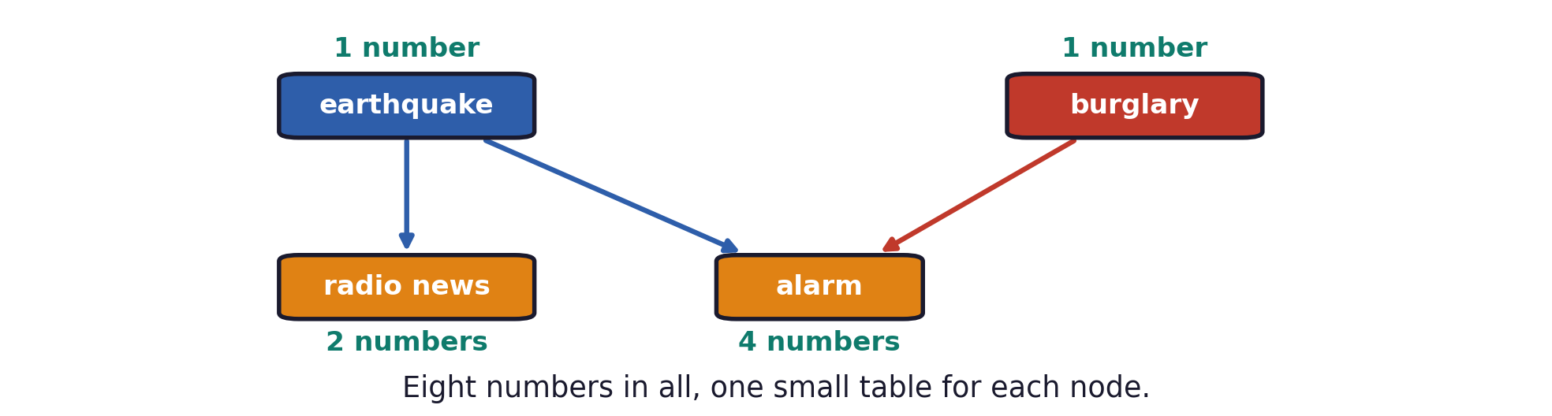
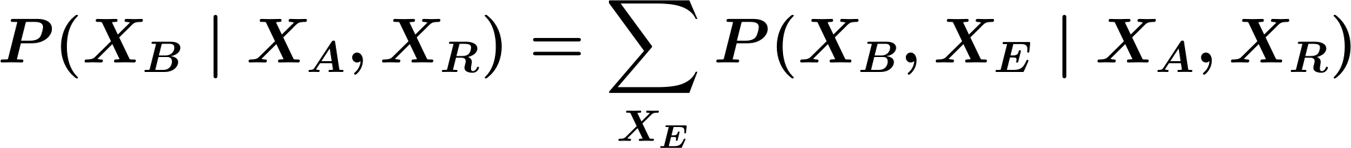
Explaining away
The factorisation reduces the numbers to learn
One general table over the four variables would need fifteen numbers instead of eight.
Probabilities on Graphs · A. Yuille
28
Notes:
Each node carries one small table; inference sums out the variables of no interest.
e29_fact:
P(X_A,X_B,X_E,X_R)=P(X_A\mid X_B,X_E)\,P(X_R\mid X_E)\,P(X_B)\,P(X_E)
e29_sum:
P(X_B\mid X_A,X_R)=\sum_{X_E}P(X_B,X_E\mid X_A,X_R)

Slide 29
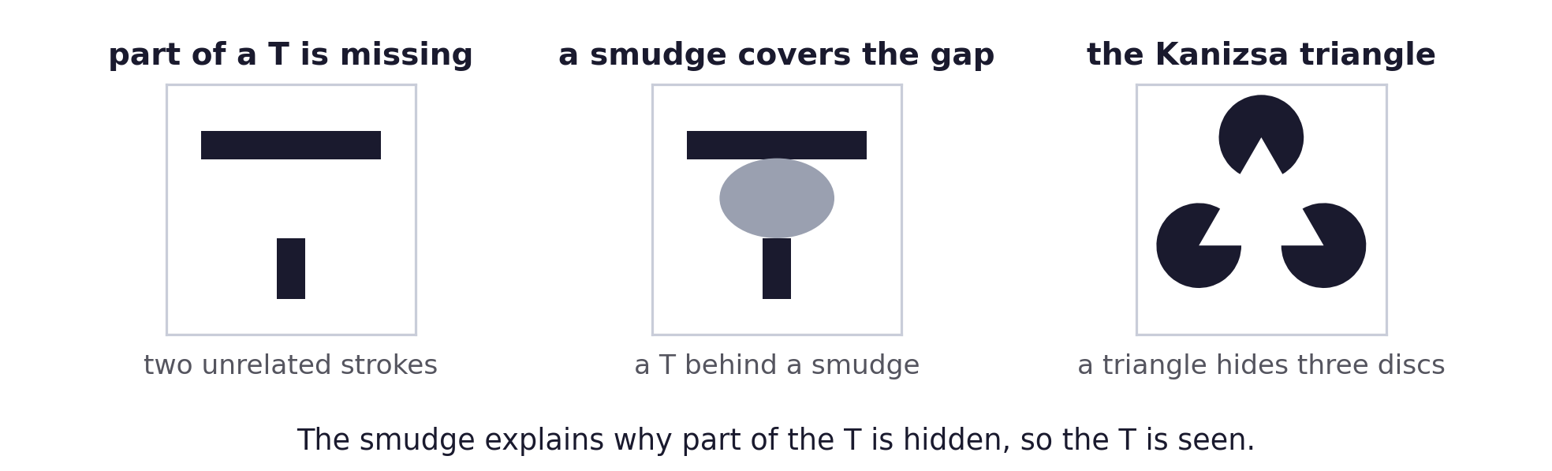
Explaining away
Explaining away in vision
With part of the T missing, observers see two separate strokes.
A grey smudge over the gap explains why part of the T is hidden, and the T is seen.
The Kanizsa triangle works the same way: the triangle explains the gaps in the three discs.
G. Kanizsa, “Subjective contours,” Scientific American, 234(4):48–52, 1976.
Probabilities on Graphs · A. Yuille
29

Slide 30
5
Model selection
Decide which model generated the image, then estimate with that model.
Probabilities on Graphs · A. Yuille
30

Slide 31
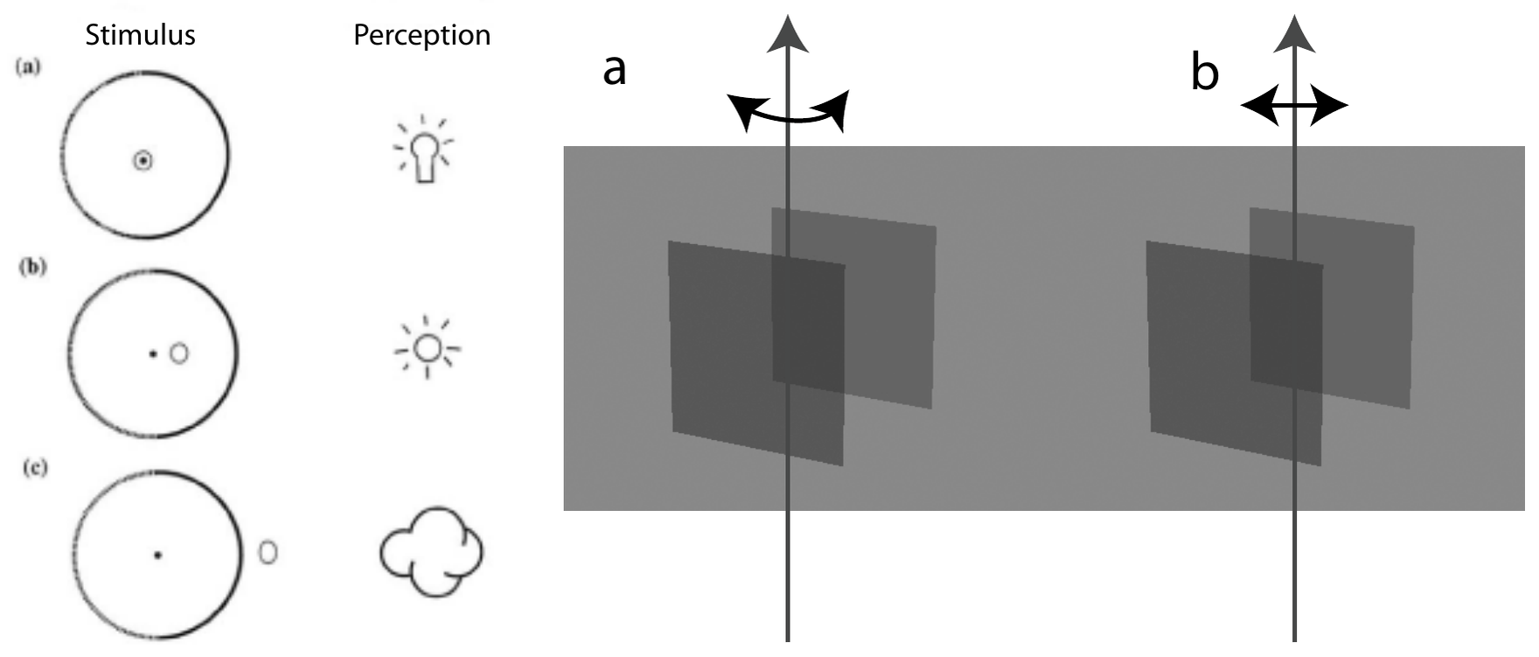
Model selection
Competing explanations of one image
A Lambertian sphere is viewed binocularly, and the highlight is placed at three different depths.
Small changes switch the percept between models, as they do for two rotating transparent planes.
A. Blake and H. Bülthoff, “Does the brain know the physics of specular reflection?” Nature, 343:165–168, 1990. · D. Kersten, H. H. Bülthoff, B. L. Schwartz and K. J. Kurtz, “Interaction between transparency and structure from motion,” Neural Computation, 4(4):573–589, 1992.
Probabilities on Graphs · A. Yuille
31

Slide 32
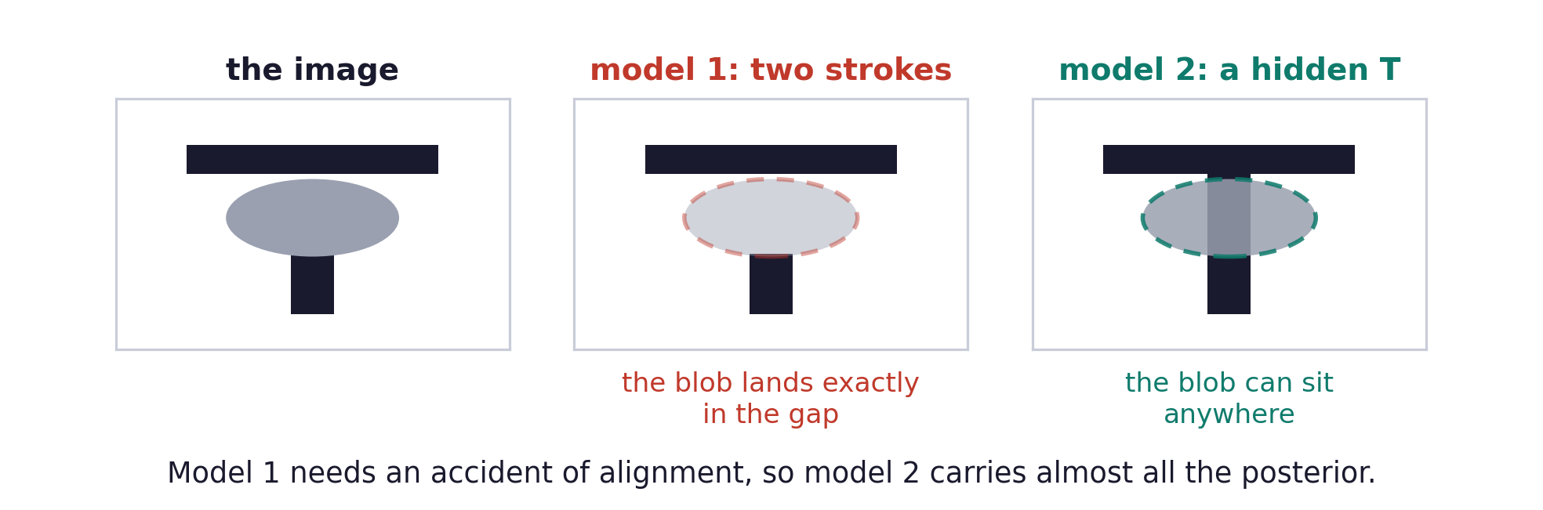
Model selection
Model selection and explaining away
The occluded T has two models: two strokes plus a blob, or a whole T hidden behind the blob.
The first needs the blob to land exactly in the gap, which would be an accident of viewpoint.
The Kanizsa triangle follows the same argument.
Probabilities on Graphs · A. Yuille
32

Slide 33
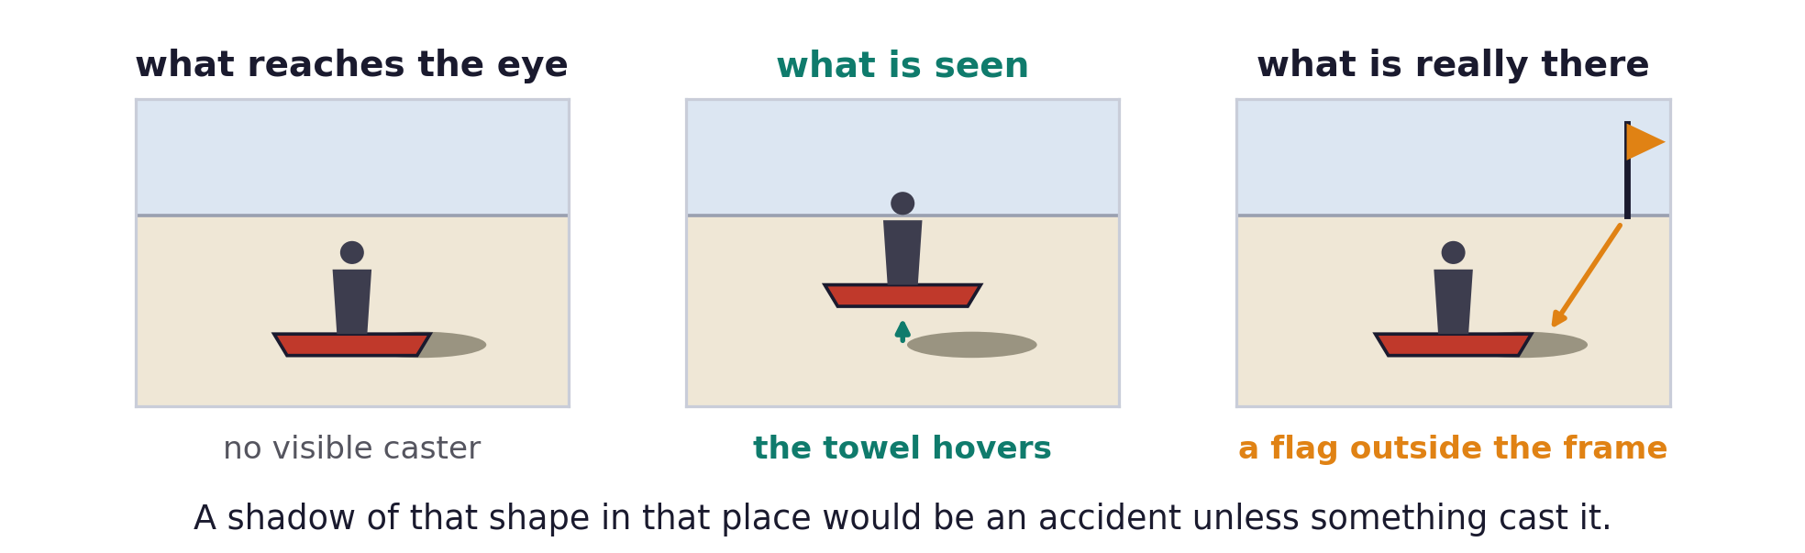
Model selection
The flying carpet revisited
The percept needs the ground plane, the segmentation of the woman and towel, and the shadow.
The generic viewpoint assumption says a shadow of that shape there would be an accident.
The object that cast it lies outside the image, so the shadow is attached to the towel.
W. T. Freeman, “The generic viewpoint assumption in a framework for visual perception,” Nature, 368:542–545, 1994.
Probabilities on Graphs · A. Yuille
33

Slide 34
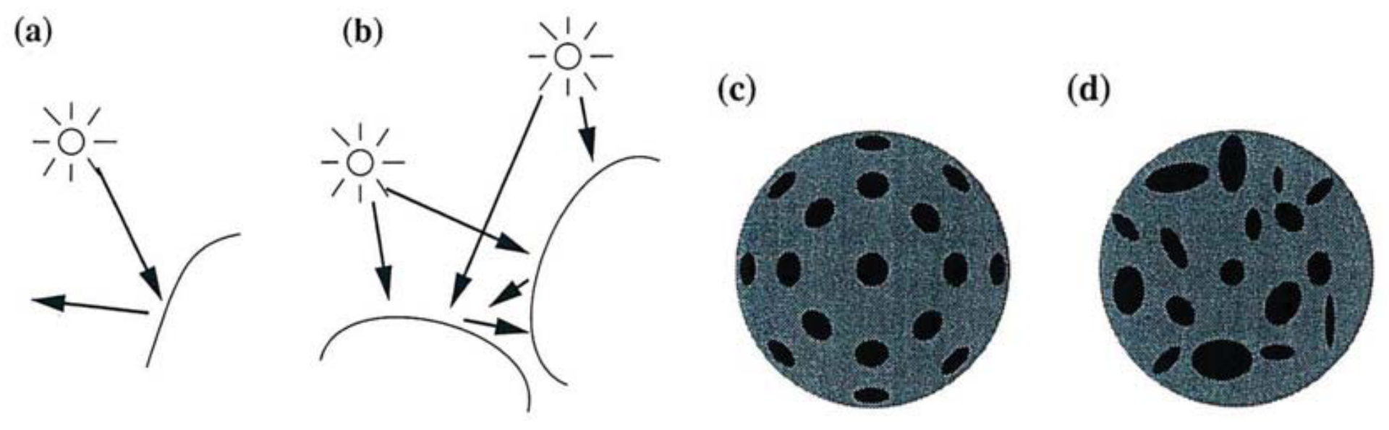
Model selection
Each cue is valid only in part of the image
Shape from shading works in (a), where one source lights a smooth convex surface.
It fails in (b), where the two surfaces reflect light onto each other.
Shape from texture works for the regular texture in (c) and fails for the irregular one in (d).
Probabilities on Graphs · A. Yuille
34

Slide 35
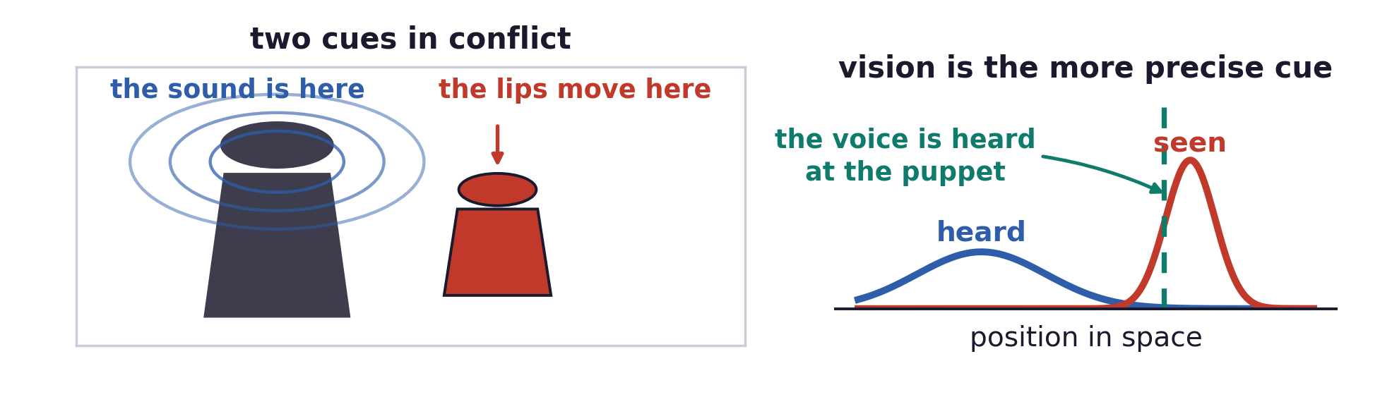
Model selection
The ventriloquism effect - audio and vision
Sight and sound sometimes have one cause, such as a barking dog, and sometimes two.
A ventriloquist makes the audience treat two causes as one.
The voice is then heard at the puppet, because vision is the more precise cue for position.
Probabilities on Graphs · A. Yuille
35

Slide 36
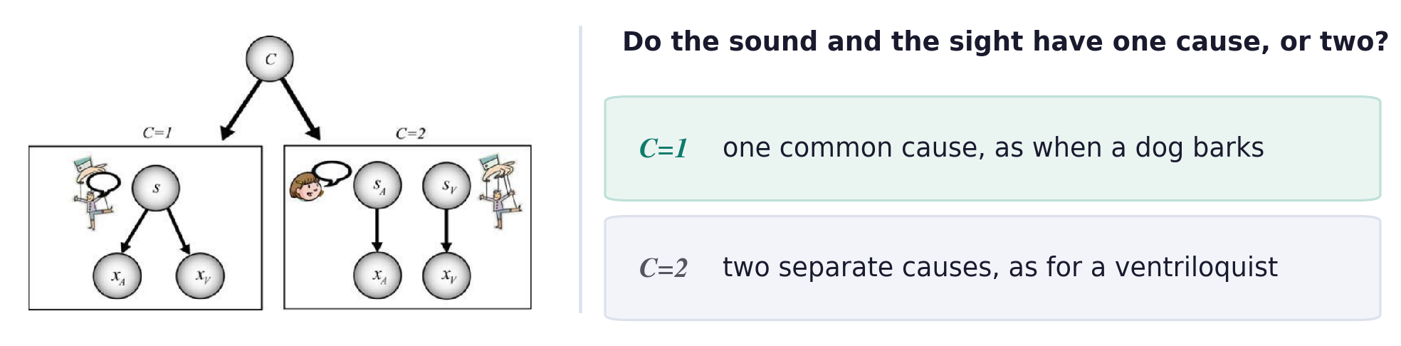
Model selection
A meta-variable for the number of causes
K. P. Körding, U. Beierholm, W. J. Ma, S. Quartz, J. B. Tenenbaum and L. Shams, “Causal inference in multisensory perception,” PLoS ONE, 2(9):e943, 2007.
Probabilities on Graphs · A. Yuille
36
Notes:
C is the meta-variable: C = 1 means one common cause, C = 2 means two separate causes.
e37_m1:
P(x_A,x_V\mid C\!=\!1)=\int\! dS\;P(x_A\mid S)\,P(x_V\mid S)\,P(S)
e37_m2:
P(x_A,x_V\mid C\!=\!2)=\iint\! dS_A\,dS_V\;P(x_A\mid S_A)\,P(x_V\mid S_V)\,P(S_A)\,P(S_V)

Slide 37
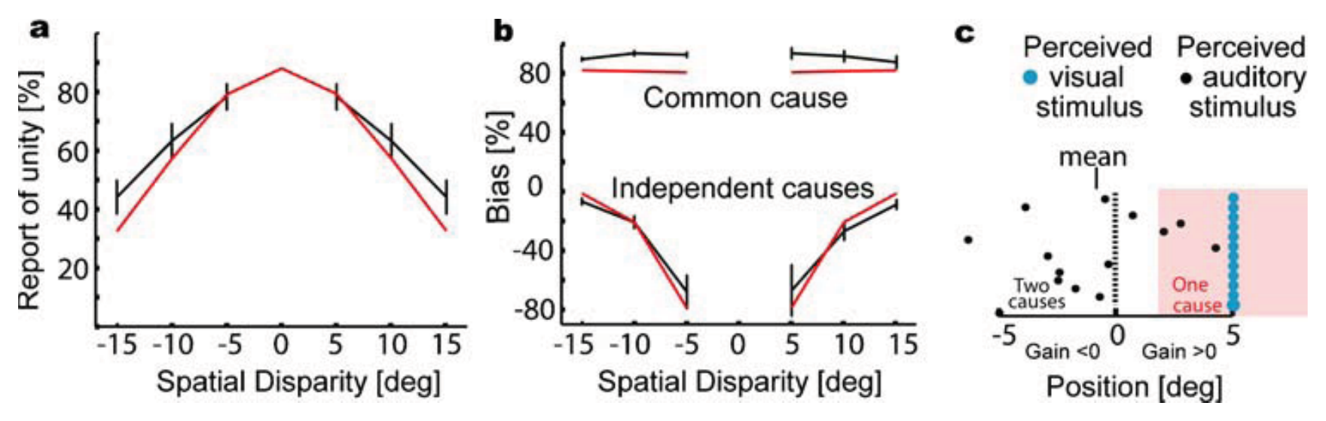
Model selection
Nearby cues are judged to have one cause
Subjects report one cause most often when the two stimuli are close together.
On trials judged to have one cause, vision captures the heard position almost completely.
On trials judged to have two causes the bias turns negative, and the sound is heard pushed away.
The causal inference model, in red, follows both curves, and the maths is in the handout.
M. T. Wallace, G. E. Roberson, W. D. Hairston, B. E. Stein, J. W. Vaughan and J. A. Schirillo, “Unifying multisensory signals across time and space,” Experimental Brain Research, 158, 2004.
Probabilities on Graphs · A. Yuille
37

Slide 38
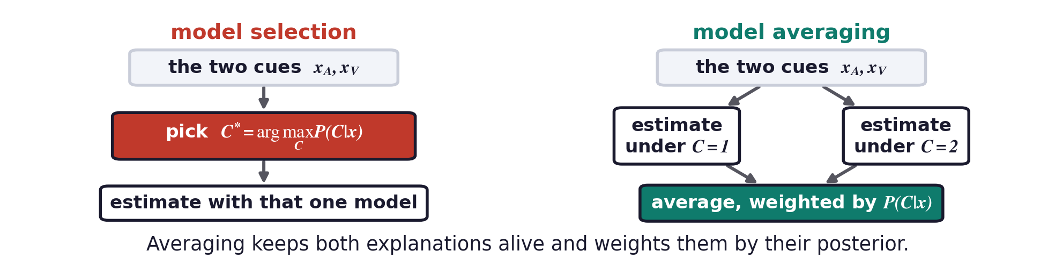
Model selection
Model selection versus model averaging
Model selection commits to the most probable model and estimates with that one.
Averaging keeps both models alive and weights them by their posterior probabilities.
The maths for both is in the handout.
Probabilities on Graphs · A. Yuille
38
Notes:
e39_avg:
P(s_A,s_V\mid x_A,x_V)=\sum_{C}P(s_A,s_V\mid x_A,x_V,C)\,P(C\mid x_A,x_V)
e39_sel:
C^{*}=\arg\max_{C}P(C\mid x_A,x_V)\,,\qquad P(s_A,s_V)\approx P(s_A,s_V\mid x_A,x_V,C^{*})

Slide 39
6
A network for diagnosis
Eight binary variables, eight small tables, one joint distribution.
Probabilities on Graphs · A. Yuille
39

Slide 40
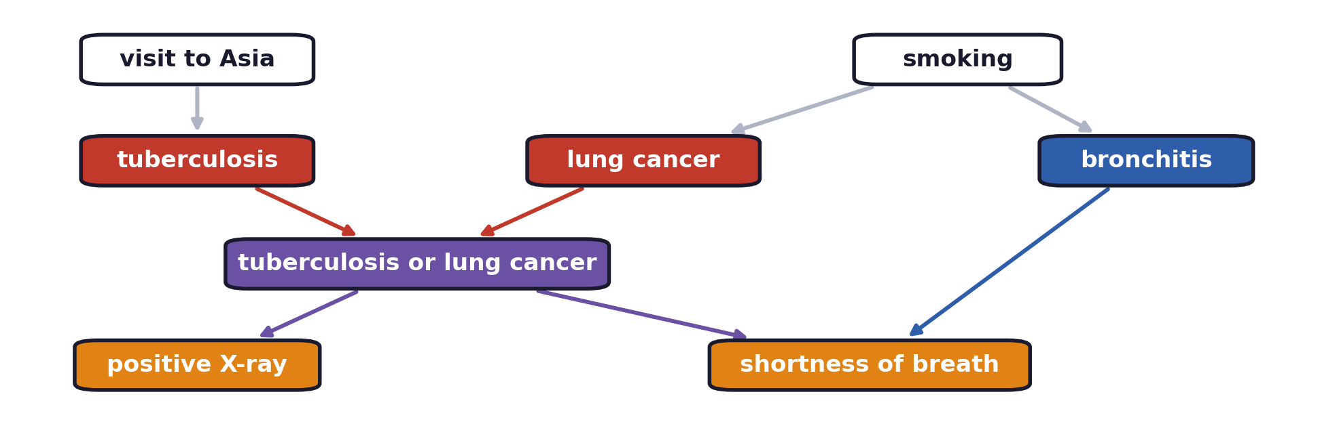
A network for diagnosis
The chest clinic network
Eight binary variables: two risk factors, three diseases, one combined node and two findings.
Every edge is a direct dependency, and the missing edges are the content of the model.
S. L. Lauritzen and D. J. Spiegelhalter, “Local computations with probabilities on graphical structures and their application to expert systems,” Journal of the Royal Statistical Society B, 50(2):157–224, 1988.
Probabilities on Graphs · A. Yuille
40

Slide 41
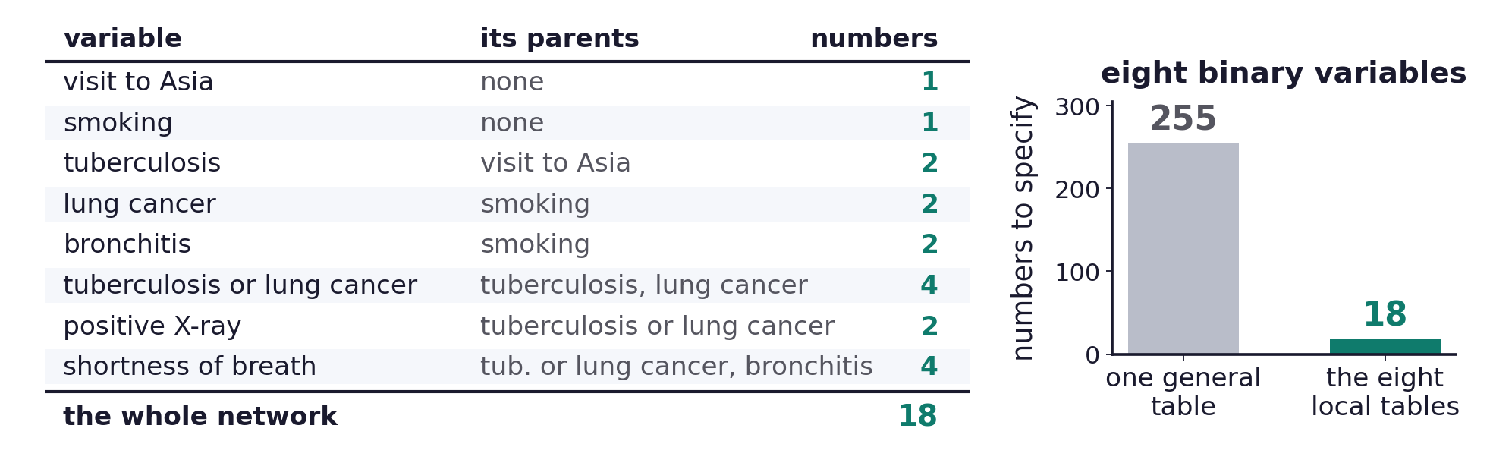
A network for diagnosis
One small table for each node
Eighteen numbers specify the whole network, in place of 255 for a general table.
Probabilities on Graphs · A. Yuille
41
Notes:
e42_asia:
\begin{aligned}P(\alpha,\sigma,\tau,\lambda,\beta,\varepsilon,\xi,\delta)=\;&P(\alpha)\,P(\sigma)\,P(\tau\mid\alpha)\,P(\lambda\mid\sigma)\,P(\beta\mid\sigma)\\[2pt]&\times\,P(\varepsilon\mid\tau,\lambda)\,P(\xi\mid\varepsilon)\,P(\delta\mid\varepsilon,\beta)\end{aligned}

Slide 42
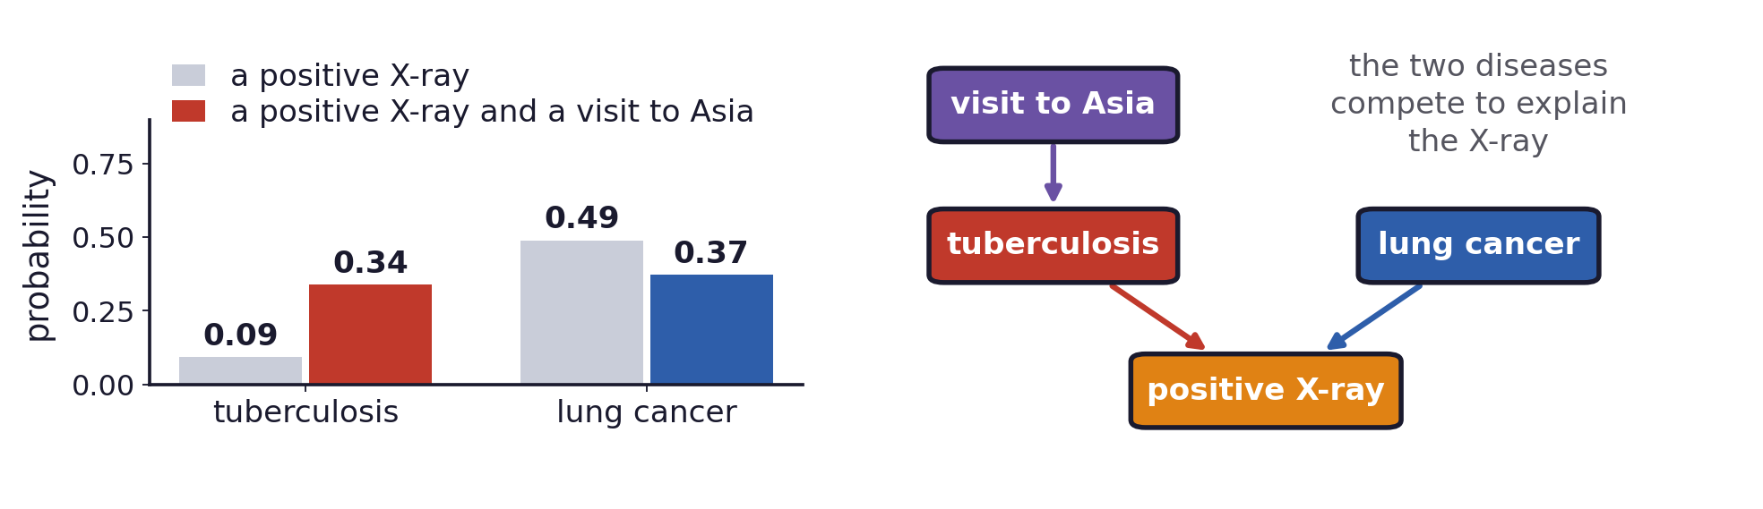
A network for diagnosis
Explaining away in the chest clinic
A positive X-ray raises both tuberculosis and lung cancer, and lung cancer is the more probable.
A recent visit to Asia raises tuberculosis, which then explains the X-ray on its own.
Lung cancer falls, although nothing was observed about smoking or about the lung.
The occluded T, the burglary alarm and this network share the same three-node shape.
Probabilities on Graphs · A. Yuille
42

Slide 43
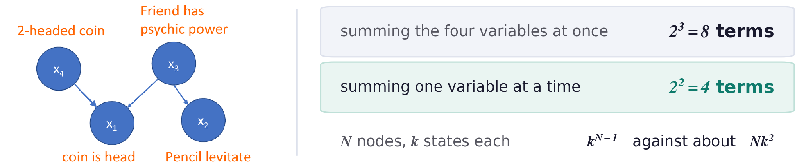
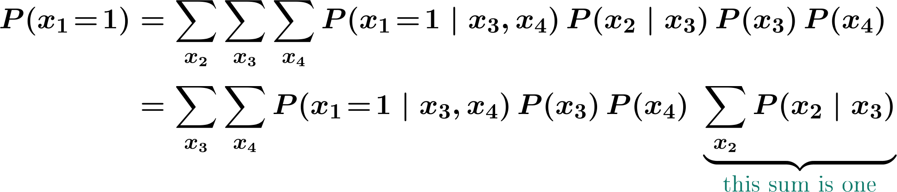
A network for diagnosis
The structure makes inference cheap
The graph must have no closed loops, and the cost is then polynomial in the number of nodes.
Figure from the course notes Vision as Bayesian Inference, Probability Distributions on Graphs.
Probabilities on Graphs · A. Yuille
43
Notes:
Direct: eight terms, one for each setting of the three summed variables. On the graph: the pencil variable is summed out once, its sum is one, and four terms remain. The source slide leaves the x4 to x1 edge without an arrowhead, though its own factorisation writes P(x1 | x4, x3); the head was drawn in.
e44_marg:
\begin{aligned}P(x_1\!=\!1)&=\sum_{x_2}\sum_{x_3}\sum_{x_4}P(x_1\!=\!1\mid x_3,x_4)\,P(x_2\mid x_3)\,P(x_3)\,P(x_4)\\[3pt]&=\sum_{x_3}\sum_{x_4}P(x_1\!=\!1\mid x_3,x_4)\,P(x_3)\,P(x_4)\;\underbrace{\sum_{x_2}P(x_2\mid x_3)}_{{\color{joint}\textrm{\fontsize{12}{14}\selectfont this sum is one}}}\end{aligned}

Slide 44
A network for diagnosis
Summary
A directed graph names the variables and says which of them directly influence which.
The joint distribution is the product of one conditional distribution per node, given its parents.
Two conditionally independent Gaussian cues with a uniform prior combine by inverse-variance weights.
Cues that share a prior are combined through the joint posterior, so the prior is applied once.
When cues depend on each other, or when the model itself is in question, the coupling is strong.
Observing a shared effect makes independent causes dependent, which is explaining away.
Inference uses the same structure: with no closed loops the cost stays polynomial.
Undirected graphs replace the parent conditionals by potentials on the edges.
Probabilities on Graphs · A. Yuille
44

