Slide 1
Regression, Perceptrons,
Backpropagation and
Convolutional Neural Networks
1 October, 2026
Alan Yuille · Probabilistic Models of the Visual Cortex

Slide 2
What this lecture covers
1
Regression versus Bayes
2
Linear regression, the perceptron
Learn the posterior P(y | x) from data
Least squares and logistic regression
3
Multi-layer perceptrons
4
Convolutional neural networks
Hidden units and backpropagation
Local shared filters, feature maps, pooling
5
AlexNet on ImageNet
6
Supervision and skip connections
Architecture, training and learnt filters
HED side outputs, ResNet and U-Net
Neural Networks · A. Yuille
2

Slide 3
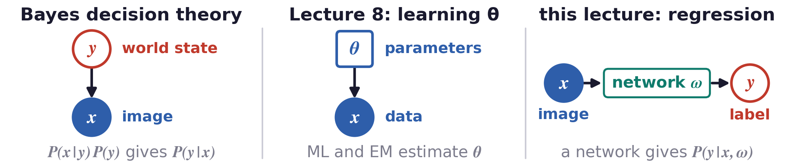
From Bayes decision theory to learning the posterior
The new question is: can we learn the posterior P(y | x) directly
from pairs (x, y), without a model of the images?
Bayes decision theory (BDT) decides from the posterior P(y | x), from the likelihood and the prior.
Lecture 8 learnt parameters θ by maximum likelihood (ML) and expectation-maximisation (EM).
Deep networks learn P(y | x, ω), where ω are the weights of the network.
Neural Networks · A. Yuille
3

Slide 4
Regression versus Bayes
1
The decision needs only the posterior:
learn P(y | x) directly from pairs (x, y).
Neural Networks · A. Yuille
4

Slide 5
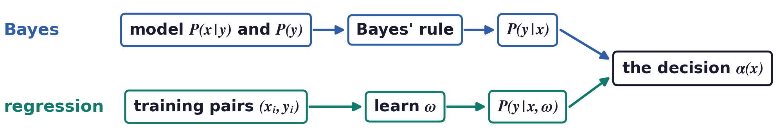
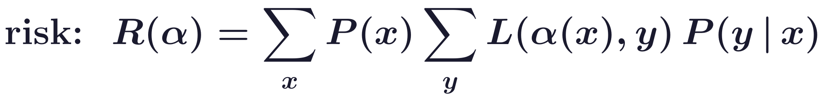
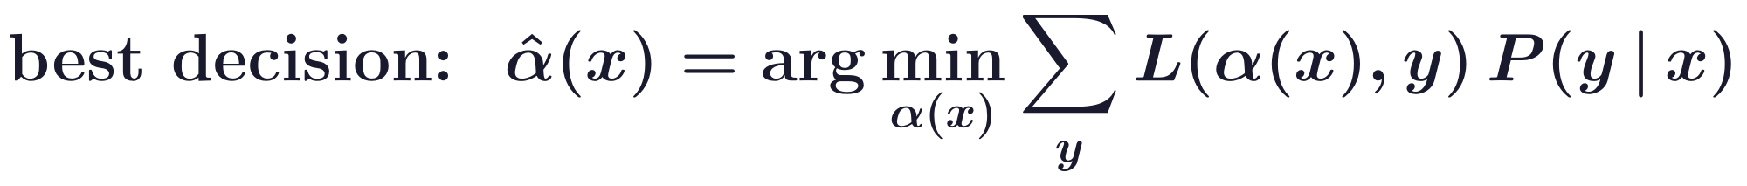
Regression versus Bayes
The decision rule depends only on the posterior P(y | x)
The Bayesian approach is formulated in terms of the joint probability distribution P(x, y) = P(x | y) P(y).
But the decision rule α(x), which minimises the risk for a loss L, depends only on the posterior P(y | x).
So maybe we only need to learn P(y | x) instead of P(x | y) P(y)?
Neural Networks · A. Yuille
5

Slide 6
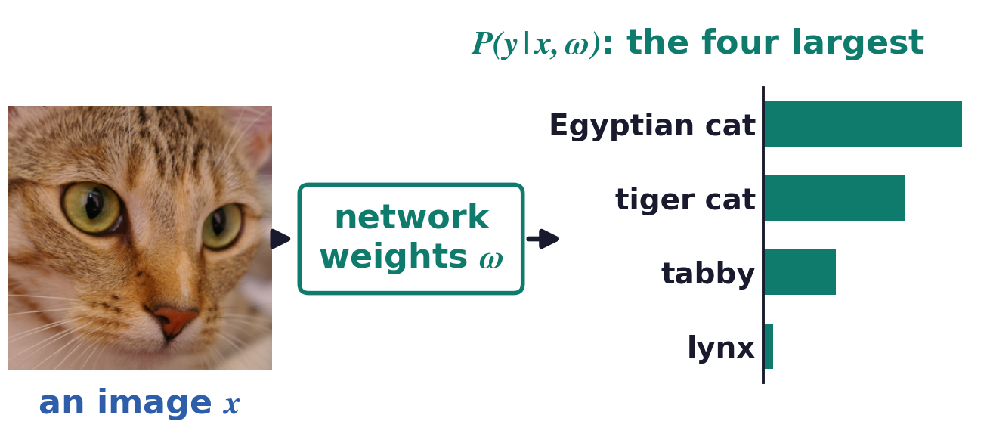
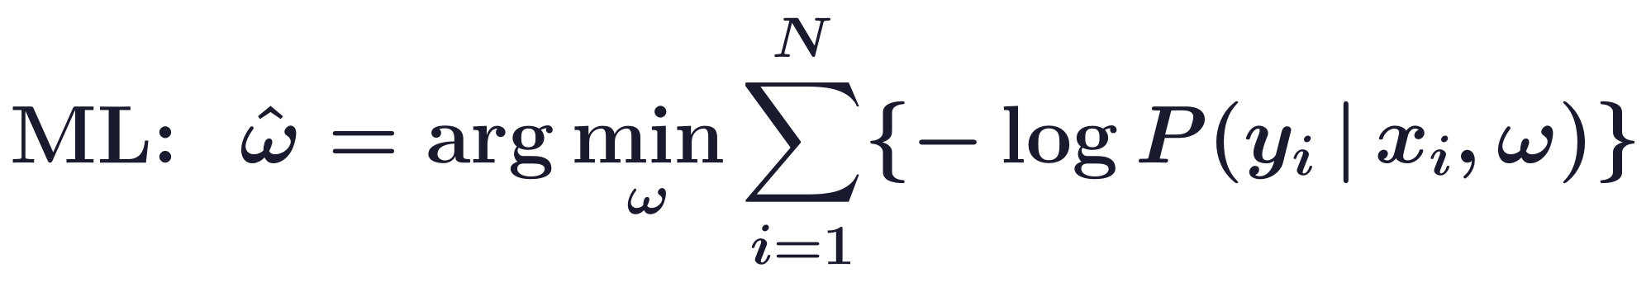
Regression versus Bayes
Learning P(y | x) from data is called regression
This requires a family of distributions P(y | x, ω), specified by ω, and estimating ω from the data by ML.
Deep nets are models of this type, where ω are the network weights; the chart is the output of one.
Confusingly, some neural network authors use “regression” only if y is a continuous variable.
Photograph: “chelsea”, scikit-image sample data (CC0). Output: AlexNet (Krizhevsky et al., 2012).
Neural Networks · A. Yuille
6

Slide 7
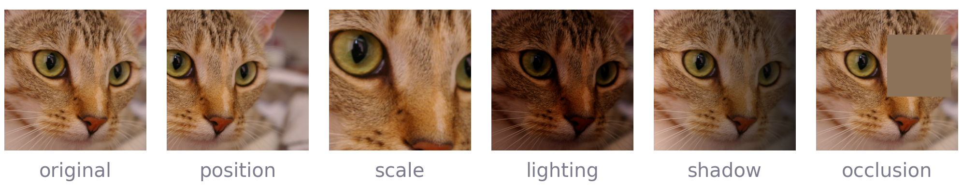
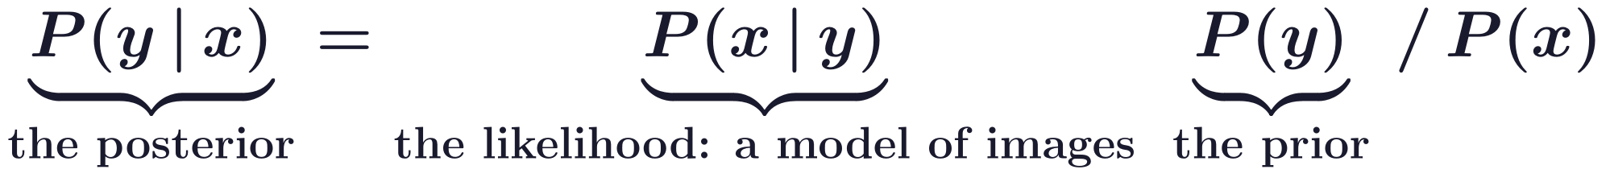
Regression versus Bayes
The true posterior depends on the likelihood and the prior
The likelihood P(x | y) is very complex: it requires specifying a probability distribution on images {x}.
For object detection, P(x | y) should be capable of generating all possible images of the object y.
Images are complicated and very high dimensional, so such generative models are very difficult to learn.
P(x | y = cat) must assign probability to all these images of one cat, and to every other cat.
Neural Networks · A. Yuille
7

Slide 8
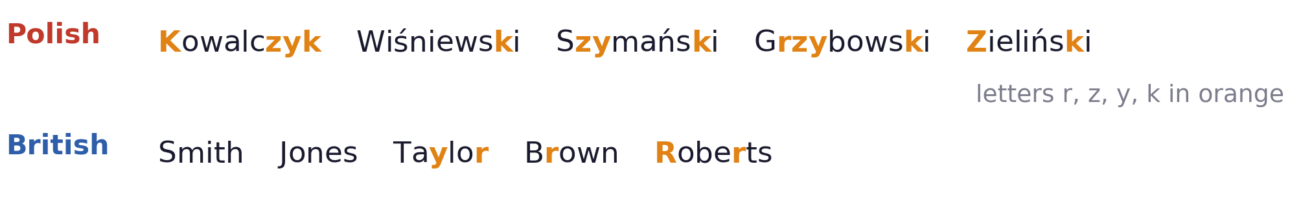
Regression versus Bayes
Some visual tasks may not need a model of the images
Deep networks may be good enough: some tasks on some domains may not need to achieve Bayes risk.
Polish or British surnames: frequencies of r, z, y, k may suffice, without a model that generates them.
To recognise a car we may not need its details: its type, its parts and boundaries, clean or dirty.
But this also depends on the data domains: the training and test sets.
Neural Networks · A. Yuille
8

Slide 9
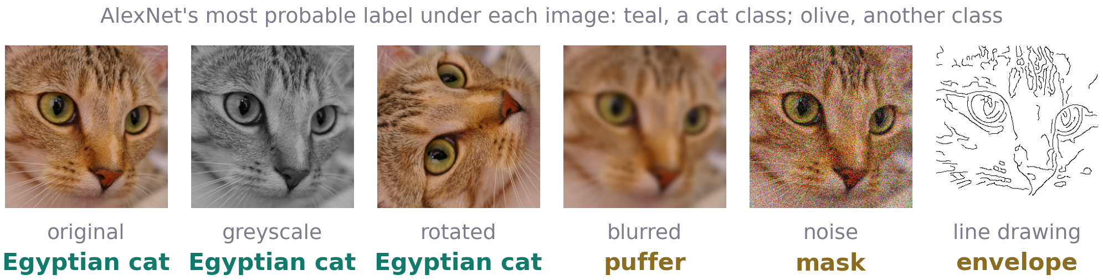
Regression versus Bayes
Training and test sets are too small
A training set specifies a domain; regression methods perform well on data from the same domain.
Trained on one domain, algorithms can fail on another, and on small changes that would not fool a human.
A CEO: “Existing methods do not work on big datasets because there are too many corner cases.”
Pragmatically, test deep networks on ever more challenging data: out-of-distribution, adversarial.
Neural Networks · A. Yuille
9

Slide 10
Linear regression,
the perceptron
2
Least squares fits a line;
a hyperplane separates two classes, softly in logistic regression.
Neural Networks · A. Yuille
10

Slide 11
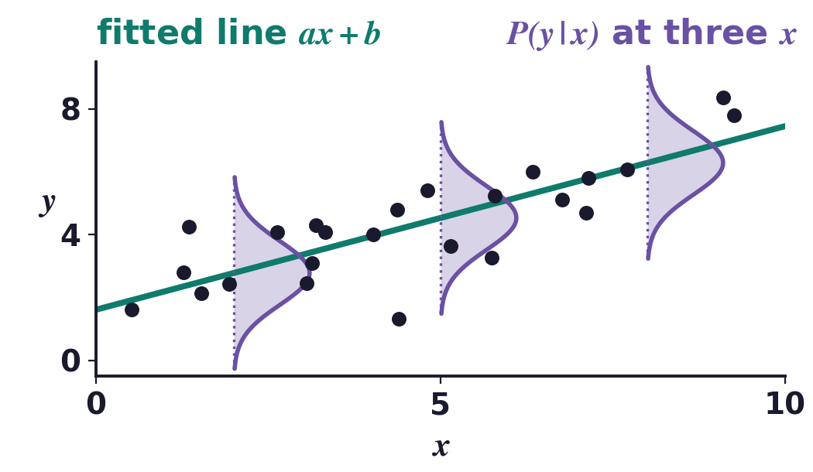
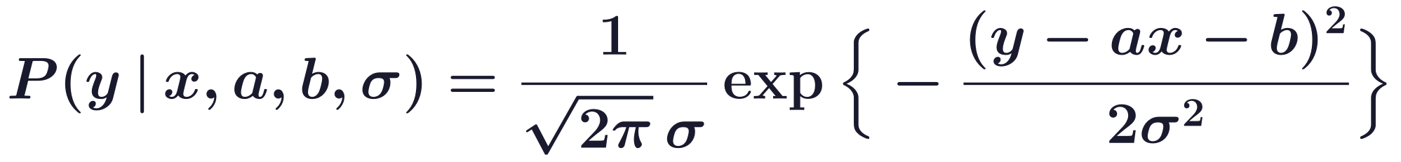
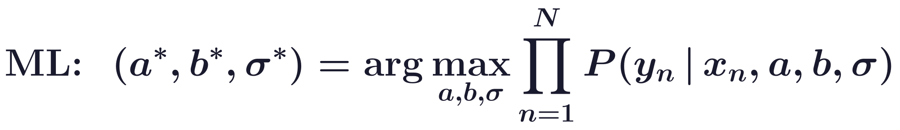
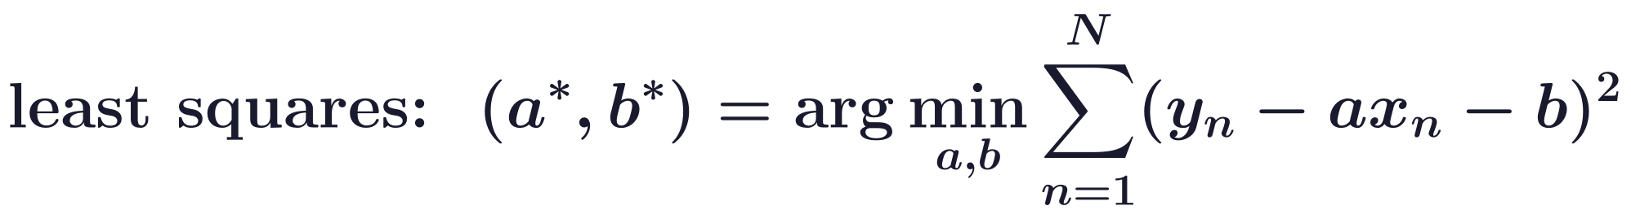
Linear regression, the perceptron
Linear regression: maximum likelihood gives least squares
Invented by Gauss (roughly 1800) to find Ceres, by predicting its position from previous estimates.
The model: y = ax + b + ε, with unknown parameters a, b and zero-mean Gaussian noise ε of variance σ².
For a, b, maximum likelihood is least squares: linear equations for a*, b*. It extends to vectors.
C. F. Gauss, Theoria motus corporum coelestium in sectionibus conicis solem ambientium, Perthes and Besser, Hamburg, 1809.
Neural Networks · A. Yuille
11

Slide 12
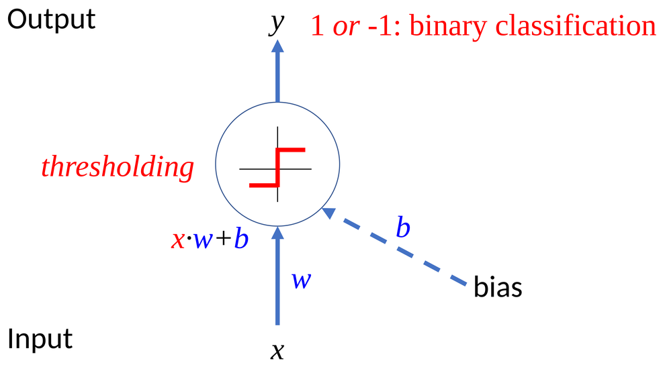
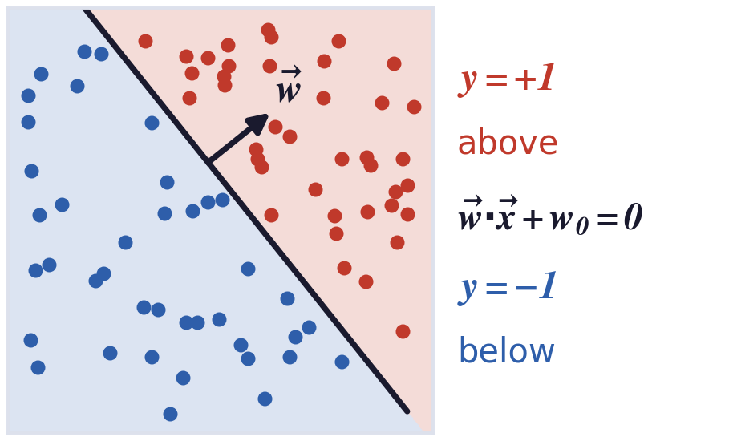
Linear regression, the perceptron
The perceptron classifies by the side of a hyperplane
The Perceptron was developed by Rosenblatt in the 1950s and started the first wave of neural networks.
A simplified neuron: x are the synaptic inputs, w the weights, −w0 the threshold (b in the figure).
F. Rosenblatt, “The perceptron: a probabilistic model for information storage and organization in the brain,”
Psychological Review, 65(6):386–408, 1958.
Neural Networks · A. Yuille
12

Slide 13
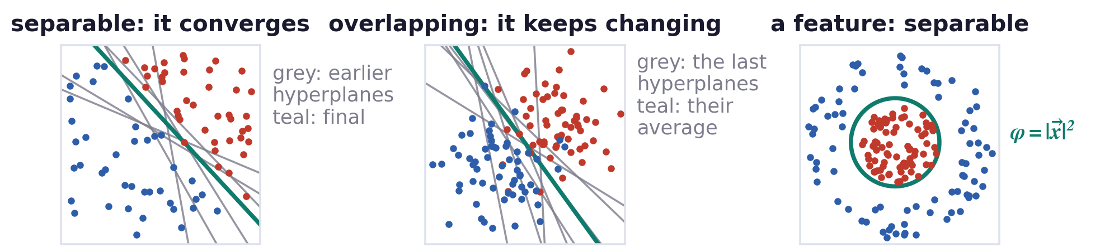
Linear regression, the perceptron
The perceptron algorithm converges on separable data
Rosenblatt's algorithm corrects w on each misclassified example; it converges if the data are separable.
Otherwise the weights keep changing; their average usually gives a good separator.
To make it useful, find features φ(x) in a principled way and apply the perceptron to those features.
Y. Freund and R. E. Schapire, “Large margin classification using the perceptron algorithm,” Machine Learning, 37(3):277–296, 1999.
Neural Networks · A. Yuille
13

Slide 14
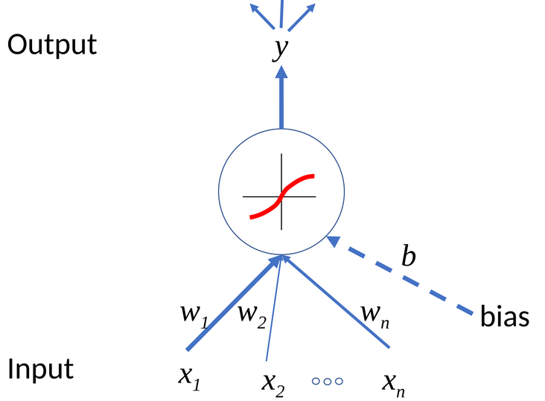
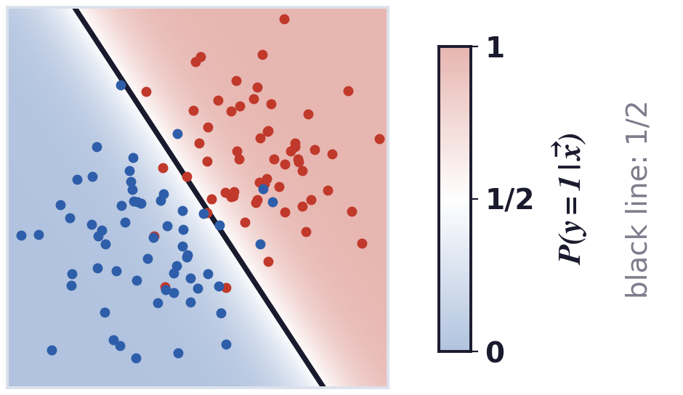
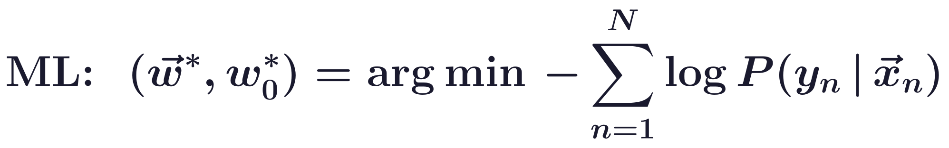
Linear regression, the perceptron
The perceptron as logistic regression
After learning, P(y = 1 | x) > 1/2 above the hyperplane and < 1/2 below: a soft separation.
Neural Networks · A. Yuille
14

Slide 15
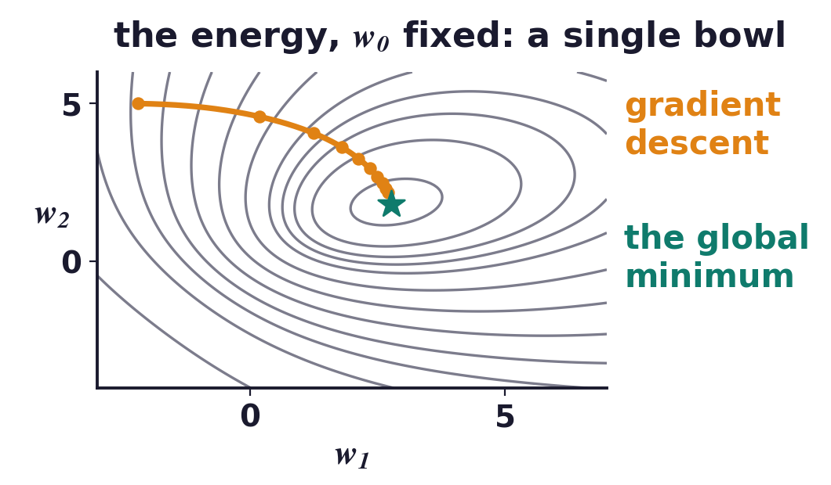
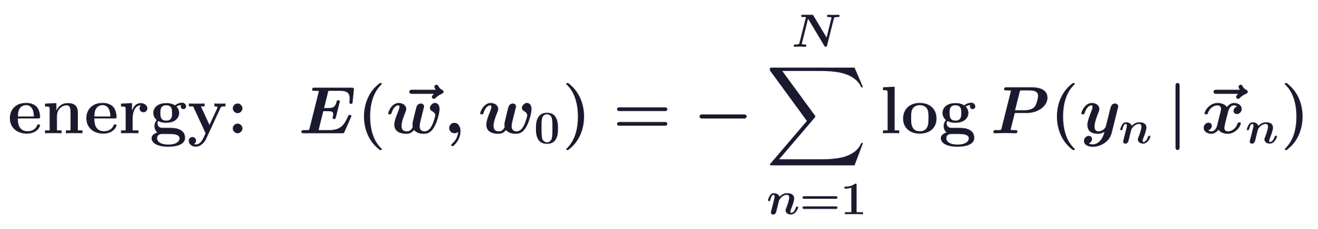
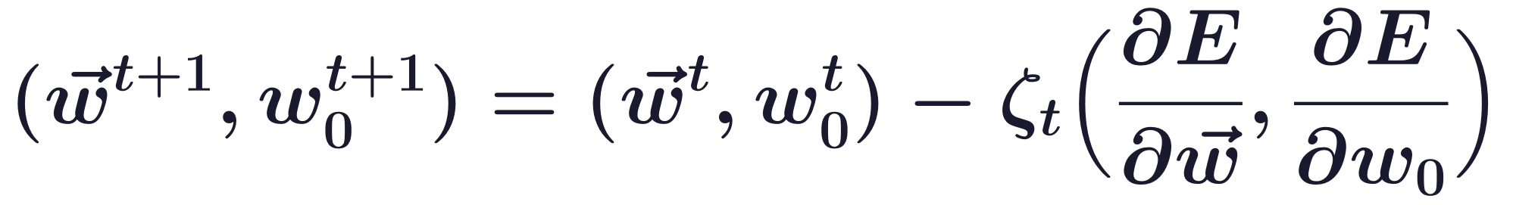
Linear regression, the perceptron
Logistic regression has a convex energy: no local minima
E is convex: gradient descent with a well-chosen learning rate ζ converges to the global optimum.
The optimum is finite when the two classes overlap; for separable data the weights grow without bound.
A fixed-point update, the concave-convex procedure (CCCP) of Lecture 7, converges with no learning rate.
Neural Networks · A. Yuille
15

Slide 16
Multi-layer perceptrons
3
Stack soft perceptrons;
backpropagation gives every weight its gradient by the chain rule.
Neural Networks · A. Yuille
16

Slide 17
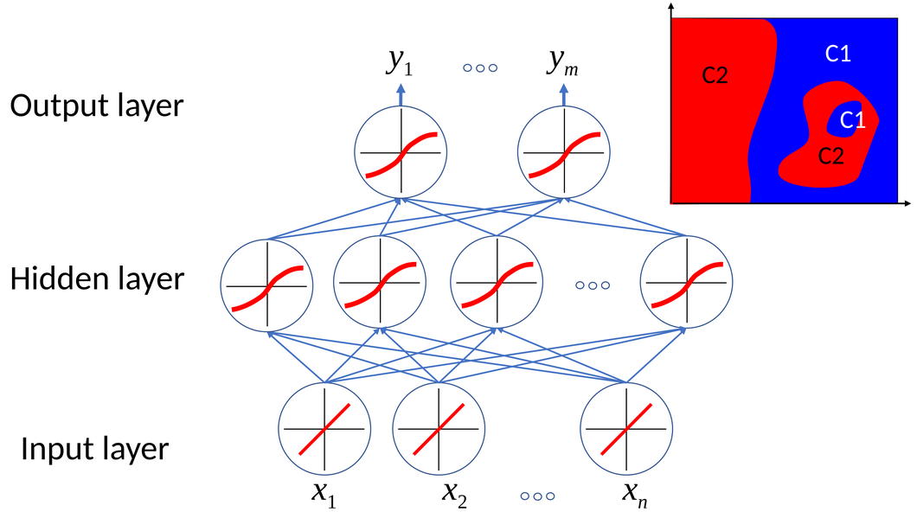
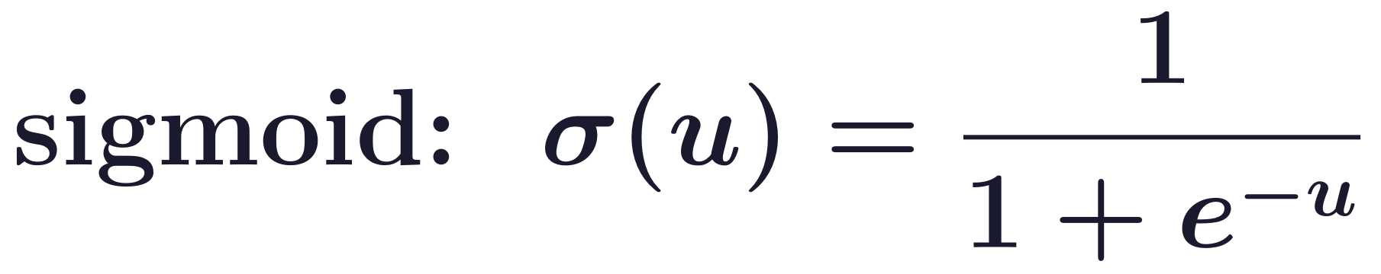

Multi-layer perceptrons
Multi-layer perceptrons stack soft perceptrons
Stacking perceptrons, each taking the outputs of others as input, gives a multi-layer perceptron (MLP).
In the example, hidden variables z are computed from x with weights Ω, and the output y from z with w.
The sigmoid σ is a soft threshold, so the output is a differentiable function of all the weights.
Minimising E is maximum likelihood for P(y | x) = (1/Z) exp{−E}, if the normaliser Z is free of the weights.
Neural Networks · A. Yuille
17

Slide 18
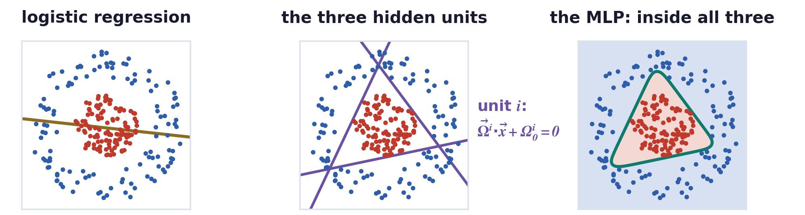
Multi-layer perceptrons
Three hidden units combine three hyperplanes
One hyperplane (logistic regression, olive) cannot enclose the disc; each hidden unit adds one (purple).
The output unit combines the three half-planes: here the positive class is the region inside all three.
All the weights, w and Ω, are learnt together by gradient descent on the energy E.
Neural Networks · A. Yuille
18

Slide 19
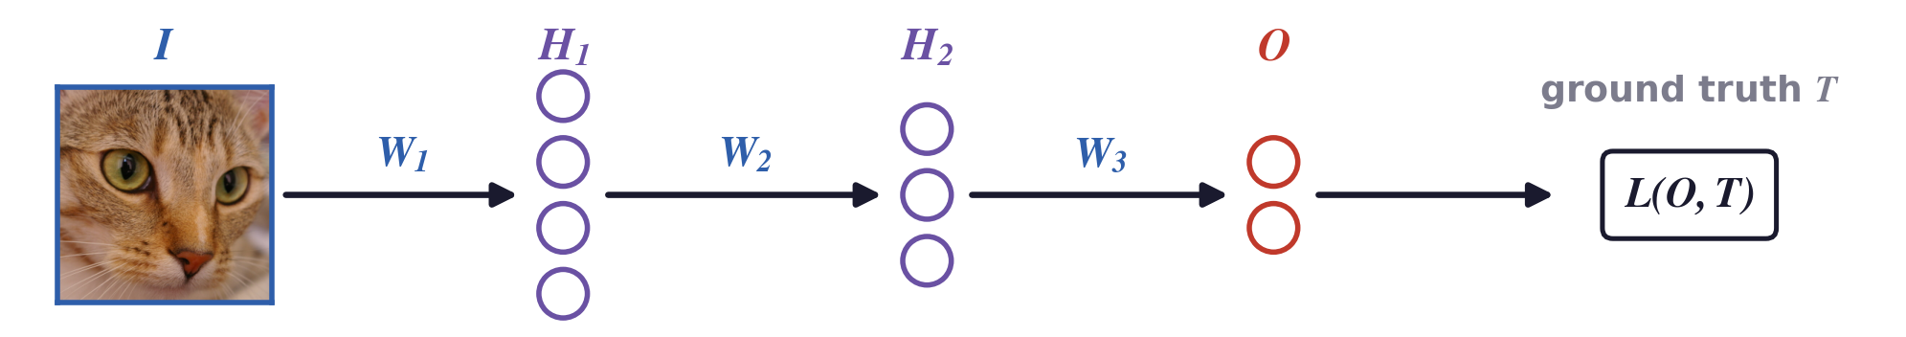
Multi-layer perceptrons
A deep network is a composition of differentiable functions
Input image I, hidden layers H1 and H2, output O: each a differentiable function of the layer below.
ReLU is the rectified linear unit, ReLU(u) = max(0, u), applied to each unit.
The loss L compares O with the ground truth T; W = (W1, W2, W3) are the weights ω of P(y | x, ω).
Neural Networks · A. Yuille
19

Slide 20
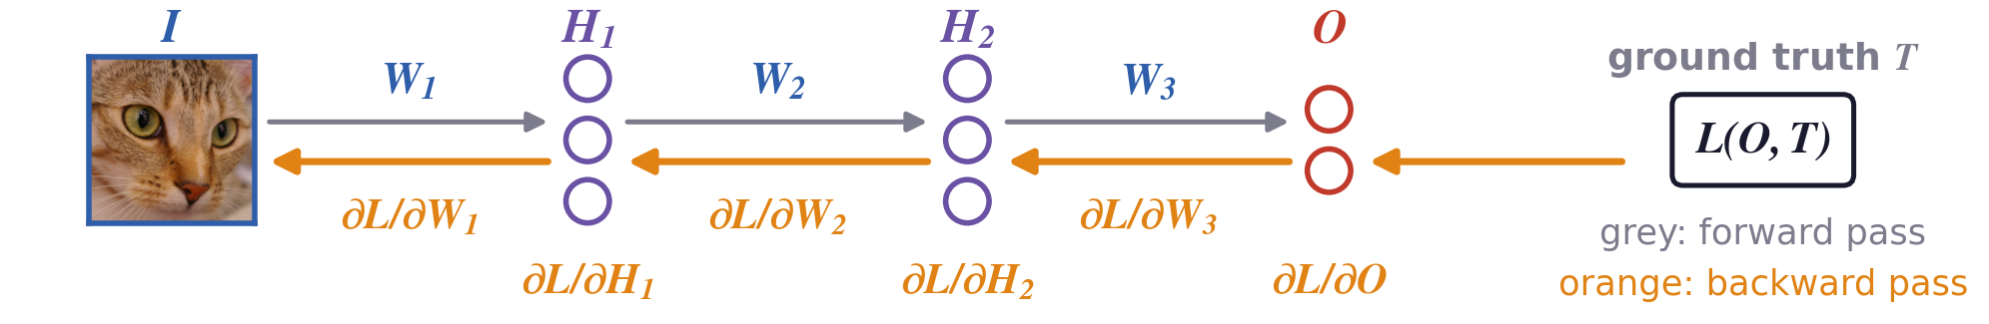
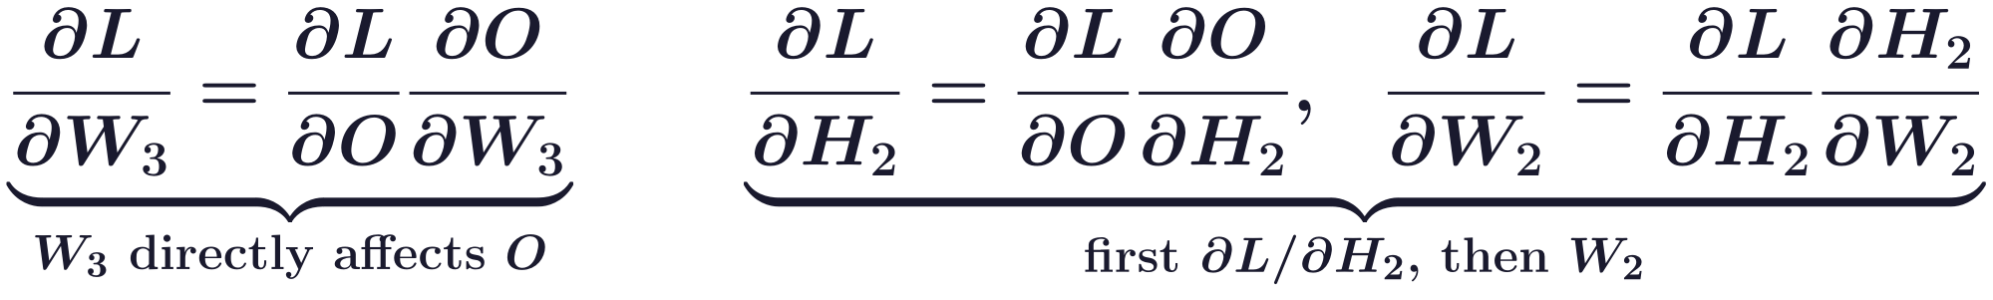
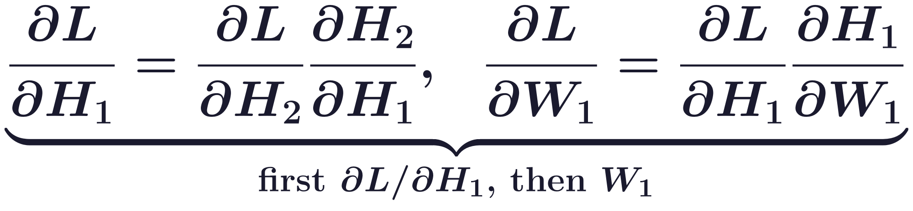
Multi-layer perceptrons
Backpropagation computes derivatives by the chain rule
Backpropagation: the error goes back to give credit to weights that do not directly affect the output.
D. E. Rumelhart, G. E. Hinton and R. J. Williams, “Learning representations by back-propagating errors,” Nature, 323(6088):533–536, 1986.
Neural Networks · A. Yuille
20

Slide 21
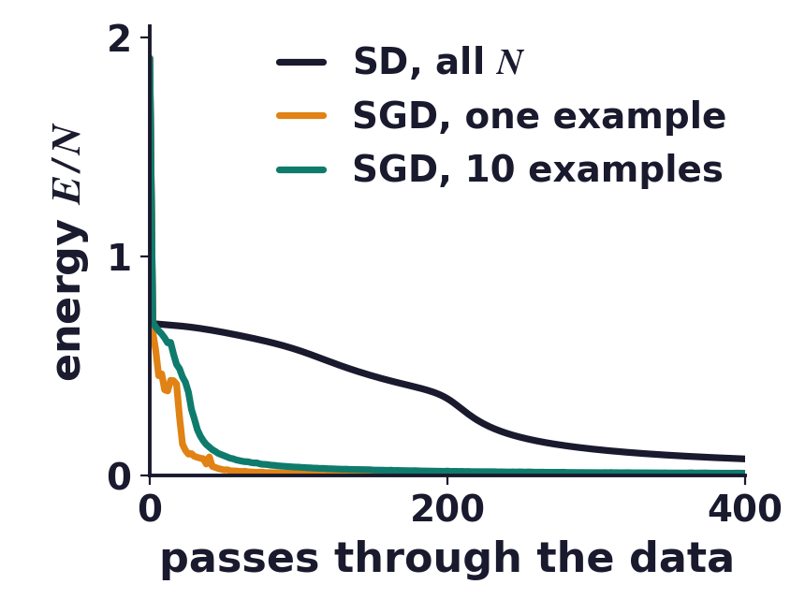
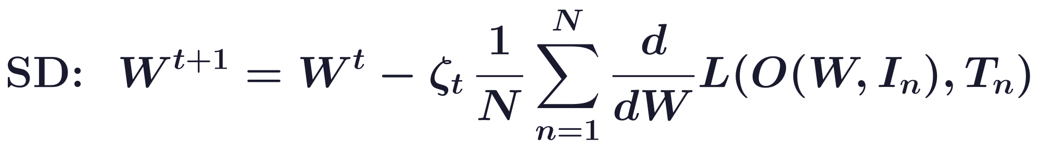
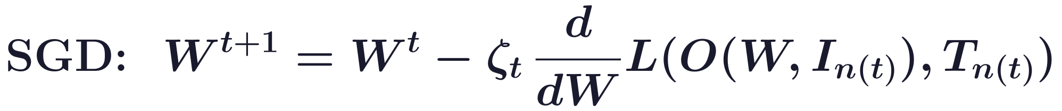
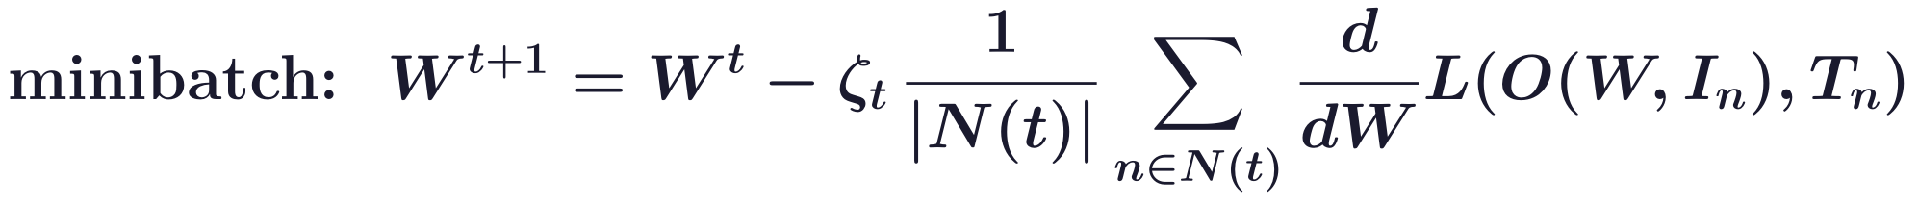
Multi-layer perceptrons
Stochastic gradient descent learns from random subsets
Steepest descent (SD) uses all N examples at each step; stochastic gradient descent (SGD) uses one.
In the second wave of neural networks (1980s), batch meant all examples at once; online meant SGD.
In the third wave (deep learning) datasets are too big for full batches: random subsets N(t) are used.
On the disc example, many cheap noisy steps lower the energy faster than a few exact ones.
Neural Networks · A. Yuille
21

Slide 22
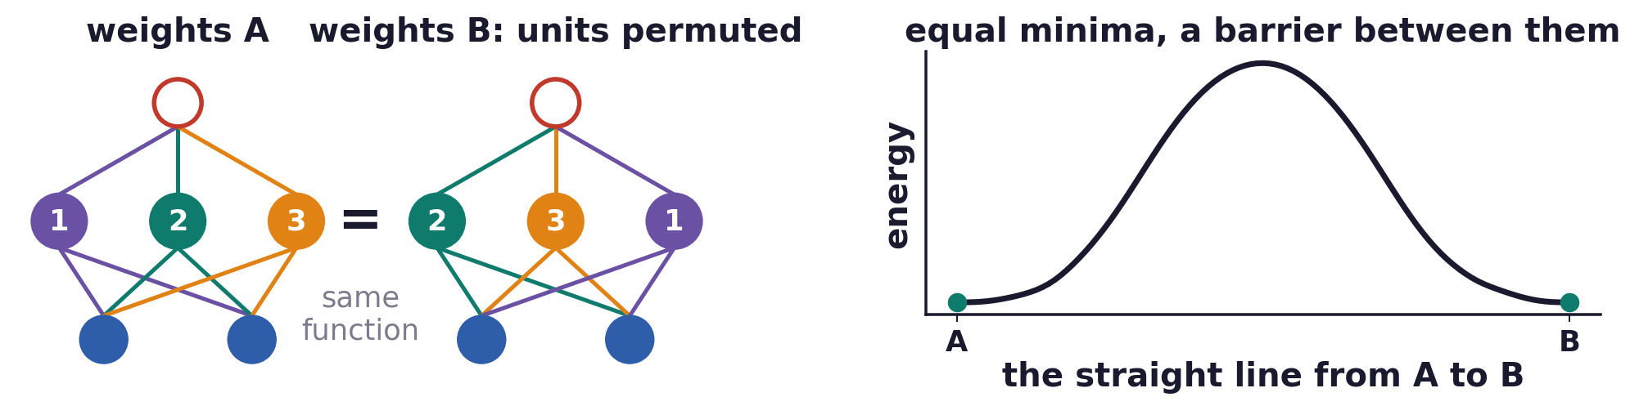
Multi-layer perceptrons
The energy is a non-convex function of the weights
Permuting the hidden units, together with their output weights, gives the same input-output function.
So every minimum has several copies with exactly the same energy; we only need to reach one.
Between two copies the energy rises: E is non-convex, and descent can stop at local minima or saddles.
SGD's randomness avoids some local minima; Robbins-Monro proofs of convergence exclude MLPs.
H. Robbins and S. Monro, “A stochastic approximation method,” Annals of Mathematical Statistics, 22(3):400–407, 1951.
Neural Networks · A. Yuille
22

Slide 23
Convolutional
neural networks
4
In a convolutional neural network (CNN) every hidden unit
applies the same local filter; pooling reduces resolution.
Neural Networks · A. Yuille
23

Slide 24
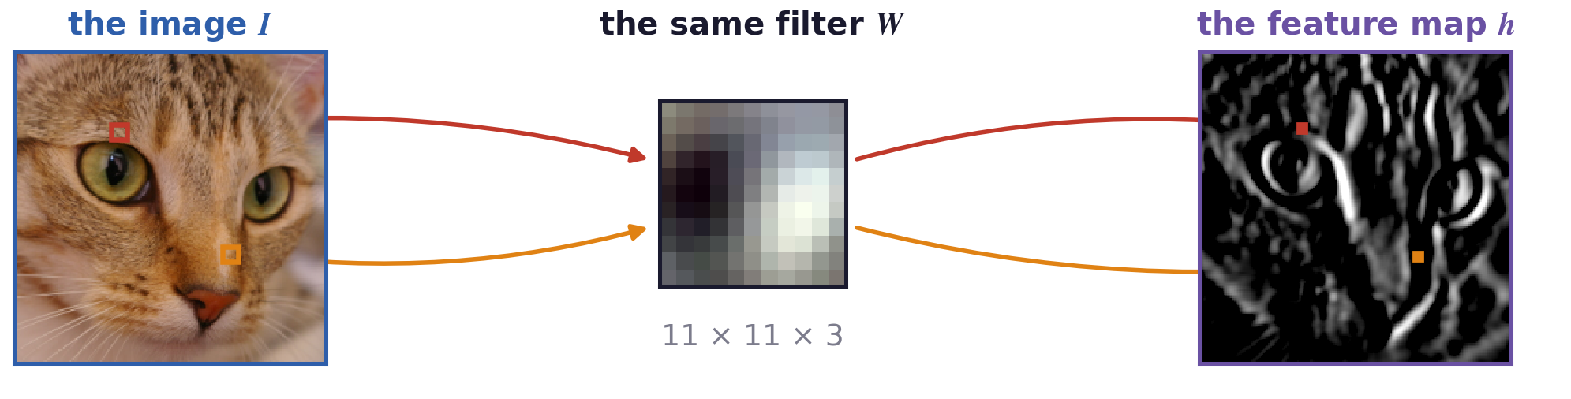
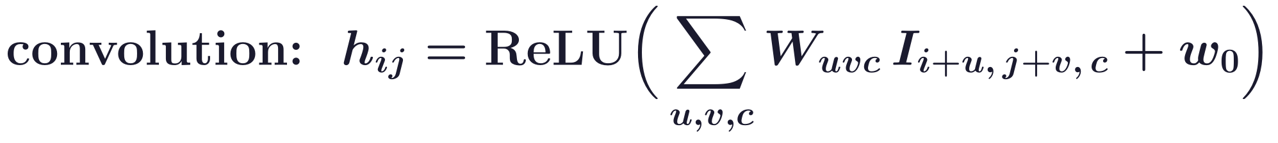
Convolutional neural networks
Each hidden neuron applies the same localized, linear filter
Local and shared: each neuron sees a small window, and all neurons of the map use the same weights W.
u, v run over the 11 × 11 window and c over the three colours; w0 is the bias.
This W, from AlexNet's first layer, responds where the image goes from dark on the left to light on the right.
Neural Networks · A. Yuille
24

Slide 25
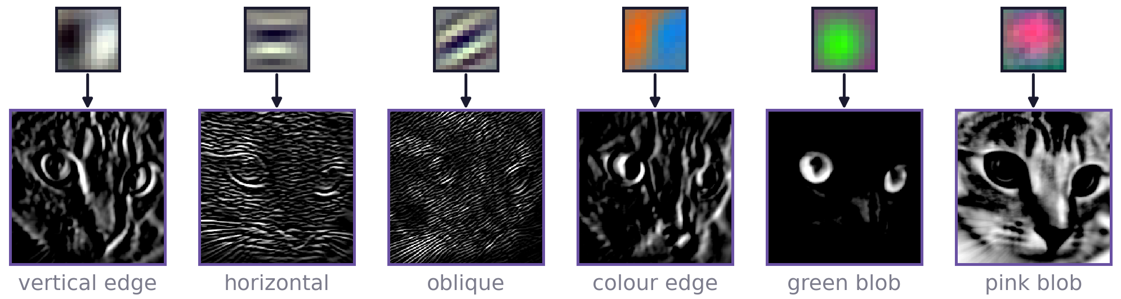
Convolutional neural networks
A bank of filters gives one feature map per filter
AlexNet's first layer has 96 filters of size 11 × 11 × 3, so its output is 96 feature maps, one per filter.
Each map shows where its feature is: the map of the green-blob filter lights up only at the eyes.
The next layer's filters are local in space and span many maps, combining the features at each position.
Neural Networks · A. Yuille
25

Slide 26
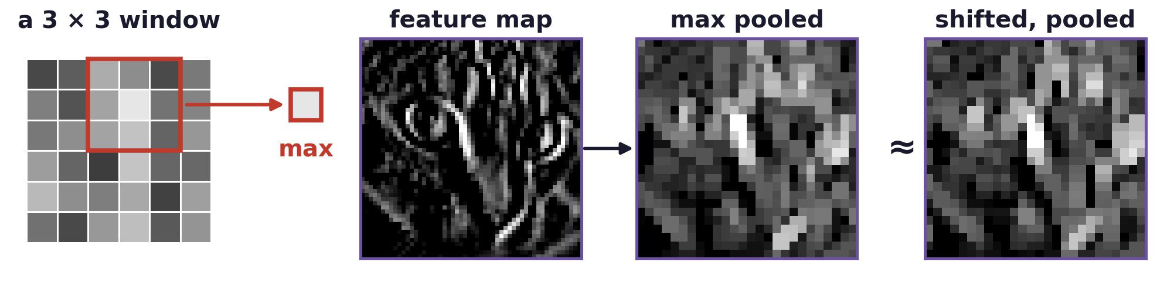
Convolutional neural networks
Local pooling keeps the largest response in each window
Max pooling keeps the largest value of each window (3 × 3, 2 pixels apart in AlexNet): lower resolution.
Deeper filters then cover a larger part of the image with the same number of weights.
Shifting the image by 4 pixels changes the pooled map less than the feature map: small shifts are tolerated.
Neural Networks · A. Yuille
26

Slide 27
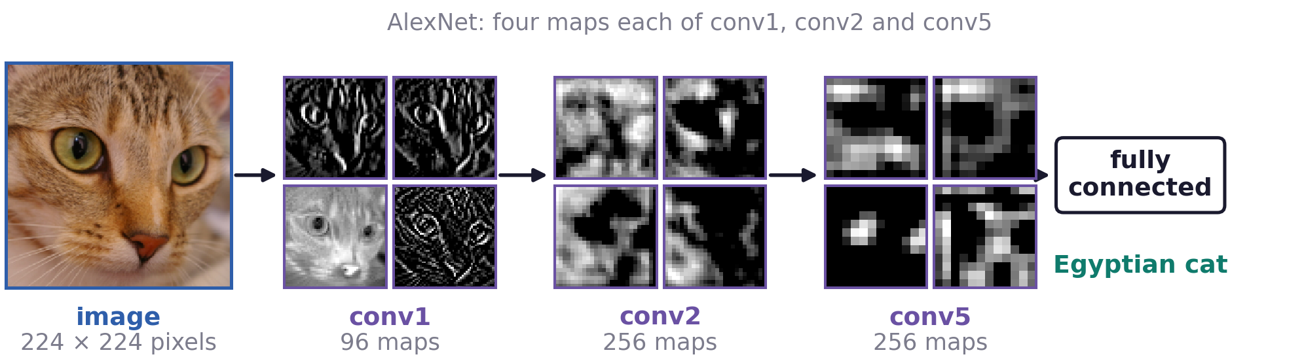
Convolutional neural networks
A deep CNN computes a hierarchy of feature maps
Each layer applies local filters to the maps of the layer below; pooling reduces the resolution.
Deeper maps are coarser and their units see larger regions: a conv5 unit sees most of the cat's face.
The hierarchy is motivated by conjectures about the mammalian visual system.
The fully connected layers at the top output P(y | x) over 1,000 classes.
Neural Networks · A. Yuille
27

Slide 28
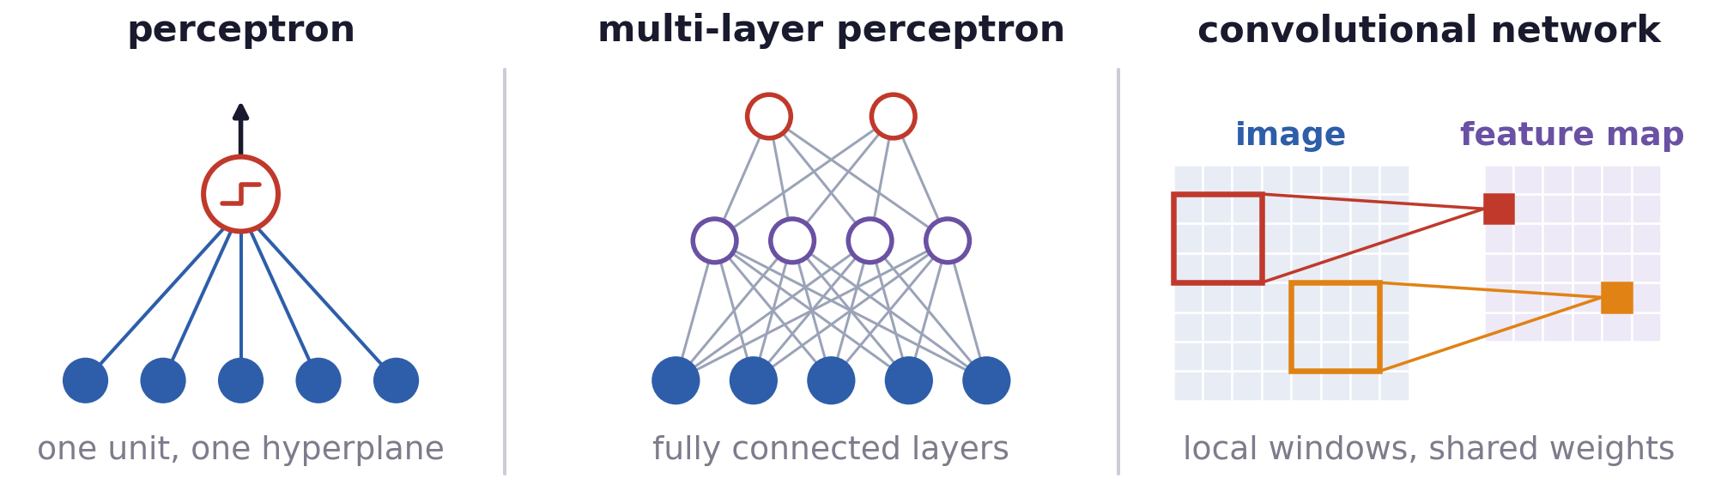
Convolutional neural networks
A CNN is an MLP with local, shared weights
Perceptron: one unit, one hyperplane. MLP: fully connected layers; every unit sees the whole layer below.
Fully connecting a 224 × 224 colour image to AlexNet's 55 × 55 × 96 first layer: 44 billion weights.
AlexNet's first convolutional layer needs about 35,000: 96 filters of 11 × 11 × 3, shared by all positions.
The soft perceptron, MLP and CNN are all trained by maximum likelihood, backpropagation and SGD.
Neural Networks · A. Yuille
28

Slide 29
AlexNet on ImageNet
5
Five convolutional and three fully connected layers
learn P(y | x) over 1,000 classes.
Neural Networks · A. Yuille
29

Slide 30
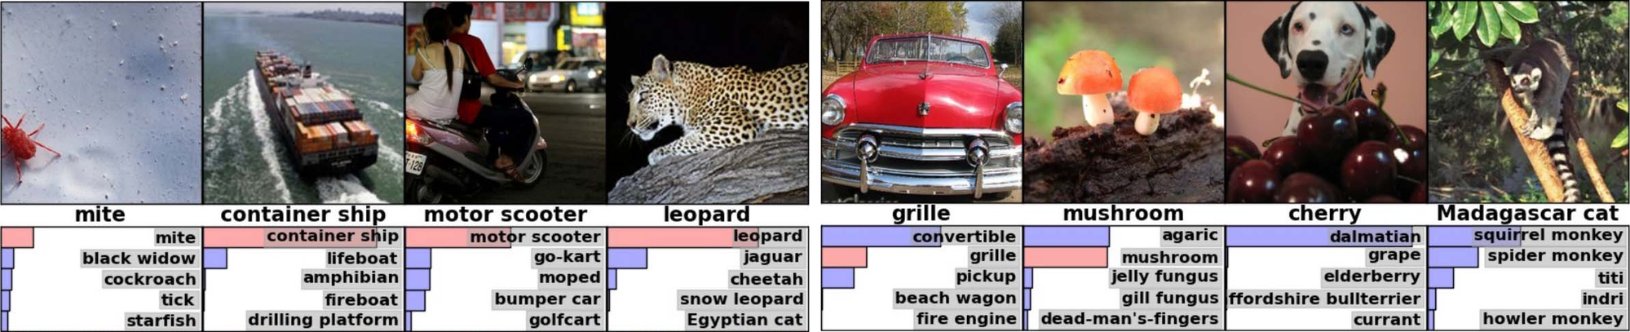
AlexNet on ImageNet
AlexNet classifies ImageNet images into 1,000 classes
ImageNet Large Scale Visual Recognition Challenge (ILSVRC): 1.2 million training images, 1,000 classes.
Deep: 7 hidden “weight” layers, plus the output layer. Entirely supervised. More data = good.
Learned: all feature extractors initialized at white Gaussian noise and learned from the data.
Below each image: its correct label, then the top five labels; bar length: probability, red: correct.
A. Krizhevsky, I. Sutskever and G. E. Hinton, “ImageNet classification with deep convolutional neural networks,” NIPS 25, 1097–1105, 2012.
J. Deng, W. Dong, R. Socher, L.-J. Li, K. Li and L. Fei-Fei, “ImageNet: a large-scale hierarchical image database,” CVPR, 248–255, 2009.
Figure: G. Hinton, slides on Krizhevsky, Sutskever and Hinton (2012).
Neural Networks · A. Yuille
30

Slide 31
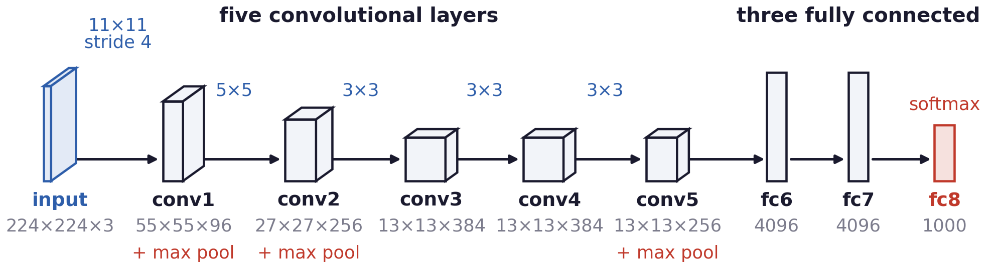
AlexNet on ImageNet
AlexNet: five convolutional and three fully connected layers
Max pooling follows conv1, conv2 and conv5; stride 4: conv1's window moves 4 pixels at a time.
650,000 neurons, 60 million parameters, 630 million connections; a 4096-dimensional final feature layer.
Trained with SGD on two graphics processors (GPUs) for about a week; the drawing merges the two.
Redrawn from Krizhevsky, Sutskever and Hinton (2012), Figure 2, as in Hinton's slides p. 12.
Neural Networks · A. Yuille
31

Slide 32
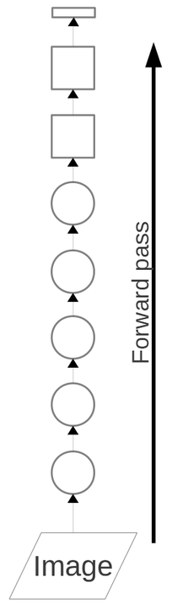
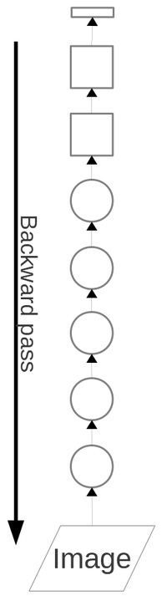
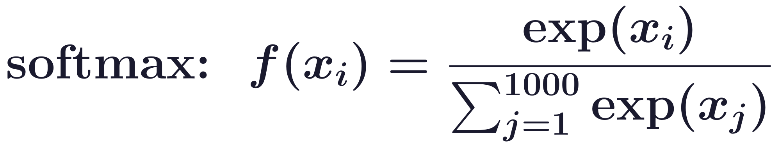
AlexNet on ImageNet
Training maximises the log-probability of the correct label
Trained by SGD and the backpropagation algorithm (just repeated application of the chain rule).
One output unit per class; the softmax f turns their total inputs into P(y | x, ω); t is the correct label.
With two classes the softmax is logistic regression. Circles: convolutional layers; squares: fully connected.
Figure: G. Hinton, slides on Krizhevsky, Sutskever and Hinton (2012).
Neural Networks · A. Yuille
32

Slide 33
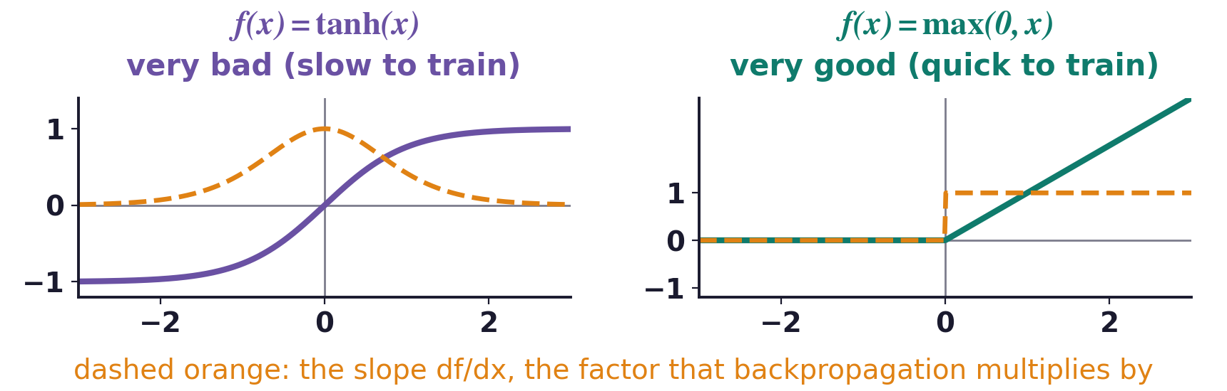
AlexNet on ImageNet
Rectified linear units train much faster than tanh units
The total input x of a neuron is a weighted sum of the outputs f(z) of the units below; f(x) is its output.
tanh saturates: for large |x| its slope is almost zero, and backpropagation multiplies the error by that slope.
Deep CNNs with ReLUs train several times faster than their equivalents with tanh units.
A. Krizhevsky, I. Sutskever and G. E. Hinton, “ImageNet classification with deep convolutional neural networks,” NIPS 25, 1097–1105, 2012.
Neural Networks · A. Yuille
33

Slide 34
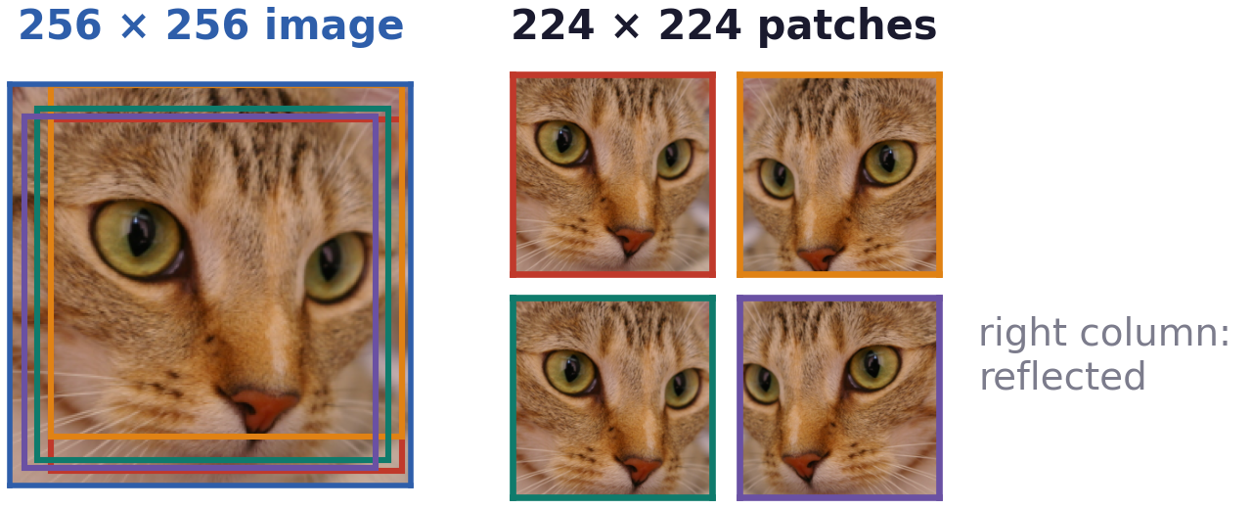
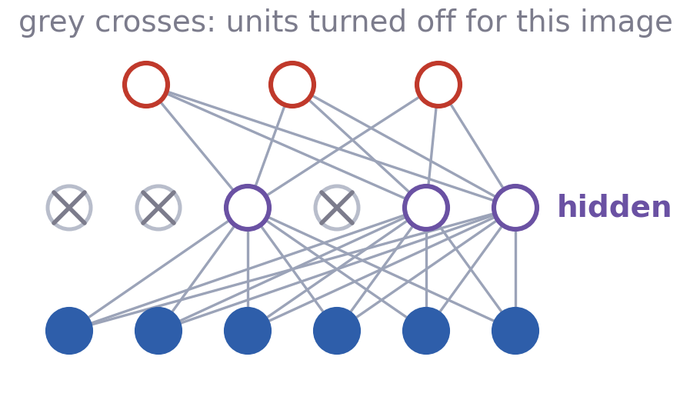
AlexNet on ImageNet
Data augmentation and dropout reduce overfitting
AlexNet has 60M real-valued parameters and 650,000 neurons. It overfits a lot.
So we train on random 224 × 224 patches of the 256 × 256 images, and on their horizontal reflections.
Dropout: set each hidden unit activity to zero with probability 0.5, in the two fully connected hidden layers.
Testing: average the predictions at five 224 × 224 patches (corners and centre) and their reflections.
Neural Networks · A. Yuille
34

Slide 35
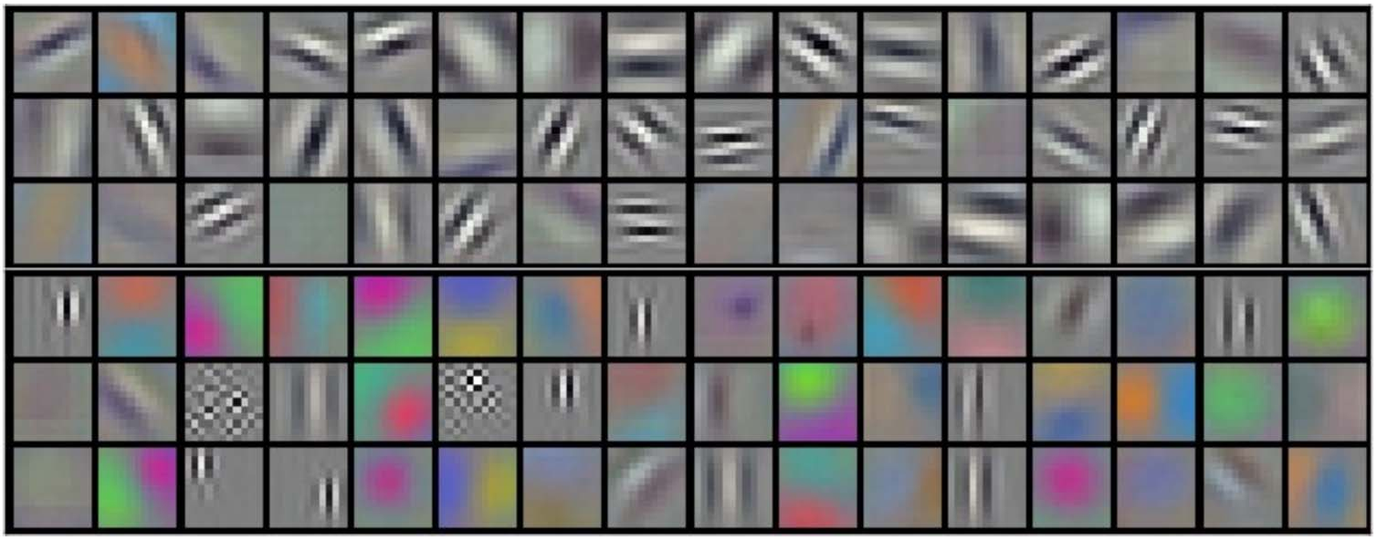
AlexNet on ImageNet
The first layer learns oriented edges and colour blobs
96 kernels (filters) of 11 × 11 × 3 in the first layer: the top 48 learned on one GPU, the rest on the other.
The network has learned frequency- and orientation-selective kernels, as well as various coloured blobs.
Many resemble the oriented receptive fields of simple cells in primary visual cortex (V1).
A. Krizhevsky, I. Sutskever and G. E. Hinton, “ImageNet classification with deep convolutional neural networks,” NIPS 25, 1097–1105, 2012.
Figure: G. Hinton, slides on Krizhevsky, Sutskever and Hinton (2012).
Neural Networks · A. Yuille
35

Slide 36

AlexNet on ImageNet
The 4096-dimensional features retrieve similar images
First column: query images from the ILSVRC-2010 test set; the other columns: retrieved training images.
The retrieved images have final feature vectors close to the query's, although their pose differs.
Figure: G. Hinton, slides on Krizhevsky, Sutskever and Hinton (2012).
Neural Networks · A. Yuille
36

Slide 37
Supervision and
skip connections
6
Fine-detail tasks need a label at every pixel:
supervise every level and carry fine detail forward.
Neural Networks · A. Yuille
37

Slide 38

Supervision and skip connections
Fine-detail tasks need a decision at every pixel
Deep networks first succeeded at object classification, a coarse task: one label per image.
They were rapidly adapted to fine-detail tasks, edges and semantic segmentation: a result per pixel.
A fully convolutional network (FCN) replaces fully connected layers by convolutions, then upsamples.
J. Long, E. Shelhamer and T. Darrell, “Fully convolutional networks for semantic segmentation,” CVPR, 3431–3440, 2015.
Neural Networks · A. Yuille
38

Slide 39

Supervision and skip connections
Edges occur at different scales in the image
Blur the image I with a Gaussian Gσ of standard deviation σ and take the derivative: edges at scale σ.
Small edges, such as texture, are blurred out by large σ; large edges remain as the blur grows.
There is information about edges at all scales, as exploited by statistical edge detectors.
Neural Networks · A. Yuille
39

Slide 40


Supervision and skip connections
HED gives the network a loss at every level
Holistically-nested edge detection (HED): a 16-layer CNN (VGG-16) in five stages, each with a side output.
Lower layers locate edges, higher layers validate them; β ≈ 0.9 makes a missed edge cost nine times more.
S. Xie and Z. Tu, “Holistically-nested edge detection,” ICCV, 1395–1403, 2015.
Neural Networks · A. Yuille
40

Slide 41


Supervision and skip connections
Residual networks add a skip connection to each block
Deeper plain networks (no skips) can train worse; residual networks up to 152 layers won ILSVRC 2015.
Each block learns only the residual F; the skip connection carries H forward, and the error back, unchanged.
K. He, X. Zhang, S. Ren and J. Sun, “Deep residual learning for image recognition,” CVPR, 770–778, 2016.
K. He, X. Zhang, S. Ren and J. Sun, “Identity mappings in deep residual networks,” ECCV, 630–645, 2016.
Neural Networks · A. Yuille
41

Slide 42

Supervision and skip connections
U-Net: skip connections carry fine detail forward
A contracting path to capture context and a symmetric expanding path that enables precise localisation.
Skip connections copy the maps of each contracting level and concatenate them into the expanding path.
Designed for biomedical image segmentation; many diffusion models also use a U-Net to remove noise.
O. Ronneberger, P. Fischer and T. Brox, “U-Net: convolutional networks for biomedical image segmentation,” MICCAI, LNCS 9351, 234–241, 2015.
J. Ho, A. Jain and P. Abbeel, “Denoising diffusion probabilistic models,” NeurIPS 33, 6840–6851, 2020.
Neural Networks · A. Yuille
42

Slide 43
Supervision and skip connections
Summary
Decisions need only the posterior; regression learns P(y | x, ω) by maximum likelihood.
P(y | x, ω) may approximate the posterior well for some tasks; datasets are too small to check.
Linear regression is least squares; logistic regression softens the perceptron's hyperplane.
An MLP stacks soft perceptrons; SGD follows the gradients that backpropagation computes.
A CNN is an MLP with local, shared filters and pooling: a hierarchy of feature maps.
AlexNet: eight layers, ReLU, augmentation and dropout; the first layer learns edges and blobs.
Per-pixel tasks need fine detail: HED supervises every level with its own loss.
Skip connections let ResNet train very deep networks and give U-Net its fine detail.
Neural Networks · A. Yuille
43

