Slide 1
Bayes-Kalman Filters,
Physical World Models,
Dynamic Programming
and Hidden Markov Models
29 September, 2026
Alan Yuille · Probabilistic Models of the Visual Cortex

Slide 2
What this lecture covers
1
The Bayes-Kalman filter
2
Modeling the physical world
Prediction, correction, the Gaussian case
World states, physics, graphics and actions
3
Dynamic programming
4
Hidden Markov models
Forward and backward passes on a chain
Evaluation, decoding and learning
Probabilities on Graphs · A. Yuille
2

Slide 3
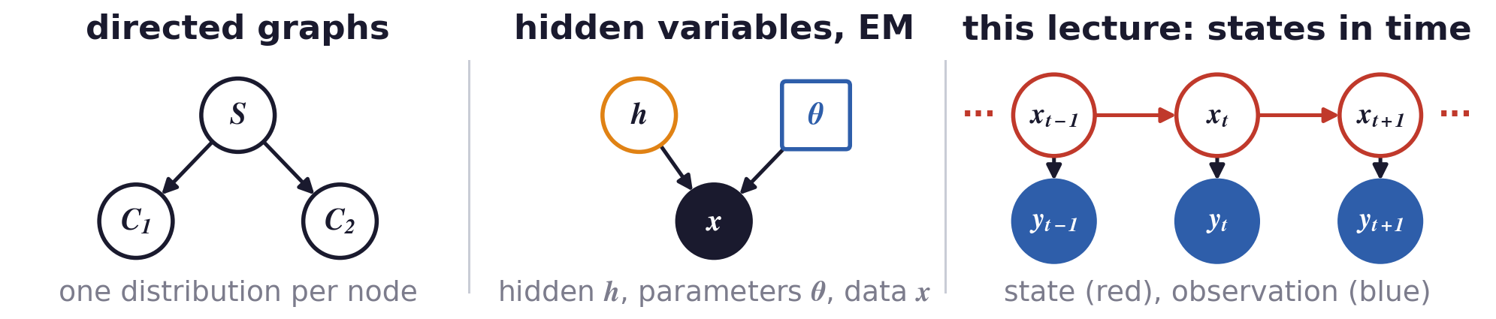
From hidden variables to hidden states that change in time
The new question is: how do we combine observations over
time, when the state of the world changes from frame to frame?
A directed graph writes a distribution as a product of one conditional distribution per node.
The last lecture learnt hidden variables by expectation-maximisation (EM): labels, lines, neurons.
In a video the hidden variable is the state of the world, and it changes from frame to frame.
Probabilities on Graphs · A. Yuille
3

Slide 4
1
The Bayes-Kalman filter
Estimate a moving state from all past observations:
predict with the motion model, correct with Bayes' rule.
Probabilities on Graphs · A. Yuille
4

Slide 5
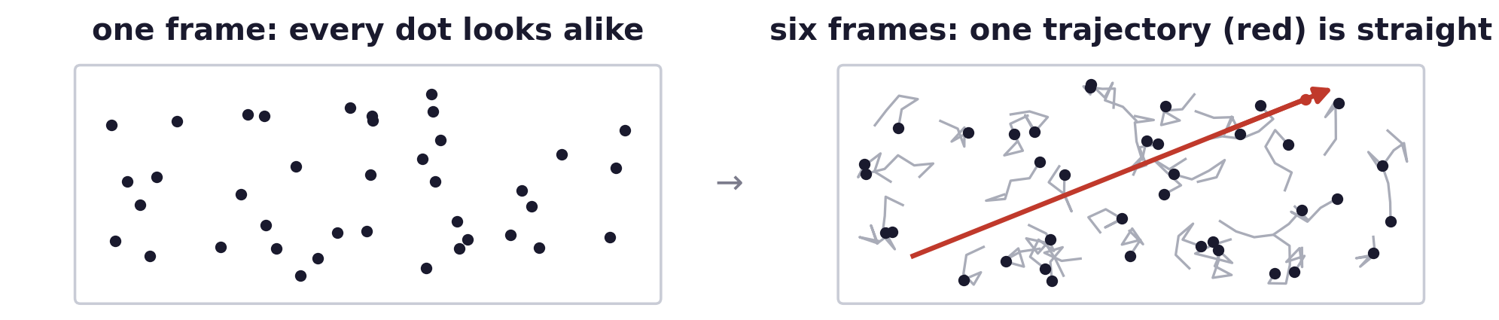
The Bayes-Kalman filter
The perception of motion depends on its history
Motion perception is strongly influenced by its history, as well as by the change from frame to frame.
Anstis and Ramachandran (1987): motion perception seems to require a temporal coherence prior.
Humans detect one coherently moving dot among many random dots (Watamaniuk et al., 1995).
Models with a prior on how motion changes over time adapt the Bayes-Kalman filter (Yuille et al., 1998).
S. Anstis and V. S. Ramachandran, “Visual inertia in apparent motion,” Vision Research, 27(5):755–764, 1987.
S. N. J. Watamaniuk, S. P. McKee and N. M. Grzywacz, “Detecting a trajectory embedded in random-direction motion noise,” Vision Research,
35(1):65–77, 1995.
A. L. Yuille, P.-Y. Burgi and N. M. Grzywacz, “Visual motion estimation and prediction: a probabilistic network model for temporal coherence,” ICCV,
973–978, 1998.
Probabilities on Graphs · A. Yuille
5

Slide 6
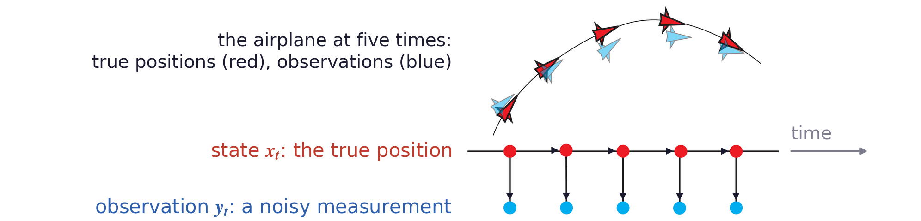
The Bayes-Kalman filter
The Bayes-Kalman filter estimates a state from observations
The task: estimate the state x at time t from the observations up to t (Kalman, 1960; Ho and Lee, 1964).
Example: x is the position of an airplane and y a noisy measurement of that position.
R. E. Kalman, “A new approach to linear filtering and prediction problems,” Journal of Basic Engineering, 82(1):35–45, 1960.
Y. C. Ho and R. C. K. Lee, “A Bayesian approach to problems in stochastic estimation and control,” IEEE Trans. Automatic Control, 9(4):333–339, 1964.
Probabilities on Graphs · A. Yuille
6

Slide 7
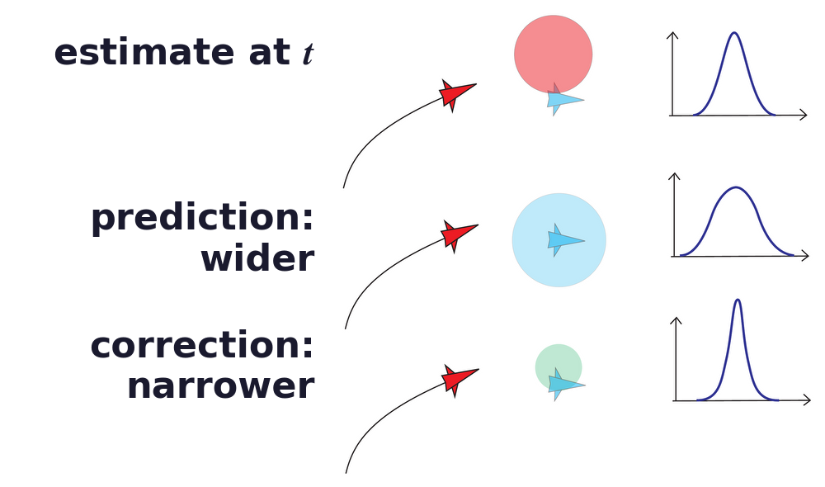
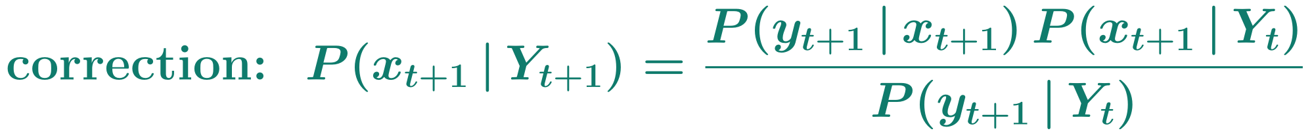
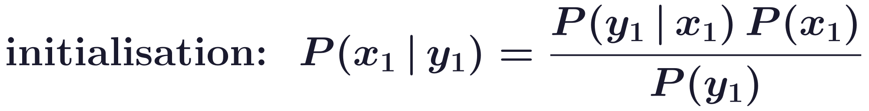
The Bayes-Kalman filter
Prediction and correction update the state's distribution
Prediction uses the motion model: it spreads the distribution and adds uncertainty about the state.
Correction integrates the new observation by Bayes' rule, and reduces the uncertainty.
The filter starts from the prior on the first position and repeats the two steps at every frame.
Probabilities on Graphs · A. Yuille
7

Slide 8
The Bayes-Kalman filter
With Gaussians the filter reduces to the Kalman equations
If the prior, motion and observation models are Gaussian, so is every distribution the filter computes.
The filter then only has to update a mean and a variance at each step (Kalman, 1960).
Prediction adds the mean step µ to the mean, and the motion variance to the variance.
Correction moves the mean towards the new observation and makes the variance smaller.
Probabilities on Graphs · A. Yuille
8

Slide 9
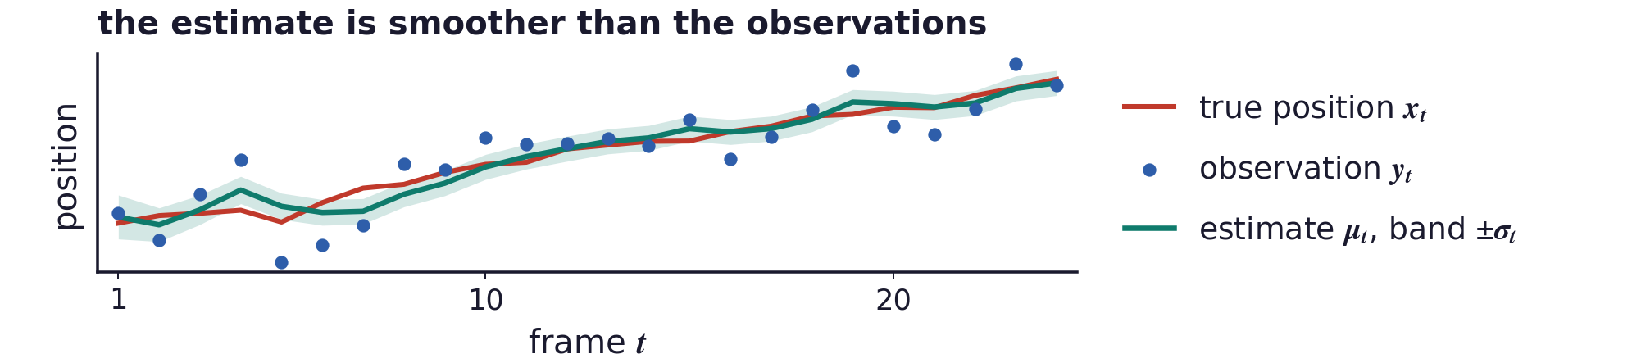
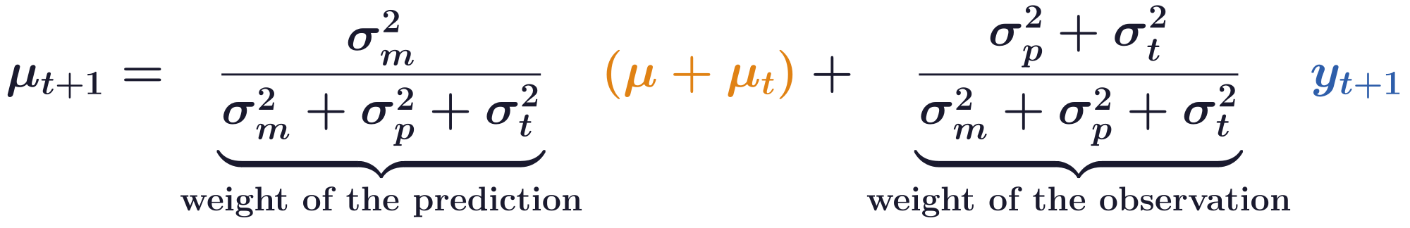
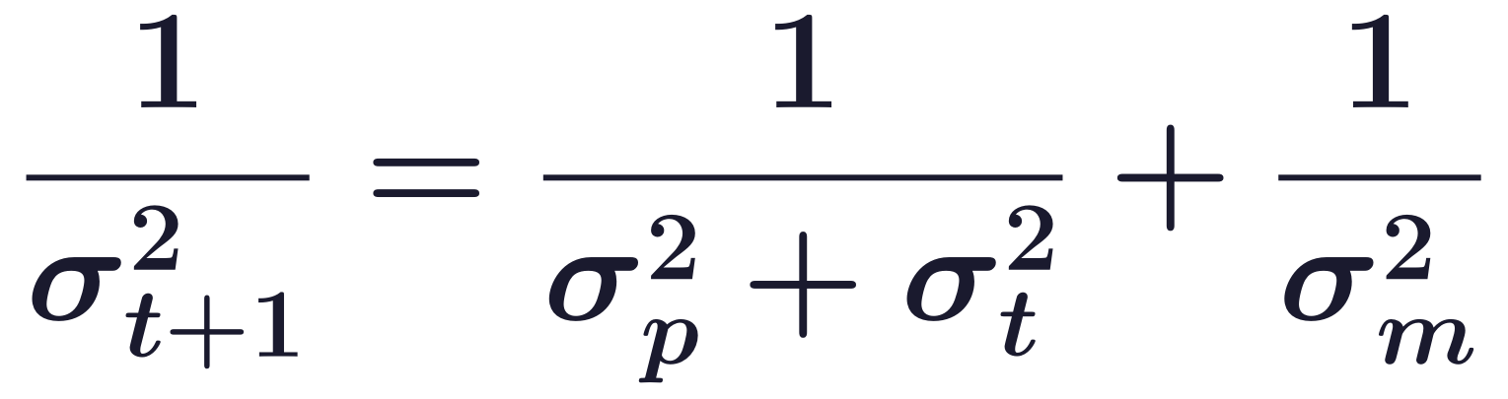
The Bayes-Kalman filter
The Kalman update is a weighted average of two cues
The update averages the predicted position and the observation, each weighted by the other's variance.
This is the linear rule for combining two cues, prediction and measurement; the inverse variances add.
Example: a target that moves by a mean step per frame, observed with noise at every frame.
Probabilities on Graphs · A. Yuille
9

Slide 10
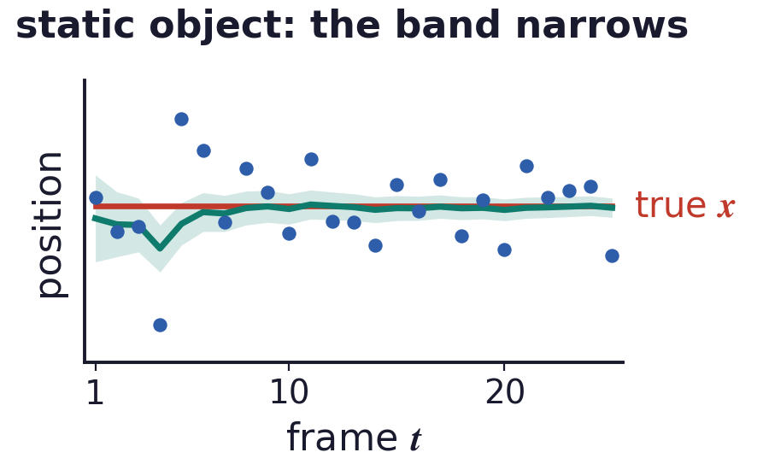
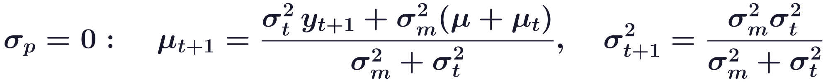
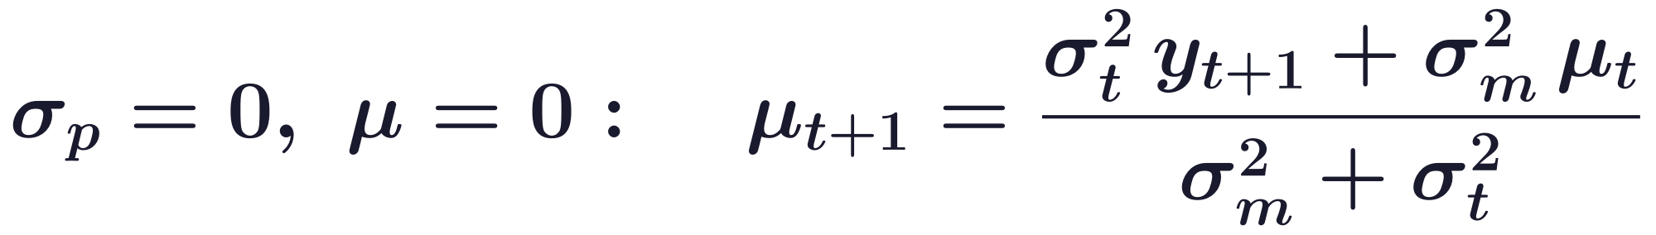
The Bayes-Kalman filter
Special cases show what each variance does
Noiseless observations: forget the history and use the current observation as the estimate.
Perfect prediction: the estimate is a weighted average of the observation and the predicted position.
A static object as well: the filter is an online method for the maximum a posteriori (MAP) estimate.
Probabilities on Graphs · A. Yuille
10

Slide 11
2
Modeling the physical world
World states evolve by physics and are rendered
by graphics: the Bayes-Kalman graph with actions.
Probabilities on Graphs · A. Yuille
11

Slide 12
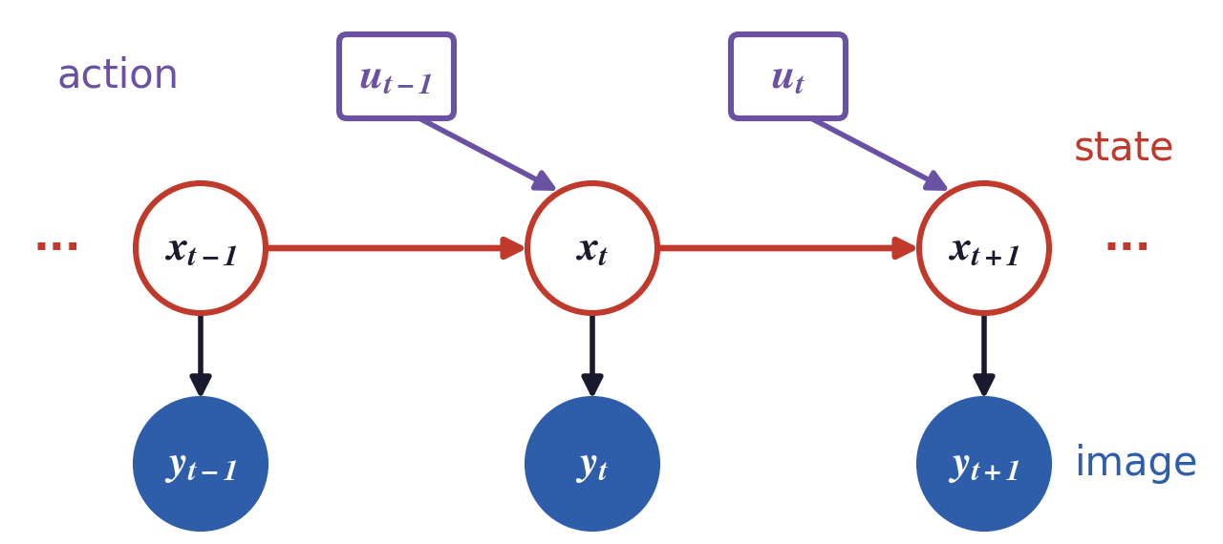
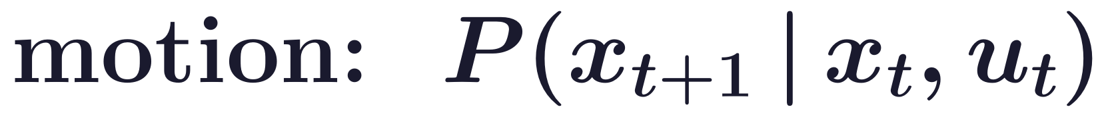
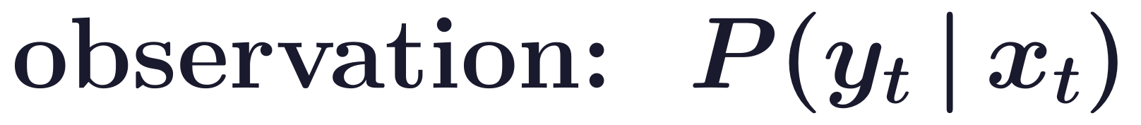
Modeling the physical world
Bayes-Kalman extends to actions: control and world models
Bayes-Kalman is a directed graphical model that integrates information over time, e.g. to track objects.
Bayes decision theory (BDT) extends to control, where the system makes a series of decisions over time.
In 1994 Dickmanns's cars drove over 1,000 km in highway traffic near Paris, largely autonomously.
World models generate images from past images and actions, and imagine new views (Lu et al., 2025).
E. D. Dickmanns, “The development of machine vision for road vehicles in the last decade,” IEEE Intelligent Vehicle Symposium, 268–281, 2002.
T. Lu, T. Shu, A. Yuille, D. Khashabi and J. Chen, “GenEx: Generating an explorable world,” ICLR, 2025.
Probabilities on Graphs · A. Yuille
12

Slide 13
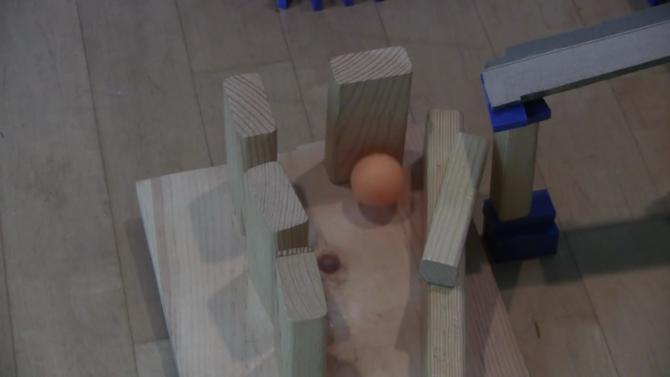
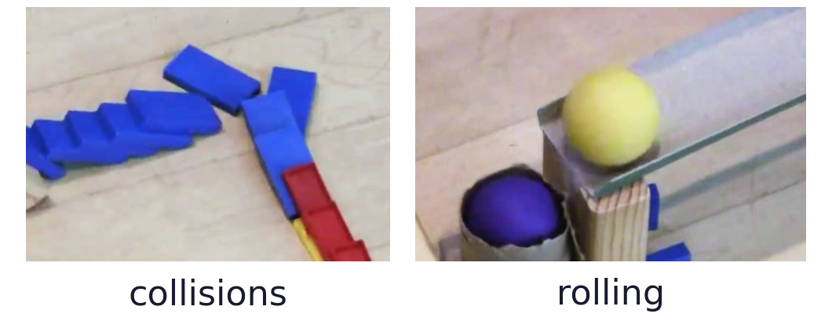
Modeling the physical world
Humans recover rich physical information from a video
Geometry: 3D object shapes. Physics: object properties, such as masses and coefficients of friction.
Interaction: physical events, such as collisions and rolling.
Humans easily answer questions like: what will happen next? what if ...? how to ...?
The video is a sequence of images of a world state that changes by physics.
Video and figures: J. Wu, “Physical Scene Understanding” (lecture slides, MIT and Stanford).
Probabilities on Graphs · A. Yuille
13

Slide 14
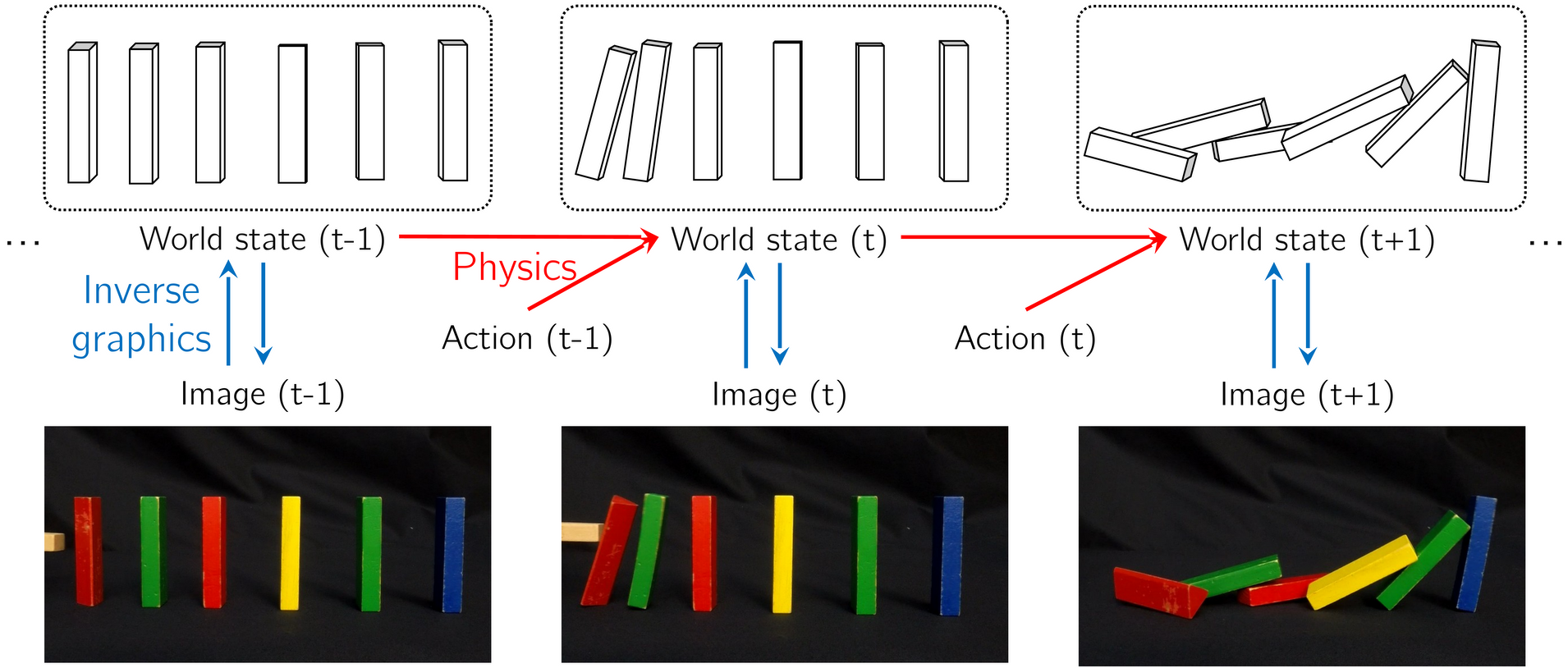
Modeling the physical world
Modeling the physical world: physics, graphics and actions
A world state holds object shapes, physical properties, positions, velocities, lighting and camera.
Physics moves the world state forward, given an action; graphics renders the world state as an image.
This is the Bayes-Kalman graph: physics is the motion model, graphics the observation model.
Probabilities on Graphs · A. Yuille
14

Slide 15
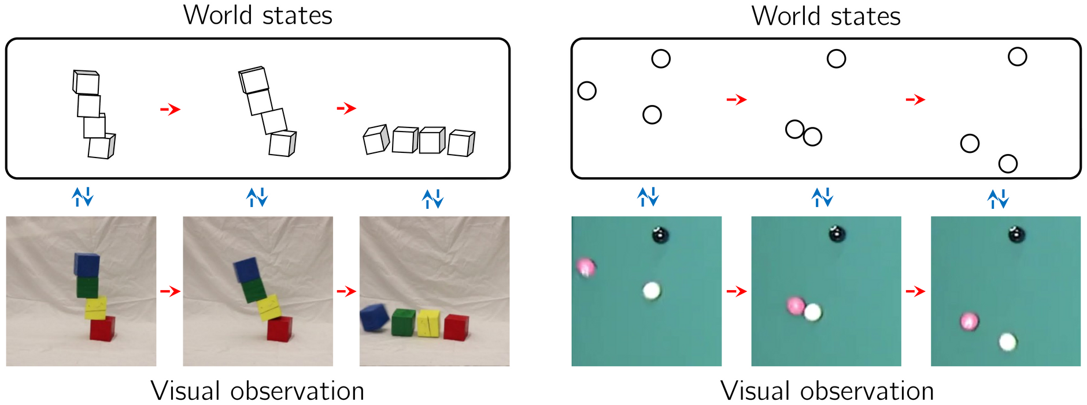
Modeling the physical world
Physical world representations are universal
The same kind of world state describes a falling tower of blocks and billiard balls on a table.
Each world state is a few objects with their shapes, positions and velocities.
Physics (red) predicts the next world state; graphics (blue) predicts the image seen at that time.
Probabilities on Graphs · A. Yuille
15

Slide 16
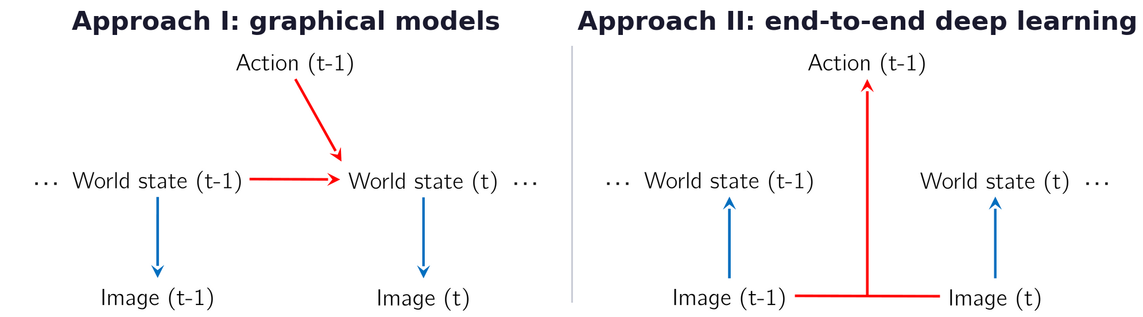
Modeling the physical world
Graphical models versus end-to-end deep learning
Approach I, graphical models such as Bayes nets: efficient inference, limited expressiveness.
Approach I, simulation engines (graphics, physics): rich representations, no general-purpose inference.
Approach II, networks map images straight to states and actions: efficient, limited outside training.
Causal structure combines them: conditional independence says where networks and simulators fit.
Probabilities on Graphs · A. Yuille
16

Slide 17
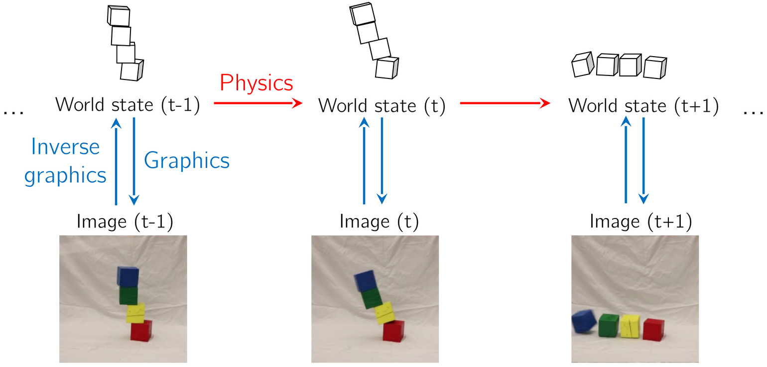
Modeling the physical world
Visual de-animation: inverse graphics, physics and graphics
Visual de-animation (VDA): a network inverts graphics, estimating the world state of every frame.
A physics engine predicts future world states, and a graphics engine renders them as images.
Simulation engines plus recognition networks can learn with little supervision (Wu et al., 2017).
J. Wu, E. Lu, P. Kohli, W. T. Freeman and J. B. Tenenbaum, “Learning to see physics via visual de-animation,” NIPS, 153–164, 2017.
Probabilities on Graphs · A. Yuille
17

Slide 18
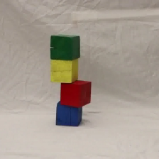
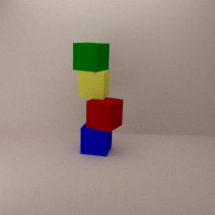
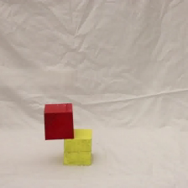
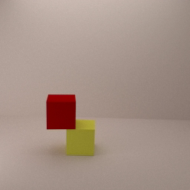
Modeling the physical world
Visual de-animation reconstructs and predicts real videos
In each pair, the real video of a block tower and the rendering of its de-animation (Wu et al., 2017).
The first frame gives the world state; the physics engine predicts whether and how the tower falls.
J. Wu, E. Lu, P. Kohli, W. T. Freeman and J. B. Tenenbaum, “Learning to see physics via visual de-animation,” NIPS, 153–164, 2017.
Probabilities on Graphs · A. Yuille
18

Slide 19
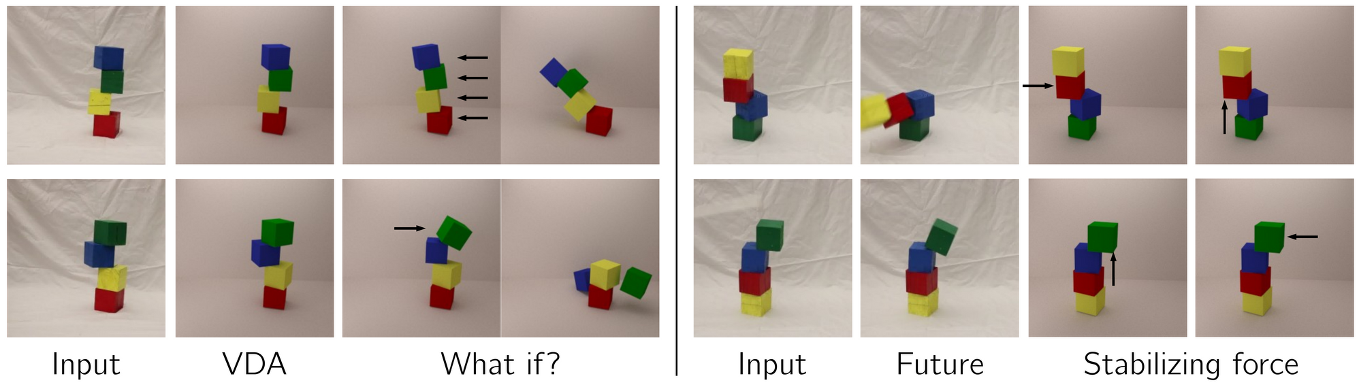
Modeling the physical world
De-animation answers what-if questions about the future
VDA: the tower rendered from the world state that the network estimates from the input image.
What if: the arrows are applied forces, and the last image is the predicted outcome.
Future: the predicted fall. Stabilizing force: the arrow is the force that keeps the tower up.
Probabilities on Graphs · A. Yuille
19

Slide 20
3
Dynamic programming
On a chain, minimise over one variable at a time: a
forward pass of costs, then a backward pass of states.
Probabilities on Graphs · A. Yuille
20

Slide 21
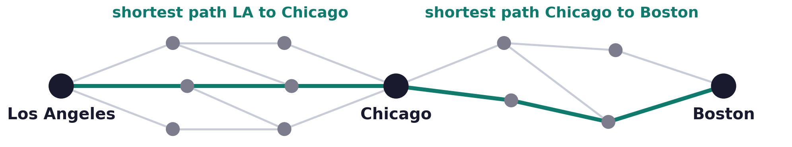
Dynamic programming
Dynamic programming exploits the linear structure
The filter gives the distribution of each state; the best whole sequence of states is a search over a chain.
Dynamic programming (DP; Bellman, 1957) splits a problem with linear structure into a chain of stages.
The shortest path from Los Angeles to Boston via Chicago joins two shortest paths.
Only the shortest paths from LA to Chicago and from Chicago to Boston need to be found.
R. Bellman, Dynamic Programming, Princeton University Press, 1957.
Probabilities on Graphs · A. Yuille
21

Slide 22
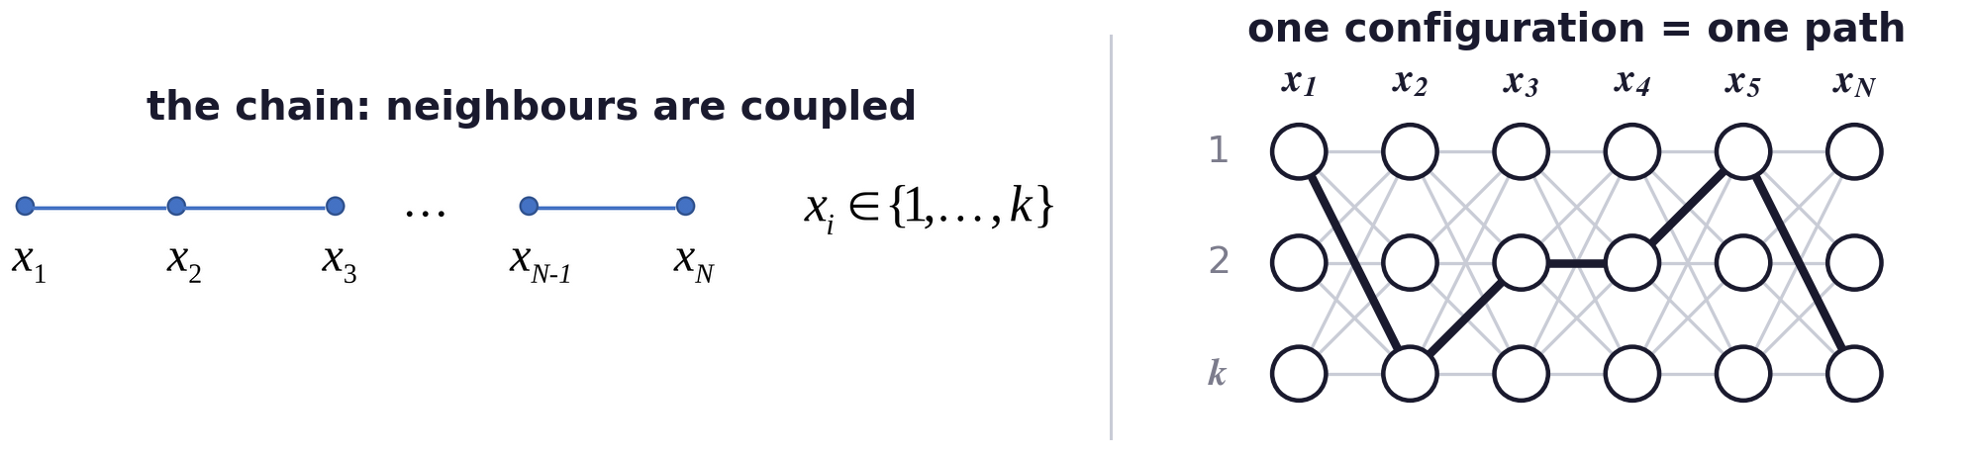
Dynamic programming
Minimise a sum of terms that couple neighbours on a chain
Each of the N variables takes one of k values: every configuration is a path through the grid of values.
Stereo: the disparities along an epipolar line form a chain (Ohta and Kanade, 1985; Geiger et al., 1995).
Y. Ohta and T. Kanade, “Stereo by intra- and inter-scanline search using dynamic programming,” IEEE TPAMI, 7(2):139–154, 1985.
D. Geiger, B. Ladendorf and A. Yuille, “Occlusions and binocular stereo,” International Journal of Computer Vision, 14(3):211–226, 1995.
Probabilities on Graphs · A. Yuille
22

Slide 23
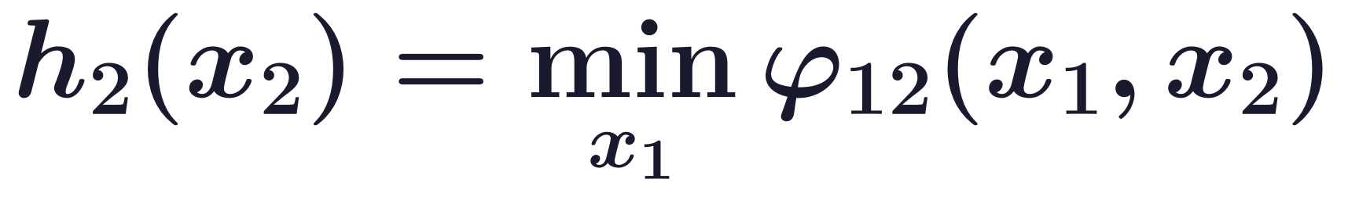
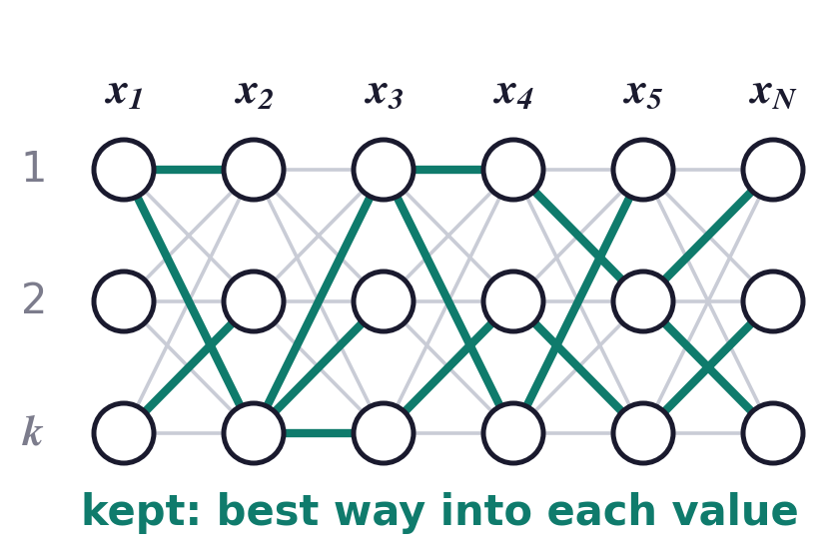
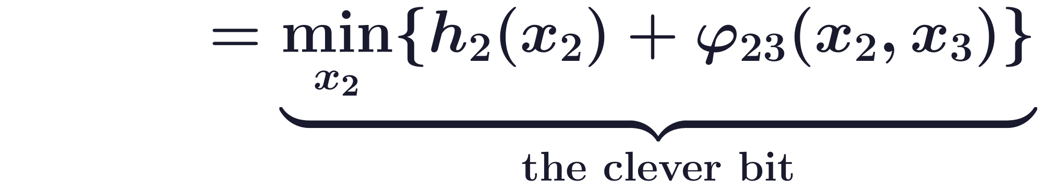
Dynamic programming
The forward pass computes the shortest cost to each state
The table h stores, for each value of the current variable, the cost of the best path that reaches it.
The minimum over the earlier variables is already inside h, so each step costs only k² operations.
The forward pass ends with the shortest cost to each value of the last variable.
Probabilities on Graphs · A. Yuille
23

Slide 24
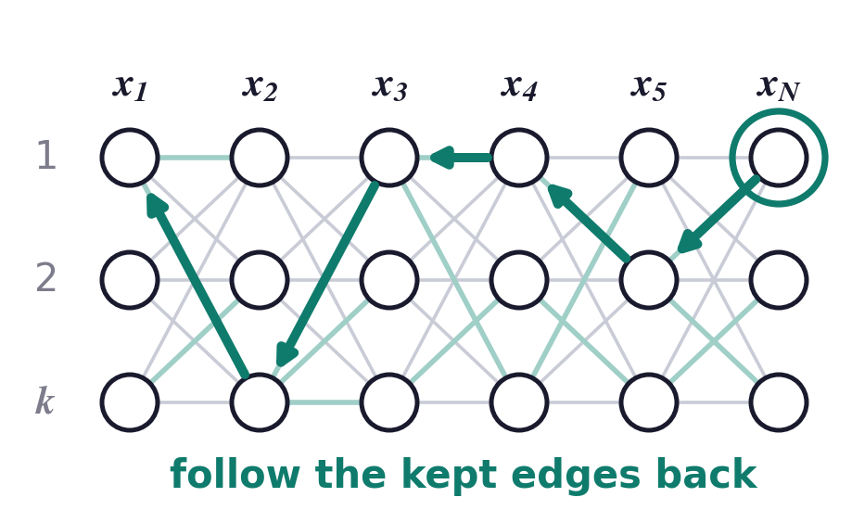
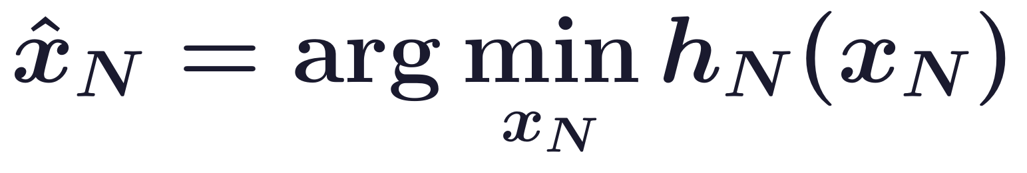
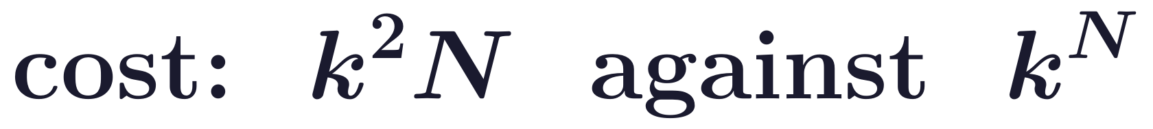
Dynamic programming
The backward pass recovers the states of the shortest path
Start from the best final value and step back, choosing each value given the value after it.
This recovers the states which give the shortest cost, from the last variable to the first.
Advantage: about k²N operations, in place of searching all the configurations.
Probabilities on Graphs · A. Yuille
24

Slide 25
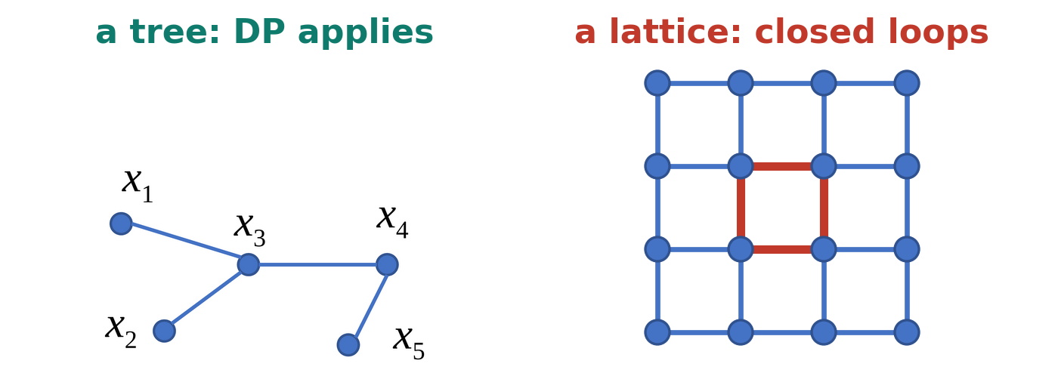
Dynamic programming
DP applies to any graph without closed loops
DP can be applied to any graph without closed loops, such as a tree.
DP also gives marginals: replace the minimum of summed costs by the sum of multiplied probabilities.
Graphs with closed loops are grouped into a tree: the junction tree (Lauritzen and Spiegelhalter, 1988).
For many graphs, such as the image lattice, the tree is so large that computation on it is impractical.
S. L. Lauritzen and D. J. Spiegelhalter, “Local computations with probabilities on graphical structures and their application to expert systems,” JRSS B,
50(2):157–224, 1988.
Probabilities on Graphs · A. Yuille
25

Slide 26
4
Hidden Markov models
Hidden states follow a Markov chain; DP evaluates
and decodes, and EM with DP learns the parameters.
Probabilities on Graphs · A. Yuille
26

Slide 27
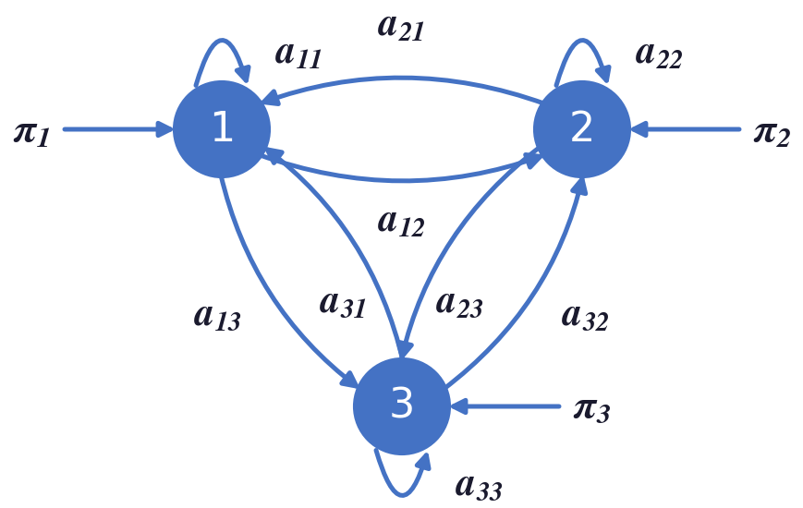
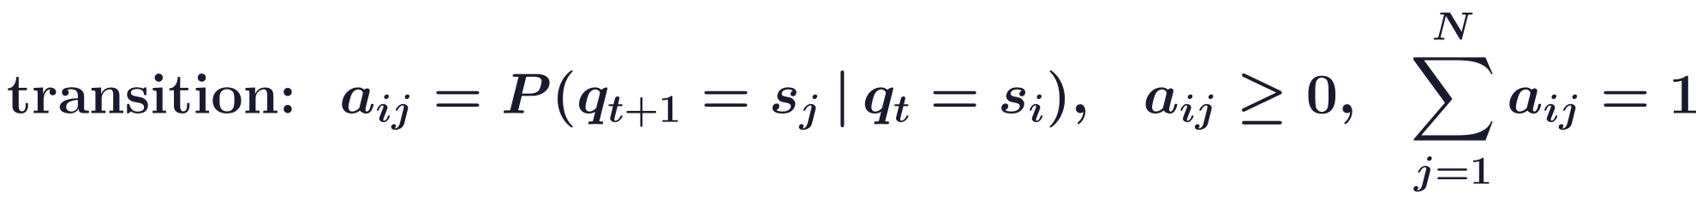
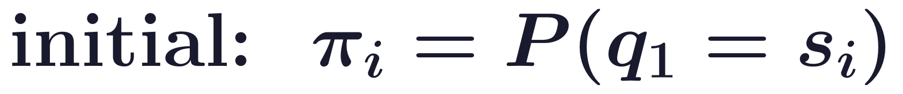
Hidden Markov models
A Markov model is a probability distribution for a sequence
First-order Markov: given the present state, the future is independent of the past.
The state q at time t is one of N states s1 to sN; the transition probability is independent of time.
Two cases: observable and hidden Markov models (HMMs), both in the exponential family.
There are no closed loops, so dynamic programming can be used for inference.
Hidden Markov models were state-of-the-art for speech recognition (Rabiner, 1989).
L. R. Rabiner, “A tutorial on hidden Markov models and selected applications in speech recognition,” Proceedings of the IEEE, 77(2):257–286, 1989.
Probabilities on Graphs · A. Yuille
27

Slide 28
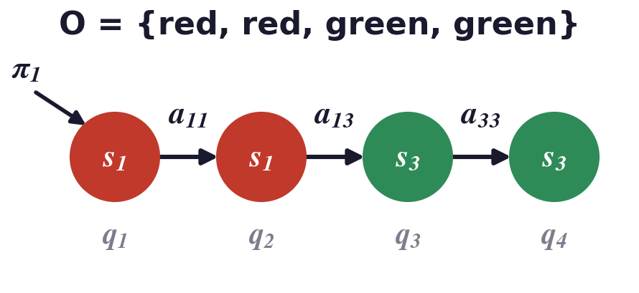
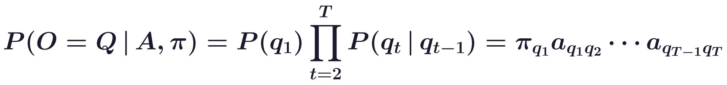
Hidden Markov models
An observable Markov model is learnt by counting
In an observable Markov model we observe the states directly, which lets us learn the transitions.
A sequence O = Q of length T has the initial probability times T − 1 transition probabilities.
Example: three urns of red, blue and green balls; the state is the urn, and the colour tells us which urn.
The counts are sufficient statistics: maximum likelihood (ML) equates empirical with model statistics.
Probabilities on Graphs · A. Yuille
28

Slide 29
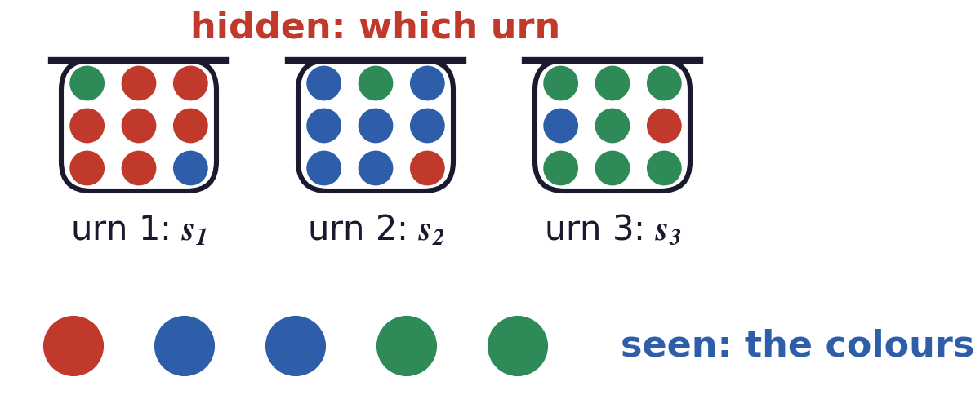
Hidden Markov models
In an HMM each hidden state emits an observation
We only observe an emission from each state; the state itself is hidden.
Two sources of stochasticity: the transition between states and the observation from a state.
Urns: urn 1 is mostly red, urn 2 mostly blue, urn 3 mostly green, and we see only the colour of each ball.
Probabilities on Graphs · A. Yuille
29

Slide 30
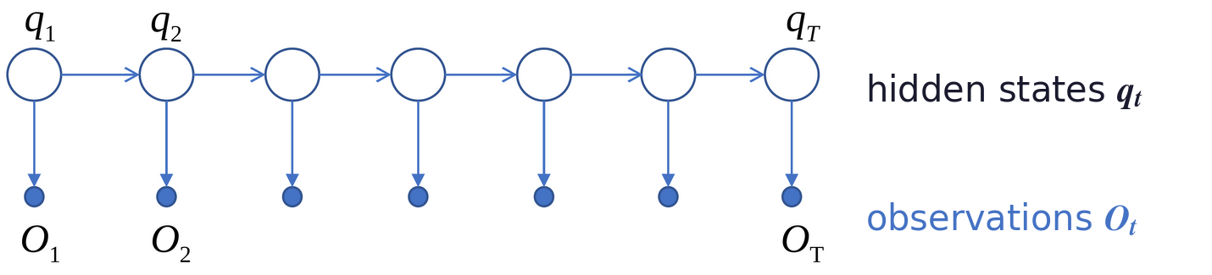
Hidden Markov models
Three basic problems: evaluation, decoding and learning
(1) Given a model λ, evaluate the probability P(O | λ) of any observation sequence O.
(2) Given λ and O, find the most probable state sequence Q.
(3) Given a training set X of sequences, find the parameters λ with the highest likelihood.
Probabilities on Graphs · A. Yuille
30

Slide 31
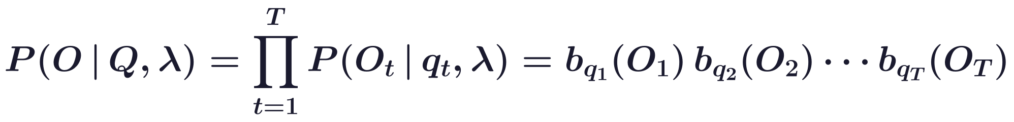
Hidden Markov models
Evaluation sums over every possible state sequence
Given the states Q, each observation depends only on its own state.
Q is unknown, so P(O | λ) sums the joint probability P(O, Q | λ) over all state sequences.
The direct sum is impractical: each of the T times has N possible states.
Probabilities on Graphs · A. Yuille
31

Slide 32
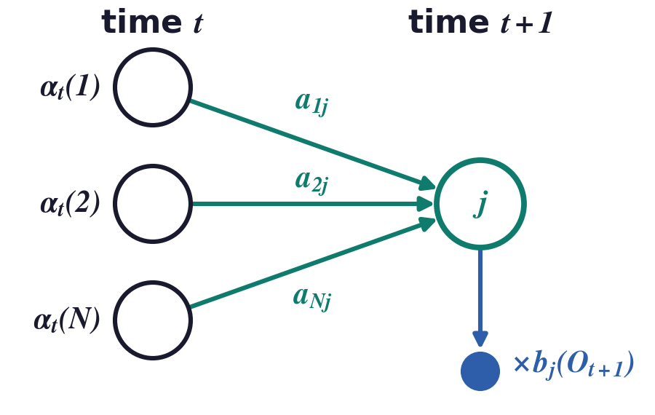
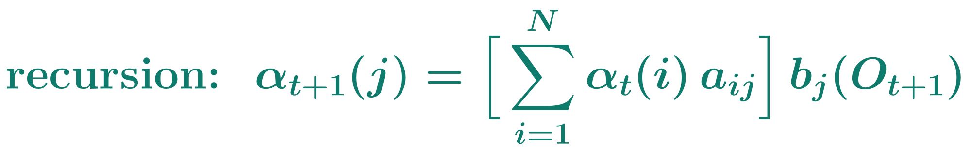
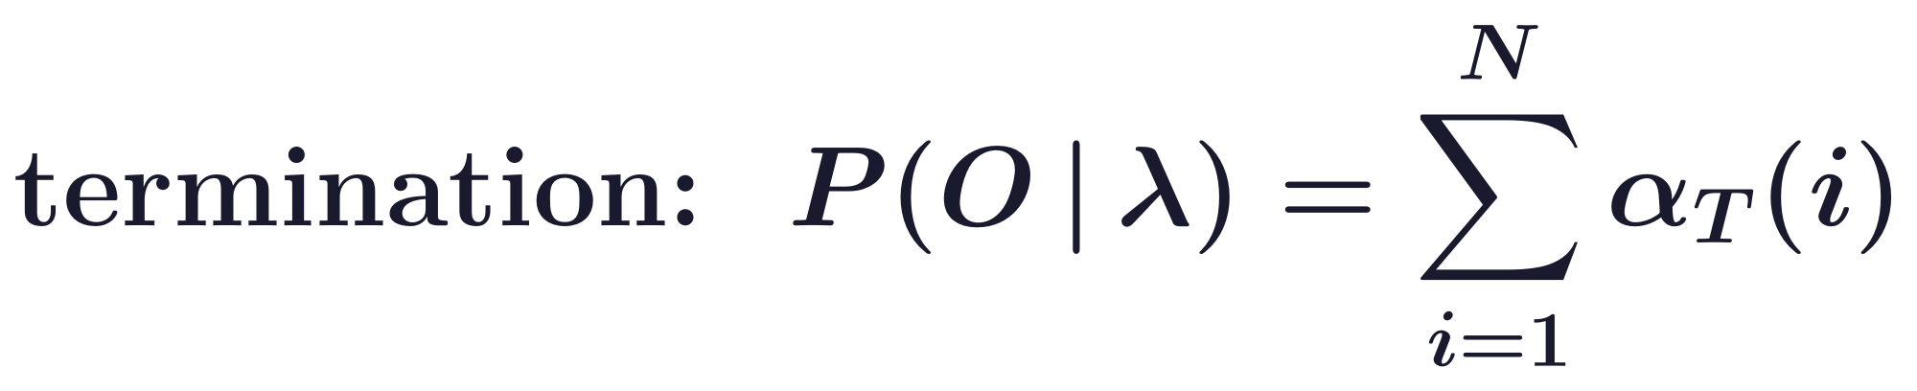
Hidden Markov models
The forward algorithm computes P(O | λ) by DP
The forward variable α explains the first t observations and ends in state i.
Sum over the states at time t, then multiply by the probability of the next observation: N²T operations.
It is the forward pass of DP, with min and + on costs replaced by sum and product on probabilities.
The sum is the prediction and the factor b is the correction of the Bayes-Kalman filter.
Probabilities on Graphs · A. Yuille
32

Slide 33
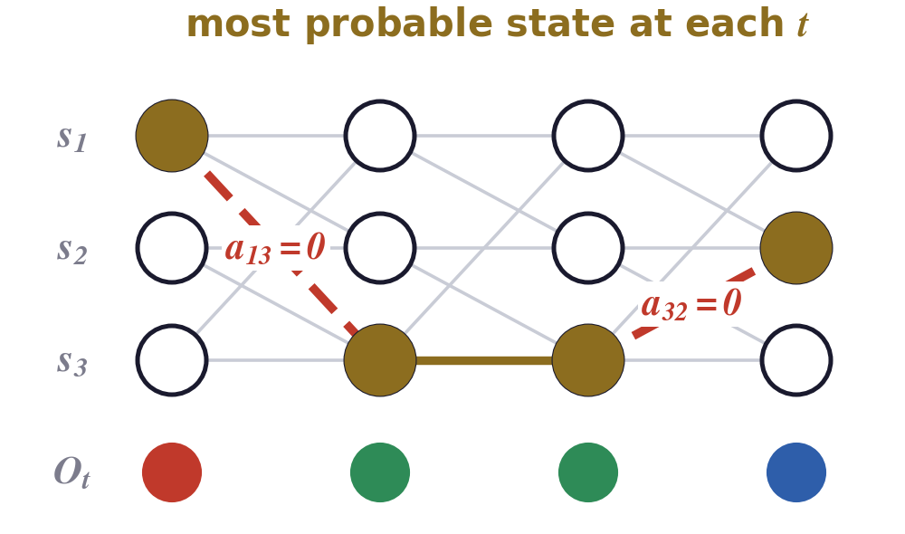
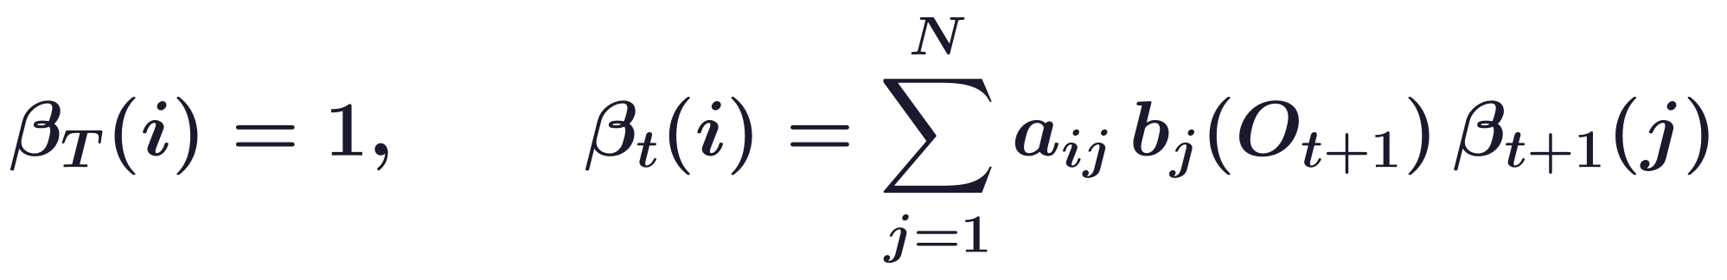
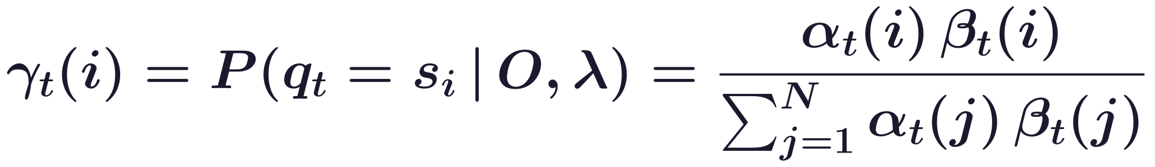
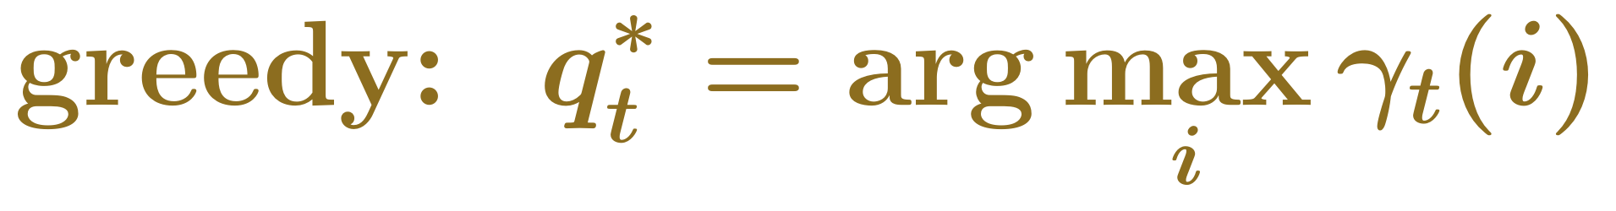
Hidden Markov models
The most probable state at each time can be inconsistent
α explains the observations up to t and β the rest, so γ is the probability of each state given all of O.
Example: urns visited in the order 1, 2, 3, 1, ..., so a13 = a32 = a21 = 0; each urn mostly gives one colour.
Choosing each state separately ignores its neighbours, and can need an impossible transition.
Probabilities on Graphs · A. Yuille
33

Slide 34

Hidden Markov models
The Viterbi algorithm finds the best state sequence by DP
δ is the probability of the best path that explains the first t observations and ends in state i.
ψ keeps the best previous state; backtracking follows it from the end.
Viterbi is DP on the chain of T times, with the N states as the values of each variable.
A. J. Viterbi, “Error bounds for convolutional codes and an asymptotically optimum decoding algorithm,” IEEE Trans. Information Theory,
13(2):260–269, 1967.
Probabilities on Graphs · A. Yuille
34

Slide 35

Hidden Markov models
The Baum-Welch algorithm learns an HMM by EM
Z is 1 if the state, or the pair of states, occurs at time t; the M-step uses these soft counts.
γ and ζ come from α and β by DP; as for any EM, the likelihood never decreases (Baum et al., 1970).
L. E. Baum, T. Petrie, G. Soules and N. Weiss, “A maximization technique occurring in the statistical analysis of probabilistic functions of Markov chains,”
Ann. Math. Statistics, 41(1):164–171, 1970.
Probabilities on Graphs · A. Yuille
35

Slide 36

Hidden Markov models
HMMs detect highlights in baseball game video
The video is cut into scene shots, each taken by one camera; every shot is one of seven view types.
The observations are cheap features: field shape, edges, grass, sand, camera motion and player height.
A typical home run: a pitch view, then an audience view, then a running close-up.
HMMs model other sequences in sports video too, such as tennis strokes (Yamato et al., 1992).
P. Chang, M. Han and Y. Gong, “Extract highlights from baseball game video with hidden Markov models,” ICIP, vol. 1, 609–612, 2002.
J. Yamato, J. Ohya and K. Ishii, “Recognizing human action in time-sequential images using hidden Markov model,” CVPR, 379–385, 1992.
Probabilities on Graphs · A. Yuille
36

Slide 37

Hidden Markov models
One HMM per type of highlight: the most probable wins
λc is the HMM of highlight type c; a highlight is detected if the best score passes a threshold.
Model selection, with the Viterbi score in place of P(O | λ); speech recognition uses one HMM per word.
Probabilities on Graphs · A. Yuille
37

Slide 38

Hidden Markov models
The HMM and the Bayes-Kalman filter share one graph
Both: hidden states form a Markov chain, and each state emits one observation.
Bayes-Kalman: a continuous state; with Gaussians the recursion updates a mean and a variance.
HMM: N discrete states; the forward recursion updates N numbers, one α for each state.
Both graphs are chains, so inference in both is dynamic programming.
Markov models of words were early language models; modern language models use a long context.
Probabilities on Graphs · A. Yuille
38

Slide 39
Hidden Markov models
Summary
The Bayes-Kalman filter tracks a changing state: predict with the motion model, correct with Bayes' rule.
With Gaussians it keeps a mean and a variance; the update is a weighted average, as in cue combination.
Physical world models use the same graph: physics moves the world state, graphics renders it.
Visual de-animation inverts graphics with a network and predicts with a physics engine.
Dynamic programming minimises a sum of neighbour terms: a forward pass, then a backward pass.
It costs about k²N operations, and applies to any graph without closed loops.
An HMM has hidden states with Markov transitions, and one observation from each state.
The forward algorithm evaluates and Viterbi decodes, both by DP; Baum-Welch learns by EM.
Probabilities on Graphs · A. Yuille
39

