Slide 1
Unsupervised Learning: Few-Shot and Self-supervised
13 October, 2026
Alan Yuille · Probabilistic Models of the Visual Cortex

Slide 2
What this lecture covers
1
Few-shot learning
2
Self-supervised learning
Predict a new category's weights
Proxy tasks train the backbone
3
Contrastive learning
4
Masked image modeling
Two views of one image form a cluster
Predict the masked patches, as in language
5
iBOT: online tokenizer
6
Masked feature prediction
Masked image modeling, self-distillation
MaskFeat: predict features, not pixels
Neural Networks · A. Yuille
2

Slide 3
Few-shot learning
1
A network trained on many categories learns a new one from a few examples;
the weights of the new category are predicted from its activations.
Neural Networks · A. Yuille
3

Slide 4
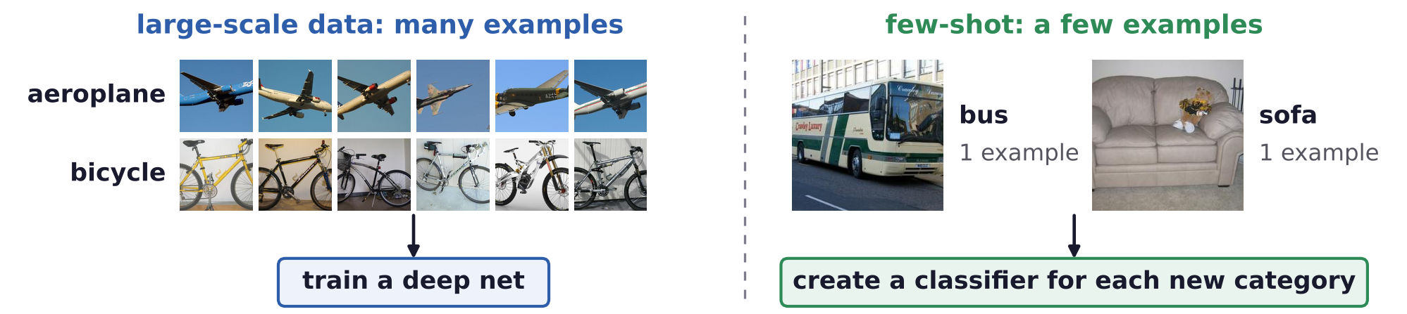
Few-shot learning
Few-shot learning creates a classifier from a few examples
Train a deep net when you have a large-scale dataset; few-shot: create a classifier from a few examples.
Few-shot learning is a human ability.
Earlier approaches learn a metric (siamese networks), then compare the test image with the examples.
Or they transfer from large-scale data: reuse the features of a network trained on many categories.
G. Koch, R. Zemel and R. Salakhutdinov, “Siamese neural networks for one-shot image recognition,” ICML Deep Learning Workshop, 2015.
S. Qiao, C. Liu, W. Shen and A. L. Yuille, “Few-shot image recognition by predicting parameters from activations,” CVPR, 7229–7238, 2018.
Neural Networks · A. Yuille
4

Slide 5
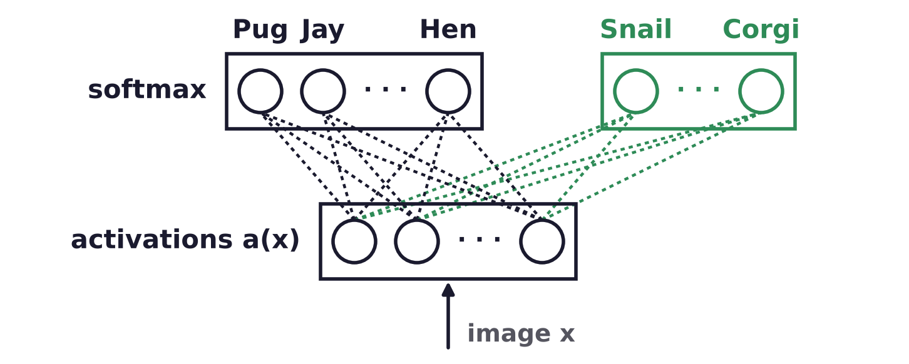
Few-shot learning
Few-shot learning should be incremental
The softmax layer holds one weight vector per category, applied to the activations a(x) of an image x.
New categories (green) are added to the large-scale ones (black); a test image may be from any of them.
Previous work tests only the new categories; here the large-scale ones must stay accurate too.
S. Qiao, C. Liu, W. Shen and A. L. Yuille, “Few-shot image recognition by predicting parameters from activations,” CVPR, 7229–7238, 2018.
Neural Networks · A. Yuille
5

Slide 6
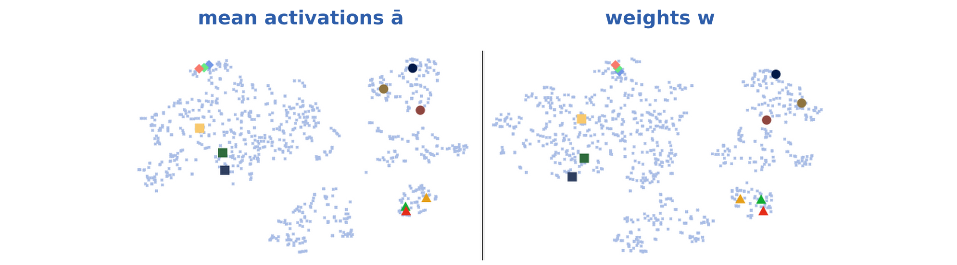
Few-shot learning
The activations and weights of a category look alike
t-SNE (t-distributed stochastic neighbor embedding) maps vectors to a plane, keeping neighbors close.
Each dot is a category of a ResNet-50 (residual network, 50 layers): mean activation left, weights right.
A marked category has the same color and shape in both maps; pale points: all other categories.
Marked: circles mammals, triangles birds, diamonds buses, squares home appliances.
S. Qiao, C. Liu, W. Shen and A. L. Yuille, “Few-shot image recognition by predicting parameters from activations,” CVPR, 7229–7238, 2018.
L. van der Maaten and G. Hinton, “Visualizing data using t-SNE,” Journal of Machine Learning Research, 9:2579–2605, 2008.
Neural Networks · A. Yuille
6

Slide 7
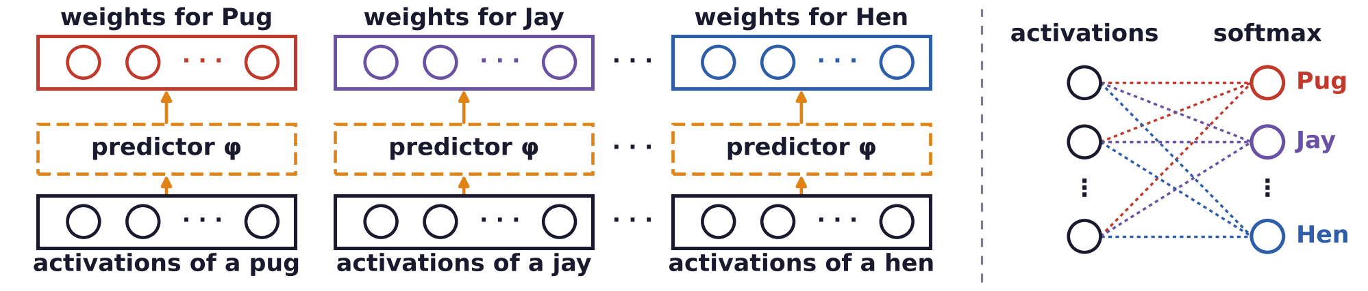
Few-shot learning
A parameter predictor maps activations to weights
φ maps the mean activation ā of a category to its weights; one φ is shared by all categories.
Training: softmax loss on the large-scale data D_large (categories C_large), plus λ||φ|| to keep φ small.
Parametric nearest neighbor: φ = identity gives cosine; φ weights the channels (entries of a) unequally.
S. Qiao, C. Liu, W. Shen and A. L. Yuille, “Few-shot image recognition by predicting parameters from activations,” CVPR, 7229–7238, 2018.
Neural Networks · A. Yuille
7

Slide 8
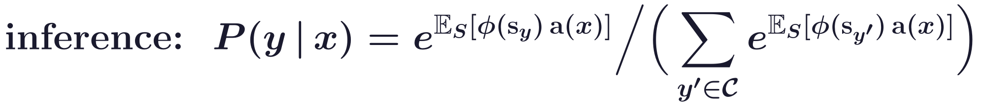
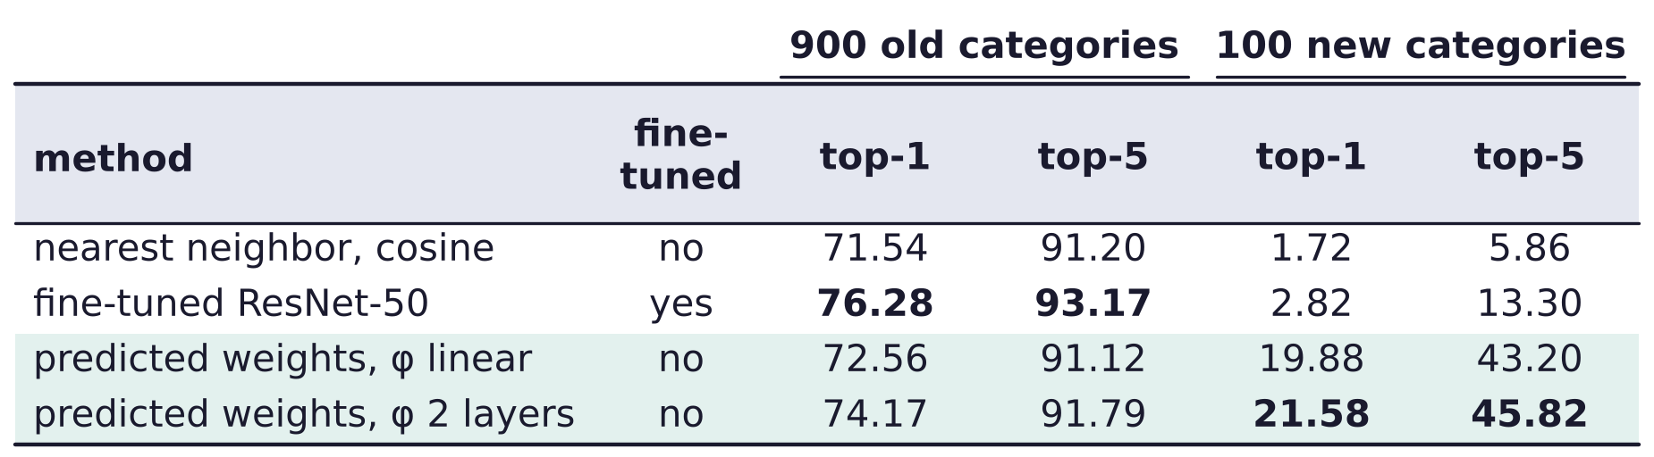
Few-shot learning
New categories get their weights from a few activations
s_y: category y's mean activation or one example's; E_S averages over these choices; C: all categories.
ImageNet, 1000-way: a ResNet-50 trained on 900 categories; 100 more learned from one example each.
Fine-tuned: the backbone is retrained; top-5: the true category is among the five most probable.
S. Qiao, C. Liu, W. Shen and A. L. Yuille, “Few-shot image recognition by predicting parameters from activations,” CVPR, 7229–7238, 2018.
Neural Networks · A. Yuille
8

Slide 9
Self-supervised learning
2
The supervision signal comes from the data itself;
proxy tasks train the backbone, and simple heads do the visual tasks.
Neural Networks · A. Yuille
9

Slide 10
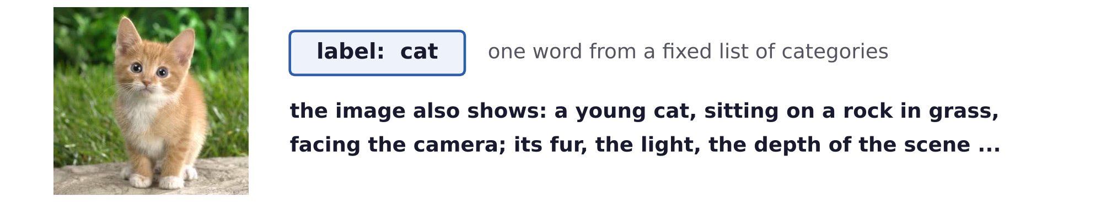
Self-supervised learning
The supervision signal comes from the data itself
Originally CNN (convolutional network) features were learned from labels, e.g. ImageNet classes.
Labels are expensive: there is little labeled data and an enormous amount of unlabeled data.
Labels are limited: the information in one image is richer than its label, which may be ambiguous.
Self-supervised learning can use a lot more data: very useful for vision, language and vision-language.
It is also attractive for researchers influenced by human vision, which learns mostly without labels.
Neural Networks · A. Yuille
10

Slide 11
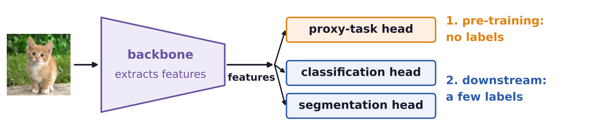
Self-supervised learning
Self-supervised learning learns the backbone
A network has a backbone, which extracts image features, and a head, which performs the task.
Features tend to be similar for different visual tasks, e.g. classification and semantic segmentation.
So maybe common features can be learned by proxy tasks, whose answers come from the data itself.
Downstream tasks then train simple heads, with few parameters and a small amount of labeled data.
Linear probing trains only a linear head on frozen features; fine-tuning also trains the backbone.
Neural Networks · A. Yuille
11

Slide 12
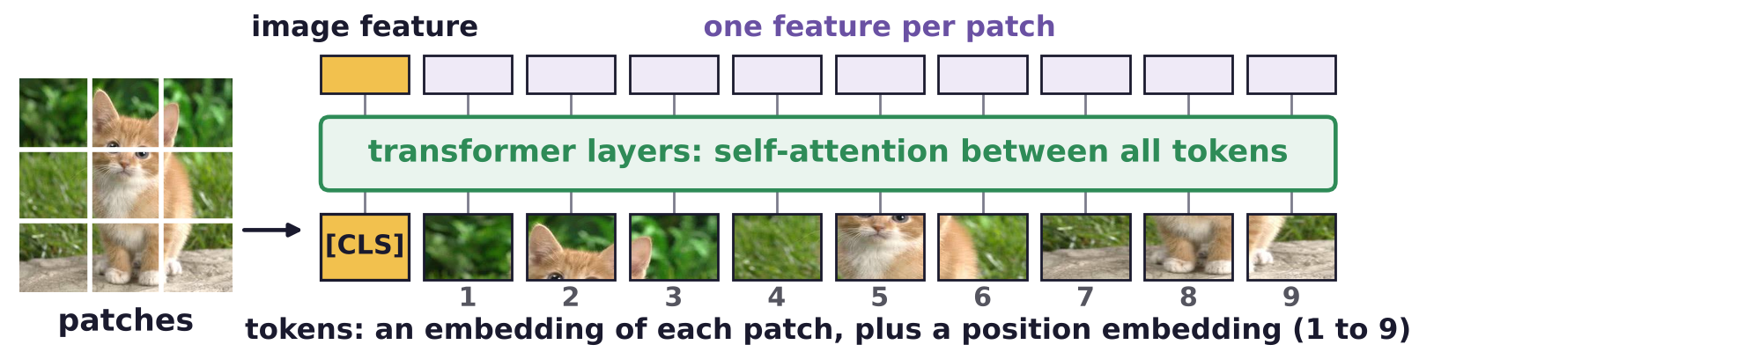
Self-supervised learning
A vision transformer treats an image as a sequence of tokens
The backbone is a CNN or a vision transformer (ViT); the ViT cuts the image into 16 × 16-pixel patches.
Each patch becomes a token: a vector embedding of the patch, plus a position embedding.
An extra [CLS] (class) token is added; its output summarizes the whole image.
Self-attention: in each layer every token averages all tokens, weighted by how similar they are.
ViT-S/16, ViT-B/16, ViT-L/16: small, base and large models on 16-pixel patches.
A. Vaswani, N. Shazeer, N. Parmar, J. Uszkoreit, L. Jones, A. N. Gomez, Ł. Kaiser and I. Polosukhin, “Attention is all you need,” NIPS, 5998–6008, 2017.
A. Dosovitskiy, L. Beyer, A. Kolesnikov, D. Weissenborn, X. Zhai, T. Unterthiner et al., “An image is worth 16x16 words: transformers for image
recognition at scale,” ICLR, 2021.
Neural Networks · A. Yuille
12

Slide 13
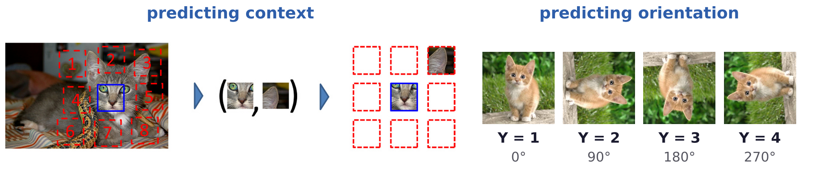
Self-supervised learning
Proxy tasks: predicting context and orientation
Proxy tasks do not require supervision: the network is trained to undo a change we made ourselves.
Context: given the center patch (blue) and one of its 8 neighbors (red), predict which one it is (1 to 8).
Orientation: rotate the image by 0, 90, 180 or 270 degrees and predict the rotation, Y = 1 to 4.
C. Doersch, A. Gupta and A. A. Efros, “Unsupervised visual representation learning by context prediction,” ICCV, 1422–1430, 2015.
S. Gidaris, P. Singh and N. Komodakis, “Unsupervised representation learning by predicting image rotations,” ICLR, 2018.
Neural Networks · A. Yuille
13

Slide 14
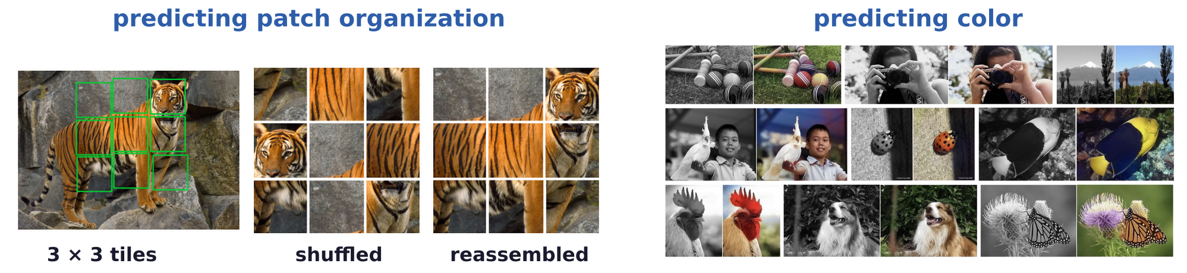
Self-supervised learning
Proxy tasks: predicting patch organization and color
Patch organization: cut the image into 3 × 3 tiles, shuffle them and predict the permutation (a jigsaw).
Color: predict the colors of an image from its grayscale version.
M. Noroozi and P. Favaro, “Unsupervised learning of visual representations by solving jigsaw puzzles,” ECCV, LNCS 9910, 69–84, 2016.
R. Zhang, P. Isola and A. A. Efros, “Colorful image colorization,” ECCV, LNCS 9907, 649–666, 2016.
Neural Networks · A. Yuille
14

Slide 15
Contrastive learning
3
Two augmented views of an image are a positive pair, other images negatives;
the loss pulls positives together and pushes negatives apart.
Neural Networks · A. Yuille
15

Slide 16
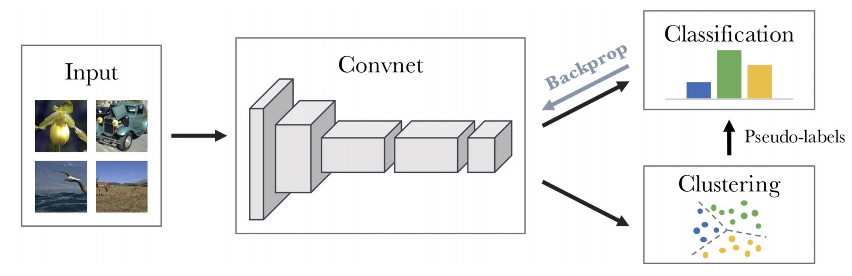
Contrastive learning
Predicting (unsupervised) cluster IDs
Cluster the CNN (convnet) features of all images with k-means; the cluster IDs are pseudo-labels.
Train the CNN to classify each image into its cluster, then cluster again, and repeat.
M. Caron, P. Bojanowski, A. Joulin and M. Douze, “Deep clustering for unsupervised learning of visual features,” ECCV, 132–149, 2018.
Neural Networks · A. Yuille
16

Slide 17
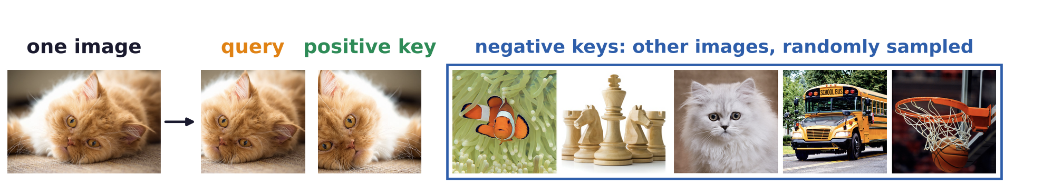
Contrastive learning
Unsupervised learning motivated contrastive learning
K-means cluster → views from one image as one cluster: instance discrimination, or contrastive learning.
Query and positive key: two views of one image; negative keys: other images, even another cat.
Contrastive learning was the first popular self-supervised learning technique.
It is also useful for supervised learning: the positive keys are then images of the same class.
Z. Wu, Y. Xiong, S. X. Yu and D. Lin, “Unsupervised feature learning via non-parametric instance discrimination,” CVPR, 3733–3742, 2018.
P. Khosla, P. Teterwak, C. Wang, A. Sarna, Y. Tian, P. Isola, A. Maschinot, C. Liu and D. Krishnan, “Supervised contrastive learning,”
NeurIPS, 18661–18673, 2020.
Neural Networks · A. Yuille
17

Slide 18
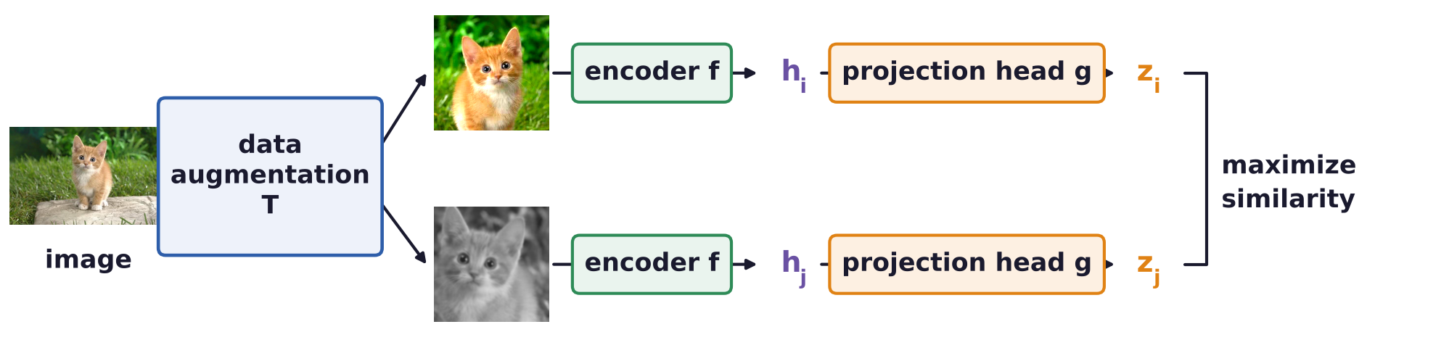
Contrastive learning
The positive keys are obtained by augmentation
Data augmentation T: random crop, flip, color distortion and blur turn one image into two views.
An encoder f (the backbone) gives the representation h; a projection head g gives z, used by the loss.
After training, the projection head g is thrown away and h is used for downstream tasks.
T. Chen, S. Kornblith, M. Norouzi and G. Hinton, “A simple framework for contrastive learning of visual representations,” ICML, 1597–1607, 2020.
Neural Networks · A. Yuille
18

Slide 19
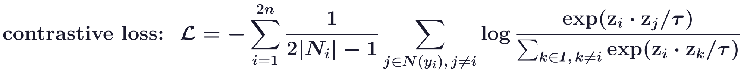
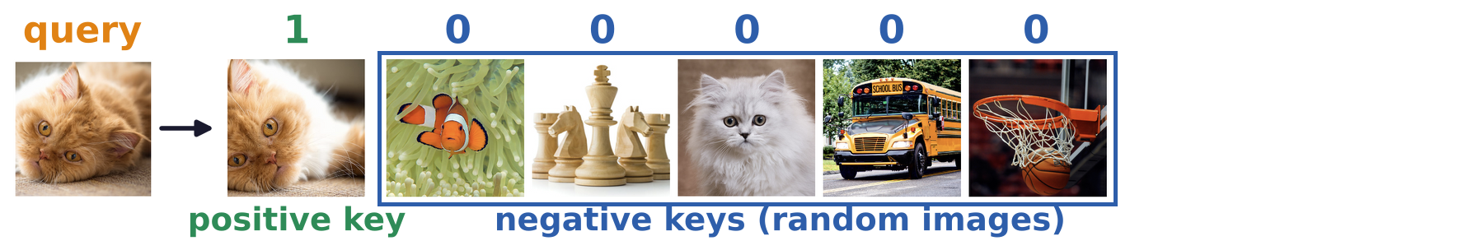
Contrastive learning
The loss makes the query similar to the positive keys
The z's are network features of length 1, functions of the image and of the weights learned by the loss.
A batch I of 2n views, two of each of n images; |N_i|: the number of images with view i's label y_i.
Query: view i; positive keys: the other views j ∈ N(y_i) with its label; k: all other views; τ: a temperature.
Self-supervised: each image is its own class, |N_i| = 1: the only positive key is the other view (the 1).
P. Khosla, P. Teterwak, C. Wang, A. Sarna, Y. Tian, P. Isola, A. Maschinot, C. Liu and D. Krishnan, “Supervised contrastive learning,”
NeurIPS, 18661–18673, 2020.
T. Chen, S. Kornblith, M. Norouzi and G. Hinton, “A simple framework for contrastive learning of visual representations,” ICML, 1597–1607, 2020.
Neural Networks · A. Yuille
19

Slide 20
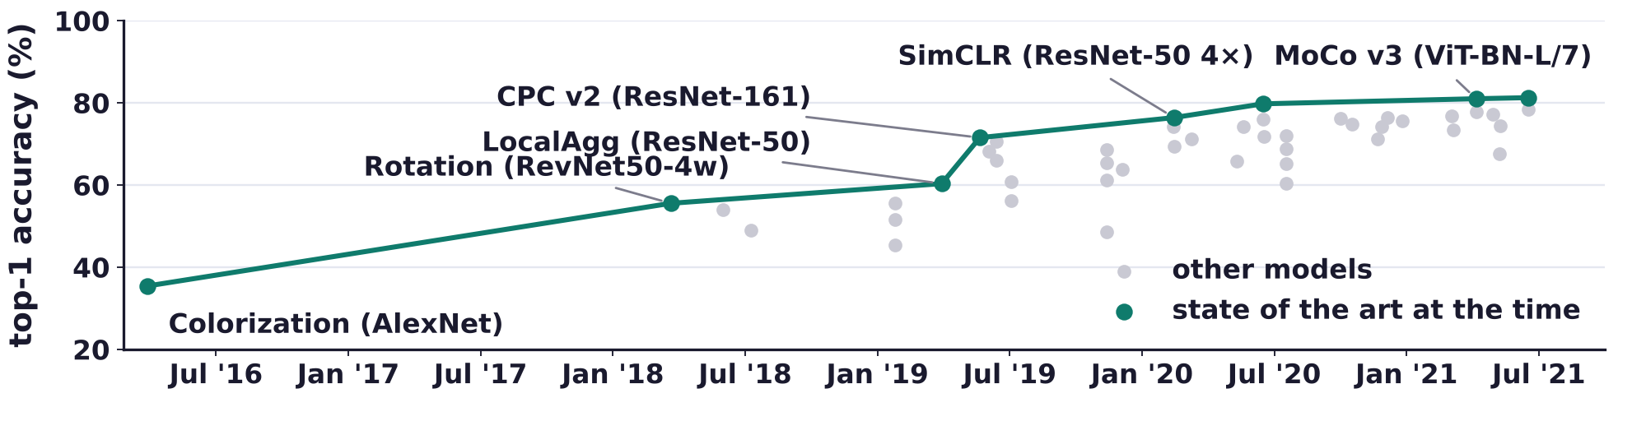
Contrastive learning
Contrastive learning was very popular before 2022
ImageNet-1K linear evaluation: a linear classifier trained on the frozen self-supervised features.
Teal: the best method at each date; the labels name the method and its backbone network.
Proxy tasks (colorization, rotation) were overtaken by contrastive methods (CPC v2, SimCLR, MoCo v3).
CPC: contrastive predictive coding; SimCLR: simple contrastive learning; MoCo: momentum contrast.
Chart: Papers with Code, self-supervised image classification on ImageNet, state of the art by date (as on the 2025 course slides).
Neural Networks · A. Yuille
20

Slide 21
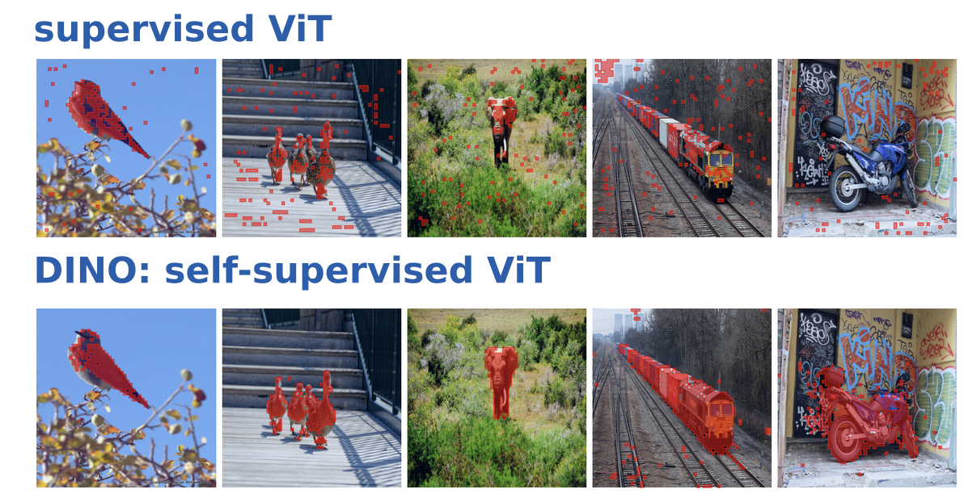
Contrastive learning
Self-supervised learning helps with attention
A supervised ViT is trained for classification; its attention maps give an approximate segmentation.
A self-supervised ViT, trained by DINO, gives tighter attention maps.
DINO: self-distillation with no labels; a student network matches a teacher's output for another view.
Red: the attention of the [CLS] token, the top 60 % of it (ViT-S/8, the best attention head of each).
M. Caron, H. Touvron, I. Misra, H. Jégou, J. Mairal, P. Bojanowski and A. Joulin, “Emerging properties in self-supervised vision transformers,”
ICCV, 9650–9660, 2021.
Neural Networks · A. Yuille
21

Slide 22
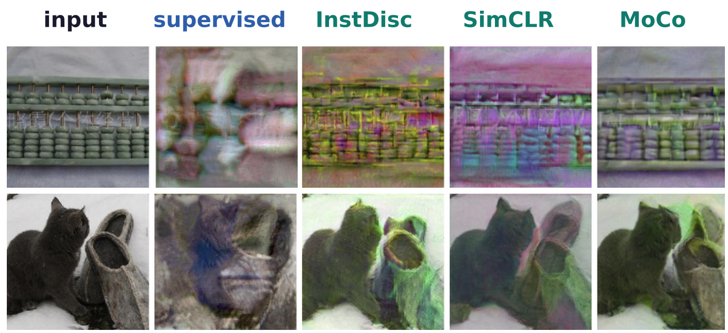
Contrastive learning
Contrastive features keep more of the image than supervised
Simple heads on contrastive features do roughly as well as supervised methods, with less labeled data.
Self-supervised features are better for image reconstruction and grouping regions by attention (DINO).
Images rebuilt from ResNet-50 features: supervised (blue) lose regions, contrastive (teal) keep them.
InstDisc: instance discrimination; the images are rebuilt by optimizing an image to match the features.
N. Zhao, Z. Wu, R. W. H. Lau and S. Lin, “What makes instance discrimination good for transfer learning?,” ICLR, 2021.
Neural Networks · A. Yuille
22

Slide 23
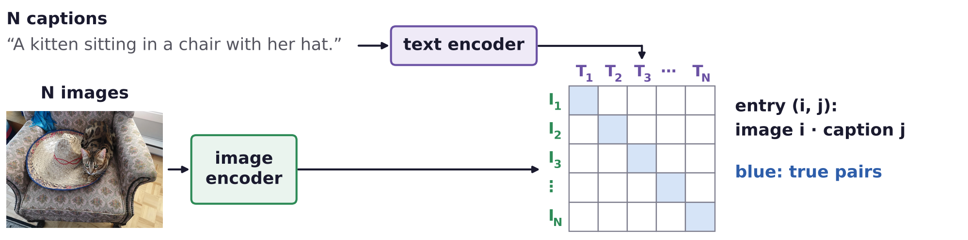
Contrastive learning
CLIP: contrastive learning of images and their captions
CLIP (contrastive language-image pre-training) is trained on paired images and text captions.
Image and text features are made similar for each pair and different for the other pairs.
Image as the query: its caption is the positive key, the other captions are negative keys (and vice versa).
CLIP is very popular for vision-language tasks: it is very low tech and good for initializing other methods.
A. Radford, J. W. Kim, C. Hallacy, A. Ramesh, G. Goh, S. Agarwal et al., “Learning transferable visual models from natural language supervision,”
ICML, 8748–8763, 2021.
Neural Networks · A. Yuille
23

Slide 24
Masked image modeling
4
Mask part of the image and predict what is missing,
as masked language modeling does with words.
Neural Networks · A. Yuille
24

Slide 25
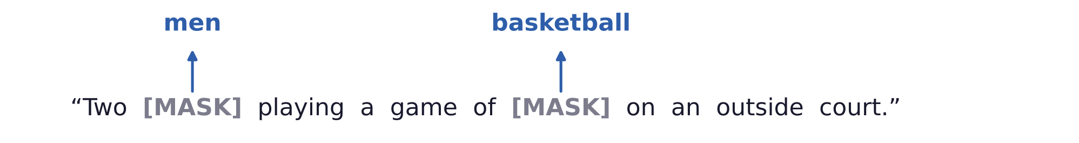
Masked image modeling
Masked language modeling predicts the missing words
BERT (a bidirectional transformer) masks some words and learns to predict them from the other words.
Masked image modeling was inspired by natural language processing (NLP), where it trained LLMs.
In NLP it is being replaced by auto-regressive methods, which predict the next word.
J. Devlin, M.-W. Chang, K. Lee and K. Toutanova, “BERT: pre-training of deep bidirectional transformers for language understanding,”
NAACL-HLT, 4171–4186, 2019.
Neural Networks · A. Yuille
25

Slide 26
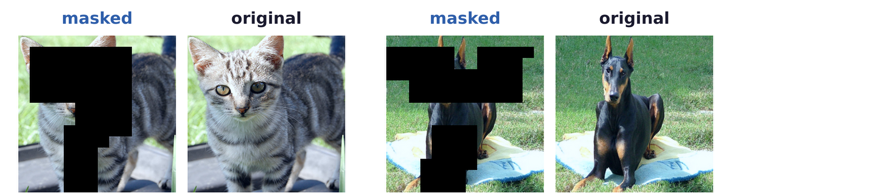
Masked image modeling
Humans can recognize a masked object and infill it
Masked image modeling: mask patches of an image and train a network to predict them.
Language is sparse, discrete and semantic-rich, with natural word tokens.
Vision is dense, continuous, high-dimensional; mimicking language suggests visual words, a codebook.
Neural Networks · A. Yuille
26

Slide 27
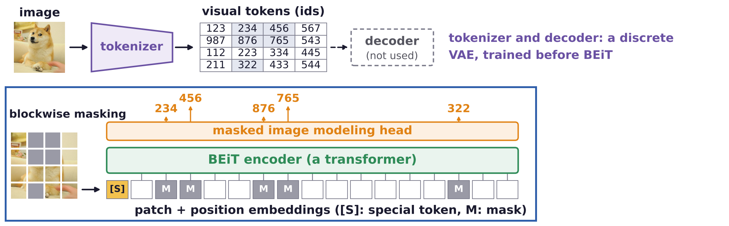
Masked image modeling
BEiT: a transformer with masked input
The image is cut into 16 × 16-pixel patches; blockwise masking replaces about 40 % of them by M.
BEiT (BERT pre-training of image transformers): a ViT computes a feature for every patch, masked or not.
The masked image modeling (MIM) head predicts the token id of each masked patch (shaded ids).
H. Bao, L. Dong, S. Piao and F. Wei, “BEiT: BERT pre-training of image transformers,” ICLR, 2022.
Neural Networks · A. Yuille
27

Slide 28
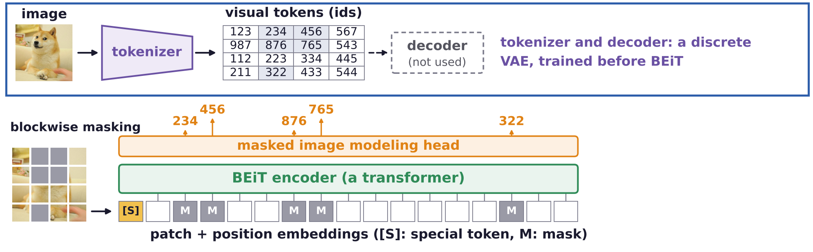
Masked image modeling
BEiT: predicting visual tokens
The visual tokens are learned by a discrete variational auto-encoder (dVAE), separately from MIM.
The visual tokens are a discrete dictionary (codebook) of image patches: each patch gets one token id.
The dVAE decoder, which rebuilds the image from the tokens, is not used during pre-training.
H. Bao, L. Dong, S. Piao and F. Wei, “BEiT: BERT pre-training of image transformers,” ICLR, 2022.
Neural Networks · A. Yuille
28

Slide 29
iBOT: online tokenizer
5
A teacher network gives every patch a visual token, learned online;
the student predicts the tokens of its masked patches.
Neural Networks · A. Yuille
29

Slide 30
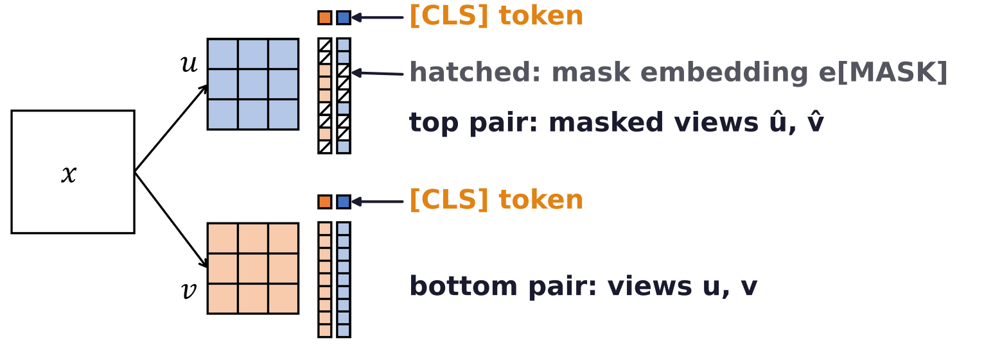
iBOT: online tokenizer
iBOT has two objectives and a single stage
iBOT: image BERT pre-training with an online tokenizer, trained at the same time as the network.
Image tokenizer: give each patch a visual token; similar patches get the same token, as in clustering.
Unlike BEiT, tokens are continuous-valued (probabilities over K ids), not learned by a separate process.
Masked image modeling: predict the visual tokens of the masked patches.
Each image x is first augmented to two views u and v, each of which has a masked version.
J. Zhou, C. Wei, H. Wang, W. Shen, C. Xie, A. Yuille and T. Kong, “iBOT: image BERT pre-training with online tokenizer,” ICLR, 2022.
Neural Networks · A. Yuille
30

Slide 31
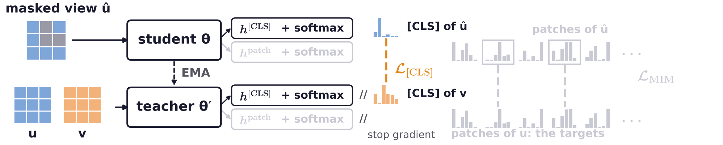
iBOT: online tokenizer
The online tokenizer is a teacher network
[CLS] embeddings are transformed to visual tokens by a head h followed by softmax: P over K = 8192 ids.
Teacher θ': an exponential moving average (EMA) of the student θ; no gradient flows into it.
The tokenizer objective: self-distillation, as in DINO; the student's P for û matches the teacher's for v.
−pᵀ log q is the cross-entropy of the student's distribution q against the teacher's p.
J. Zhou, C. Wei, H. Wang, W. Shen, C. Xie, A. Yuille and T. Kong, “iBOT: image BERT pre-training with online tokenizer,” ICLR, 2022.
Neural Networks · A. Yuille
31

Slide 32
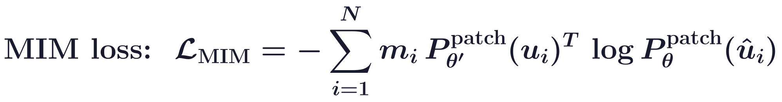
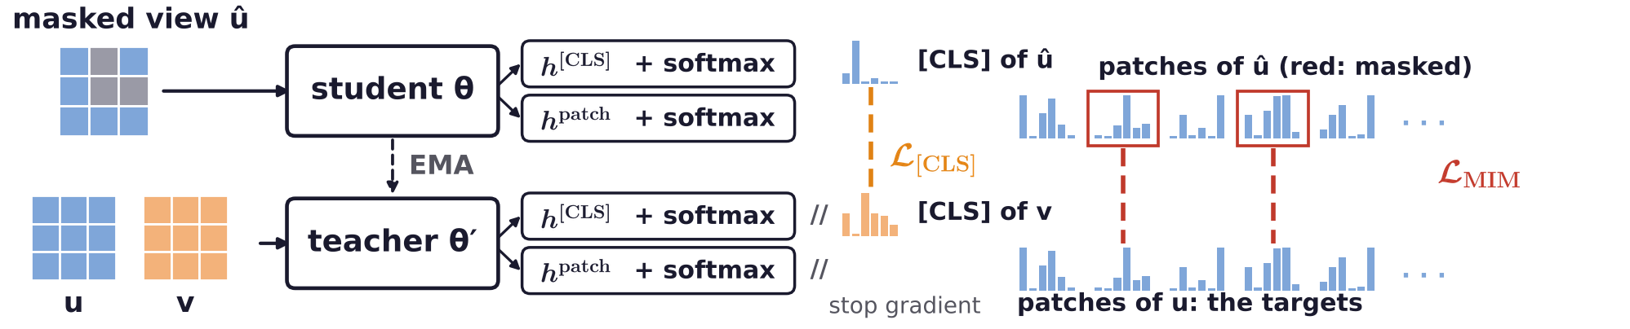
iBOT: online tokenizer
Masked patches predict the tokens of the unmasked view
The teacher sees the unmasked view u and gives each of its N patches a token; m_i = 1: i is masked.
The student predicts them from û; h[CLS] and h patch share their weights; the two losses are summed.
The model is effective, but it has black-box aspects: it is hard to give intuitive reasons why it works.
J. Zhou, C. Wei, H. Wang, W. Shen, C. Xie, A. Yuille and T. Kong, “iBOT: image BERT pre-training with online tokenizer,” ICLR, 2022.
Neural Networks · A. Yuille
32

Slide 33
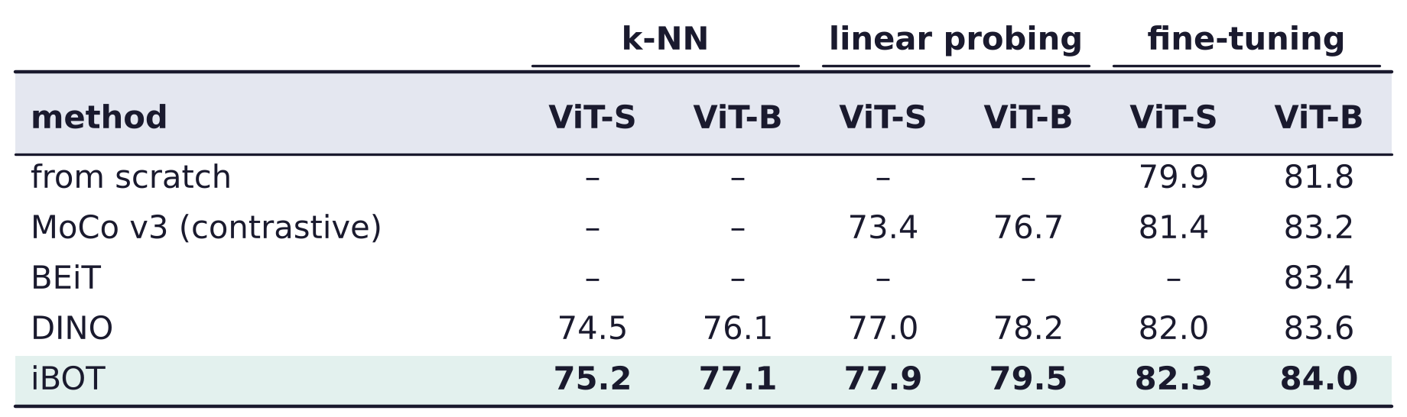
iBOT: online tokenizer
iBOT is very effective with simple heads
ImageNet-1K top-1 (%); ViT-S has 21 million parameters, about as many as a ResNet-50; ViT-B 85 million.
k-NN: classify by the k nearest training images in feature space; it freezes the backbone, as linear does.
Fine-tuning trains all the weights; from scratch: no pre-training; –: not reported.
J. Zhou, C. Wei, H. Wang, W. Shen, C. Xie, A. Yuille and T. Kong, “iBOT: image BERT pre-training with online tokenizer,” ICLR, 2022.
X. Chen, S. Xie and K. He, “An empirical study of training self-supervised vision transformers,” ICCV, 9640–9649, 2021.
Neural Networks · A. Yuille
33

Slide 34
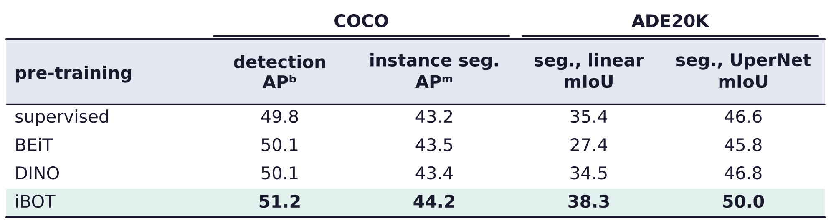
iBOT: online tokenizer
iBOT features transfer to detection and segmentation
ViT-B pre-trained on ImageNet-1K without labels (supervised: with labels), then trained on each task.
COCO: detection and instance segmentation, average precision of boxes (APᵇ) and masks (APᵐ).
ADE20K: semantic segmentation, mean intersection over union (mIoU).
Linear: a head on frozen features; Cascade Mask R-CNN and UperNet fine-tune the backbone.
J. Zhou, C. Wei, H. Wang, W. Shen, C. Xie, A. Yuille and T. Kong, “iBOT: image BERT pre-training with online tokenizer,” ICLR, 2022.
Neural Networks · A. Yuille
34

Slide 35
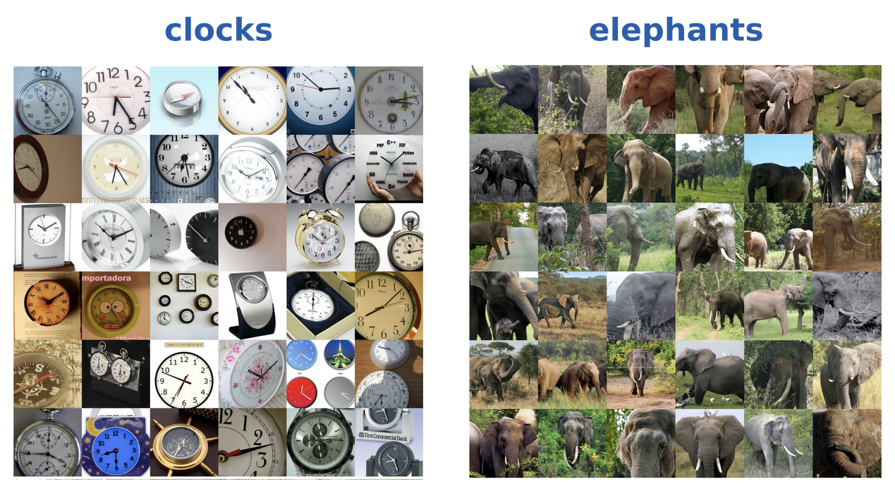
iBOT: online tokenizer
Image-level visual tokens are qualitatively interpretable
Each grid: ImageNet images whose [CLS] output gives one token id (of 8192) the highest probability.
One token holds clocks of many kinds; another holds elephants.
J. Zhou, C. Wei, H. Wang, W. Shen, C. Xie, A. Yuille and T. Kong, “iBOT: image BERT pre-training with online tokenizer,” ICLR, 2022.
Neural Networks · A. Yuille
35

Slide 36
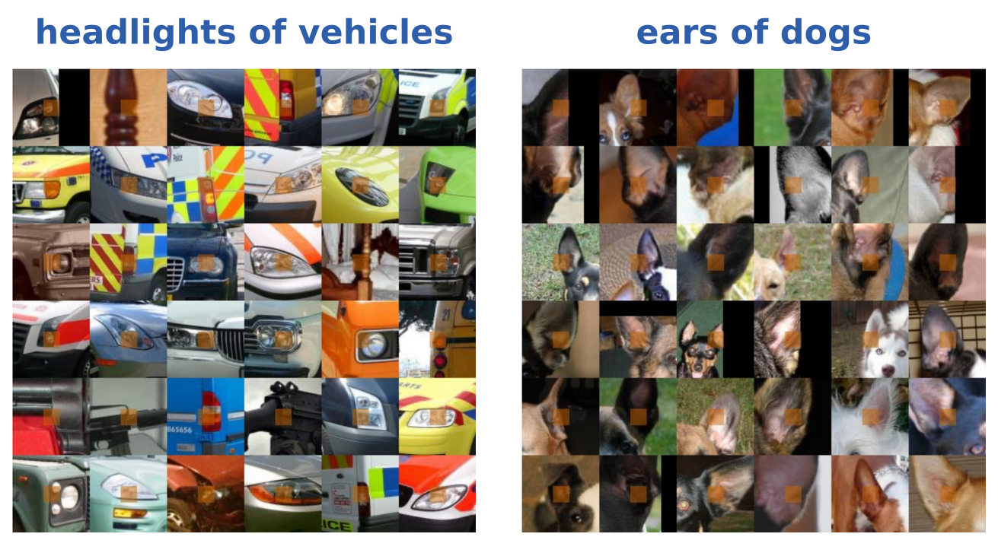
iBOT: online tokenizer
Patch-level visual tokens are qualitatively interpretable
Each grid: the 36 ImageNet patches with the highest probability for one visual token (ViT-S/16).
Orange: the 16 × 16 patch, shown with its context, five times its size; black: beyond the image.
These tokens share part semantics: the headlight of a vehicle, the ear of a dog.
J. Zhou, C. Wei, H. Wang, W. Shen, C. Xie, A. Yuille and T. Kong, “iBOT: image BERT pre-training with online tokenizer,” ICLR, 2022.
Neural Networks · A. Yuille
36

Slide 37
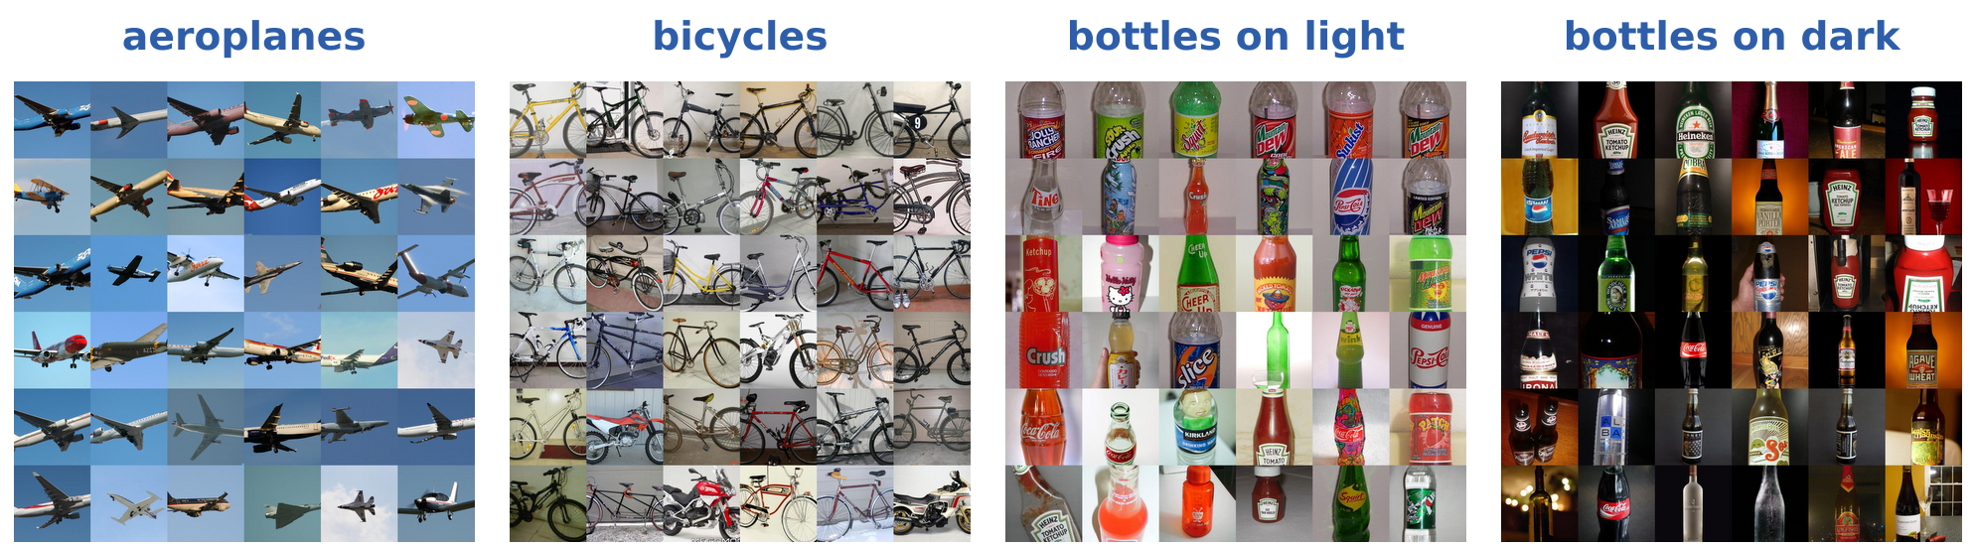
iBOT: online tokenizer
On PASCAL3D+, class tokens cluster images by category
Chen Wei's runs: iBOT on PASCAL3D+ (12 rigid categories), ViT-S, [CLS] and patch losses, 128 tokens.
Each grid: 36 images given one token; generally correct clustering, a few motorbikes among bicycles.
Some categories split over several tokens: bottles on a light and on a dark background.
Y. Xiang, R. Mottaghi and S. Savarese, “Beyond PASCAL: a benchmark for 3D object detection in the wild,” WACV, 75–82, 2014.
J. Zhou, C. Wei, H. Wang, W. Shen, C. Xie, A. Yuille and T. Kong, “iBOT: image BERT pre-training with online tokenizer,” ICLR, 2022.
Neural Networks · A. Yuille
37

Slide 38
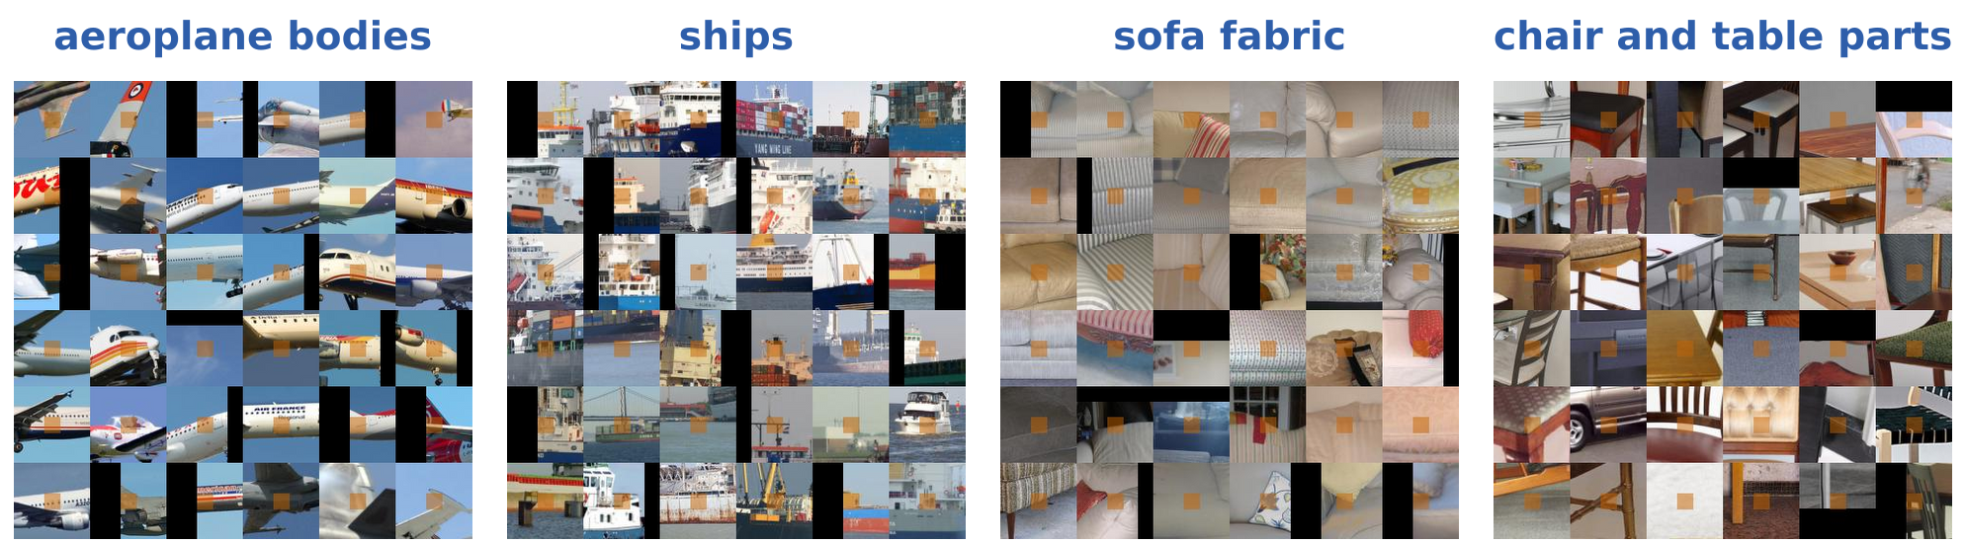
iBOT: online tokenizer
On PASCAL3D+, patch tokens group parts across images
Each grid: 36 patches given one token; orange: the patch, with its context; black: beyond the image.
Tokens for aeroplane bodies against the sky, ships, sofa fabric, and parts of chairs and tables.
In these examples, patch tokens follow parts and surfaces; class tokens follow whole objects.
J. Zhou, C. Wei, H. Wang, W. Shen, C. Xie, A. Yuille and T. Kong, “iBOT: image BERT pre-training with online tokenizer,” ICLR, 2022.
Neural Networks · A. Yuille
38

Slide 39
Masked feature prediction
6
Predict features of the masked patches instead of their pixels; histograms
of oriented gradients (HOG), a hand-designed feature, are a strong target.
Neural Networks · A. Yuille
39

Slide 40
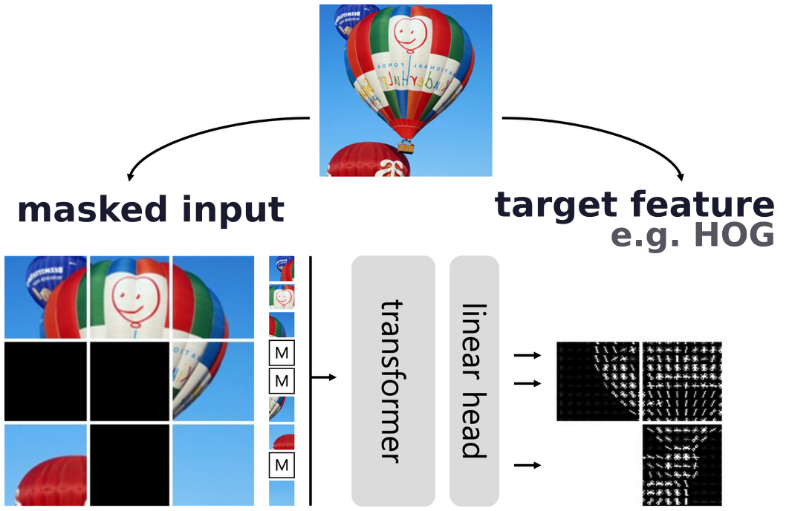
Masked feature prediction
MaskFeat regresses the features of the masked patches
Mask patches of the image; a transformer and a linear head regress a feature of each masked patch.
Five types of targets: pixel colors, HOG, dVAE tokens, deep features, pseudo labels (per-patch classes).
Each target: ViT-B pre-trained on ImageNet-1K, then fine-tuned; the top-1 accuracies are compared.
C. Wei, H. Fan, S. Xie, C.-Y. Wu, A. Yuille and C. Feichtenhofer, “Masked feature prediction for self-supervised visual pre-training,”
CVPR, 14668–14678, 2022.
Neural Networks · A. Yuille
40

Slide 41
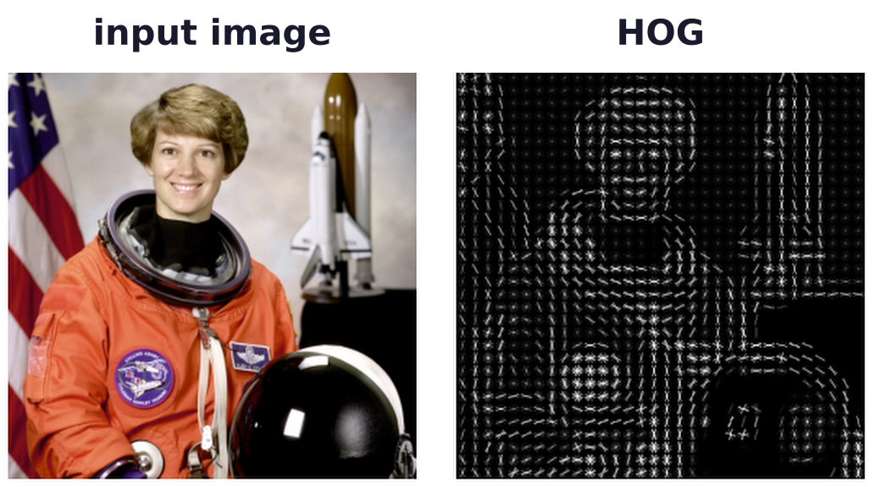
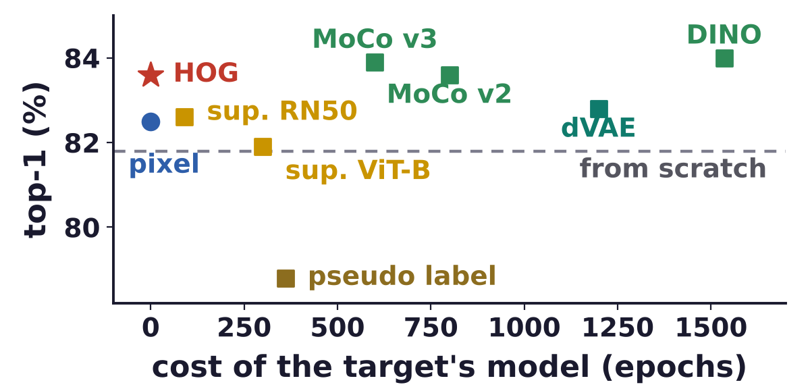
Masked feature prediction
HOG rivals unsupervised deep features as a target
HOG: histograms of oriented gradients in small cells, popular in the 2000s; fast to compute on a GPU.
Its invariance to geometric and photometric change (to some extent) helps: HOG beats pixel colors.
Horizontal axis: the cost of training the model that gives the target; none for pixels and HOG.
Unsupervised deep features (green) work best, supervised (gold) less; pseudo labels fall below scratch.
N. Dalal and B. Triggs, “Histograms of oriented gradients for human detection,” CVPR, 886–893, 2005.
C. Wei, H. Fan, S. Xie, C.-Y. Wu, A. Yuille and C. Feichtenhofer, “Masked feature prediction for self-supervised visual pre-training,”
CVPR, 14668–14678, 2022.
Neural Networks · A. Yuille
41

Slide 42
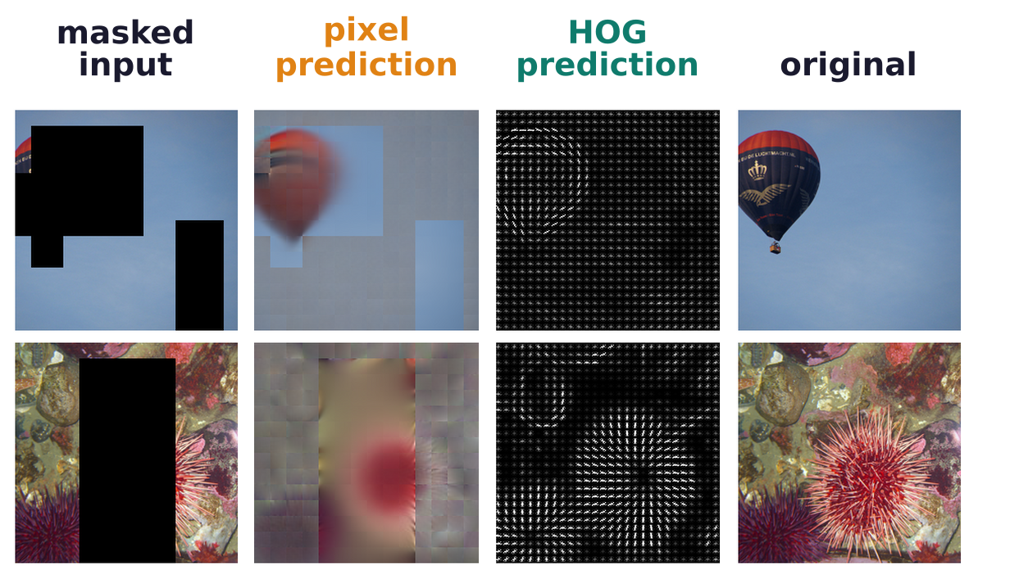
Masked feature prediction
Pixel targets suffer from color and texture ambiguity
Pixel targets give a large loss penalty when the predicted color is plausible but unmatched (the balloon).
HOG captures the major edge directions and is robust to ambiguous color and texture (the sea urchin).
The loss covers only the masked regions, so the predictions outside them are not trained.
C. Wei, H. Fan, S. Xie, C.-Y. Wu, A. Yuille and C. Feichtenhofer, “Masked feature prediction for self-supervised visual pre-training,”
CVPR, 14668–14678, 2022.
Neural Networks · A. Yuille
42

Slide 43
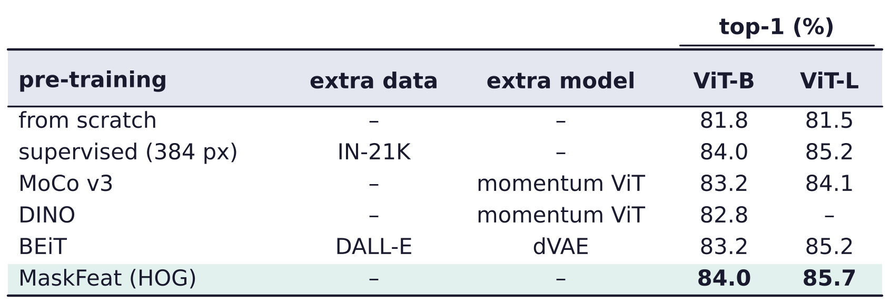
Masked feature prediction
MaskFeat models one image, with minimal augmentation
Contrastive methods: invariance to data augmentation, but invariance is not always correct.
They rely heavily on augmentation engineering, and are complex because of the multiple views.
MaskFeat: image modeling of the structure inside one image, with minimal augmentation; it drives ViT-L.
Accuracies as reported by MaskFeat; papers fine-tune differently (DINO ViT-B: 82.8 here, 83.6 in iBOT).
C. Wei, H. Fan, S. Xie, C.-Y. Wu, A. Yuille and C. Feichtenhofer, “Masked feature prediction for self-supervised visual pre-training,”
CVPR, 14668–14678, 2022.
Neural Networks · A. Yuille
43

Slide 44
Masked feature prediction
Summary
Few-shot learning: predict a new category's weights from its activations, a parametric nearest neighbor.
Self-supervised learning trains the backbone from the data itself; simple heads then do the visual tasks.
Proxy tasks predict context, orientation, patch organization or color; clustering led to contrastive.
Contrastive learning: two views of an image attract, other images repel; CLIP pairs images with captions.
Masked image modeling predicts masked patches; BEiT's visual tokens come from a dVAE trained first.
iBOT learns its tokens online by self-distillation; they group objects and their parts.
MaskFeat: the HOG of the masked patches is a strong target, with minimal augmentation.
The features work with simple heads; DINOv2 (2024), strongly motivated by iBOT, is the most popular.
Neural Networks · A. Yuille
44

