Slide 1
Transformers for Vision:
from Self-Attention to
k-means Cross-Attention
15 October, 2026
Alan Yuille · Probabilistic Models of the Visual Cortex

Slide 2
What this lecture covers
1
Self-attention
2
Cross-attention and ViT
Queries, keys, values; the transformer block
Latent queries, correspondence, patches
3
Axial attention
4
Mask transformers
Axial-DeepLab: long range, position
MaX-DeepLab: masks end to end
5
Cross-attention as clustering
6
k-means cross-attention
CMT-DeepLab: pixels choose clusters
kMaX-DeepLab: normalize over clusters
Neural Networks · A. Yuille
2

Slide 3
Self-attention
1
Each output is an average of values, weighted by query-key affinities
that are normalized over the keys; positions must be added.
Neural Networks · A. Yuille
3

Slide 4
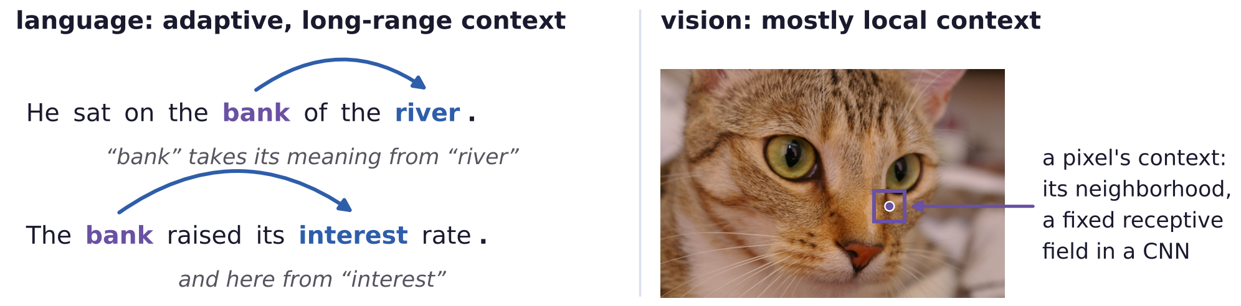
Self-attention
Transformers were developed for text and adapted to vision
Transformers are the default architecture of large language models (LLMs), and of vision and speech.
In language the meaning of a word depends on its context, which is adaptive and can be very long range.
The success of LLMs is largely due to transformers modeling long-range and adaptive context.
In vision the context is more local and less adaptive; CNNs (fixed receptive fields) capture it fairly well.
Transformers for vision are still work in progress: aspects suited to language are often copied blindly.
Neural Networks · A. Yuille
4

Slide 5
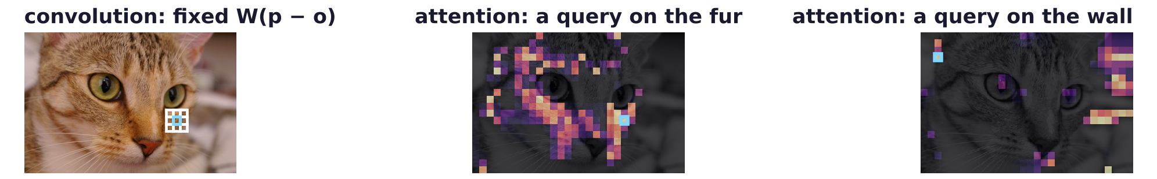
Self-attention
Attention computes a weighted average of feature vectors
y_o: the output at position o; x_p: the input feature at position p (patch, CNN feature, block output).
Convolution: the weight W_{p−o} depends only on the relative position p − o and is fixed after learning.
Self-attention: the weight depends on the inputs themselves and is normalized to sum to 1 over p.
Key property: the weights are highest between inputs which are similar.
Image: x_p = mean color of a 15 × 15 patch; cyan: the position o; bright: a large weight.
Neural Networks · A. Yuille
5

Slide 6
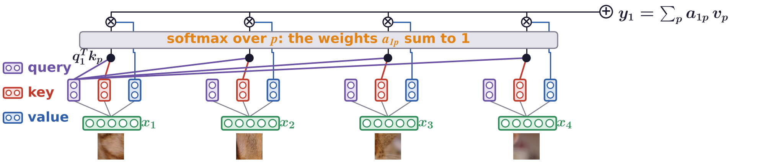
Self-attention
Self-attention with query, key and value
Each layer learns matrices W^Q, W^K, W^V for queries, keys and values (terms from language).
The dot product of q_o and k_p is the affinity of o and p; with W^Q, W^K identities, that of x_o and x_p.
The features at o are updated so that they become more similar to those at the positions of high affinity.
Neural Networks · A. Yuille
6

Slide 7
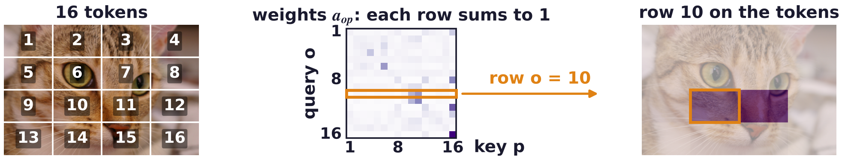
Self-attention
Scaled dot-product attention is quadratic in the tokens
Token: one input vector x_p, a word or an image patch; d: its dimension.
Dividing by √d stops the dot products of d-dimensional vectors growing with d and saturating softmax.
Every query meets every key: n tokens need n² affinities, O(n² d) operations, too many for images.
Each row of weights (one query o) sums to 1; here x_p = mean color of a patch, W^Q = W^K = identity.
A. Vaswani, N. Shazeer, N. Parmar, J. Uszkoreit, L. Jones, A. N. Gomez, Ł. Kaiser and I. Polosukhin, “Attention is all you need,” NIPS, 5998–6008, 2017.
Neural Networks · A. Yuille
7

Slide 8
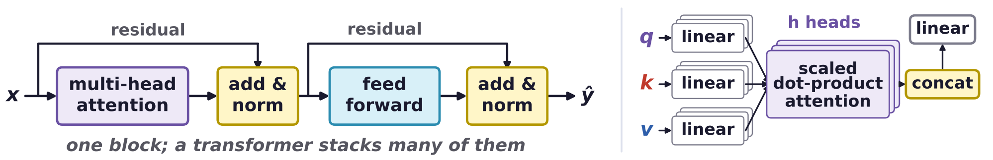
Self-attention
A transformer is a sequence of transformer blocks
Multi-head attention: h attentions in parallel on different projections, concatenated and projected again.
Add & norm: a residual connection, then layer normalization (each vector to zero mean, unit variance).
Feedforward f: an MLP (multi-layer perceptron) with weights θ, the same at every position (1 × 1 conv).
Attention is the only interaction between positions; Vaswani et al.: 6 + 6 blocks, 8 heads, 512 dims.
A. Vaswani, N. Shazeer, N. Parmar, J. Uszkoreit, L. Jones, A. N. Gomez, Ł. Kaiser and I. Polosukhin, “Attention is all you need,” NIPS, 5998–6008, 2017.
J. L. Ba, J. R. Kiros and G. E. Hinton, “Layer normalization,” arXiv:1607.06450, 2016.
Neural Networks · A. Yuille
8

Slide 9
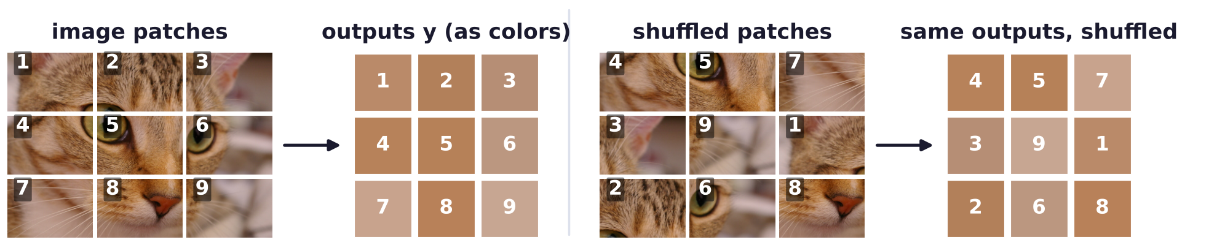
Self-attention
Positional encoding gives each feature its position
Attention ignores the order of its inputs: permuting the patches permutes the outputs in the same way.
In language order is crucial: “The cat sat on the mat” differs from “The mat sat on the cat”.
Appending p is simplest; e_p: a learned or sinusoidal code; relative position matters more than absolute.
The inputs need not lie on a regular lattice; some positions may be missing (masked image modeling).
Neural Networks · A. Yuille
9

Slide 10
Cross-attention and ViT
2
Queries from one set attend to keys and values from another;
the vision transformer (ViT) treats image patches as words.
Neural Networks · A. Yuille
10

Slide 11
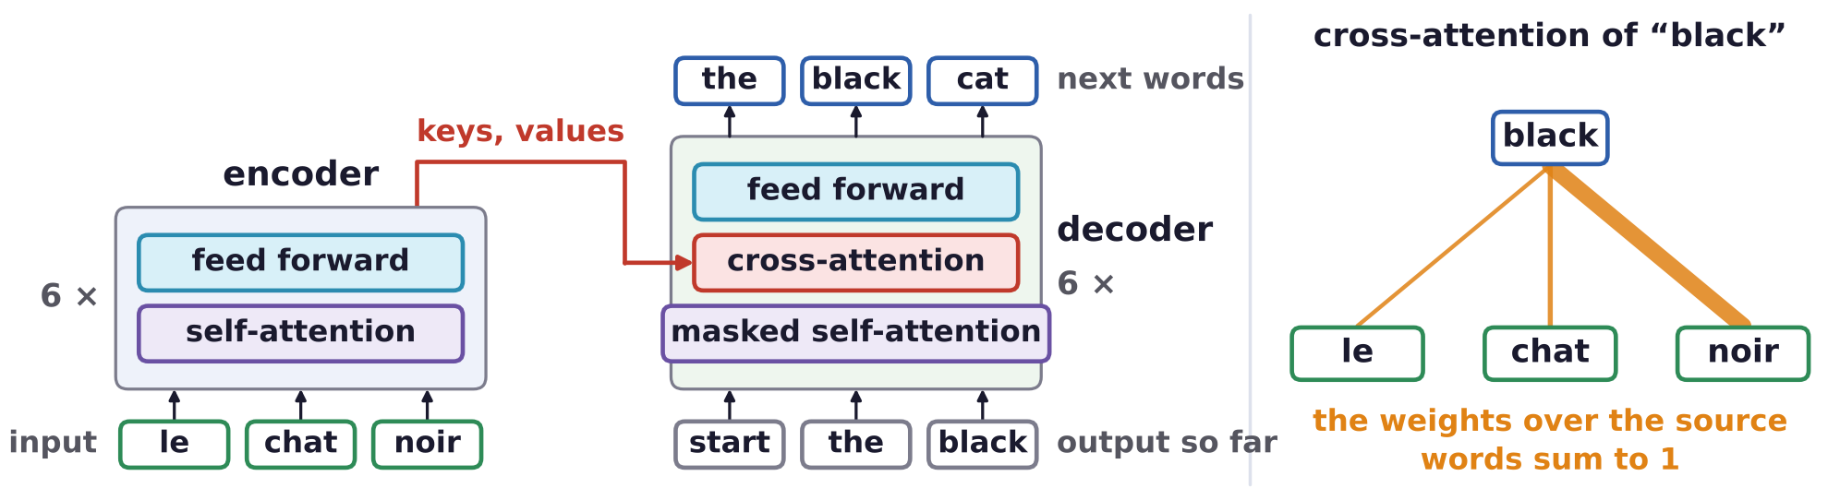
Cross-attention and ViT
The encoder uses self-attention, the decoder cross-attention
The application was translation between languages: the encoder converts the input text into features.
The decoder converts the features into text word by word; masked: it sees only the words so far.
Cross-attention specifies the correspondence between the words of the input and of the output.
For vision: encoders extract pixel-level features; decoders convert them to object-level representations.
A. Vaswani, N. Shazeer, N. Parmar, J. Uszkoreit, L. Jones, A. N. Gomez, Ł. Kaiser and I. Polosukhin, “Attention is all you need,” NIPS, 5998–6008, 2017.
Neural Networks · A. Yuille
11

Slide 12
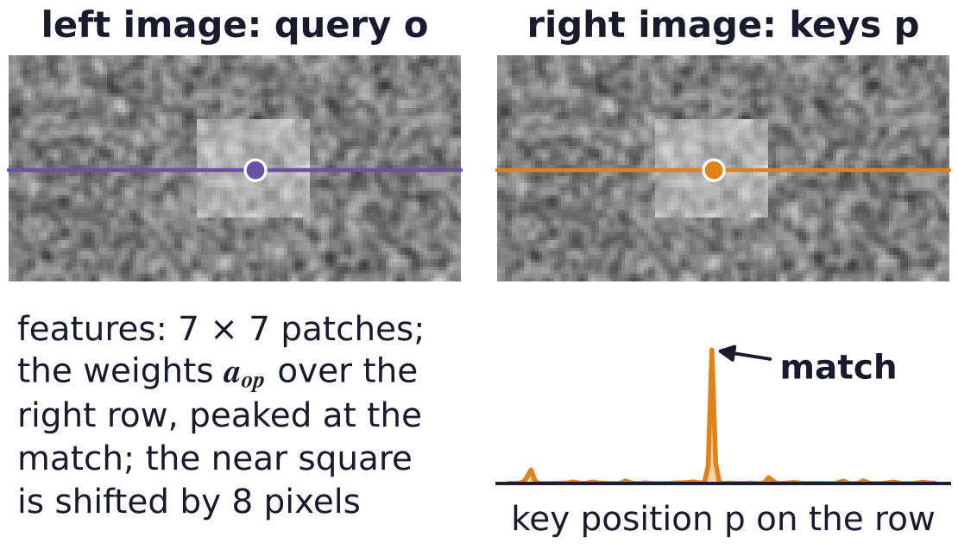
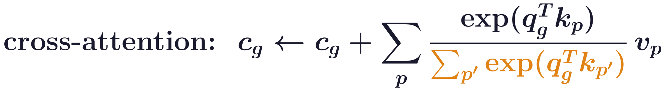
Cross-attention and ViT
Cross-attention: queries from one set, keys from another
Queries come from one set, keys and values from another: here N latent variables c_g query x_p.
Orange: the weights sum to 1 over the inputs p; each latent variable looks for its match.
Stereo (context-enhanced stereo transformer, CSTR): a left-image pixel o queries the right image's row.
Cross-attention introduces latent variables that can be used as output, for example objects.
W. Guo, Z. Li, Y. Yang, Z. Wang, R. H. Taylor, M. Unberath, A. Yuille and Y. Li, “Context-enhanced stereo transformer,” ECCV, 2022.
Neural Networks · A. Yuille
12

Slide 13
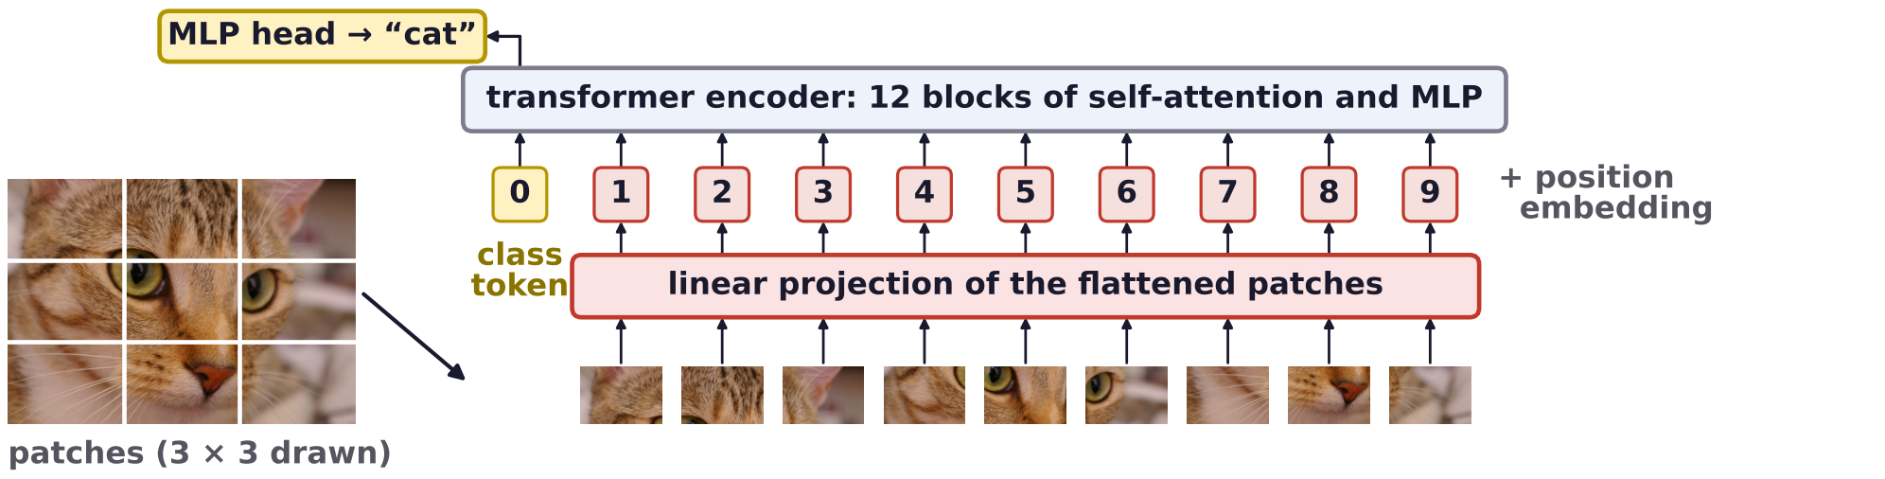
Cross-attention and ViT
ViT: the pioneer of transformer architectures for vision
Divide the image into 16 × 16-pixel patches (196 for a 224-pixel image), treated as words in language.
An encoder only (self-attention): position embeddings, a learned class token, 12 blocks (ViT-Base).
Trained on ImageNet alone ViTs trail ResNets; pre-trained on JFT-300M (303M images), large ViTs win.
Strength: long range, scalability; weakness: quadratic cost, no locality, coarse 16 × 16 patches.
A. Dosovitskiy, L. Beyer, A. Kolesnikov, D. Weissenborn, X. Zhai, T. Unterthiner et al., “An image is worth 16x16 words: transformers for image
recognition at scale,” ICLR, 2021.
Neural Networks · A. Yuille
13

Slide 14
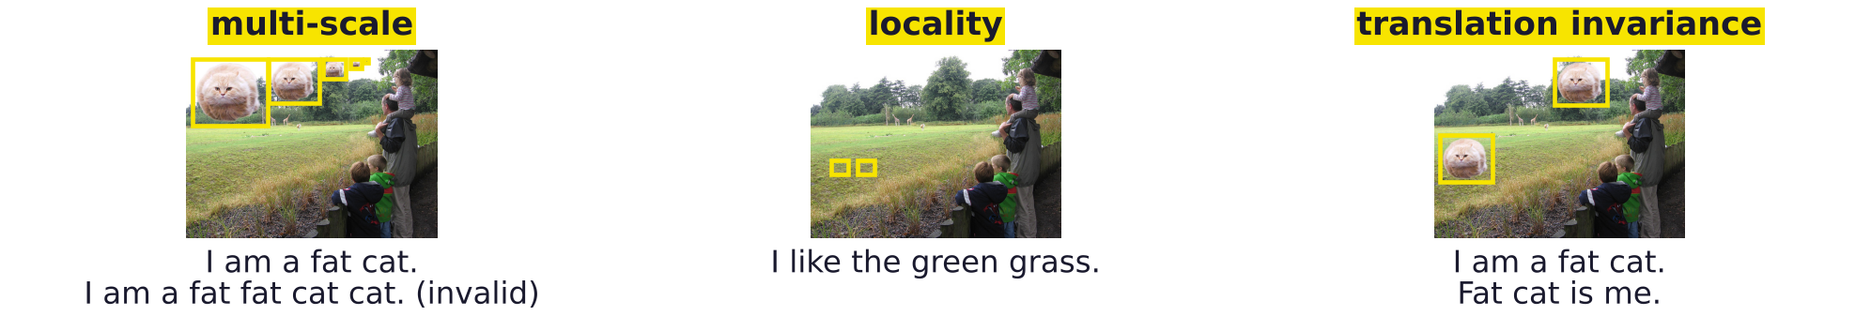
Cross-attention and ViT
Visual signals differ from text: scale, locality, position
Multi-scale: a cat can appear at any size; a word cannot (“I am a fat fat cat cat” is invalid).
Locality: neighboring pixels are similar (grass); a sentence has no spatial smoothness.
Translation invariance: a cat is a cat anywhere; text is sensitive to absolute word positions.
Swin (shifted windows): attention in 7 × 7-patch windows, shifted between blocks, at 1/4 to 1/32 scale.
Hybrid models (MOAT, TransUNet, ViTamin) add convolutions: locality, translation invariance, hierarchy.
Example adapted from Ross Girshick and Ze Liu.
Z. Liu, Y. Lin, Y. Cao, H. Hu, Y. Wei, Z. Zhang, S. Lin and B. Guo, “Swin transformer: hierarchical vision transformer using shifted windows,”
ICCV, 10012–10022, 2021.
C. Yang, S. Qiao, Q. Yu, X. Yuan, Y. Zhu, A. Yuille, H. Adam and L.-C. Chen, “MOAT: alternating mobile convolution and attention brings strong
vision models,” ICLR, 2023.
Neural Networks · A. Yuille
14

Slide 15
Axial attention
3
Attention along the height axis, then the width axis, reaches the whole image;
three positional terms make it position-sensitive.
Neural Networks · A. Yuille
15

Slide 16
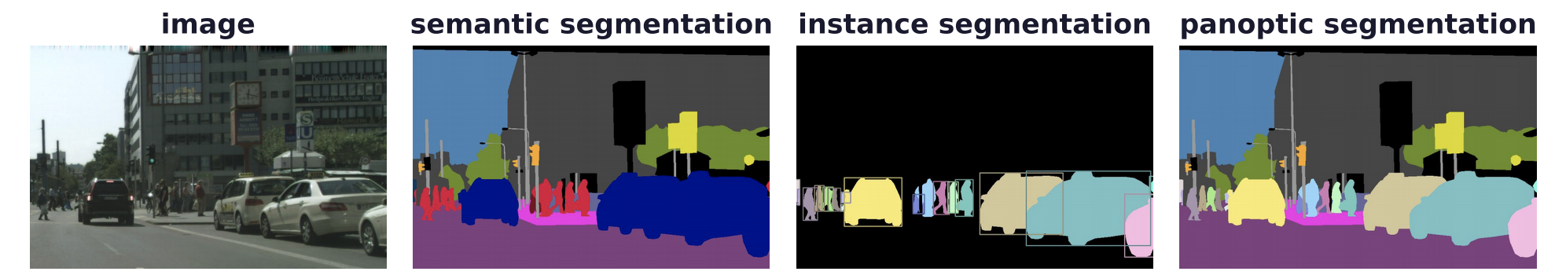
Axial attention
Panoptic segmentation gives every pixel a class and instance
Semantic segmentation gives each pixel a class; instance segmentation separates the objects (things).
Panoptic: every pixel gets a class, and a pixel of a thing (car, person) an instance; stuff (road, sky) not.
Panoptic quality (PQ) scores recognition and segmentation together; datasets: COCO, Cityscapes.
Four DeepLab papers by Huiyu Wang, Qihang Yu et al.: Axial, MaX (mask), CMT (clustering mask), kMaX.
A. Kirillov, K. He, R. Girshick, C. Rother and P. Dollár, “Panoptic segmentation,” CVPR, 9404–9413, 2019.
M. Cordts, M. Omran, S. Ramos, T. Rehfeld, M. Enzweiler, R. Benenson, U. Franke, S. Roth and B. Schiele, “The Cityscapes dataset for semantic
urban scene understanding,” CVPR, 3213–3223, 2016.
Neural Networks · A. Yuille
16

Slide 17
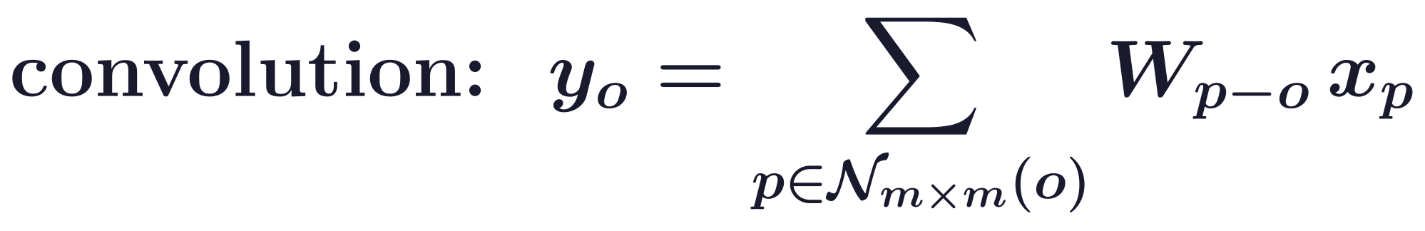
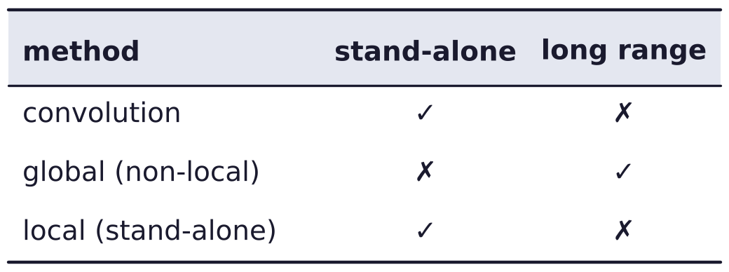
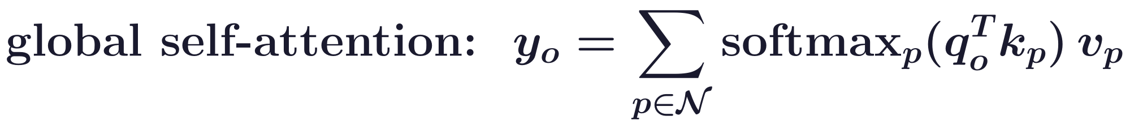
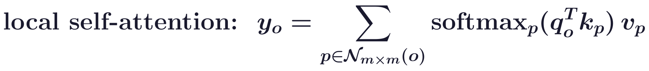
Axial attention
Self-attention can be global or restricted to a local square
Stand-alone: the layer alone can build the network, as convolution does (1 × 1 layers aside).
Convolution: a local m × m square around o; the weights W_{p−o} depend only on the relative position.
Global (non-local) self-attention: the whole image, long range but O(H²W²) for an H × W feature map.
Local self-attention: an m × m square, O(HWm²); it replaces convolution, but is not long range.
X. Wang, R. Girshick, A. Gupta and K. He, “Non-local neural networks,” CVPR, 7794–7803, 2018.
P. Ramachandran, N. Parmar, A. Vaswani, I. Bello, A. Levskaya and J. Shlens, “Stand-alone self-attention in vision models,” NeurIPS, 68–80, 2019.
Neural Networks · A. Yuille
17

Slide 18
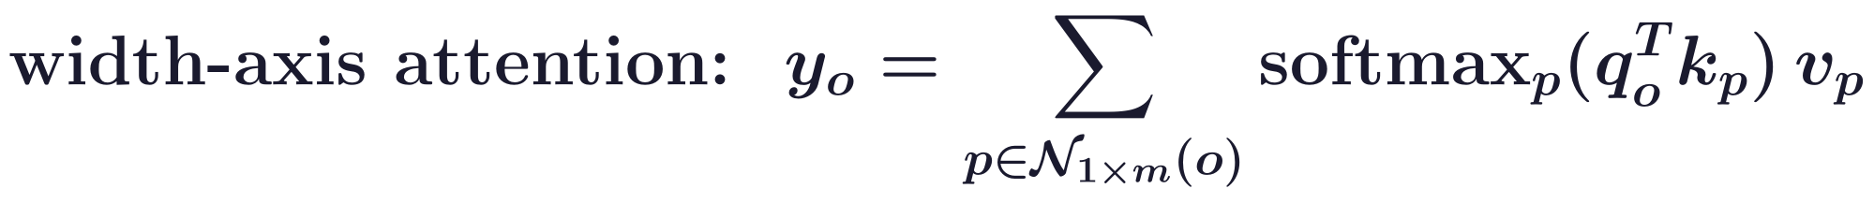
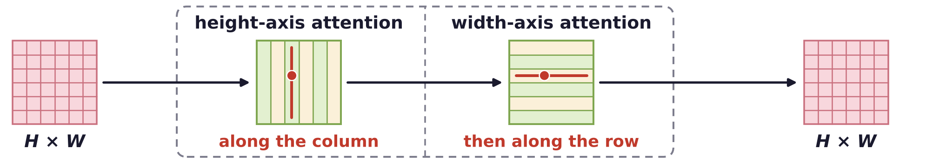
Axial attention
Axial attention factorizes 2D attention into height and width
N_{1×m}(o): a 1 × m segment of the row through o; a height-axis layer does this along the column.
With the span m set to the whole row and column, height then width lets every pixel reach every other.
The cost falls to O(HWm): stand-alone and long range.
J. Ho, N. Kalchbrenner, D. Weissenborn and T. Salimans, “Axial attention in multidimensional transformers,” arXiv:1912.12180, 2019.
Z. Huang, X. Wang, L. Huang, C. Huang, Y. Wei and W. Liu, “CCNet: criss-cross attention for semantic segmentation,” ICCV, 603–612, 2019.
H. Wang, Y. Zhu, B. Green, H. Adam, A. Yuille and L.-C. Chen, “Axial-DeepLab: stand-alone axial-attention for panoptic segmentation,”
ECCV, LNCS 12349, 108–126, 2020.
Neural Networks · A. Yuille
18

Slide 19
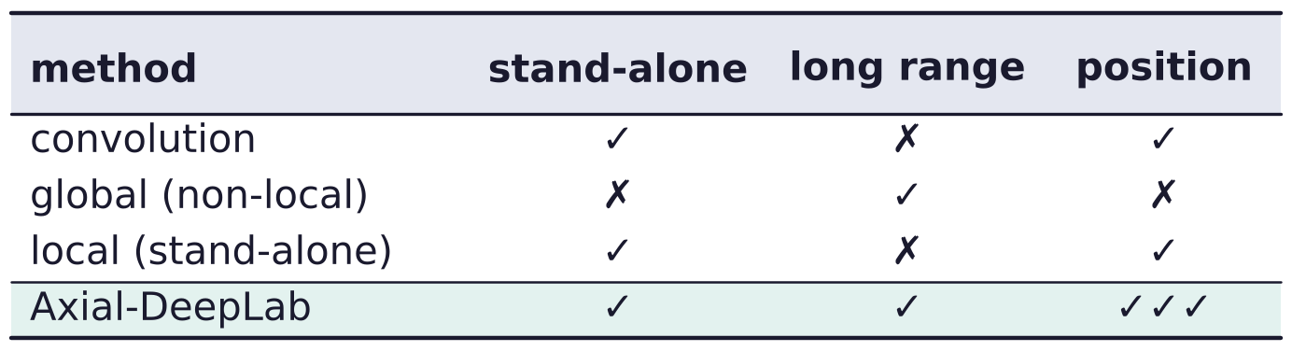
Axial attention
Position-sensitive attention adds three positional terms
Query bias: q_o times a learned vector r^q for the offset p − o (from stand-alone attention).
Key bias: k_p times a learned vector r^k; the key also says where to attend.
Position retrieval: a learned vector r^v added to v_p, so the output also retrieves relative positions.
P. Shaw, J. Uszkoreit and A. Vaswani, “Self-attention with relative position representations,” NAACL-HLT, 464–468, 2018.
P. Ramachandran, N. Parmar, A. Vaswani, I. Bello, A. Levskaya and J. Shlens, “Stand-alone self-attention in vision models,” NeurIPS, 68–80, 2019.
H. Wang, Y. Zhu, B. Green, H. Adam, A. Yuille and L.-C. Chen, “Axial-DeepLab: stand-alone axial-attention for panoptic segmentation,”
ECCV, LNCS 12349, 108–126, 2020.
Neural Networks · A. Yuille
19

Slide 20
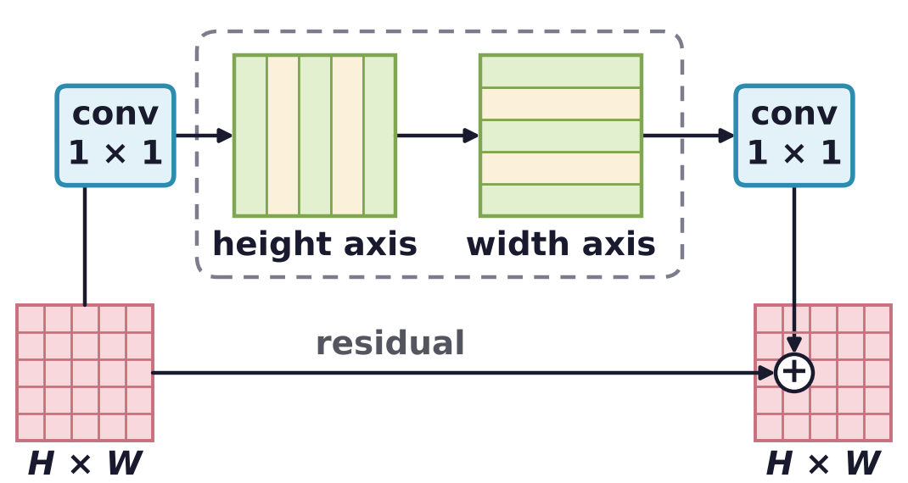
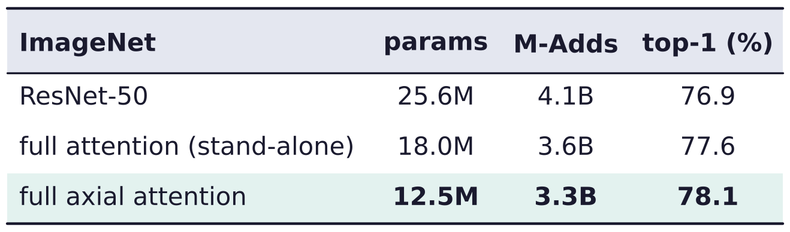
Axial attention
The axial block replaces the 3 × 3 convolution of a ResNet
Residual bottleneck: 1 × 1 conv, height-axis then width-axis attention (8 heads each), 1 × 1 conv.
Every block of a ResNet-50 made axial, the stem (first layers) included: half the parameters (params).
ImageNet classification; M-Adds: multiply-adds; top-1: the correct class is the most probable.
K. He, X. Zhang, S. Ren and J. Sun, “Deep residual learning for image recognition,” CVPR, 770–778, 2016.
P. Ramachandran, N. Parmar, A. Vaswani, I. Bello, A. Levskaya and J. Shlens, “Stand-alone self-attention in vision models,” NeurIPS, 68–80, 2019.
H. Wang, Y. Zhu, B. Green, H. Adam, A. Yuille and L.-C. Chen, “Axial-DeepLab: stand-alone axial-attention for panoptic segmentation,”
ECCV, LNCS 12349, 108–126, 2020.
Neural Networks · A. Yuille
20

Slide 21
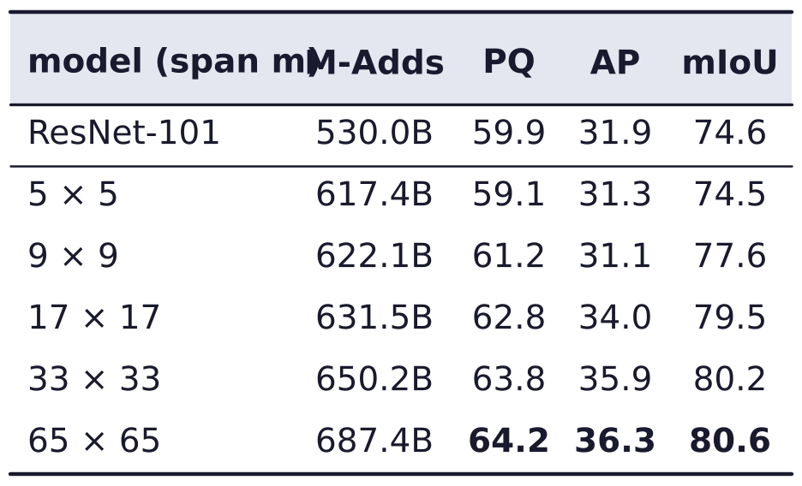
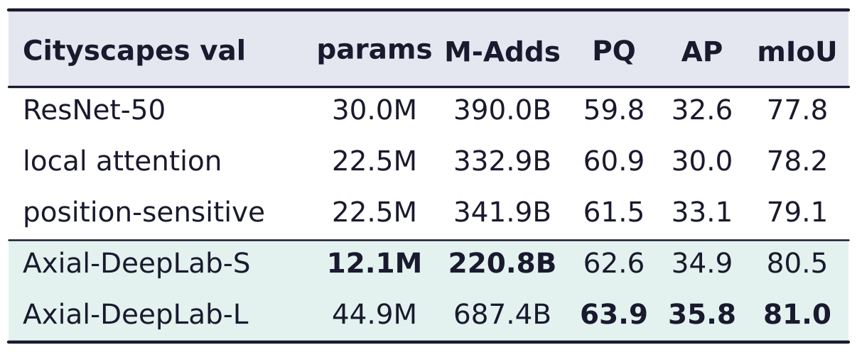
Axial attention
Long-range axial attention helps panoptic segmentation
Cityscapes validation: Axial-DeepLab-S (small) beats ResNet-50 and local attention, with fewer params.
Larger spans m (Axial-ResNet-L) improve PQ and mIoU at every step, at marginal cost.
AP: average precision of instance masks; mIoU: mean intersection over union of semantic classes.
Huiyu Wang's summary: axial attention was tested in the ViT paper and is used in AlphaFold 2.
H. Wang, Y. Zhu, B. Green, H. Adam, A. Yuille and L.-C. Chen, “Axial-DeepLab: stand-alone axial-attention for panoptic segmentation,”
ECCV, LNCS 12349, 108–126, 2020.
J. Jumper, R. Evans, A. Pritzel, T. Green, M. Figurnov et al., “Highly accurate protein structure prediction with AlphaFold,” Nature, 596:583–589, 2021.
Neural Networks · A. Yuille
21

Slide 22
Mask transformers
4
N latent vectors become N masks and N classes; Hungarian matching
assigns them to the ground truth, with no boxes or anchors.
Neural Networks · A. Yuille
22

Slide 23
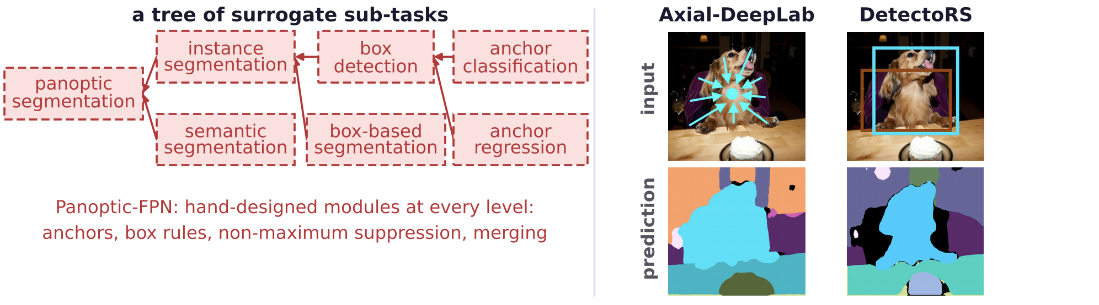
Mask transformers
Earlier methods split panoptic segmentation into sub-tasks
Panoptic-FPN (feature pyramid network): a tree of surrogate (stand-in) sub-tasks, merged at the end.
Axial-DeepLab's head regresses object centers: it fails when two centers are close (dog and chair).
DetectoRS classifies boxes instead of masks: it drops the chair, whose box (brown) has low confidence.
A. Kirillov, R. Girshick, K. He and P. Dollár, “Panoptic feature pyramid networks,” CVPR, 6399–6408, 2019.
H. Wang, Y. Zhu, H. Adam, A. Yuille and L.-C. Chen, “MaX-DeepLab: end-to-end panoptic segmentation with mask transformers,”
CVPR, 5463–5474, 2021.
Neural Networks · A. Yuille
23

Slide 24
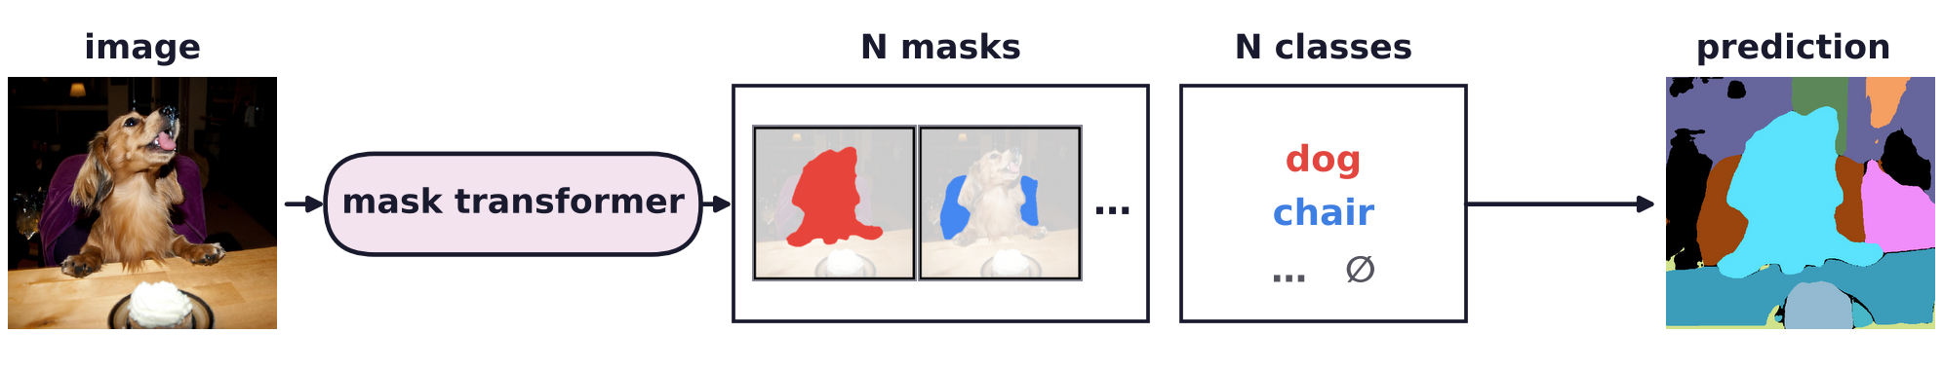
Mask transformers
MaX-DeepLab predicts N masks and N classes end to end
The mask transformer outputs N = 128 masks and their classes directly: no boxes, anchors or centers.
Masks: dot products of x_p with N latent vectors c_g (the memory), normalized over the masks (teal).
Each pixel takes its most probable mask; the class ∅ (no object) discards the unused masks.
H. Wang, Y. Zhu, H. Adam, A. Yuille and L.-C. Chen, “MaX-DeepLab: end-to-end panoptic segmentation with mask transformers,”
CVPR, 5463–5474, 2021.
Neural Networks · A. Yuille
24

Slide 25
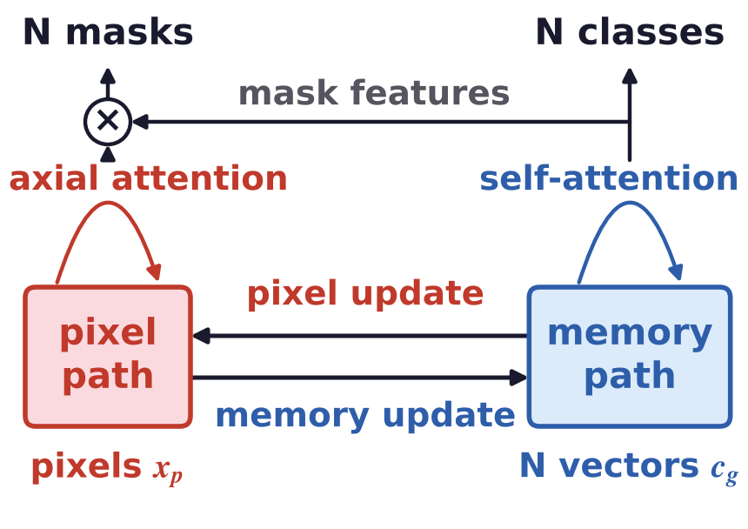
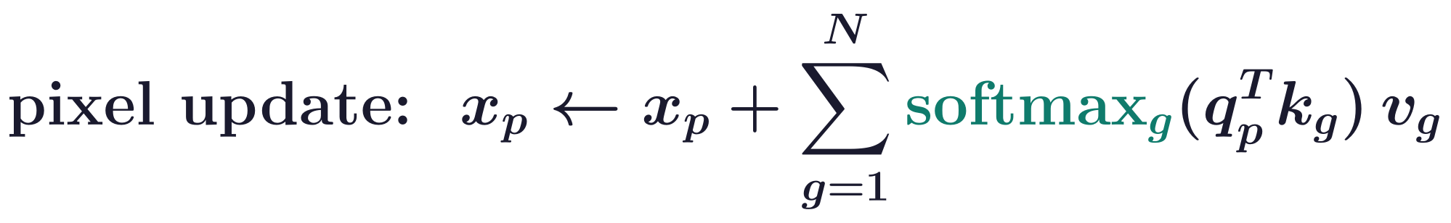
Mask transformers
A dual-path transformer couples pixels and memory
Pixel path: axial attention among pixels; memory path: N vectors c_g that store non-local information.
Memory update: memory queries attend to all pixels and memory slots, with one softmax over both.
Pixel update: each pixel's weights sum to 1 over the N memory slots (teal); this refines the pixel features.
q, k, v carry the index of their source: q_g, k_g, v_g are projections of c_g; q_p, k_p, v_p of x_p.
H. Wang, Y. Zhu, H. Adam, A. Yuille and L.-C. Chen, “MaX-DeepLab: end-to-end panoptic segmentation with mask transformers,”
CVPR, 5463–5474, 2021.
Neural Networks · A. Yuille
25

Slide 26
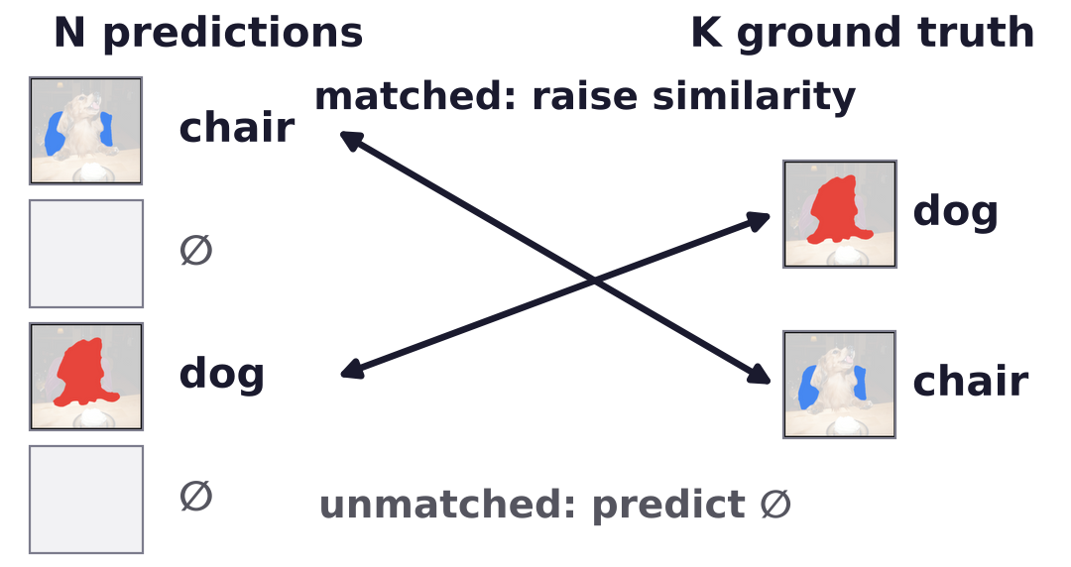
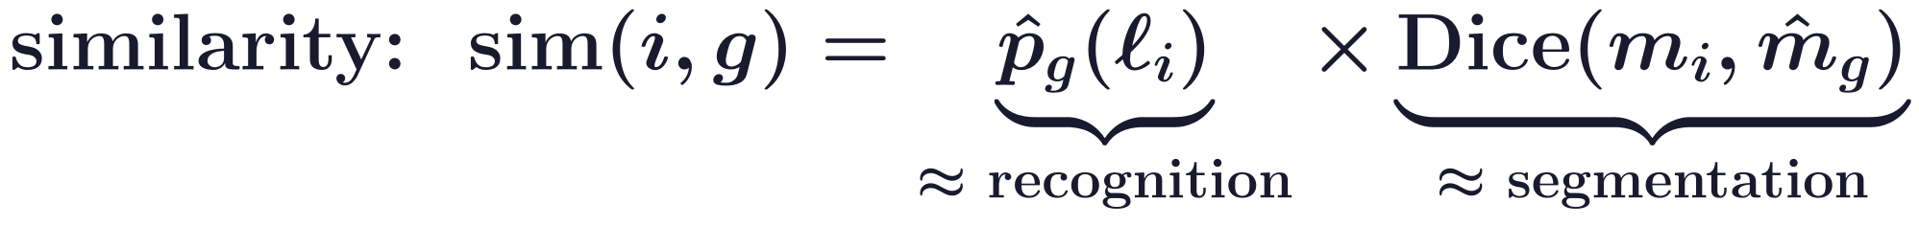
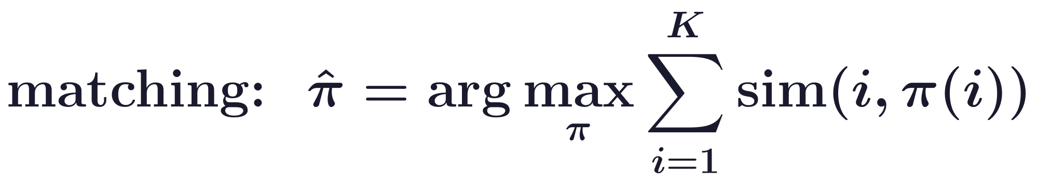
Mask transformers
Hungarian matching pairs predicted and true masks
Ground truth: K masks m_i with classes ℓ_i; prediction: N > K masks, each with class probabilities.
PQ = recognition quality × segmentation quality; Dice: twice the overlap divided by the total area.
The Hungarian algorithm finds the one-to-one matching with the largest total similarity.
The loss raises the matched similarities; the unmatched masks are trained to predict ∅ (no object).
H. Wang, Y. Zhu, H. Adam, A. Yuille and L.-C. Chen, “MaX-DeepLab: end-to-end panoptic segmentation with mask transformers,”
CVPR, 5463–5474, 2021.
H. W. Kuhn, “The Hungarian method for the assignment problem,” Naval Research Logistics Quarterly, 2(1–2):83–97, 1955.
Neural Networks · A. Yuille
26

Slide 27
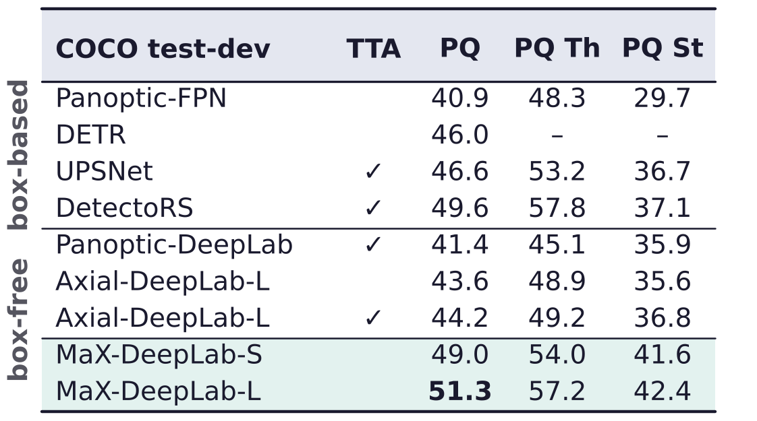
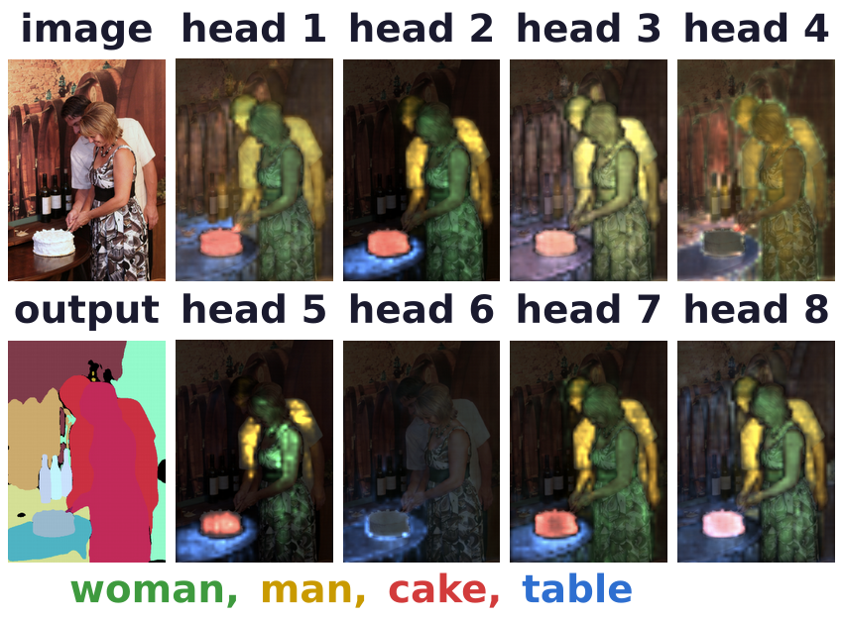
Mask transformers
MaX-DeepLab outperforms box-based methods on COCO
COCO test-dev: held-out test set; PQ of all classes, things (Th), stuff (St); TTA: test-time augmentation.
Box-free MaX-DeepLab-L has the highest PQ, above every box-based method, without augmentation.
Memory-to-pixel attention of 8 heads, for the masks of the woman, man, cake and table.
H. Wang, Y. Zhu, H. Adam, A. Yuille and L.-C. Chen, “MaX-DeepLab: end-to-end panoptic segmentation with mask transformers,”
CVPR, 5463–5474, 2021.
T.-Y. Lin, M. Maire, S. Belongie, J. Hays, P. Perona, D. Ramanan, P. Dollár and C. L. Zitnick, “Microsoft COCO: common objects in context,”
ECCV, LNCS 8693, 740–755, 2014.
Neural Networks · A. Yuille
27

Slide 28
Cross-attention as clustering
5
Object queries are cluster centers; cross-attention normalized over pixels
assigns objects to pixels, while clustering assigns pixels to objects.
Neural Networks · A. Yuille
28

Slide 29
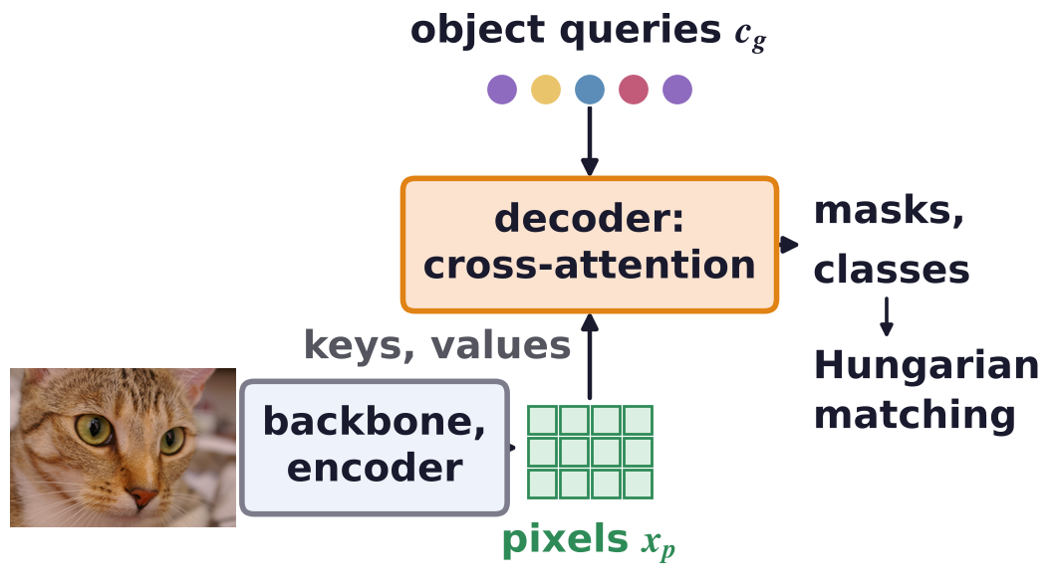
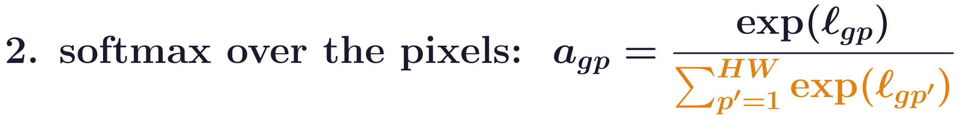
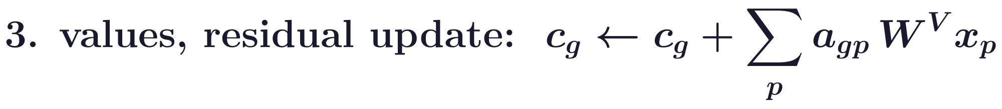
Cross-attention as clustering
Mask transformers update object queries by cross-attention
Common pipeline: backbone, transformer encoder (self-attention), decoder (cross-attention), matching.
The latent vectors c_g are now called object queries; each gathers pixel features into a mask embedding.
The softmax runs over the HW pixels (orange): each query's weights over the image sum to 1.
N. Carion, F. Massa, G. Synnaeve, N. Usunier, A. Kirillov and S. Zagoruyko, “End-to-end object detection with transformers,” ECCV, 213–229, 2020.
B. Cheng, A. Schwing and A. Kirillov, “Per-pixel classification is not all you need for semantic segmentation,” NeurIPS, 17864–17875, 2021.
Q. Yu, H. Wang, D. Kim, S. Qiao, M. Collins, Y. Zhu, H. Adam, A. Yuille and L.-C. Chen, “CMT-DeepLab: clustering mask transformers for panoptic
segmentation,” CVPR, 2560–2570, 2022.
Neural Networks · A. Yuille
29

Slide 30
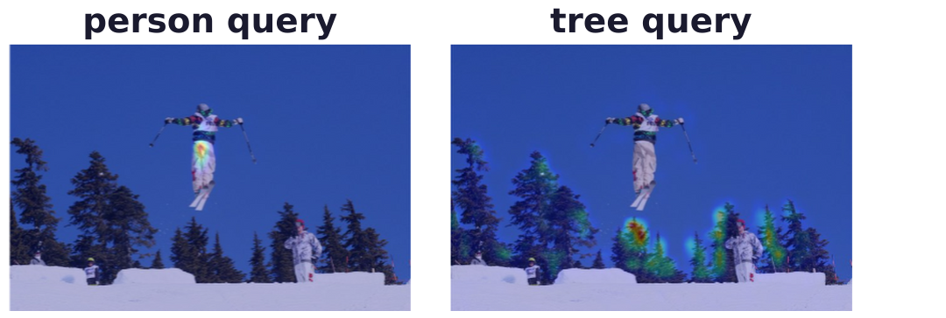
Cross-attention as clustering
Mask prediction and query update normalize differently
Mask prediction: for each pixel, the probabilities over the N queries sum to 1 (teal).
Query update: for each query, the weights over the HW pixels sum to 1 (orange).
Similar affinities, normalized along different axes: a query can gather pixels its mask does not claim.
A softmax over thousands of pixels concentrates on a few: MaX-DeepLab's person and tree queries.
Q. Yu, H. Wang, D. Kim, S. Qiao, M. Collins, Y. Zhu, H. Adam, A. Yuille and L.-C. Chen, “CMT-DeepLab: clustering mask transformers for panoptic
segmentation,” CVPR, 2560–2570, 2022.
Neural Networks · A. Yuille
30

Slide 31
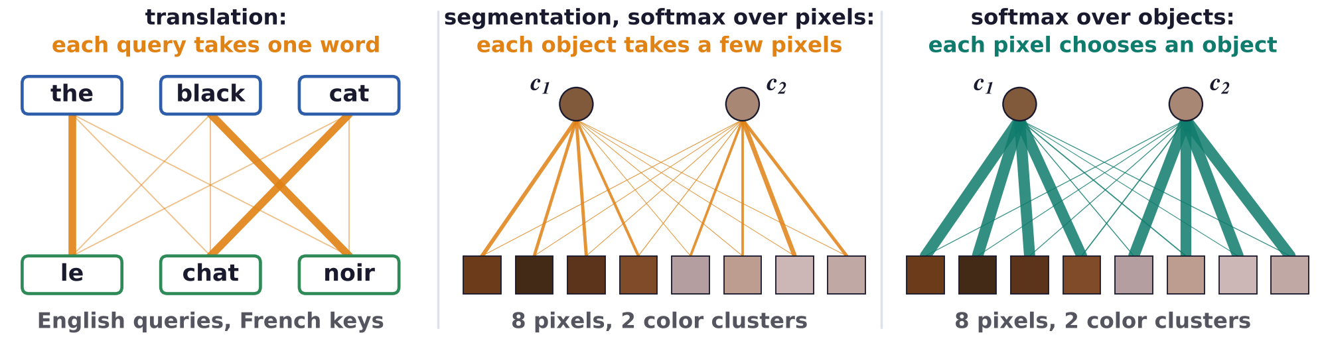
Cross-attention as clustering
Cross-attention as clustering: each pixel chooses an object
Object queries are cluster centers, the attention map an assignment, the query update a center update.
Translation: each object query (a target word) takes its update from one most affiliated source word.
Read this way, each object looks for its few best pixels; we expect many pixels in one object.
The softmax over the pixels inverts the assignment; normalized over the objects, each pixel chooses one.
Q. Yu, H. Wang, D. Kim, S. Qiao, M. Collins, Y. Zhu, H. Adam, A. Yuille and L.-C. Chen, “CMT-DeepLab: clustering mask transformers for panoptic
segmentation,” CVPR, 2560–2570, 2022.
Neural Networks · A. Yuille
31

Slide 32
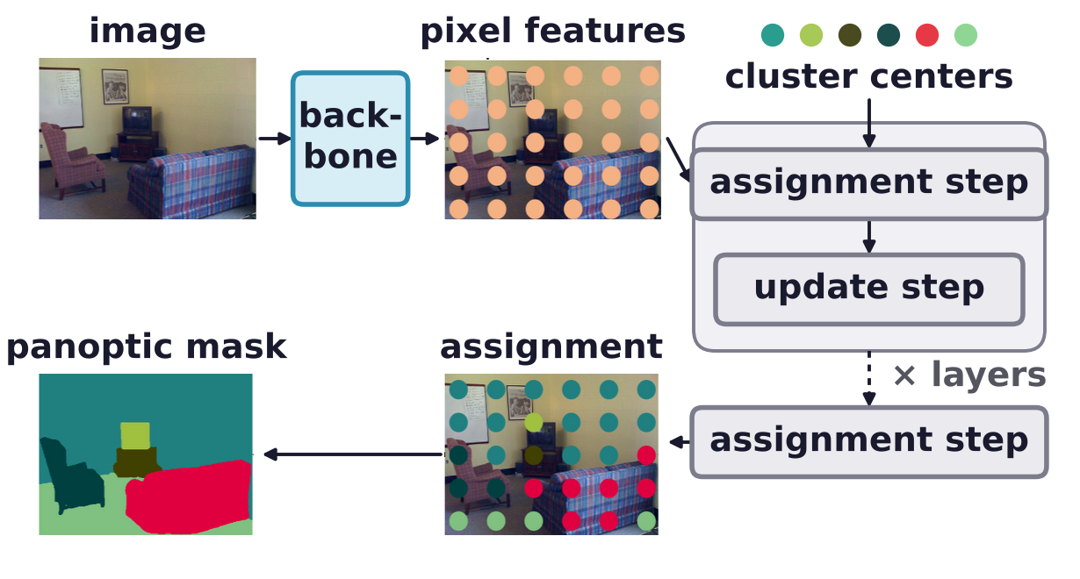
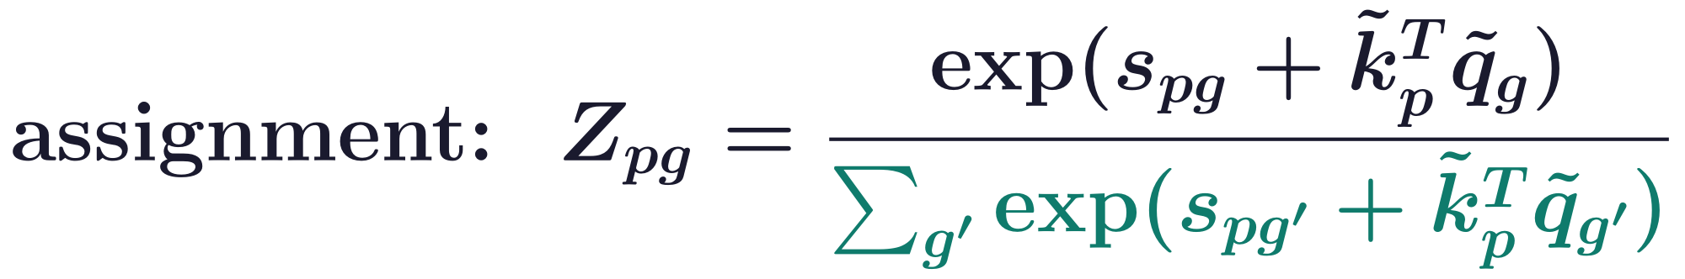
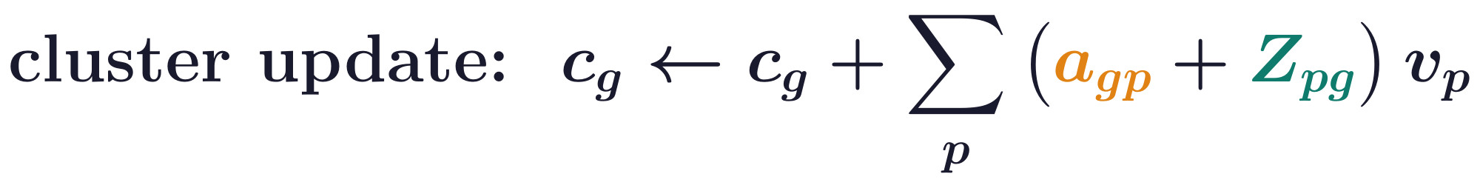
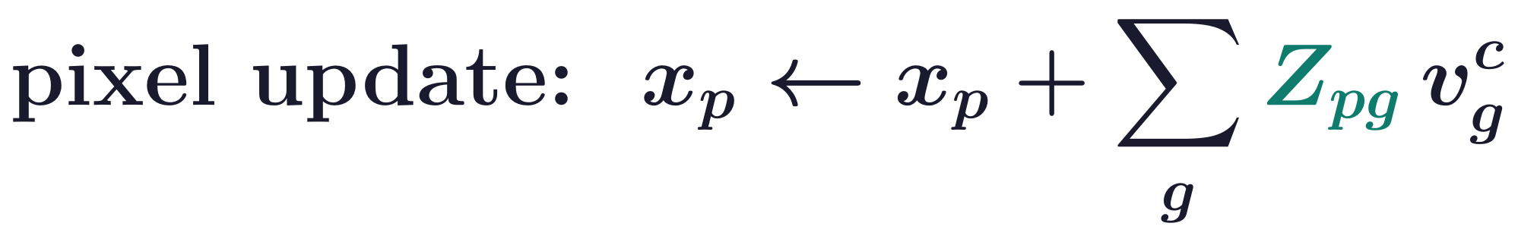
Cross-attention as clustering
CMT-DeepLab assigns pixels to clusters, then updates both
Assignment Z: a softmax over the N clusters, the form of the mask prediction, trained with true masks.
k̃_p, q̃_g: second projections of pixels, centers; s_pg: the previous layer's logits; v^c_g: center values.
The clustering term Z is added to the original cross-attention; the pixel features are updated too.
Q. Yu, H. Wang, D. Kim, S. Qiao, M. Collins, Y. Zhu, H. Adam, A. Yuille and L.-C. Chen, “CMT-DeepLab: clustering mask transformers for panoptic
segmentation,” CVPR, 2560–2570, 2022.
Neural Networks · A. Yuille
32

Slide 33
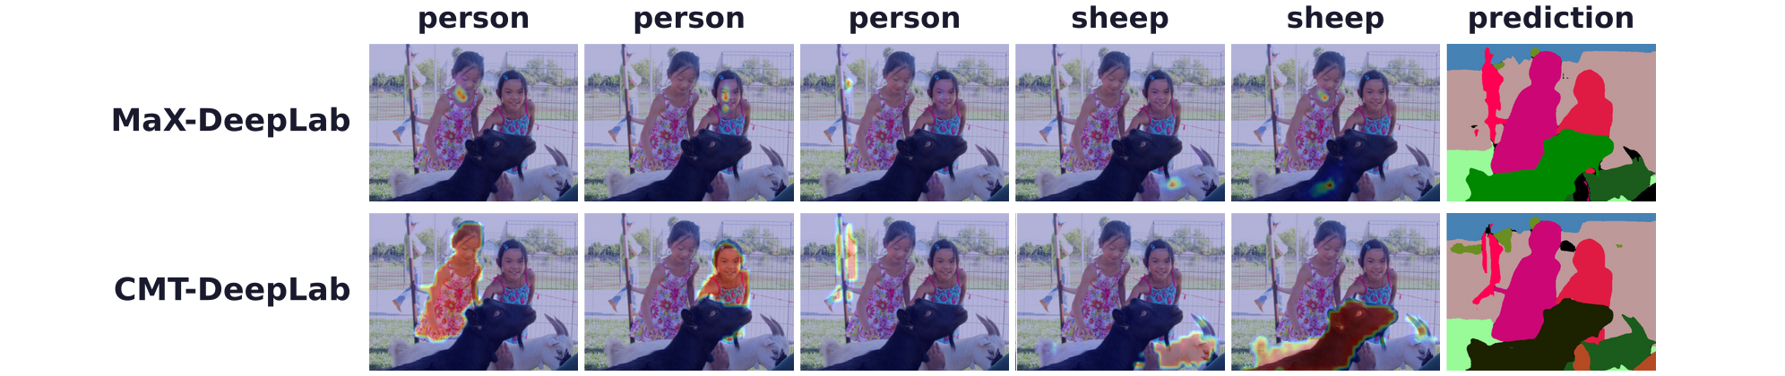
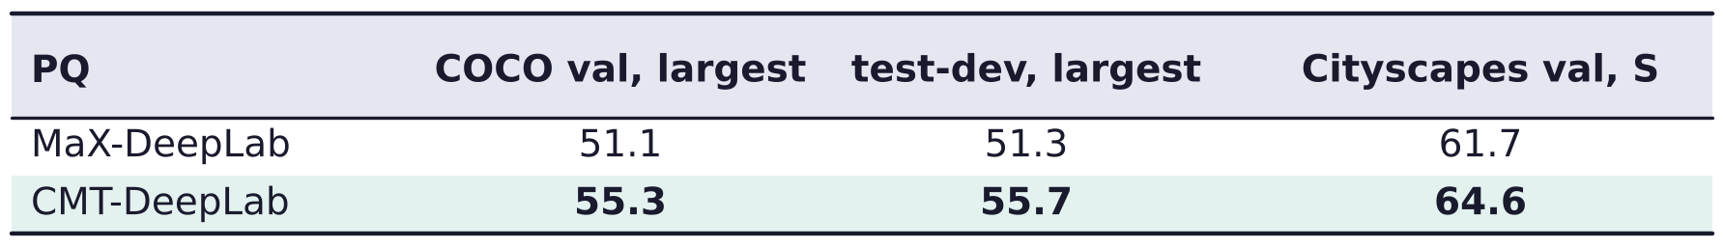
Cross-attention as clustering
Clustering gives denser attention and better panoptic quality
Last-layer attention for each predicted mask: sparse in MaX-DeepLab, dense in CMT-DeepLab.
CMT-DeepLab also adds location-sensitive clustering and a pixel-wise contrastive loss.
Q. Yu, H. Wang, D. Kim, S. Qiao, M. Collins, Y. Zhu, H. Adam, A. Yuille and L.-C. Chen, “CMT-DeepLab: clustering mask transformers for panoptic
segmentation,” CVPR, 2560–2570, 2022.
Neural Networks · A. Yuille
33

Slide 34
k-means cross-attention
6
Each pixel joins one cluster: an argmax over the clusters replaces
the softmax over the pixels, as in k-means clustering.
Neural Networks · A. Yuille
34

Slide 35
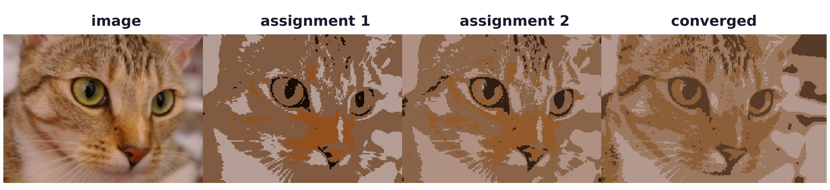
k-means cross-attention
k-means alternates an assignment step and an update step
Assignment: pixel p joins the most similar center c_g (the nearest, when the centers have equal length).
Update: each center becomes the mean of its pixels; the sum is divided by the number of pixels.
Image: k-means on the pixel colors, k = 4 centers, each pixel to its nearest center.
Neural Networks · A. Yuille
35

Slide 36
k-means cross-attention
The constraint on the assignment decides the normalization
V_pg = 1 assigns pixel p to cluster g; ⟨V_pg⟩ is its probability under the Gibbs distribution P(V).
Each pixel joins one cluster: normalize over clusters (teal), as in k-means and the mask prediction.
Each cluster takes one pixel: normalize over pixels (orange); its expected pixel is cross-attention's update.
Neural Networks · A. Yuille
36

Slide 37
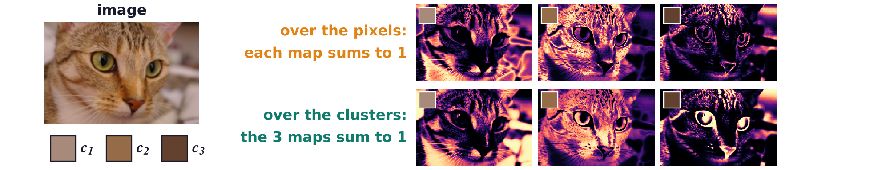
k-means cross-attention
Normalizing over the clusters is Gaussian clustering
A Gaussian mixture with equal priors and covariance σ²I: the posterior of cluster g given x_p.
|x_p|² cancels in the normalization over clusters; |c_g|² too, when all the centers have equal length.
Image: Gaussian weights of the pixel colors for three k-means color centers, normalized each way.
Over pixels, each map is a distribution over the image; over clusters, the three maps partition each pixel.
Neural Networks · A. Yuille
37

Slide 38
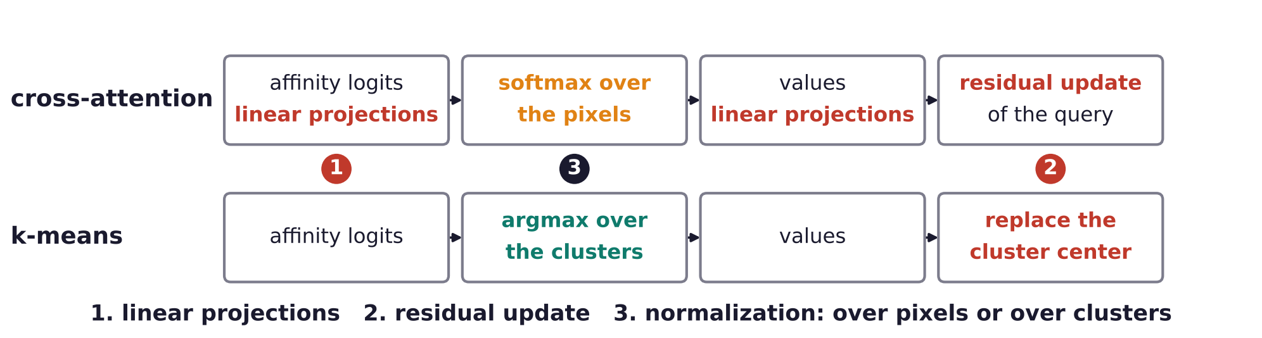
k-means cross-attention
Cross-attention and k-means clustering differ in three ways
Linear projections: cross-attention learns W^Q, W^K, W^V; k-means has no parameters.
Residual update: cross-attention adds to the old c_g; k-means replaces c_g by the new mean.
Normalization: cross-attention takes a softmax over the pixels; k-means an argmax over the clusters.
The kMaX authors consider the normalization the most significant difference.
Q. Yu, H. Wang, S. Qiao, M. Collins, Y. Zhu, H. Adam, A. Yuille and L.-C. Chen, “k-means mask transformer,” ECCV, LNCS 13689, 288–307, 2022.
Neural Networks · A. Yuille
38

Slide 39
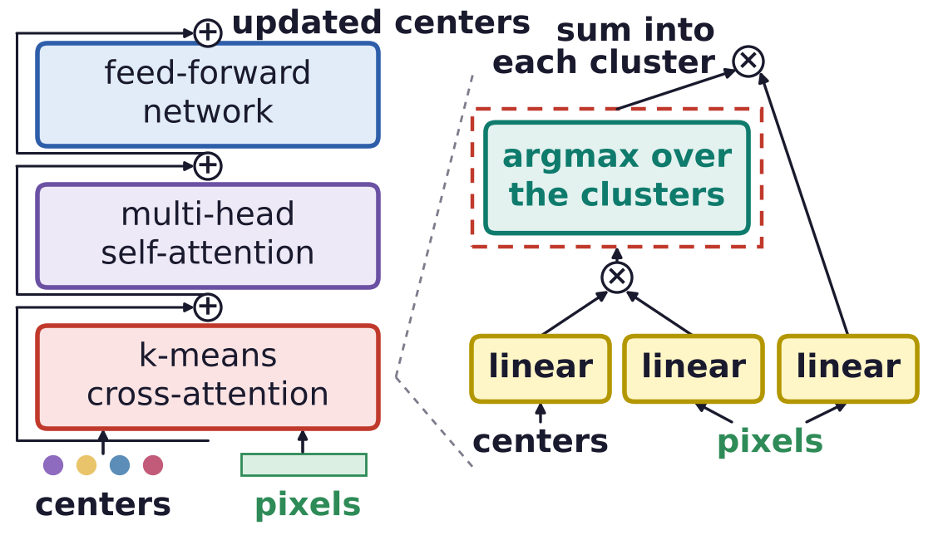
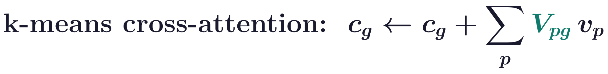
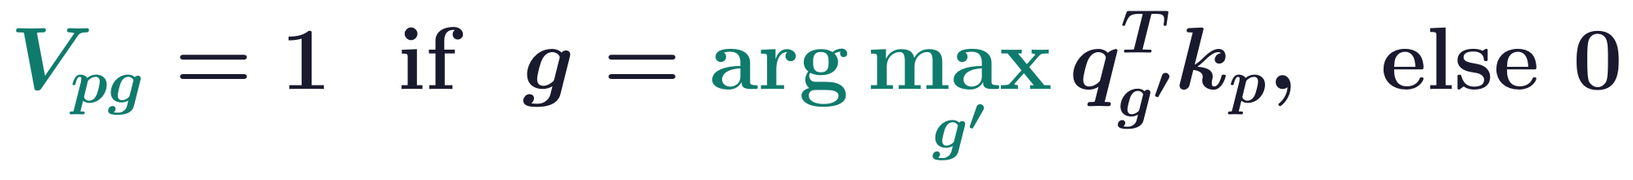
k-means cross-attention
k-means cross-attention takes an argmax over the clusters
The change (red box): the softmax over pixels becomes an argmax over clusters: each pixel, one cluster.
The values v_p of the pixels with V_pg = 1 are summed into c_g (k-means would divide by their number).
The argmax has no gradient: each decoder's affinities q_g^T k_p also get a mask loss (deep supervision).
This works because the attention map now has the form of the mask prediction (over clusters).
Q. Yu, H. Wang, S. Qiao, M. Collins, Y. Zhu, H. Adam, A. Yuille and L.-C. Chen, “k-means mask transformer,” ECCV, LNCS 13689, 288–307, 2022.
Neural Networks · A. Yuille
39

Slide 40
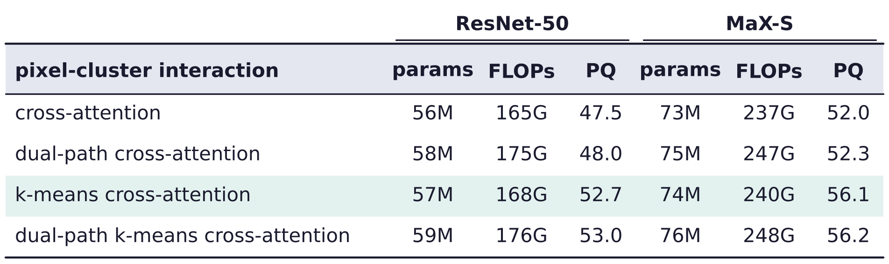
k-means cross-attention
The simple change improves PQ at negligible extra cost
COCO val, 100k iterations: only the module where pixels and clusters interact changes.
ResNet-50: 47.5 → 52.7 PQ (+5.2) with one change; MaX-S (ResNet-50 with axial attention): 52.0 → 56.1.
Dual-path versions, where the pixels also attend to the clusters, add little; kMaX does not use them.
Deep supervision alone does not help plain cross-attention; params, FLOPs: millions, billions.
Q. Yu, H. Wang, S. Qiao, M. Collins, Y. Zhu, H. Adam, A. Yuille and L.-C. Chen, “k-means mask transformer,” ECCV, LNCS 13689, 288–307, 2022.
Neural Networks · A. Yuille
40

Slide 41

k-means cross-attention
kMaX-DeepLab updates cluster centers at three resolutions
Pixel encoder: any backbone; enhanced pixel decoder: axial blocks and upsampling to 1/4 resolution.
Six kMaX decoders, two at each of 1/32, 1/16 and 1/8 resolution, update the cluster centers.
N = 128 centers start as learned embeddings; they give each mask's embedding and class.
Masks: a softmax over the clusters of x_p^T c_g, the normalization of the k-means assignment.
Q. Yu, H. Wang, S. Qiao, M. Collins, Y. Zhu, H. Adam, A. Yuille and L.-C. Chen, “k-means mask transformer,” ECCV, LNCS 13689, 288–307, 2022.
Neural Networks · A. Yuille
41

Slide 42


k-means cross-attention
kMaX-DeepLab improves PQ on COCO and Cityscapes
Each method with its strongest backbone; FPS: frames per second; kMaX uses 256 cluster centers here.
COCO: higher PQ than earlier mask transformers, at fewer operations and a higher frame rate.
Cityscapes: one panoptic model gives the best PQ, AP and mIoU of the methods compared.
Q. Yu, H. Wang, S. Qiao, M. Collins, Y. Zhu, H. Adam, A. Yuille and L.-C. Chen, “k-means mask transformer,” ECCV, LNCS 13689, 288–307, 2022.
Neural Networks · A. Yuille
42

Slide 43

k-means cross-attention
Cluster assignments are refined from decoder to decoder
The argmax assignment after each of the six kMaX decoders, then the panoptic prediction and the label.
The image is first divided into regions, which are gradually merged and refined into the final clusters.
Q. Yu, H. Wang, S. Qiao, M. Collins, Y. Zhu, H. Adam, A. Yuille and L.-C. Chen, “k-means mask transformer,” ECCV, LNCS 13689, 288–307, 2022.
Neural Networks · A. Yuille
43

Slide 44
k-means cross-attention
Summary
Self-attention averages values with query-key weights normalized over the keys; blocks add MLPs.
Vision needs position, locality and scale: positional encoding, axial attention, shifted windows, hybrids.
Cross-attention: queries from one set attend to another; in translation and stereo it finds matches.
Axial-DeepLab: position-sensitive attention along height and width is long range at O(HWm) cost.
MaX-DeepLab: a mask transformer predicts N masks and classes end to end, with Hungarian matching.
CMT-DeepLab: cross-attention read as clustering, in which each pixel should choose an object.
kMaX-DeepLab: k-means cross-attention takes an argmax over the clusters; one change, much better PQ.
The normalization decides the task: over pixels it finds correspondences, over clusters it clusters.
Neural Networks · A. Yuille
44

