Slide 1
Computer Vision and Cognitive
Science, Part 2: Deep Networks
and Bayes Decision Theory
20 October, 2026
Alan Yuille · Probabilistic Models of the Visual Cortex

Slide 2
What this lecture covers
1
Features and deep networks
2
Transformers, foundation models
Filters, the ventral stream, CNNs
Attention, scale, vision and language
3
Generative models, conjectures
GANs, diffusion; Bayes and cognition
Neural Networks · A. Yuille
2

Slide 3
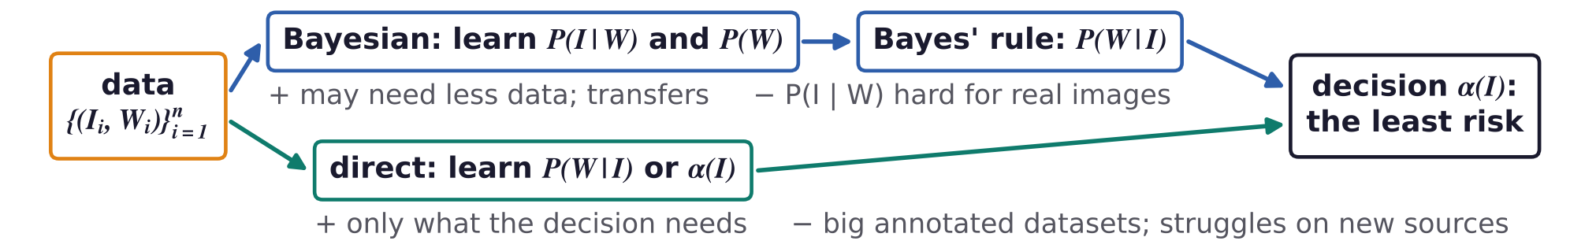
Recap: Bayes decision theory and two ways to use data
I: the image; W: the world state; L(W, α(I)): the loss; (I_i, W_i): n annotated examples.
BDT chooses the rule α(I) with the least risk R(α); the direct route minimizes the empirical risk instead.
The best rule depends only on the posterior P(W | I), so arguably P(I | W) and P(W) need not be learnt.
With limited data, P(I | W) and P(W) may be easier to model; they transfer (Konishi et al. 2003).
S. Konishi, A. L. Yuille, J. M. Coughlan and S. C. Zhu, “Statistical edge detection: learning and evaluating edge cues,” IEEE TPAMI, 25(1):57–74, 2003.
Neural Networks · A. Yuille
3

Slide 4
Features and deep networks
1
Hand-designed filters, then hierarchies inspired by the ventral stream;
a network is a class of decision rules; its weights minimize the empirical risk.
Neural Networks · A. Yuille
4

Slide 5
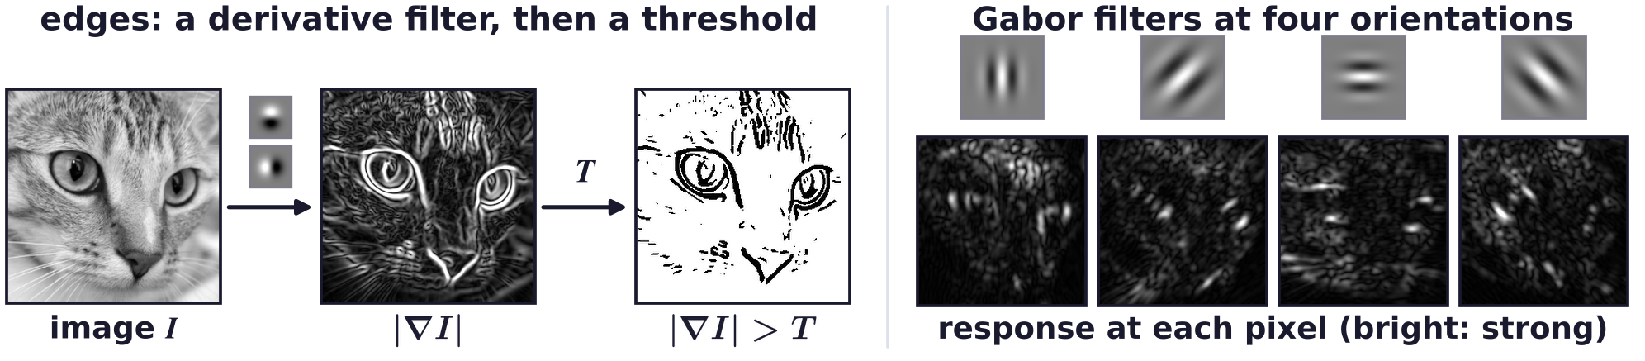
Features and deep networks
Features give a straightforward way to process images
Edge detection: x and y derivative filters give the gradient; threshold its magnitude at T.
A filterbank of Gabor filters can classify textures, or describe each part of an image locally.
Local descriptions address the correspondence problem of binocular stereo and motion.
These filters are designed by hand; deep networks learn their filters from data.
Neural Networks · A. Yuille
5

Slide 6
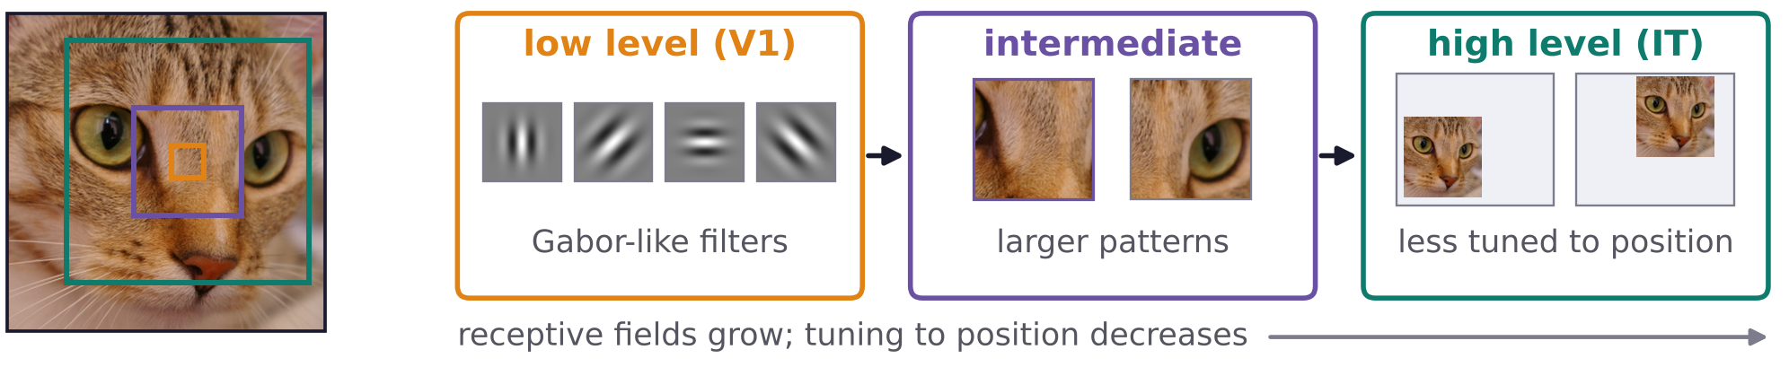
Features and deep networks
The ventral stream inspired hierarchical models of cortex
In the ventral stream, low-level filters (in V1, the primary visual cortex) are similar to Gabor filters.
Neurons higher up (to IT, the inferotemporal cortex) are more specific to patterns, less tuned to position.
This inspired models of cortex: the neocognitron, then a more realistic one (Riesenhuber and Poggio).
Multi-layer perceptrons, with learnt weights, were modified into convolutional neural networks (CNNs).
K. Fukushima, “Neocognitron: a self-organizing neural network model for a mechanism of pattern recognition unaffected by shift in position,”
Biological Cybernetics, 36(4):193–202, 1980.
M. Riesenhuber and T. Poggio, “Hierarchical models of object recognition in cortex,” Nature Neuroscience, 2(11):1019–1025, 1999.
Y. LeCun, B. Boser, J. S. Denker, D. Henderson, R. E. Howard, W. Hubbard and L. D. Jackel,
“Backpropagation applied to handwritten zip code recognition,” Neural Computation, 1(4):541–551, 1989.
Neural Networks · A. Yuille
6

Slide 7
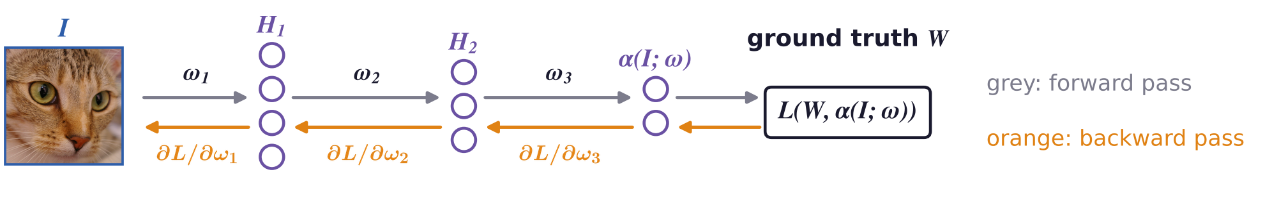
Features and deep networks
A neural network specifies a class of decision rules
The weights ω parameterize the decision rule α(I; ω); learning chooses ω from n annotated examples.
For a network that outputs P(W | I; ω), the loss −log P(W | I; ω) makes the empirical risk differentiable.
Stochastic gradient descent (SGD): a step of size η down the gradient for one random example i.
Backpropagation passes the gradient back through the hidden layers H_1, H_2: it exploits the hierarchy.
Neural Networks · A. Yuille
7

Slide 8
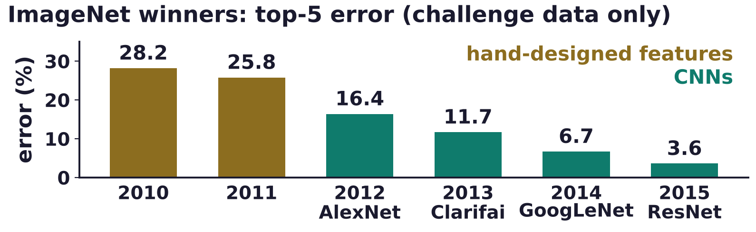
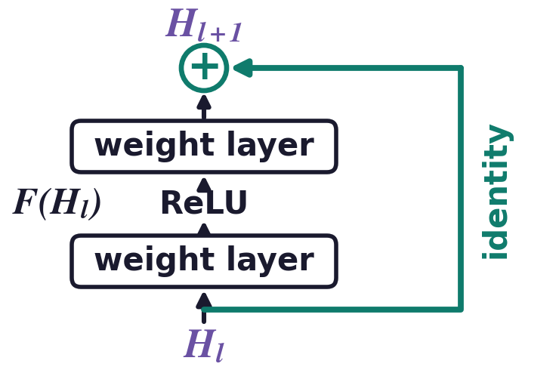
Features and deep networks
CNNs succeeded with large annotated datasets and GPUs
Computer vision researchers were skeptical: deformable part models (DPMs) won on smaller datasets.
AlexNet won in 2012, partly by efficient computation: shared features, graphics processing units (GPUs).
Top-5 error on ImageNet (1,000 classes): the true class is not among the network's five most probable.
ResNet: each block outputs H_l + F(H_l), a residual connection; networks of 152 layers train well (2015).
P. Felzenszwalb, D. McAllester and D. Ramanan, “A discriminatively trained, multiscale, deformable part model,” CVPR, 1–8, 2008.
A. Krizhevsky, I. Sutskever and G. E. Hinton, “ImageNet classification with deep convolutional neural networks,” NIPS 25, 1097–1105, 2012.
K. He, X. Zhang, S. Ren and J. Sun, “Deep residual learning for image recognition,” CVPR, 770–778, 2016.
O. Russakovsky, J. Deng, H. Su, J. Krause, S. Satheesh et al., “ImageNet large scale visual recognition challenge,” IJCV, 115(3):211–252, 2015.
Neural Networks · A. Yuille
8

Slide 9
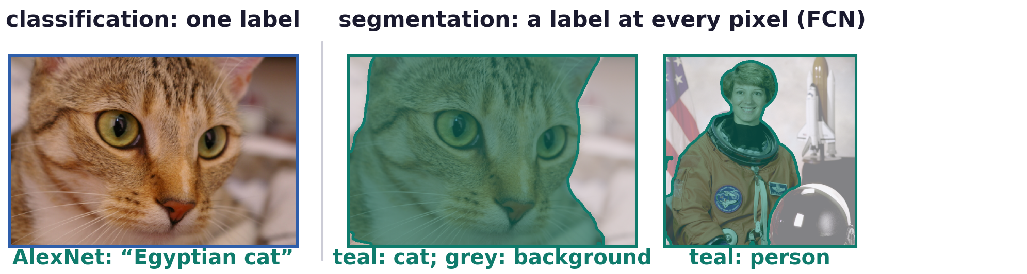
Features and deep networks
CNNs were rapidly applied to all tasks with annotated data
Semantic segmentation: a fully convolutional network (FCN) gives every pixel a semantic class.
Edge detection, e.g. holistically-nested edge detection (HED), and 2D pose: detecting human joints.
Performance increased enormously, e.g. in semantic segmentation, edge detection and pose.
J. Long, E. Shelhamer and T. Darrell, “Fully convolutional networks for semantic segmentation,” CVPR, 3431–3440, 2015.
S. Xie and Z. Tu, “Holistically-nested edge detection,” ICCV, 1395–1403, 2015.
X. Chen and A. Yuille, “Articulated pose estimation by a graphical model with image dependent pairwise relations,” NIPS 27, 1736–1744, 2014.
Neural Networks · A. Yuille
9

Slide 10
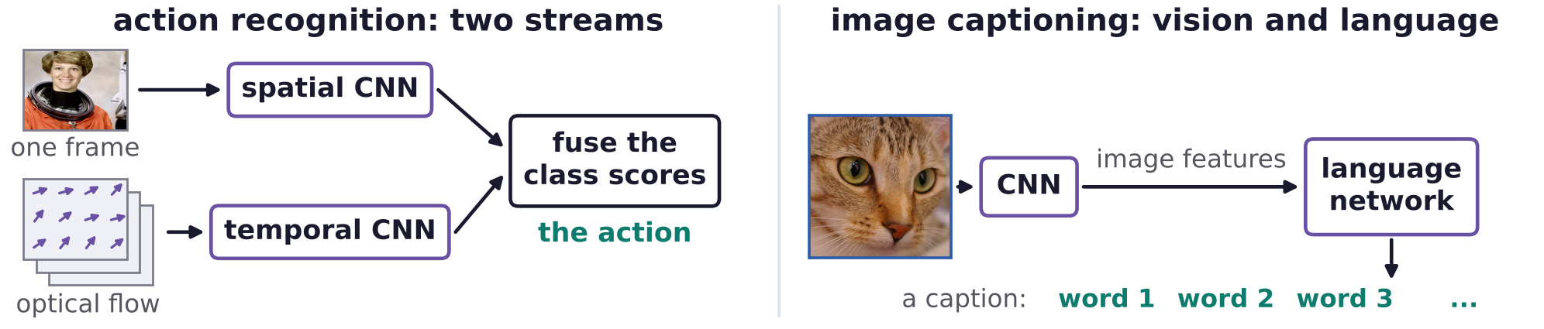
Features and deep networks
New architectures tackled tasks once considered intractable
Researchers created datasets and novel architectures for tasks that had been considered intractable.
Action recognition: one network sees a frame, one the motion (optical flow); their class scores are fused.
Image captioning: a network combines vision and language features to generate a text caption.
K. Simonyan and A. Zisserman, “Two-stream convolutional networks for action recognition in videos,” NIPS 27, 568–576, 2014.
A. Karpathy and L. Fei-Fei, “Deep visual-semantic alignments for generating image descriptions,” CVPR, 3128–3137, 2015.
Neural Networks · A. Yuille
10

Slide 11
Transformers,
foundation models
2
Attention models long-range, adaptive context. Foundation models suggest
that, for some tasks, enough data makes networks work on nearly all images.
Neural Networks · A. Yuille
11

Slide 12
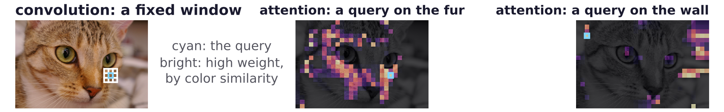
Transformers, foundation models
Transformers model long-range context adaptively
Transformers came from language and, as the vision transformer (ViT), have largely replaced CNNs.
Self- and cross-attention bind neurons dynamically, so long-range interactions exploit spatial context.
CNN neurons have fixed receptive fields (white grid): only local and non-adaptive context.
Attention gives some sideways interactions, as in Markov random fields (MRFs).
Transformers trained only to classify partly segment objects; they share some properties of grammars.
A. Vaswani, N. Shazeer, N. Parmar, J. Uszkoreit, L. Jones, A. N. Gomez, Ł. Kaiser and I. Polosukhin, “Attention is all you need,”
NIPS 30, 5998–6008, 2017.
A. Dosovitskiy, L. Beyer, A. Kolesnikov, D. Weissenborn, X. Zhai et al., “An image is worth 16x16 words: transformers for image recognition
at scale,” ICLR, 2021.
D. Mumford and A. Desolneux, Pattern Theory: The Stochastic Analysis of Real-World Signals, A K Peters, 2010 (Chapter 3).
Neural Networks · A. Yuille
12

Slide 13
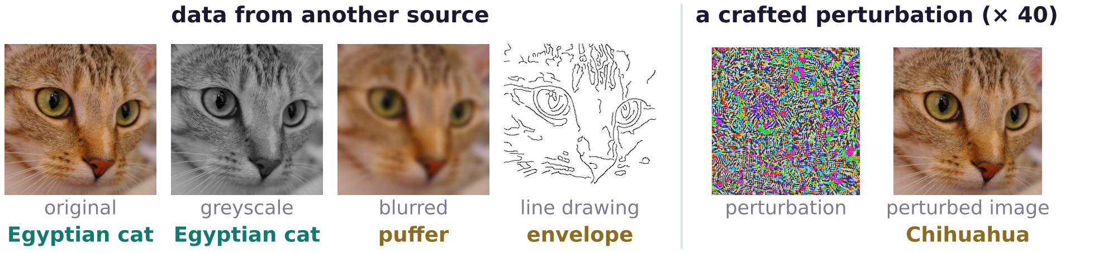
Transformers, foundation models
Networks degrade on another source and are fooled easily
Trained on one source, networks degrade on another: ImageNet detectors err in automated cars.
Performance is inflated by dataset biases, as Ideal Observers beat humans by knowing the data.
Minor perturbations, often invisible to humans, fool networks: adversarial examples (Szegedy et al.).
AlexNet's label under each image: teal, a cat class; olive, another class.
BDT perspective: the datasets are not big enough to represent the complexity of natural images.
C. Szegedy, W. Zaremba, I. Sutskever, J. Bruna, D. Erhan, I. Goodfellow and R. Fergus, “Intriguing properties of neural networks,” ICLR, 2014.
Neural Networks · A. Yuille
13

Slide 14
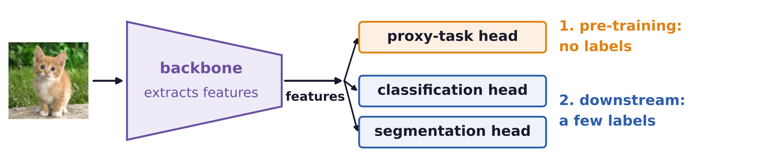
Transformers, foundation models
Unsupervised learning gives one backbone for many tasks
Foundation models address these failures; first, unsupervised learning on enormous unannotated data.
iBOT and DINOv2: self-supervised vision transformers; DINOv2 used 142 million curated images.
They combine masked image modeling (MIM) with contrastive-style self-distillation.
The backbone is shared by many visual tasks; only a small decision head is trained for each task.
J. Zhou, C. Wei, H. Wang, W. Shen, C. Xie, A. Yuille and T. Kong, “iBOT: image BERT pre-training with online tokenizer,” ICLR, 2022.
M. Oquab, T. Darcet, T. Moutakanni, H. Vo, M. Szafraniec et al., “DINOv2: learning robust visual features without supervision,” TMLR, 2024.
Neural Networks · A. Yuille
14

Slide 15
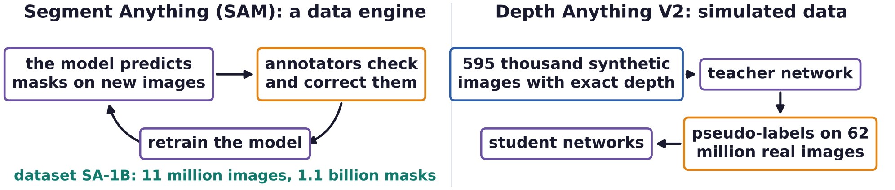
Transformers, foundation models
Data engines and simulation create enormous datasets
Networks predict pseudo-labels for new images; annotators check and correct them; networks retrain.
SAM's cues: texture typically differs inside and outside an object; intensity often jumps at its boundary.
Depth Anything V2: a teacher trained on synthetic images, as in video games, labels real images.
For some tasks, datasets may reach a critical size beyond which networks work on almost all real images.
BDT perspective: this suggests no need for priors and likelihoods; networks learn the posterior directly.
A. Kirillov, E. Mintun, N. Ravi, H. Mao, C. Rolland et al., “Segment anything,” ICCV, 4015–4026, 2023.
L. Yang, B. Kang, Z. Huang, Z. Zhao, X. Xu, J. Feng and H. Zhao, “Depth Anything V2,” NeurIPS 37, 2024.
Neural Networks · A. Yuille
15

Slide 16
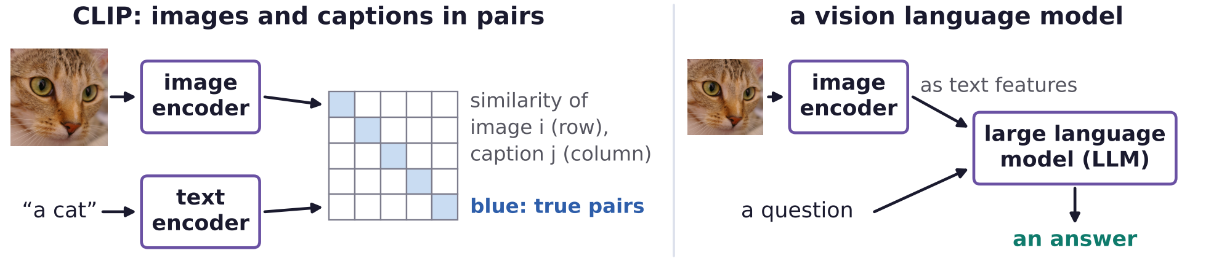
Transformers, foundation models
Vision language models exploit common-sense knowledge
Large language models (LLMs) capture common-sense knowledge about the world.
CLIP (contrastive language-image pre-training) maps image and text features into one shared space.
Transformers trained on paired images and captions give vision language models (VLMs).
VLMs do amazingly well, e.g. visual question answering (VQA), but are black boxes that hallucinate.
J. Devlin, M.-W. Chang, K. Lee and K. Toutanova, “BERT: pre-training of deep bidirectional transformers for language understanding,”
NAACL-HLT, 4171–4186, 2019.
A. Radford, J. W. Kim, C. Hallacy, A. Ramesh, G. Goh et al., “Learning transferable visual models from natural language supervision,”
ICML, 8748–8763, 2021.
Neural Networks · A. Yuille
16

Slide 17
Generative models,
conjectures
3
Generative models suggest that P(I | W) is practical even for complex images;
we conjecture that Bayes is needed for responsible artificial intelligence.
Neural Networks · A. Yuille
17

Slide 18
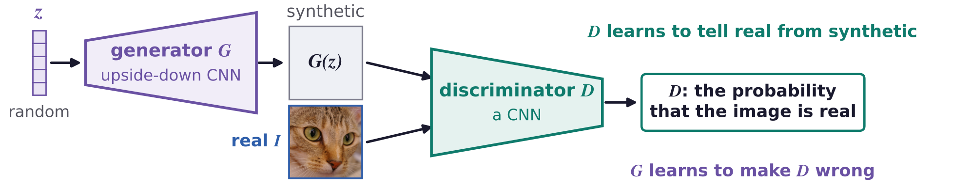
Generative models, conjectures
GANs train a generator against a discriminator
Generative networks now produce images so realistic that they have won prizes in art competitions.
Generative adversarial network (GAN): generator G, an upside-down CNN, maps random z to an image.
It competes with a discriminator D, trained to tell real images I from the synthetic images G(z).
The expectations are over real images I and random codes z; D maximizes the objective, G minimizes it.
I. Goodfellow, J. Pouget-Abadie, M. Mirza, B. Xu, D. Warde-Farley et al., “Generative adversarial nets,” NIPS 27, 2672–2680, 2014.
Neural Networks · A. Yuille
18

Slide 19
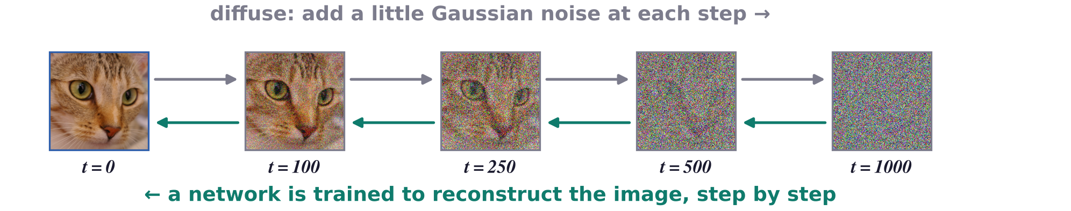
Generative models, conjectures
Diffusion models learn to reconstruct images from noise
Diffusion models dominate; text captions prime the generation through attention, as in transformers.
I_0: the image; γ_t falls from 1 to 0 in 1000 steps; ε: Gaussian noise; the network ε_ω predicts ε.
Bayes: with game-engine graphics, they suggest P(I | W), generating even complex images, is practical.
J. Ho, A. Jain and P. Abbeel, “Denoising diffusion probabilistic models,” NeurIPS 33, 6840–6851, 2020.
C. Saharia, W. Chan, S. Saxena, L. Li, J. Whang et al., “Photorealistic text-to-image diffusion models with deep language understanding,”
NeurIPS 35, 36479–36494, 2022.
Neural Networks · A. Yuille
19

Slide 20
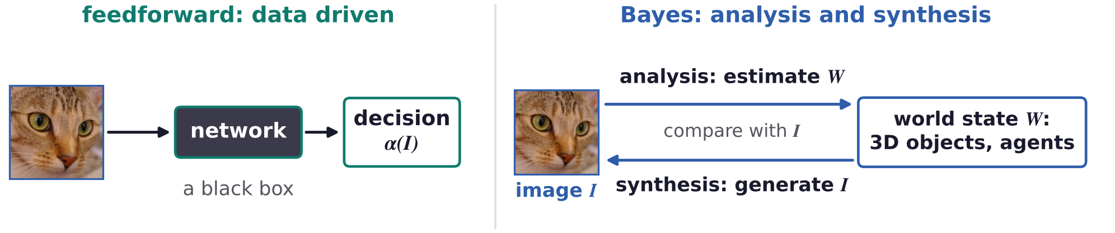
Generative models, conjectures
We conjecture that Bayes is needed for responsible AI
There are concerns that computer vision relies too much on complex, hard-to-interpret black boxes.
Responsible artificial intelligence (AI): understandable failure modes, performance guarantees, control.
Bayes, though technically more challenging, gives a duality between analysis and synthesis.
It uses structured representations: 3D world models of objects, agents, interactions and knowledge.
This fits human cognition: children are “baby scientists”, who predict the world and test by experiment.
Neural Networks · A. Yuille
20

Slide 21
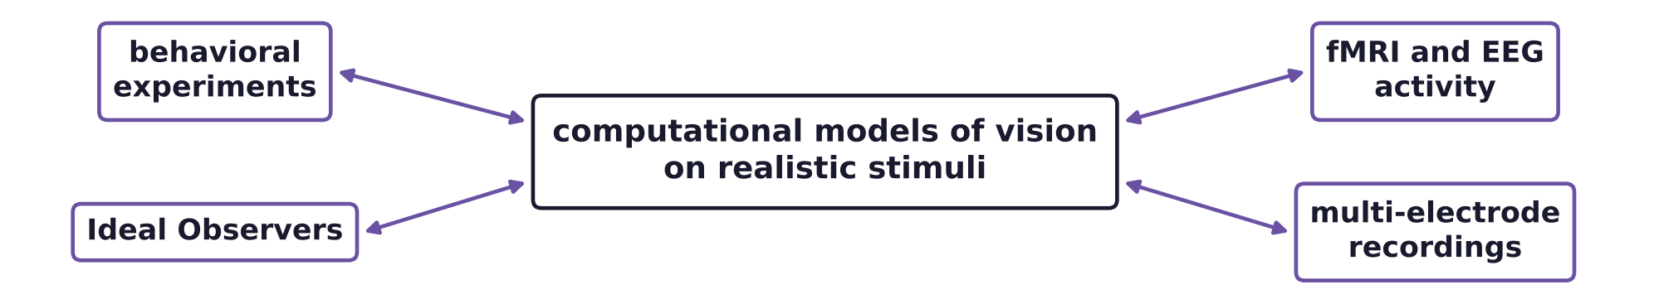
Generative models, conjectures
Computer vision may increasingly shape cognitive science
Computer vision builds models of vision on realistic stimuli, which behavioral experiments can test.
Ideal Observer studies give insight into human vision, which may in turn improve computer vision.
Models already predict functional magnetic resonance imaging (fMRI) activity of visual areas.
They also predict electroencephalography (EEG), giving insight into the functions of visual areas.
Feedforward networks predict multi-electrode recordings: maybe better science and new architectures.
A. J. E. Kell and J. H. McDermott, “Deep neural network models of sensory systems: windows onto the role of task constraints,”
Current Opinion in Neurobiology, 55:121–132, 2019.
Neural Networks · A. Yuille
21

Slide 22
Generative models, conjectures
Summary
BDT: learn P(I | W) and P(W) (may need less data), or learn P(W | I) and the rule directly (big datasets).
Features: hand-designed filters, then hierarchical networks inspired by the ventral stream.
A network is a class of decision rules; backpropagation and SGD minimize the empirical risk.
CNNs succeeded with large annotated datasets and GPUs, then spread to every annotated visual task.
Transformers add long-range, adaptive context; foundation models address datasets that were too small.
At a critical dataset size, the posterior may be learnt directly; VLMs add world knowledge from language.
Generative models (GANs, diffusion) suggest that P(I | W) is practical even for complex images.
Conjectures: Bayes is needed for responsible AI; computer vision will shape cognitive science.
Neural Networks · A. Yuille
22

