Slide 1
Approximate
Analysis by Synthesis
5 November, 2026
Alan Yuille · Probabilistic Models of the Visual Cortex

Slide 2
What this lecture covers
1
Analysis by synthesis
2
Robust vision and 3D models
Bayes, proposals, top-down checks
Deep networks, graphics, inverse rendering
3
Neural mesh models
4
Inference and robustness
Vertex features, contrastive learning
Occlusion, OOD tests, classification
Analysis by Synthesis · A. Yuille
2

Slide 3
Analysis by synthesis
1
Analysis by synthesis inverts the process that synthesizes images: low-level
cues propose world states, high-level models validate them.
Analysis by Synthesis · A. Yuille
3

Slide 4
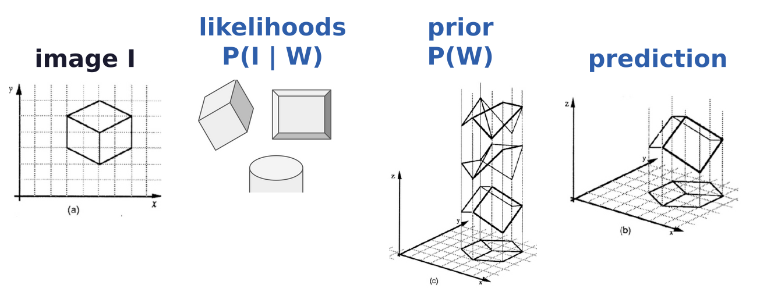
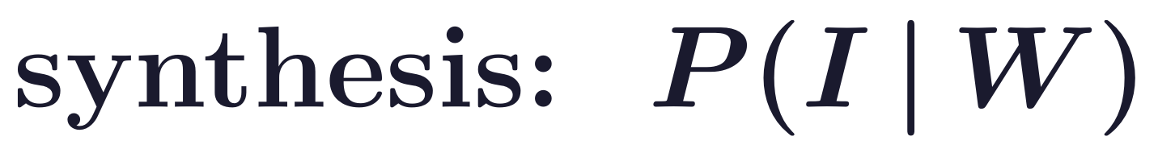

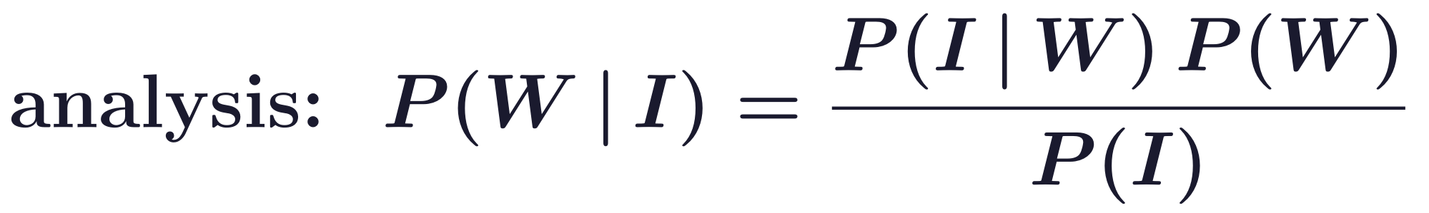
Analysis by synthesis
Analysis by synthesis inverts the synthesis of images
Image I, objects W; first formulated by U. Grenander in the 1960s in Bayesian probability theory.
Analysis of an image is performed by inverting the process that synthesizes it.
Different from direct prediction of P(W | I) by standard discriminators.
The drawing (a) fits many 3D shapes (c); the prediction (b) is the shape the posterior prefers.
A. Yuille and D. Kersten, “Vision as Bayesian inference: analysis by synthesis?,” Trends in Cognitive Sciences, 10(7):301–308, 2006.
U. Grenander, Lectures in Pattern Theory, Vol. 2: Pattern Analysis, Springer, New York, 1978.
P. Sinha and E. Adelson, “Recovering reflectance and illumination in a world of painted polyhedra,” ICCV, 156–163, 1993.
Analysis by Synthesis · A. Yuille
4

Slide 5
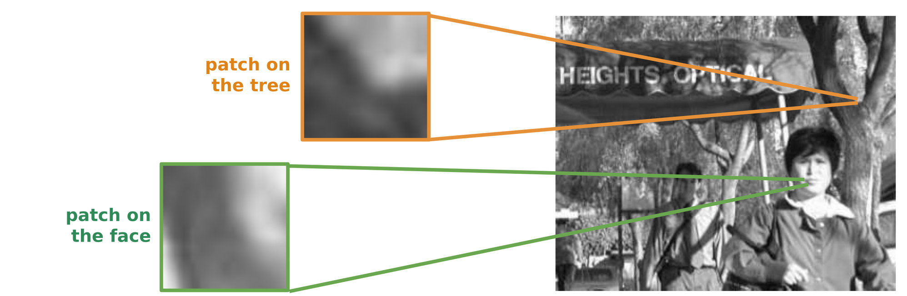
Analysis by synthesis
Low-level vision is ambiguous; high-level vision rarely is
Low-level vision (such as edges) is ambiguous: it is hard to tell if an edge belongs to a face or a tree.
High-level vision is rarely ambiguous: patterns of objects are more complex and rarely occur by chance.
Analysis by Synthesis · A. Yuille
5

Slide 6
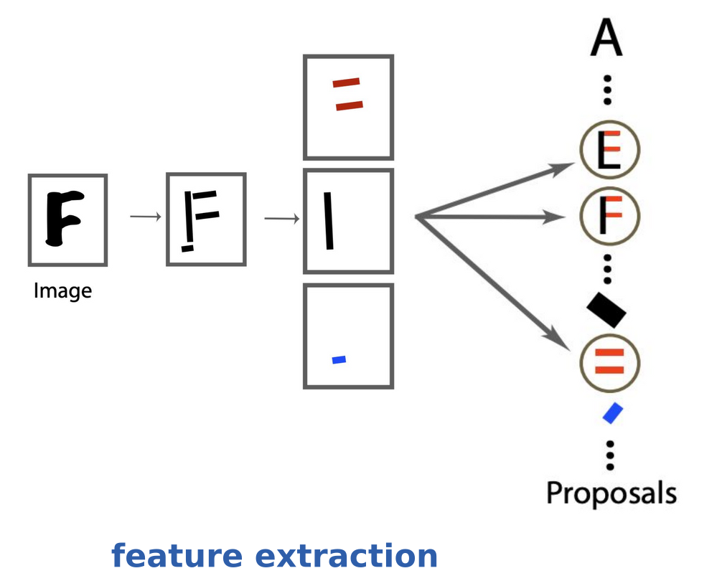
Analysis by synthesis
Low-level cues propose; high-level models validate
Question: how can low-level cues access the right high-level models and resolve low-level ambiguities?
Low-level cues make bottom-up proposals: the bars of the image propose an E, an F or parallel bars.
High-level models validate them.
Analysis by Synthesis · A. Yuille
6

Slide 7
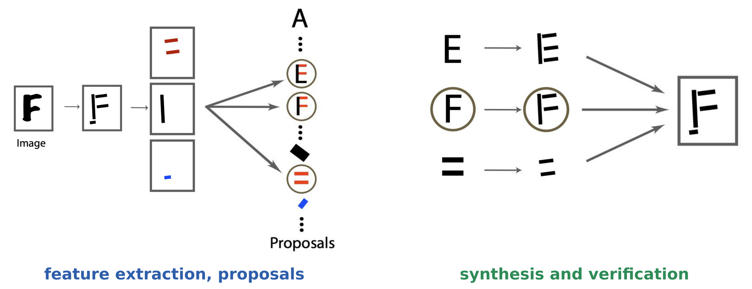
Analysis by synthesis
Synthesis and verification: the F explains the features
Each proposal synthesizes, top-down, the features it predicts; these are compared with the image.
The F explains almost all the features, so it is preferred to the E and to the parallel bars.
A. Yuille and D. Kersten, “Vision as Bayesian inference: analysis by synthesis?,” Trends in Cognitive Sciences, 10(7):301–308, 2006.
Analysis by Synthesis · A. Yuille
7

Slide 8
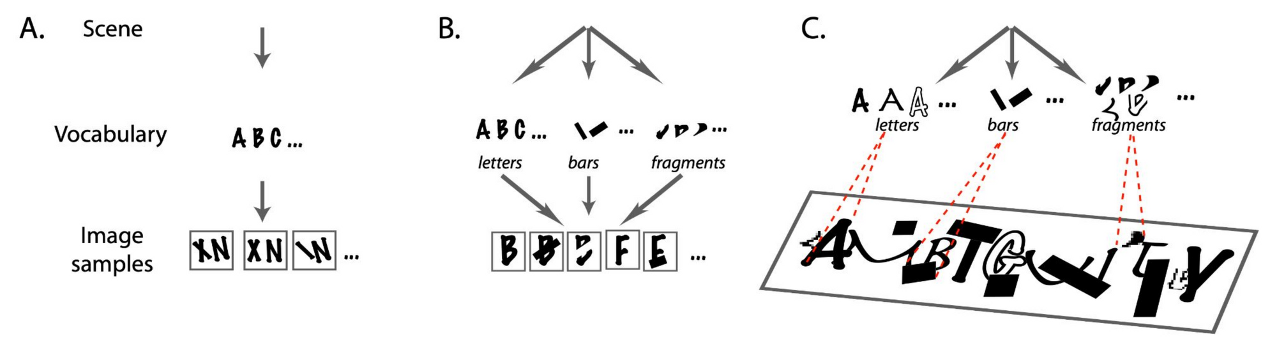
Analysis by synthesis
Analysis by synthesis is harder when the world is complex
World A: a simple vocabulary generates the image; there is little or no ambiguity in interpreting it.
World B: a richer vocabulary; a given cause, such as a letter, can appear in many different images.
World C: the richer the vocabulary, the greater the ambiguity and the harder it is to interpret the image.
A. Yuille and D. Kersten, “Vision as Bayesian inference: analysis by synthesis?,” Trends in Cognitive Sciences, 10(7):301–308, 2006.
Analysis by Synthesis · A. Yuille
8

Slide 9
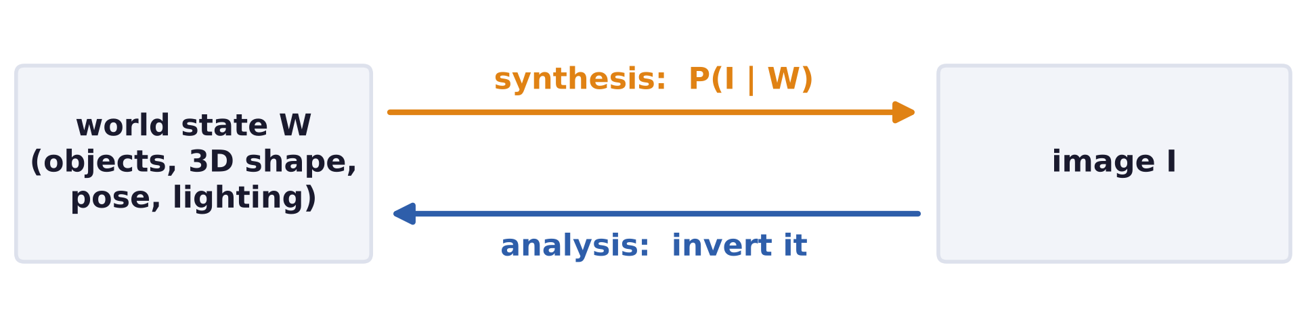
Analysis by synthesis
Analysis by synthesis faces three challenges
Synthesis: it requires generative models of the image, conditioned on the world state.
Analysis: inverting the model is not easy; searching all ways an image could be generated is impractical.
Evaluation: current annotated benchmarks are not designed for evaluating analysis by synthesis.
Analysis by Synthesis · A. Yuille
9

Slide 10
Robust vision and 3D models
2
Discriminative networks lack robustness outside their training data; a 3D
graphics model of the object can be inverted by render-and-compare.
Analysis by Synthesis · A. Yuille
10

Slide 11
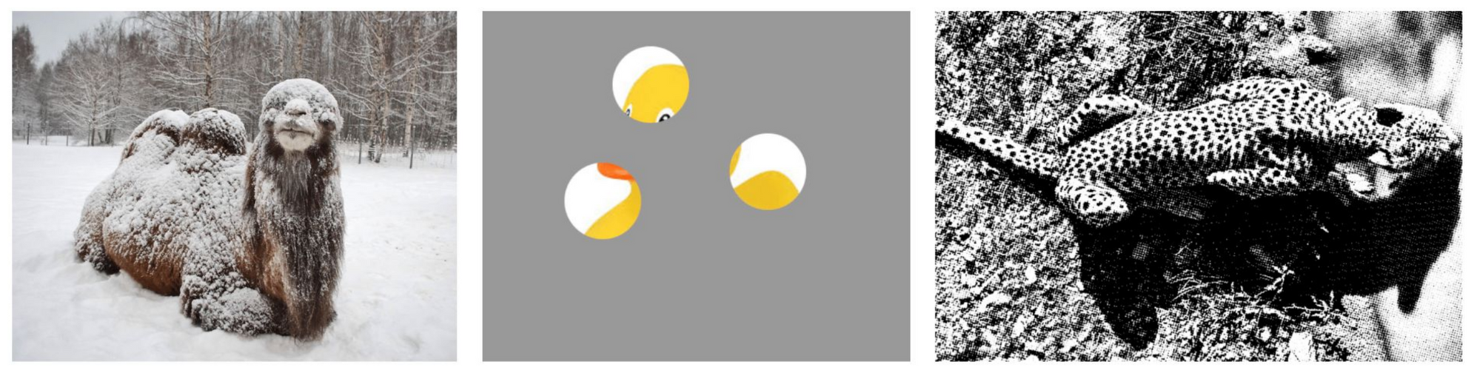
Robust vision and 3D models
Robust vision generalizes beyond the training data
Human vision is robust in unseen viewing conditions.
Important side note: once you recognize the object, you know its pose, parts, shape, ...
Analysis by Synthesis · A. Yuille
11

Slide 12
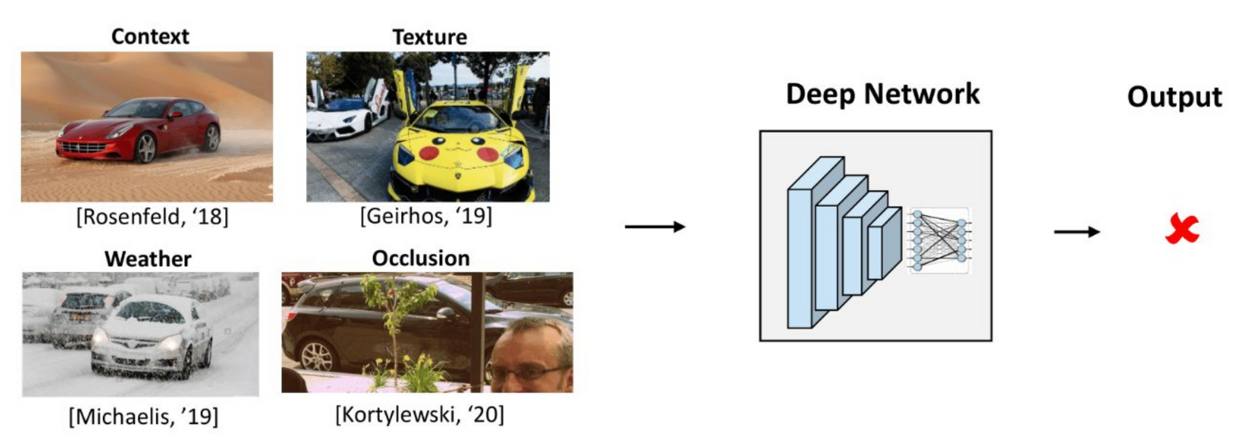
Robust vision and 3D models
Neural network discriminative models lack robustness
Successful at large-scale visual recognition, but not robust to 3D changes: unusual poses and viewpoints.
Changes of image components also break them: context, texture, weather and occlusion.
W. Qiu and A. Yuille, “UnrealCV: connecting computer vision to Unreal Engine,” ECCV Workshops, LNCS 9915, 909–916, 2016.
M. A. Alcorn et al., “Strike (with) a pose: neural networks are easily fooled by strange poses of familiar objects,” CVPR, 4845–4854, 2019.
A. Rosenfeld, R. Zemel and J. K. Tsotsos, “The elephant in the room,” arXiv:1808.03305, 2018.
R. Geirhos et al., “ImageNet-trained CNNs are biased towards texture; increasing shape bias improves accuracy and robustness,” ICLR, 2019.
C. Michaelis et al., “Benchmarking robustness in object detection: autonomous driving when winter is coming,” arXiv:1907.07484, 2019.
A. Kortylewski, J. He, Q. Liu and A. L. Yuille, “Compositional convolutional neural networks: a deep architecture with innate robustness
to partial occlusion,” CVPR, 8940–8949, 2020.
Analysis by Synthesis · A. Yuille
12

Slide 13
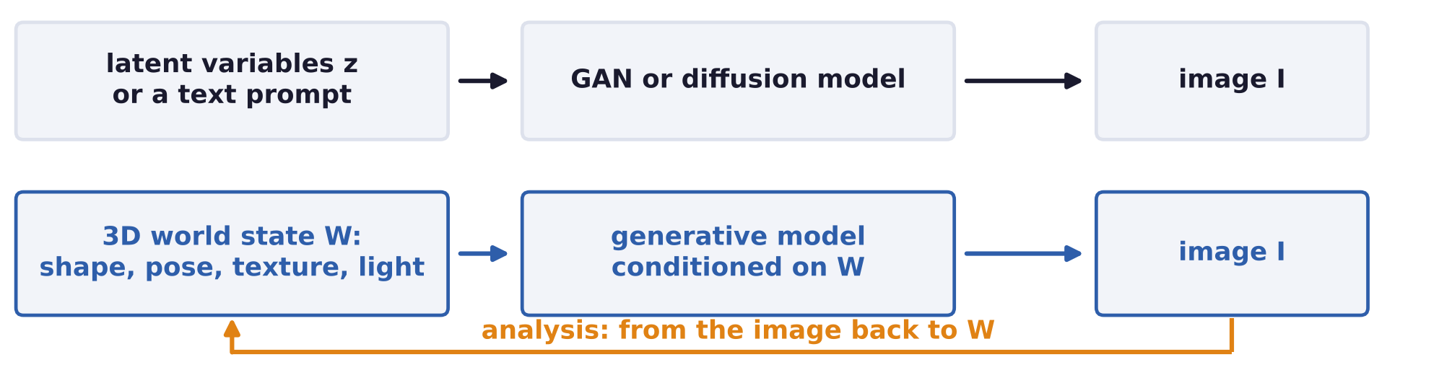
Robust vision and 3D models
Neural network generative models concentrate on synthesis
GANs (generative adversarial networks) and diffusion models can generate amazing images.
They concentrate on synthesis (generating images) instead of analysis.
Most are conditioned on latent variables or text; analysis by synthesis needs the 3D world state W.
Analysis by Synthesis · A. Yuille
13

Slide 14
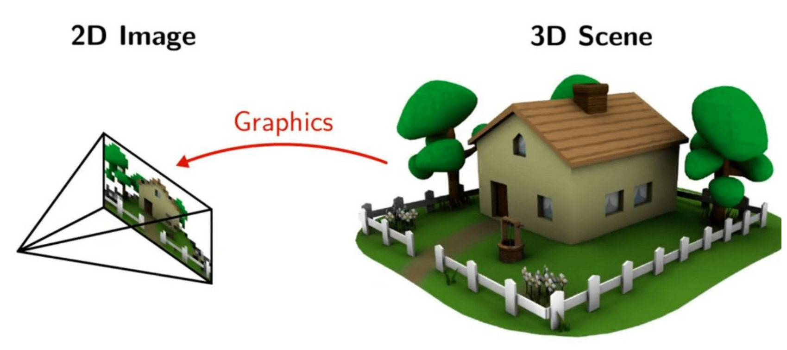
Robust vision and 3D models
Computer vision via analysis by synthesis inverts graphics
Computer graphics synthesizes a 2D image from a 3D scene.
Computer vision via analysis by synthesis inverts it: it finds the 3D scene that synthesizes the image.
U. Grenander, Lectures in Pattern Theory, Vol. 2: Pattern Analysis, Springer, New York, 1978.
D. Mumford, “Pattern theory: a unifying perspective,” First European Congress of Mathematics, Vol. I, 187–224, Birkhäuser, 1994.
A. Yuille and D. Kersten, “Vision as Bayesian inference: analysis by synthesis?,” Trends in Cognitive Sciences, 10(7):301–308, 2006.
Analysis by Synthesis · A. Yuille
14

Slide 15
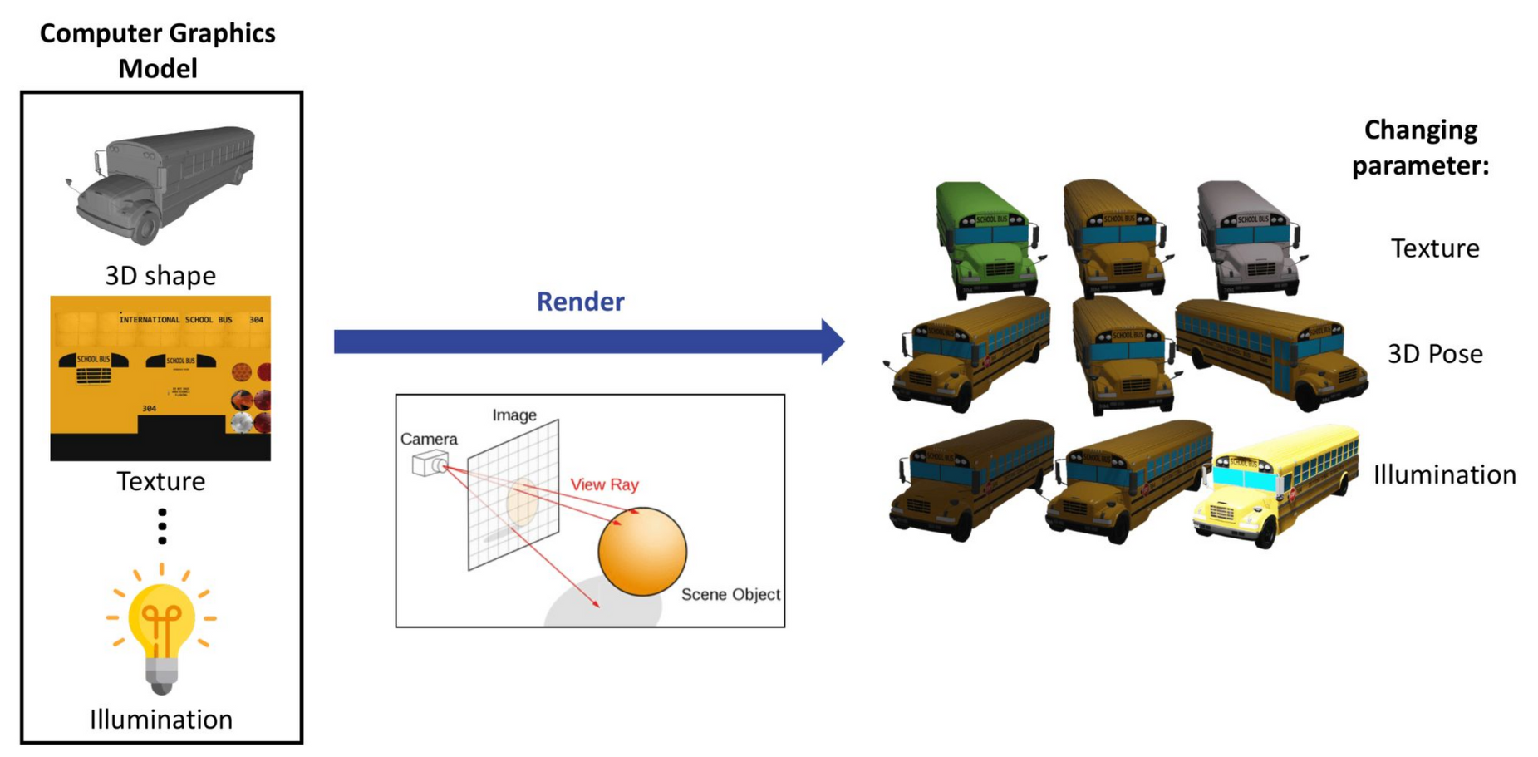
Robust vision and 3D models
A computer graphics model generates images of the object
A computer graphics model of the object: its 3D shape, texture, ..., illumination.
Rendering with a changed parameter (texture, 3D pose, illumination) gives new images of the object.
Analysis by Synthesis · A. Yuille
15

Slide 16
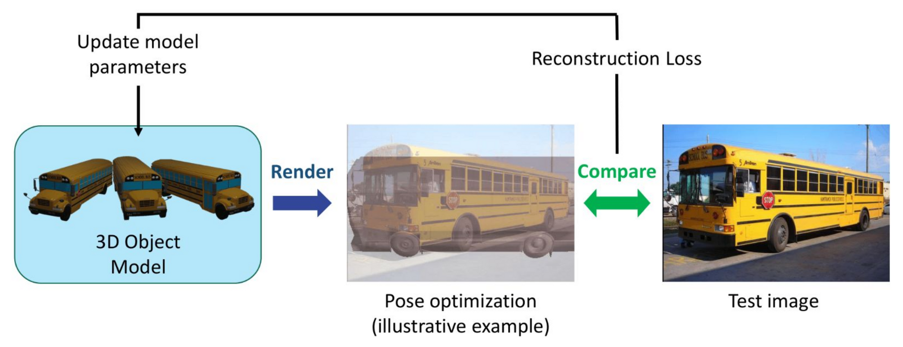
Robust vision and 3D models
Inverse rendering: render, compare, update the parameters
Render the 3D object model and compare the rendering with the test image: the reconstruction loss.
Update the model parameters, here the 3D pose, to reduce the loss, and repeat.
Analysis by Synthesis · A. Yuille
16

Slide 17
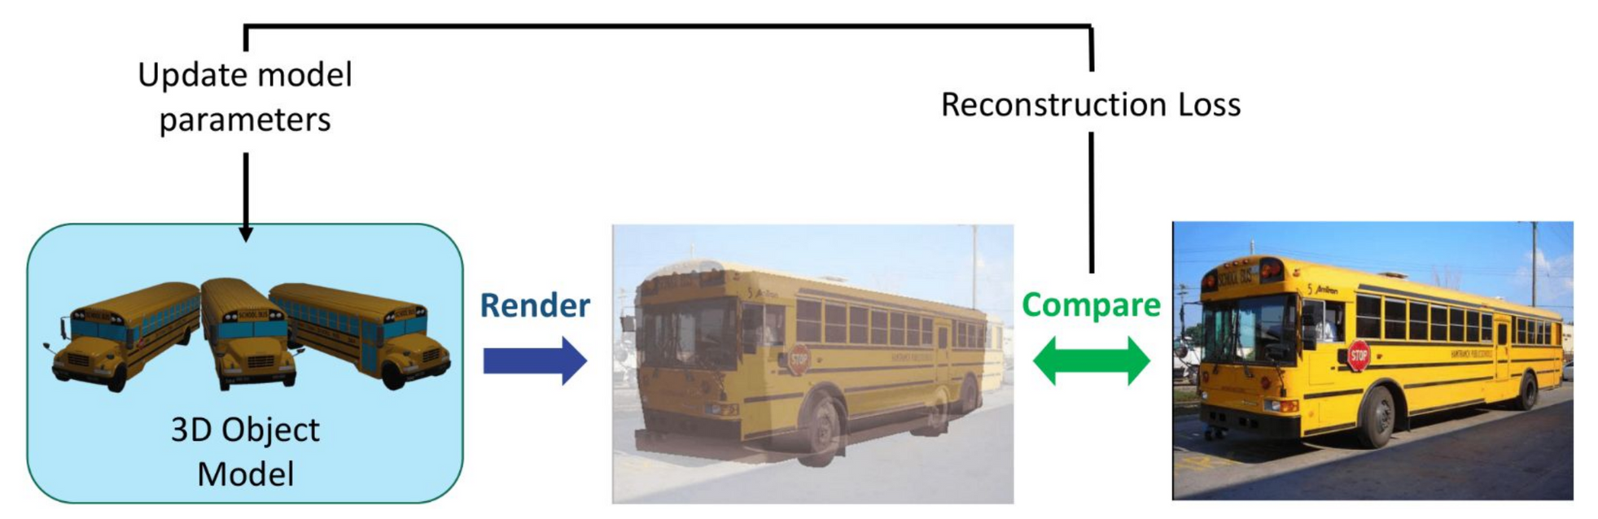
Robust vision and 3D models
Analysis by synthesis is 3D-aware, compositional and robust
Advantages over deep networks: analysis by synthesis is 3D-aware and compositional.
Robust to occlusion and unseen poses: faces (Paysan 2009, Egger 2018) and objects (Wang 2021).
Multi-tasking: one model of the object serves several tasks.
P. Paysan et al., “A 3D face model for pose and illumination invariant face recognition,” AVSS, 296–301, 2009.
B. Egger et al., “Occlusion-aware 3D morphable models and an illumination prior for face image analysis,” IJCV, 126(12):1269–1287, 2018.
A. Wang, A. Kortylewski and A. Yuille, “NeMo: neural mesh models of contrastive features for robust 3D pose estimation,” ICLR, 2021.
Analysis by Synthesis · A. Yuille
17

Slide 18
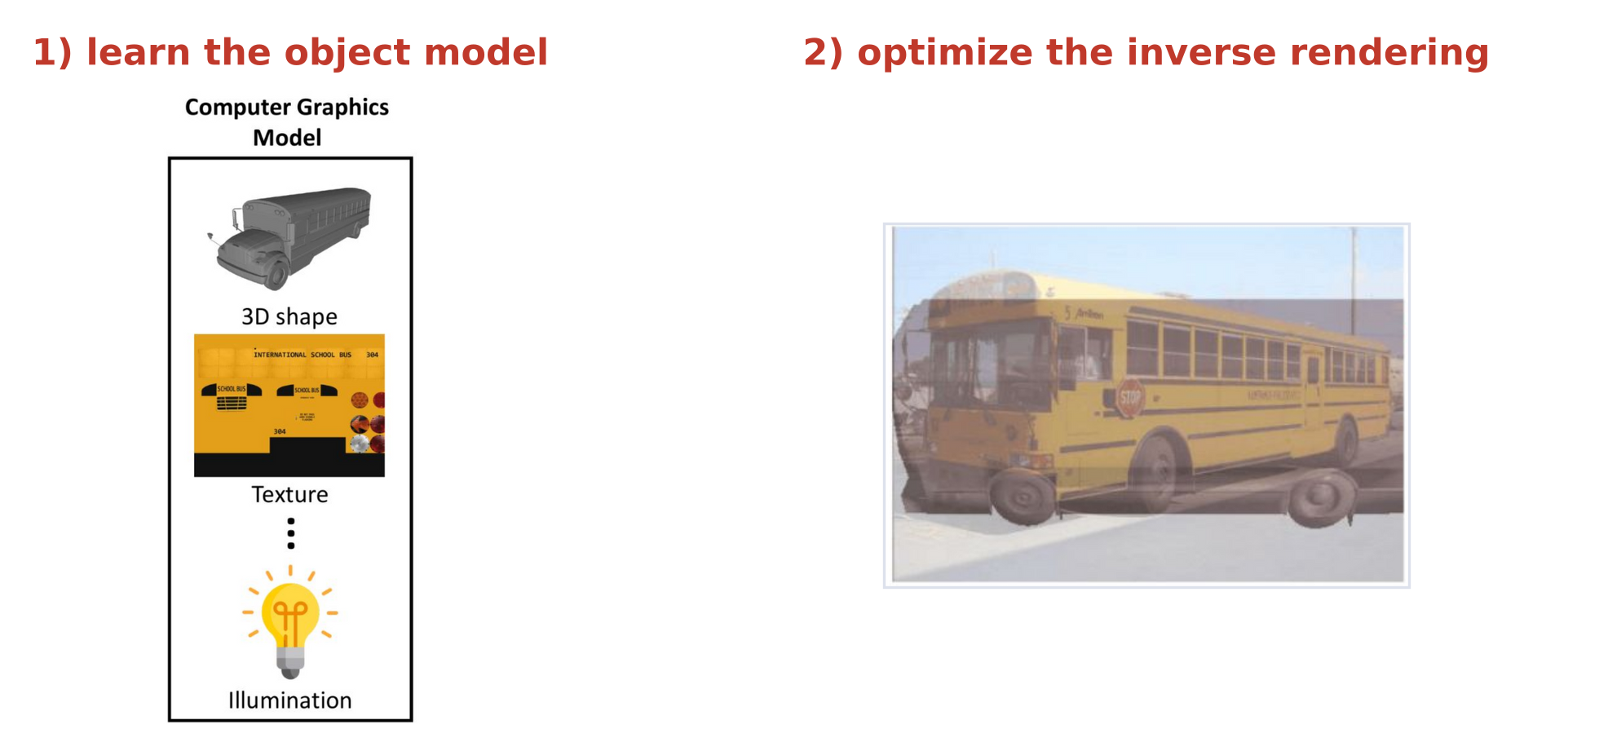
Robust vision and 3D models
Generative object models are hard to learn and to invert
Why is analysis by synthesis not widely used in computer vision?
1) It is hard to learn the generative object model. 2) It is hard to optimize the inverse rendering process.
Analysis by Synthesis · A. Yuille
18

Slide 19
Neural mesh models
3
A neural mesh model generates features instead of pixels: a mesh whose
vertices carry feature vectors, trained by contrastive learning.
Analysis by Synthesis · A. Yuille
19

Slide 20
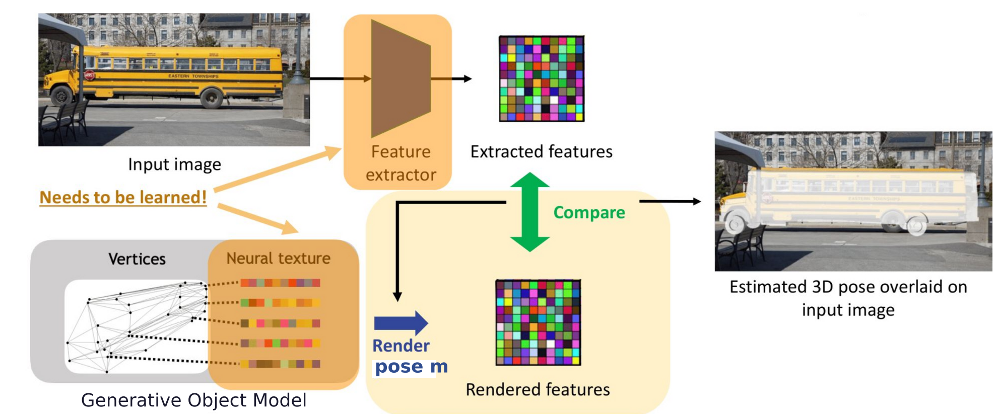
Neural mesh models
Neural analysis by synthesis estimates 3D pose from features
A feature extractor maps the image to features; the generative object model renders features at pose m.
The pose m is found by comparing the two; the feature extractor and the neural texture are learned.
A. Wang, A. Kortylewski and A. Yuille, “NeMo: neural mesh models of contrastive features for robust 3D pose estimation,” ICLR, 2021.
Analysis by Synthesis · A. Yuille
20

Slide 21
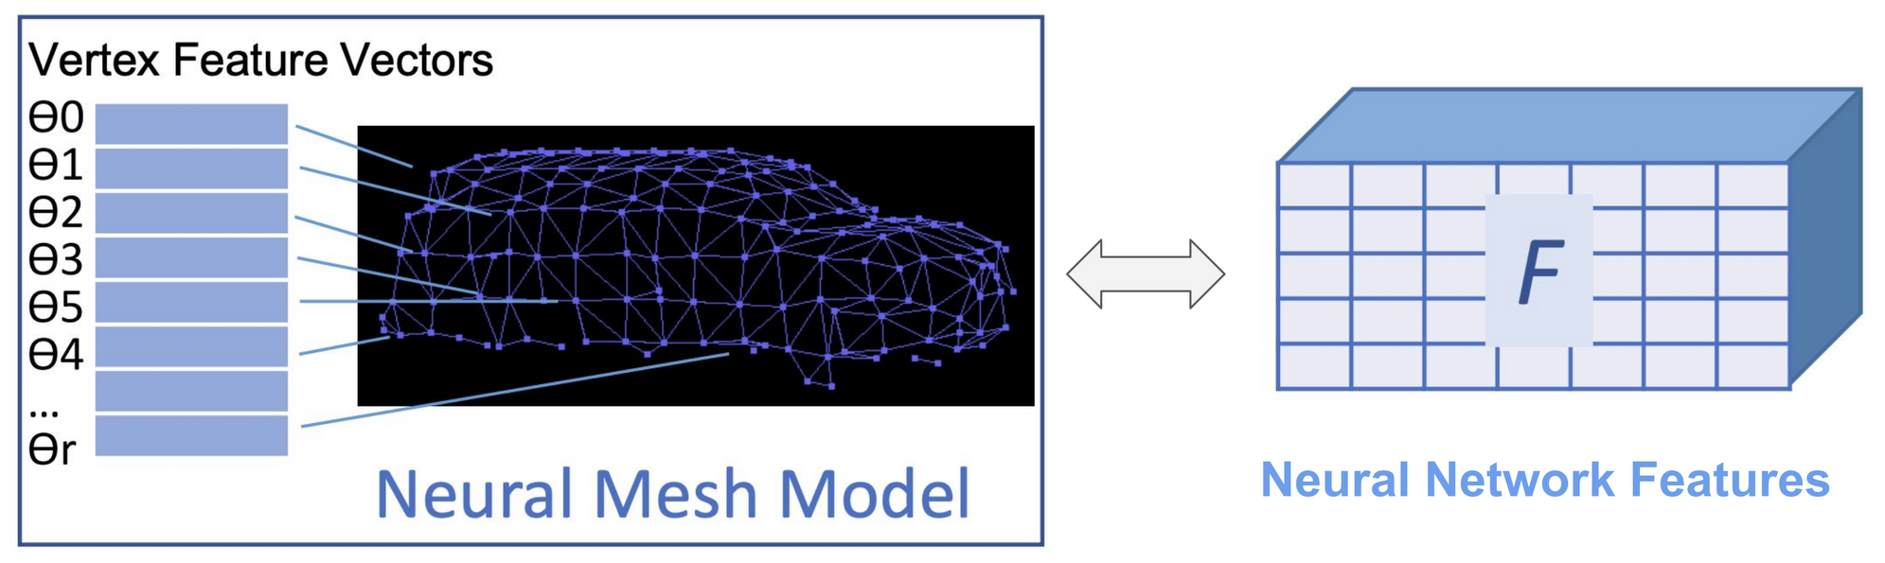
Neural mesh models
A neural mesh model stores a feature vector at each vertex
A mesh for each category y; vertex r stores a feature vector θ_r instead of a color: a neural texture.
A CNN (convolutional neural network) maps the image to a feature map F of neural network features.
Rendering the mesh at a pose m predicts features, which are compared with F instead of the pixels.
A. Wang, A. Kortylewski and A. Yuille, “NeMo: neural mesh models of contrastive features for robust 3D pose estimation,” ICLR, 2021.
Analysis by Synthesis · A. Yuille
21

Slide 22
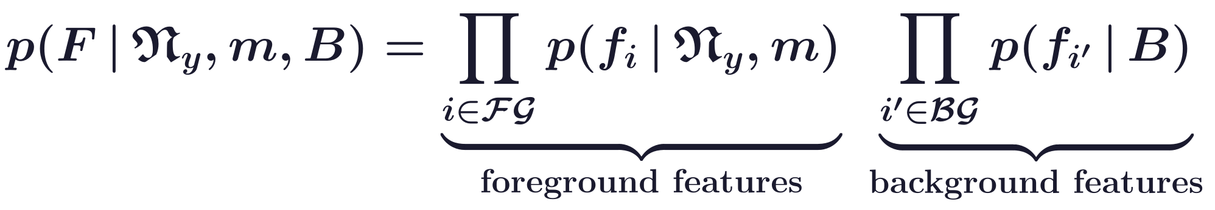
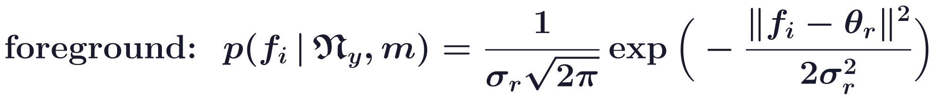
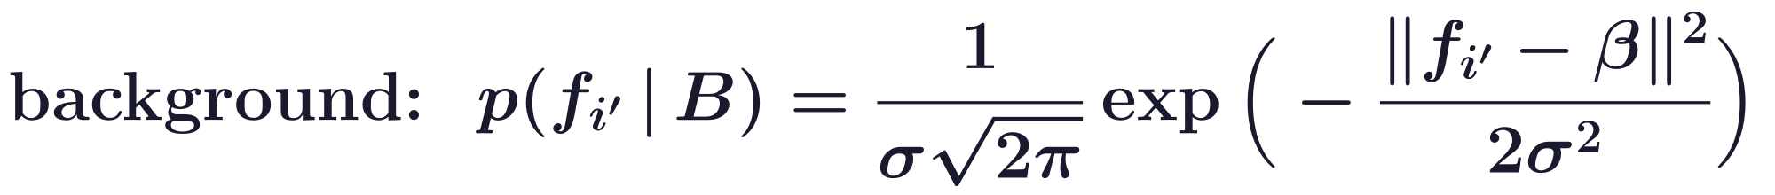
Neural mesh models
The likelihood factorizes over foreground and background
Given: the neural mesh model N_y of category y, the camera pose m, the background model B = {β, σ}.
Foreground FG: the positions covered by the mesh rendered at pose m; background BG: the rest.
At a foreground position i, f_i is Gaussian (s.d. σ_r) around θ_r, the feature of the vertex r at i.
Every background feature is Gaussian around the clutter feature β.
A. Wang, A. Kortylewski and A. Yuille, “NeMo: neural mesh models of contrastive features for robust 3D pose estimation,” ICLR, 2021.
Analysis by Synthesis · A. Yuille
22

Slide 23
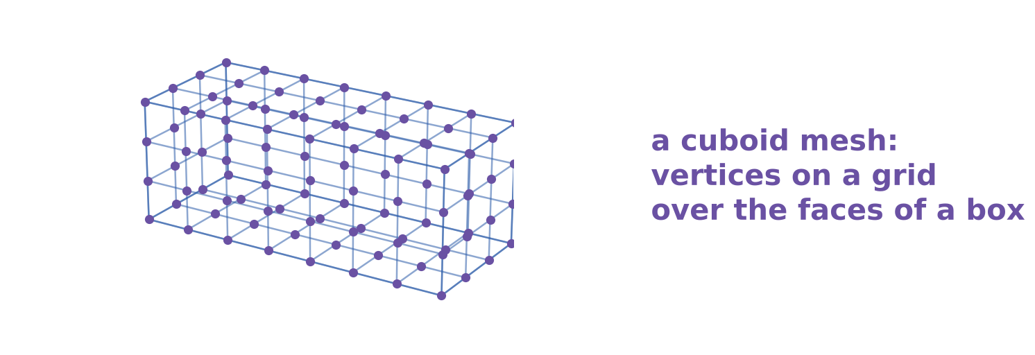
Neural mesh models
The approximations: features, factorization, weak geometry
Approximate: it generates features instead of pixels.
Factorization: the features are independent of each other, given the mesh and the pose.
Weak geometry: a cuboid is used for aligning instances of the same category.
Why? Efficiency: inference with the neural feature representation (mesh + neural features) is efficient.
Analysis by Synthesis · A. Yuille
23

Slide 24
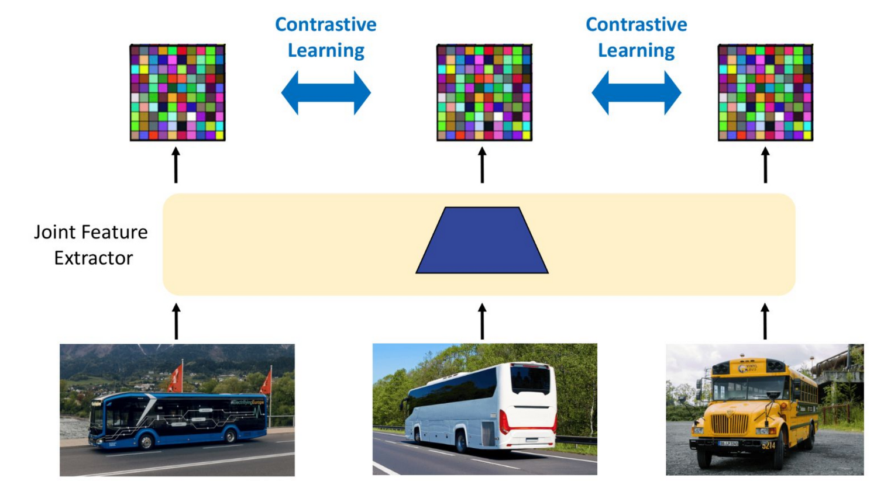
Neural mesh models
Contrastive learning trains a joint feature extractor
One feature extractor is shared by all training images of a category.
The annotated 3D pose projects each mesh vertex into each image: corresponding points across images.
A. Wang, A. Kortylewski and A. Yuille, “NeMo: neural mesh models of contrastive features for robust 3D pose estimation,” ICLR, 2021.
Analysis by Synthesis · A. Yuille
24

Slide 25
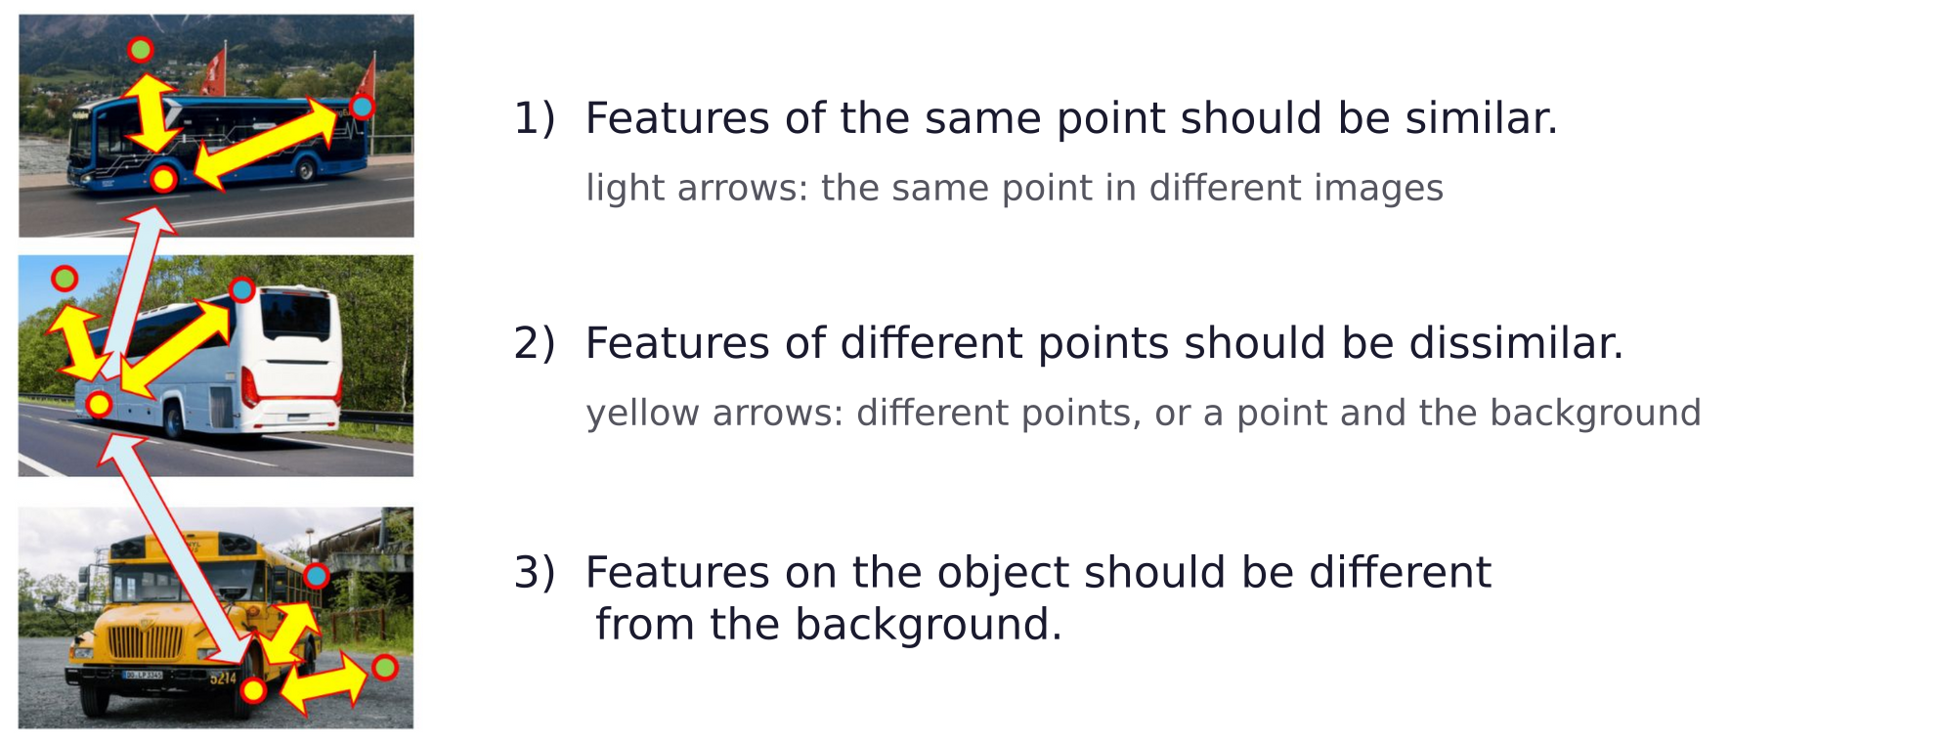
Neural mesh models
Contrastive learning follows three rules for the features
Analysis by Synthesis · A. Yuille
25

Slide 26
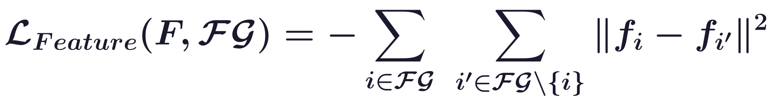
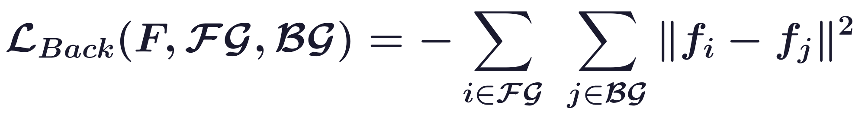
Neural mesh models
The contrastive losses push features apart
Train the feature extractor so that object features are distinct from each other and from the background.
Here i, i′ are two foreground positions and j a background position.
L_ML, the negative log-likelihood, pulls each foreground feature toward its vertex feature θ_r.
A. Wang, A. Kortylewski and A. Yuille, “NeMo: neural mesh models of contrastive features for robust 3D pose estimation,” ICLR, 2021.
Analysis by Synthesis · A. Yuille
26

Slide 27
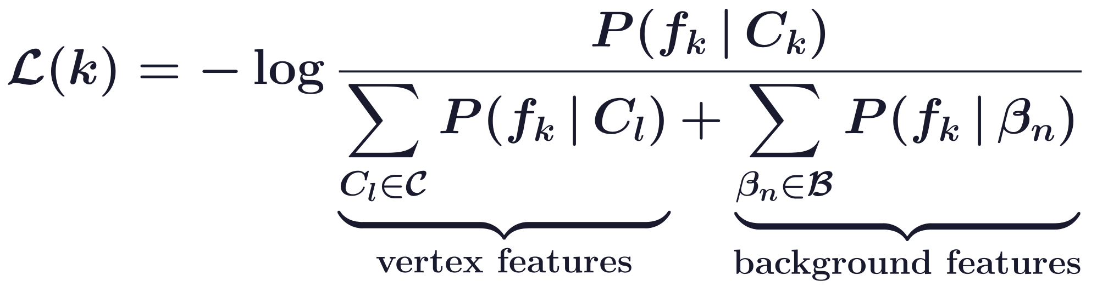
Neural mesh models
With unit features the loss is a softmax over vertex features
Later neural mesh models (NOVUM, 3D-CompNets) use unit features and a von Mises-Fisher P.
f_k: the image feature where vertex k projects; C_k: its vertex feature (θ_r in NeMo); β_n: background.
c(κ) normalizes P; κ: concentration; the sums run over all vertex and all background features.
A softmax: f_k must match its own vertex feature better than the other vertices and the background.
X. Yuan, G. Zhang, P. Kaushik, A. Jesslen, A. Kortylewski and A. Yuille, “Scaling 3D compositional models for robust classification and
pose estimation,” ICCV, 6406–6415, 2025.
Analysis by Synthesis · A. Yuille
27

Slide 28
Inference and robustness
4
Render-and-compare finds the 3D pose and explains occluders by a
background model; it is robust to occlusion and extends to classification.
Analysis by Synthesis · A. Yuille
28

Slide 29
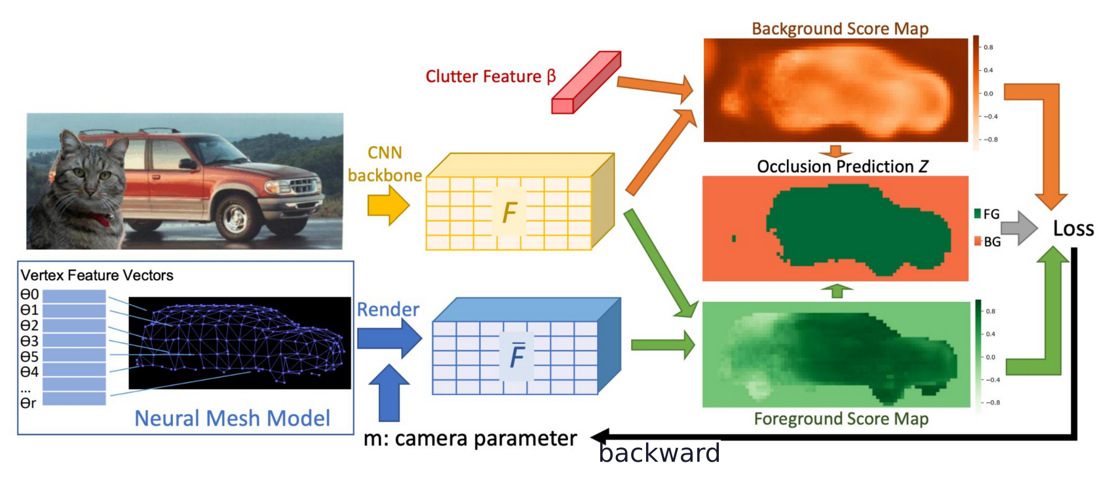
Inference and robustness
Render-and-compare finds the pose and the occluded parts
At each position, compare the foreground score (vertex features) with the background score (clutter β).
Where the background score wins, the position is predicted occluded: the map Z.
The loss is backpropagated to the camera pose m, which is optimized by gradient descent.
A. Wang, A. Kortylewski and A. Yuille, “NeMo: neural mesh models of contrastive features for robust 3D pose estimation,” ICLR, 2021.
Analysis by Synthesis · A. Yuille
29

Slide 30
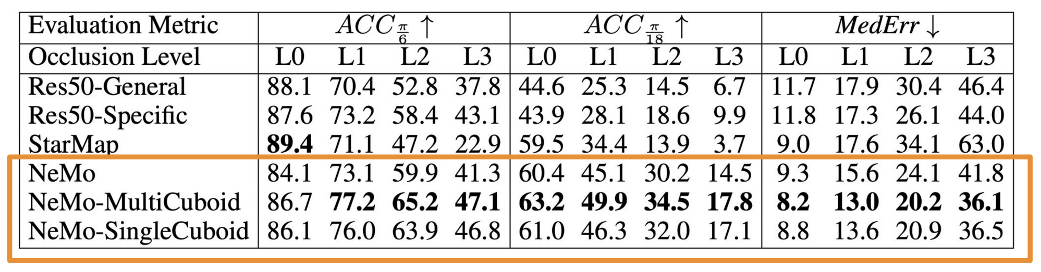
Inference and robustness
NeMo-MultiCuboid is the most accurate under occlusion
PASCAL3D+: 12 categories with 3D pose; L1, L2, L3: occluders cover 20-40, 40-60, 60-80 % of the object.
NeMo: a down-sampled CAD mesh; MultiCuboid: a cuboid per subtype; SingleCuboid: one per category.
ACC π/6, ACC π/18: fraction of images with error below the angle; MedErr: median error in degrees.
Res50: ResNet-50 classifiers of the pose (General: one, Specific: one per category); StarMap: keypoints.
A. Wang, A. Kortylewski and A. Yuille, “NeMo: neural mesh models of contrastive features for robust 3D pose estimation,” ICLR, 2021.
Y. Xiang, R. Mottaghi and S. Savarese, “Beyond PASCAL: a benchmark for 3D object detection in the wild,” WACV, 75–82, 2014.
X. Zhou, A. Karpur, L. Luo and Q. Huang, “StarMap for category-agnostic keypoint and viewpoint estimation,” ECCV, 318–334, 2018.
Analysis by Synthesis · A. Yuille
30

Slide 31
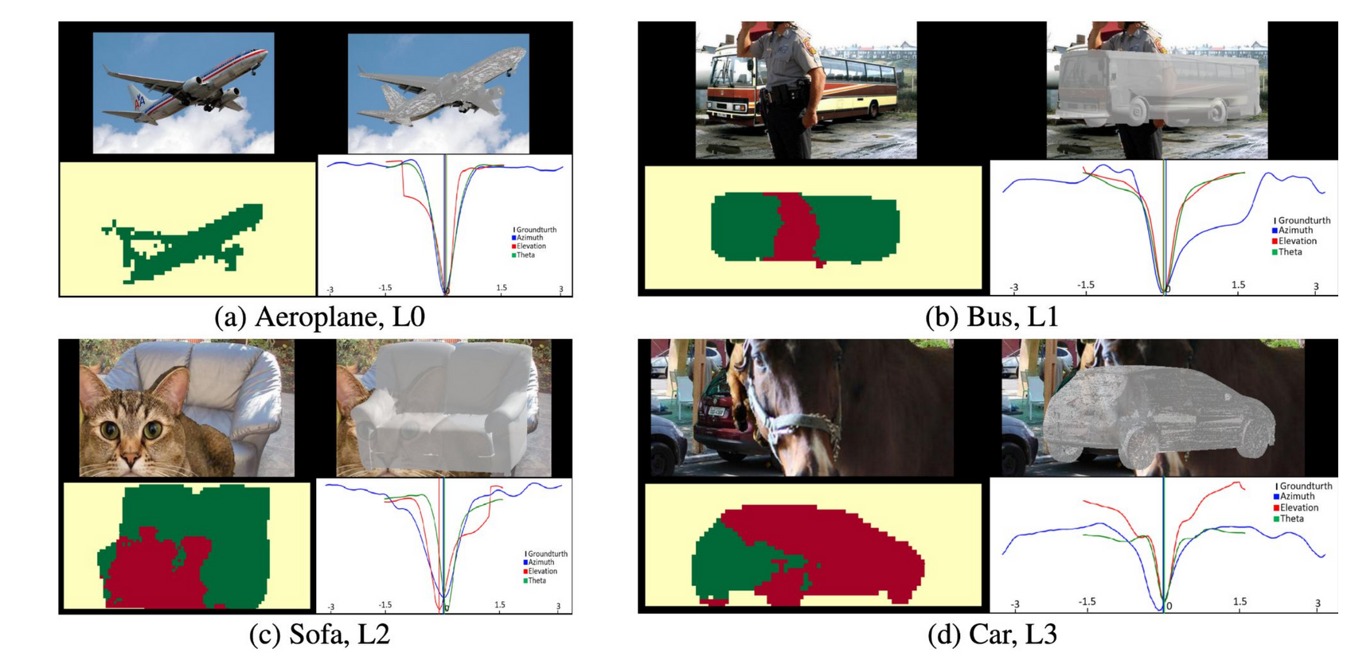
Inference and robustness
NeMo finds the pose and marks the occluded parts
Occlusion maps: yellow is background, green the visible object, red the part predicted occluded.
Curves: the loss as azimuth, elevation or in-plane rotation varies; the ground truth is at the center.
A. Wang, A. Kortylewski and A. Yuille, “NeMo: neural mesh models of contrastive features for robust 3D pose estimation,” ICLR, 2021.
Analysis by Synthesis · A. Yuille
31

Slide 32
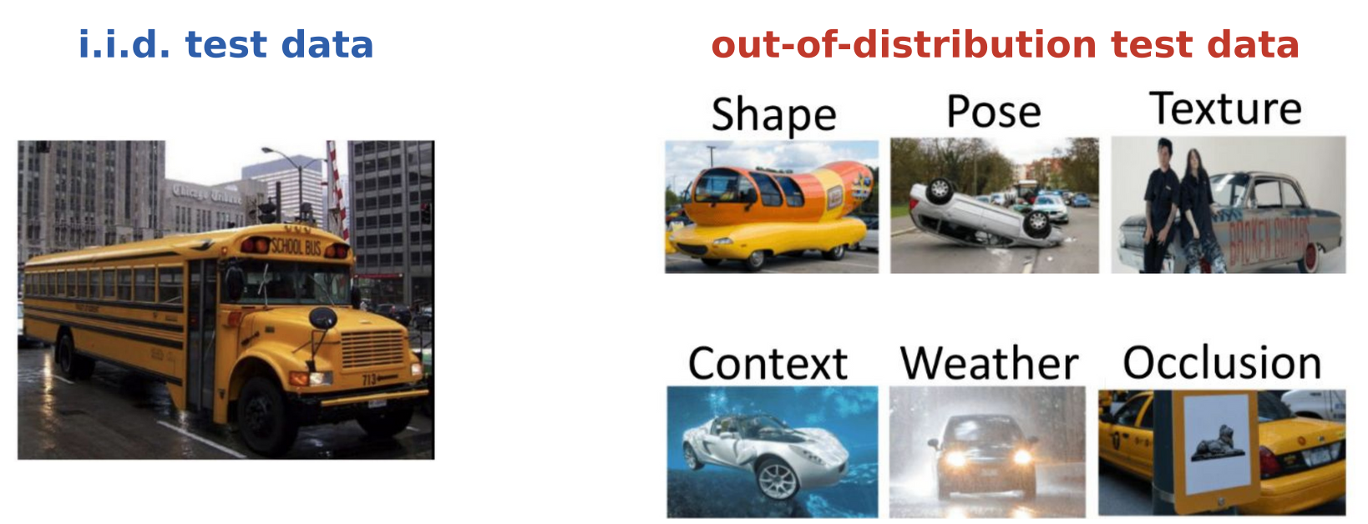
Inference and robustness
Out-of-distribution test data change one nuisance at a time
i.i.d.: independent and identically distributed; the test images follow the training distribution.
OOD-CV: images of 10 categories that differ in one nuisance: shape, pose, texture, context or weather.
A nuisance changes the image but not the object's class; OOD-CV-v2 adds occlusion as a nuisance.
B. Zhao et al., “OOD-CV: a benchmark for robustness to out-of-distribution shifts of individual nuisances in natural images,” ECCV,
LNCS 13668, 163–180, 2022.
B. Zhao et al., “OOD-CV-v2: an extended benchmark for robustness to out-of-distribution shifts of individual nuisances in natural images,”
arXiv:2304.10266, 2023.
Analysis by Synthesis · A. Yuille
32

Slide 33
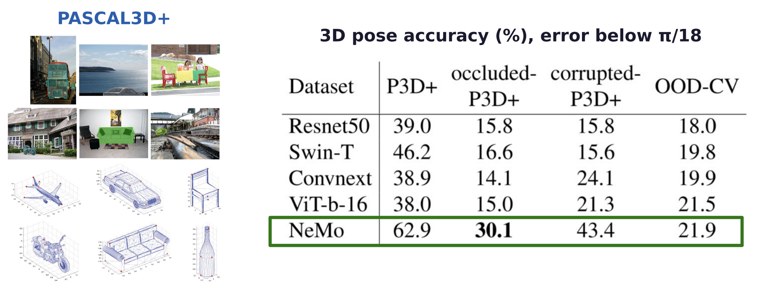
Inference and robustness
Pose accuracy: NeMo leads, by a small margin on OOD-CV
P3D+: PASCAL3D+; occluded- and corrupted-P3D+ add occluders and image corruptions to its images.
Swin-T (shifted-window transformer), ConvNeXt (a modern CNN), ViT-B/16 (vision transformer).
Y. Xiang, R. Mottaghi and S. Savarese, “Beyond PASCAL: a benchmark for 3D object detection in the wild,” WACV, 75–82, 2014.
B. Zhao et al., “OOD-CV-v2: an extended benchmark for robustness to out-of-distribution shifts of individual nuisances in natural images,”
arXiv:2304.10266, 2023.
Analysis by Synthesis · A. Yuille
33

Slide 34
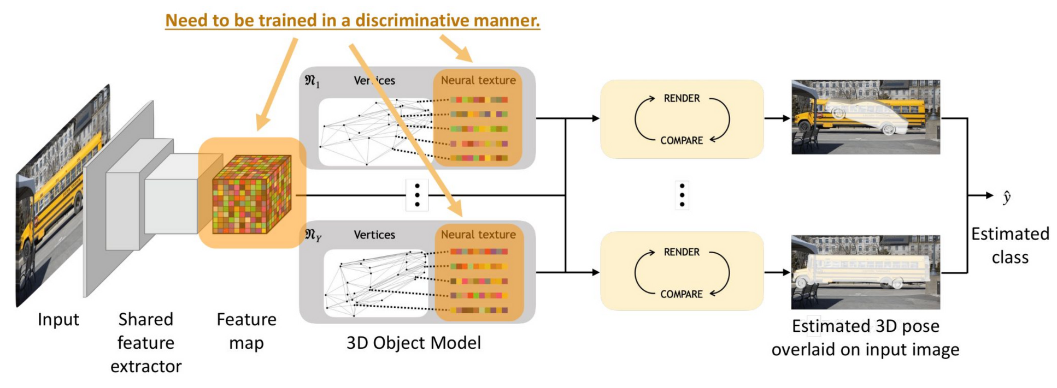
Inference and robustness
One render-and-compare model per class gives the class
A shared feature extractor; one 3D object model (vertices and neural texture) for each class.
Render-and-compare with every class model; the class whose model explains the features best wins.
Trained discriminatively: the features and textures make the right class's model score highest.
A. Jesslen, G. Zhang, A. Wang, A. Yuille and A. Kortylewski, “Robust 3D-aware object classification via discriminative render-and-compare,”
arXiv:2305.14668, 2023.
Analysis by Synthesis · A. Yuille
34

Slide 35
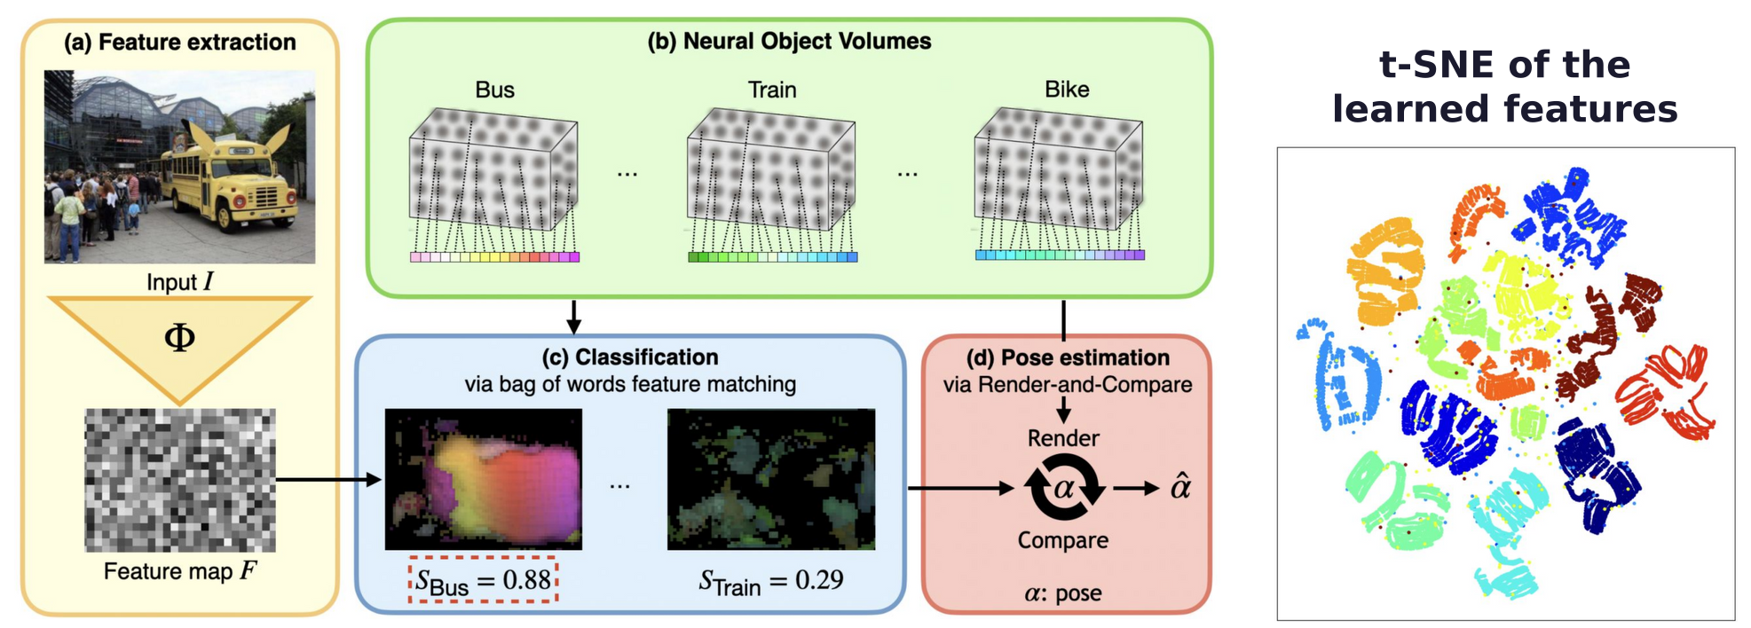
Inference and robustness
NOVUM classifies by matching features, then finds the pose
Neural object volumes, one per class; the class score S counts matching features, ignoring position.
Render-and-compare then finds the pose α of the chosen class; Φ: the feature extractor.
t-SNE (a 2D map of the features): the 12 PASCAL3D+ classes form one cluster each.
A. Jesslen, G. Zhang, A. Wang, W. Ma, A. Yuille and A. Kortylewski, “NOVUM: neural object volumes for robust object classification,”
ECCV, 2024.
Analysis by Synthesis · A. Yuille
35

Slide 36
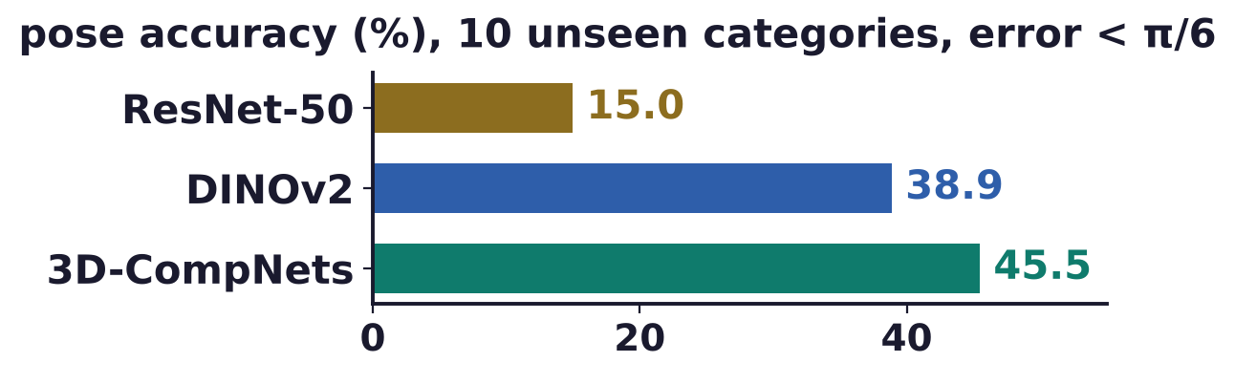
Inference and robustness
3D-CompNets scale neural mesh models to 188 categories
3D-CompNets (3D compositional networks): neural mesh models of 188 categories of ImageNet3D.
DINOv2: a self-supervised vision transformer; both use a ViT-B/14 backbone.
Trained on 178 categories, 3D-CompNets estimate the pose of 10 unseen ones better than DINOv2.
They match DINOv2 on in-distribution images and are more robust to occlusion and corruption.
The tasks are object-centric: the object's location can come from Grounding DINO or another detector.
X. Yuan, G. Zhang, P. Kaushik, A. Jesslen, A. Kortylewski and A. Yuille, “Scaling 3D compositional models for robust classification and
pose estimation,” ICCV, 6406–6415, 2025.
W. Ma, G. Zhang, Q. Liu, G. Zeng, A. Kortylewski, Y. Liu and A. Yuille, “ImageNet3D: towards general-purpose object-level 3D understanding,”
NeurIPS Datasets and Benchmarks, 2024.
S. Liu et al., “Grounding DINO: marrying DINO with grounded pre-training for open-set object detection,” ECCV, 2024.
Analysis by Synthesis · A. Yuille
36

Slide 37
Inference and robustness
Summary
Analysis by synthesis inverts the synthesis of images: P(W | I) ∝ P(I | W) P(W).
Low-level cues make bottom-up proposals; high-level generative models validate them top-down.
It offers the potential to perform multiple visual tasks in a consistent way.
Discriminative networks lack robustness to 3D changes and to changes of image components.
It needs object models conditioned on the 3D world state, hard to learn and hard to invert.
Neural mesh models approximate it: vertex features, a factorized likelihood, a cuboid mesh.
Contrastive learning makes the vertex features distinct from each other and from the background.
Render-and-compare estimates 3D pose robustly under occlusion and extends to classification.
Analysis by Synthesis · A. Yuille
37

