Slide 1
Diffusion Models
and De-Diffusion
12 November, 2026
Alan Yuille · Probabilistic Models of the Visual Cortex

Slide 2
What this lecture covers
1
Recap: diffusion with text
2
Image-conditioned diffusion
Denoising, sampling, guidance
ControlNet and LooseControl
3
Text as an image representation
4
De-Diffusion
Embeddings, tokens or text
A frozen diffusion model as decoder
5
Applications of De-Diffusion
6
De-Diffusion V2
Prompts, VQA, few-shot learning, chat
Continuous embeddings, LLM decoder
Generative Models · A. Yuille
2

Slide 3
Recap: diffusion with text
1
The trained network estimates the posterior mean of the clean image;
classifier-free guidance sharpens the text condition at sampling time.
Generative Models · A. Yuille
3

Slide 4
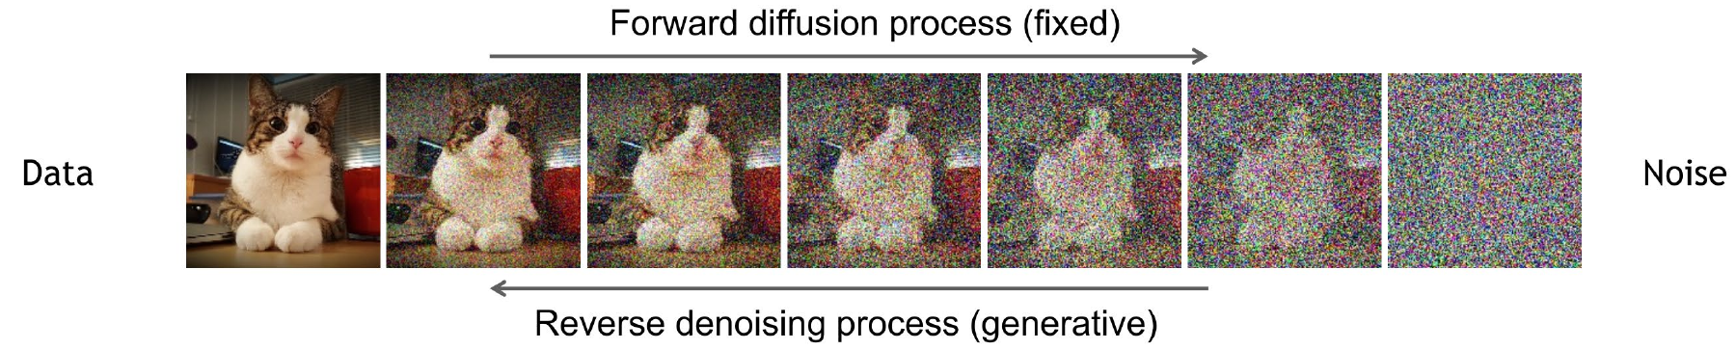
Recap: diffusion with text
Denoising diffusion models consist of two processes
Recap of Lecture 20: the forward process adds noise and is fixed; a U-Net ε_{θ} learns to predict the noise.
Bayes: the best ε_{θ} for the squared loss is a posterior mean, so it estimates E[x₀ | x_{t}].
J. Ho, A. Jain and P. Abbeel, “Denoising diffusion probabilistic models,” NeurIPS, 6840–6851, 2020.
Figure: K. Kreis, R. Gao and A. Vahdat, “Denoising diffusion-based generative modeling: foundations and applications,” CVPR 2022 tutorial.
Generative Models · A. Yuille
4

Slide 5
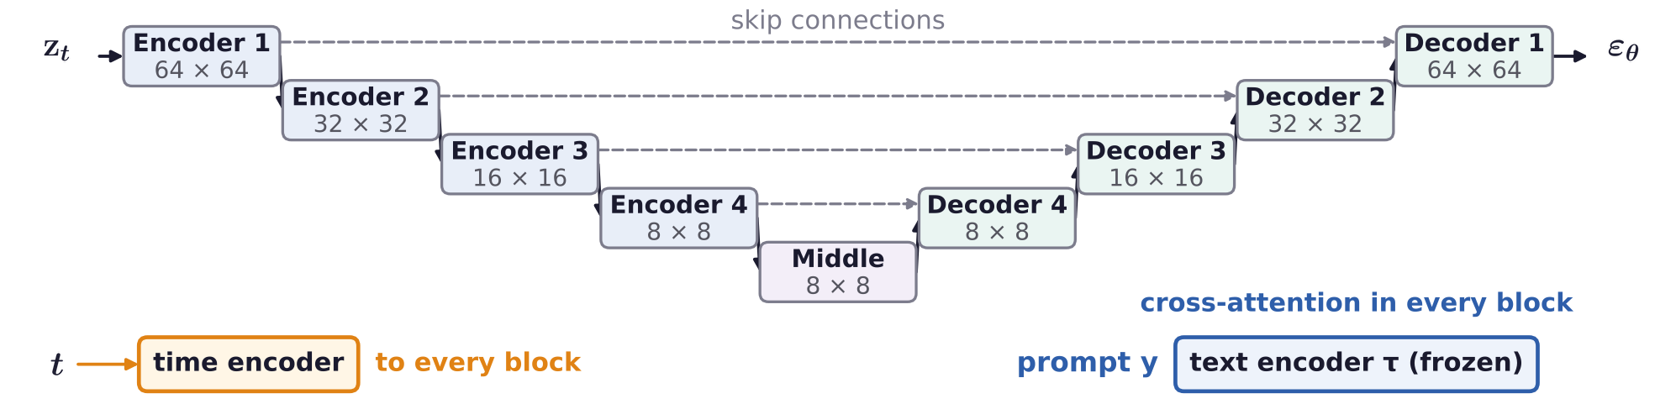
Recap: diffusion with text
Recap: Stable Diffusion denoises a latent given the prompt
The U-Net denoises a 64 × 64 × 4 latent z_{t} from an image autoencoder (Lecture 20); y is the prompt.
A frozen text encoder τ (CLIP's in Stable Diffusion v1) gives one feature vector per token of y.
Cross-attention in every block: queries from the latent, keys and values from τ(y).
R. Rombach, A. Blattmann, D. Lorenz, P. Esser and B. Ommer, “High-resolution image synthesis with latent diffusion models,” CVPR,
10684–10695, 2022.
A. Radford, J. W. Kim, C. Hallacy et al., “Learning transferable visual models from natural language supervision,” ICML, 8748–8763, 2021.
Generative Models · A. Yuille
5

Slide 6
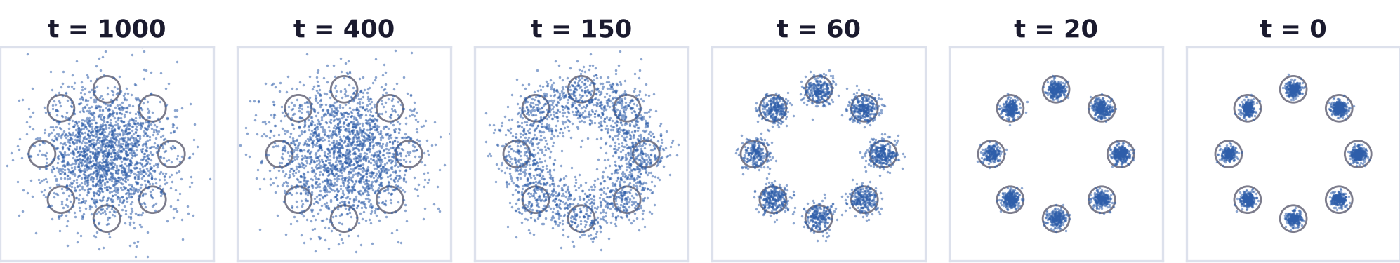
Recap: diffusion with text
Generation denoises step by step, from noise to data
Start from pure noise x_{T} ~ N(0, I) and apply the step for t = T, …, 1; n: fresh noise, σ_{t}² = β_{t}.
Toy example: 2D points from eight Gaussian clusters, with the exact optimal noise predictor as ε_{θ}.
J. Ho, A. Jain and P. Abbeel, “Denoising diffusion probabilistic models,” NeurIPS, 6840–6851, 2020.
Generative Models · A. Yuille
6

Slide 7
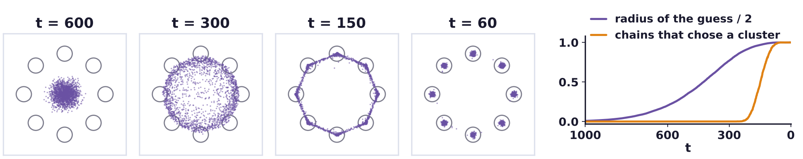
Recap: diffusion with text
Each step moves a little towards the predicted clean image
x̂₀(x_{t}) = E[x₀ | x_{t}]: the network's current guess; a step mixes it with x_{t} and adds fresh noise.
Toy: the guess first finds the ring (t ≈ 220), then picks one cluster (t ≈ 150 to 100): coarse to fine.
J. Ho, A. Jain and P. Abbeel, “Denoising diffusion probabilistic models,” NeurIPS, 6840–6851, 2020.
Generative Models · A. Yuille
7

Slide 8
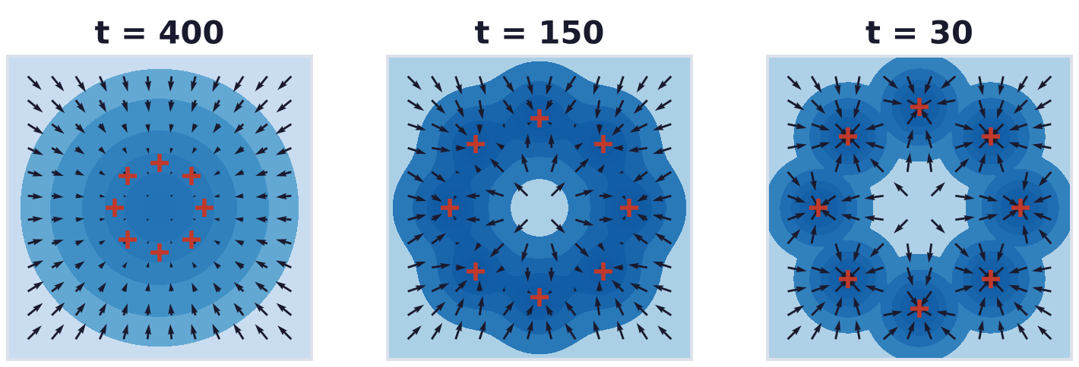
Recap: diffusion with text
Predicted noise points down the log-density of noisy images
A step is noisy gradient ascent on log p_{t}; p_{t} sharpens as t falls, so the search is annealed.
With a prompt y, Bayes adds a likelihood: ∇ log p_{t}(x_{t} | y) = ∇ log p_{t}(x_{t}) + ∇ log p_{t}(y | x_{t}).
J. Ho, A. Jain and P. Abbeel, “Denoising diffusion probabilistic models,” NeurIPS, 6840–6851, 2020.
Generative Models · A. Yuille
8

Slide 9
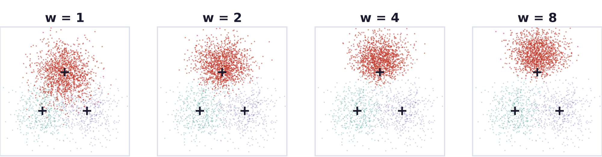
Recap: diffusion with text
Classifier-free guidance strengthens the text condition
Training drops the prompt at random (y is the empty prompt), so one network learns both predictions.
w multiplies the likelihood term, so guidance samples p(z) p(y | z)^{w}; w = 1 is plain conditional sampling.
Toy example: as w grows, the samples of class 1 (red) move away from the other two classes.
J. Ho and T. Salimans, “Classifier-free diffusion guidance,” NeurIPS Workshop on Deep Generative Models and Downstream Applications, 2021.
Generative Models · A. Yuille
9

Slide 10
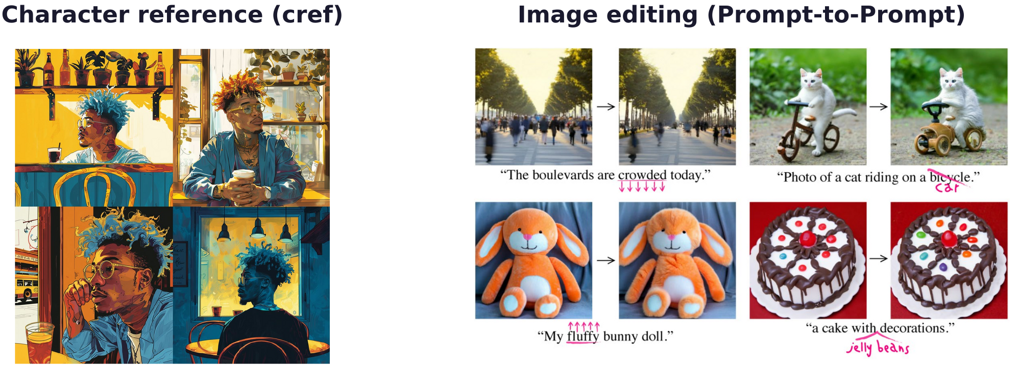
Recap: diffusion with text
Diffusion models also keep a character and edit images
Character reference: new pictures of the same person in new scenes (Midjourney's cref option).
Image editing: change one word of the prompt and keep the rest of the image (Prompt-to-Prompt).
A. Hertz, R. Mokady, J. Tenenbaum, K. Aberman, Y. Pritch and D. Cohen-Or, “Prompt-to-prompt image editing with cross-attention control,”
ICLR, 2023.
Generative Models · A. Yuille
10

Slide 11
Image-conditioned diffusion
2
ControlNet adds edges, poses or depth to a frozen text-to-image model
through a trainable copy joined by zero convolutions.
Generative Models · A. Yuille
11

Slide 12
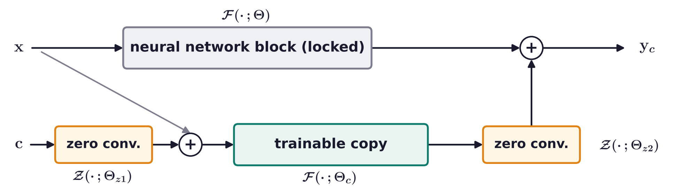
Image-conditioned diffusion
ControlNet adds visual conditioning with zero convolutions
Zero convolution Z: a 1 × 1 convolution with weights and bias initialized to zero, so at first y_{c} = y.
The base model is fixed; only an adapter, a trainable copy of its encoder, learns the condition c.
L. Zhang, A. Rao and M. Agrawala, “Adding conditional control to text-to-image diffusion models,” ICCV, 3836–3847, 2023.
Generative Models · A. Yuille
12

Slide 13
Image-conditioned diffusion
Zero convolutions start at the base model yet still learn
At step 0 the output is exactly the pretrained model's: no random noise is added to a good model.
The gradient of W is not zero: the first update makes W nonzero, then gradients reach the copy.
The model moves smoothly away from a known good point, like a residual branch that starts at zero.
L. Zhang, A. Rao and M. Agrawala, “Adding conditional control to text-to-image diffusion models,” ICCV, 3836–3847, 2023.
Generative Models · A. Yuille
13

Slide 14
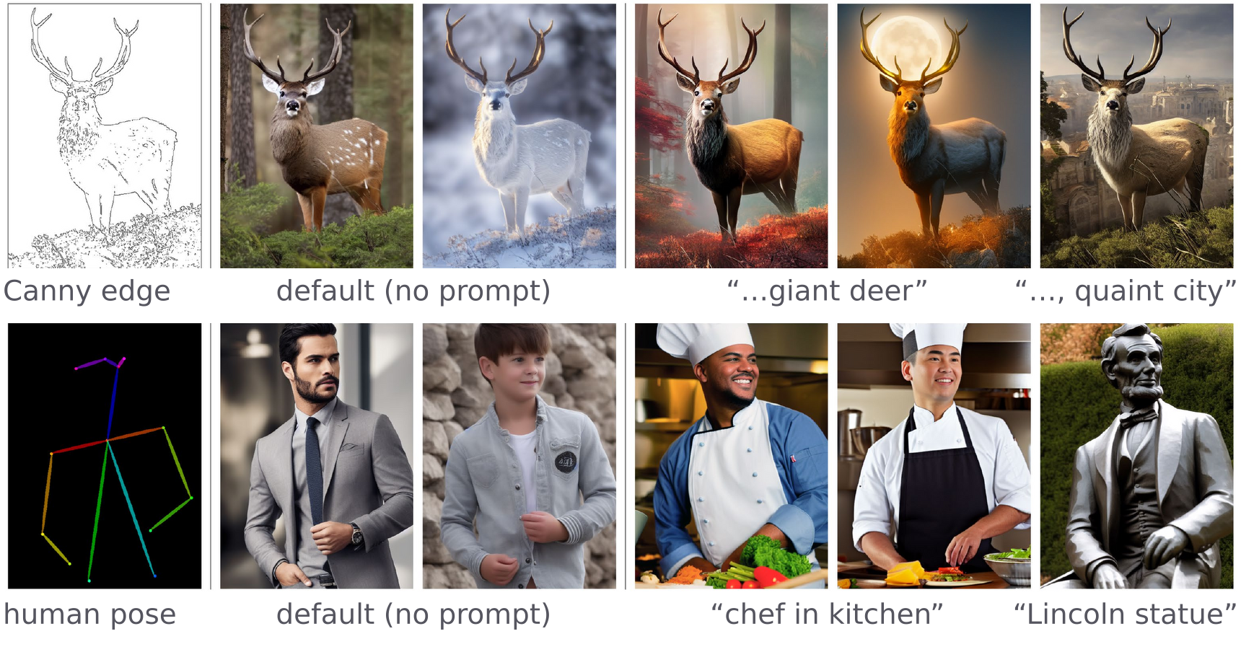
Image-conditioned diffusion
Edges and human poses control the generated image
Input: a Canny edge map or a human pose skeleton; each kind of condition has its own ControlNet.
L. Zhang, A. Rao and M. Agrawala, “Adding conditional control to text-to-image diffusion models,” ICCV, 3836–3847, 2023.
Generative Models · A. Yuille
14

Slide 15
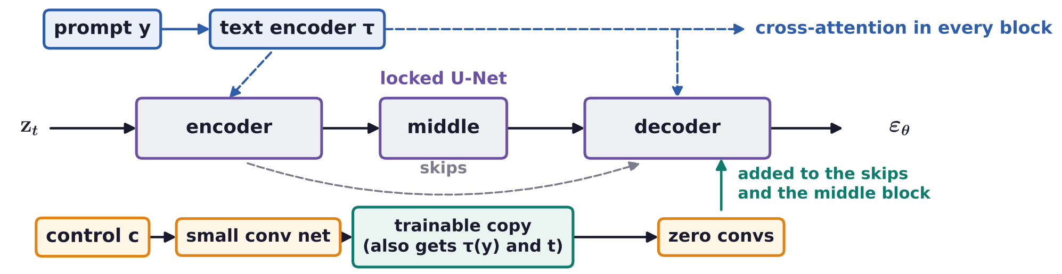
Image-conditioned diffusion
The prompt and the control image guide the same denoiser
Training drops 50 % of the prompts, so the copy learns to read the meaning of the edges itself.
It works with no prompt, a vague one, a conflicting one (text changes the meaning) or a full one.
L. Zhang, A. Rao and M. Agrawala, “Adding conditional control to text-to-image diffusion models,” ICCV, 3836–3847, 2023.
Generative Models · A. Yuille
15

Slide 16
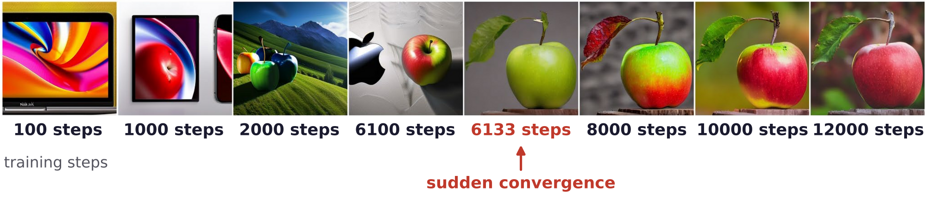
Image-conditioned diffusion
ControlNet training converges suddenly
Same prompt “apple” and same condition (an apple sketch), after more and more training steps.
For about 6,000 steps the output ignores the condition; at about 6,133 steps it suddenly follows it.
The zero convolutions keep the base model's output intact while the trainable copy learns.
L. Zhang, A. Rao and M. Agrawala, “Adding conditional control to text-to-image diffusion models,” ICCV, 3836–3847, 2023.
Generative Models · A. Yuille
16

Slide 17
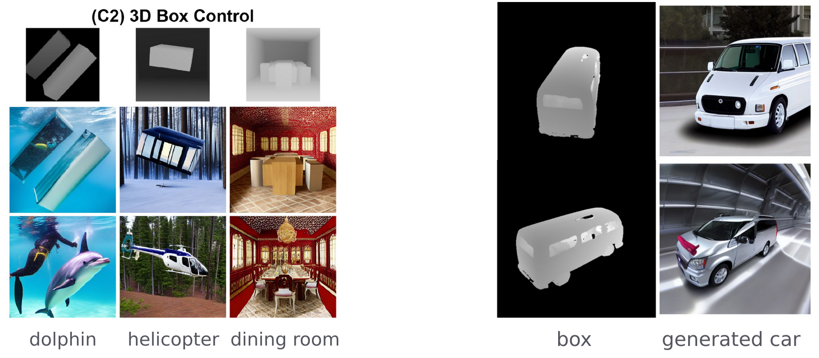
Image-conditioned diffusion
LooseControl conditions on 3D boxes instead of exact depth
ControlNet's depth condition needs an exact depth map, which is as hard to make as the image itself.
LooseControl: 3D boxes give only the rough layout; the prompt and the model fill in the objects.
A box drawn as a car's rough shape becomes a detailed car seen from that viewpoint.
S. F. Bhat, N. J. Mitra and P. Wonka, “LooseControl: lifting ControlNet for generalized depth conditioning,” SIGGRAPH Conference
Papers, 2024.
Generative Models · A. Yuille
17

Slide 18
Text as an image
representation
3
An image can be represented by embeddings, by quantized tokens or by
text; De-Diffusion writes an image as a scrambled caption.
Generative Models · A. Yuille
18

Slide 19
Text as an image representation
De-Diffusion uses diffusion models to train VLMs
Vision-language models (VLMs) take an image as input and output text, for example captions.
The best VLMs require industry-level datasets and compute: only companies can train them.
Text-to-image diffusion models also need large data and compute, but pretrained ones are public.
Key idea: an autoencoder whose decoder is a fixed pretrained diffusion model; the encoder is the VLM.
De-Diffusion V1 (CVPR 2024) required industry resources; De-Diffusion V2 (JHU) does not.
C. Wei, C. Liu, S. Qiao, Z. Zhang, A. Yuille and J. Yu, “De-Diffusion makes text a strong cross-modal interface,” CVPR, 13492–13503, 2024.
T. Zhang, Y. Li, Y.-C. Chou, J. Chen, A. Yuille, C. Wei and J. Xiao, “Vision-language-vision auto-encoder: scalable knowledge distillation
from diffusion models,” NeurIPS, 2025.
Generative Models · A. Yuille
19

Slide 20
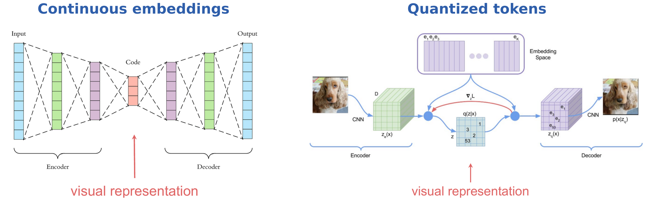
Text as an image representation
Images are represented by embeddings or quantized tokens
Continuous embeddings: autoencoders, iBOT, MaskFeat, DiffMAE; the code is a vector of real numbers.
Quantized tokens: VQ-VAE, DALL-E, Parti; each feature vector is replaced by its nearest codebook entry.
J. Zhou, C. Wei, H. Wang, W. Shen, C. Xie, A. Yuille and T. Kong, “iBOT: image BERT pre-training with online tokenizer,” ICLR, 2022.
A. van den Oord, O. Vinyals and K. Kavukcuoglu, “Neural discrete representation learning,” NeurIPS, 6306–6315, 2017.
Generative Models · A. Yuille
20

Slide 21
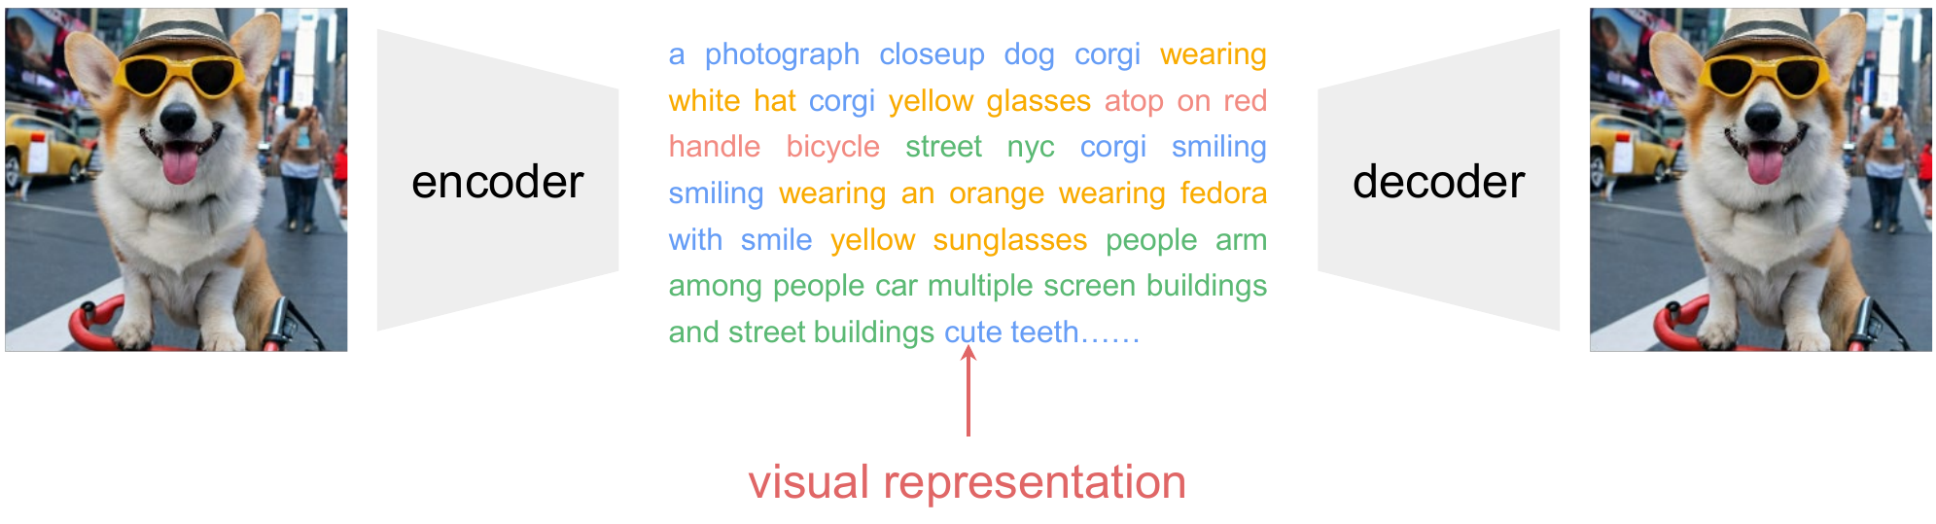
Text as an image representation
De-Diffusion represents an image as text
The encoder writes the image as a sequence of words; the decoder draws the image back from them.
The text is the visual representation, readable by people and by language models.
C. Wei, C. Liu, S. Qiao, Z. Zhang, A. Yuille and J. Yu, “De-Diffusion makes text a strong cross-modal interface,” CVPR, 13492–13503, 2024.
Generative Models · A. Yuille
21

Slide 22
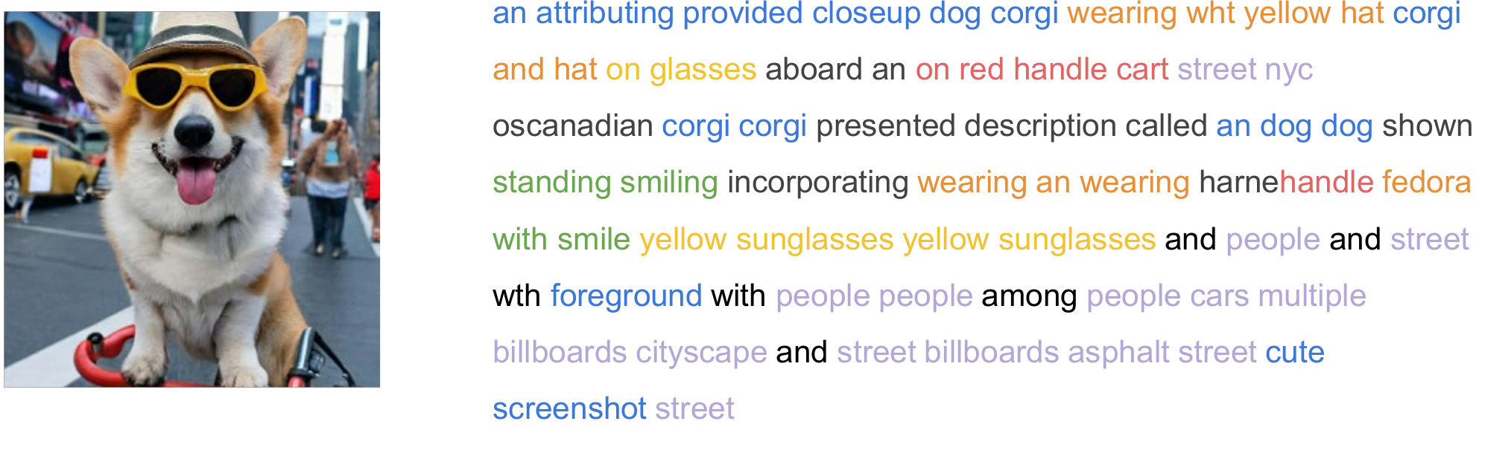
Text as an image representation
De-Diffusion text is a scrambled caption
The words list objects, attributes and background: corgi, yellow sunglasses, red handle cart, street, nyc.
Colors group the words by the part of the image they describe; black words carry little content.
The word order carries little meaning, and misspelled words such as wht and harnehandle appear.
C. Wei, C. Liu, S. Qiao, Z. Zhang, A. Yuille and J. Yu, “De-Diffusion makes text a strong cross-modal interface,” CVPR, 13492–13503, 2024.
Generative Models · A. Yuille
22

Slide 23
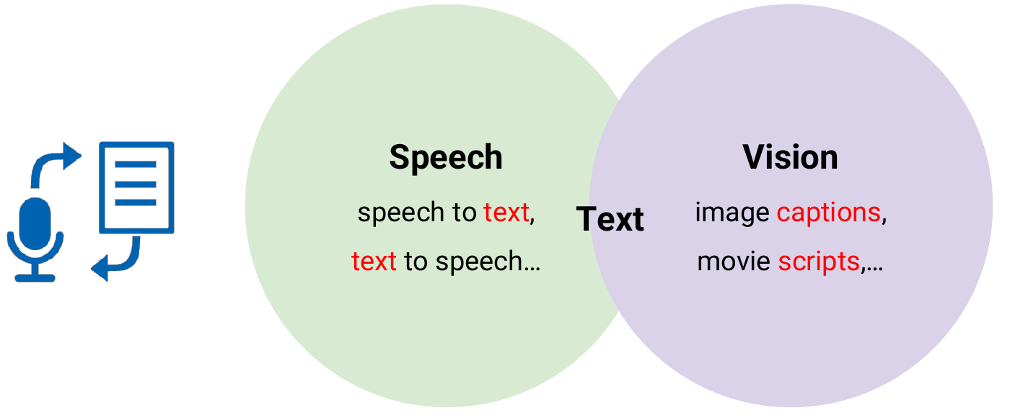
Text as an image representation
Humans encode many different modalities into text
Speech is written as text and read back; images get captions, and movies get scripts.
“In daily life, language often acts as an interface to higher-level cognition.”
Why not captions? Captions usually name only the most salient objects.
Why not deep embeddings? Text is interpretable, and LLMs and text-to-image models use it directly.
C. Wei, C. Liu, S. Qiao, Z. Zhang, A. Yuille and J. Yu, “De-Diffusion makes text a strong cross-modal interface,” CVPR, 13492–13503, 2024.
Generative Models · A. Yuille
23

Slide 24
De-Diffusion
4
An autoencoder whose decoder is a frozen text-to-image diffusion model:
the encoder learns, from images only, to write text that redraws them.
Generative Models · A. Yuille
24

Slide 25
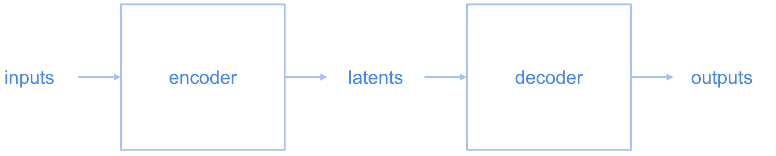
De-Diffusion
An autoencoder needs only images for training
The encoder maps the input to latents; the decoder maps the latents back to an output.
The loss compares the output with the input, so training only requires images: no captions, no labels.
Generative Models · A. Yuille
25

Slide 26
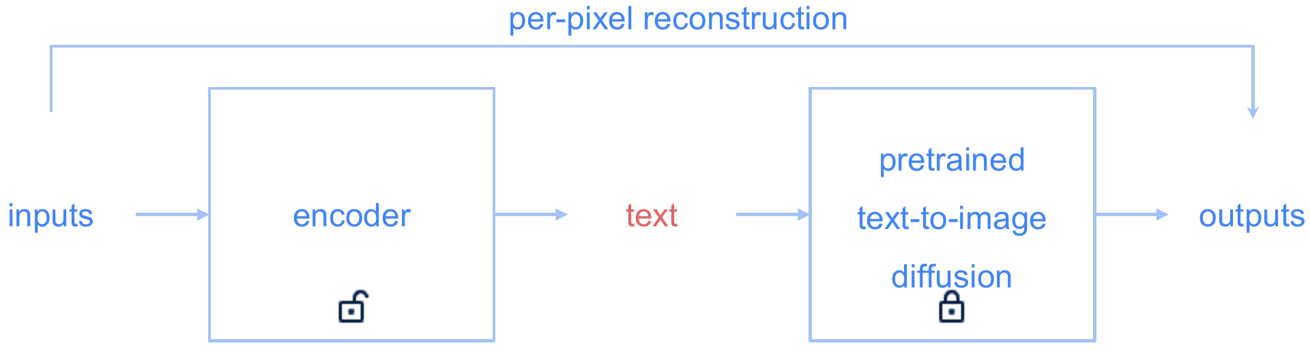
De-Diffusion
A pretrained text-to-image diffusion model is the decoder
The latent is text; only the encoder E_{φ} is trained (open lock); the decoder is frozen (closed lock).
Training unpacks the knowledge encapsulated within the text-to-image generative model.
To minimize the per-pixel reconstruction error, the text has to be accurate and comprehensive.
C. Wei, C. Liu, S. Qiao, Z. Zhang, A. Yuille and J. Yu, “De-Diffusion makes text a strong cross-modal interface,” CVPR, 13492–13503, 2024.
Generative Models · A. Yuille
26

Slide 27
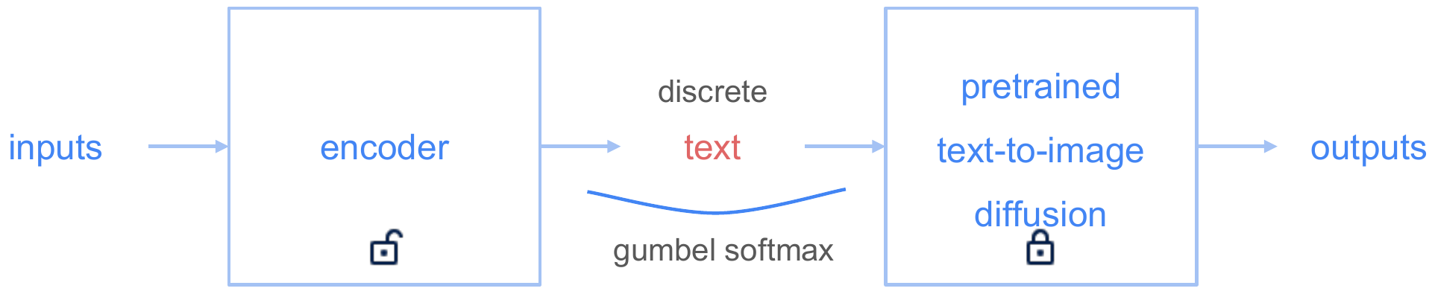
De-Diffusion
Discrete text tokens are trained with Gumbel softmax
π_{i}: the encoder's probability of word i; g_{i}: Gumbel noise; λ: a temperature, annealed from 2.0 to 0.3.
s is a soft one-hot vector that gradients can pass through; as λ → 0 it approaches a single word.
E. Jang, S. Gu and B. Poole, “Categorical reparameterization with Gumbel-softmax,” ICLR, 2017.
Generative Models · A. Yuille
27

Slide 28
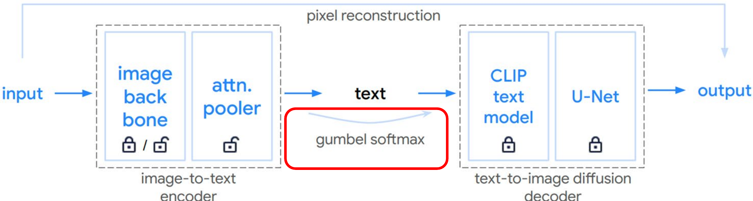
De-Diffusion
The encoder is an image backbone with an attentional pooler
Image backbone: a pretrained CoCa ViT-L, frozen by default; the paper also trains one from scratch.
Attentional pooler: 75 learned queries cross-attend to the image features; each query gives one word.
Its 75 words come from CLIP's vocabulary; with start and end they fill the 77-token text input.
Decoder: a 64 × 64 Imagen-style diffusion U-Net with a CLIP text model; training uses web images only.
C. Wei, C. Liu, S. Qiao, Z. Zhang, A. Yuille and J. Yu, “De-Diffusion makes text a strong cross-modal interface,” CVPR, 13492–13503, 2024.
C. Saharia, W. Chan, S. Saxena et al., “Photorealistic text-to-image diffusion models with deep language understanding,” NeurIPS,
36479–36494, 2022.
Generative Models · A. Yuille
28

Slide 29
Applications of De-Diffusion
5
De-Diffusion text prompts other text-to-image tools and lets text-only
language models answer questions about the image.
Generative Models · A. Yuille
29

Slide 30
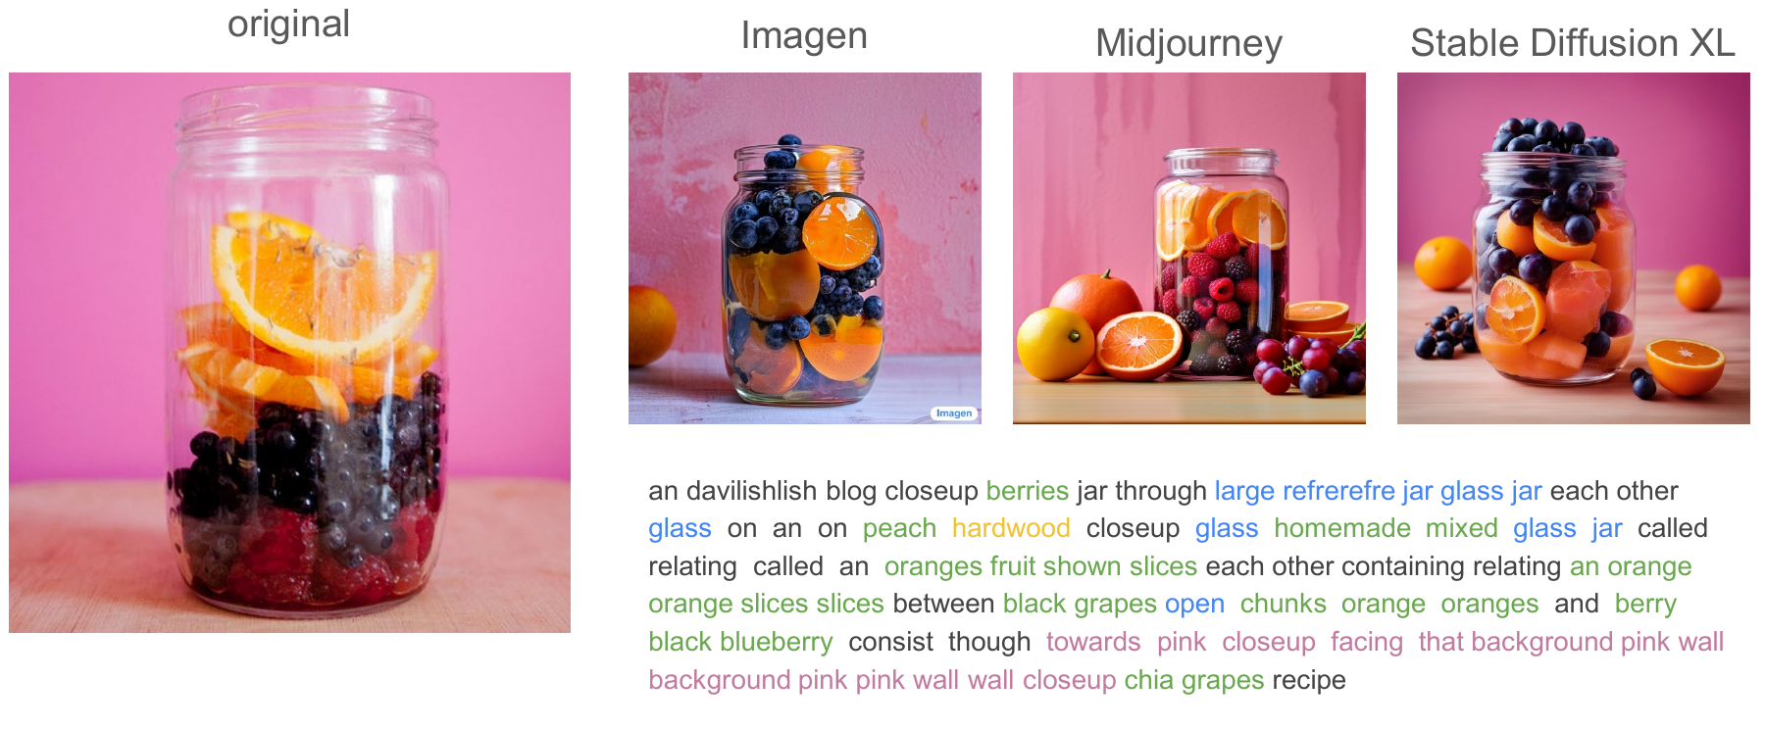
Applications of De-Diffusion
De-Diffusion text is a transferable text-to-image prompt
The text from one image is given to Imagen, Midjourney and Stable Diffusion XL.
Each tool redraws the glass jar of orange slices and berries in front of the pink wall.
C. Saharia, W. Chan, S. Saxena et al., “Photorealistic text-to-image diffusion models with deep language understanding,” NeurIPS,
36479–36494, 2022.
D. Podell, Z. English, K. Lacey et al., “SDXL: improving latent diffusion models for high-resolution image synthesis,” ICLR, 2024.
Generative Models · A. Yuille
30

Slide 31
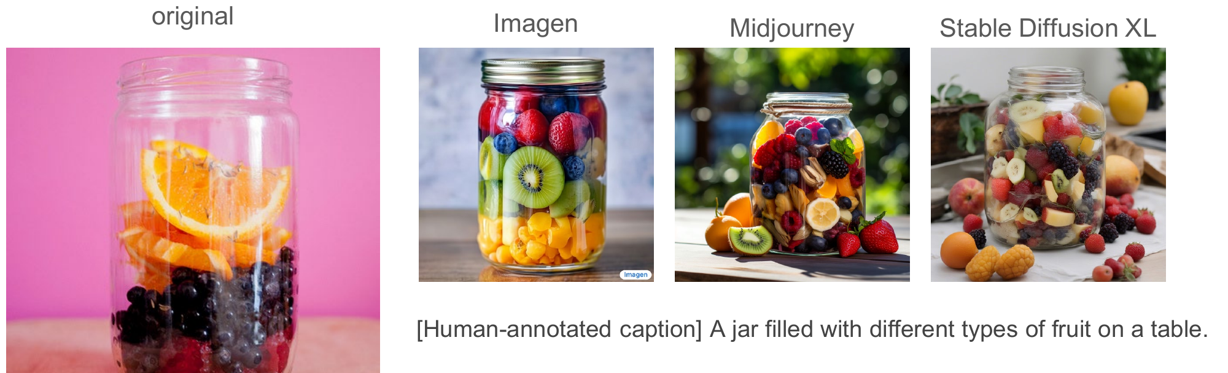
Applications of De-Diffusion
Human captions describe only the most salient content
The same three tools prompted with the human caption draw a jar of mixed fruit on a table.
The orange slices, the berries, the pink wall and the close-up view are lost.
Generative Models · A. Yuille
31

Slide 32
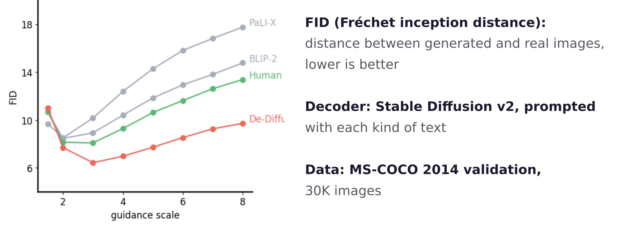
Applications of De-Diffusion
De-Diffusion text reconstructs better than captions
Stable Diffusion v2 redraws 30K MS-COCO images from each kind of text, at each guidance scale w.
From w = 2 on, De-Diffusion text gives the lowest FID; human, BLIP-2 and PaLI-X captions are higher.
M. Heusel, H. Ramsauer, T. Unterthiner, B. Nessler and S. Hochreiter, “GANs trained by a two time-scale update rule converge to a local
Nash equilibrium,” NeurIPS, 6626–6637, 2017.
Generative Models · A. Yuille
32

Slide 33
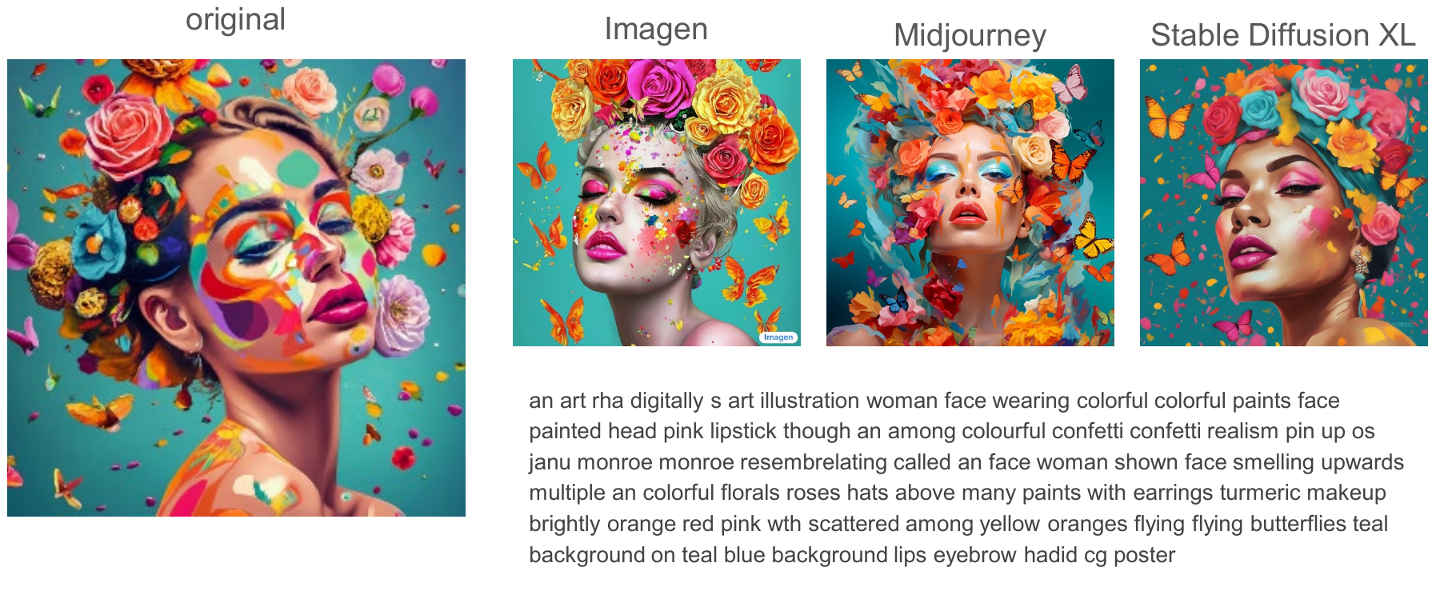
Applications of De-Diffusion
De-Diffusion text also prompts for synthetic images
The original is itself a generated picture; its text still transfers to the three tools.
The words name the style as well as the content: illustration, colorful paints, confetti, teal background.
Generative Models · A. Yuille
33

Slide 34
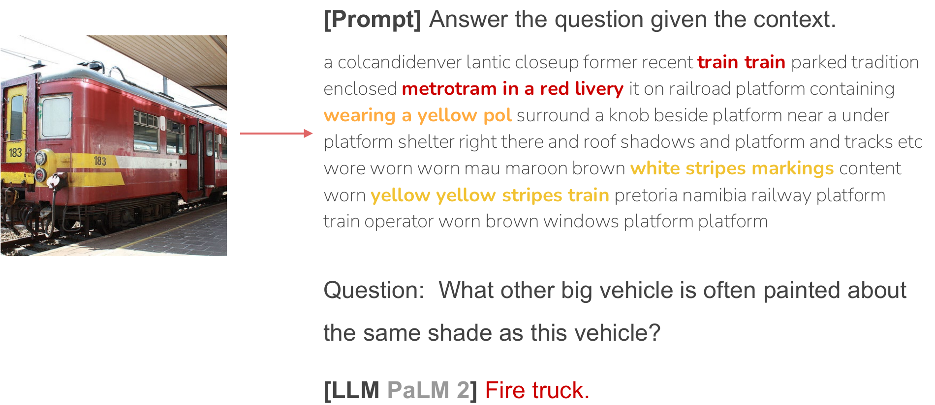
Applications of De-Diffusion
An LLM answers visual questions from De-Diffusion text
The prompt holds the image's De-Diffusion text as context, then the question.
PaLM 2, a text-only language model, answers “Fire truck”: it knows the color of fire trucks.
R. Anil, A. M. Dai, O. Firat et al., “PaLM 2 technical report,” arXiv:2305.10403, 2023.
Generative Models · A. Yuille
34

Slide 35
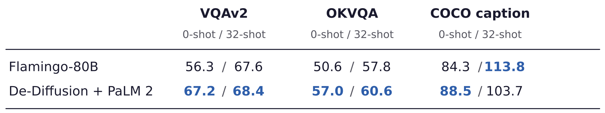
Applications of De-Diffusion
Text makes multimodal few-shot learning modular
Flamingo is trained on interleaved image-text data to answer from a few examples given in its prompt.
De-Diffusion with PaLM 2: the examples' text goes into the prompt of an LLM trained on text only.
Easy exploitation of advanced LLMs: just inference; easy data collection: just images.
J.-B. Alayrac, J. Donahue, P. Luc et al., “Flamingo: a visual language model for few-shot learning,” NeurIPS, 23716–23736, 2022.
C. Wei, C. Liu, S. Qiao, Z. Zhang, A. Yuille and J. Yu, “De-Diffusion makes text a strong cross-modal interface,” CVPR, 13492–13503, 2024.
Generative Models · A. Yuille
35

Slide 36
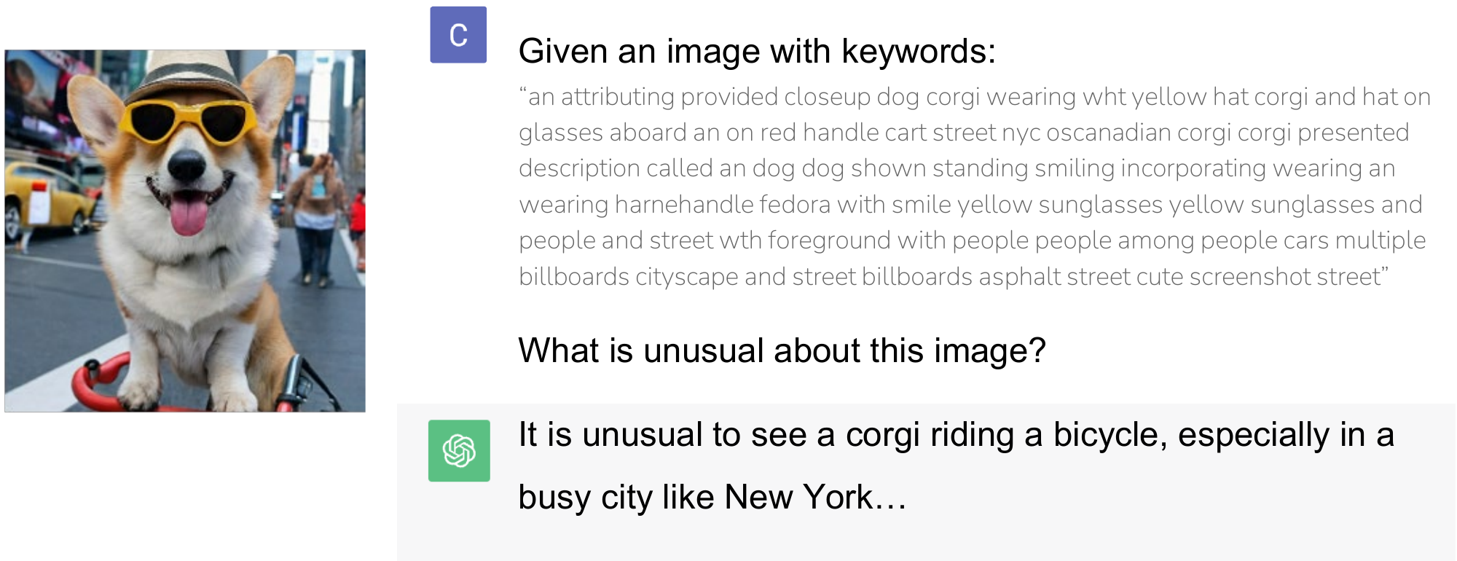
Applications of De-Diffusion
A text-only chatbot discusses the image through its text
ChatGPT receives the De-Diffusion text as keywords and is asked what is unusual about the image.
It answers that a corgi riding a bicycle in a busy city like New York is unusual.
Generative Models · A. Yuille
36

Slide 37
De-Diffusion V2
6
Continuous embeddings replace the discrete text, and an LLM decoder
turns them into readable captions; training costs far less.
Generative Models · A. Yuille
37

Slide 38
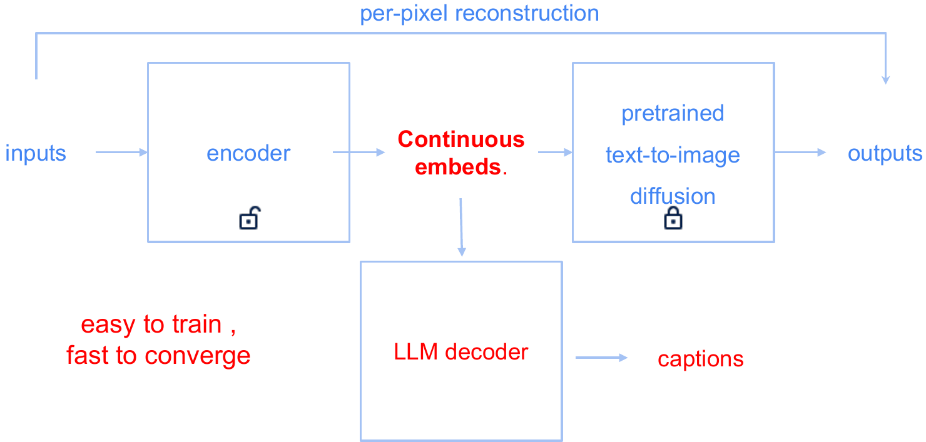
De-Diffusion V2
Continuous embeddings make training easy and fast
The discrete text of De-Diffusion, trained with Gumbel softmax, is hard to train and slow to converge.
V2 passes 77 continuous vectors in the text encoder's input space to the frozen diffusion decoder.
Published as the Vision-Language-Vision (VLV) auto-encoder (NeurIPS 2025).
T. Zhang, Y. Li, Y.-C. Chou, J. Chen, A. Yuille, C. Wei and J. Xiao, “Vision-language-vision auto-encoder: scalable knowledge distillation
from diffusion models,” NeurIPS, 2025.
Generative Models · A. Yuille
38

Slide 39
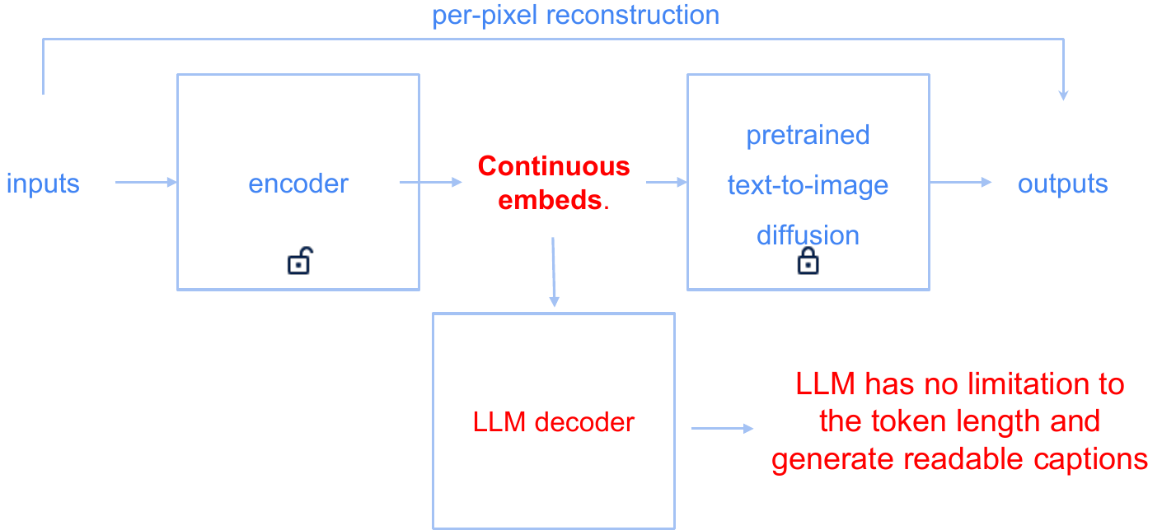
De-Diffusion V2
An LLM decoder writes readable captions of any length
Stage 2: a pretrained LLM (Qwen2.5) learns to turn the same embeddings into captions.
Training uses 40M images without text, then 6M images with captions written by Gemini 2.0 Flash.
The whole training costs under 1,000 US dollars, far less than De-Diffusion V1.
T. Zhang, Y. Li, Y.-C. Chou, J. Chen, A. Yuille, C. Wei and J. Xiao, “Vision-language-vision auto-encoder: scalable knowledge distillation
from diffusion models,” NeurIPS, 2025.
Qwen Team, A. Yang, B. Yang et al., “Qwen2.5 technical report,” arXiv:2412.15115, 2024.
Generative Models · A. Yuille
39

Slide 40
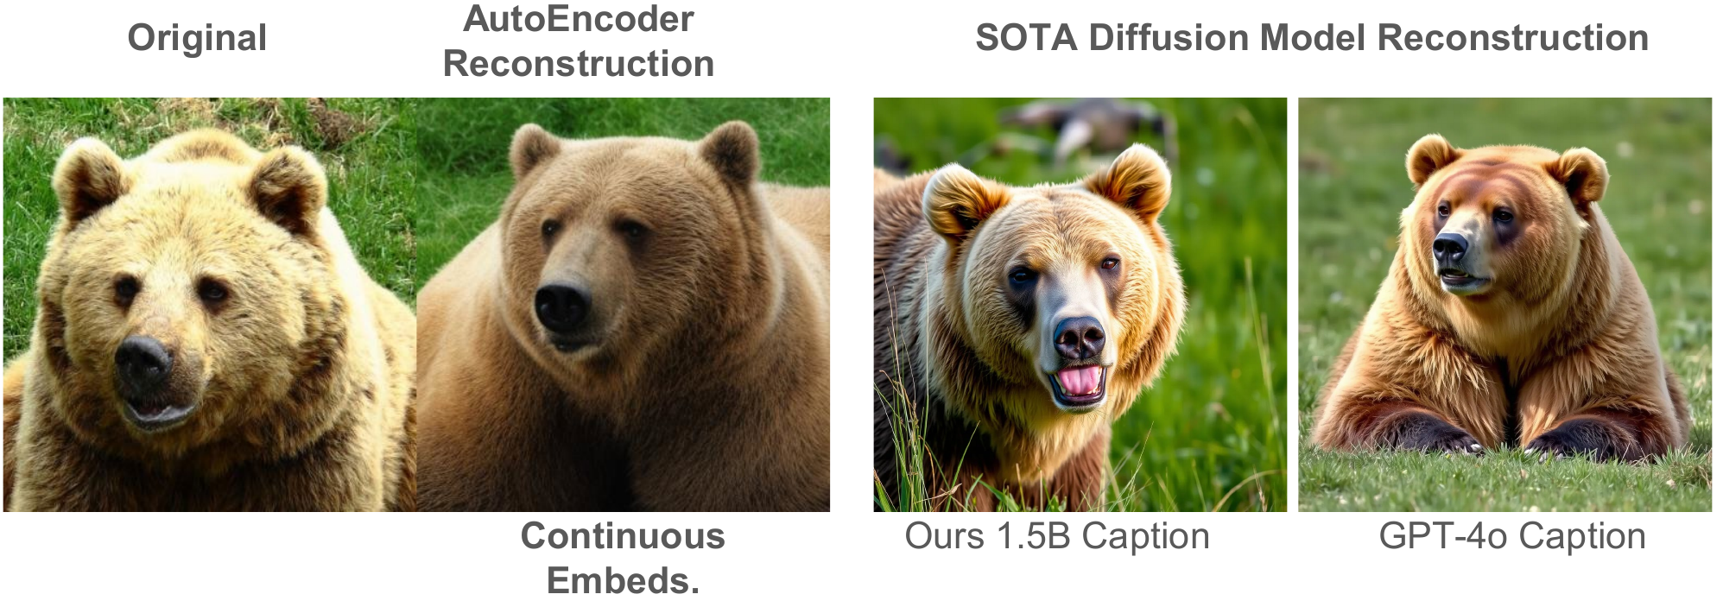
De-Diffusion V2
The captions are detailed enough to redraw the image
The autoencoder's reconstruction keeps the content (the bear's face in grass) but darkens the fur.
A diffusion model redraws the bear from the caption of V2's 1.5B captioner and from GPT-4o's.
T. Zhang, Y. Li, Y.-C. Chou, J. Chen, A. Yuille, C. Wei and J. Xiao, “Vision-language-vision auto-encoder: scalable knowledge distillation
from diffusion models,” NeurIPS, 2025.
Generative Models · A. Yuille
40

Slide 41
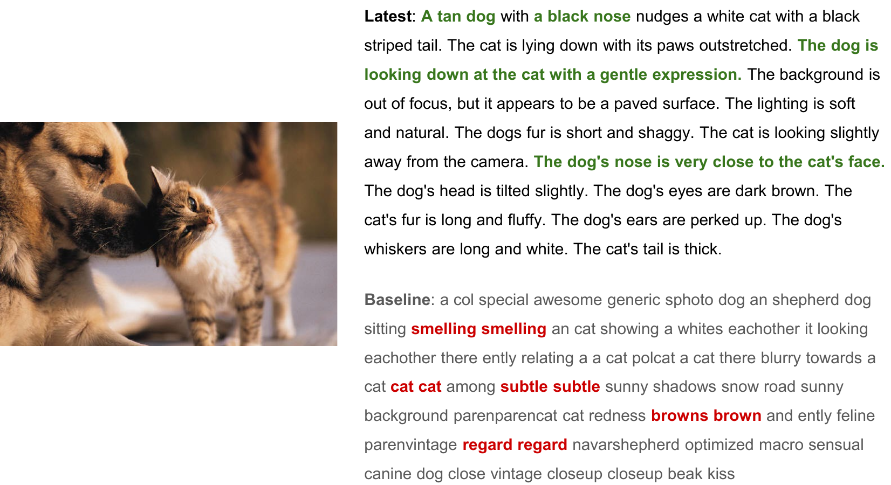
De-Diffusion V2
V2 captions are readable; De-Diffusion text is scrambled
Latest: the V2 caption, correct details in green; Baseline: De-Diffusion text, repeated words in red.
T. Zhang, Y. Li, Y.-C. Chou, J. Chen, A. Yuille, C. Wei and J. Xiao, “Vision-language-vision auto-encoder: scalable knowledge distillation
from diffusion models,” NeurIPS, 2025.
Generative Models · A. Yuille
41

Slide 42
De-Diffusion V2
Summary
Recap: a diffusion model's network estimates the posterior mean of the clean image.
Each step moves towards that guess: noisy gradient ascent on log p_t; guidance samples p(z) p(y | z)^w.
ControlNet adds edges, poses or depth by zero convolutions; prompt and control act as likelihoods.
De-Diffusion: an autoencoder with a frozen text-to-image decoder learns to write an image as text.
Its text prompts other text-to-image tools and lets text-only LLMs answer visual questions.
De-Diffusion V2 uses continuous embeddings and an LLM decoder for readable captions.
Generative Models · A. Yuille
42

