Slide 1
Bayes
Decision Theory
8 September, 2026
Alan Yuille · Probabilistic Models of the Visual Cortex

Slide 2
What this lecture covers
1
Bayes decision theory
2
Probabilities
Risk, loss, and the optimal rule
Likelihood, prior, posterior
3
The Bayes rule
4
Signal detection theory
MAP, ML, thresholds, likelihood ratios
Gaussians, d′, ROC curves
5
Learning the distributions
6
The limits of BDT
ML, MAP, empirical risk, CNNs
Where the framework breaks down
Bayes Decision Theory · A. Yuille
2

Slide 3
1
Bayes decision theory
A probability distribution, a set of decision rules, and a loss.
3

Slide 4
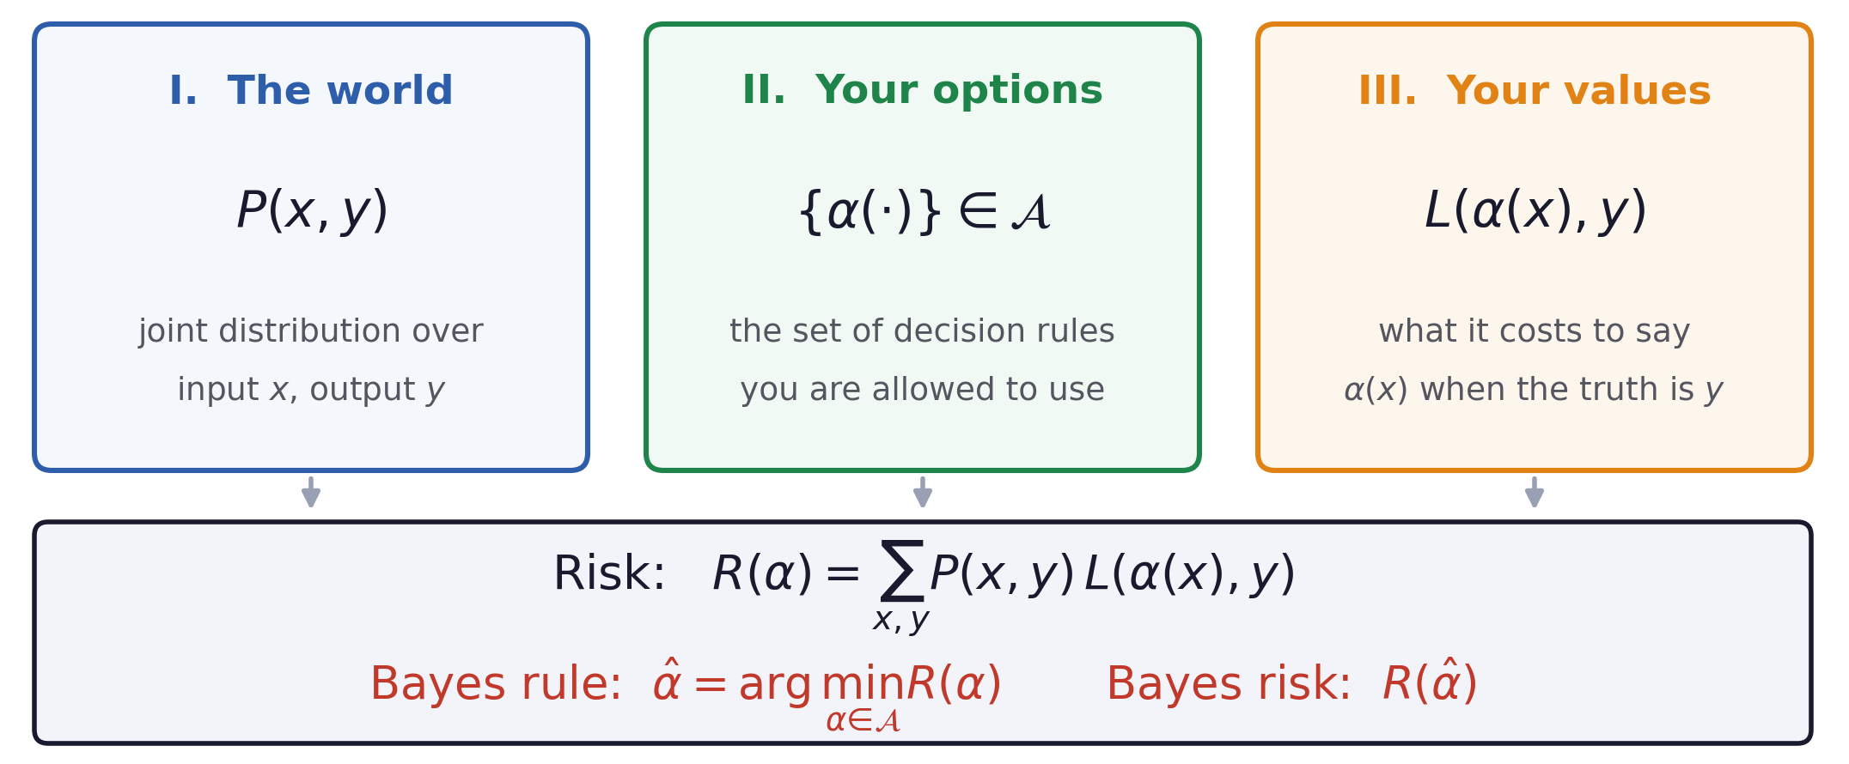
Bayes decision theory
The three ingredients
Only the first is empirical.
The other two are choices you must make.
Bayes Decision Theory · A. Yuille
4

Slide 5
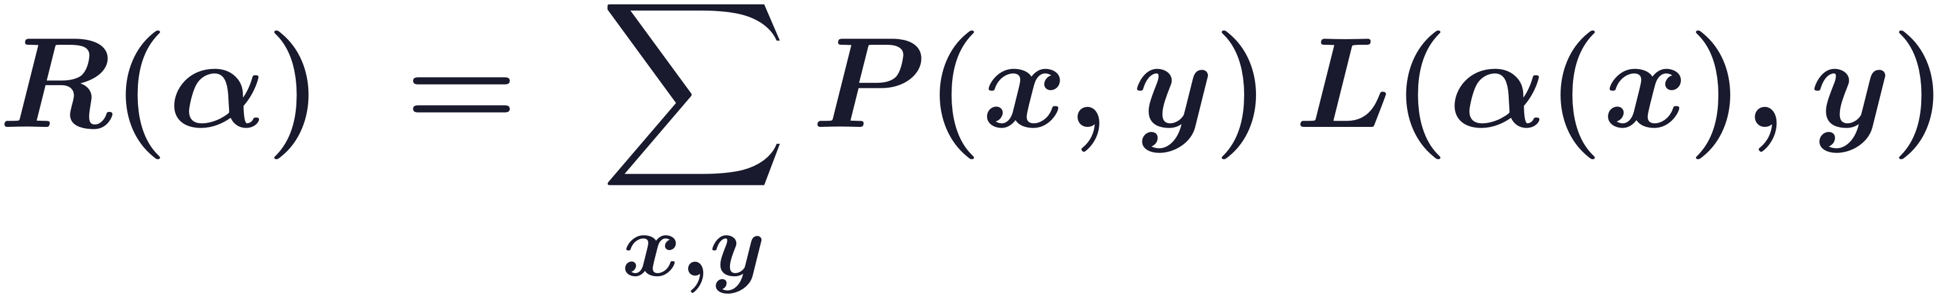
Bayes decision theory
Risk and the Bayes rule that minimises it
The risk is the average cost of a rule over all examples.
The Bayes risk is never zero, because decisions cannot be perfect.
Every visual tasks can be formalized with this formula, evaluated with different losses.
Bayes Decision Theory · A. Yuille
5
Notes:
$\displaystyle R(\alpha)\;=\;\sum_{x,y} P(x,y)\,L(\alpha(x),y)$
$\displaystyle \hat{\alpha}\;=\;\arg\min_{\alpha\in\mathcal{A}} R(\alpha)\qquad\quad \mathrm{Bayes\ risk}\;=\;R(\hat{\alpha})$

Slide 6
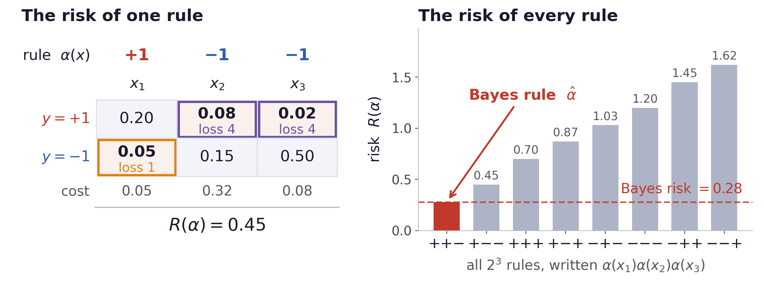
Bayes decision theory
An example of risk and decision rules
The Bayes rule is the one with the smallest risk among the 2^3 decision rules.
Imperfection of decisions keeps that risk above zero.
Bayes Decision Theory · A. Yuille
6
Notes:
Joint P(x,y) and losses are in figs.py (JOINT, L_FP, L_FN, RULE); every number on the slide is computed, not chosen.

Slide 7
2
Probabilities
Bayes’ theorem turns the likelihood and the prior into the posterior.
7

Slide 8
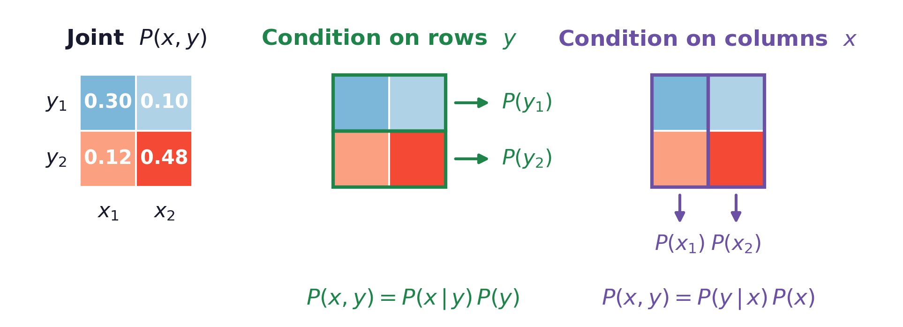
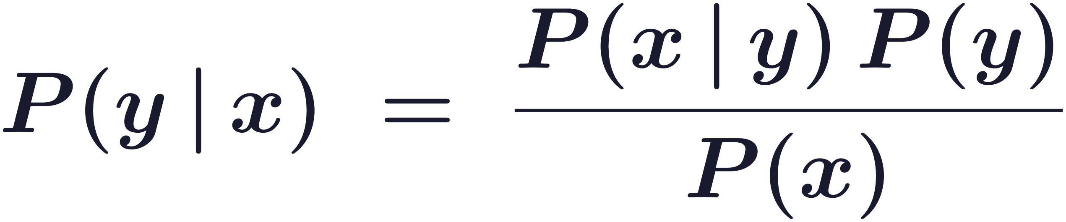
Probabilities
Two ways to represent the joint probability
Bayes’ theorem
The denominator P(x) just normalises it, It does not affect which y is probable.
Bayes Decision Theory · A. Yuille
8
Notes:
$\displaystyle P(y\,|\,x)\;=\;\frac{P(x\,|\,y)\,P(y)}{P(x)}$

Slide 9
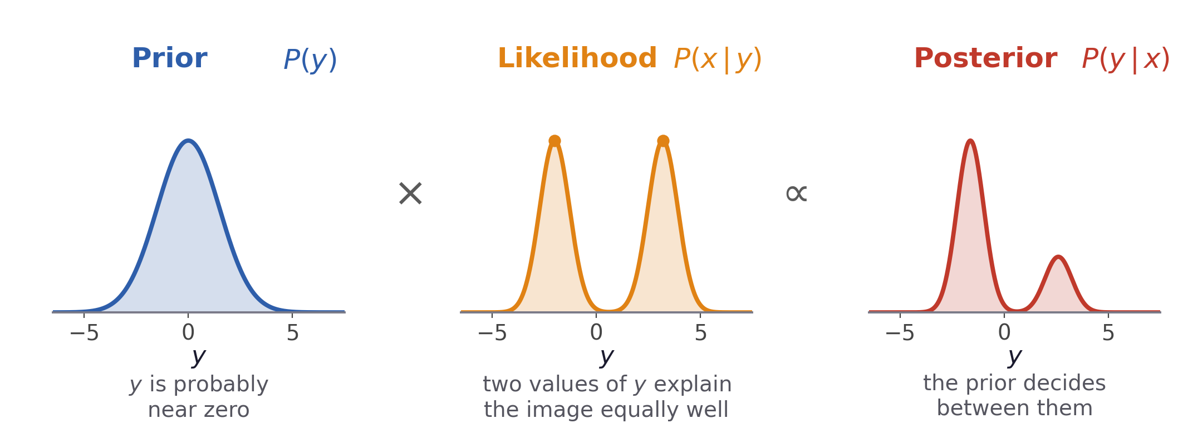
Probabilities
Likelihood, prior, posterior
P(x | y) is what this observation says about y.
P(y) is what you knew independently of the observation.
P(y | x) is your belief after combining the two.
Bayes Decision Theory · A. Yuille
9

Slide 10
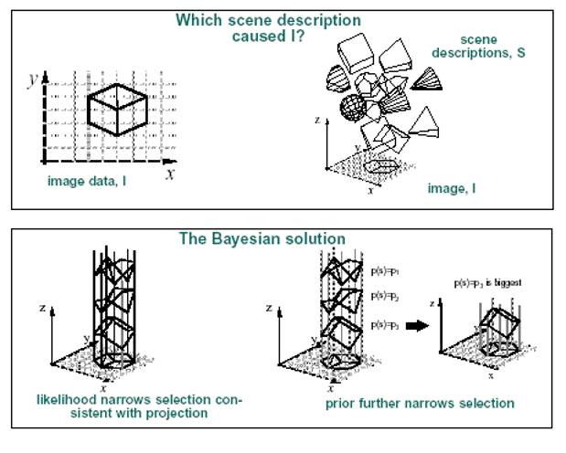
Probabilities
Why inverse problems need prior
In vision, P(I|W) is the probability of generating an image I from a world state W.
The forward process is what you can specify by computer graphics: geometry, lighting, projection and noise.
The inverse P(W|I) is posterior distribution of the world state but ill-posed.
Why a prior is needed
The prior P(W) supplies what the image alone leaves undetermined, making the inverse problem well posed.
Bayes Decision Theory · A. Yuille
10

Slide 11
3
The Bayes rule
From the posterior to a decision: MAP, ML, and the ratio test.
11

Slide 12
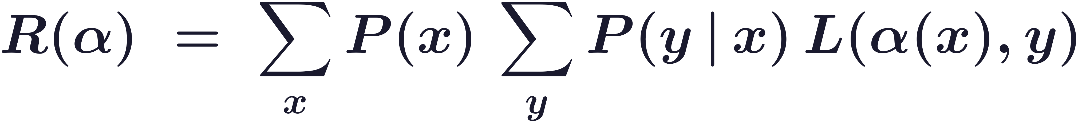
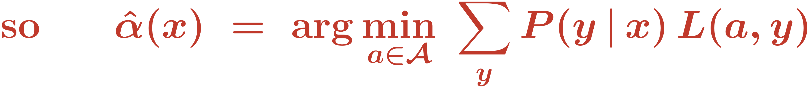
The Bayes rule
The rule depends only on the posterior
The inner sum minimises separately for each x, so the decision only depends on x.
Specifically, it only depends on the posterior distribution P(y|x).
Many researchers usually learn P(y|x) directly and skip the prior P(y) and likelihood P(x|y).
Bayes Decision Theory · A. Yuille
12
Notes:
$\displaystyle R(\alpha)\;=\;\sum_{x} P(x)\,\sum_{y} P(y\,|\,x)\,L(\alpha(x),y)$
$\displaystyle \mathrm{so}\qquad \hat{\alpha}(x)\;=\;\arg\min_{a\in\mathcal{A}}\;\sum_{y} P(y\,|\,x)\,L(a,y)$

Slide 13
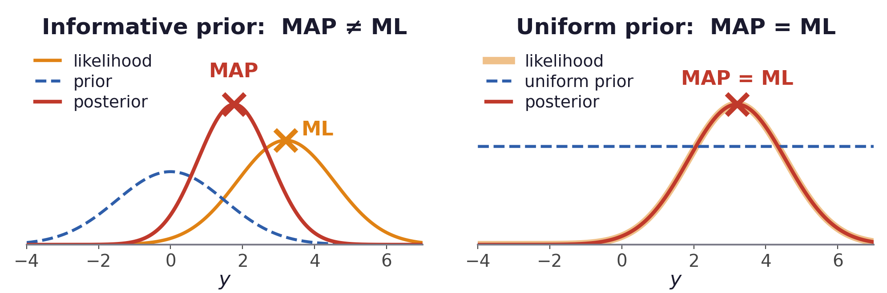
The Bayes rule
The two special cases: MAP and ML
Bayes Decision Theory · A. Yuille
13
Notes:
$\displaystyle \mathrm{equal\ costs}\;\longrightarrow\;\hat{\alpha}(x)=\arg\max_{y} P(y\,|\,x)\qquad \mathrm{MAP}$
$\displaystyle \mathrm{equal\ costs\ and\ a\ uniform\ prior}\;\longrightarrow\;\hat{\alpha}(x)=\arg\max_{y} P(x\,|\,y)\qquad \mathrm{ML}$
$\displaystyle \mathrm{equal\ costs}\;\longrightarrow\;\hat{\alpha}(x)=\arg\max_{y} P(y\,|\,x)\qquad \mathrm{MAP\ (maximum\ a\ posteriori)}$
$\displaystyle \mathrm{equal\ costs\ and\ a\ uniform\ prior}\;\longrightarrow\;\hat{\alpha}(x)=\arg\max_{y} P(x\,|\,y)\qquad \mathrm{ML\ (maximum\ likelihood)}$

Slide 14
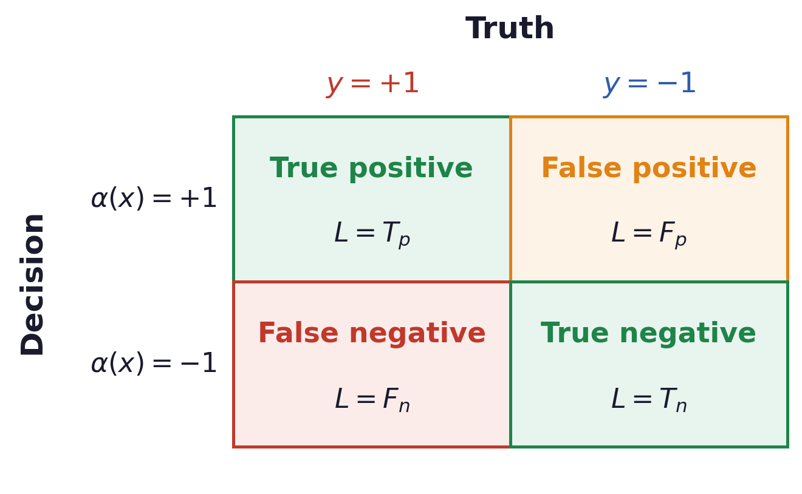
The Bayes rule
Targets, distractors, and four types of outcomes
By convention:
y = +1 is the target
y = −1 the distractor
Two types of errors:
False positive: you say target, the truth is distractor.
False negative: you say distractor, the truth is target.
Lowering one of the two error rates raises the other.
The outcome depends on the likelihood and the loss function.
Bayes Decision Theory · A. Yuille
14

Slide 15
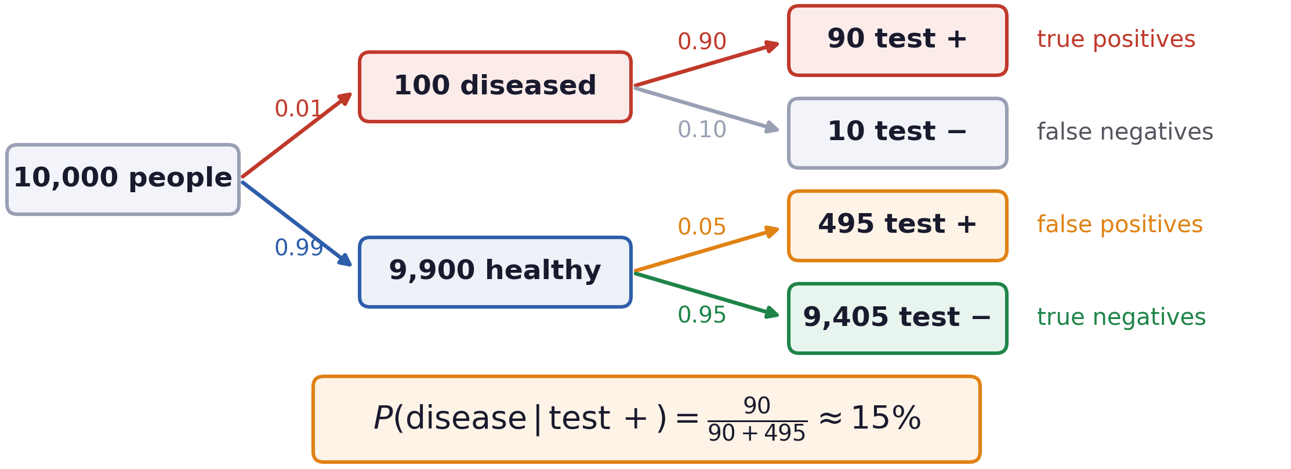
The Bayes rule
Worked example: why a positive test rarely means disease
90% sensitivity, 95% specificity, and a disease 1 person in 100 has.
When the disease is rare, most positive tests come from the healthy group.
Bayes Decision Theory · A. Yuille
15

Slide 16
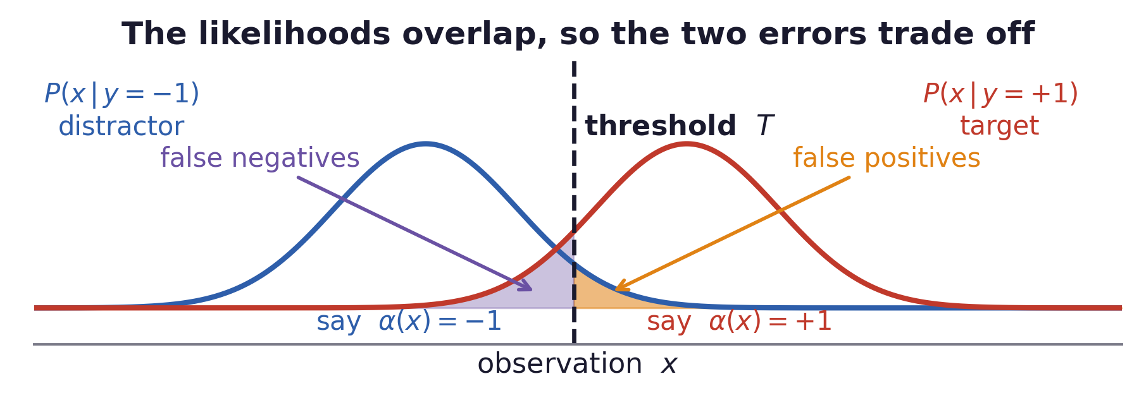
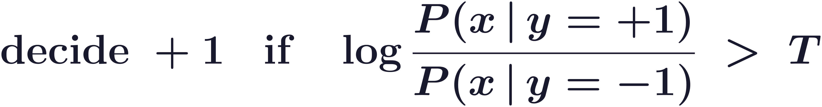
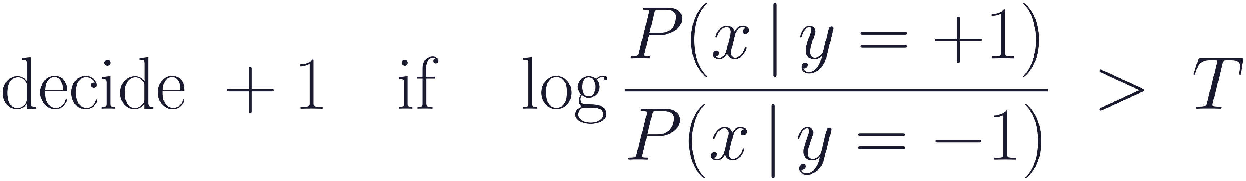
The Bayes rule
The Bayes rule is a log-likelihood ratio test
The scalar T is a function of Loss and prior.
Bayes Decision Theory · A. Yuille
16
Notes:
$\displaystyle \mathrm{decide}\;+1\quad \mathrm{if}\quad\log\frac{P(x\,|\,y=+1)}{P(x\,|\,y=-1)}\;>\;T$

Slide 17
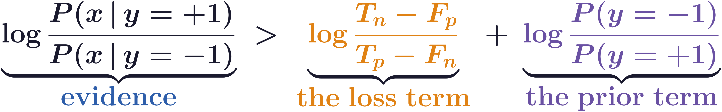
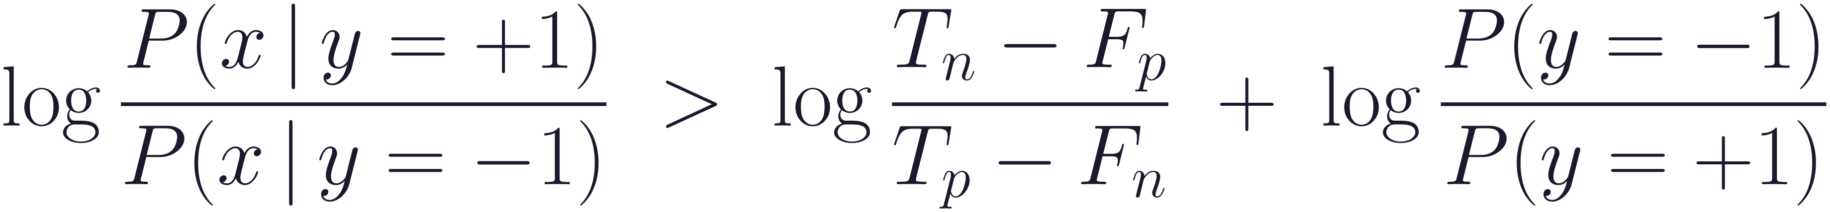
The Bayes rule
Where the threshold comes from
Evidence
The loss term
The prior term
What this observation says.
Computed from the two likelihoods alone.
How much worse a miss is than a false alarm.
This lowers T when misses are costly.
How rare the target was before you looked.
This raises T when targets are rare.
Bayes Decision Theory · A. Yuille
17
Notes:
$\displaystyle \log\frac{P(x\,|\,y=+1)}{P(x\,|\,y=-1)}\;>\;\log\frac{T_n-F_p}{T_p-F_n}\;+\;\log\frac{P(y=-1)}{P(y=+1)}$
$\displaystyle \underbrace{\log\frac{P(x\,|\,y=+1)}{P(x\,|\,y=-1)}}_{\textstyle\color{ev}\mathrm{evidence}}\;>\;\underbrace{\color{ls}\log\frac{T_n-F_p}{T_p-F_n}}_{\textstyle\color{ls}\mathrm{the\ loss\ term}}\;+\;\underbrace{\color{pr}\log\frac{P(y=-1)}{P(y=+1)}}_{\textstyle\color{pr}\mathrm{the\ prior\ term}}$

Slide 18
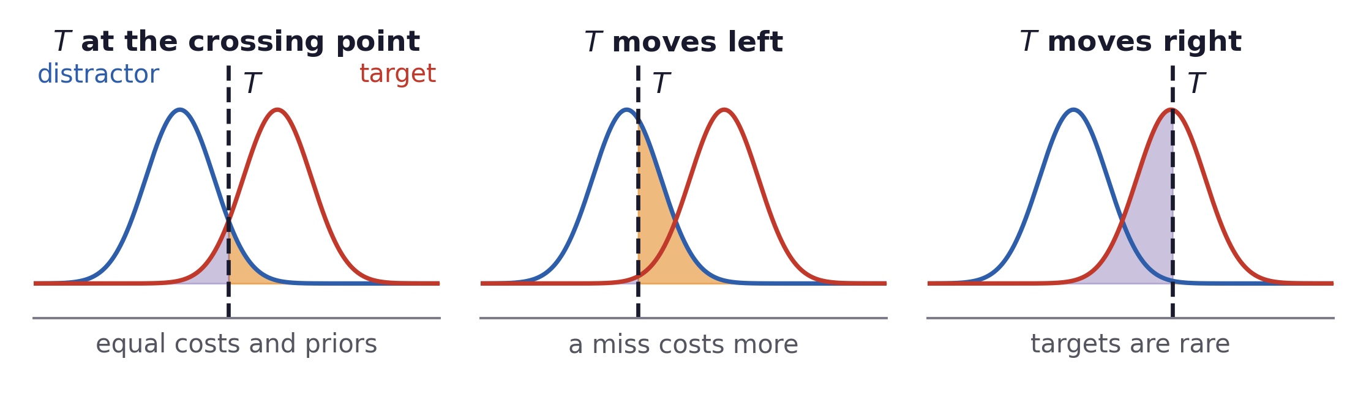
The Bayes rule
Moving the threshold, and what it costs
Moving T trades one shaded area for the other.
Bayes Decision Theory · A. Yuille
18

Slide 19
4
Signal detection theory
What the ratio test becomes when the likelihoods are Gaussian.
19

Slide 20
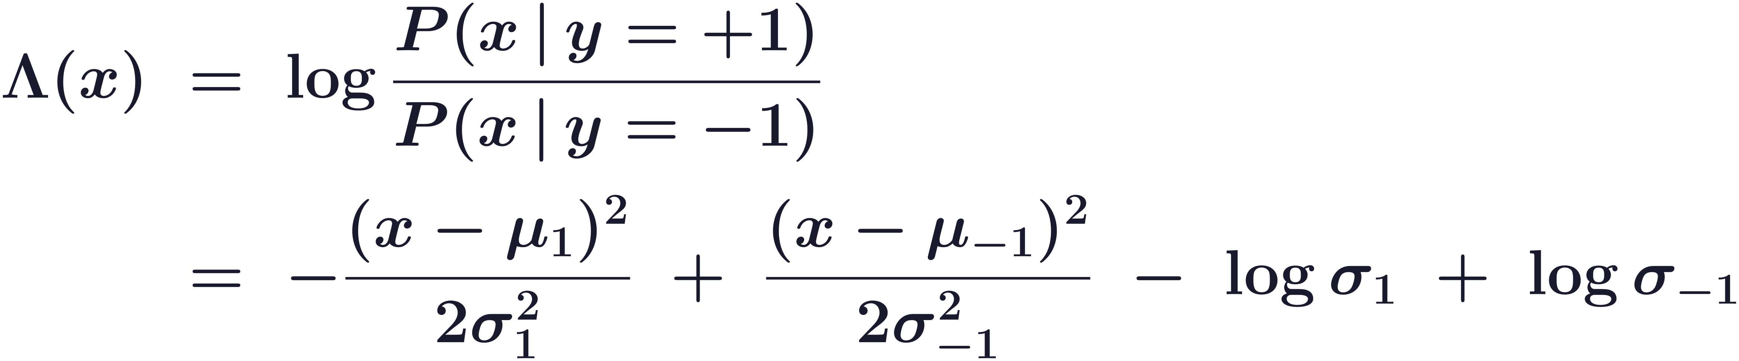
Signal detection theory
Gaussian likelihoods give a quadratic decision rule
A classic book Signal detection theory and psychophysics (Green & Swets, 1966) modelled the observer as a Bayesian decision maker.
The likelihoods are assumed Gaussian, differing in their means and in their variances.
Substituting the two Gaussians into the log-likelihood ratio gives a quadratic polynomial in x.
Bayes Decision Theory · A. Yuille
20
Notes:
$\displaystyle \begin{aligned}\Lambda(x)\;&=\;\log\frac{P(x\,|\,y=+1)}{P(x\,|\,y=-1)}\\[7pt]&=\;-\frac{(x-\mu_{1})^{2}}{2\sigma_{1}^{2}}\;+\;\frac{(x-\mu_{-1})^{2}}{2\sigma_{-1}^{2}}\;-\;\log\sigma_{1}\;+\;\log\sigma_{-1}\end{aligned}$

Slide 21
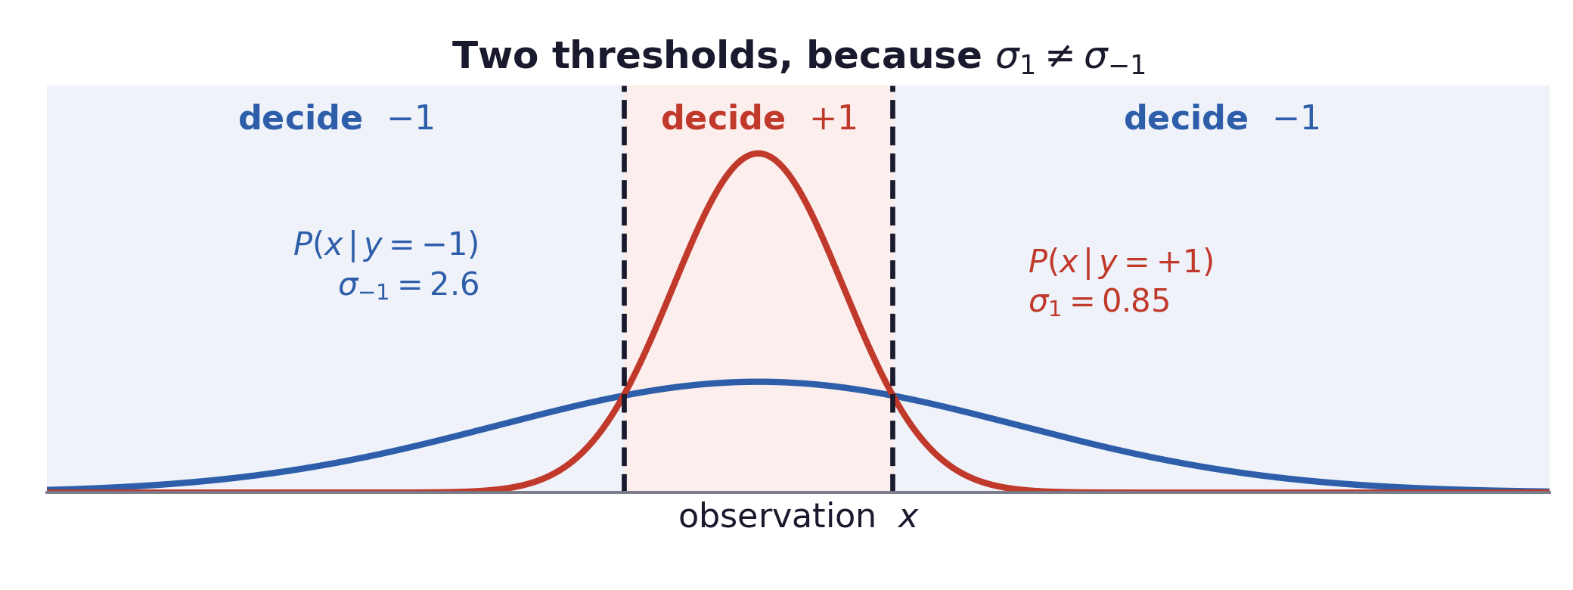
Signal detection theory
Unequal variances give two thresholds
An extreme observation is evidence for the class with the larger variance.
Bayes Decision Theory · A. Yuille
21

Slide 22
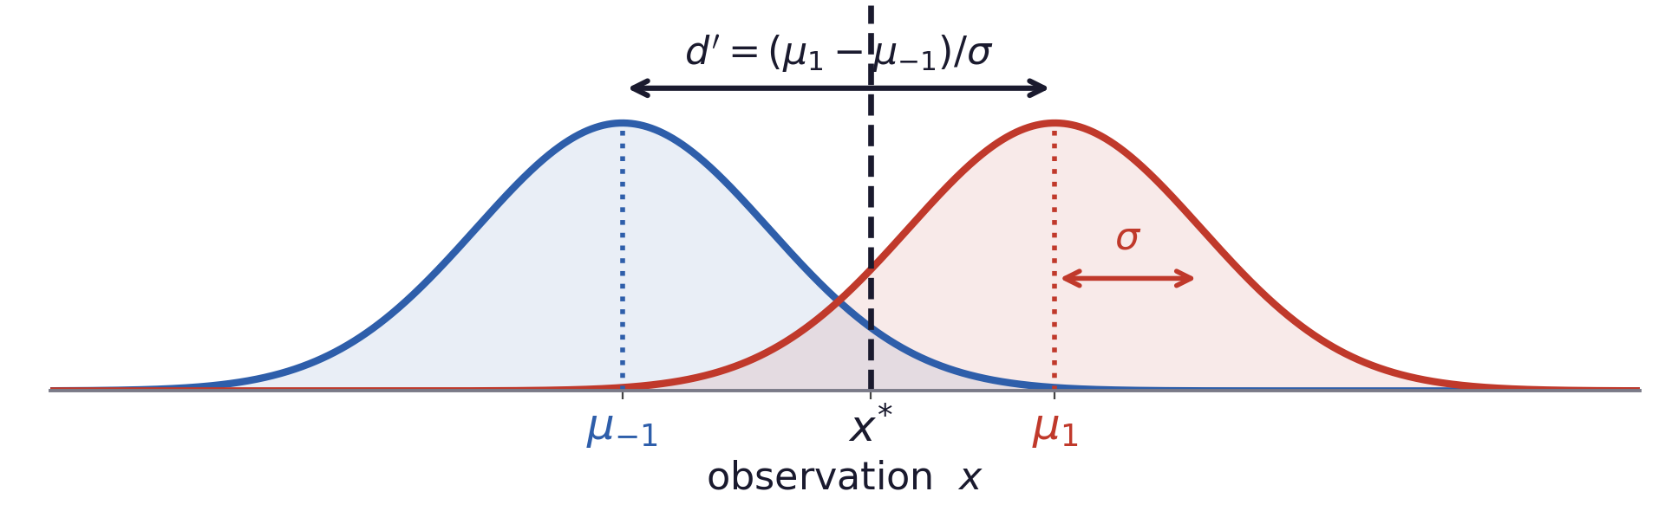
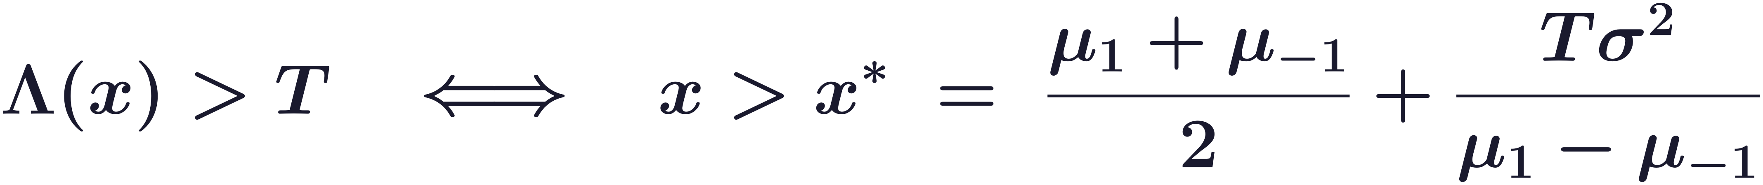
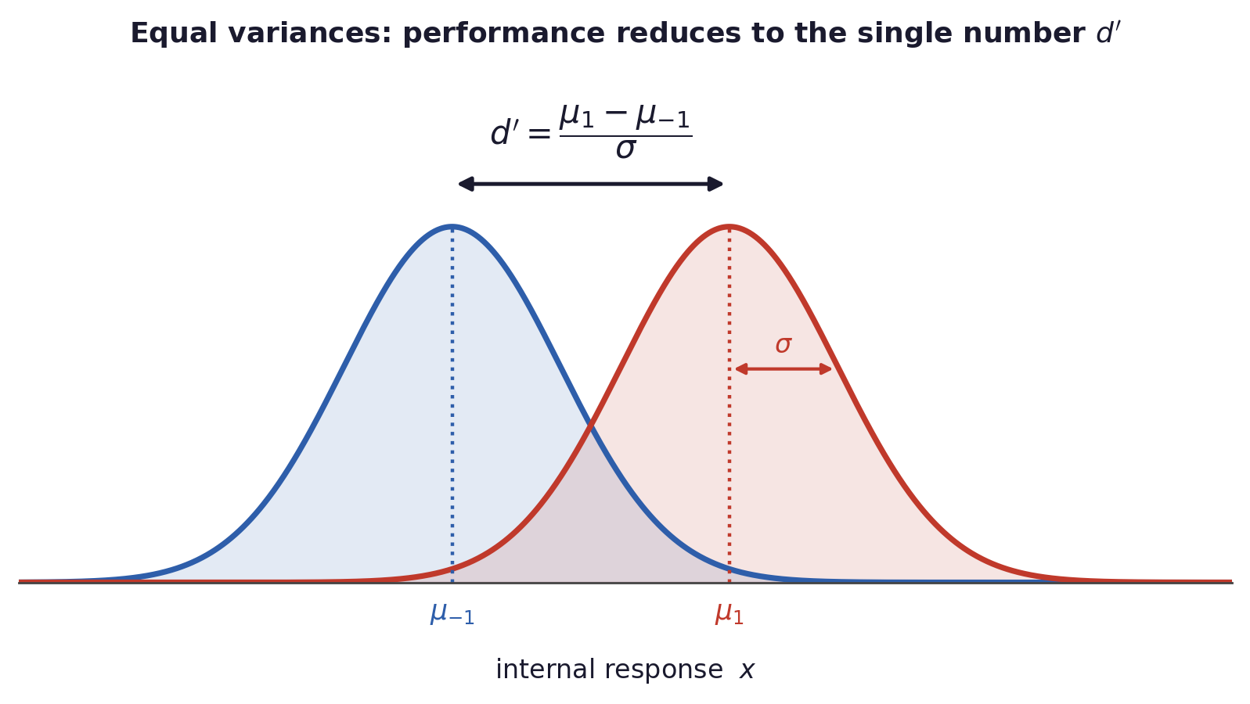
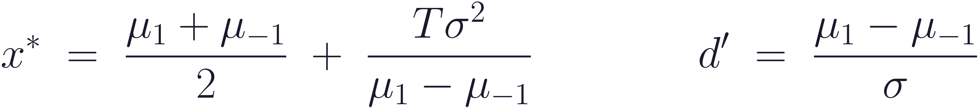
Signal detection theory
Equal variances: everything reduces to d′
Bayes Decision Theory · A. Yuille
22
Notes:
$\displaystyle x^{*}\;=\;\frac{\mu_{1}+\mu_{-1}}{2}\;+\;\frac{T\sigma^{2}}{\mu_{1}-\mu_{-1}}\qquad\qquad d'\;=\;\frac{\mu_{1}-\mu_{-1}}{\sigma}$
$\displaystyle \Lambda(x)\;=\;\frac{\mu_{1}-\mu_{-1}}{\sigma^{2}}\left(x-\frac{\mu_{1}+\mu_{-1}}{2}\right)\qquad \mathrm{when}\ \sigma_{1}=\sigma_{-1}=\sigma$
$\displaystyle \Lambda(x)>T\quad\Longleftrightarrow\quad x>x^{*}\;=\;\frac{\mu_{1}+\mu_{-1}}{2}+\frac{T\sigma^{2}}{\mu_{1}-\mu_{-1}}$
$\displaystyle d'\;=\;\frac{\mu_{1}-\mu_{-1}}{\sigma}\qquad \mathrm{the\ separation\ measured\ in\ units\ of\ }\sigma$

Slide 23
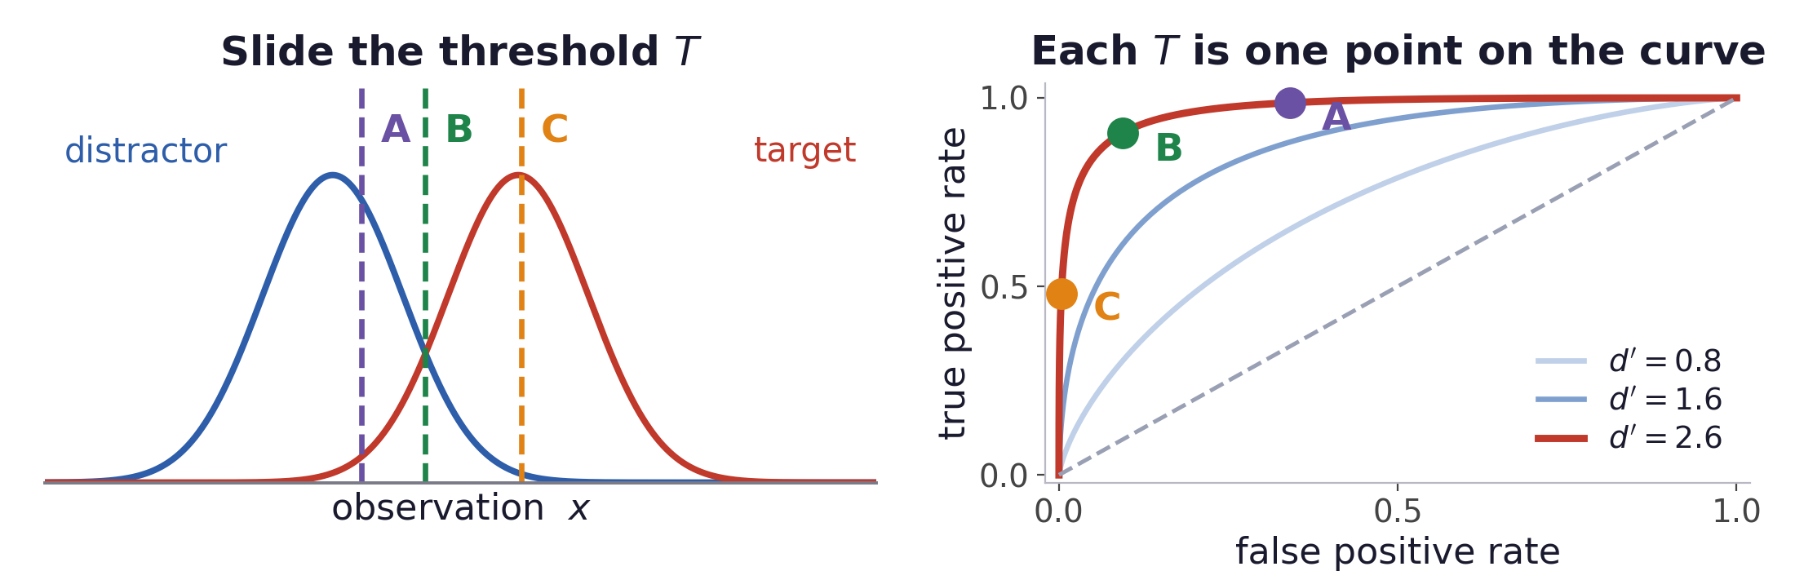
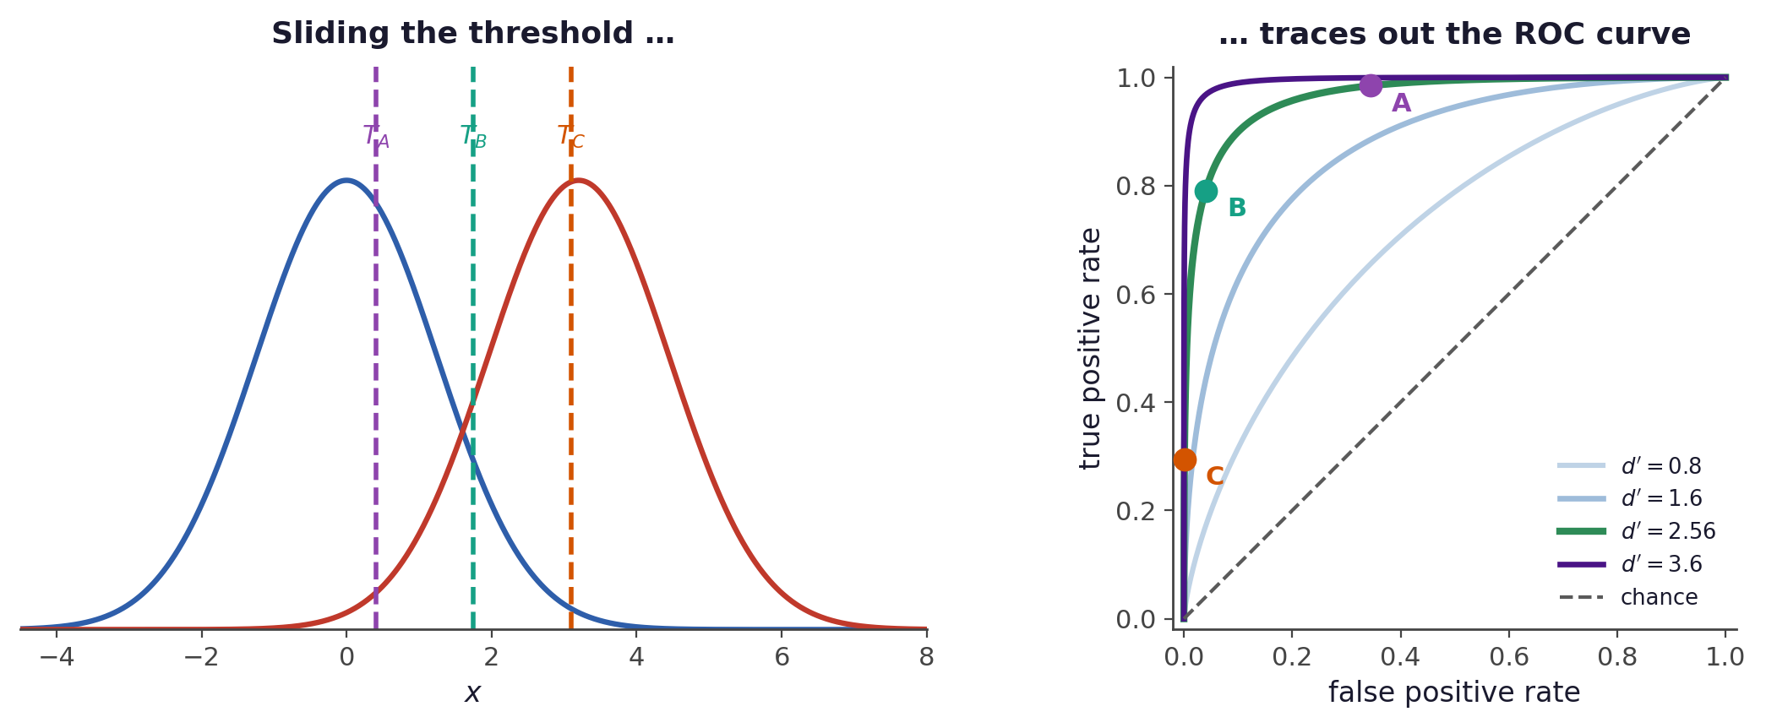
Signal detection theory
Sweeping the threshold traces the ROC curve
Left: each threshold T keeps a different fraction of each density.
Right: that pair of fractions is one point, and sweeping T traces the curve.
d′ fixes which curve you are on, and T picks the point on it.
Bayes Decision Theory · A. Yuille
23
Notes:
$\displaystyle H(T)=\int_{T}^{\infty}\! P(x\,|\,y=+1)\,dx\qquad\quad F(T)=\int_{T}^{\infty}\! P(x\,|\,y=-1)\,dx$

Slide 24
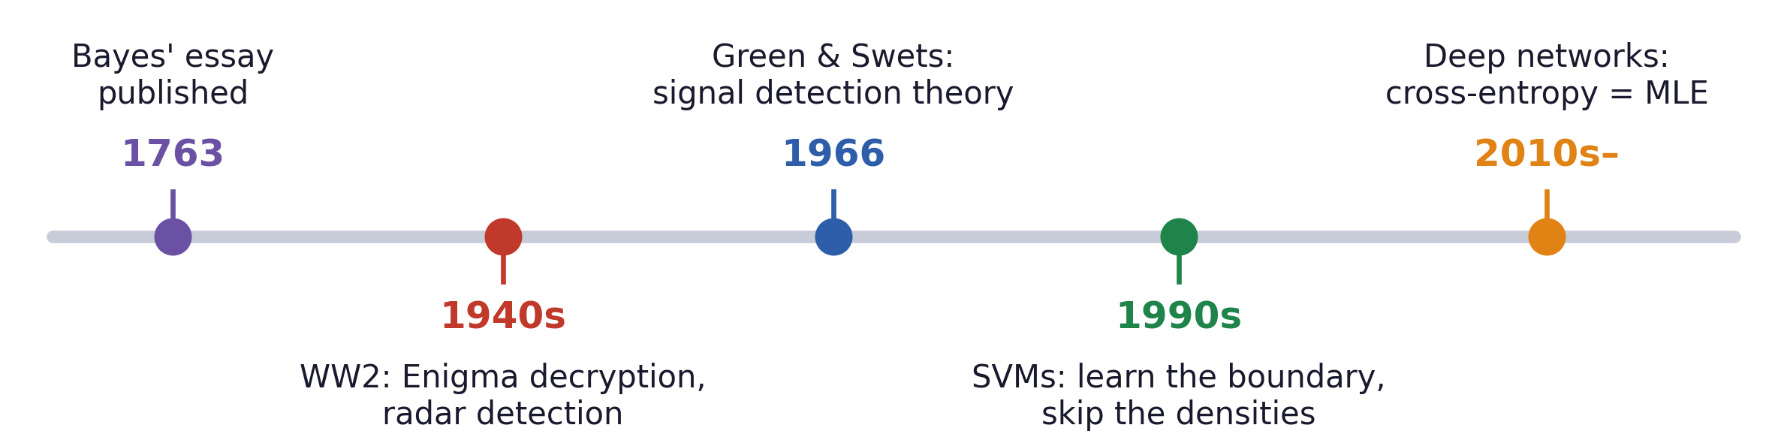
Signal detection theory
Where the theory came from
Wartime code-breaking and radar; then psychophysics; then machine learning.
Bayes Decision Theory · A. Yuille
24

Slide 25
5
Learning the distributions
Estimate the distributions, or the decision rule, from N samples.
25

Slide 26
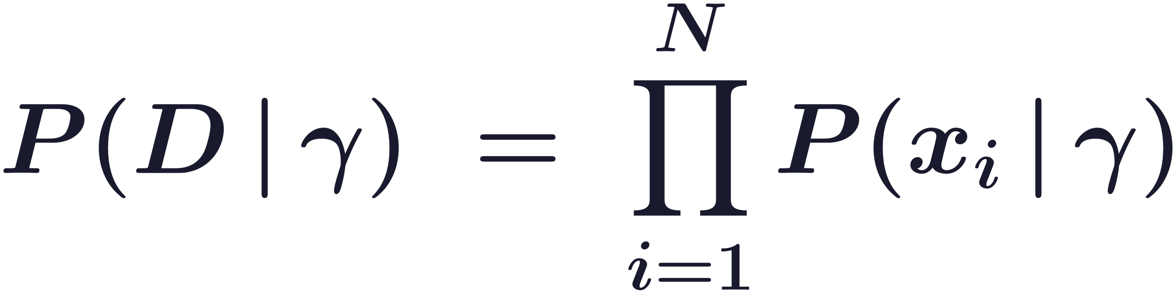
Learning the distributions
From hand-designed distributions to learned ones
Until now P(x | y) and P(y) were assumed known.
Assume a functional form P(x | γ) and estimate γ from a set D of N observed samples.
Assume too that the data are independent and identically distributed (i.i.d.).
What maximising the likelihood does
P(D | γ) is the probability of the whole data set under a particular γ.
Estimating γ means picking the value that makes the observed data most probable.
Bayes Decision Theory · A. Yuille
26
Notes:
$\displaystyle P(D\,|\,\gamma)\;=\;\prod_{i=1}^{N} P(x_i\,|\,\gamma)$

Slide 27
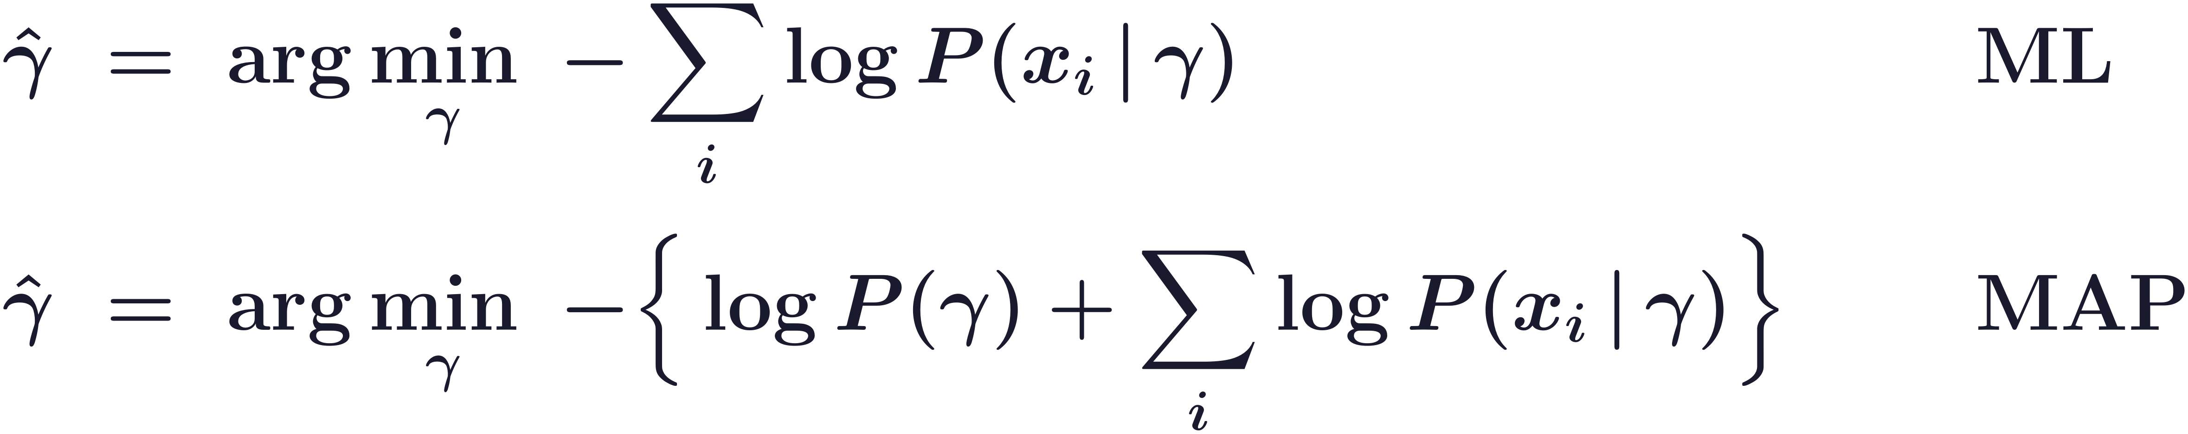
Learning the distributions
Maximum likelihood, and what a prior adds
ML is Bayes decision theory with a uniform prior over γ and all errors penalised equally.
One prior term against N data terms, so the prior’s influence shrinks like 1/N.
You can learn by only a few example with a sophisticated prior (cognitive science theory for small N).
Bayes Decision Theory · A. Yuille
27
Notes:
$\displaystyle \begin{aligned}\hat{\gamma}\;&=\;\arg\min_{\gamma}\;-\sum_{i}\log P(x_i\,|\,\gamma)&&\qquad \mathrm{ML}\\[7pt]\hat{\gamma}\;&=\;\arg\min_{\gamma}\;-\Big\{\log P(\gamma)+\sum_{i}\log P(x_i\,|\,\gamma)\Big\}&&\qquad \mathrm{MAP}\end{aligned}$

Slide 28
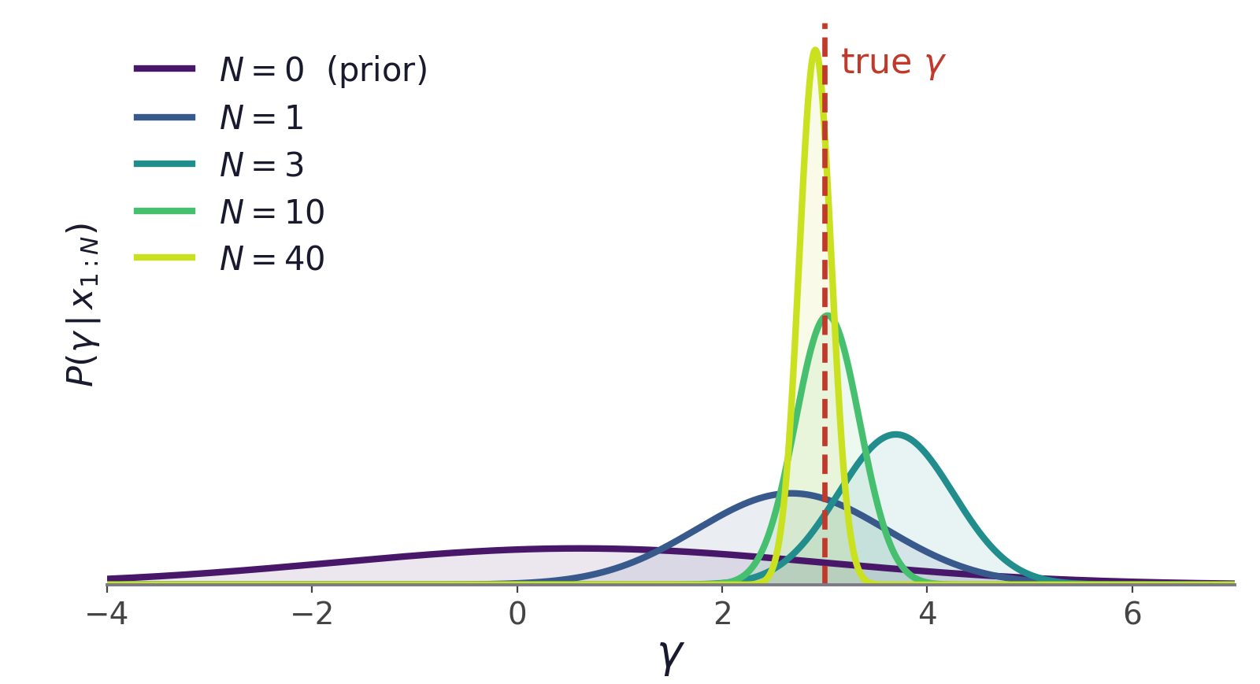
Learning the distributions
Evidence accumulates and the prior’s influence falls
On priors
With one or three observations the posterior is broad, and the prior still shifts where it sits.
By forty observations the data has decided, and the choice of prior no longer matters.
Statisticians resisted Bayesian methods because the prior is a choice; I. J. Good and Turing used them anyway.
Bayes Decision Theory · A. Yuille
28

Slide 29
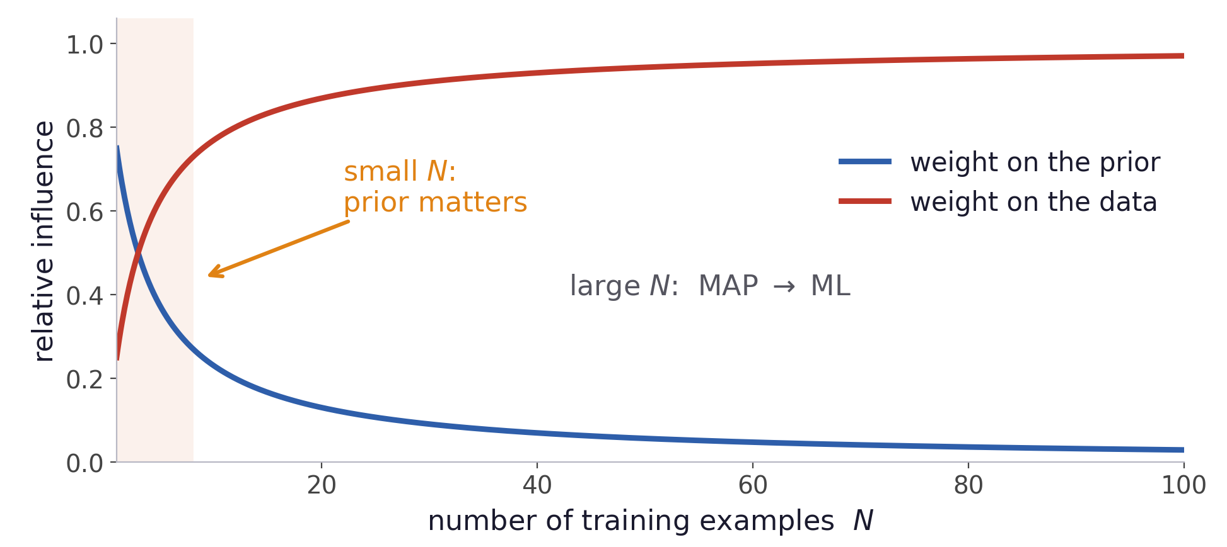
Learning the distributions
The prior matters only when data is scarce
A good prior makes you learn with less data
Bayes Decision Theory · A. Yuille
29

Slide 30
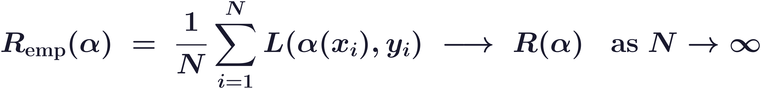
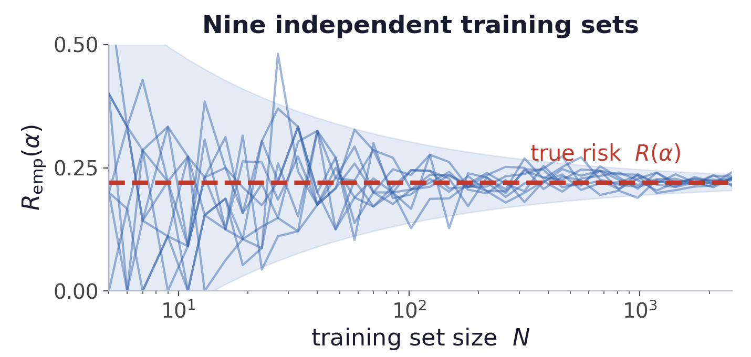
Learning the distributions
Learn the decision rule directly
Advocates argue that data is precious and should not be spent estimating distributions when only a rule is wanted.
The true joint P(x, y) is unknown, so the sample average of the loss replaces the expectation over it.
The sample average converges to the true risk when the samples are i.i.d.
Bayes Decision Theory · A. Yuille
30
Notes:
$\displaystyle R_{\mathrm{emp}}(\alpha)\;=\;\frac{1}{N}\sum_{i=1}^{N} L(\alpha(x_i),y_i)\;\longrightarrow\;R(\alpha)\quad \mathrm{as}\ N\to\infty$

Slide 31
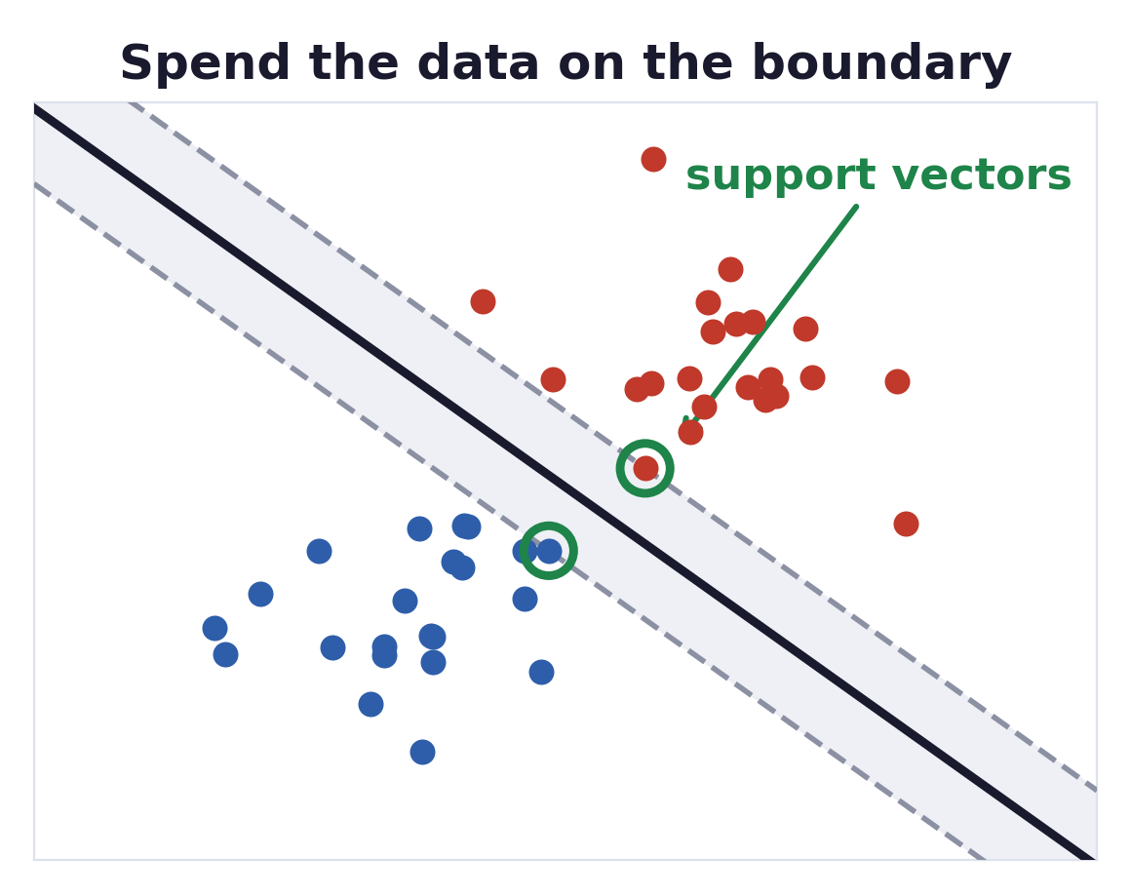
Learning the distributions
Support vector machines
The argument is that estimating probabilities is wasteful: go straight for the boundary.
The boundary is fixed by a handful of points, the support vectors.
Everything far from the margin could be deleted without changing the answer.
The result is an efficient classifier that carries no model of how the data were generated.
Bayes Decision Theory · A. Yuille
31

Slide 32
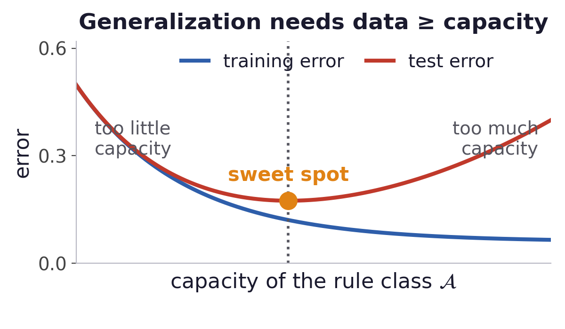
Learning the distributions
PAC theory: capacity and generalization
PAC gives an upper bound on the data needed for the estimated rule to be close to the best rule in the class.
You need more data than the capacity of the rule class, and regularization reduces that capacity.
The bounds are loose, and capacity is hard to measure except for simple rules.
Bayes Decision Theory · A. Yuille
32

Slide 33
Learning the distributions
Learning the posterior directly is what CNNs do
A CNN is a parameterised family of distributions P(y | x ; θ).
With no prior on θ and equal costs, Bayes decision theory recommends maximum likelihood, which is the cross-entropy loss.
Asymmetric losses appear where they should: edge detection penalises a missed edge more.
Over-parameterised networks can fit random labels and still generalize, which PAC capacity bounds do not explain.
Zhang, Bengio, Hardt, Recht & Vinyals, Understanding Deep Learning Requires Rethinking Generalization, ICLR 2017.
Bayes Decision Theory · A. Yuille
33
Notes:
$\displaystyle \hat{\alpha}(x)=\arg\max_{y} P(y\,|\,x;\theta)\qquad\qquad \hat{\theta}=\arg\min_{\theta}\;-\sum_{i}\log P(y_i\,|\,x_i;\theta)$

Slide 34
6
The limits of BDT
Every guarantee so far assumed an average over one fixed P(x, y).
34

Slide 35
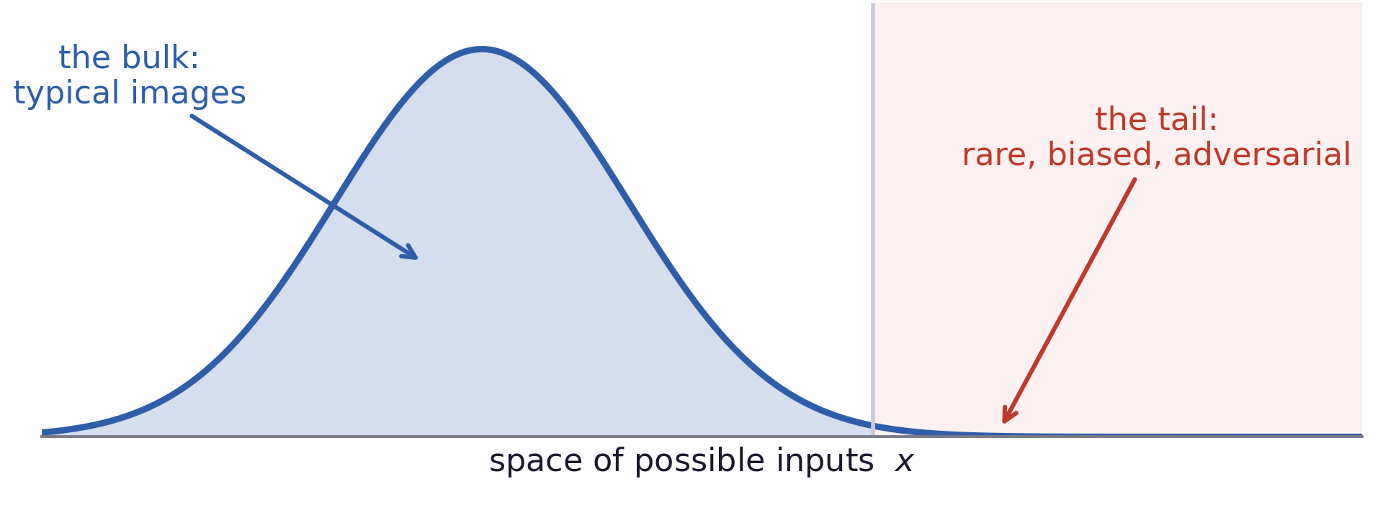
The limits of BDT
BDT measures performance by the average case
A rule can be optimal on average and still fail on every case that matters.
Bayes Decision Theory · A. Yuille
35

Slide 36
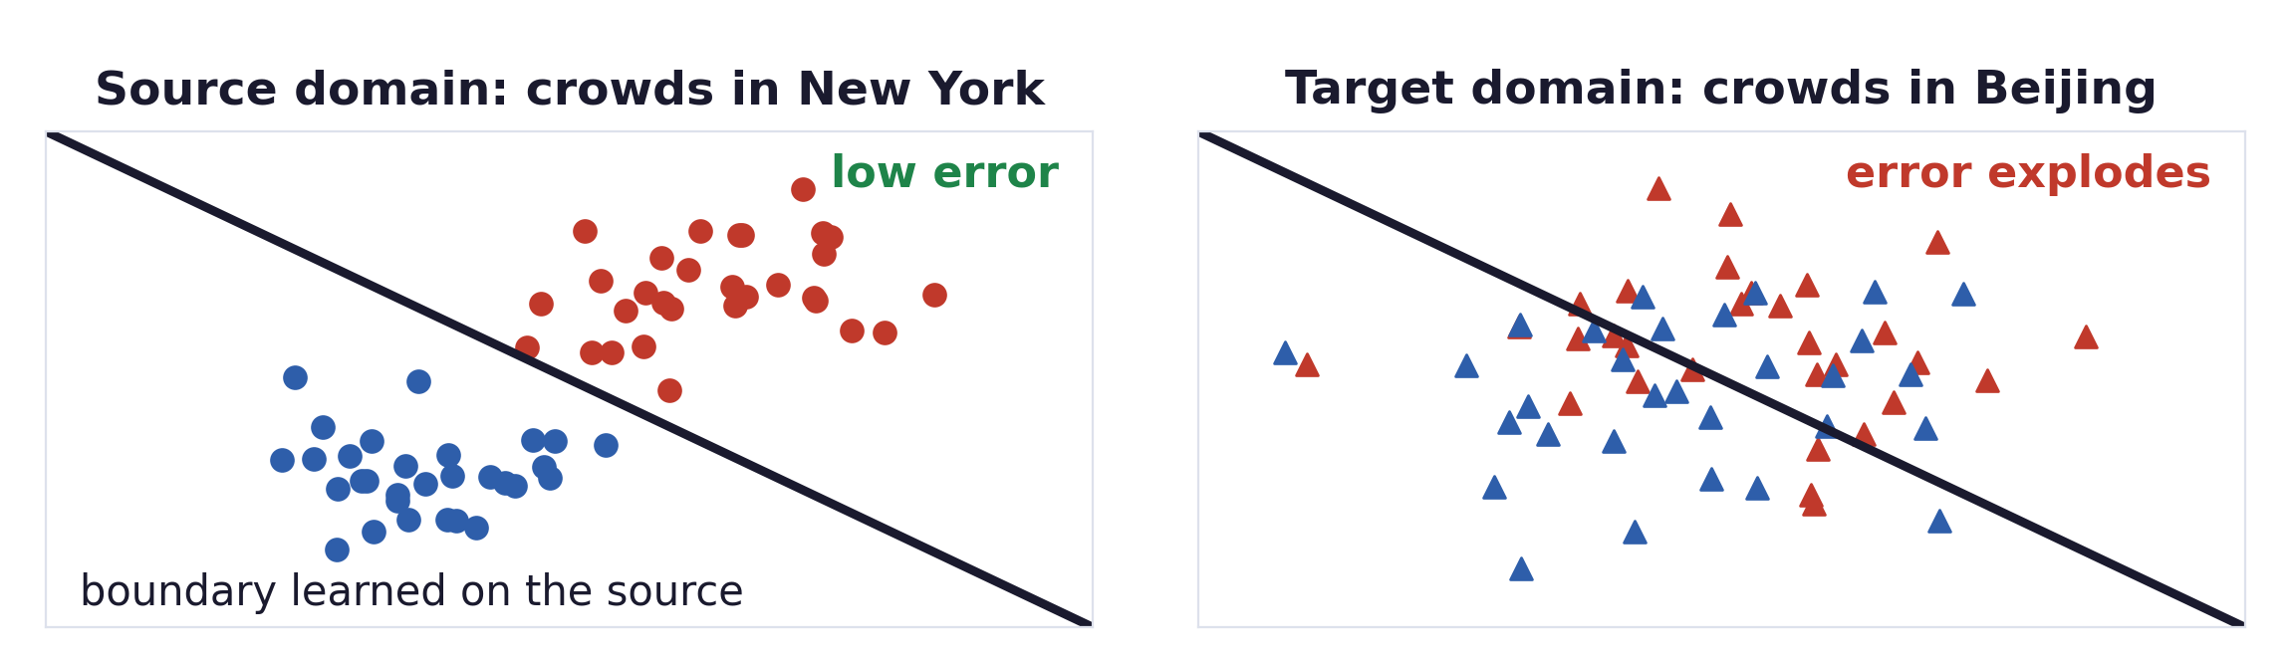
The limits of BDT
Dataset bias, and domain shift
Where the failure comes from
The rule is optimal for the dataset’s P(x, y), and that distribution differs from the world’s.
Train on crowds in New York, deploy in Beijing, the algorithm would perform badly.
Bayes Decision Theory · A. Yuille
36

Slide 37
The limits of BDT
Searching for failure modes instead of averages
Average-case evaluation
Adversarial examination
Sample a test set from the same distribution.
This measures what usually happens.
Search the stimulus space for inputs that make the rule fail.
This measures what can happen.
Adversarial examples: perturbations too small to see that flip the decision entirely.
Being vanishingly improbable, they cost almost nothing in risk.
Average-case optimality and worst-case fragility are perfectly compatible.
Bayes Decision Theory · A. Yuille
37

Slide 38
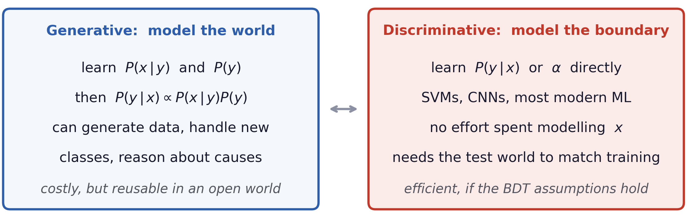
The limits of BDT
When is BDT sufficient?
If a dataset could represent every possible image, estimating P(y | x) would be enough.
In an open world, we will need P(x | y) and P(y).
Bayes Decision Theory · A. Yuille
38

Slide 39
The limits of BDT
Summary
Bayes decision theory has three ingredients: a joint distribution P(x, y), a set of decision rules, and a loss function.
The Bayes rule minimises the expected loss. It depends on the observation only through the posterior, which is what licenses learning the posterior directly.
MAP and ML are the two special cases: equal costs, and equal costs with a uniform prior.
For two classes the rule is a log-likelihood ratio test. The threshold T carries the prior and the loss, and moving it trades one kind of error for the other.
Learning is Bayes decision theory again: maximum likelihood, the empirical risk and the cross-entropy loss all follow from it.
The guarantees are about the average over one fixed distribution. Dataset bias, domain shift and adversarial cases live outside that average.
Bayes Decision Theory · A. Yuille
39

