Slide 1
Bayesian Edge
Detection
10 September, 2026
Alan Yuille · Probabilistic Models of the Visual Cortex

Slide 2
What this lecture covers
1
Edge detection problem
2
The observation – Filter response
Label every pixel edge or non-edge
From the image to one number
3
Learning the distributions
4
From evidence to a decision
Two histograms from annotated data
Likelihood ratio, prior, loss
5
Ambiguity and multiple cues
6
Semantic segmentation
Combining several filter responses
Many classes, and domain transfer
Bayesian Edge Detection · A. Yuille
2

Slide 3
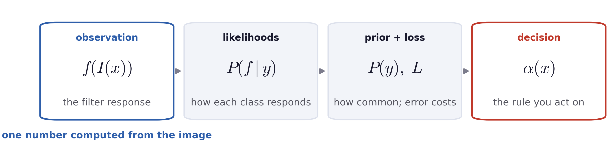
Recap: Bayes decision theory
The new question is: what is the observation when the data is an image?
For an image, we discuss the two class-conditional distributions for edge and non-edge pixels.
Bayesian Edge Detection · A. Yuille
3

Slide 4
1
Edge detection as a decision
Label every pixel edge or non-edge: y(x) ∈ {+1, −1}.
4

Slide 5
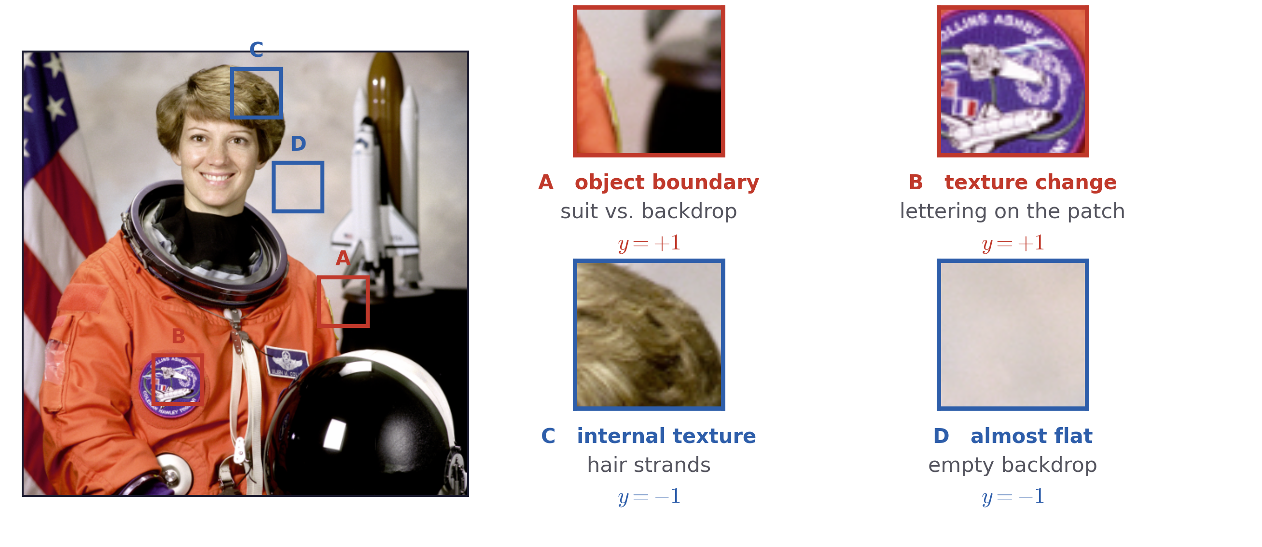
A decision problem
Definition of an edge
Edges are object boundaries and significant texture changes.
Everything else, including strong internal texture, is background.
Bayesian Edge Detection · A. Yuille
5

Slide 6
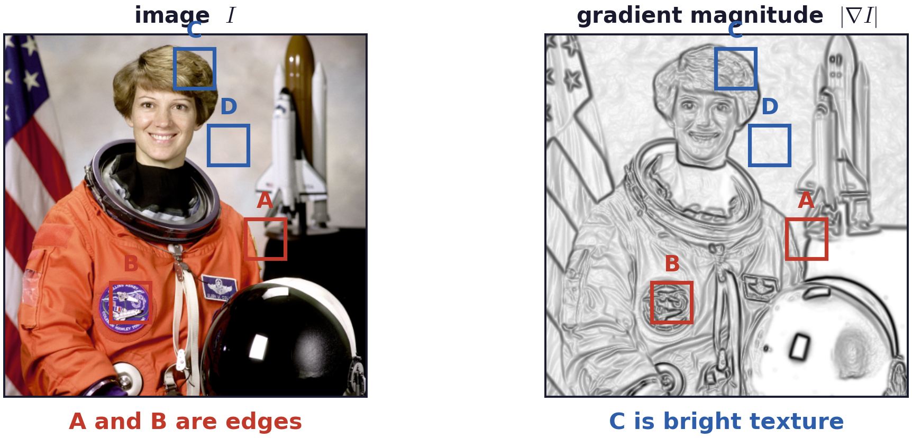
A decision problem
Large gradients are usually edges
The research question is: how to distinguish the edge from background in an image?
Bayesian Edge Detection · A. Yuille
6

Slide 7
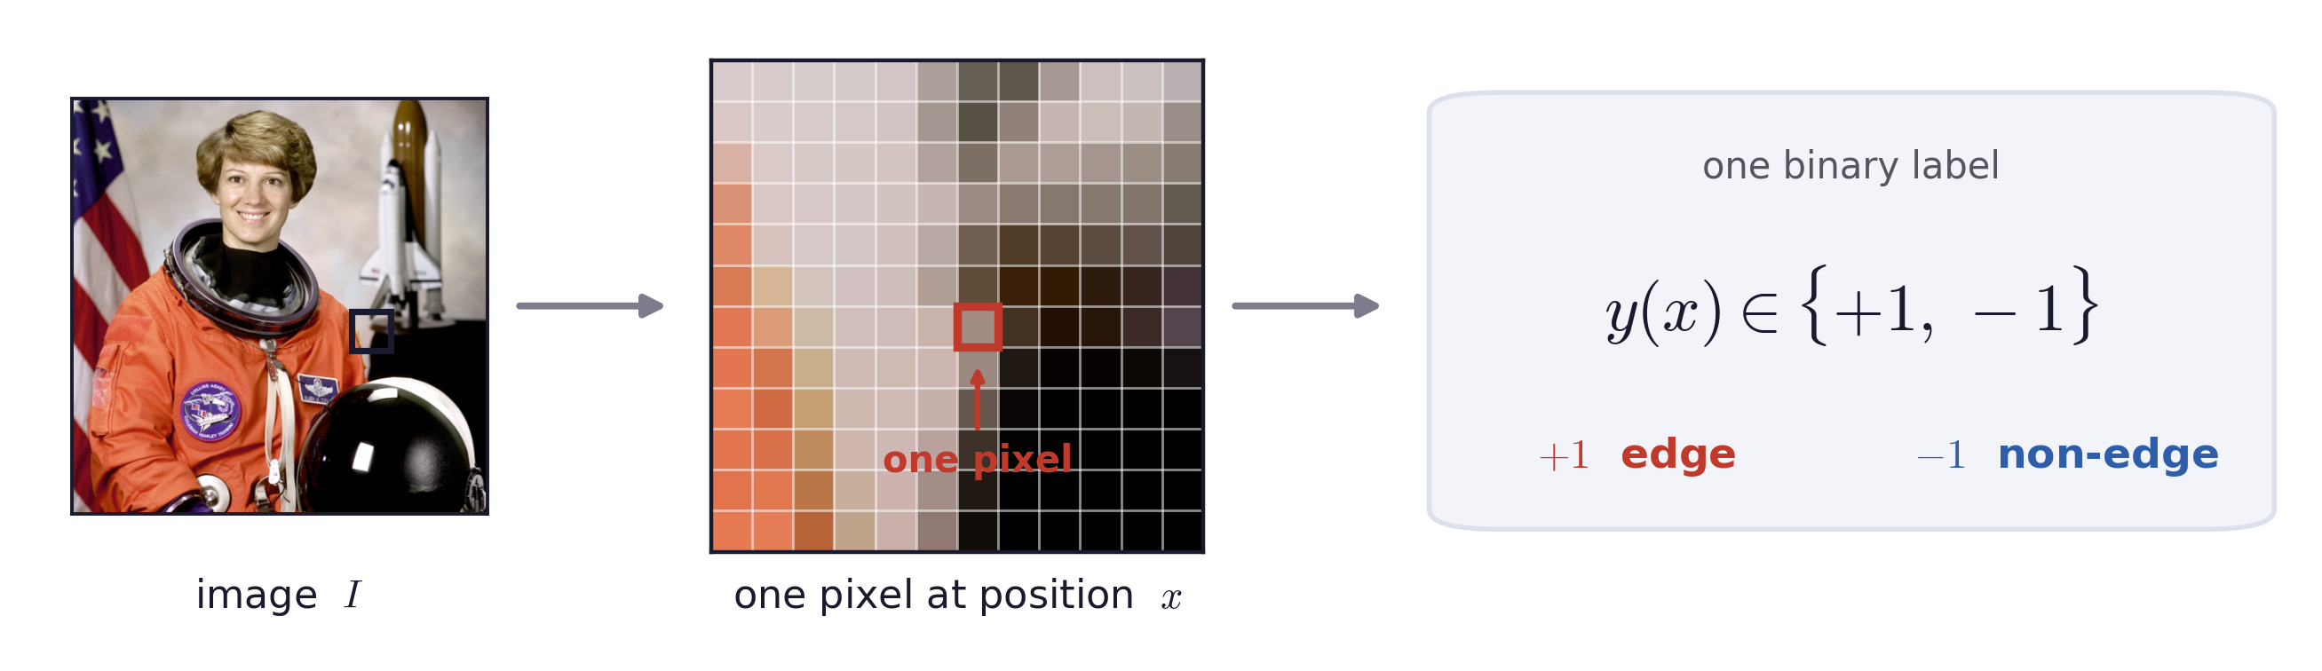
A decision problem
Formulation of the edge detection problem
One binary decision per pixel, which is the problem Bayes decision theory solves.
We will elaborate on the observation and the two class-conditional distributions.
Bayesian Edge Detection · A. Yuille
7
Notes:
$\mathrm{given\ } I : \quad \mathrm{decide\ } y(x) \in \{\, +1,\ -1 \,\} \ \ \mathrm{at\ every\ pixel\ } x \ \ \mathrm{from\ } f(I(x))$

Slide 8
2
Filter response as observation
A filter turns the image at pixel x into one number, f(I(x)).
8

Slide 9
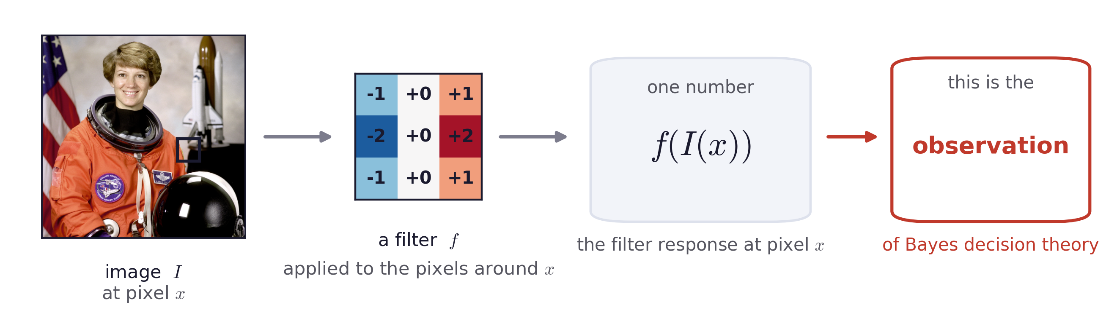

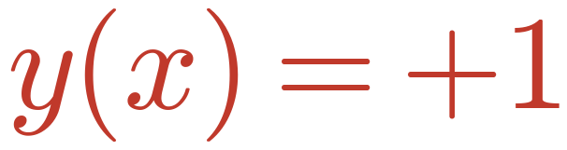
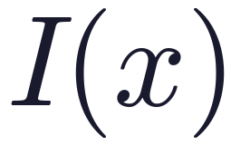
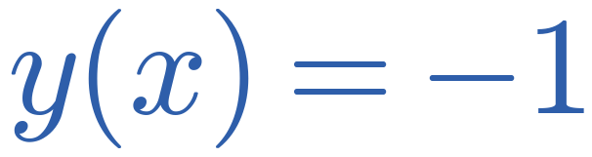
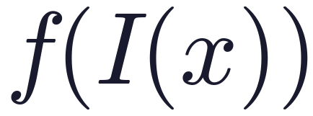

The observation
From an image to a number
Notation for the rest of the lecture
the pixel position
edge
the image intensity there
non-edge
the filter response, written f for short
the decision threshold
Bayesian Edge Detection · A. Yuille
9

Slide 10
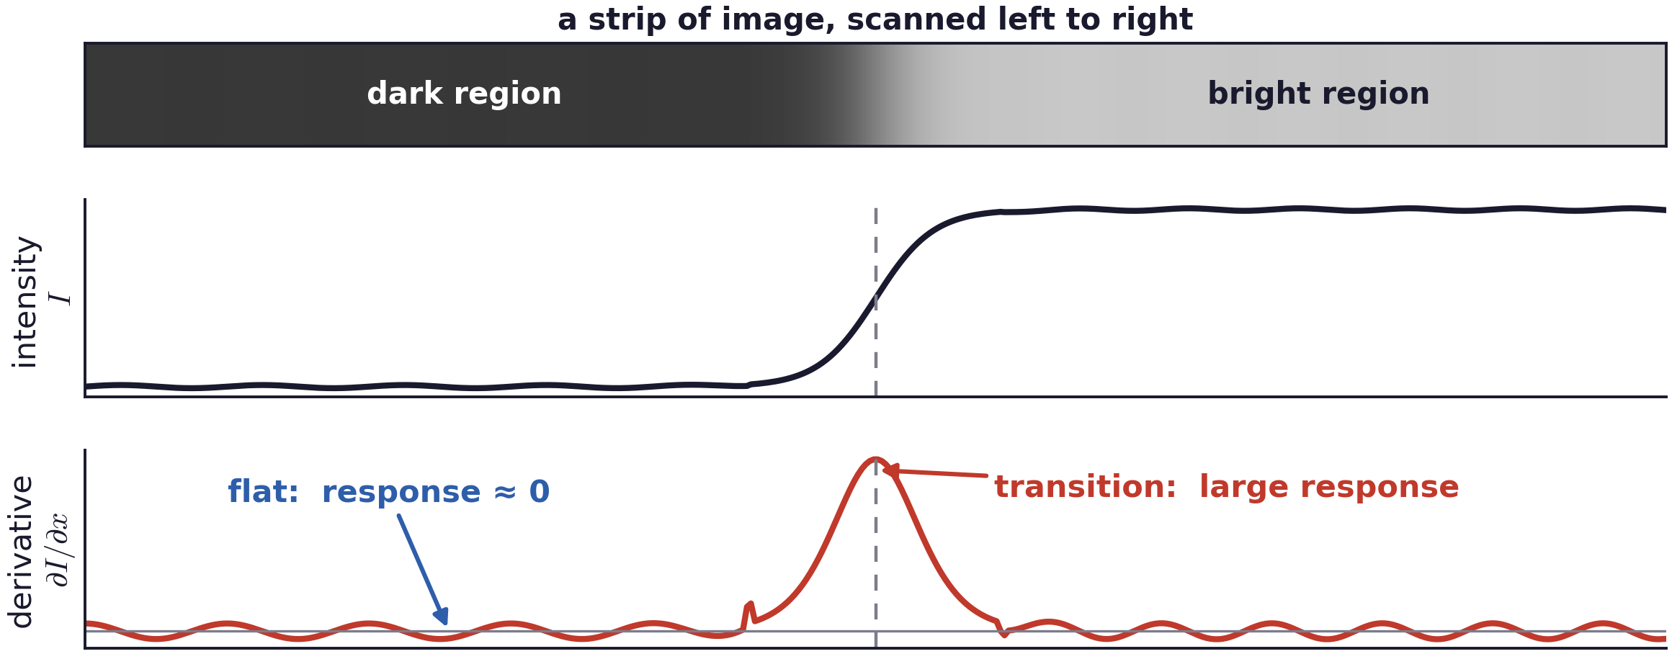
The observation
The simplest filter: the derivative
Scanning one row of pixels. The derivative is near zero inside a region and large where the intensity changes.
Bayesian Edge Detection · A. Yuille
10

Slide 11
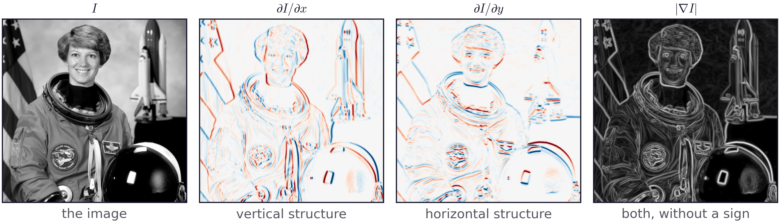
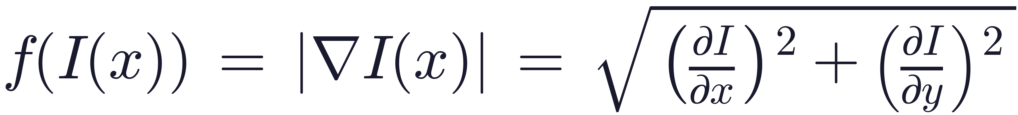
The observation
In two dimensions: the gradient
One number per pixel: how fast the intensity is changing, whichever way it changes.
Bayesian Edge Detection · A. Yuille
11
Notes:
$f(I(x)) \;=\; |\nabla I(x)| \;=\; \sqrt{\left(\frac{\partial I}{\partial x}\right)^{2} + \left(\frac{\partial I}{\partial y}\right)^{2}}$

Slide 12
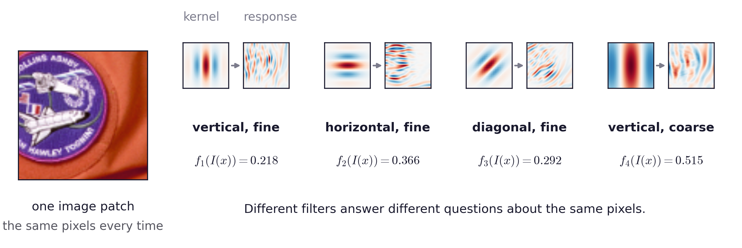
The observation
Filterbanks: orientation and scale
A filterbank is a set of filters at different orientations and scales.
We start from one filter for simplicity, and discuss the complex case.
Bayesian Edge Detection · A. Yuille
12

Slide 13
3
Learning the two distributions
Estimate P(f | y=+1) and P(f | y=−1) as histograms from annotated data.
13

Slide 14
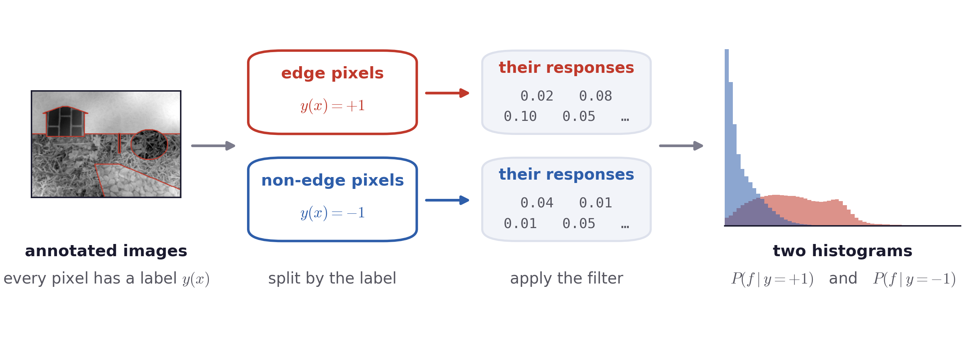
Learning the distributions
One filter produces two distributions for pixels
The two distributions are estimated by counting filter responses for a filter on annotated data.
Bayesian Edge Detection · A. Yuille
14

Slide 15
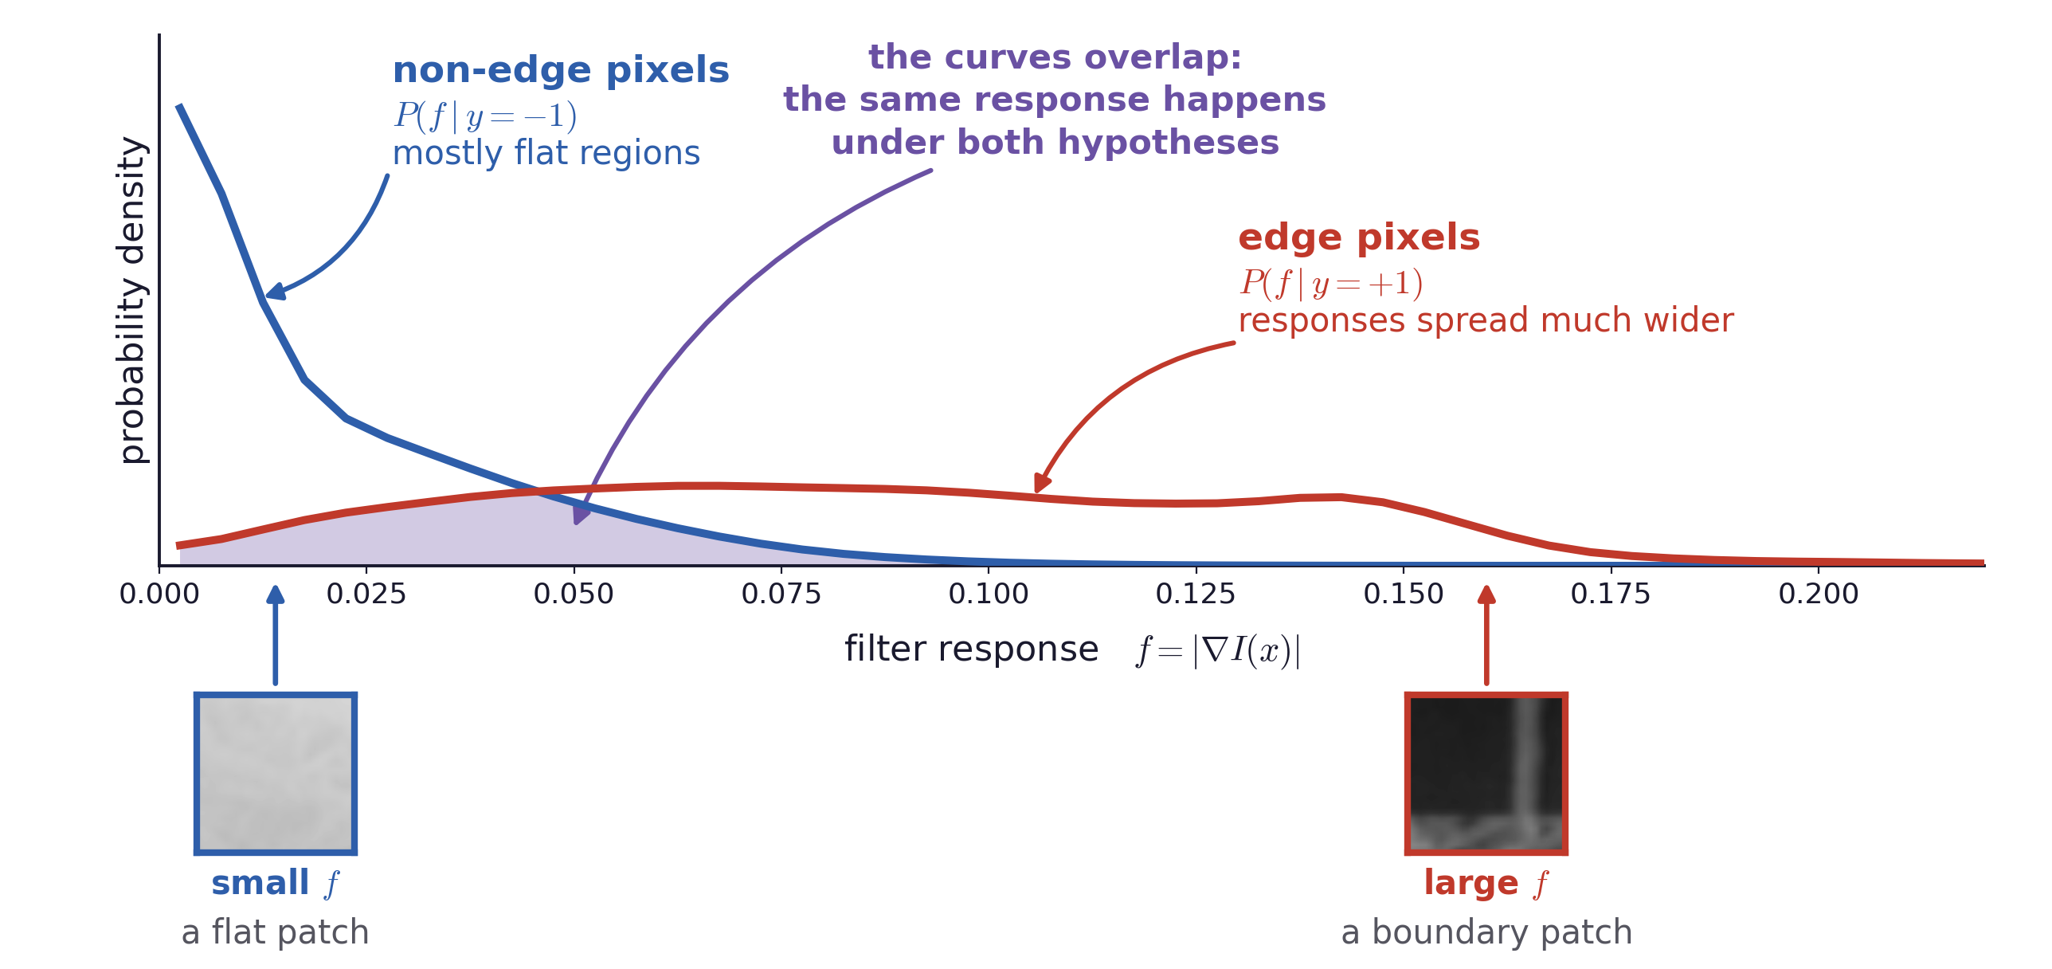
Learning the distributions
Reading the two distributions
Both curves are computed, on a scene whose edges are known by construction. Same axis, two conditions.
Bayesian Edge Detection · A. Yuille
15

Slide 16
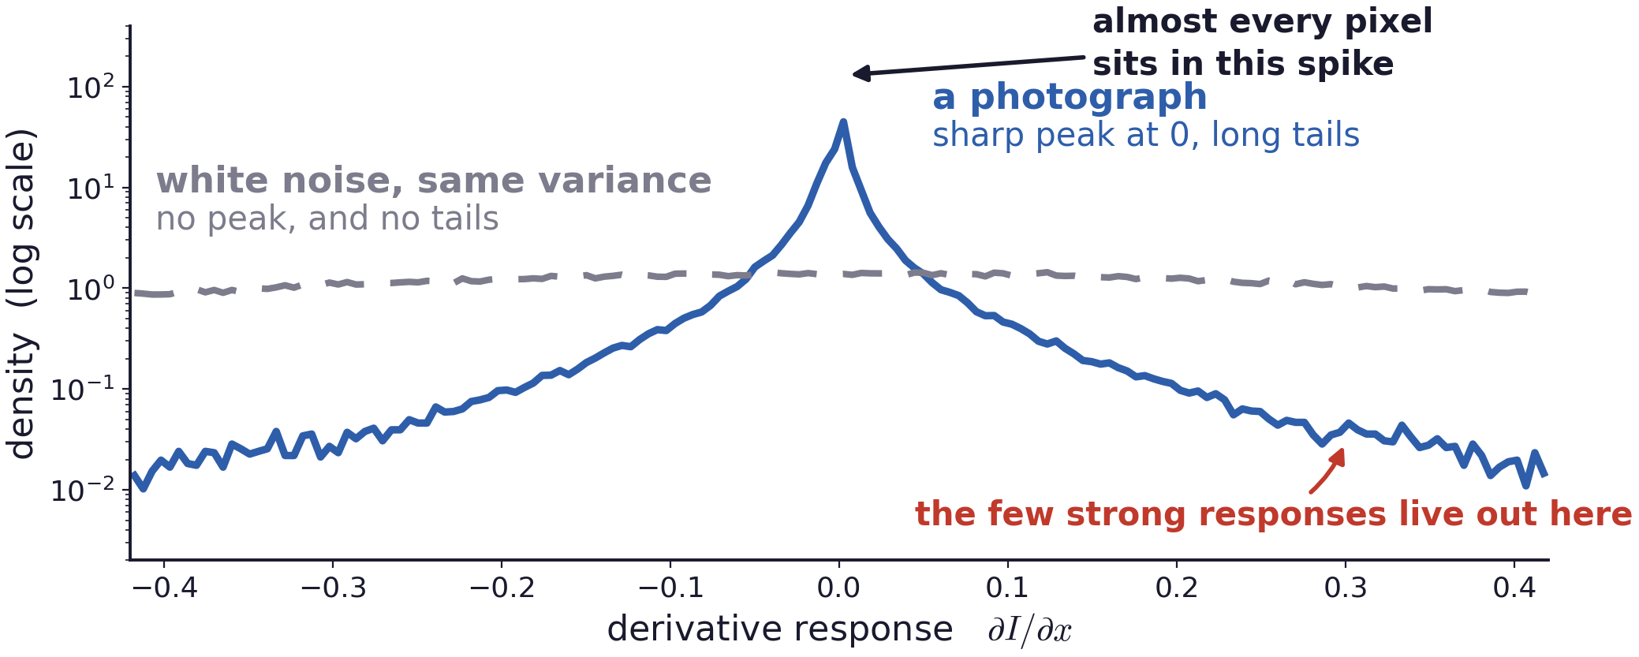
Learning the distributions
Why the non-edge curve piles up at zero
This heavy-tailed shape is a property of natural-image statistics, which describe how photographs differ from noise.
The class prior P(y) is a separate quantity: it says how often a pixel is an edge.
Bayesian Edge Detection · A. Yuille
16

Slide 17
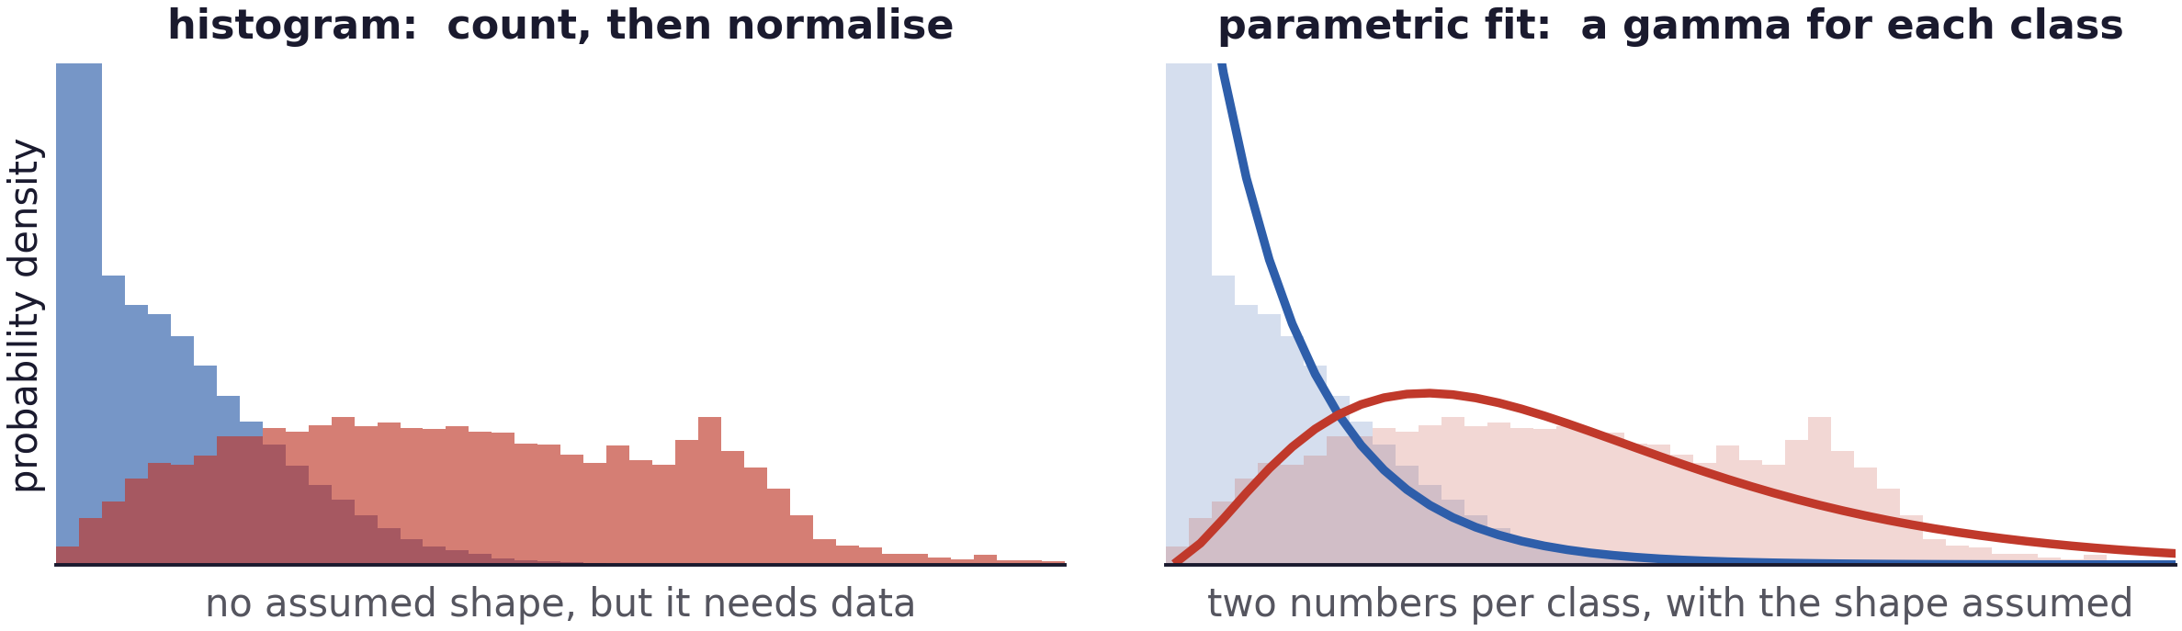
Learning the distributions
Histograms assume nothing about the shape
A histogram is non-parametric: it takes whatever shape the data has, including shapes no standard density would give.
The price is data. With many filters this becomes the binding constraint.
Bayesian Edge Detection · A. Yuille
17

Slide 18
4
From likelihood ratio to a decision
Threshold the log-likelihood ratio at T, set by the prior and the loss.
18

Slide 19
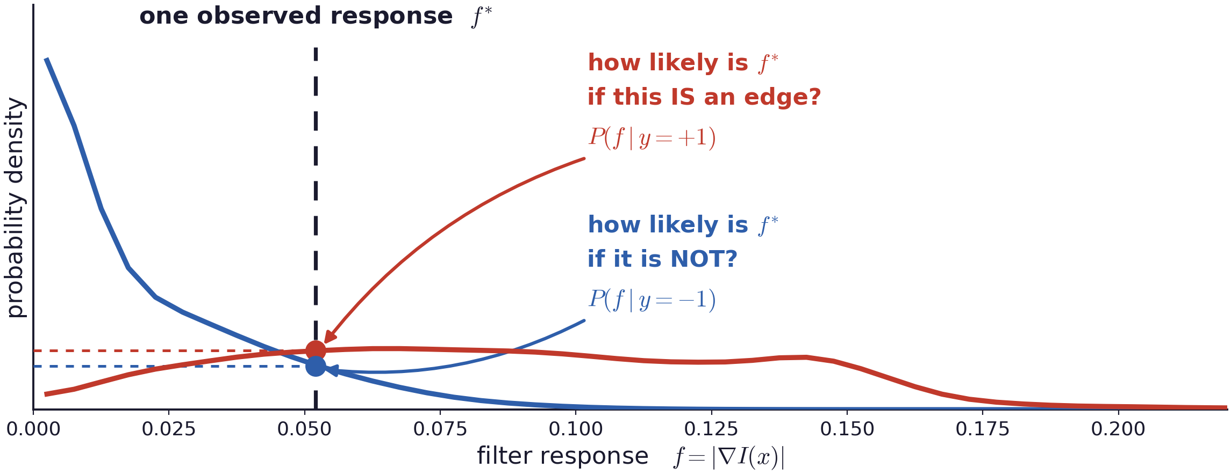
From evidence to a decision
Evaluating one response under both hypotheses
The decision depends on which of the two densities is larger, and by how much.
Bayesian Edge Detection · A. Yuille
19

Slide 20
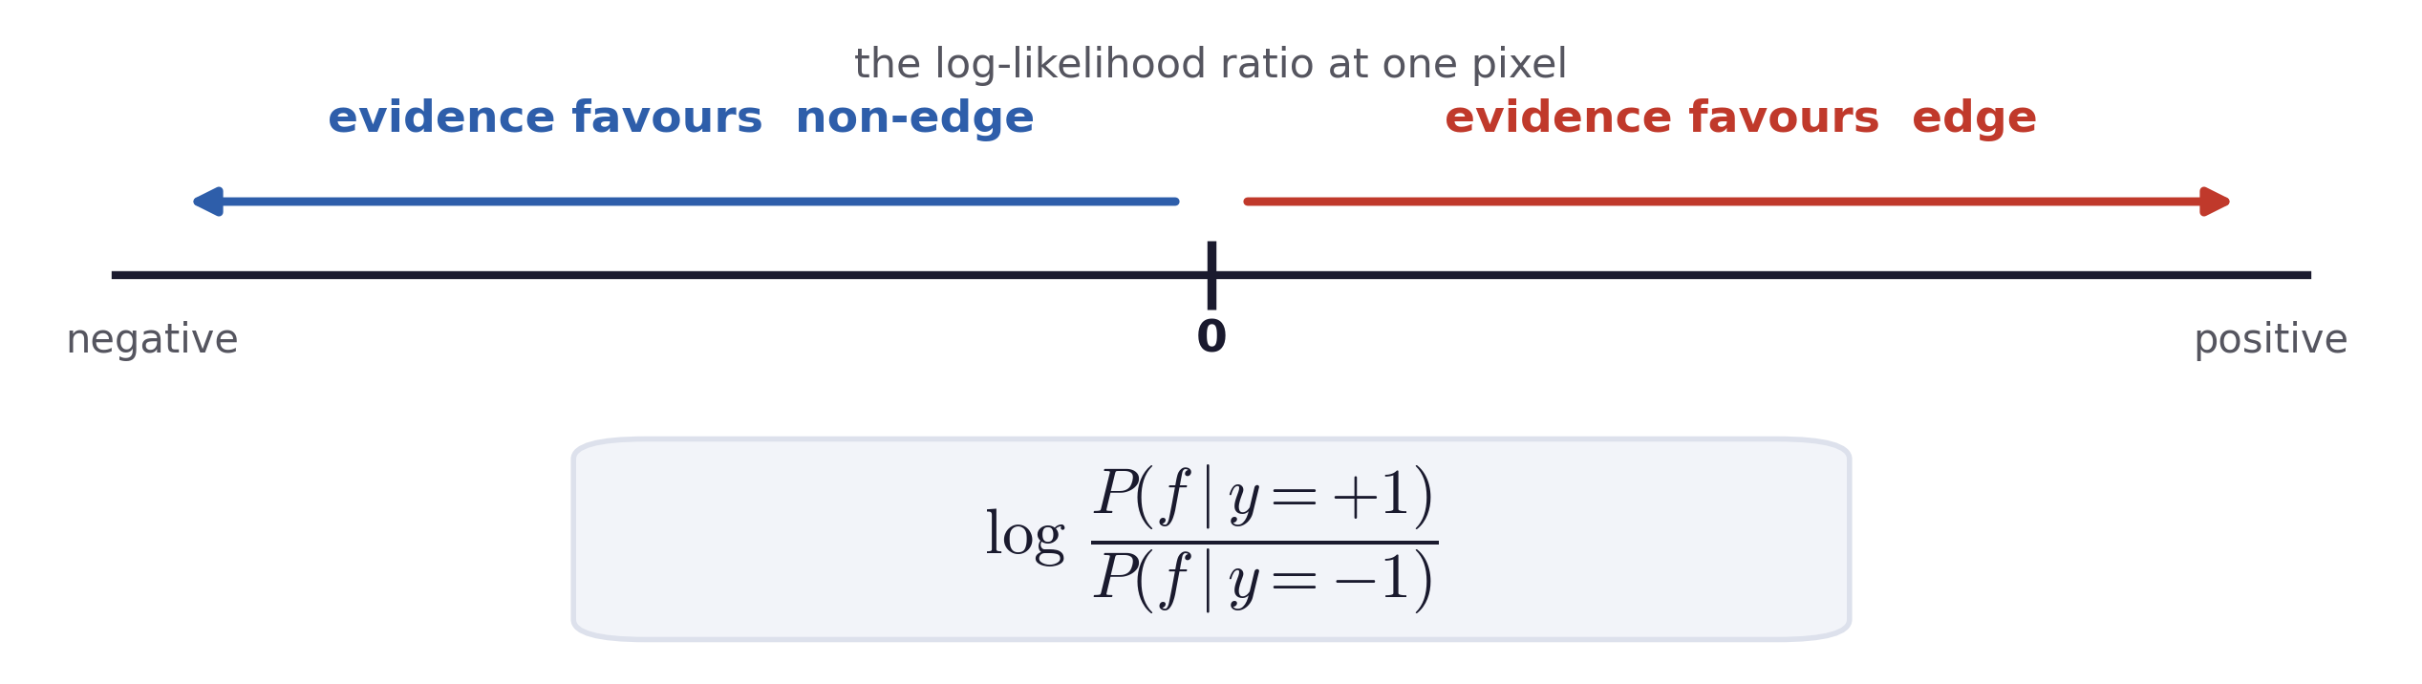
From evidence to a decision
The likelihood ratio
The ratio compares the same observation under the two hypotheses. Its logarithm turns “several times more likely” into a signed amount of evidence.
Positive means the response is more typical of edges; negative means it is more typical of background.
Bayesian Edge Detection · A. Yuille
20

Slide 21
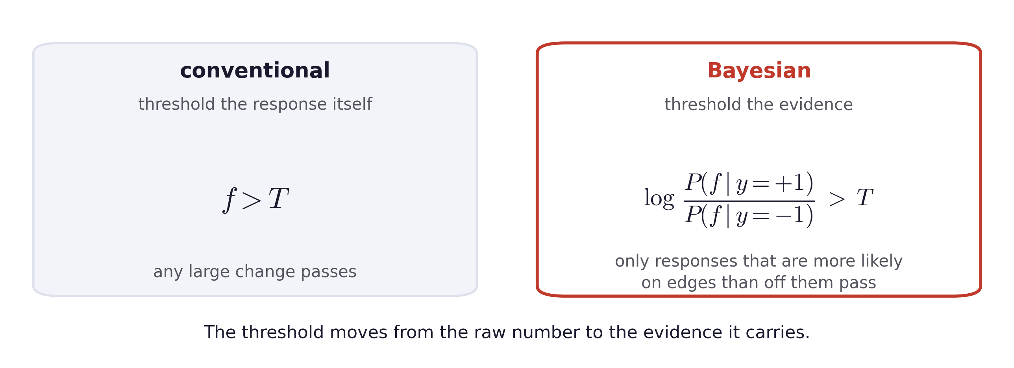
From evidence to a decision
The Bayesian test thresholds the likelihood ratio
The likelihood ratio measures how much more likely the response is on an edge.
The threshold T sets how much evidence is required.
Bayesian Edge Detection · A. Yuille
21

Slide 22
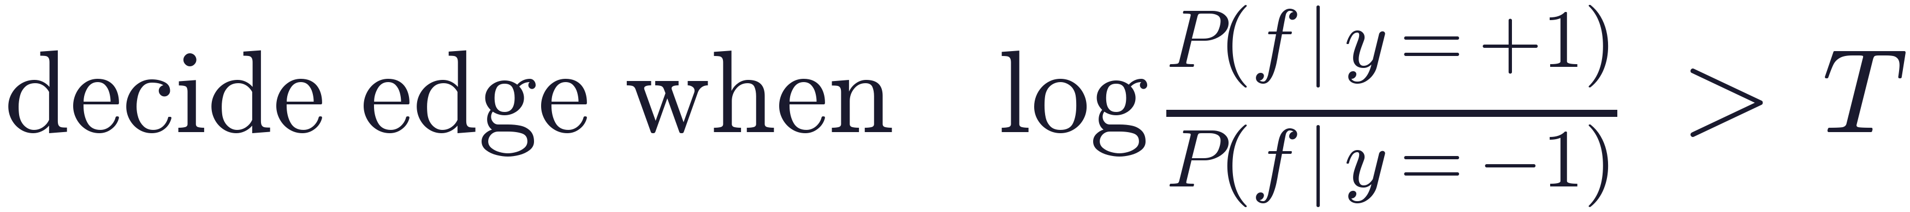
From evidence to a decision
The threshold comes from the prior and the loss
Testing whether the log-likelihood ratio exceeds zero assumes that edge and non-edge are equally likely, and that the two kinds of error cost the same.
The prior. Most pixels are not edges, so a pixel has to be unusual before we call it one. This raises the threshold T.
The loss. Missing a boundary usually costs more than a spurious one. If we would rather over-detect and clean up later with context, this lowers the threshold T.
Similar to what it did in the previous lecture, Bayes decision theory sets T from the two factors.
Bayesian Edge Detection · A. Yuille
22
Notes:
$\mathrm{decide\ edge\ when} \quad \log \frac{P(f \mid y = +1)}{P(f \mid y = -1)} \;>\; T$

Slide 23
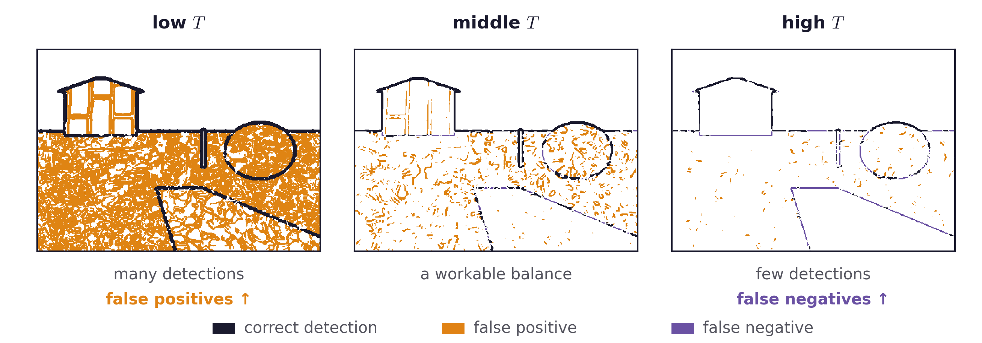
From evidence to a decision
Moving the threshold
Lowering T detects more edges and more texture with them.
Raising T keeps only the strongest evidence and loses real boundaries.
Bayesian Edge Detection · A. Yuille
23

Slide 24
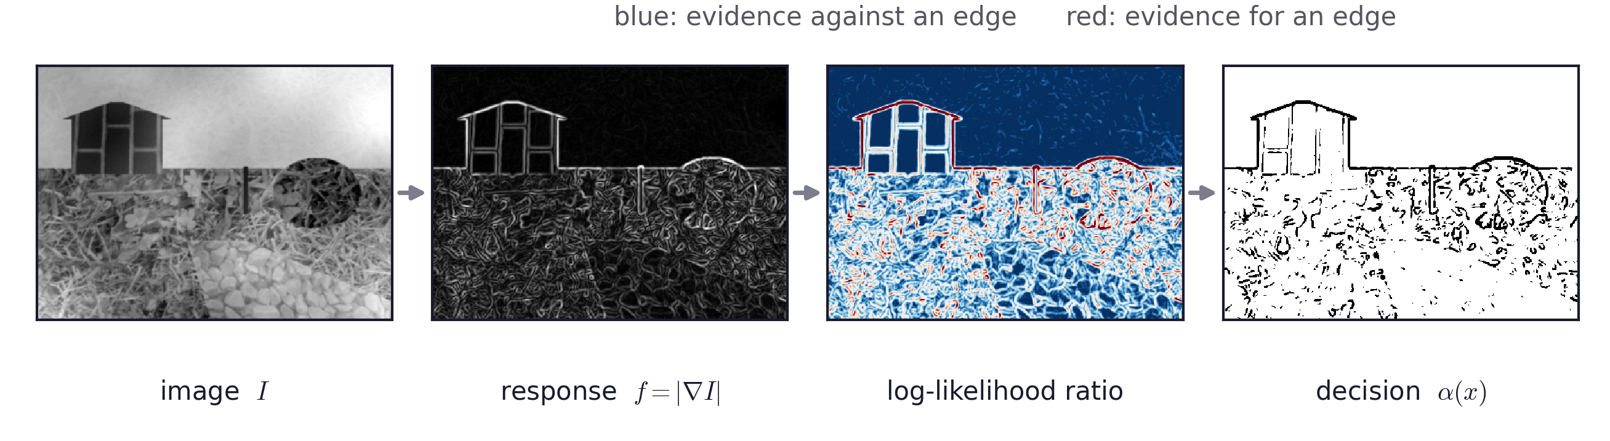
From evidence to a decision
The full pipeline on one image
The third panel is the log-likelihood ratio computed at every pixel from the two learned distributions.
The fourth is that map thresholded.
Bayesian Edge Detection · A. Yuille
24

Slide 25
5
Ambiguity and multiple cues
Combine M filter responses; the joint distribution is the difficulty.
25

Slide 26
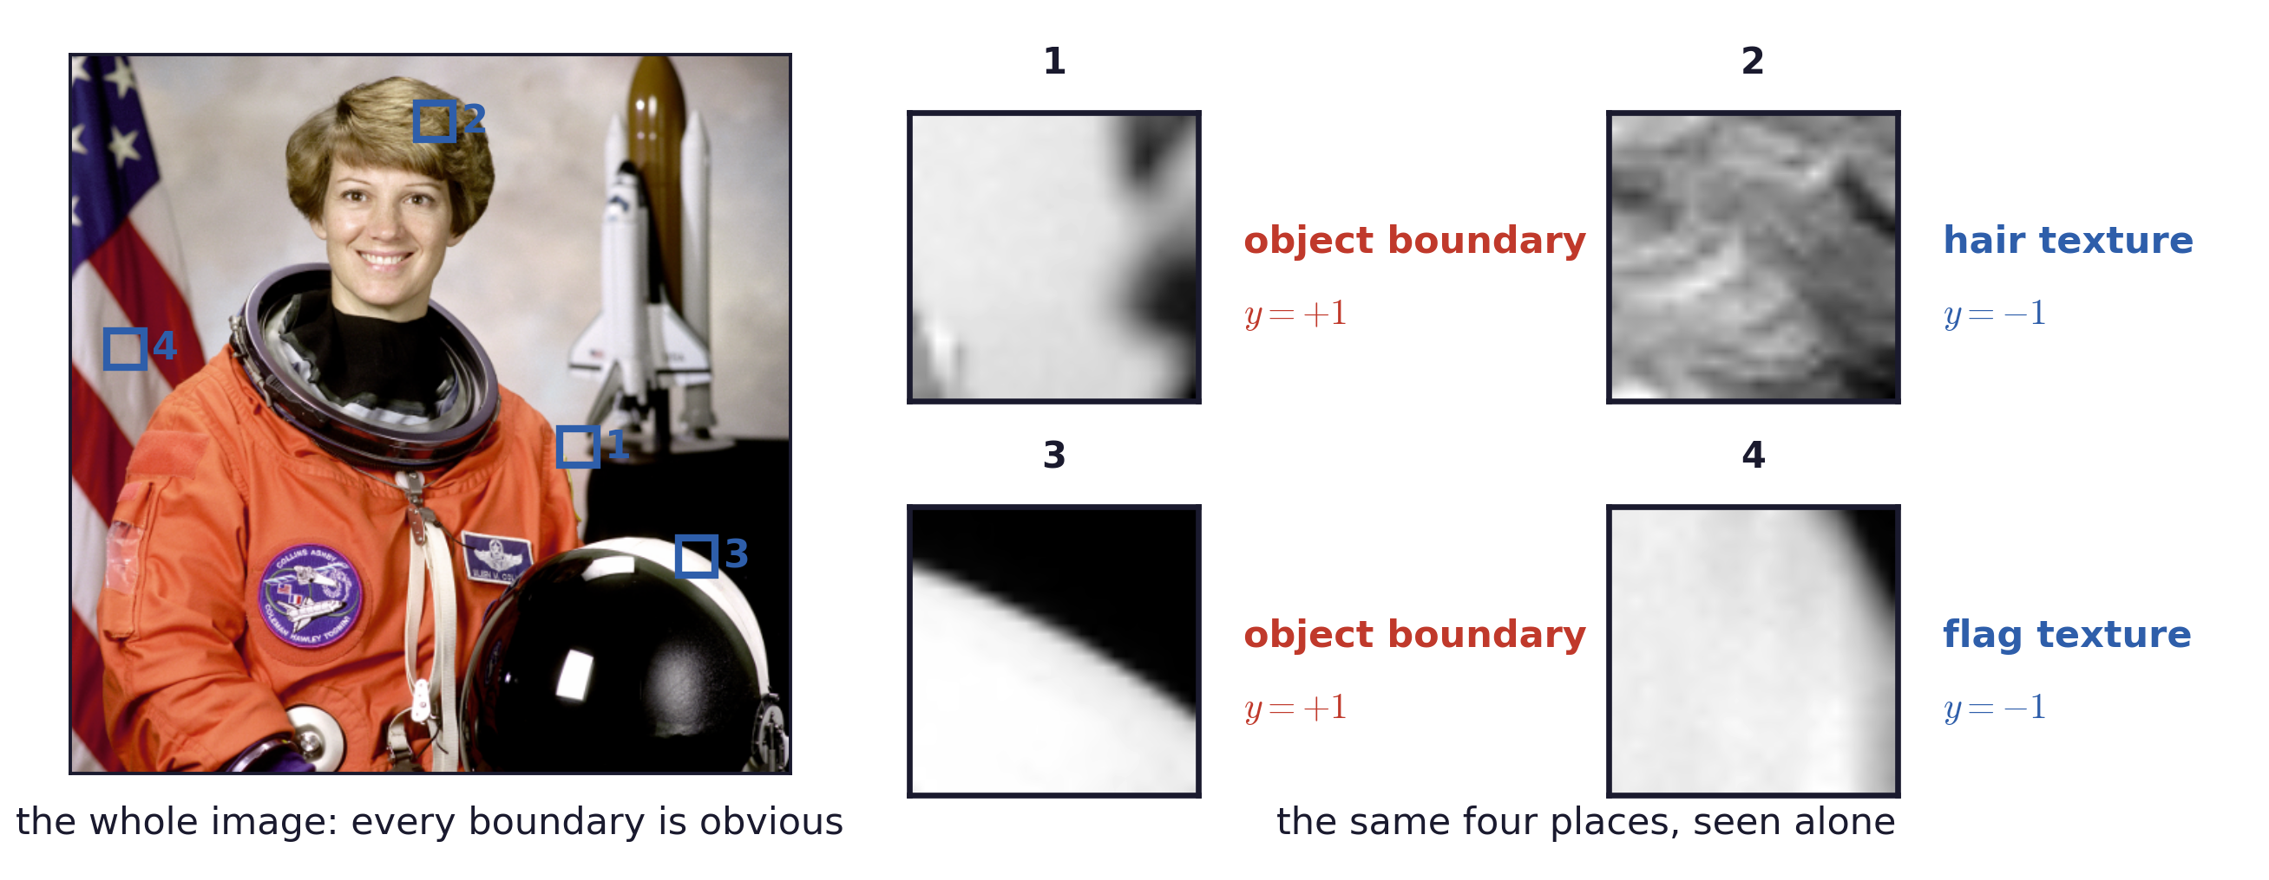
Ambiguity and many cues
Local evidence is ambiguous
Spatial context and object knowledge can disambiguate local edge evidence
Bayesian Edge Detection · A. Yuille
26

Slide 27
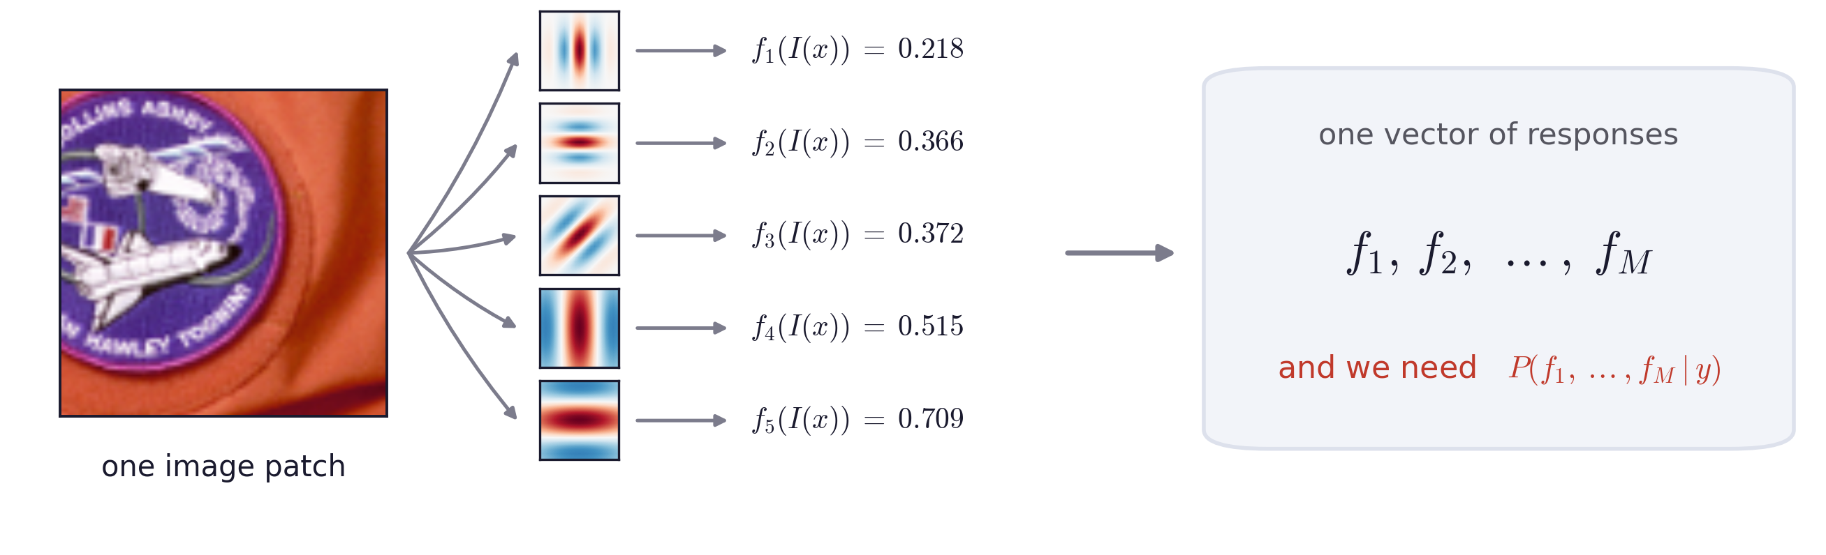
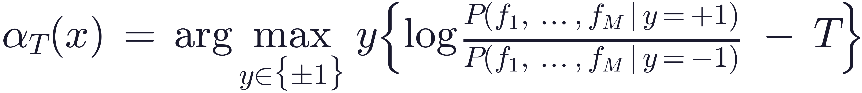
Ambiguity and many cues
Many filters at one pixel
Bayesian Edge Detection · A. Yuille
27
Notes:
$\alpha_T(x) \;=\; \arg\max_{y \in \{\pm 1\}}\; y \left\{ \log \frac{P(f_1,\dots,f_M \mid y = +1)}{P(f_1,\dots,f_M \mid y = -1)} \;-\; T \right\}$

Slide 28
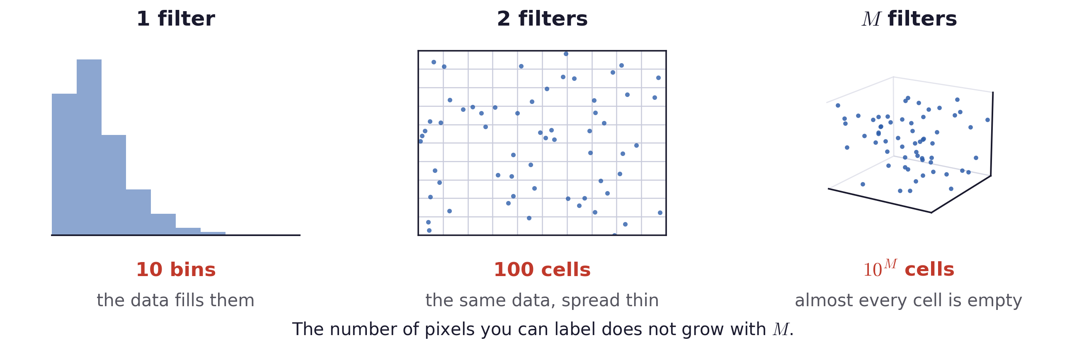
Ambiguity and many cues
Learning the joint distribution is hard
A joint histogram over M filters needs data in every cell, and the number of cells grows exponentially in M.
It is also opaque: a filled-in table gives the answer, but not which cue produced it.
Bayesian Edge Detection · A. Yuille
28

Slide 29
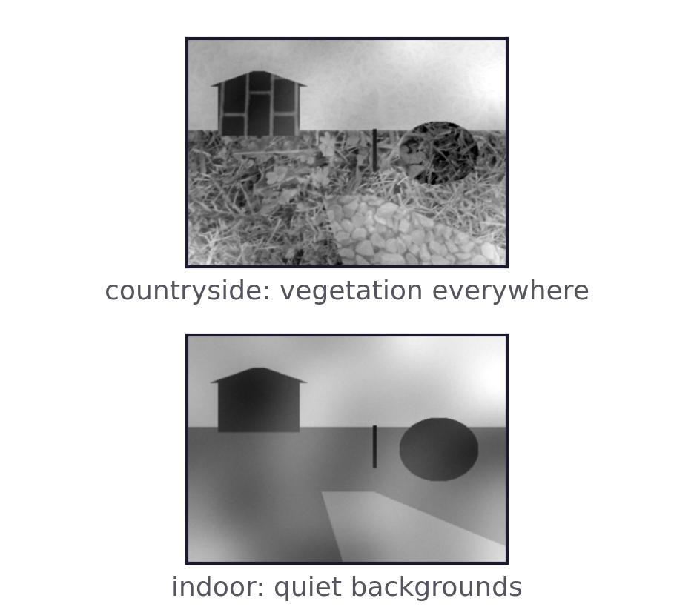
Ambiguity and many cues
Konishi et al., 2003
Sowerby: one hundred pre-segmented colour images of English country roads, with a great deal of vegetation.
South Florida: fifty greyscale images, largely indoor, with very little background texture.
Cues: gradient magnitude, the Laplacian and the Nitzberg operator at several scales, and oriented filterbanks.
What they found
On South Florida, where the background carries no texture, a single derivative cue is already enough.
On Sowerby the learned combination of cues wins: vegetation produces strong responses that one cue cannot tell from boundaries.
S. Konishi, A. L. Yuille, J. M. Coughlan and S. C. Zhu, “Statistical Edge Detection: Learning and Evaluating Edge Cues,” IEEE TPAMI 25(1), 2003.
Bayesian Edge Detection · A. Yuille
29

Slide 30
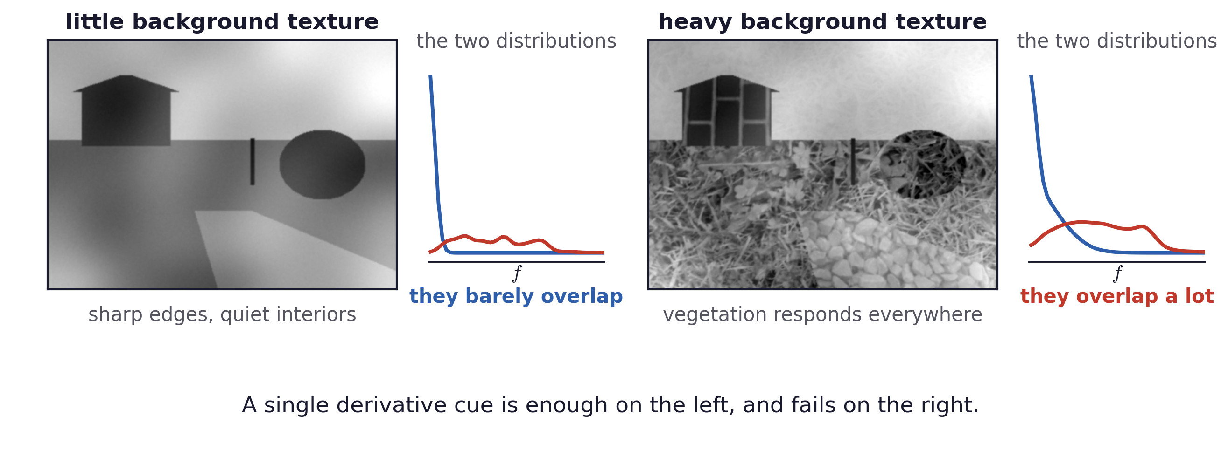
Ambiguity and many cues
Why the two datasets behave differently
Dataset descriptions after Konishi et al., TPAMI 2003.
Bayesian Edge Detection · A. Yuille
30

Slide 31
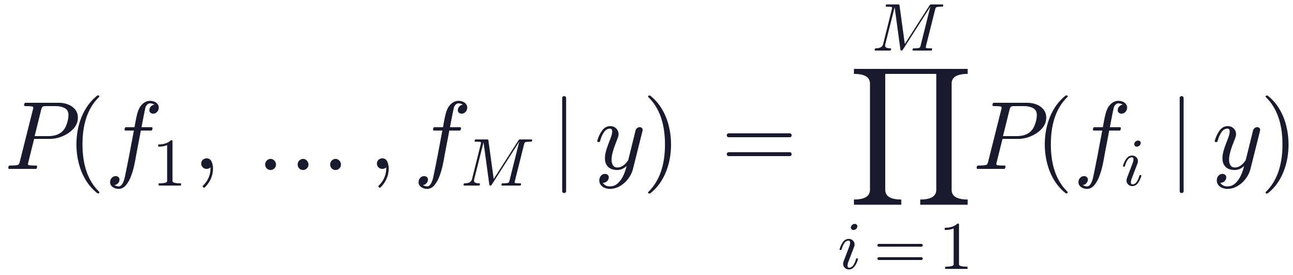
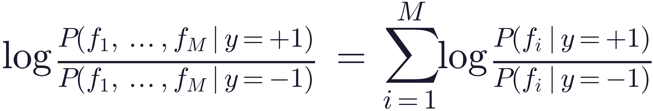
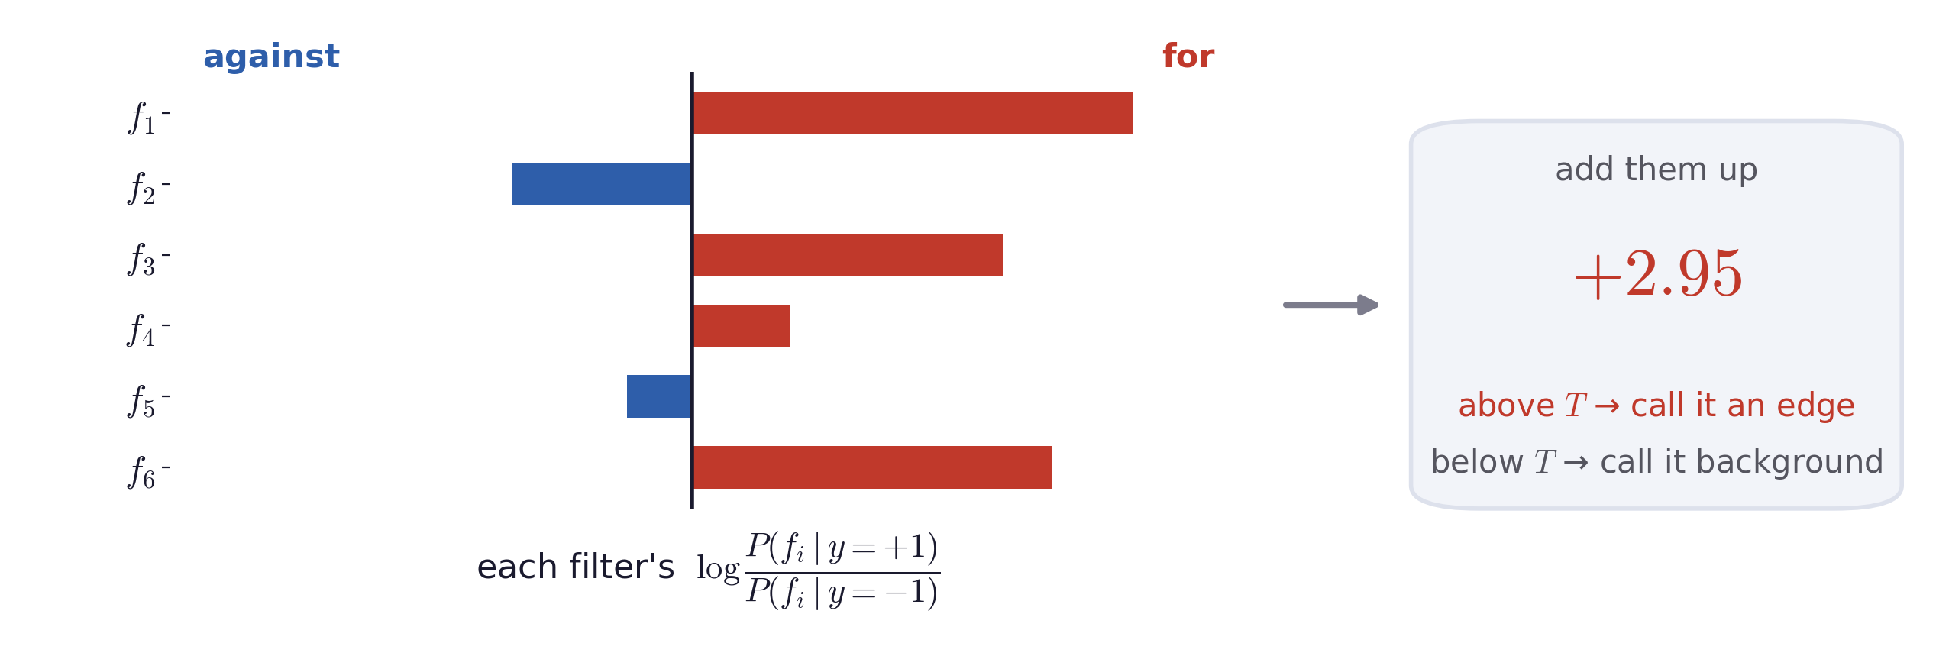
OPTIONAL · OUT OF SCOPE
Ambiguity and many cues
Independent cues: the evidence adds
Each filter casts a signed vote; the decision is the sign of their sum, offset by T.
Each distribution can then be learned on its own.
Bayesian Edge Detection · A. Yuille
31
Notes:
$P(f_1,\dots,f_M \mid y) \;=\; \prod_{i=1}^{M} P(f_i \mid y)$
$\log \frac{P(f_1,\dots,f_M \mid y = +1)}{P(f_1,\dots,f_M \mid y = -1)} \;=\; \sum_{i=1}^{M} \log \frac{P(f_i \mid y = +1)}{P(f_i \mid y = -1)}$

Slide 32
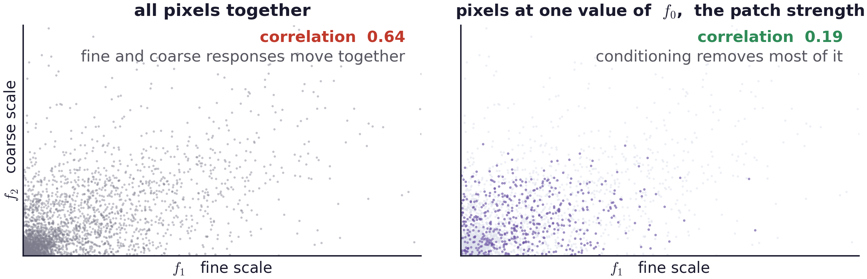
OPTIONAL · OUT OF SCOPE
Ambiguity and many cues
The filters are correlated
Every filter responds more strongly on a strong edge than on a weak one, so their responses rise and fall together.
Add one more filter f₀ that measures the overall brightness, or strength, of the patch. Conditioned on it, the other filters come close to independent.
C. Morrone and D. Burr, “Feature detection in human vision: a phase-dependent energy model,” Proc. R. Soc. Lond. B 235:221–245, 1988. · C. A. Ramachandra and B. W. Mel, “Computing local edge probability in natural scenes from a population of oriented simple cells,” Journal of Vision, 2013.
Bayesian Edge Detection · A. Yuille
32
Notes:
$P\left(\{f_i(I(x))\},\, f_0(I(x)) \mid y\right) \;=\; P\left(f_0(I(x)) \mid y\right)\, \prod_{i=1}^{M} P\left(f_i(I(x)) \mid f_0(I(x)),\, y\right)$

Slide 33
6
Semantic segmentation
The same rule extends to many classes.
33

Slide 34
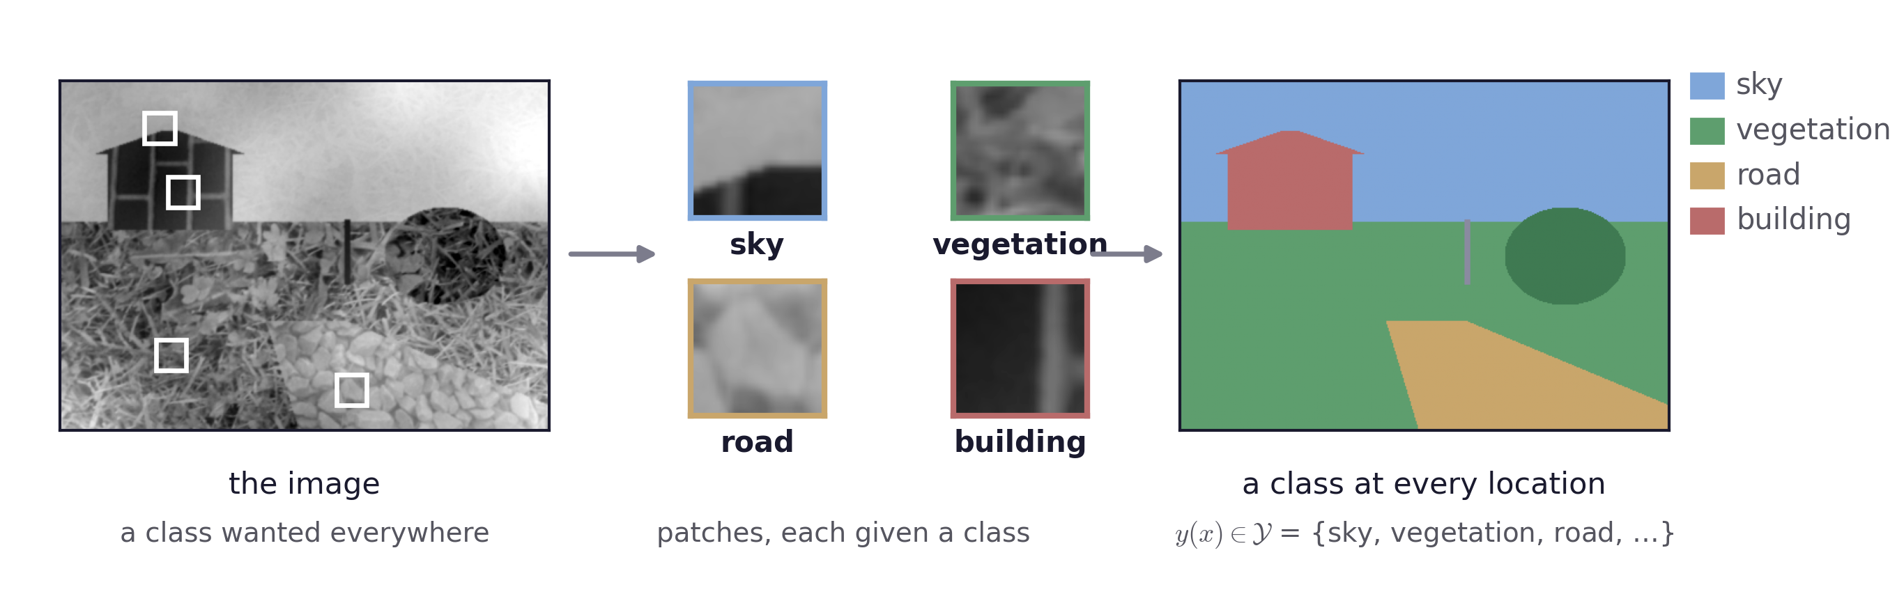
Semantic segmentation
The same machinery, more classes
Semantic segmentation gives every location in the image a class label, the way we have been giving every pixel an edge label.
Bayesian Edge Detection · A. Yuille
34

Slide 35
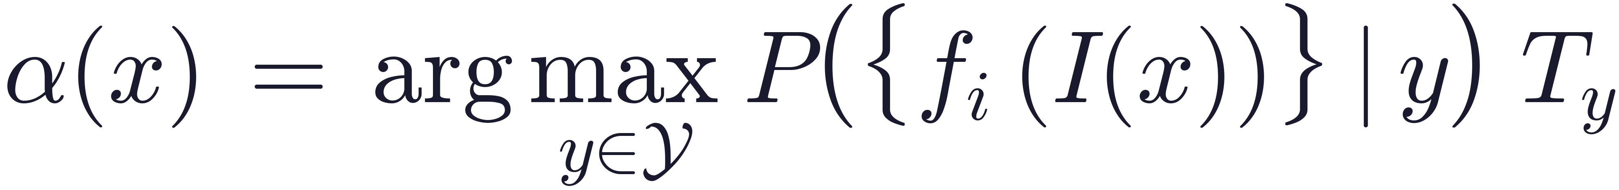
Semantic segmentation
The multiclass rule
The class set is now sky, vegetation, water, road and other, and one class-conditional distribution is learned for each of them.
T_{y} is one weight per class. It carries what the prior and the loss carried in the binary case: how common the class is, and what it costs to get it wrong.
With two classes and equal weights this reduces to the previous likelihood-ratio test.
Bayesian Edge Detection · A. Yuille
35
Notes:
$\alpha(x) \;=\; \arg\max_{y \in \mathcal{Y}}\; P\left(\{f_i(I(x))\} \mid y\right)\; T_y$

Slide 36
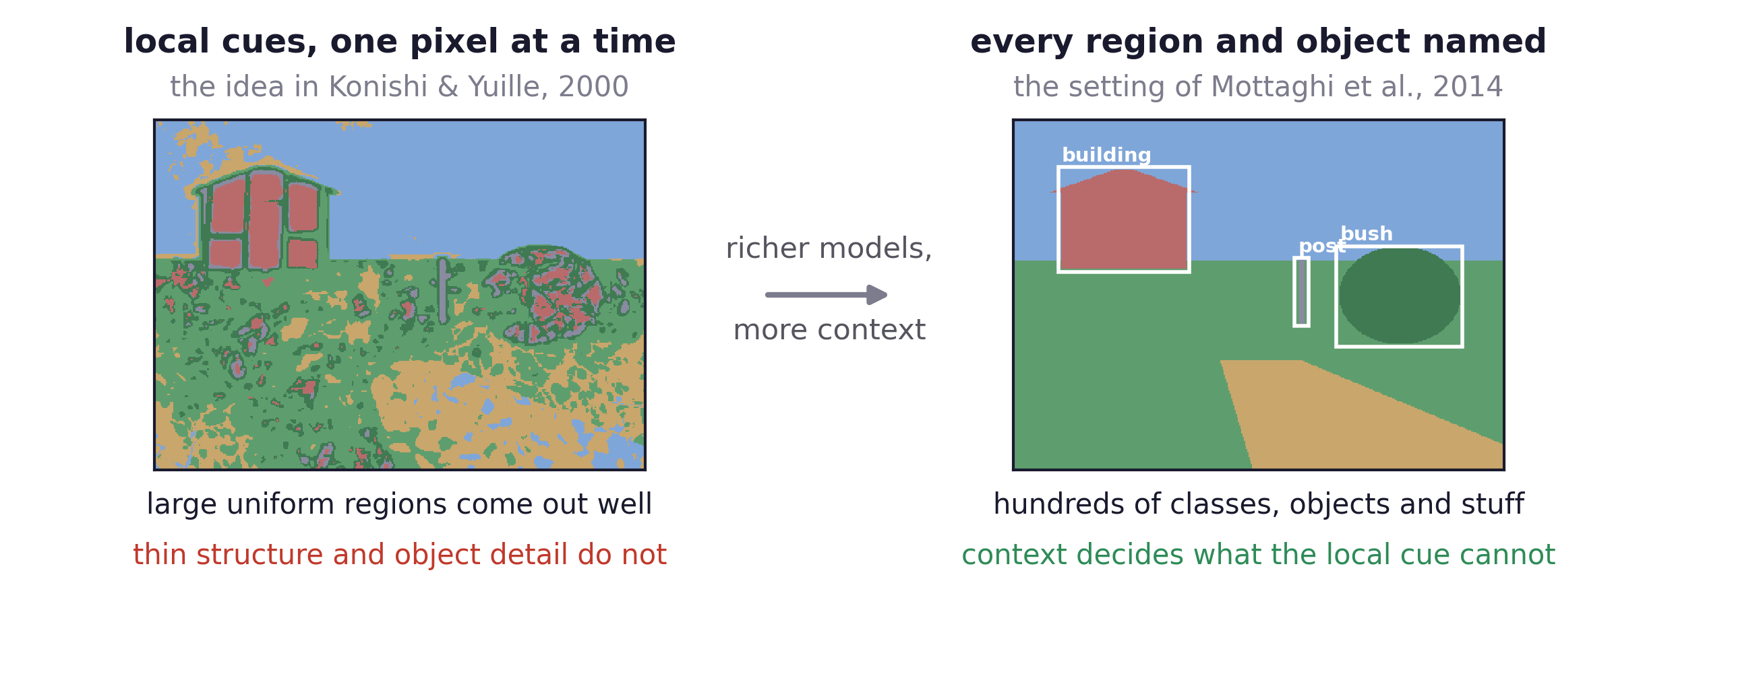
Semantic segmentation
From local classes to scene parsing
S. Konishi and A. L. Yuille, “Statistical Cues for Domain Specific Image Segmentation with Performance Analysis,” CVPR 2000.
R. Mottaghi et al., “The Role of Context for Object Detection and Semantic Segmentation in the Wild,” CVPR 2014.
Bayesian Edge Detection · A. Yuille
36

Slide 37
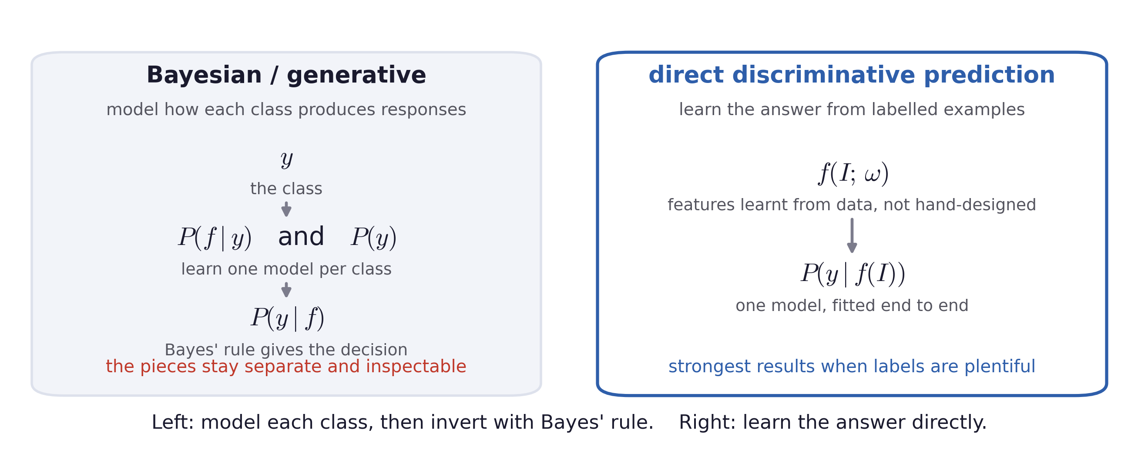
Semantic segmentation
Bayes versus direct prediction
Bayesian Edge Detection · A. Yuille
37

Slide 38
Semantic segmentation
What deep networks changed
In the statistical edge detectors the filters were chosen by hand: derivatives, Laplacians and Gabor functions. Only the distributions over their responses were learned.
A deep network learns the features as well: the response is f(I; ω), a hierarchy of filters whose weights ω are fitted along with the classifier.
Given enough annotated data this is the stronger method, and it is the state of the art for edge detection.
What the Bayesian version still gives you
The model is factored into named pieces: one distribution for edges, one for the background, a prior and a loss. When something about the world changes, you can often say which piece changed.
For the discriminative side: S. Xie and Z. Tu, “Holistically-Nested Edge Detection,” ICCV 2015.
Bayesian Edge Detection · A. Yuille
38

Slide 39
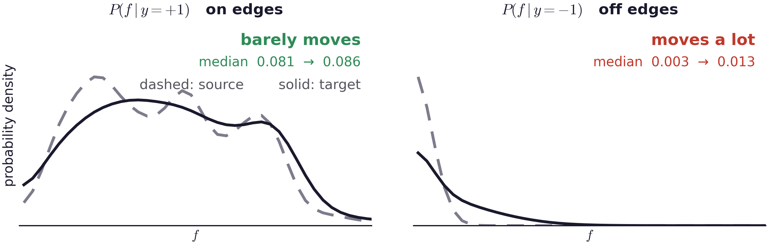
Semantic segmentation
Domain transfer is a problem for vision algorithms
An edge is an edge: the same contrast gives much the same response wherever the picture was taken.
The background is domain-specific. Replace an indoor wall with vegetation and the off-edge distribution moves a long way to the right.
Bayesian Edge Detection · A. Yuille
39

Slide 40
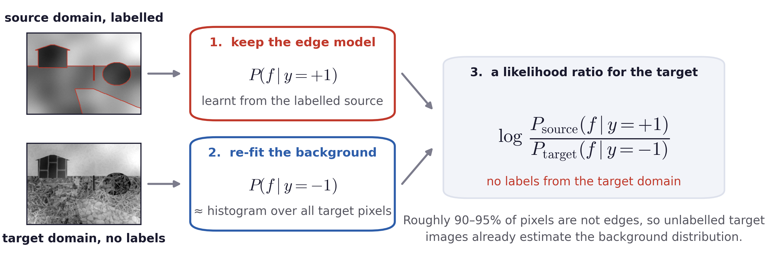
Semantic segmentation
Domain transfer using the factorisation
Konishi et al. report that distributions adapted between their two datasets lose very little accuracy.
Bayesian Edge Detection · A. Yuille
40

Slide 41
Semantic segmentation
Summary
Edge detection was written as a decision at every pixel: edge or non-edge.
The observation is a filter response. The two class-conditional distributions were learned by counting responses on annotated images.
The decision compares the two distributions at the observed response, and thresholds that comparison. The threshold comes from the prior and the loss.
One filter is often ambiguous. Several filters can be combined, and spatial context and object knowledge are the next two ways out.
Because the model is written in named pieces, the background distribution can be re-estimated for a new domain while the edge distribution is kept.
Bayesian Edge Detection · A. Yuille
41

