Slide 1
Probabilistic Models of the Visual Cortex Fall 2026
Alan Yuille
Course Website:
https://tiezheng11.github.io/ProbabilisticModelsOfVisualCognition2026FA/

Slide 2
Part 1: Artificial and Natural Intelligence
The relationship between the study of AI & NI is at a critical. AI is booming, but it is likely that taking AI to the level of human performance will require better understanding of NI – meaning Human and Primate Intelligence. Cognitive Science inspired AI.
The goal of unifying AI and NI should yield: (i) Scientific Understanding of Intelligence and (ii) the development of more advanced AI systems that can augment human intelligence, cooperate with humans, and in some situations replace humans.

Slide 3
Part 1. Big Data and Brute Force AI
Current AI relies heavily on brute force black-box methods trained on webscale data. These models have spectacular successes but also unpredictable failure modes.
This type of Intelligence is arguably orthogonal to Human Intelligence. A modern AI system relies on, and can exploit, much more data than a Human can absorb in a lifetime.
But Humans outperform AI for Vision Tasks, with a few exceptions, and do this with little training data. Arguably because Humans have Mental World Models, Structured Compositional Representations, and Causality.
A new generation of AI that embraces these Cognitive Science concepts will produce AI that is Interpretable, Reliable, with well understood failure modes.

Slide 4
Part 2. What is Vision?
The goal of Vision is to extract information from the environment in order to take action, starting with estimating the physical properties of the 3D world from light rays that reach our eyes (or cameras).
These physical properties vary from coarse interpretations of an image -- a horse in a field -- to more detailed -- the hair on the horse, is the horse young or old, sick or healthy, and what is it doing.
Images are generated from the 3D physical world. Computer graphics and Generative AI describes how images are generated in terms of the lighting, the geometry and material properties of objects.

Slide 5
Part 2: What is Vision?
Vision is a miracle. It is human’s underappreciated superpower. From a set of light rays/waves we construct a representation of the 3D world. By contrast, we cannot estimate the 3D world from water waves in a swimming pool (Richard Feynman).
Vision is subdivided into tasks which can be addressed by separate modules -- object recognition, object detection, depth estimation. But this is partly for convenience of Vision researchers for simplification.
A full AI system needs to couple these modules together. The human visual systems performs many tasks at the same time.

Slide 6
Part 2: What is Vision
Computer Vision is increasingly conceived as part of a bigger Perception (Vision), Reasoning, and Action system.
This is partly due to the availability of Large Language Models (LLMs) as general purpose reasoning and action systems which can take advantage of the enormous knowledge stored in text.
This results in impressive systems – from Open AI, Google Deep Mind, and Anthropic – but lacks the mental world models possessed by Humans.
If you add Communication to Perception/Reasoning/Action that you have much of Full AI and core Human Intelligence.

Slide 7
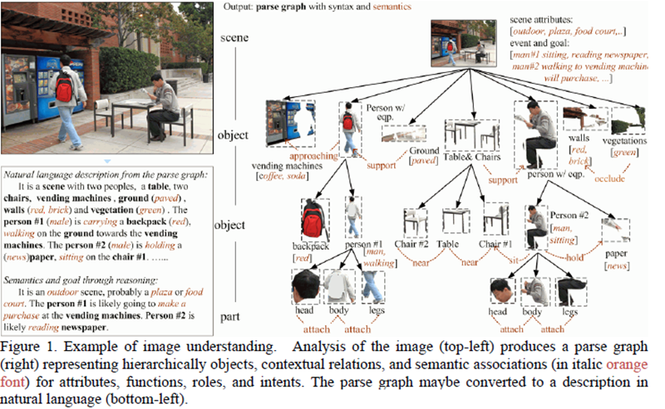
Part 2. The Full AI problem
Understanding of objects, scenes, and events. Describing them in language.
Reasoning about the functions and roles of objects, the goals and intentions of agents, and predicting the outcomes of events
Planning and taking actions to achieve goals.
Communicating and coordinating these plans/actions with humans and agents (robots).

Slide 8
Part 3. Why is Vision Hard? Complexity.
The set of images is enormous. If each pixel value to take 256 possible values (as in a digital camera), then there are more images of size 10x10 than have been seen by all mankind over all history and pre-history. Humans see at most 10^9 each year.
These are imaged from world scenes consisting of objects in environments. For a single object – allowing 13 viewing factors which take 1,000 values we reach 10^39 images for a single object.
A scene can be composed from objects in a combinatorial number of ways – placing N possible objects into M possible positions – yielding M^N possible ways to build a scene (more if you also include lighting, texture patterns, material).
The complexity increases further for image sequences.

Slide 9
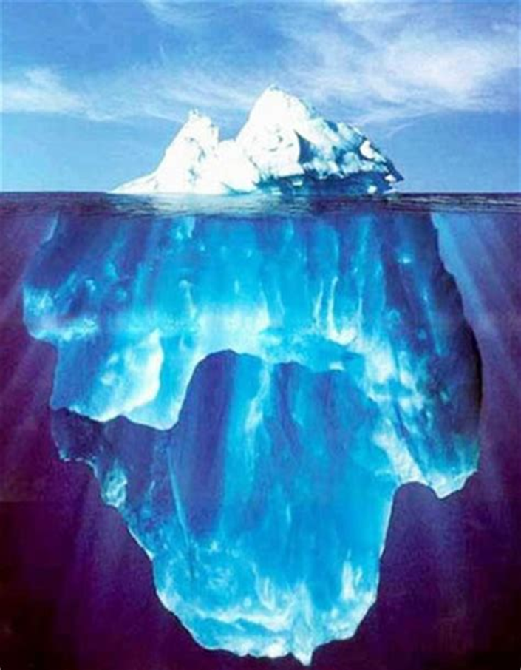
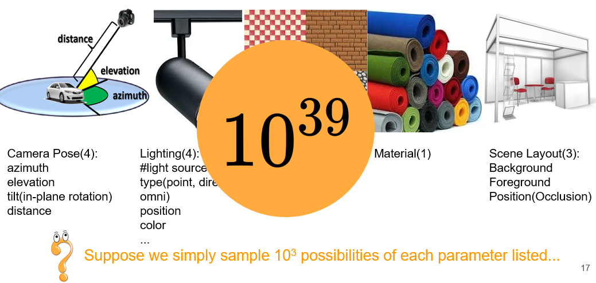
Part 3. Why is Vision Hard? Complexity.
The set of images in any dataset are only an infinitesimal fraction of all images. The tip of the iceberg.
Image of a single object is a function of 13 parameters – camera pose (4),
Lighting (4), material (1), scene (3).

Slide 10
Part 3. Why is Vision Hard? Local Ambiguity.
There is ambiguity in how images are generated as functions of the geometry and material properties of the objects and the lighting.
This can result in global ambiguity. We can confuse material properties for geometry, or geometry for material properties (Demo later).
Local ambiguity – subregions of images are often locally ambiguous and need context to disambiguate them.

Slide 11
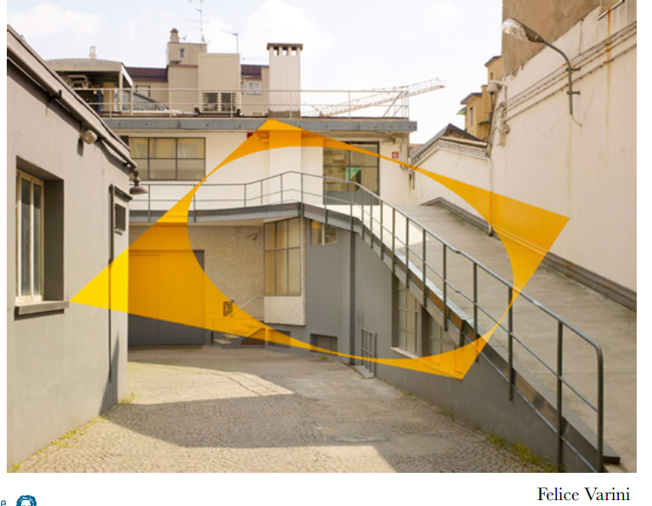
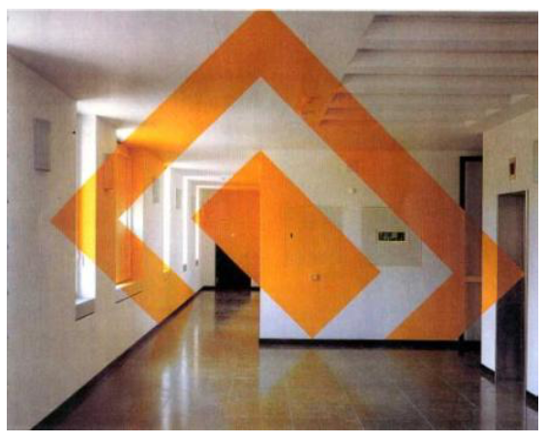
Part 3. Why is Vision Hard? Global Ambiguity.
Ambiguity – geometry, material properties, lighting. C. von der Malsburg.

Slide 12
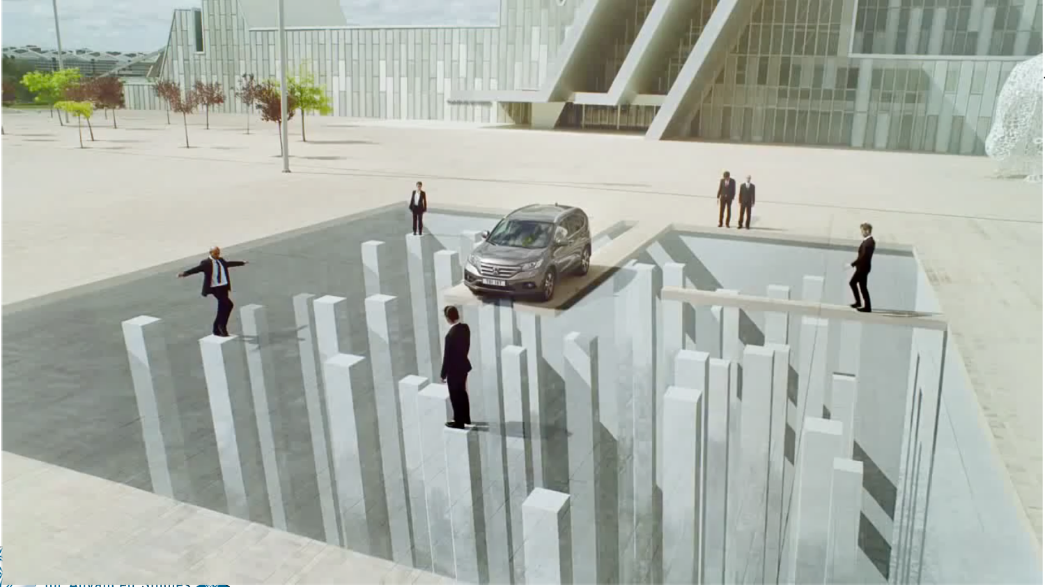
Part 3. Why is Vision Hard
Global Ambiguity – Honda Visual Illusions.
https://www.youtube.com/watch?v=e_UvpGOW-cc

Slide 13

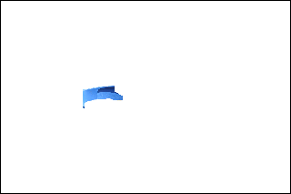
Part 3. Why is Vision Hard. Local Ambiguity.
Airplane
Car
Boat
Sign
Building

Slide 14
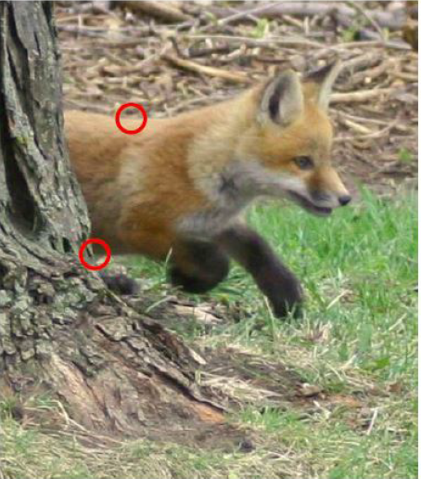
Part 3: Why is Vision Hard? The more you look the more you see.
“There is a fox in the garden” (coarse).
“There is a young fox emerging from behind the base of a tree not far from the view point, it is heading right, stepping through short grass, and moving quickly. Its body fur is fluffy, reddish-brown, light in color, but with some variation. It has darker colored front legs and a dark patch above the mouth. Most of the body hairs flow from front to back.” (detailed).

Slide 15
Part 4. How can Humans do Vision?
Humans and Primates devote an enormous amount of neural resources to do vision. Roughly 40-60% of the cortex is involved in vision.
The cortex is the “intelligent part” of our brain – perception, reasoning, and decision making. It is roughly 80% of our brain (20% for mice). It grew rapidly over the last 3 million years, nearly quadrupling in volume as hominid brains grew from about 350 grams to over 1,300 grams.
Humans are visual machines – we have evolved to see and take action.
Humans are skilled at fine-detailed tasks (due to our opposable thumbs) at long distance travel (running 3,000 miles in 60 days), at tracking and chasing animals for food. All these tasks are impossible with an advanced visual system. We are born to see.

Slide 16
Part 4. How can Humans do Vision?
The human visual system is extremely complex. The number of neurons is enormous -- more than all the trees in the Amazon rain forest -- and their connections are bigger than the number of leaves in the Amazon rainforest. They would reach to the moon and back.
Real neurons are very complex and variable. Many types of cells with a large diversity of morphology (shapes). Complex dendritic structures, maybe internal states (in the cell body), and ways to rapidly change synaptic strength. They could be an order of magnitude (or more) complicated than artificial neurons.
We have limited understanding of real neurons. There are many scientific conjectures about neurons which are hard to test. Computations on dendrites (Koch and Poggio), rapidly changing synapses (Crick).
The human brain is the most complicated physical system that we know of.

Slide 17
Part 4: How can Humans do Vision?
This course ignores neuroscience – despite the title. Neuroscience is an extremely complex and important subject. But it is also extremely difficult and very hard to test the types of theories we will describe.
Instead, for reasons of time and clarity, this course concentrates on AI and Cog-Sci inspired AI, with occasional remarks about Neuroscience.
Cog-Sci inspired means the AI is motivated by a conceptual big picture of Human Intelligence and how it differs from current AI.
Care must be taken with building theories based on Cog-Sci experiments. They are typically done, by necessity, on simplified stimuli – toy worlds – and their findings may not generalize to the complexity of the real world. Many famous theories only work for the stimuli in the lab.

Slide 18
5. What is Human Vision Good and Bad at?
Brains are much more energy efficient than computers. The Brain uses 1 watt for computation (20 more watts to stay alive) while a computer with 4GPUS uses 1,500 watts. But brains need to sleep and computers do not.
Human vision is much more general purpose and adaptive than AI Vision. Humans can perform a large number of visual tasks consistently. Humans can quickly generalize to visual stimuli they have not seen before.
Comparisons between Human and AI Vision are often poorly done and can be misleading. Arguably many current performance criteria miss-measure Human and AI performance.

Slide 19
5. What is Human Vision Good and Bad at?
Perceptual Organization. Gestalt Grouping.
Humans have also the ability to see patterns and to group basic elements into more complex structures. This was studied by Gestalt psychologists (e.g., Wertheimer, Kanisza).
This can be illustrated by various grouping properties – accidental alignment, common fate, etc. (the phenomena are so strong – everybody gets the same perception) that demonstrations are sufficient.
The ability to group patterns, of highly variable components, shows that human vision can deal with abstraction.
Certain types of grouping (e.g., Kanisza) shows that human vision is aware of geometry and occlusion (independent of object knowledge)

Slide 20
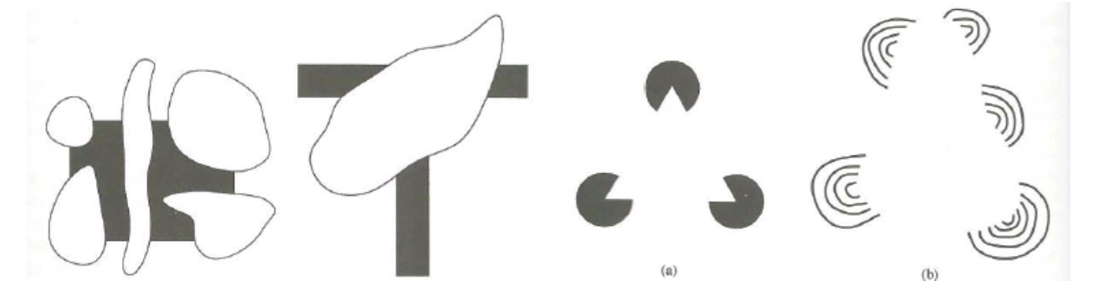
5. What is Human Vision Good and Bad at?
Examples from Kanisza’s book. Organization in Vision.
Something humans can do which is not addressed well by AI vision.

Slide 21
5. What is Human Vision Good and Bad at?
Many human failures result from limited computational resources and low resolution outside the fovea. These result in selective attention, short-cuts taken by the brain, which are sensible most of the time.
Inattention Blindness – the Gorilla in the Room (next slide).
Change Blindness – blindness to changes in the visual periphery.
Crowding in visual periphery -- recognize objects but not their position.
Failures of Consistency – inconsistent interpretation of entire image.
Accidental Alignment --
Limited tracking of objects – humans cannot track more than five objects, and perhaps less if they have complex interactions.
Other effects – e.g., after-effects may be due to “tired neurons” or a sensible strategy for the system to self-callibrate.

Slide 22
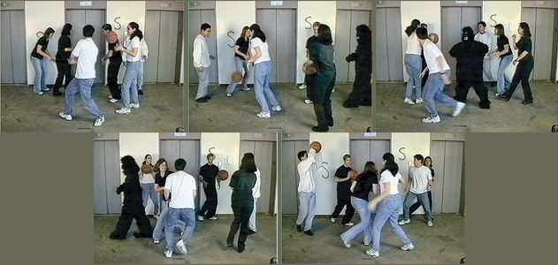
Part 5. What is Human Vision Good and Bad at?
Inattention Blindness. Gorilla in the Room. We fail to see gorilla’s if our visual attention is directed elsewhere. Skilled illusionists perform tricks by diverting the observers attention.
https://www.youtube.com/watch?v=vJG698U2Mvo

Slide 23
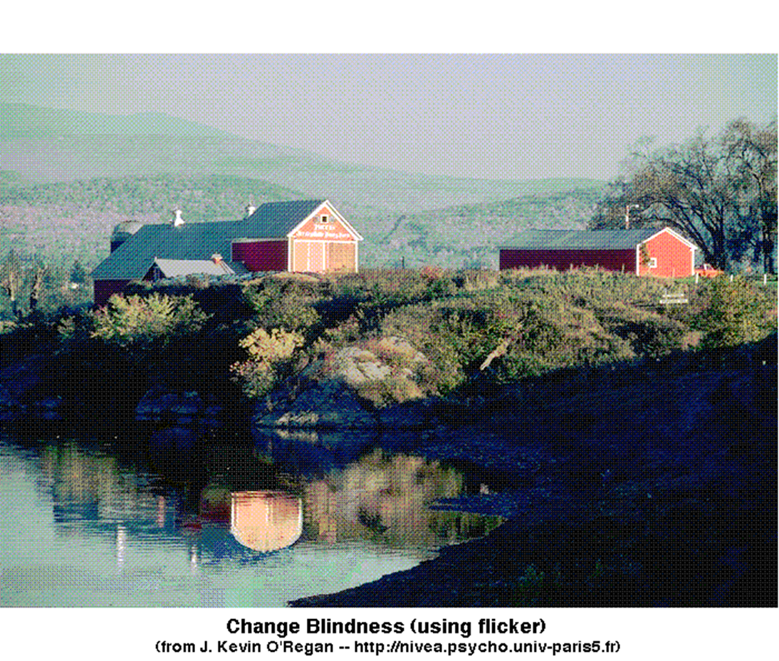
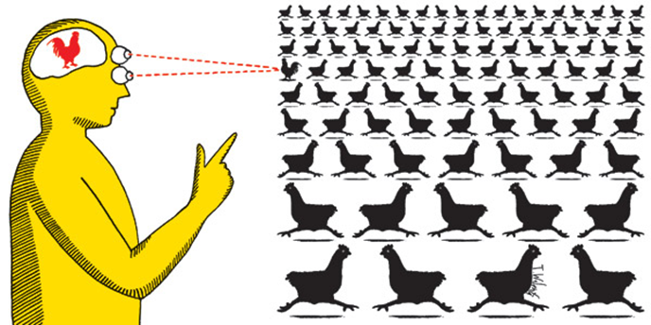
Part 5. What is Human Vision Good and Bad at?
Change Blindness. Humans are bad at noticing differences between images (provided they have similar semantic content). We are bad at noticing changes outside our center of gaze.

Slide 24
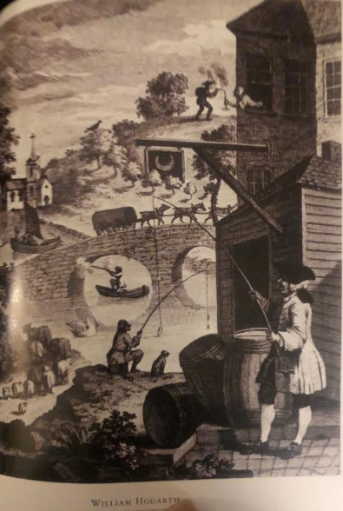
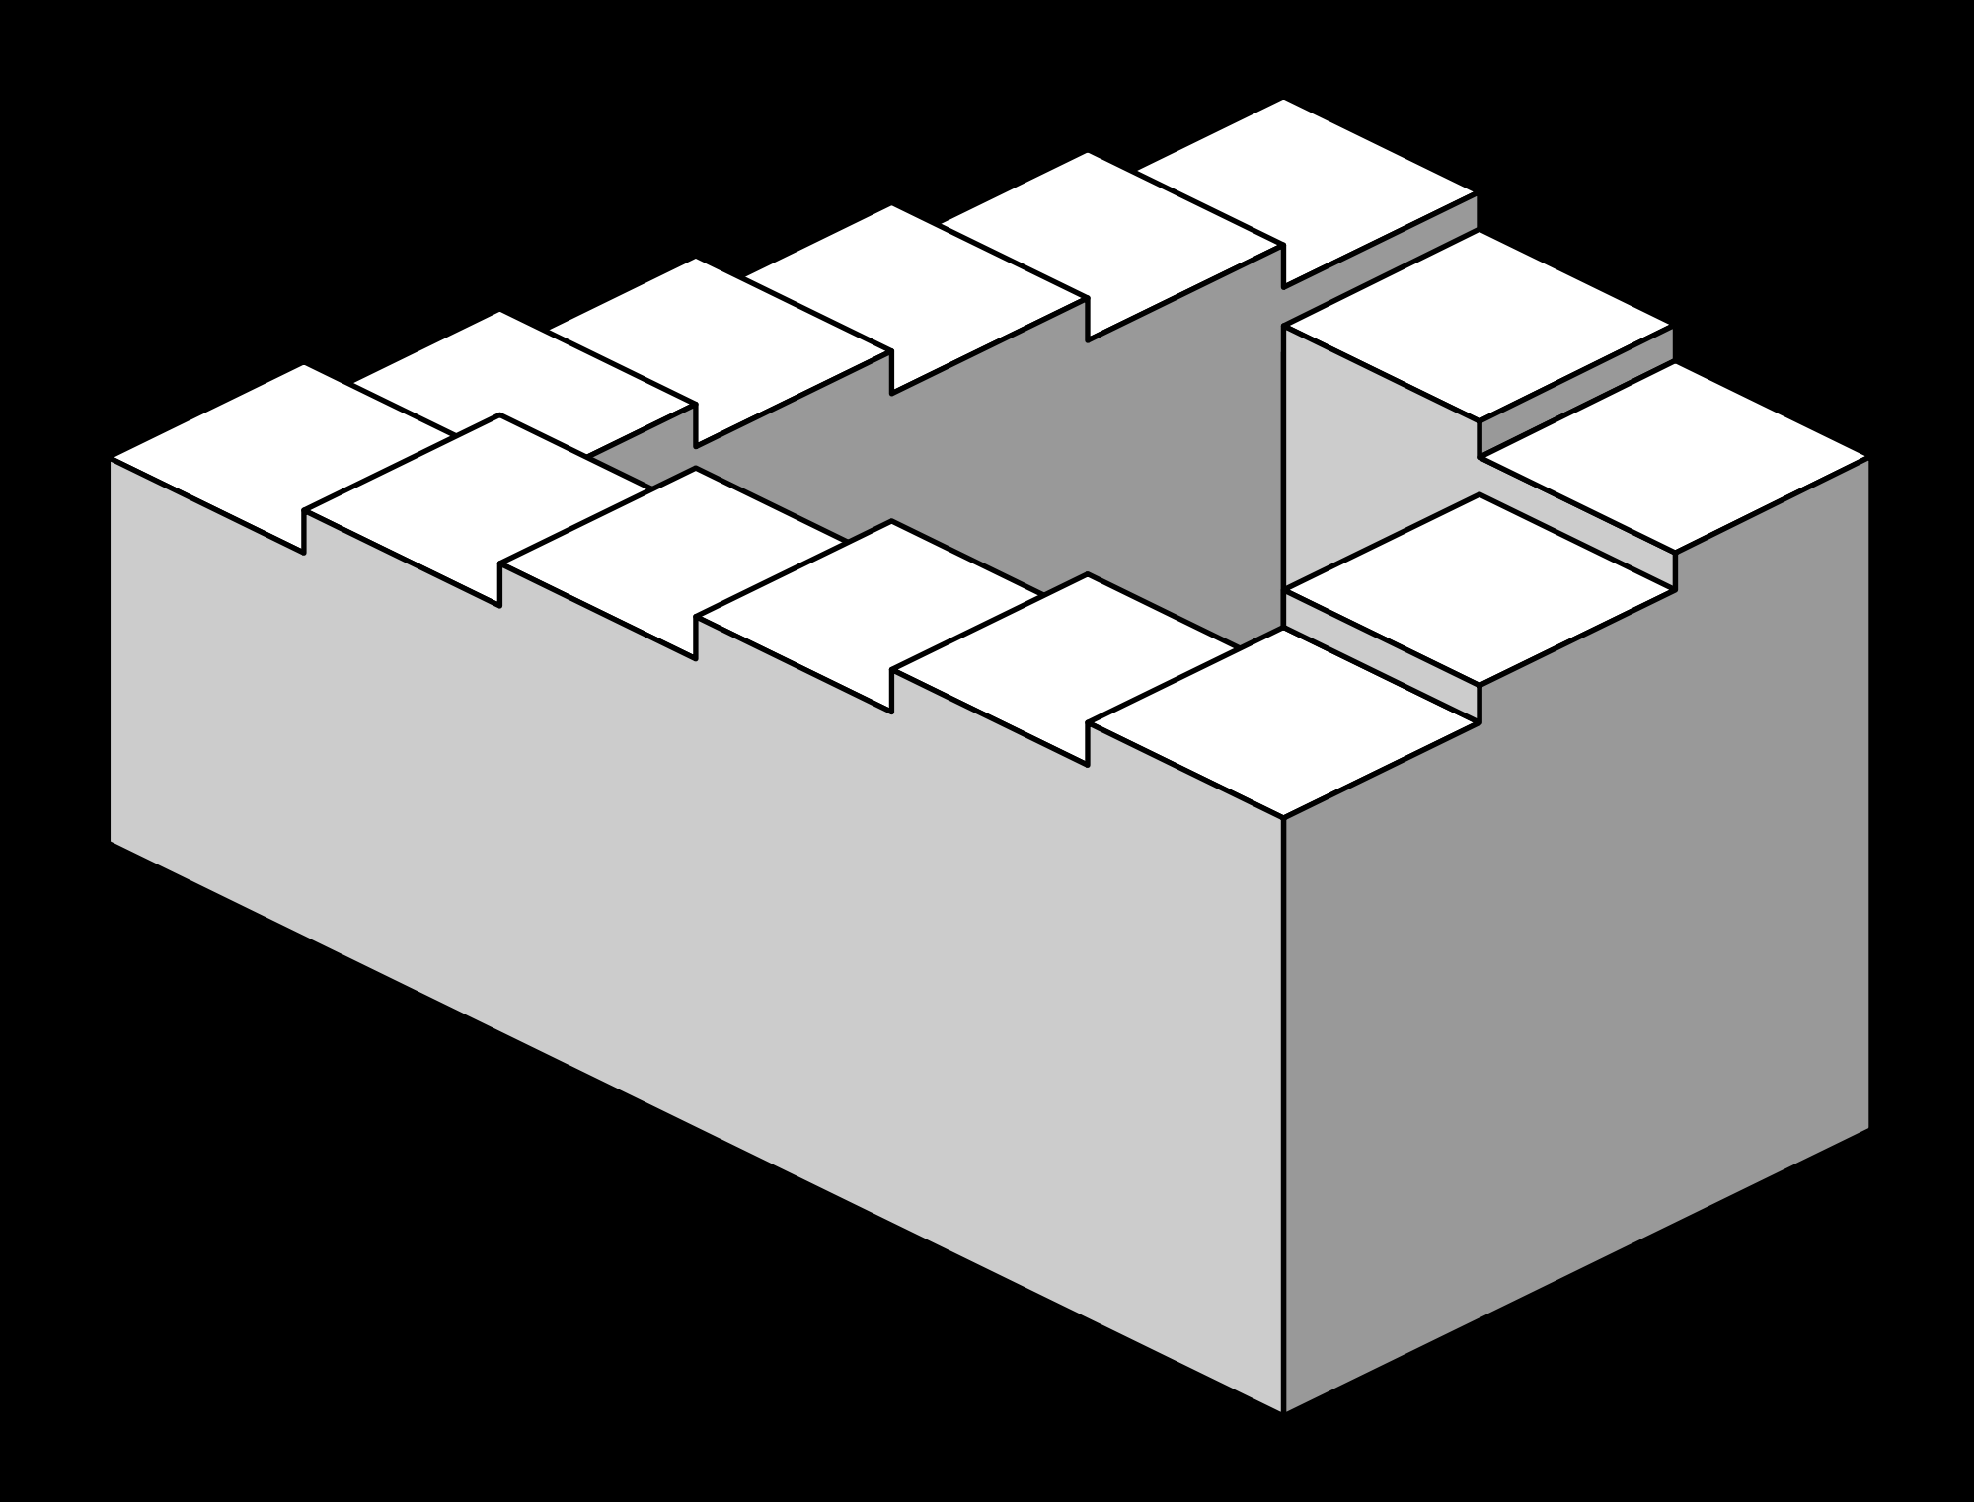
Part 5. What is Human Vision Good and Bad at?
Failures of consistency. Without careful attention we may fail to notice the inconsistency. Probably a sensible efficient (i.e. lazy) strategy

Slide 25

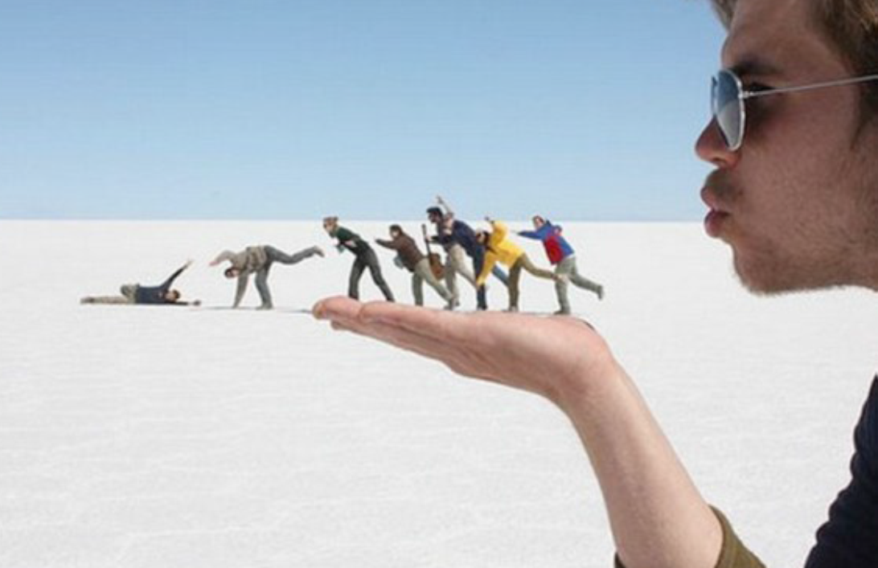
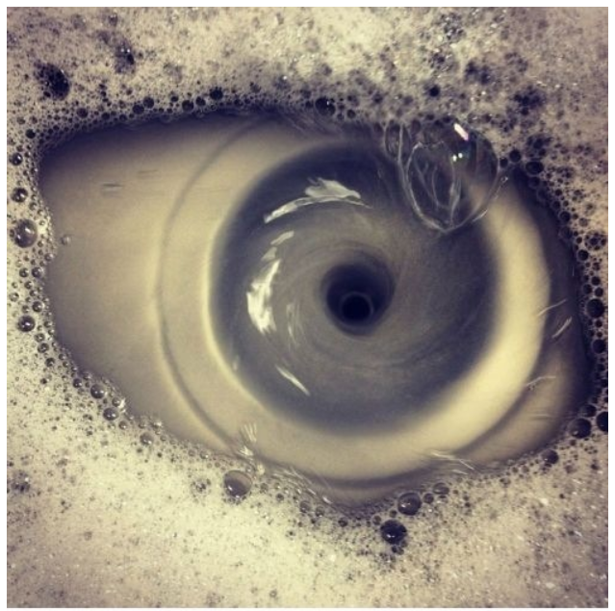
Part 5. What is Human Vision Good and Bad at?
Accidental Alignment. This may also result from a sensible visual strategy that is correct most of the time. (Far right – eye in the kitchen sink).

Slide 26
Part 5. What is Human Vision Good and Bad at?
Michael Bach’s webpage gives a huge set of visual illusions with discussions and possible explanations. http://www.michaelbach.de/ot/
Most of these can be explained as sensible visual strategies in Bayesian terms (see next lecture) -- which are effective most of the time but can make mistakes particularly due to impoverished stimuli.
Consciousness, Visual Awareness, and Blindsight. It is argued that we can sometimes see things but not be consciously aware of them. If asked to guess, we guess correctly. This effect is debatable.

Slide 27
Part 6: The big picture of CogSci and AI
Humans can perform multiple visual tasks consistently.
As we can look round the room and see multiple objects (chairs, pictures, books, a robot dog, carpets, clothes, a sleeping cat, an empty wine glass, a projector, an exercise machine, and many others).
For all of them, we can estimate their shape, their position in the world, and the positions and shapes of their parts. We can also describe their properties, like the age of the carpet and how recently it has been cleaned.

Slide 28
Part 6: The big picture of CogSci and AI
Humans contain mental models of the world. These contain enormous world knowledge obtained from infancy. We learn to model the world during development using multiple sensing cues – sight, touch, taste, sound – and by interacting with it. Babies/infants are tiny scientists who learn about the world by making predictions.
This differs enormously from Machine Learning which is the basis of much recent AI.
Humans have structured compositional representations and causal knowledge about the world. This mental world knowledge gives humans the ability to perform induction – to learn rapidly in new domains and perform novel tasks.
Humans can imagine the world and make counterfactual – what if? – predictions. We may have a computer graphics simulator in our head (J.B. Tenenbaum).
This is a modern update to the classic ideas of “Vision as Inference” (Helmholz, Gregory).“Vision is not just a passive acceptance of stimuli, but an active process involving memory and other internal processes”.
This can be formulated by Bayesian Theories of Vision which combine Analysis – understanding images – with Synthesis – generating them. This estimate properties of the 3D world.

Slide 29
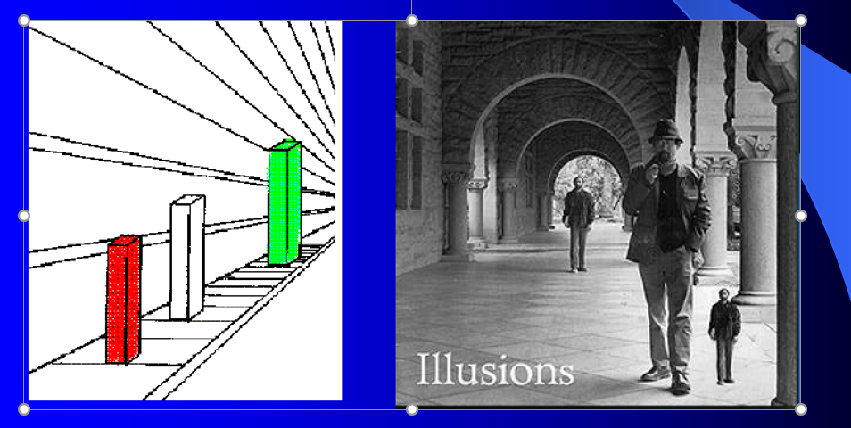
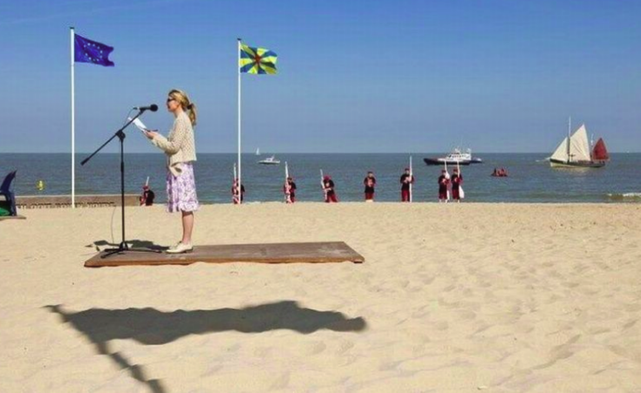
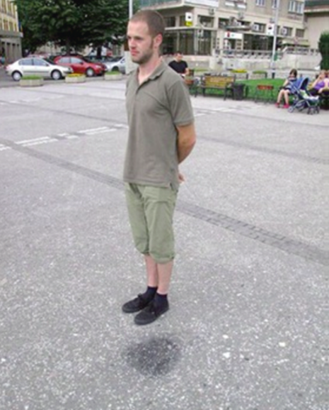
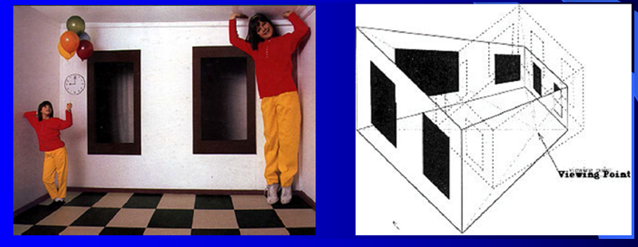
Part 6: The big picture of CogSci and AI
We see in 3D by assuming normal 3D structure (ground planes, shadows, and 3D structure), but are fooled sometimes.

Slide 30
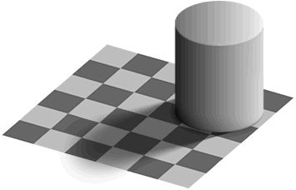
Part 7: Which square is brighter?

Slide 31
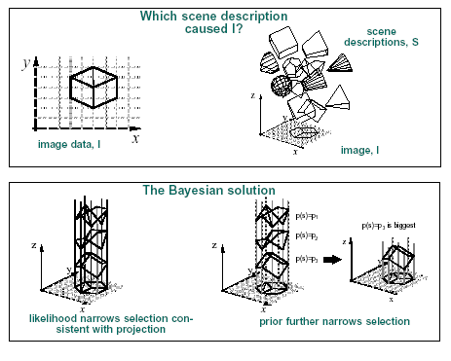
Part 6: The big picture of CogSci and AI
There are an infinite number of ways that images can be formed.
Why do we see a cube?
The likelihood P(I|S) rules
out some interpetations S
Prior P(S)– cubes are more
likely than other shapes
consistent with the image.
.

Slide 32
Part 7: Key Aspects of Human Vision
Cues and Modularity.
The study of human vision has identified visual cues which are sufficient for performing visual tasks in restricted (toy environments).
E.g., Shape from shading, texture, contour, focus, and perspective.
These cues are effective in simplified domains (toy worlds) although extending them to work in the complexity of real images is often extremely challenging.
Many of these cues are now embedded in AI-Vision models, but many are not.

Slide 33
Part 7. Key Aspects of Vision
Abstraction and Domain Transfer.
Humans can understand an object from an image, from a drawing, from an highly abstract sketch. This is, in AI-vision terminology, an extreme form of domain transfer.
Humans can factor shape and geometry – and recognize a blue tree, even if they have never seen one before.
Humans can perform analogical reasoning. We can not only recognize visual similarity between objects, but also relationships (e.g., part-whole: paw to cat, hand to person), and functional relations (e.g., hammer is in toolbox, notebook is in backpack), and other relations (e.g., woman chases child is like cat chases mouse – but only in some ways!).

Slide 34
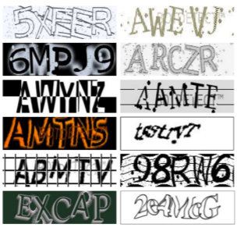
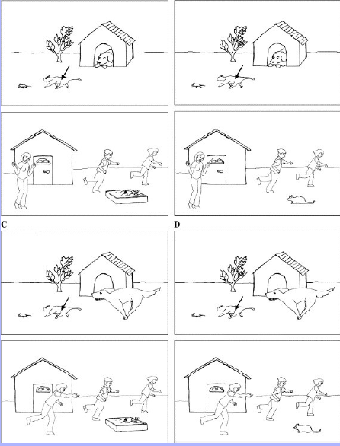
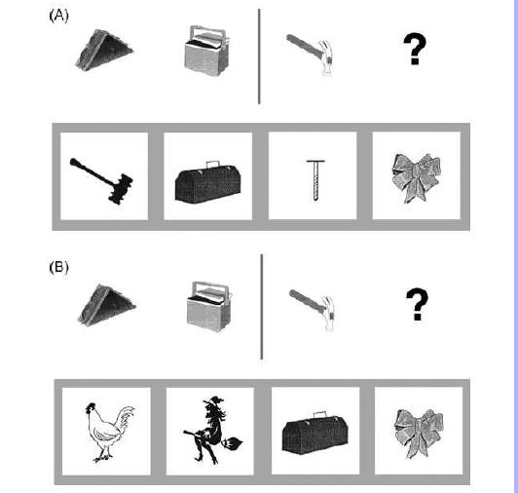
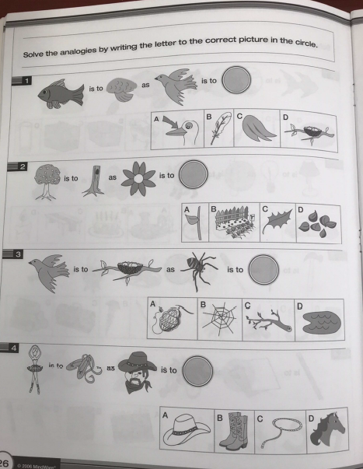
Part 7. Domain Transfer & Analogies
Domain Transfer. Analogies.

Slide 35
Part 7: Key Aspects of Vision
Internal representations of parts. Vision is explainable.
These parts can be detected without context. They can also be described by language.
Humans can explain why they have recognized an object – this is a car because I can see the wheels, the chassis, the doors, etc – and they satisfy the correct spatial relationships.
These parts can also be abstract – i.e. we can recognize a fish even if it is constructed from bicycle parts.
Humans have the ability to deal with the complexity of vision and to answer many different tasks using the same underlying representation

Slide 36
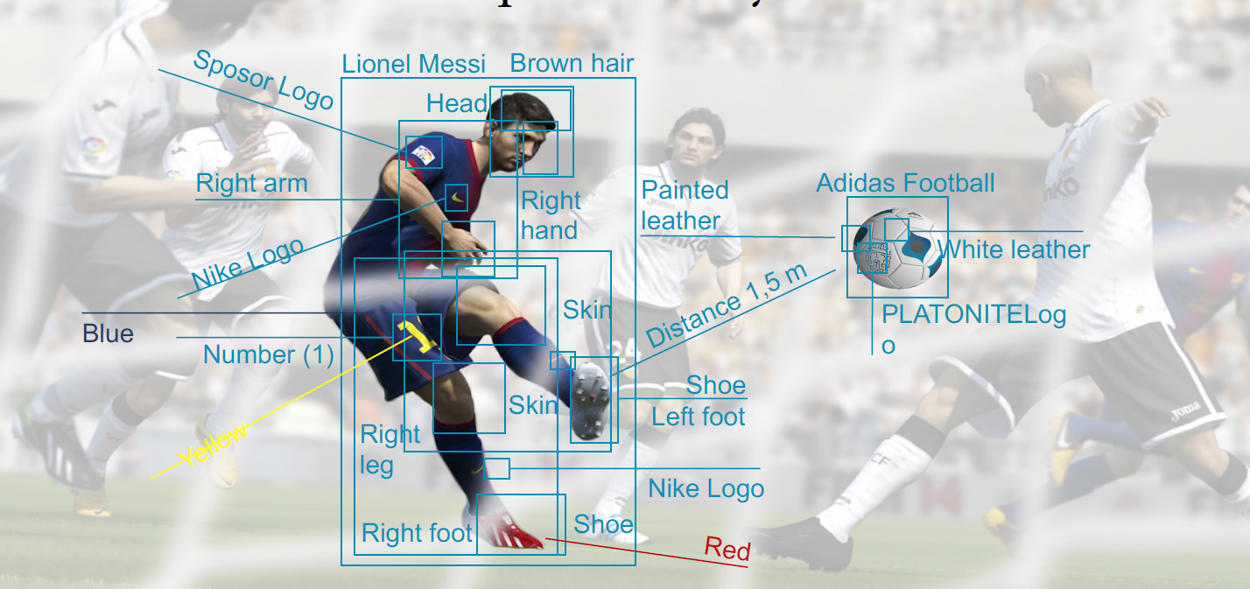
Part 7: Key Aspects of Human Vision
Part Examples (from von der Malsburg)

Slide 37

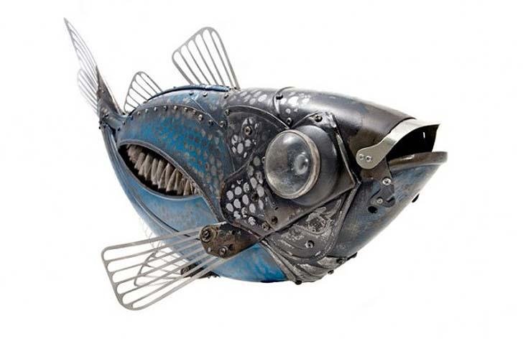
Part 7: Key Aspects of Vision
Parts. And Abstractions. Beethoven constructed from Humans.

Slide 38
Part 7: Key Aspects of Human Vision
Humans have the ability to deal with the complexity of vision and to answer many different tasks using the same underlying representation.
Compositionality is an strategy for doing this. Objects are composed hierarchically in terms of basic elements. This gives the ability to construct an enormous number of objects from basic elements.

Slide 39
Part 8. How To Test Vision Theories
Currently we test AI by average case performance for simgle over large annotated datasets. But this is not tough enough and mismeasures AI because these datasets are not big enough. The AI may do brilliantly on big datasets but suffer from inexplicable failure modes if we modify the images only slightly. AI can take short-cuts for single tasks resulting in catastrophic failures.
This is a very important issue which we will keep returning to in this course.
Ideal: test theories for all visual tasks on all possible stimuli with a controlled strategy and an Adversarial approach. This is now practical due to advances in Computer Graphic tools – Blender and Unreal Engine 5 -- and Generative AI.

Slide 40
Part 8. How To Test Vision Theories
This is even worse for Biological Vision because it is impractical to show humans, or animals, many images.
Many experiments on Biological Vision are run on small datasets (toy datasets), their results are only true on these datasets, and often do not generalize outside the datasets.
Also many experiments lack rigorous controls or have too many. This means that many of the most well known biological vision experiments can be very misleading.
They may best be thought of as demonstrations than as rigorous proofs. Always ask what dataset has been used for the experiment.

Slide 41
Part 9. This course.
The course is converging to CogSci inspired AI. There will be changes to previous years – some material removed and new material added.
This course will be complimented by my Spring course on Vision as Bayesian Inference. Some topics briefly summarized in this course will be presented in detail in my Spring course – and vice versa.
I am excited that CogSci inspired AI will serve both as a theory for Human Perception and for general purpose AI.

