Slide 1
Computer Vision and Its Relationship
to Cognitive Science
A Perspective from Bayes Decision Theory
Alan Yuille · Dan Kersten
Slides covering pp. 1–10: from vision systems and the Bayesian perspective
through the vision modules to Bayes Decision Theory, benchmarking,
and Ideal Observer Theory.

Slide 2
Overview
■ An introduction to computer vision and its relationship to cognitive science, seen through Bayes Decision Theory (Berger 1985).
■ Vision is a vast and complex field, so this is a deliberately narrow scope: a theoretical lens which captures many of the key concepts.
■ BDT is rich enough to include two very different approaches.
(i) The Bayesian viewpoint
A conceptually attractive framework for vision, with concepts that resonate with Cognitive Science (Griffiths et al. 2024).
(ii) The Deep Network approach
Real-world successes that made Computer Vision a trillion-dollar industry; motivated by the hierarchical structure of the visual ventral stream.
BDT relates and captures the strengths and weaknesses of these two approaches — and by discussing the limitations of BDT, it points the way to how they can be combined in a richer framework.
Yuille & Kersten — Computer Vision and Cognitive Science
Overview | 2

Slide 3
Roadmap
1. Vision systems and human perception
2. Three levels of explanation
3. The Bayesian perspective on vision
4. Modularity
5. Stereo, motion, and structure from motion
6. Image segmentation
7. Shape from shading and texture
8. Coupling visual cues
9. Inference algorithms
10. Bayes and its extensions
11. Object recognition and high-level vision
12. Bayes Decision Theory, datasets, ideal observers
Yuille & Kersten — Computer Vision and Cognitive Science
Overview | 3

Slide 4
Vision Systems and Human Perception
■ The goal of a vision system is to infer information about the world from images captured by cameras or human eyes. This is a profoundly difficult task.
■ The human ability to interpret visual data has been called our underappreciated superpower.
■ Cognitive science seeks to understand how humans accomplish this, while computer vision attempts to develop vision systems that perform this task in complex, real-world environments.
■ Both fields began to flourish in the late 1970s, enabled by growing access to computational resources for exploring human and artificial intelligence.
■ Both built on the long history of psychophysics of human perception and the growing understanding of the biology of vision — particularly the hierarchical structure of the visual cortex.
Computer vision researchers developed theories that perform well on complex real images, which required borrowing, adapting and exploiting tools from a range of disciplines: signal processing, linear algebra, algorithms, pattern recognition, cybernetics, statistics, physics, and geometry.
Yuille & Kersten — Computer Vision and Cognitive Science
Vision Systems | 4

Slide 5
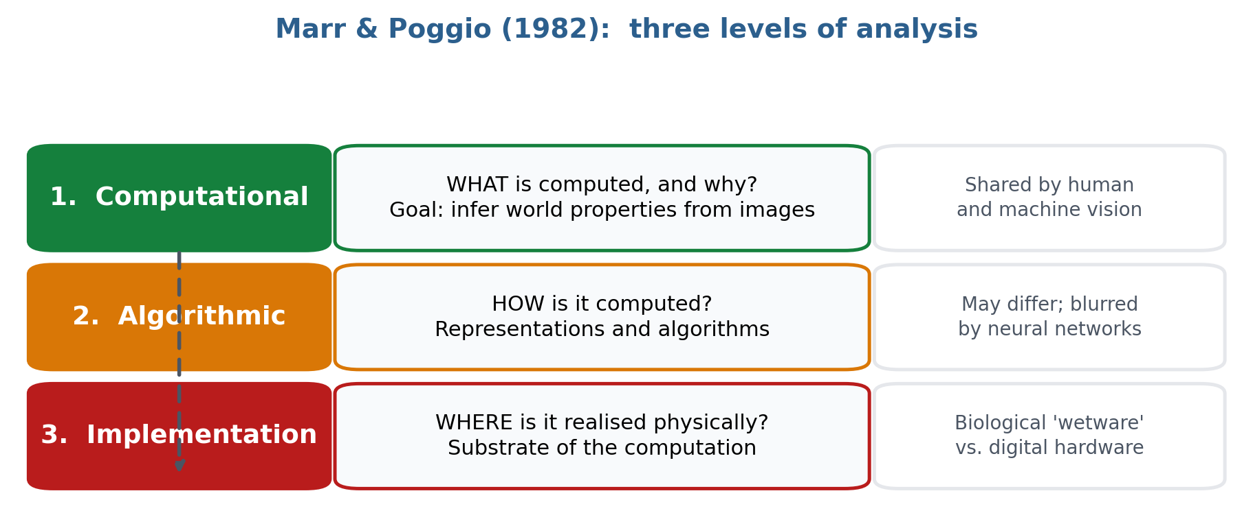
Cognitive Science and Computer Vision
Three levels of explanation (Marr & Poggio; Marr 1982)
Yuille & Kersten — Computer Vision and Cognitive Science
Three Levels | 5

Slide 6
What the Three Levels Bought Us — and What They Did Not
What it enabled
What it does not imply
■ Vision could be studied at different levels of analysis.
■ The computational level was particularly attractive to researchers who wanted theories for both human and computer vision, but who did not want to deal with the underlying biology.
■ Most computer vision researchers, however, had limited interest in human perception.
■ The computational/algorithmic distinction became blurred as computer vision increasingly relied on neural networks.
■ It does not imply that computer vision should develop systems that mimic all aspects of human vision.
■ Human vision remains the gold standard for many tasks — but there are situations where computer vision now outperforms it.
■ Biological systems are constrained by limited memory and computational power, and evolved to perform tasks of value to human survival — not, for example, to detect tumours in CT images.
■ Humans make mistakes machines would not: inattentional effects like failing to see a gorilla in the room due to attending elsewhere.
It is conjectured that the human visual system uses strategies which are energy efficient and have evolved to perform those visual tasks relevant to our ancestors.
Yuille & Kersten — Computer Vision and Cognitive Science
Three Levels | 6

Slide 7
The Bayesian Perspective on Vision
■ Early vision scientists like Helmholtz and Gregory anticipated Bayes by showing that the human visual system combines both direct sensory processing with prior knowledge about the world stored in memory.
■ More precisely, Bayes formulates vision as an inverse inference problem whose goal is to infer the state of the world W from an image I.
Likelihood P( I | W )
Prior P( W )
How the image is generated from the world state — the image-formation, or rendering, process.
The prior probability of the world state: knowledge about how the world tends to be.
P( W | I ) = P( I | W ) P( W ) / P( I )
Bayes advocates selecting the W that maximises the posterior probability P(W | I), combining evidence from the likelihood with evidence from the prior.
Yuille & Kersten — Computer Vision and Cognitive Science
Bayesian Perspective | 7

Slide 8
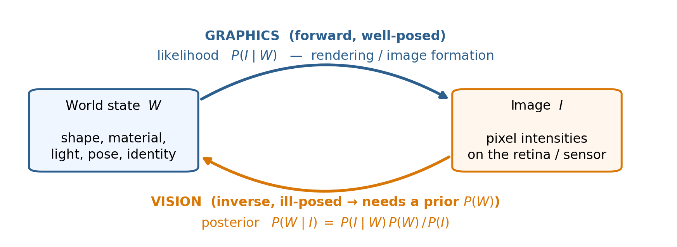
Vision as Inverse Computer Graphics
If the generative process P(I | W) is specified by a graphics engine, then vision is inverse computer graphics. The likelihood function alone is not sufficient to determine the world's state uniquely — prior knowledge is required to obtain a unique percept.
Yuille & Kersten — Computer Vision and Cognitive Science
Bayesian Perspective | 8

Slide 9
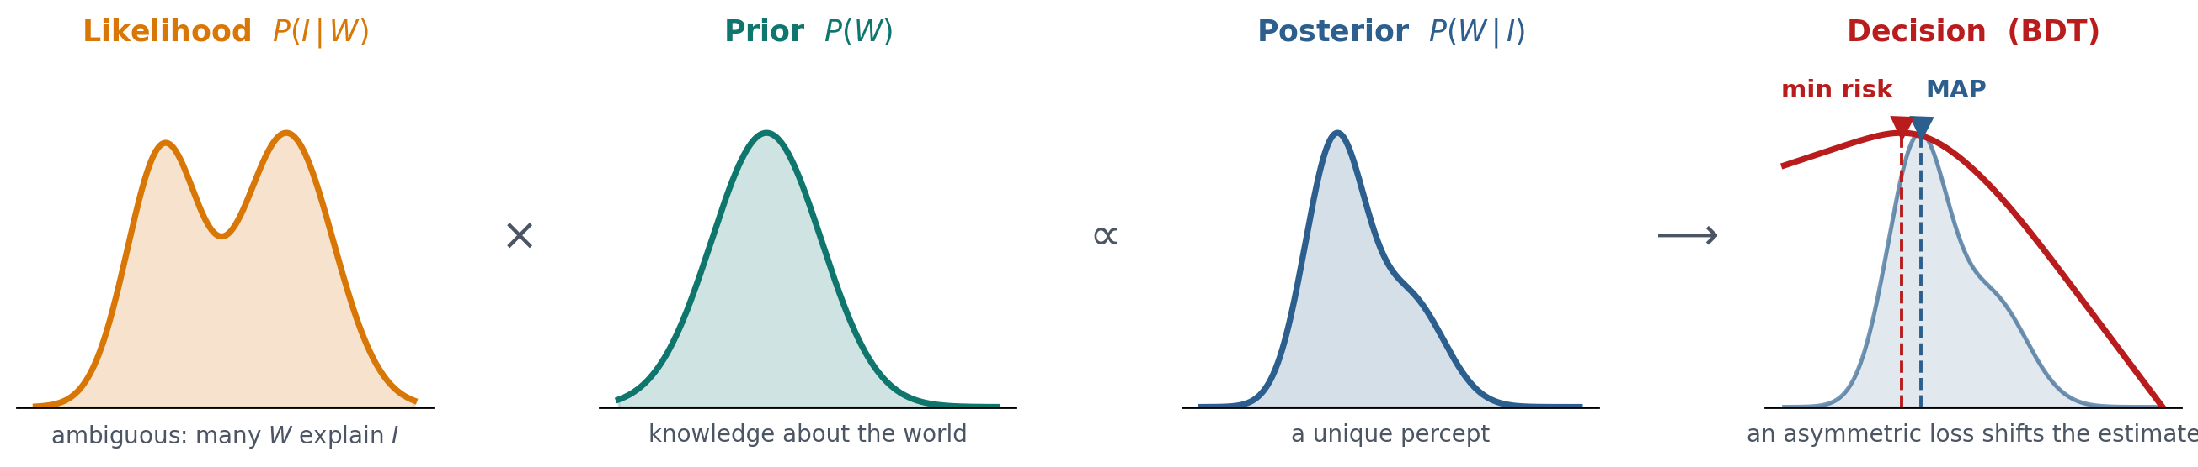
Prior × Likelihood → Posterior → Decision
Yuille & Kersten — Computer Vision and Cognitive Science
Bayesian Perspective | 9

Slide 10
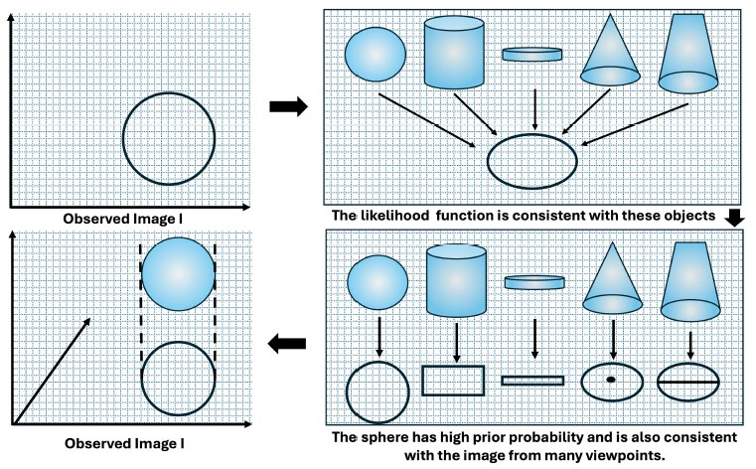
Figure 1: Why the Likelihood Is Not Enough
Left: the image of a circle is consistent with the projection of many objects — a sphere, a cylinder, a disc, a cone, a truncated cone. Right: of these, the sphere has high prior probability and also looks similar from many viewpoints, so it needs no accidental view.
The likelihood puts restrictions on which objects can generate an image, but is not sufficient to yield a percept. This requires additional prior assumptions P(W) — supplemented by the assumption that the object is not seen from an unusual viewpoint (Knill & Richards, Ch. 9).
Yuille & Kersten — Computer Vision and Cognitive Science
Bayesian Perspective | 10

Slide 11
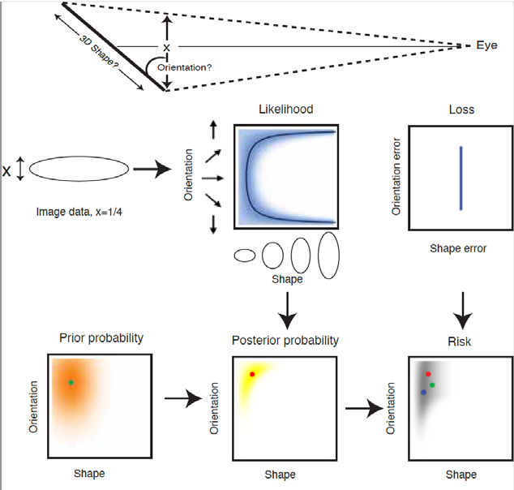
Figure 1 (right panel): From Image Data to Minimum Risk
Interpreting the image as a planar two-dimensional object: the likelihood (the black curve) is insufficient, and a prior is required for a unique percept.
■ The blue gradient represents degrees of uncertainty due to noise in the data.
■ The prior is that surfaces tend to be oriented away from the viewer and have shapes closer to a circle.
■ The loss function prioritises accurate estimation of the 3D shape compared to orientation.
● maximum prior ● maximum posterior ● minimum risk
Yuille & Kersten — Computer Vision and Cognitive Science
Bayesian Perspective | 11

Slide 12

Human Vision Does Approximate Inverse Graphics
■ Many visual demonstrations suggest that humans are capable of approximate inverse computer graphics consistent with Bayes.
■ Illusions of “flying carpets” and “levitations” are hard to explain without assuming humans are estimating the 3D world that generated the image — and in particular the positions of shadows.
■ The illusions arise from accidental alignments of shadows and other dark image regions.
■ Quantified in experimental settings like Kersten's “ball in a box”.
michaelbach.de/ot/ · kerstenlab.psych.umn.edu/demos/shadows/
Figure 2: illusions of levitation and flying carpets.
Yuille & Kersten — Computer Vision and Cognitive Science
Bayesian Perspective | 12

Slide 13
Inverse Graphics Is Often Unnecessary
■ The Bayesian perspective acknowledges that inverse computer graphics is often unnecessary — for computer vision and for biological vision systems.
■ For many tasks — playing baseball, driving a car — a vision system only needs to extract the information which is relevant for the task.
■ But the demonstrations suggest that humans can perform inverse computer graphics approximately and as-needed.
■ It has been hypothesised that this can be performed by a bottom-up and top-down process, exploiting the structure of the visual cortex and its huge number of top-down connections (Mumford 1992).
Inverse graphics is a capability, invoked when the task demands it — not an obligatory first step in every act of seeing.
Yuille & Kersten — Computer Vision and Cognitive Science
Bayesian Perspective | 13

Slide 14
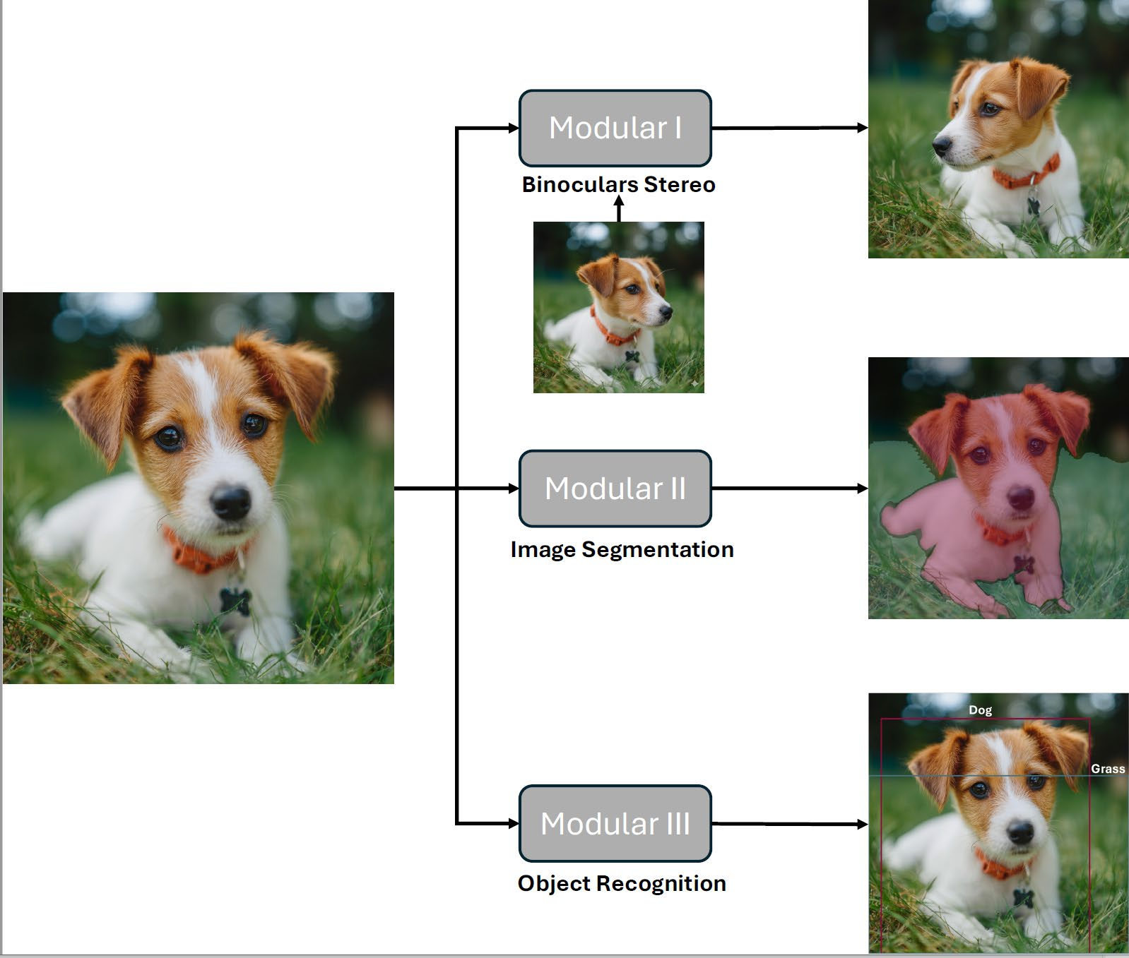
Modularity
The complexity of vision motivated researchers to break it down into modular components that could be studied separately (Marr 1982).
(I) Binocular Stereo — depth is estimated from two eyes.
(II) Image Segmentation — identifies and estimates the boundaries between a foreground and a background object.
(III) Object Recognition — specifies the name of a viewed object.
These decompose even further into depth from binocular stereo, structure from motion, shape from shading, and shape from texture.
Yuille & Kersten — Computer Vision and Cognitive Science
Modularity | 14

Slide 15
What Modularity Made Possible — and What It Did Not
Practical
Out of reach
Modularity made it practical to develop Bayesian theories for some vision modules, by designing plausible likelihoods and priors.
But until recently it was not practical to do this for object recognition, let alone for full inverse computer graphics.
■ Even when annotated datasets became available, researchers lacked the tools to learn these probabilities.
■ Instead they learnt the posterior distributions directly, by feedforward deep networks — as discussed later in the paper.
The tension between modelling the generative process and learning the posterior directly is the thread that runs through the rest of the paper.
Yuille & Kersten — Computer Vision and Cognitive Science
Modularity | 15

Slide 16
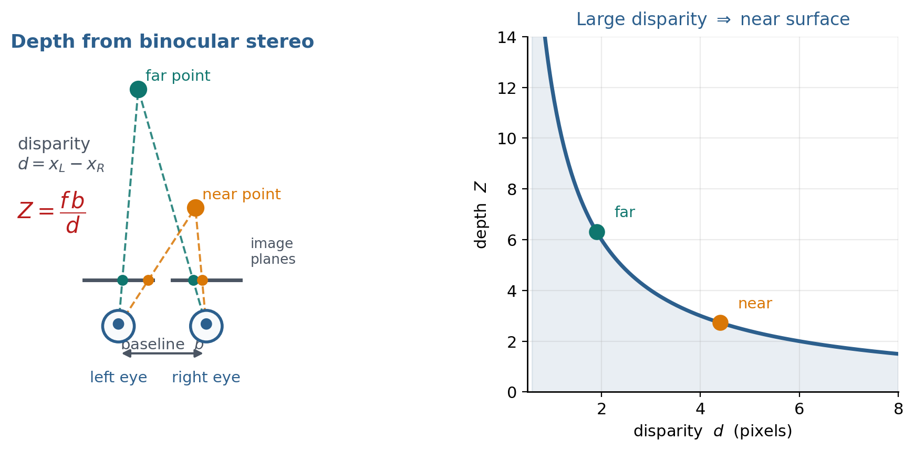
Modules: Binocular Stereo
Early computer vision research focused on modular tasks like depth from binocular stereo, optical flow, and recovering 3D structure from motion — all special cases of obtaining depth from multiple image frames.
Yuille & Kersten — Computer Vision and Cognitive Science
Stereo & Motion | 16

Slide 17
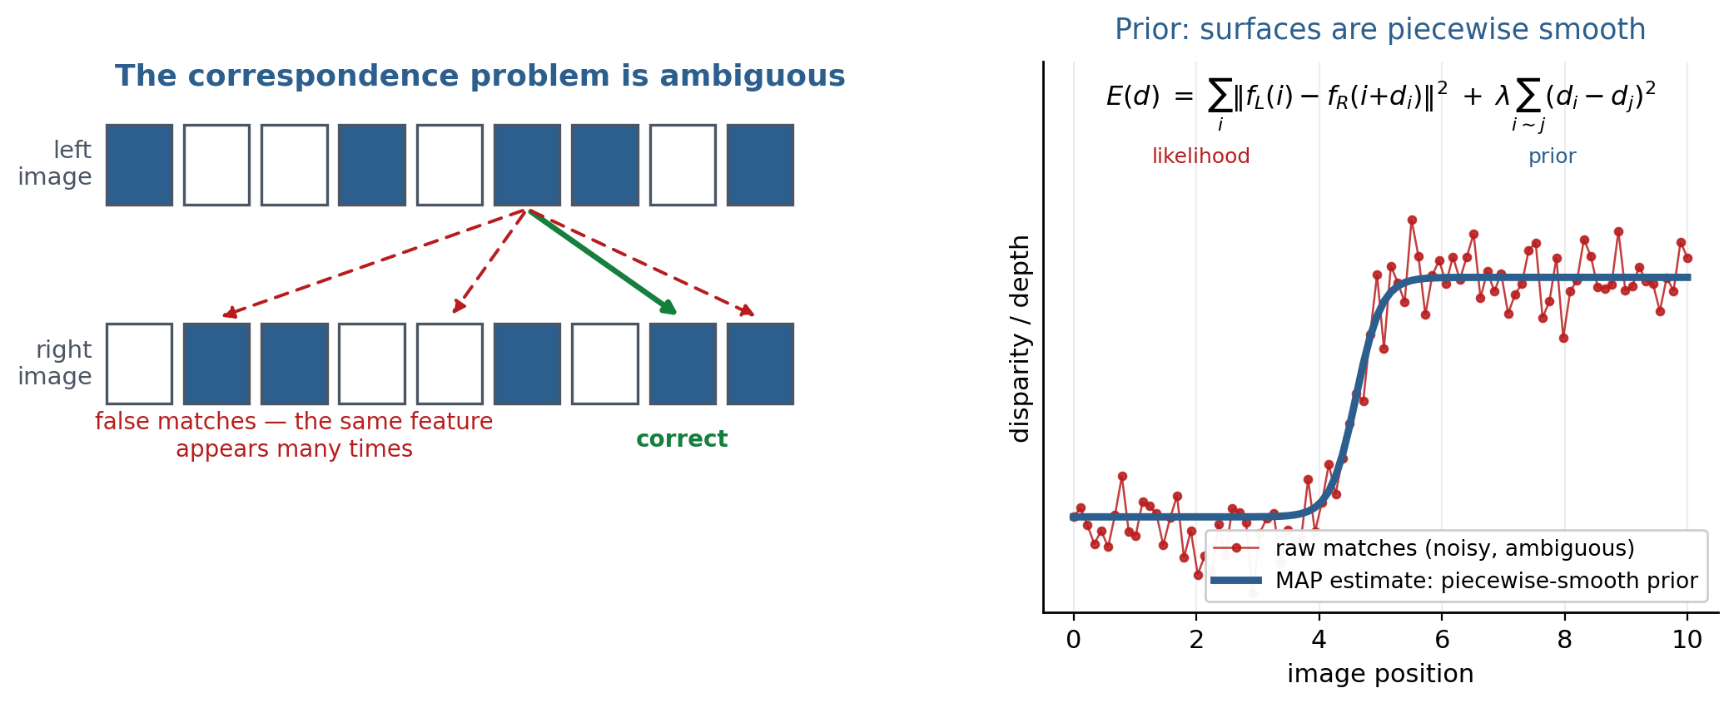
The Correspondence Problem
Analysing these tasks revealed a major challenge: pixels must be matched across image frames. This is ambiguous and requires assumptions about the structure of the world — that surfaces are piecewise smooth, and that objects typically move slowly and smoothly.
Yuille & Kersten — Computer Vision and Cognitive Science
Stereo & Motion | 17

Slide 18
Marr & Poggio (1976): Stereo as Energy Minimisation
■ Early researchers formulated the stereo correspondence problem by an algorithm which, with hindsight, minimises an energy function containing two terms.
First term — the data
Second term — the constraint
Depends on the input images: pixels in the left image must be matched to pixels in the right image with similar features.
Imposes smoothness on the correspondence, which translates into smoothness of the depth.
■ Similarly, models for optical flow (motion in the image) assume that the flow is slow (Ullman 1979) and, more generally, slow and smooth (Yuille & Grzywacz 1987).
■ After correspondence had been found, the shape of an object could be estimated assuming it was moving rigidly (Ullman 1979). Efficient linear-algebra methods were developed to estimate object shape (Tomasi & Kanade 1993).
Yuille & Kersten — Computer Vision and Cognitive Science
Stereo & Motion | 18

Slide 19
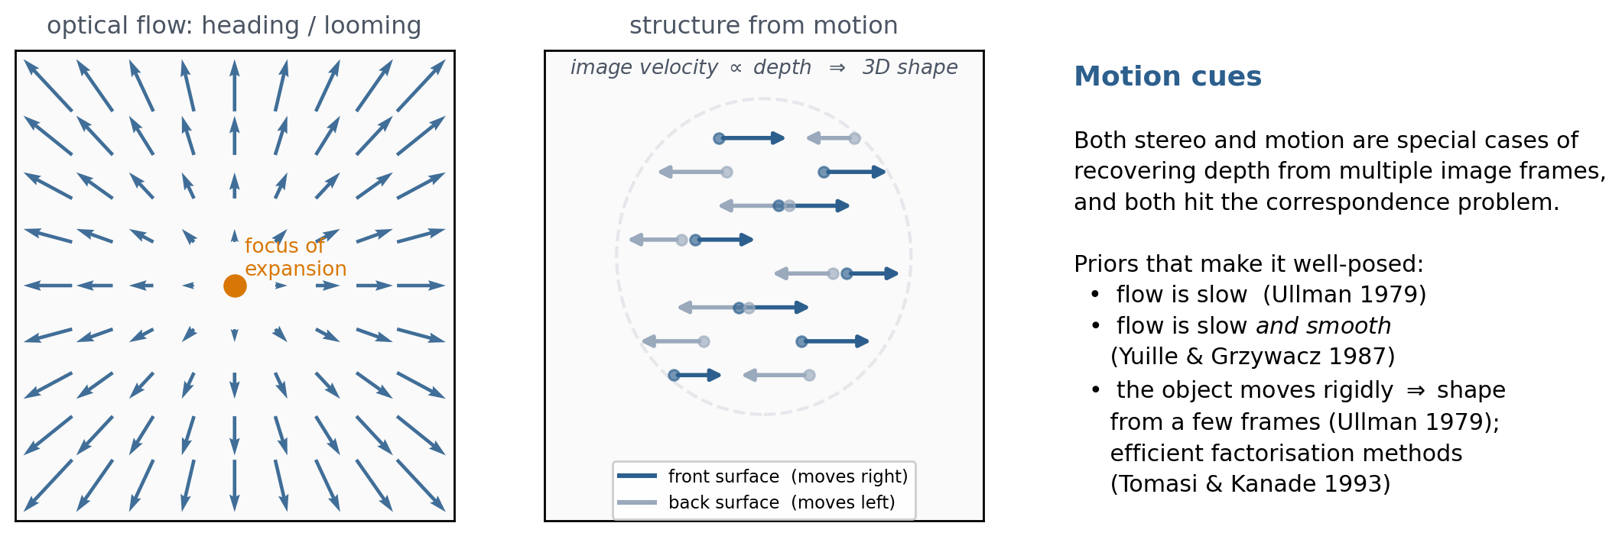
Motion, Optical Flow, and Structure from Motion
Yuille & Kersten — Computer Vision and Cognitive Science
Stereo & Motion | 19

Slide 20
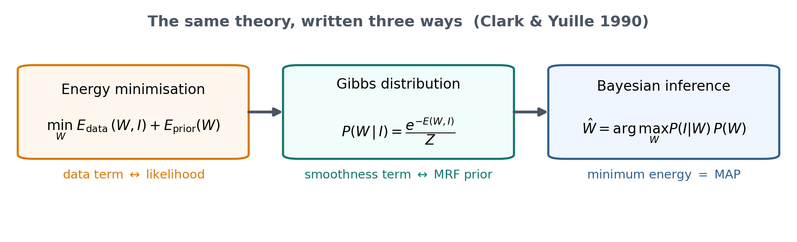
From Energy Functions to Bayes
Energy-function theories align with Bayesian formulations via Gibbs distributions (Clark & Yuille 1990): probabilities are the exponential of the negative energy. The first and second energy terms correspond to the likelihood and the prior. Priors on spatial properties are expressed as Markov Random Fields. Minimising energy = maximising probability = Bayesian inference (Knill & Richards, Ch. 8, 1996).
Yuille & Kersten — Computer Vision and Cognitive Science
Stereo & Motion | 20

Slide 21
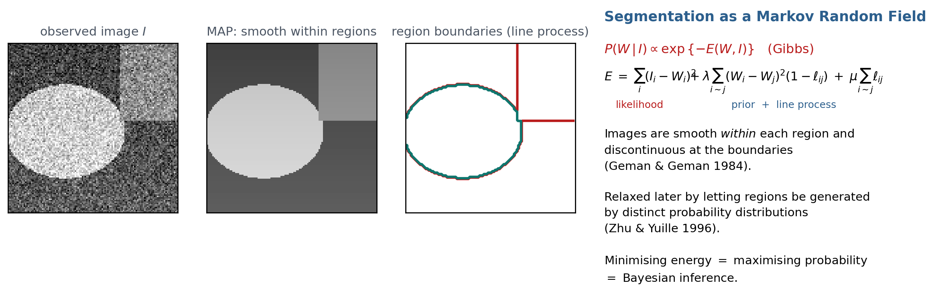
Image Segmentation
Image segmentation decomposes images into regions which ideally correspond to objects. An influential explicitly Bayesian model used the assumption that images were smooth within each region and discontinuous at the boundaries (Geman & Geman 1984). This restricted assumption was relaxed in later models — for example, by assuming the image regions are generated by distinct probability distributions (Zhu & Yuille 1996).
Yuille & Kersten — Computer Vision and Cognitive Science
Segmentation | 21

Slide 22
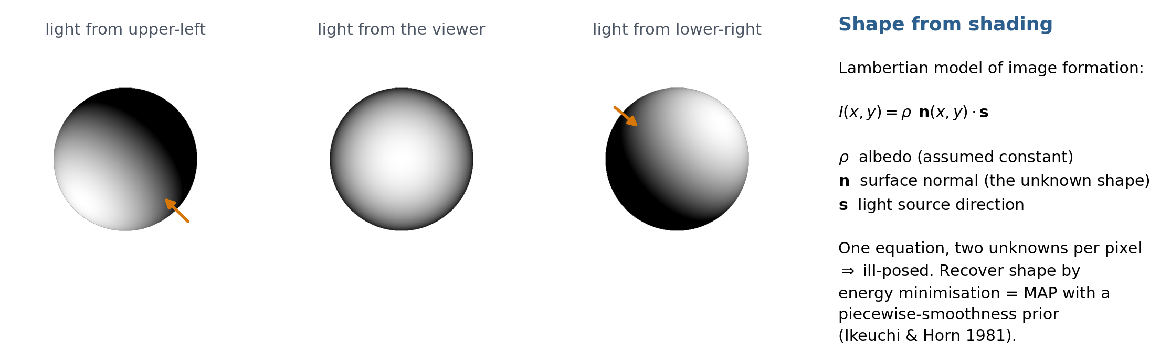
Shape from Shading
Researchers studied estimating the 3D shape of isolated objects from shading. The objects were restricted to having constant texture and Lambertian reflection, used to model how image intensity depends on the shape of the object and the illumination. Estimating the shape was formulated as energy minimisation, which could be reinterpreted as Bayes using a prior that the shape is piecewise smooth (Ikeuchi & Horn 1981).
Yuille & Kersten — Computer Vision and Cognitive Science
Shading & Texture | 22

Slide 23
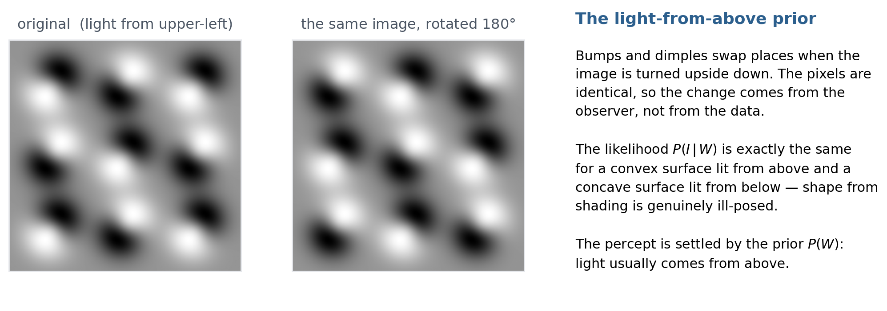
Shape from Shading Is Genuinely Ambiguous
Yuille & Kersten — Computer Vision and Cognitive Science
Shading & Texture | 23

Slide 24
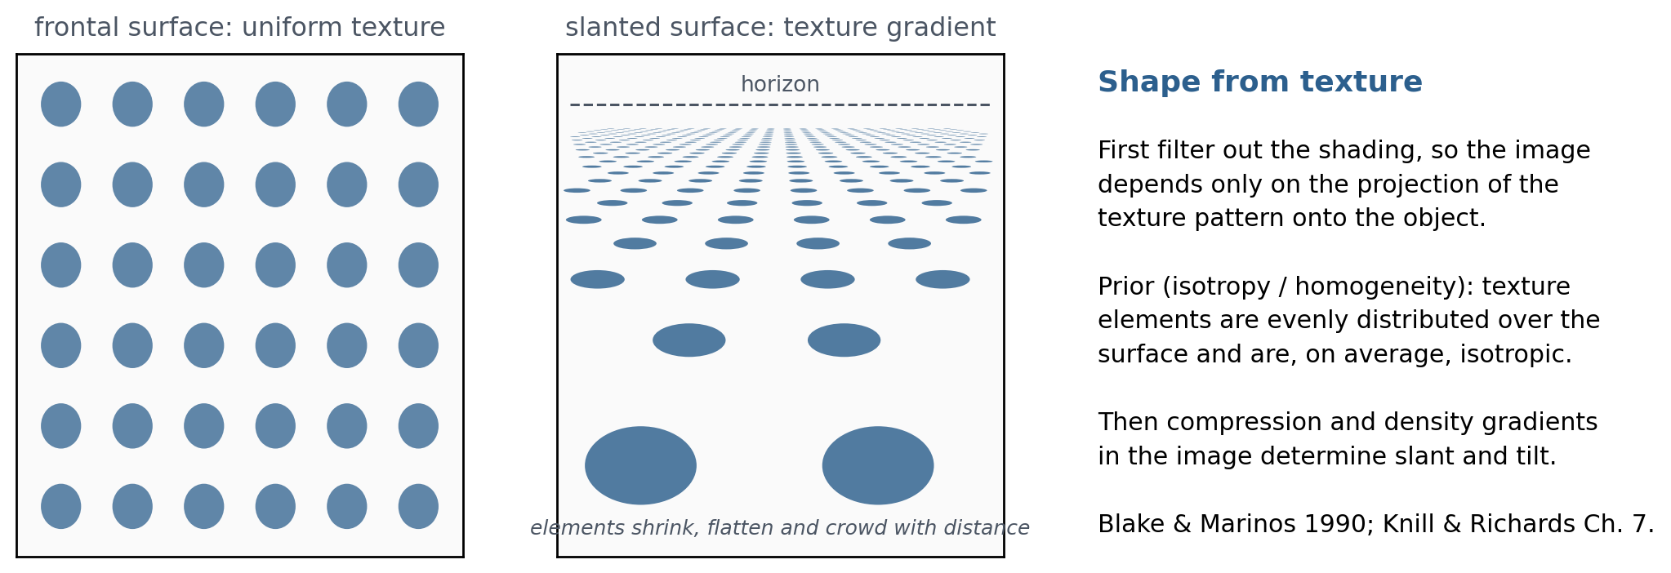
Shape from Texture
For the related task of shape from texture, the theories first filter out the shading, so that the image depends only on the projection of the texture patterns on the objects. The shape of the object can then be estimated by assuming that the texture was evenly distributed on the object's surface (Blake & Marinos 1990; Knill & Richards, Ch. 7, 1996).
Yuille & Kersten — Computer Vision and Cognitive Science
Shading & Texture | 24

Slide 25
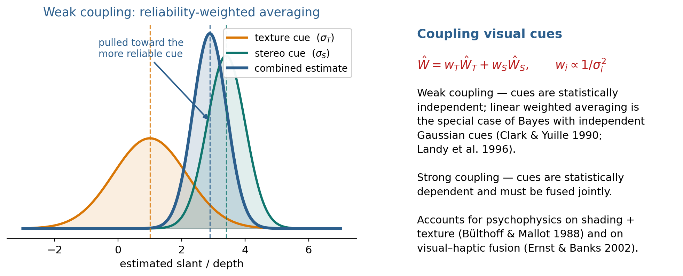
Coupling Visual Cues
Bayes gives a conceptual framework to describe how multiple visual cues — stereo, shading, and motion — can be combined optimally, by considering the uncertainty of each cue and their statistical dependencies (Clark & Yuille 1990).
Yuille & Kersten — Computer Vision and Cognitive Science
Coupling Cues | 25

Slide 26
Weak and Strong Coupling
■ An influential theory (Marr 1982) proposed that visual cues were implemented modularly, and their results combined in representations like the 2½ D sketch.
■ Quantitative studies showed that some cues could be combined by weighted averaging (Landy et al. 1996).
Weak coupling
Strong coupling
The cues are statistically independent. Weighted linear averaging arises as the special case which assumes independence and Gaussian probabilities.
The cues are not statistically independent, and must be fused jointly.
Bayes was able to account for psychophysics findings when shading and texture were combined (Bülthoff & Mallot 1988), on different types of texture cues (Doya et al., Ch. 9, 2007), and for a range of other phenomena investigated by the nascent field of computer-graphics psychophysics (Knill & Richards 1996; Ernst & Banks 2002).
Yuille & Kersten — Computer Vision and Cognitive Science
Coupling Cues | 26

Slide 27
Inference Algorithms for Bayesian Theories
■ Bayes does not specify inference algorithms to estimate the most probable state of the posterior distribution (MAP).
■ But for several vision modules there are algorithms which are not only effective at approximately estimating MAP, but which are also neurally plausible.
Steepest descent
Markov Random Fields
Mean field theory
The simplest case: used for shape from shading (Ikeuchi & Horn 1981).
The context prior of weak spatial smoothness, modelled as an MRF (Geman & Geman 1984; Clark & Yuille 1990).
A novel algorithm adapted from statistical physics, performing approximate inference for a range of tasks (Clark & Yuille 1990).
Examples included a neurally plausible algorithm for the early visual cortex (Koch et al. 1986), later found to be roughly consistent with some neuroscience studies (Doya et al., Ch. 8). Researchers also developed faster learning-based inference algorithms, but these are beyond the scope of the article.
Yuille & Kersten — Computer Vision and Cognitive Science
Inference | 27

Slide 28
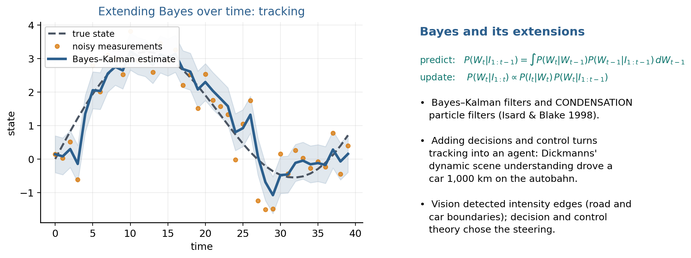
Bayes and Its Extensions: Tracking Over Time
Yuille & Kersten — Computer Vision and Cognitive Science
Extensions | 28

Slide 29
From Tracking to Acting: Decision and Control
■ Bayes can be naturally extended to combine information over time, for tasks like tracking objects (Blake & Yuille 1989) — and in particular by Bayes–Kalman filters (Isard & Blake 1998).
■ It can also be extended to enable an agent to control a system by making a sequence of decisions.
■ This was exemplified by the seminal work of Dickmanns and collaborators on dynamic scene understanding, which resulted in automated cars that could drive 1,000 kilometres on the autobahn (Blake & Yuille, Ch. 18, 1992).
The vision component
The control component
Detected intensity edges from images, corresponding to the boundaries of the roads and cars.
Applied decision and control theory to make optimal choices for how to steer the car, keep it in lane, and avoid other cars.
Yuille & Kersten — Computer Vision and Cognitive Science
Extensions | 29

Slide 30
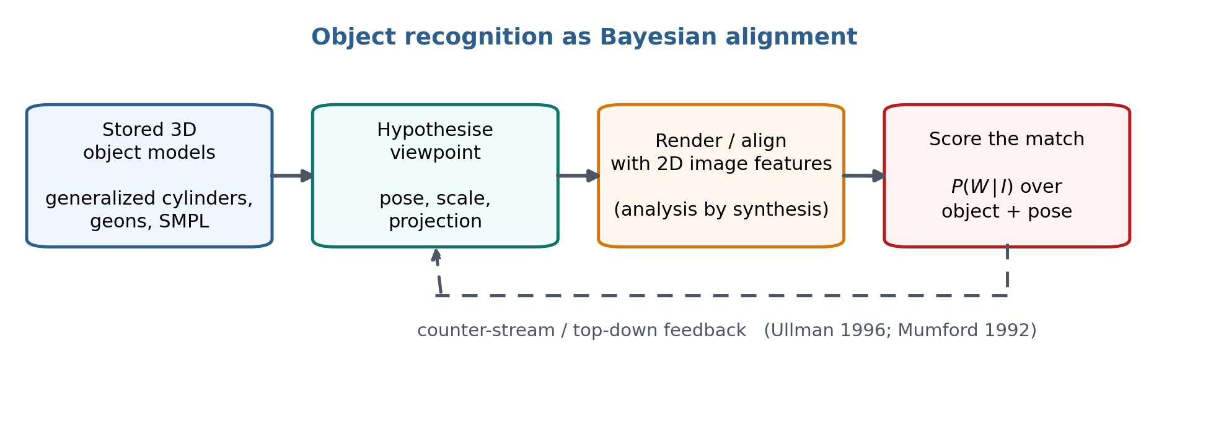
Object Recognition and High Level Vision
High-level vision tasks were typically studied on simplified images of edges and features. Ullman (1996) formulated object recognition as aligning stored 3D object models with features in the 2D image — which is consistent with Bayes — describing core problems such as dealing with viewpoint, and proposing inference algorithms including a counter-stream approach related to analysis by synthesis.
Yuille & Kersten — Computer Vision and Cognitive Science
Recognition | 30

Slide 31
Bayesian Models for Object Recognition
■ This work describes other high-level vision problems, contains psychophysical studies, and describes earlier work representing 3D objects by generalized cylinders (Marr 1982) and geons (Biederman 1987).
■ An explicit Bayesian approach was formulated in Liu et al. (1995), which showed that models with 3D object representations were more consistent with human performance than alternatives with 2D representations.
■ Bayesian models for object recognition were not developed for real images, because it is only recently becoming practical to specify realistic likelihood functions.
■ A notable exception: the SMPL models (Loper et al. 2023), which can represent the shape and pose of humans, and estimate shape by predicting the boundaries of the objects and the positions of key points.
These classes of models can be used to model the experimental finding of Johannsen (1973) on biological motion.
Yuille & Kersten — Computer Vision and Cognitive Science
Recognition | 31

Slide 32
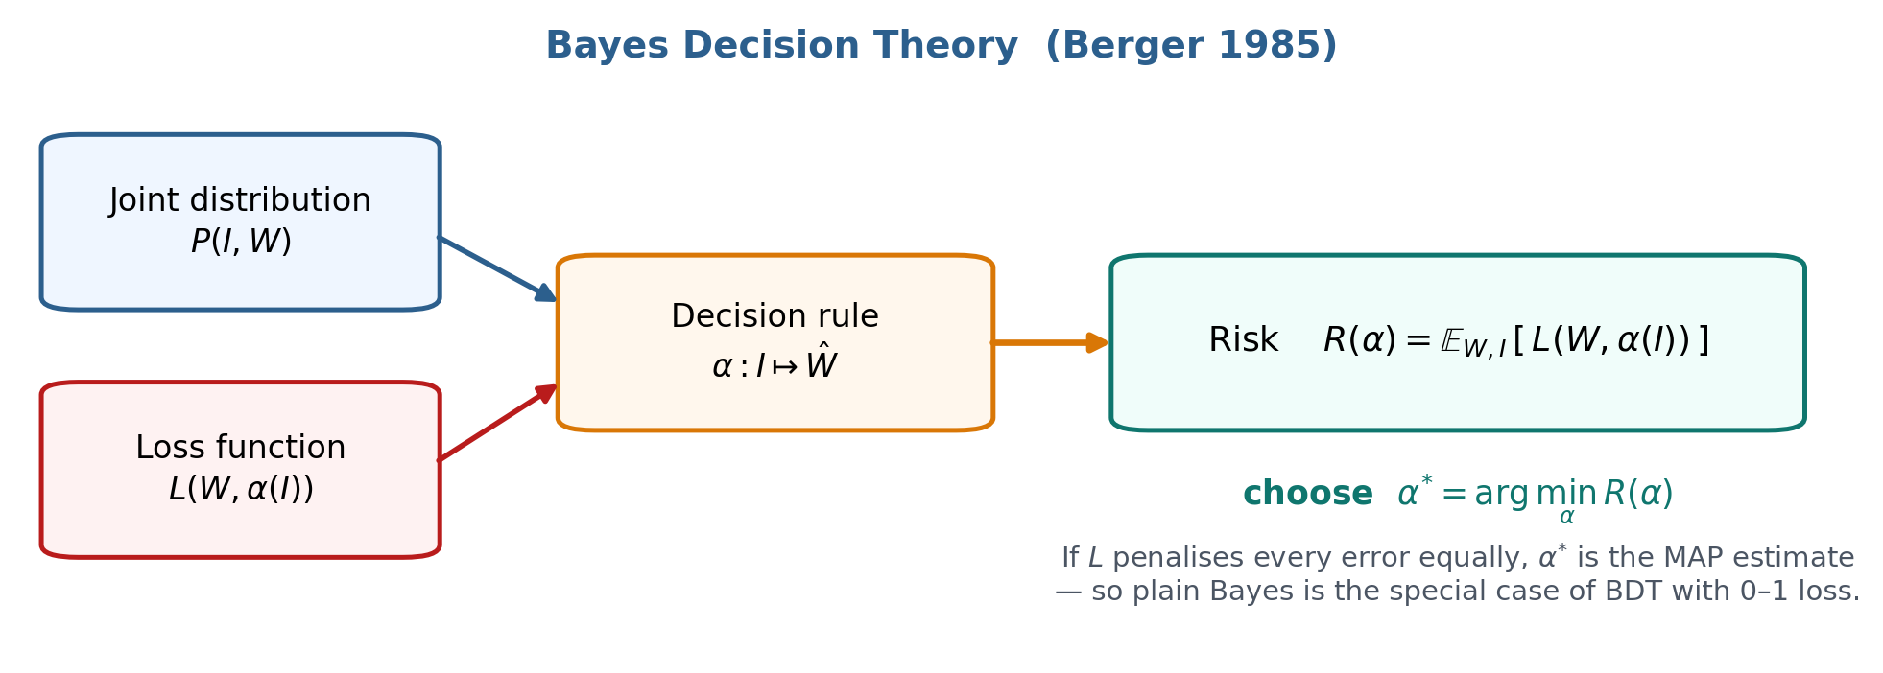
Bayes Decision Theory (BDT)
Bayes is a special case of Bayes Decision Theory (Berger 1985): a normative approach to making decisions under uncertainty which, in addition to the probability distribution P(I, W), introduces a decision rule and a loss function for making the wrong decision.
Yuille & Kersten — Computer Vision and Cognitive Science
Bayes Decision Theory | 32

Slide 33
Why Loss Functions Matter
■ BDT proposes that the decision rule should be chosen to minimise the risk — the expectation of the loss function with respect to the probability of the data.
■ If the loss function penalises all errors equally, then the best decision rule is the MAP, as in the Bayesian theories above.
■ In practice, loss functions are needed because not all losses are equally costly.
■ The MAP estimator is problematic when estimating a continuous variable, because it corresponds to penalising all errors equally — whether they are infinitesimal or enormous. This can be corrected by a loss function (Knill & Richards, Ch. 4, 1996).
The loss function is where the task enters the theory: it says which mistakes actually matter.
Yuille & Kersten — Computer Vision and Cognitive Science
Bayes Decision Theory | 33

Slide 34
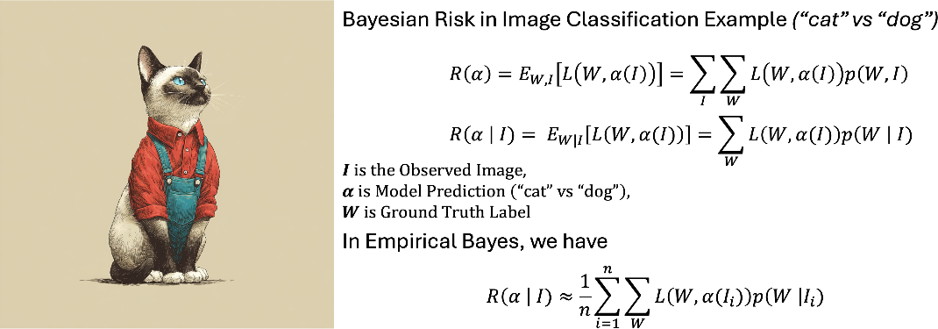
Figure 4: Bayesian Risk in Image Classification
The risk is the expected loss with respect to the distribution of W and I. The empirical risk is the average loss over data samples.
Yuille & Kersten — Computer Vision and Cognitive Science
Bayes Decision Theory | 34

Slide 35
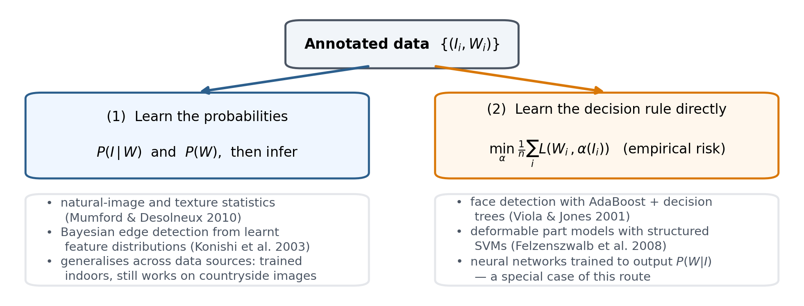
BDT in Practice: Two Ways to Use Data
BDT assumes that we know the probability distributions — but in practice all we have is data, which can be exploited in several ways.
Yuille & Kersten — Computer Vision and Cognitive Science
Bayes Decision Theory | 35

Slide 36
Which Route Should We Take?
The argument for learning P(W | I) directly
The counterargument
From the BDT perspective, the optimal decision rule depends only on the posterior P(W | I) — so arguably there is no need to learn the likelihood and the prior at all.
If data is limited, it may sometimes be easier to model the prior and likelihood — as illustrated by the vision modules described earlier, and by many cognitive examples (Griffiths et al. 2024).
■ Moreover, as illustrated in Konishi et al. (2003), the Bayesian approach can make it easy for an algorithm trained on one type of data — images of house interiors — to generalise and perform well on other data — images of the countryside.
Neural networks were often trained to learn the conditional distribution P(W | I), which is a special case of the empirical-risk route.
Yuille & Kersten — Computer Vision and Cognitive Science
Bayes Decision Theory | 36

Slide 37
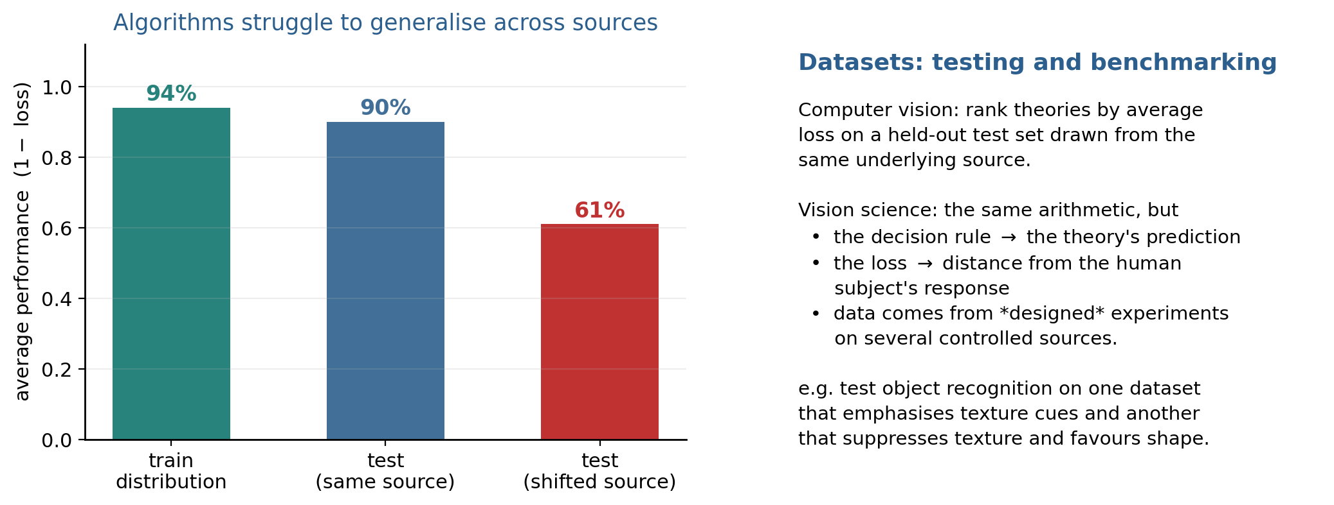
Datasets: Testing and Benchmarking
Computer vision algorithms are evaluated, and compared to alternative theories, by their average loss on testing datasets which consist of data from the same underlying source. In general, algorithms struggle to generalise and perform well on data that comes from another source which differs significantly from the training data.
Yuille & Kersten — Computer Vision and Cognitive Science
Datasets & Ideal Observers | 37

Slide 38
How Vision Scientists Evaluate Theories
■ Vision scientists evaluate theories in a similar way:
• the decision rule is replaced by the prediction of the theory;
• the loss function measures the difference between the prediction and the response of a human subject.
■ One significant difference: vision scientists use experimental design and test their theories on data from a variety of controlled sources.
■ For example, a theory of object recognition may be tested on two different datasets — the first emphasising texture cues, the second de-emphasising texture and enhancing shape.
Same arithmetic, different epistemics: computer vision samples the world; vision science designs the stimulus to isolate the cue under test.
Yuille & Kersten — Computer Vision and Cognitive Science
Datasets & Ideal Observers | 38

Slide 39
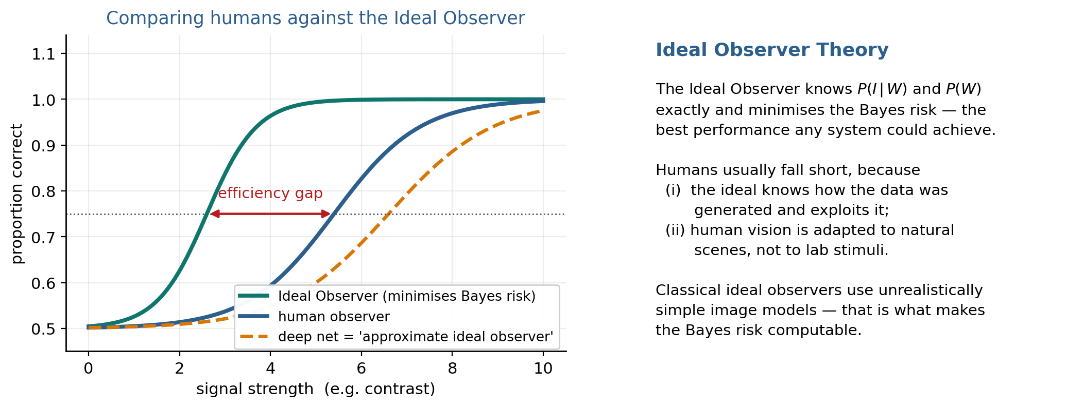
Ideal Observer Theory
Yuille & Kersten — Computer Vision and Cognitive Science
Datasets & Ideal Observers | 39

Slide 40
Ideal Observers, Humans, and Deep Networks
■ Human perception can be tested using BDT by comparing human performance to that of an Ideal Observer who minimises the Bayes risk (Knill & Richards 1986; Liu et al. 1995; Geisler 2011). The data is generated from known distributions P(I, W) and P(W).
■ In most cases the Ideal Observer performed much better than humans, partly because:
• (i) it knows how the data is generated, which it can exploit when making its decision;
• (ii) human vision is adapted for making decisions in natural situations, not in laboratory experiments.
■ Typical Ideal Observers lack realism, using simple models for generating images — which is precisely what enables the computation of Bayes Risk, because realistic models were unavailable.
The success of deep networks means we can learn “approximate ideal observers” by training networks on datasets. They are only approximate: deep networks are not guaranteed to achieve Bayes Risk. For many tasks, humans outperform these observers, suggesting they are too approximate (see Kell & McDermott 2019, and its application to models of the ventral stream).
Yuille & Kersten — Computer Vision and Cognitive Science
Datasets & Ideal Observers | 40

Slide 41
Summary
■ Vision is inverse inference: recover the world W from the image I. The likelihood alone is ill-posed; a prior is what makes the percept unique.
■ Marr's three levels let human and machine vision be compared at the computational level — a distinction blurred by neural networks.
■ Modularity made Bayesian theories tractable: stereo, motion, segmentation, shape from shading and texture.
■ Each module is an energy function = a Gibbs distribution = Bayesian inference, with data and smoothness terms as likelihood and prior.
■ Cue coupling explains how stereo, shading and texture combine — weighted averaging as the weak-coupling special case.
■ BDT adds a decision rule and a loss function; plain Bayes is the 0–1 loss special case.
■ Data can be used to learn the probabilities or the decision rule directly; deep networks take the second route.
■ Ideal Observers give the performance ceiling; deep networks approximate them, and humans still beat both on many tasks.
Yuille & Kersten — Computer Vision and Cognitive Science
Summary | 41

Slide 42
Key References
Framework
· Berger (1985). Statistical Decision Theory and Bayesian Analysis.
· Marr (1982). Vision.
· Knill & Richards (1996). Perception as Bayesian Inference.
· Clark & Yuille (1990). Data Fusion for Sensory Information Processing Systems.
· Mumford (1992). On the computational architecture of the neocortex.
· Griffiths et al. (2024).
Modules
· Marr & Poggio (1976). Stereo correspondence.
· Ullman (1979). The Interpretation of Visual Motion.
· Yuille & Grzywacz (1987). Slow-and-smooth motion.
· Tomasi & Kanade (1993). Shape and motion from image streams.
· Ikeuchi & Horn (1981). Shape from shading.
· Blake & Marinos (1990). Shape from texture.
· Geman & Geman (1984); Zhu & Yuille (1996). Segmentation.
Cues, tracking, recognition
· Bülthoff & Mallot (1988). Shading and texture.
· Landy et al. (1996). Weighted cue combination.
· Ernst & Banks (2002). Visual–haptic integration.
· Doya et al. (2007). Bayesian Brain.
· Koch et al. (1986). Neurally plausible inference.
· Isard & Blake (1998). CONDENSATION.
· Ullman (1996). High-Level Vision.
· Biederman (1987). Geons.
· Liu et al. (1995). 3D vs. 2D object representations.
· Loper et al. (2023). SMPL.
· Johansson (1973). Biological motion.
Learning, data, ideal observers
· Viola & Jones (2001); Felzenszwalb et al. (2008).
· Konishi et al. (2003). Bayesian edge detection.
· Mumford & Desolneux (2010). Pattern Theory.
· Geisler (2011); Kell & McDermott (2019).
Yuille & Kersten — Computer Vision and Cognitive Science
References | 42

