Slide 1
Fitting SMPL to Images:
Optimization and Transformers
3 November, 2026
Alan Yuille · Probabilistic Models of the Visual Cortex

Slide 2
What this lecture covers
1
3D humans from one image
2
Fitting a generative model
Depth ambiguity, body models, SMPL
Posterior, image features, matching
3
Non-linear least squares
4
SMPLify
Gauss-Newton and Levenberg-Marquardt
2D joints, priors, interpenetration
5
HMR 2.0: transformers
6
Tracking humans in 4D
Human mesh recovery with a transformer
Tracking, recognition, camera motion
Geometry and Vision · A. Yuille
2

Slide 3
3D humans from one image
1
One image leaves 3D pose and shape ambiguous; a body model such as SMPL
turns a person into a few pose and shape parameters.
Geometry and Vision · A. Yuille
3

Slide 4
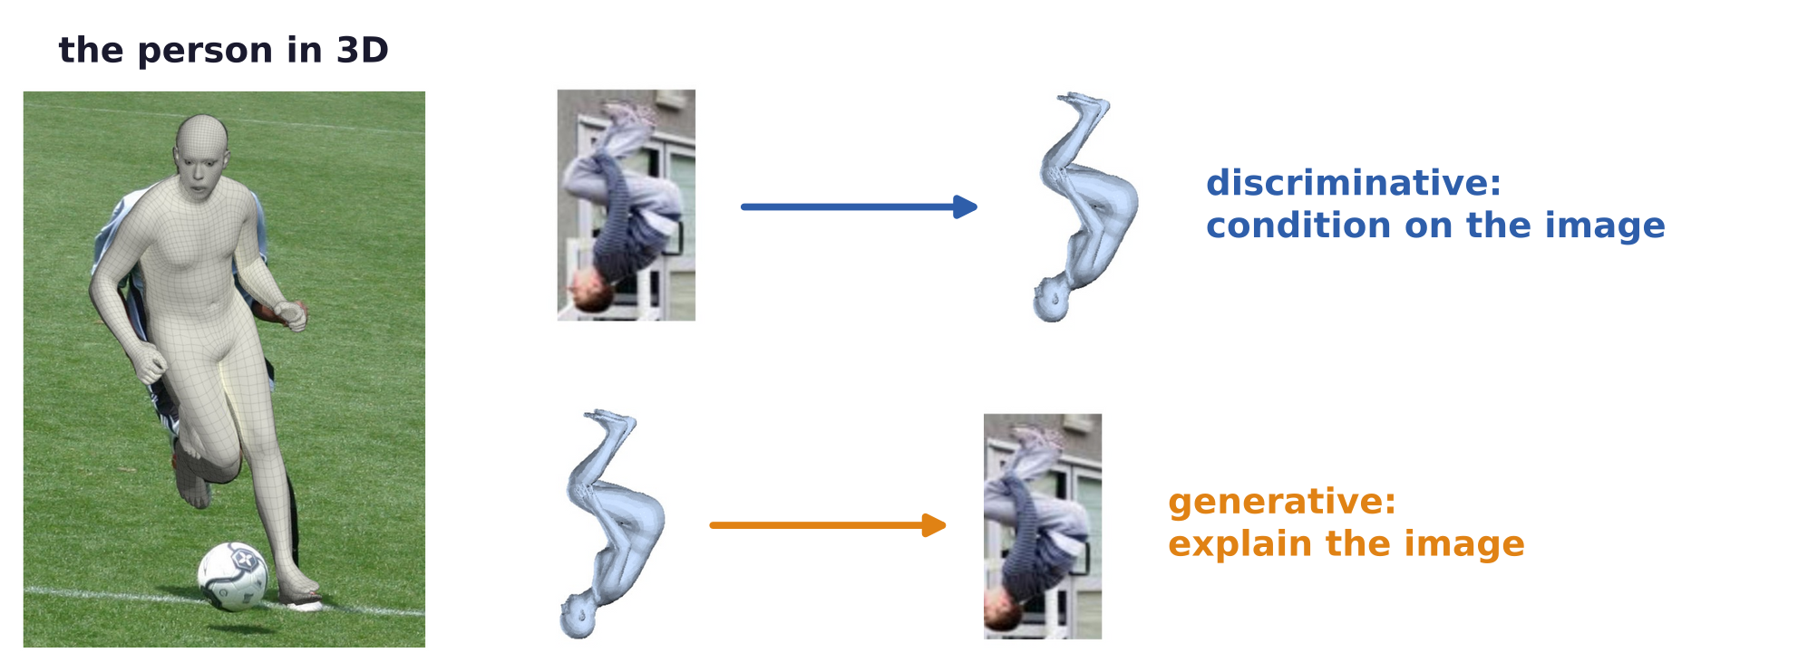
3D humans from one image
Two ways to estimate 3D humans
Goal: from a single RGB (color) image, estimate the 3D pose and shape of the person: “see” them in 3D.
Discriminative models condition on the image: they map the image directly to pose and shape.
Generative models explain the image: they predict the image from a pose and shape, and compare.
Geometry and Vision · A. Yuille
4

Slide 5
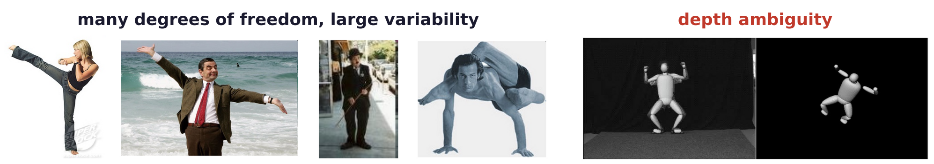
3D humans from one image
Many degrees of freedom and depth ambiguity make 3D hard
Many degrees of freedom; highly dynamic motion; skinning, clothing and outdoor scenes.
Large variability and individuality of motion patterns.
Depth ambiguity: many 3D poses produce the exact same projection in the image.
C. Sminchisescu and B. Triggs, “Covariance scaled sampling for monocular 3D body tracking,” CVPR, I:447–454, 2001.
Geometry and Vision · A. Yuille
5

Slide 6
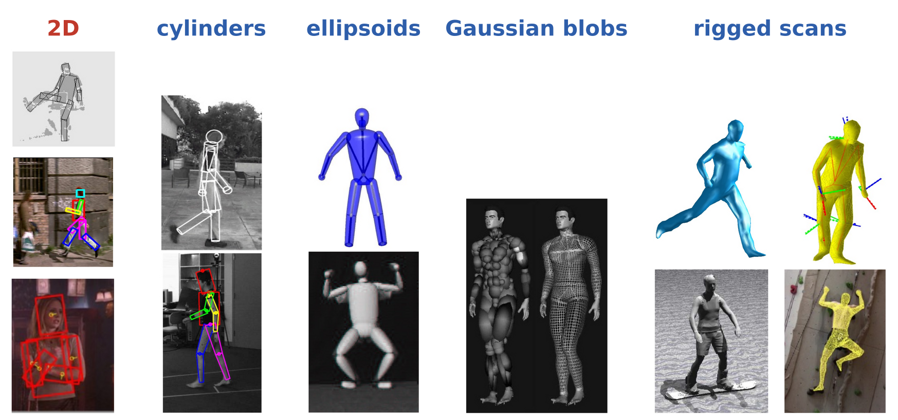
3D humans from one image
We need a body model
We know humans have a fixed skeletal structure, and motion is mostly articulated.
Human shape is roughly symmetric, and lives in a subspace.
Past body models: 2D parts; 3D cylinders, ellipsoids, Gaussian blobs, rigged scans (with a skeleton).
Geometry and Vision · A. Yuille
6

Slide 7
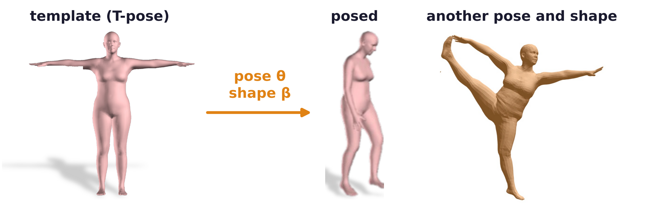
3D humans from one image
SMPL is the de-facto model for human pose and shape
SMPL: Skinned Multi-Person Linear model, learned from thousands of 3D scans of people.
Shape β: 10 coefficients of a PCA (principal component analysis) of body shapes.
Pose θ: the 3D rotations of 23 joints and of the whole body (the root): 72 numbers.
The output is a mesh of 6890 vertices: a flexible and easy to use model which adapts to different shapes.
M. Loper, N. Mahmood, J. Romero, G. Pons-Moll and M. J. Black, “SMPL: a skinned multi-person linear model,” ACM Trans. Graphics
(Proc. SIGGRAPH Asia), 34(6):248, 2015.
Geometry and Vision · A. Yuille
7

Slide 8
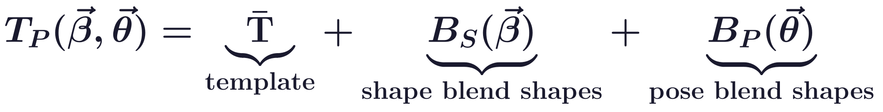
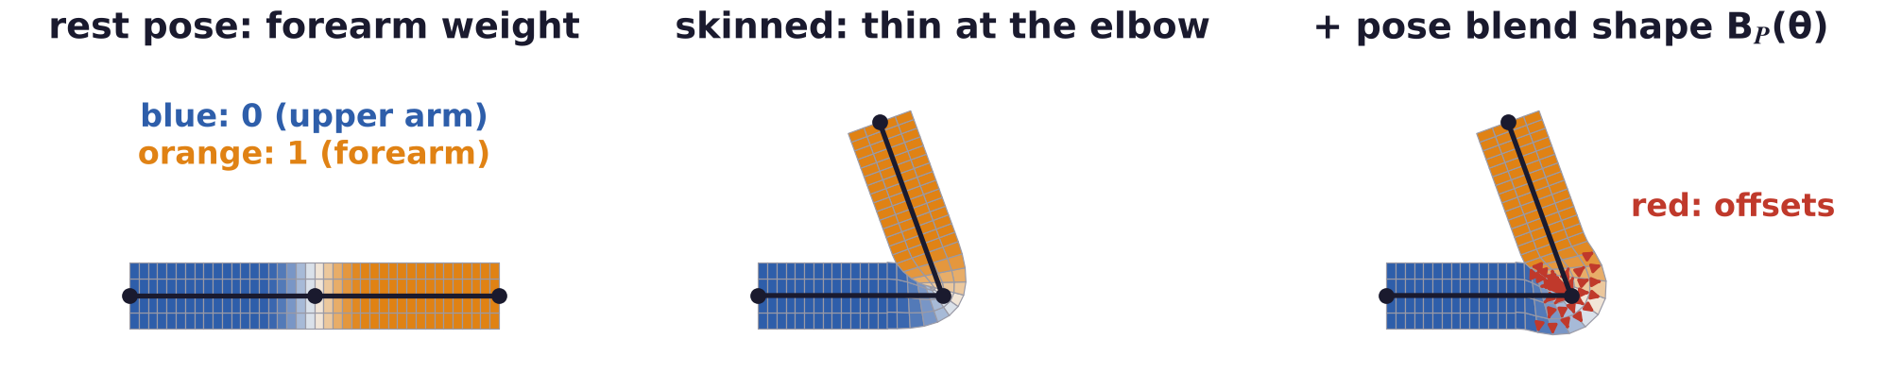
3D humans from one image
SMPL deforms a template, then poses it by skinning
Blend shapes are offsets of the template's vertices: B_S(β) for the shape, B_P(θ) for each pose.
J(β): joints regressed from the shaped mesh; W: linear blend skinning, with the blend weights last.
Skinning moves each vertex by a weighted average of the rigid motions of the bones around it.
Geometry and Vision · A. Yuille
8

Slide 9
Fitting a generative model
2
Fitting maximizes p(x | I) ∝ p(I | x) p(x): extract image features, predict
them from the model, and change x until the two match.
Geometry and Vision · A. Yuille
9

Slide 10
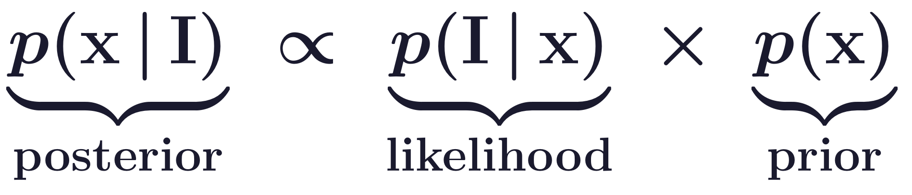
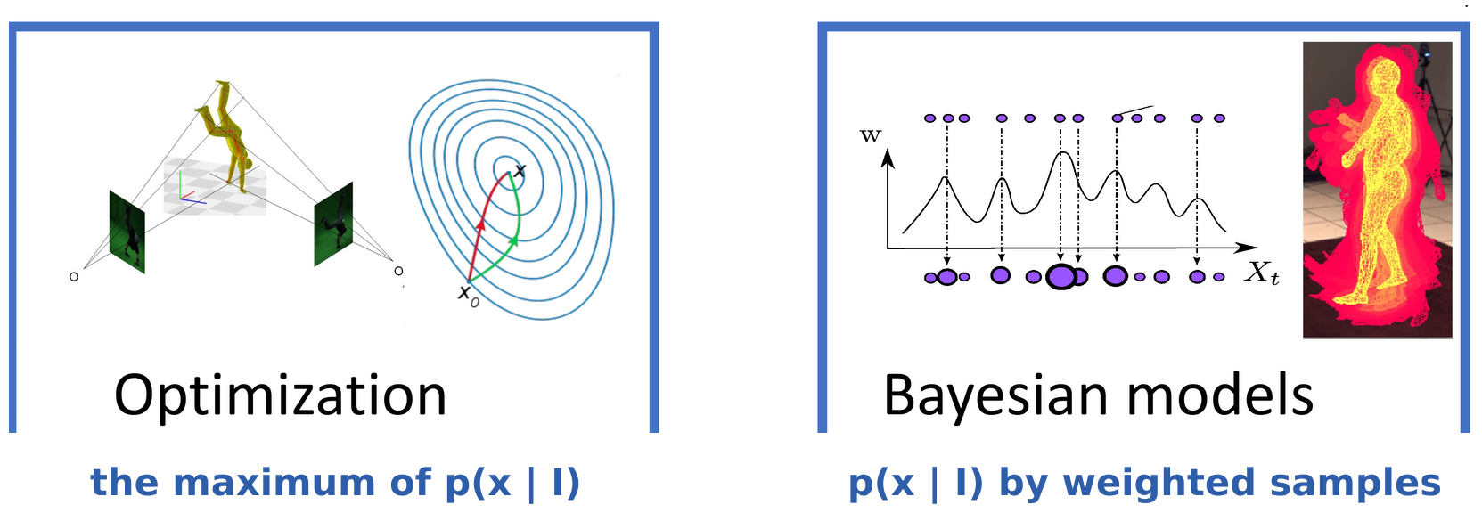
Fitting a generative model
Inference with a generative model such as SMPL
Input: an RGB image I. Estimate: the model parameters x: pose, shape and, optionally, the camera.
Optimization moves from a start x_0 to the maximum of p(x | I): the MAP (maximum a posteriori).
Bayesian models approximate p(x | I) with weighted samples.
Geometry and Vision · A. Yuille
10

Slide 11
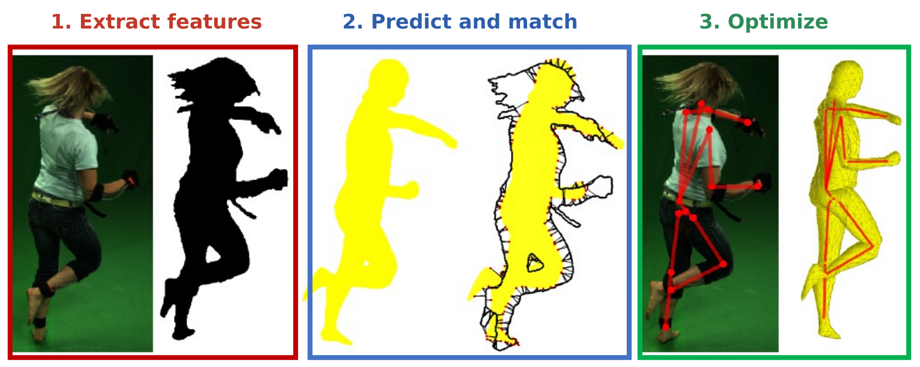
Fitting a generative model
Optimization: extract features, predict and match, optimize
1. Extract features: what are good features for fitting?
2. Predict and match: how to “match” the 3D SMPL model with the 2D image?
3. Optimize: what objective should we optimize?
Geometry and Vision · A. Yuille
11

Slide 12
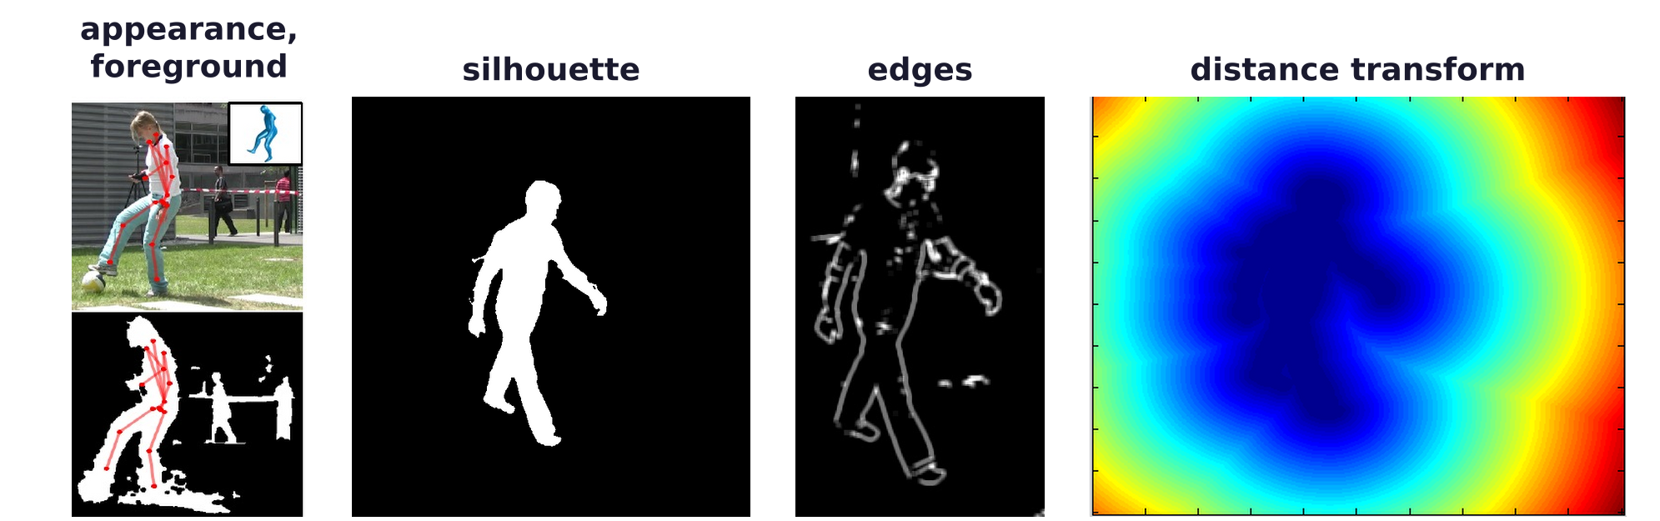
Fitting a generative model
Good features: predicted from the model, fast to compute
Silhouettes, edges, distance transforms, SIFT (scale-invariant feature transform), optic flow, appearance.
Any feature that can be predicted from the model and is fast to compute.
Distance transform: at each pixel, the distance to the nearest silhouette pixel (blue: near, red: far).
Geometry and Vision · A. Yuille
12

Slide 13
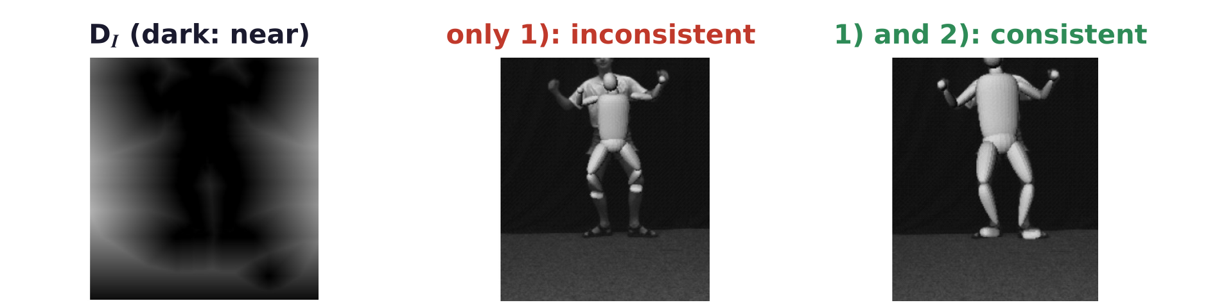
Fitting a generative model
Two distance-transform terms make the fit consistent
S_I, S_M: the image and the model silhouettes; D_I, D_M: their distance transforms; q: a pixel.
1) pushes the model inside the silhouette; 2) forces the model to explain the image.
With 1) only, a model shrunk inside the silhouette costs nothing; 2) makes it cover the silhouette.
C. Sminchisescu, “Consistency and coupling in human model likelihoods,” Proc. IEEE Int. Conf. Automatic Face and Gesture Recognition,
27–32, 2002.
Geometry and Vision · A. Yuille
13

Slide 14
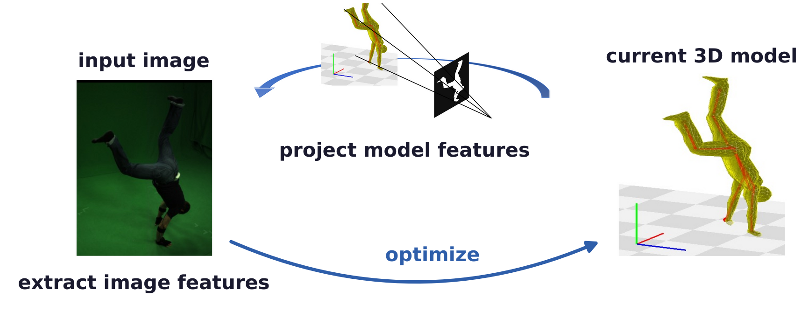
Fitting a generative model
Project the model features and match them to the image
Model to image: every projected model feature needs an image match, which fails for a partial body.
Image to model: every image feature needs a model match, so background features become outliers.
Matching both ways (as the two distance-transform terms do) needs robust costs against outliers.
G. Pons-Moll, A. Baak, T. Helten, M. Müller, H.-P. Seidel and B. Rosenhahn, “Multisensor-fusion for 3D full-body human motion capture,”
CVPR, 663–670, 2010.
Geometry and Vision · A. Yuille
14

Slide 15
Non-linear least squares
3
Fitting minimizes a sum of squared residuals; linearizing the residuals gives
the Gauss-Newton step, and damping it gives Levenberg-Marquardt.
Geometry and Vision · A. Yuille
15

Slide 16
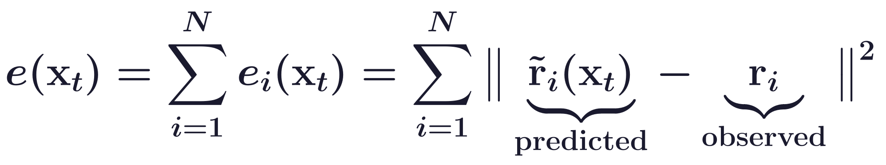
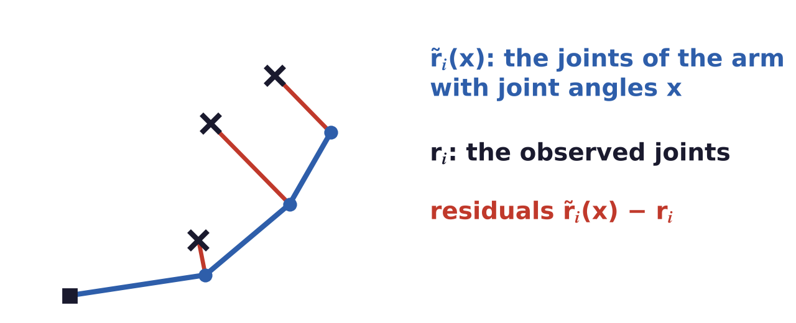
Non-linear least squares
A lot of problems are non-linear least squares
x_t: the SMPL parameters for image t; the sum runs over all N features.
Non-linear: the predicted features depend on x_t through rotations, skinning and projection.
A toy problem: a planar arm; x: its three joint angles; the features: its three joints.
Geometry and Vision · A. Yuille
16

Slide 17
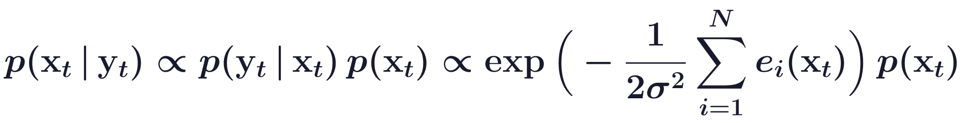
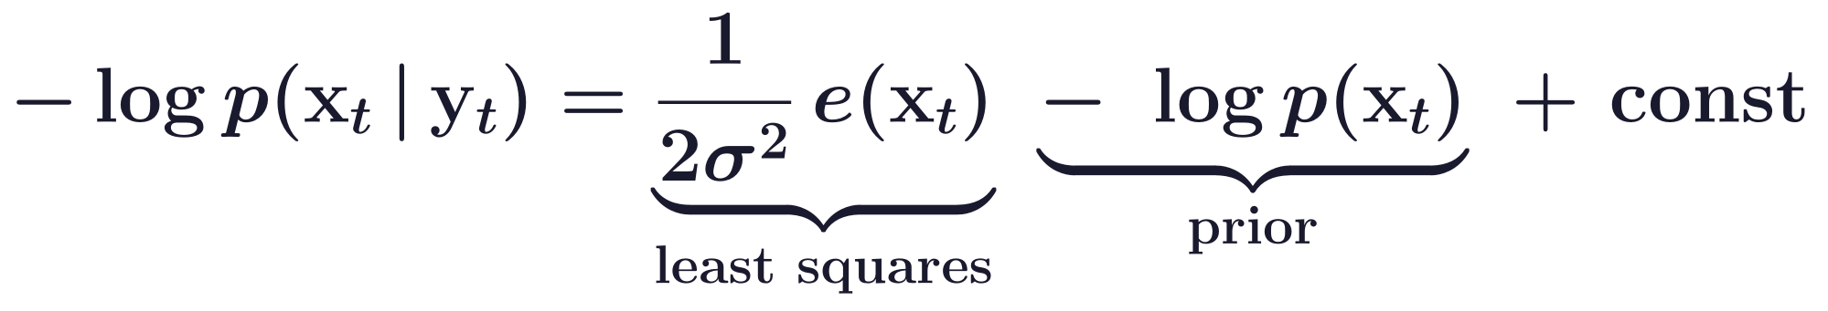
Non-linear least squares
Least squares is maximum likelihood; a prior makes it MAP
y_t: the observation (image t); the errors are independent and Gaussian, with variance σ².
Minimizing e(x_t) maximizes the likelihood; adding −log p(x_t) gives the MAP estimate.
Priors on pose and shape enter the objective as −log p(x_t) terms.
Geometry and Vision · A. Yuille
17

Slide 18
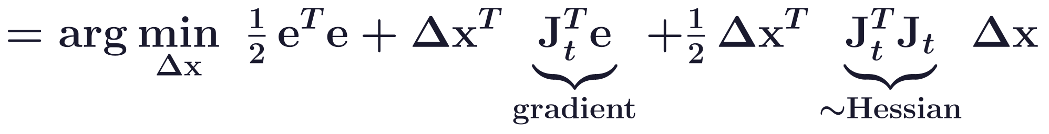
Non-linear least squares
Linearizing the residuals gives the Gauss-Newton step
e stacks the 2D residual vectors e_i of the N matches; e_i(x_t) in the sum is the squared length of e_i.
J_t: the Jacobian of the vector e at x_t; to first order, the vector e(x_t + Δx) ≈ e + J_t Δx.
Setting the gradient with respect to Δx to zero gives the Gauss-Newton step.
Geometry and Vision · A. Yuille
18

Slide 19
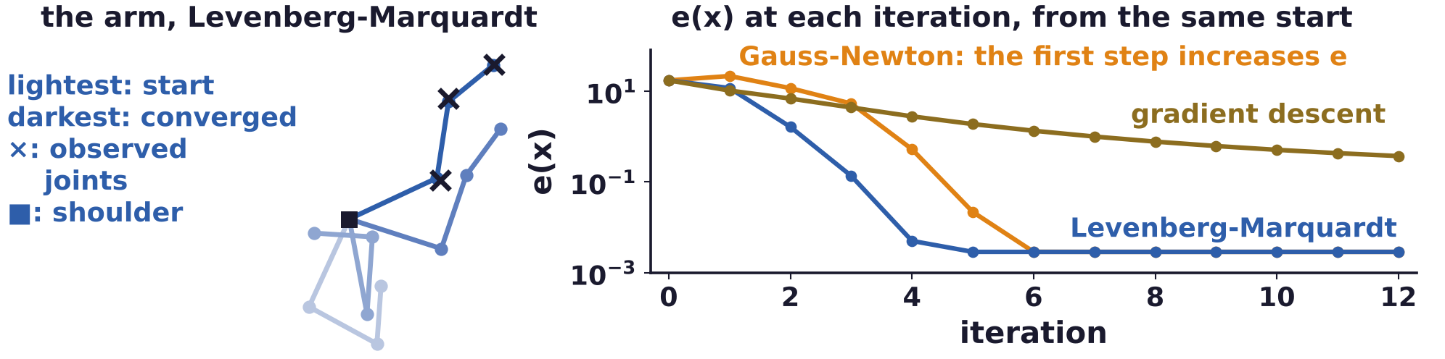
Non-linear least squares
Levenberg-Marquardt damps the Gauss-Newton step
J_t: Jacobian of the vector error; J_t^T J_t approximates the Hessian; J_t^T e is the gradient of ½ e(x).
μ = 0 gives Gauss-Newton; a large μ gives a short step down the gradient, −J_t^T e / μ.
μ is lowered after a step that reduces e(x) and raised after a step that does not.
K. Levenberg, “A method for the solution of certain non-linear problems in least squares,” Quarterly of Applied Mathematics, 2(2):164–168, 1944.
D. W. Marquardt, “An algorithm for least-squares estimation of nonlinear parameters,” J. SIAM, 11(2):431–441, 1963.
Geometry and Vision · A. Yuille
19

Slide 20
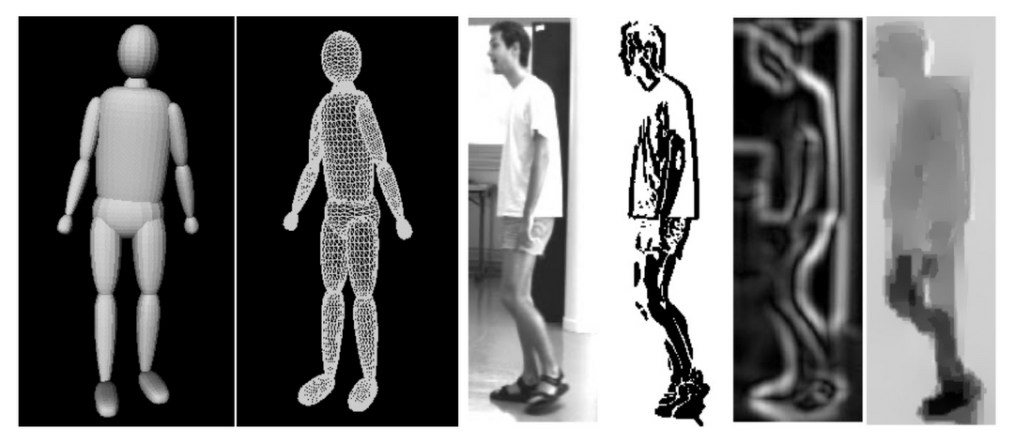
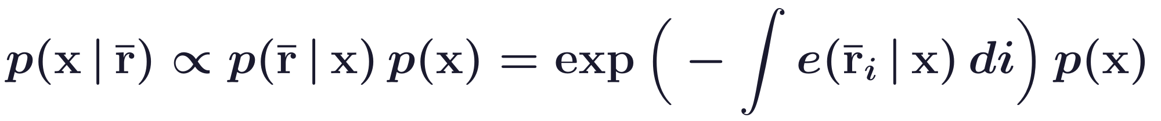
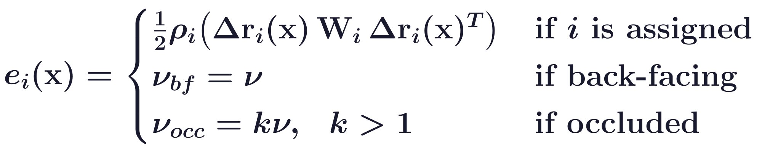
Non-linear least squares
Covariance scaled sampling tracks a body with one camera
Features: motion boundaries, edges, optical flow; r̄_i: an image feature, r_i(x): the model's prediction.
Δr_i = r̄_i − r_i(x); a feature assigned (matched) pays a robust cost ρ_i; W_i: a weighting matrix.
Model features facing away or occluded pay ν and kν. Pictures: the model, the image, its features.
Covariance scaled sampling: samples spread along the fit's most uncertain directions, then are refined.
Remarkable for 2001, but constrained to lab settings and not robust to difficult poses and backgrounds.
C. Sminchisescu and B. Triggs, “Covariance scaled sampling for monocular 3D body tracking,” CVPR, I:447–454, 2001.
Geometry and Vision · A. Yuille
20

Slide 21
SMPLify
4
SMPLify fits SMPL to 2D joints found by a neural network; priors on pose,
shape and interpenetration pick a plausible body among the ambiguous ones.
Geometry and Vision · A. Yuille
21

Slide 22
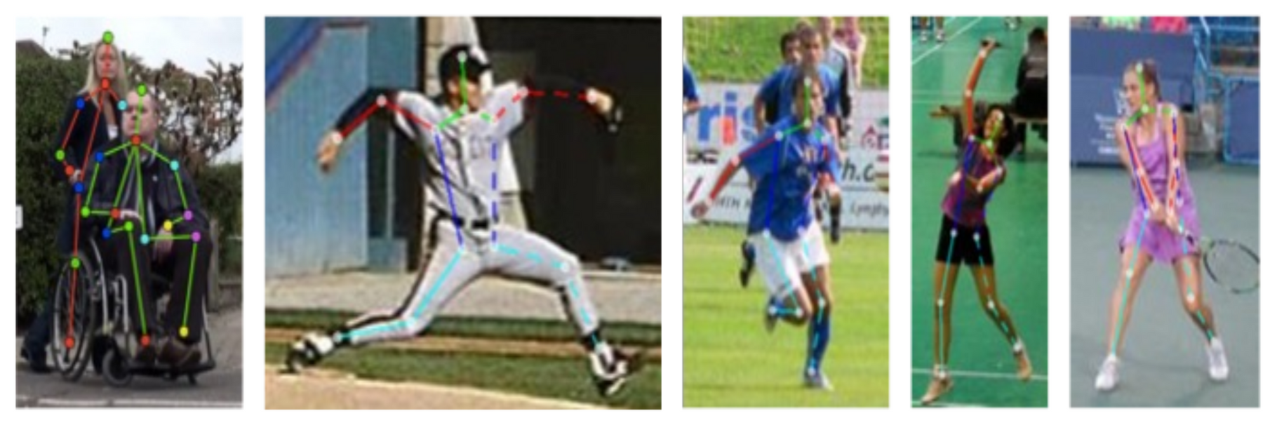
SMPLify
What changed since 2001: 2D pose detection and SMPL
2D pose detection works reliably on most images: a CNN (convolutional neural network) finds the joints.
2D joints are a very good feature: SMPL predicts them directly, and detectors work in the wild.
SMPL: a flexible and easy to use model which adapts to different shapes.
Geometry and Vision · A. Yuille
22

Slide 23
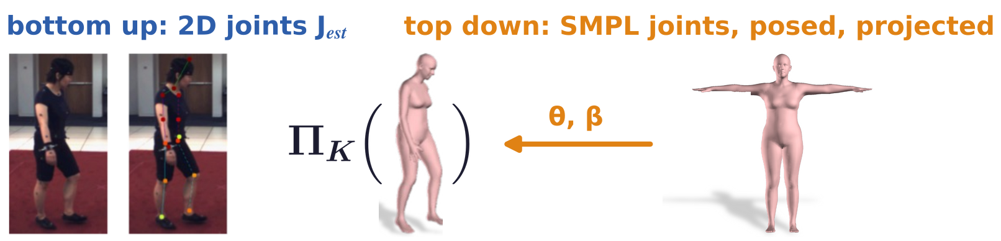
SMPLify
Bottom up and top down should match
Bottom up: a CNN (DeepCut) detects the 2D joints J_est,i, with confidences w_i.
Top down: SMPL joints J(β)_i, posed by R_θ and projected by the camera Π_K with parameters K.
ρ: a robust (Geman-McClure) version of the squared distance. J(β) are joints, unlike the Jacobian J_t.
F. Bogo, A. Kanazawa, C. Lassner, P. Gehler, J. Romero and M. J. Black, “Keep it SMPL: automatic estimation of 3D human pose and shape
from a single image,” ECCV, LNCS 9909, 561–578, 2016.
L. Pishchulin, E. Insafutdinov, S. Tang, B. Andres, M. Andriluka, P. Gehler and B. Schiele, “DeepCut: joint subset partition and labeling for
multi person pose estimation,” CVPR, 4929–4937, 2016.
Geometry and Vision · A. Yuille
23

Slide 24
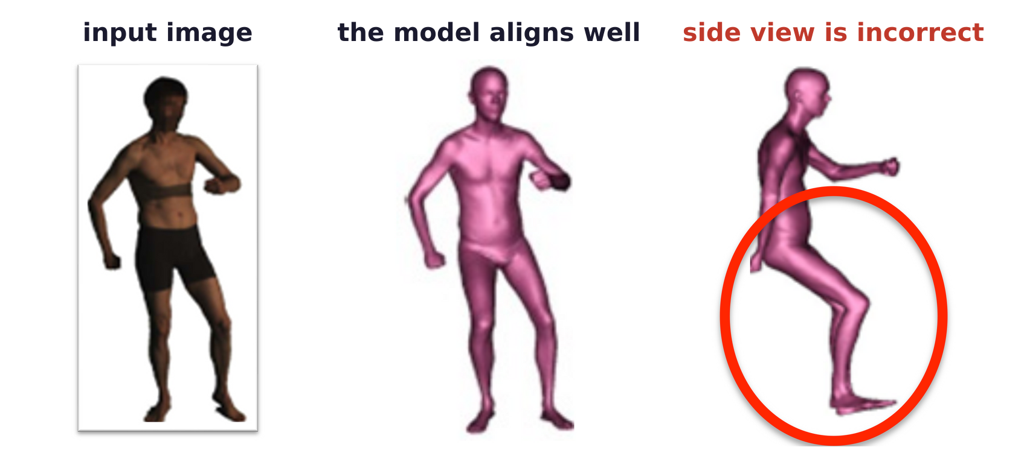
SMPLify
The data term alone leaves a depth ambiguity
The data term E_J compares 2D joints only: many 3D poses and shapes fit them equally well.
Here a body model aligns well with the image, but the side view shows the legs of a person sitting down.
Priors on pose and shape choose among the 3D bodies that fit the 2D joints.
P. Guan, A. Weiss, A. O. Bălan and M. J. Black, “Estimating human shape and pose from a single image,” ICCV, 1381–1388, 2009.
Geometry and Vision · A. Yuille
24

Slide 25
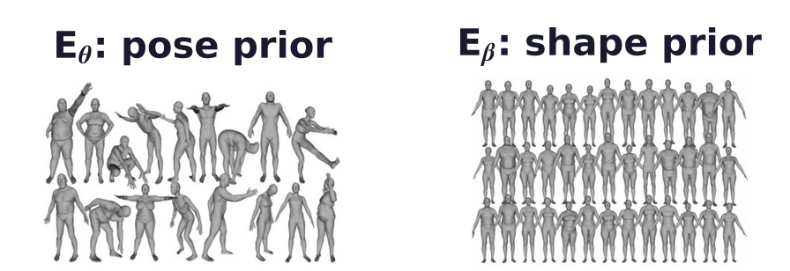
SMPLify
Pose and shape priors favor plausible bodies
E_a: elbows and knees bending the unnatural way have θ_i > 0 and are penalized exponentially.
E_θ: 8 Gaussians N(·) (weights g_j, means μ_θ,j, covariances Σ_θ,j) fit to 1M motion-capture poses.
For the solver the sum becomes its largest term (c: a constant); E_β: Σ_β from the PCA of shapes.
F. Bogo, A. Kanazawa, C. Lassner, P. Gehler, J. Romero and M. J. Black, “Keep it SMPL: automatic estimation of 3D human pose and shape
from a single image,” ECCV, LNCS 9909, 561–578, 2016.
Geometry and Vision · A. Yuille
25

Slide 26
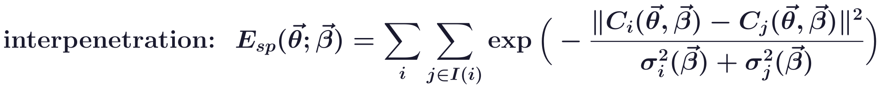
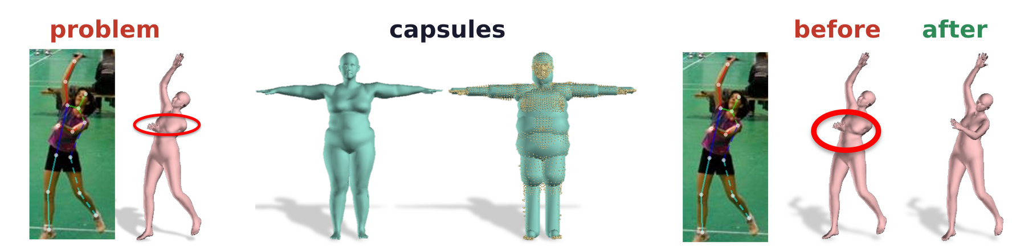
SMPLify
Capsules approximate the surface to penalize intersections
Problem: SMPL can fit the 2D joints with an arm passing through the body (red ellipse).
Capsules (cylinders with round ends) approximate the body; their radii depend on the shape β.
Capsules become spheres: centers C_i, Gaussian widths σ_i(β); I(i): spheres that must not meet sphere i.
F. Bogo, A. Kanazawa, C. Lassner, P. Gehler, J. Romero and M. J. Black, “Keep it SMPL: automatic estimation of 3D human pose and shape
from a single image,” ECCV, LNCS 9909, 561–578, 2016.
Geometry and Vision · A. Yuille
26

Slide 27
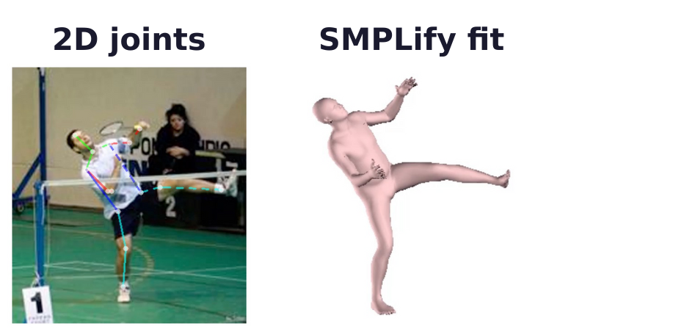
SMPLify
The SMPLify objective adds four priors to the data term
λ: scalar weights. The data term plays the role of −log p(I | x) and the priors of −log p(x).
The focal length is known; the camera's depth is first estimated from the torso length.
Stages lower λ_θ and λ_β; if the 2D shoulders are close, two body orientations are tried.
F. Bogo, A. Kanazawa, C. Lassner, P. Gehler, J. Romero and M. J. Black, “Keep it SMPL: automatic estimation of 3D human pose and shape
from a single image,” ECCV, LNCS 9909, 561–578, 2016.
Geometry and Vision · A. Yuille
27

Slide 28
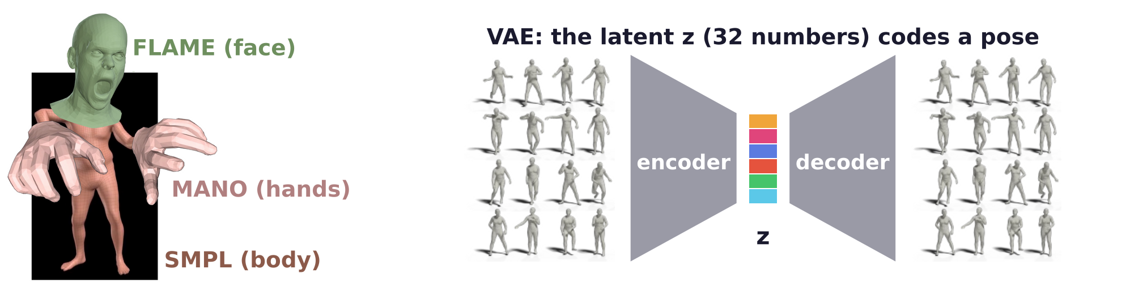
SMPLify
SMPLify-X adds hands, face and a learned pose prior
SMPL-X: SMPL with the MANO hand model and the FLAME face model; θ_b: its body pose.
Pose prior: a VAE (variational auto-encoder) learns the manifold of poses; the fit optimizes its latent z.
A classifier predicts gender and selects the model accordingly. The key ideas remain the same.
G. Pavlakos, V. Choutas, N. Ghorbani, T. Bolkart, A. A. A. Osman, D. Tzionas and M. J. Black, “Expressive body capture: 3D hands, face,
and body from a single image,” CVPR, 10975–10985, 2019.
Geometry and Vision · A. Yuille
28

Slide 29
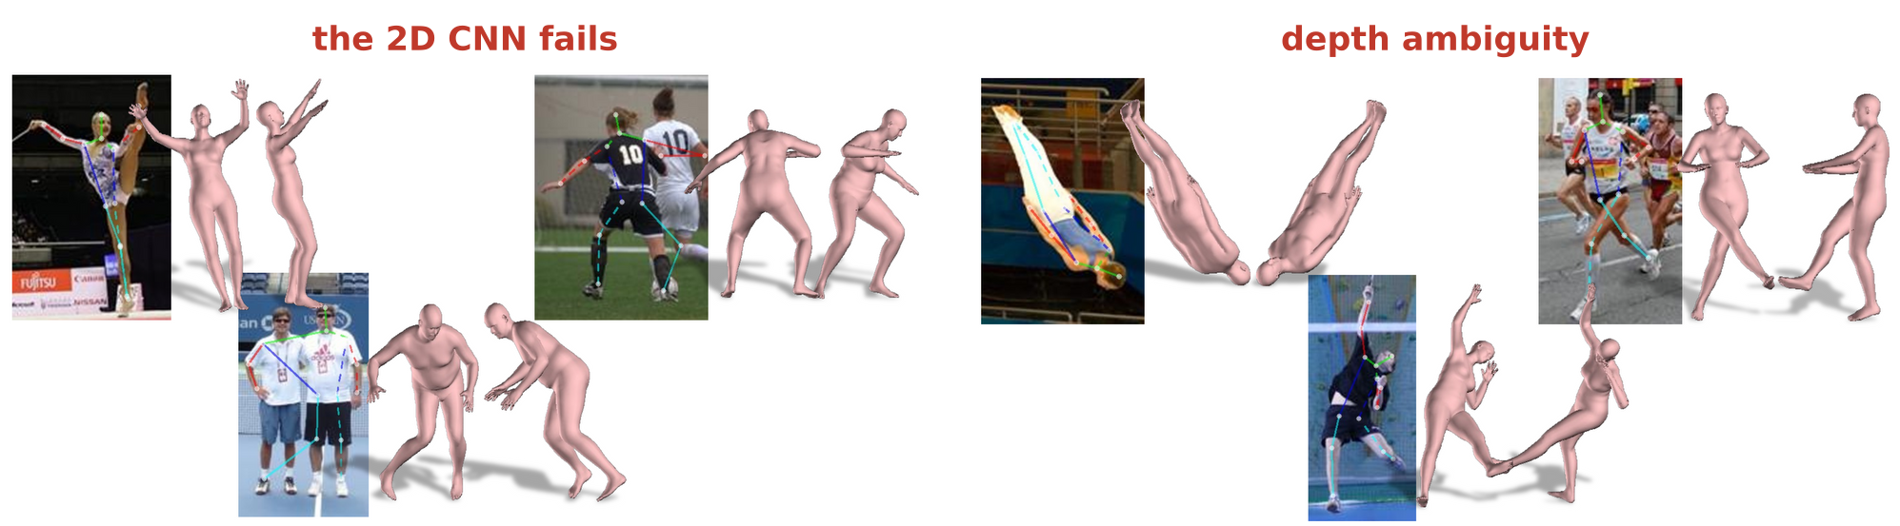
SMPLify
Local optimization can be fast but needs initialization
Failure modes: the 2D CNN fails, or the depth is ambiguous. Each image: two views of the fit.
Pros: it (can be) fast and accurate. Cons: prone to local minima; requires initialization.
The matching cost is ambiguous: several bodies fit the same 2D joints.
Can we use learning to address some of these limitations?
Geometry and Vision · A. Yuille
29

Slide 30
HMR 2.0: transformers
5
HMR 2.0 (human mesh recovery) regresses SMPL and the camera with a
transformer, trained on big data labeled by fitting SMPL to 2D keypoints.
Geometry and Vision · A. Yuille
30

Slide 31
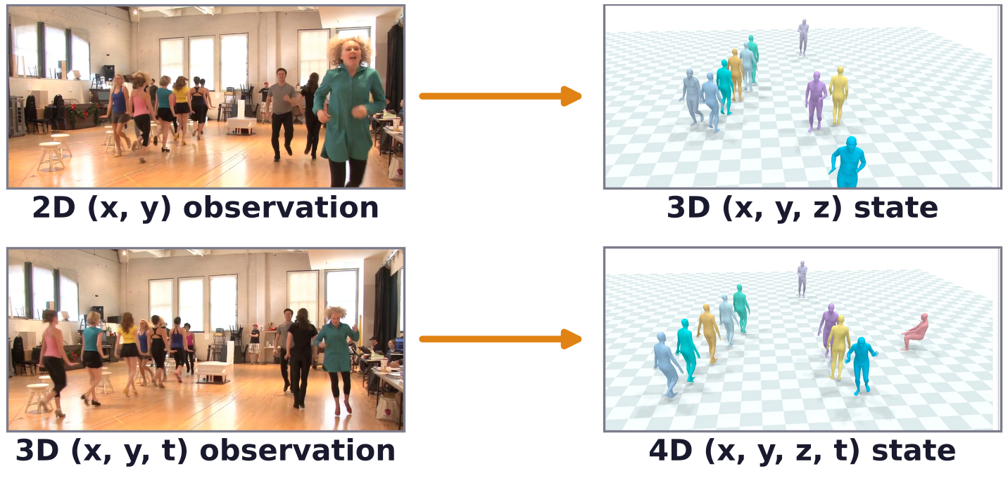
HMR 2.0: transformers
Humans in 4D: every person's 3D body, tracked over time
An image is a 2D (x, y) observation; its state is the 3D (x, y, z) mesh of every person.
A video is a 3D (x, y, t) observation; its state is 4D (x, y, z, t): every person's mesh over time.
4DHumans: a network reconstructs each person in each frame; a tracker links them over time.
S. Goel, G. Pavlakos, J. Rajasegaran, A. Kanazawa and J. Malik, “Humans in 4D: reconstructing and tracking humans with transformers,”
ICCV, 14783–14794, 2023.
Geometry and Vision · A. Yuille
31

Slide 32
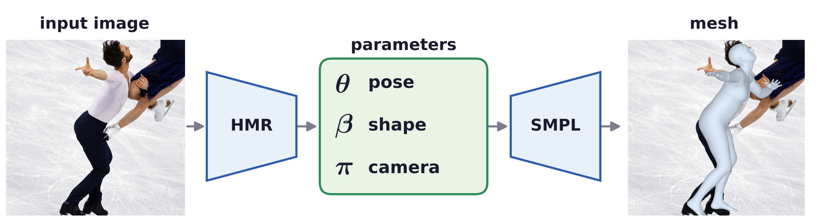
HMR 2.0: transformers
Human Mesh Recovery (HMR) regresses SMPL parameters
A discriminative model: one forward pass maps the image to pose θ, shape β and camera π.
HMR: a ResNet-50 (residual network) encoder and a regressor that refines its estimate three times.
π: a weak-perspective camera (a scale and a 2D translation); SMPL turns θ and β into the mesh.
Losses: the reprojected 2D joints, 3D joints when known, and discriminators as a learned prior.
A. Kanazawa, M. J. Black, D. W. Jacobs and J. Malik, “End-to-end recovery of human shape and pose,” CVPR, 7122–7131, 2018.
Geometry and Vision · A. Yuille
32

Slide 33
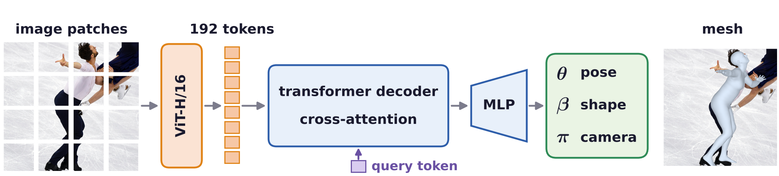
HMR 2.0: transformers
HMR 2.0: a big model with a vision transformer
ViT-H/16 (vision transformer, huge, 16 × 16 patches): a 256 × 192 crop gives 16 × 12 = 192 image tokens.
Transformer decoder: one query token cross-attends to the image tokens; an MLP reads out θ, β and π.
MLP: multilayer perceptron. The ViT is pretrained to find 2D keypoints (ViTPose).
Camera π: perspective, with a fixed focal length; the network predicts its translation.
S. Goel, G. Pavlakos, J. Rajasegaran, A. Kanazawa and J. Malik, “Humans in 4D: reconstructing and tracking humans with transformers,”
ICCV, 14783–14794, 2023.
A. Dosovitskiy et al., “An image is worth 16x16 words: transformers for image recognition at scale,” ICLR, 2021.
Geometry and Vision · A. Yuille
33

Slide 34
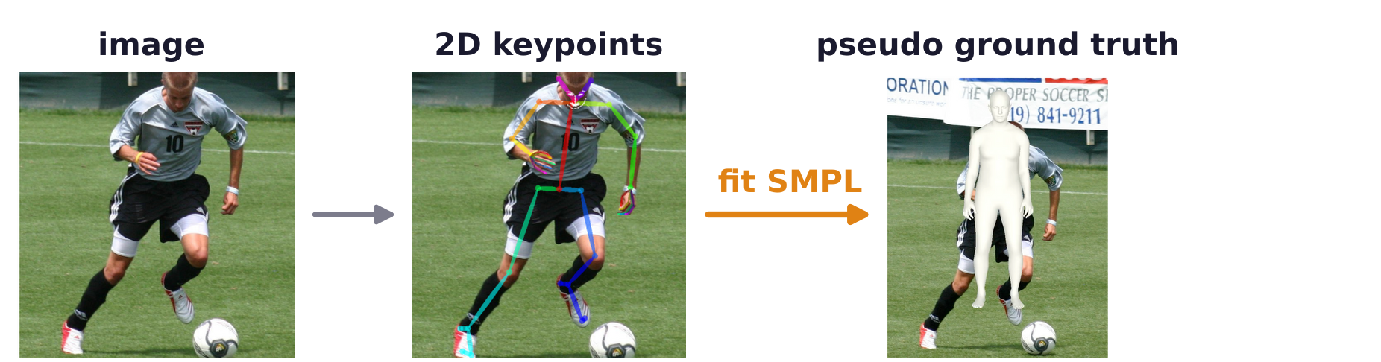
HMR 2.0: transformers
HMR 2.0: big data with pseudo ground truth from fitting
Images with 3D ground truth are few, mostly recorded in one room (Human3.6M, MPI-INF-3DHP).
Pseudo ground truth: detect people (ViTDet), find their 2D keypoints (ViTPose), fit SMPL to them.
The fit minimizes a 2D joint term plus priors, as SMPLify does; implausible fits are filtered out.
HMR 2.0b adds AVA (atomic visual actions), AI Challenger, InstaVariety; trains longer, also the ViT.
S. Goel, G. Pavlakos, J. Rajasegaran, A. Kanazawa and J. Malik, “Humans in 4D: reconstructing and tracking humans with transformers,”
ICCV, 14783–14794, 2023.
N. Kolotouros, G. Pavlakos, M. J. Black and K. Daniilidis, “Learning to reconstruct 3D human pose and shape via model-fitting in the loop,”
ICCV, 2252–2261, 2019.
N. Kolotouros, G. Pavlakos, D. Jayaraman and K. Daniilidis, “Probabilistic modeling for human mesh recovery,” ICCV, 11605–11614, 2021.
Geometry and Vision · A. Yuille
34

Slide 35
HMR 2.0: transformers
The training losses compare joints and add a learned prior
Each image uses the losses for its labels: SMPL parameters θ*, β*, 3D joints X* or 2D keypoints x*.
X: the 3D joints of the predicted mesh; π(X): their projection by the predicted camera.
L_kp2D plays the role of SMPLify's data term; θ_b: the body pose without the global rotation.
L_adv: a discriminator D_k for each factor of the body scores whether pose and shape look human.
S. Goel, G. Pavlakos, J. Rajasegaran, A. Kanazawa and J. Malik, “Humans in 4D: reconstructing and tracking humans with transformers,”
ICCV, 14783–14794, 2023.
Geometry and Vision · A. Yuille
35

Slide 36
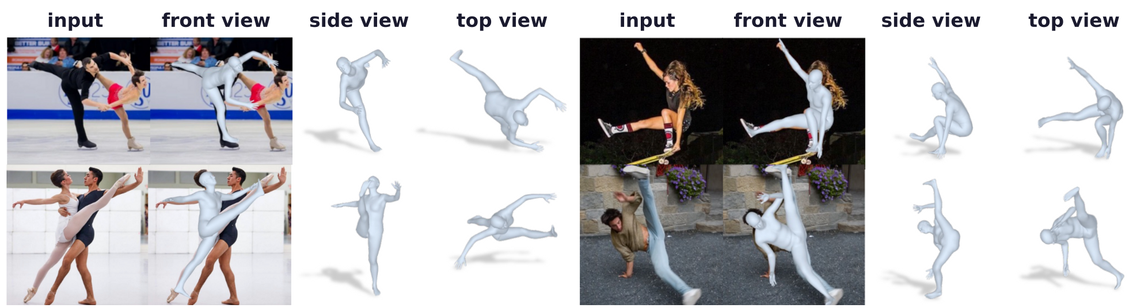
HMR 2.0: transformers
HMR 2.0 recovers unusual poses in the wild
Front view: the mesh over the image; side and top views: the same 3D mesh from other directions.
Figure skating, ballet, skateboarding, breakdance: each image is reconstructed on its own.
Each mesh is predicted from one image, with no smoothing over time.
S. Goel, G. Pavlakos, J. Rajasegaran, A. Kanazawa and J. Malik, “Humans in 4D: reconstructing and tracking humans with transformers,”
ICCV, 14783–14794, 2023.
Geometry and Vision · A. Yuille
36

Slide 37
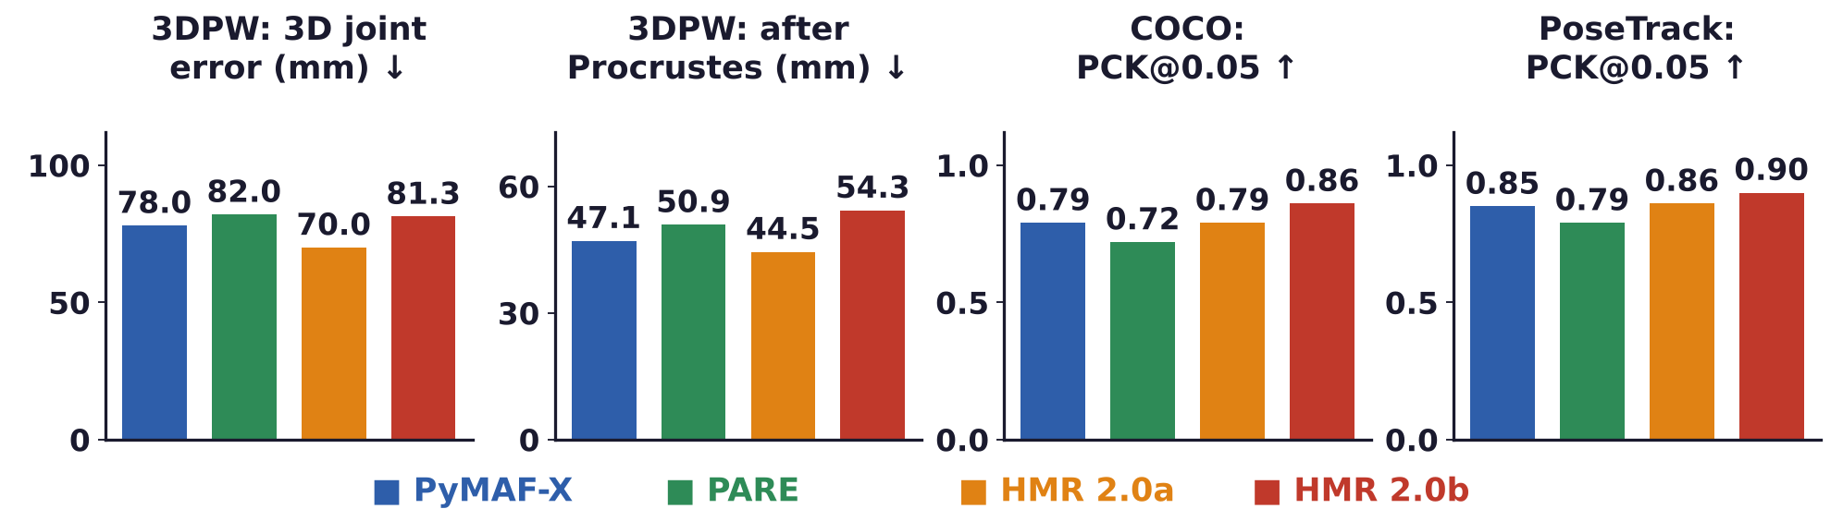
HMR 2.0: transformers
Among these methods, HMR 2.0b is the most accurate in 2D
3DPW (3D Poses in the Wild): 3D joint error in mm, lower is better; Procrustes: best rotation, scale first.
PCK@0.05 (percentage of correct keypoints): within 5 % of image size; COCO: images; PoseTrack: video.
PyMAF-X, PARE: earlier regressors. HMR 2.0a is best on 3DPW; HMR 2.0b, with more data, best in 2D.
H. Zhang, Y. Tian, Y. Zhang, M. Li, L. An, Z. Sun and Y. Liu, “PyMAF-X: towards well-aligned full-body model regression from monocular
images,” IEEE TPAMI, 45(10):12287–12303, 2023.
M. Kocabas, C.-H. P. Huang, O. Hilliges and M. J. Black, “PARE: part attention regressor for 3D human body estimation,” ICCV, 11127–11137, 2021.
Geometry and Vision · A. Yuille
37

Slide 38
Tracking humans in 4D
6
Linking the 3D meshes of each person over time gives 4D humans;
separating the camera's motion places them in the world.
Geometry and Vision · A. Yuille
38

Slide 39

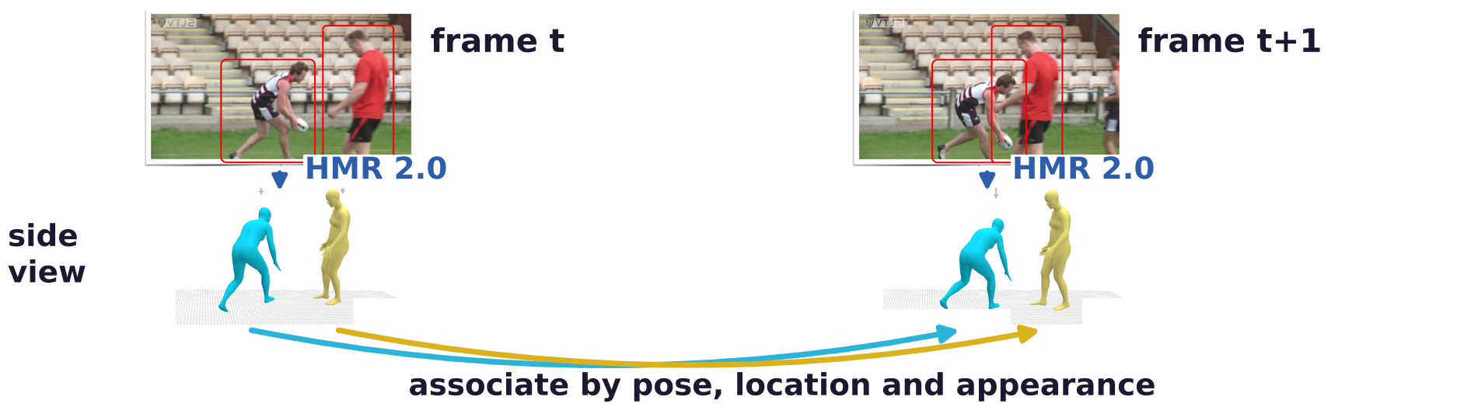
Tracking humans in 4D
From 3D to 4D: tracking associates people across frames
Red boxes: detected people. The tracker builds on PHALP (predicting appearance, location and pose).
Each person: SMPL pose, 3D location, appearance (colors on the mesh); a track predicts its next frame.
The cost adds −log P of each cue; the Hungarian algorithm finds the best assignment to tracks.
J. Rajasegaran, G. Pavlakos, A. Kanazawa and J. Malik, “Tracking people by predicting 3D appearance, location and pose,” CVPR, 2740–2749, 2022.
Geometry and Vision · A. Yuille
39

Slide 40
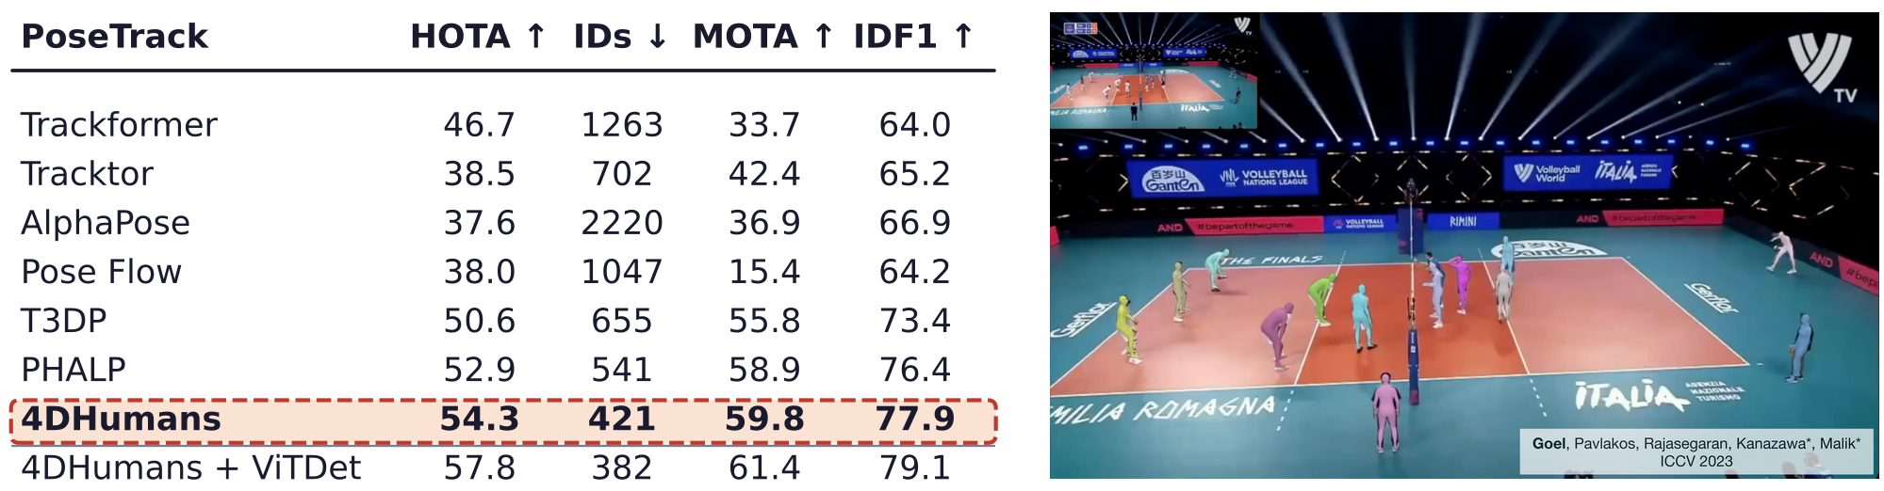
Tracking humans in 4D
4DHumans tracks people better than earlier trackers
PoseTrack: videos of many people. HOTA: higher order tracking accuracy (detection and association).
MOTA: multiple object tracking accuracy; IDF1: identity F1 score; IDs: identity switches (lower is better).
With the detector of PHALP, 4DHumans has 22 % fewer identity switches; ViTDet improves it further.
S. Goel, G. Pavlakos, J. Rajasegaran, A. Kanazawa and J. Malik, “Humans in 4D: reconstructing and tracking humans with transformers,”
ICCV, 14783–14794, 2023.
Geometry and Vision · A. Yuille
40

Slide 41
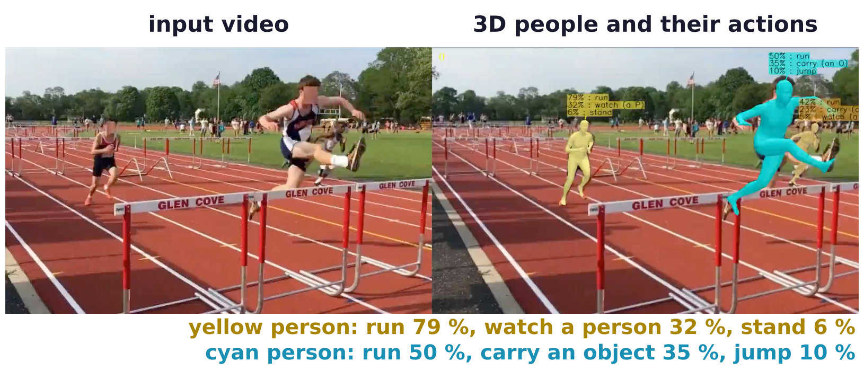
Tracking humans in 4D
3D poses and tracks improve action recognition
AVA: the actions (stand, run, carry, watch, ...) of every person in movie clips.
A transformer reads each person's track of 3D pose, location and appearance and predicts the actions.
+2.8 mAP (mean average precision), 7 % better on AVA than the best video model before it (VideoMAE).
J. Rajasegaran, G. Pavlakos, A. Kanazawa, C. Feichtenhofer and J. Malik, “On the benefits of 3D pose and tracking for human action
recognition,” CVPR, 640–649, 2023.
Geometry and Vision · A. Yuille
41

Slide 42
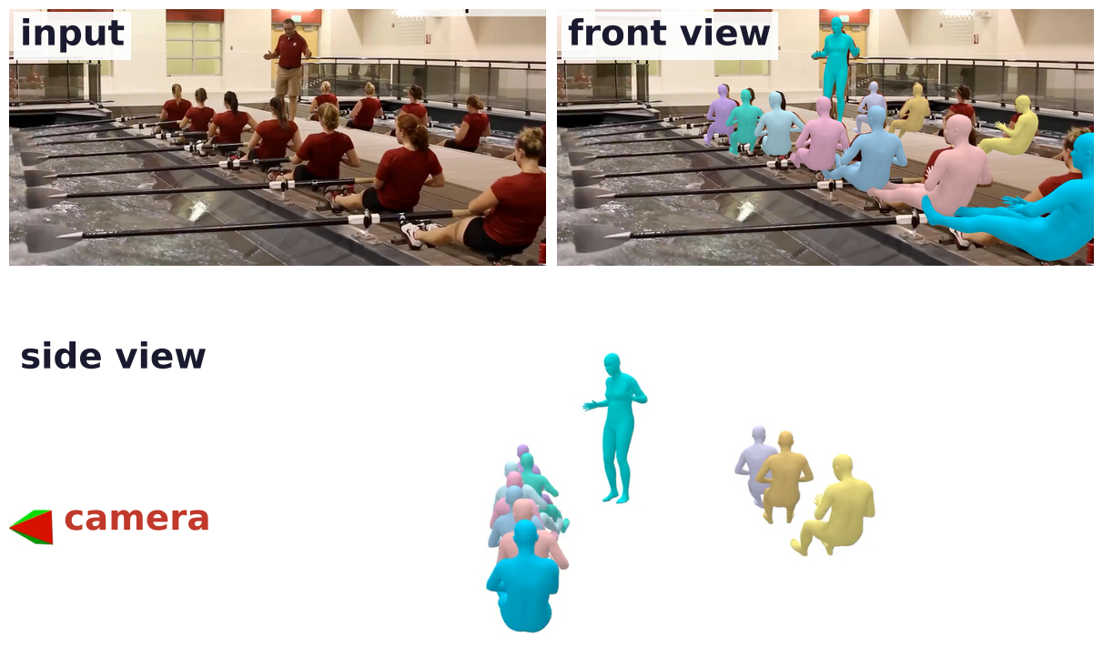
Tracking humans in 4D
4DHumans places people in the camera's coordinate frame
Side view: the reconstructed people and the camera (red and green), in the camera's coordinate frame.
When the camera moves, its motion is added to the motion of the people.
Placing people in the world needs the camera's motion, its scale and the ground.
S. Goel, G. Pavlakos, J. Rajasegaran, A. Kanazawa and J. Malik, “Humans in 4D: reconstructing and tracking humans with transformers,”
ICCV, 14783–14794, 2023.
Geometry and Vision · A. Yuille
42

Slide 43
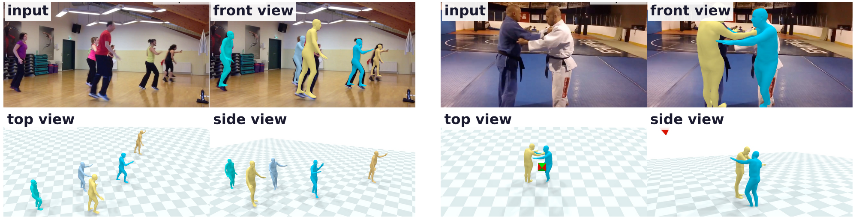
Tracking humans in 4D
SLAHMR decouples human and camera motion in the wild
SLAM (simultaneous localization and mapping) + HMR = SLAHMR; SLAM gives the camera up to scale.
Optimization: SMPLify's robust 2D joint term, pose and shape priors, HuMoR (a learned motion prior).
All people share one world frame, the scale and the ground plane: top and side views on that ground.
V. Ye, G. Pavlakos, J. Malik and A. Kanazawa, “Decoupling human and camera motion from videos in the wild,” CVPR, 21222–21232, 2023.
Geometry and Vision · A. Yuille
43

Slide 44
Tracking humans in 4D
Summary
3D pose and shape from one image are ambiguous; SMPL describes a person by a few parameters.
SMPL deforms a template with shape and pose blend shapes and poses it by linear blend skinning.
Fitting a generative model: extract features, predict and match them, optimize p(x | I) ∝ p(I | x) p(x).
Non-linear least squares: Gauss-Newton linearizes the residuals; Levenberg-Marquardt damps the step.
SMPLify fits SMPL to 2D joints with pose, shape and interpenetration priors: a MAP estimate.
Optimization needs an initialization; a network can predict the parameters directly from the image.
HMR 2.0: a vision transformer regresses SMPL; big data gets pseudo ground truth from fitting.
4DHumans tracks the 3D people over time; SLAHMR separates their motion from the camera's.
Geometry and Vision · A. Yuille
44

