Slide 1
Python visualization: bar plot
Tiezheng Yuan
April 20th, 2020

Slide 2
bar-plot
Usage: matlibplot.pyplot: plt.bar() pandas: df.plot.bar()
application: present and compare categorical data in pairwise analysis.

Slide 3
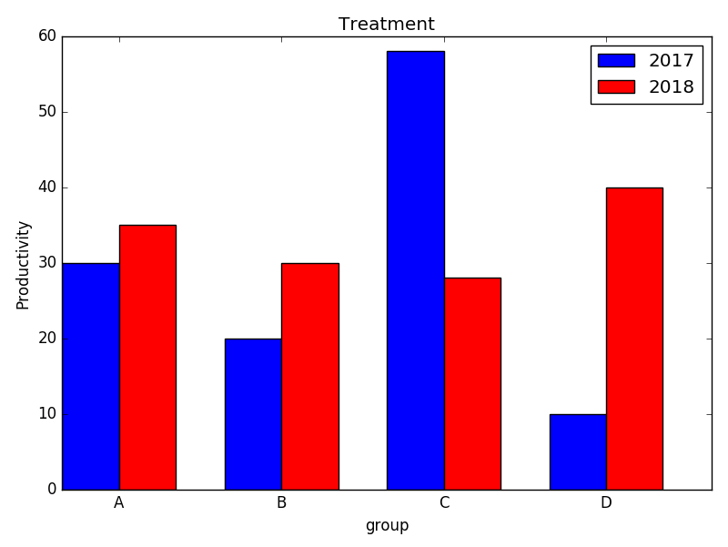
plt.bar(index, a, bar_width, color='blue', label='2017')
plt.bar(index+bar_width, b, bar_width, color='red', label='2018')
plt.xticks(index+bar_width, ['A','B','C','D'])
plt.xlabel('group')
plt.ylabel('Productivity, ton')
plt.title('Treatment')
plt.legend()

Slide 4
decorate bar-plot
pro=pd.DataFrame({'2017':a, '2018':b}, index=list('ABCD'))
fig, (ax1,ax2)=plt.subplots(1,2, figsize=(13,6))
#bar1
pro.plot.bar(ax=ax1, rot=0)
ax1.axhline(30)
ax1.set_xlabel("group")
ax1.set_ylabel("productivity tons")
ax1.set_title("vertical pattern")
#bar2
pro.plot.barh(color=['grey','lightgrey'], ax=ax2)
ax2.axvline(30, linestyle="--", color='grey')
ax2.set_ylabel("group")
ax2.set_xlabel("productivity tons")
ax2.legend(loc="lower right")
ax2.set_title("horizontal pattern")
fig.suptitle("productivity of 2017-2018", fontsize=20)
plt.show()

Slide 5
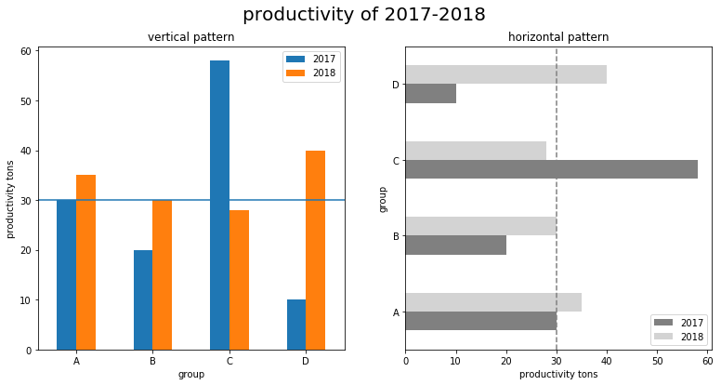

Slide 6
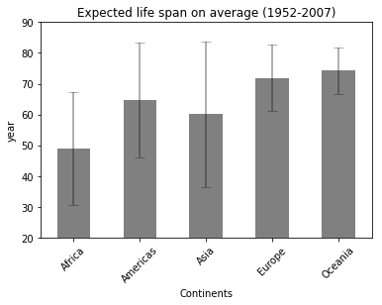
df1=df.groupby('continent').agg({'lifeExp': [np.mean, np.std]})
df1.columns=df1.columns.map('_'.join)
ax = df1.plot.bar(df1.index, 'lifeExp_mean', color='grey', rot=45,
legend=False, title="Expected life span on average (1952-2007)")
ax.errorbar(df1.index, df1.lifeExp_mean, yerr=2*df1.lifeExp_std,
linewidth=2, color='black', alpha=.3, capsize=5)
ax.lines[0].remove()#remove lines between error bars
plt.ylim(20,90)
plt.xlabel('Continents')
plt.ylabel('year')

Slide 7
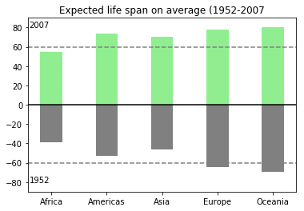
plt.bar(df21.index, df21.lifeExp, width=bar_width, color='lightgreen')
plt.bar(df11.index, -df11.lifeExp, width=bar_width, color='grey')
plt.title("Expected life span on average (1952-2007")
plt.axhline(60, color="grey", linestyle='--')
plt.axhline(-60, color="grey", linestyle='--')
plt.axhline(0, color="black")
plt.text(-.4, -80, "1952")
plt.text(-.4, 80, "2007")
plt.ylim(-90,90)

