Slide 1
Visualize Distribution
Tiezheng Yuan
April 19-20th, 2020

Slide 2
visualize distributions of data
boxplot: Use plt.boxplot() from matplotlib.pyplot Use df.boxplot() from pandas Use sns.boxplot() from seaborn
histogram or density plot Use plt.hist() from matplotlib.pyplot

Slide 3
application of boxplot
observe shape of data distribution: symmetrical or skewed
observe discreteness or tightness of data groups: mean and median, 50 quantiles (Q3-Q1), outliers.
analyze associations of numeric variable and categorical variable

Slide 4
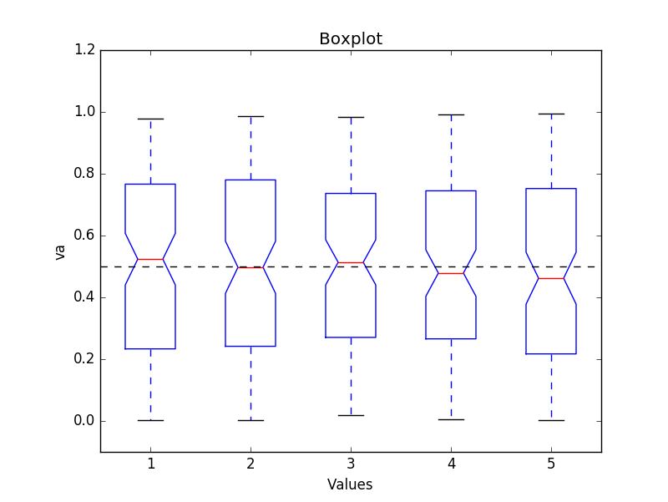
#boxplot
a1=np.random.rand(100,5)#matrix with 100 rows, 5 columns
a1.shape
plt.cla()
plt.boxplot(a1, 1, 'gD')
plt.axhline(y=.5,color='black', linestyle='dashed', linewidth=1)
plt.ylim(ymin=-.1,ymax=1.2)
plt.title('Boxplot')
plt.xlabel('Groups')
plt.ylabel('Values')
plt.show()

Slide 5
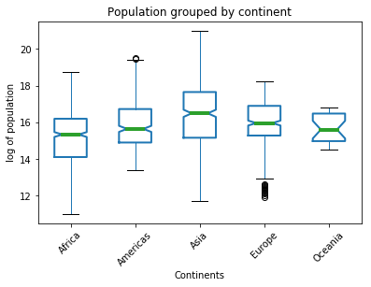
boxprops = dict(linestyle='-', linewidth=2, color='blue')
medianprops = dict(linestyle='-', linewidth=4, color='green')
bp = df.boxplot(column='logPop', by="continent", rot=45,
grid=False, notch=True, boxprops=boxprops,
medianprops=medianprops, return_type='dict')
plt.title("Population grouped by continent") #new title
plt.suptitle('')#remove sub-stitle
plt.xlabel("Continents")
plt.ylabel("log of population")

Slide 6
#multiple boxplot
fig, (ax1,ax2,ax3) = plt.subplots(1,3, figsize=(18,6))
df.boxplot(column='logPop', by="continent", ax=ax1,
rot=45, grid=False, notch=True, boxprops=boxprops,
layout=(1,3),medianprops=medianprops, return_type='dict')
ax1.set_title('Population')
ax1.set_ylabel('Log million')
df.boxplot(column= 'lifeExp', by="continent", ax=ax2,
rot=45, grid=False, notch=True, boxprops=boxprops,
layout=(1,3),medianprops=medianprops, return_type='dict')
ax2.set_title('expected life span')
ax2.set_ylabel('Year')
df.boxplot(column= 'gdpPercap', by="continent", ax=ax3,
rot=45, grid=False, notch=True, boxprops=boxprops,
layout=(1,3),medianprops=medianprops, return_type='dict')
ax3.set_title("GDP")
ax3.set_ylabel("million USD")
fig.suptitle("Population grouped by continent", fontsize=20)
fig.subplots_adjust(left=.4, right=1.2, hspace=.2)

Slide 7
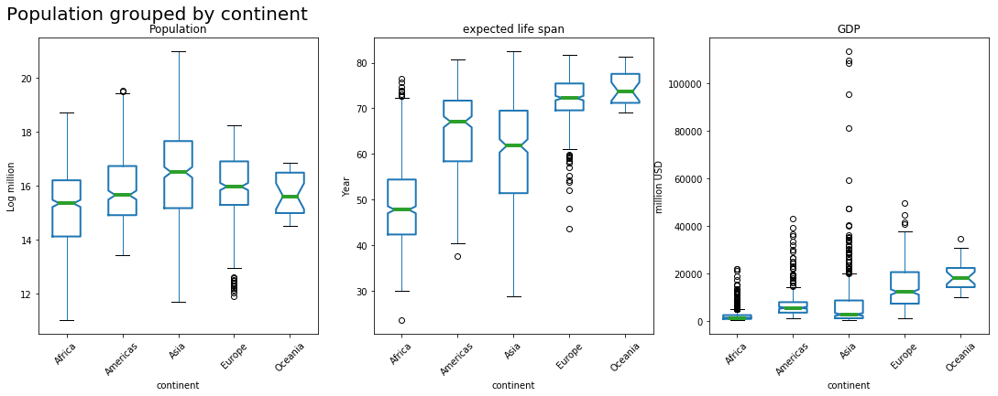

Slide 8
application of histogram
estimate frequency of part of a data set given a span
observe shape of data distribution: symmetric or skewed, single peak or bimodel, overdispersion (var>>mean)
estimate discreteness of a data set: range, mode values, outliers
present goodness-of-fit: observed data vs. fitted statistical model

Slide 9
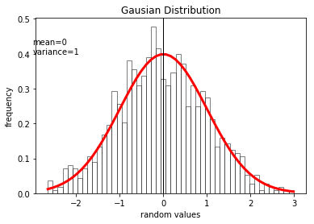
Draw histogram: plt.hist()
mean=0;var=1
a1=np.random.normal(mean,var, 1000)#mean=0, var=1
n1, bins1, patches1= plt.hist(a1, 50, normed=1,
facecolor='white', edgecolor='black', alpha=.5)
y1 = scs.norm.pdf(bins1, mean, var)#fitted line
plt.plot(bins1, y1, '-', color='red',linewidth=3)
plt.axvline(x=u1,color='black', linewidth=1)
plt.text(-3, .4, 'mean={}\nvariance={}'.format(mean, var))
plt.title("Gausian Distribution")
plt.xlabel('random values')
plt.ylabel('frequency')

Slide 10
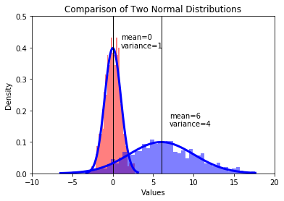
#1
n1,bins1,patches1=plt.hist(a1, 50, normed=1, facecolor='red',alpha=.5)
y1 = scs.norm.pdf(bins1, u1, var1)#fitted line
plt.plot(bins1, y1, '-', color='blue',linewidth=3)
plt.axvline(x=u1,color='black', linewidth=1)
plt.text(u1+1,.4, 'mean={}\nvariance={}'.format(u1,var1))
#2
n2,bins2,patches2=plt.hist(a2, 50, normed=1, facecolor='blue',alpha=.5)
y2 = scs.norm.pdf(bins2, u2, var2)#fitted line
plt.plot(bins2, y2, '-', color='blue',linewidth=3)
plt.axvline(x=u2,color='black', linewidth=1)
plt.text(u2+1,.15, 'mean={}\nvariance={}'.format(u2,var2))

Slide 11
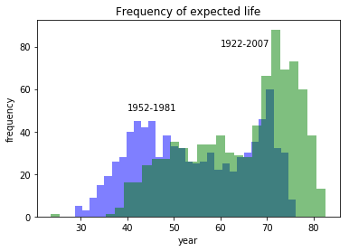
#expected life
df1 = df.loc[(df.year<=1981)]
df2 = df.loc[(df.year>=1982)]
plt.cla
plt.hist(df1.lifeExp, bins=30, color="blue", alpha=.5)
plt.hist(df2.lifeExp, bins=30, color="green", alpha=.5)
plt.text(40, 50, '1952-1981')
plt.text(60, 80, '1922-2007')
plt.title("Frequency of expected life")
plt.xlabel("year")
plt.ylabel("frequency")

