Slide 2
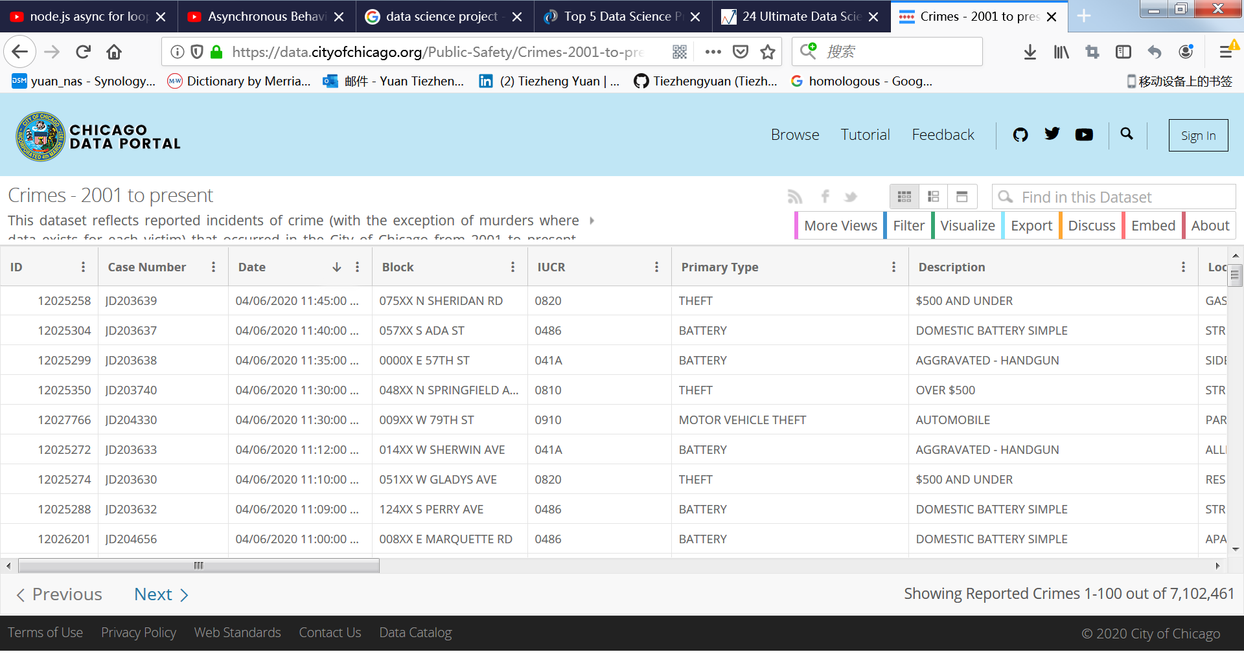
https://data.cityofchicago.org/Public-Safety/Crimes-2001-to-present/ijzp-q8t2/data

