Slide 1
Statistics in Python: Linear Regression
Tiezheng Yuan
April 20th, 2020

Slide 2
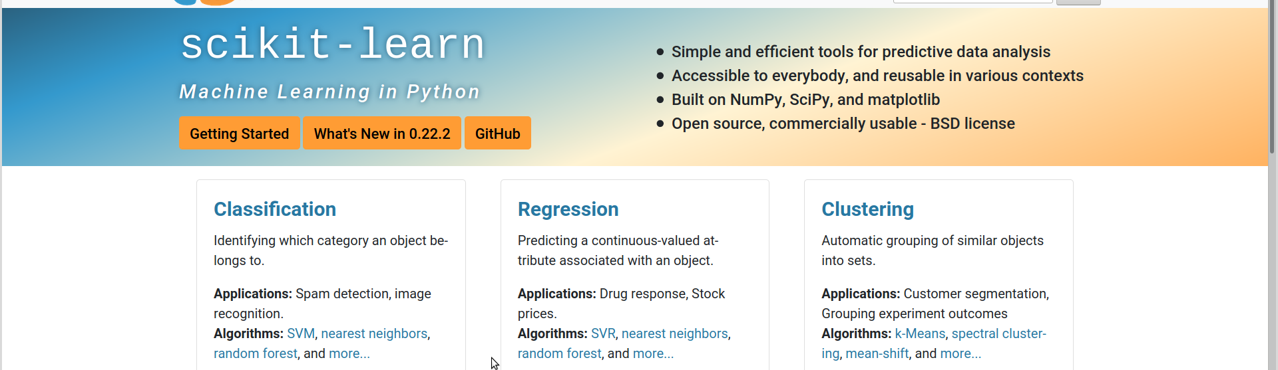
scikit-learn
https://scikit-learn.org/stable/

Slide 3
steps for linear regression modelling
collect and organize data, and handle missing data
observe data: variables, distribution, outliers
determine variables and co-variates
determine coefficients: random effects, interactions, polynomial
evaluate models: residuals, F-test, coefficients, cross-validation

Slide 4
example data
df = pd.read_csv('gapminder-FiveYearData.csv', header=0, index_col=False)
df.shape
Out: (1704, 8)
country year pop continent lifeExp gdpPercap \
0 Afghanistan 1952 8425333.0 Asia 28.801 779.445314
1 Afghanistan 1957 9240934.0 Asia 30.332 820.853030
2 Afghanistan 1962 10267083.0 Asia 31.997 853.100710
log-gdpPercap log2-gdpPercap
0 9.606304 9.606304
1 9.680980 9.680980
2 9.736572 9.736572

Slide 5
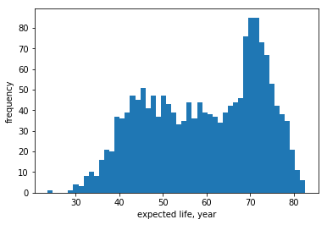
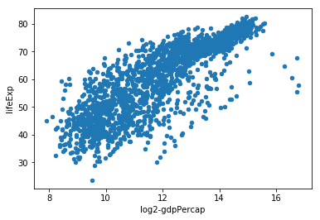
dependent variable: lifeExp

Slide 6
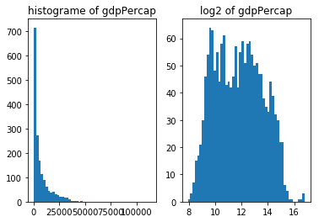
independent variable: gdpPercap

Slide 7
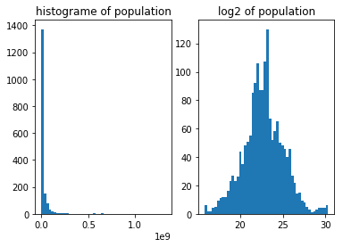
independent variable: population

Slide 8
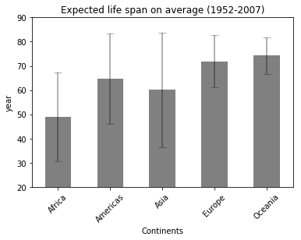
df1=df.groupby('continent').agg({'lifeExp': [np.mean, np.std]})
df1.columns=df1.columns.map('_'.join)
ax = df1.plot.bar(df1.index, 'lifeExp_mean', color='grey', rot=45,
legend=False, title="Expected life span on average (1952-2007)")
ax.errorbar(df1.index, df1.lifeExp_mean, yerr=2*df1.lifeExp_std,
linewidth=2, color='black', alpha=.3, capsize=5)
ax.lines[0].remove()#remove lines between error bars
plt.ylim(20,90)
plt.xlabel('Continents')
plt.ylabel('year')

Slide 9
conduct simple linear regression
df['log2-gdpPercap']= np.log2(df['gdpPercap'])
X=df['log2-gdpPercap'].values.reshape(-1,1)
Y=np.array(df['lifeExp'])
#observe: scatter plot
df.plot.scatter('log2-gdpPercap', 'lifeExp')
#2: linear regression
lm=linear_model.LinearRegression(fit_intercept=True)
#fit
reg=lm.fit(X, Y)

Slide 10
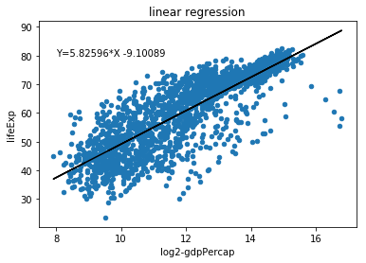
#predicted Y
predY=lm.predict(X)
predY.shape
#coefficients: slope
slope=round(reg.coef_[0], 5)
#coefficients: intercept
intercept=round(reg.intercept_, 5)
predicted values, and coefficients(slope, intercept)

Slide 11
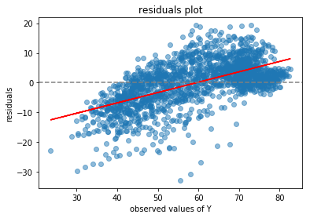
observe residuals
#residuals
res=Y-lm.predict(X)
#
reg_res=lm.fit(Y, res)
reg_res.coef_
#residual plot
plt.scatter(Y, res, alpha=.5)
plt.plot(Y, reg_res.predict(Y), color="red")
plt.axhline(0, color='grey', linestyle='--')
plt.xlabel('observed values of Y')
plt.ylabel('residuals')
plt.title("residuals plot")
The plot reveals that other unknown
co-variates should be considered.

Slide 12
multiple linear regression
consider more independent variables
convert categorical data to dummy variables
X1=df[['year','log2-pop', 'log2-gdpPercap']]
Y1=df['lifeExp'].values.reshape(-1,1)
lm=linear_model.LinearRegression(fit_intercept=True)
reg1=lm.fit(X1,Y1)
res1= Y1-reg1.predict(X1)
np.sum(res1**2)
reg1.coef_
reg1.intercept_
#convert dummy variables
continents=list(pd.unique(df['continent']))
df=df.join(pd.get_dummies(df['continent']))
X2=df[['year','log2-pop', 'log2-gdpPercap']+continents]

Slide 13
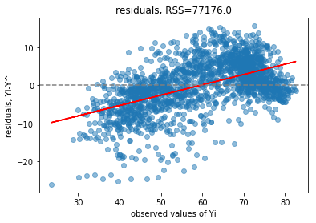
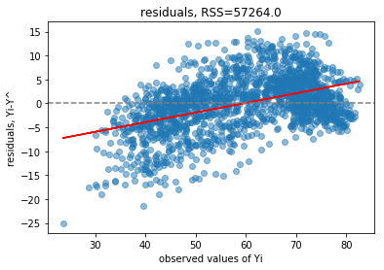
determine co-variates
Model1: lifeExpectation = year + log₂-population + log₂-gdpPercap
Model2: lifeExpectation = year + log₂-popuplation + log₂-gdpPercap + continent

Slide 14
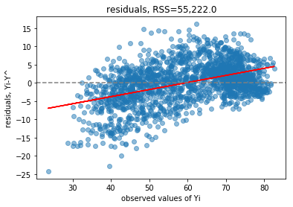
polynomial regression
Model3: lifeExpectation = log₂-gdpPercap + log₂-population + log₂-gdpPercap² +log₂-population² + log₂-gdpPercap*log₂-population + Asia + Europe + Africa + Americas + Oceania

Slide 15
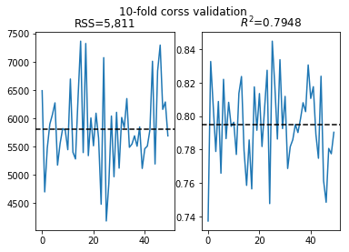
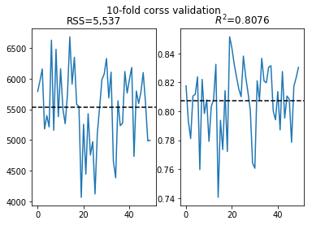
10-fold cross validation
Model2 Model3: +polynomial

Slide 16
#10-fold cross validation
def cross_validation(X, Y, times=20):
RSS=[]
R2=[]
for i in range(times):
#split data
X_train,X_test,Y_train,Y_test = \
model_selection.train_test_split(X, Y, test_size=.1)
#lm
lm=linear_model.LinearRegression(fit_intercept=True)
reg=lm.fit(X_train,Y_train)
#residuals
res=Y_test-reg.predict(X_test)
#RSS
RSS.append(np.sum(res**2))
#R^2 coefficient correlation
R2.append(reg.score(X_test, Y_test))
#
return (RSS, R2)

Slide 17

Estimate prediction intervals of coefficients
statsmodels could return summary() like R pattern.
In sklearn, bootstrap pattern could be used. t_{α/2, n-1} = t_{(1-0.5/2),1704-11-1} = t_{0.975,1690} = 1.960

Slide 18
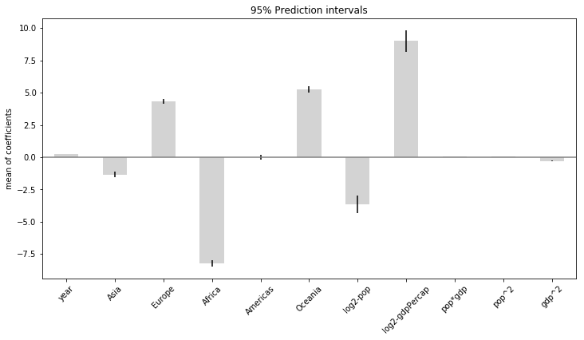
Prediction intervals of coefficients

