Slide 1
Python: Visulization

Slide 2
Draw a pie plot
Usage: plt.pie()
applications: Analyze compositions based on a category using percentage or proportion. Reveal most abundant part of a data set.
weakness: can’t compare different pie plots due to the percentage feature

Slide 3
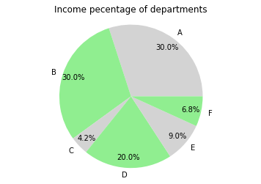
d=[30,30,4.2,20,9,6.8]
col=['lightgrey','lightgreen']*3
names=list('ABCDEF')
#
plt.cla()
plt.pie(d,colors=col,labels=names, autopct='%1.1f%%',
pctdistance=.85, labeldistance=1.1)
plt.axis('equal')
plt.title('Income pecentage of departments')
plt.show()

Slide 4
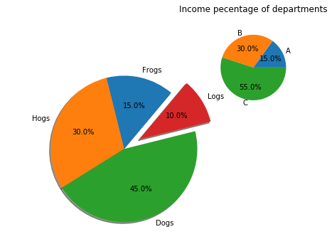
fig = plt.figure()
#pie1
ax1 = fig.add_axes([.1, .1, .8, .8], aspect=1)
ax1.pie(sizes, explode=explode, labels=labels,
autopct='%1.1f%%', shadow=True, startangle=50)
# Equal aspect ratio ensures that pie is drawn as a circle.
ax1.axis('equal')
#pie2
ax2 = fig.add_axes([.65, .65, .5, .5], aspect=1)
ax2.pie(logs_sizes, labels=logs_labels, autopct='%1.1f%%', radius=.8)

Slide 5
