Slide 1
Visualization in Python: Scatter and Line Plot
Tiezheng Yuan
April 19th, 2020

Slide 2
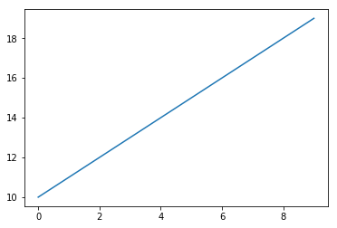
draw a line
import matplotlib.pyplot as plt
x=np.arange(10)
y=np.arange(10,20)
plt.plot(x,y)

Slide 3
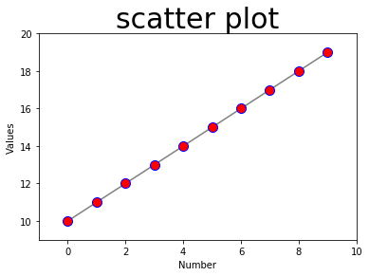
Add more options
plt.cla()#clear plot
plt.plot(x, y, color='grey', linestyle='solid', linewidth=1.5,
marker='o', markersize=10, markerfacecolor='red',
markeredgecolor='blue')
plt.xlim(-1,10)
plt.ylim(9,20)
plt.xlabel('Number',fontsize=10)
plt.ylabel('Values', fontsize=10)
plt.title('scatter plot', fontsize=30)
#plt.show()#show plot

Slide 4
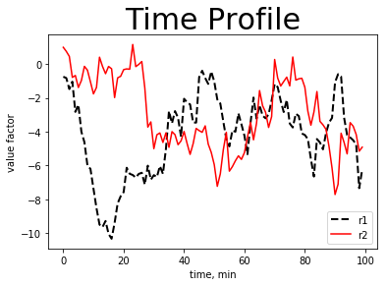
r1=np.random.randn(100).cumsum()
r2=np.random.randn(100).cumsum()
#draw line plot
plt.plot(r1, linestyle='--', color='black', linewidth=2)
plt.plot(r2, linestyle='-', color='red')
plt.title('Time Profile', fontsize=30)
plt.xlabel('time, min')
plt.ylabel('value factor')
plt.legend(['r1','r2'], loc=4)

Slide 5
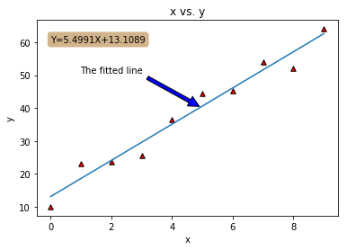
Draw a scatter plot with a fitted line
plt.scatter()
plt.plot()
plt.annotate()
plt.text()

Slide 6
x=np.arange(10)
y=np.array(5*x+10)+np.random.rand(10)*10
# Fit with polyfit
slope, intercept = np.polyfit(x, y, deg=1)#one degree
#draw plot
plt.cla()#clear plot
plt.scatter(x,y, color='red',edgecolor='black',marker='^', s=30)
plt.plot(x, intercept+slope*x, '-')#draw fitted line
plt.title("x vs. y")
plt.xlabel('x')
plt.ylabel('y')
#add arrows
plt.annotate('The fitted line',ha='center',va='bottom',
xy=(5,40), xytext=(2,50),
arrowprops={'facecolor':'blue','shrink':.05})
#add annotation
box={'facecolor':'tan', 'edgecolor':'tan', 'boxstyle':'round'}
formula_text='Y={}X+{}'.format(round(slope,4),round(intercept,4))
plt.text(0,60, formula_text, bbox=box)
#plt.show()#show plot

Slide 7
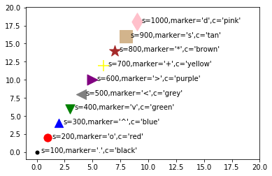
dot style: plt.scatter(x,y, s=’’, marker=’’, c=’’)

Slide 8
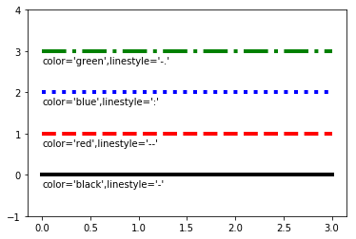
line style: plt.plot(x, y, color=’’, linestyle=’’)

Slide 9
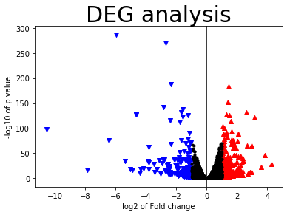
cond1= DEG['PValue']<=0.05
cond2 = DEG['logFC']>=1
cond3 = DEG['logFC']<=-1
up=DEG.loc[ cond1 & cond2 ]
plt.scatter(up.logFC, -np.log10(up.PValue),
marker='^', c='red')
down=DEG.loc[cond1 & cond3]
plt.scatter(down.logFC, -np.log10(down.PValue),
marker='v', c='blue')
normal=DEG.loc[ ~( (cond1 & cond2)|(cond1 & cond3) )]
plt.scatter(normal.logFC, -np.log10(normal.Pvalue),
marker='.', c='black')
plt.axvline(x=0, color='black')
plt.xlabel("log2 of Fold change")
plt.ylabel("-log10 of p value")
plt.title('DEG analysis', fontsize=30)
volcano plot

