Slide 1
Virtual Screening of Protein Design: Predict Thermophilic Regions of Enzymes Using Hugging Face Transformers
Tiezheng Yuan
2023-2024

Slide 2

Enzyme Characteristics: Optimum Temperature and Temperature Stability
cold room temperature hot
Enzyme
Application
detergent drug, food biofuel, food
Goal: Predict thermophilic regions using LLMs
Application of the model: To be pre-trained model for improvement of enzyme characteristics and protein design.
Notes:
Enzyme are widely used in food or drug industry. Its optimum temperature and its thermal stability shall be compatible with conditions where its enzymatic reaction is working. For example, a lactase should be thermal stable when that is used for milk production. To meet such demands, except that screening enzyme from environments, protein design followed by mutation is good approach. Start from a certain enzyme, and select one or two regions for mutations. Obviously, what or where such those regions for mutations is challenges. Except prior knowledge, computing-aided virtual screening is emerging and powerful approach. Here, I am going to show an example: apply LLM models into virtual screening to select thermal regions of enzymes.

Slide 3
Train Model from Scratch and Virtual Screening Using Prokaryote, Genome and Protein Annotations
Prokaryotic annotations
Reference genomes
Prepare ORF using mutation PCR, or
Gene Synthesis
Annotated Ref proteins
Pre-train LLM model
Using genome-wide proteins
Gene Cloning into
Expression Vector
Fine-Tuning Model
Using OptTemp Enzymes
Gene Overexpression
In E. coli
Target protein
Enzyme Purification
Using His-tag Affinity
Detect
Thermophilic Regions
Assay Optimum Temperature
Notes:
This is entire study design. Here, modeling and virtual screening is working together with bench work. Input data are prokaryotic annotations, reference genome for pr-training, and reference proteins for fine-tuning.

Slide 4
Generative Machine Learning (GML): Unlabeled Sentence A and B Pair
Training Pattern: “<amino acid sequence of protein> is <temperature>”
Example data for training:
“MIRLFERHKKRRSFTLDGLWKFRTDPERKGFDEKWFECFPEDFTE
VFVPSCWNNELGLYEYEGTA….. EIPMWGFPESVL KNPLVKERG
LKMLEEMIERDYHHPCIIIWGLHNEIATHTEAGYNITKAFA is 45”
Mask (Bytes tokenization, 512 amino acids):
“MIRLFERHKKRRSFTLDGLWKFRTDPERKGFDEKWFECFPEDFTE
VFVPSCWNNELGLYEYEGTA….. EIPMWGFPESVL KNPLVKERG
LKMLEEMIERDYHHPCIIIWGLHNEIATHTEAGYNITKAFA is <mask>”
Notes:
For training of LLM, the input data could be unlabeled sentence A and B pair. Here is my text pattern:

Slide 5
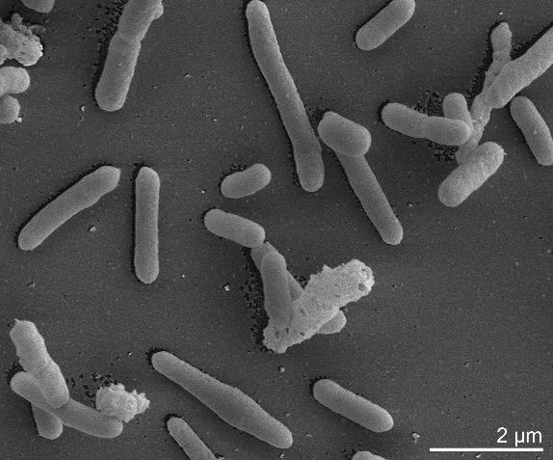
Optimum Temperature and Thermal Stability of Enzymes
β-galactosidase (lactase)
Alicyclobacillus acidocaldarius 60 °C
optimum temperature
70 °C
Temperature stability
30 min at 70 °C
Tiezheng Yuan, Biotechnol Lett. 2008 Feb;30(2):343-8.
Notes:
The next, I am going to introduce training data. Without assay of characterization, there is no way to know its optimum temperature or thermal stability. Here, I employ an alternative way.
Usually, Optimum temperature of enzyme or proteins would match the optimum incubation temperature of prokaryotes. In some cases, optimum temperature would accommodate wider temperature range . For example, the bacteria Alicyclobaccilus acidocaldarius grow under 60 temperature. But the optimum temperature of beta-galactosidase is 70 C.

Slide 6
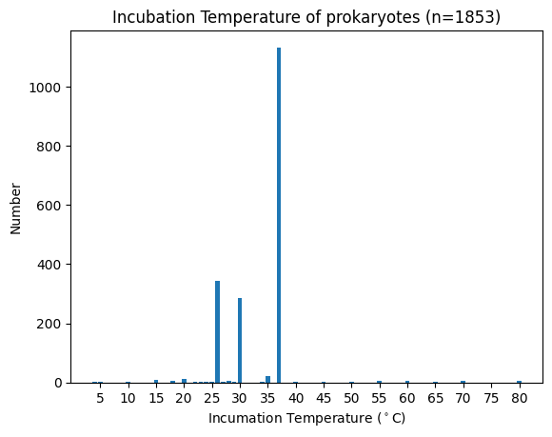
Pre-training: Temperature ~ Prokaryotic Incubation
< 20 °C 30-37 °C > 45 °C
Psychrophile Mesophile Thermophile
Among 1,083 reference genomes out of 1,853 prokaryotes, a number of 1,590,198 proteins are used for pre-training.
American Type Culture Collection: https://www.atcc.org/
Notes:
Prokaryotic microorganism could grow in various temperature range (cold, room temperature, hot). The optimum incubation temperature of 1852 prokaryotes. ~60% are good at 37C. The lowest temperature is as low as 5 C. The highest is as high as 80 C. All strains are identified and stored in ATCC (American Type Culture Collection). Sprawl data from HTML. Some of their reference genomes are available in FTP of NCBI.

Slide 7
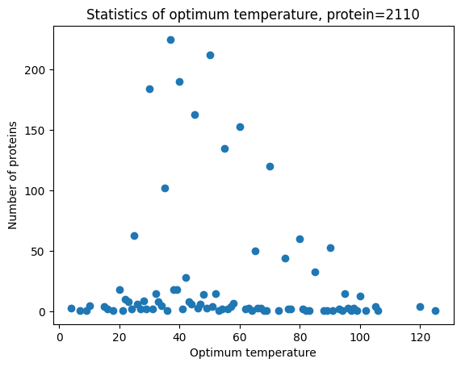
Fine-Tuning Pre-trained Model
Input data: 2,110 enzymes with assayed optimum temperature (UniProt Ref)

Slide 8
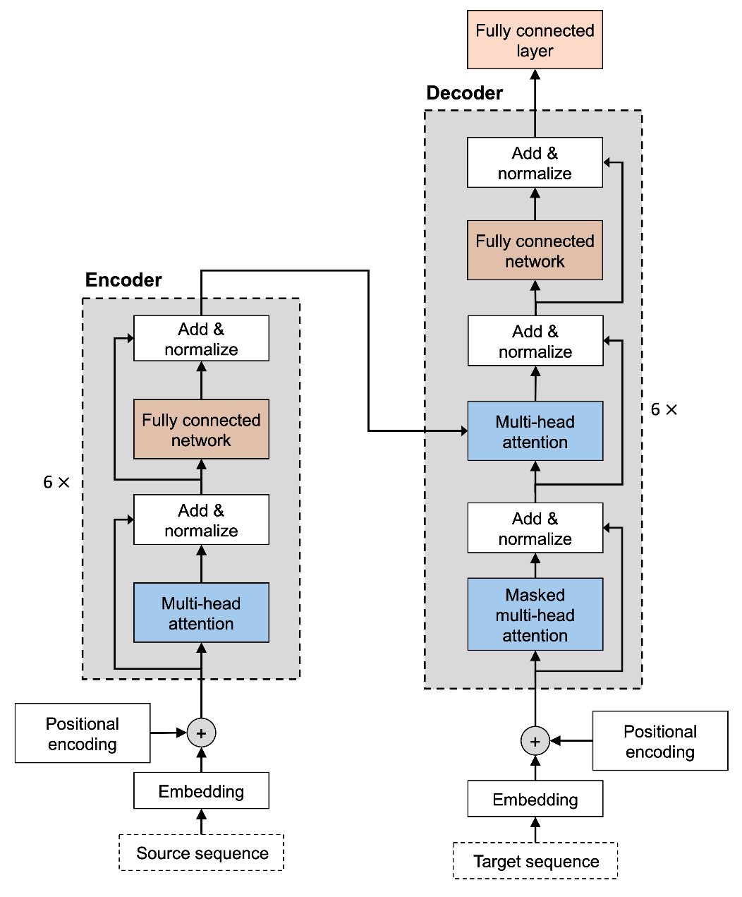
Large Language Models (LLMs)
BERT:
Bidirectional encoder representation.
Bidirectional self-attention.
Accept unlabeled text.
Masked language modeling (MLM)
Transformers Architecture
KantaiBERT(distilled version of BERT):
byte-pair encoding
6 layers, 12 heads
84M parameters
Jacob Devlin et al. 2018
A. Vaswani et al. 2017.
Notes:
In this study, my LLM structure is based on KantaiBERT, a distillation of BERT. My hardware is not enough to support LLM namely ChatGPT. BERT is bidirectional transformer. As described in its article in 2018 (a meeting article), BERT is …..
Transformers is new structure model released in 2017. Compared with attention used in RNN, hidden layers are attention layers in transformer architecture. As described in this article: attention is all you need. There are encoder and decoder parts.

Slide 9
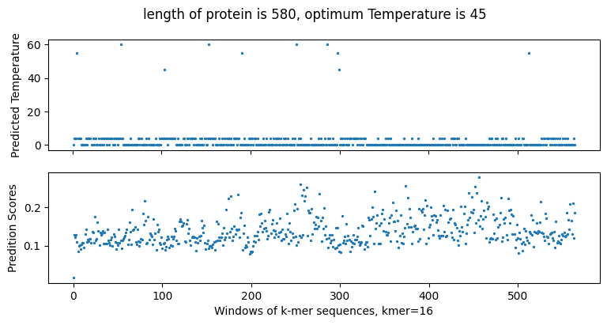
Virtual screening: Detect Thermophilic Regions (Case I)

Slide 10
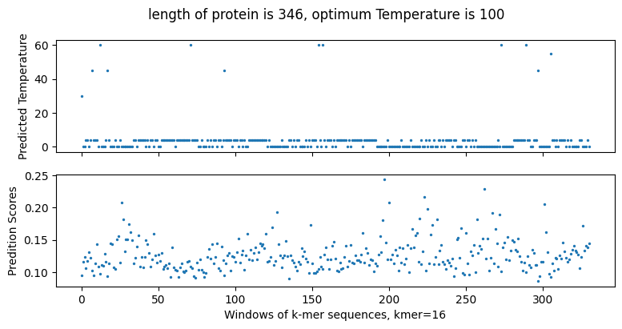
Enrichment of Thermal Regions (Case II)

Slide 11
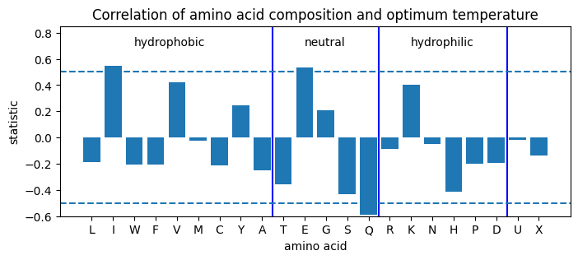
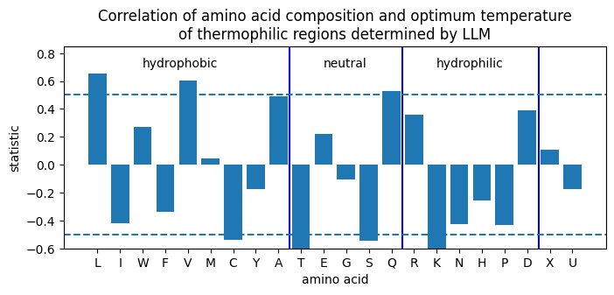
Amino Acid Compositions of Thermophilic Regions determined by LLM
Notes:
Generally speaking, hydrophobic aa is wrapped into the interior, and hydrophilic aa is usually on the surface of protein. In thermophilic protein, hydrophobic aa have higher composition compared with mesophilic proteins. However, that is not always true. mutations of protein by replacement of hydrophobic aa may not have impact on thermos characteristics of a protein. To my experience, such mutations have much more than half chance of failure. Theoretically, not all AA make contributions to thermos characteristics. 1. hydrophobic AA I, V, A. 2.neutral AA, namely Glutamine (Q) negative correlated to positive correlation. 3. hydrophilic AA namely lysine (K) descreases.

Slide 12
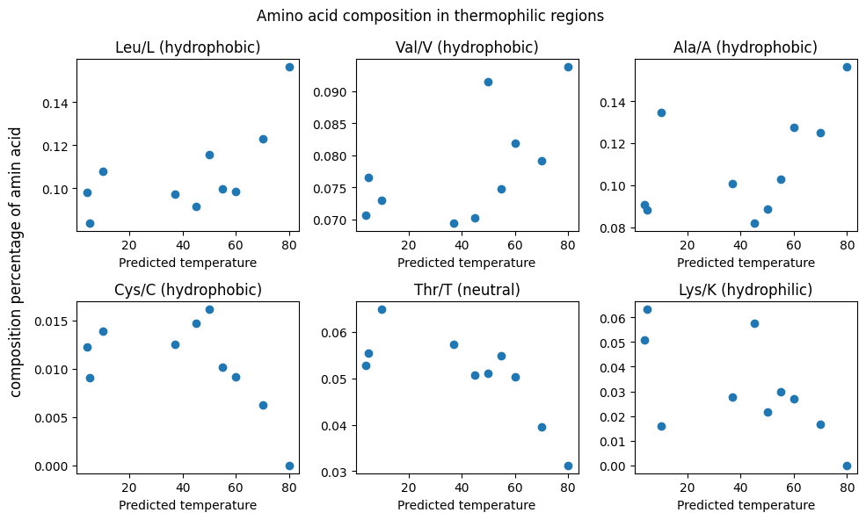
Hydrophobicity of Amino Acids in Thermophilic Regions
Notes:
Here, I list 6 amino acids which have correlation with thermophilic regions.
Positive correlations: Leucine, valine, alanine.
Negative correlations: cysteine, threonine, lysine

Slide 13
Discussion
Masked LM may either predict next sequences or temperatures. Long sequence -> next sequence short sequence -> temperature.
Lack of standard dataset for evaluation like GLUE or SQuAD. Compare multiple LLMs on the same baseline.
None positive assays are not collected in biological practice. In this case, mutations have not significant impact on characteristics of proteins. Such results are deprecated rather than recorded.
Chain of thoughts for comprehensive standing. From example, mutations of thermal regions should not affect on its activity.

Slide 14
Thanks
Source code: https://github.com/Tiezhengyuan/llm_enzyme

