Slide 1
Linear Epitope Prediction
Tiezheng Yuan
2024-2025

Slide 2
Outline
Introduction
Employ composition of amino acids
Explore protein sequence as contextual
Explore 3D structure data from Antigen-Antibody complex
Discussion

Slide 3
Do we need epitope prediction?
Discover antibody clone for therapeutic intent.
Discover potential mutation site for overcoming drug resistance.
Design mutation sites for assessing antibodies.
Produce antibodies.
Optimize antibody discovery system.

Slide 4
Algorithms Used by Epitope Predictors
Calculate statistics: epitope score: EpiPred ( 2014), SEPPA (2009), PEPITO (2008) Baysian: Epitopia (2009)
Machine learning: SVM: LBTope (2013), SVMTrip (2012), COBEpro (2009) random tree: iBCE-EL (2015) bootstrap: BepiTBR (2022), epitope3D (2022)
Deep learning: ANN: Martin etal. (2019) CNN: EPMP (2021) RNN: BepiPred (2022), EpiDope (2021), ABCPred (2006)
large language models: BERT: LECE-BERT (2024) ESM: DiscoTope (2024), SEMA (2022)

Slide 5
Features used by epitope predictors
Amino acids: Frequency of AA Physical-chemical properties including hydrophobicity, polarity, polarizability, Van de Waals volume
Protein sequence as contextual
Secondary structure (ligands) from PDB

Slide 6
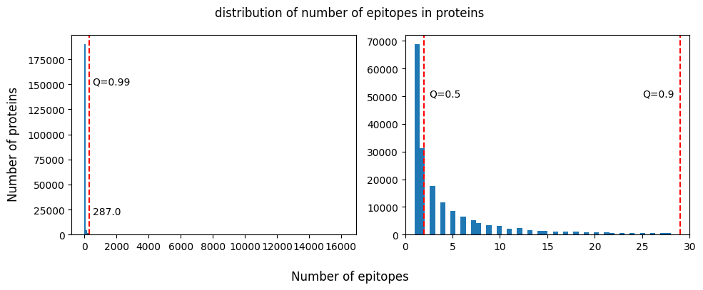
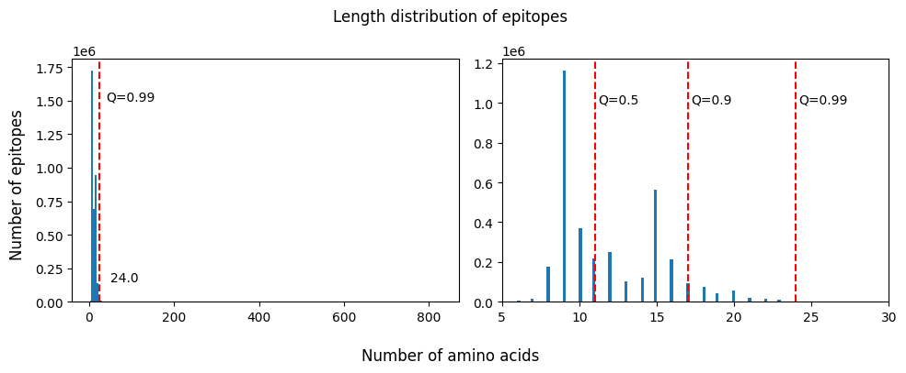
Summary of Annotated Epitopes
~3.6M epitopes
(IEDB, Jan 2004)
Notes:
The plots on the right side are enlarged from the left side.
1. Most antigens are annotated by <5 epitopes. 99% antigens are annotated by <30 epitopes.
2. Most epitopes range from 9 – 20 amino acids.

Slide 7
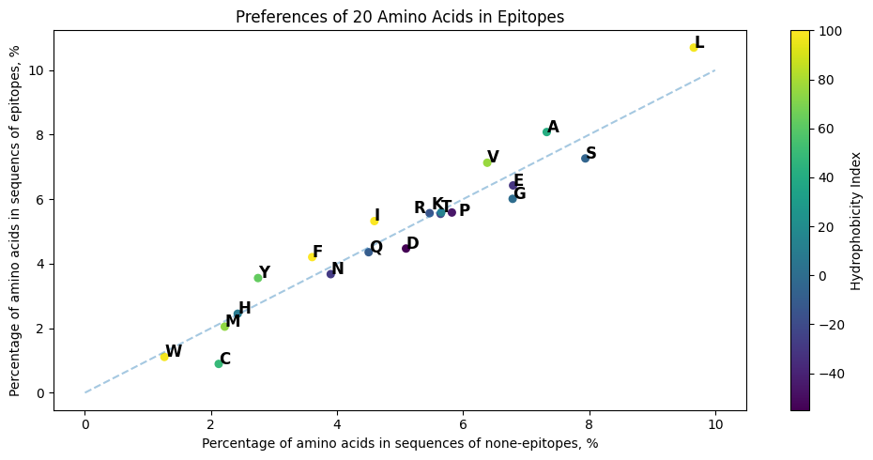
Hydrophobicity of Amino Acids (AA)
Hydrophobic
Neural
Hydrophilic
More hydrophobic/neural AAs in epitopes
https://www.sigmaaldrich.com/US/en/technical-documents/technical-article/protein-biology/protein-structural-analysis/amino-acid-reference-chart#hydrophobicity
Notes:
Compare AA compositions of epitopes with those in none-epitope sequence regions. Hydrophobic or neural Aas are more than those in non-epitope regions.

Slide 8
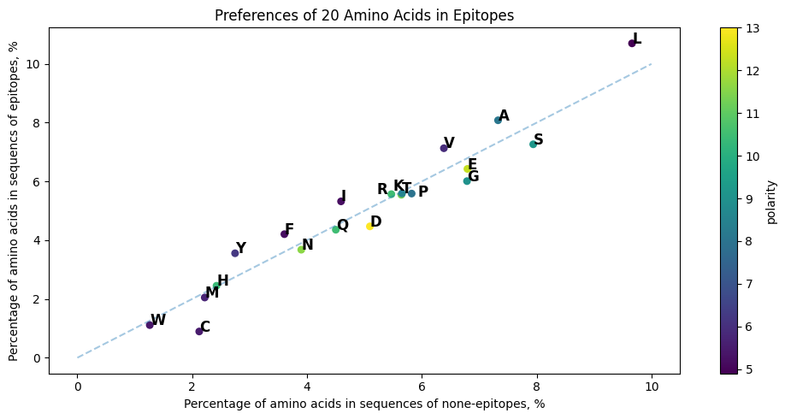
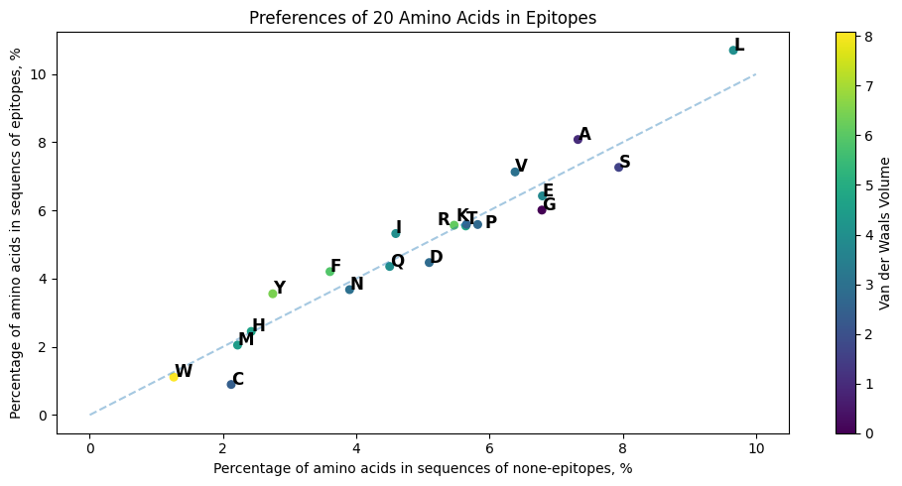
Polarity and VDWV of AA
polarity
Van der Waals Volume
https://pmc.ncbi.nlm.nih.gov/articles/PMC5037676/
Notes:
Compared with hydrophobicity, rules of polarity and VDWV in epitopes compared with none-epitopes are not obvious.

Slide 9
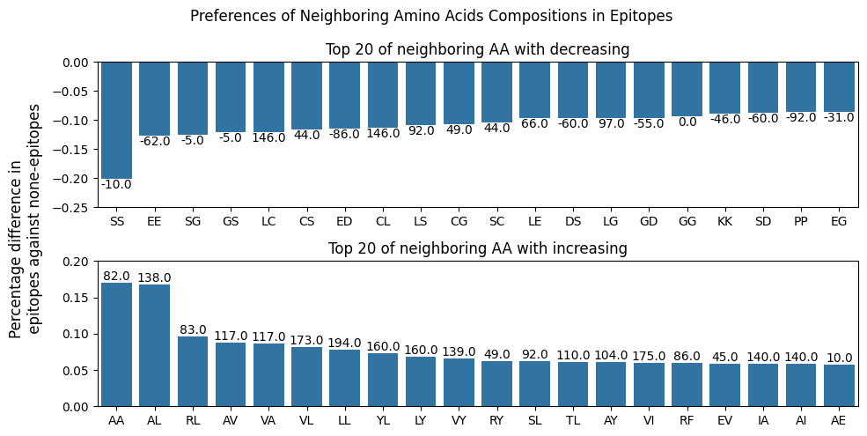
Composition Preferences of Neighboring Amino Acids in epitopes against non-epitopes.

Slide 10
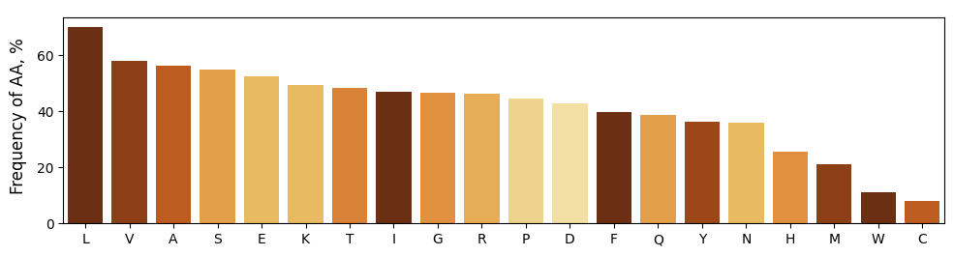
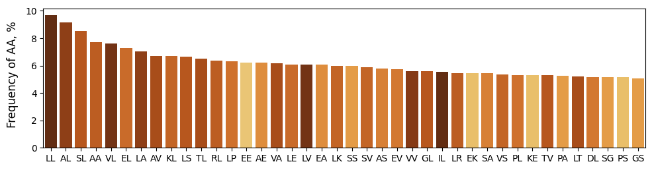
Frequency of amino acids in epitopes

Slide 11
Artificial Neural Network
Normalized Input
[hydrophobicity, polarity, polarizability, VDWV, frequencies of AA]
Features: 25
1 x 25
Linear Layer + Dropout Layer
parameters: 128 x 25 + 128 = 3328
Datasets Train: 6.2M Validate: 2.7M Test: 2.2M
Features: 25
1 x 128
Linear Layer + Dropout Layer
Parameters: 48 x 128 + 48 = 6192
1 x 48
Linear Layer
Parameters: 1 x 48 + 1 = 49
1 x 1
Binary identity: 1 – epitope, 0 – none epitope

Slide 12
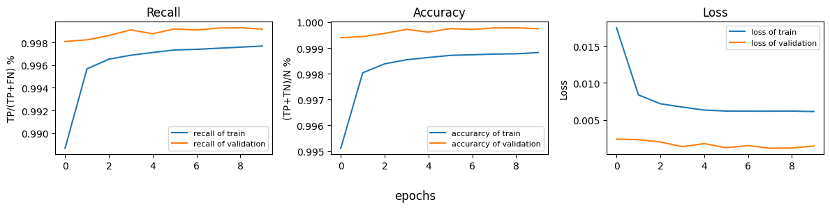
Train ANN model

Slide 13
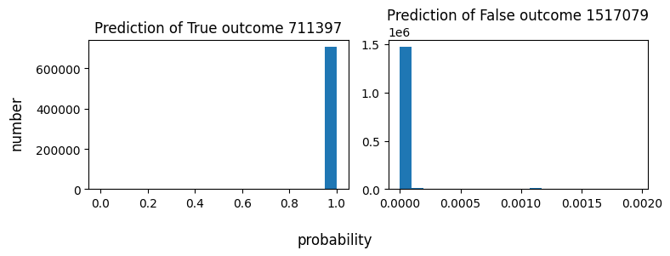
Test the ANN model using testing dataset

Slide 14
Discussion of the ANN model
Strength: - Accuracy is good. - It is straight forward to interpret the results. - Compatible to various lengths of epitopes
Issues: - It is supposed that all features are random variables. The effect of each feature is accumulative. - Doesn’t consider contextual of AA sequence. - Doesn’t distinguish various lengths of sequence. - Can’t distinguish pseudo-sequence, namely shuffled input.

Slide 15
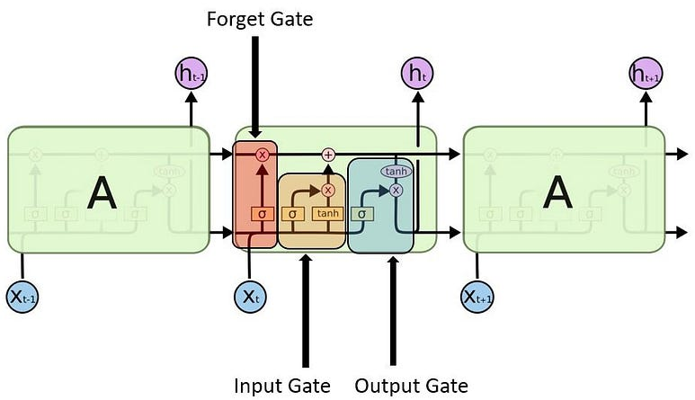
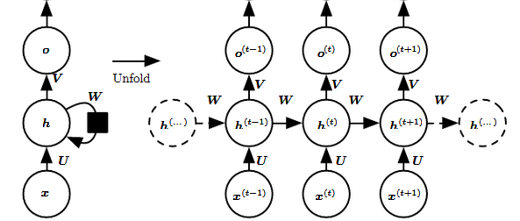



Recurrent Neural Network (RNN)
$$O\left(t\right)=∅_{0}\left(W_{h0}h_{t}+b_{0}\right)$$
Forget gate
Input gate
Output gate
$$f_{t}=φ\left(W_{xf}x_{t}+W_{hf}h_{t−1}+b_{f}\right)$$
Hidden unit
$$h_{t}=∅_{h}\left(W_{xh}x_{t}+W_{hh}h_{t−1}+b_{h}\right)$$
$$i_{t}=φ\left(W_{xi}x_{t}+W_{hi}h_{t−1}+b_{i}\right)$$
$$τ_{t}=tanh\left(W_{xτ}x_{t}+W_{hτ}h_{t−1}+b_{τ}\right)$$
https://www.deeplearningbook.org/contents/rnn.html
F. Gers, et al. Neural computation 12, 2451-2471, 2000
Notes:
In RNN, the output is determined by the current input and the hidden unit of latest previous layer. Therefore, a RNN model could predict the next word based on current word in a text sequence. LSTM(long-short term memory) is decoration of conventional RNN. There are forget, input and output gate added in the model. The three gates update the cell state. Forget reset the hidden unit to zero. Input decide if input could be removed. Output decide if hidden unit could be used.

Slide 16
LSTM model
Input: amino acids sequence
Text: 32 x p; lengths: 32 x 1
Embedding layer
32 x max_len x 48
packing
Sum of lengths x 48
Datasets Train: 6.2M Validate: 2.7M Test: 2.2M
LSTM layer
Sum of lengths x 64
Fully-connected layer
32 x 128
Fully-connected layer
32 x 1
Loss: Binary Cross Entropy
Labels: 1 - epitope, 0 – none epitope

Slide 17
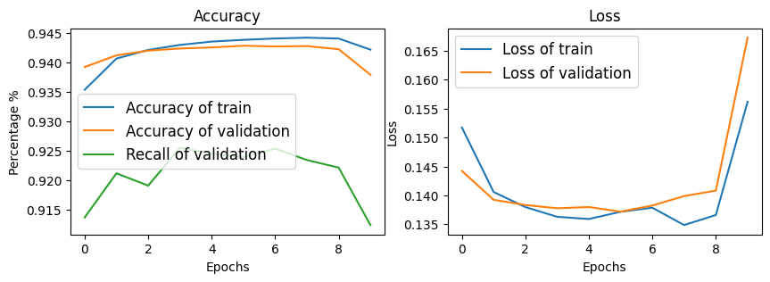
Train RNN model

Slide 18
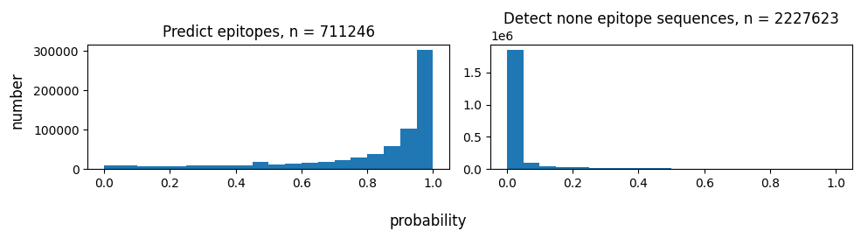
Test the trained model using test data

Slide 19
Discussion of the RNN model
Strength: Consider the contextual of amino acid sequences. Being compatible with various length of sequences. Both accuracy and recall using validation and testing data are > 90%.
Ready for improvements: Accuracy would decrease when sequences are > 50 AA. Optimization for better recall (> 95%). Tokenization of single amino acid is lack of variety. RNN model doesn’t accept high dimensional input.

Slide 20
EGFR monoclonal antibody drugs binding to the domain III
Case study: HER1 (EGFR, epidermal growth factor receptor)
Drug (brand name) | R&D Company | Domain III
Cetuximab | Eli Lilly | 408-468
GC1118 | Green Cross | 350-360
Matuzumab | EMD, Merck | 460-461
Necitumumab | Eli Lilly | 384-409
Nimotuzumab | InnoMab, Biocon | 353-358
Panitumumab | Amgen, Takeda | 386-391
Front Oncol. 2020 Jul 24;10:1249.

Slide 21
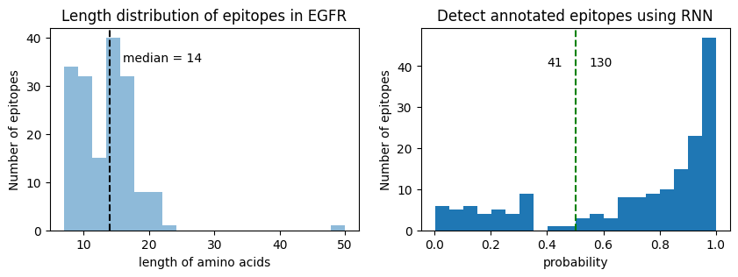
Summary of Virtual Epitope Mapping
270 annotated epitopes (171 unique sequences) with 14 AA on average.
The model can detect 130 out of 171 (Probability > 0.5)

Slide 22
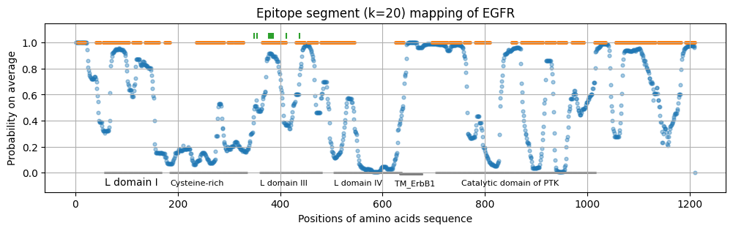
Epitope mapping of EGFR with window 20 AA
~600 AA: extracellular – transmembrane – intracellular
Domain III contains competitively binding sites used by lots of monoclonal antibody drugs.
Notes:
In this case study, I did virtual epitope mapping using that model. K-mer =20 means the epitope window is 20 AA. Scan the entire protein sequence from N-terminus. The dots stand for prediction on that AA. The orange color lines represents the regions annotated as epitopes region. HER1 is transmembrane protein, which are extracellular, transmembrane, and intracellular regions. Showed in the plot, the cysteine-rich region and transmembrane regions are not predicted as epitopes, consistence with previous bench work study. Domain III contains competitively binding sites used by lots of monoclonal antibody drugs which are labeled by vertical bars.

Slide 23
Discussion of epitope predictions
Applications: - Discover antibody clone. - Discover mutated epitopes for solving drug resistance. - Design peptide libraries for epitopes mapping. - Screen epitopes with high affinity for antibody production.
Challenges of ML models: - Uncertain negative labels. - Sequence representations: token. - Orchestrate your screening systems.

Slide 24
Thanks
Source code: https://github.com/Tiezhengyuan/ml_epitope/

Slide 25
Epitope prediction is pre-beginning rather than beginning in screening
Shall I try bioinformatics predictors as much as I can ? - I’m going to design a protocol according to epitope predictions.
What epitope-related features are employed for modeling ? - Try to interpret the predictions using biological knowledge.
What is the best hit? - Narrow down my scope and reduce work load.
Can assay data be integrated into you modeling process? - Gradient descent to the target based on previous bench work.
Notes:
Antibody production and medicine is a very long and complex process. The screening could be phage, or mice system.

Slide 26
Notes:
HER2 () is involved in normal cell growth. But overexpression in cancer cells including breact ovarian, bladder, pancreatic , stomach and esophageal cancers.

