Slide 1
Linear Epitope Prediction: Features Selection and Model Optimization
Tiezheng Yuan
2024-2025

Slide 2
Outline
Introduction
Employ composition of amino acids: RF, ANN.
Explore protein sequence as contextual: RNN.
Optimize predictor: feature selection, and model optimization.
Discussion

Slide 3
Do we need epitope prediction?
Discover antibody clone for therapeutic intent.
Antibody purification in drug production.
Discover potential mutation site for overcoming drug resistance.
Design mutation sites for assessing antibodies.
Optimize antibody discovery system.
Notes:
Here, I list applications of epitope predictor.

Slide 4
Algorithms Used by Epitope Predictors
Calculate statistics: epitope score: EpiPred ( 2014), SEPPA (2009), PEPITO (2008) Baysian: Epitopia (2009)
Machine learning: SVM: LBTope (2013), SVMTrip (2012), COBEpro (2009) random tree: iBCE-EL (2015) bootstrap: BepiTBR (2022), epitope3D (2022)
Deep learning: ANN: Martin etal. (2019) CNN: EPMP (2021) RNN: BepiPred (2022), EpiDope (2021), ABCPred (2006)
large language models: BERT: LECE-BERT (2024) ESM: DiscoTope (2024), SEMA (2022)
Notes:
Here, I listed all major bioinformatics tools of epitope predictor.

Slide 5
Features used by epitope predictors
Amino acids: Frequency of AA Physical-chemical properties including hydrophobicity, polarity, polarizability, Van de Waals volume
Protein sequence as contextual
Secondary structure (ligands) from PDB

Slide 6
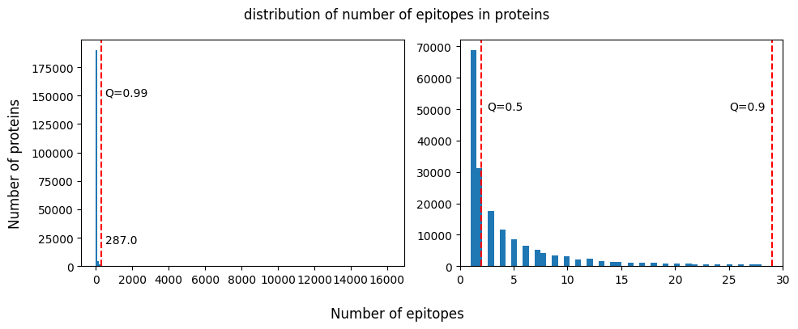
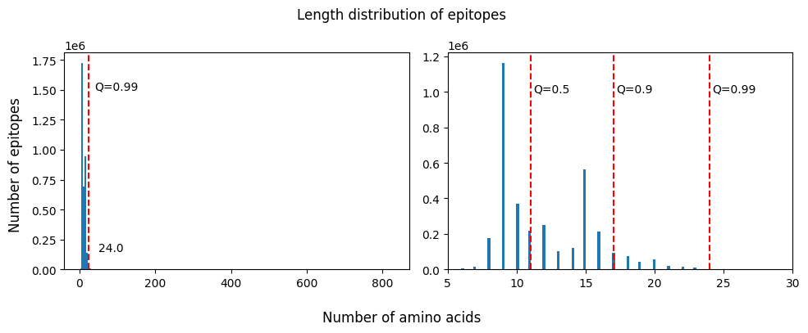
Summary of Annotated Epitopes
~3.6M epitopes
(IEDB & UniProt, Jan 2024)
Notes:
The plots on the right side are enlarged from the left side.
1. Most antigens are annotated by <5 epitopes. 99% antigens are annotated by <30 epitopes.
2. Most epitopes range from 9 – 20 amino acids.

Slide 7
ANN Predictor: Physical-chemical Properties and Frequencies of Amino Acids

Slide 8
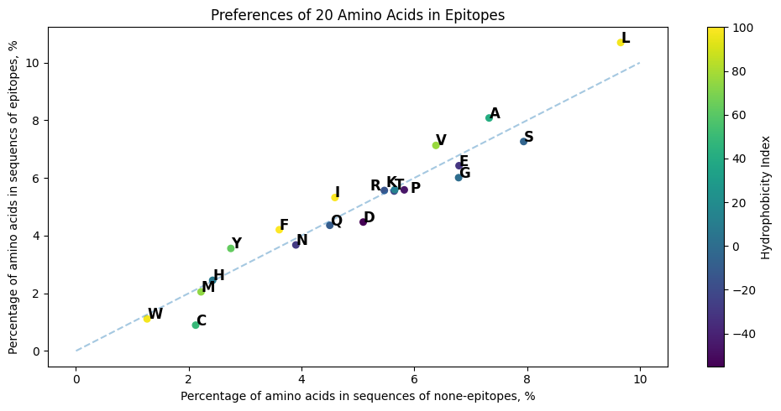
Hydrophobicity of Amino Acids (AA)
Hydrophobic
Neural
Hydrophilic
More hydrophobic/neural AAs in epitopes
https://www.sigmaaldrich.com/US/en/technical-documents/technical-article/protein-biology/protein-structural-analysis/amino-acid-reference-chart#hydrophobicity
Notes:
Compare AA compositions of epitopes with those in none-epitope sequence regions. Hydrophobic or neural Aas are more than those in non-epitope regions.

Slide 9
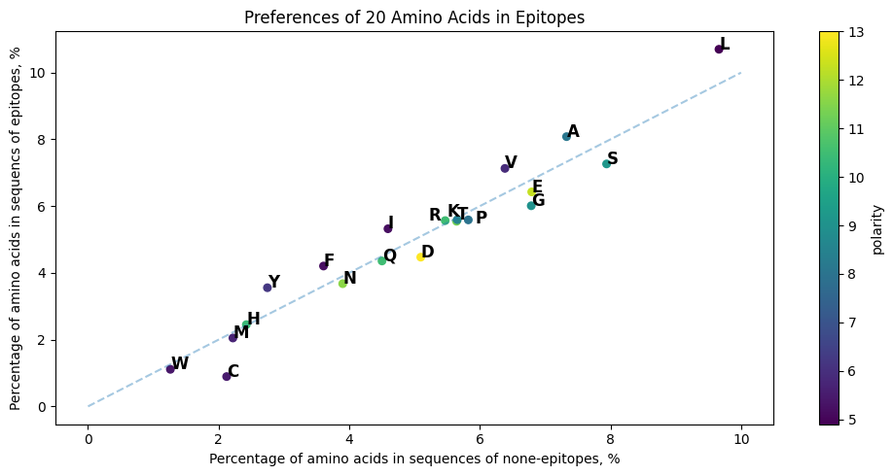
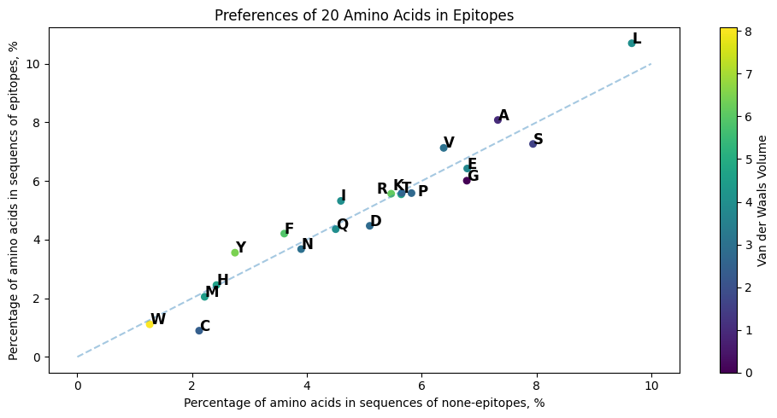
Polarity and VDWV of AA
polarity
Van der Waals Volume
https://pmc.ncbi.nlm.nih.gov/articles/PMC5037676/
Notes:
Compared with hydrophobicity, rules of polarity and VDWV in epitopes compared with none-epitopes are not obvious.

Slide 10
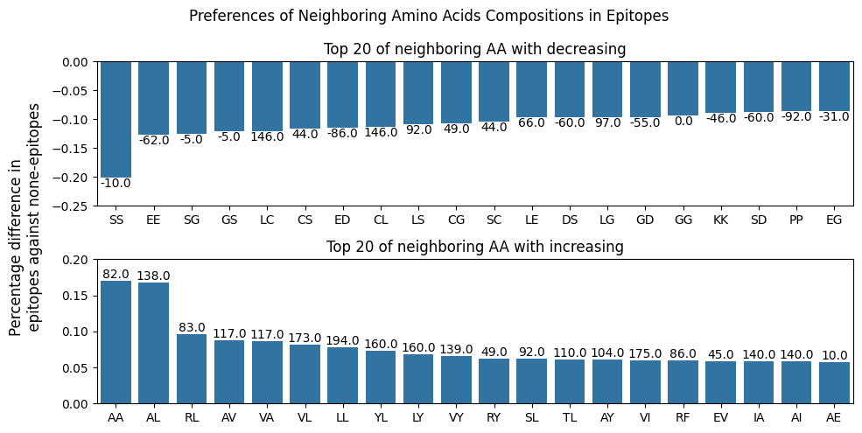
Composition Preferences of Neighboring Amino Acids in epitopes against non-epitopes.
Notes:
Two neighoring amino acids

Slide 11
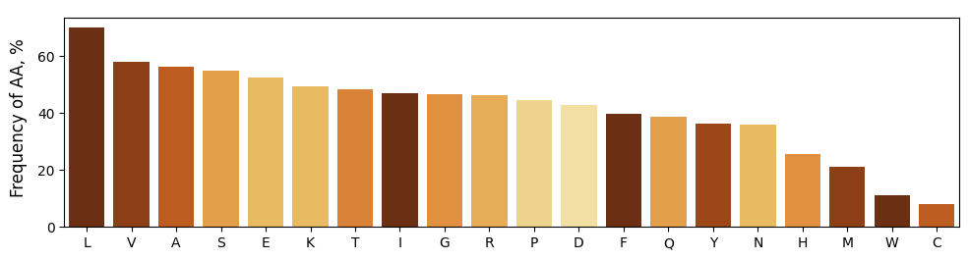
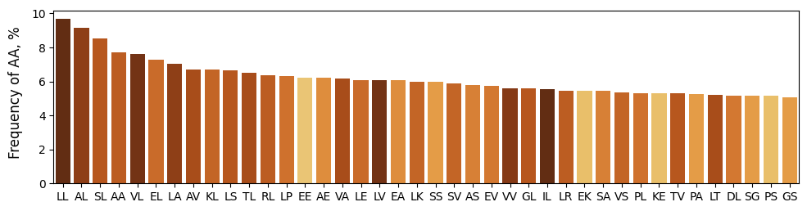
Frequency of amino acids in epitopes
Notes:
Frequency of amino acids

Slide 12
Artificial Neural Network
Normalized Input
hydrophobicity, polarity, polarizability, VDWV, and frequencies of AA
Linear Layer + Dropout Layer
parameters: 2048 * 25 + 2048 = 53,248
Label | Size
Epitopes (positive labels) | Filtered epitopes: ~ 1.9M
Non-epitopes (negative labels) | Non-epitopes: ~ 3.2M
Linear Layer + Dropout Layer
Parameters: 512 * 2048 + 512 = 1,049,088
Linear Layer
Parameters: 96 * 512 + 96 = 49,248
Datasets Train: 1.9M Validate: 0.8M Test: 0.7M
Features: 25
Linear Layer
Parameters: 1 * 96 + 1 = 97
Binary identity: 1 – epitope, 0 – non-epitope

Slide 13
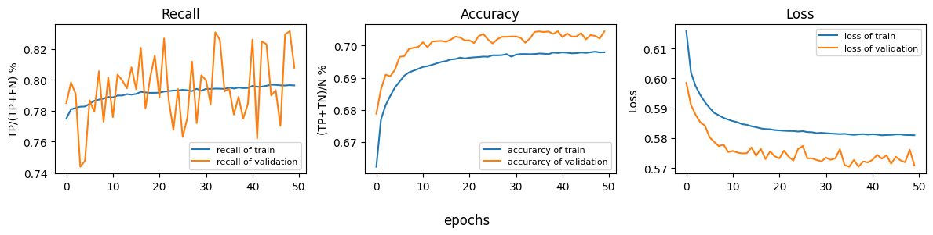
Train ANN model
Notes:
Recall/sensitivity is 80%. Accuracy is 70%.

Slide 14
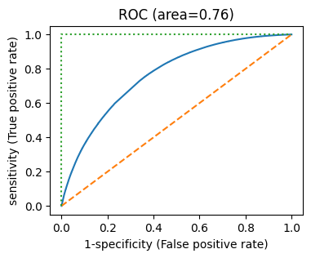
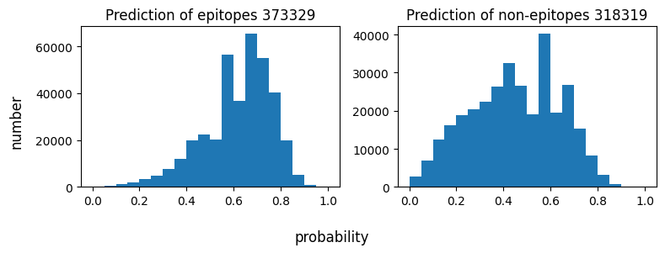
Test the ANN model using testing dataset
Notes:
Test model using testing data.

Slide 15
Discussion of the ANN model
Strength: - It is straight forward to interpret the results. - Compatible to various lengths of epitopes
Issues: - It is supposed that all features are random variables. The effect of each feature is accumulative. - Doesn’t consider contextual of AA sequence. - Doesn’t distinguish various lengths of sequence. - Can’t distinguish pseudo-sequence, namely shuffled input.

Slide 16
RNN Predictor: Amino Acids Sequence

Slide 17
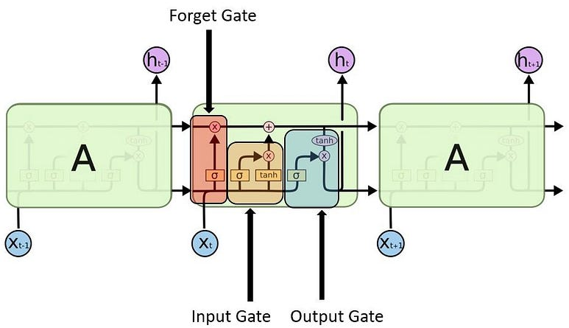
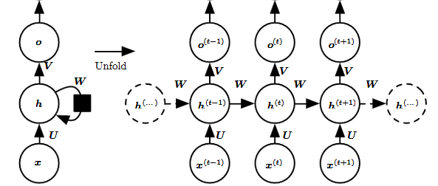



Recurrent Neural Network (RNN) and LSTM
$$O\left(t\right)=∅_{0}\left(W_{h0}h_{t}+b_{0}\right)$$
Forget gate
Input gate
Output gate
$$f_{t}=φ\left(W_{xf}x_{t}+W_{hf}h_{t−1}+b_{f}\right)$$
Hidden unit
$$h_{t}=∅_{h}\left(W_{xh}x_{t}+W_{hh}h_{t−1}+b_{h}\right)$$
$$i_{t}=φ\left(W_{xi}x_{t}+W_{hi}h_{t−1}+b_{i}\right)$$
$$τ_{t}=tanh\left(W_{xτ}x_{t}+W_{hτ}h_{t−1}+b_{τ}\right)$$
https://www.deeplearningbook.org/contents/rnn.html
F. Gers, et al. Neural computation 12, 2451-2471, 2000
Notes:
In RNN, the output is determined by the current input and the hidden unit of latest previous layer. Therefore, a RNN model could predict the next word based on current word in a text sequence. LSTM(long-short term memory) is decoration of conventional RNN. There are forget, input and output gate added in the model. The three gates update the cell state. Forget reset the hidden unit to zero. Input decide if input could be removed. Output decide if hidden unit could be used.

Slide 18
LSTM model
Input: amino acids sequence
Text: 32 x p; lengths: 32 x 1
Embedding layer
32 x max_len x 48
Label | Size
Epitopes (positive labels) | Filtered epitopes: ~ 1.9M
Non-epitopes (negative labels) | Non-epitopes: ~ 3.2M Random ligands: ~ 1.9M
packing
Sum of lengths x 48
LSTM layer
Sum of lengths x 64
Fully-connected layer
32 x 128
Datasets:
Train: 4.1M Validate: 1.4M Test: 1.4M
Fully-connected layer
32 x 1
Loss: Binary Cross Entropy
Labels: 1 - epitope,
0 – non-epitope , random sequence

Slide 19
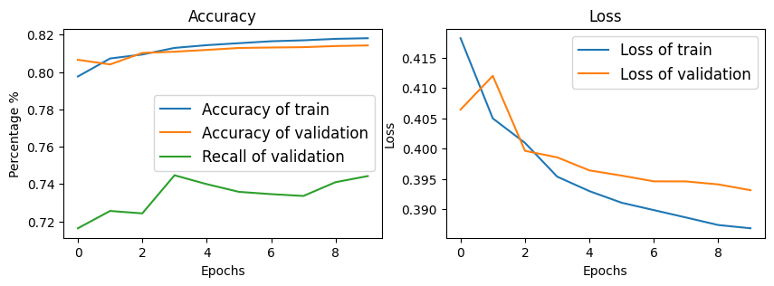
Train RNN model
Notes:
Recall on validate data is 75%. Accuracy is 80%

Slide 20
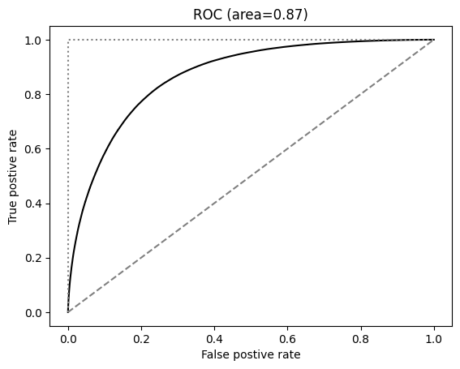
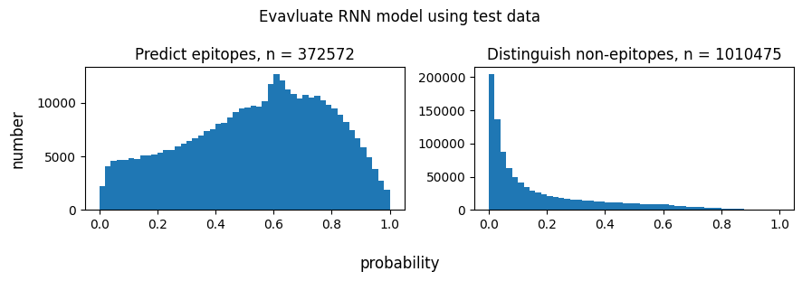
Test the trained model using test data

Slide 21
Discussion of the RNN model
Strength: Consider the contextual of amino acid sequences. Being compatible with various length of sequences. Both accuracy and recall using validation and testing data are > 80%.
Ready for improvements: Accuracy would decrease when sequences are > 50 AA. Optimization for better recall (> 90%). Tokenization of single amino acid is lack of variety. RNN model doesn’t accept high dimensional input.

Slide 22
Optimize Predictor
Include more features and Select features.
Specialize predictors on categorized data.
Combine ANN and RNN

Slide 23
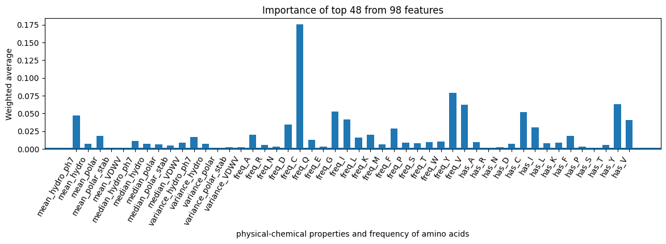
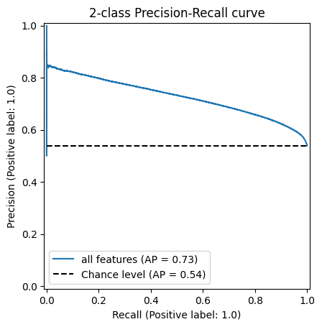
Select Features: Feature importance determined by Random Forest
Notes:
Expand 25 features to 420 features: mean, median, variance of 5 phy-che properties. Frequencies of 1-AA, 2-AA, existences of of 1-AA, and 2-AA (binary). The RF can help us to evaluate importance of features. Showed as the upper plot, mean value of hydrophobicity, frequency of cys, tyr,val etc, existence of cys, tyr, val Ile, or Phe,

Slide 24
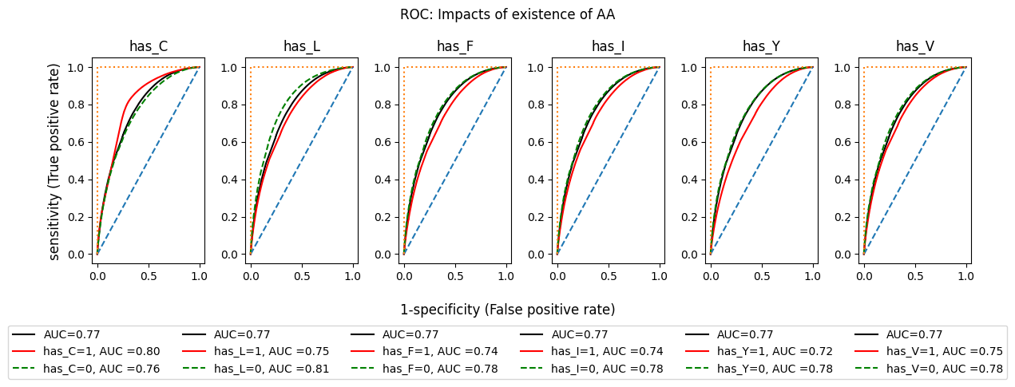
Notes:
All of AA are hydrophobic amino acid. Leu is strongest Hydro. Cys is less hydro, of which is close to the neutral AA. AUC of identification of epitopes containing Cys or without Leu are larger than others.

Slide 25
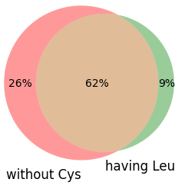
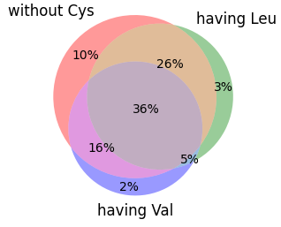
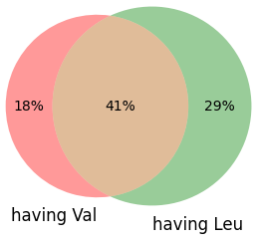
Percentage of AA-specific epitopes among 1.9M
Notes:
Up to 62% epitopes contains at least one leu and don’t include Cys. That indicates Cys and Leu are contrary parts in lots of epitopes. Val and Leu is compatible to each other in 41% epitopes.

Slide 26
Chain of thoughts for Optimization
Input Data
Filter
Epitopes
Without Cys, having Leu
Epitopes
Having Cys, without Leu
I II
ANN model (I or II), RNN model (I or II)
Prediction

Slide 27
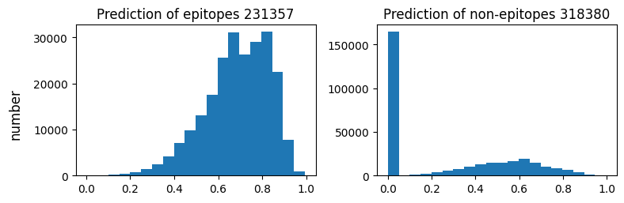
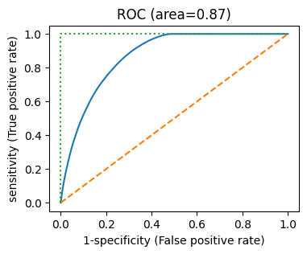
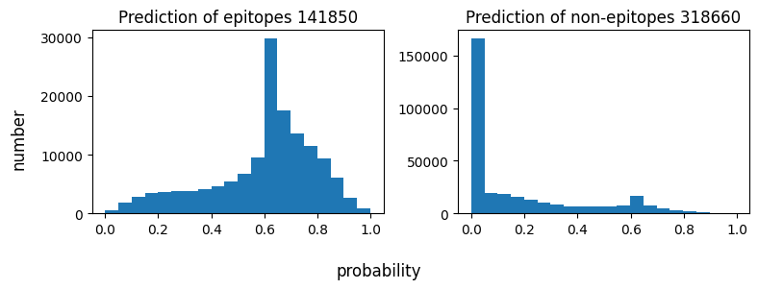
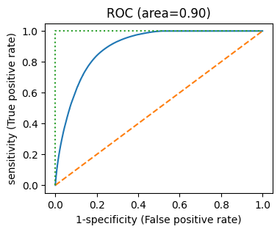
ANN, Epitopes without Cys but having Leu
ANN, Epitopes without Leu but having Cys

Slide 28
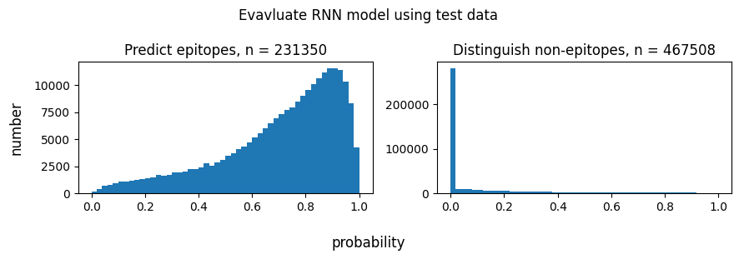
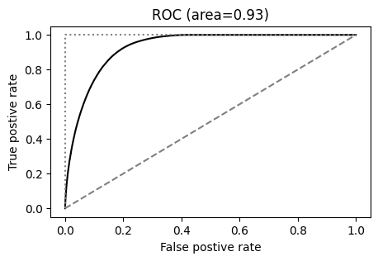
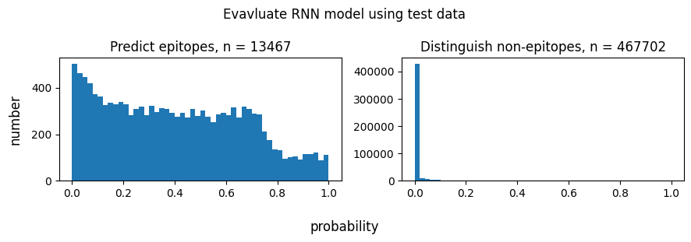
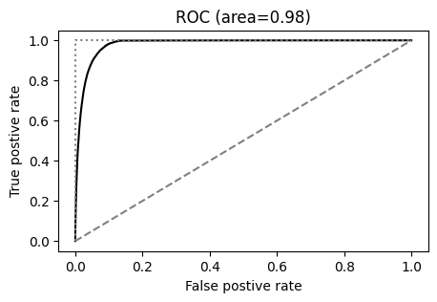
RNN, Epitopes without Cys but having Leu, recall=84%
RNN, Epitopes without Leu but having Cys, recall=69%

Slide 29
Case Study
Notes:
The next, I employ the models to perform epitope virtual mapping using some well-studied proteins.

Slide 30
EGFR monoclonal antibody drugs binding to the domain III
Case study: HER1 (EGFR, epidermal growth factor receptor)
Drug (brand name) | R&D Company | Domain III
Cetuximab | Eli Lilly | 408-468
GC1118 | Green Cross | 350-360
Matuzumab | EMD, Merck | 460-461
Necitumumab | Eli Lilly | 384-409
Nimotuzumab | InnoMab, Biocon | 353-358
Panitumumab | Amgen, Takeda | 386-391
Front Oncol. 2020 Jul 24;10:1249.
Notes:
Epidermal growth factor receptor is drug to treat cancer namely metastatic colorectal cancer, non-small cell lung cancer. Those antibody targeting is domain III of HER1. that is transmembrane protein.

Slide 31
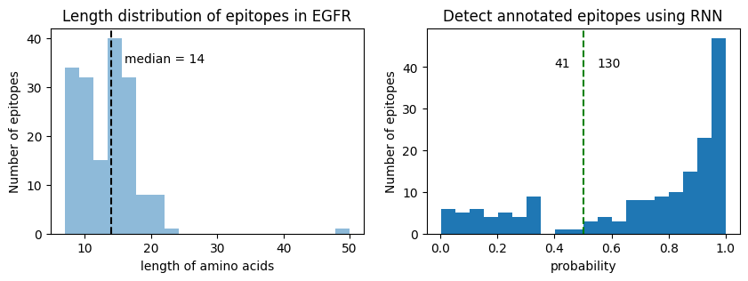
Summary of Virtual Epitope Mapping
270 annotated epitopes (171 unique sequences) with 14 AA on average.
The model can detect 130 out of 171 (Probability > 0.5)

Slide 32
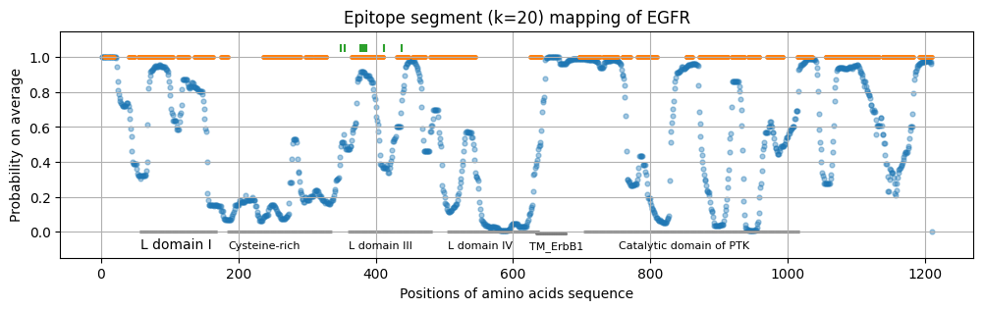
Epitope mapping of EGFR with window 20 AA
~600 AA: extracellular – transmembrane – intracellular
Domain III contains competitively binding sites used by lots of monoclonal antibody drugs.
Notes:
In this case study, I did virtual epitope mapping using that model. K-mer =20 means the epitope window is 20 AA. Scan the entire protein sequence from N-terminus. The dots stand for prediction on that AA. The orange color lines represents the regions annotated as epitopes region. HER1 is transmembrane protein, which are extracellular, transmembrane, and intracellular regions. Showed in the plot, the cysteine-rich region and transmembrane regions are not predicted as epitopes, consistence with previous bench work study. Domain III contains competitively binding sites used by lots of monoclonal antibody drugs which are labeled by vertical bars.

Slide 33
Challenges of ML models
Uncertain negative labels. Negative labels have impact on accuracy and recall of models.
Sequence representations: Word piece tokenization.
Orchestrate screening systems: Peptide array or phage display.

Slide 34
Thanks
Source code: https://github.com/Tiezhengyuan/ml_epitope/

Slide 35
Epitope prediction is pre-beginning rather than beginning in screening
Shall I try bioinformatics predictors as much as I can ? - I’m going to design a protocol according to epitope predictions.
What epitope-related features are employed for modeling ? - Try to interpret the predictions using biological knowledge.
What is the best hit? - Narrow down my scope and reduce work load.
Can assay data be integrated into you modeling process? - Gradient descent to the target based on previous bench work.
Notes:
Antibody production and medicine is a very long and complex process. The screening could be phage, or mice system.

