Slide 1
Application for
Bioinformatics position
Tiezheng Yuan Ph.D.
2020.03.12
Notes:
Good morning everyone. Thank you for scheduling this time to meet.

Slide 2
About me
Education:
Ph.D. (2008.09-2012.01) Biochemistry and Molecular Biology, Chinese Academy of Agricultural Sciences.
Master (2018.08-2020.05) Software Engineering, University of Maryland, University College.
Work Experience
Postdoc (2012-2015), Bioinformatics
Medical College of Wisconsin, Milwaukee, WI.
Postdoc (2015-2018), Bioinformatics
Johns Hopkins University-School of Medicine, Baltimore, MD.
Notes:
I’ve gotten PhD in 2012, Biochemistry and molecular biology. I am pursuing my second master degree Software engineering. I work as Posdoc fellow in Department of Pathology &Cancer Center in Medical College of Wisconsin in 2012-2015, and then in Johns Hopkins University-School of Medicine in 2015-2018.

Slide 3
Today’s Agenda
My practice of bioinformatics pipeline development
Bioinformatics pipelines
Biomarker research
Notes:
Based on the responsibilities required in this position, today’s talks will focus on pipeline development and my computing skills. After that, I would like spend short time to introduce my academic results in biomarker research.

Slide 4
Features of bioinformatics pipeline development
Hybrid of object-oriented and process-oriented programming
Hybrid of computing programming and statistical modeling
Integrate and organize data
Use modules or embed external tools
Fast delivery
Linux-based environment
Notes:
I summarized some features of design and implementation of bioinformatics pipeline according my experience. The summarization might not cover all stuffs.
1. Hybrid of object-oriented and process-oriented: Python programming support object-oriented, but process-oriented programming is often used because some bioinformatics steps should be executed in order.
2. Hybrid of computing programming and statistics: sometimes statistical models need to be integrated into pipeline.
3. Integrate and organize data means you may figure out how to handle raw data, or how to extract annotation data. Sometimes some particular scripts are required.
4. Employ third-party python modules or embed external tools into pipelines
5. Fast delivery: In my experience , the Agile practise is frequently used. One advantage of the Agile is that requirements could not be clarified in details at the beginning.
6.Linux-based environment

Slide 5
Phases of pipeline development life cycle
Requirements analysis
Pipeline design and modeling analysis
Coding work
Pipeline testing
Task management
Risk management
Notes:
Over my experience of developing pipeline, I usually follows four phases in its life cycle: requirement analysis, pipeline design and modeling analysis, coding work, and finally pipeline testing and implementation. The two processes task and risk management cover all phases in its life cycle. The next, I will discuss all aspects one by one.

Slide 6
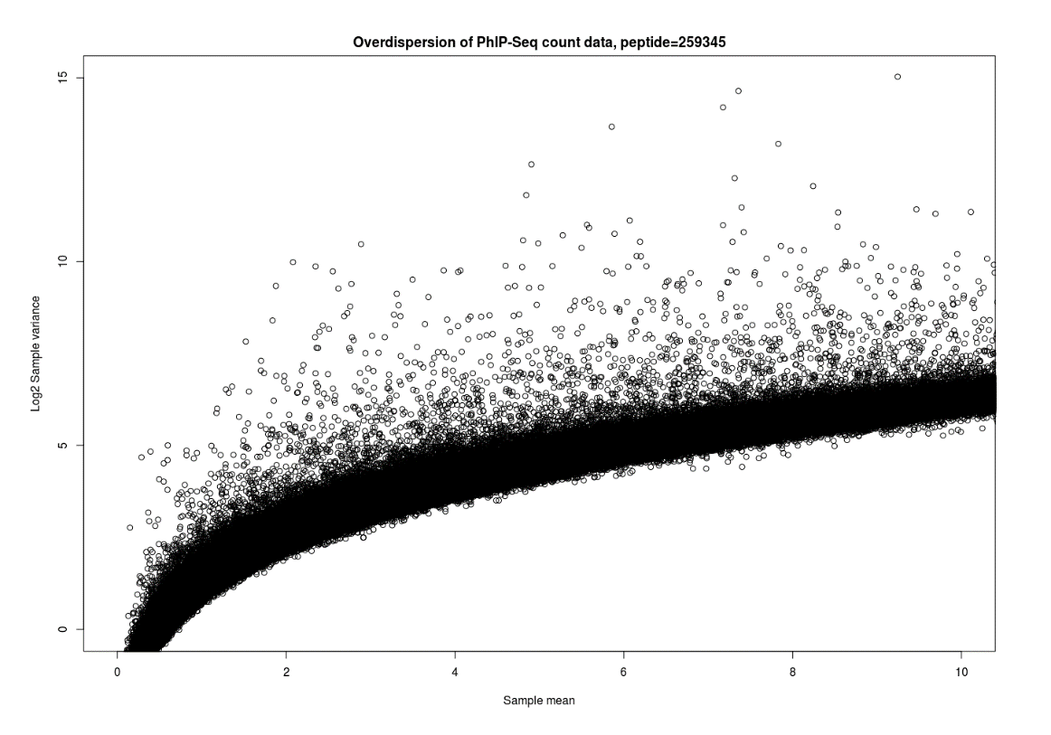
Phase 1: Requirements Analysis
Elicit and gather requirements from user stories, or collaborators’ expectations.
Notes:
Once a project is assigned, requirements analysis should be finished as soon as possible. Elicit and gather requirements from user stories, collaborators’ expectations or needs. Gathering correct requirements is important.
Here is a study I conducted before. A project aims at developing pipeline for phipseq data analysis. There are false positive signals. The question is how to build the model of false positive signals. This picture shows comparison of mean and variance of read counts from a negative control. Biologist think it is noise, and want apply linear regression to estimate mean and variance. But in biostatistician, this phenomenon is overdispersion of counts data. There are some parametric model available such as poisson, binomial, negative-binomial, and beta-binomial. Different thinking and elicitation results in different data modeling path.

Slide 7

We testified the workflow of beach work and analytic pipeline on the study of exosomal RNAs, and compare of miRNA-seq library preparation method
Notes:
This case shows how bioinformatics works enhance wet bench work. I collaborate with biologists to investigate exosomal RNAs. We need to answer some questions what is the best protocol for extracting exosomal RNAs, and what the expression profiles, and miRNA variants. My work is to translate those problems into bioinformatics solutions. Employing data analysis to answer these questions, and give light on the direction for future study.
The comparision showed that the widely used methods of miRNA-seq Library preparation has serious effect on the detection of exosomal miRNAs.
Except miRNAs, other RNA species were also detected. Here, we implement different alignment strategy for small RNA-seq analysis: iterative alignment. based on RNA species, list references in order we concerned. Alignment against the first reference, and aligned to the second reference using unmapped reads from the previous alignment and so one.

Slide 8
Create Development Plan
Goals and objectives
Scope: tasks list
Use case: functionalities of pipeline
Constraints: pipeline dependencies
Resources: hardware, data access
Notes:
Once requirements are gathered, prepare project plan. Here are the contents should be put into the plan.
Goals and objectives. Scopes: Tasks and functionalities of pipeline. Use cases: business logic. Constraints: pipeline dependencies Resources: hardware, data access
No much should be covered in the project plan - just 2-3 pages. I find many collaborators don’t like verbose. In my experience, it is risky to begin your coding work before you clarified requirements or without precise approval on the details of the project plan.

Slide 9
Lightweight bioinformation system
Customer expectations -> CPU
Customized: Particular tools and customized pipelines.
Portable: Dependencies packaged, fast deployment, and free maintenance.
Usable: Friendly use and straightforward routine.
Technical solution:
Hybrid of Linux virtual machine at Azure cloud and Docker containers at user end.
Notes:
I master how to design and implement bioinformation system for biologists. Here is one example I experienced. When I gathered requirements from biologists, I summarized their expectations: That is CPU, stands for customized, portable and usable. The system shall build large number of particular bioinformatics tools. I should develop some bioinformatics pipelines for them. And portable means…… And Usable means . Finally, the technical solution is hybrid of Linux virtual machine and Docker containers.

Slide 10
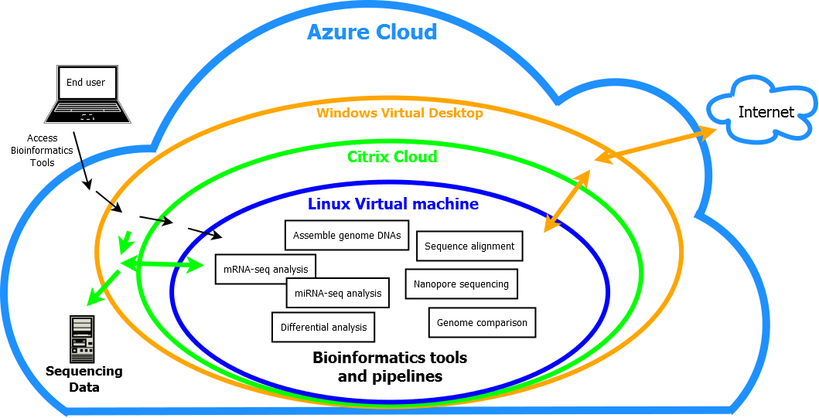
Cloud Computing Platform
Notes:
At this company, all computing systems are being transferred to Cloud computing platform. The three outer layers Azure cloud, VDA desktop, and Citrix have been established and fixed. What I should do is to design and build bioinformatics environments at the Linux level. All bioinformatics analysis are categorized into mRNA-seq, miRNA-seq, genome assembly, genome comparison, nanopore sequencing data analysis, and so on.

Slide 11
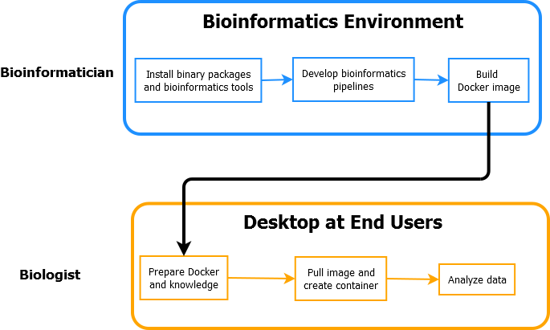
Docker Containers
Notes:
As an alternative bioinformatics environment, Docker containers are built. The great advantages of Docker is its portability and maintenance-free. End users could employ bioinformatics tools at their windows desktop without much requirements on Linux knowledge. My major work is to create a comprehensive image based on a basic image. The key point is to build dockerfile. End users could directly go into data analysis after creating containers at their Windows desktop.

Slide 12
Phase 2: Pipeline design and modeling
Object-oriented analysis: Design desktop version software
Process-oriented analysis: Design bioinformatics pipelines
Notes:
Recent few years, I concentrate on biomedical software engineering. I could design and develop stand-alone software, as Java programmer. And I could design and implement bioinformatics system or build bioinformatics environments for biologists.

Slide 13
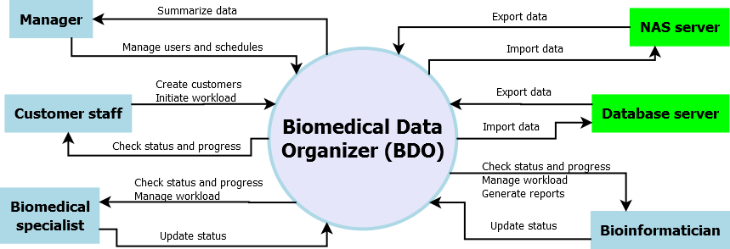
Biomedical Data Organizer (BDO)
System context diagram
Notes:
Here, I am going to show you an example.
This is a context diagram for a software - biomedical data organizer. Scientists and managers employ the software to schedule tasks, manage sequencing data, and track bench work progress. Four physical entities are identified: manager, customer staff, biomedical specialist, and bioinformatician. Two logical entities are used for data stores. Major defined processes are showed as arrow lines

Slide 14
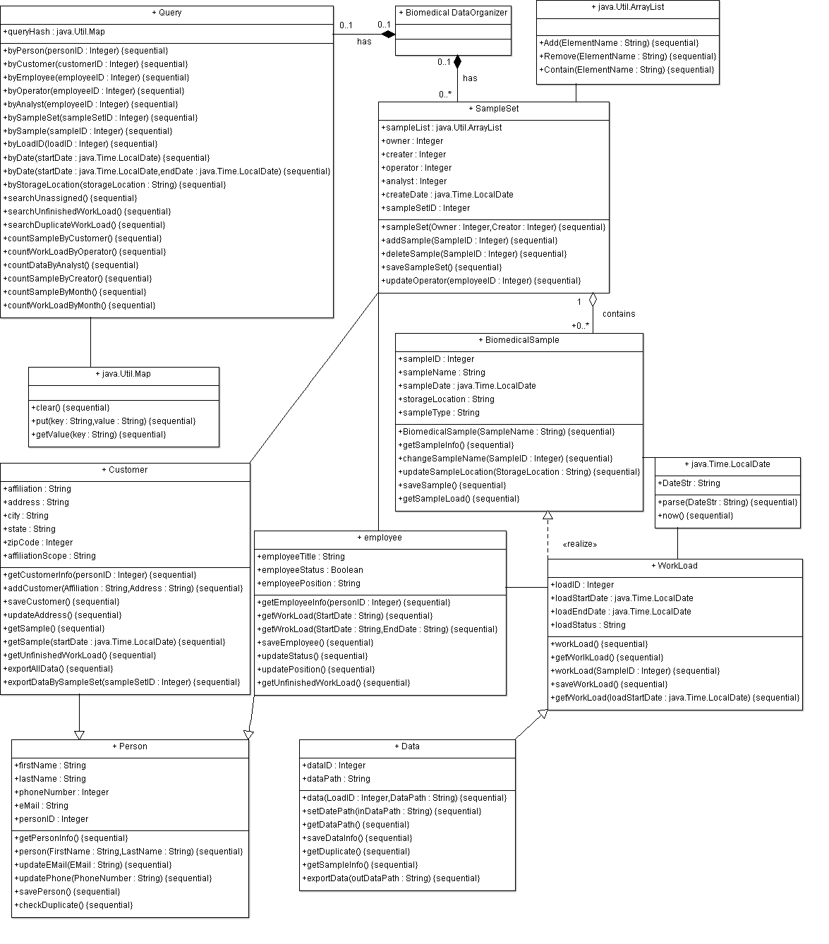
Summarization
and monitoring
Biomedical
sample
organization
Resource
allocation
Notes:
This class diagram shows all classes and objects involved in source code. There are three main functional modules. One is biomedical sample module, which organize samples and data. This one is human resource module, which relocate work load and control and monitor status. The last one is statistics modules, which carry out some summarization of relevant information. All functional modules work together for data integration and make the process of controlling and monitoring through sample life cycle.

Slide 15
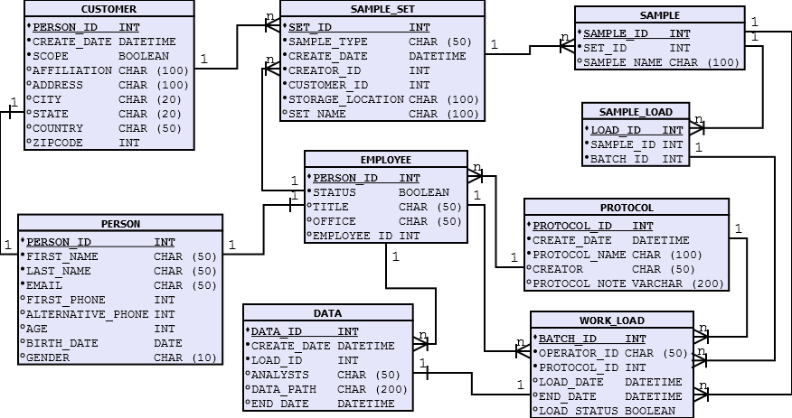
Design Database
Notes:
Design database tables.

Slide 16
Describe processes
Process description shows logistic steps of the pipeline operations, which correspond with operations in real world.
Notes:
Process description shows logistic steps of the pipeline operations, which correspond with operations in real world.
This is an example- a pipeline used for analyzing RNA-seq. This sequence structure shows process structure. All steps required for RNA-seq analysis: prepare data: fastq files and genome references and annotation files, verify parameters for bioinformatic tools, conduct genome mapping and transcripts assembly, and finally gather read counts for further statistical analysis.

Slide 17
Phase 3: Coding work
coding…..
coding…..
coding…..
Notes:
Coding work is intensive computing work. For a lightweight pipeline, if requirements analysis and design are good, coding working will not consume much time. The final achievement is hierarchical source code.

Slide 18
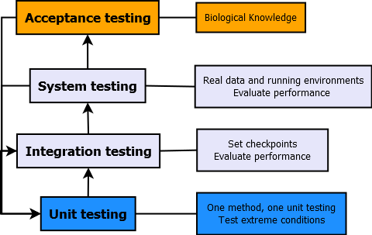
Phase 4: Pipeline Testing
Notes:
The process of pipeline testing is combined with coding work. There are four levels of testing in my practice.
The basic testing is unit testing. One method needs one unit testing case. All bugs should be fixed. For robustness, some extreme conditions should be tested.
Integration testing used for testing functionality of the pipeline. Some checkpoint should be set for better locating errors. Performance of execution should be evaluated. System testing is close to real running status, and executed at server computer.
Acceptance testing is conducted by biologists. They will scrutinize the results, and employ their knowledge other than bioinformatic knowledge to glean errors .

Slide 19
Task management
Tasks list
Tasks decomposition
Scheduling: GANTT Charts
Source code management: Git/Github
Update progress regularly.
Documentation: development plan, progress report, pipeline manual, delivery report
Notes:
Task management integrate all phases of a project life cycle. Here, I listed major components .

Slide 20
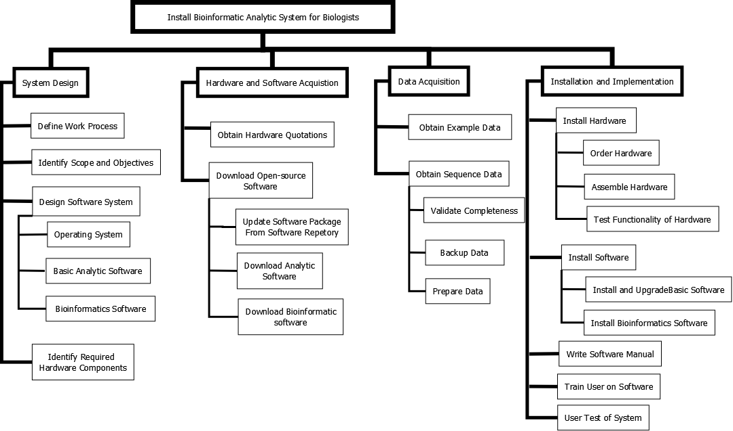
Work breakdown structure
Notes:
Tasks decomposition means a complicated or long-term task is decomposed into small and short-term tasks. I installed and configure bioinformatics environments for a team. Because the project is initiated, I have to report progress everyday. I draw the work breakdown structure, showing how many I should do.
The work breakdown structure focuses on installation and implementation of bioinformatics system for biologists. A total of three levels tasks are identified. This system is deployed in Azure cloud computing platform. Theoretically, installing a bioinformatic system is not a big deal for a computer specialist. It is unreasonable to spread them in details. Actually, I did spend almost two months in real world. Correct task decomposition allows you to understand the whole things in advance, and schedule task and allocate resources.

Slide 21
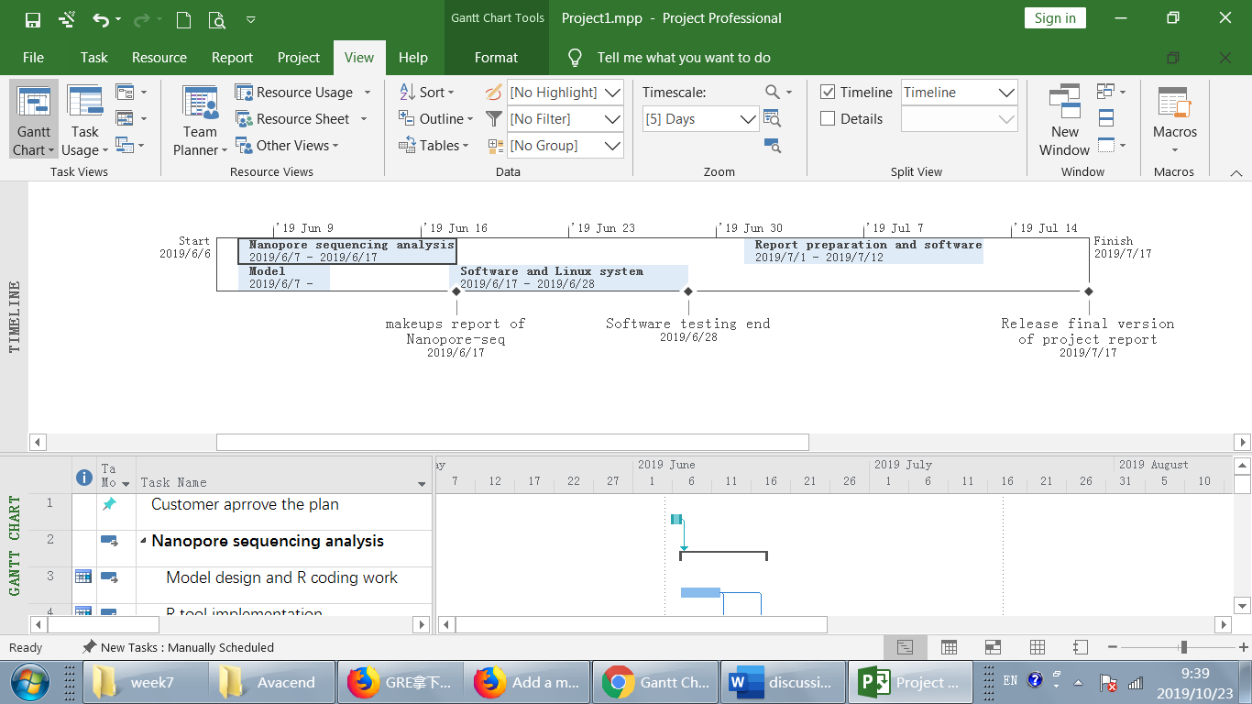
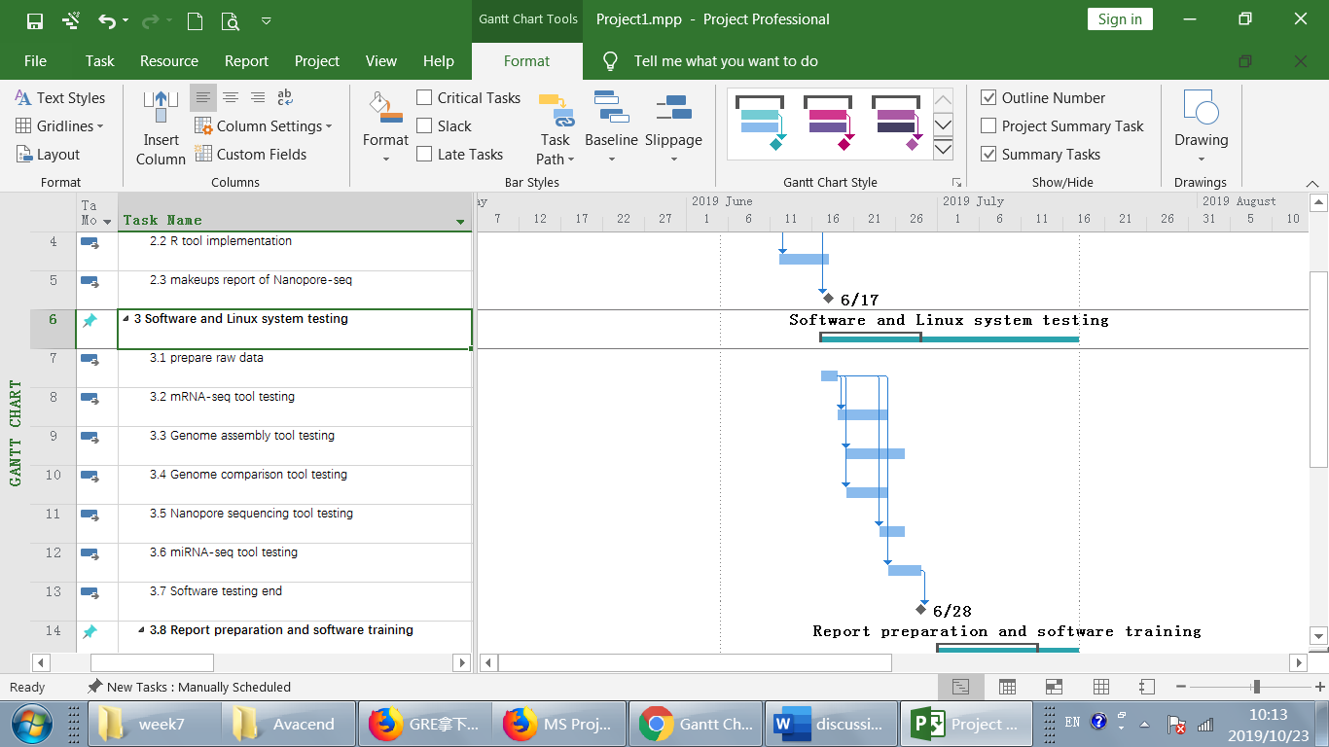
Use GANTT Charts to manage tasks
Notes:
GANTT charts is a good tool to schedule tasks. This charts shows my time and tasks arrangement in the last month before the deadline of the project. I developed some pipeline for a team. The time is so tight and the deadline is fixed. I share this charts with other team member. For me, this GANTT chart shows what I should do in the last month, which help me to schedule my time. For other members, that relieve their anxiety and indicate them that everything is under control.

Slide 22
Risk Management
Delay
Technical issues
Conflicts
Project failure
Unclear requirements
Unpredictable changes
Communication
Invisible information
Clarify requirements
Quick but regular delivery
Make project visible
Documentation and memo
Detect risks as early as possible
Notes:
Some negative factors may have impact on development process. Here I listed some risk factors I experienced.
I identify some reasons that are attributable to those risks and then I summarize some solutions.
1. Unclear requirements are typical problem. In a project, collaborator draw a flowchart and want me to follow it and develop pipeline. In his mind, coding work is the majority of bioinformatics and other work is trivial . Therefore, I should work together with to elicit requirements and clarify goals/objectives/scopes and so on.
2. Unpredictable changes. I love to feed back changes so I support fast delivery but I keep being watchful to unpredictable changes. For example, I was assigned to work on a dataset one day, but the next day, I was told to give up it and turn to another one because it looks like amazing. Analyze the reasons leading to the changes before actions.
3. Communication: I worked in hybrid environments over past years. There are biologists, bioinformatist, biostatistician. They use different language. Use jargon free words. Sometime I will write down something to make sure that there is no misunderstanding.
4. Invisible information: project documents, status, scheduling should be visible to all team members.

Slide 23
On Time / Delay Delivery
On-time delivered:
2015.08-2016.04
Delayed:
2016.10-2018.01
Notes:
These are two example: one is delivered on time. Requirement, goals and scopes are clarified and defined well. The other is delayed. Because requirement gathering is umbiguous; Goaling definition is skipped. With more data rolling out, more requirements are added. The pipeline finally become clumsy.

Slide 24
Use data to make your comments convincing
Notes:
This is an approach on how to dealing with disagreement. This picture shows how researchers operations affects on results. For constructing miRNA library, one key point is to recover DNA fragments (140-160bp) from 5% acrylamide gel. This guy work so hard. He did 40 gels in one week and did more than 100 miRNA library for sequencing. The pictures shows the amount of miRNA decrease when a large number of tasks were accumulated. There are multiple reasons. Precision of cutting gel, RNA extraction quality or gel quality varied from Monday to Sunday. In my experience of working with biologists, other than drawing straightforward conclusion with some reasoning, showing data sometimes make your comments more convincing.

Slide 25
II: Development of bioinformatics pipelines
PhIP-Seq Analyzer for PhIP-Seq data analysis
eRNA for mRNA-Seq data analysis
3C Analyzer for 3C-Seq data analysis

Slide 26
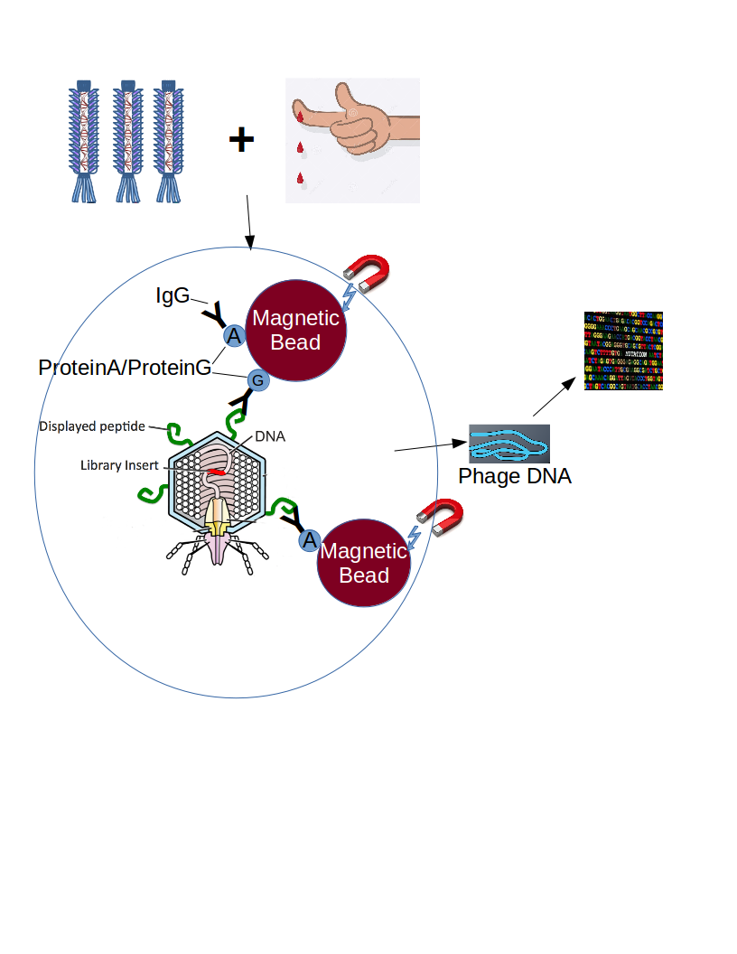
PhIP Complex and PhIP-Seq Analyzer
Nat. Biotechnol. 2014, 29(6):535-541.
The Python pipeline: https://github.com/LarmanLab/PhIP-Seq-Analyzer.
Notes:
Some one might be confused because our interest is antibody, but actually antibody and the amount is measured by sequencing. How did phipseq make that?
This is Phage. This is blood sample. It would be IgG. Look at the circled region. Antigens are on the surface of phage. Antigens are specific binded with IgG from the blood sample. IgG captured by proteinA/proteinG, which conjugated to beads. Those magnetic beads are pulled down by magnets. After that, we recover phage DNA, and construct DNA library for sequencing. Here, DNA is the counterpart of antigen. The amount of DNA corresponds to the binding of antigen-antibody and amount of antibodies.

Slide 27
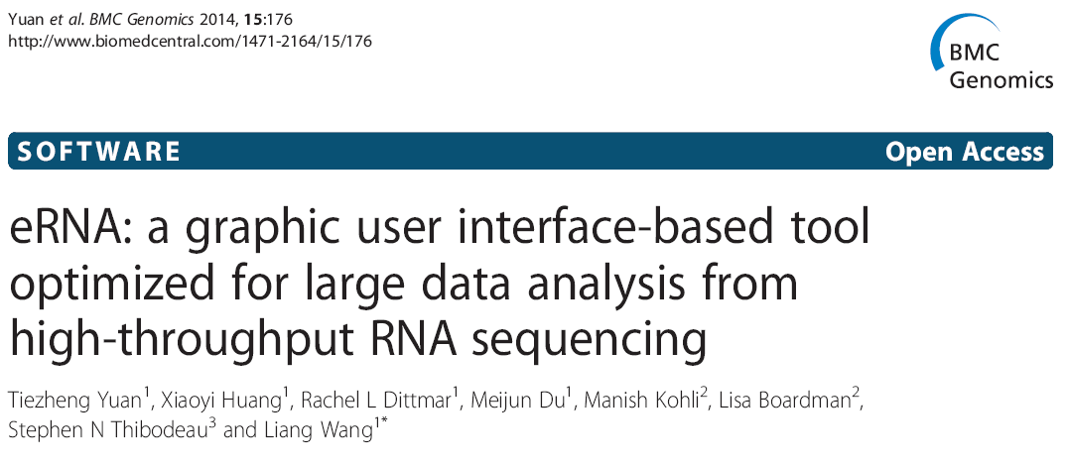
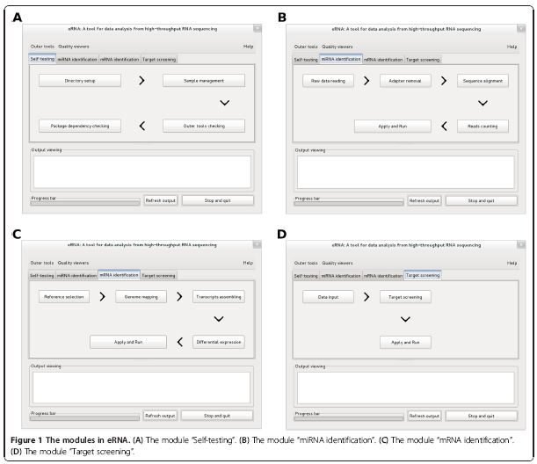
Notes:
I developed a software known as eRNA for RNA-seq analysis. eRNA provide Graphic user interface integrated with the third-party software. The pipeline of eRNA provides parallel processing through muti-threading and sample management. Quickly operate analysis of hundreds RNA-seq samples

Slide 28
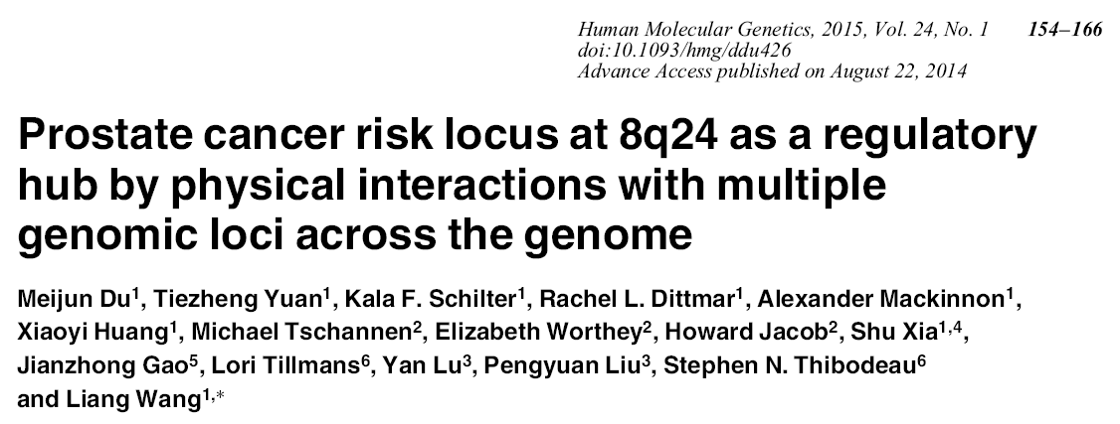
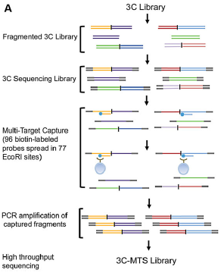
Chromatin Conformation Capture (3C)-MTS technology
Notes:
I developed a new method based on this 3C (chromatin conformation capture) technique. That is multiple target capture at an experiment. The challenge for the analysis is how to glean the small number targets from the huge data and also correct the noise due to neighboring region interaction. The algorithm of coding and data structure and multithreading are used to asure presenting real hits.

Slide 29
III: Biomarker
Autoantigen based on PhIP-seq data.
miRNA based on miRNA-seq data.

Slide 30
Epitope level analysis of SS autoantigens using PhIP-Seq

Slide 31
192 individuals:
25+25 normal individuals
25x4 colon cancer patients
23+13 prostate cancer patients
6 pancreatic cancer patients
Notes:
Expression profiles in cancer patients and hunt small silencing RNAs candidates as biomarker reporting the early cancer stage.
This study is the continuation of the previous paper. It’s a large cohort study. 192 clinic cases with double sequencing replicates included colon cancer, prostate cancer, pancreatic patients.

Slide 32

Prognostic biomarkers
Only CRPC patients (23 out of 192 )
Notes:
The third paper is related to biomarker. Of 192 samples, we only focus on PC in this study, only 23 CRPC (castration-resistant) patients. Our study revealed that expression levels of the two miRNAs were associated with survival validated by follow-up 100 CRPC cases.

Slide 33
Thank You
Questions?

