Slide 1
Practice in Design and Implementation of Nextflow Pipeline
Tiezheng Yuan
Oct 10th, 2019- Mach 23, 2020
Notes:
This presentation is a response to the requirements of the ability of nextflow programming.

Slide 2
Outline
NextFlow pipeline Introduction
Pipeline topology
Steps of NextFlow development
Example practice using aligner pipeline:
Blast, Bowtie2, variants-calling

Slide 3
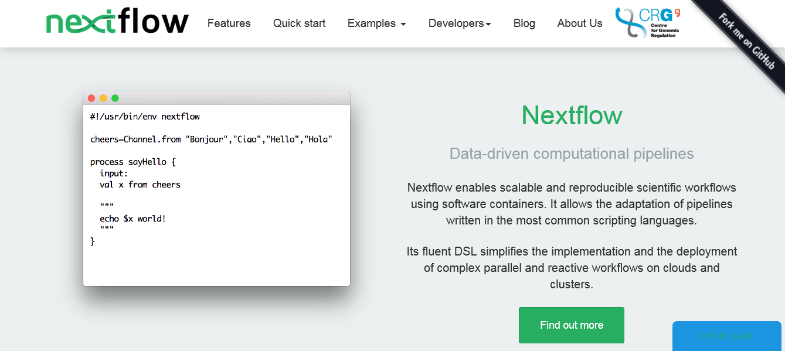
What is NextFlow?
https://www.nextflow.io/
Notes:
The workflow engine NextFlow rules some minimal syntax to allow you develop pipeline for bioinformatics data analysis. NextFlow is like Linux/Unix-style bash script programming, but its programming pattern is routine for fast development and easy deployment.

Slide 4
What do a NextFlow script look like?
#!/usr/bin/bash
Hello = ( “A” “B” “C” “D” “E” “F” )
for x in “${Hello[@]}”
echo “$x” is printed!
done
#!/usr/bin/env nextflow
Hello = channel.from “A” “B” “C” “D” “E” “F”
Process sayHello{
input:
val x from Hello
“””
echo $x is printed!
“””
}
Bash script NextFlow script

Slide 5
NextFlow: Channel and Process
Process is basic component of a nextflow pipeline.
Channel determines parallel status of a process
Input and output blocks determine the workflow of processes execution in a pipeline.
Process topology reveals relationship of processes and their execution order in analytic process.
Clarification of process topology will facilitate coding work of nextflow pipeline development.

Slide 6
Why we talk about “topology”
Split data ->
handle data concurrently->
determined by “Channel” block
Decompose tasks ->
Handle processes concurrently or sequentially ->
determined by “process” block
Notes:
There are two basic topology: sequential and concurrent topology. Most advanced nextflow pipeline come from basic topology and their combinations.

Slide 7
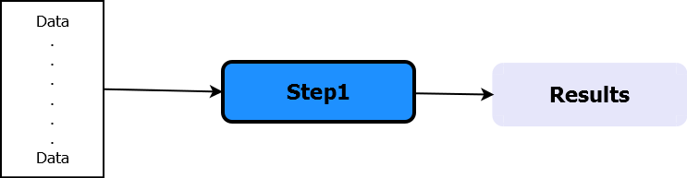
A single-process pipeline
#!/usr/bin/env nextflow
echo true
x = Channel.from('a', 'b', 'c')
process print2{
input:
val e from x
script:
"""
echo 'process $e'
"""
}
Data handling: concurrent
Process: N/A
NextFlow script NextFlow topology
Notes:
This a simple script. Only one process is defined. Data is array like.

Slide 8
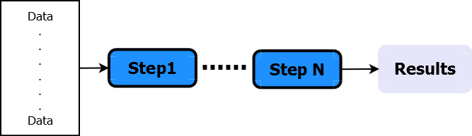
Sequential Processes
s1_ch = Channel.from(1,2,3)
process step1{
input:
val x from s1_ch
output:
val x into s2_ch
"""
echo "step1: $x"
"""
}
process step2{
input:
val x from s2_ch
"""
echo "step2: $x"
"""
}
Data handling: concurrent
Process: sequential
NextFlow script NextFlow topology
Notes:
Two processes are defined. Data is array like. In real world two or more processes could be defined.
In nextflow, input and output will define the order of different processes. The order of writing doesn’t determine the execution order.

Slide 9
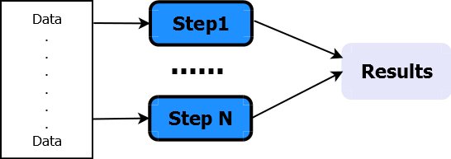
Concurrent Processes
ch1 = Channel.create()
ch2 = Channel.create()
Channel.from(1,2,3).separate (ch1, ch2) { it -> [it, it] }
process step1{
input:
val x from ch1
"""
echo "step1: $x"
"""
}
process step2{
input:
val x from ch2
"""
echo "step2: $x"
"""
}
Data handling: parallel
Process: concurrent
NextFlow script NextFlow topology
Notes:
Here, two channels are defined, which could be different. And two processes are concurrent launched.

Slide 10
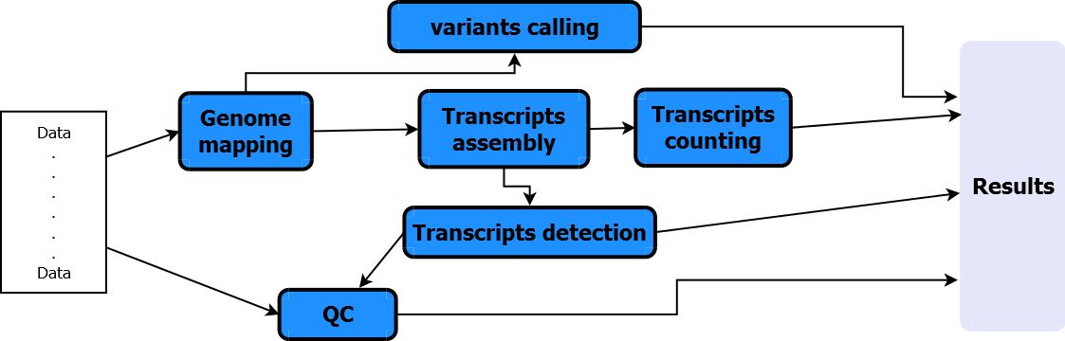
Hybrid Processes: mRNA-seq analytic pipeline
NextFlow script NextFlow topology
Notes:
There is usually a critical path in the pipeline. And there are some optional branches. Some processes could be concurrent. Some should be sequential.

Slide 11
Strategy of developing Nextflow pipeline
The Agile method
Coding strategy:
build pipeline from new: Blast pipeline v1
Transplant similar topology: bowtie Pipeline from Blast pipeline
Expand functionality: variants calling

Slide 12
Advantages of NextFlow
Easily conduct concurrent analysis by splitting both data and analytic task.
Coding blocks are templates. All coding blocks are developed based on process, channel and operators.
Pipeline is cross-platform: high-performance computer, cloud computing
Coding is readable for non-professional scientists.
The code allows developers to embed shell commands, binary tools, perl or python scripts, etc.
Notes:
Easily conduct concurrent analysis by splitting both data and analytic task. I think this point is the biggest strength of nextflow

Slide 13
Weakness of NextFlow
It is not programming language. Don’t overload it.
Example, process and branch prohibit branch
There is certain learning curve though it is pledged that nextflow is easy to learn.
Example: the operator map()
The official technical document is not friendly to beginners.
The 2018 version is 200 pages
example: The function splitFastqPairs()
Not always being easy to locate bugs when testing
Example: input and output in process

Slide 14
Steps of developing NextFlow pipeline
Requirement analysis and understand biological background
Pipeline topology analysis and design:
Define tasks and decompose tasks if necessary
Identify critical path and determine branches.
Identify input and output.
Development preparation:
prepare example data (query fasta) and references (*fasta)
Install and test bioinformatics tools (blast)
Execution of the whole analytic process at command lines.
Coding work -> unit testing -> integral testing -> documentation
System testing and deployment

Slide 15
Requirement analysis
Needs or expectations from biologists: I would like to conduct sequence alignment using Blast. Or Can you help to to detect similarity of some certain sequences against a given references.
High-level functional requirements specifications:
The pipeline shall do nucleotide sequence alignment using blastn.
The pipeline shall do amino acid sequence alignment using blastp.
The pipeline shall automatically recognize nucleotide or protein sequences based on nextflow.config.
The pipeline shall automatically build reference database based on reference in fasta format.

Slide 16
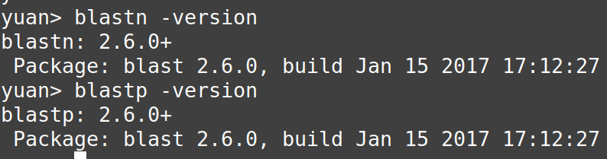
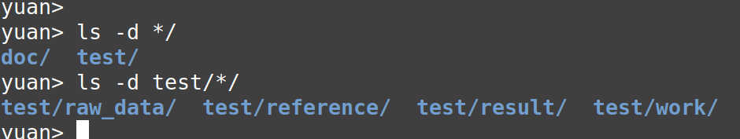
Create a repository as a starting point
That could be used as coding template, which standardize development process.

Slide 17
White-box testing
Unit testing:
Isolate functions and codes at unit testing
test all small blocks: channels, and processes
Integral testing:
Combine channels or process once unit testing is done.
System testing:
test pipeline use real data at real running environments

Slide 18
Unit testing: test make db process
//
process makedb{
script:
if ( db_index.isFile() ){
"""
echo "The index files of $ref_fa exist. skip makeblastdb"
"""
}
else{
"""
echo "Build blast index file based on $ref_fa."
makeblastdb -in $ref_fa -dbtype $params.dbtype -out $db
"""
}
}
params.reference = './reference/nucleotide_reference.fa'
params.dbtype = 'nucl'
ref_fa = file(params.reference)
db = file("${ref_fa.parent}/${ref_fa.baseName}")
if (params.dbtype == 'nucl'){
db_index = file("${ref_fa.parent}/${ref_fa.baseName}.nsq")
}else{
db_index = file("${ref_fa.parent}/${ref_fa.baseName}.psq")
}
NextFlow script

Slide 19
Unit testing: test alignment process
process blast{
input:
file 'query_file' from query_ch
output:
file 'blast_hits' into hit_ch
script:
if (params.dbtype == 'nucl'){
"""
blastn -db $db -outfmt $params.outfmt -query query_file -out blast_hits
"""
}
else if (params.dbtype == 'prot'){
"""
blastp -db $db -outfmt $params.outfmt -query query_file -out blast_hits
"""
}
}
hit_ch.collectFile(name: "$params.out", newLine:true)
.subscribe { println "Export blast results to $it"}

Slide 20
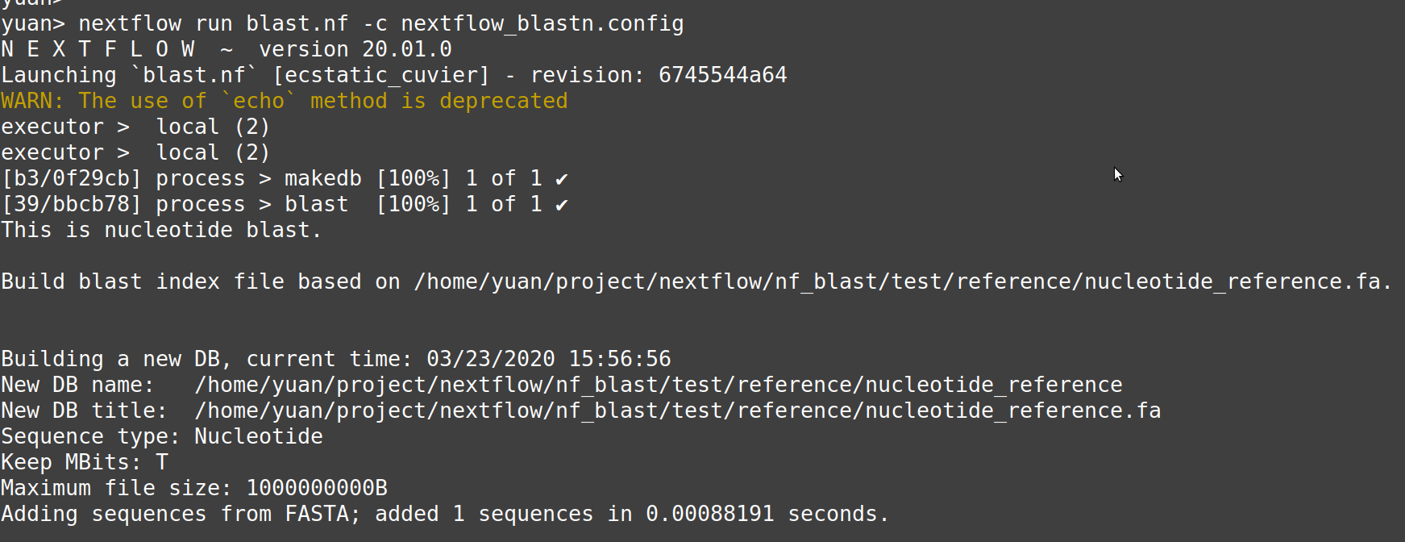
Integral Testing: blast.nf on blastn

Slide 21
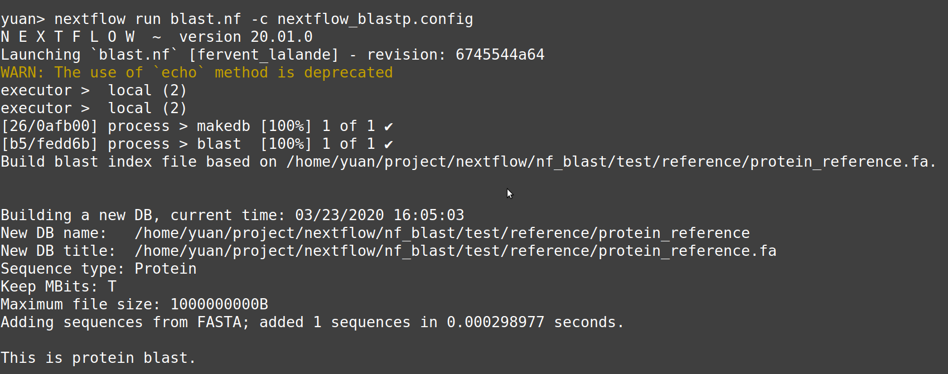
Integral Testing: blast.nf on blastp
Notes:
The second example is more complicated

Slide 22
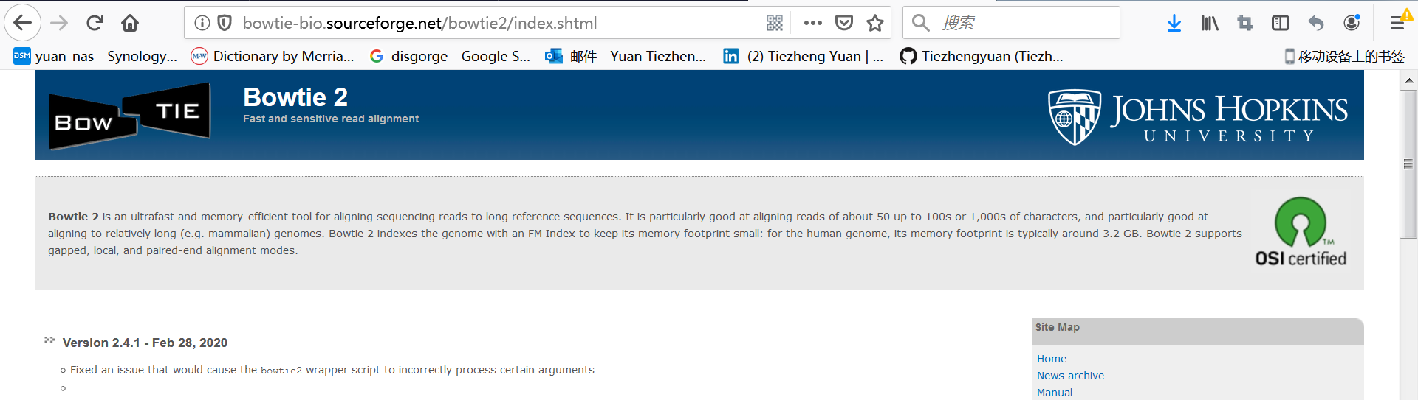
Sequence aligner: Bowtie
Bowtie2 is widely used for short reads sequence alignment
Notes:
After that, I am going to show how to build nextflow alignment pipeline for short read alignment

Slide 23
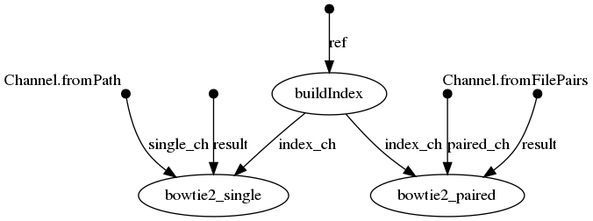
Topology of nextflow pipeline
Notes:
This example is more complicated than blast pipeline.

Slide 24
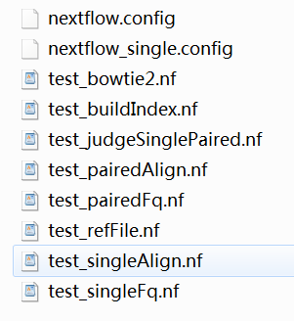
Unit Testing
Test all nextflow blocks

Slide 25
Test functions of picking files
//pick up fastq files
rawData = file(params.rawData)
fqType = params.fqType
Channel
.fromFilePairs("${rawData}/*R{1,2}*.fq")
.set {paired_ch}
Channel
.fromPath("${rawData}/*R1*.fq")
.set {single_ch}
//reference
ref_fa = file(params.reference)
//result
result_path = file("${params.result}")
Files needed:
reference in fasta
DNA query file in fastq with single- or paired-end

Slide 26
Nextflow process for building index
process buildIndex{
input:
file ref from ref_fa
output:
val index into index_ch
script:
index = file("${ref_fa.parent}/${ref_fa.baseName}")
index_file = file ("${ref_fa.parent}/${ref_fa.baseName}.1.bt2")
if ( index_file.isFile() ){
"""
echo "The index files of $ref exist. skip index building"
"""
}
else{
"""
echo "Build blast index file based on $ref."
bowtie2-build ${ref} ${index}
"""
}
}
The process recognizes index file, and automatically decides whether to build a new one or skip this process

Slide 27
Sequence alignment
process bowtie2_paired{
input:
set sampleID, pair from paired_ch
val index from index_ch
val result from result_path
when:
fqType == 'paired'
"""
bowtie2 -x ${index} -S $result/${sampleID}.sam -1 ${pair[0]} -2 ${pair[1]}
"""
}
process bowtie2_single{
input:
file R1 from single_ch
val index from index_ch
val result from result_path
when:
fqType == 'single'
"""
bowtie2 -x ${index} -S $result/${R1.baseName}.sam -q ${R1}
"""
}
Automatically decide either of the two processes can be launched.

Slide 28
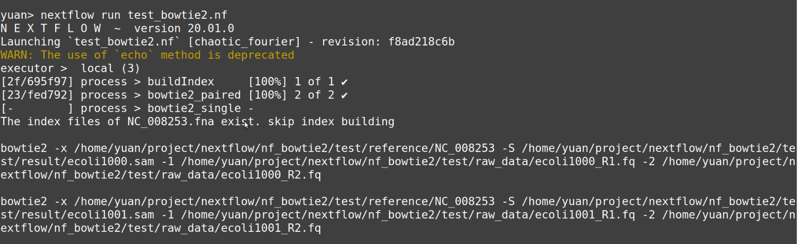
Integral testing on all pipeline

Slide 29
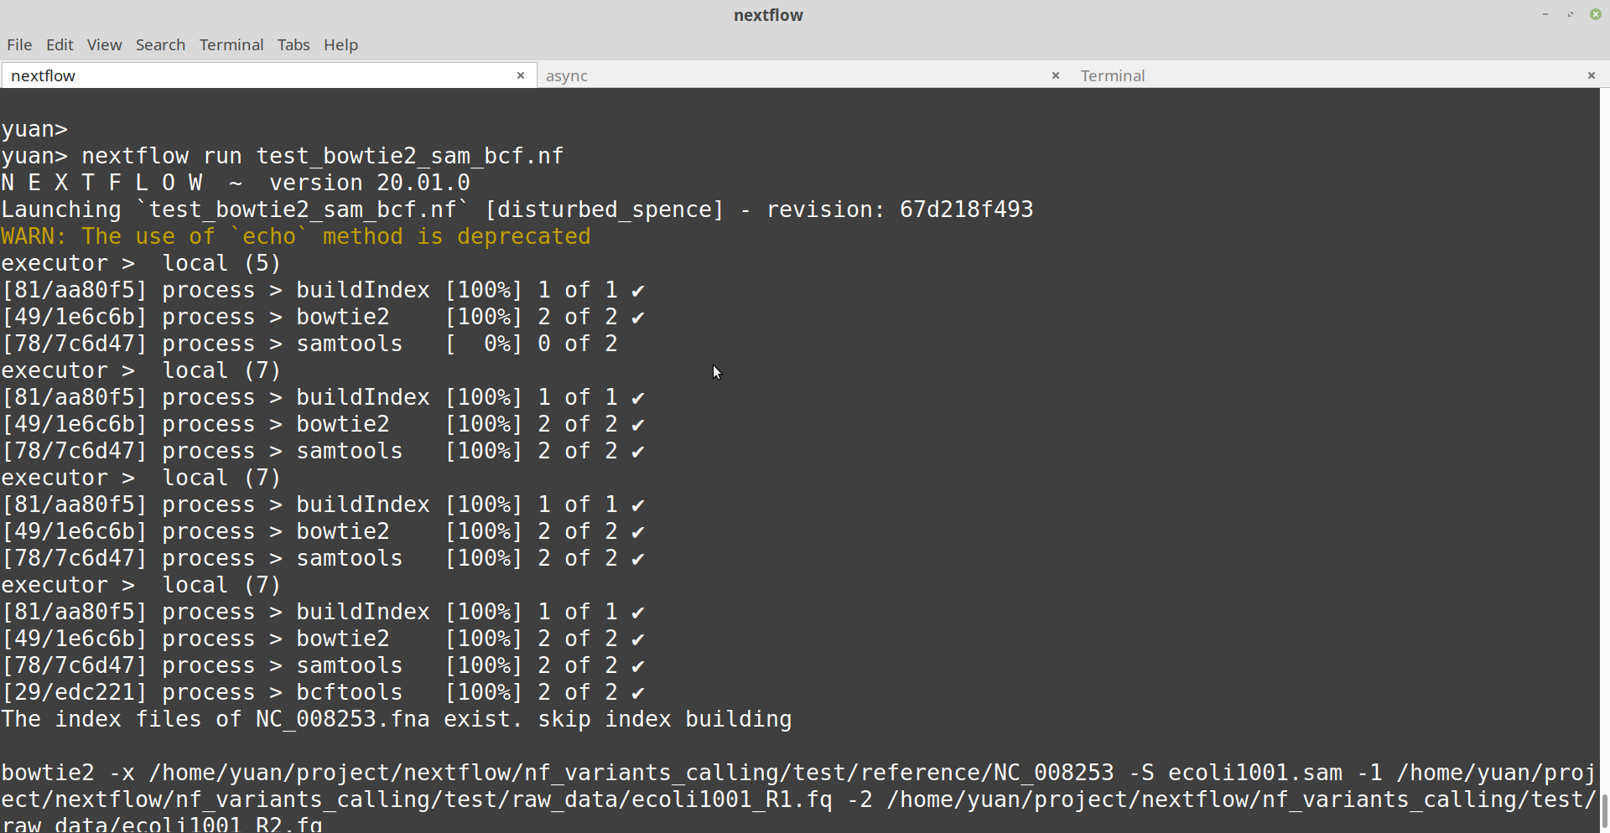
Integral Testing

Slide 30
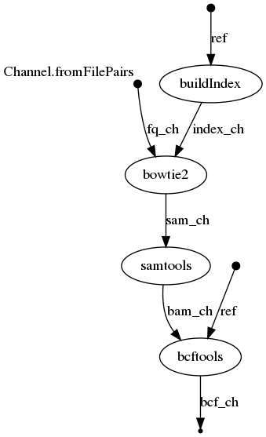
Topology of the VC pipeline
Variants: SNPs, copy number variation (CNV), deletion, insertion
Data source:
DNA level: whole genome sequencing, exome sequencing
RNA level: mRNA-seq
Bioinformatics tools: bowtie2, samtools, bcftools

Slide 31
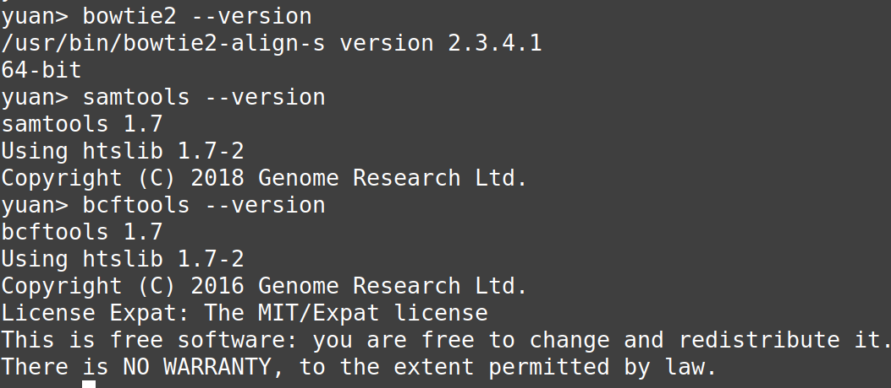

Bowtie2 -> samtools -> bcftools

Slide 32
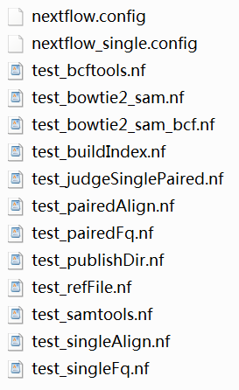
Unit Testing

Slide 33
Pick up input files
//pick up fastq files
rawData = file(params.rawData)
fqType = params.fqType
if(fqType == 'paired'){
Channel
.fromFilePairs("${rawData}/*R{1,2}*.fq")
.set {fq_ch}
}else{
Channel
.fromPath("${rawData}/*R1*.fq")
.map {it -> [it.baseName, it]}
.set {fq_ch}
}
//reference
ref_fa = file(params.reference)
//result
out = file("${params.result}")

Slide 34
Samtools convert sam file to bam file
process samtools{
publishDir "${out}"
input:
file sam from sam_ch
output:
file "${sam.baseName}.bam" into bam_ch
"""
echo "samtools sort -T ${sam.baseName}.tmp -o ${sam.baseName}.bam ${sam}"
samtools sort -T ${sam.baseName}.tmp -o ${sam.baseName}.bam ${sam}
"""
}

Slide 35
bcftools conduct variants calling
process bcftools{
publishDir "${out}"
input:
file ref from ref_fa
file bam from bam_ch
output:
file "${bam.baseName}.bcf" into bcf_ch
"""
echo "bcftools mpileup -f ${ref} ${bam} | bcftools call -mv -Ob -o ${bam.baseName}.bcf"
bcftools mpileup -f ${ref} ${bam} | bcftools call -mv -Ob -o ${bam.baseName}.bcf
"""
}

Slide 36
Integral testing

