Slide 1
Work with github
Tiezheng Yuan

Slide 2
Outline
Clone a remote repository from github
Synchronize local repos with remote repos
Work with public repository
Handle errors

Slide 3
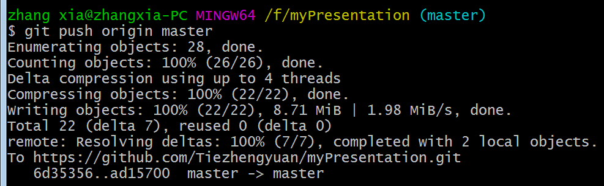
Synchronize local with remote
git push origin master

Slide 4
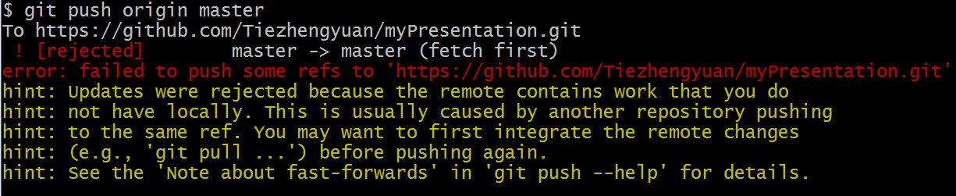
Failure of push operation
Fetch remote and merge them into local using “git pull origin master”

