Slide 1
Bioinformatics Database and Data Organization
Tiezheng Yuan
March 9th, 2020

Slide 2
Outline
My practice in using bioinformatics public database.
Organize bioinformatics data facilitating further data analysis.
Notes:
This presentation is a response to the ability of biological sources including database and tools required by qualified bioinformatician.

Slide 3
Sequence Database
GenBank: https://www.ncbi.nlm.nih.gov/genbank/
UniProt/SwissProt: https://www.uniprot.org/
Entrez Gene: www.ncbi.nlm.nih.gov/entrez/query.fcgi?db=gene
Pfam: https://pfam.xfam.org/
Notes:
I employ Perl scripting to extract sequences and annotations for those databases.

Slide 4
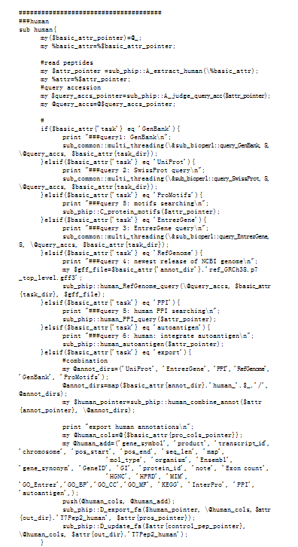
Retrieve sequences from database using Bio-Perl
Source code: https://github.com/Tiezhengyuan/single_pipeline/blob/master/Perl/bioTreat_refseq.pl
Notes:
This example shows how I extract sequences and their annotations by accession number from various database including GenBrank, UniProt, ProMotifs, EntrezGene, and RefGenome.

Slide 5
Genome database
NCBI genome browser and its FTP: https://www.ncbi.nlm.nih.gov/genome/
Ensembl genome browser and its FTP: https://useast.ensembl.org/index.html
Notes:
I mainly employ either of them to download genome and view annotations.

Slide 6
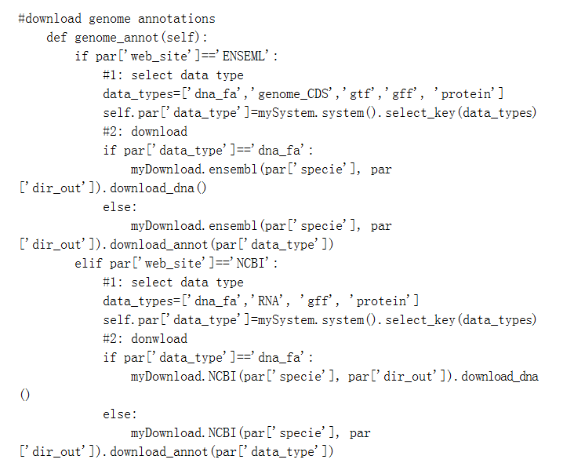
Retrieve genome for FTP site using Python
Source code: https://github.com/Tiezhengyuan/single_pipeline/blob/master/Python/eRNA_download.py
Notes:
In this example, I show how I employ python scripting to download genome sequences from NCBI and Ensembl for RNA-seq data analysis

Slide 7
Functional genomic database
Gene Ontology (GO): http://geneontology.org/
KEGG: https://www.genome.jp/kegg/
DAVID: https://david.ncifcrf.gov/
miRbase: http://www.mirbase.org/
Notes:
I employed those database and tools embedded for functional analysis.

Slide 8
Cancer Research Database for pairwise and association analysis
COSMIC (Catalogue of Somatic Mutations In Cancer): https://cancer.sanger.ac.uk/cosmic
TCGA (The Cancer Genome Atlas):https://www.cancer.gov/about-nci/organization/ccg/research/structural-genomics/tcga

Slide 9
Organize and integrate data
Organize data for further study
Integrate data into table sheet
Specify certain data from various files.

Slide 10
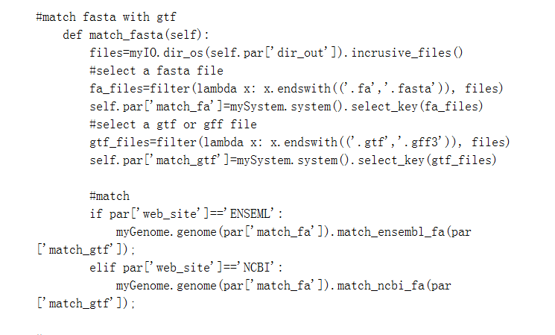
Match data between fasta and gtf using Python
Source code: https://github.com/Tiezhengyuan/single_pipeline/blob/master/Python/eRNA_download.py
Notes:
In this example, I show how I employ python scripting to match genome sequences between fasta and gtf file format for RNA-seq data analysis

Slide 11
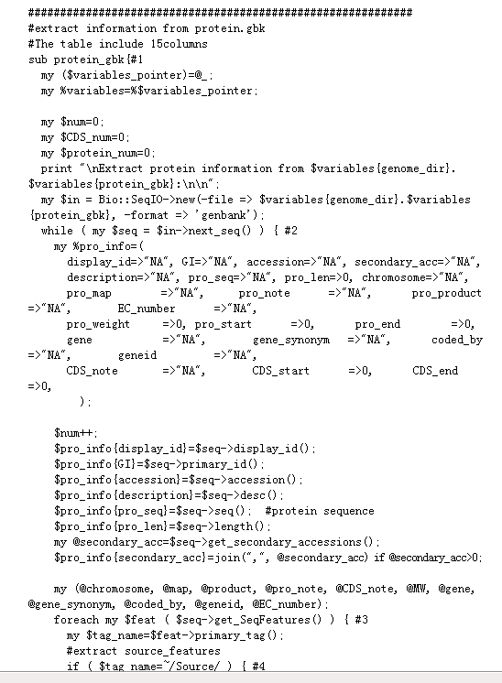
Analyze .GBK file using bioPerl
Source code:https://github.com/Tiezhengyuan/single_pipeline/blob/master/Perl/get_genome_information.pl
Notes:
In this example, I shows how I employ bioperl to retrieve genome annotations from GBK file.

Slide 12
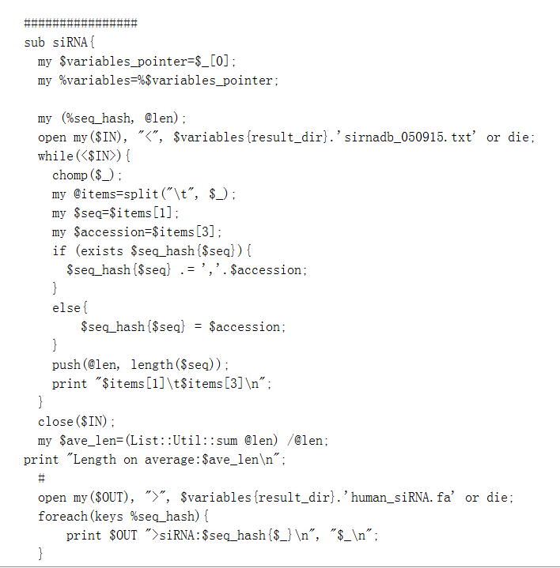
Extract miRNAs from miRBase
Source code:https://github.com/Tiezhengyuan/single_pipeline/blob/master/Perl/get_genome_information.pl
Notes:
In this example, I shows how I employ bioperl to analyze micro-RNAs downloaded from miRBase.

Slide 13
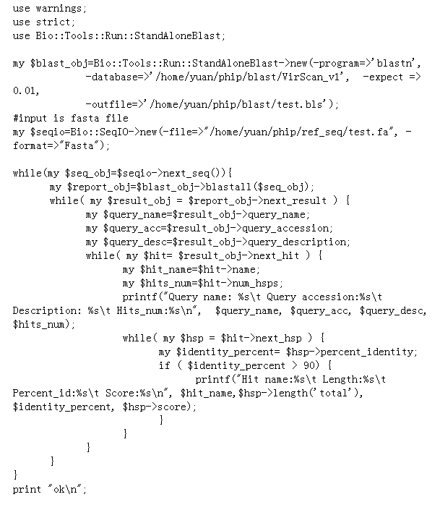
Analyze Blast results
Source code: https://github.com/Tiezhengyuan/single_pipeline/blob/master/Perl/test_alignment.pl

