Slide 1
Bioinformatics Computing Environments
Tiezheng Yuan
March 9th, 2020
Notes:
This presentation is a response to the ability of bioinformatics computing environments required by a qualified bioinformatician.

Slide 2
Work with bioinformatics environments
Build bioinformatics running environments.
Build Docker containers.

Slide 3
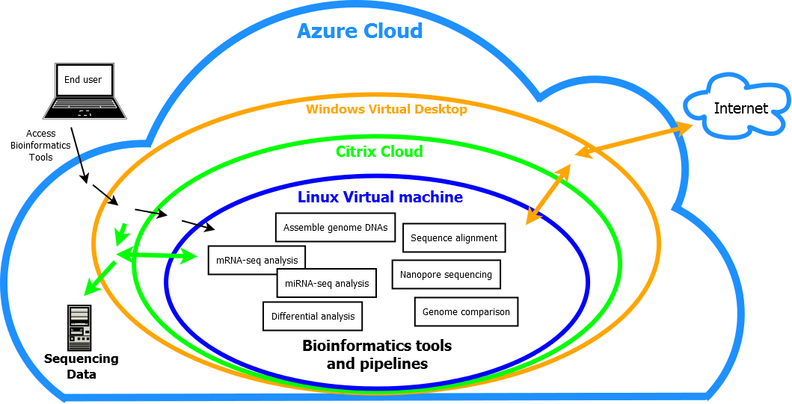
Build Bioinformatics Environments at Cloud Computing Platform
Notes:
At this company, all computing systems are being transferred to Cloud computing platform. The three outer layers Azure cloud, VDA desktop, and Citrix have been established and fixed. What I should do is to design and build bioinformatics environments at the Linux level. All bioinformatics analysis are categorized into mRNA-seq, miRNA-seq, genome assembly, genome comparison, nanopore sequencing data analysis, and so on.

Slide 4
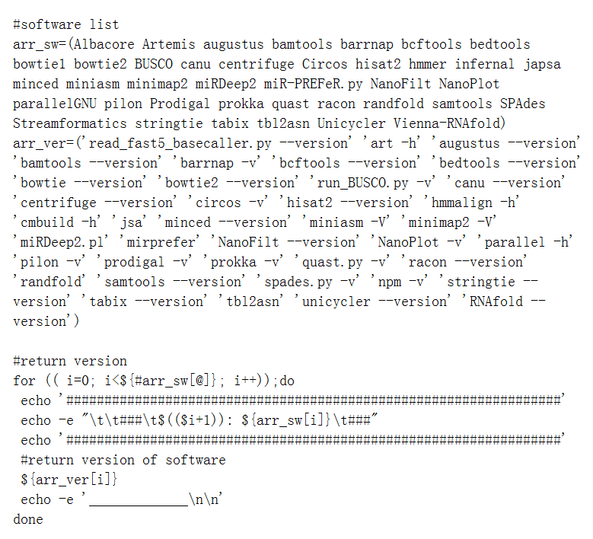
Bash script for testing software installation
Source code: https://github.com/Tiezhengyuan/single_pipeline/blob/master/ShellScripts/yuan_version.sh

Slide 5
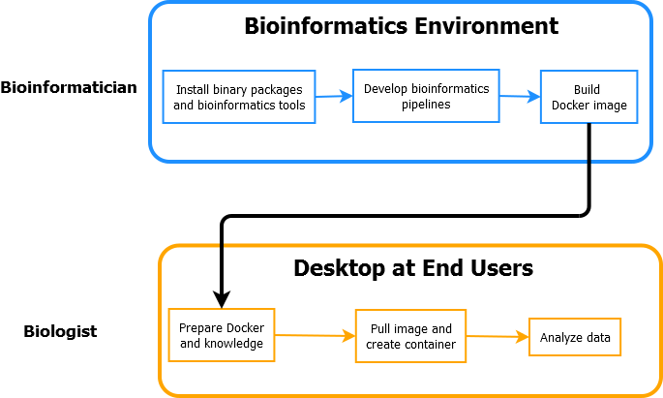
Docker Containers
Notes:
As an alternative bioinformatics environment, Docker containers are built. The great advantages of Docker is its portability and maintenance-free. End users could employ bioinformatics tools at their windows desktop without much requirements on Linux knowledge. My major work is to create a comprehensive image based on a basic image. The key point is to build dockerfile. End users could directly go into data analysis after creating containers at their Windows desktop.

Slide 6
Create Dockerfile and Build Docker Image
The key point for applying docker is to create a dockerfile and build docker image based on the dockerfile.
In my github, I uploaded some dockerfiles and docker image for bioinformatics analysis.

